Slide 1
Excursions
HUGS 2017

Slide 2
Sat june 3 , 10 am – 5 pm : hampton
Meeting point :
Residence facility front parking lot
9:45-10 am
FORT MONROE
People in-charge: Evan McClellan
Juan Vicente Guerrero

Slide 3
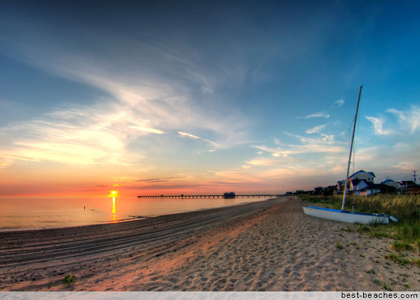
or ocean view beach, nolrfolk
Meeting point :
Residence facility front parking lot
9:45-10 am
FORT MONROE
People in-charge: Evan McClellan
Juan Vicente Guerrero

Slide 4
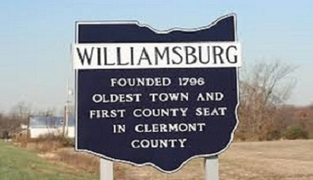
Sat june 10 , 10 am – 5 pm + free time: williamsburg
Meeting point :
Residence facility front parking lot
9:45-10 am
People in-charge: Evan McClellan
Juan Vicente Guerrero

Slide 5
More suggestions for your free time
http://www.newport-news.org
greek festval : http://newportnewsgreekfestival.org
Jamestown, yorktown : http://www.historyisfun.org/visit/admission-rates/
Theme parks: https://seaworldparks.com/en/buschgardens-williamsburg/
https://www.visitnorfolk.com
http://virginiabeach.guide
Virginia air & space center : http://www.vasc.org

