Slide 1


Plans for future neutrino oscillation beams in Europe
Marcos DRACOS
IPHC-IN2P3/CNRS Strasbourg

Slide 2
Plans for future neutrino beams in Europe
(oscillations)
Anything more to do with the CNGS?
LAGUNA-LBNO Projects
EUROnu Super Beam
  SPL to Fréjus
  derivatives
    SPL to Canfranc
    ESS Super Beam

Slide 3
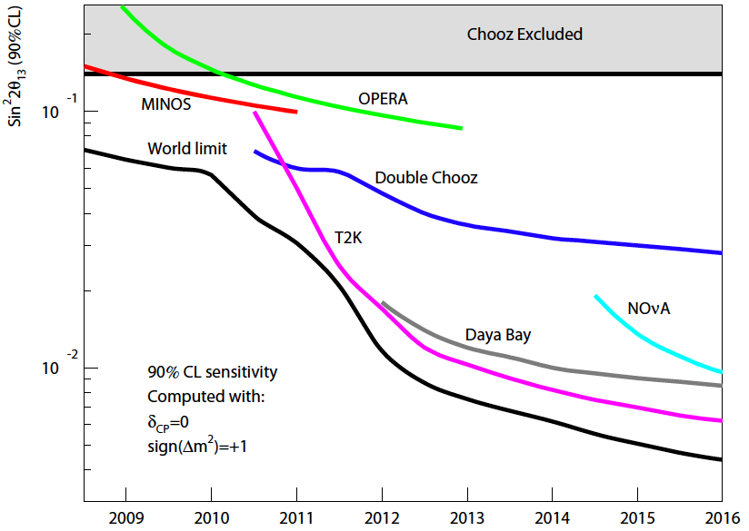
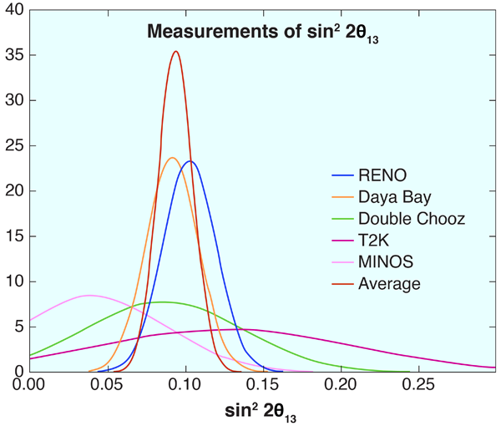
θ13 is large…
expectations
measurements
year
proposed facilities have to be readjusted…

Slide 4
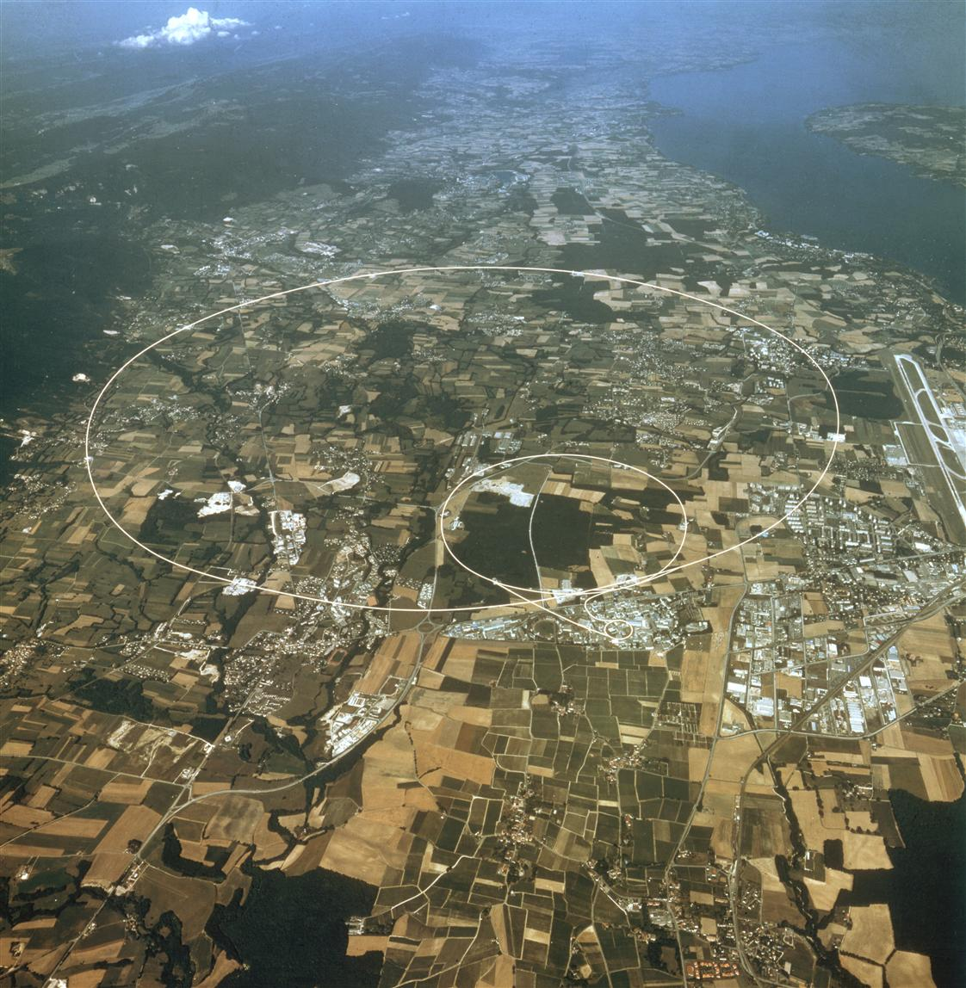
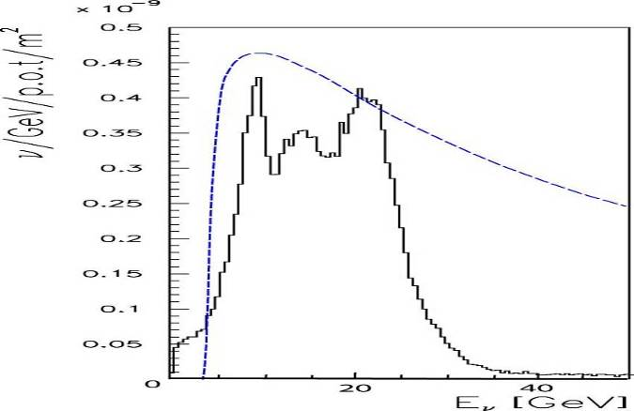
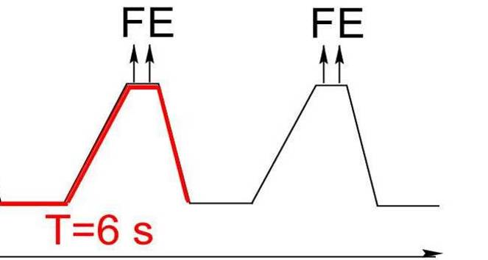
CNGS Beam at CERN
Lake Geneva
LHC
CNGS
SPS
PS
CERN
From SPS: 400 GeV/c
Cycle length: 6 s
2 Extractions: separated by 50ms
Pulse length: 10.5μs
Beam intensity: 2x 2.4 · 10¹³ ppp
Beam power: up to 500kW
σ ~0.5mm
P_{osc}*σ_{τcc}
(arbitrary units)
ν_{μ}-fluence
<17GeV>
Edda Gschwendtner, CERN
Neu2012, 27-28 Sept. 2010, CERN
4

Slide 5
CNGS Facility: Intensity Limitations
Intensity per PS batch | # PS batches | Int. per SPS cycle | 200 days, 100% efficiency, no sharing | 200 days, 55% efficiency, no sharing | 200 days, 55% efficiency, 60% CNGS sharing
 |  | [prot./6s cycle] | [pot/year] | [pot/year] | [pot/year]
2.4×10¹³ - Nominal CNGS | 2 | 4.8×10¹³ | 1.38×10²⁰ | 7.6×10¹⁹ | 4.56×10¹⁹
3.5×10¹³ - Ultimate CNGS | 2 | 7.0×10¹³ | (2.02×10²⁰) | (1.11×10²⁰) | (6.65×10¹⁹)
Working hypothesis for RP calculations
no possibility for near detector
Design limit for target, horn, kicker, instrumentation
CNGS working hypothesis
Design limit for horn, shielding, decay tube, hadron stop
CERN-AB-2007-013 PAF
"…It must however be underlined that, after the planned 5 years run for CNGS, the target chamber will be so activated that the replacement of the present target and its shielding by a new assembly will be extremely challenging if not impossible."
"…As for the target, it must be underlined that, after the planned 5 years run for CNGS, the target chamber will be so activated that the removal of the horn of the first generation and its replacement with a newly designed device will be extremely challenging if not impossible."
  (Horn designed for 2x10⁷ pulses, today we have ~1.6x10⁷ pulses → spare horn)

Slide 6
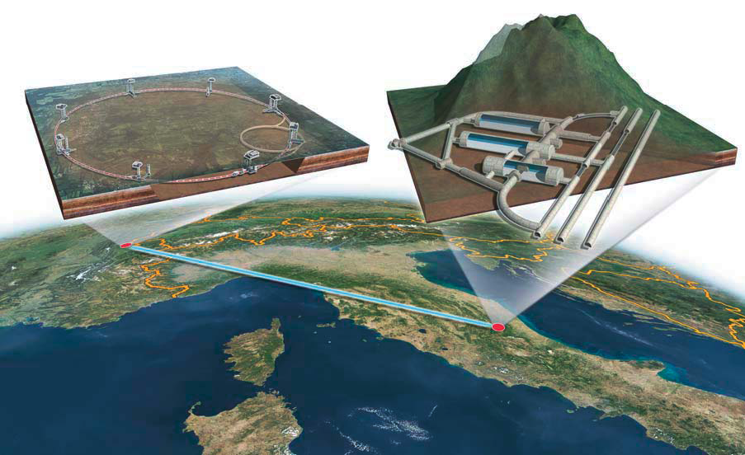
MODULAr
ν_{μ} → ν_{e}
LAr-TPC Imaging underground detector made of several identical units 5 kt fid. mass each, 20 kt LAr-TPC detector as a first step.
New experimental area LNGS-B, 10 km Off-Axis the main lab.
~1200 mwe depth for p-decay and cosmic ν searches
Neutrino beam derived from the existing CNGS facility with an increased intensity.
Nearly optimal ν_{μ} beam in few GeV energy range.
Very massive modular Liquid Argon Imaging Chamber to detect low energy off-axis neutrinos from the CNGS beam

Slide 7
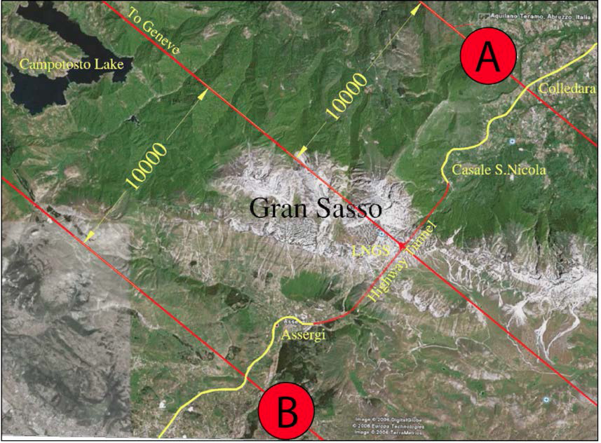
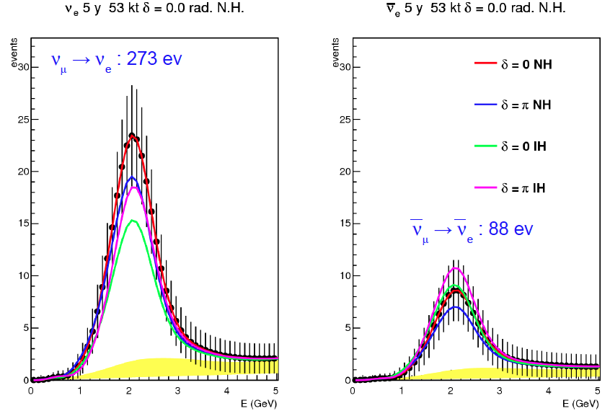
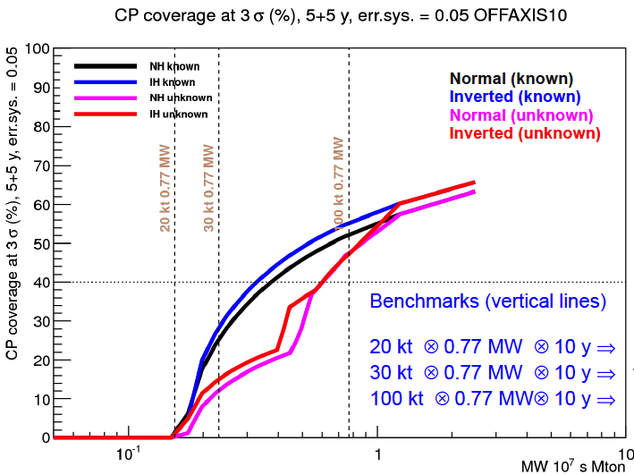
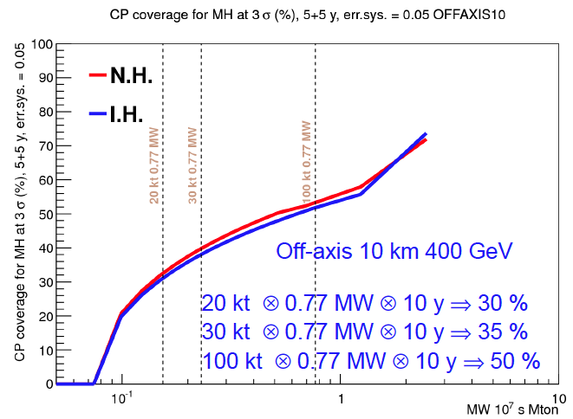
MODULAr Performance
(off-axis, 10 km, 400 GeV)
Mass Hierarchy
0.77 MW=1.2x10²⁰ p.o.t.

Slide 8



Neutrino Related European Projects
Two FP7 projects:
EUROν (http://www.euronu.org/)
  Design Study for new neutrino facilities in Europe
  Project started: 1st September 2008
  Duration: 4 years – completion August 2012
LAGUNA-LBNO (Large Apparatus for Grand Unification and Neutrino Astrophysics, http://laguna.ethz.ch:8080/Plone)
  Design Study for large underground laboratories for astroparticle and neutrino studies
  Project started: 2011
  Duration: 3 years – completion in 2014

Slide 9
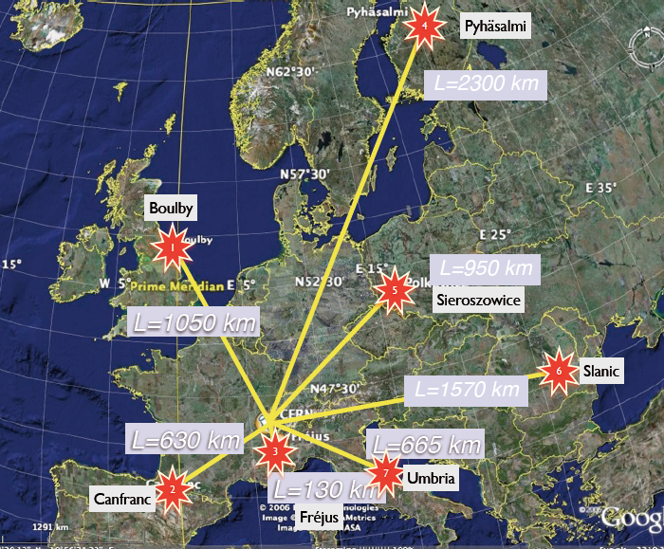
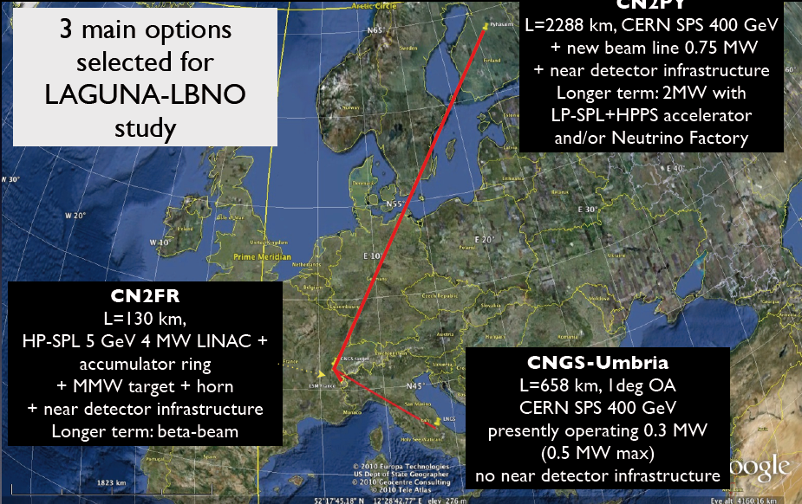
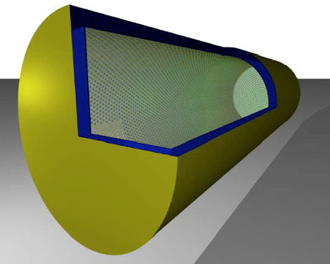
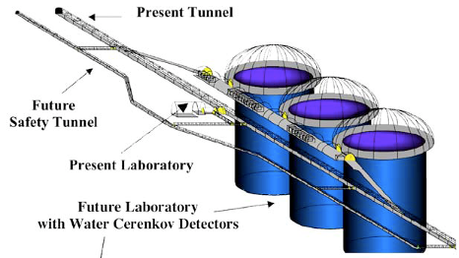
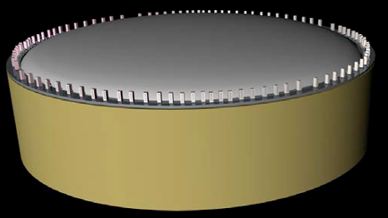
All sites and detection techniques under consideration by LAGUNA and possible neutrino beams from CERN
LAGUNA
LAGUNA-LBNO
LENA 50 ktons
MEMPHYS 450 Ktons
GLACIER 100 ktons

Slide 10
Possible neutrino beam CERN strategy
Layout using the 400 GeV beam from SPS
Option A: LSS6 extraction, target near BA2
  LSS6 fast extraction and TT60 beam line exists
  New switch to direct the proton beam towards North
  New 2 km tunnel and beam line to BA2
Option B: LSS2 extraction, NA target
  New fast extraction system in LSS2
  TT20 beam line exists
  Target area near existing EA
Option B
North Area
Option A
West Area

Slide 11
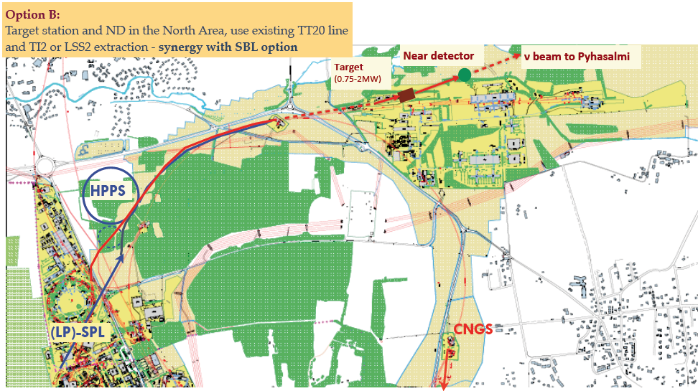
Possible CERN strategy for neutrino beams
I. Efthymiopoulos

Slide 12
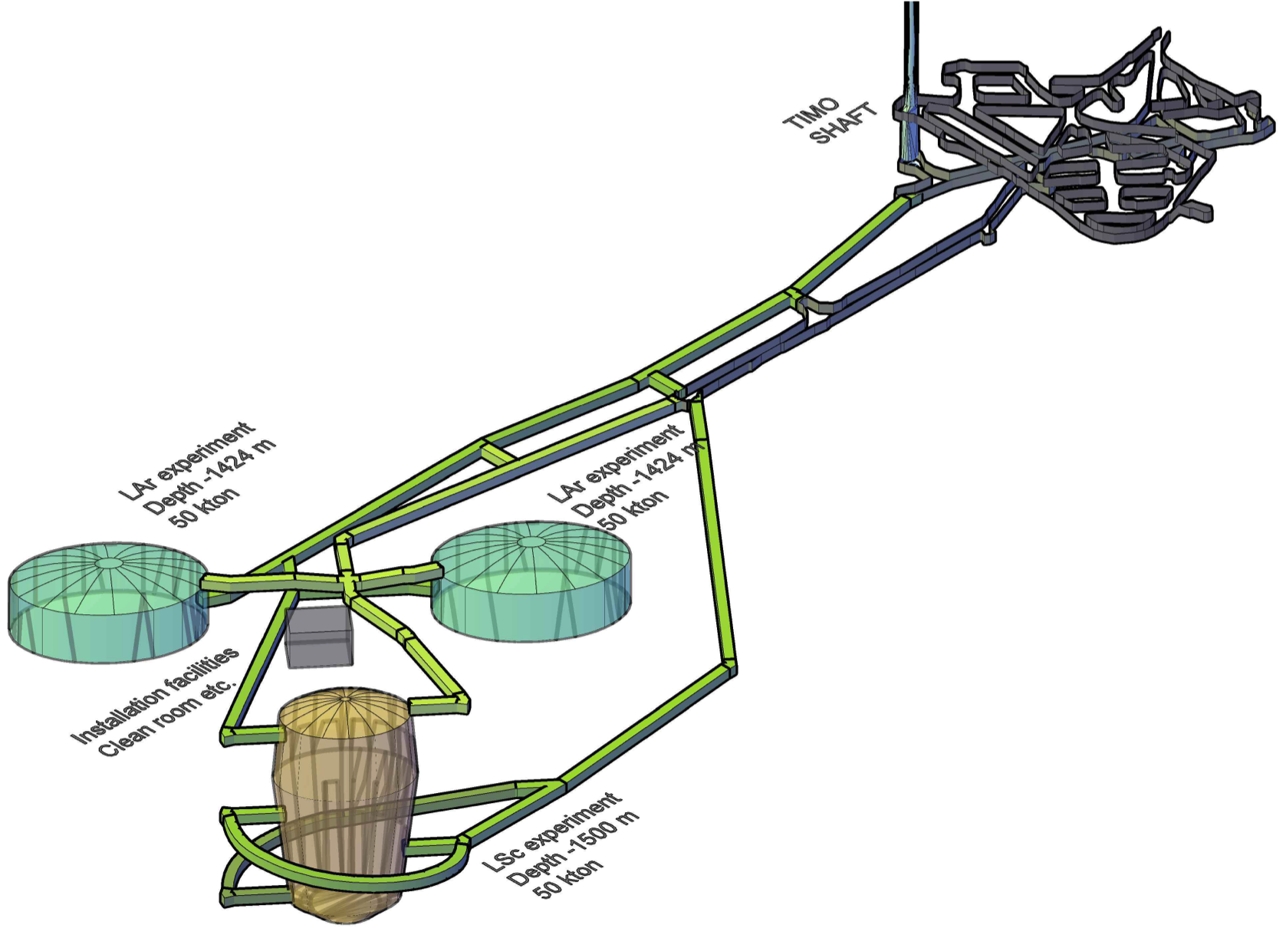
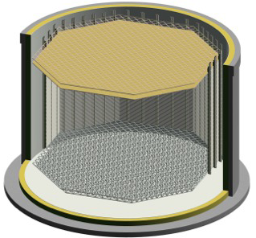
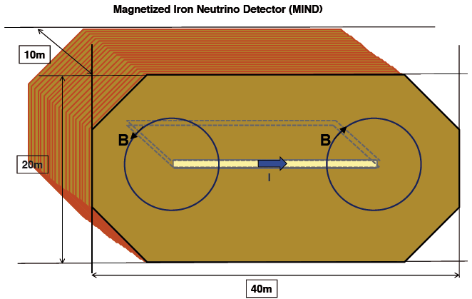
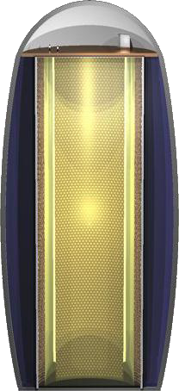
Far detectors for CN2PY
Layout of the LAGUNA-LBNO observatory at Pyhäsalmi (-1400m)
Necessary space for 2x50 kton LAr + 50 kton LSc
879’000 m3 excavation
Design to be finalized within LAGUNA-LBNO by ≈2014
In 1st phase: 20 kton double phase LAr LEM TPC
35 kton magnetized Muon Detector (MIND)
Liquid scintillator

Slide 13
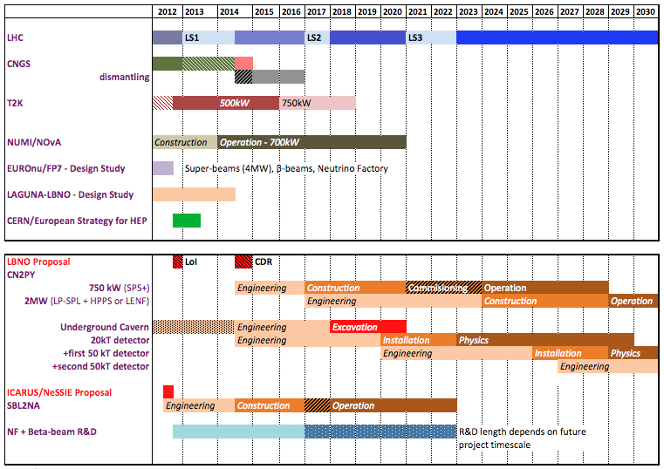
Possible CERN strategy for neutrino beams
Timescales driven by LHC long shutdowns as known today
Projects beyond 2013 would depend on the outcome of the CERN - European Strategy decisions
I. Efthymiopoulos

Slide 14
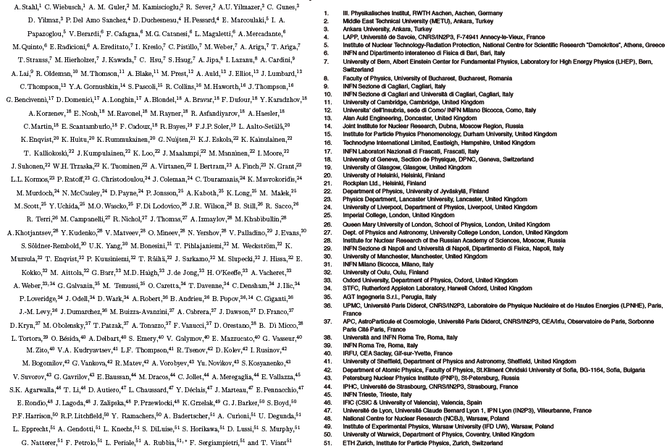
Expression of Interest sent to SPSC

Slide 15
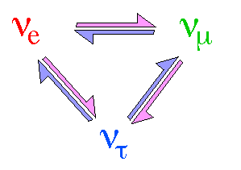
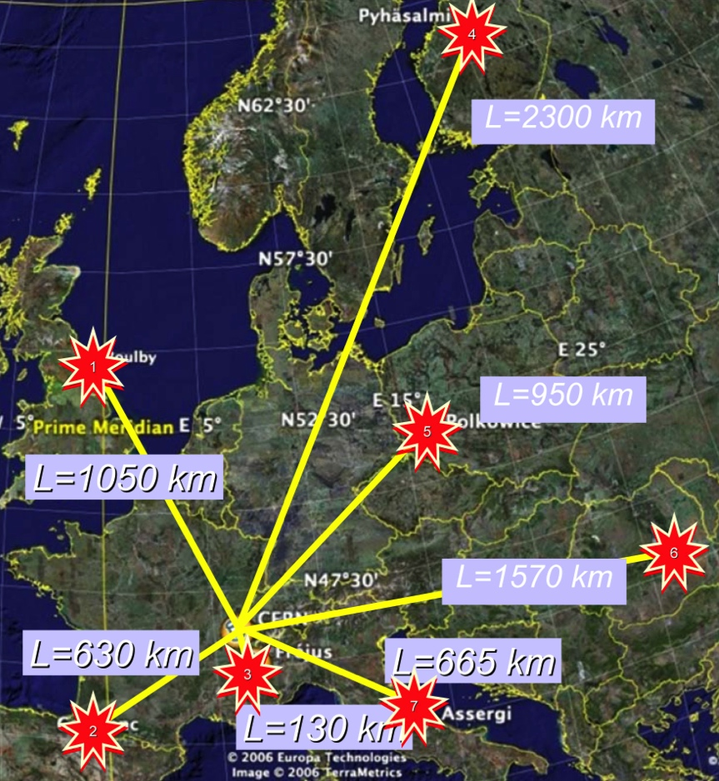
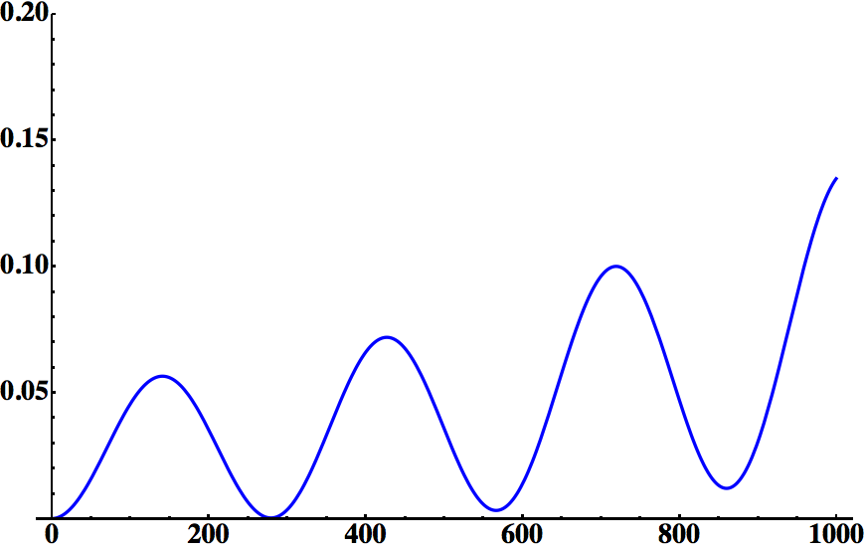
Neutrino Super Beam from SPL
(4 MW, a real Super Beam)
SPL proton kinetic energy: ~4 GeV
Neutrino energy: ~300 MeV
Δm²_{sun}=7.7x10⁻⁵ eV²
Δm²_{atm}=2.4x10⁻³ eV²
θ₂₃=45°
θ₁₃=10°
δ_{CP}=0
p(ν_{μ}→ν_{e})
LAGUNA DS
distance (km)
~130 km
Fréjus tunnel

Slide 16
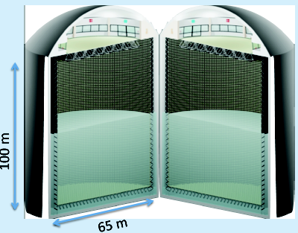
The MEMPHYS Project
(within FP7 LAGUNA DS)
Mainly to study:
Proton Decay (GUT)
  up to ~10³⁵ years lifetime
Neutrino properties and Astrophysics
  Supernovae (burst + "relics")
  Solar neutrinos
  Atmospheric neutrinos
  Geoneutrinos
  neutrinos from accelerators (Super Beam, Beta Beam)
Water Cerenkov Detector with total fiducial mass: 500 kt:
2 Cylindrical modules 100x65 m
Readout: 22.2k 8” PMTs, 30% geom. cover.
(arXiv: hep-ex/0607026)

Slide 17
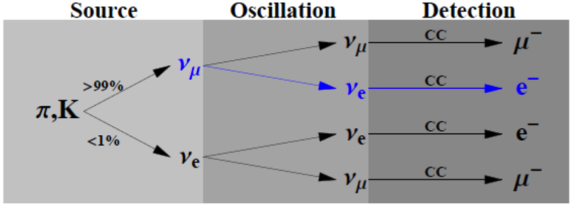
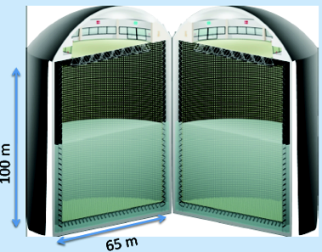
SPL Super Beam
Linac 4, (4.0 GeV, 4 MW, 50 Hz)
p
proton driver (SPL)
Accumulator
ring
(http://doc.cern.ch/yellowrep/2006/2006-006/full_document.pdf)
Magnetic
horn capture
(collector)
p
Target
ν, μ
hadrons
decay tunnel
~300 MeV ν_{μ} beam to far detector
Water Cherenkov detector MEMPHYS at Fréjus

Slide 18
Combination of Super Beam with Beta Beam
Beta-Beam
Super-Beam
ν_{e} → ν_{μ} (β+) | (T) | ν_{μ} → ν_{e} (π⁺)
(CP) | (CPT) | (CP)
ν_{e} → ν_{μ} (β-) | (T) | ν_{μ} → ν_{e} (π⁻)
combines CP and T violation tests
2 beams
1 detector
using the same detector

Slide 19
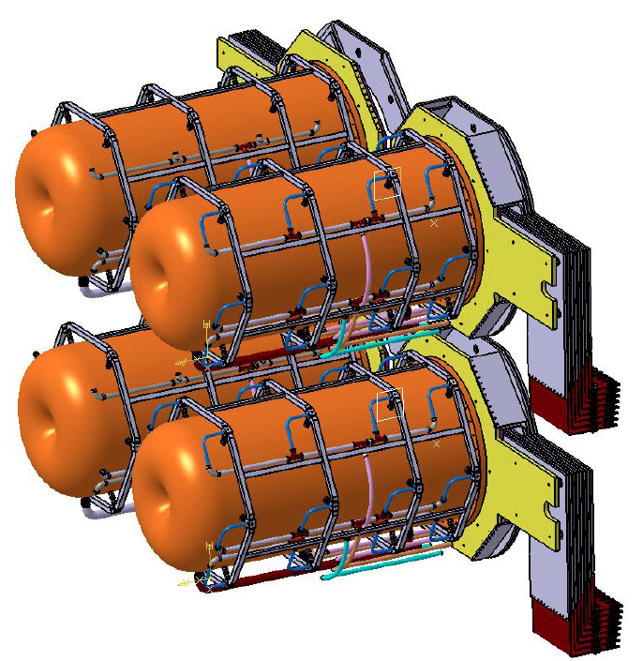
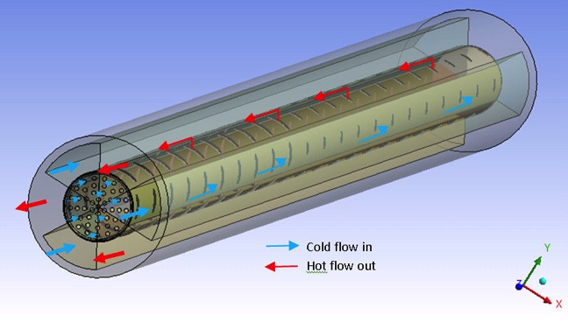
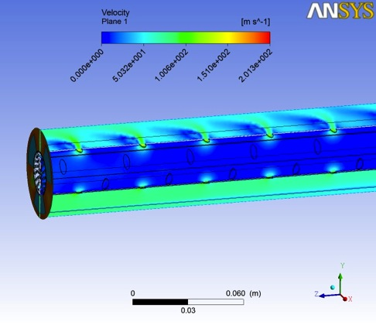
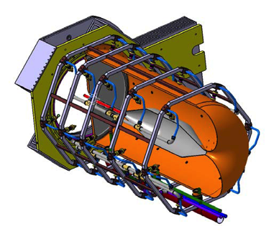
4-Target/Horn system
Packed bed canister in symmetrical transverse flow configuration (titanium alloy spheres)
Helium Velocity
Maximum flow velocity = 202m/s
Maximum Mach Number < 0.2
Helium Gas Temperature
Total helium mass flow = 93 gr/s
Maximum Helium temperature = 584°C
Helium average outlet Temperature = 109°C
First tests with beam in the new HiRadMat@SPS facility at CERN in 2014
Helium Flow

Slide 20
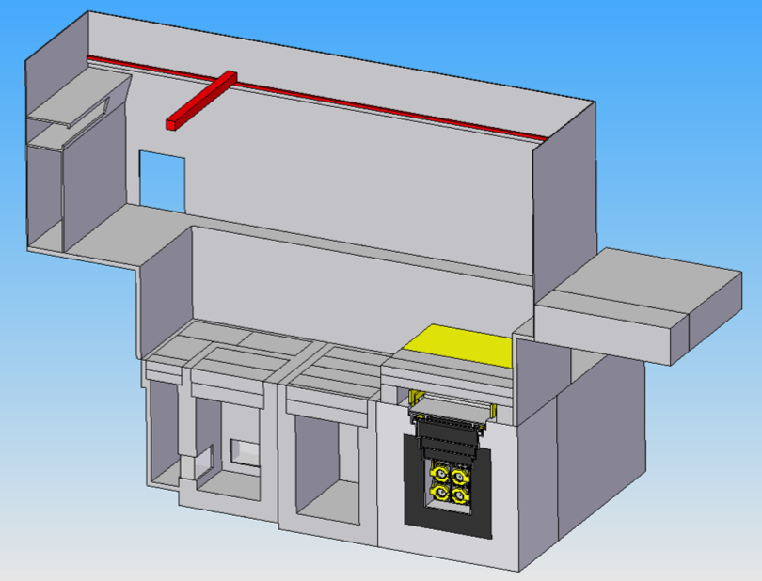
Target Station
Control Room
Crane
Main Hall
Delivery Access
Office Space
Truck unloading area
Ground Level
Pump House
Power supply room
Hot cell operator room
Ground Level
Hot cell
Beam dump building here
Morgue
Beam Direction
Horns and collimators

Slide 21
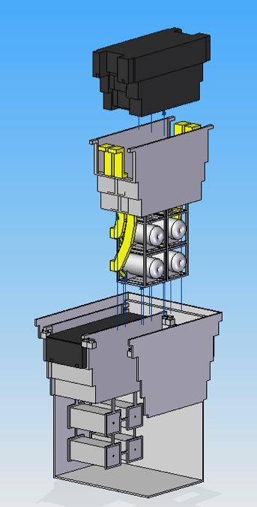
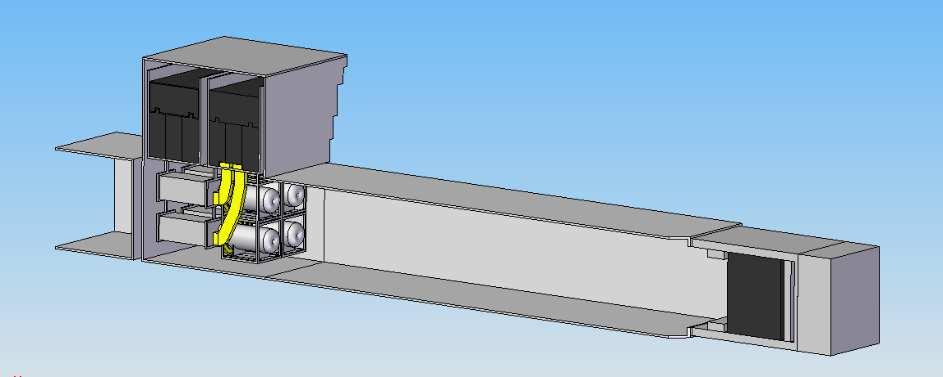
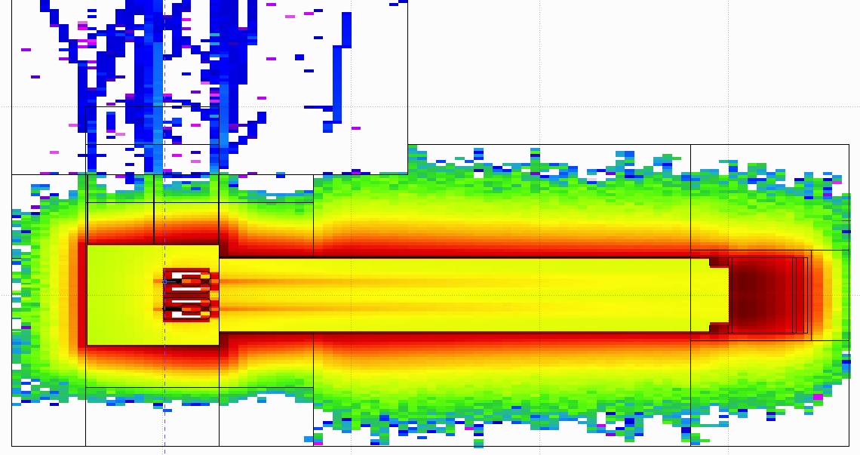
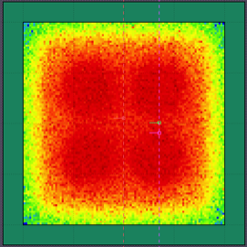
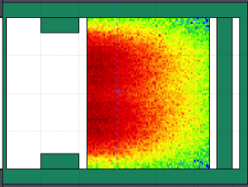
General Layout
Shield Blocks
Horn Support Module
Split Proton Beam
Horns and Targets
Collimators
Decay Volume (He)
Neutrino Beam Direction
Beam Dump

Slide 22
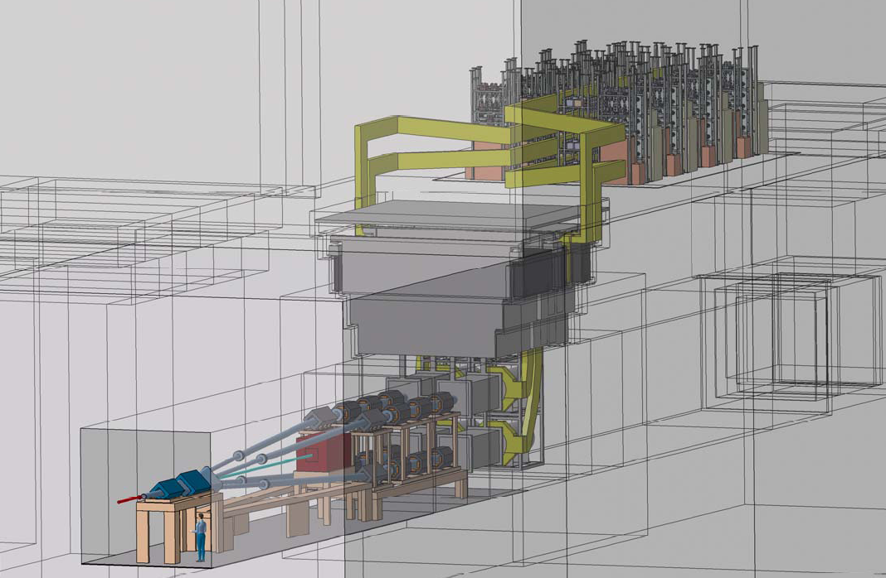
Target Station
horn power supply
strip lines
decay tunnel
beam switchyard
targets/horns

Slide 23
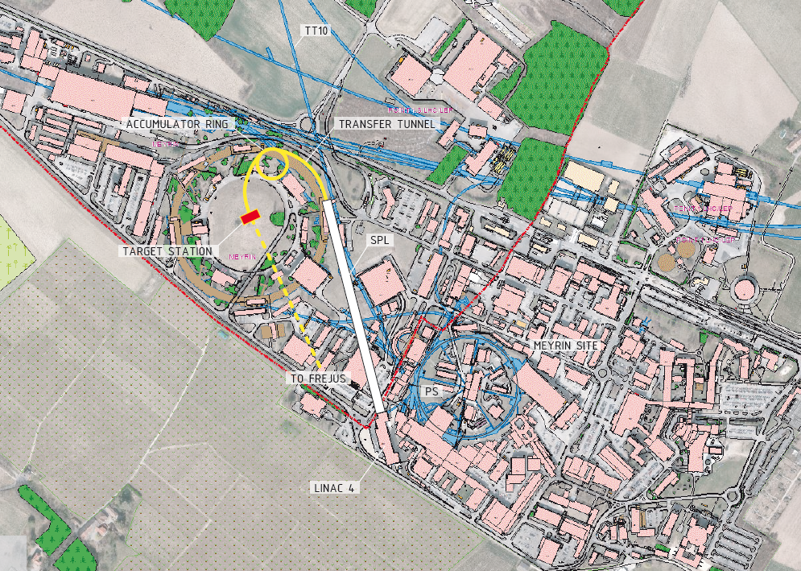
HP-SPL Super Beam at CERN
can also be used by NF (a real synergy)
near detector

Slide 24
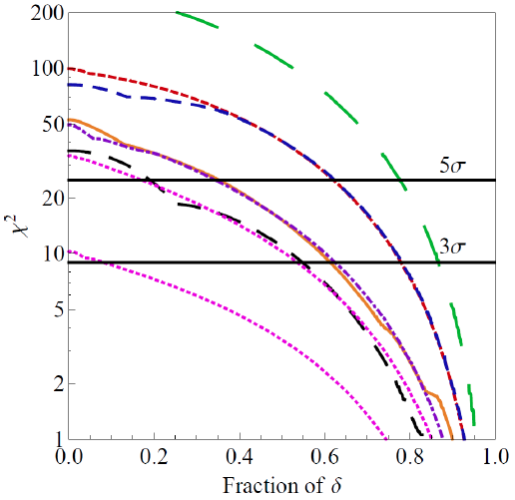
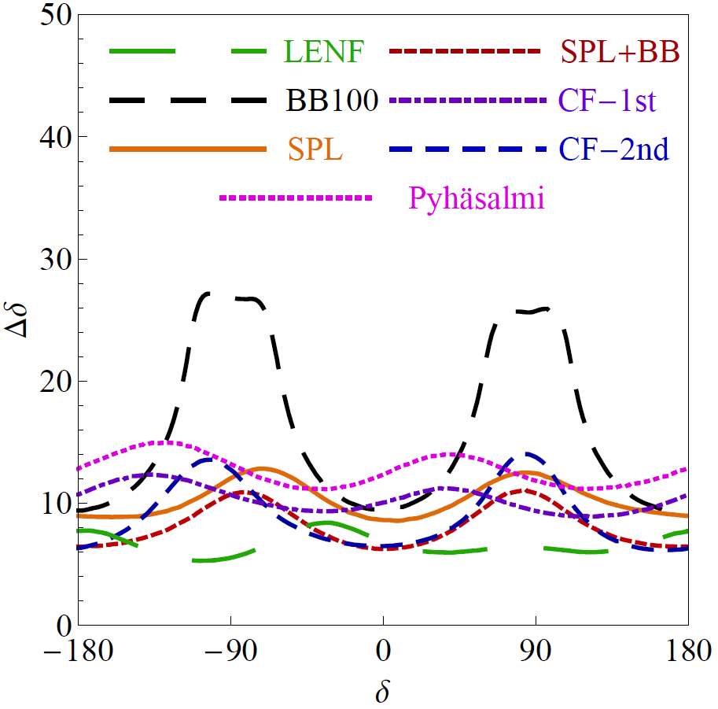
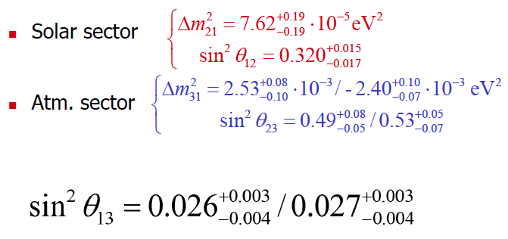
Physics Performance (CPV)
(Enrique Fernantez et al.)
100 kt LAr
100 kt LAr
20 kt LAr
SPL: CERN to Fréjus (130 km)
CF-1st: CERN to Canfranc (650 km) 1st max.
CF-2nd: CERN to Canfranc 2nd max.
1 Mton WC detector (440 kton fiducial), 5% syst.

Slide 25
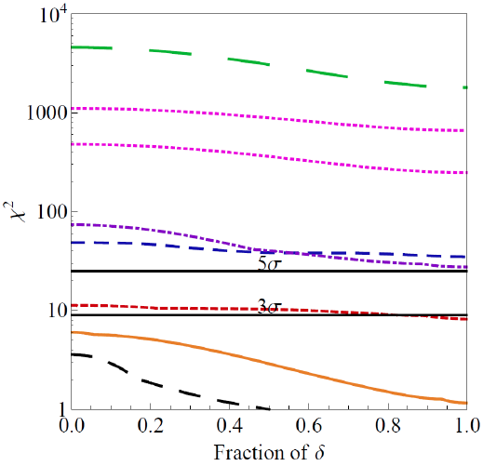
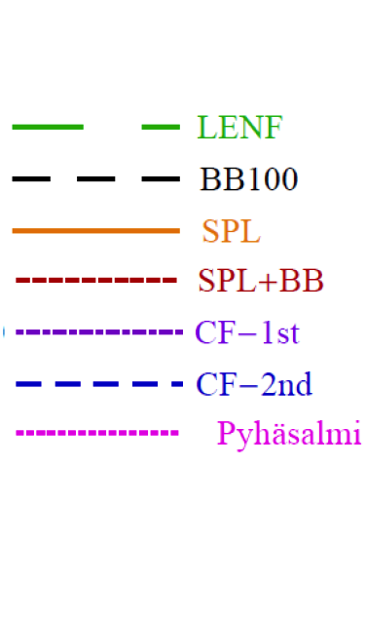
Physics Performance (MH)
without adding atmospherics
SPL: CERN to Fréjus (130 km)
CF-1st: CERN to Canfranc (650 km) 1st maximum
CF-2nd: CERN to Canfranc 2nd maximum
1 Mton WC detector (440 kton fiducial), 5% syst.

Slide 26

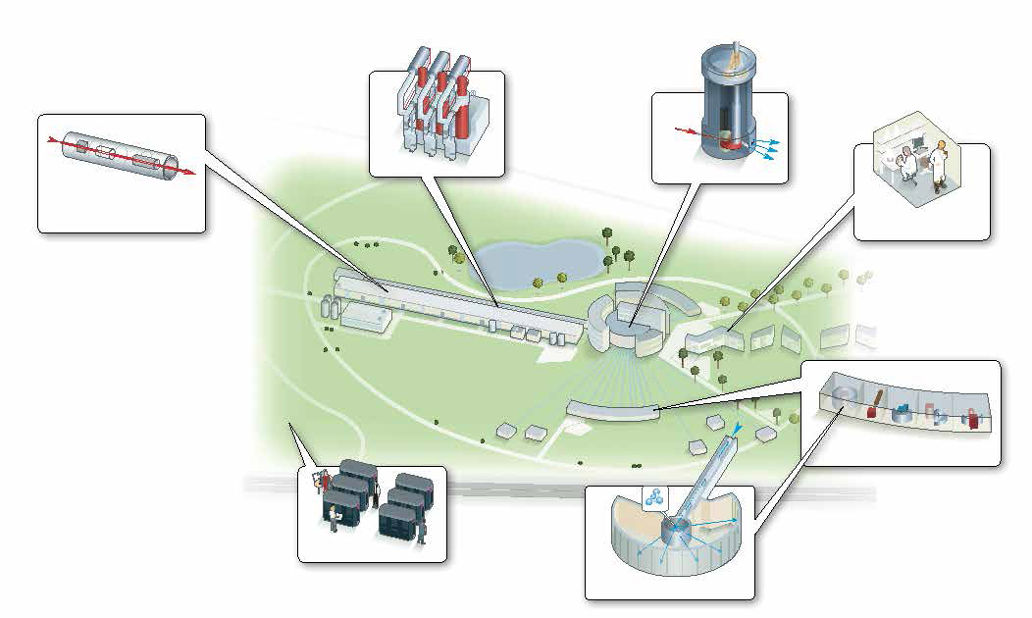

European Spallation Source
(Lund)

Slide 27
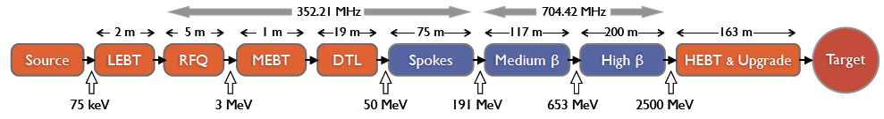
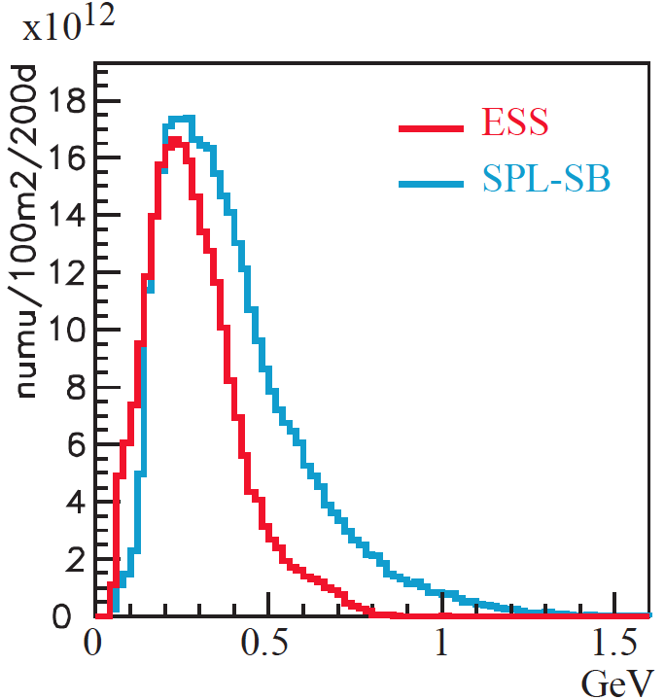
Which is the potential of the ESS project from the view of Neutrino Physics?
The ESS will be a copious source of spallation neutrons but also of neutrinos
5 MW proton beam
2.5 GeV protons
~300 MeV neutrinos
flux at 100 km

Slide 28
Additions to the present ESS proton linac required for the generation of such a beam
A special (thinner) neutrino target with a neutrino horn (studied in detail in EUROν).
A 2.5 GeV accumulator ring to compress the 3 ms long ESS pulse to a few microseconds pulse (to reduce the cosmic ray background in the underground ν detector and current in horn).
Acceleration of H⁻ pulses in the 70 ms long empty buckets between the ESS proton 3 ms pulses (70 ms spacing is needed for the TOF measurement of the spallation neutrons) requiring more RF power generation capacity.
A very large Kton neutrino detector + a smaller near detector.
EUROν SPL-SB
MEMPHYS

Slide 29
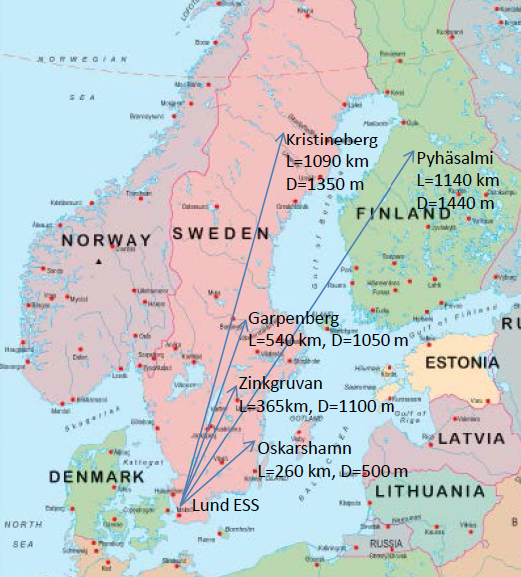
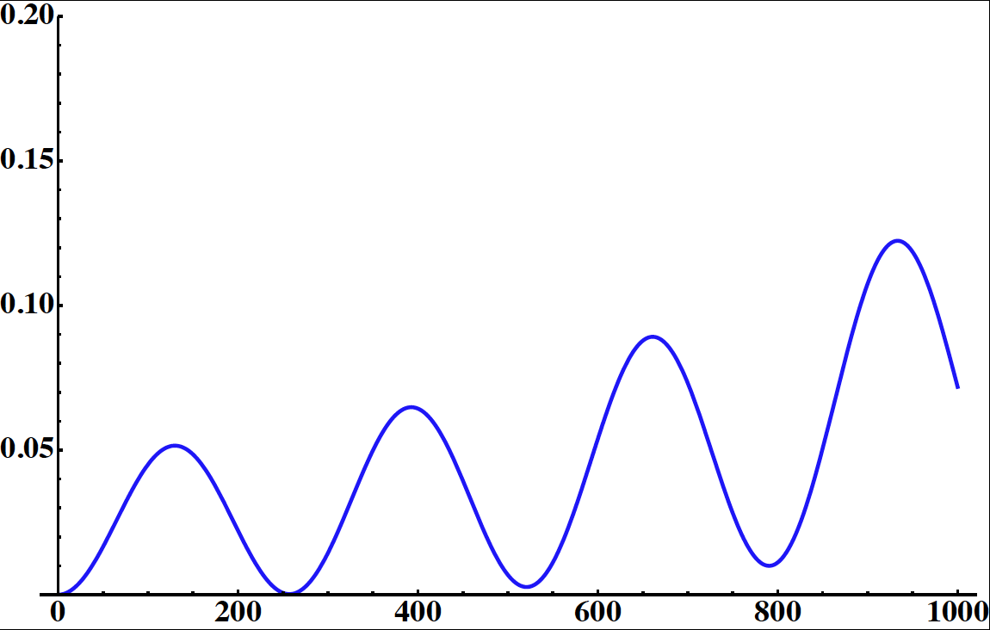
Possible Detector Locations
Many mines (active or not) are available in Sweden
What is the optimal position for CPV
How this project could help for MH?
Δm²_{sun}=7.6x10⁻⁵ eV²
Δm²_{atm}=2.5x10⁻³ eV²
θ₂₃=44.4°
θ₁₂=34.4°
θ₁₃=9.3°
δ_{CP}=0
E~290 MeV
p(ν_{μ}→ν_{e})
CN2PY
distance (km)

Slide 30

Physics Performance
(Enrique Fernantez)
CPV
MH
without adding yet atmospheric neutrinos (optimization is needed)
Very preliminary
Very preliminary
fraction
fraction
EUROν parameters without any particular optimization
1 Mton WC detector (440 kton fiducial), 5% syst.
2.5 GeV protons
5 MW proton beam

Slide 31
Conclusions
CNGS will probably stop at the end of this year. Very difficult to be used for future projects.
Federation of many European neutrino physicists around a long base line from CERN to Pyhasalmi.
  very good mass hierarchy performance
  very limited CPV performance
  for CPV, the Neutrino Factory is needed (using the same base line)
The SPL SB project under study in FP7 EUROnu:
  Conventional technology
  Cost effective
  Many synergies with other projects (Beta Beam, Neutrino Factory)
  Very competitive CPV sensitivity
  Fréjus (130 km): 60% (35%) CP coverage at 3σ (5σ).
    Canfranc (650 km):
      77% (65%) CP coverage at 3σ (5σ),
      Mass Hierarchy at 5σ.
Excellent opportunity of neutrino Super Beam using the 5 MW ESS proton beam (ready before 2020) with very good CPV sensitivity.

Slide 32

Sensitivity to mass Hierarchy?
solid line: LBL+atm.
dashed line: LBL
BB: 5 ν+5 anti-ν years
SB: 2 ν+8 anti-ν years
arXiv:hep-ph/0603172v3

Slide 33


Physics Performance (CPV)
sin²2θ₁₃ = 0.1
arXiv:1203.5651v1

Slide 34




Horn Power Supply and Strip Lines
External Shield Blocks
Horn Power Supplies
Vessel Lid
Beam Direction
Iron Shield
Concrete Shield
each MODULE delivers a current of 44kA max at F=50HZ
For each HORN : current of 350kA max at 12.5HZ
energy recuperation (>90%) and reinjection
lifetime > 13 Bcycles (10 years, 200 days/year)

Slide 35
Maximum potential proton flux to CNGS
Protons on target per year [x10¹⁹] for 200 days of operation with 80% machine availability
 | SPS cycle length | 6 s |  | 4.8 s
 | Injection momentum | 14 GeV/c |  | 26 GeV/c
 | Beam sharing Max SPS intensity @ 400GeV [x10¹³] | 0.45 | 0.85 | 0.45 | 0.85
Present injectors + machines’ improvement | 4.8 “nominalCNGS” | 5 | 9.4
 | 5.7 “maximum SPS” | 5.9 | 11.1
Future injectors + SPS RF upgrade | 7 “ultimate CNGS” |  |  | 9 | 17.1
Future injectors + new SPS RF system + CNGS new equipment design | 10 “Maximum PS2” |  |  | 12.9 | 24.5
CERN-AB-2007-013
"…It must however be underlined that, after the planned 5 years run for CNGS, the target chamber will be so activated that the replacement of the present target and its shielding by a new assembly will be extremely challenging if not impossible."
"…As for the target, it must be underlined that, after the planned 5 years run for CNGS, the target chamber will be so activated that the removal of the horn of the first generation and its replacement with a newly designed device will be extremely challenging if not impossible."

Slide 36



Physics Performance
Super Beam optimization
final design

Slide 37

HP-SPL and Neutrino Factory at CERN
Neutrino Factory
Super Beam

Slide 38

ESS and C2PY

Slide 39
Technological Challenge
Can we conceive a neutrino beam based on a multi-MW proton beam?
Can we design a target for a multi-MW proton beam?
Can we do it with a reliable design without compromising the physics reach?
Target
  huge energy deposition (300-1000 J/cm³/pulse)
  Severe problems from: sudden heating, stress, activation
  Solid versus liquid targets
  cooling
Horn
  cooling
  vibrations
  pulser (up to 350 kA, 50 Hz)
Safety
Lifetime (supposed to run for 10 years)

Slide 40

How to mitigate the power effect
4 target/horn system (4x4 m²) with single decay tunnel (~25 m)
solid targets able to afford up to ~1.5 MW proton beam
send 4 MW/system every 50/4 Hz
  in case of failure of one horn/target, continue with the 3 remaining ones sharing the 4 MW power
p
we get rid of Hg
more expensive but more reliable system

Slide 41

target
magnetic
horns
decay tunnel
hadron absorber
muon detector 1
muon detector 2

Slide 42

Fréjus underground laboratory
Depth (meter)
0
1000
2000
3000
muon flux/m2/year
10
6
IMB
SOUDAN
(WIPP)
CANFRANC
KAMIOK
A
10
4
BOULB
Y
MINE
S
T
GOTHARD
GRAN SASSO
(FINLANDE)
10
3
HOMES
T
AKE
LSM (
FREJUS
)
BAKSAN
MON
T
BLANC
(Laboratoire Souterrain de Modane)
SUDBU
R
Y
10
2
2000
4000
4800
6000
8000
Depth (meter of water equivalent)
new safety gallery under construction, profit of this opportunity to enlarge LSM

Slide 43

4-proton lines
Energy | 4-5 GeV
Beam Power | 4 MW
Proton per pulse | 1.1 x 10⁺¹⁴
Rep. rate | 50 Hz
Pulse duration | 3.2 μs
Beam shape | Gaussian
Emittances rms | 3π mm mrad**
Beam rigidity:
16.16 T.m (4 GeV)
17.85 T.m (4.5 GeV)
T1
T2
T4
T3
D1
D2
D4
D3
K2
K1
p
Configuration 3: K-D-Q-Q-Q-T

Slide 44


Neutrino Spectra
horn on/off
neutrinos
anti-neutrinos
(A. Longhin)

