Slide 1
RF Power Klystrons & 20 Year Look
R. Nelson
7/15/15

Slide 2
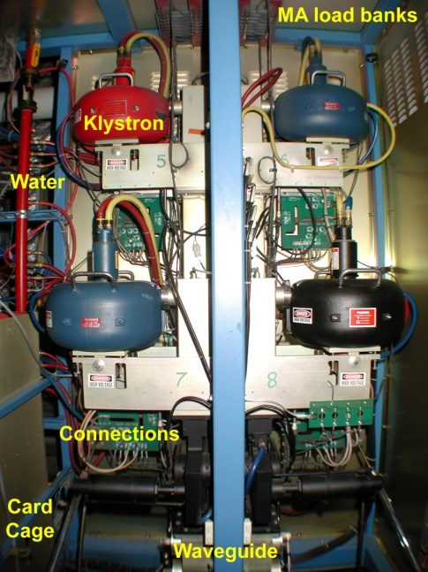
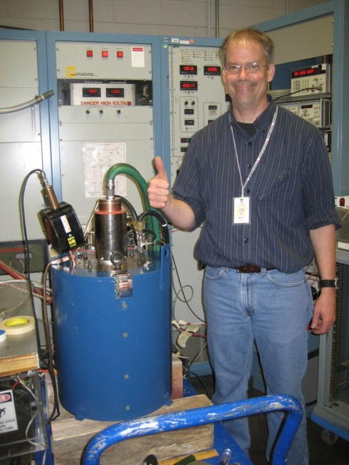
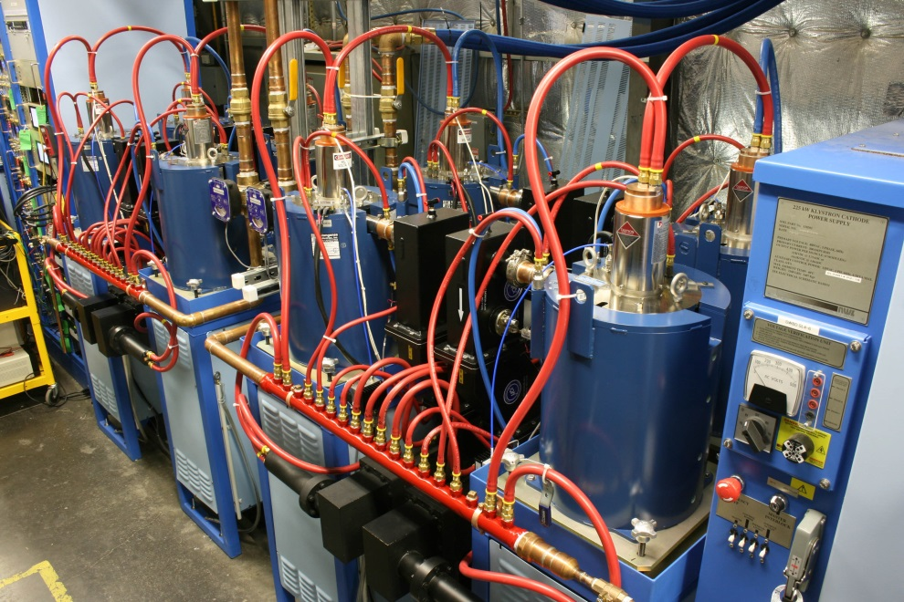
RF Power
klystrons
8 x 13 kW klystrons

Slide 3
Why A klystron?
Best (only) choice at the time - 1988
Easy to use: Input (drive), output (to CM), power source (CPS)
High gain
Moderate efficiency, when operating saturated
We don’t run there
Existing design tweaked for frequency and power
2kW became 5kW (later 8), 1.3 GHz to 1.497 GHz
Water-cooled (most heat dumped into water)
33% efficient (rated power)
A custom solution for our requirements

Slide 4
RF Power
Only klystrons were considered
5kW saturated power using klystrons
Up to 8 kW (FEL & 0L04)
42¼ cryomodules + capture = 340 klystrons
Initial purchase: 350
24 in FEL zones, 4 for cavity testing
1 prototype in FEL buncher
Supplemental purchases: 120 for spares, FEL, 10 for 0L02 R100 upgrade
Rebuilds along the way
4 x 1 kW SSAs for separation
IOTs: 4 for separation (499 & 748.5 MHz)

Slide 5
12 GeV Upgrade
80 cavities = 80 klystrons
Higher efficiency, higher power
Purchase: 84 including first article
Also considered IOT & SSA
IOT concerns
None built for 1.497 GHz
Some in service at 1.3 GHz
Higher cost, lower gain (high drive required - 100W preamp vs 0.1 – 2 W
IOT advantages: efficiency
SSA: Advancing, but not there yet (cost, size, capabilities)

Slide 6
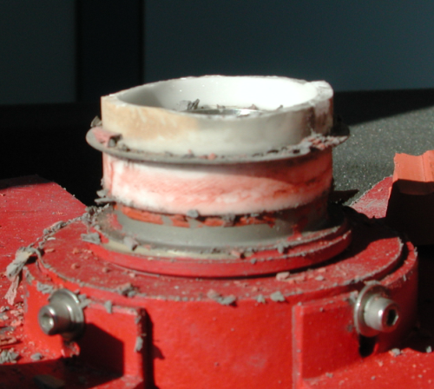
How We’ve Fared
Original spec asked for minimum 20k hour life
Anticipated failures: 100 failures/yr. Didn’t happen
Repair contracts (3)
Rebuild up to 3 times
Early fails: catastrophic not cathode depletion
Internal leakage on ceramic
Thermal runaway (mod anode effects)
Leakage still most common fail
Imposes limits on tube

Slide 7
Klystron Failures: Part 1

Slide 8
Klystron Failures: Part 2
Year | Failed | Weeks Running
FY2008 | 9 (11?)
FY2009 | 11
FY2010 | 7
FY2011 | 4
FY2012 | 5
FY2015 | 5 | 18
240

Slide 9
Klystron Procurement Times
Recent: R100 upgrade klystron buy (10 pcs)
Req entered: 10/1/12
Signed/Bid: 10/3/12 - 12/20/12
Placed: 12/21/12
1st received: 5/30/14
Last received: 8/26/14
5.4 months ARO for 1st (8 mo from start)
Time to 10th unit: 8.3 mo ARO (11 mo from start)
Maximum delivery rate?

Slide 10
Klystron Pros & Cons
Pros
Cons
Proven solution
Long life
Fits our sockets
Easy replacement
High gain
High output power
Moderate / variable efficiency
Input power remains constant
Rising replacement cost (like most things)
“Dangerous” high voltage (…always touted by SSA proponents)

Slide 11
SSA (Solid State Amplifiers)
Evolving, prices dropping, power per device up though 1.497 GHz not a mainstream frequency
Transistors developed for large markets – we’re a small user
Generally higher efficiency (more constant)
Complex designs (multiple stages, splitters, combiners, etc.)
Soft failure modes (gradual power loss)
“Safe low voltage operation” (50V/400A)
Major hardware changes to drop in
At $11/w, 88k$ per device X340 units = 30M$

Slide 12
SSA SBIR Efforts
Several attempts over 10+ years
Nothing usable yet
Price, unknown
SBIR companies typically not production capable, nor are developing an “Innovative” design

Slide 13
SBIR: Design to Fit Our Space
Multi-module amplifier could be installed in our HPA

Slide 14
SBIR SSA

Slide 15
Magnetrons
Research being done here at JLab and looking with multiple approaches
It’s an oscillator - industrial cookers, radar
Cost-effective power with high efficiency
As an amplifier, more complex system (multiple magnetrons, waveguide components, etc.)
Injection locking for frequency control, hybrid combining to adjust power? Modulated HV and magnetic?
Not a drop-in replacement for our klystrons
Significant changes – a new system (as with SSA)

Slide 16
Other Magnetron Comments
Shorter life (than klystrons or SSA)
Applicability based on requirements
Individual devices may cost less per watt, but additional hardware adds significant expense

Slide 17
MEIC RF Power (H. Wang)
 | CEBAF 12GeV | E-Ring PEP-II 10GeV | Ion-linac Pb 60MeV/u | Booster | Ion-Ring Pb 40GeV/u |  | CC-ERL Cooler 55MeV | Crab (16+6)X2MV
Frequency (MHz) | 1497 | 476.3 | 162.5 /325 | 0.6-1.3 | 1.2-1.3 | 952.6 | 476.3 /952.6 | 952.6
Duty Cycle (%) | cw | cw | 0.5 | ramp | ramp | cw | cw | Cw
Cavity | sc 2K | nc | nc | nc | nc | sc 2K | nc/sc 2K | sc 2K
Max Peak Power(MW) | 2.76 | 12.79 | 42 |  | 0.36 | 0.73 | 0.12 | 0.0023
Average Power (MW) | 2.76 | 12.79 | 0.46 | 0.084 | 0.36 | 0.73 | 0.12 | 0.0023
Klystron DC-RF Efficiency (%) | 35-51 | 67 | 50-60 | na | na | 50-60 | 50-60 | 50-60
Magnetron DC-RF Efficiency (%) | 80-90 | 80-90 | 80-90 | na | na | 80-90 | 80-90 | 80-90
DC Power Save (MW) | 3.4-3.8 | 3.1-4.9 | 0.26-0.35 | na | na | 0.41-0.55 | 0.07-0.09 | 0.0013-0.0017

Slide 18
Future – Continue to Supply RF
Continue buying present klystrons
… unless requirements change
2 vendors (one hasn’t built it since our original buy)
Prices on the rise
1990 $9k (Varian)
2000 $13k (Litton)
2012 $32k (L-3)
2014 $43k (budgetary) $60k
2016-2035 ??
Monitor options for alternate tech with major system changes
Monitor integrity of other components
1990 | $9k | Varian
2000 | $13k | L-3
2012 | $32k | L-3
2014 | $43k | L-3
2016-35 | TBD | ??

Slide 19
Klystron Health
2009 snapshot: 0.63/week of operation (.28 later)
How many weeks, how many failures?
Expect rate to increase as EOL approaches
When?
Metrics not available to predict
Spares: 12 on hand
Installed: 16 poor (limited) tubes
Cost: increasing
20 per year proposal wasn’t funded
Arne suggests 500k$/year (~10 units per year)
A good start – but start soon

Slide 20
Thank You
OK, we haven’t run out yet, but we really should buy klystrons… crying wolf?

