Slide 1
OPS 2015 StayTreat
Operations Session
Arne Freyberger
Operations Dept.
Accelerator Div.
Jefferson Lab

Slide 2
OPS StayTreat Goals
The purpose of this two day workshop is to provide a forum for presentations and discussions on CEBAF operations during the recent commissioning operations. The presentations should present a balance of successes and shortcomings, with the ultimate goal of improving CEBAF operations, prepare for the challenges of 12GeV operations and establishing routine multi-user operations at the 12GeV design energy.
Additional items to be addressed during the workshop include, improving user<->OPS<->Eng communications, reducing the duration for CEBAF restoration and configuration change, reducing the duration for Hall setup, improving CEBAF reliability, and regaining the confidence of the user community that CEBAF and OPS can support the experimental program.

Slide 3
Outline
Accelerator Operations Overview
12GeV Upgrade
Overview
Beam Commissioning to date
Plans for Beam Operations at Design Energy
Summer 2015 Shutdown Tasks
Gradient Maintenance and Helium Processing
Fall 2015 Beam Plan
Summary/Agenda

Slide 4
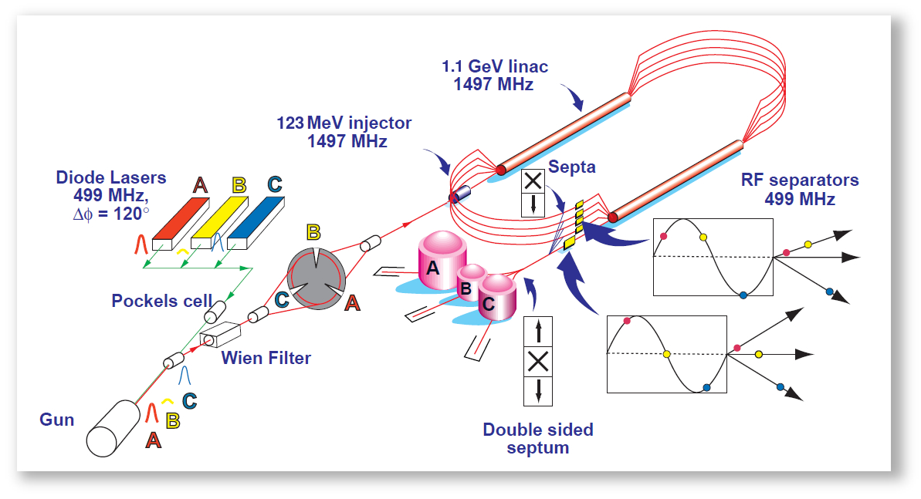
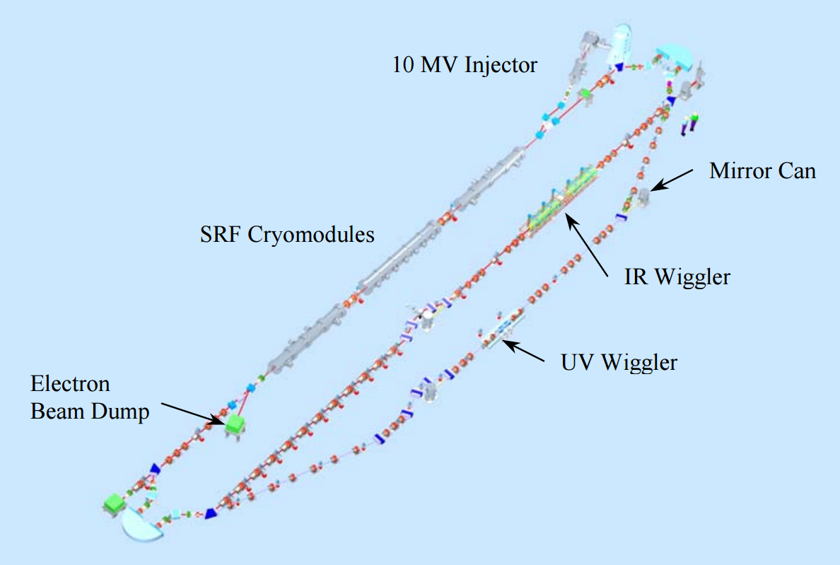
Accelerator Mission
Operate and upgrade the JLab accelerator facilities
JLab accelerator facilities:
CEBAF, Continuous Electron Beam Accelerator Facility
LERF, Low Energy Recirculator Facility (formerly called the FEL).

Slide 5
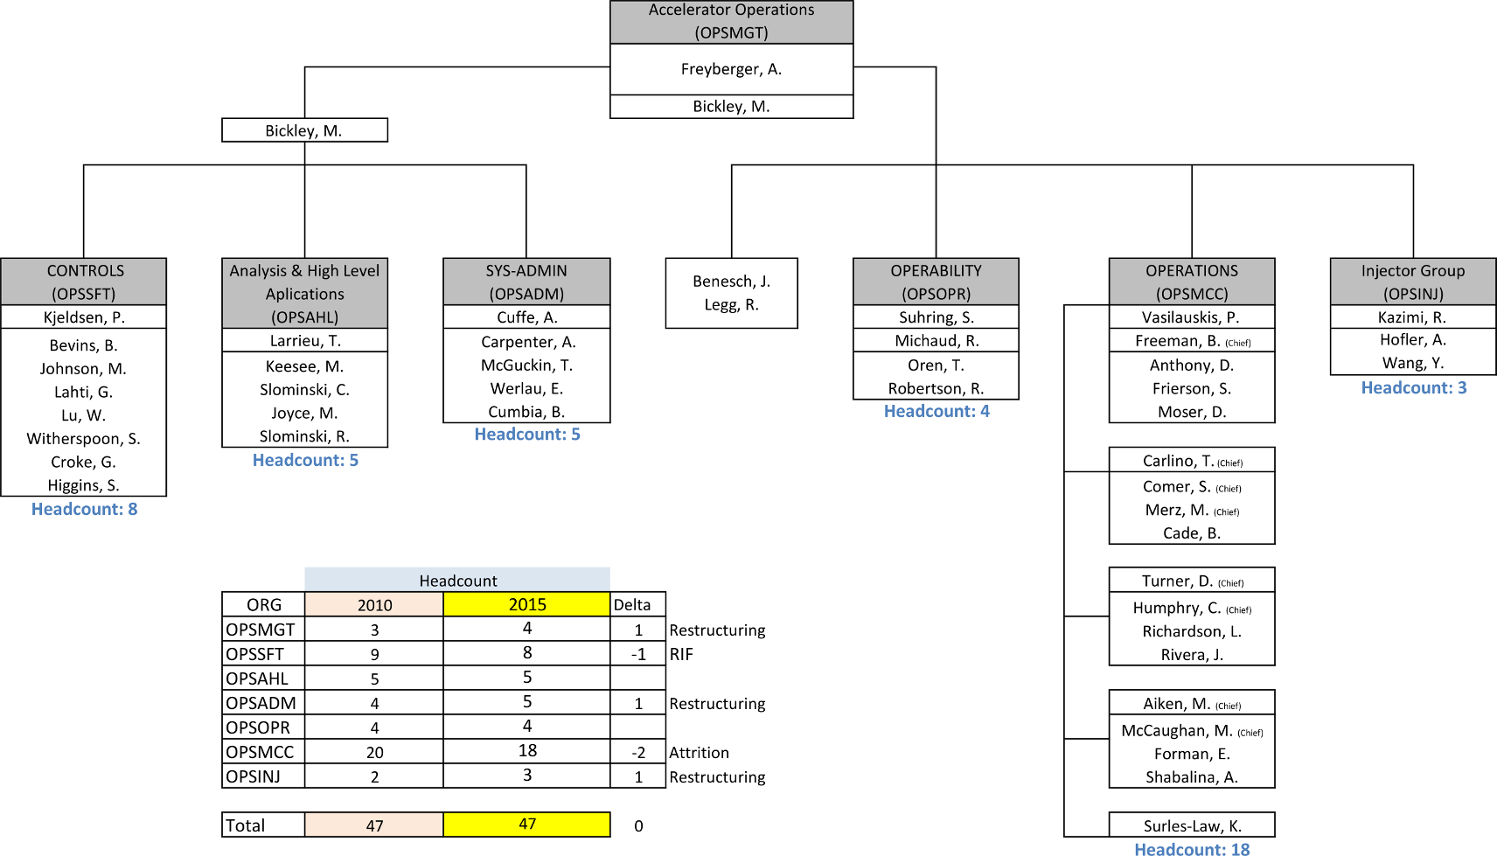
Operations Department
Presently have one open operator position

Slide 6
CEBAF Beam Delivery(WBS)
90 FTE (Beam Delivery 1.04.02) for FY15
Work plans are developed each year to account for:
Operating weeks
Expected machine performance
Preventative maintenance tasks

Slide 7
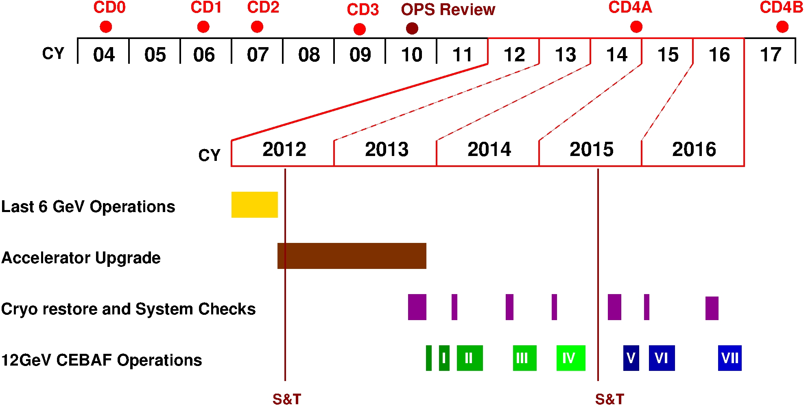
12GeV Timeline
First extensive S&T review in the 12GeV era, mini-S&T reviews held in 2013 & 2014

Slide 8
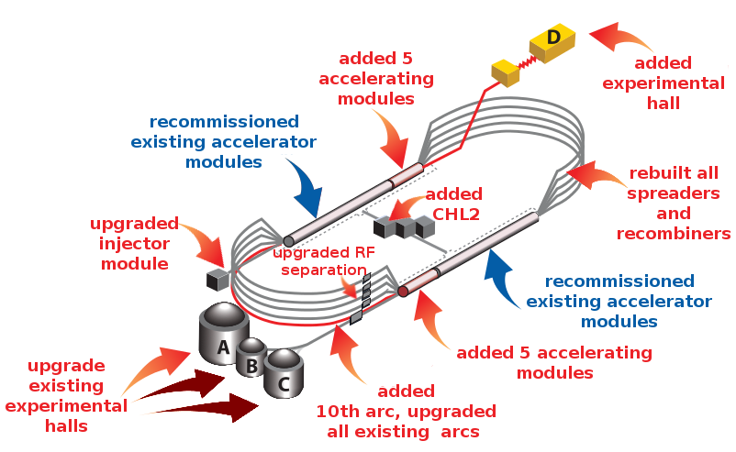
12GeV Upgrade Overview
Notes:
A similar picture as presented to describe the 6GeV CEBAF.
The upgrade impacted the entire machine.
The injector energy had to be doubled to match the doubling of CEBAF energy.
5 new cryomodules were added to each linac.
The spreaders and recombiner section were completely removed, floor swept clean, and the new 12GeV spreader/recombiners were installed.
All the arcs had to be upgraded and a tenth arc was added.
RF separation was upgraded not only for the increase in energy but also in capability to support 4-hall operation.
A new extraction line and Hall-D were added
A new CHL2 was installed and commissioned.
The one system that was not modified was the existing 41 cryomodules, but time was taking to recommission them to establish a complete SRF baseline for 12GeV CEBAF.

Slide 9
First Beam Operations
Run I (E_{pass} = 2.2GeV)
2013-Dec-13 to 2014-Feb-06
Establish 1-pass beam
12GeV Project KPP: 2.2 GeV/pass of energy gain
Run II (E_{pass} = 2.0GeV)
2014-Mar-07 to 2014-May-11
12GeV Project KPP: 5.5 pass beam to the Hall-D dumplet
Operations Goal: Demonstrate full injection energy (123 MeV)
Operations Goal: First multi-pass beams in the 12 GeV era
Operations Goal: CW operations to Hall-A, 3-pass beam with E>6 GeV
Notes:
OK, the tunnel work is complete, systems are checked. Let’s send some beam!!!
First run, is a short run to establish that the RF gradient has sufficient energy gain to achieve 12GeV on 5.5 passes.
The second run was to establish full energy from the Injector, multipass operation, CW beam to end-station A on 3pass and 5.5 pass beam to Hall-D

Slide 10
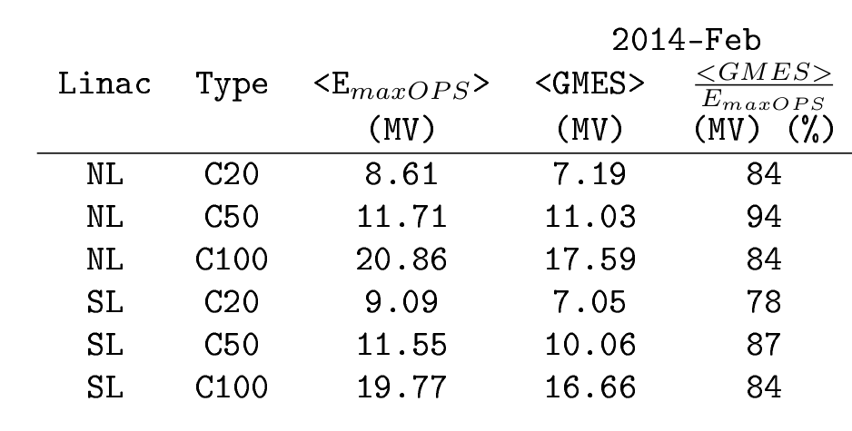
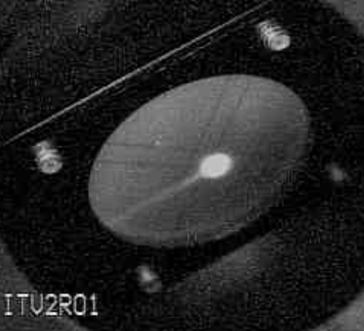
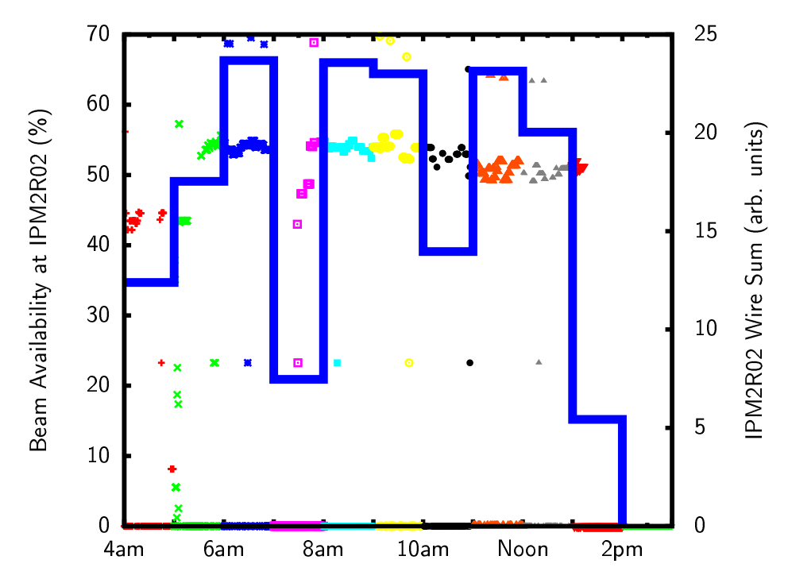
Run I
2.2 GeV/pass
2014-02-05
12GeV Project KPP Achieved
Beam Arc2 viewer
Availability > 50%, 8h run
E_{maxOPS}: maximum gradient during commissioning
GMES: Operational gradient
Majority of downtime due to C20 trips
Based on this and other data from Spring2014 operations, the estimated maximum 5.5pass energy with less than 10 trips per hour is:
11.25 GeV, or 6% below design, or 2.05GeV/pass.
Notes:
We hit our marks!!!
One-pass beam at 2.2GeV, what does this mean? Cryo plants are operating and stable at 2K with the RF system at full gradient. The RF gradients and phases are stable and maintaining the target one-pass energy of 2.2GeV/pass, 1100MeV/linac
6GeV to Hall-A: First multi-pass CW beam operations. Pathlength is under control, although the machine circumference shrunk by about 2cm during the installation requiring the master oscillator frequency to be changed by 22kHz. The machine has since relaxed back to nominally length. CW beam !!! And the users are engaged and starting their detector commissioning.
5.5pass beam to Hall-D: New Arc10 and Hall-D transport lines transport beam for the first time. The north linac transport SIX beams. Pathlength is under control. Full model loaded for the first time!

Slide 11
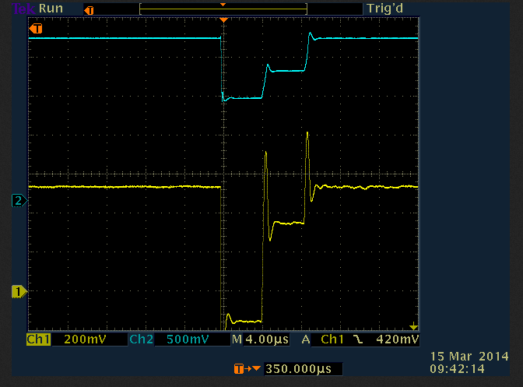
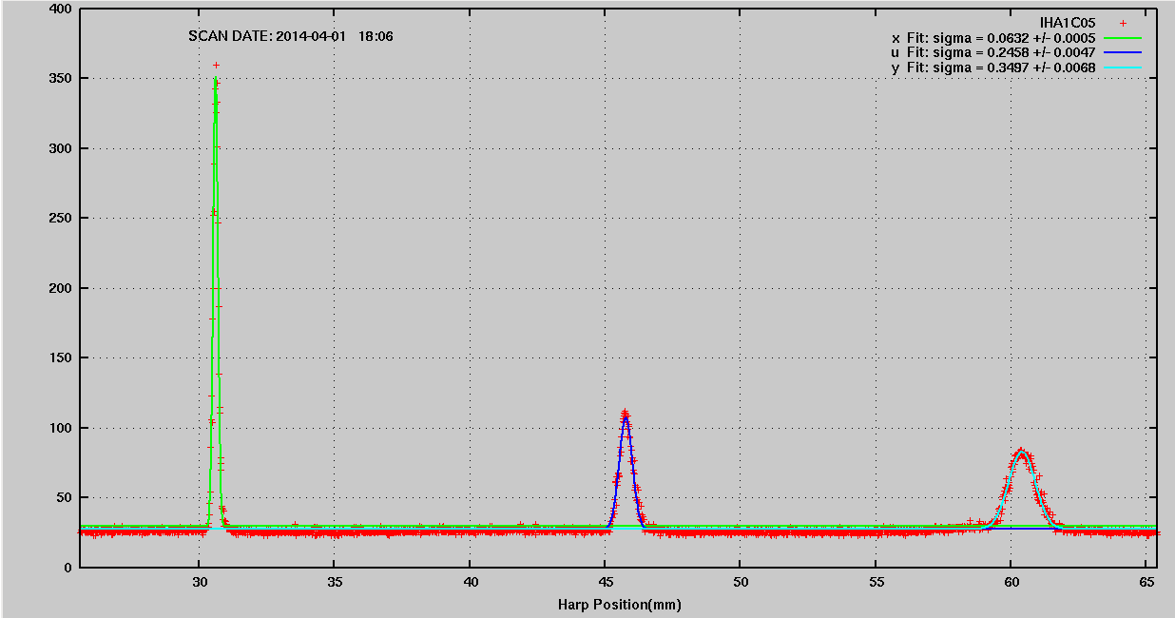
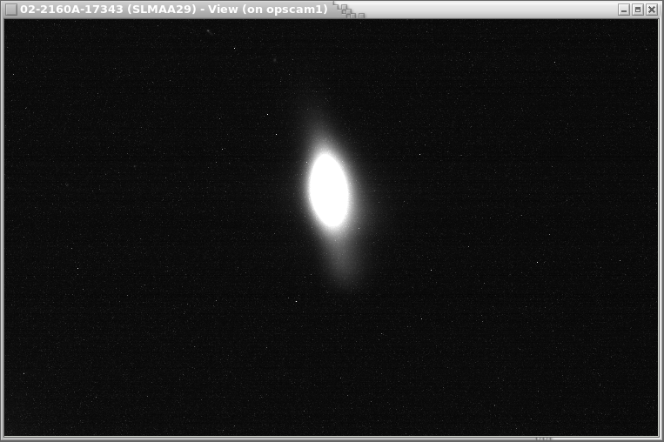
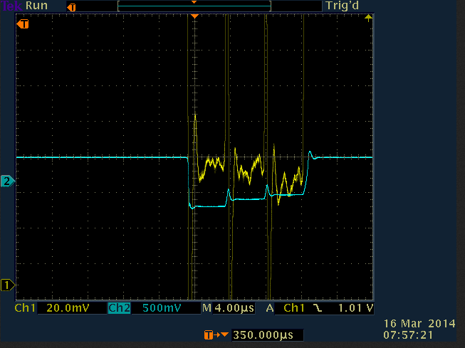
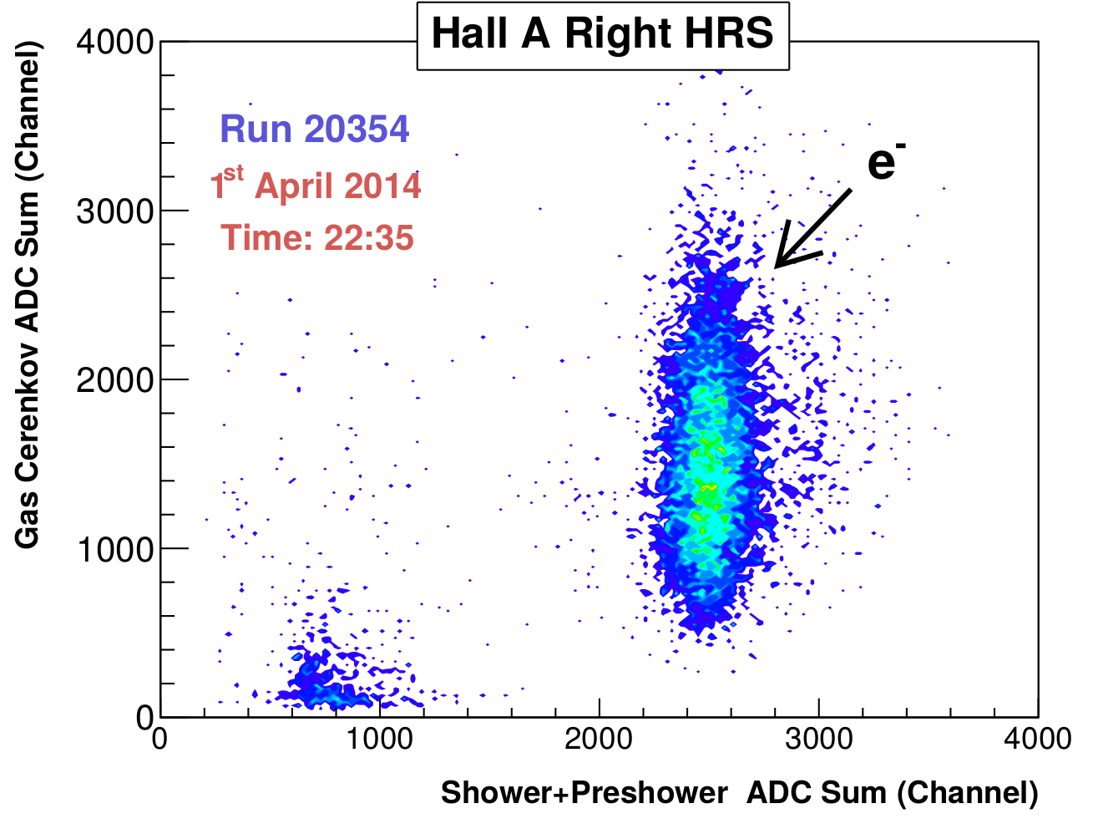
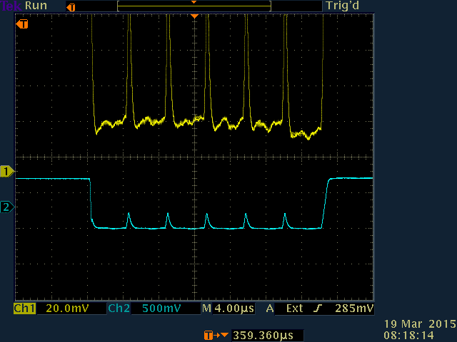
Run II: Milestones
Multi-pass (3-passes)
2014-03-15
>6 GeV to Hall A
2014-04-01
5.5 Pass Beam
2014-05-09
Initial 1st to 2nd pathlength difference
Beam profile in A line
Synchrotron Light in Arc10
1st,2nd,3rd pass pathlength difference after MO adjustment + arc offsets
Elastic events in A Spectrometer
6-beams in North Linac
Notes:
We hit our marks!!!
One-pass beam at 2.2GeV, what does this mean? Cryo plants are operating and stable at 2K with the RF system at full gradient. The RF gradients and phases are stable and maintaining the target one-pass energy of 2.2GeV/pass, 1100MeV/linac
6GeV to Hall-A: First multi-pass CW beam operations. Pathlength is under control, although the machine circumference shrunk by about 2cm during the installation requiring the master oscillator frequency to be changed by 22kHz. The machine has since relaxed back to nominally length. CW beam !!! And the users are engaged and starting their detector commissioning.
5.5pass beam to Hall-D: New Arc10 and Hall-D transport lines transport beam for the first time. The north linac transport SIX beams. Pathlength is under control. Full model loaded for the first time!

Slide 12
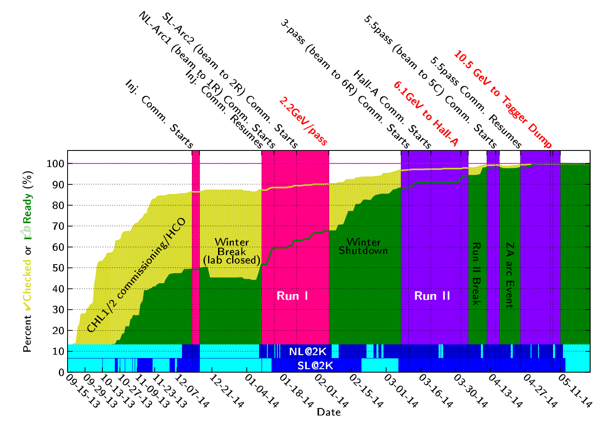
Run I and II Progression
Notes:
This slide shows progression of three activities during Fall 2013 to Spring 2014. Cryogenics commissioning, HCO and beam commissioning.
Cryogenics was commissioning the new CHL2 and the new configuration. Dark blue represents that the Linacs were at 2K.
The yellow curve shows the percent complete of the HCO elements into the checked state. Note that HCO activities are going on in parallel with beam activities.
Green curve shows the percent complete of the elements into the READY state.
And the upper tics show the beam activities and the vertical bands show when the tunnel was locked up for beam operations.

Slide 13
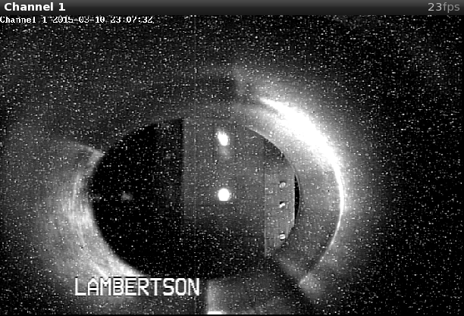
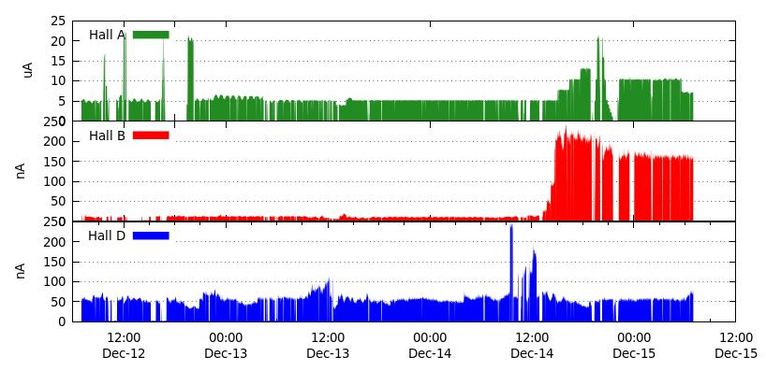
Run III (E_{pass} = 1.8GeV)
2014-Oct-08 to 2014-Dec-21
CW beam, E>10 GeV, 5.5pass beam to Hall-D
First photons into the new experimental hall
12GeV Project KPP: Hall-D detector commissioning
Operations Goal: RF separation (1-4 pass), first simultaneous multiple users in the 12GeV era
Operations Goal: Establish 2-hall operation
Separated beams on beam viewer
Sustained 3-Hall operations
4-pass, RF separated
A-beam (4-pass)
1-pass, RF separated
B-beam (1-pass)
5.5-pass
Notes:
During the Summer 2014: hall-D completed their detector installation and checkout. And an “early physics” experiment was installed in Hall-B.
The two main goals for the Fall2014 was to establish CW beam to the Hall-D tagger dump and to generate photons for the first time. This was to support the commissioning of the new Hall-D detector.
In addition the upgraded RF-separation was to be commissioned.
The images at the bottom show the separating beams on 1st and 4th pass to halls B and A.
And the plot to the right shows a sustained three day period with all three halls receiving beam with high availability.

Slide 14
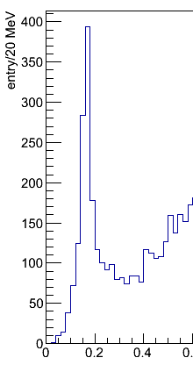
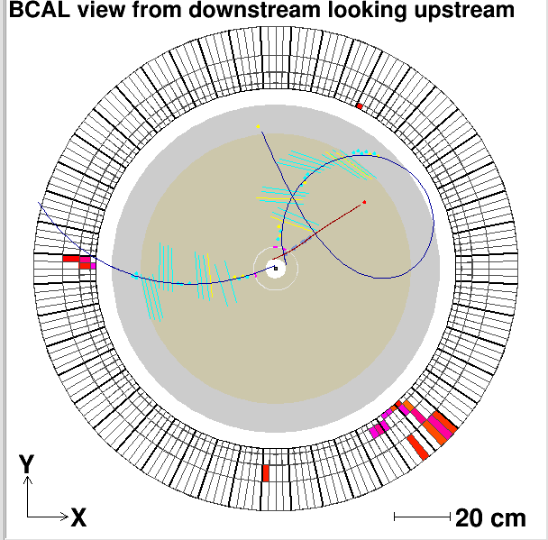
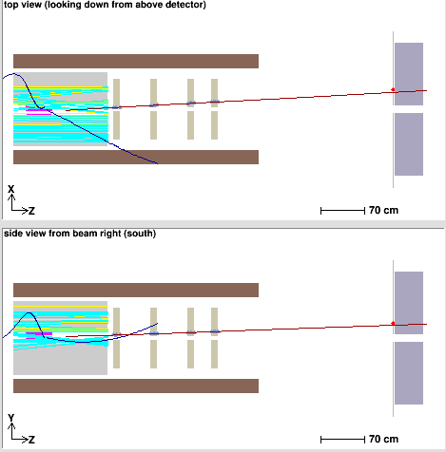
Hall D Commissioning
Hall D: facility for experiments using linearly polarized photon beam
Main goal: search for gluonic excitations in light meson spectra (GlueX experiment)
Photon beam line + large acceptance spectrometer for charged particles & photons
Commissioning with beam Nov. & Dec. 2014
Program Goals demonstrated
Charged particles tracking
Neutral particles reconstruction
Results with preliminary detector calibration and alignment
Vertex
reconstruction
π°→γγ
Event Display
Drift chambers
Target location
Electromagnetic calorimeters
Spectrometer in solenoidal magnetic field
γγ mass, GeV
Z,cm
Notes:
The main program goal was the commissioning of the Hall-D detector.
With the beams delivered in Nov/Dec of 2014, the program goals with demonstrated with tracks in their tracking system, pi0s in their calorimeter and even a vertex reconstruction.

Slide 15
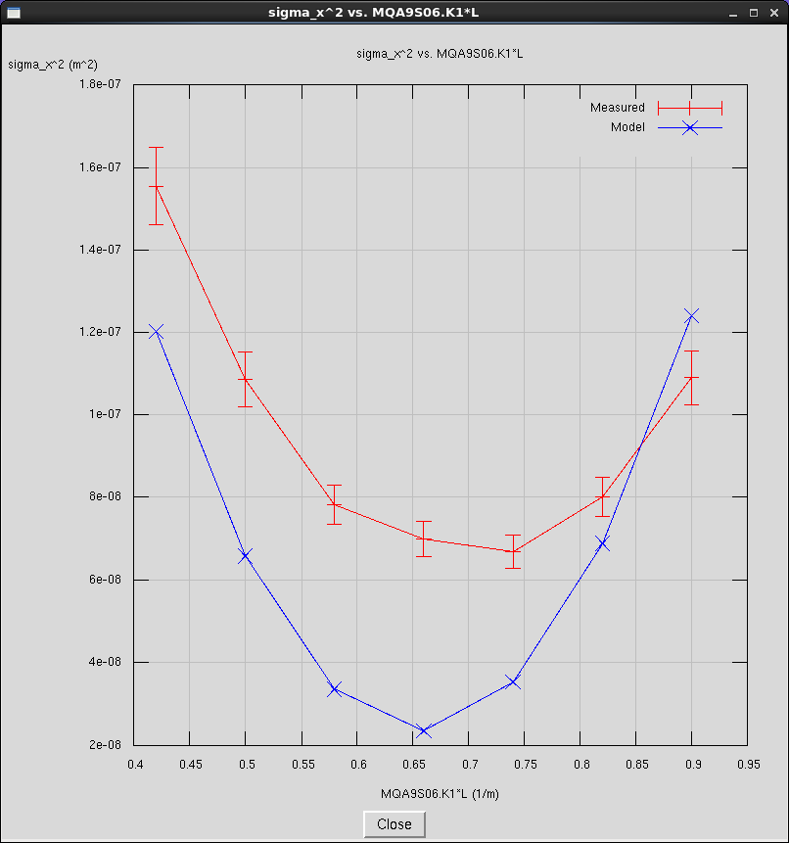
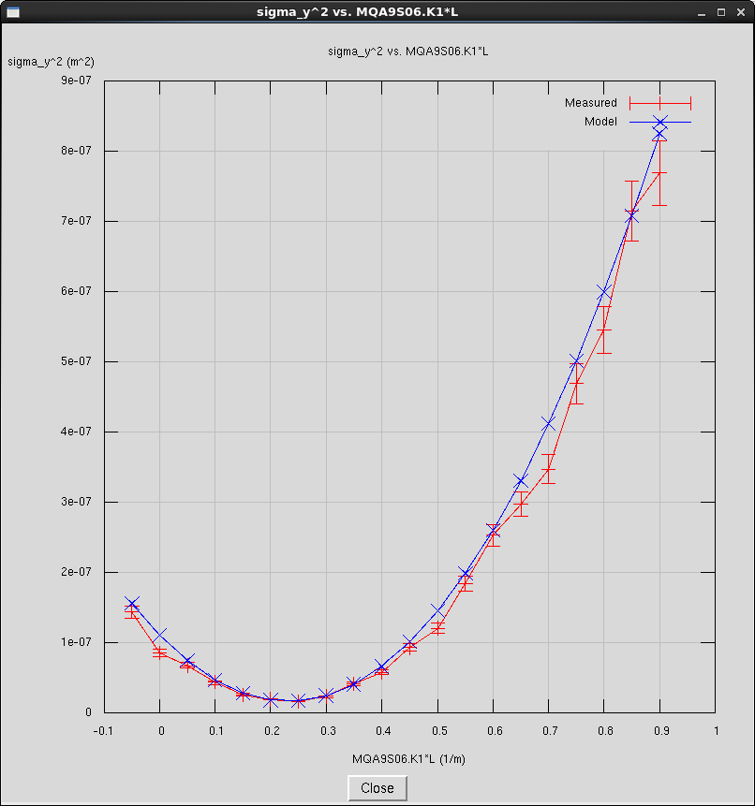
Run IV (E_{pass} = 1.9GeV)
2015-Feb-13 to 2015-May-18
Commission new 249.5 MHz laser/injector configuration
Commission new 750 MHz 5-pass separators
Exercise new setup process and associated tools: New beam matching process
Establish baseline emittance and bunch length evolution
Support ~5wk “early Physics” Operation
Quad Scan: Before match
Quad Scan: After match
Measured
$$σ_{y}^{2}$$
$$σ_{y}^{2}$$
Model
K1*L (1/m)
K1*L (1/m)
Notes:
The run presently in progress, included the commissioning of the new 5th pass separation system which are on the following slides.
Interleaved with the RF separation commissioning was optics tool development and measuring some baseline beam parameters.
CEBAF was setup as per the procedure developed during the design phase. Orbit offsets in the arc were minimized if not nulled. The MO was adjusted to achieve this, it is now only 2KHz off nominal. The beam was matched and set on design at the entrance to each arc. The Arcs and recombiners quadrupoles were set to design and did not require any significant changes going forward, confirming that the model is converging.
More on this in Todd Satogata’s talk on Wednesday.

Slide 16
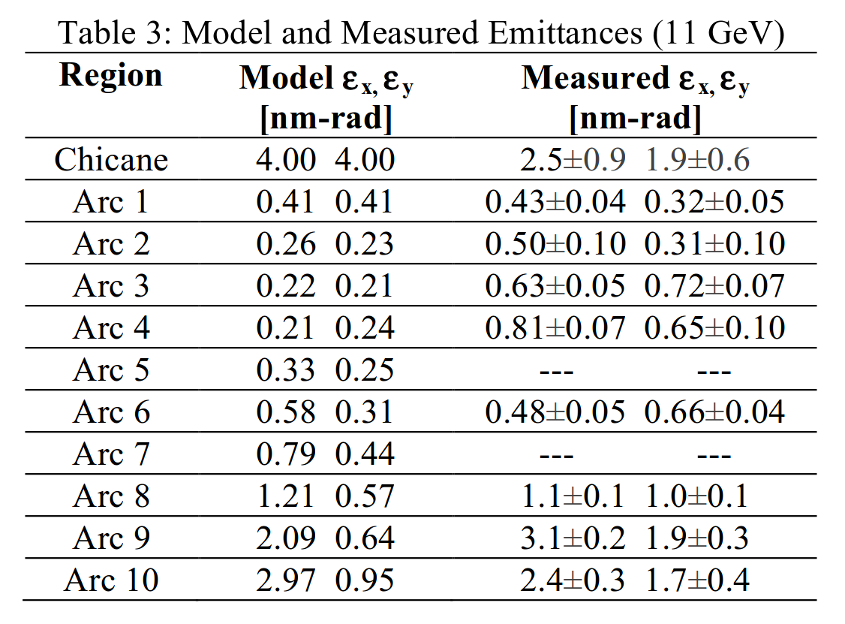
Beam Emittance Evolution at 1.9GeV/pass
Presented at IPAC15: Satogata (WEBD1), more beam physics later today.

Slide 17
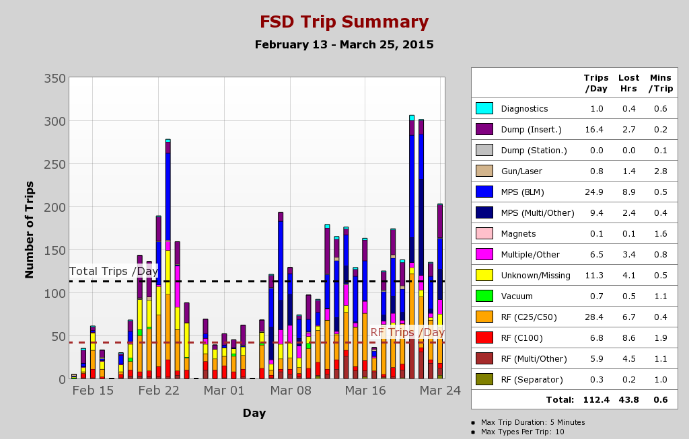
Tracking Performance: Beam Trips

Slide 18
CEBAF Reliability
 | Scheduled Weeks | Operated Weeks | Reliability Target | Reliability Achieved
FY14 | 13 | 10.3 | 50 | 48
FY15 | 18 | 19.7 | 58 | 68 | Received additional funds for more operating weeks
FY16 | 16 |  | 66
FY17 | 27 |  | 70
FY18 | 27 |  | 74
FY19 | 28 |  | 78
FY20 | 28 |  | 82
FY21 | 28 |  | 85
Long term schedule is based on “Cost of Living” scenario.
Additional funding will generally add more operating weeks and may also result in an increase to the reliability target.
Reliability session this afternoon
Metrics presentation on Friday

Slide 19
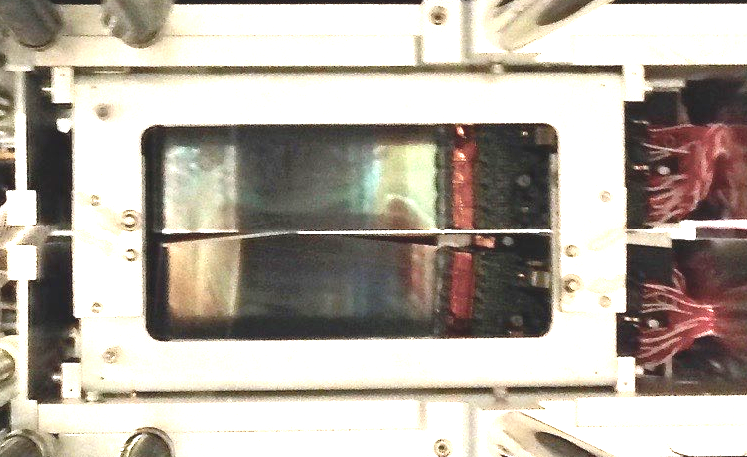
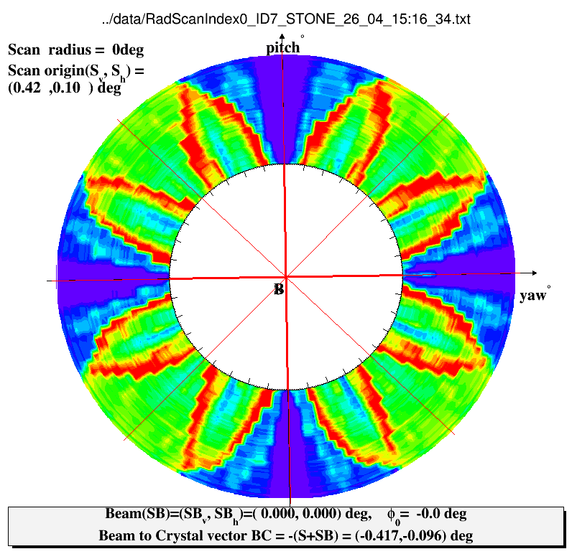
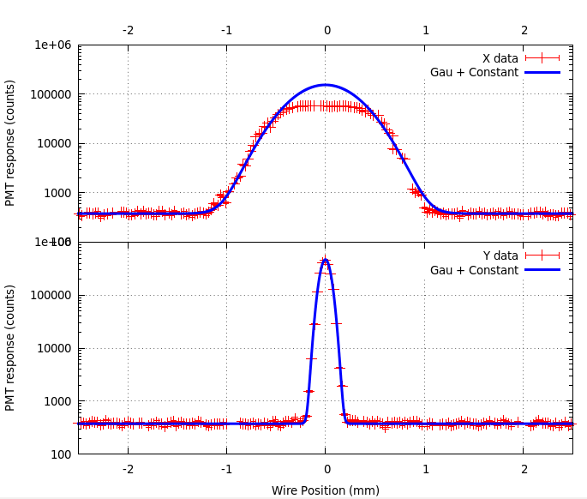
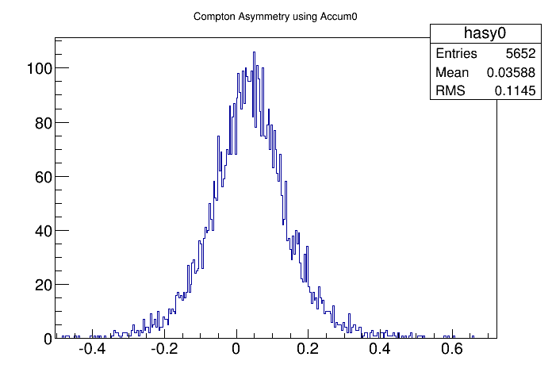
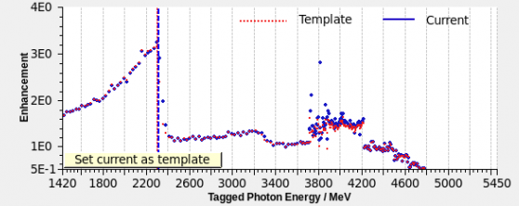
Three Hall Program: (E_{pass}= 1.0 GeV)
Hall-A: Commissioning e⁻ polarimeters
Hall-B: Ribbon beam for dark matter search
Hall-D: First coherent bremsstrahlung spectrum
Si detectors
BEAM goes here, 1mm gap in Si
$$A_{Raw}=\frac{N_{+}−N_{−}}{N_{+}+N_{−}}$$
$σ_{x}^{}=$ 294µm
Compton Asymmetry
$σ_{y}^{}=$ 48µm
Notes:
With CEBAF reconfigured at a lower energy, progress in all three halls.
Hall-A commissioned their upgraded polarimeters and were able to measure an asymmetry in the compton polarimeter.
Hall-B has transitioned from commissioning the dark matter experiment to taking data. This experiment requires a ribbon beam to pass between SI strip detectors that reside 0.5mm from the beam. Stability!!!
Hall-D has established the alignment of the diamond radiator and the generation of a coherent bremsstrahlung photon beam.

Slide 20
Summer 2015 Shutdown Tasks
Preparing for 12GeV Operations:
Utilities Infrastructure Modernization upgrade
Power grid, cooling towers, communications
Helium Processing
Energy Reach
750MHz Separator Cavities
Modifications to achieve design, enable RF separation at 11GeV.
Cryogenic plant repair and maintenance
Pathlength chicane upgrade
Restoring the range of the pathlength chicane to the 6GeV equivalent.
Tunnel Air Conditioning
Control temperature rise in tunnel. Temperature should not rise above 35 C.
Vacuum system hardening
Preparing for synchrotron radiation induced vacuum loads
Operations StayTreat

Slide 21
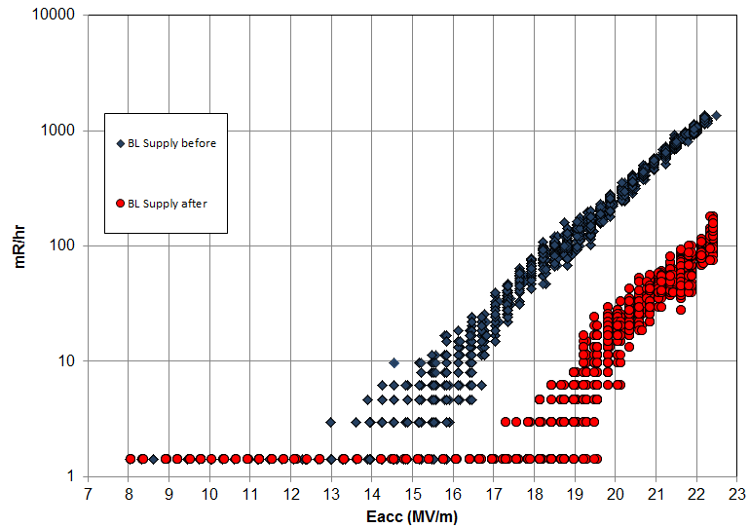
Helium Processing
Utilized during 6GeV era to improve maximum operating gradient of SRF cavities (to reach 6GeV).
Insert small amount of gaseous He into the cavity.
Process cavity with RF power, watch for the radiation signature to drop (field emitters extinguished).
Cryo-cycle the cavity to remove the He.
Determine the new maximum operating gradient
Before HeProc
Representative gain (~4MV/m) on one C100 cavity recently Helium processed.
After HeProc

Slide 22
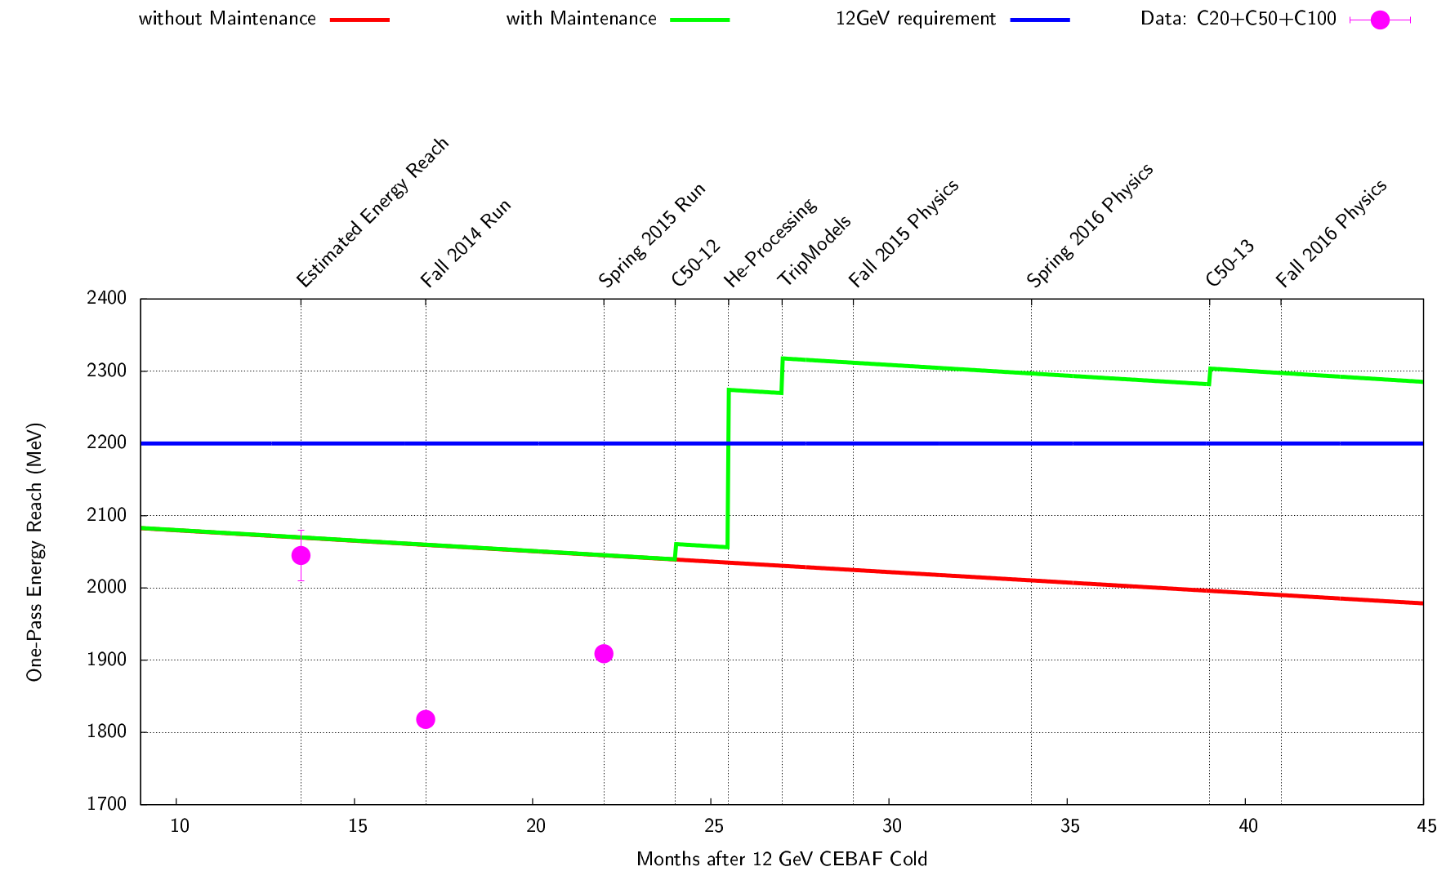
Energy Reach: Past and Future
S&T
Helium processing of all cavities planned for Summer 2015
C20/C50 performance degradation:
0.21 MV/m – year (~34 MeV/pass - year).
Cause of degradation is unknown, actively being investigated.
C100 insufficient data to date to reliably estimate degradation, if any.
Commissioning vs. Operations cavity performance:
$78\%<\frac{Operational Gradient}{Commissioning Gradient}<94\%$
Notes:
With 20+ years of SRF operations on over 320 cavities, gradient degradation of roughly 34MeV/pass of energy has been observed.
In order to restore the energy gain of CEBAF to support high availability physics operations, all the cavities will be helium processed this summer. The plot shows the gain expected from this effort. This gain is based on previous helium processing cycles in the 6GeV era and some recent measurements.
Long term, a continuous C50 upgrade program, one C50 per year, will help keep the gradient from declining at a large rate.
Also effort in minimizing the gap between the Commissioning gradients and operations gradient is on going.

Slide 23
12GeV Operations: Future
Complete the Summer 2015 shutdown tasks.
Operate RF systems 24/7 for two weeks prior beam operations.
Optimize C100 LLRF to achieve design gradients (or beyond).
Collect data on C20 trip rates, used to optimize gradient distribution with minimal trip rate.
Decrease the gap between E_{maxOPS} and GMES for all cavity types.
Fall2015 (E_{pass} = 2.2 GeV):
2015-Oct-26 to 2015-Dec-21
Emittance/energy spread growth studies.
SRF performance optimization at full energy.
Minimize trip rate
Minimize recovery time
Maximize gradient
Detector commissioning at full energy.
Opportunistic beams for Physics.
Spring2016 (E_{pass} = 2.2 GeV):
2016-Jan-28 to 2016-Mar-31
First Physics runs with CEBAF at 12 GeV energy: Halls A&D
Notes:
In two weeks, the Summer shutdown starts. During the following major activities are planned:
Helium processing of every cavity
Complete tunnel air conditioning so that the temperature in the Arc regions of the tunnel do not exceed the 45C (electronics in tunnel).
Complete the pathlength chicane upgrade to minimize the need to change arc orbit offsets or the MO.
Repair the 2K cold box.
In the fall, a 12GeV, 1100MeV/linac configuration will be setup following the same process used this past run. All eyes will be on measuring emittance/energy spread growth and the SRF performance.
In the Spring, the plan is to support the Physics program at the design enegy.

Slide 24
Non-Beam Accomplishments
Successfully completed the Accelerator Readiness Review process (several staged reviews) for 12GeV CEBAF.
Commissioned the cryo plants and established 2K operations in North and South linacs.
Established the CEBAF Element Database (CED) as the definitive source for CEBAF configuration.
CED used to drive many other new developments, Hot Check Out tool, control screen generation, beam matching tool, etc.
Installed and checked every CEBAF element (over 8000) before beam transport.
Accelerator 12GeV KPP demonstrated
Fully characterized (E_{max}, Q₀, Field Emission) every SRF cavity before the start of 12GeV operations.
Provides a baseline for gauging SRF performance in the future.

Slide 25
Beam Commissioning Accomplishments
2.2GeV/pass one-pass beam transport with greater than 50% availability.
Accelerator 12GeV Project KPP demonstrated
Evidence that the RF gradient is insufficient for Physics operations (high availability).
Multi-pass capability established.
First use of small (kHz) change of the Master Oscillator to deal with large (2cm’ish) changes in CEBAF circumference.
5.5pass beam transported to the Hall-D dump.
Shielding issues identified and addressed.
CW beam successfully transported to Hall-D dump.
First photons generated and sent into Hall-D.
Hall-D detector 12GeV Project KPP demonstrated.

Slide 26
Beam Commissioning Accomplishments (cont.)
Multi-user capability established.
CW beam, up to 50μA delivered to Hall-A (2-pass).
Extraction system 499MHz and 750MHz commissioned.
New 750MHz cavity power limitation identified.
New 249.5MHz laser drive system issues identified.
Physics quality beams delivered to Hall-A and Hall-B.
Hall-A DVCS exp. one Q² point measured.
Hall-B HPS exp. ~1/3 of the 1GeV data collected (additional runs at 2.2,4.4 and 6.6 GeV).

Slide 27
What We’ve Learned
Gradient not quite enough for Physics operations
Helium Processing required to achieve design energy
C100 controls optimization/operations training -> increase C100 operational gradients.
CEBAF Circumference can change significantly during long down periods.
Master Oscillator Δλ crucial in dealing with large change.
Some diagnostics (a few special BPMs) not happy with large (10kHz) changes.
Beam matching at the Arc entrance is a valid approach for CEBAF setup.
Non-zero M₅₆ in the upper arcs has presented some challenges.
Plan to revert back to M₅₆=0 (6GeV CEBAF Optics) for the Fall program.
Four hall separation system, 750MHz cavities & 249.5MHz laser drive, not 11GeV capable.
New 249.5MHz drive system under design, in the meantime analog system in place.
750MHz cavity power issues identified and being addressed.

Slide 28
Summary
Turbulent Spring 2015:
Beam matching at entrance to each Arc demonstrated as a valid approach.
4-hall separation system commissioned.
Cryogenics remains a single point of failure.
Plan for 12GeV Operations:
Helium processing of all cavities will provide the gradient reach needed for 12GeV operations.
Tunnel AC, Dogleg upgrade, 750MHz cavity, vacuum system hardening, etc. will ease some of the challenges of 12GeV operation.
Majority of the Summer 2015 shutdown work is in support of operating CEBAF at the 12GeV design energy this Fall, Spring 2016 and beyond.

Slide 29
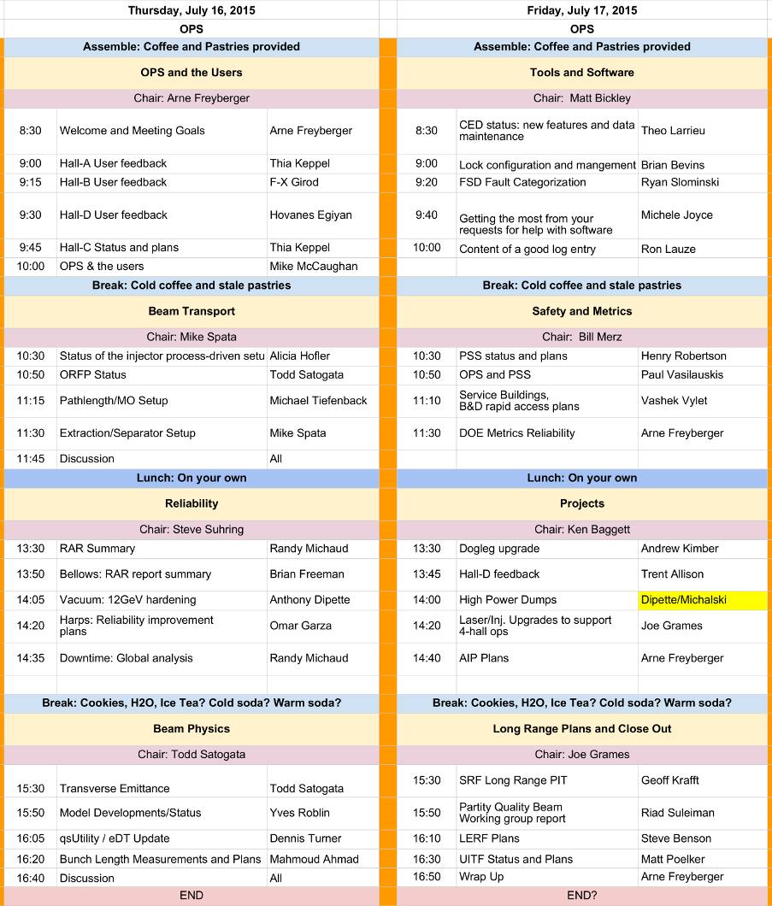
Operations 3-day StayTreat
Chairs please keep the speakers on schedule and the discussion focused.
Speakers please respect the schedule.
Audience please keep the discussion relevant, respectful, crisp and invigorating.
Actions items will be distilled from the presentations and discussion. No need to solve the problem during the meeting.

Slide 30
Back Ups

Slide 31
Accelerator Mission
The Accelerator Mission is to advance the capability of Jefferson Lab to carry out world-class nuclear science and, more broadly, to develop Jefferson Lab’s expertise in technologies associated with high-power superconducting linacs
The goals to achieve the mission deliver results in four strategic areas:
Operate and upgrade the JLab accelerator facilities
Prepare for a Medium-Energy Electron Ion Collider (MEIC) at Jefferson Lab
Sustain Jefferson Lab’s core accelerator competencies to support DOE Office of Science projects and other partnerships
Attract and educate the next generation of accelerator scientists and engineers
Goals are in priority order

Slide 32
RF Separation – Four Halls
A/B/C separator is located downstream
Beam to Halls
A
A
C
C
B
B
A
A
C
Accelerator
Frequency
1500 MHz
C
A
A
B
B
C
A
B
C
D
C
A
B
D
A
A
Hall Lasers
Hall A: 250 MHz
Hall B: 250 MHz
Hall C: 250 MHz
C
C
B
B
C
D
C
B
B
A
A
C
C
B
B
Hall D
Beam
Hall D: 250 MHz
(existing hall lasers run at 500 MHz)
5th Pass RF Separator Cavity
750 MHz
Four-Hall Operation!
(D+3)
New Hall D laser fills empty buckets at 250 MHz
Notes:
The majority of the experiment proposals are for full 5-pass energy in Halls A,B &C. In order to support simultaneous 5-pass operation to the old end-stations while also supporting beam to Hall-D (5.5passes) a new 5-pass separator was conceived, designed, installed, commissioned and operated.
In order to squeeze a four beam into the 1497MHz machine frequency, the Hall beam structure was changed to 249.5MHz (allows for 6-halls, was 499MHz) and the separator cavity frequency is now 750MHz.

Slide 33
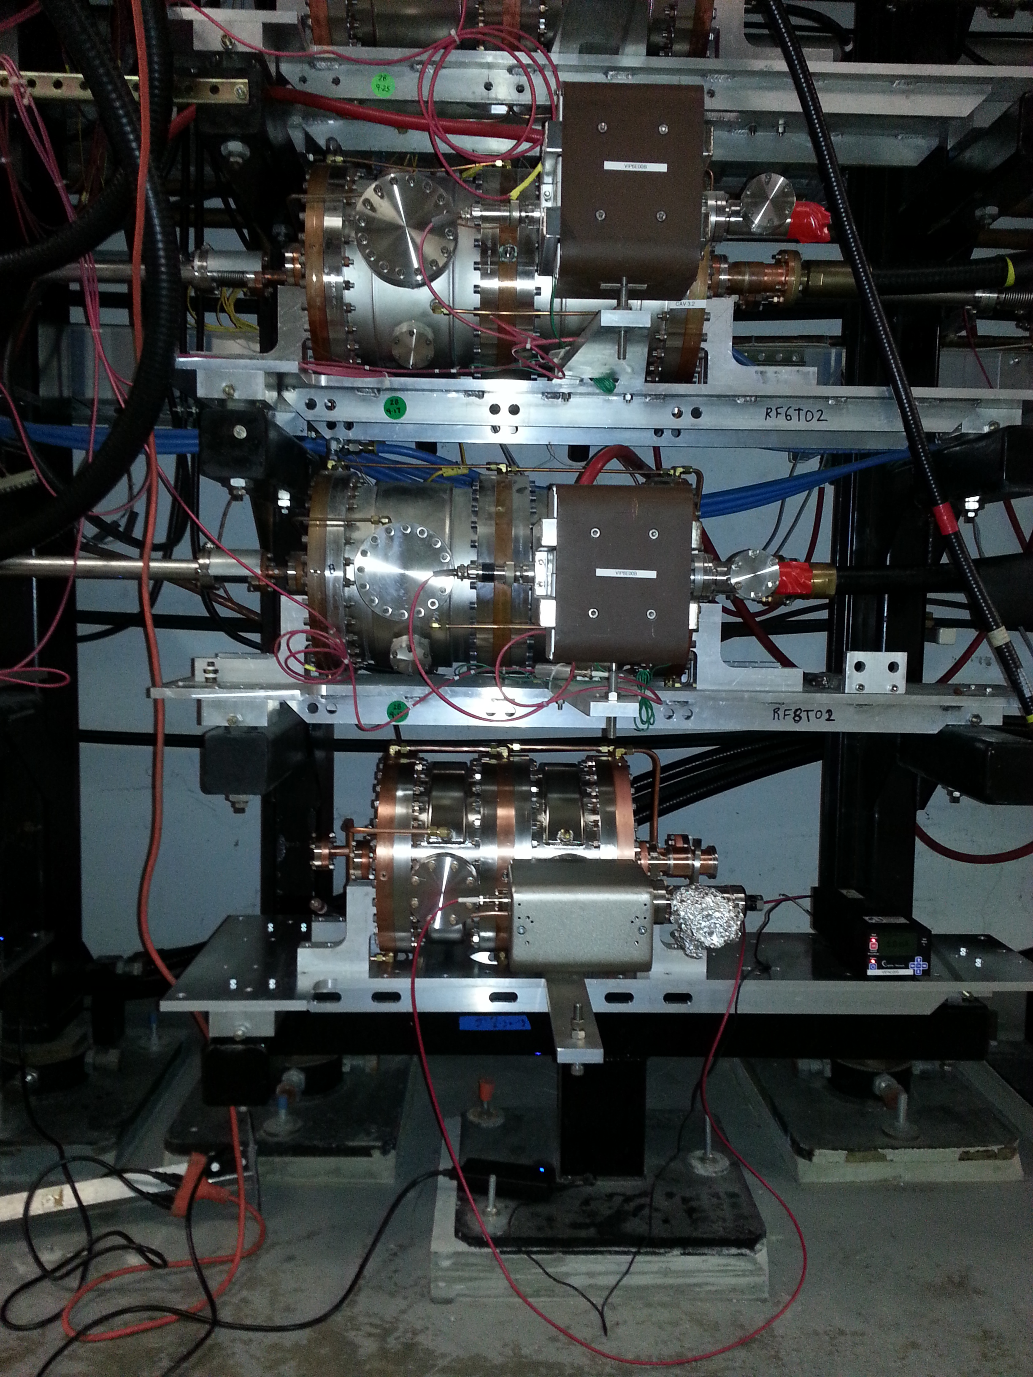
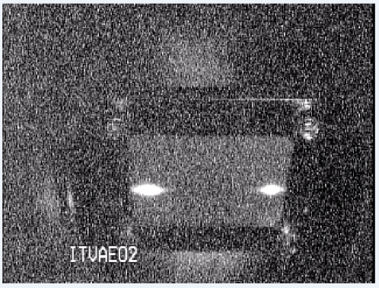
750MHz Separation
A & D beam separated on 5th pass at 9.6 GeV.
500MHz
750MHz
Commissioning effort identified improvements required to achieve full-energy separation
Design maximum beam energy is 11 GeV
Notes:
The new 750MHz cavity on 5th pass below the 500MHz 4th and 3rd pass separators which remain at 499MHz.
And the separated beams on the beam viewer.
OK, so we’re sitting pretty. Machine optics are the on design and well tuned. RF separation is complete. CEBAF is ready for the users.
The “lights go out”. An off-site power event results in CEBAF loosing power for several hours. CHLs trip and prove to be difficult to recover.
Turns out 2K cold box one, the original 2K cold-box has a seized cold compressor and will take months to repair.
Reconfigure Cryo to support CEBAF at 2K on one Cryo plant and change CEBAF energy to 500MeV/linac.

Slide 34
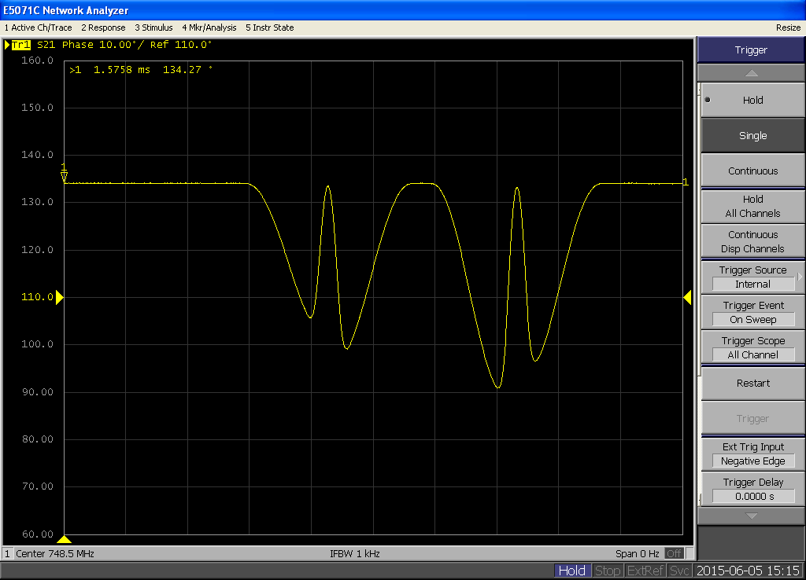
750MHz Separators: Path toward 11GeV capability
Increase power input by operating Inductive Output Tubes (IOT) at full power (done)
Improve resonance controls (Prototype done, production systems in progress):
Warm Cu cavities, tuning controlled via temperature
Improve temperature control hardware (better valves, sensors) and software (feedback loops).
Improve coupling into the cavity (Prototype done, modifications in progress):
Improve alignment
Improve field monitoring
Example of poor field flatness, poor coupling into 2nd cell
Example of improved field flatness and coupling into 2nd cell

Slide 35
Cryogenic Plants
SC1 CC4 Repair
SNS Spare CC shipped to JLab
SNS Spare CC installation in SC1 on-going
Expect SC1 ready for operation by end of August
Still waiting for vendor quote on repair of damaged CC4
CHL2 Heat Exchanger
CHL2 efficiency not meeting specifications
New heat exchanger being installed by vendor
Expect work to be completed by end of August.

Slide 36
Gradient Maintenance
Repeated Helium processing in the near term after this years processing will have limited return.
C50 program: Refurbish the weakest original CEBAF cryomodules (C20).
Refurbished energy gain is ~50MeV, for a delta of about 20MeV (depends on C20 being refurbished).
Plan is to refurbish one C20 every year.
Energy gain of one refurbishment per year is insufficient to maintain constant energy reach.
R&D on the source of the gradient loss:
Examine C20 modules at start of refurbishment process for sources of gradient degradation.
Examination of the most recent C20 undergoing refurbishment, while preliminary, encouraging.
Monitor, track and document installed SRF performance.
C75 development:
Develop an alternative to the C50 refurbishment program that results in a cryomodule with 75MeV of energy gain.
Competitive, in terms of k$/MV, if cost is less than $3.5M (C50 refurbishment is about $1.5M)

Slide 37
March 25th Power Event: Technical Stop
Offsite power failure, CEBAF Site without power
ALL systems affected, including cryo plants
Power restored in a couple of hours
4K operations resumed immediately (Helium inventory management)
Restoring 2K operations problematic:
CHL2->SC2->NorthLinac cannot achieve stable 2K operations due to contamination issues.
CHL1->SC1->SouthLinac cannot start due to issue with cold compressor 4 (CC4) in SC1.
12GeV cryogenic configuration

Slide 38
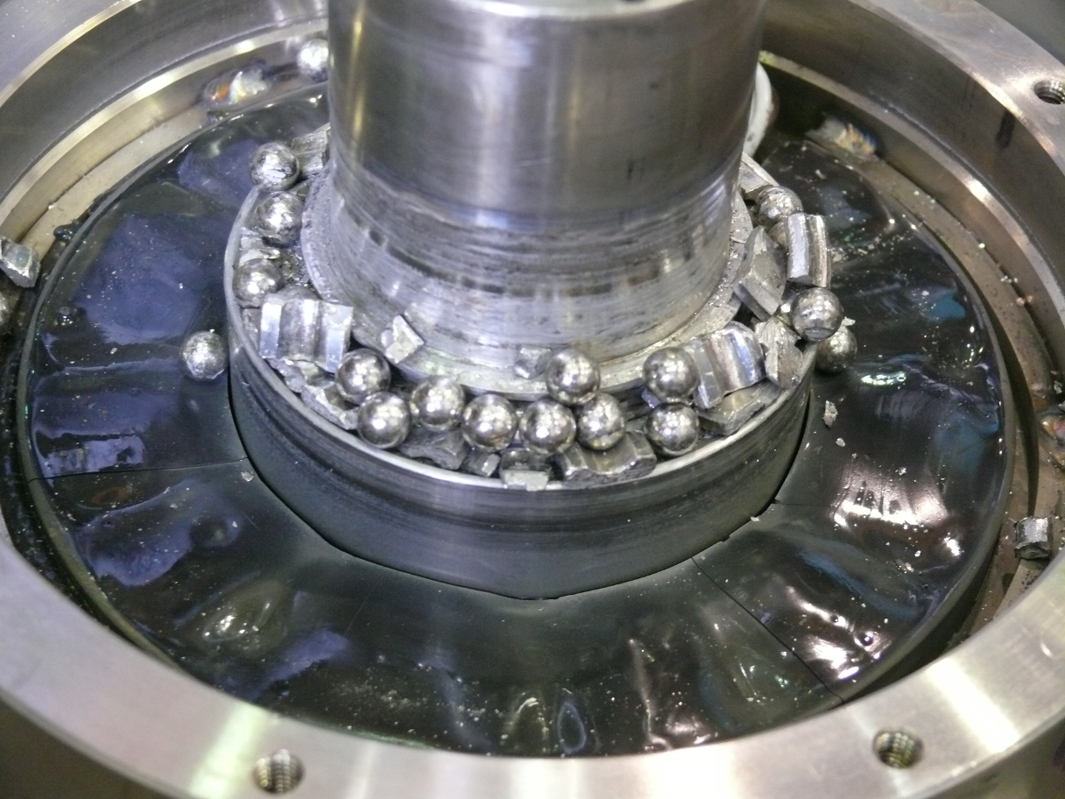
Power Event Impact
CEBAF Down hard: 2015-03-25 – 2015-04-15
Warm up SC2 to remove contaminants, purge/pump cycles.
SC1 CC4 Failure
Compressor wheel stuck, will not rotate, seized, not good.
CC4 safe shutdown system found not working.
Compressor wheel had a hard landing at full speed (>30000 rpm).
Reconfigure cryo-plants/CEBAF with both linacs connected to CHL2->SC2.
CC4 disassembled in June:
Return to CEBAF Ops with one CHL plant
Limited cooling capacity
Limited beam energy
Physics program continued with an alternative program at 1GeV/pass.

