Slide 1
Vacuum: 12GeV Hardening
Anthony DiPette
Installation / Vacuum Group Leader
7/16/2015

Slide 2
Vacuum: 12GeV Hardening
Vacuum Improvements & Status
Synchrotron Radiation Effects
Vacuum Spares

Slide 3
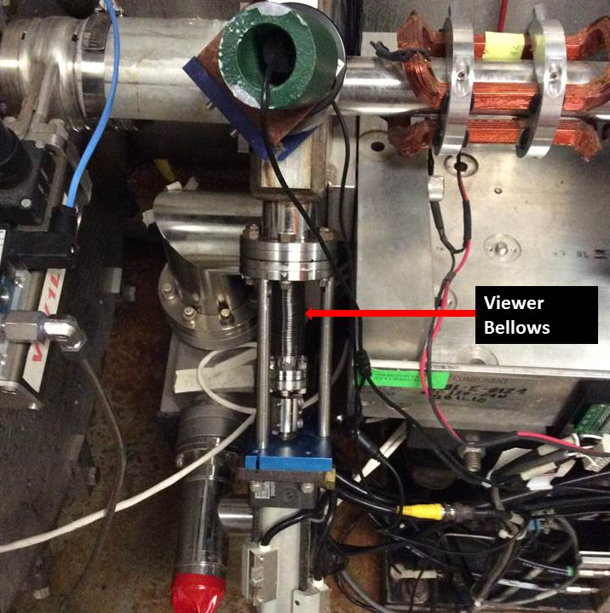
Vac Improvements - Linac Viewer Bellows
9 of 11 Done
Viewer Location | New Bellows
1L02
1L06
1L10 | Done
1L14 | Done
1L18 | Done
1L22 | Done
2L02 | Done
2L06 | Done
2L10 | Done
2L14 | Done
2L18 | Done
Viewer Bellows

Slide 4
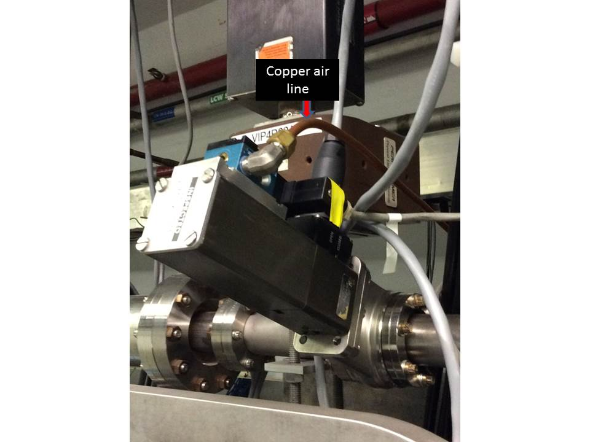
Vac Improvements - Air Lines
Air Lines changed from Poly to Copper
100% Complete
Copper Air Line

Slide 5
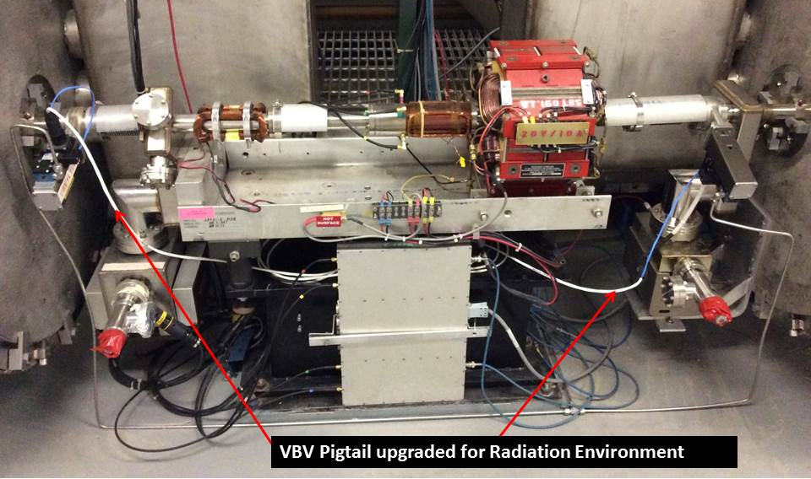
Vac Improvements - VBV Pigtails
New Connectors & Cables to replace Rad damage
100% Complete North and South
VBV Pigtail upgraded for Radiation environment

Slide 6
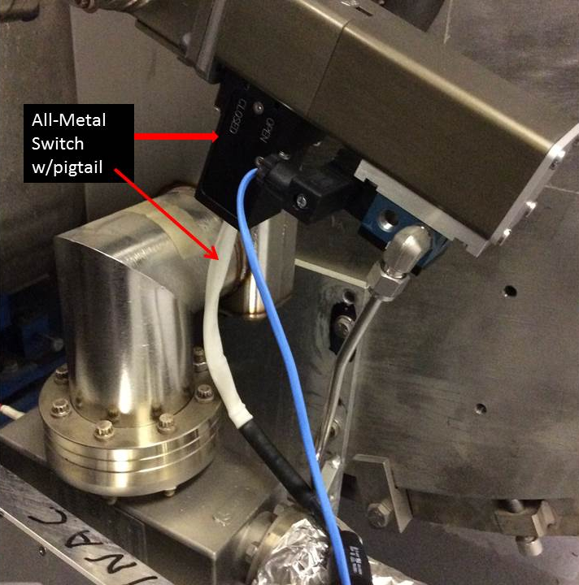
Vac Improvements - Position Switches
VBV Position Switches from Plastic to Metal
41% Complete
All-Metal Switch w/pigtail

Slide 7
Vac Improvements - Position Switches
VBV Position Switches
from Plastic to Metal
VBV Position Switches (A,B) | Replaced Metal switches | Steve's Rad Survey List
1L02
1L03
1L04
1L05 |  | 1L05
1L06 |  | 1L06
1L07
1L08
1L09
1L10
1L11
1L12 |  | 1L12
1L13 |  | 1L13
1L14
1L15
1L16
1L17
1L18
1L19
1L20
1L21
1L22
1L23 |  | 1L23
1L24 |  | 1L24
1L25 |  | 1L25
1L26 | 1L26A | 1L26
2L02
2L03
2L04
2L05
2L06
2L07
2L08 | 2L08A
2L09
2L10
2L11
2L12
2L13
2L14
2L15
2L16 | 2L16A | 2L16
2L17 | 2L17A
2L18
2L19
2L20
2L21
2L22 | 2L22B | 2L22
2L23 | 2L23A & B | 2L23
2L24 | 2L24A | 2L24
2L25 | 2L25A | 2L25
2L26 |  | 2L26
VBV Position Switches (A,B) | Replaced Metal Switches
1L02
1L03
1L04
1L05
1L06
1L07
1L08
1L09
1L10
1L11
1L12
1L13
1L14
1L15
1L16
1L17
1L18
1L19
1L20
1L21
1L22
1L23
1L24
1L25
1L26 | 1L26A
2L02
2L03
2L04
2L05
2L06
2L07
2L08 | 2L08A
2L09
2L10
2L11
2L12
2L13
2L14
2L15
2L16 | 2L16A
2L17 | 2L17A
2L18
2L19
2L20
2L21
2L22 | 2L22B
2L23 | 2L23A & B
2L24 | 2L24A
2L25 | 2L25A
2L26
VBV Position Switches (A,B) | Replaced Metal switches | Steve‘s Rad Survey List | Mike's Data Avg Radial | Mike's Data Max Radial | Mike's Data Avg BL | Mike's Data Max BL
2L24 | 2L24A | 2L24 | 14310 | 25828 | 18964 | 30790
2L22 | 2L22B | 2L22 | 12861 | 25278 | 29167 | 46439
2L23 | 2L23A & B | 2L23 | 10773 | 24127 | 10947 | 33016
2L03 |  |  | 10241 | 37414 | 18387 | 32537
2L25 | 2L25A | 2L25 | 9280 | 18504 | 16101 | 22827
1L05 |  | 1L05 | 8487 | 15458 | 17753 | 24932
1L26 | 1L26A | 1L26 | 8477 | 18791 | 17264 | 29080
1L21 |  |  | 7744 | 25107 | 13095 | 27204
1L17 |  |  | 7645 | 29932 | 10042 | 20304
2L11 |  |  | 7515 | 39940 | 7335 | 25834
2L08 | 2L08A |  | 7294 | 31405 | 15642 | 27668
2L26 |  | 2L26 | 6892 | 14864 | 11204 | 21240
2L16 | 2L16A | 2L16 | 6813 | 19658 | 7482 | 23771
1L24 |  | 1L24 | 6729 | 19440 | 10628 | 19998
2L15 |  |  | 6614 | 37020 | 11860 | 38074
1L11 |  |  | 5717 | 15853 | 13506 | 28183
2L07 |  |  | 5474 | 12225 | 15625 | 35212
2L02 |  |  | 5346 | 16099 | 15090 | 25201
2L06 |  |  | 5164 | 21834 | 14594 | 31348
2L12 |  |  | 5054 | 27510 | 13738 | 25189
1L02 |  |  | 5016 | 20928 | 5265 | 18226
1L12 |  | 1L12 | 4935 | 33561 | 5925 | 20519
1L19 |  |  | 4930 | 32688 | 11810 | 29611
1L13 |  | 1L13 | 4657 | 14807 | 7533 | 21421
1L10 |  |  | 4459 | 18698 | 11045 | 31768
2L21 |  |  | 4311 | 16005 | 10765 | 36347
1L18 |  |  | 4288 | 9416 | 11913 | 45666
1L14 |  |  | 3809 | 11576 | 11513 | 47077
1L09 |  |  | 3806 | 11173 | 6264 | 28979
1L03 |  |  | 3674 | 8719 | 11798 | 25852
1L22 |  |  | 3321 | 18218 | 5973 | 23824
1L23 |  | 1L23 | 2952 | 16929 | 6646 | 28138
2L18 |  |  | 2552 | 7491 | 5404 | 22704
2L13 |  |  | 2417 | 8782 | 6399 | 18516
2L14 |  |  | 2307 | 6815 | 8890 | 23024
2L05 |  |  | 2252 | 7469 | 7642 | 23682
1L25 |  | 1L25 | 2212 | 9837 | 1983 | 13798
2L20 |  |  | 2184 | 11635 | 8409 | 23812
1L06 |  | 1L06 | 2116 | 7138 | 10732 | 28415
1L07 |  |  | 2098 | 7347 | 4277 | 24006
1L20 |  |  | 1958 | 3678 | 12370 | 21459
1L15 |  |  | 1372 | 2776 | 5760 | 21597
2L19 |  |  | 1263 | 6802 | 7795 | 30006
1L16 |  |  | 1147 | 4060 | 4896 | 20528
2L10 |  |  | 1118 | 8771 | 830 | 6414
1L08 |  |  | 990 | 6142 | 7024 | 31234
2L17 | 2L17A |  | 870 | 1712 | 4880 | 12489
1L04 |  |  | 248 | 1075 | 3528 | 17874
2L09 |  |  | 88 | 200 | 245 | 857
2L04 |  |  | 32 | 230 | 159 | 1202
Replace during SAD 2015
2L24B
2L22A
2L03A & B
2L25B
1L05A & B
1L26B
1L21A & B
1L17A & B
2L11A & B
2L08 B
2L26A & B
2L16B
1L24A & B
2L15A & B
1L11A & B
2L07A & B
2L12A & B
1L12A & B
1L13A & B
Switches Replaced:
PreSAD | 9
SAD | 32
Total | 41
Remaining | 59 | $38k

Slide 8
Vac Improvements – VIP’s
VIP | Problem | Status |  | Counts
3A17 | Pump Shorted | Red |  | 0 | Green
4S00B | Railed | Red |  | 37 | Red
4S01A | Railed | Red |  | 0 | Yellow
4S03A | Railed | Red |  | 37 | Total VIP's
4S00C | Railed | Red
BS00 | Clean High Volt Feed through. Install pwr supplies | Red
3S02 | Clean High Volt Feed through. Install pwr supplies | Red
9S01 | Clean High Volt Feed through. Install pwr supplies | Red
7S01A | Clean High Volt Feed through. Install pwr supplies | Red
AT02 | Railed | Red
6E03 | Railed | Red
AT05B | Railed plus Small Leak found | Red
0L10 | Suspect leak | Red
AA05 | Spurious Burps in Pressure needs investigation | Red
AA06 | Spurious Burps in Pressure needs investigation | Red
AA08 | Spurious Burps in Pressure needs investigation | Red
AA09 | Spurious Burps in Pressure needs investigation | Red
2L24A | Leak check | Red
1L18A | degraded due to leaking ITV | Red
1L22A | buggered out widen trip level | Red
0102 | not communicating with epics- had been intermittent | Red
1P01 | Configuration issue-Ketchum | Red
1A24 | Railed needs investigation | Red
1A26 | Railed needs investigation | Red
2A16 | Railed needs investigation | Red
4T09A | Railed needs investigation | Red
6S03A | Railed needs investigation | Red
6E01A | Railed needs investigation | Red
6E02 | Railed needs investigation | Red
6T06A | Railed needs investigation | Red
6A01 | Railed needs investigation | Red
8A25 | Yellow needs investigation | Red
8R01 | Yellow needs investigation | Red
5C03 | Intermittant grn, yellow, railed. Investigate | Red
9A22 | Railed needs investigation | Red
9R07A | Railed needs investigation | Red
1R09 | Railed new | Red
VIP Recovery
Goal is 100%
Status @ SAD Start

Slide 9
Vac Improvements – VIP’s
VIP | Problem | Status |  | Counts
3A17 | Pump Shorted | Green |  | 30 | Green | <80 uA
4S00B | Railed | Red |  | 3 | Red | ≥100 uA
4S01A | Railed | Red |  | 0 | Yellow | 80-99 uA
4S03A | Railed | Green |  | 4 | OFF
4S00C | Railed | Red |  | 37 | Total VIP's
BS00 | Clean High Volt Feed through. Install pwr supplies | Green
3S02 | Clean High Volt Feed through. Install pwr supplies | Green
9S01 | Clean High Volt Feed through. Install pwr supplies | Green
7S01A | Clean High Volt Feed through. Install pwr supplies | Green
AT02 | Railed | Green
6E03 | Railed | Green
AT05B | Railed plus Small Leak found | Green
0L10 | Suspect leak | Green
AA05 | Spurious Burps in Pressure needs investigation | Green
AA06 | Spurious Burps in Pressure needs investigation | OFF
AA08 | Spurious Burps in Pressure needs investigation | OFF
AA09 | Spurious Burps in Pressure needs investigation | OFF
2L24A | Leak check | Green
1L18A | degraded due to leaking ITV | Green
1L22A | buggered out widen trip level | Green
0102 | not communicating with epics- had been intermittent | Green
1P01 | Configuration issue-Ketchum | Green
1A24 | Railed needs investigation | Green
1A26 | Railed needs investigation | Green
2A16 | Railed needs investigation | Green
4T09A | Railed needs investigation | Green
6S03A | Railed needs investigation | Green
6E01A | Railed needs investigation | Green
6E02 | Railed needs investigation | Green
6T06A | Railed needs investigation | Green
6A01 | Railed needs investigation | Green
8A25 | Yellow needs investigation | Green
8R01 | Yellow needs investigation | Green
5C03 | Intermittant grn, yellow, railed. Investigate | OFF
9A22 | Railed needs investigation | Green
9R07A | Railed needs investigation | Green
1R09 | Railed new | Green
VIP Recovery
81% Complete
Joint effort troubleshooting by Vac & Vac ICN to include cables, connectors, cards, VIP hi-potting, VIP repair, and power supply replacements.
Additional improvements made by Vac ICN to Rad harden the VIP power supplies with upgraded HV diodes.

Slide 10
Synchrotron Radiation Effects
Analysis of Thermal effects*
Synchrotron radiation heating was evaluated in the higher energy arcs (x-direction) and the higher energy spreader/recombiner dipoles (y-direction).
Arc’s max temperature at girder bellows flange is 70 deg C (158F)
ZA’s max temperature at top of chamber is 39 deg C (102 F).
Reports indicate these are conservative temps higher than expected and indicate the synchrotron radiation heating will not be a problem for 12GeV CEBAF.
Run Experience
During our Spring run some vacuum excursions were noted in the 2R and 2S regions. As a precautionary measure additional Turbo pumps were added to the common vacuum in 2R and 2S (unexpected synchrotron radiation effect?). The pumps provided no change in the vacuum state and were valved out. The machine settled out and the Turbo’s remained valved out for the duration of the run.
Actions Taken
The turbo pumps were removed and serviced, if needed they are ready to be deployed.
*”Synchrotron Radiation Power at CEBAF 12 GeV Upgrade” B Yunn and Eduard Pozdeyev. TN-06-004
*“Synchrotron Radiation Thermal Effect on the 12 GeV CEBAF” - June 20, 2006, M. Wiseman, S. Slachtouski, K. Wilson, and B. Yunn
*“Synchrotron Light Radiation Heating in 1st Spreader” – 2010 (unreleased), C. Dubbe

Slide 11
Vacuum Spares
Position Switches, Metal - 0 ($640 ea), Plastic - 24
VBV’s
Linacs – 4
General Accel – 20
VIP’s
New 11 L/s – 2
New 25 L/s – 1 ($1800 ea)
11 L/s ready for rebuild ($600 ea)
11 L/s on Rad Hold – 21 (approx. 6 mo to 1 yr to release)
VIP Ion Packs/ Power Supplies - 11
Tunnel Pump Carts - 4

Slide 12
Vacuum: 12GeV Hardening - Conclusion
Proactive improvements have been made to the Vacuum System based on downtime and repairs and is ready for the 12 GeV run.
Vacuum Improvements will continue during upcoming SAD’s.

Slide 13
Vacuum: 12GeV Hardening
Thank You!!!
Anthony Dela Cruz
George Greenfield
John Heckman
Leo Ketchum
Jim Kortze
Mark Lester
Greg Marble
Elliott Smythe
Joshua Thomason

