Slide 1
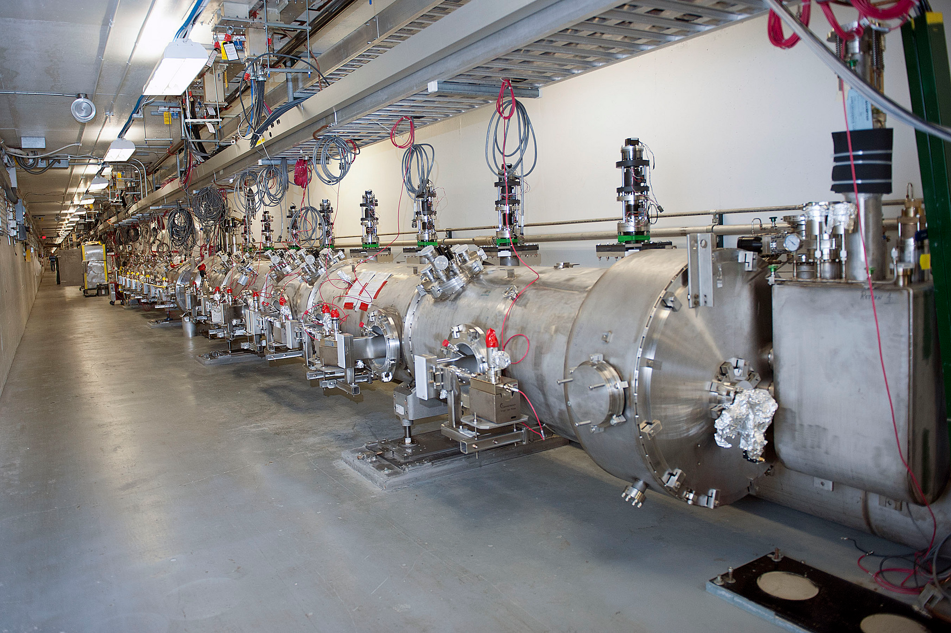
12 GeV CEBAF

Slide 2
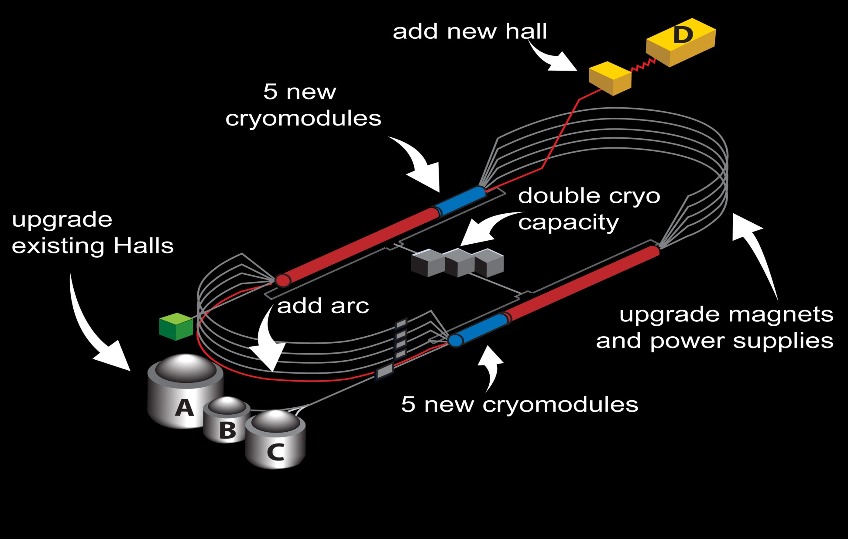
From 6 to 12 GeV

Slide 3
Optics layout for 12GeV
ARC1,ARC2 have 16 dipoles
ARC2 and beyond have 32
Split tune 5/4, ¾ with 4 superperiods.
Spreader+arc+recombiner are achromatic and isochronous to first order.
Sextupoles are unpowered and could be used
to ensure 2nd order.
We can tune them off from zero M56 if we need to manipulate the long. Phase space for recovery.
Energy acceptance around +/- 3e-3.
ARC1 and ARC2 can be retuned to have a low dispersion pattern.

Slide 4
Beam line occupancy
R=4(σ_{beam} + σ_{orbit}) = 4σ_{beam} + 2.4mm
σ_{orbit} <600 µm RMS
Consistent with current operating practices

Slide 5
Transverse Emittance* and Energy Spread†
Area | δp/p [x10⁻³] | ε_{x} [nm] | ε_{y} [nm]
Chicane | 0.5 | 4.00 | 4.00
Arc 1 | 0.05 | 0.41 | 0.41
Arc 2 | 0.03 | 0.26 | 0.23
Arc 3 | 0.035 | 0.22 | 0.21
Arc 4 | 0.044 | 0.21 | 0.24
Arc 5 | 0.060 | 0.33 | 0.25
Arc 6 | 0.090 | 0.58 | 0.31
Arc 7 | 0.104 | 0.79 | 0.44
Arc 8 | 0.133 | 1.21 | 0.57
Arc 9 | 0.167 | 2.09 | 0.64
Arc 10 | 0.194 | 2.97 | 0.95
Hall D | 0.18 | 2.70 | 1.03
DBA option
Damping
Sync. Rad.
* Emittances are geometric
† Quantities are rms
Notes:
Values are calculated at the end of each arc.
Normalized emittance is beta.gamma*egeometric
Point out that it is the theoritical value if everything is perfect.
These calculations were checked with 3 different codes and also agree with a simpler analytical estimate (sand’s formula) which
Does not take into account synch rad. Loss in quadrupoles.

Slide 6
12 GeV CEBAF Top Level Parameters
 | Comments | 12 GeV
Energy to Halls A,B,C / D | Can tune linac gains to cover from 6 to 12 | 11 GeV / 12 GeV
Number of passes for Halls A,B,C / D |  | 5 / 5.5 (add a tenth arc)
Duty Factor | Tune mode is 60Hz, 200 μsec yielding 1.5% duty factor | CW 499 Mhz, 250 Mhz,31 Mhz
Max. Beam Power | 1 MW Per pass tune mode dumps limited to 2kW | 1 MW
Emittance at max. energy (unnormalized, rms): x, y | We measured 3.6 nmrad at 10.5 GeV | 10 nm-rad, 2 nm-rad
Energy spread at max. energy | Assuming linacs are crested | 5 x 10⁻⁴
Notes:
Here, point out that the frequency change will be explained later and is needed for the D+3 option

Slide 7
Coordinate system

Slide 8
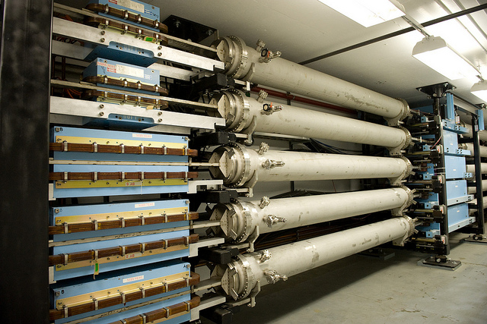
Pathlength control
Chicane Dipoles (doglegs)
ARC | Adjustment Capacity (RF °)
E1 | 18
W1 | 18
E2 | 15
W2 | 17
E3 | 15
W3 | 12
E4 | 10
W4 | 7
E5 | 6
Capacity limited so we also shift orbits in the arcs (up to 3mm) and slew the RF frequency from its nominal 1497 Mhz. Limited by RF cavity tuning capabilities (tuners). So far, adequate.

Slide 9
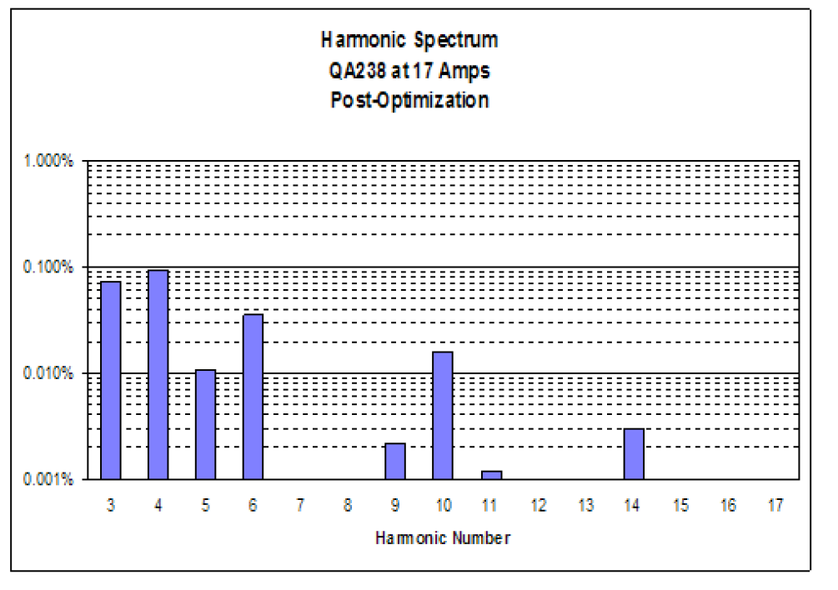
Quadrupoles and dipoles Field quality
Dipoles were converted
From C to H style
Notes:
Typical values for dipoles.

Slide 10
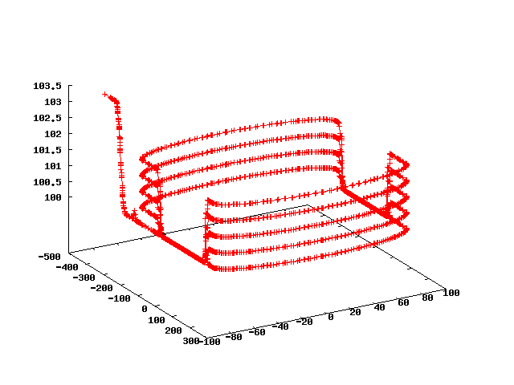
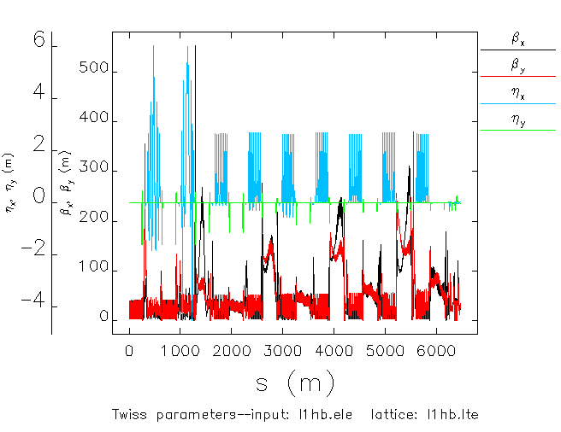
Start to end simulations
Beamline modeled with errors, multipoles, misalignments, apertures, …
Full start to end simulation including extraction
Use of LQCD clusters for massive halo studies (hallD)
DBA optics Arc6 thru 9
Floor coordinates
HallB
Exit of injector
Notes:
The purpose was to stress test the tuning knobs to see if one could always setup the line regardless of the errors in the beamline.

Slide 11
Path forward
Generate a longitudinal match for the recirculation
Assess magnet field qualities for recirculation
design dump system and chicane
Optimize transverse matches to the linacs for recirculation
Integrate the FFAG arc in the design
Start to end tracking, ELEGANT, ZGOUBI, etc..

