Slide 1
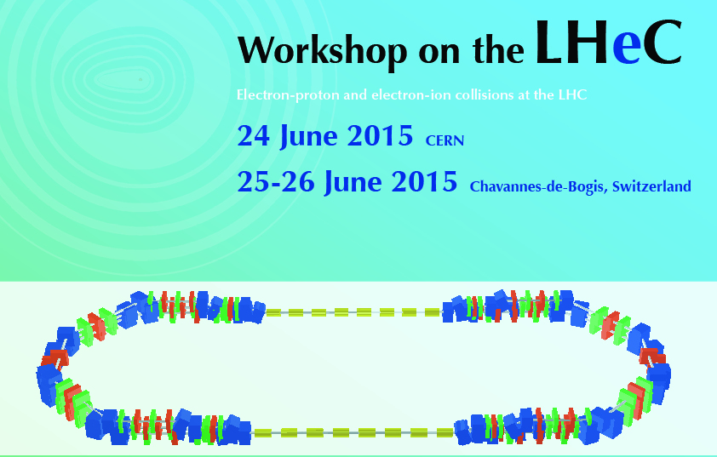
Summary
Accelerator and ERL Facility Sessions
Gianluigi Arduini & Erk Jensen

Slide 2
Thank you!
Thank you all for the excellent presentations!
Thank you equally for the constructive discussions!
… and last but not least: thanks to the speakers for providing to us a summary slide!

Slide 3
ERL Facility (ies)
Fri 26th June, Morning Session on
MESA Progress | Kurt Aulenbacher
High Intensity ERL Developments | Christopher Mayes
ERL Design based on FFAG arcs (eRHIC, LHeC, Cornell) | Dejan Trbojevic
RF performance of SC cavities with nitrogen doping | Anna Grasselino
400 MHz cavity development | Ilan Ben-Zvi
ERL SCRF Facility for CERN – CDR Status | Erk Jensen
Source and Injector | Boris Militsyn
ERL Facility: Design and Parameters | Alessandra Valloni
Photon Beam Generation | Fabian Zomer
Cavities | Rama Calaga
Magnets | Attilio Milanese
Cryomodule | Andrew Hutton
Site | Nuria Catalan
LHeC Cavity Design Considerations | Frank Marhauser

Slide 4
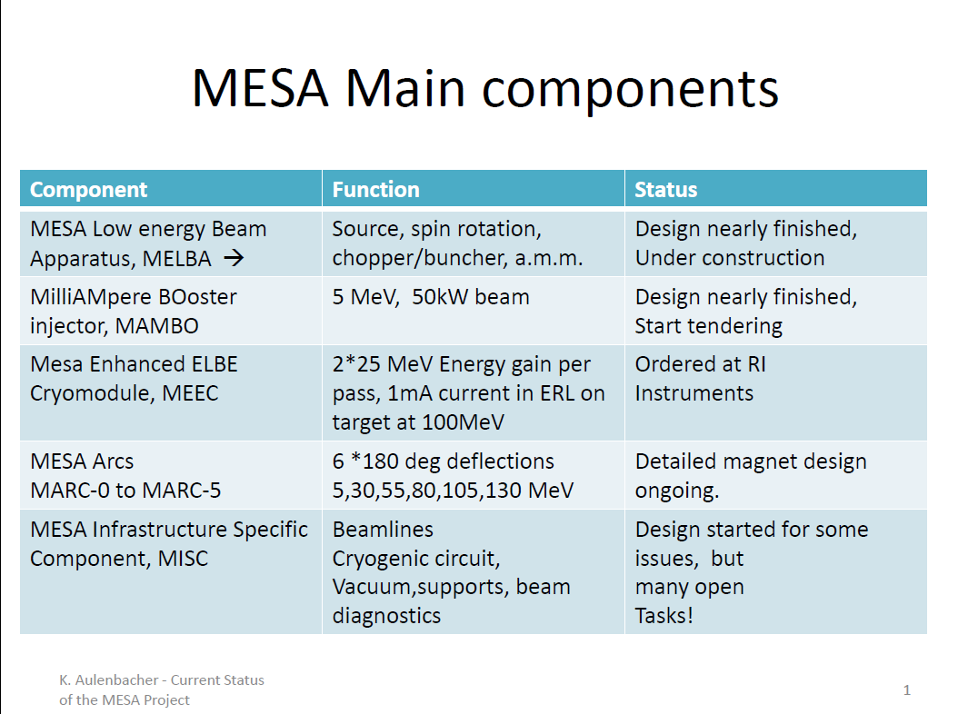

Slide 5
High Intensity ERL Developments – Christopher Mayes
Cornell has been funded for ERL R&D since 2005, and has designed and built:
Prototype high-power ERL injector & beam stop
Record current peak 75 mA, and 65 mA sustained for 8 hours
Emittance through merger meets Cornell ERL specifications
Emittance straight meets LCLS-II specifications
Horizontal Test Cryomodule (HTC)
First ERL cavity achieved Q₀ of 6x10¹⁰ @ 16 MV/m, 1.8K
(with couplers and HOM absorbers) (3 times spec.)
Tested with 40 mA in the injector
Prototype Main Linac Cryomodule (MLC)
6 cavities completely built and tested (vertical) in-house
Assembly completed in November 2014
Cooldown and testing begins in July
Cornell-BNL FFAG-ERL Test Accelerator (Cβ)
Currently designing in collaboration with BNL
Uses injector, MLC, and beam stop in Cornell’s L0E hall
Injector and MLC recently moved to L0E

Slide 6
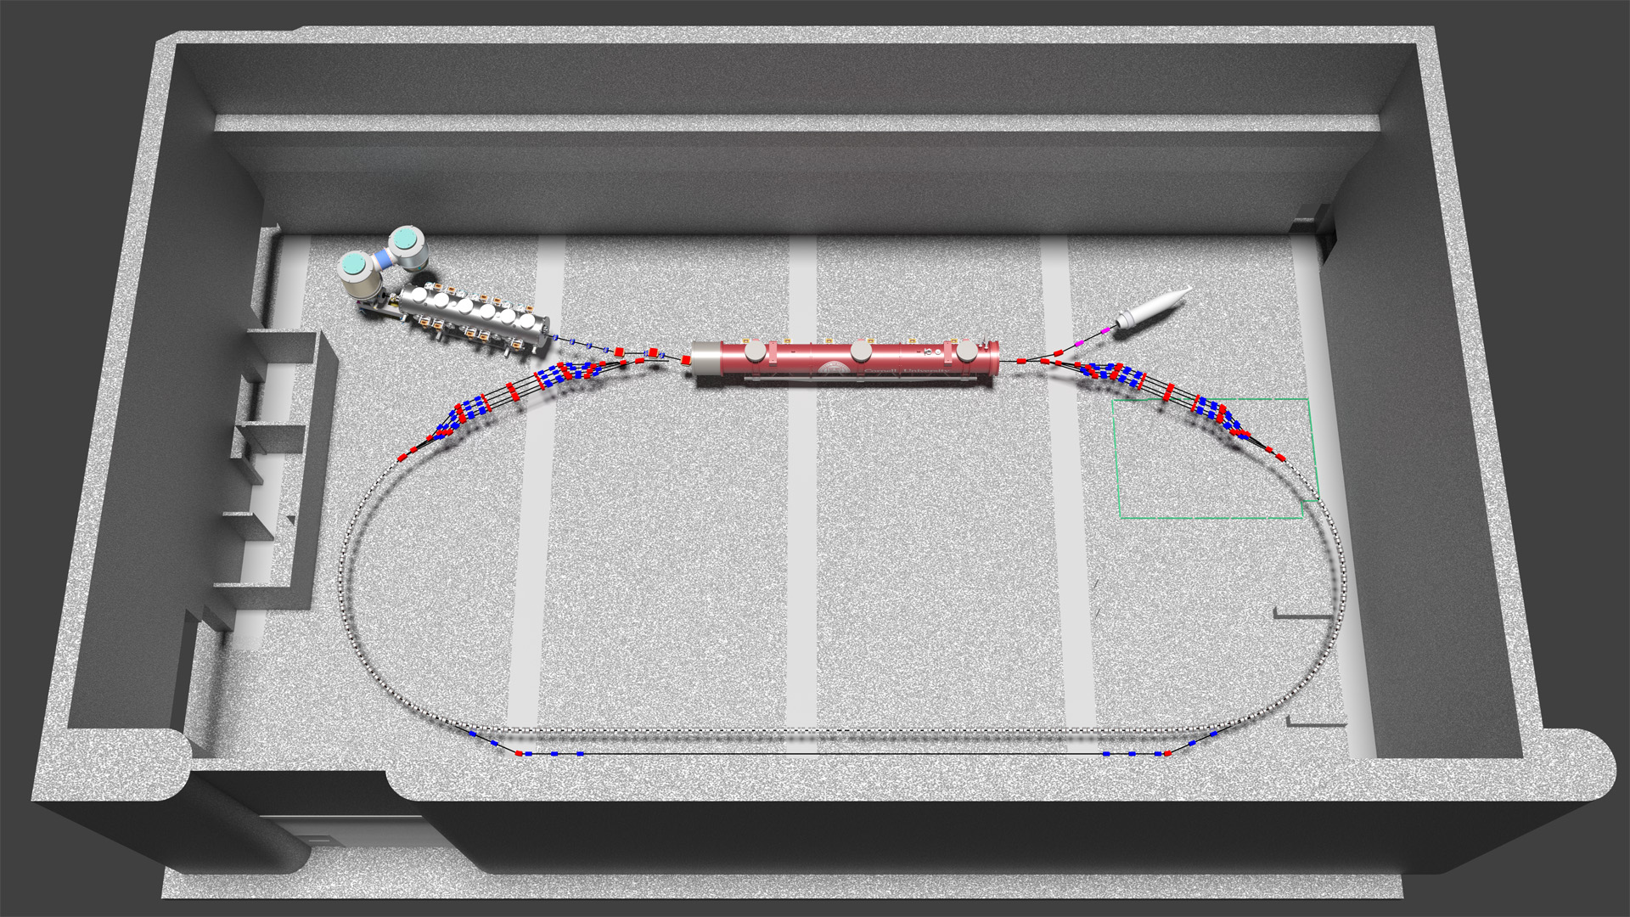
Cβ: Cornell-BNL ERL-FFAG Test Accelerator
Christopher Mayes/Cornell
6 MeV
6 MeV
+/- 70 MeV
76, 146, 214, 286 MeV

Slide 7
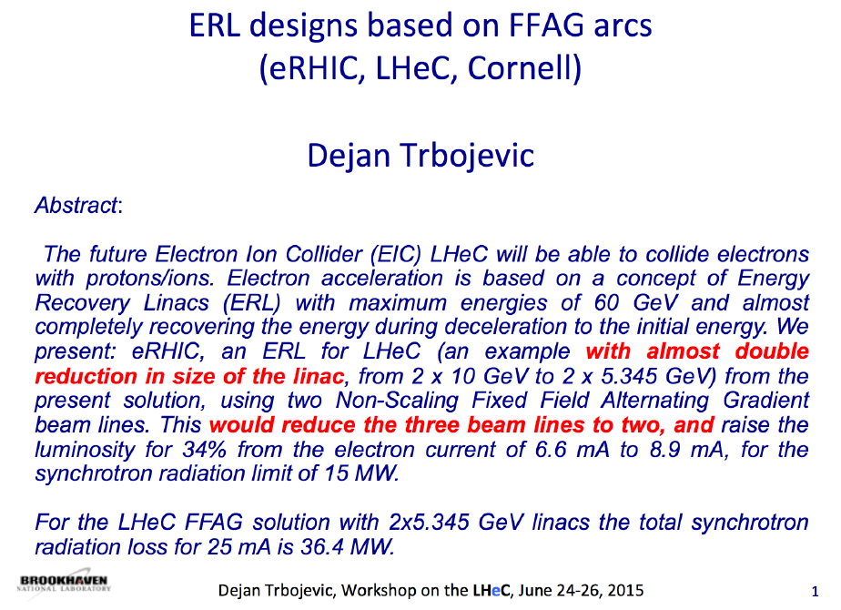

Slide 9
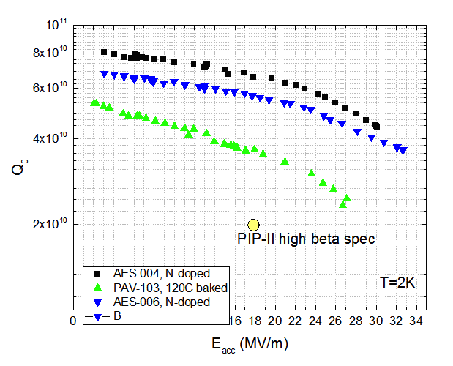
N doping applied to 650 MHz cavities at FNAL
Q~ 7e10 at 2K, 18 MV/m – record at this frequency!
Applying N doping to 650 MHz (beta=0.9) leads to double Q compared to 120C bake (standard surface treatment ILC/XFEL)
But from frequency scaling from 1.3GHz to ~800 MHz, with ideal recipe the projected Q value is ~1e11 at 18 MV/m, 2K! Need some R&D to optimize doping recipe for lower frequency
Anna Grassellino/FNAL

Slide 10
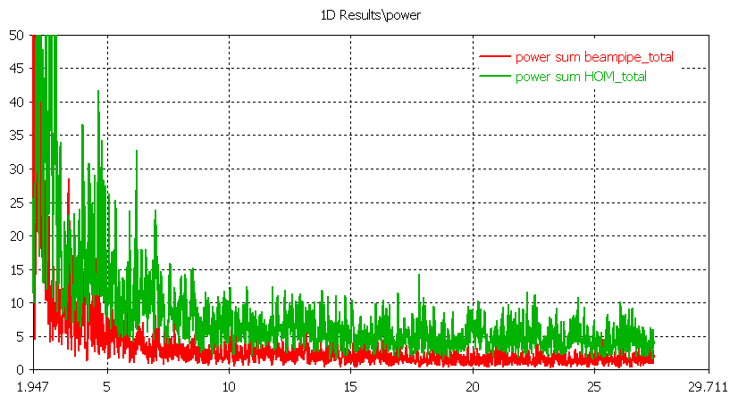
Ilan Ben-Zvi: 5-cell 422 MHz cavity for the eRHIC ERL
  We are building a prototype a 3-cell niobium cavity.
  We will build a prototype HOM damping system aiming at HOMs’ external Q < 50,000, up to 30 GHz.
  The 5-cell cavity is stable against BBU in eRHIC’s multi-pass, high-current configuration.
  It has a loss factor of 1.9 V/pC, very low for a 2.6 m cavity.
  The HOM damping scheme uses 6 coaxial band-pass HOM dampers and 3 high-frequency waveguide to capture frequencies up to 30 GHz.
Ilan Ben-Zvi/BNL
Waveguides
Waveguides power
Coaxial ports power
Ilan Ben-Zvi, LHeC Workshop June 2015

Slide 11
Concept of the ERL test facility photoinjector
Boris Militsyn/STFC
Single cell 802/401 MHz
buncher
SRF booster
5 individually fed 802 MHz cells
Storage vessel
350/220 kV
Photocathode
Gun
Reloading chamber
5 MeV electron
beam
Preparation
chamber
Loading
chamber/transport
vessel
Photocathode Material | Typical operational wavelength | Work Function | Observed Q.E. | Laser power required for 12.8 mA | Observed maximum current | Observed operational lifetime
Sb-based family, unpolarised | 532 nm | 1.5-1.9 eV | 4-5% | 3.0 W | 65 mA | Days
GaAs-based family, polarised | 780 nm | 1.2 eV* | 0.1-1.0% | 20.4 | 5-6 mA | Hours

Slide 12
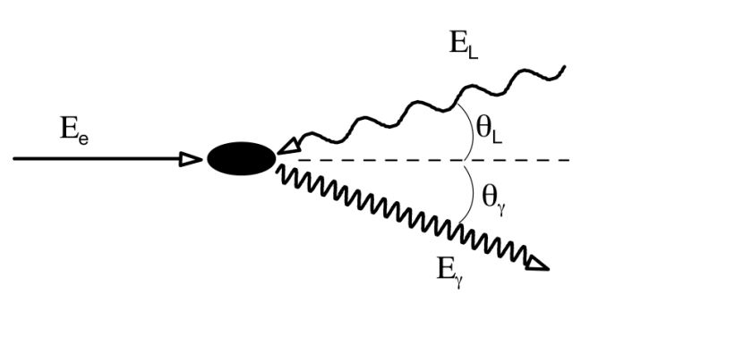
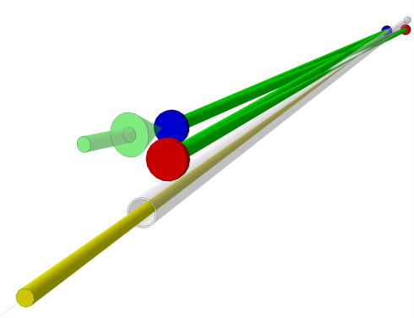
Gamma beams at the ERL Facility
Incident
laser beam
Incident
electron beam
Fabian Zomer/LAL
LASER BEAM PARAMETERS
Wavelength | 515 nm - 1030 nm
Average Power Optical resonator | 300kW - 600 kW (can be increased R&D)
Pulse length | 3 ps (can be reduced)
Pulse energy | 7.5mJ - 15 mJ
Spot size | 30 µm (can be reduced)
Bandwidth | 0.02 %
Repetition Rate | 40 MHz
Incident
laser
Gamma beam
GAMMA BEAM PARAMETERS (for λ=515nm)
Energy | 30 MeV
Spectral density | 9*10⁴ ph/s/eV (can be increased)
Bandwidth | < 5% (can be reduced)
Flux within FWHM bdw | 7*10¹⁰ ph/s (total flux 9*10^12)
ph/e⁻ within FWHM bdw | 10⁻⁶
Peak Brilliance | 3*10²¹ ph/s*mm²*mrad² 0.1%bdw

Slide 13
Magnets for PERLE
about 200 magnets for 6 arcs, including spreaders and combiners
preliminary design show feasibility of compact dipoles and quadrupoles, to allow vertical stacking
preference is given for classical electromagnets, for full tunability
an iteration with the optics will provide
  confirmation of aperture and field quality requirements
  input for the corrector magnets (possibly embedded in the quadrupoles)
  revised strengths / lengths, in view of grouping the magnets in families
design of the coil and overall power consumption depends on an overall optimization including the power converters
multiple aperture magnets are not part of the baseline, though they can still be further explored to reduce overall quantity, number of supports and possibly cost
Attilio Milanese/CERN

Slide 14
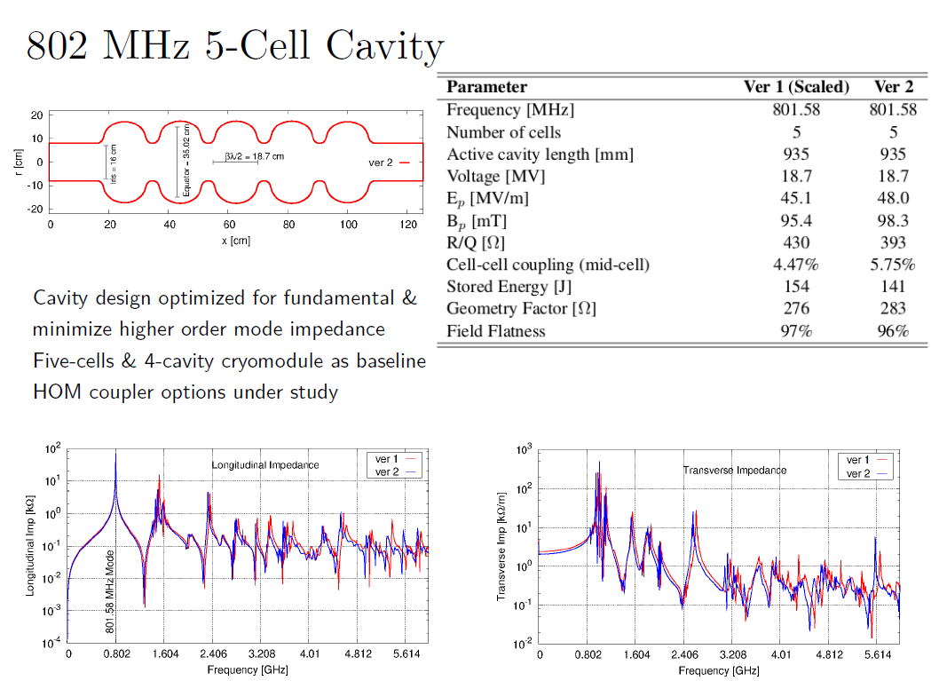
Rama Calaga/CERN

Slide 15
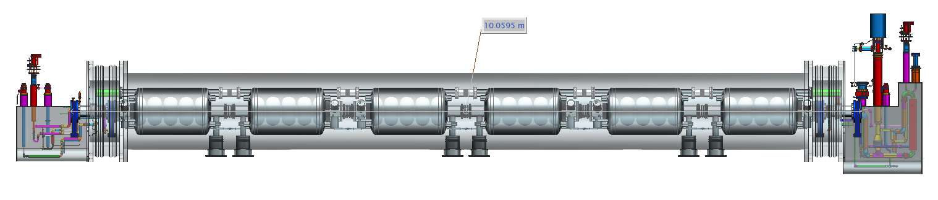
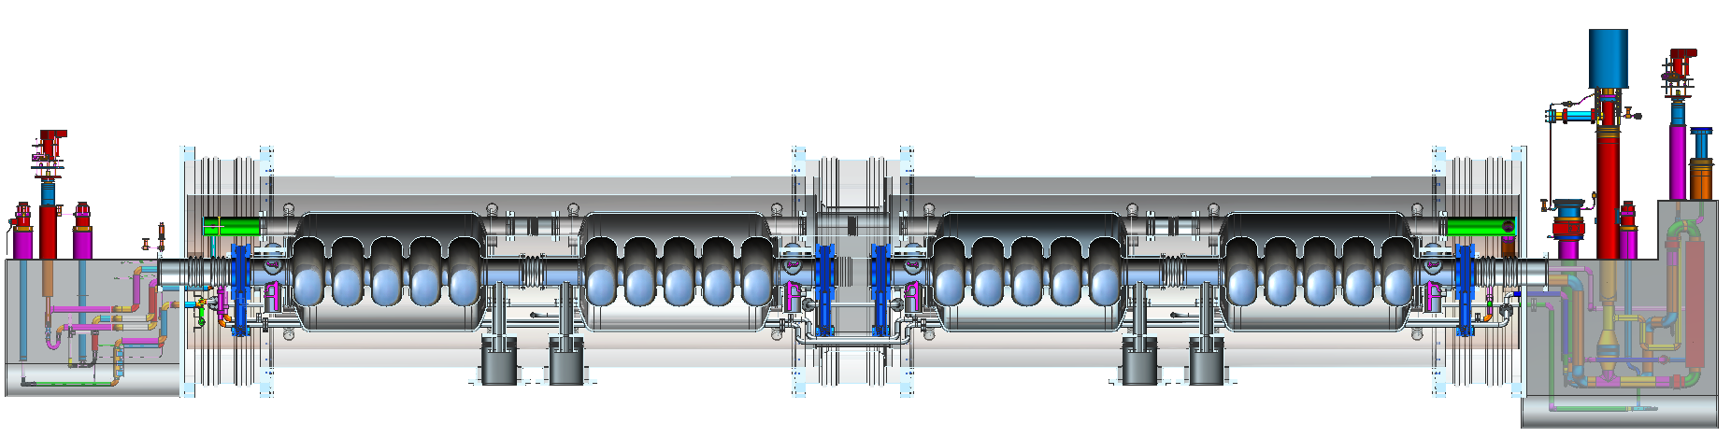
JLab-CERN Collaboration
Hutton-Rimmer
CERN and JLAB aim to develop a conceptual design for a cryostat and fabricate a prototype cavity suitable for LHeC
CERN will provide engineering support, JLab will provide technical advice and recommendations

Slide 16
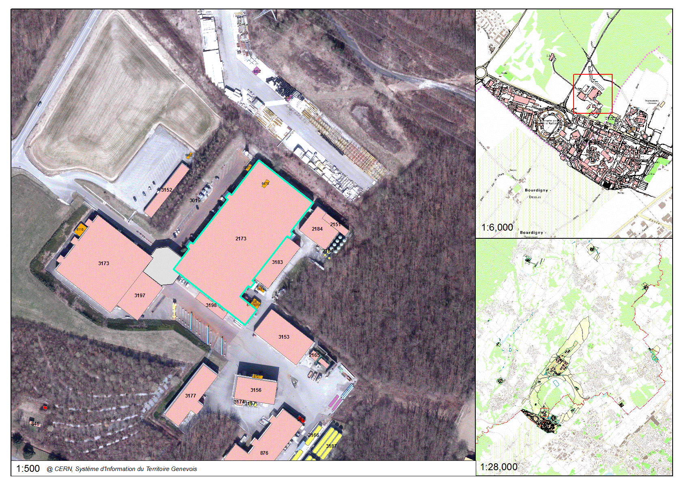
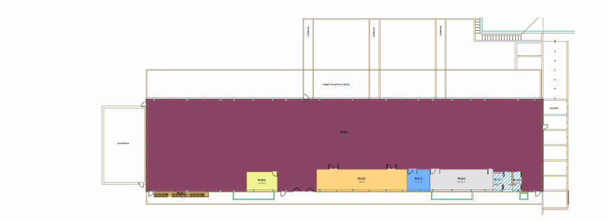
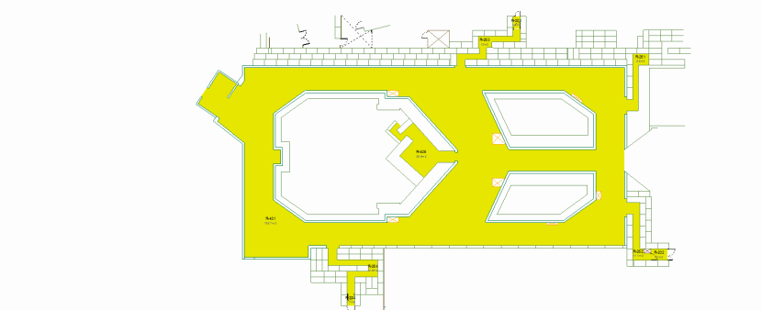
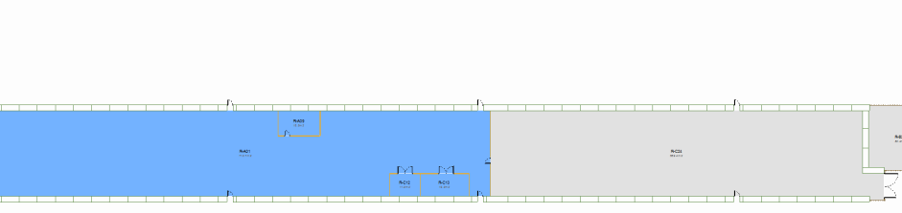
Site considerations
Nuria Catalan/CERN
B. 2275
46x17
B. 2003
47x16
46x17
B. 973
46x17

Slide 17

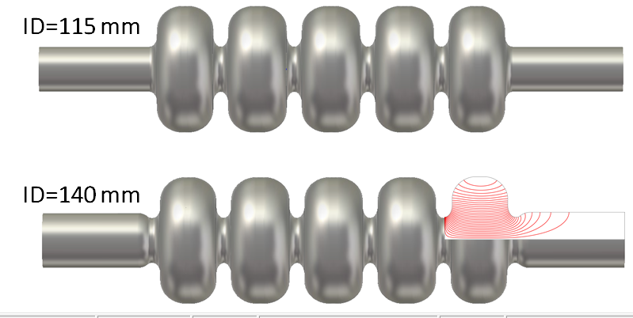
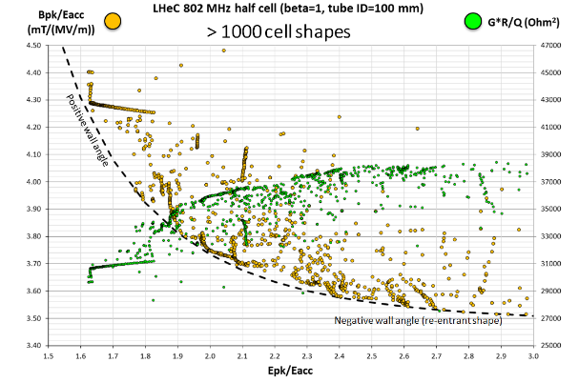
Frank Marhauser/JLAB
LHeC Cavity Design Considerations
Prototype 802 MHz multi-cell bare SRF cavity design has been proposed with performance parameters well balancing cryogenic losses (R/Q ∙ G) and surface field enhancement ratios (E_{pk}/E_{acc}, B_{pk}/E_{acc})
Iris diameter affects all key parameters
Optimization rationale has been discussed (1000s of cavity shapes investigated to illustrate interdependence of key parameters and to reveal truly optimized cell shapes)
Beam tube diameter may be enlarged to reduce cutoff frequency depending on HOM damping requirements and HOM damping scheme without affecting key parameters
Single die-design proposed for prototyping, which reduces up-front investment costs for proof-of-principle high power tests (not a requirement for final design)
Notes:
Red Title Page

Slide 18

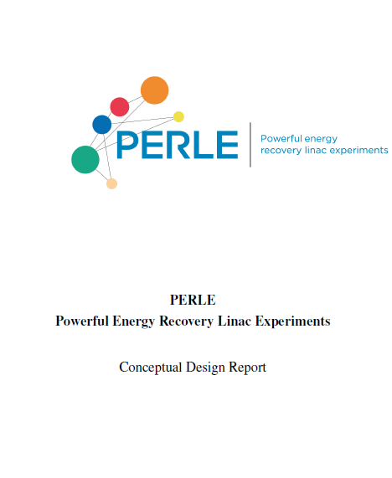

Summary “Facility” Session
Thanks to all contributors, today we have a substantial draft conceptual design report with significant content.
  … still needs some additions, editing,
  polishing – but it’s a remarkable progress!
We have a name and a logo!

Slide 19

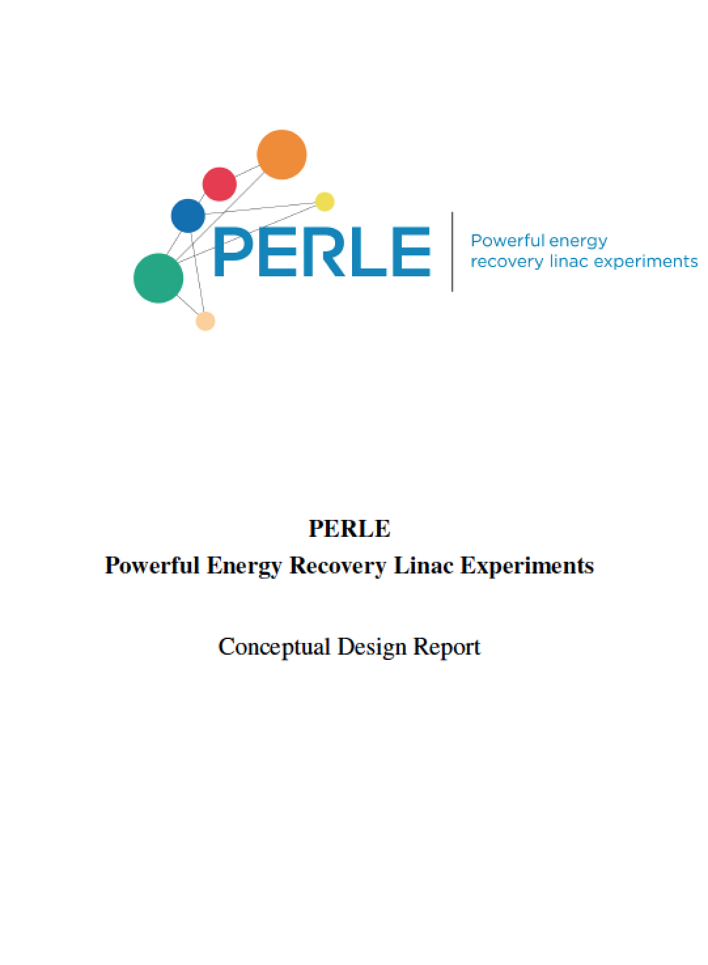

Conceptual Design Report
1. Purpose
1.1 SCRF Developments
1.2 Technical Applications
1.2.1 Magnets, cables, quench tests
1.2.2 RF developments with beam
1.2.3 Beam diagnostic developments
1.3 Injector for the LHeC
1.4 Physics with electron beam
1.5 Physics with photon beam
1.6 A Detector Test Beam at ERL
2. Design and Parameters
2.1 System Architecture
2.2 Transport Optics
2.3 Layout and Magnet Inventory
2.4 Bunch recombination pattern
2.5 Start-to-end beam dynamics simulations
3. Components
3.1 Source and Injector
3.2 802 MHz Cavity Design
3.3 Cryo Module
3.4 Arc Magnets
3.5 Dumps and Transfers
3.6 Photon Beam Production
4. Monitoring and Operation
4.1 Operational Regimes
4.2 Machine Commissioning
4.3 Machine Operation
4.4 System Stabilization
4.5 Transient Control
5. Site Considerations
A. Valloni

Slide 20
LIST OF AUTHORS
B. Auchmann(1), J. Bernauer, (9), A. Bogacz (4), O. Brüning(1), R. Calaga(1), K. Cassou (2),
N. Catalan Lasheras (1), V. Chetvertkova (1), E. Cormier (6), E. Daly (4), D. Douglas (4),
K. Durpaz (2), P. Favier (2), J. Henry (4), E. Jensen (1), R. Jones (1), M. Klein (5),P. Kostka (5),
F. Marhauser (4), A. Martens (2), A. Milanese (1), B. Militsyn (3), Y. Peinaud (2),
D. Pellegrini (1), N. Pietralla (8), Y.A. Pupkov (7), , R. Rimmer (4), R. Torres (1), A. Valloni (1),
G. Willering (1), D. Wollmann (1), F. Zomer (2)
1. CERN, Geneva, Switzerland
2. LAL, CNRS-IN2P3, Université Paris-Sud, Centre Scientifique d’Orsay, France
3. Cockcroft Institute, Daresbury, UK
4. Jefferson Lab, Newport News, VA, USA
5 University of Liverpool, UK
6. CELIA, University of Bordeaux 1, CNRS UMR 5107, Talence, France
7. BINP, Novosibirsk
8. Institut für Kernphysik, Technische Universität Darmstadt
9. Massachusetts Institute of Technology, Boston, MA, USA
Please speak up if we forgot you!!!!
A. Valloni

Slide 21
^{Why PERLE?}
Fundamental Motivation:
Validation of key LHeC Design Choices
Build up expertise in the design and operation for a facility with a
fundamentally new operation mode:
ERLs are circular machines with tolerances and timing requirements
similar to linear accelerators (no ‘automatic’ longitudinal phase stability, etc.)
Proof validity of fundamental design choices:
Multi-turn recirculation (other existing ERLs have only two passages)
Implications of high current operation (3 * [6mA – 12mA] > 30mA!!)
  Verify and test machine and operation tolerances before designing
  a large scale facility
  Tolerances in terms of field quality of the arc magnets
  Required RF phase stability (RF power) and LLRF requirements
A. Valloni

Slide 22
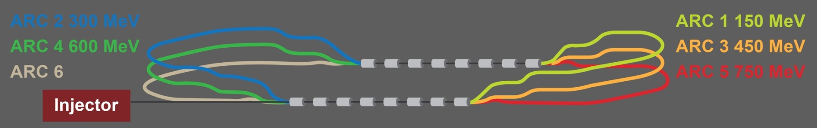
^{Why PERLE?}
Dedicated Accelerator physics studies and R&D:
Injector studies
Beam diagnostics developments and testing with beam
SCRF
Scientific and technical applications:
Possible use for detector development
Controlled quench and damage test for SC magnets
Generation of gamma-ray beams via Compton backscattering
TARGET PARAMETER* | VALUE
Injection Energy [MeV] | 5
Final Beam Energy [MeV] | 905
Normalized emittance γε_{x,y} [μm] | <25
Delivered Beam Current [mA] | 12.8 (6.4)
Bunch Spacing [ns] | 25 (50)
Passes | 3
*in few stages
A. Valloni

Slide 23
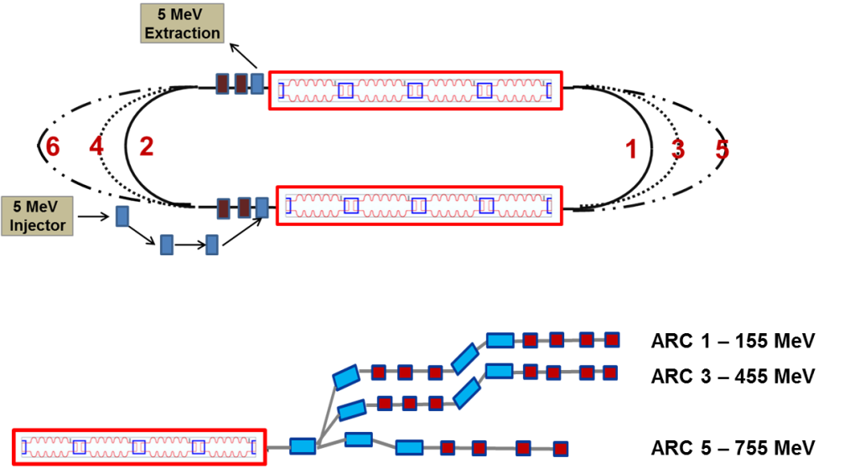
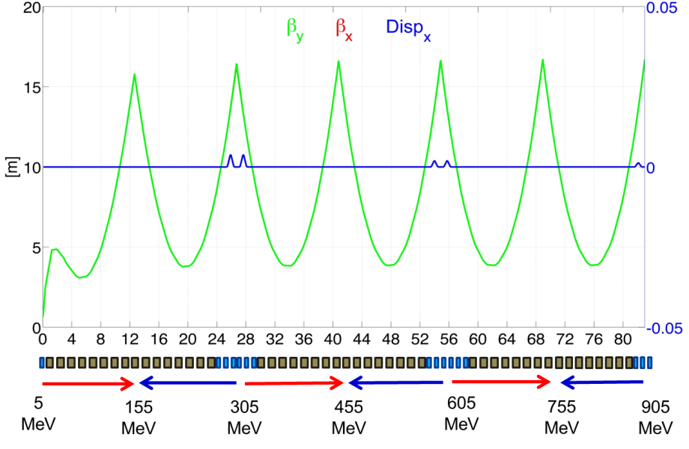
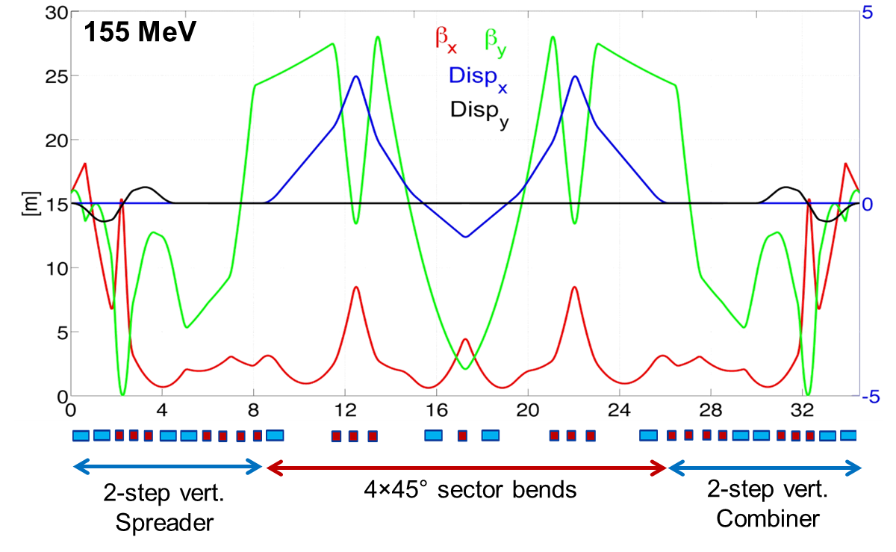
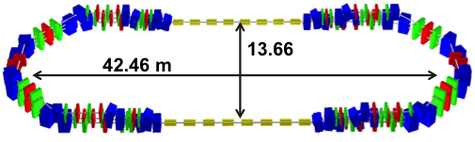
^{PERLE optics}
A. Valloni

Slide 24
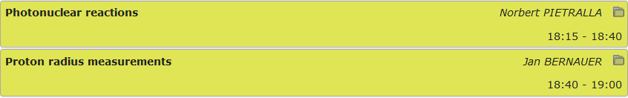
Physics with the ERL Facility
Thu 25th June, Plenary Session on

Slide 25
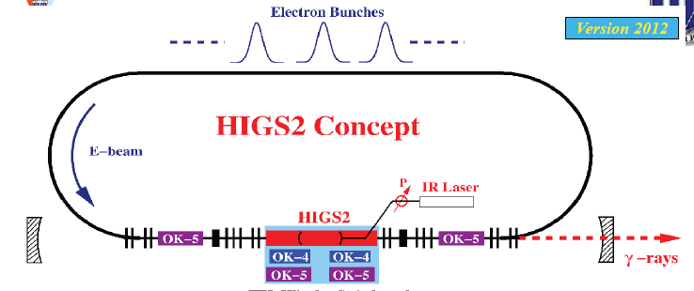
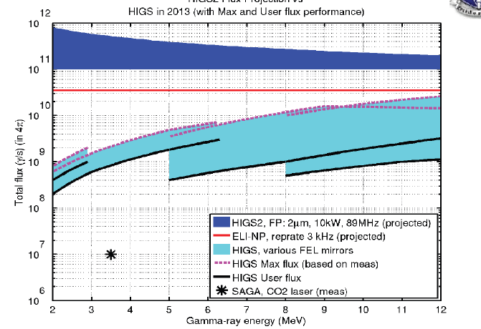
Higs @ Duke Univ.
World’s most intense
γ source
Fabian Zomer/LAL
9×10¹²
ERL facility
@ 30 MeV

Slide 26
Photonuclear Reactions
Norbert Pietralla/TU Darmstadt
Separation
threshold
~ 8 MeV
Absorption
γ
γ´
γ´
β
^{A´}Y
β
gs
^{A}X
Nuclear Resonance Fluorescence (NRF)
Photoactivation
Photodesintegration
Photofission
(-activation)

Slide 27
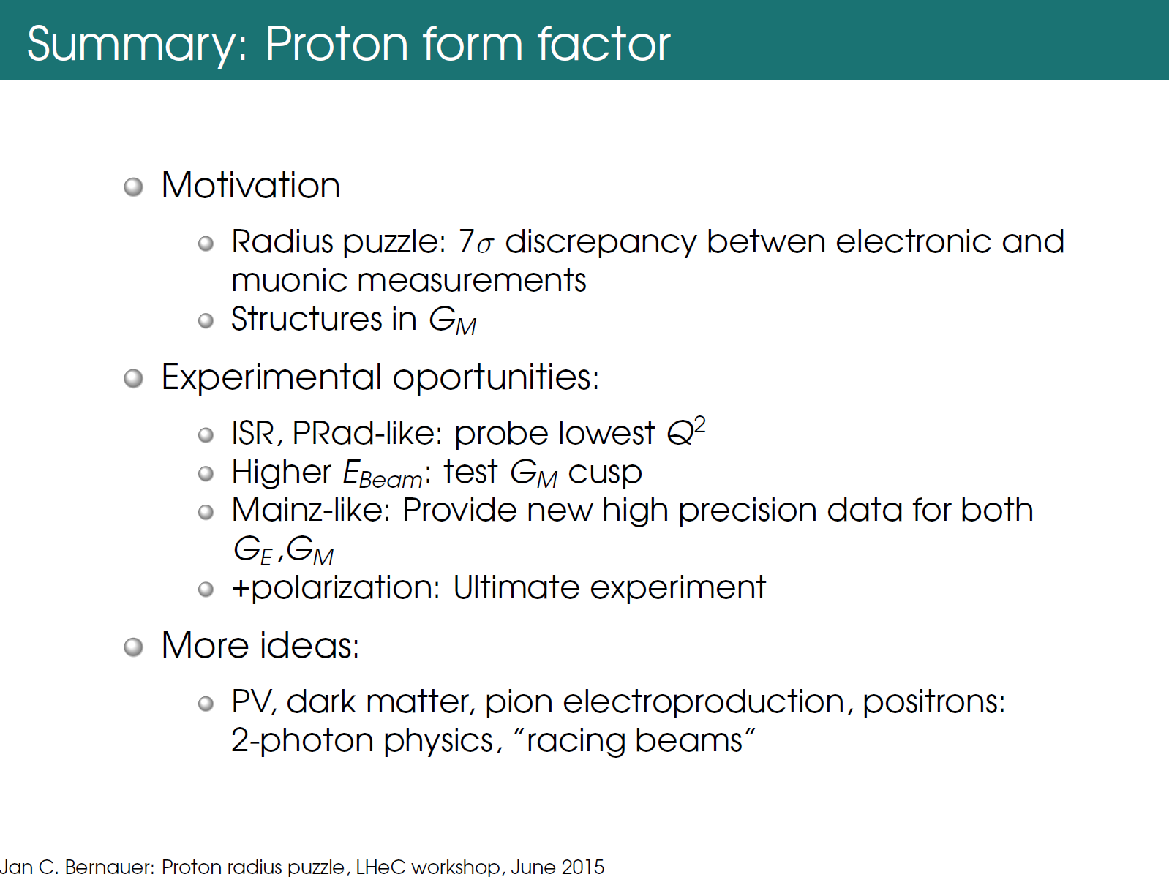
Jan Bernauer/MIT

Slide 28
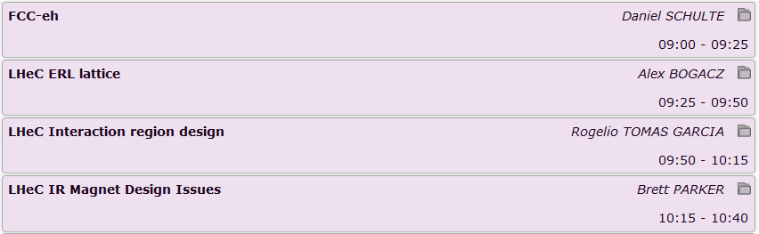
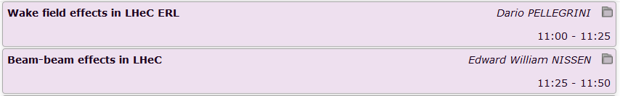
Accelerator
Fri 26th June, Morning Session on

Slide 29
FCC-he Summary
FCC should be consistent with FCC-he option
Very preliminary assessment of potential parameters presented
Design based on LHeC ERL with increased current and FCC-hh ring
Could hope for 250 to 380 fb⁻¹ per 5 years during FCC-hh baseline operation
Strong dependence on ion gap
Parameter assumptions need to be verified by studies (electron charge, proton beta-function, …)
Similar performance for FCC-hh during ultimate operation for 25ns proton bunch spacing
difficulties for 5ns => could be of O(100 fb⁻¹) per 5 years
Parameter limitations need to be explored (electron emittance, proton beta-function, …)
Some remarks:
Variation of proton beam during luminosity run is important
Strong pinch is important and leads to almost universal electron beta-function of O(45mm)
Need to explore electron filling patterns
How can we best profit from different electron emittance growth in the two planes?
Operational models of FCC-hh are being further developed
Much more work to be done …
Daniel Schulte/CERN

Slide 30

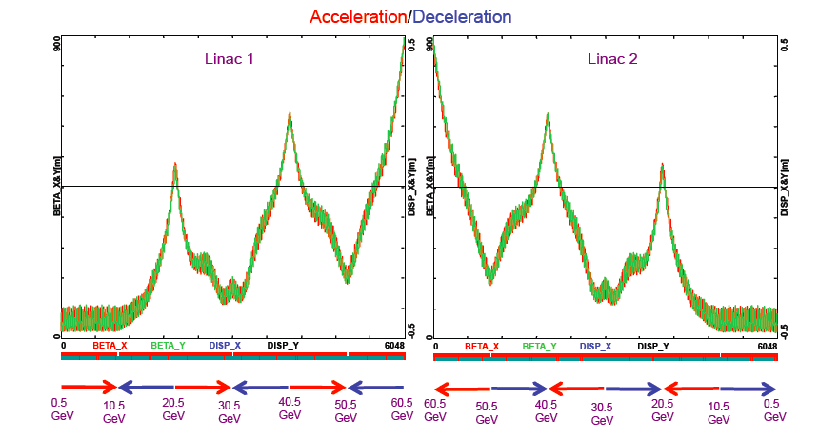
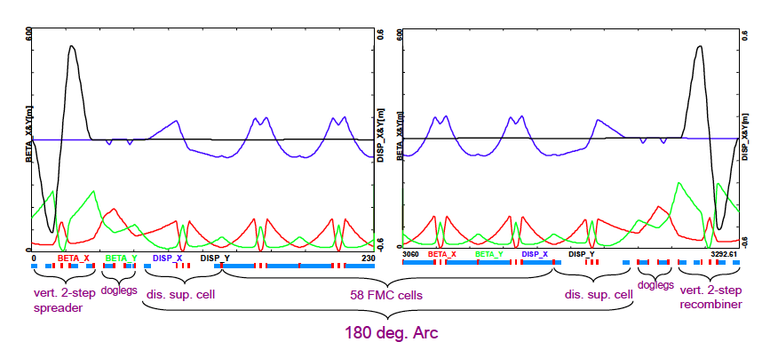
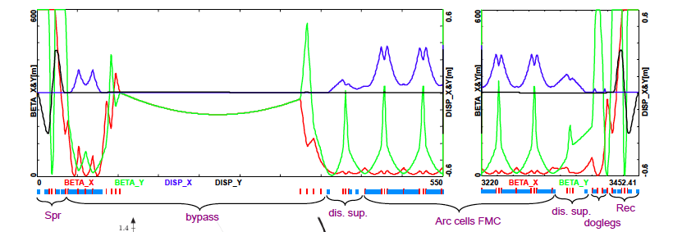
  A. Bogacz, JLab
LHeC ERL – Lattice Design
  Multi-pass linac optics
  Isochronous arc optics
  Arc with an IR bypass - emittance preserving optics

Slide 31
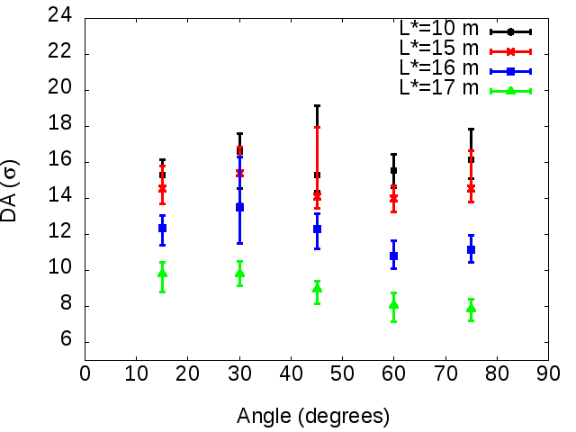
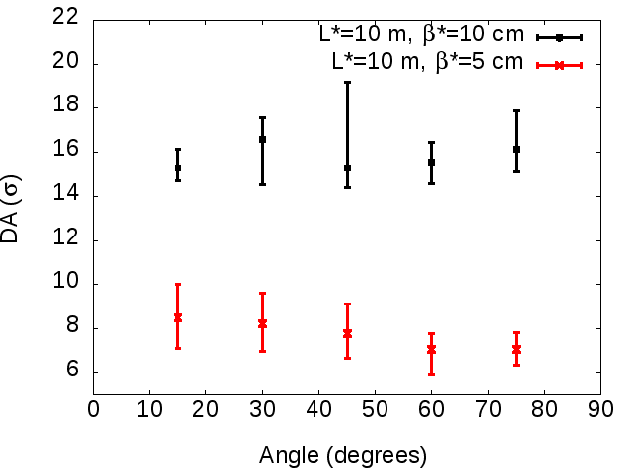
IR Summary
Rogelio Tomas/CERN
Emilia Alaniz/U Liverpool
Case 10³³ cm⁻²s⁻¹
(β*=10 cm):
Case 10³⁴ cm⁻²s⁻¹
(β*=5 cm):
Too low DA (6 σ without triplet errors!).
No longer possible to increase L* to 15 m to mitigate SR.
Minimum β* 8 cm with good LHeC-like crhomatic correction
  From DA studies largest L* is 15 m. A steep reduction of DA is observed for larger values.
  L* of 15 m could also reduce the SR by a factor of 2.

Slide 32
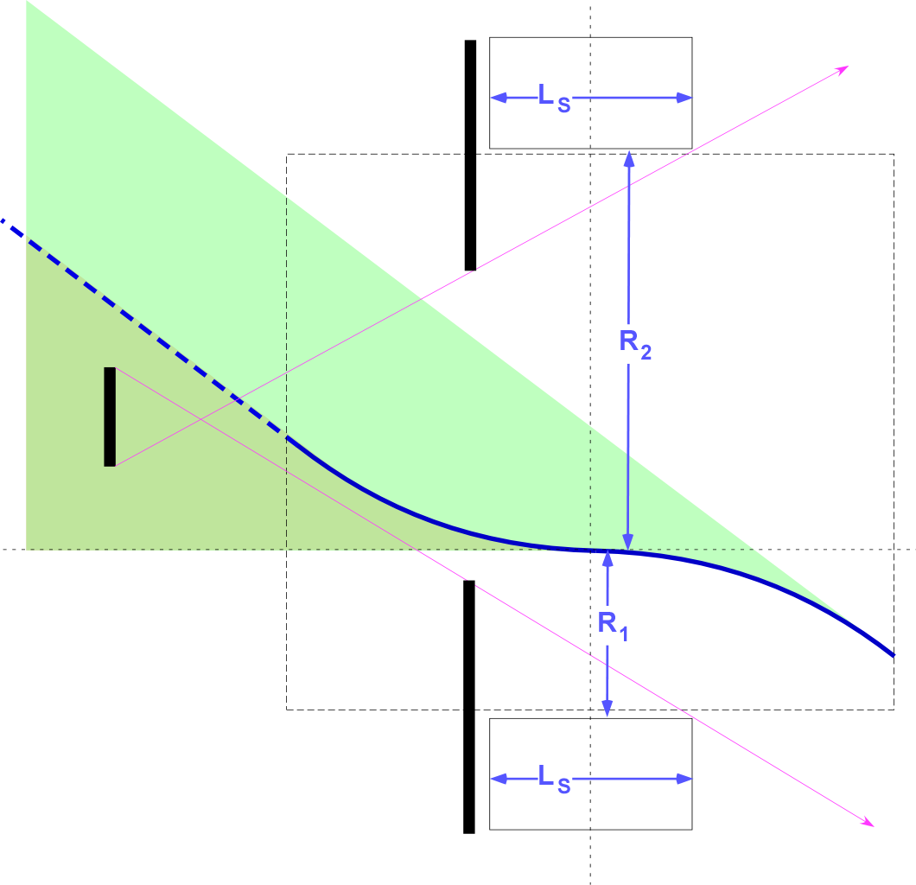
Principles for Locating the Anti-Backscatter Masks
Brett Parker/BNL
If even a quite small fraction of the backscattered synrad albedo hits sensitive central regions of the detector, it can cause unacceptable background and detector trips (HERA-II experience).
Masks placed between the closest primary absorbers and a sensitive region can protect against this but they must stay back from the primary beams.
Having the separation bend stop too close to the synrad absorber means that there is then no good place for these masks; we need some extra distance (as shown in the new layout) for these masks to be effective.
Background Reduction Mask Scheme Layout

Slide 33
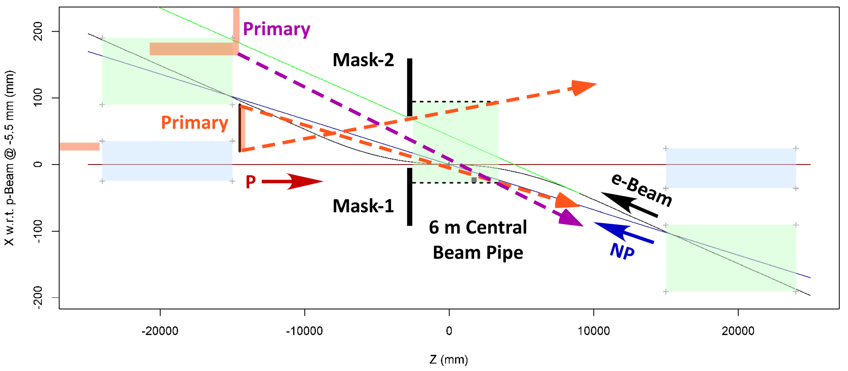
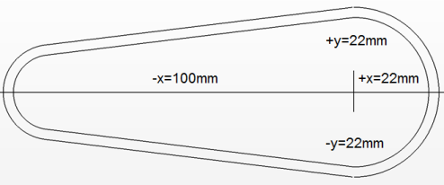
Locating the Anti-Backscatter Masks for LHeC IR
Brett Parker/BNL
Even with smaller bend angle and 15 m L*, we need a bit larger cutout region.
9 m of Q1
9 m of Q1
For Mask-1 to be effective we might need more space here.
With this new, improved beam separation scheme, it almost looks possible to protect the central 6 m beam pipe region from the backscatter albedo off the central synrad absorber (note LHeC CDR has only 1 m between the end of the separation dipole and the magnetic edge of Q1). But because in this design Q1 still does not pass the outer edge of the full synrad band, it is impossible to protect against albedo backscatter from this outer edge... this is an important lesson. Note that in the LHeC CDR the synrad band was much wider!

Slide 34
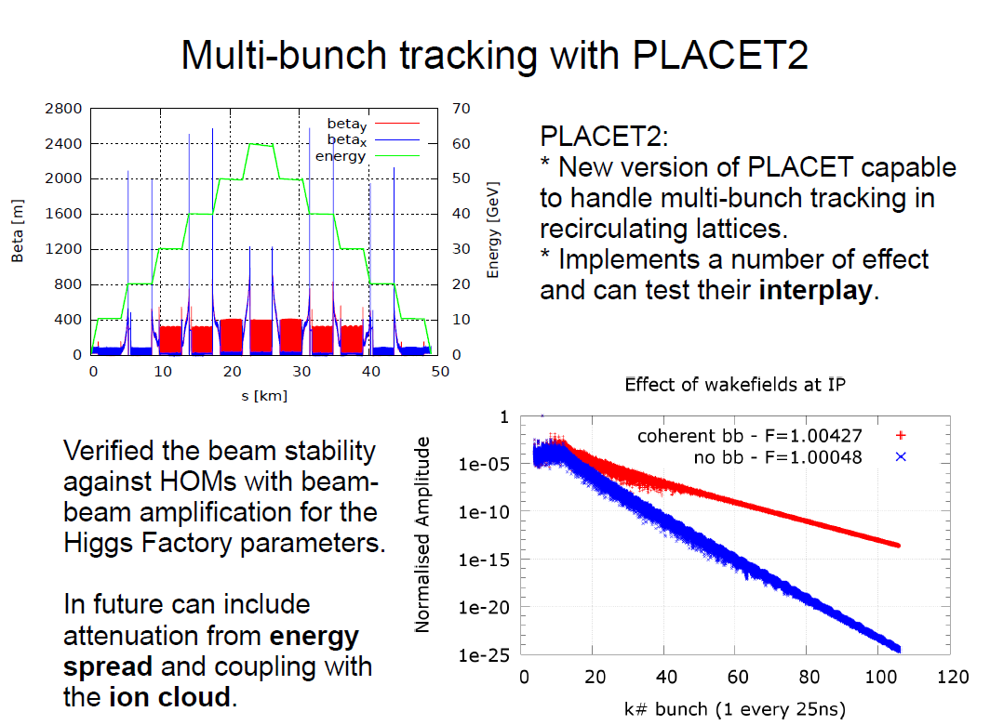
Dario Pellegrini/CERN

Slide 35
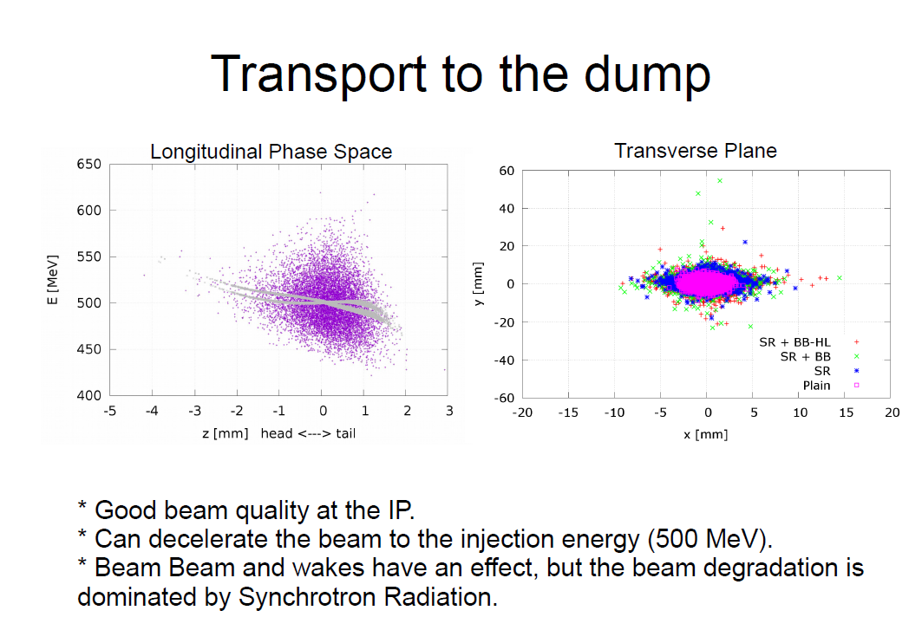
Dario Pellegrini/CERN

Slide 36
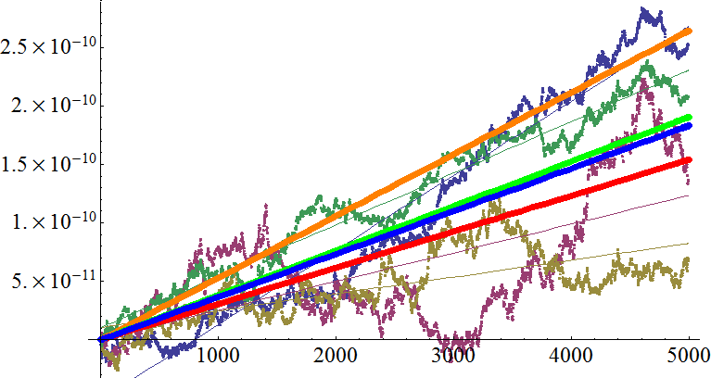
Emittance Growth Rate Predictions
Edward Nissen/CERN
Using measurements of the head-tail effect in the interaction region of the electron and ion beams, we can predict the growth rate of the ion beam emittance from the beam-beam effect.
Δε_{n} (m)
Turns
$$∆ε_{n}=\frac{1}{2}γβ^{∗}<∆{p_{x}}^{2}>\frac{σ_{jitter}^{2}}{σ_{x}^{2}}$$
5.28x10⁻¹⁴ m/turn
Rate predicted by Guinea-Pig
Rate Predicted by Ansatz
3.81x10⁻¹⁴ m/turn
This can be used to determine the correction system tolerances needed for the LHeC
3.66x10⁻¹⁴ m/turn
Average Simulation Rate
Rate Predicted by Integration
3.08x10⁻¹⁴ m/turn

Slide 37
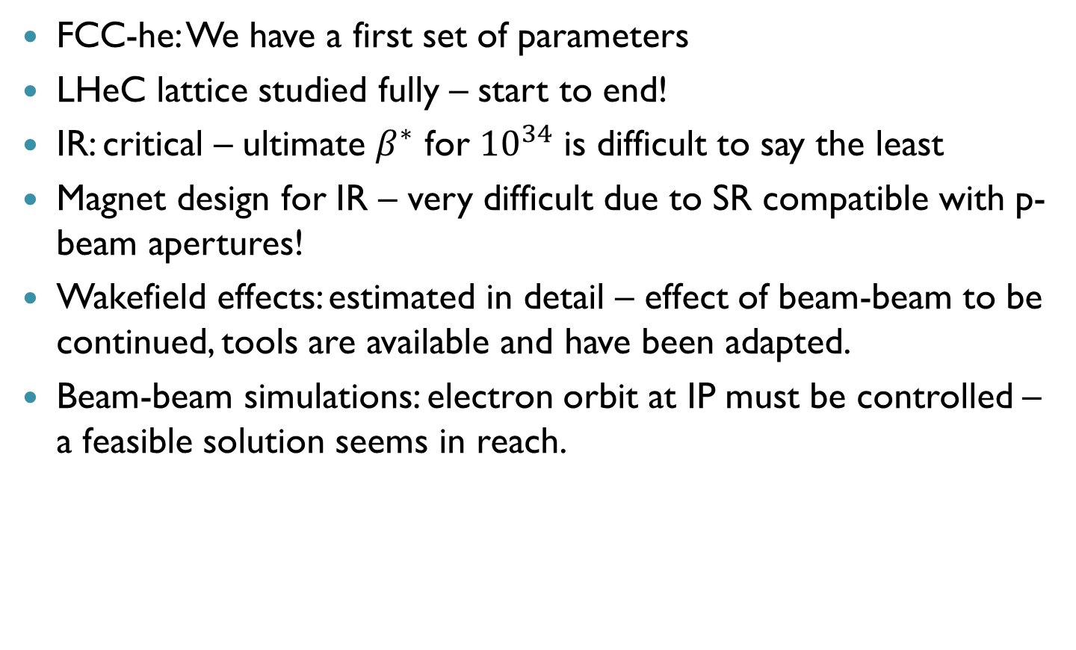
Summary “Accelerator” Session
FCC-he: We have a first set of parameters
LHeC lattice studied fully – start to end!
IR: critical – ultimate $β^{∗}$ for ${10}^{34}$ is difficult to say the least
Magnet design for IR – very difficult due to SR compatible with p-beam apertures!
Wakefield effects: estimated in detail – effect of beam-beam to be continued, tools are available and have been adapted.
Beam-beam simulations: electron orbit at IP must be controlled – a feasible solution seems in reach.

