Slide 1
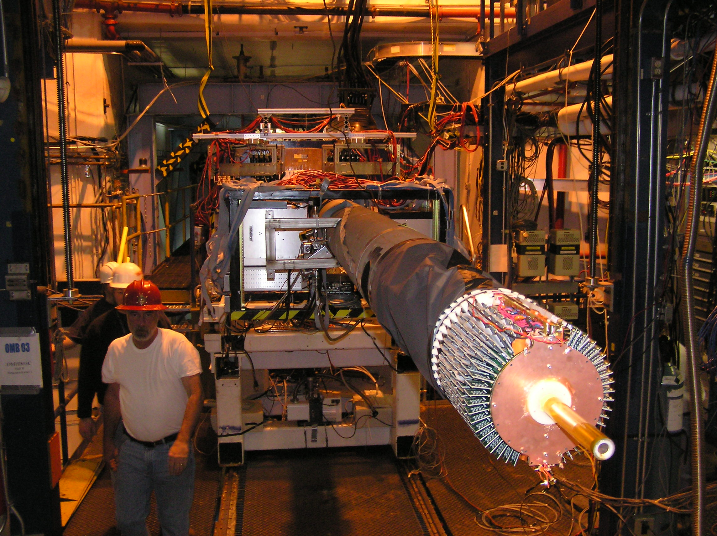
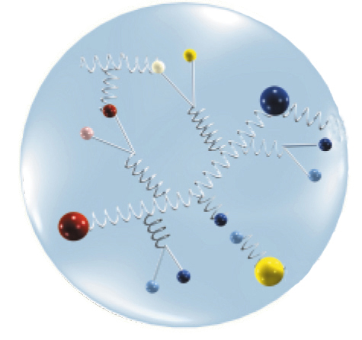
Run Group F –
(More than one) BONuS in your near future?
Sebastian Kuhn
Old Dominion University
Notes:
Image from PANDA

Slide 2
Overview
BONuS and BONuS12: The physics
BONuS12: The experiment
Run Group F: Getting ready
Run Group F: What else can we do?

Slide 3
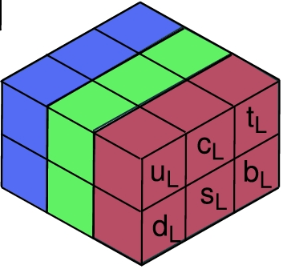
Fundamental Problem of Nuclear and Hadronic Physics
Nearly all well-known (“visible”) mass in the universe is due to hadronic matter
Fundamental theory of hadronic matter exists since the 1960’s: Quantum Chromo Dynamics
  “Colored” quarks (u,d,c,s,t,b) and gluons; Lagrangian
BUT: knowing the ingredients doesn’t mean we
know how to build hadrons and nuclei from them!
  akin to the question:
  “Given bricks and mortar, how do you build a house?”
Four related puzzles:
  What is the “quark-gluon wave function” of known hadrons?
  How are hadrons (nucleons) bound into nuclei?
  Does their quark-gluon wave function change inside a nucleus?
  How do fast quarks and gluons propagate inside hadronic matter?
  How do fast quarks and gluons turn back into observable hadrons?
Notes:
UTFSM and ODU are working on all four!

Slide 4
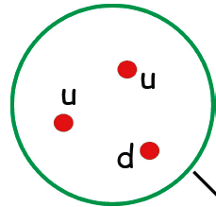

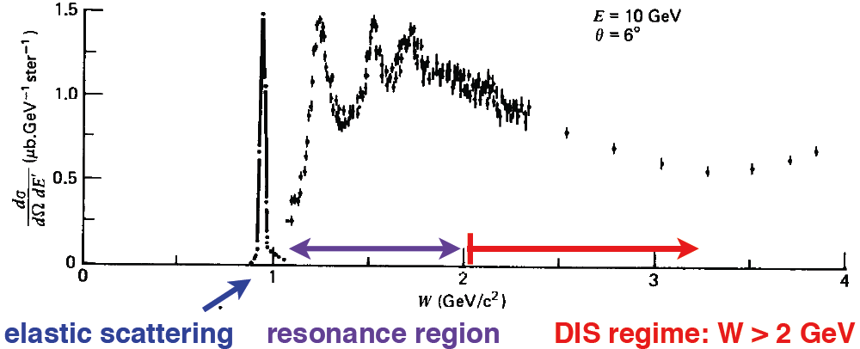
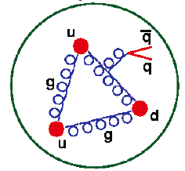
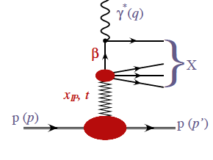
Our 1D View of the Nucleon
Depends on momentum fraction x, final state mass W
and the resolution of the virtual photon ∼ 1/Q²
Elastic scattering
(Whole system recoils, x = 1)
Resonances
(x < 1, W < 2 GeV)
Valence quarks (JLab12 core mission)
(x ≈ 0.3 - 0.9, W > 2 GeV)
Sea quarks, gluons
(x < 0.3)
“Wee Partons”
(x → 0, Diffraction,
Pomerons)
D I S

Slide 5
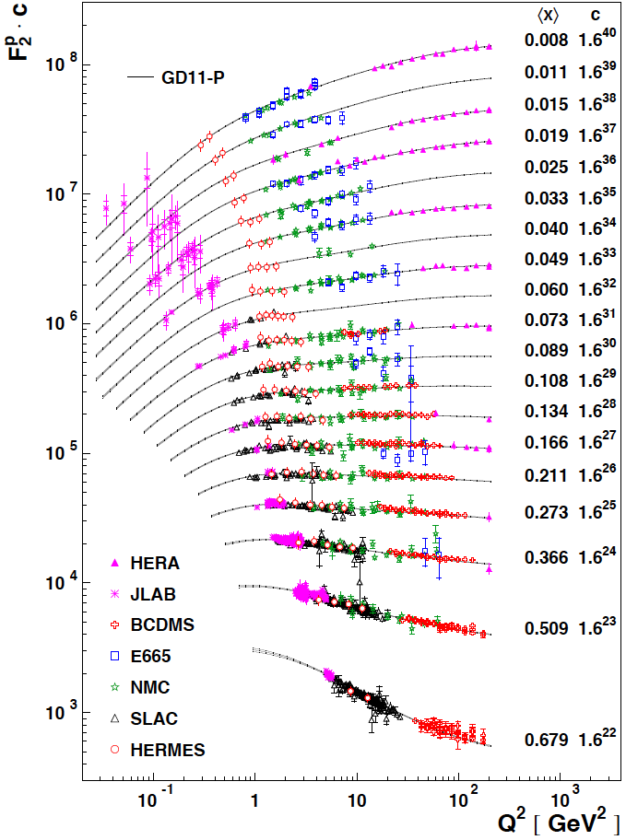
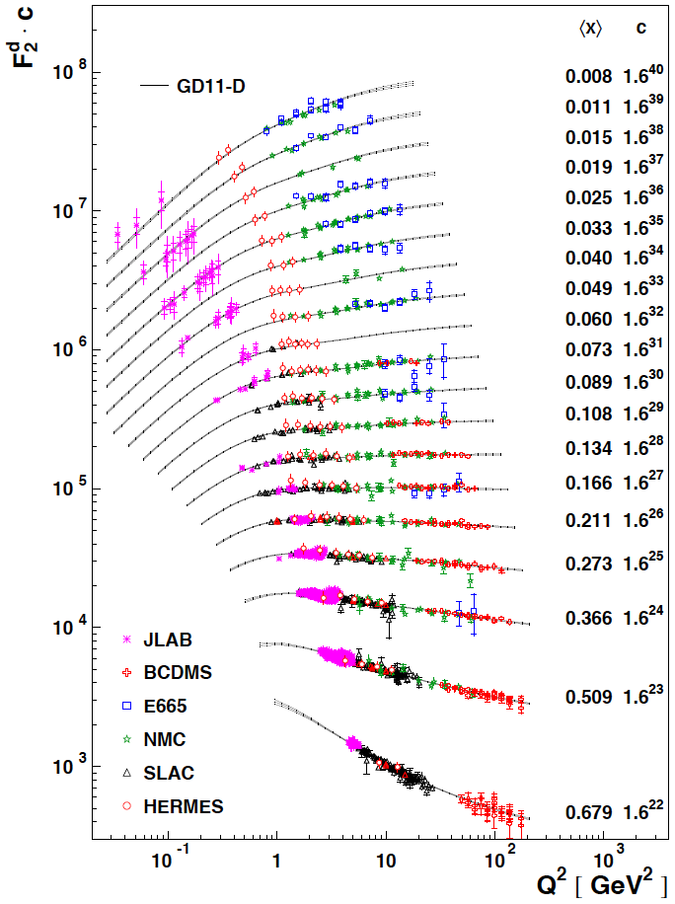

Slide 6
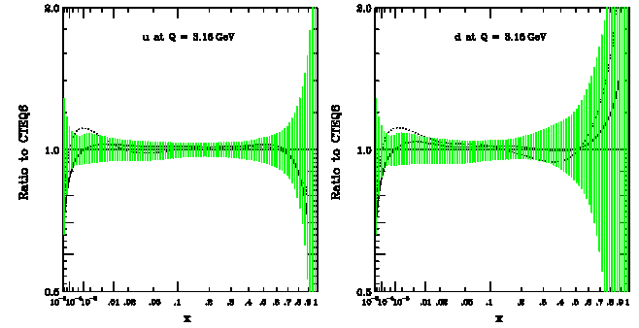
Structure Functions and Moments:
Why large x? Why neutron?
d/u(x→1) is a crucial test of valence quark models
  SU(6) breaking, pQCD,…
Precise PDFs at large x needed as input for LHC, ν experiments etc.
  Large x, medium Q² evolves to medium x, large Q²
  Also: NUCLEAR structure functions, EMC effect require (free) n data!
Moments can be directly compared with OPE (twist expansion), Lattice QCD and Sum Rules
  All higher moments are weighted towards large x; non-singlet moments
Quark-Hadron Duality – both N?
q_{up}(x, Q²)
q_{down}(x, Q²)
+ TM corr.

Slide 7
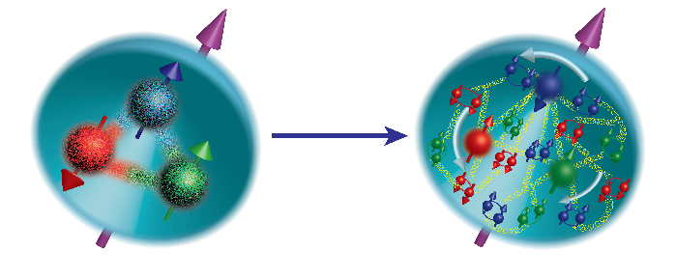
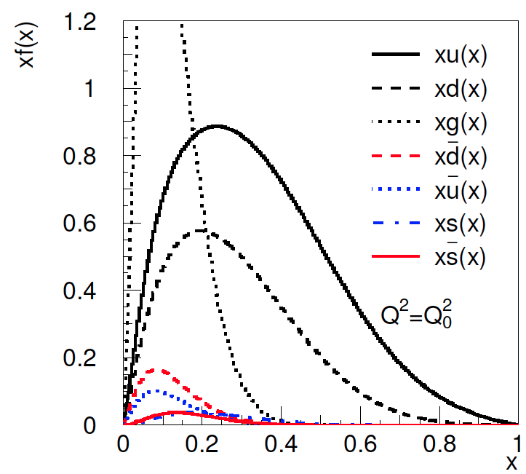
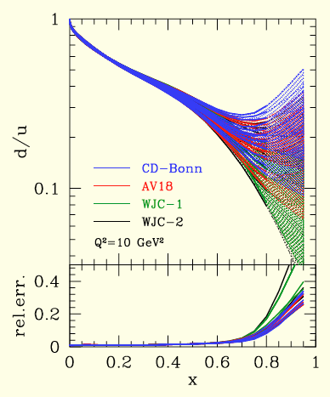
Alekhin et al.
Valence PDFs
2
Behavior of PDFs still unknown for x → 1
  SU(6): d/u = 1/2, Δu/u = 2/3, Δd/d = -1/3 for all x
  Relativistic Quark model: Δu, Δd reduced
  Hyperfine effect (1-gluon-exchange): Spectator spin 1 suppressed, d/u = 0, Δu/u = 1, Δd/d = -1/3
  Helicity conservation: d/u = 1/5, Δu/u = 1, Δd/d = 1
  Orbital angular momentum: can explain slower convergence to Δd/d = 1
Plenty of data on proton → mostly constraints
on u and Δu
Knowledge on d limited by lack of free neutron
target (nuclear binding effects in d, ³He)
Large x requires very high luminosity and resolution; binding effects become dominant uncertainty for the neutron
SU(6)
pQCD
QM + HF

Slide 8
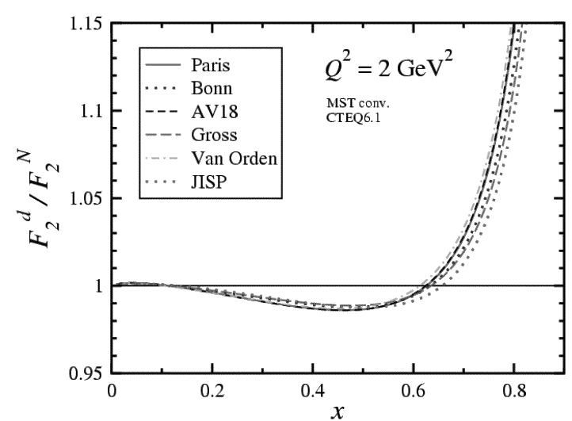
Large x = Large Nuclear Effects
Even simple “Fermi Smearing” leads to significant dependence on D wave function
Different models for off-shell and “EMC” effects lead to large additional variations
Contributions from MEC, Δ(1232) and “exotic” degrees of freedom?
FSI?

Slide 9
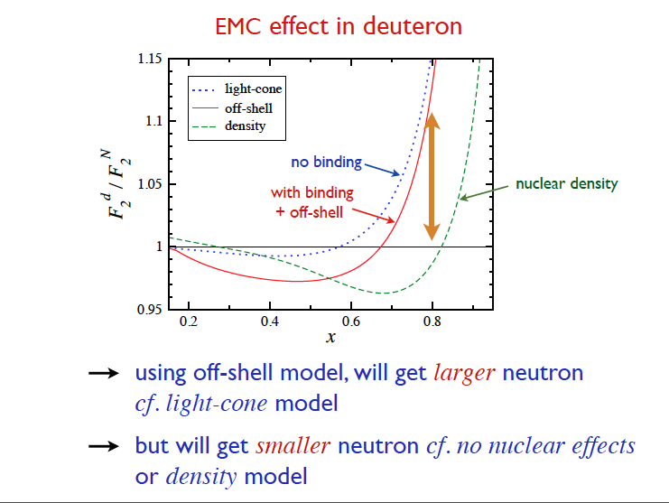
Note: a 10% uncertainty in F2N/F2p gives a
84% uncertainty on d/u!

Slide 10
Bound Neutron Structure Functions - 2 Questions:
How can we explore the structure of the neutron if all we have are neutrons bound in nuclei?
  In many cases, a neutron bound in deuterium can be considered “nearly free”.
  BUT: For certain kinematics (large x > 0.5, resonance region
  W < 2) the high-momentum (short-distance tail) of the deuteron wave function plays a large role and might distort the result.
Can we learn something about what happens to a nucleon if it is bound in a nucleus?
  Many ideas: Off-shell modifications of on-shell structure functions, color delocalization, suppression of point-like components, ΔΔ components, extra mesons or 6-quark bags, high-momentum (short range) correlations…
  Fundamental question about QCD in bound hadron systems that we haven’t understood yet. Relevant for QCD phase diagram (high baryon density, neutron stars, color superconductivity?)

Slide 11
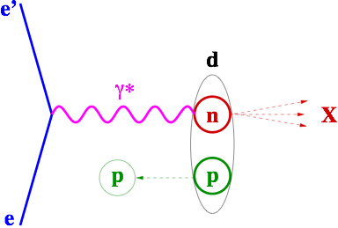
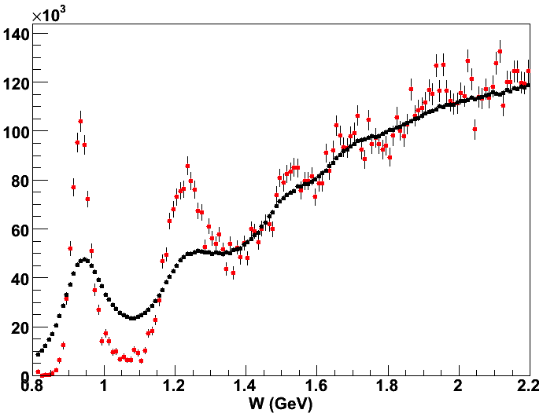

Spectator Tagging
d(e,e’ps)X
spectator
D(e,e’p_{s})X: Cts vs. W*
D(e,e’)X: Cts vs. W

Slide 12
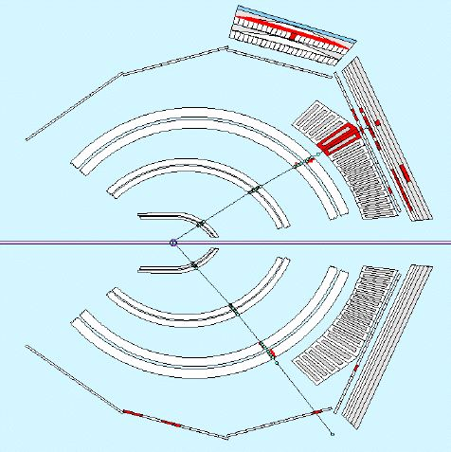
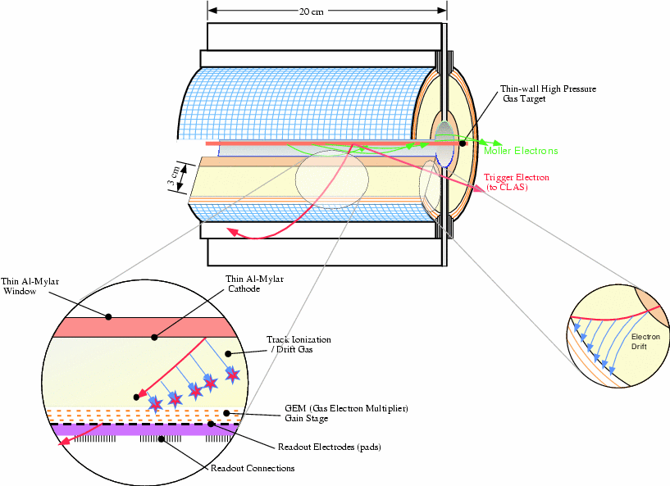

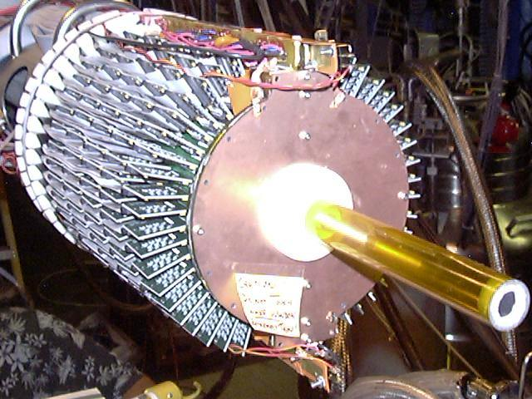
Spectator Tagging
Example: BoNuS
CLAS
7 atm D₂ gas
Gas
Electron
Multiplier
e⁻
backwards p
Møller el.
e⁻ to CLAS
Drift Region
Helium/DME at 80/20 ratio
3 GEMs
Readout pads and electronics

Slide 13
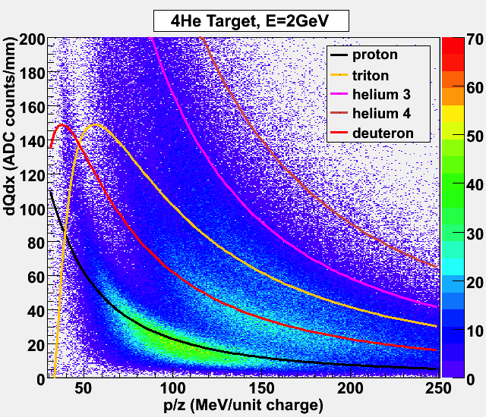
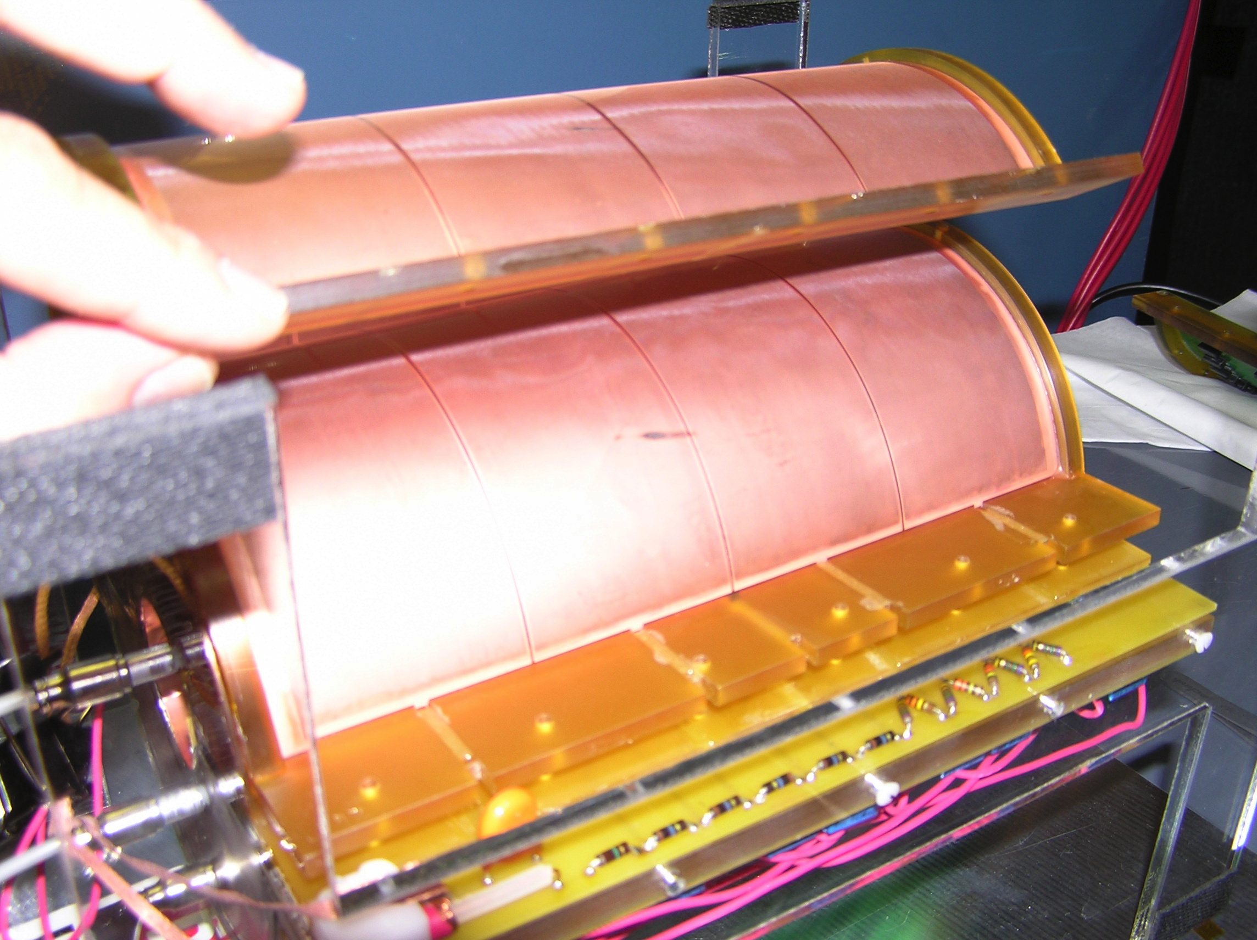
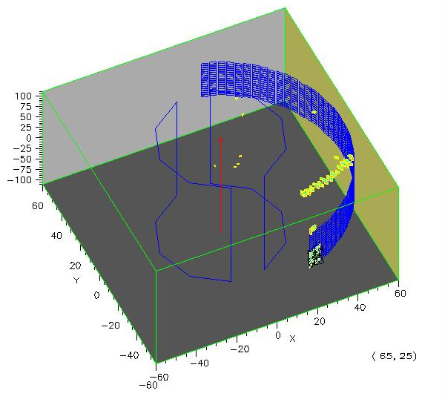
BoNuS RTPC
140 µm
7 atm D₂ gas
Gas
Electron
Multiplier
Møller el.
dE/dx from charge
along track (particle ID)
e⁻ (to CLAS)
Drift Region
Helium/DME at 80/20 ratio
3 GEMs
Readout pads and electronics
φ, z from pads
r from time
Nucl. Instr. Meth. A592, 273 (2008)

Slide 14
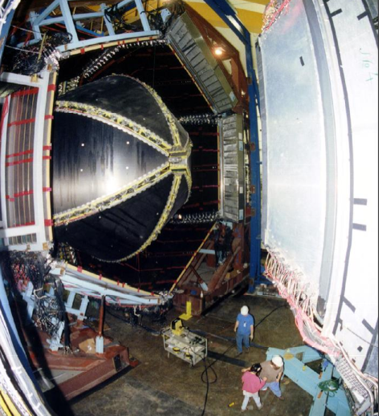
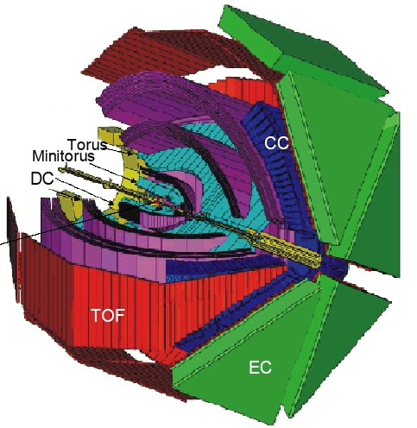
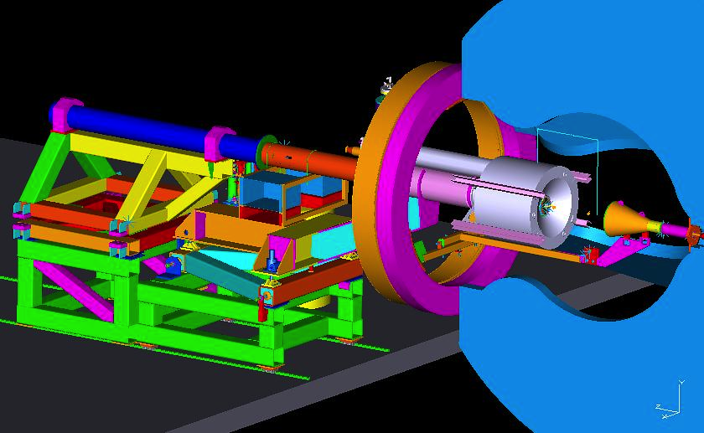
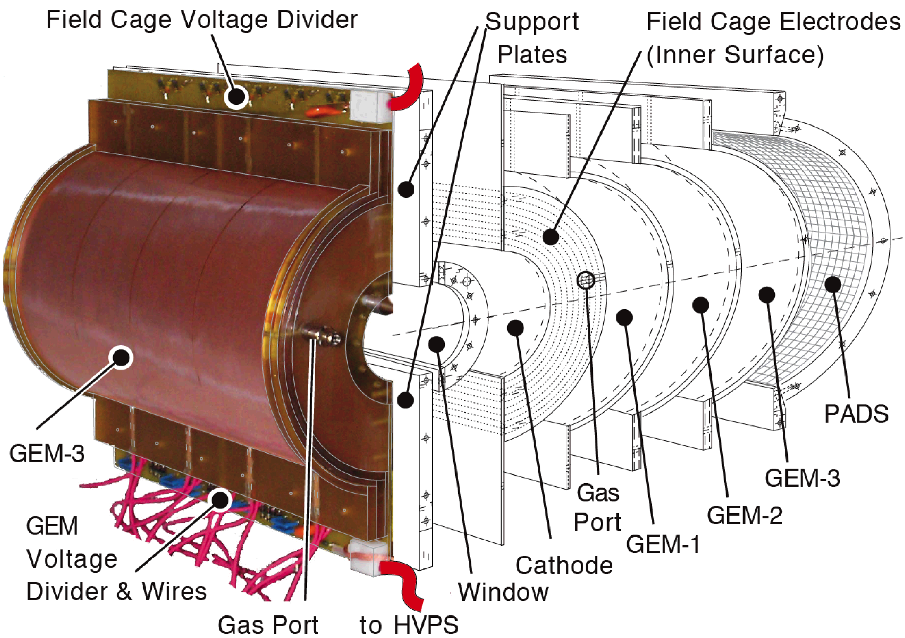
BoNuS
in CLAS

Slide 15
Spectator Tagging
Example: BoNuS - Results
F_{2n}
FSI: Cosyn et al.
Duality
EMC
Ratio

Slide 16
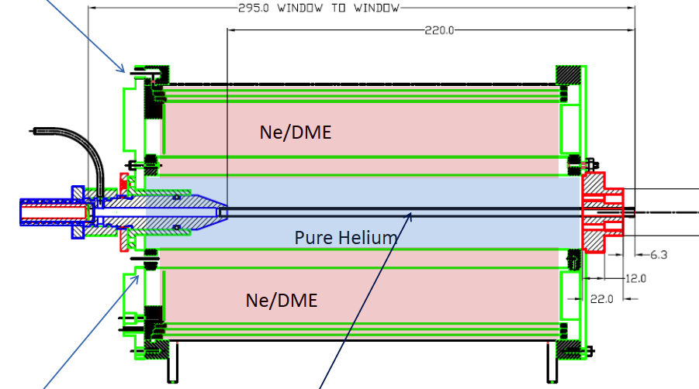
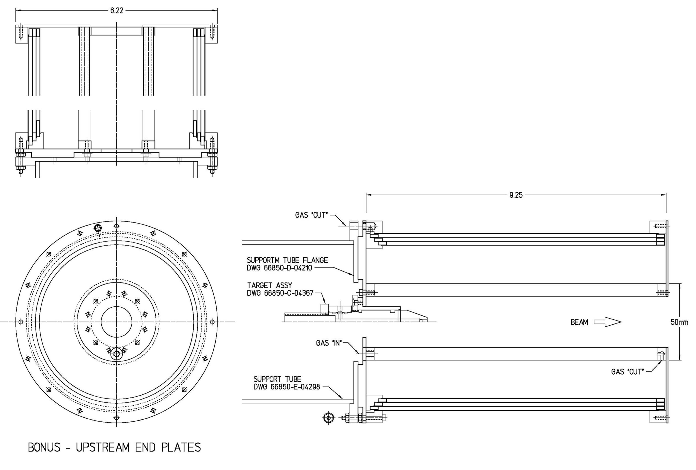
The 2nd RTPC (EG6)
Lightweight (carbon-foam composite structure) rungs for stress-free, self support of GEMs – to avoid “wrinkles”
Ground and cathode foils, each 6μm thick
Target region - new cell – ID 4mm, 30μm thick wall
Open, 2π geometry – only 80% were accessible due to the GEM and readout pad sizes

Slide 17
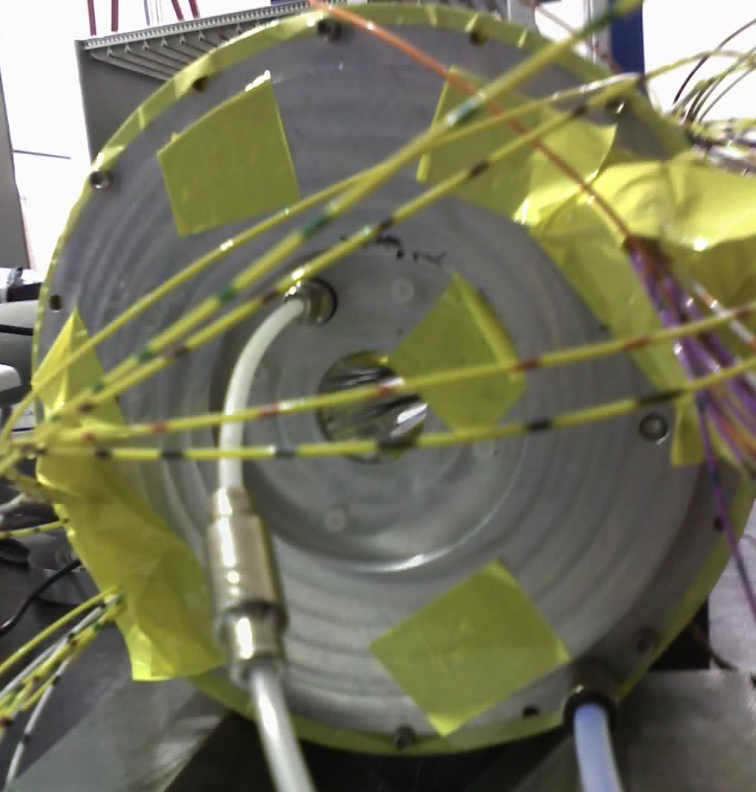
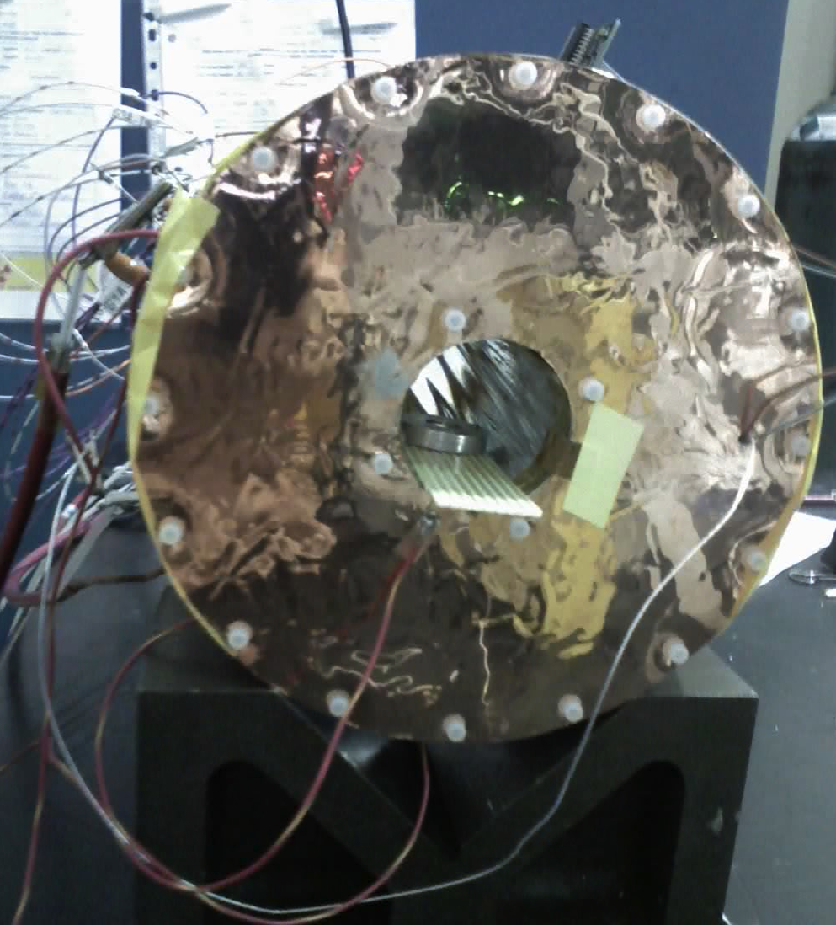
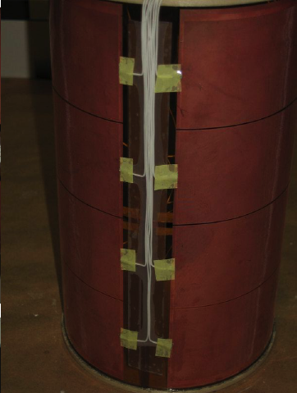
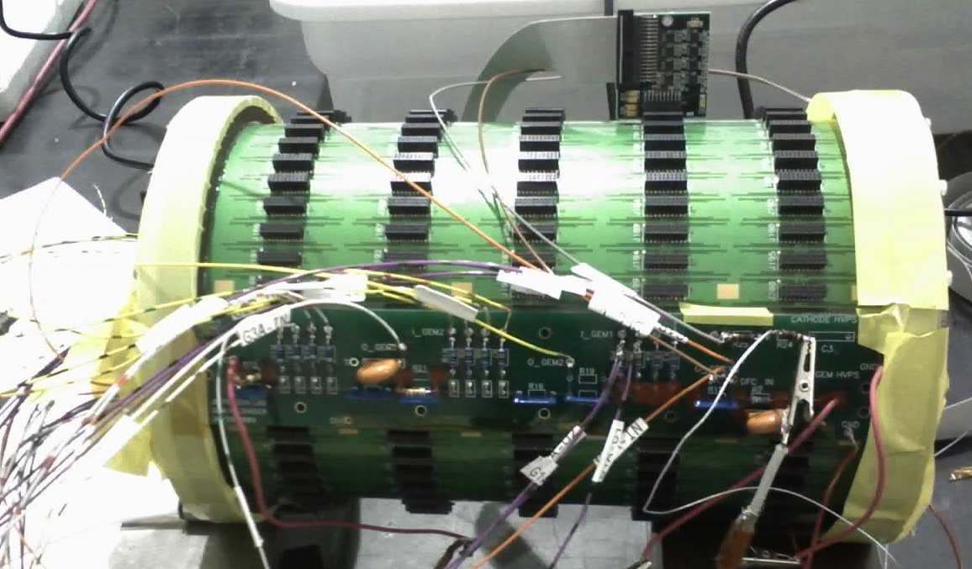
The EG6 RTPC (ii)

Slide 18
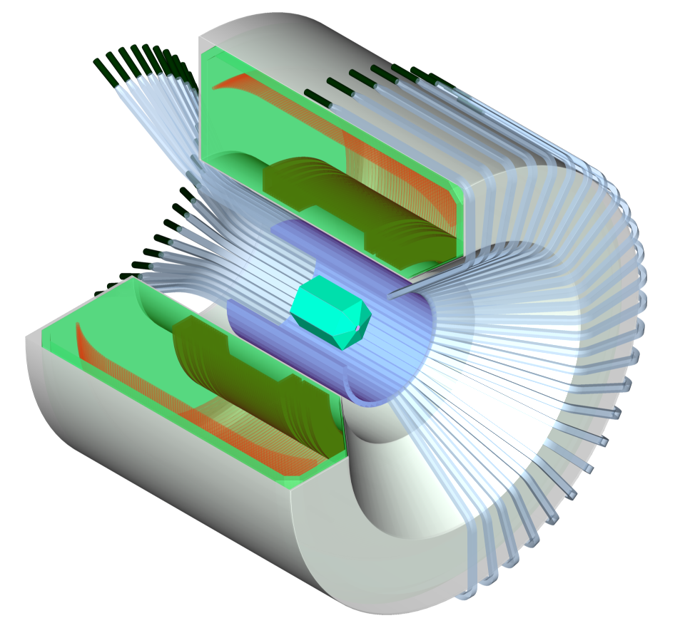
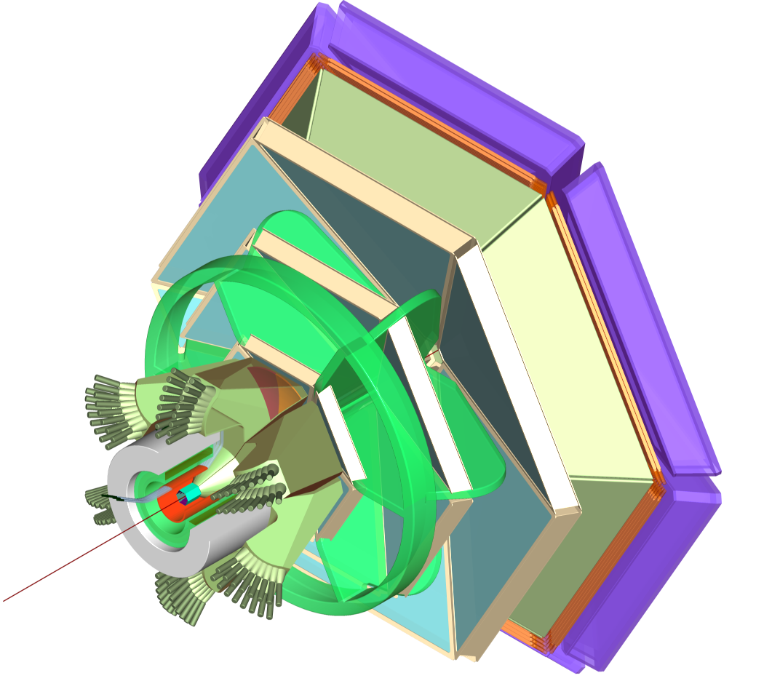
Plans for 11 GeV
BONuS12
E12-06-113
Contact Person: S. Bültmann
+ Spokespersons: S. Kuhn, H. Fenker, W. Melnitchouk, M.E. Christy, C. Keppel, V. Tvaskis
Central
Detector
Data taking of 35 days on D₂ and 5 days on H₂ with L = 2 · 10 ³⁴ cm⁻² sec⁻¹
Planned RTPC detector, DAQ and trigger upgrade
DIS region with
  Q ² > 1 GeV ²/c ²
  W *> 2 GeV
  p_{s} > 70 MeV/c
  10° < θ_{pq} < 170°
CLAS12

Slide 19
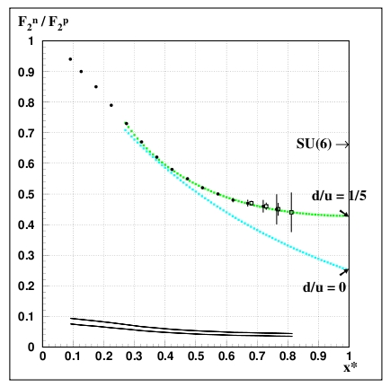
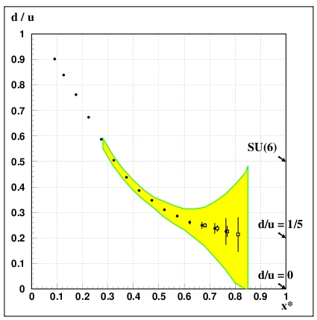
Expected Results
Neutron/Proton structure function
d/u
Dark Symbols: W* > 2 GeV (x* up to 0.8, bin centered x* = 0.76)
Open Symbols: “Relaxed cut” W* > 1.8 GeV (x* up to 0.83)

Slide 20
The context: JLab at 11 GeV
Notes:
Rich program to measure F1, F2, R on nucleons and nuclei. Extend measurements on neutron

Slide 21
^{*)}
Possibly Winter/Spring 2018!
^{*)} (S. Kuhn, run group coordinator)
Notes:
Volker

Slide 22
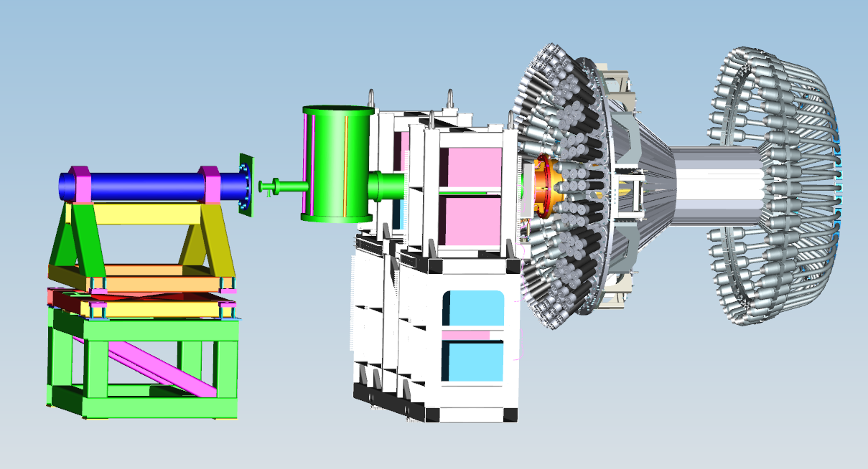
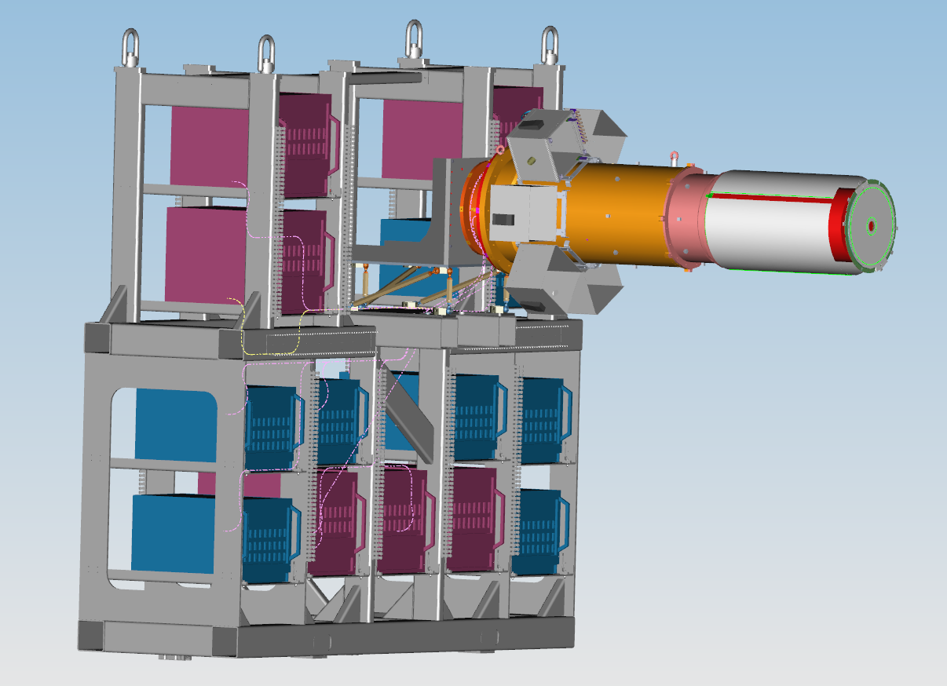
BONuS12 RTPC Design
CLAS12 Central Detector
BONuS12 RTPC replaces SiVtxT + perhaps µmegas (but forward Vtx tracking needed!)

Slide 23
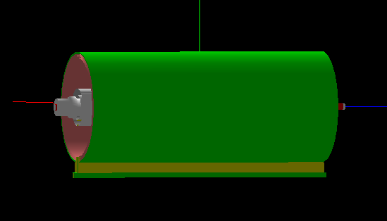
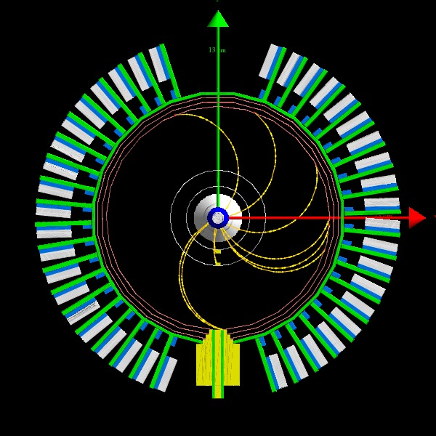
GEANT4 Studies (Jixie Zhang)
70 MeV/c protons
Target: D₂ gas, 293k,
7.0 atm, 3(5?) mm radius, 40 cm long
Target Wall: 28 µm Kapton
Drift Region: 3<R<7 cm
Drift Gas: 293k, 1 ATM, He/DME (90/10)
Use CLAS12 Solenoid with 5T field pointing upstream

Slide 24
GEANT4 Studies

Slide 25
GEANT4 Studies – Hybrid Design
(E. Christy, H. Fenker, J. Zhang)
69 MeV/c p – may be recoverable!

Slide 26
GEMC Studies
(K. Park, N. Dzbenski)

Slide 27
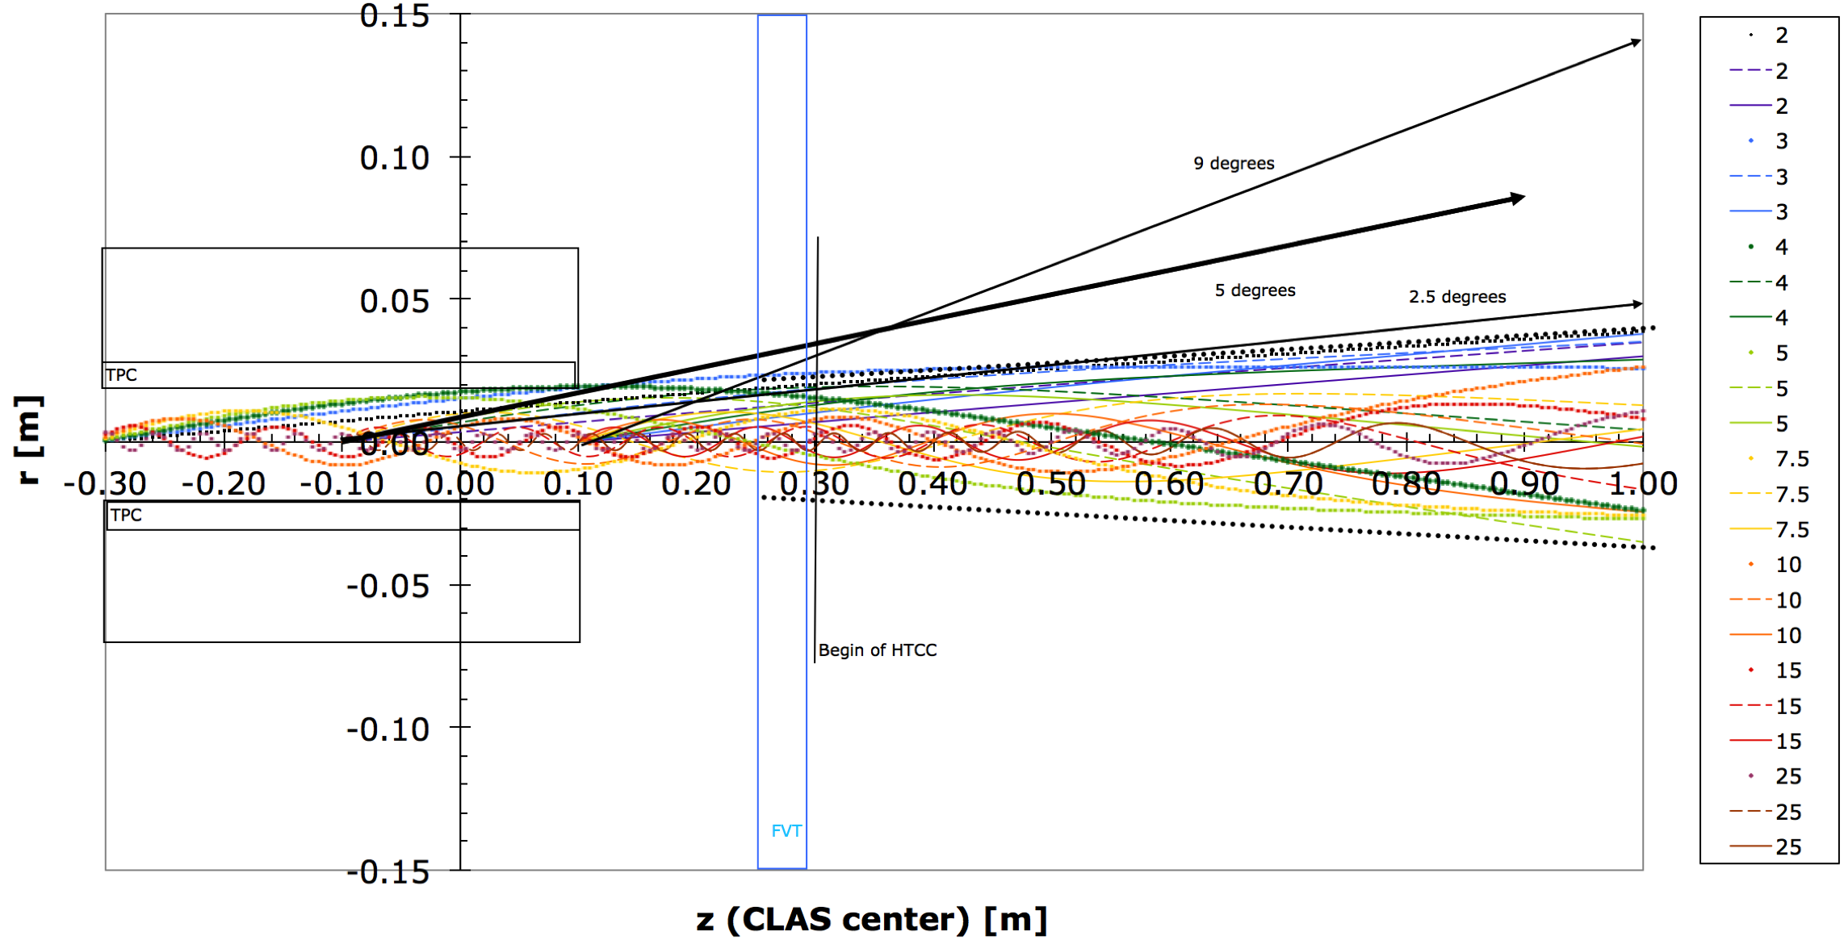
Møller Bckgnd:

Slide 28
Magboltz/Garfield calculations
Potential for hybrid design
Drift time and Lorentz angle in the RTPC active region

Slide 29
What else can we do with RG F?
EMC effect in D
  tag on slow/fast p; bench mark for heavier nuclei? FSI, d WF,…
“LAND” experiment E12-11-003A
  tag p structure in d with backward n (Approved Run Group proposal, PAC43; Or Hen, L. Weinstein, E. Piasetzky, H. Hakobyan)
nDVCS?
  At least calibrate CND and get first sample without nuclear distortions; fully exclusive!
n Form Factors? Alternative method to cross check
n resonances? (Use forward tagger)
n SIDIS? (Flavor tagging, TMDs)
YOUR IDEA HERE!
Notes:
TMDs: ALU, AUUcosphi, AUU cos2phi; multiplicities, hadronization

Slide 30
Summary
BONuS12 has been designated high priority by PAC41
Present schedule: 2nd experiment after LH₂ target
(Run Group F, Winter 2017-18?)
Opportunity for many groups to make major contribution, get thesis data, gain experience with CLAS12
Plethora of potential additional Physics topics
Detector/target system under design
  Lots of work left
  Need all the help we can get: Electronics, DAQ, gas system, target/beam line, CLAS12 integration, slow controls, documentation, online and offline software
=> Y’all are strongly encouraged to participate!

Slide 31
Backup Slides

Slide 32
Simple (Constituent) Quark Model

Slide 33
Quark Model:
SU(6)-symmetric wave function of the proton in the quark model:
In this model: d/u = 1/2, Δu/u = 2/3, Δd/d = -1/3 for all x
=> A_{1p} = 5/9, A_{1n} = 0, A_{1D} = 1/3 *)
Hyperfine structure effect: S=1 suppressed => d/u = 0, Δu/u = 1, Δd/d = -1/3
for x -> 1 => A_{1p} = 1, A_{1n} = 1, A_{1D} = 1
pQCD: helicity conservation (q↑↑p) => d/u =2/(9+1) = 1/5, Δu/u = 1, Δd/d = 1
for x -> 1
Wave function of the neutron via isospin rotation:
replace u -> d and d -> u => using experiments with protons and neutrons one can extract information on u, d, Δu and Δd in the valence quark region.
*)

Slide 34

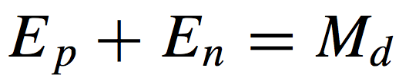
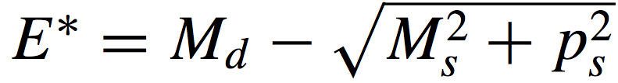


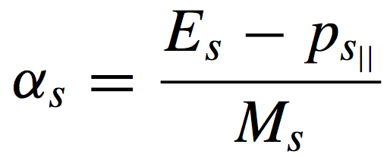
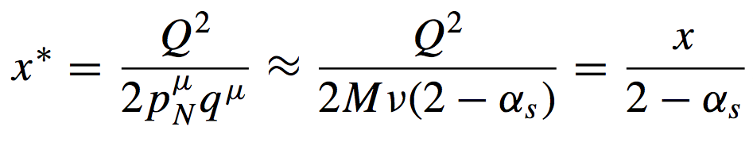
before
d(e,e’ps)X
neutron
(ν,q)
ps
after
kμ
spectator
plane-wave impulse approximation
backward-emitted p is spectator
struck neutron is off-shell
momenta are equal and opposite
Lorentz invariants are corrected for initial neutron 4-momentum

Slide 35
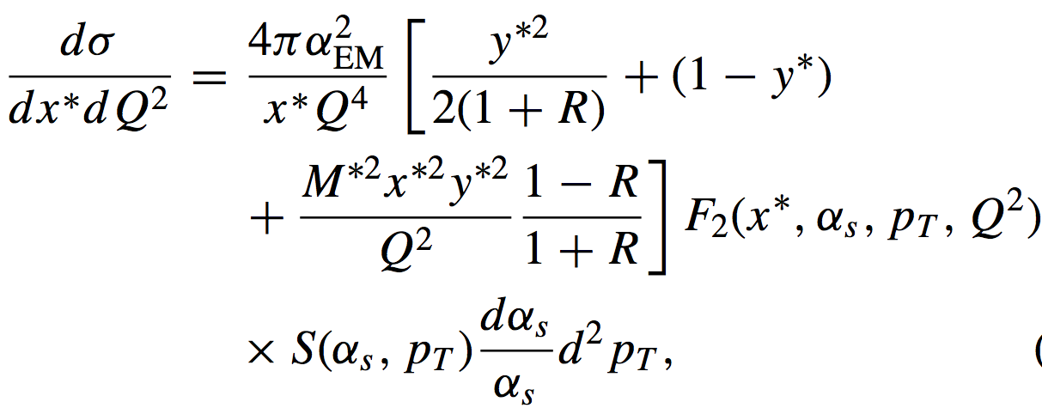
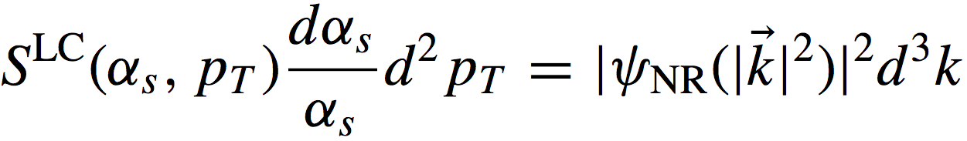
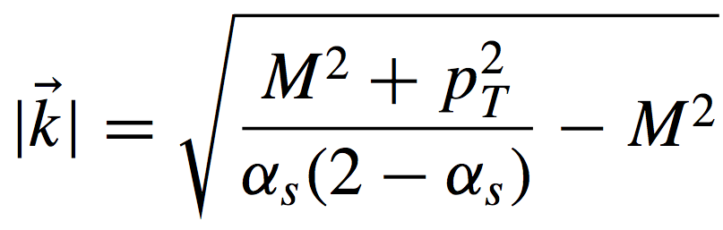







PWIA Spectator Formalism
Cross Section
Off-Shell F2
  R=σL/σT
Light Cone
Spectral Function
Nonrelativistic w.f.

Slide 36


Very Important Protons 70<ps<100 MeV/c
Corrections make resonances stand out
F2^{n}/F2^{p} can be measured at high x*
ps distribution
BoNuS
Region
70, 100, 200 MeV/c
VIPs

Slide 37


Final State Interactions
struck neutron can interact with the spectator proton
proton momentum is enhanced
FSIs are small at low ps and large Θpq
(ν,q)
Palli et al, PRC80(09)054610
kμ
ps
several groups have calculated FSIs
Θpq > 110º minimizes FSIs
Θpq
ps

Slide 38

Target Fragmentation
Palli et al, PRC80(09)054610
target fragmentation enhances the proton yield only at forward angles (cos Θpq >0.6)
this can be ignored
cos Θpq

Slide 39

Low Spectator Momenta - Nearly Free Neutrons ?
The
Experiment
BoNuS
Region
VIPs
0.07 0.2 GeV/c
CLAS
backwards p
e⁻
Radial TPC (view from downstream)
*BoNuS = Barely off-shell Nucleon Scattering
**RTPC = Radial Time Projection Chamber

Slide 40



CLAS
Cherenkov
target
beam
drift chambers
e⁻
Time of flight scintillators
calorimeter

Slide 41


BoNuS RTPC
140 µm
7 atm D₂ gas
Gas
Electron
Multiplier
Møller el.
dE/dx from charge
along track (particle ID)
e⁻ (to CLAS)
Drift Region
Helium/DME at 80/20 ratio
3 GEMs
Readout pads and electronics
φ, z from pads
r from time

Slide 42


RTPC Cross Section

Slide 43


Slide 44





Kinematic Coverage - 2.1, 4.2 & 5.3 GeV
3.5
RTPC Performance
W (GeV)
e⁻ reconstructed in CLAS & RTPC
σ=8mm
0.5
0
Q² (GeV²)
3.5
z
σ=1.4º
σ=4º
p_{spec} (MeV)
VIPs
φ
VIPs
cos(θ_{pq})
θ

Slide 45




Particle ID (after gain calibration of each channel)
Gain constants for every channel (RTPC-Right on top) – red (blue) indicates “hotter” (“colder”) than average pads
Out-of-time track suppression

Slide 46
Minimizing Nuclear Uncertainties: “Spectator Tagging”
E = 4.223 GeV
e
n
<Q²> = 1.19 (GeV/c)²
p
*

Slide 47


Modifications to Simple Spectator Picture
“BoNuS”
"Deeps"...
Final State Interactions
Binding Effects
Ciofi degli Atti and Kopeliovich, Eur. Phys. J. A17(2003)133

Slide 48

Deviations from free structure function:
Off-shell Effects [should depend on α (p_{s}), x, Q²]
p_{T} = 0
Modification of the off-shell scattering amplitude (Thomas, Melnitchouk et al.)
Color delocalization
Close et al.
Suppression of “point-like configurations”
Frankfurt, Strikman et al.
939 MeV
905 MeV
823 MeV
694 MeV
… plus 6-quark bags, ΔΔ, MEC…
“Off-shell” mass of the nucleon M*
P_{s} = 0 0.09 0.17 0.25 0.32 0.39 GeV/c

