Slide 1
CLAS12 Torus Magnetic Field Mapping
Physics Requirements
Sensitivity to Manufacturing Imperfections
Strategy
where to map field
measure deviation from ideal model
fit to error tables
Conceptual Design
Project Plan
prototyping, data-taking plans, analysis plans
Measurement Team
Physicist: Mac Mestayer
Hall B Engineers: Renuka Ghoshal, Probir Ghoshal, Ruben Fair
Accelerator: Ken Baggett, Joe Meyers
Shift Personnel: collaboration
Notes:
Outline: see slide 10 for quick answers to each point

Slide 2
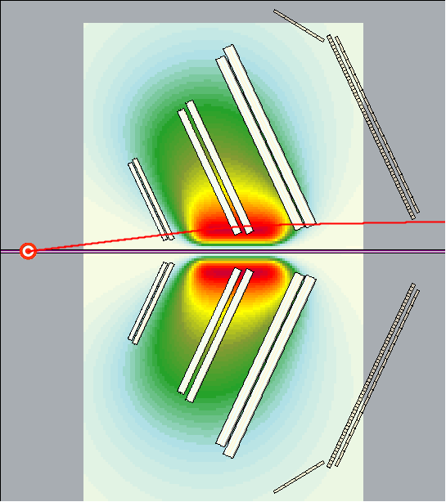
CLAS12 Torus Magnetic Field Mapping
Physics Requirement
Best dp/p resolution is from particle trajectories near the beam-line (highest B-field) → low-angle elastic scattering
Here is the trajectory of an elastically scattered electron from 11 GeV beam
(p = 10.1 GeV/c, θ = 7º)
For this track, dp/p ~ 0.3%
→ need to know $\int{B dl}$ to ~ 0.1%

Slide 3
Strategy for Mapping and Adjusting the CLAS12 Torus Magnetic Field
Two types of distortions:
expected from design, (e.g. shrinkage at low temperature ) and
those due to small manufacturing differences (like one coil being shifted in z, or one coil not being wound as tight as another, etc.).
Strategy to map and adjust the magnetic field:
include any average distortions from design as part of the nominal field calculation
calculate the error B-field*, i.e.(B_{distorted}- B_{nominal}), for various anticipated distortions due to manufacturing tolerances
after mapping, fit (B_{measured} - B_{nominal}) to a sum of these "error B-fields" scaled by adjustable coefficients

Slide 4
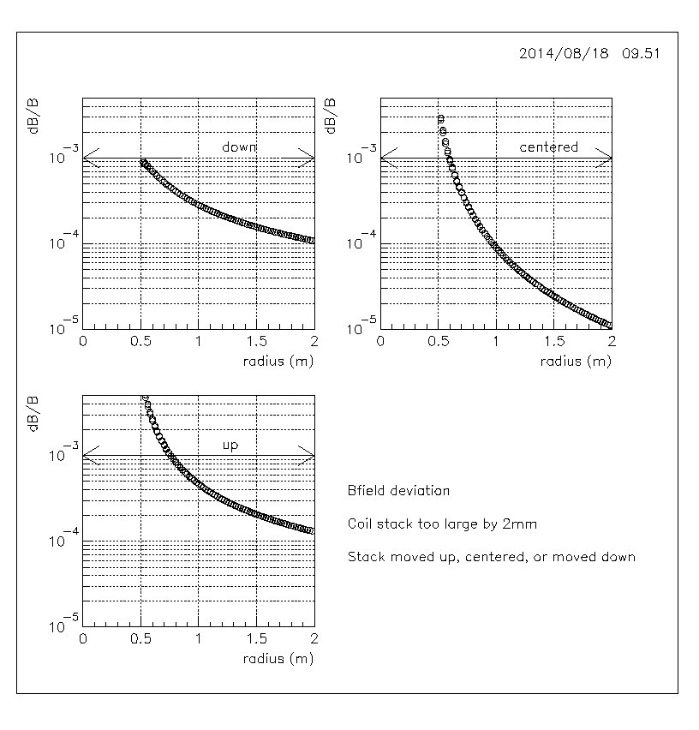
Effect of Distortion in Coil-Winding
% Change in B-field:
plotted vs. radius
coil stack too large by 2mm
coil moved down, centered, up
2 mm increase in stack size can cause field distortions of up to a few parts per thousand
large radius surface of inner coil is most critical dimension
Notes:
Here is a plot of the fractional deviation of the B-field from ideal (measured at the mid-plane between coils, for
radii between 0.5 and 2 m) for a coil that was made with a stack height 2mm too large. Upper left: closest to
beam edge aligned, upper right: centered, below left: coil aligned on outer edge. Main point: 1 -2mm imperfections
create problems which are barely at the noticeable level.

Slide 5
Effect of Change in Coil Stack Height of 1 mm
~ 18 Gauss change
in field; ~ 0.1 %

Slide 6
Need to know
radius to ~ 0.1mm

Slide 7
Fitting the Measurements
Number of measurements
6 (sectors) x 4 (x-y posn’s) x 3 (dim.) x 50 (z posn’s) = 3600
Method
fit measured deviation from ideal to adjustable parameters which scale tables of calculated deviations from ideal due to ‘unit distortions’
Number of parameters
6 (coils) x [ 2 (movements) + 1 (expansion) ] x 3 (dim.) = 36
6 total; is 2 enough?

Slide 8
Definition of χ²
χ² $= \sum_{imeas}{\sum_{idim}{\left(\frac{∆Bmeas(idim,imeas)−∆Bcalc(idim,imeas)}{δB(idim)}\right)2}}$
sum over measurement points and dimensions
$$∆Bmeas\left(idim,imeas\right)=[Bmeas\left(idim,imeas\right)−Bideal\left(idim,imeas\right)]$$
table of measurements minus ‘ideals’
$∆Bcalc(id,im)$ = $\sum_{icoil}{\sum_{imode}{ α ic,imode (Bideal\left(id,im\right)−Bdistorted\left(id,im,ic,imode\right))}}$
pre-calculated table of ideal field plus fields due to
‘unit distortions’
adjustable parameters

Slide 9
How Are We Going to Map?
Measurement Tubes
non-magnetic
~ 2” diameter Carbon
Hall Probes in Sensor Block
Three 1-dimensional probes
measure ~ every 5cm in Z
Digital Voltage
Meter
linear stage

Slide 10
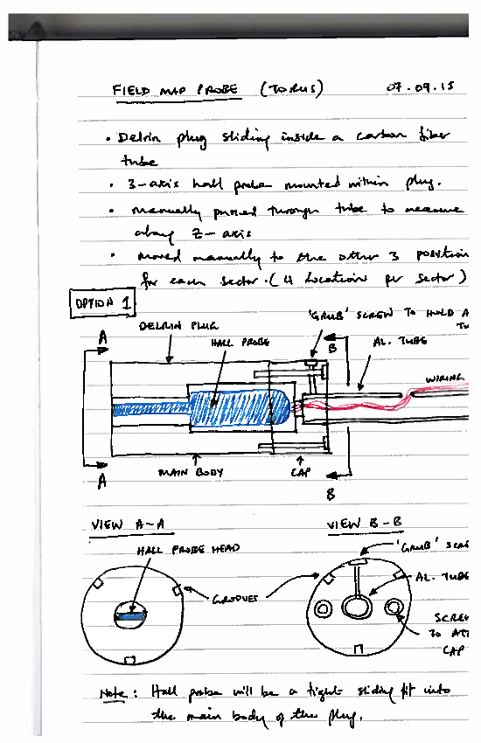
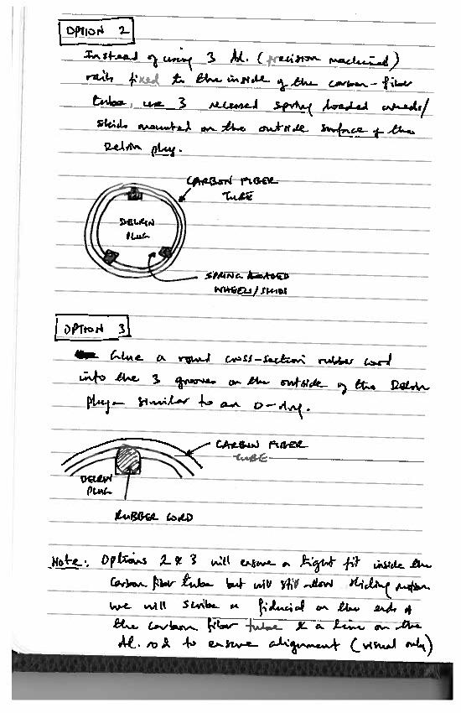
Magnet Mapping Sensor Head Mechanical Sketch

Slide 11
Torus Mapper Prototype: Build
Shim and adjust test magnet
field strength of ~2 Tesla
enlarge gap to accommodate one measurement tube and assembly
produce gradient of ~2% per cm
Procure and build prototype
- sensor
cylindrical sensor head containing three 1-dimensional Hall probes
connection to translation rod
electrical connections
- tube
tube assembly
attachment and survey points
- translation system
- analysis and display software
- control system: motion, data-taking runs, interlocks,

Slide 12
Torus Mapper Prototype: Test
Test operation of prototype
Do all systems work?
placement and survey
rotating and moving of sensor
signal readout under various conditions; noise measurement
quick ‘real-time’ analysis of results
Do procedures make sense? How long does a scan take?
Verify reproducibility to better than 0.1%
many scans, no changes
changing step size
changing position within magnet; removing, replacing
changing orientation with respect to gravity
Calibration of Hall probes

Slide 13
Tube Holder ?
Move 1 Sensor or Fixture Holds Several ?
my vote →Move 1 Sensor via Links
Pro: mapping location flexible; single probe calibration
Con: need to survey all locations within one sector
Issues: where to locate link ends ? beam axis ?
Move to exact position ?
→ more complicated hardware, survey procedure
Move to approx. position and survey ?
more complicated software

Slide 14
Torus Mapping Timelines
 | Sep |  | Oct |  | Nov |  | Dec |  | Jan |  | Feb |  | Mar |  | Apr |  | May |  | Jun |  | Jul |  | Aug |  | Sep
Sensor Conceptual Design
Prototype Sensor
Fixture Design
Mapper Built
Location, Procedure Verified
Torus Ready for Installation
Mapper Installed
Torus Commissioned
Mapping Done

Slide 15
Summary
Physics Requirements : measure field to 0.1% accuracy at a radius known to 0.1mm
Sensitivity to Manufacturing Imperfections ~ 1mm
Strategy
where to map field : 4 locations each sector, ~25 – 50 pts in z
measure actual, calculate deviation from ideal model
fit to error tables : with adjustable strength
Conceptual Design
moving sensor head with 3 Hall probes
Project Plan
timeline: prototype in fall 2015, build in spring, map in June
Notes:
brief answers to the various points

