Slide 1

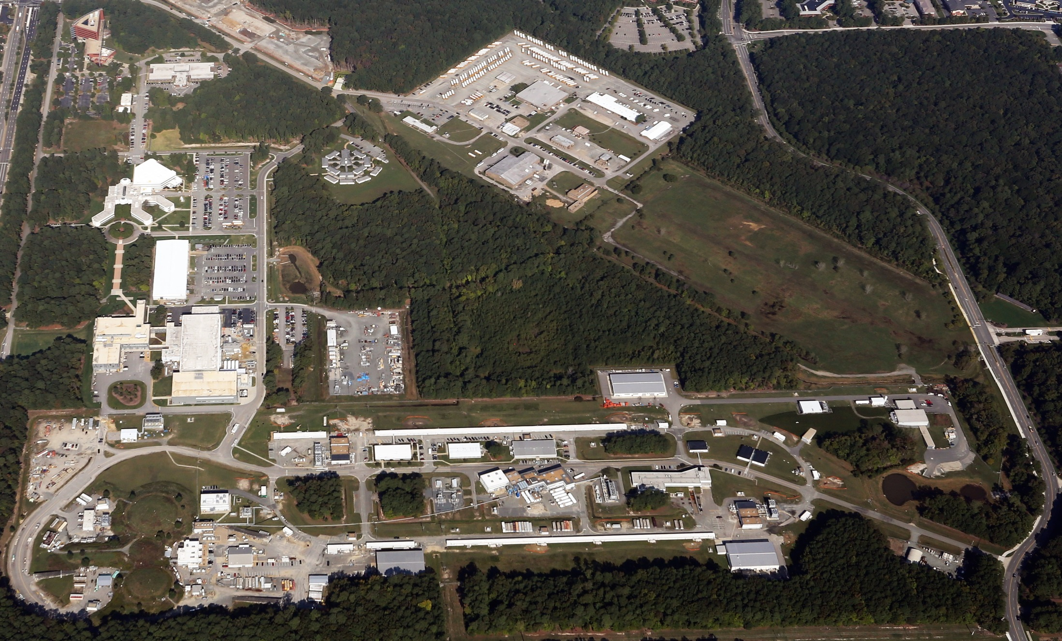
Jefferson Lab Status
Bob McKeown
October 21, 2015

Slide 2
Outline
12 GeV Project
PAC43
Budgets and Schedule
NSAC Long Range Plan
JLEIC
Outlook

Slide 3
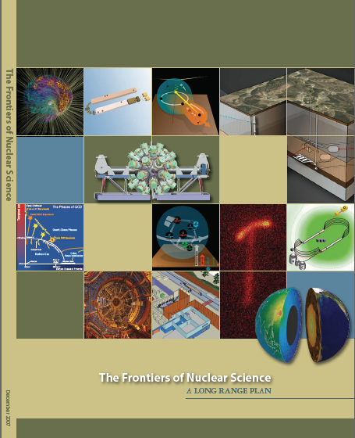
12 GeV Upgrade Project
Completion of the
12 GeV CEBAF Upgrade was ranked the highest priority in the 2007 NSAC Long Range Plan.
Upgrade is designed to build on existing facility: vast majority of accelerator and experimental equipment have continued use.
New Hall
Upgrade arc magnets
and supplies
Add 5 cryomodules
20 cryomodules
CHL upgrade
Add arc
20 cryomodules
TPC = $338M
ETC = ~$15M
Add 5 cryomodules
Project Scope (~96% complete):
Doubling the accelerator beam energy - DONE
New experimental Hall D and beam line - DONE
Civil construction including Utilities - 99.7%
Upgrades to Experimental Halls B & C - ~89%
Enhanced capabilities
in existing Halls
Maintain capability to deliver lower pass beam energies: 2.2, 4.4, 6.6….

Slide 4
PAC43
Scheduled for July 28-August 1
Proposals were due June 2
Charge:
Review new proposals, previously conditionally approved proposals, and letters of intent for experiments that will utilize the 12 GeV upgrade of CEBAF and provide advice on their scientific merit, technical feasibility and resource requirements.
Identify proposals that represent high quality physics within the range of scientific importance represented by the previously approved 12 GeV proposals and recommend for approval.
Also provide a recommendation on scientific rating and beam time allocation for proposals newly recommended for approval.
Identify other proposals with physics that have the potential for falling into this category pending clarification of scientific and/or technical issues and recommend for conditional approval. Provide comments on technical and scientific issues that should be addressed by the proponents prior to review at a future PAC.
8 new proposals
2 new parallel experiments
7 Letters of Intent

Slide 5
PAC43 Call for Proposals
As we started with PAC40, the Hall B collaboration should submit proposals for complete run groups at one PAC meeting, where all of the anticipated physics associated with the proposed run group will be considered. Each run group can submit up to 4 individual proposals (up to 3 physics topics plus 1 summary of additional topics) and will be granted a maximum of 4 presentations corresponding to these proposals. The PAC may consider each of these for grading, but will attempt to provide an common assessment of the whole run group. New experimental proposals that run in parallel with previously approved run groups should be considered internally by the CLAS collaboration. It is also requested that documentation (e.g., proposal and report) from the internal review be submitted to the PAC for their information. A CLAS representative will have the opportunity to report on these to the PAC, and the PAC will then provide comments on them in its report. Proposed parallel running in other halls should be handled in a similar fashion.

Slide 6
PAC43 Results
NUMBER | TITLE | CONTACT PERSON | HALL | DAYS REQUESTED | DAYS AWARDED | SCIENTIFIC RATE | PAC DECISION
PR12-15-001 | Measurement of the Generalized Polarizabilities of the Proton in Virtual Compton Scattering | N. Sparveris | C | 15 |  |  | C2
PR12-15-002 | The sidereal time variations of the Lorentz force and maximum attainable speed of electrons | B. Wojtsekhowski | Acc | 3.5 |  |  | Defer
PR12-15-003 | Polarization Observables in Wide-angle Compton Scattering at Photon Energies up to 8 GeV | B. Wojtsekhowski | A | 15 |  |  | Defer
PR12-15-004 | Deeply virtual Compton scattering on the neutron with a longitudinally polarized deuteron target | S. Niccolai | B | 125 |  |  | C2
PR12-15-005 | Measurements of the Quasi-Elastic and Elastic Deuteron Tensor Asymmetries | E. Long | C | 44.3 |  |  | C2
PR12-15-006 | Measurement of Tagged Deep Inelastic Scattering | C. Keppel | A | 27 | 27 | A- | C1
PR12-15-007 | Measurements of the Charge and Magnetic Form Factors of the Triton at Large Momentum Transfers | G. Petratos | A | 10 |  |  | Defer
PR12-15-008 | A study of the Lambda-N interaction through the high precision spectroscopy of Lambda-hypernuclei with electron beam | S. N. Nakamura | A | 73 |  |  | C2/D

Slide 7
12 GeV Approved Experiments by Physics Topics
Topic | Hall A | Hall B | Hall C | Hall D | Other | Total
The Hadron spectra as probes of QCD (GlueX and heavy baryon and meson spectroscopy) |  | 1 |  | 3 |  | 4
The transverse structure of the hadrons (Elastic and transition Form Factors) | 5 | 3 | 2 | 1 |  | 11
The longitudinal structure of the hadrons (Unpolarized and polarized parton distribution functions) | 2 | 3 | 6 |  |  | 11
The 3D structure of the hadrons (Generalized Parton Distributions and Transverse Momentum Distributions) | 5 | 9 | 7 |  |  | 21
Hadrons and cold nuclear matter (Medium modification of the nucleons, quark hadronization, N-N correlations, hypernuclear spectroscopy, few-body experiments) | 6 | 3 | 7 |  | 1 | 17
Low-energy tests of the Standard Model and Fundamental Symmetries | 3 | 1 |  | 1 | 1 | 6
TOTAL | 21 | 20 | 22 | 5 | 2 | 70

Slide 8
12 GeV Approved Experiments by PAC Days
Topic | Hall A | Hall B | Hall C | Hall D | Other | Total
The Hadron spectra as probes of QCD (GluEx and heavy baryon and meson spectroscopy) |  | 119 |  | 540 |  | 659
The transverse structure of the hadrons (Elastic and transition Form Factors) | 145.5 | 85 | 102 | 25 |  | 357.5
The longitudinal structure of the hadrons (Unpolarized and polarized parton distribution functions) | 65 | 230 | 165 |  |  | 460
The 3D structure of the hadrons (Generalized Parton Distributions and Transverse Momentum Distributions) | 409 | 872 | 212 |  |  | 1493
Hadrons and cold nuclear matter (Medium modification of the nucleons, quark hadronization, N-N correlations, hypernuclear spectroscopy, few-body experiments) | 180 | 175 | 201 |  | 14 | 570
Low-energy tests of the Standard Model and Fundamental Symmetries | 547 | 205 |  | 79 | 60 | 891
TOTAL | 1346.5 | 1686 | 680 | 644 | 74 | 4430.5
Total Approved Run Group Days (includes MIE) | 1346.5 | 671 | 667 | 644 | 74 | 3402.5
A Decade of Experiments

Slide 9
FY2016 Budget
ONP Guidance / FY16 President’s Budget Request supports ~ 16 weeks running
  This matched somewhat with some infrastructure work in CHL and UIM which happened during the summer shutdown
  But we would have liked more running in FY16 and tried with Senate and House
Current Expectations
  No immediate lapse of Government Funding
  A short-term Continuing Resolution
    Impacts on ability to mount experiments & UITF …
    Partial mitigation coming from NP
  Potential for a Year Long CR, potential impact ~$2.5M
    Protect the workforce, operating weeks
    Take the hits elsewhere

Slide 10
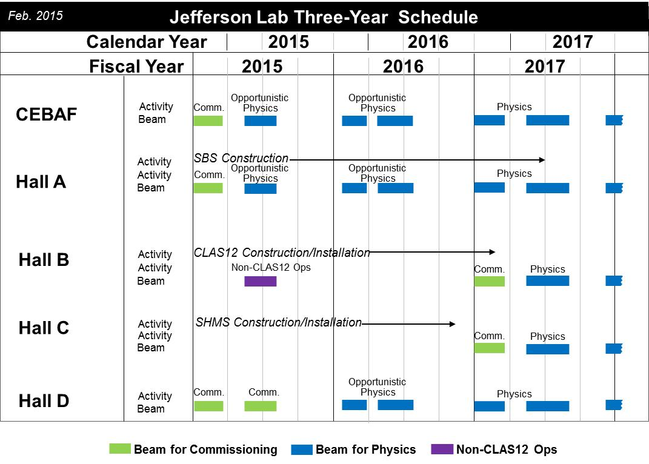

Slide 11
Schedule
Beam restoration now Nov. 9
Commissioning only in 2015
New schedule to be issued in early November
CLAS12 construction has priority in Hall B.
Hope to run HPS in Feb.
Perhaps PRAD later in April-May

Slide 12
NSAC 2015 LRP
RECOMMENDATION I
The progress achieved under the guidance of the 2007 Long Range Plan has reinforced U.S. world leadership in nuclear science. The highest priority in this 2015 Plan is to capitalize on the investments made.
With the imminent completion of the CEBAF 12-GeV Upgrade, its forefront program of using electrons to unfold the quark and gluon structure of hadrons and nuclei and to probe the Standard Model must be realized.
Expeditiously completing the Facility for Rare Isotope Beams (FRIB) construction is essential. Initiating its scientific program will revolutionize our understanding of nuclei and their role in the cosmos.
The targeted program of fundamental symmetries and neutrino research that opens new doors to physics beyond the Standard Model must be sustained.
The upgraded RHIC facility provides unique capabilities that must be utilized to explore the properties and phases of quark and gluon matter in the high temperatures of the early universe and to explore the spin structure of the proton.

Slide 13
NSAC 2015 LRP
RECOMMENDATION II
The excess of matter over antimatter in the universe is one of the most compelling mysteries in all of science. The observation of neutrinoless double beta decay in nuclei would immediately demonstrate that neutrinos are their own antiparticles and would have profound implications for our understanding of the matter-antimatter mystery.
We recommend the timely development and deployment of a U.S.-led ton-scale neutrinoless double beta decay experiment.

Slide 14
NSAC 2015 LRP
RECOMMENDATION III
Gluons, the carriers of the strong force, bind the quarks together inside nucleons and nuclei and generate nearly all of the visible mass in the universe. Despite their importance, fundamental questions remain about the role of gluons in nucleons and nuclei. These questions can only be answered with a powerful new electron ion collider (EIC), providing unprecedented precision and versatility. The realization of this instrument is enabled by recent advances in accelerator technology.
We recommend a high-energy high-luminosity polarized EIC as the highest priority for new facility construction following the completion of FRIB.

Slide 15
NSAC 2015 LRP
RECOMMENDATION IV
We recommend increasing investment in small-scale and mid-scale projects and initiatives that enable forefront research at universities and laboratories.

Slide 16
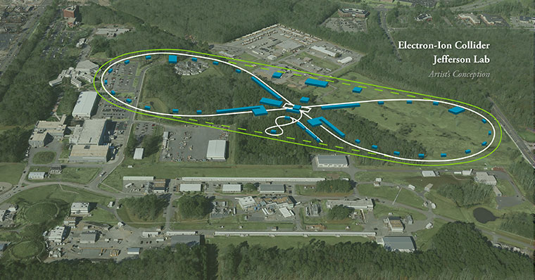
JLEIC: EIC at Jefferson Lab

Slide 17
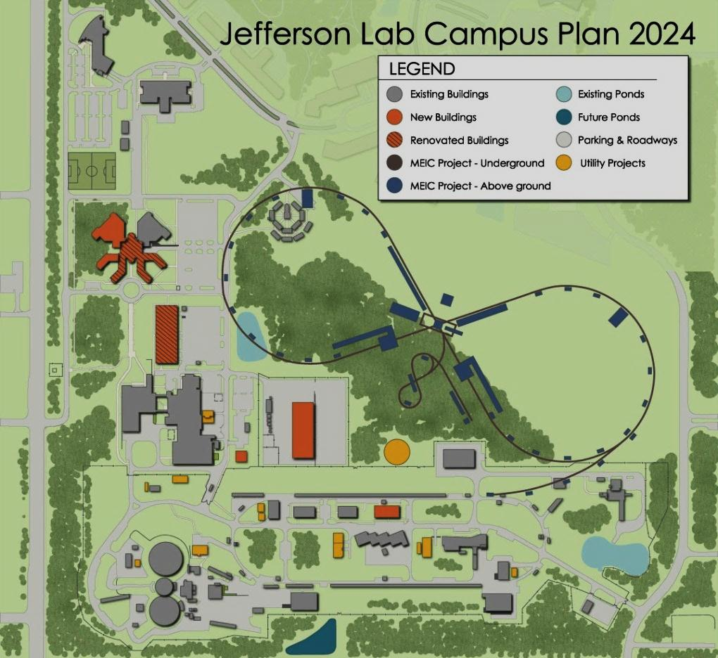
JLEIC: EIC at Jefferson Lab
JLab EIC Figure 8 Concept
Initial configuration:
  3-10 GeV on 20-100 GeV ep/eA collider
  Optimized for high ion beam polarization:
    polarized deuterons
  Luminosity:
    up to few x 10³⁴ e-nucleons cm⁻² s⁻¹
    Low technical risk
    Upgradable to higher energies
    250 GeV protons + 20 GeV electrons
    Flexible timeframe for Construction
    consistent w/running 12 GeV CEBAF
    Thorough cost estimate completed
    presented to NSAC EIC Review
    Cost effective operations
    Fulfills White Paper Requirements
Current Activities
Site evaluation (VA funds)
Accelerator, detector R&D
Design optimization
Cost reduction
Notes:
Deleted
Brightened graphic (no more shame); added current activities from previous version;
Mary Beth please format text

Slide 18


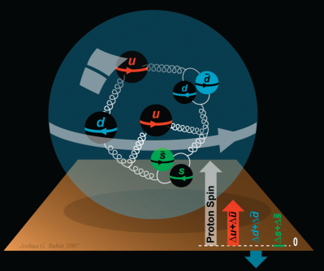
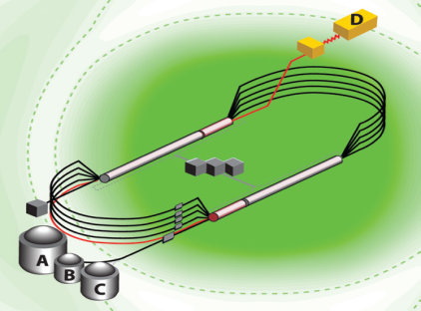
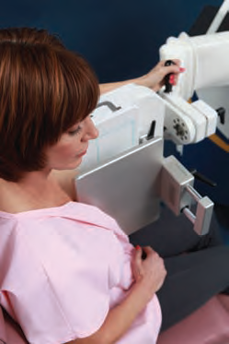
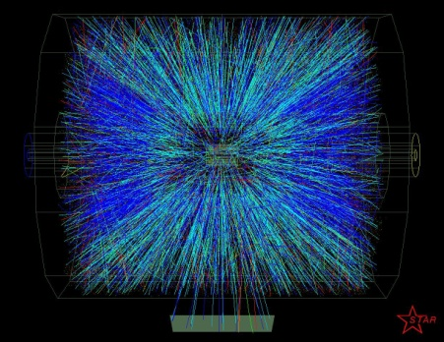


Summary and Outlook
12 GeV Upgrade making good progress – challenges remain
PAC process revised for parallel running
CR budget – we plan to run 16 weeks, but…
NSAC LRP released
- good for Jlab
- requires modest budget growth
- recommends future EIC construction

