Slide 1
Cathodes in CW Operation at the Cornell Photoinjector
Adam Bartnik
Cornell University

Slide 2
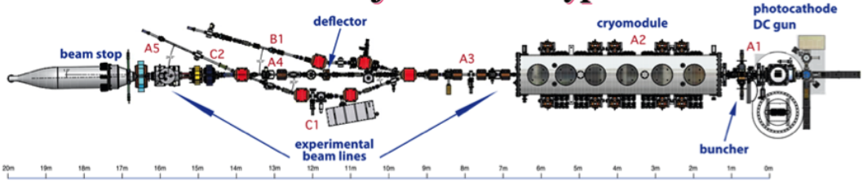
CU Injector Status
Since the last P3 Workshop…
Disassembled our injector
Sent SRF cryomodule across campus for maintenance
Made a gun-only beamline for high current reliability tests
Disassembled that beamline
Brought the cryomodule back
Rebuilt the full injector in a new location
Initial (re-)commissioning being completed as I speak (oops)

Slide 3
CU Injector Status
Since the last P3 Workshop…
Disassembled our injector
Sent SRF cryomodule across campus for maintenance
Made a gun-only beamline for high current reliability tests
Disassembled that beamline
Brought the cryomodule back
Rebuilt the full injector in a new location
Initial (re-)commissioning being completed as I speak (oops)
Used a cathode here… whew…

Slide 4

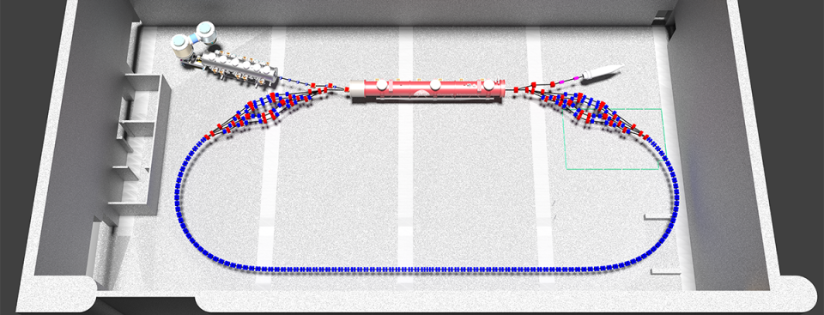
Why did we move?
CBETA target parameters (relevant here)
400 kV DC gun
40 mA gun current
125 pC @ 325 MHz
ε_{n} < 1 μm

Slide 5
Cathode Challenges
What challenges do cathodes have in our injector?
Challenge | Comment | Status
Lifetime ∼10,000 C | 40 mA for 3 days
QE > 1% | 40 mA @ 1% QE = 10 W of laser power
Cathode emit. < 0.5 μm/mm | MTE < 150 meV, ε_{cath} @ 125 pC < 0.25 μm
Localized, offset active area | Roughly = laser size, reduces halo
QE spatially flat
Response time < 1 ps | Long tails will be lost in RF
And how well are we doing towards solving these challenges?…

Slide 6
Cathode Challenges
Challenge | Comment | Status
Lifetime ∼10,000 C | 40 mA for 3 days | Solved
QE > 1% | 40 mA @ 1% QE = 10 W of laser power | Solved
Cathode emit. < 0.5 μm/mm | MTE < 150 meV, ε_{cath} @ 125 pC < 0.25 μm | Solved
Localized, offset active area | Roughly = laser size, reduces halo | Solved
QE spatially flat |  | Solved
Response time < 1 ps | Long tails will be lost in RF | Solved
They’re done!
(Unless you actually want to use the cathode…)
The biggest remaining challenge for high current machines is not ruining the cathode that is given to us.

Slide 7
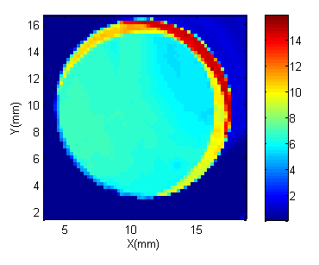
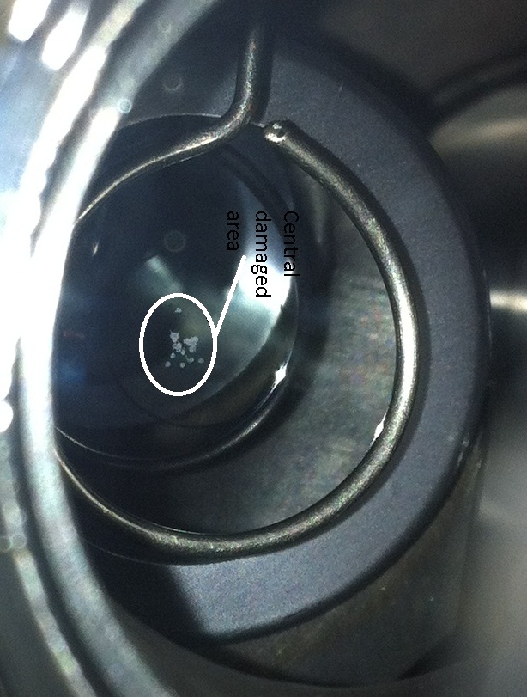
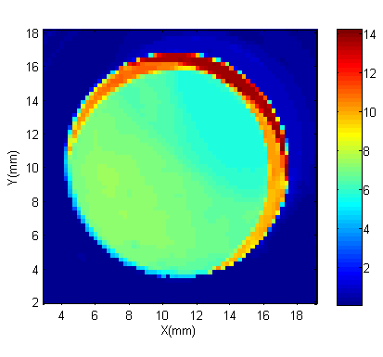
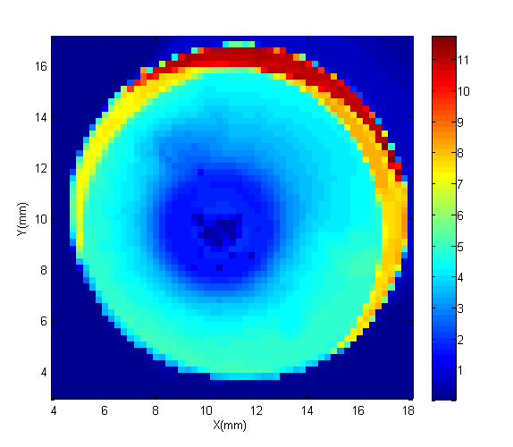
How do you ruin a cathode?
New cathode
Central damaged area
2 hours,
No trips
2 hours,
Many trips

Slide 8
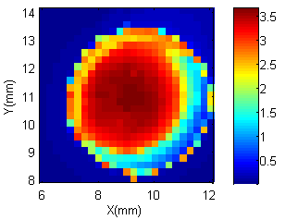
Offset Na₂KSb over 2 days
What about an offset cathode?
3 mm active area

Slide 9
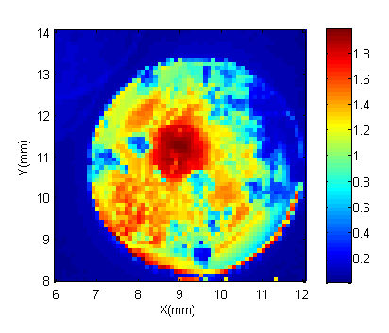
Offset Na₂KSb over 2 days
After extracting 4500 C… barely usable?
But this wasn’t exactly ideal operation…

Slide 10
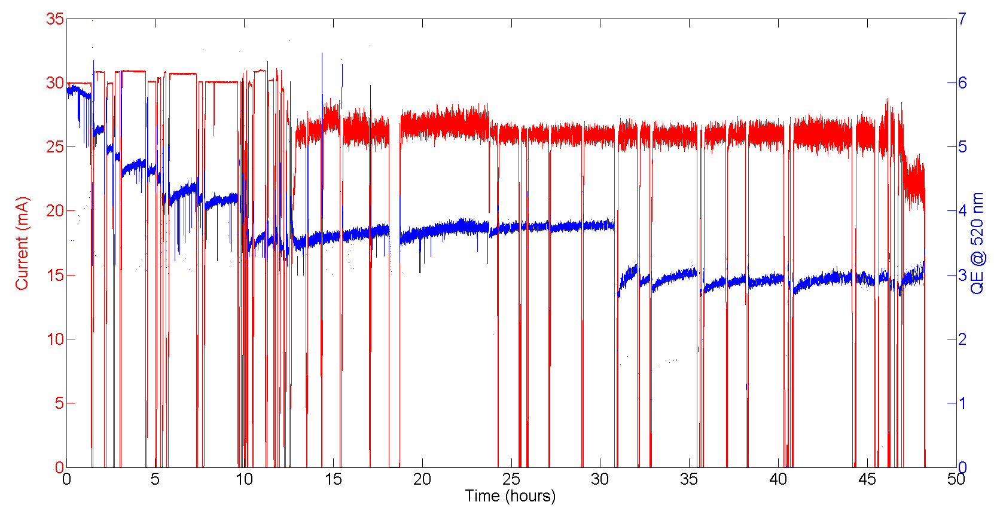
Offset Na₂KSb over 2 days
The cathode experienced many machine trips, roughly 1-2/hour
Most were SRF Cavity “coupler arc”

Slide 11
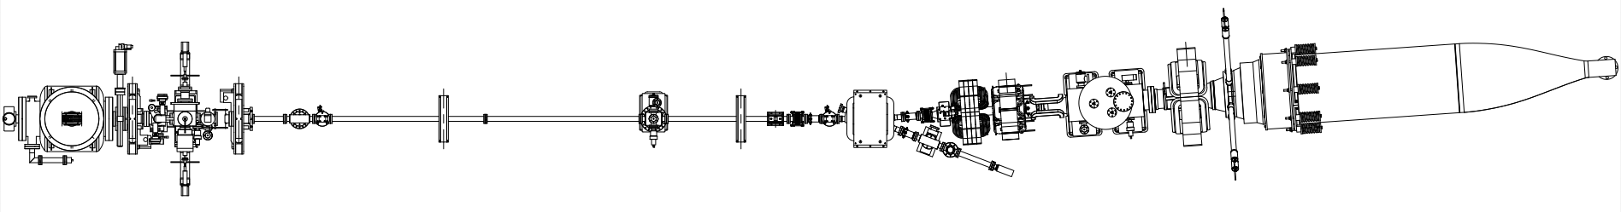
Gun Test Beamline
During maintenance on our SRF booster linac, we constructed a “gun test” beamline.
350 kV
1.3 GHz @ 15 pC = 20 mA
Expectation: No SRF = No trips
Transport, solenoids
Beam Stop
Gun
10 meters

Slide 12
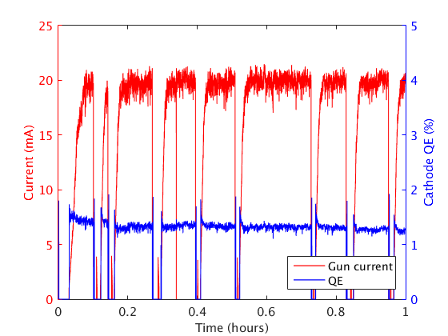
Gun Test Beamline
Surprise! The machine tripped 10x more often with only the gun.
Upon further inspection, an error was discovered in our previous reasoning– it was possibly always the gun.

Slide 13
Gun Test Beamline
When confused, take a lot of data…
Trip rate fits well to an exponential probability distribution (i.e. random, no memory)
No significant gun voltage dependence (?)
Strong beam current dependence (∼I^{2.5})
None of this made any sense…
If still confused, hope for a lucky accident…
Trip rate, current & voltage dependence
Voltage (kV) | Current (mA) | λ (95% confidence) (minutes)
250 | 10 | 38 (17-140)
250 | 20 | 6.4 (3.1-20)
350 | 10 | 23 (15-39)
350 | 20 | 3.5 (2.0-7.3)

Slide 14
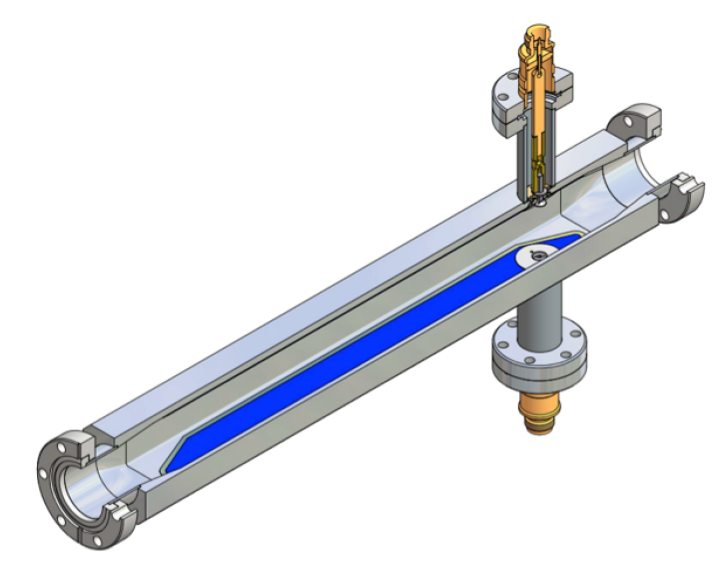
Gun Test Beamline
Luckily, we had an ion clearing experiment planned
With the clearing electrode turned on to ∼100 V, the trips disappeared
Evidently, our trips were due to back ion bombardment (charged dust?)
This explains why the trip rate was better with SRF– the fields act as a barrier to ions.
Ion Clearing Electrode
Transport, solenoids
Beam Stop
Gun
10 meters

Slide 15
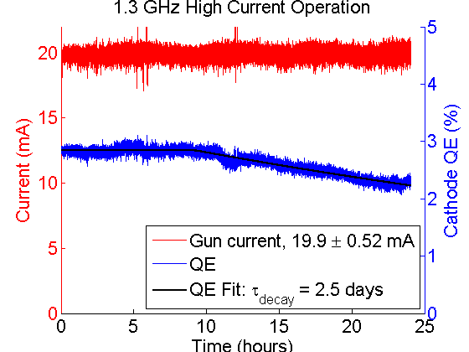
Gun Test Beamline
With ion clearing, 24 hours at 20 mA with no trips
Time (hours)

Slide 16
Final Thoughts
Cathode growth has matured to the point that meeting our specs is routine!
  High average current, moderate charge & emittance, ps response time
But, high current machines are a very hostile environment for the cathode
  Trips can be disastrous, and very hard to pinpoint the root cause
  Can anything be done about “bad trips” resulting in non-uniform QE?
Are there ways to better protect the cathode?
  Biased anode for ion/dust clearing
  Can the cathode itself be made more robust?

Slide 17
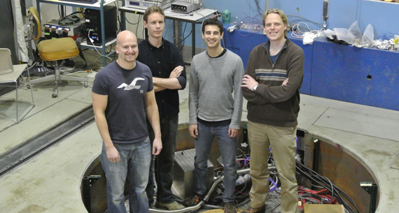
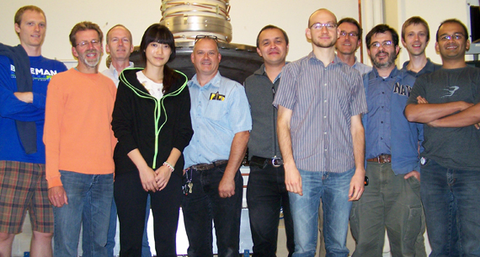
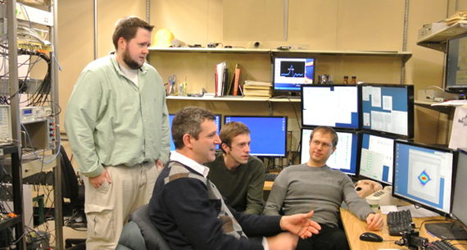
Acknowledgements
Thanks to all (past and present!) in the Cornell Photoinjector Group
And to the NSF, DOE, and NYSERDA for funding

