Slide 1
K₂CsSb photocathodes performance in SRF guns
Erdong Wang on behalf of ERL and CeC group
BNL

Slide 2
Outline
Gun introduction
Timeline of SRF gun tests in BNL
Cathode preparation and transferring
704 MHz gun commissioning
Cathode performance in the gun
112MHz gun commissioning
Cathode performance in the gun
Dark current and multipacting

Slide 3
Gun introduction

Slide 4
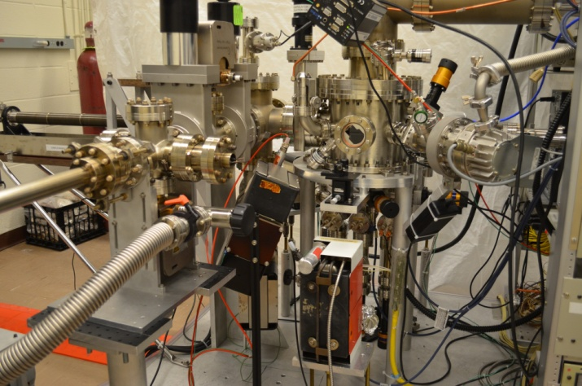
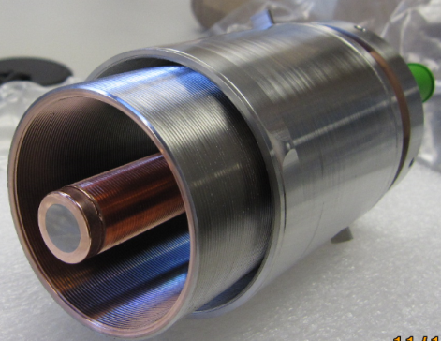
Multi-alkali photocathode preparation
7~10% QE K2CsSb cathode for 112 MHz gun.
4% QE cathode to the ERL gun. Tested one cathode before shut down.
Preparation system for 112MHz gun
Preparation system for 704MHz gun

Slide 5
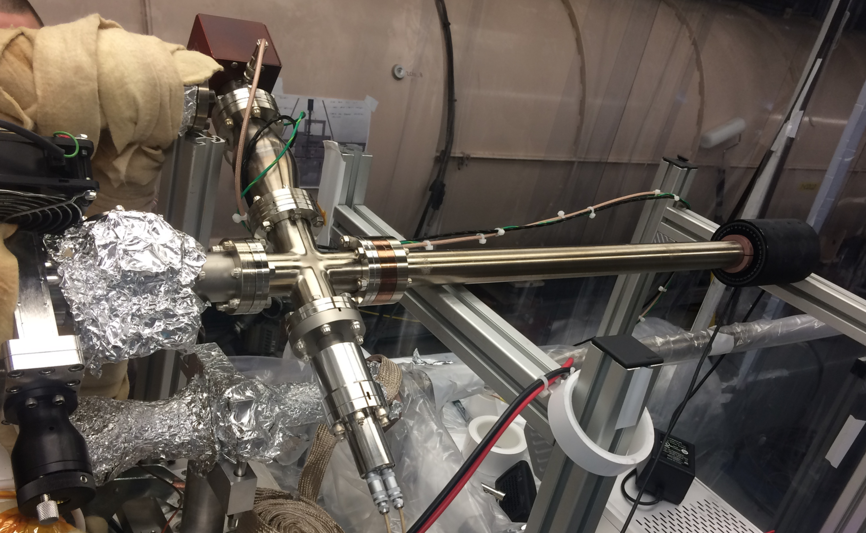
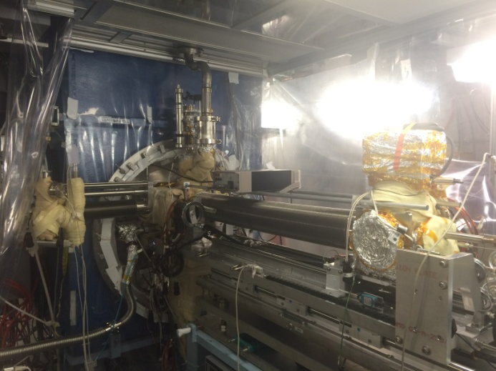
Cathode transfer chamber
The cathode is prepared in a dedicated cathode preparation system.
The cathode is moved into transport cart which has low-10⁻¹⁰ torr scale vacuum.
Disconnecting the transport cart from the preparation system and connecting the cart to the SRF gun require a class-100 clean enclosure.
The loadlock section is baked about 2 days and reach 10⁻⁹ torr scale Vacuum.
We keep monitoring the QE evolution inside the transport cart. We make sure that the cathode still has a good QE before moving it into the SRF gun.
112 MHz gun cathode transferring chamber
704 MHz gun cathode transferring cart

Slide 6
Photocathode transfer
112 MHz SRF gun
Cathode transfer
In garage, the QE dropped about 2% in transferring due to load-lock bake. Then the QE is almost stabilized with the lifetime more than months.
704 MHz SRF gun

Slide 7
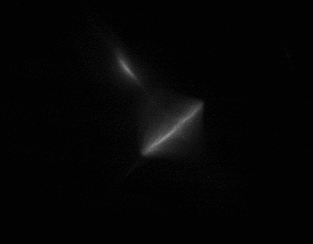
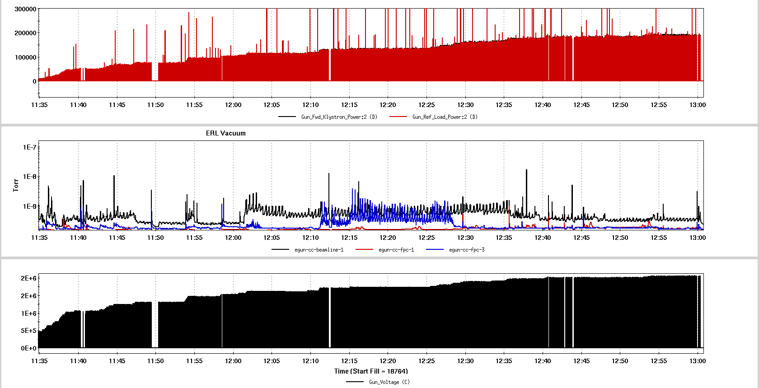
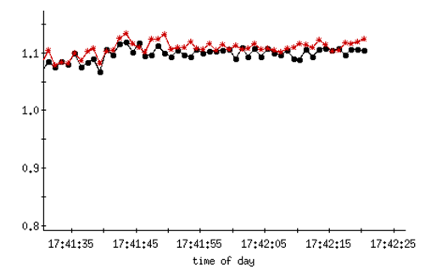
704MHz gun commission result
Dark current
Photo current
The QE of CsK₂Sb was 4.1% at initial prepared and 3.8% before inserting into the gun.
The gun was then conditioned and sent beam to a Faraday cup. Pulsed operations yielded bunches with up to 0.55nC per-bunch.
The gun was operated in pulsed mode at 0.85MV kinetic energy. The ICT and Faraday cup measurements confirmed QE=1% at low current.
After running for a couple of days including condition and high bunch charge test, there was no observed degradation of the QE.
Dark current is 6nA @ 3ms pulse due to the cathode.
550pC bunch charge

Slide 8
Cathode QE evolution in 704 MHz gun
3 months QE decay
QE measured in transport cart
The cathode QE inside gun is smaller than in room temperature due to work function change from room temperature to 77K!

Slide 9
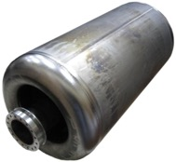
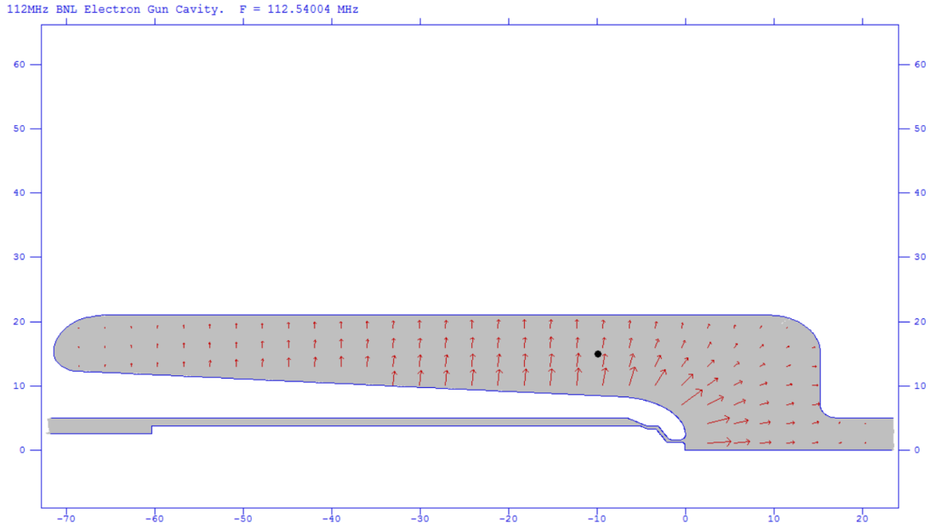
112 MHz SRF QWR Cavity
Parameter | Value
Frequency | 112.54 MHz
Gap voltage | 2 MV
Q₀ | 1.3e9
Cathode surface field | 26 MV/m
Cathode | K₂CsSb
Bunch length | 0.1~1ns
Bunch charge | 1-5nC
Normalized emittance | <5mm-mrad
Temperature | 4 K
SRF Quarter wave resonator advantages:
4K operation: Simple cryogenic system; low cost
High gradient: Small emittance; High bunch charge
Long bunch: reduce the space charge; generate high bunch charge
Constant field: small energy spread
Good vacuum: long lifetime

Slide 10
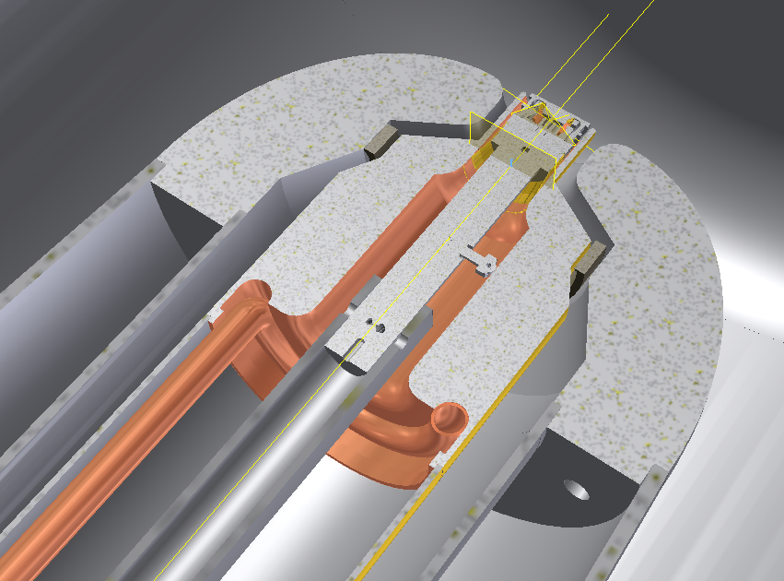
Cathode insertion
Photocathode end assembly

Slide 11
112MHz gun RF Commissioning
Vacuum condition and Helium processing
Gun voltage:
2 MV in pulse mode
1.3 MV CW with K₂CsSb cathode

Slide 12
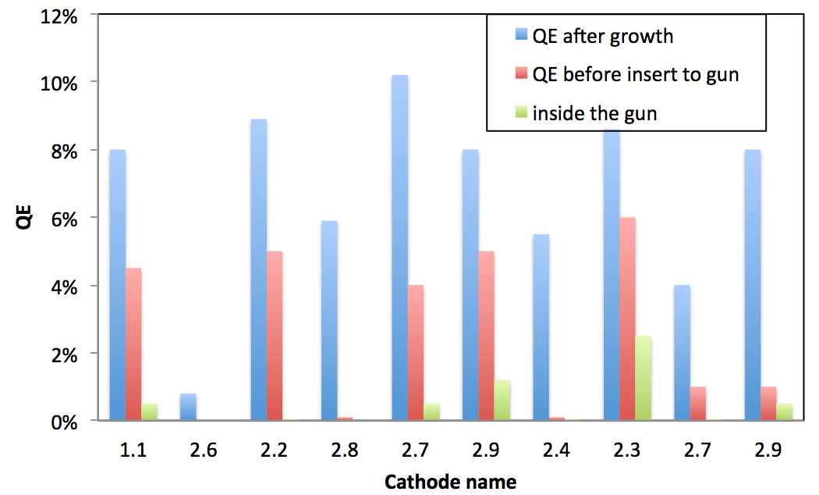
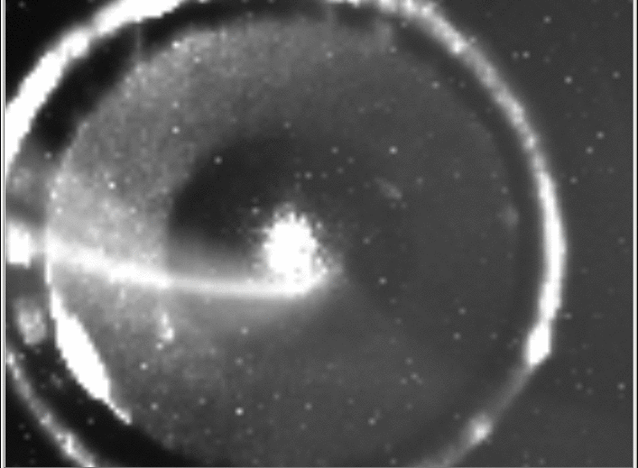
Insert cathode into gun
Laser on the cathode
Totally ten cathodes delivered in to 112 MHz gun from 2015 to 2016.
There were seven cathodes survived in cathode transferring from preparation chamber to RHIC tunnel and keeping in storage chamber for a week.
There are three cathodes loss the photoemission due to pumping power outage or garage misassembled.
Beam spot on YAG

Slide 13
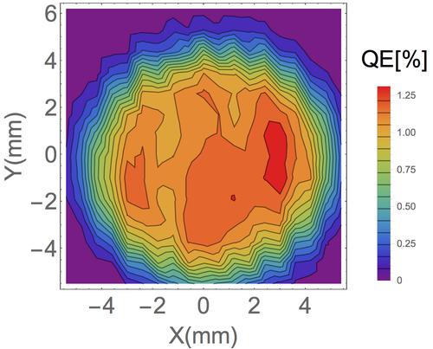
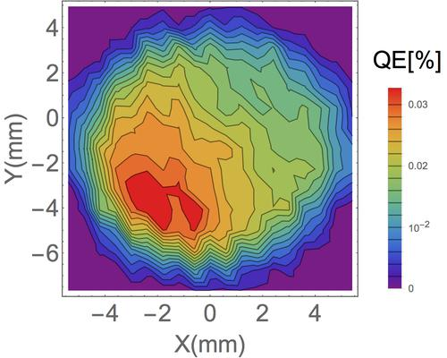
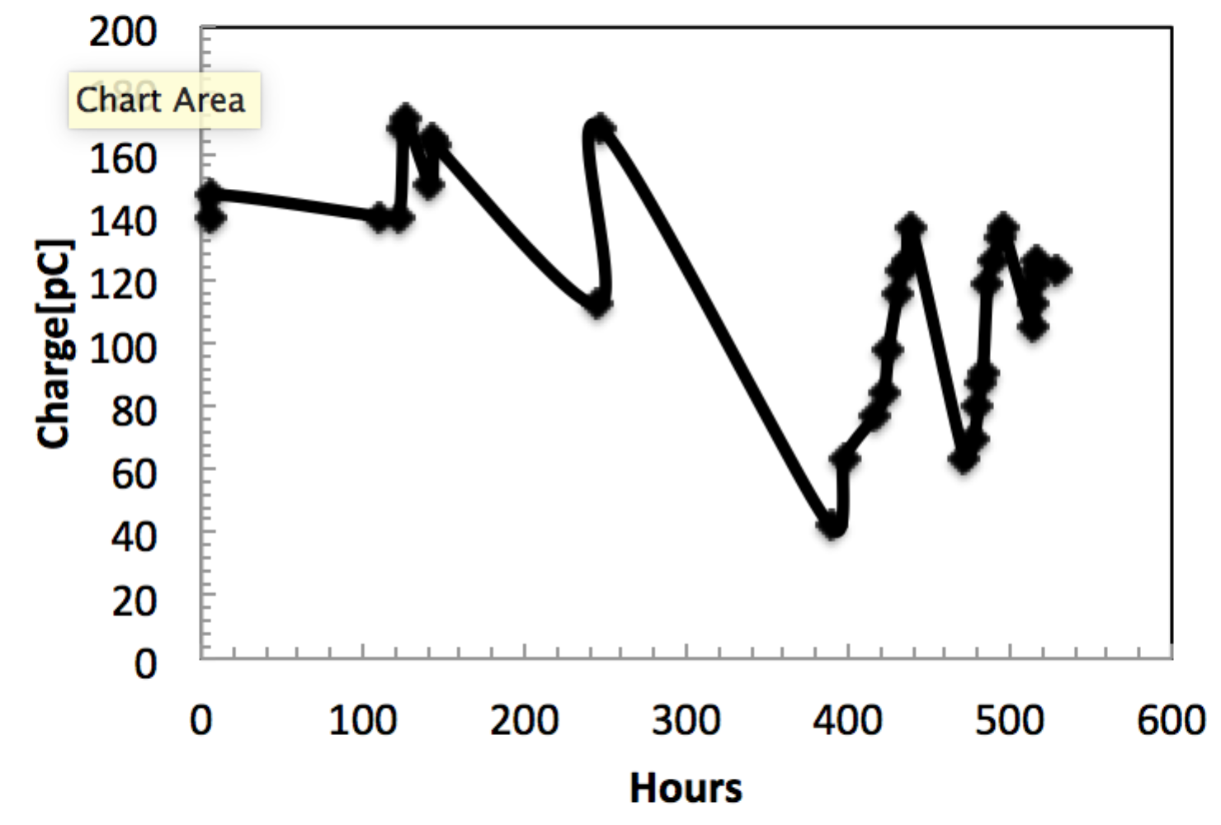
Cathode performance in the gun
Multipacting is the main reason that degrades the high QE cathode. Fine tune the RF start procedure could avoid QE degrade.
Cover all the view-ports on the gun to make sure no ambient light could leak into the gun.
Move the main coupler to strong coupling position and off set the center frequency to break the multipacting resonance.
Use pulse mode to boost gun voltage to desired range.
Multipacting happen

Slide 14
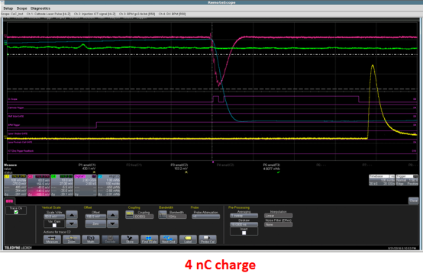
Start the gun with cathode
With Multi-alkali cathode, the gun has strong multipacting in boosting power.
The gun could operate with a gap voltage in the range of 0.8 MV to 1.3 MV.
In stable operation, cathode preserved 1.2% QE without decay. However, it is very sensitive to vacuum spikes. the QE will significantly degrade orders of magnitude.
Maximum 3.7 nC bunch generated from gun
Aftermultipacting, QE will recover in gun operation.

Slide 15
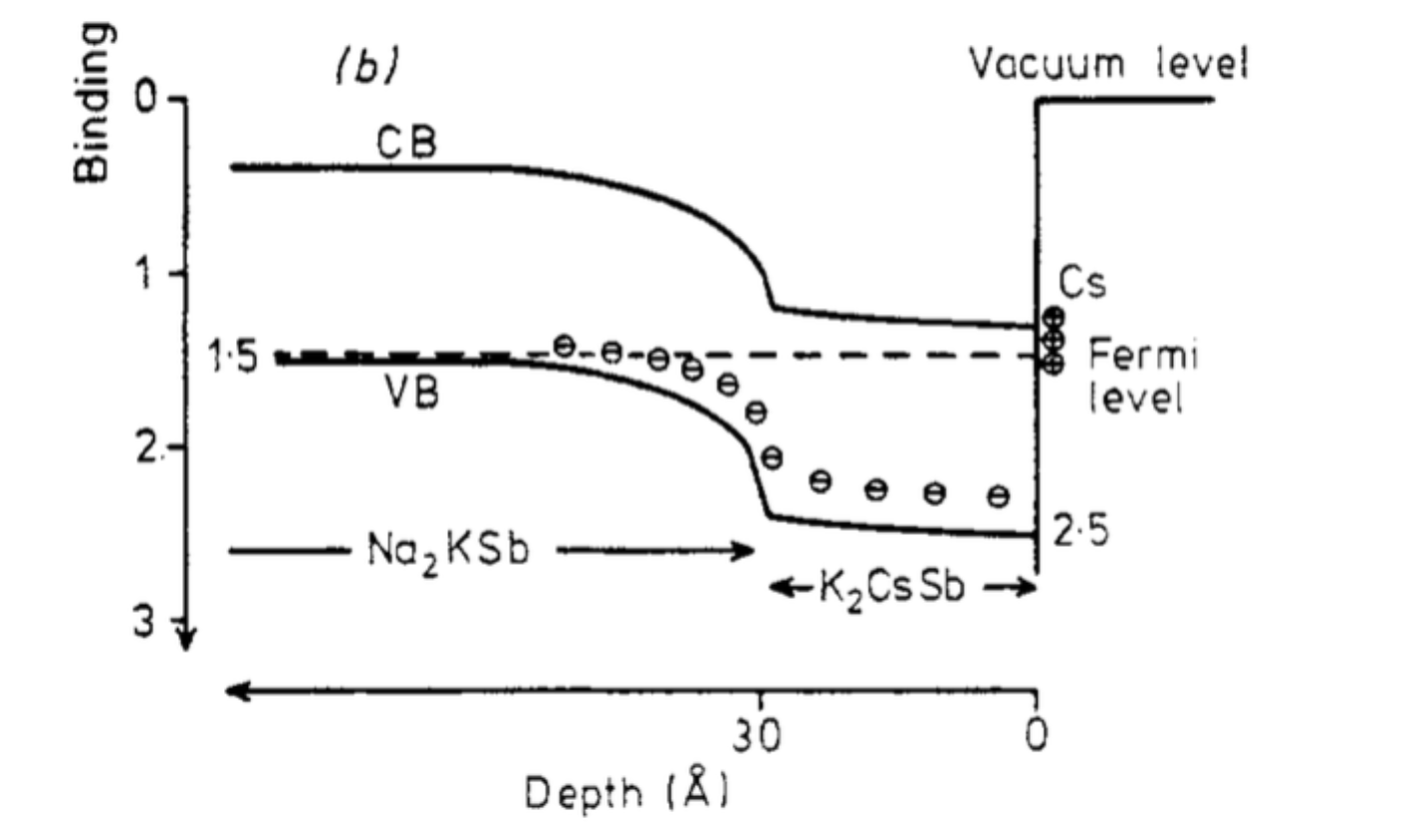
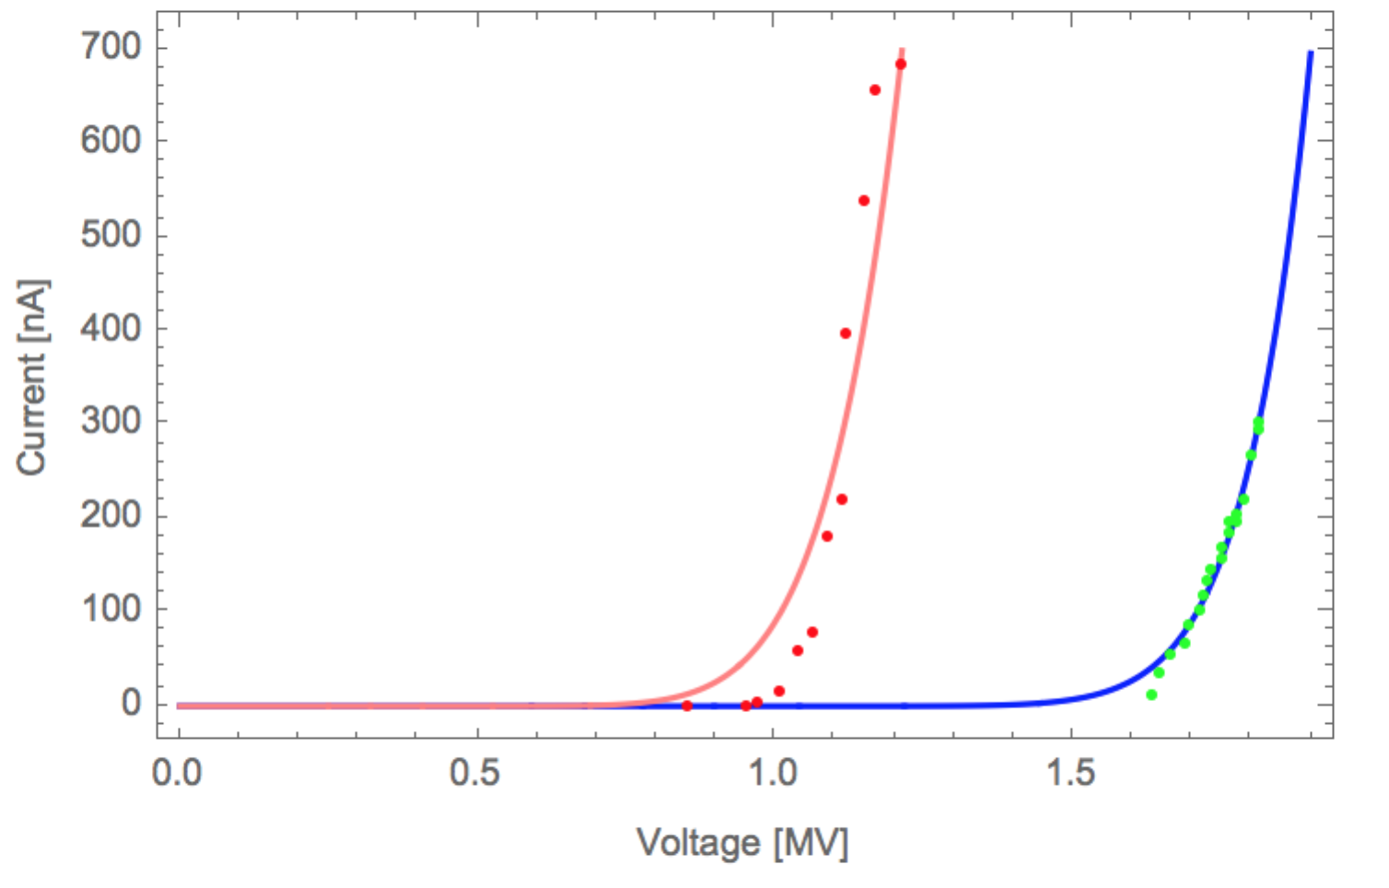
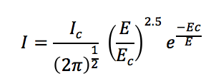
Dark current
In CW operation, we observed dark current in both coated cathode and no cathode cases. with the cathode in the gun, dark current is more than 100nA when voltage is above 1.1 MV.
One solution for eliminating the dark current is choose S20 cathode, which has higher work function.
With cathode
Without cathode
Ionization energy significantly increased in S20 case.
Fit by:

Slide 16
Summary
We are capable to provide high quality K₂CsSb photocathodes and transfer them into SRF gun.
The 704MHz SRF gun generated high bunch charge from K₂CsSb cathode. In two days operation, no QE decay was observed. We observed the Schottky effect by scanning the RF phase.
The 112MHz SRF gun beam tests were carried out in 2015 and 2016. 3.7nC bunch charge generated from the gun.
Multipacting is the main reason that degrades the high QE cathode. In stable operation, cathode preserved 1.2% QE without decay.
The way to eliminate the multipacting and dark current is under study.

Slide 17
Thanks for you attention!

Slide 18
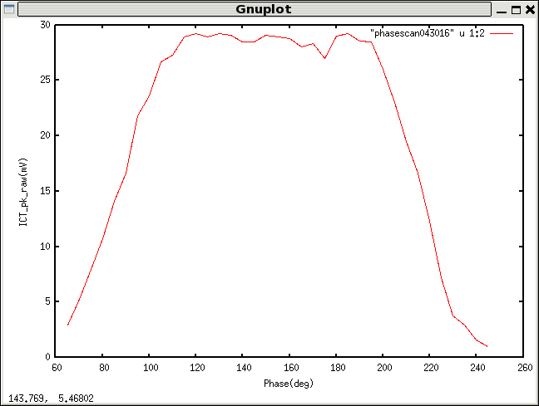
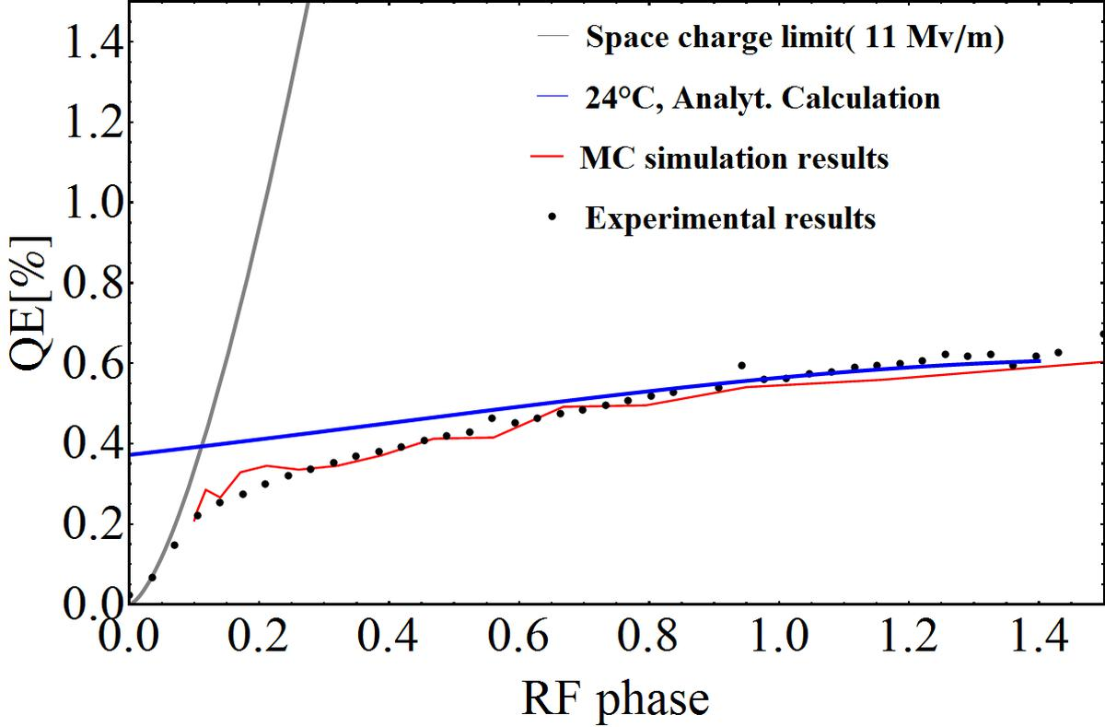
Schottky effect
In 704 MHz gun, we observed the Schottky effect.
In 112MHz gun, we didn’t.
Schottky effect compensates the QE decay due to cryogenic temperature induced work function increase.

Slide 19
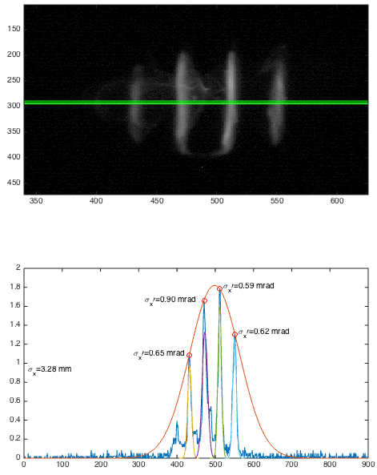
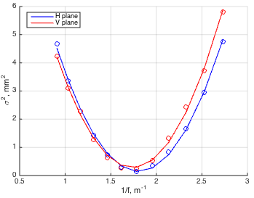
Emittance measurement
300pC, 500ps
beam emittance:
X=1.3 mm mrad
Y=1.9 mm mrad

