Slide 1
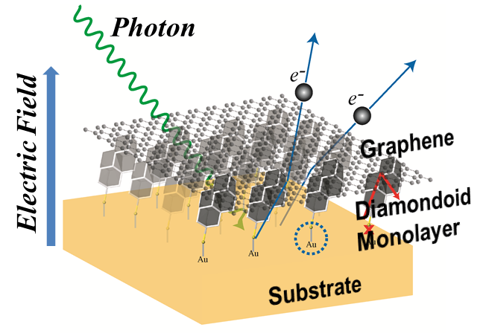
Graphene Protected Diamondoid Photocathodes
Diamondoids: Molecular-size diamond particles, surface coating via ALD
Zhi-Xun Shen Group at Stanford
W. L. Yang et al. Monochromatic electron photoemission from diamondoid monolayers. Science 316, 1460 (2007)
W. A. Clay et al. The origin of monochromatic photoemission peak in diamondod monolayer. Nano Lett. 9, 56 (2009)
H. Ishiwata et al. Diamondoid coating enables disruptive approach for chemical and magnetic imaging with 10 nm spatial resolution. Appl. Phys. Lett. 101, 163101 (2012)
P. R. Schreiner et al. Overcoming lability of extremely long alkane carbon-carbon bonds through dispersion forces. Nature 477, 308 (2011)
Goals:
Engineered work function
Generate monochromatic beam using direct photoemission from diamondoid monolayer
Air stable diamondoids, operationally stable graphene protective coating
Technical challenges:
Weak anchoring can lead to dissociation in operation -> graphene coating
Improving uniformity of hot-spot dominated emission
Effect on emittance needs to be considered
Not sure but maybe: ~100 nm vertical roughness over ~100 nm horizontal spacing?

Slide 2
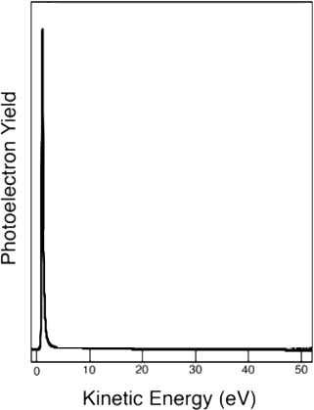
Graphene Protected Diamondoid Photocathodes
negative electron affinity (NEA)
+ strong e-ph coupling + high transmittance of photons and electrons
-> give rise to monochromatic photoemission without energy filtering
Photo-excitation
1
70% electrons within the NEA peak!
2
Relaxation by e-ph scattering
Energy
NEA level
E_{vac}
3
Spontaneous emission
hv
e
e
Substrate
Diamondoid monolayer
Vacuum
Question: 30% is in a very long high energy tail?

Slide 3
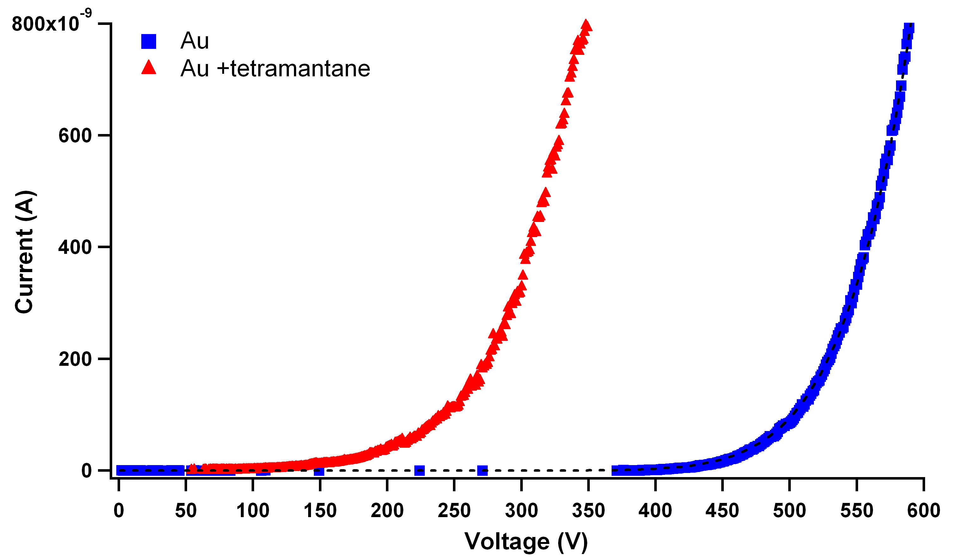
Graphene Protected Diamondoid Photocathodes
Bare Au
3 eV WF reduction
Au + diamondoid monolayer
Monolayer diamondoid coating reduces the WF of Au by 3 eV
Size / species of diamondoid may change WF shift
Effect is comparable to Cs on Au yet air stable
Effect is believed to derive from the creation of a surface dipole

