Slide 1
HTCC
CLAS12 software workshop
N. Markov, W. Phelps, A. Pucket, Y. Sharabian
2/21/16

Slide 2
Outline
Simulation status
Reconstruction status
Calibration development
Monitoring software
Trigger studies
Future plans

Slide 3
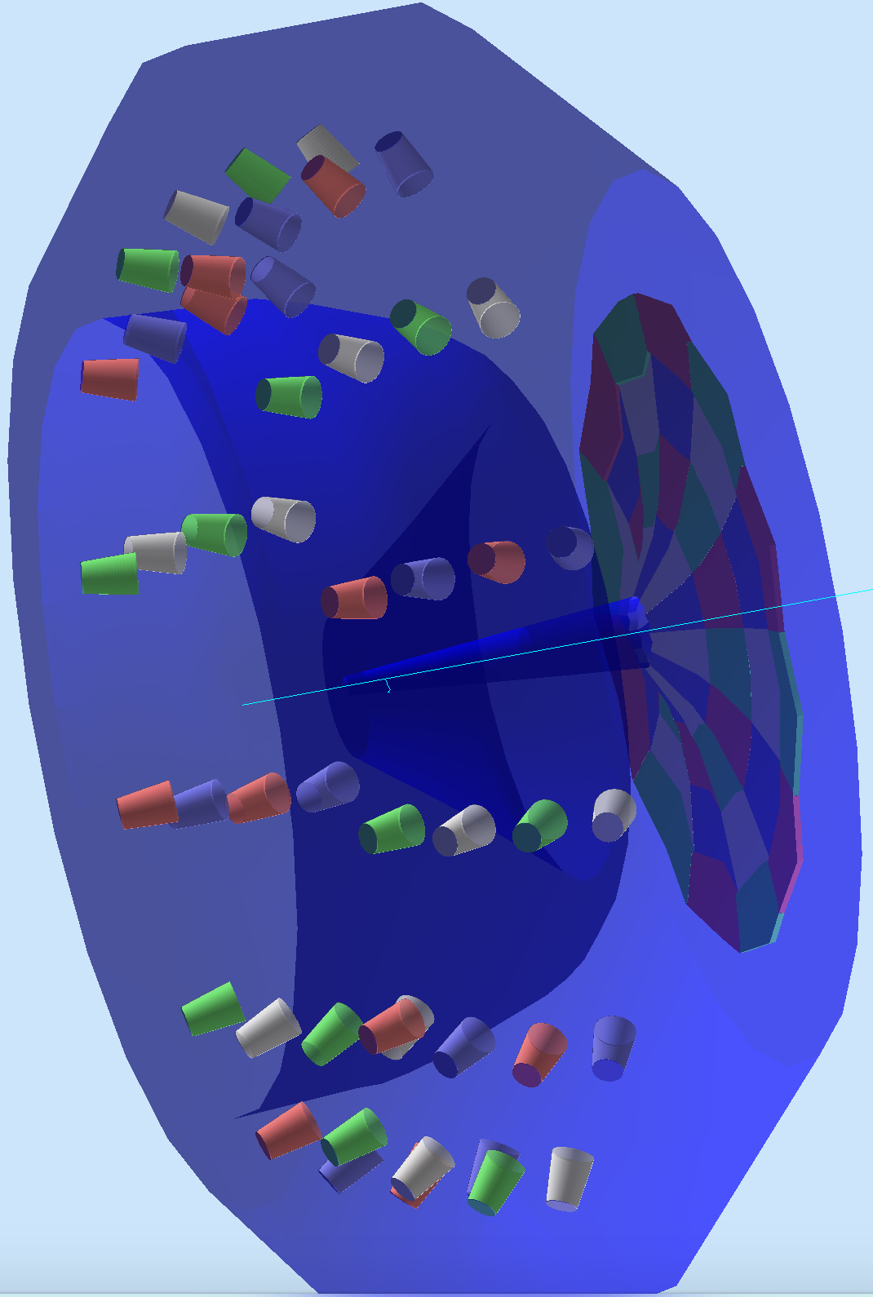
Simulation
PMTs
Mirror
Detector:
Angular coverage:
θ=5º −35º,
φ=0º −360º
gemc:
Realistic Mirror and Winston cone reflectance
Realistic Quantum Efficiency of the PMT with Quartz Entry Window
Realistic C0₂ gas transparency
Realistic C0₂ gas refraction index
Beam

Slide 4
Simulation
12 halfsectors over φ (15º each)
4 rings over θ (7.5º each),
Total of 48 mirror segments monitored by 48 PMTs
Ring 4
Ring 3
Ring 2
S
e
c
t
o
r
Ring 1
Halfsector
Halfsector

Slide 5
Simulation
R1
R2
R3
R4
NPE
11 GeV electrons uniformly distributed over θand φ
Number of photoelectrons increases with theta since the path of the electron in the C0₂ increases and so does intensity of the Cerenkov radiation
Lower number of photoelectrons at the theta of 5, 12.5, 20, 27.5 and 35 is due to the fact that Cerenkov radiation cone splits between two mirrors of different rings or goes out of the mirrors at all (θ~5, θ~35)
Lower number of photoelectrons between the sectors at φ ~ -150, -120, -90 etc. is due to the fact that Cerenkov radiation cone splits between two mirrors of different half sectors
NPE

Slide 6
Reconstruction: clusters
~ 1.5 Mirrors in event
To PMT 1
To PMT 2
Cerenkov radiation from single electron splits between two mirrors and is collected by different PMTs
1 Hit
2 Hits
3 Hits
4 Hits
φ
φ
φ
φ
θ
θ
θ
θ

Slide 7
Reconstruction: clusters
φ₁
φ₂
5. Hit in 4 different mirrors
θ₁
θ₂
Cluster is reconstructed between four mirrors.
θ gen
θ generated
φ cluster
θ cluster
θ cluster

Slide 8
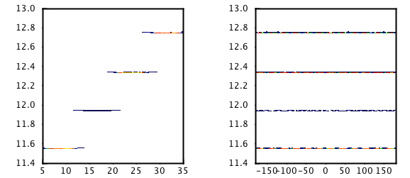
Reconstruction: clusters, timing
T, ns
T 4
T, ns
T 4
Time is fixed within a given ring
Every T_{i} corresponds to mirror number i
T 3
T 3
T 2
T 2
T 1
T 1
θ
φ
L2, T2
Ring 2
Ring 1
PMT
L1, T1
PMT
L2, T2
L1, T1
target
target

Slide 9
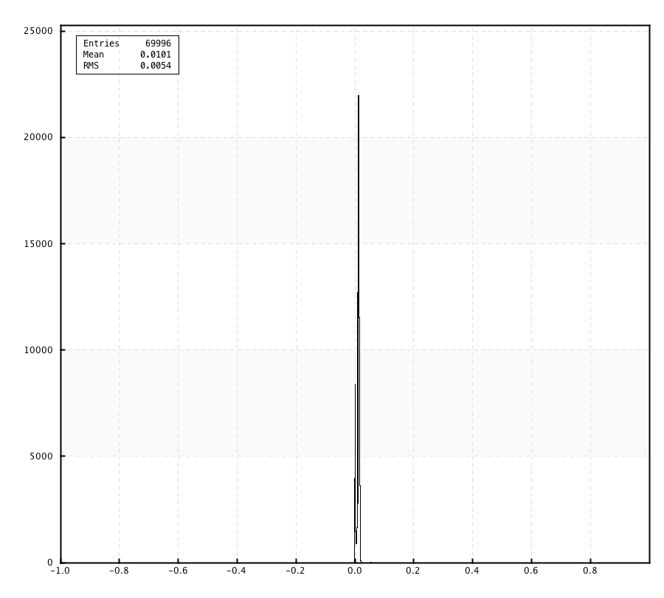
Time of the cluster
T_{i} measured time of the hit i in the cluster
T_{gi} is calculated from detector geometry
T_{c}, ns
Cluster time

Slide 10
Calibration
HTCC is part of the trigger – gain equalization is extremely important
Establish Calibration Curve: Gain (HV) for every channel
Choose certain gain for all channels
Using Calibration Curve set the HV for each channel
Check individual gains
Adjust HV if needed

Slide 11
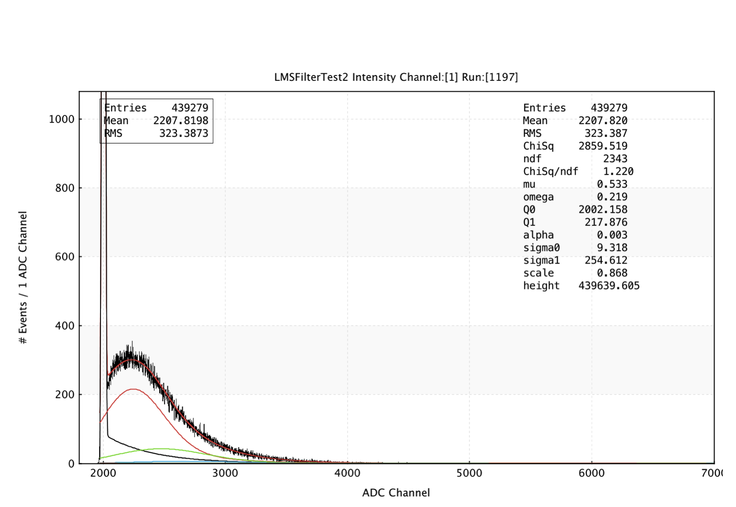
Calibration software
Fit to PMT response to find a position of
single photoelectron peak: signal + noise
Fit stability
SPE Peak
Calibration curve
Updated EVIO reader and fitting in Java:
Multithreaded
Optimized code
~ 2 minutes per fit on a single core

Slide 12
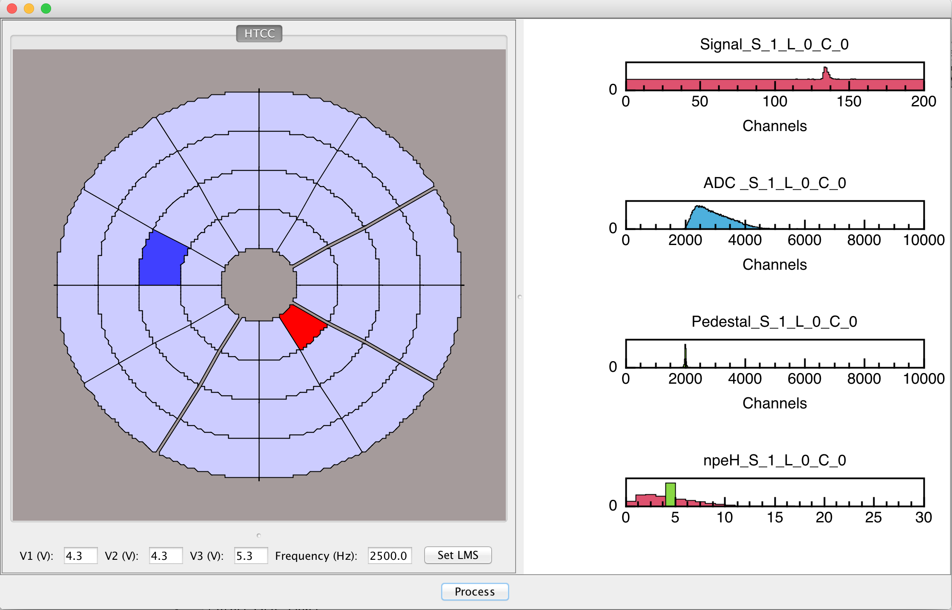
Monitoring
Signal shape in time
Active channel
Select channel
ADC spectrum, signal
ADC spectrum, pedestal
Npe within a given ring
Detector schematics
Based on common tools
Integration with ccdb
Implemented translational table
LMS control

Slide 13
Trigger studies
Correlation between HTCC and EC
U plane
V plane
W plane
HTCC ring
EC Strip
EC strip
EC Strip
Clear geometrical matching between HTCC and EC
No need to sum over full sector
Possibility to decrease noise

Slide 14
Future plans
Implement a measured mirror and WC reflectance (under way)
Implement signal digitization in gemc (under way)
Introduce reconstruction with a quasi-real signal
Finish development of calibration suite and obtain calibration curves for all 48 PMTs
Finish development of monitoring software
Continue trigger development

