Slide 1
CLAS12 Beamline Configurations
R. DeVita M. Ungaro

Slide 2
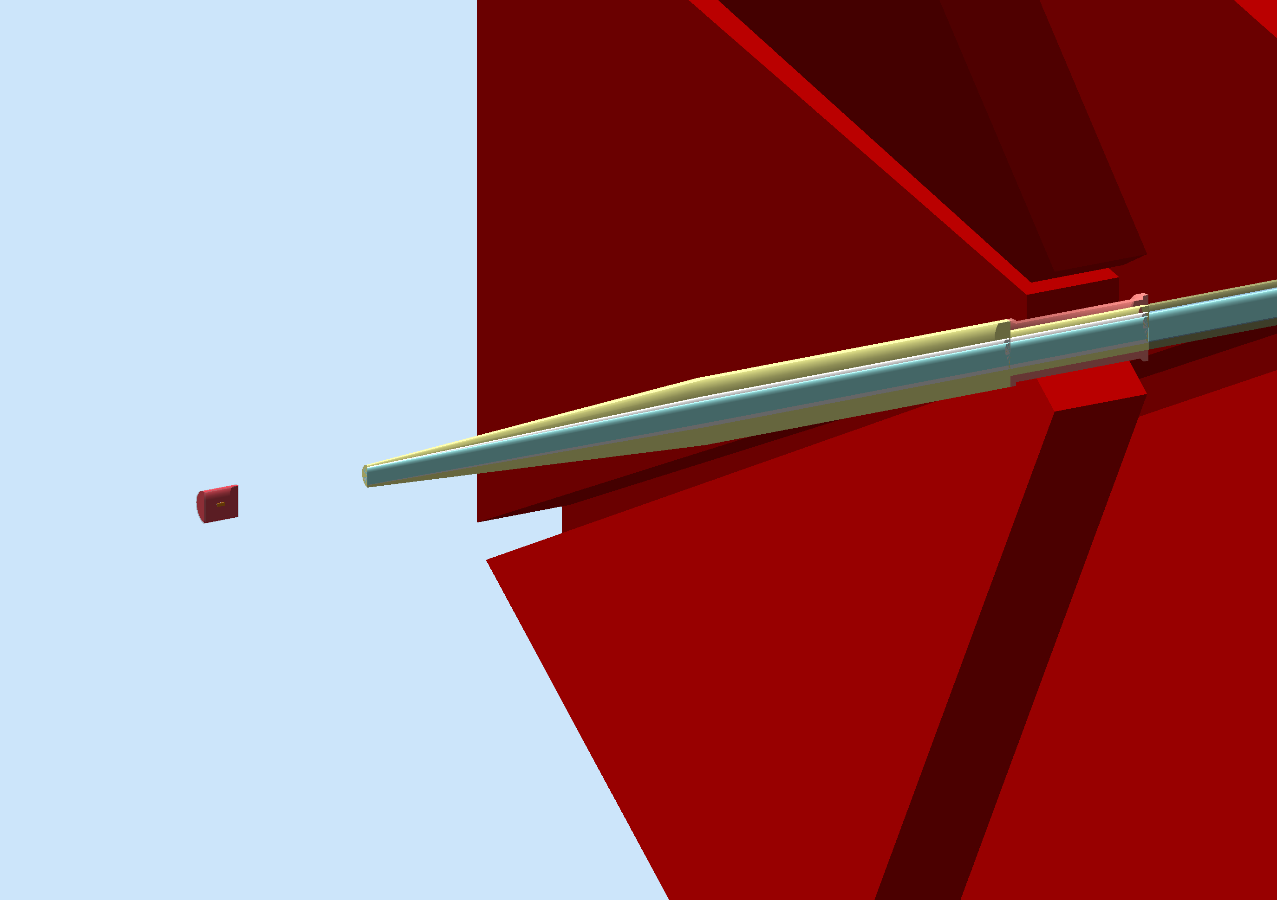
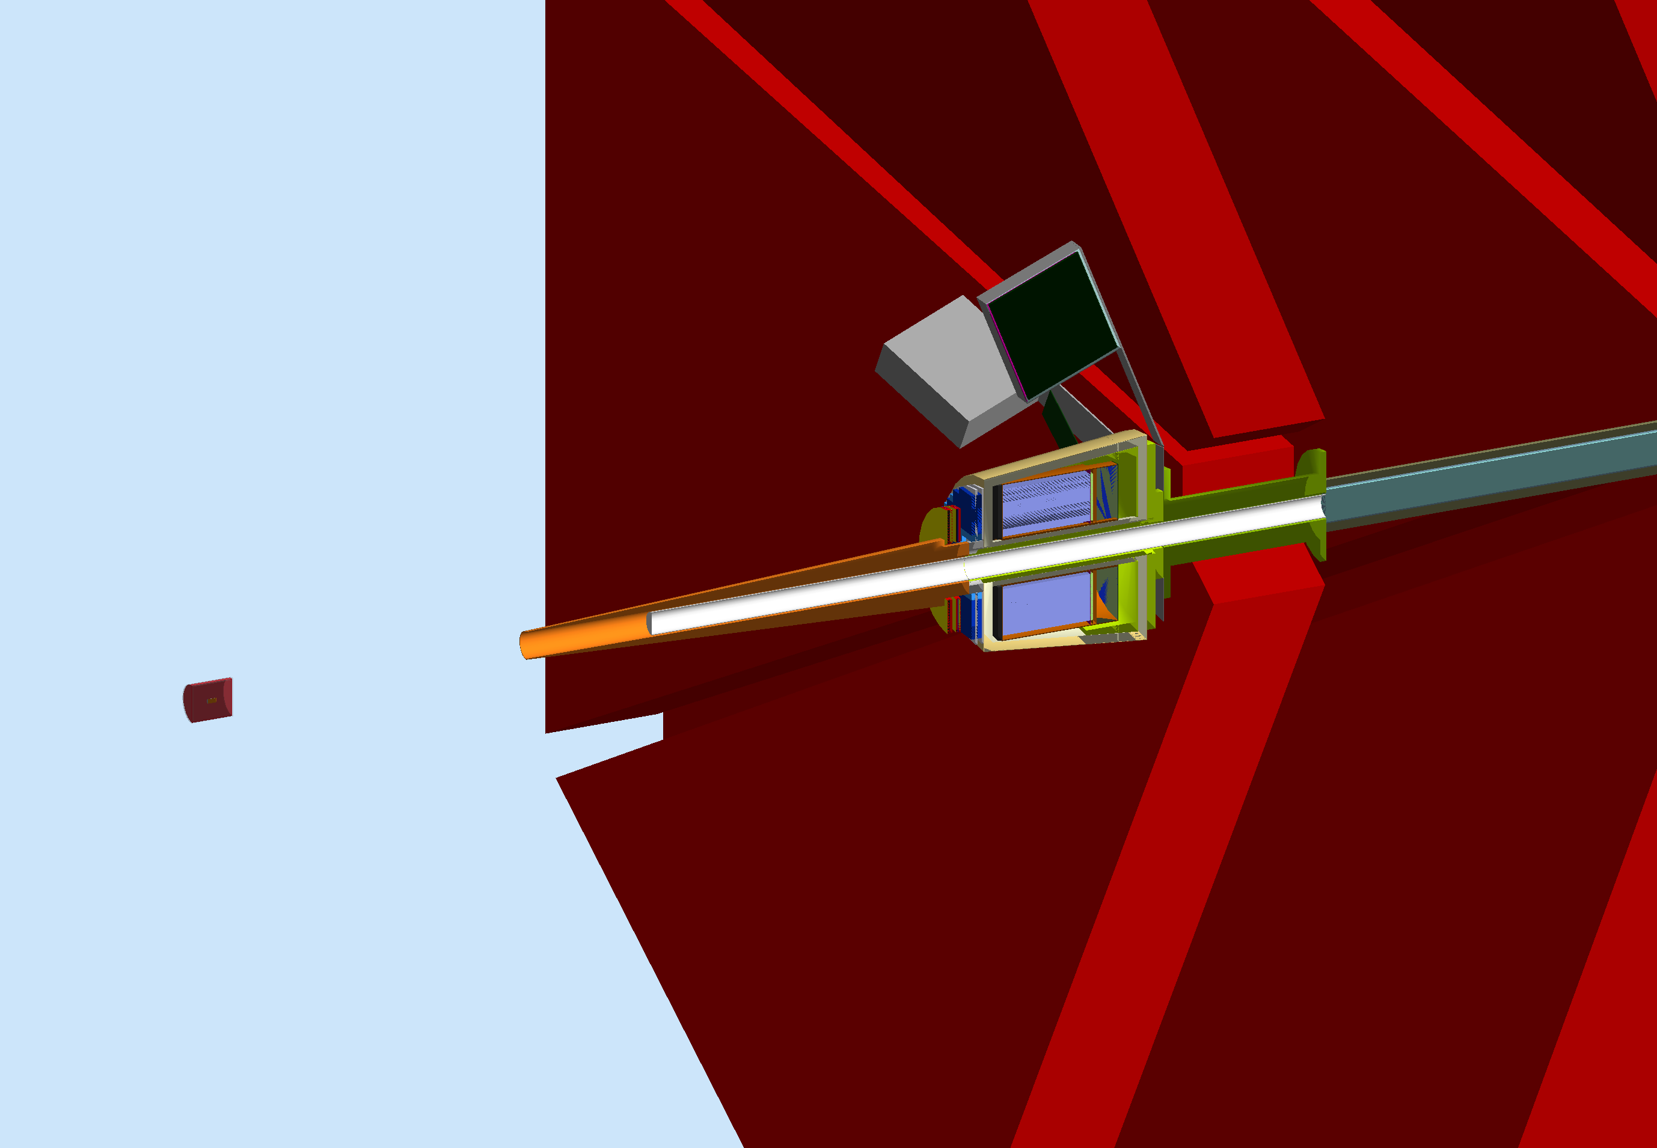
Starting from…
Shield starts at z ~ 420mm
Shield starts at z ~ 750mm
W/O FT Configuration
~0.8% occupancy in R3
With FT Configuration
~3% occupancy in R1
Notes:
This was the starting point after 2-3 years of studying background and adding shields. General description of left and right pics.
The shield is shaped as a truncated cone, pointing to to the CLAS12 center
The shield is made of a single material, i.e. tungsten
The shape and positioning of the shield was based on accurate studies of the beam sausage, details in the next two slides.
W: alloy of W and Fe

Slide 3
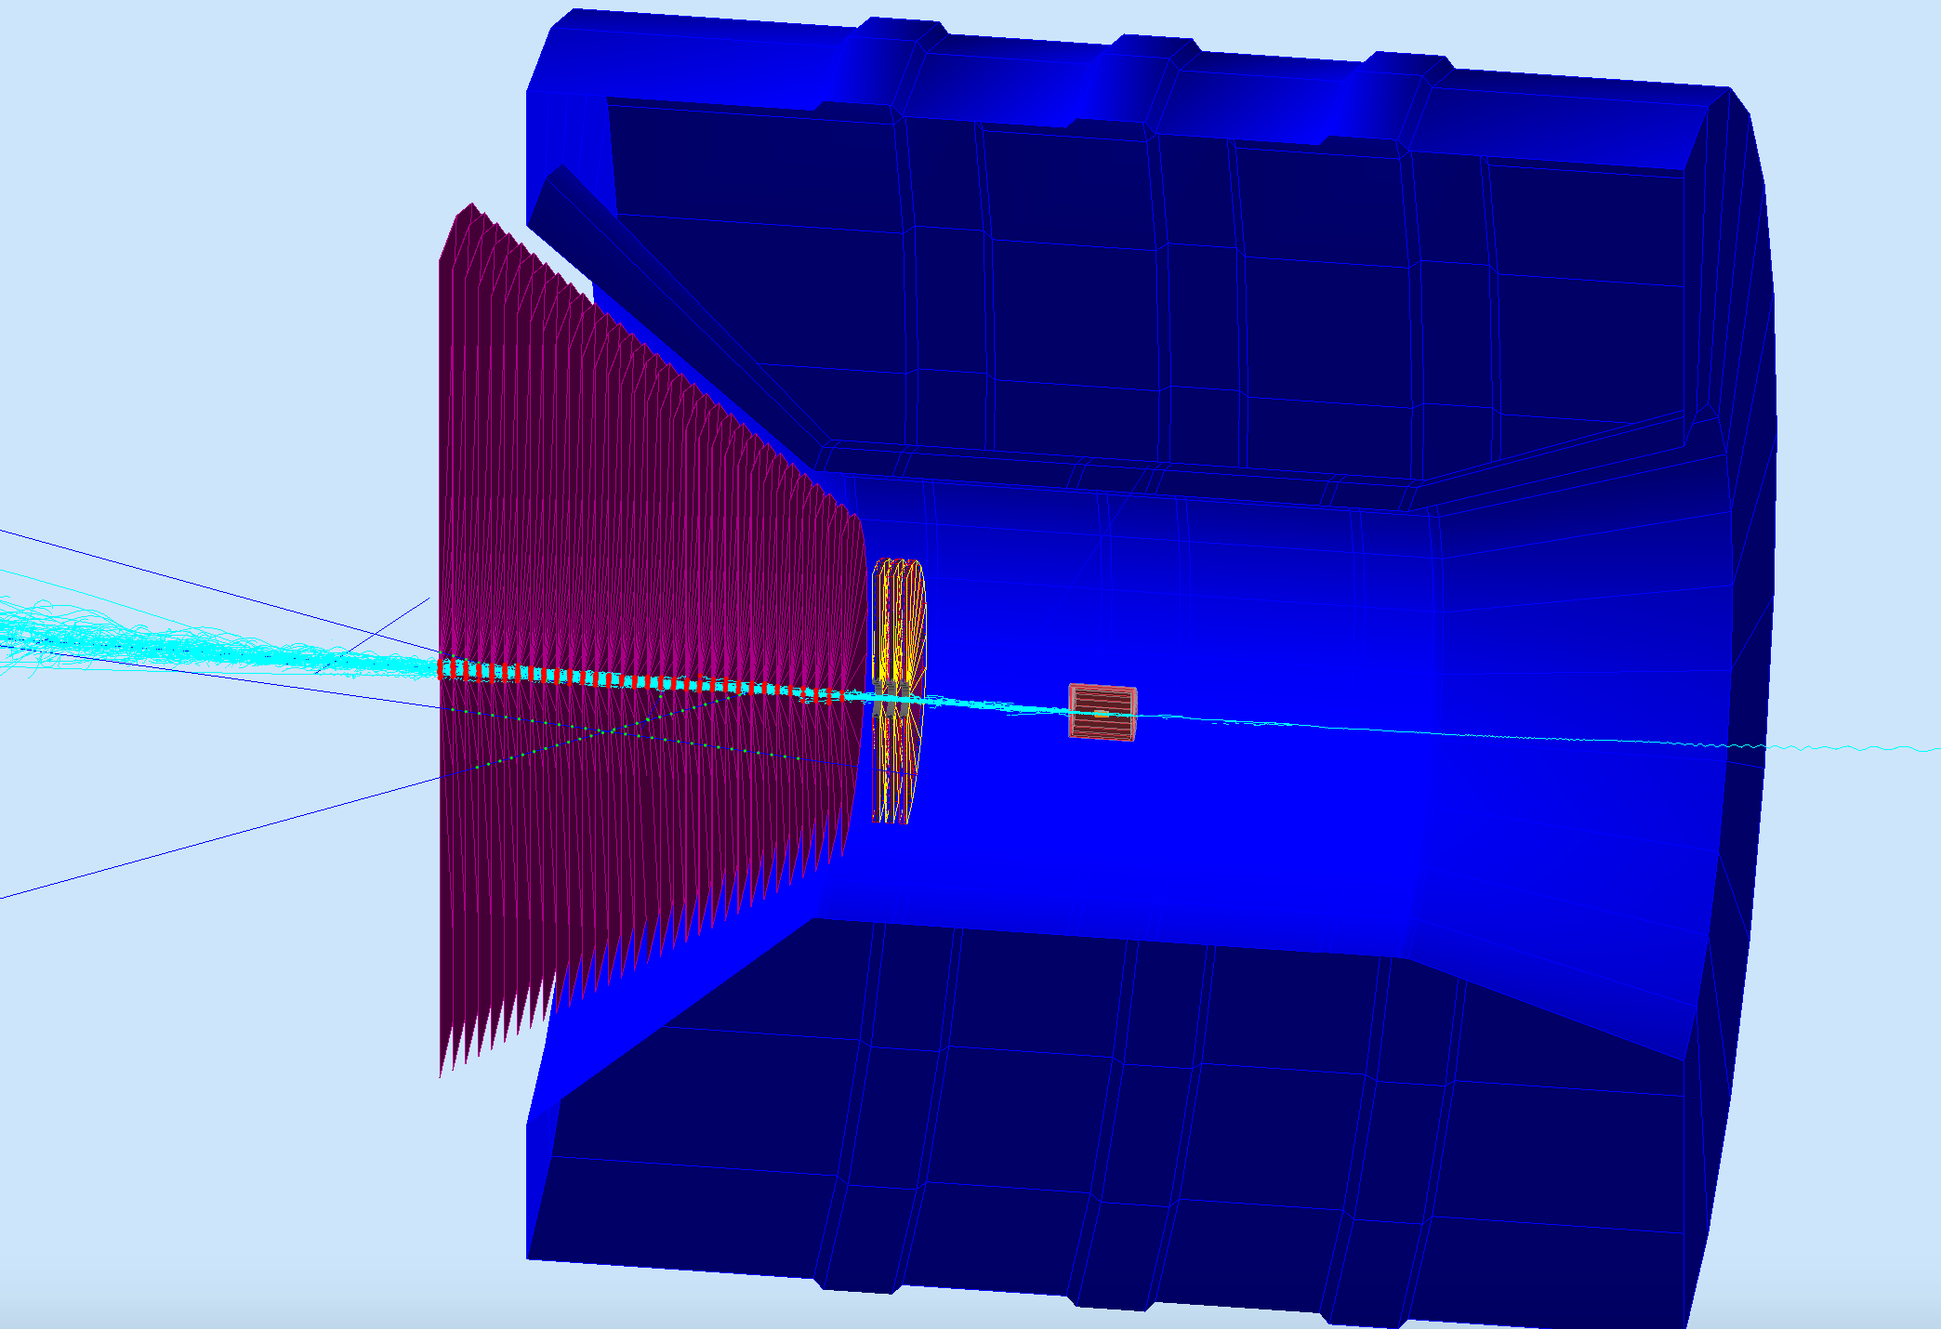
Beam profile studies
32 disks used to sample particles fluxes from z=40 cm to z=102 cm every 2 cm, covering up to 35 deg.
New beam profile studies for different configurations between target and shield:
Air
Vacuum
He4
FMT included
85%, 75% solenoid field

Slide 4
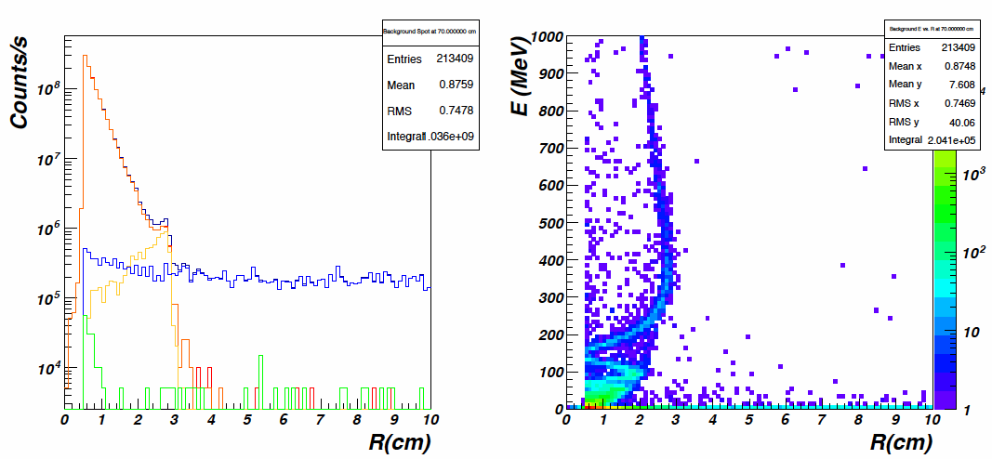
Beam profile (Air)
Profile at Z=750mm (entrance of Moller Cone in FT configuration)
All particles
Electrons
Moller electrons
Moller electrons with E>200MeV
Photons
Other
Electrons “contained” by solenoid field
Photons and neutrons spread at all angles
Beam “radius” defined from edge of moller electron distribution

Slide 5
Nov 2015 to Feb 2016
Bob Miller
Mike Zarecky
Latifa Elouadrhiri
Volke Burkert
Glenn Young
Stepan Stepania
Raffaella DeVita
Maurizio Ungaro
Francois Xavier
David Riser
Costs
Support
Practicality: switching configuration
Notes:
A committee was formed

Slide 6
Starting from…
“physicist design”
Finalize torus mount so it’s same for both configurations
Very hard to support weight
Notes:
This was the starting point after 2-3 years of studying background and adding shields. General description of left and right pics.
The shield is shaped as a truncated cone, pointing to to the CLAS12 center
The shield is made of a single material, i.e. tungsten
The shape and positioning of the shield was based on accurate studies of the beam sausage, details in the next two slides.

Slide 7
Simulating 10³⁵ luminosity
1 event is 250 ns long, 124,000 e- on LH2 target, bunched every 4 ns
Speeds up:
Fixed and simplified geometry, overlaps
Luminosity mechanism improved
Simplified Range Kutta
Production Cut
1 event: ~110 seconds on farm, or 0.8 msec / electron on target
Statistics:
10K events = 1.2 billion e⁻ on target / configuration
Total: ~ 0.1 trillion e⁻ on target
Notes:
A committee was formed

Slide 8
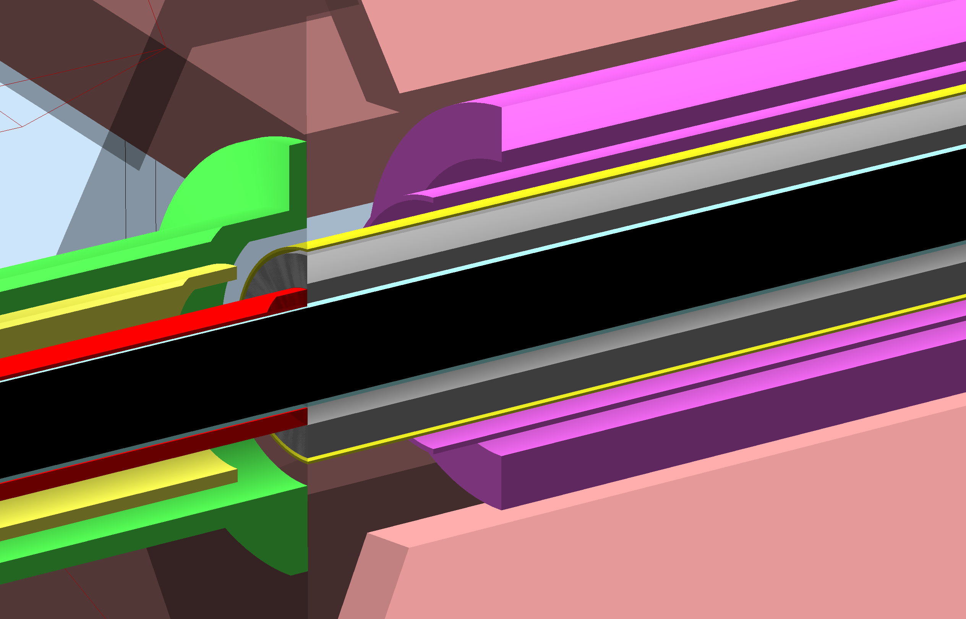
Torus Mount, Torus Bore
Tungsten Shield around Al beampipe inside torus, 2cm, 12 cm OD
Torus Warm Bore
Torus Warm Bore Shield
Torus Cold Hub
Also: torus vacuum jacket, plates, coils box and coils all re-designed

Slide 9
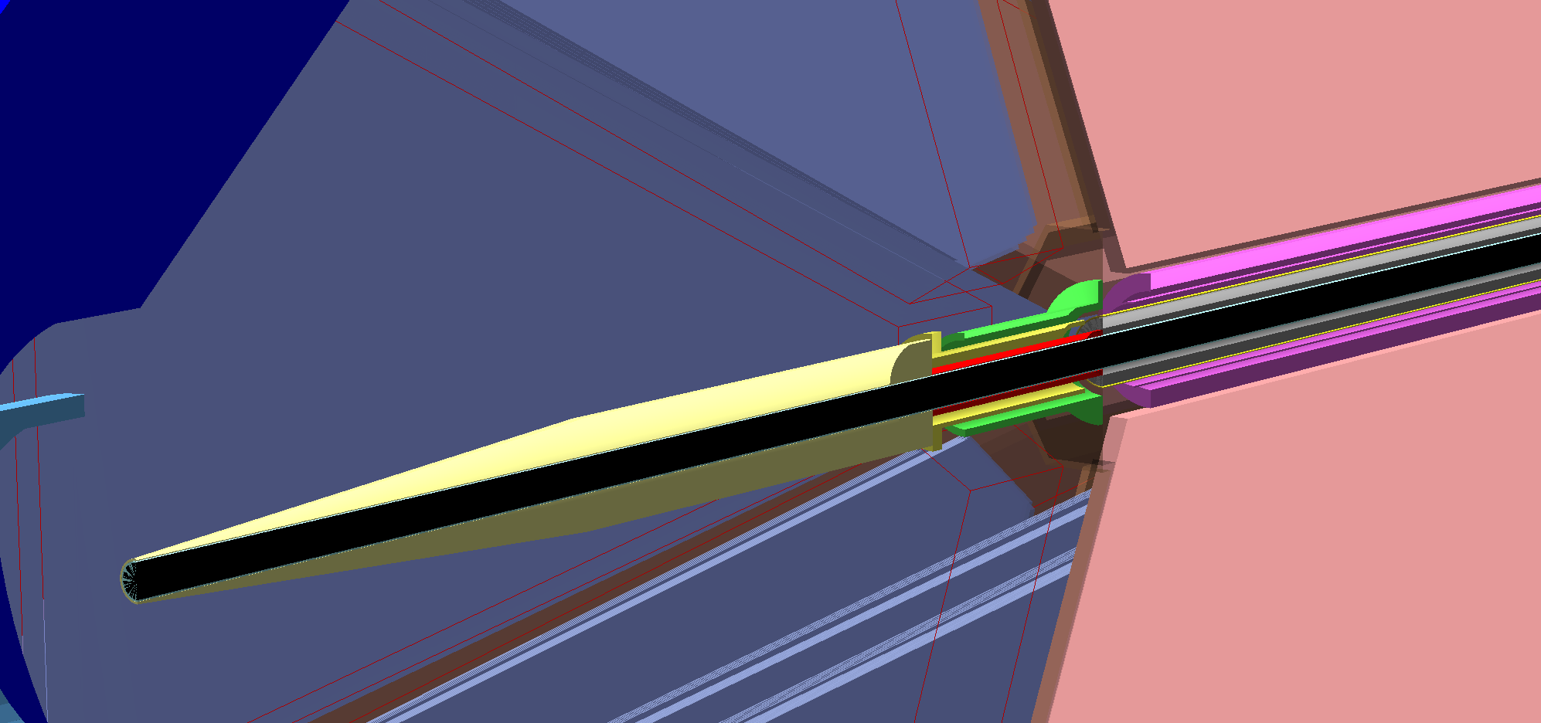
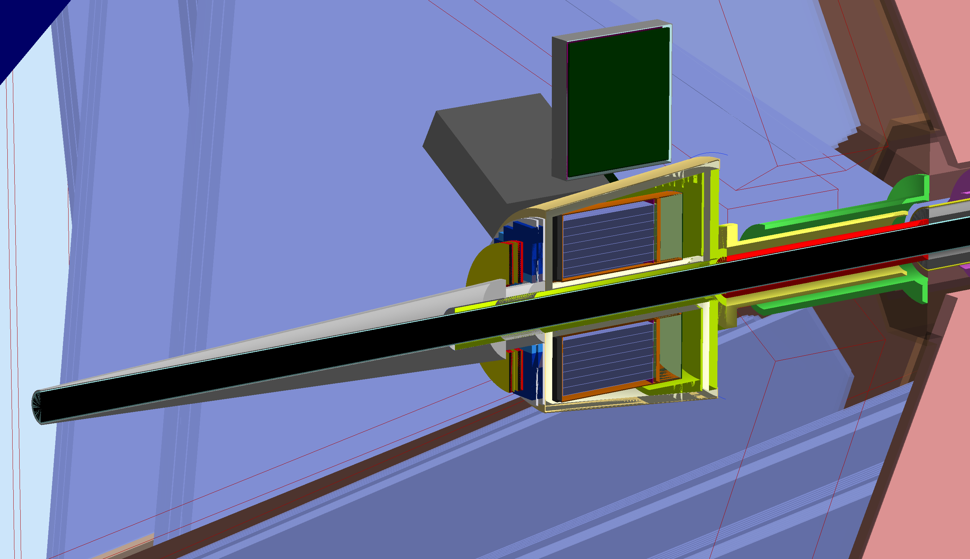
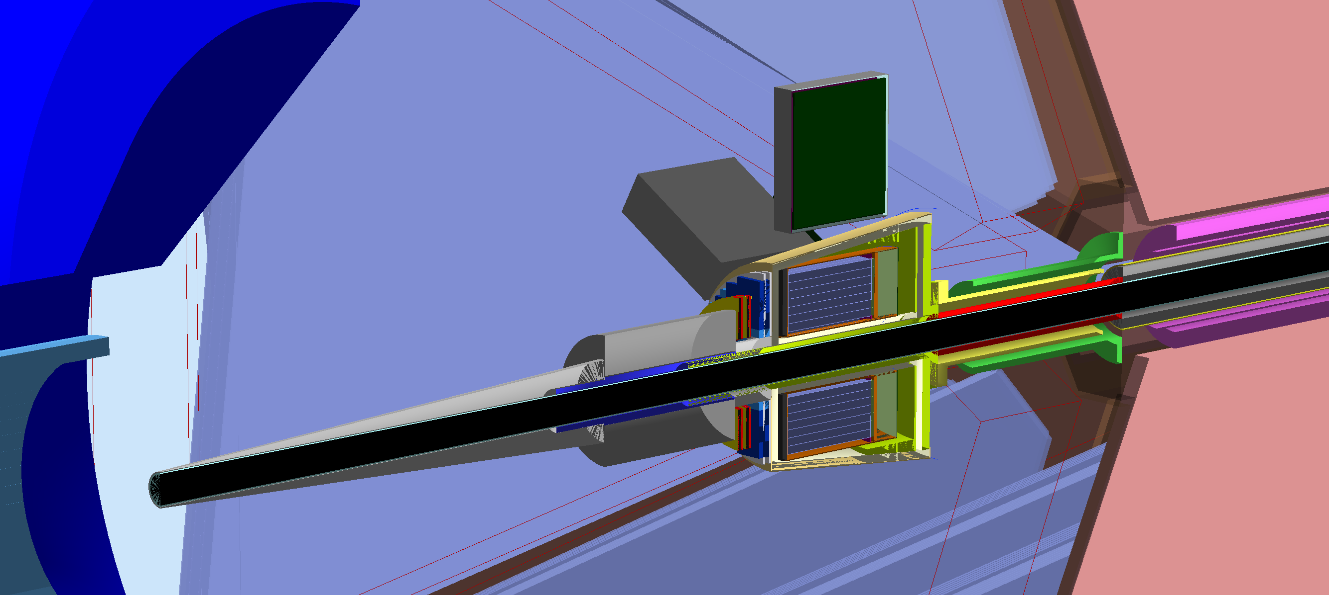
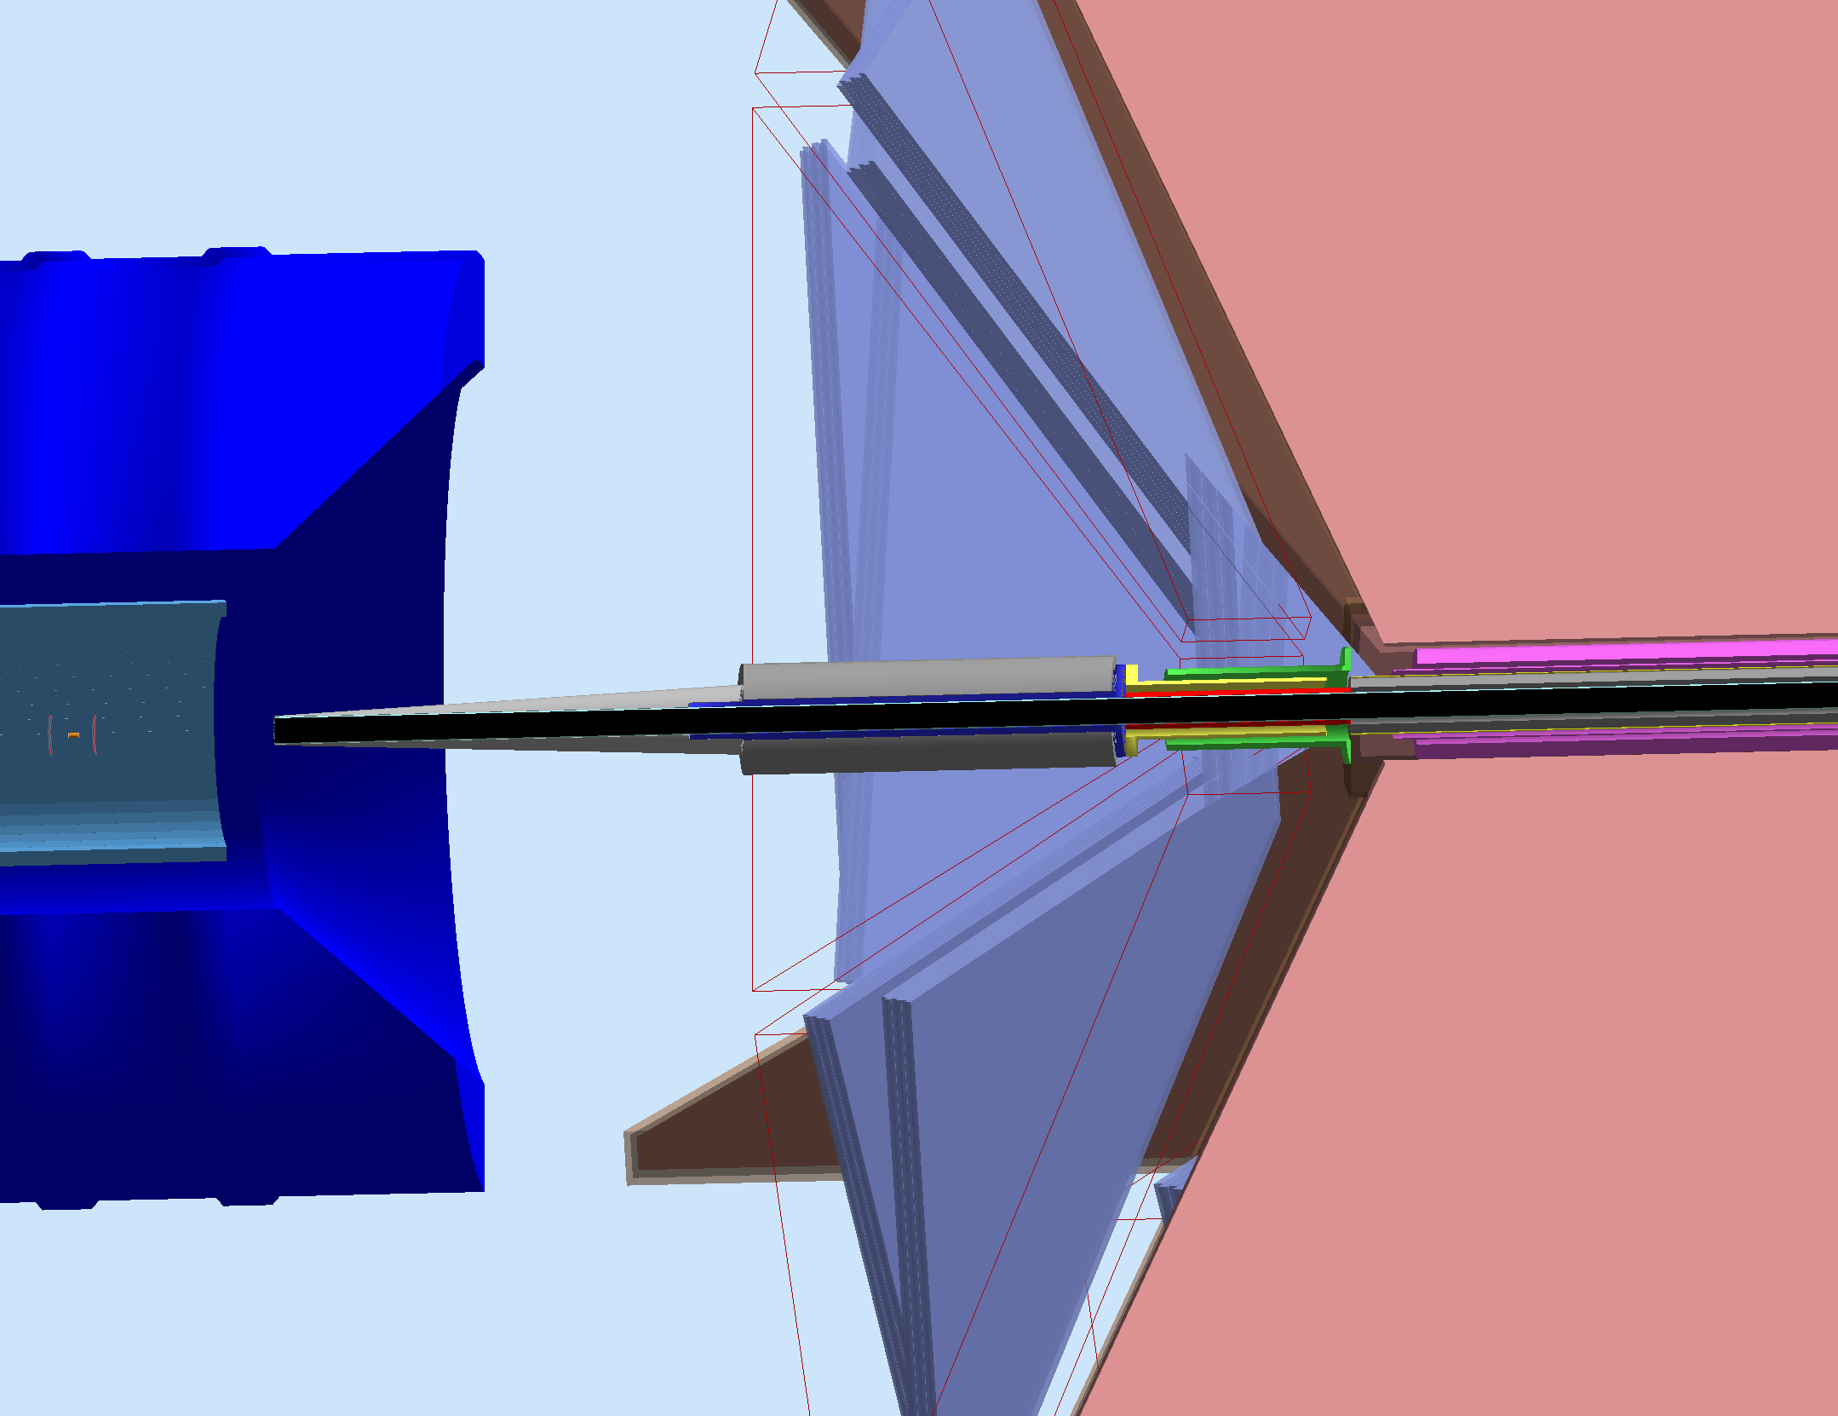
Four “realistic” configurations
All same mount to torus
No FT shield. Still hard to support weight.
FT configuration.
FT non operational, used as shield
No FT, but same shield as FT

Slide 10
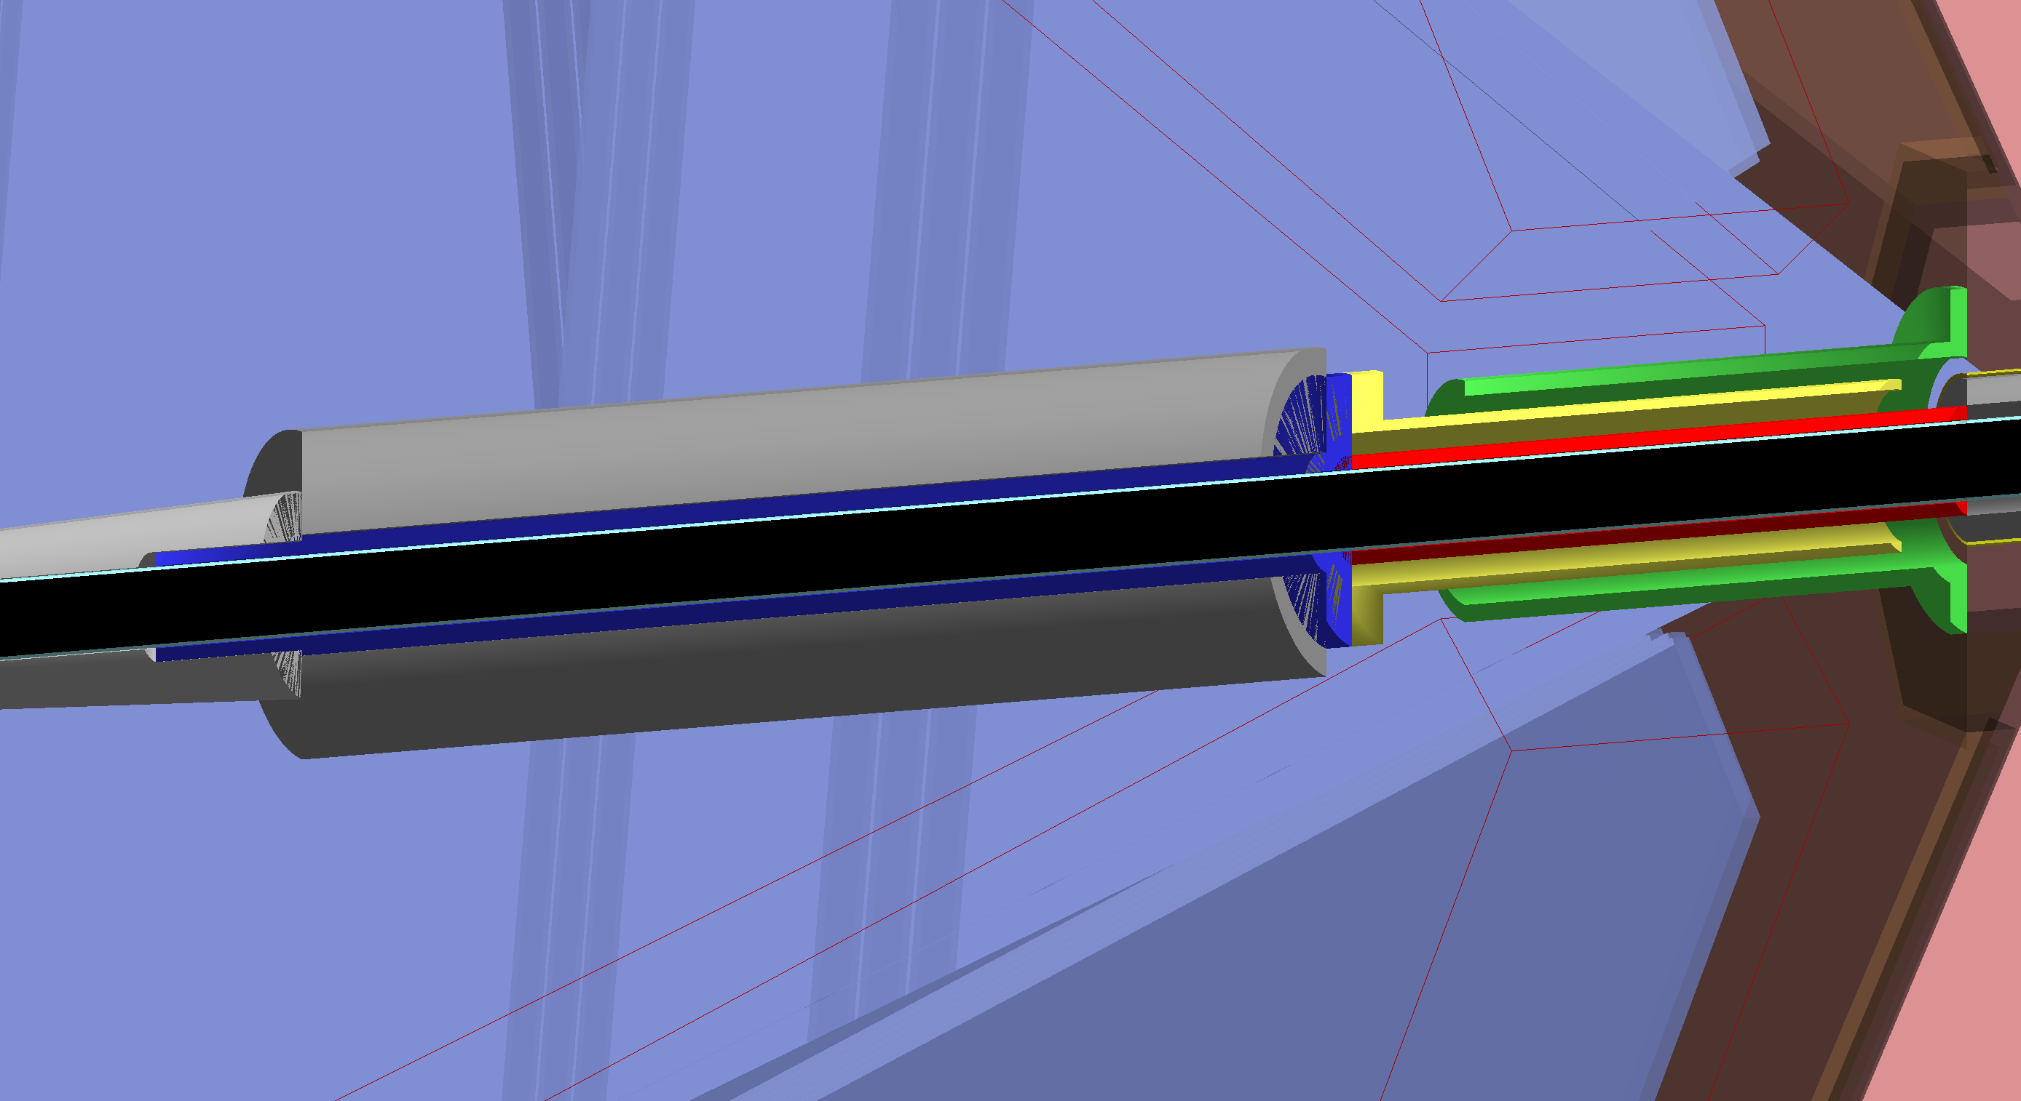
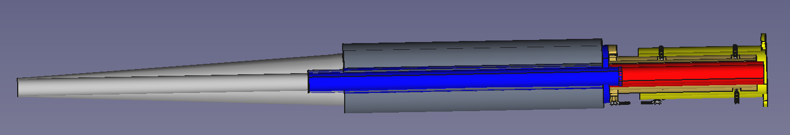
FT Cone. No FT. Lead in place of FT.
R=120 at z=1444mm: 4.75º
Torus Start: z=2753mm
Mount Start: z=2270mm
SST Support inside tube and cone
Notes:
Top: simulation implementation. Bottom: engineering design

Slide 11
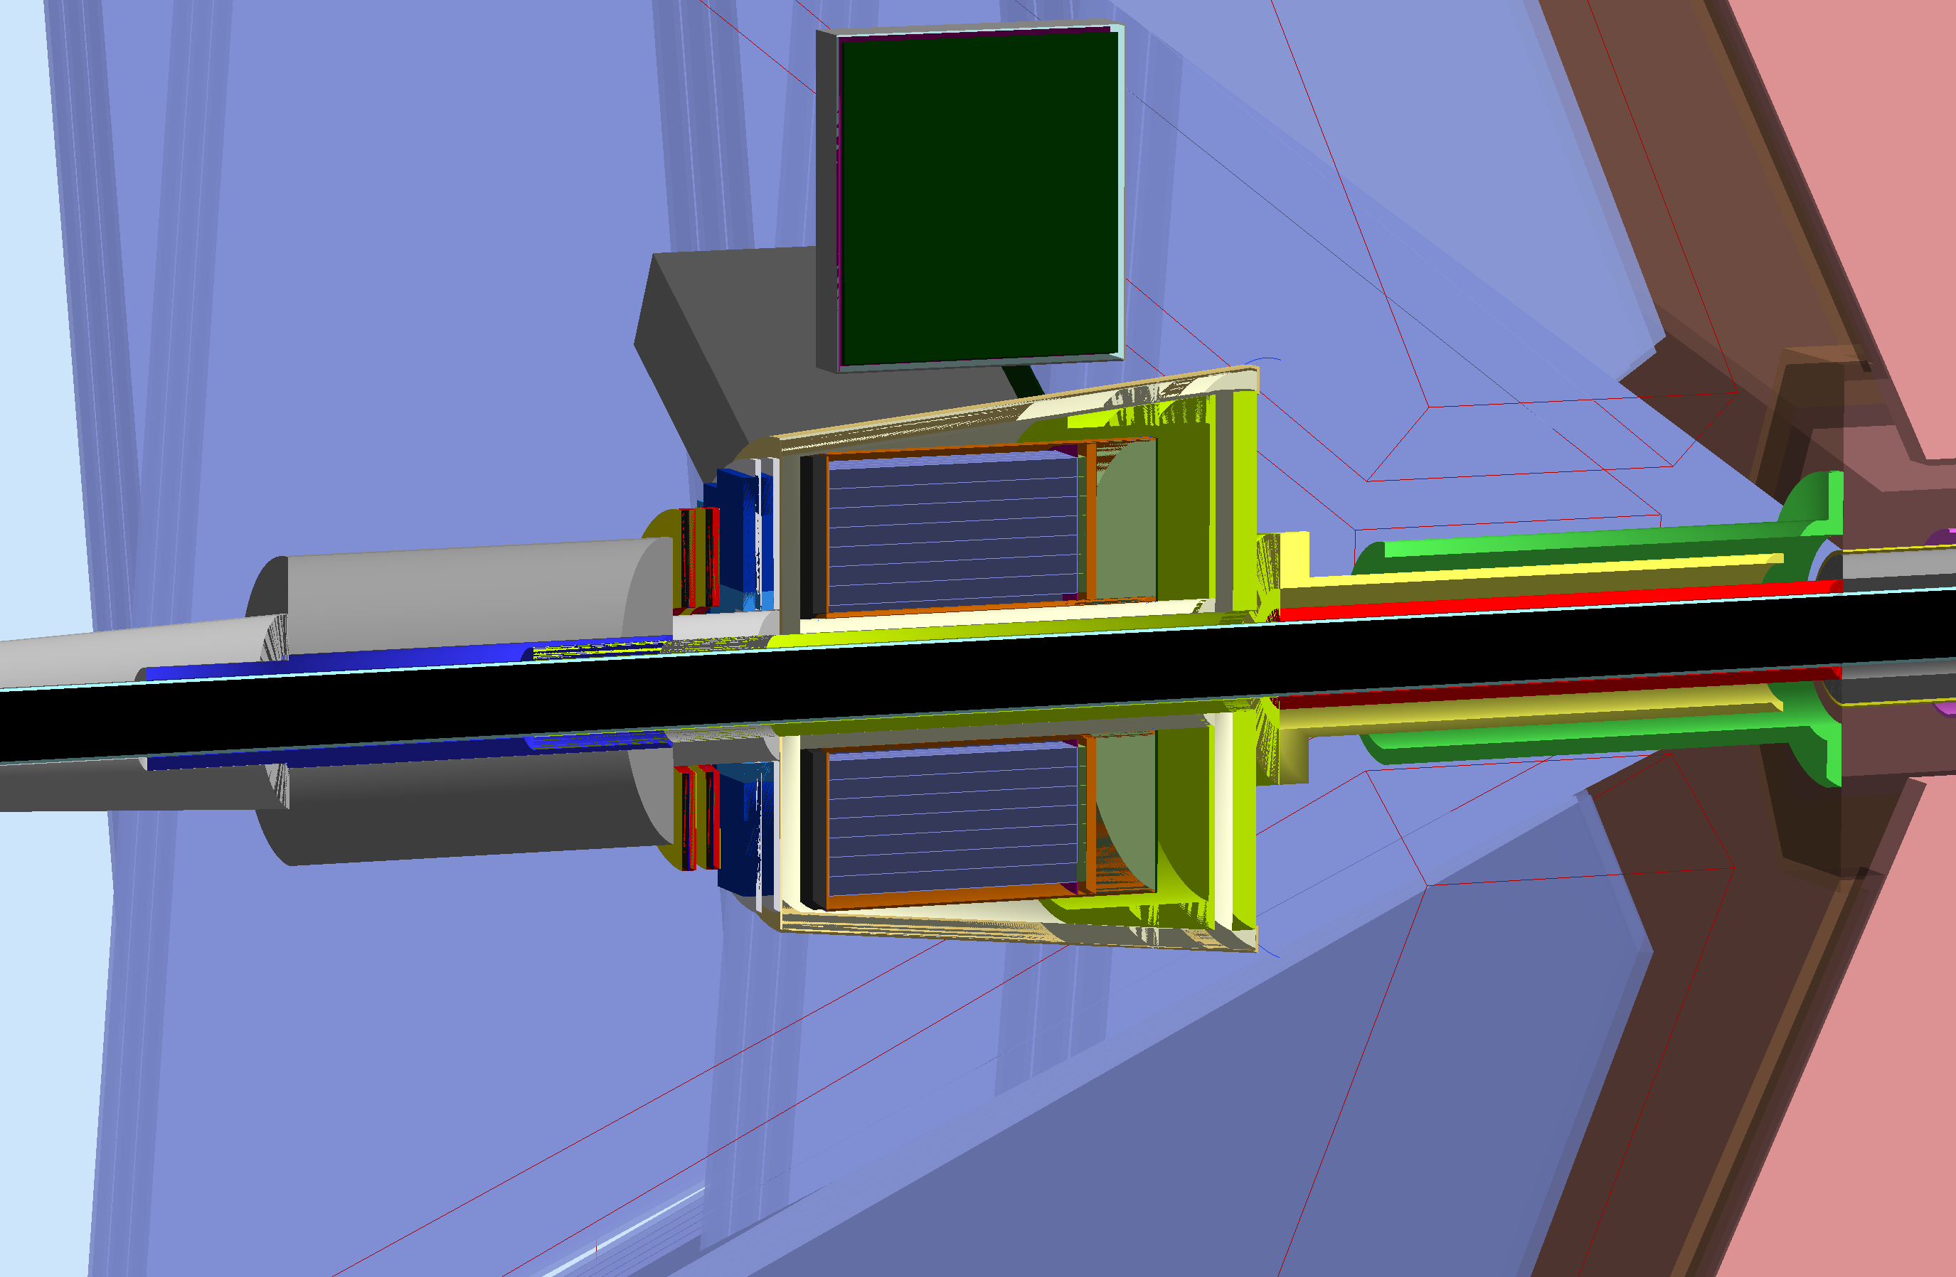
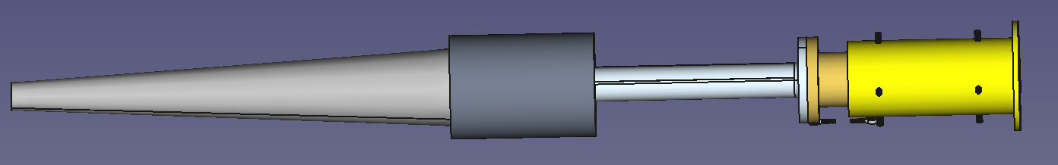
FT not operational, as shielding.
R=120 at z=1444mm: 4.75º
Torus Start: z=2753.8mm
Mount Start: z=2269.6mm

Slide 12
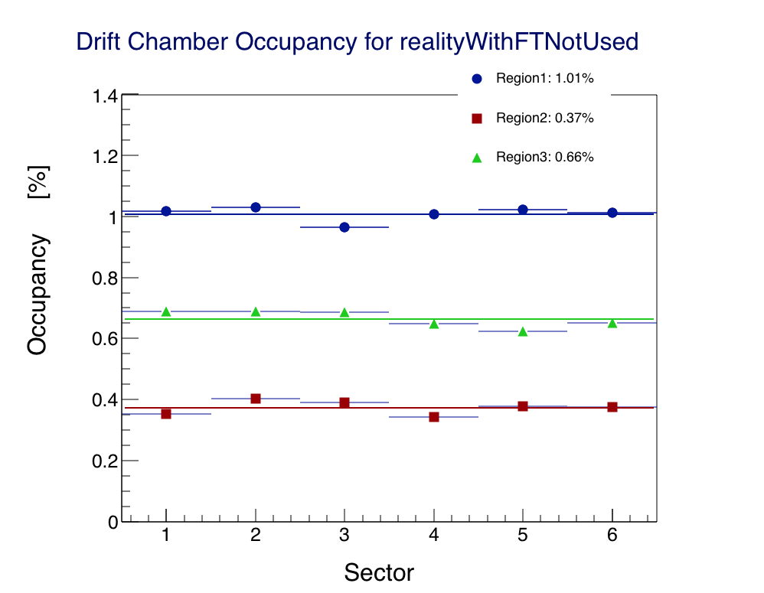
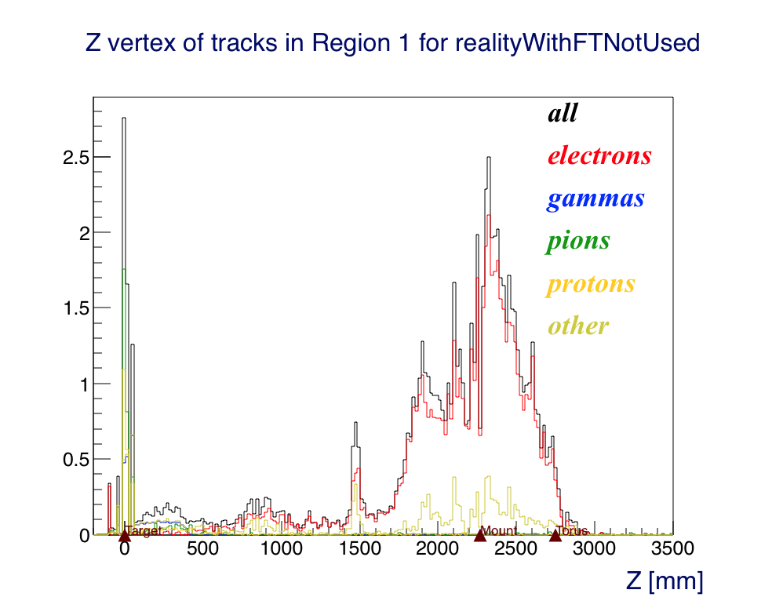
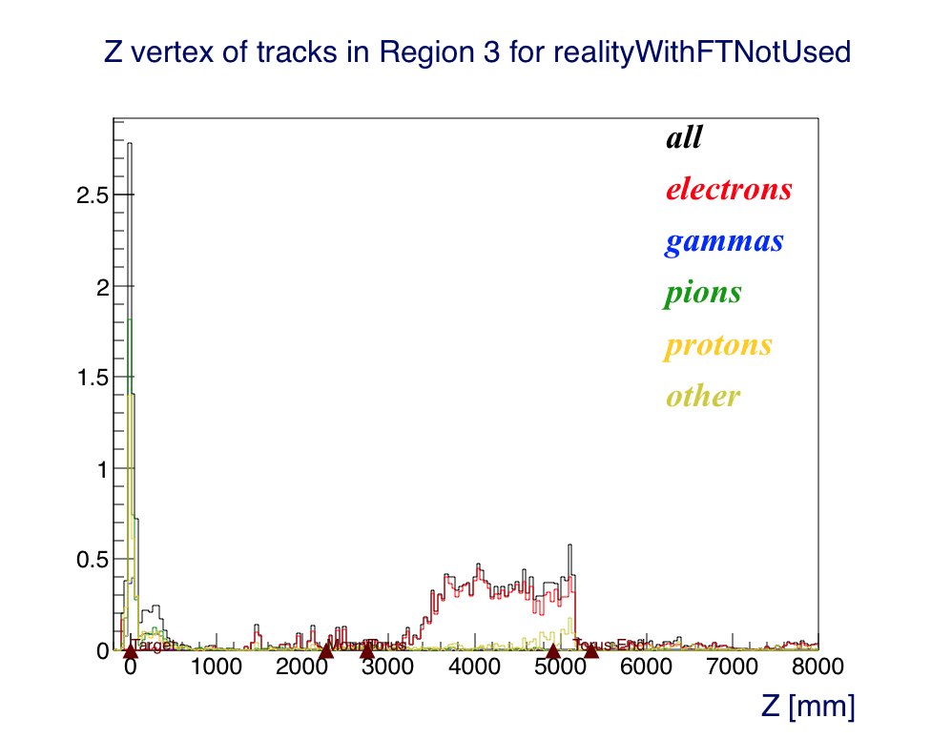
FT not operational, as shielding.
R1 Background Source
R3 Background Source

Slide 13
Four “realistic” configurations
All same mount to torus
R1: 0.7%
R3: 0.6%
R1: 1.75%
R3: 1.0%
No FT shield. Still hard to support weight.
FT configuration.
R1: 1.0%
R3: 0.66%
R1: 1.0%
R3: 0.6%
FT non operational, used as shield
No FT, but same shield as FT
Conclusions: can use same shield, just move it!
Notes:
Very promising results on using same shield.

Slide 14
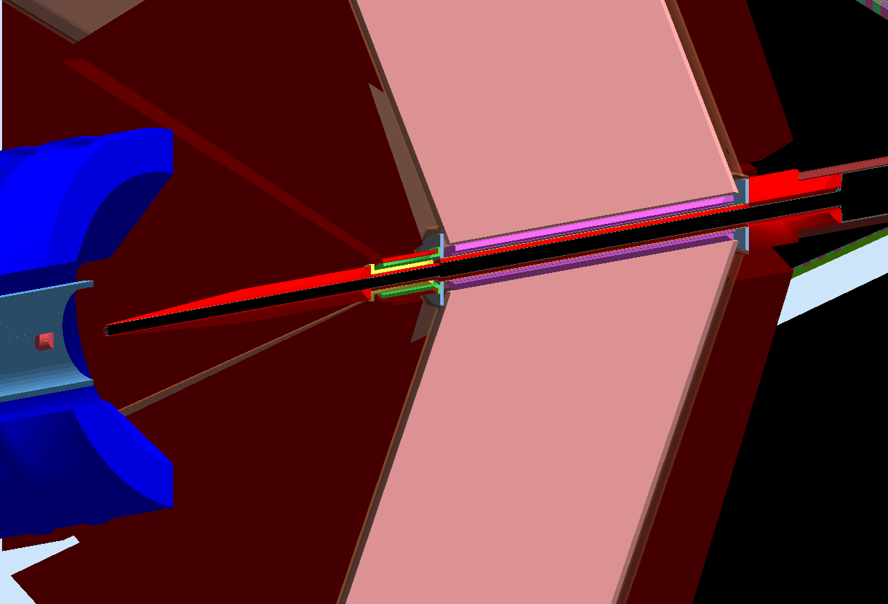
January 2016: Modifications
Torus was 25cm too long. Coils now in correct position. Hub Plates. All Tungsten is now RED.
Baseline Reference

Slide 15
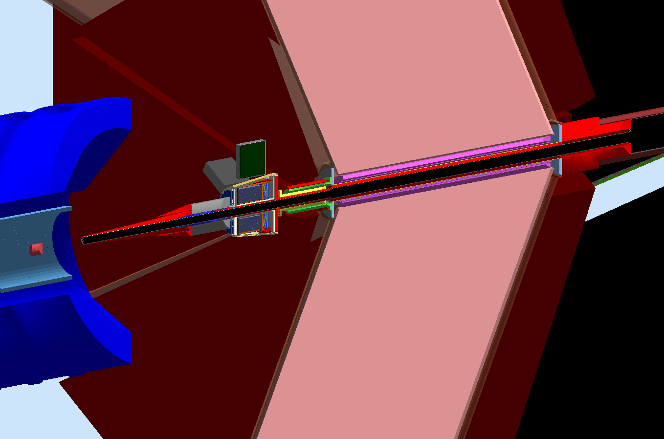
January 2016: Modifications
Tracker removed. More Shielding. Additional Piece to FT Cone.
With FT as shielding

Slide 16
January 2016: Modifications
Beampipe 0.125” thick (3.175mm), was 2mm. OR = 30. OR 40 in torus. OR 66 downstream
With FT as shielding

Slide 17
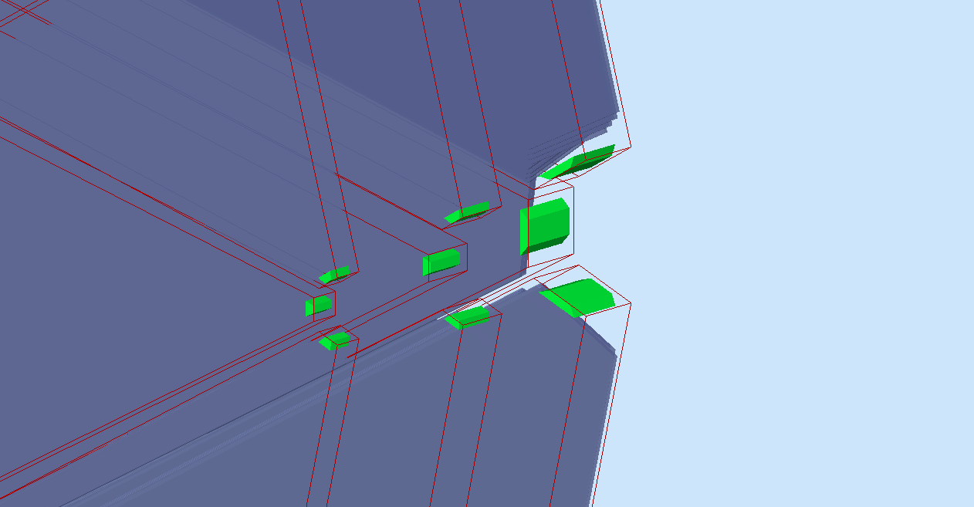
January 2016: Modifications
D. Riser: DC Mount Plates, Overlaps fixes.
With FT as shielding

Slide 18
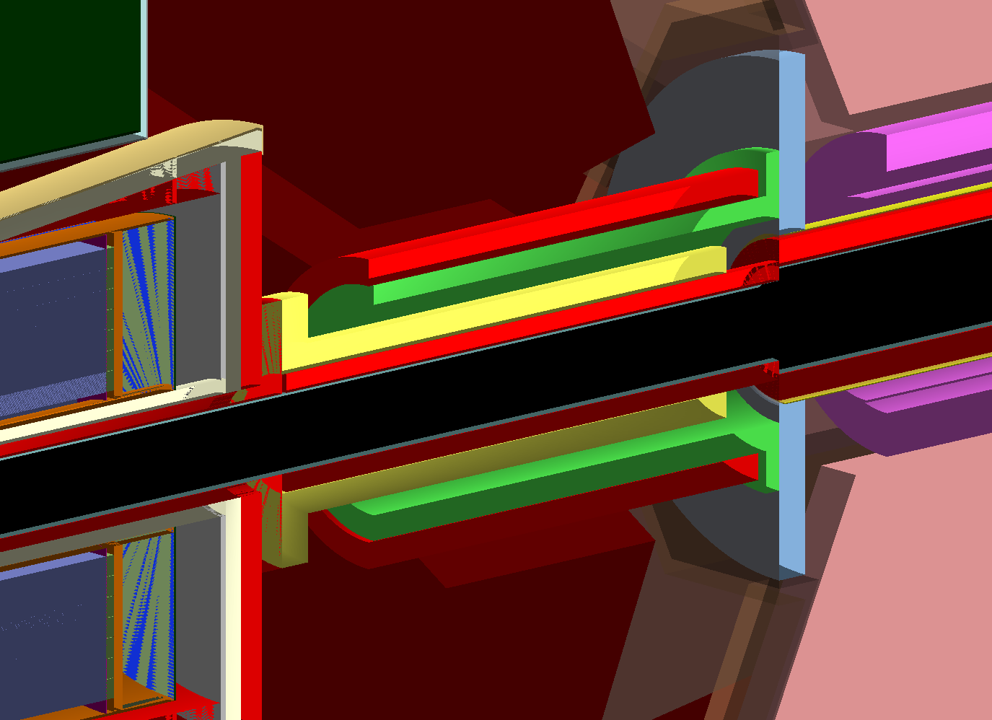
January 2016: Modifications
Mount thicker. Less than anticipated shielding inside, but outside shielding.
With FT as shielding

Slide 19
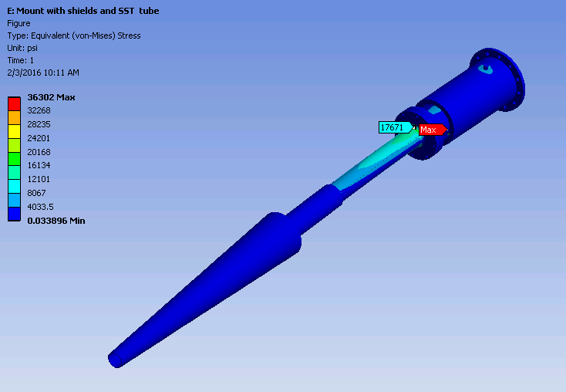
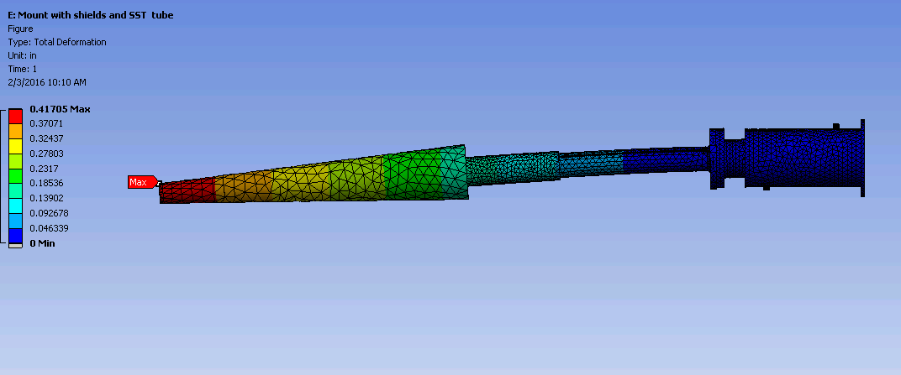
January 2016: Engineer Analyses
Calculations
FEA of assembly with tungsten tube
FEA of assembly with stainless steel tube
Bolt analysis
Weld Analysis
Point Masses:
Lead shield 267 lbs
Forward Tagger 625 lbs
Inner mount shield 60 lbs (ID 60 mm, OD 88 mm, Length 480 mm)
Outer mount shield 194 lbs (ID 191 mm, OD 231 mm, Length 380 mm)
Load Cases
Gravity
Gravity, and acceleration of 0.1G in X, Y, and Z (this analysis will be added when the final details of the assembly are completed)

Slide 20
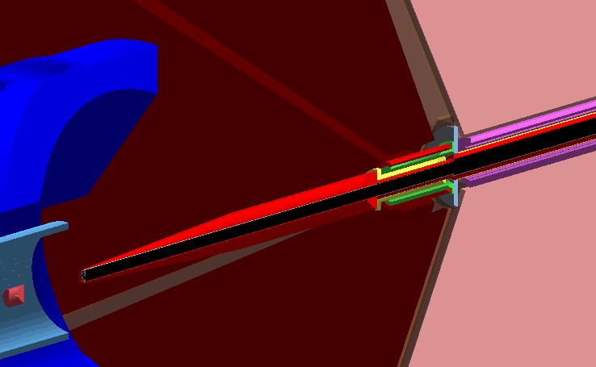
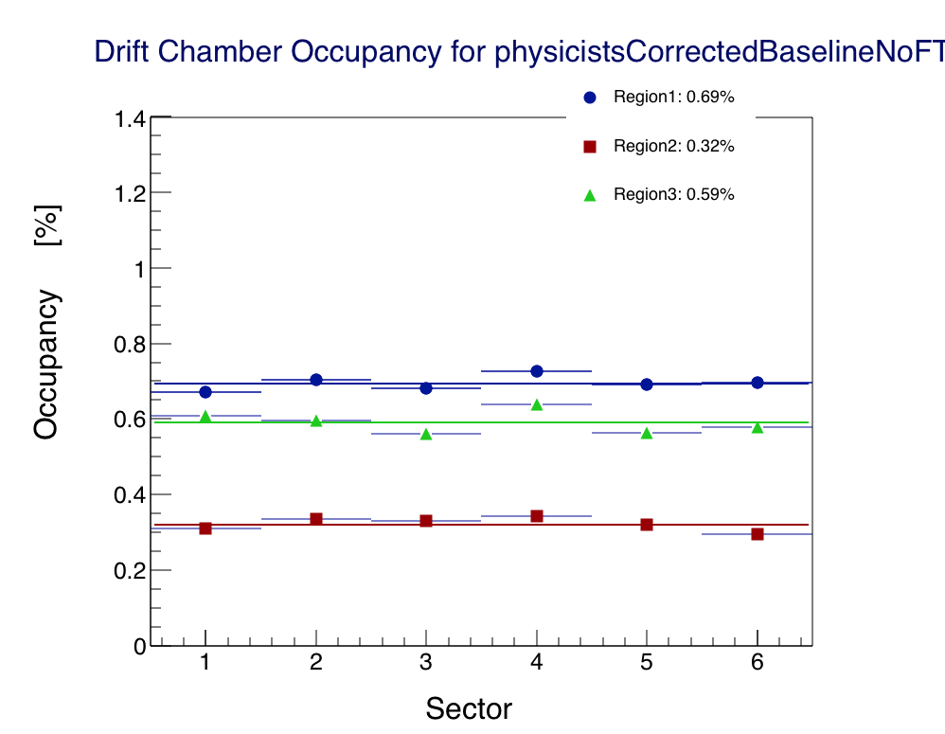
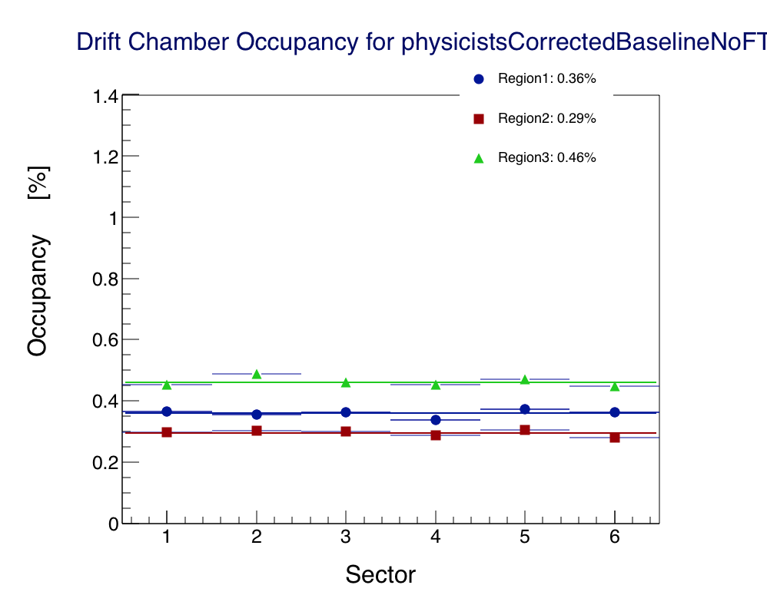
New Baseline
Before
After

Slide 21
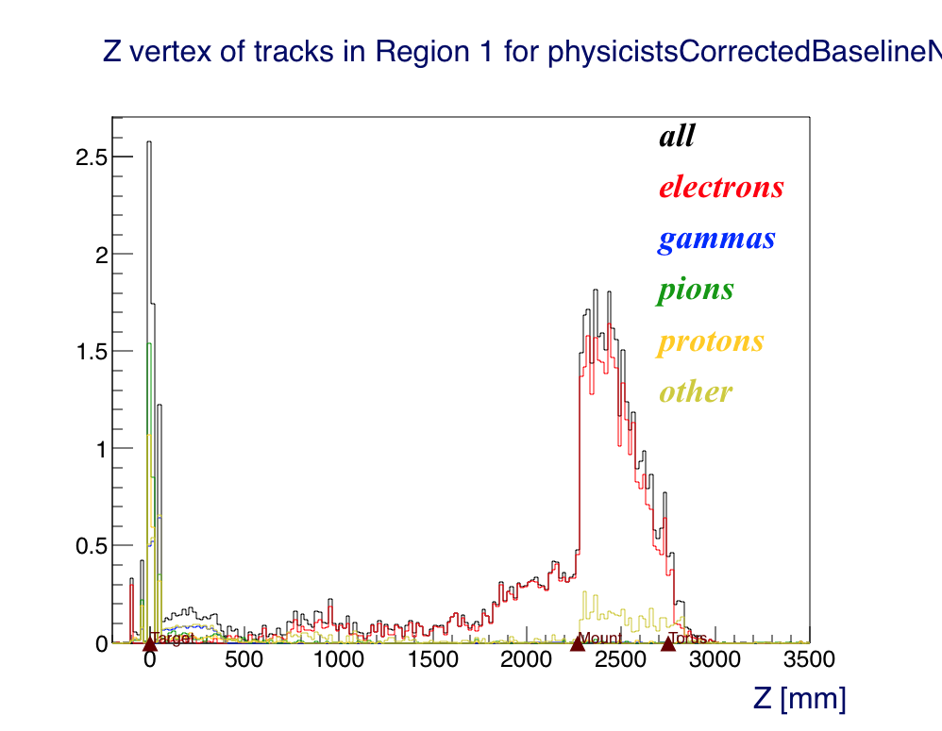
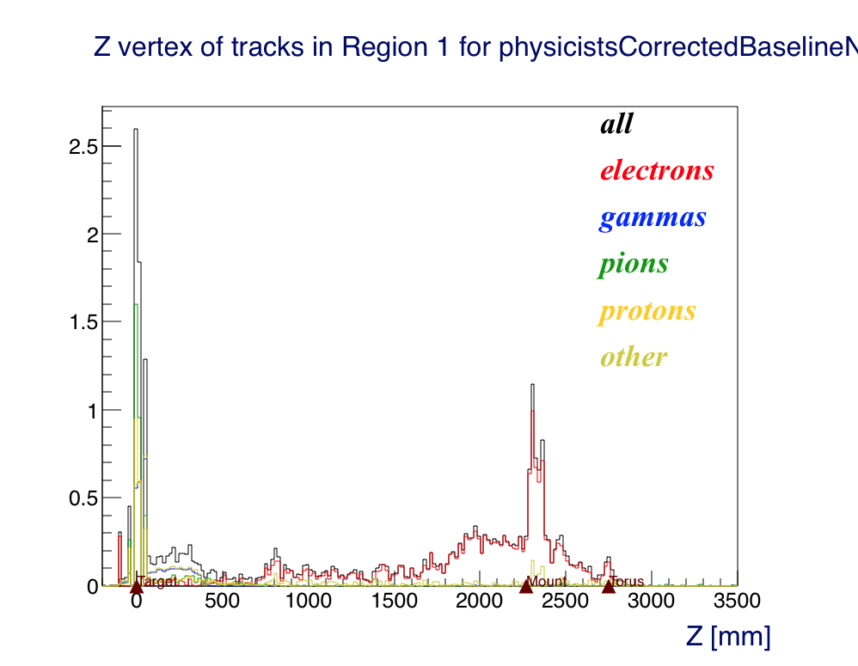
New Baseline
Mount Start: 2270
Torus Start: 2750
Before
After

Slide 22
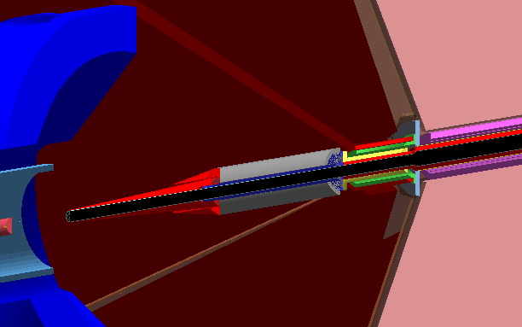
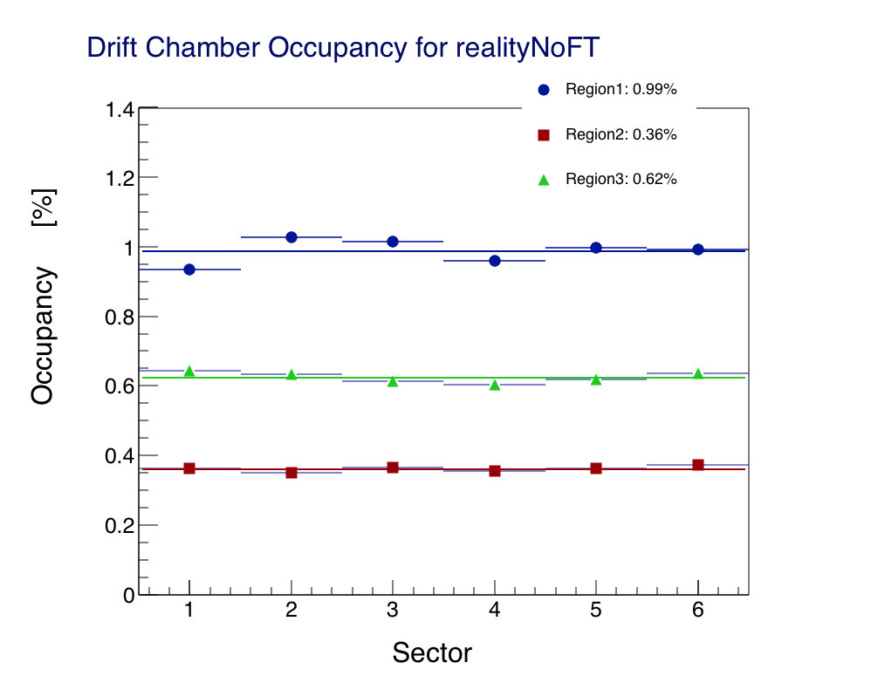
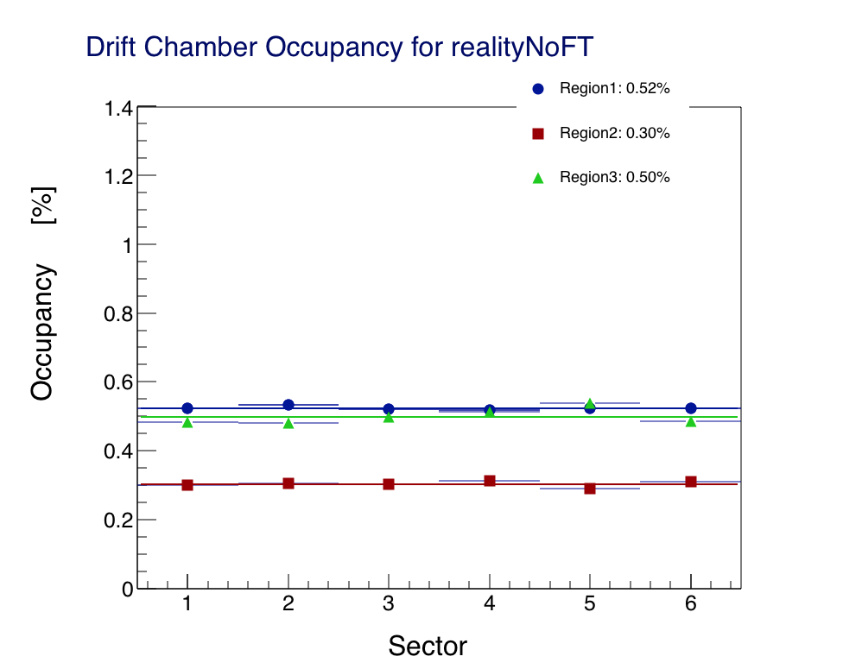
Reality, No FT
Before
After

Slide 23
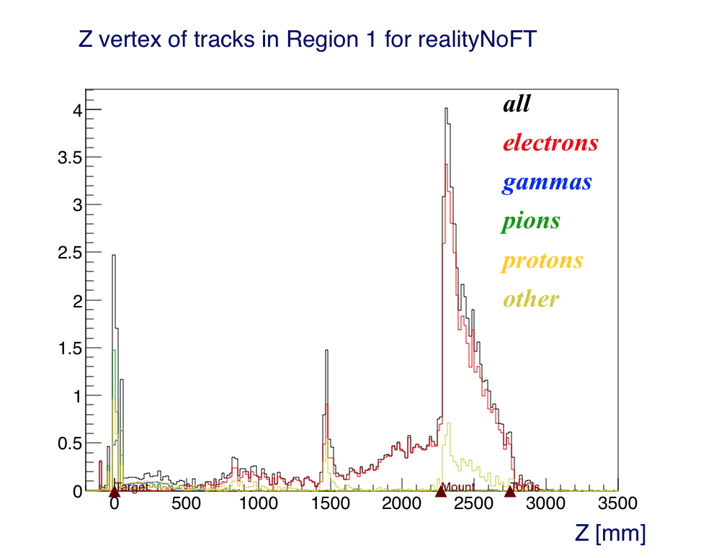
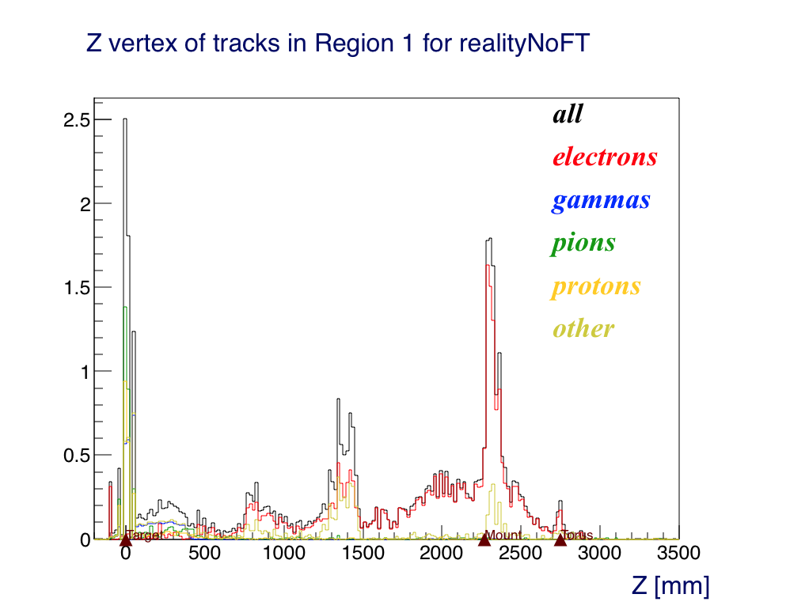
Reality, No FT
Mount Start: 2270
Torus Start: 2750
FT Cone END: 1444
Before
After

Slide 24
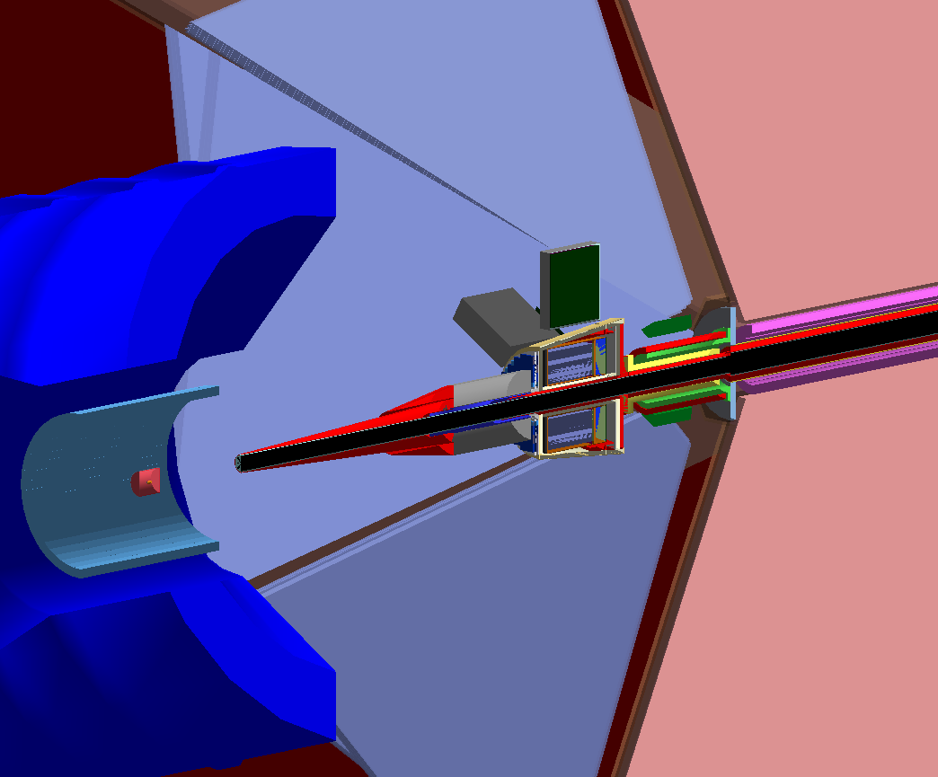
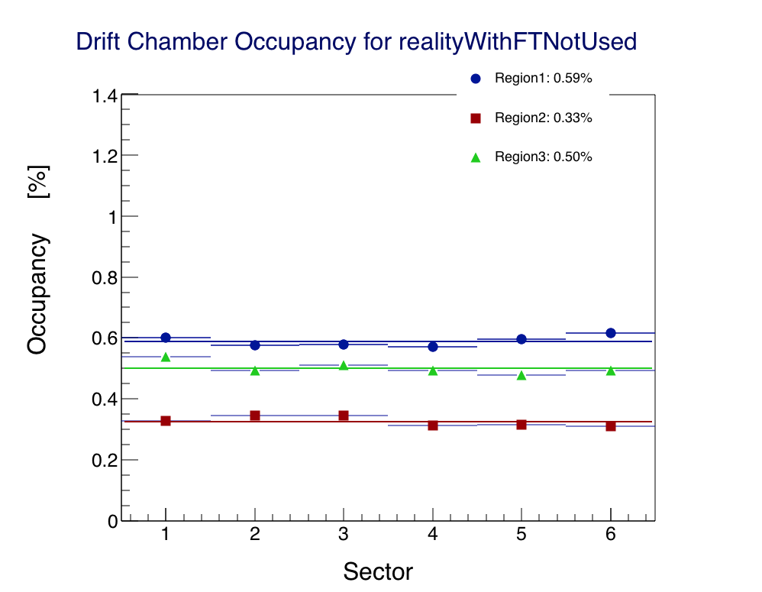
Reality, FT is shield
Before
After

Slide 25
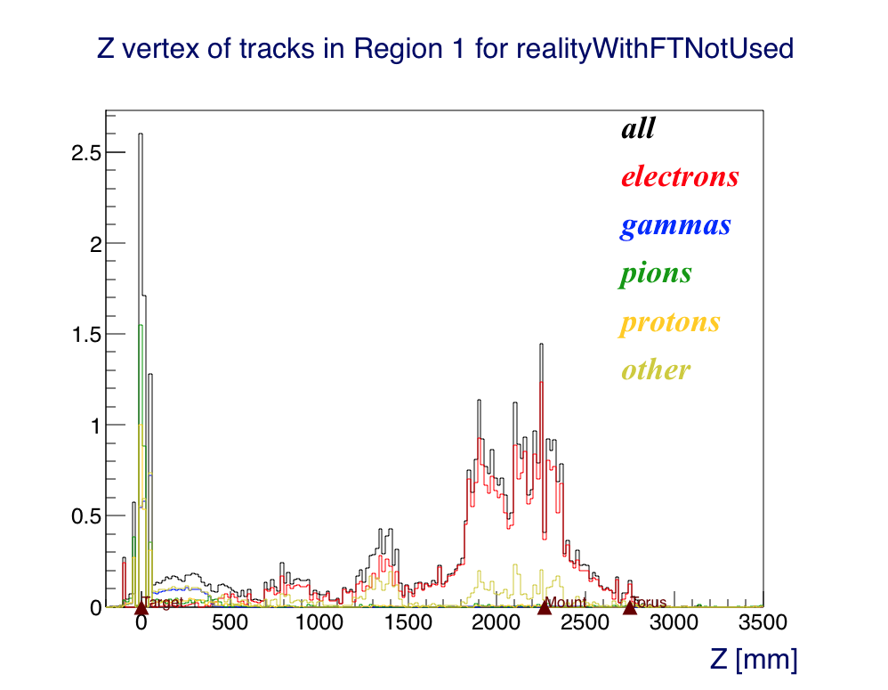
Reality, FT is shield
Mount Start: 2270
Torus Start: 2750
FT Cone END: 1444
Before
After

Slide 26
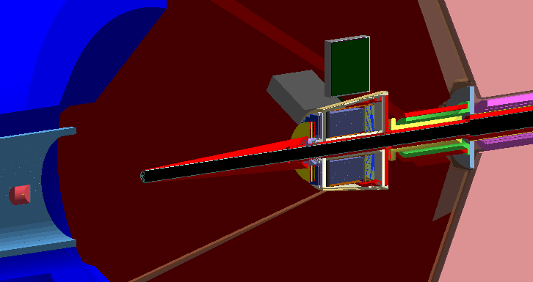
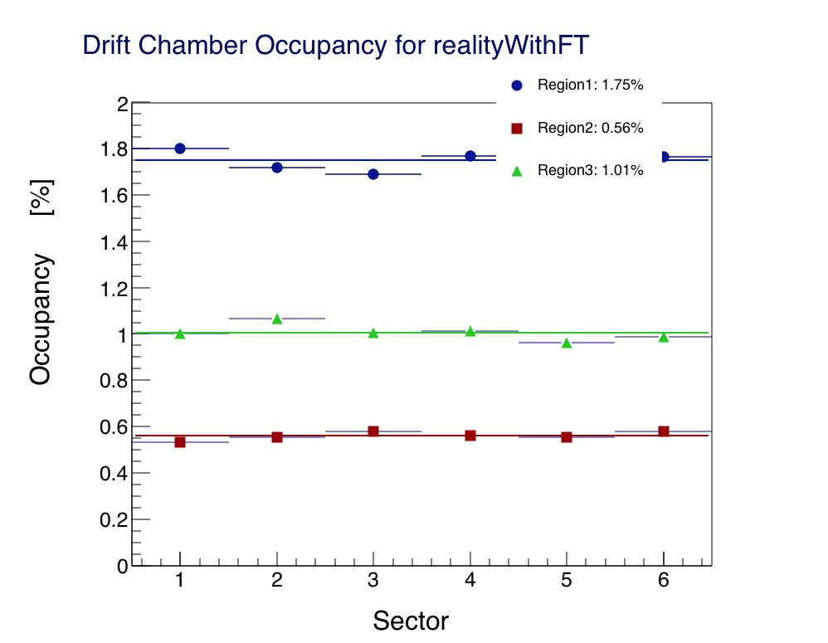
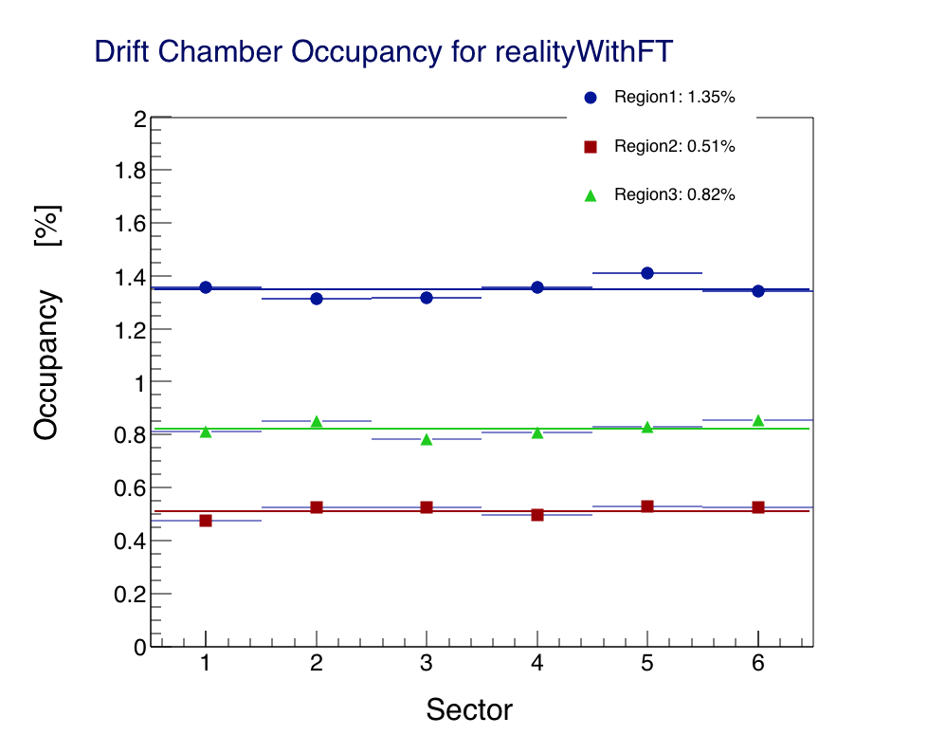
Reality, With FT
Before
After

Slide 27
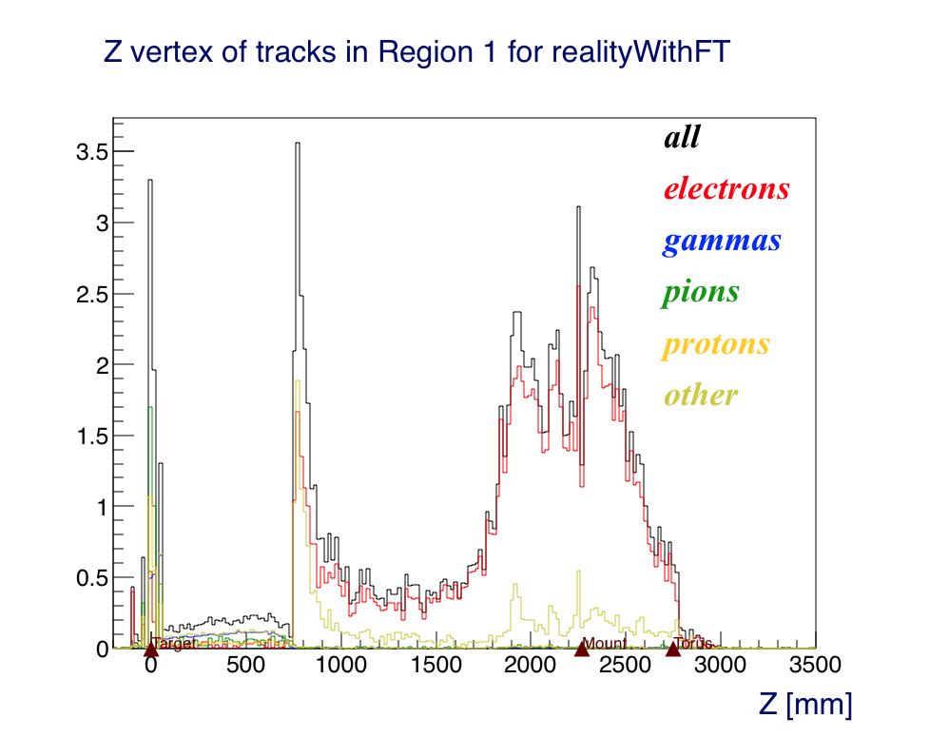
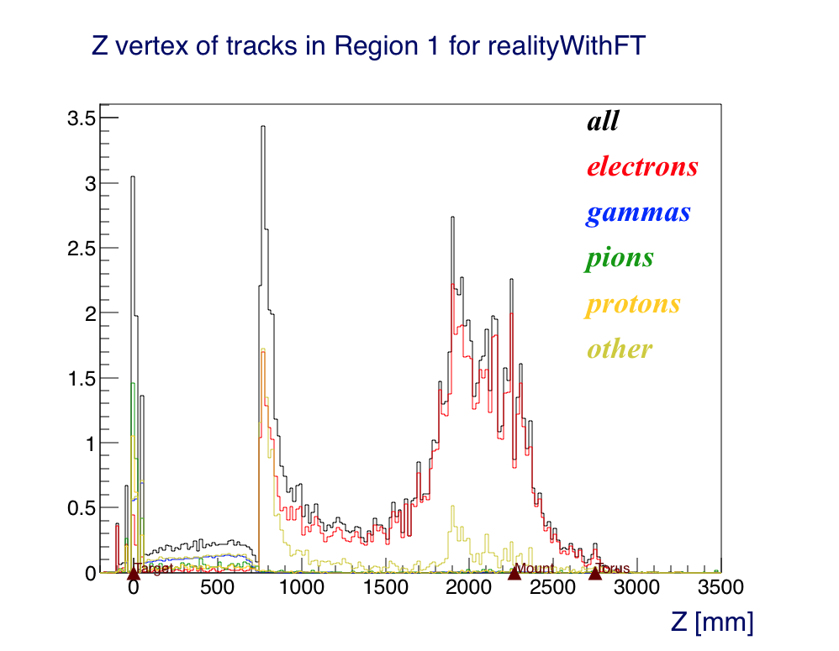
Reality, With FT
Mount Start: 2270
Torus Start: 2750
FT Cone END: 1760
Before
After

Slide 28
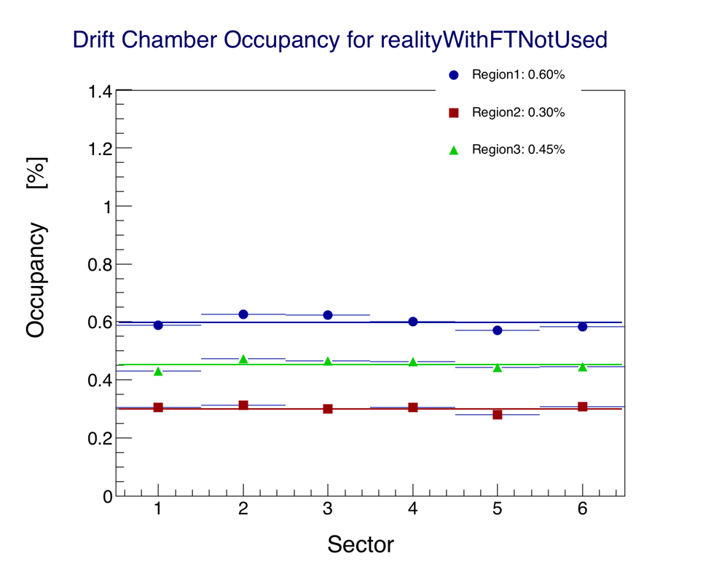
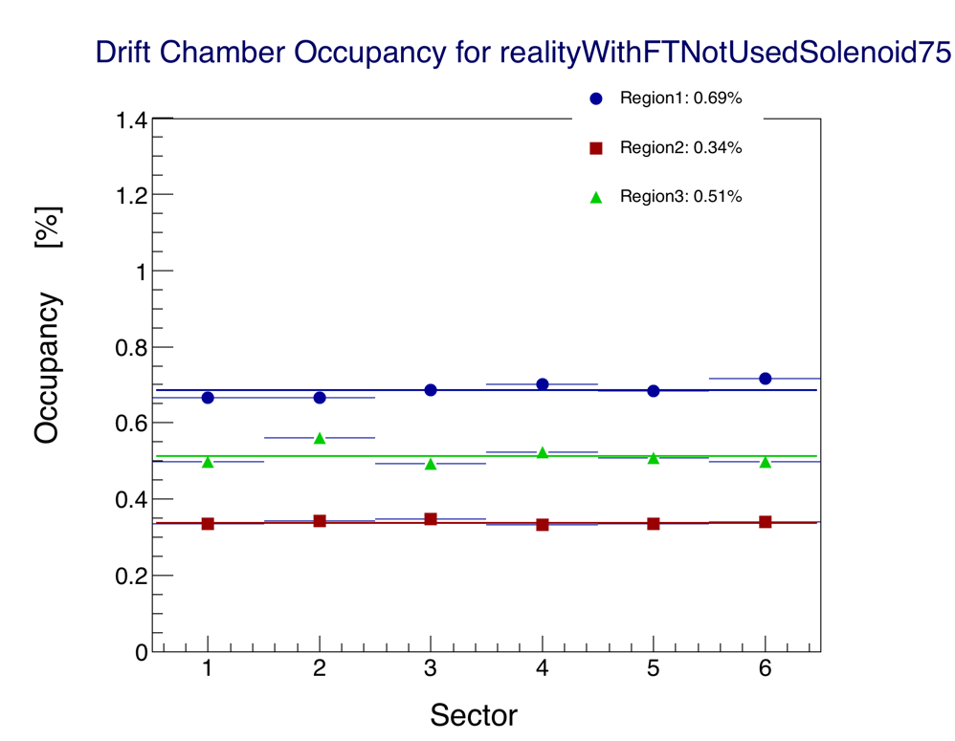
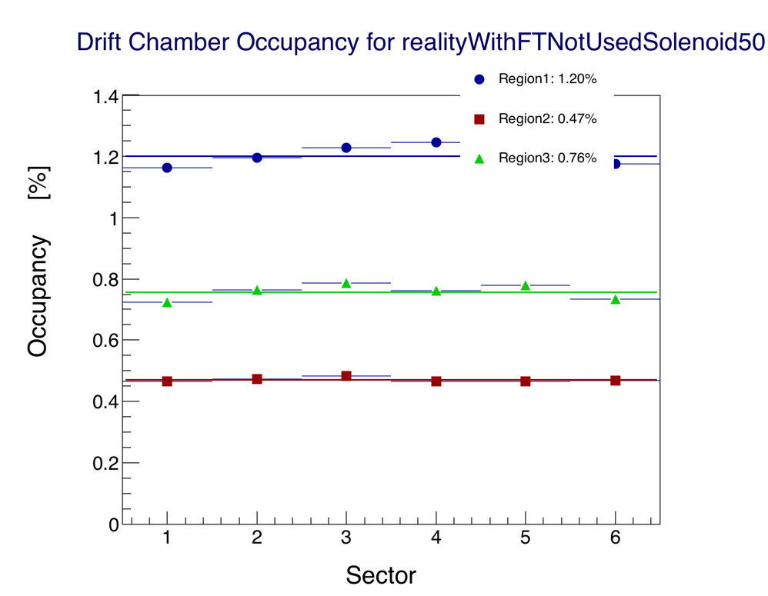
Reality, FT is shield
Full Solenoid
75% Solenoid
50% Solenoid

Slide 29
FT: field strength effect
Beam spot “angle” defined as:
Angle = tan⁻¹(R/Z)
Present FT design (realityWithFT)
Spot size increases significantly at lower field
Moller cone entrance radius could be smaller than beam spot
Solution if full field would not be available ➙ move cone upstream
  No effect on CLAS12 acceptance
  Reduction of FT angular coverage
  Can be implemented via modular design for in-situ optimization depending on solenoid field

Slide 30
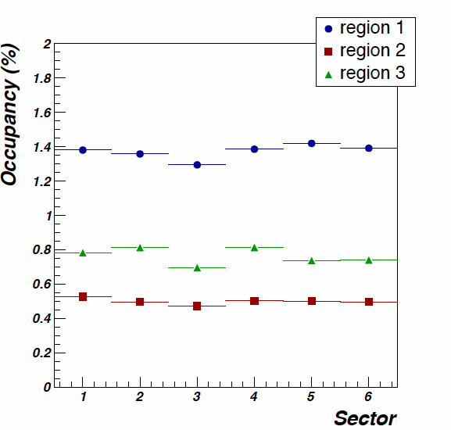
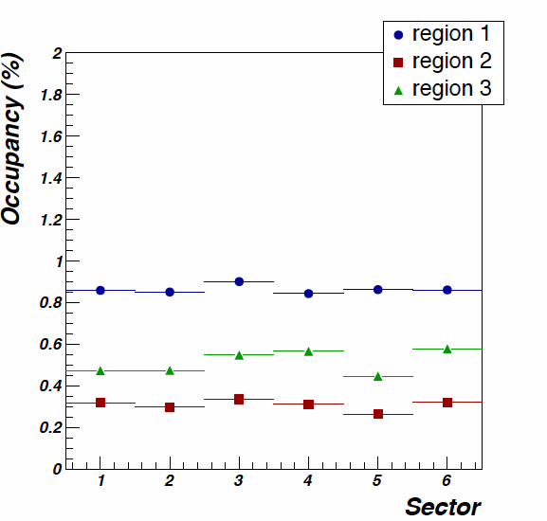
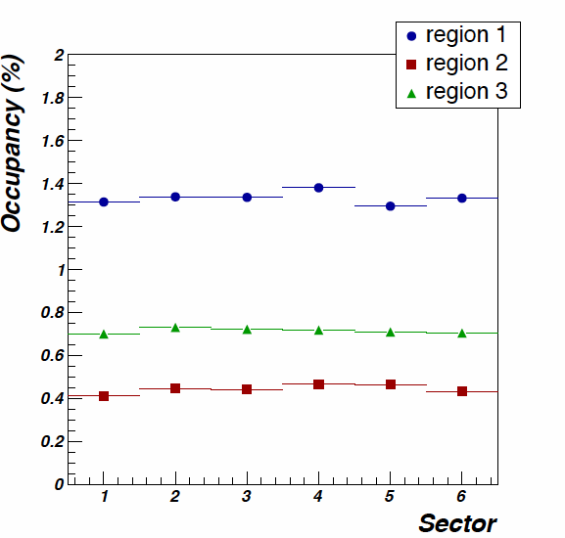
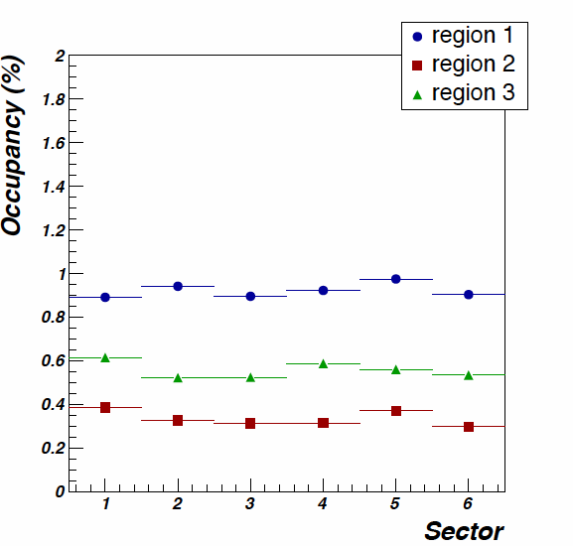
Material between target and shield
Air
Vacuum
Lower dc occupancy for vacuum or helium
Small reduction with FMT due to shielding of low energy particles
Air+FMT
Helium

Slide 31
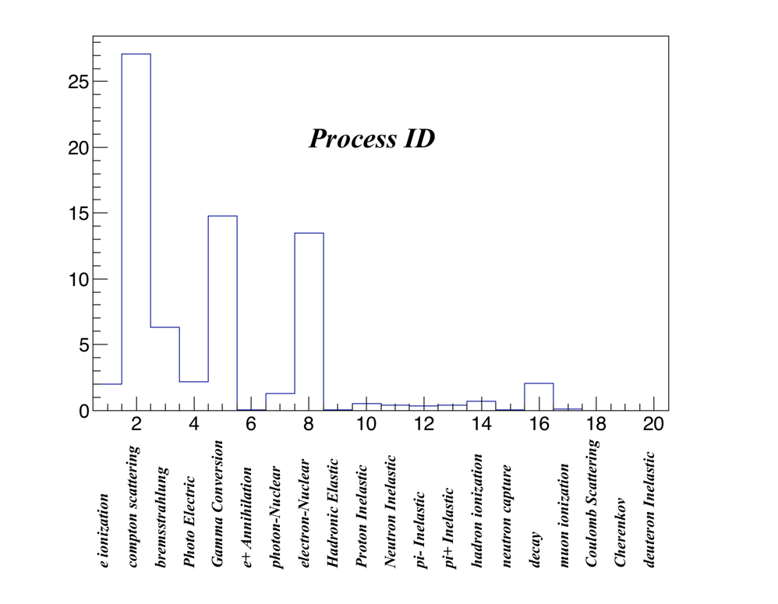
Physics Processes

Slide 32
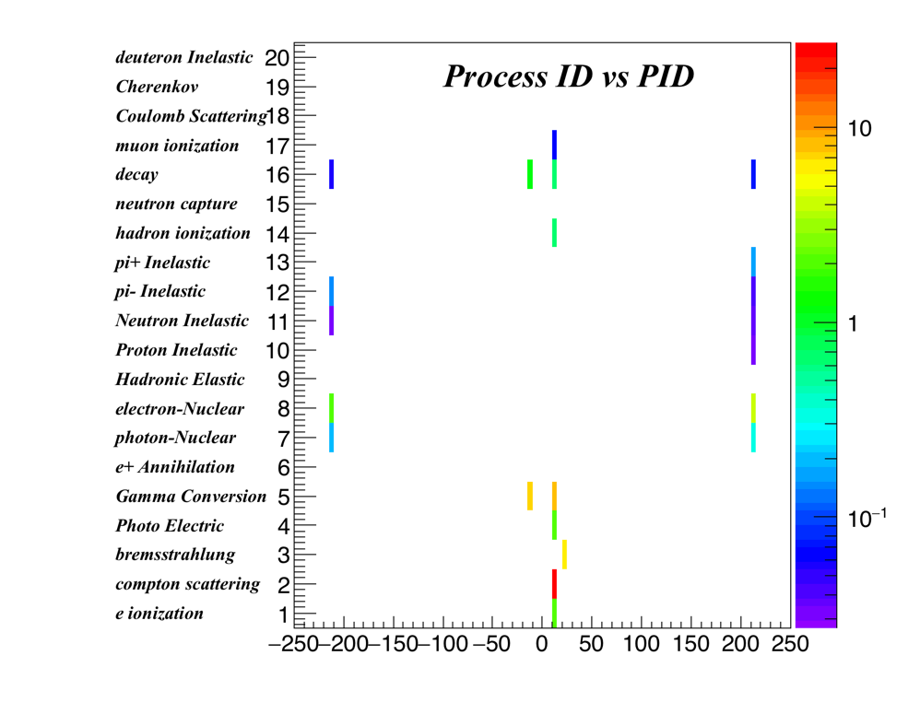
Physics Processes

Slide 33
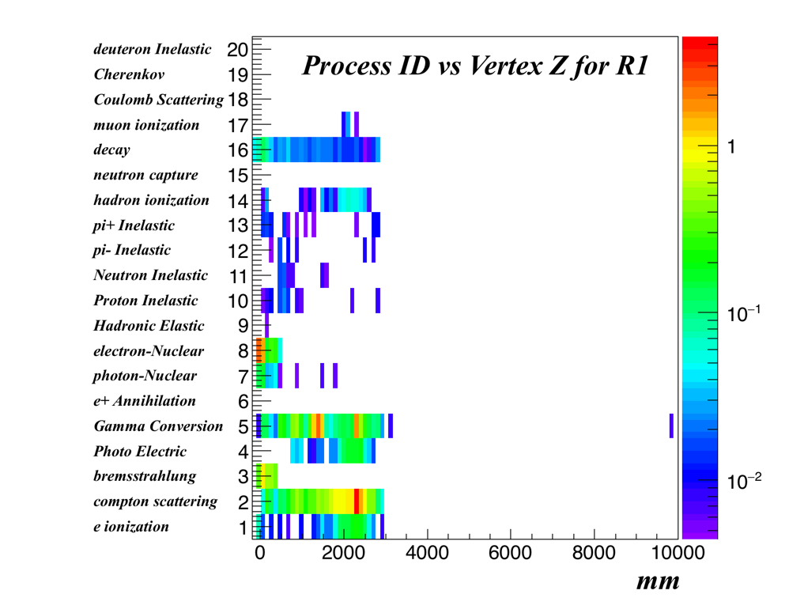
Physics Processes

Slide 34

Physics Processes

Slide 35

Physics Processes

Slide 36

Physics Processes
MeV

Slide 37
Summary: two configurations
Narrowed it down to two configurations
Same FT shield can be used when FT is not in used.
Removal of FT tracker has minimal schedule impact.
Hot spot in Torus Mount can be shiel
Helium between target and shield improves background by:
~ 10% if FT is used
~ 50% if FT is used – at which point the occupancy is < 1% in R1

