Slide 1
Hall-B Slow Controls
N. Baltzell
2nd 1st CLAS12 Experiment Workshop
February 23, 2016

Slide 2
Overview
Hall-B Team:
  Glasgow & JLab: N. Baltzell, K. Livingston, B. McKinnon, W. Moore
  Biweekly meetings: 8:30 on Fridays in L210A
  Wiki: https://clasweb.jlab.org/wiki/index.php/CLAS12_Slow_Controls
    With meeting agendas and minutes, Gantt chart, subsystem specs, improving documentation
  First goal: KPP, full baseline support by summer’s end
  Essential Groups Involved:
    Detector Support Group (Torus/Solenoid/Cryo/Gas)
    S. Boyarinov (DAQ)
Framework:
  UI: java-based CS-Studio
  OS: RHEL7
  EPICS: R3.14.12.5
  Lots of sharing with Hall-D
  BEAST alarm handler inside CS-Studio
  JLab Mya EPICS archiver
  Porting & improving/replacing CLAS6 software
  Upgrading hardware where necessary/possible

Slide 3
Overview
Detector specific GUIs developed and in use
Hierarchical system with navigable tree view
Alarm system tested and to be deployed spring 2016
Gas/Torus/Solenoid/Cryo EPICS interface in progress
DAQ-Integration developed with HPS
Moller counters refurbished
Hardware Purchases Ongoing
FTC controls

Slide 4
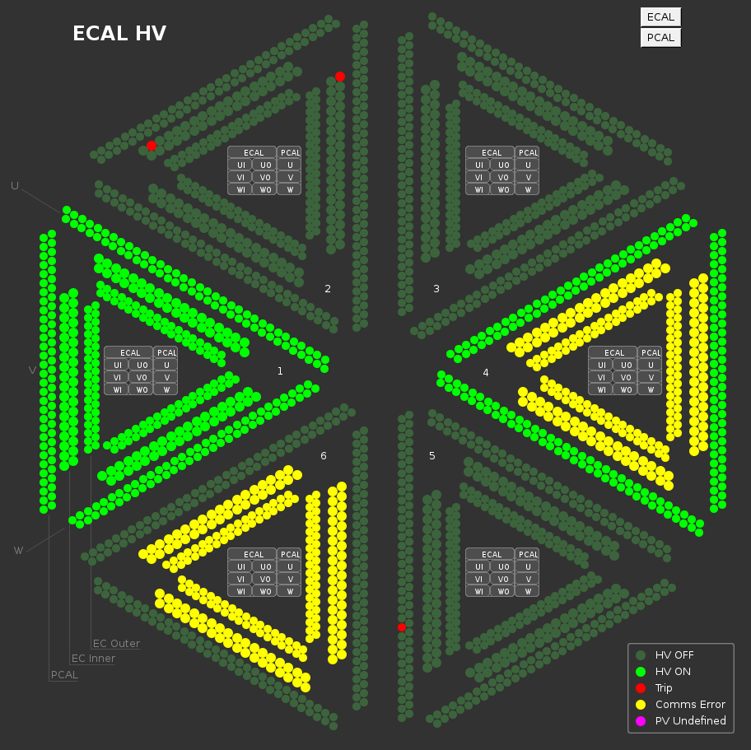
Detector HV
Geographic screens for HV
  shows status via color
    trip/on/off/ramping/comms

Slide 5

Detector HV
Geographic screens for HV
  shows status via color
    trip/on/off/ramping/comms
Provides acces to
  global/group/individual controls

Slide 6
Detector HV
Geographic screens for HV
  shows status via color
    trip/on/off/ramping/comms
Provides acces to
  global/group/individual controls

Slide 7

Detector HV
Geographic screens for HV
  shows status via color
    trip/on/off/ramping/comms
Provides acces to
  global/group/individual controls
  save/restore

Slide 8
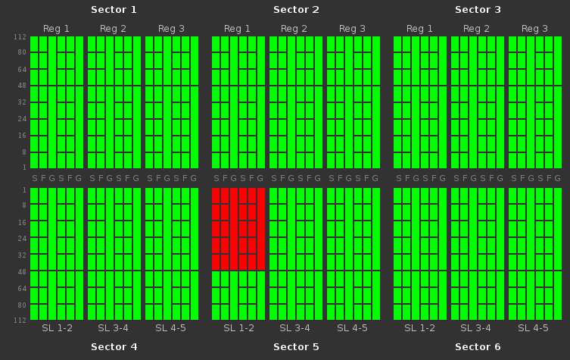
Detector HV
Geographic screens for HV
  shows status via color
    trip/on/off/ramping/comms
Provides acces to
  global/group/individual controls
  save/restore
ECAL,PCAL,FTOF,CTOF,HTCC
  Coming soon: DC, LTCC

Slide 9
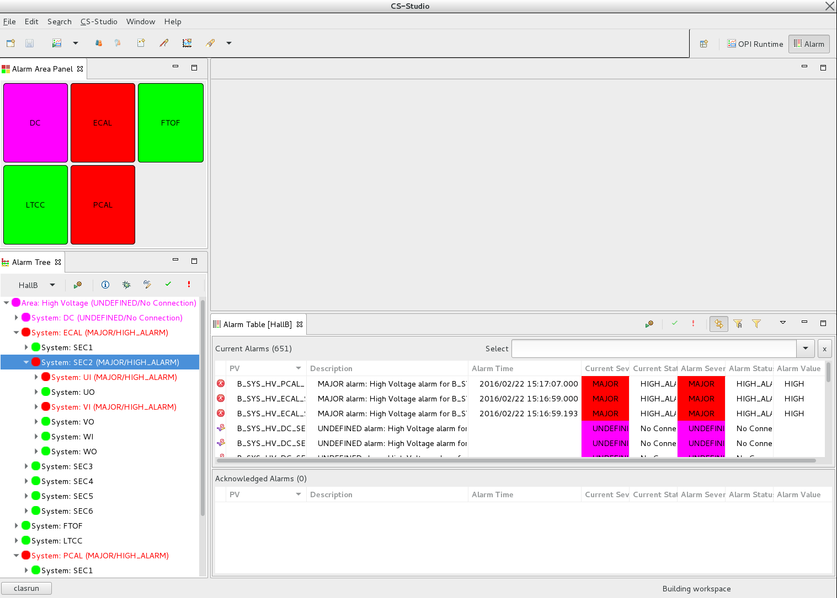
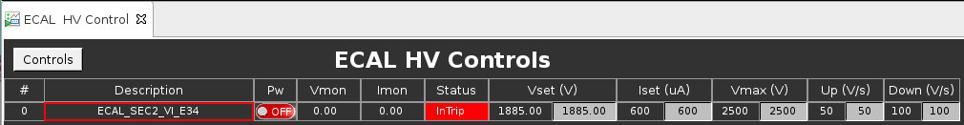
Alarm Handler

Slide 10
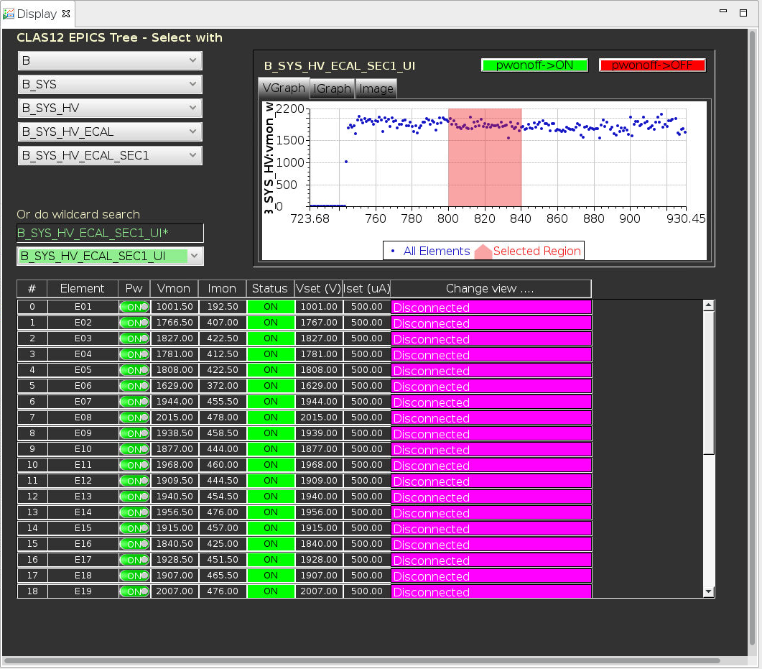
Hierarchical Tree View
Navigate through entire system
  by detector/sector
  *with wildcard search*
Graphs can be included in any screen
  e.g. HV Current/Voltage
Hierarchy to be used for alarm system
  including daq info, scalers, etc

Slide 11
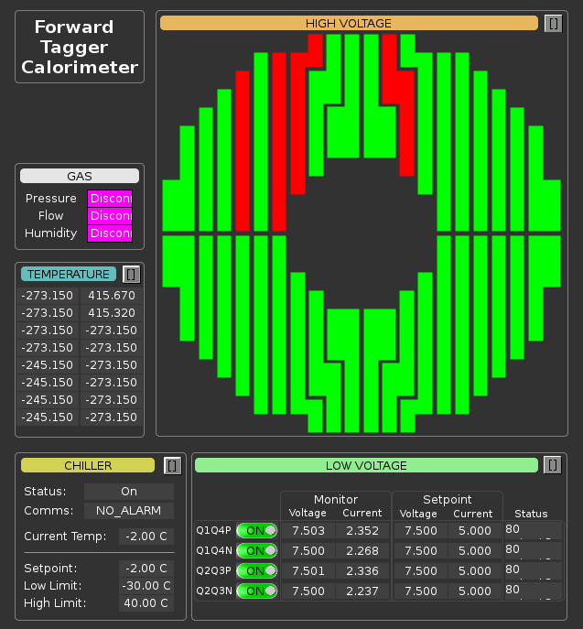
Detector Overview Screens
By request of detector groups
Example shown for FTC
  Includes HV, LV, Gas, Temps, Chiller
  Links to controls for each subsystem
  Involvement from detector group
Similar overview for HTCC exists

Slide 12
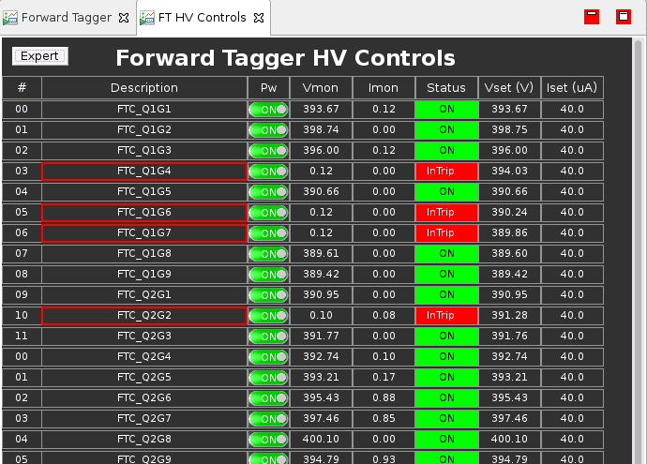
Detector Overview Screens
By request of detector groups
Example shown for FTC
  Includes HV, LV, Gas, Temps, Chiller
  Links to controls for each subsystem
  Involvement from detector group
Similar overview for HTCC exists

Slide 13
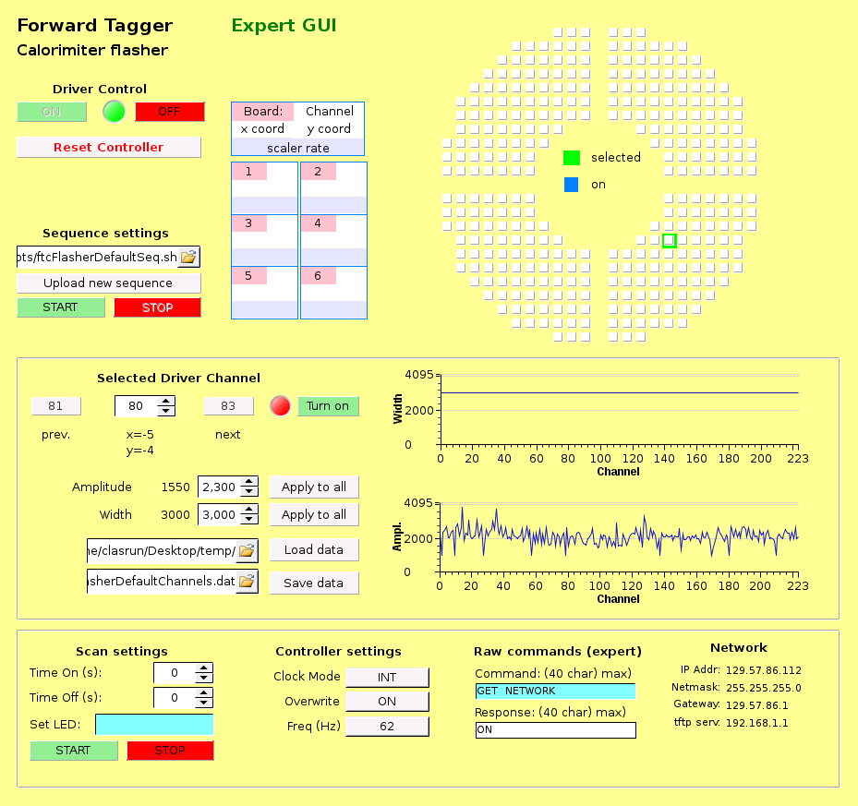
Detector Overview Screens
By request of detector groups
Example shown for FTC
  Includes HV, LV, Gas, Temps, Chiller
  Links to controls for each subsystem
  Involvement from detector group
Similar overview for HTCC exists
Flasher controls screen

Slide 14
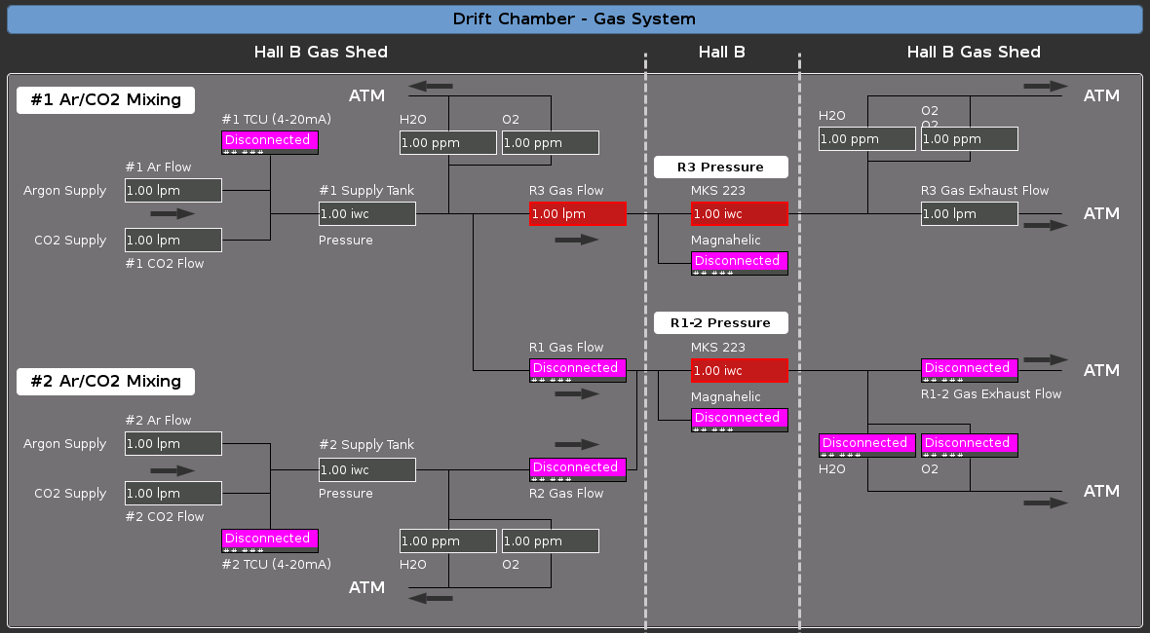
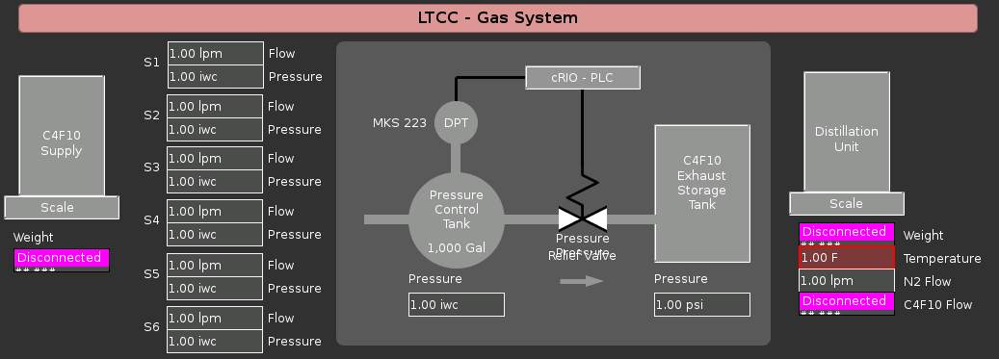
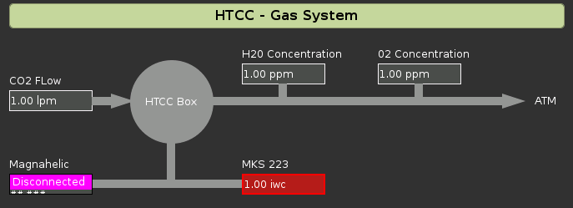
Gas System
CompactRIO (DSG)
EPICS integration for user monitoring & alarms in counting house in progress

Slide 15
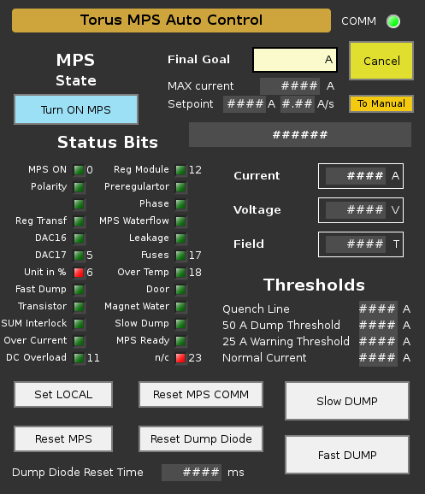
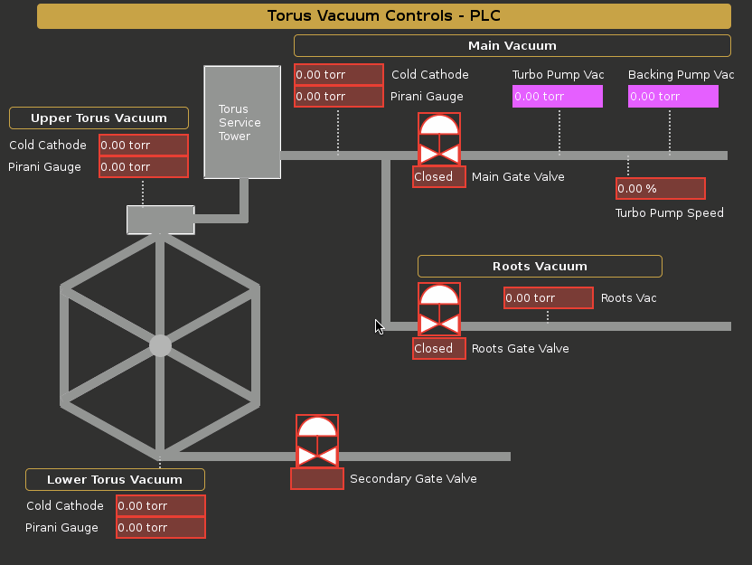
Torus, Solenoid
3 Allen-Bradley PLCs (DSG): Power Supplies, Vacuum, Cryo
EPICS integration for user monitoring & alarms in counting house in progress

Slide 16
Summary / Outlook
Progress Status
HV System [95%]
Alarms [50%]
Beamline Motors/Scalers [80%]
Moller Polarimeter [10%]
EPICS ⟺ DAQ [90%]
EPICS ⟹ rundb [95%]
MYA Archiver [50%]
Select FADC/DISC Scalers [0%]
Gas System [75%]
Torus, Solenoid, Cryo [75%]
Saclay Target [EPICS=0%]
Hall Weather [50%]
Wiener Crates [80%]
IOC Admin [90%]
Detector Specific Screens [50%]
SVT (by OPS) [95%]
BTA [0%]
En Route to KPP by end of summer 2016
Some of the bigger unfinished pieces:
  Refurbish Moller Polarimeter system
  FADC/DSC2 scalers to EPICS
  Saclay Target integration into EPICS
Wish List
Web browser access (WebOPI/VDI)
All FADC/DISC Scalers in EPICS
Full DAQ controls in CS-Studio
Full SVT integration in CS-Studio
More …

Slide 17
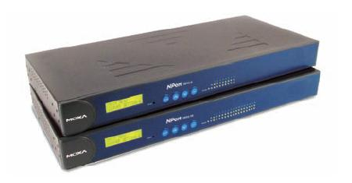
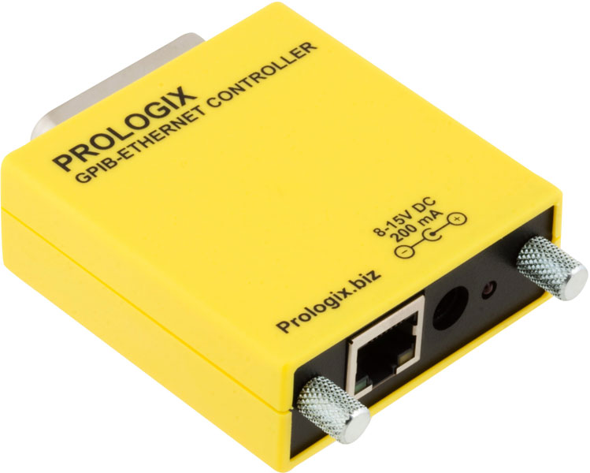

Upgrade Purchases
Server for Mya EPICS archiver (all systems)
MOXA serial comms (various→ EPICS)
  chillers, thermocouples, gaussmeters …
GPIB-ETH converters (DC LV → EPICS)
Weather system (FC, SF, CH) *
  Temperature+Humidity
CAEN mainframe CPU+MPS (HV)
Cameras (general) *
Additional server for remote users *
* not finalized

