Slide 1


Inverted-Insulator and electrode studies
for a 350 kV Photoelectron Gun
P. Adderley, D. Bullard, E. Forman, J. Grames, J. Hansknecht,
C. Hernandez-Garcia, M. Poelker, M. Stutzman,
R. Suleiman, S. Zhang
Students: M. BastaniNejad, Md. Abdullah A. Mamun, Y. Wang
Juelich contingent visit to JLab, Feb. 3-5, 2016
Notes:
Interior Page Design 2

Slide 2
overview
We have a 200kV photogun, but want a 350kV, WHY?
Evaluating insulator and electrode configurations
  Bias electrode at target kV without breakdown
Dealing with field emission phase I,
  From electrode material choice to surface finish techniques
Dealing with field emission phase II,
  High Voltage processing, with Kr gas, a powerful technique.
Notes:
Interior Page Design 2

Slide 3

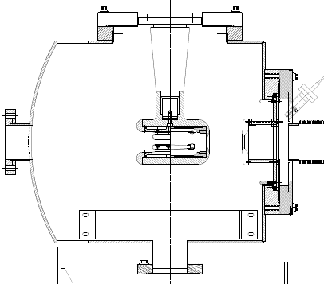
The CEBAF - ILC 200kV Inverted Gun
Our photoguns are based on inverted geometry ceramic insulators that connect with a HV cable to a power supply
Notes:
Interior Page Design 2

Slide 4
We always want higher gun voltage:
Reduce space-charge-induced emittance growth, maintain small transverse beam profile and short bunch-length. In other words, make a “stiff” beam right from the gun
Reduce problems associated with Surface Charge Limit (i.e., QE reduction at high laser power)
Prolong Charge Lifetime (?)
Compact, less-complicated and less-expensive injector
Biggest Obstacle: Field Emission and HV Breakdown… which lead to bad vacuum and photocathode death
Notes:
Interior Page Design 2

Slide 5
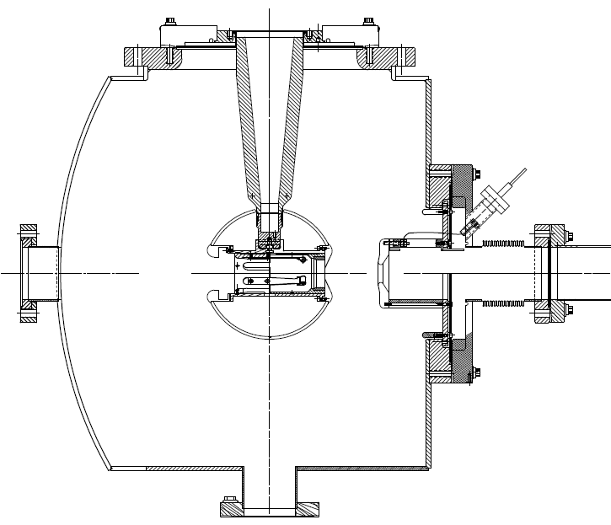
CEBAF-ILC 200kV vs 350 kV option
~ 11 MV/m
@ 200 kV
~ 12 MV/m
@ 350kV
Maximum Field strength
“R28” insulator
Longer “R30” insulator
Spherical electrode
Notes:
Interior Page Design 2

Slide 6
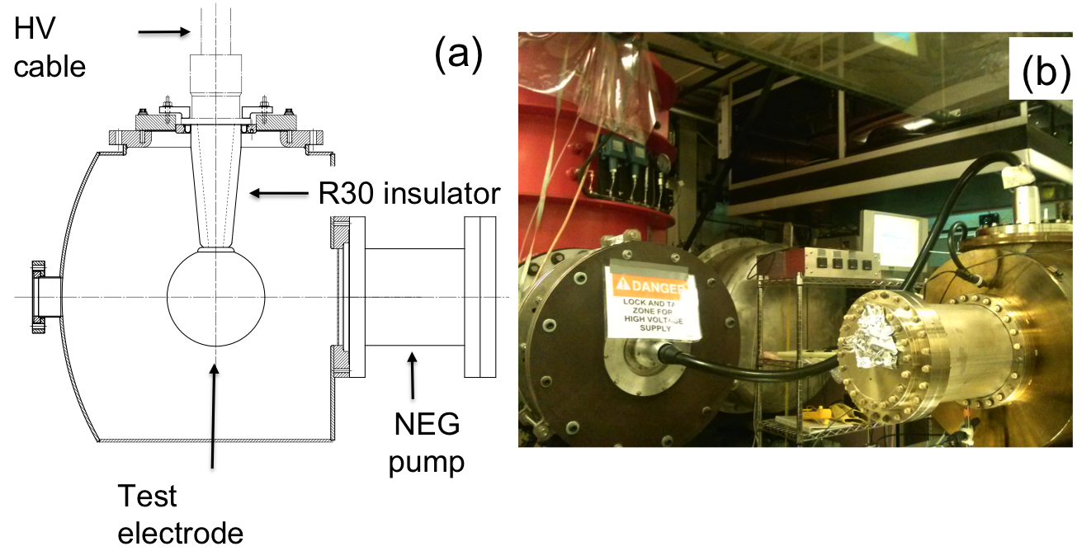
In pursue of the 350 kV Gun start by evaluating HV breakdown at the cable/insulator interface
Utilize “dummy” electrodes to test different insulators and triple point screening electrode
Notes:
Interior Page Design 2

Slide 7
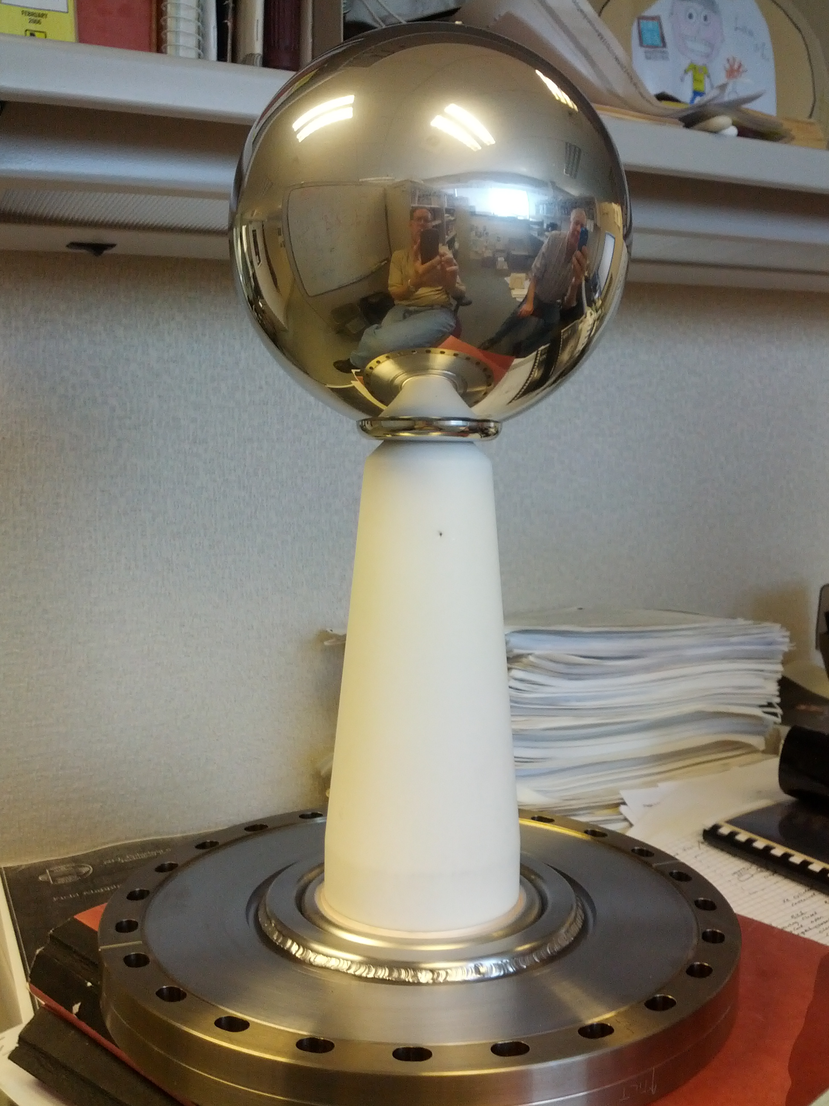
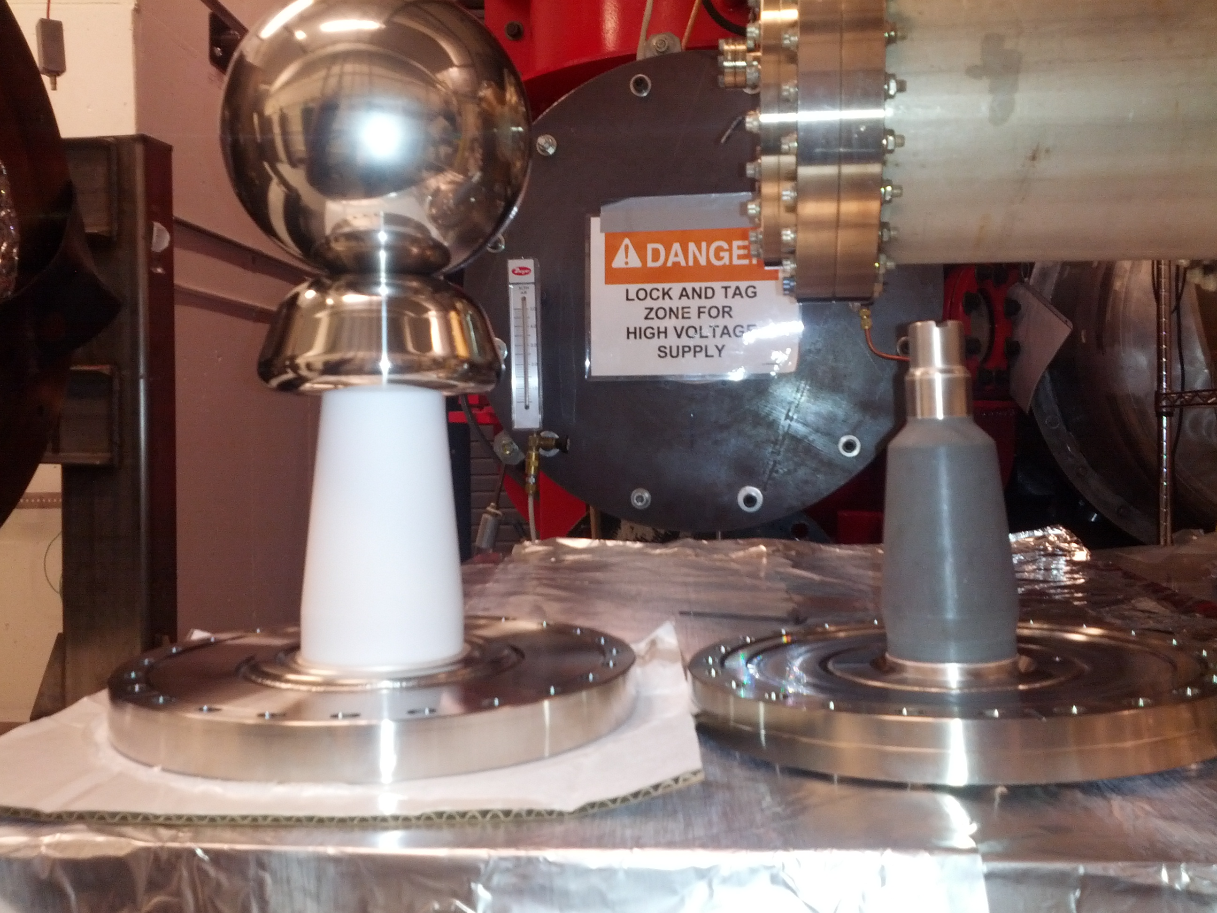
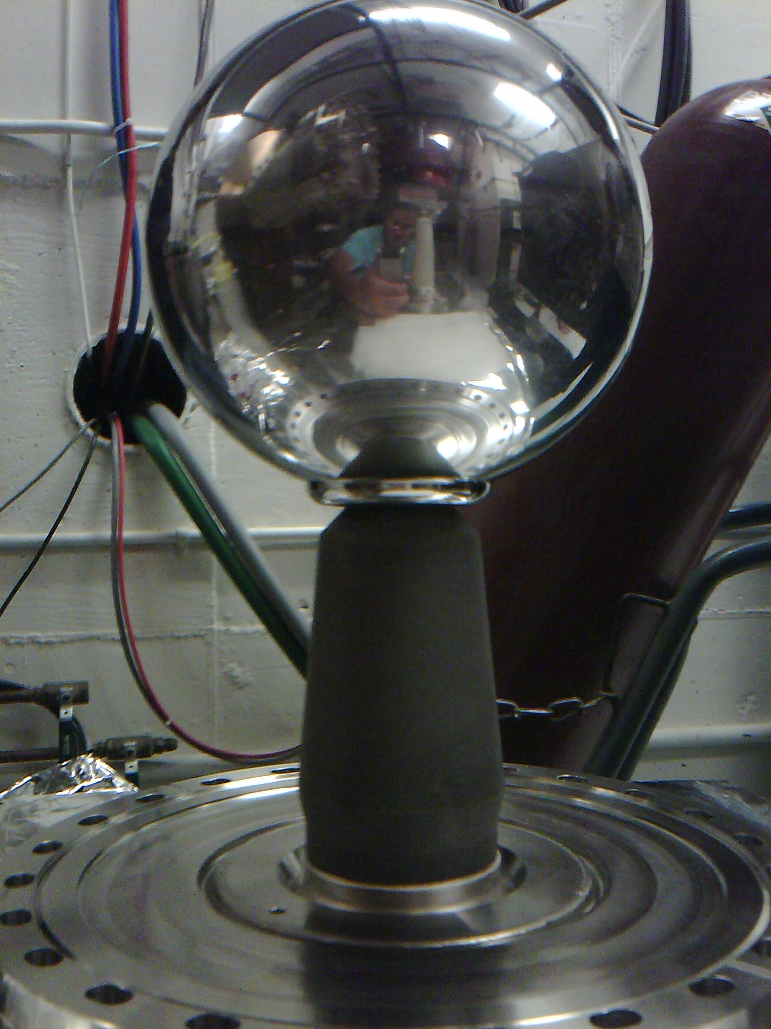
We tested insulators with 15 cm dia. spherical “dummy” electrode
Short R28 insulator, doped alumina, mild bulk conductivity
Longer R30 insulators, conventional alumina
Longer R30 insulator, conventional alumina with a screening electrode (shed)
Longer R30 insulator, doped alumina, mild bulk conductivity
ZrO-coated R30 insulator, also mildly conductive
Notes:
Interior Page Design 2

Slide 8
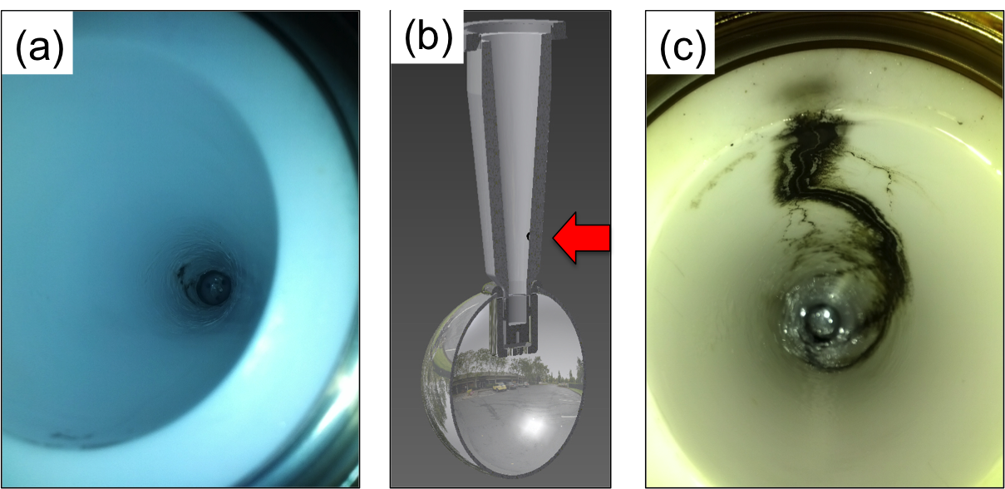
And faced the realities of breakdown at Cable/Insulator Interface
Problems at the cable junction, cable plug side
The first test with R30 pure alumina ceramic suffered breakdown at ~315kV with subsequent puncture at 330kV.
A second test with a new R30 pure alumina suffered breakdown at ~315 kV.
Note: Field emission was managed via krypton-processing. i.e., voltage first applied with ~10⁻⁵ Torr krypton added to gun chamber
Notes:
Interior Page Design 2

Slide 9
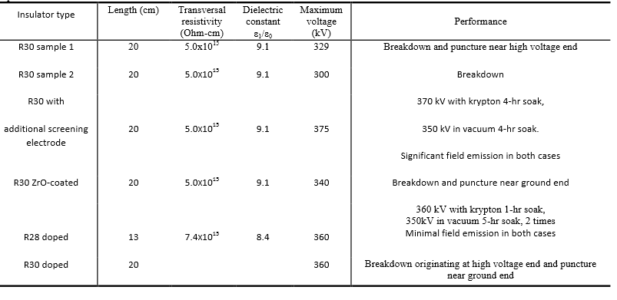
Summary of Tests & Results
Two and 1/2 configurations reached our voltage goal
7.4x10¹¹
7.4x10¹¹ ??
Notes:
Interior Page Design 2

Slide 10
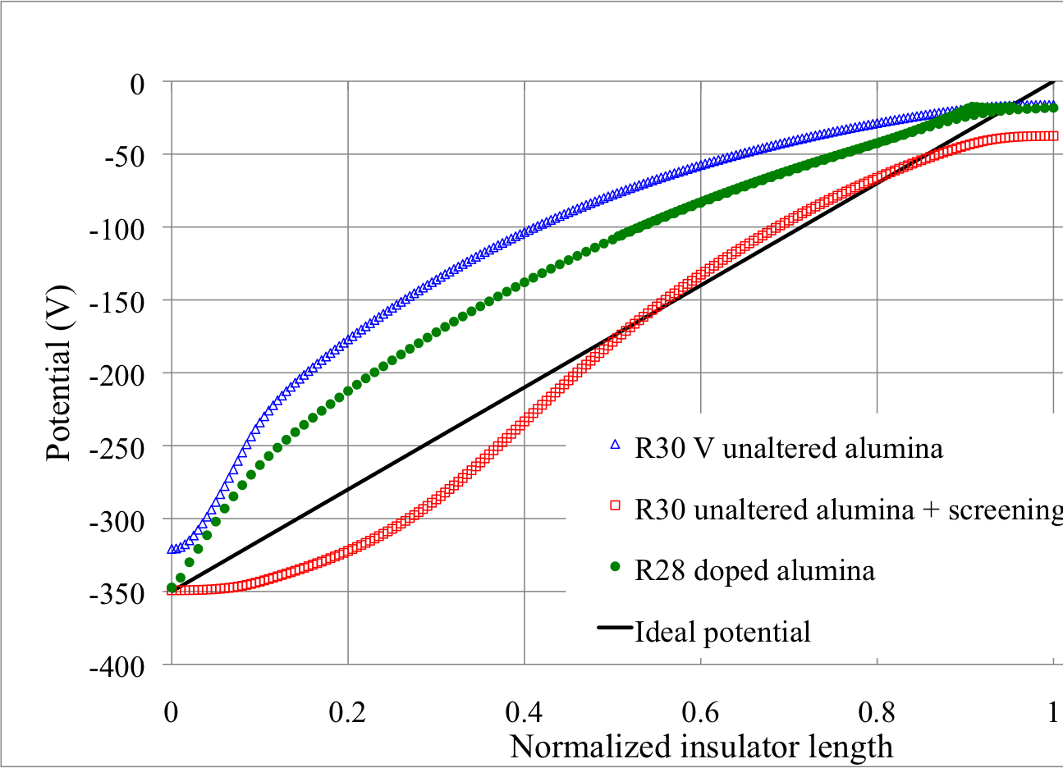
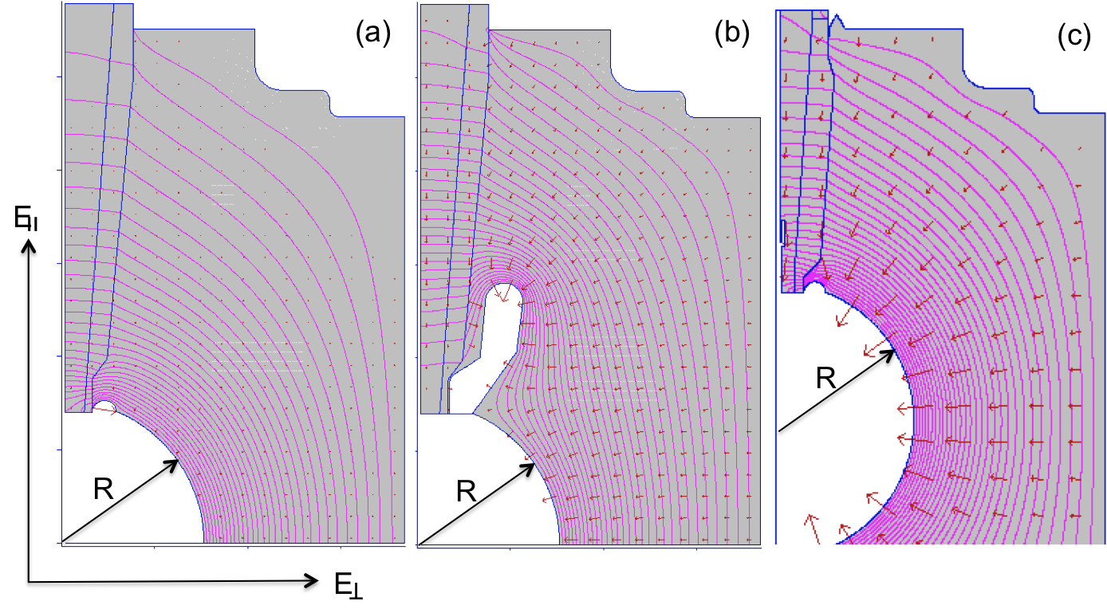
Linear Potential Drop
Want a linear potential gradient along length of the insulator
Note - POISSON does not model the mildly-conductive feature of the black doped insulator
Notes:
Interior Page Design 2

Slide 11
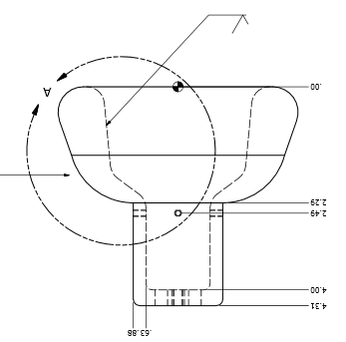
Plan Y: Combine the two features that provided incremental success: screening electrode and doped black R30 insulator
Replace dummy ball with electrode that can hold photocathode

Slide 12
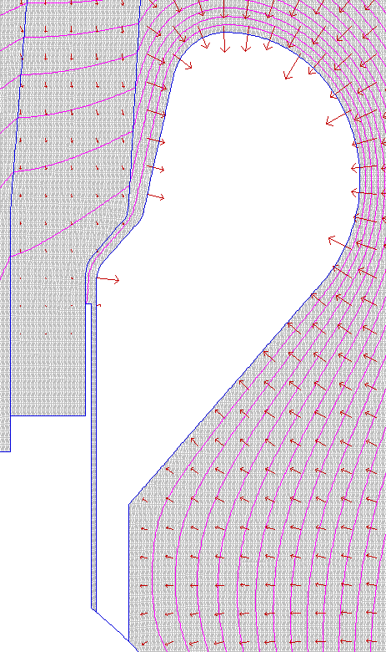
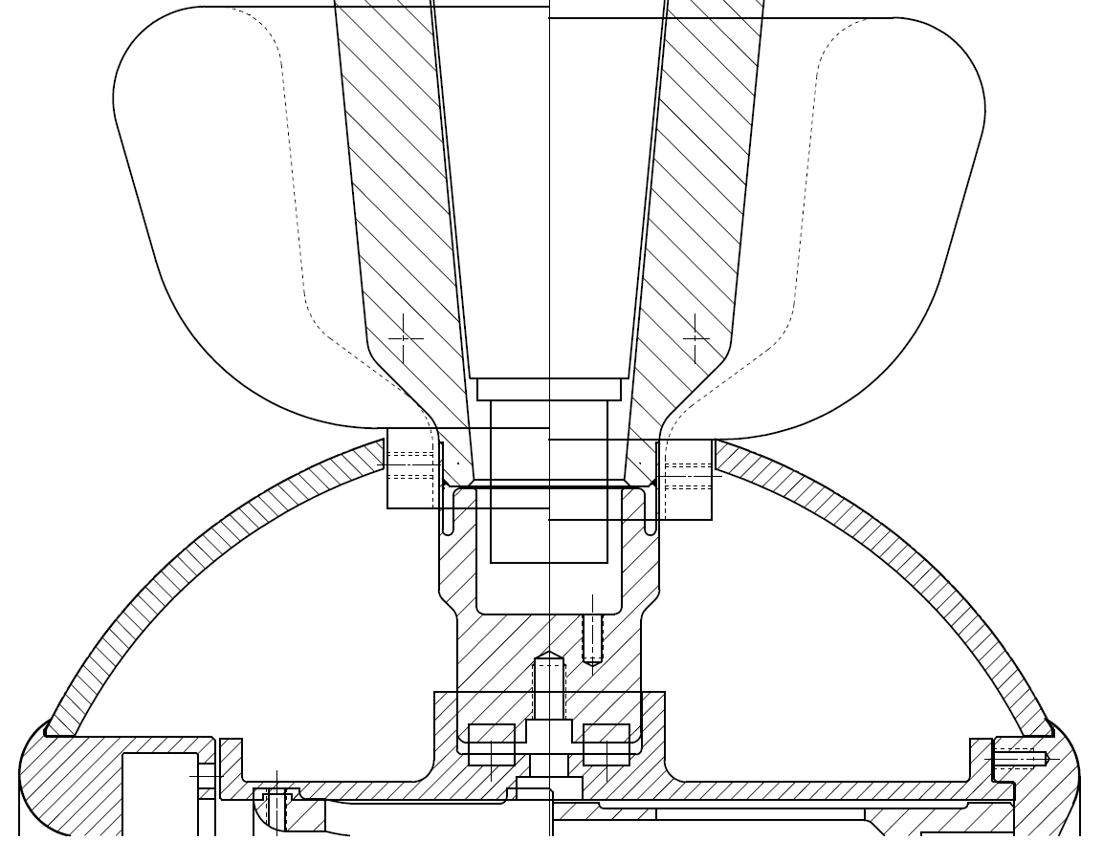
The gap between shed and insulator
reduce
7 MV/m
9.5 MV/m
10 MV/m
10.8 MV/m
Keep field strength low at triple point (metal, insulator, vacuum)
8 MV/m
9.5 MV/m
7 MV/m
8 MV/m
Gap = 1 mm

Slide 13
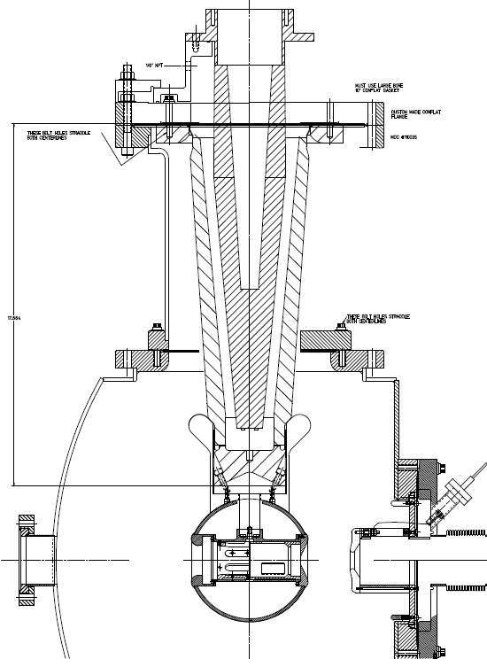
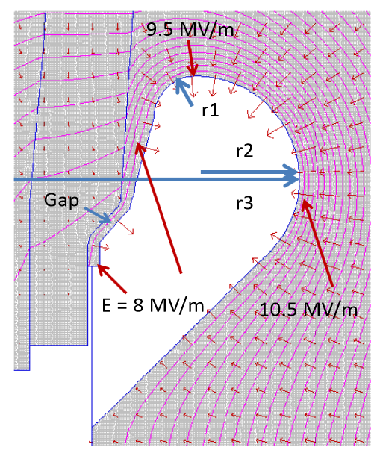
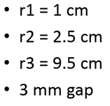
R350 epoxy receptacle
Plan Z
Combination of doped insulator and shed, SF6 and epoxy receptacle, plus added length
the screening electrode, a good design…
SF6
Doped insulator
Screening electrode
Work of Yan Wang

Slide 14
Field Emission
Sources of Field Emission: micro-protrusions, contamination on surface, material defects and impurities, ionization of desorbed gas, etc.,
Material choices: hardness, work function, grain structures and grain boundaries, electrical conductivity, thermal conductivity
Surfaces: generally people assume smooth is better than coarse, although experiments indicate smooth does not guarantee “good”
Mostly, people assume 5 MV/m is “easy” - we want to operate at 10 MV/m or higher
Notes:
Interior Page Design 2

Slide 15
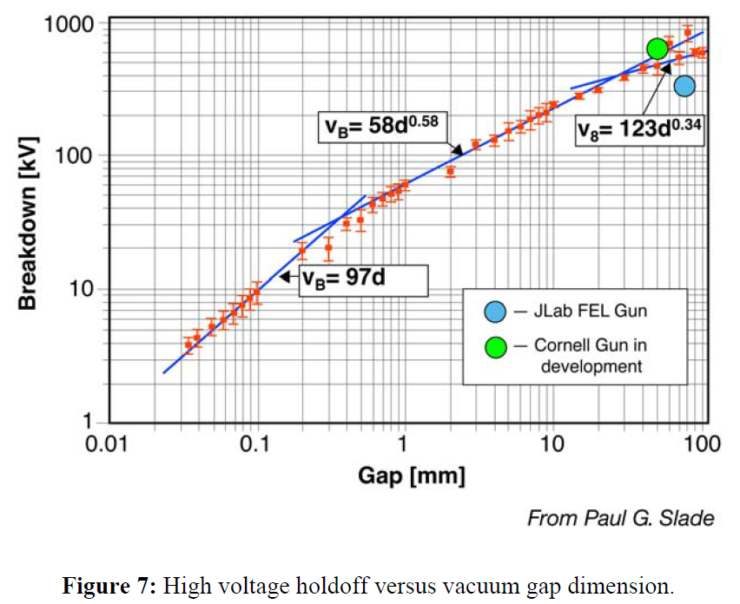
Breakdown in Vacuum
Notes:
Interior Page Design 2

Slide 16
Field Emission: Things we’ve been Studying
Fowler-Nordheim Theory: a good place to start, but it will disappoint …
Diamond-paste polished stainless steel
  Is it necessary to have such a smooth surface?
Gas conditioning: an essential tool
Electropolished stainless steel: speed the process?
Barrel-polished stainless steel: another option
BCP-d niobium: expensive
TiN-coated aluminum: promising…
900 ºC degas, CO₂ snow, high pressure rinsing…
Notes:
Interior Page Design 2

Slide 17
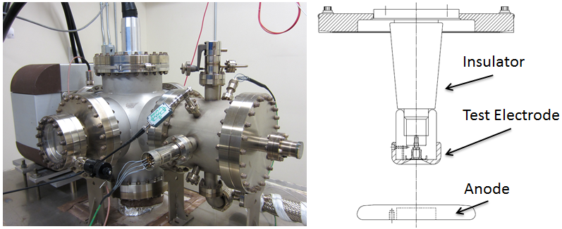
Field Emission Test Stand
Spellman -225kV supply, small “R28” inverted insulators, variable cathode/anode gap from to 10 to 50mm, field strength to ~ 20 MV/m
Build a test stand that resembles an actual gun (tests with small gaps and high field strength but low voltage, don’t appear to be very useful)
Notes:
Interior Page Design 2

Slide 18
Diamond-Paste Polishing
Receive the electrode from the machine shop with “32” surface finish
Silicon carbide polishing with 240 grit paper to remove obvious visible scratches
Solvent cleaning in ultrasonic bath of alkali solution
Silicon carbide polishing with 300 and progressively finer sand paper up to 600 grit with solvent cleaning in ultrasonic bath of alkali solution between grits.
Polish with 6μm grit diamond paste, then with 3μm and finish with 1μm grit diamond paste with solvent cleaning in ultrasonic bath of alkali solution between grits
High pressure rinsing (1200 psi) for 20 minutes with ultrapure de-ionized water with resistivity > 18 MΩcm.
High temperature (900ºC) vacuum degas for one hour
Two months later and the electrode is ready for high voltage!
Maybe it will work!?
Notes:
Interior Page Design 2

Slide 19
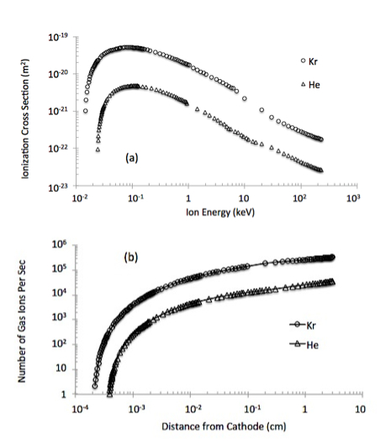
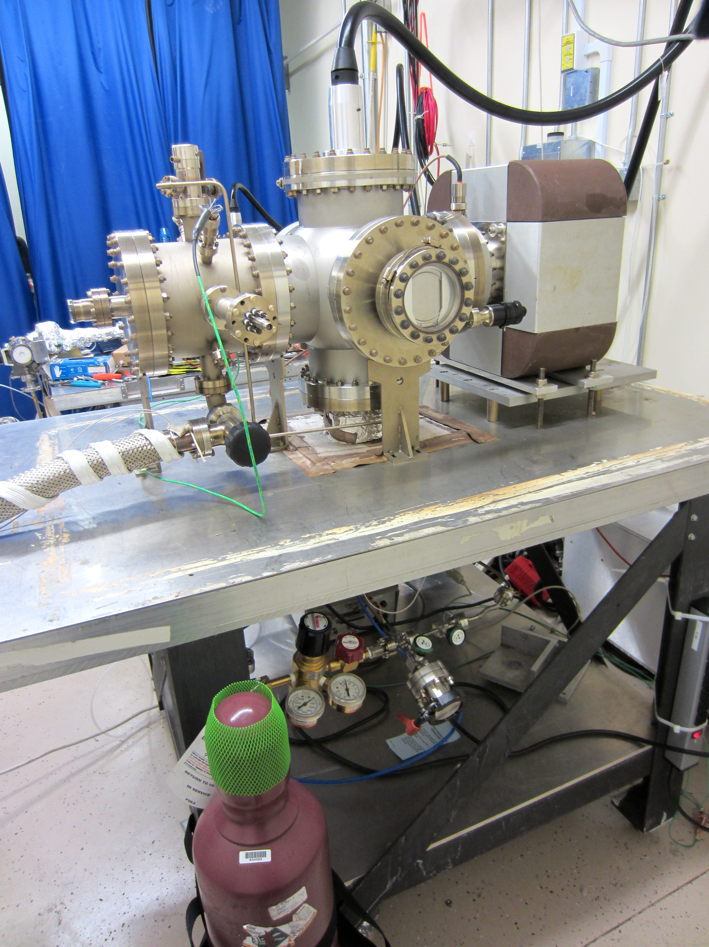
High Voltage Gas Conditioning
Leak Valve
Field emission ionizes inert gas
Ions bombard electrode, hopefully near field emitter, which can be sputtered away
And ions get implanted, increasing work function
Gas Bottle
Notes:
Interior Page Design 2

Slide 20
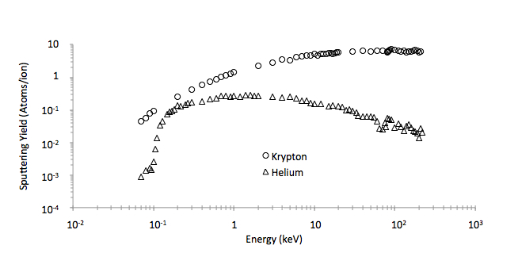
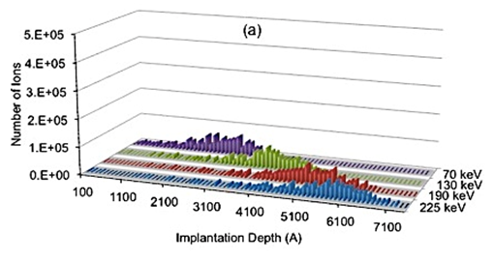
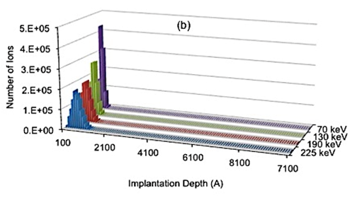
What Does Gas Conditioning Do?
Sputtering and Implantation
Helium: provides a shallow implantation depth, so it seems to work best when FE turns ON at lower voltages, and/or with small gaps (10 to 20mm), don’t expect much sputtering
Krypton: can work at any voltage, good for larger gaps (30 to 50mm), sometimes too much sputtering creates a new field emitters
Helium
Krypton
Implantation
Sputtering Yield
Notes:
Interior Page Design 2

Slide 21
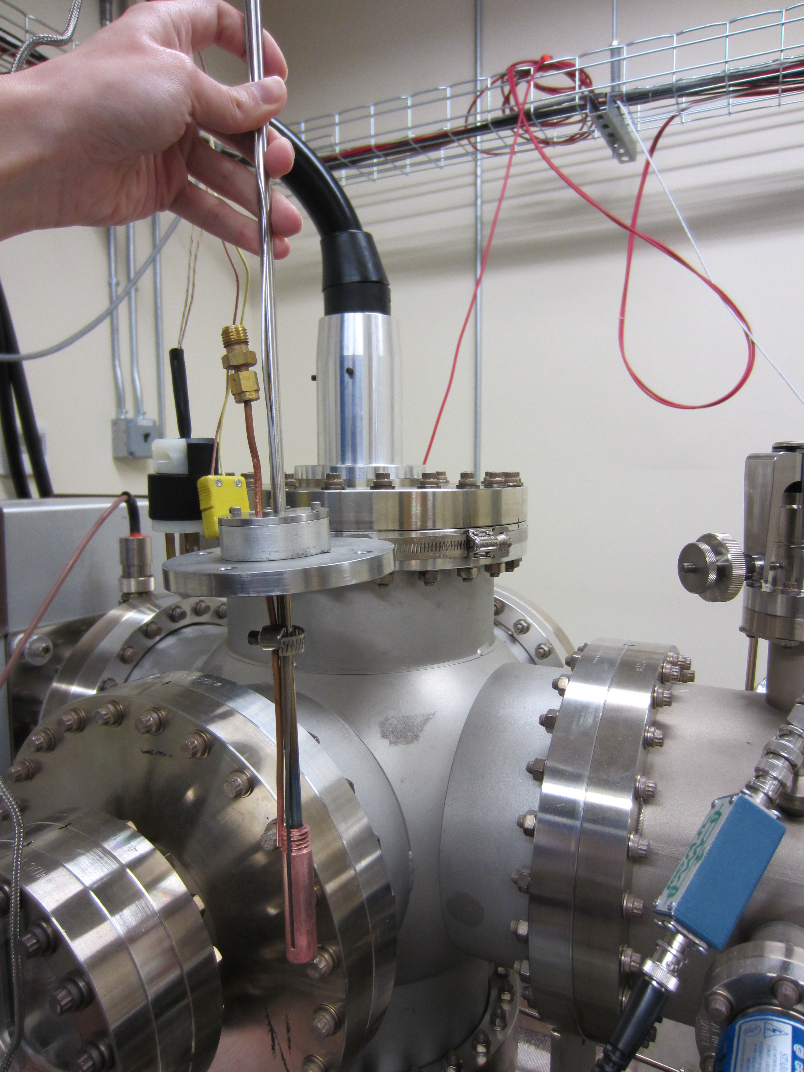
What Does Gas Conditioning Do?
Benefits of implantation are reversible
Work of M. BastaniNejad, E. Forman, C. Hernandez-Garcia
Notes:
Interior Page Design 2

Slide 22
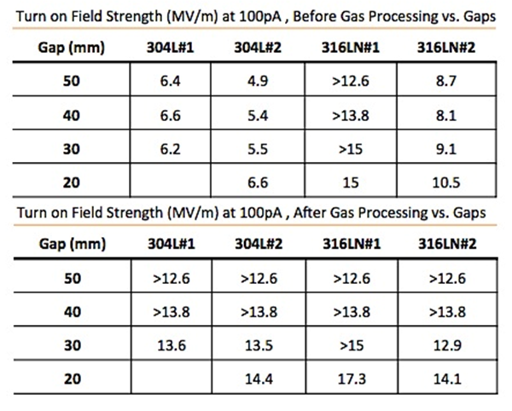
A Powerful Technique
Gas conditioning can turn a BAD electrode into a GOOD electrode
TURN OFF ion pump
NEG pumps don’t pump inert gas
Add gas at 10⁻⁵ Torr, apply voltage and watch for sharp decrease in FE current
Perhaps 316L is better than 304L?
Notes:
Interior Page Design 2

Slide 23
HV conditioning with Kr gas in action
Once the Kr pressure has been established ~10⁻⁵ Torr:
As the voltage is incrementally increased:
  Monitor the HV power supply current,
  Monitor the radiation around the gun
There are two phases:
  Field emission processing (current ‘quenching’)
  Voltage induced gas desorption, typically starting >200kV
Notes:
Interior Page Design 2

Slide 24
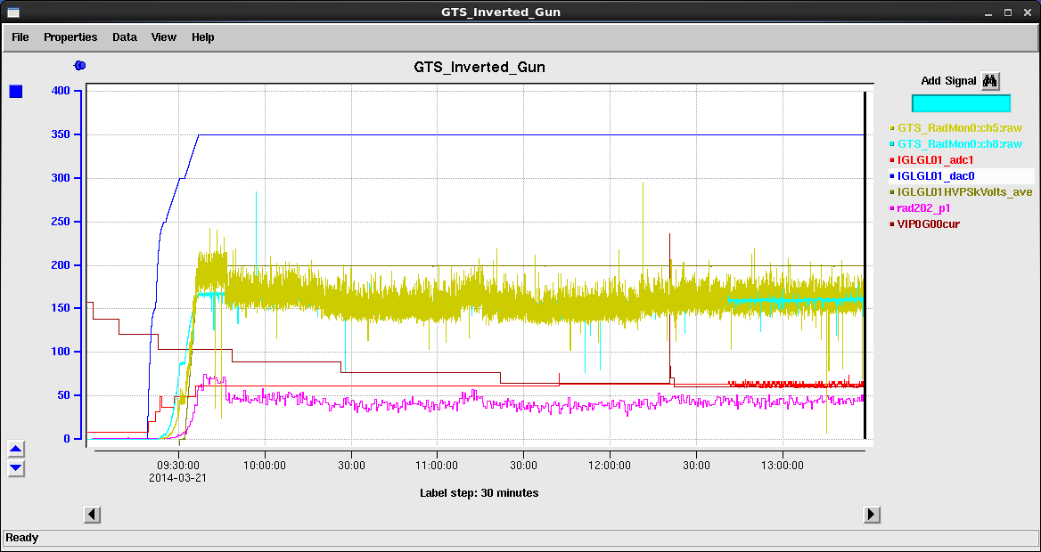
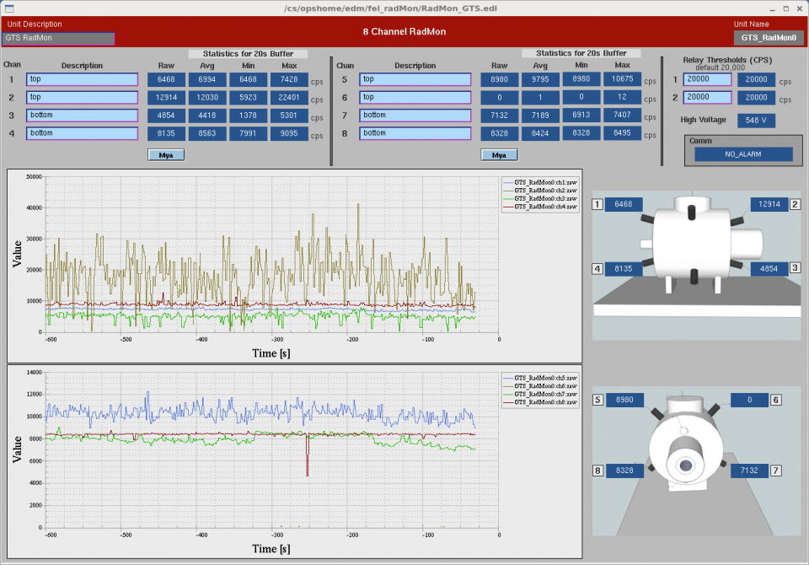
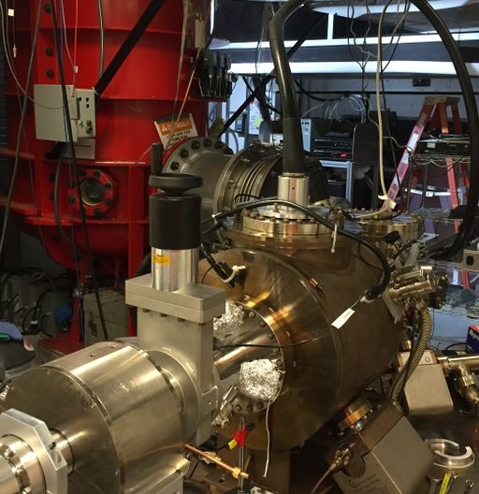
Monitoring voltage, current and radiation
Voltage
radiation
Geiger monitors
current
Notes:
Interior Page Design 2

Slide 25
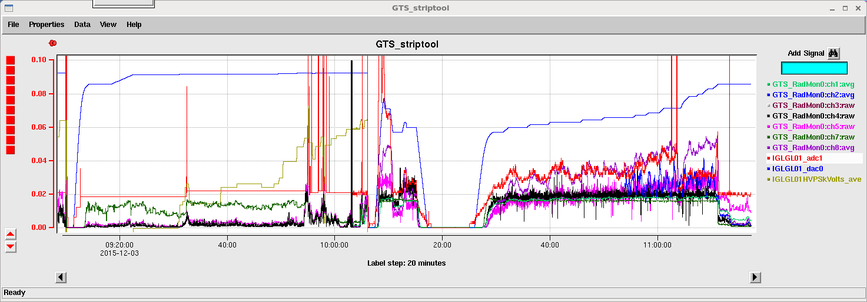
Field emission processing phase
Can occur at any voltage
Typically more problematic at higher voltages > 200 kV
It is critical to set a “current limit” for shutting off the high voltage power supply, typically no higher than 0.5 mA
Usually is under control with Kr gas HV processing, unpredictable under vacuum HV processing conditions.
Voltage
current
radiation
Matt Poelker, Jefferson Lab
Notes:
Interior Page Design 2

Slide 26
Voltage induced gas desorption
Depends on voltage, not on field strength (gradient)
Typically starts > 200 kV
It is related to the gas (Hydrogen) ‘stored’ in the anode (chamber walls). We did not see any difference between baked and unbaked electrodes.
Gas is desorbed from the chamber walls each time the voltage is increased to a new value, but once the gas is pumped out, the system is and remains conditioned up that last voltage value.
In our photougn, it takes about 10 minutes per 1 kV step for the released gas to pump out between 200 and 300 kV.
The load of released gas increases with voltage. In our photogun, it takes about one hour per 1 kV step to pump the gas >350kV.
If the gas load is not allowed to pump out before increasing the voltage, it is likely that a field emitter will be created.
Notes:
Interior Page Design 2

Slide 27
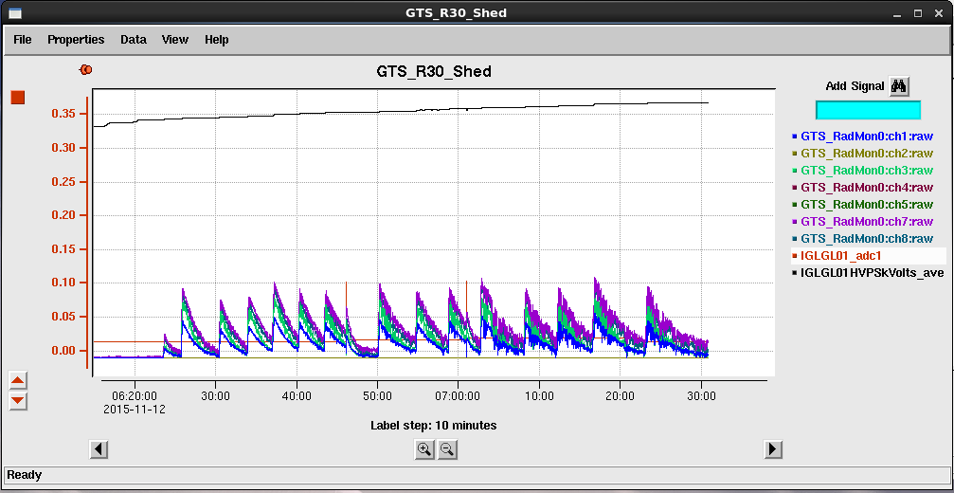
Classical example of Voltage Induced Gas Desorption with Krypton
Voltage
current
radiation
Notes:
Interior Page Design 2

Slide 28
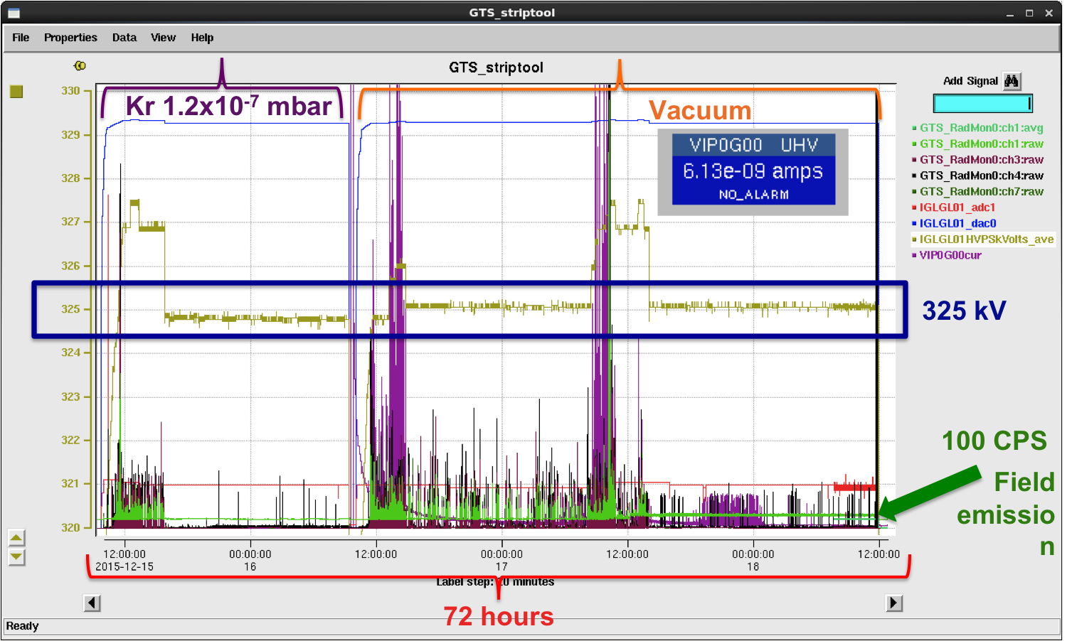
The target voltage is sustained when the gun is fully conditioned. Usually it takes us
~150 hours to condition a gun to 350kV
Notes:
Interior Page Design 2

Slide 29
Backup Slides
Thank You
Notes:
Interior Page Design 2

Slide 30
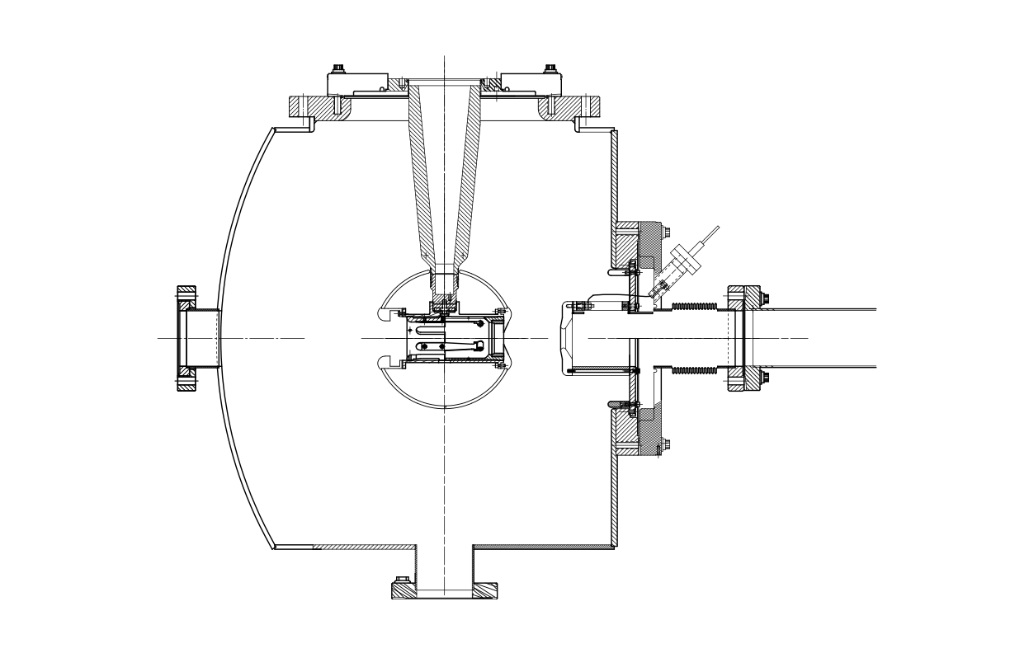
We then tested an R28 (shorter) semi-conducting ceramic (is this ceramic useful for CEBAF-type gun -225kV?), and worked to 360kV with Krypton!!!
119 mm
We stopped at that voltage b/c is sufficient for electron gun operations and did not want to cause failure

Slide 31
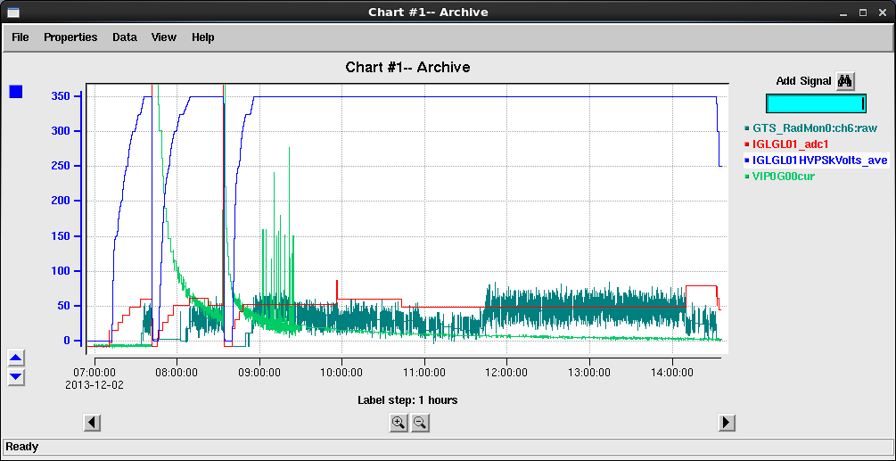
R28 partially conductive ceramic multi-hour run at 350kV under vacuum conditions

Slide 32
Why did the R28 partially conductive ceramic work at higher voltage if it is shorter than the R30 pure alumina ceramic?
We think is a combination of:
The potential along the ceramic on the plug (air) side and on the vacuum side becomes more linear with decreasing ceramic resistivity,
The partially conductive nature of the insulator helps ‘draining’ accumulated charge.
The electrode is closer to ground side of insulator making the potential along the insulator more linear.

Slide 33
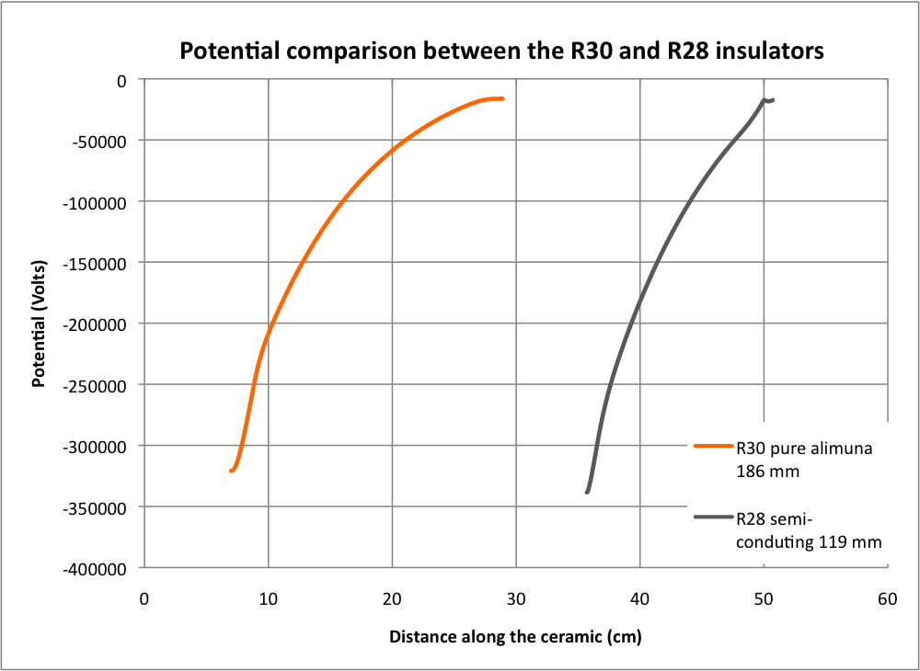
In addition, the potential for the shorter R28 insulator is more linear than that for the longer R30 insulator, the electrode is closer to ground

Slide 34
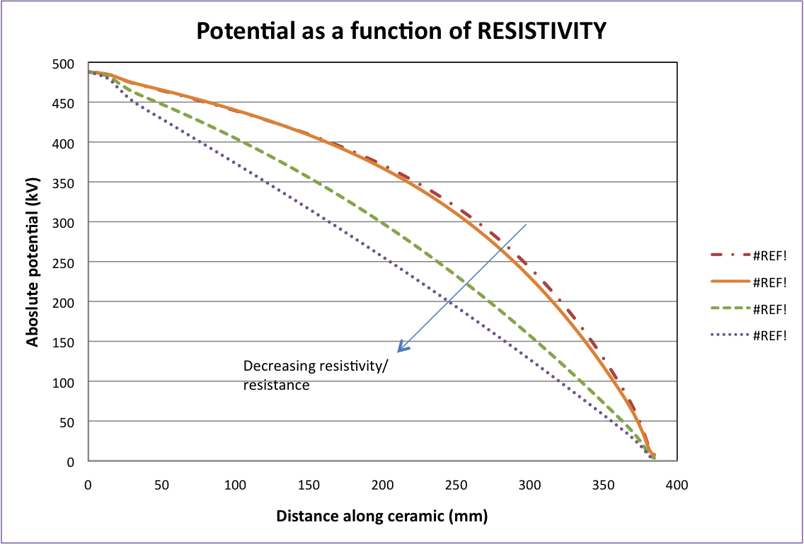
Calculations done by Fay Hannon (2009) show that the potential along the ceramic becomes more linear as the resistivity decreases
10.0x10¹¹ Ohm-cm
7.4x10¹¹ Ohm-cm
2.0x10¹¹ Ohm-cm
1.0x10¹¹ Ohm-cm

Slide 35
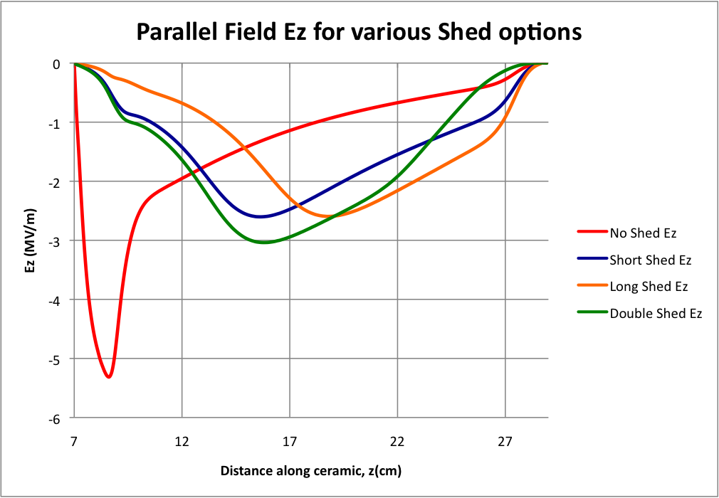

Slide 36
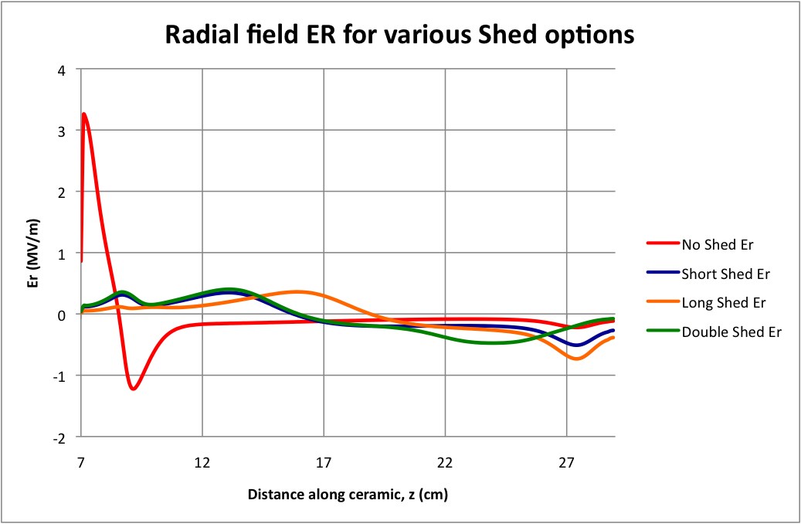

Slide 37
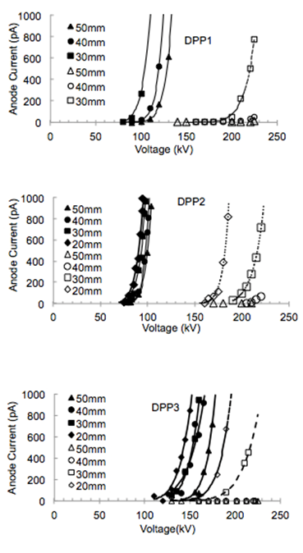
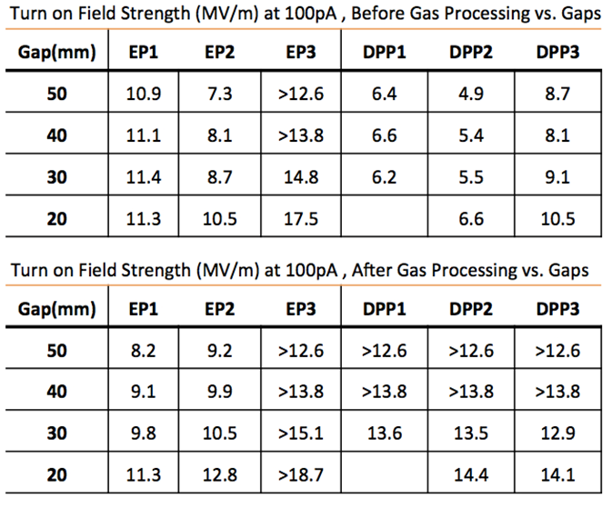
Diamond-Paste Polished Stainless Steel
Variable performance is common
Favorable response to gas conditioning
Matt Poelker, Jefferson Lab
Notes:
Interior Page Design 2

Slide 38
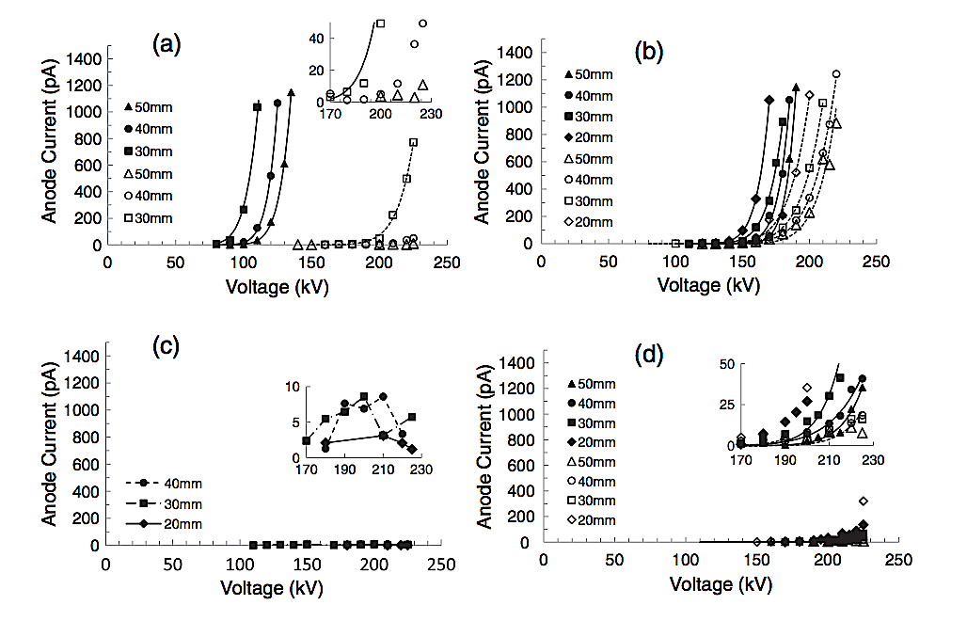
I to V curves for Niobium
Text goes here
304-SS
Fine Grain Nb
Large Grain Nb
Single Crystal Nb
Notes:
Interior Page Design 2

Slide 39
Buffered Chemical Polishing of Niobium
Receive the electrode from the machine shop with “32” surface finish
Silicon carbide polishing with 600 grit paper, if necessary, to remove obvious visible scratches
Solvent cleaning in ultrasonic bath of alkali solution
Buffered-chemical polishing to remove ~ 100 μm material
High pressure rinsing (1200 psi) for 20 minutes with ultrapure de-ionized water with resistivity > 18 MΩcm.
High temperature (900ºC) vacuum degas for one hour
Notes:
Interior Page Design 2

Slide 40
A New Photogun for New Initiatives
Compact 10 MeV accelerator to commission new hardware destined for CEBAF
  HDIce
  New SRF capture section for injector
  Test bed to improve beam quality for demanding parity-violation experiments
Load-locked gun for JLab’s FEL/ERL for DarkLight and other experiments
  DC high voltage gun, but with CsK₂Sb photocathode
Electron Ion Collider (MEIC, eRHIC, LHeC)
  High average current polarized beams and very high current un-polarized beams for cooling proton beams
  Magnetized beam
Matt Poelker, Jefferson Lab
Notes:
Interior Page Design 2

Slide 41
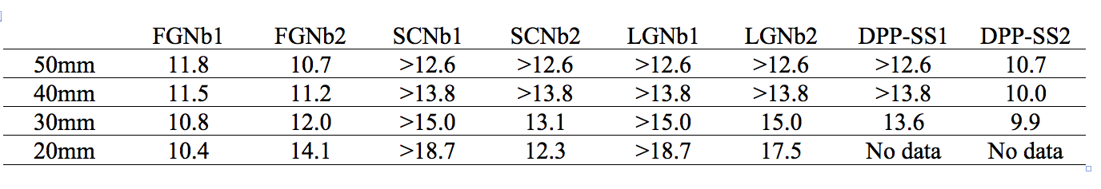
FE results of BCP-ed Niobium
Field strength at which the electrode exhibited 100pA of field emission, post krypton gas conditioning
“>” symbol….the electrode did not produce 100pA of field emission
Notes:
Interior Page Design 2

Slide 42
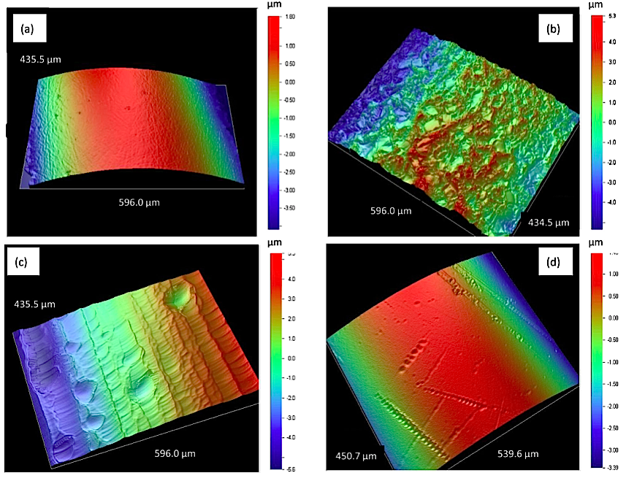
Niobium Electrodes
More evidence that there’s more to field emission than topography
SS Roughness: 10.9 nm
FGNb Roughness: 215.1 nm
LGNb Roughness: 141.01 nm
SCNb Roughness: 17.6 nm
This one performed best!
Notes:
Interior Page Design 2

Slide 43
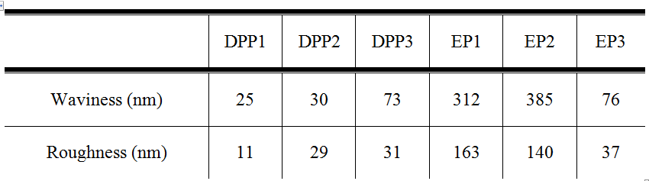
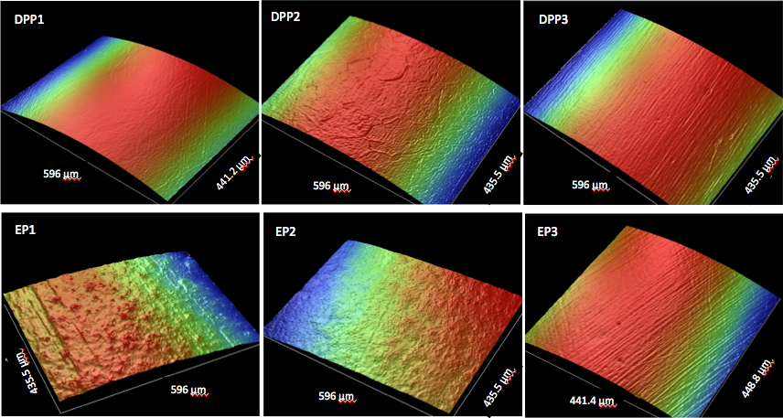
Electropolished Stainless Steel
Can we avoid time-consuming diamond-paste polishing?
Start with three test electrodes having different surface finish, and send them to commercial electropolishing company
Matt Poelker, Jefferson Lab
Notes:
Interior Page Design 2

Slide 44
TiN-coated aluminum
Aluminum is cheap and easy to machine
Takes just hours to polish to mirror-like finish with silicon-carbide paper
Good thermal conductor, compared to steel, a nice feature when gun provides high current
We used a “boutique” vendor to coat our small electrodes
Can an industrial TiN-coating provide the same benefit? Need to test
Matt Poelker, Jefferson Lab
Notes:
Interior Page Design 2

Slide 45
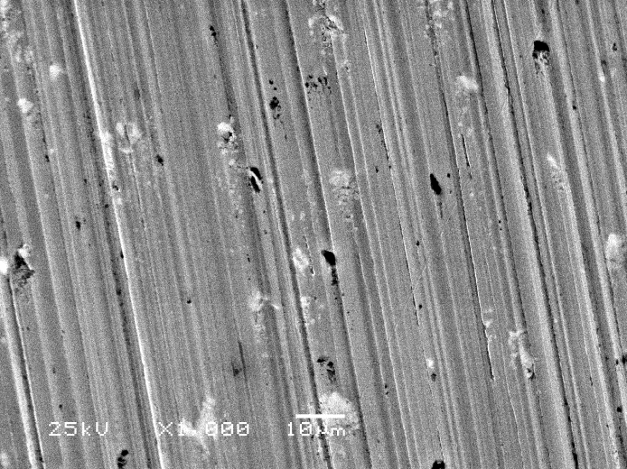
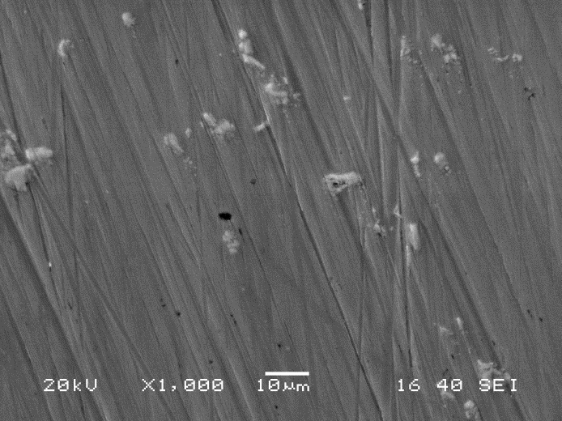
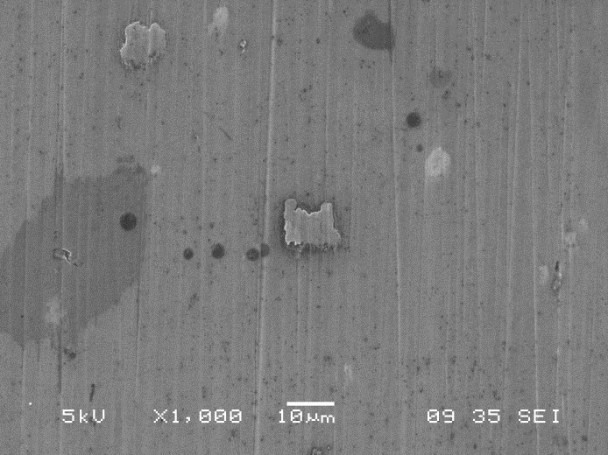
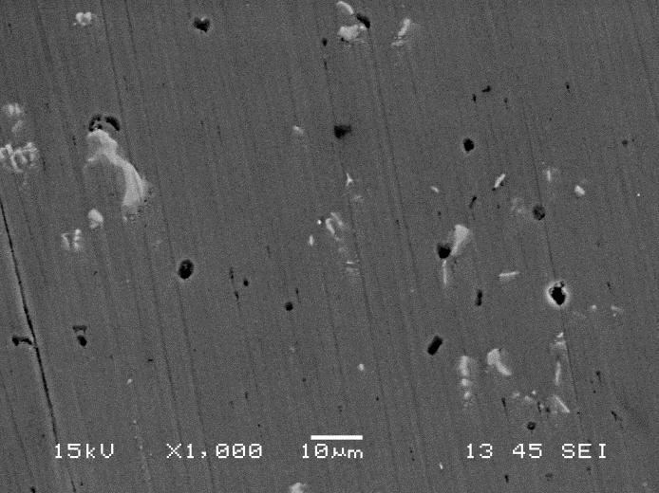
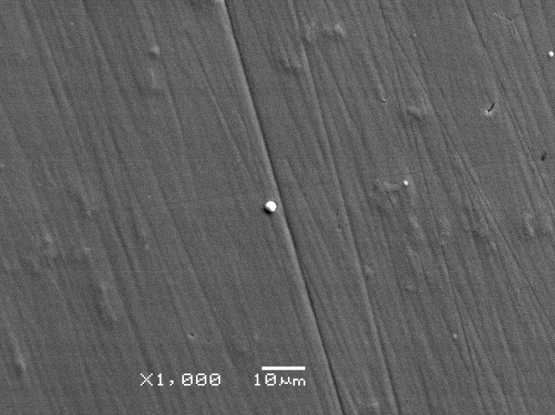
Surface Images Al and TiN-Al
Al: 400 grit
Al: 600 grit
Al: 800 grit
Al: 1200 grit
TiN coated: 1200 grit
Note, the black spots are voids and defects, not particulate contamination from sand paper polishing
Matt Poelker, Jefferson Lab
Notes:
Interior Page Design 2

Slide 46
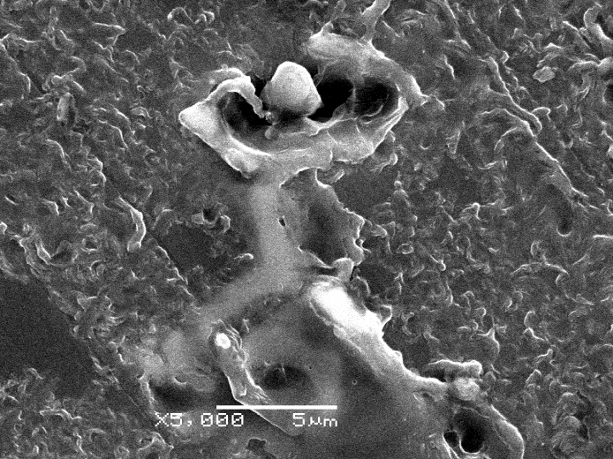


TiN-coated aluminum
Bare aluminum:
easily damaged
TiN-coated
aluminum
Diamond-paste polished Ti-alloy:
a traditional “hard” electrode
Matt Poelker, Jefferson Lab
Notes:
Interior Page Design 2

Slide 47




Fowler-Nordheim Line Plots
$$I= C_{1}{A_{e}β}^{2}E^{2}e^{{−C_{2}}/{βE}}$$
$C_{1}=\frac{1.54x{10}^{−6 }∙{10}^{4.52⋅φ^{−0.5}}}{φ}$
$C_{2}=6.53x{10}^{9}φ^{1.5}$
$slope= \frac{d(\log_{10}I/{E^{2})}}{d(1/E)}$= - $\frac{2.84×{10}^{9}φ^{1.5}}{β}$
intercept = ${{Log}_{10}({I_{F}}/{E^{2})}}_{E→∞}={Log}_{10}[\frac{1.54×{10}^{−6}A_{e}β^{2}{×10}^{4.52φ^{−0.5}}}{φ}]$
But it’s wrong to assume work function, Φ , is a constant
With three variables, there are an infinite number of solutions that provide a good fit
These plots tell you β, the field enhancement factor, and A_{e}, the field emitter area
Notes:
Interior Page Design 2

Slide 48


Fowler-Nordheim Line Plots
Text goes here
Why not identical here?
Identical here
Notes:
Interior Page Design 2

Slide 49



Electropolished Stainless Steel
EP-d electrodes exhibited less variability
EP-d electrodes did not respond favorably to gas conditioning
Best electrodes were DPP-d
Matt Poelker, Jefferson Lab
Notes:
Interior Page Design 2

Slide 50


Barrel Polishing of Stainless Steel
On our to-do list for testing
Notes:
Interior Page Design 2

Slide 51




Plan B
Insulator sleeve
Plan A
No Improvement
Plan D
Plan C
Screening electrode, or “shed”

