Slide 1
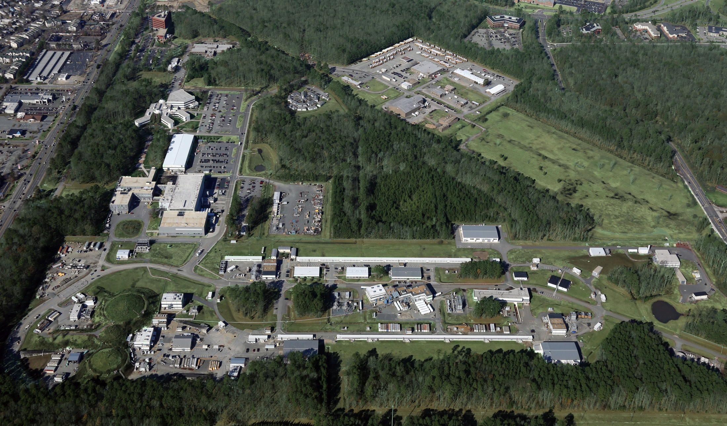
CLAS12 First Experiment Preparation
Latifa Elouadrhiri
June 16, 2016

Slide 2
RUN GROUP A - Experiments
Duration: 139 days
20 days commissioning
60 days high luminosity
39 days low luminosity
20 days reversed torus polarity
New equipment: CND, MM, Forward Tagger, (RICH?)
Energy: 11 GeV
Target: LH2
Experiment | Contact | Topic | Specifics
E12-06-108 | Stoler | Deep pi0/eta
E12-06-108A | Carman | N*->KY studies
E12-06-112 | Avakian | Pion SIDIS
E12-06-112A | Mirazita | Lambda SIDIS
E12-06-112B | Pisano | Di-Hadron SIDIS
E12-06-119 | Sabatie | DVCS
E12-09-003 | Gothe | Nucleon Resonance
E12-11-005 | Battaglieri | Meson Spectroscopy | Needs FT + special trigger + low-luminosity running time
E12-11-005A | Guo | Very strange baryons
E12-12-001 | Nadel-Turonski | TCS & J/Psi | Needs reversed torus polarity running
E12-12-007 | Stoler, Weiss | Deep Phi

Slide 3
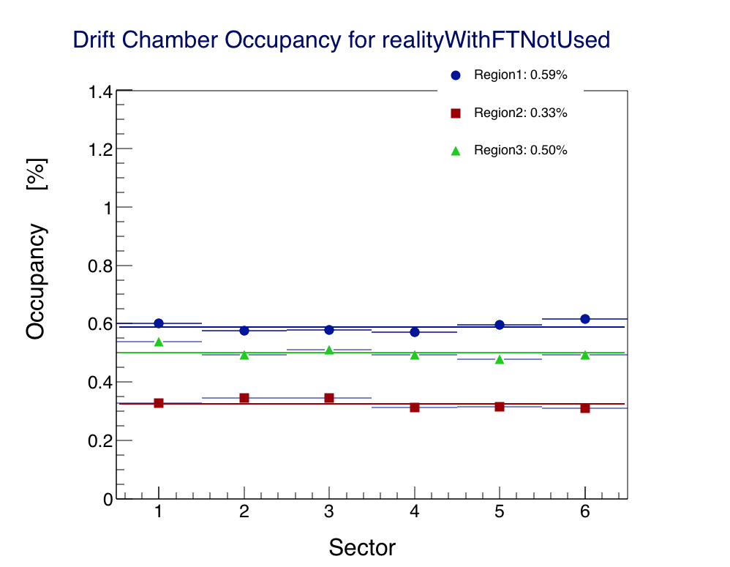
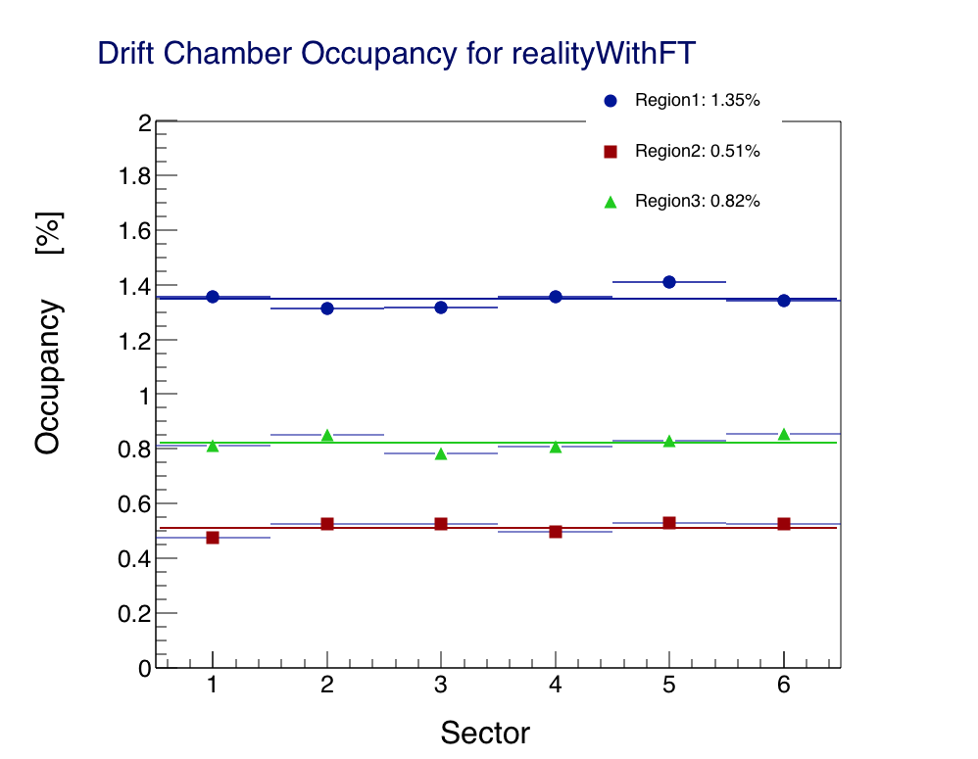
Two Configurations
“FT OFF”
“FT ON”

Slide 4
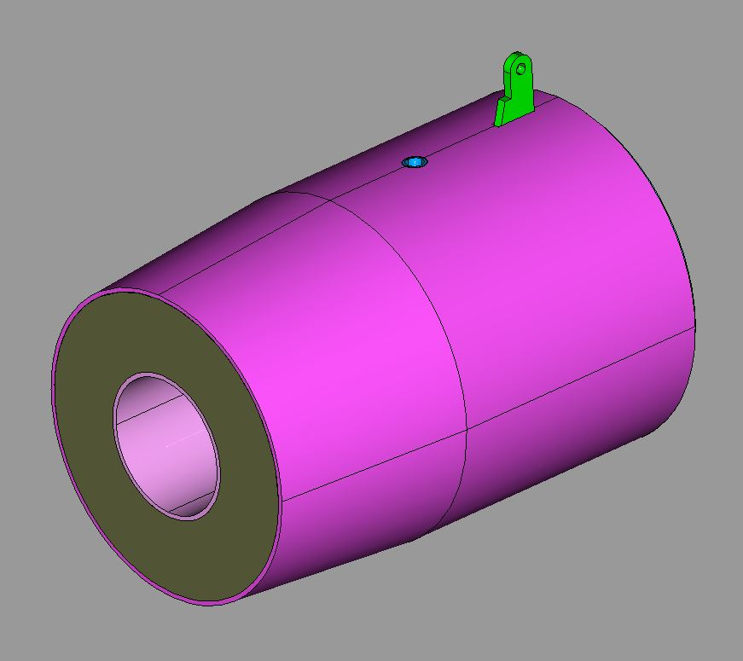
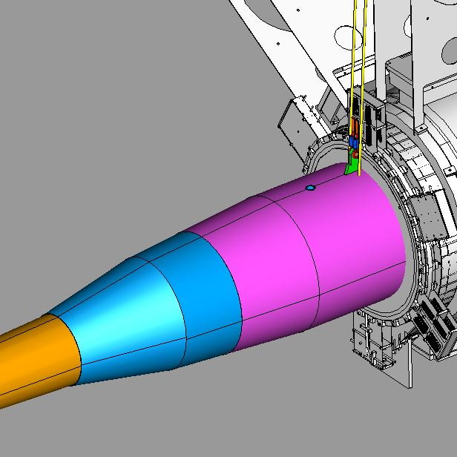
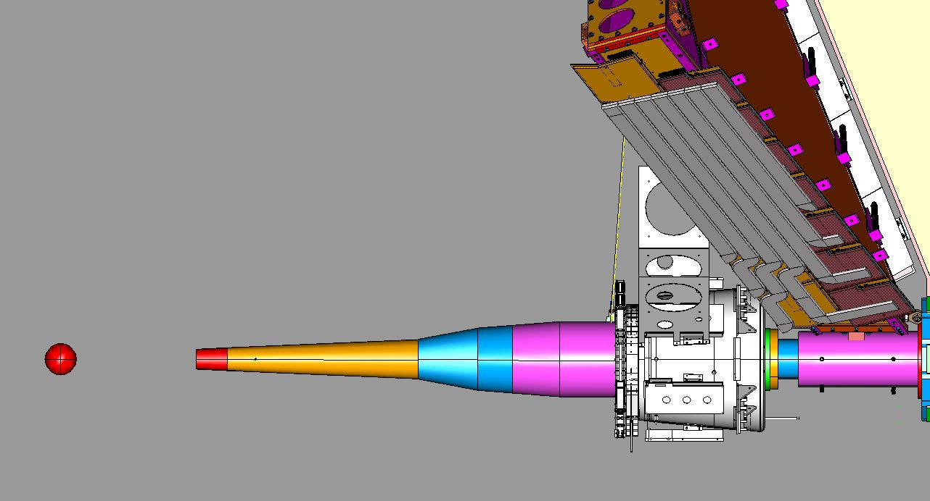
Engineering reality
SST Shell
Support Eye
2 4mm SST cables
Beam shielding finalized
ready to order

Slide 5
Target to shield
Vacuum improves occupancy 10%-50% (FT Off / FT On)
Work in progress (FX, Stepan, S. Christo)
Also on scattering chamber to be spherical between 5 and 32 degrees

Slide 6
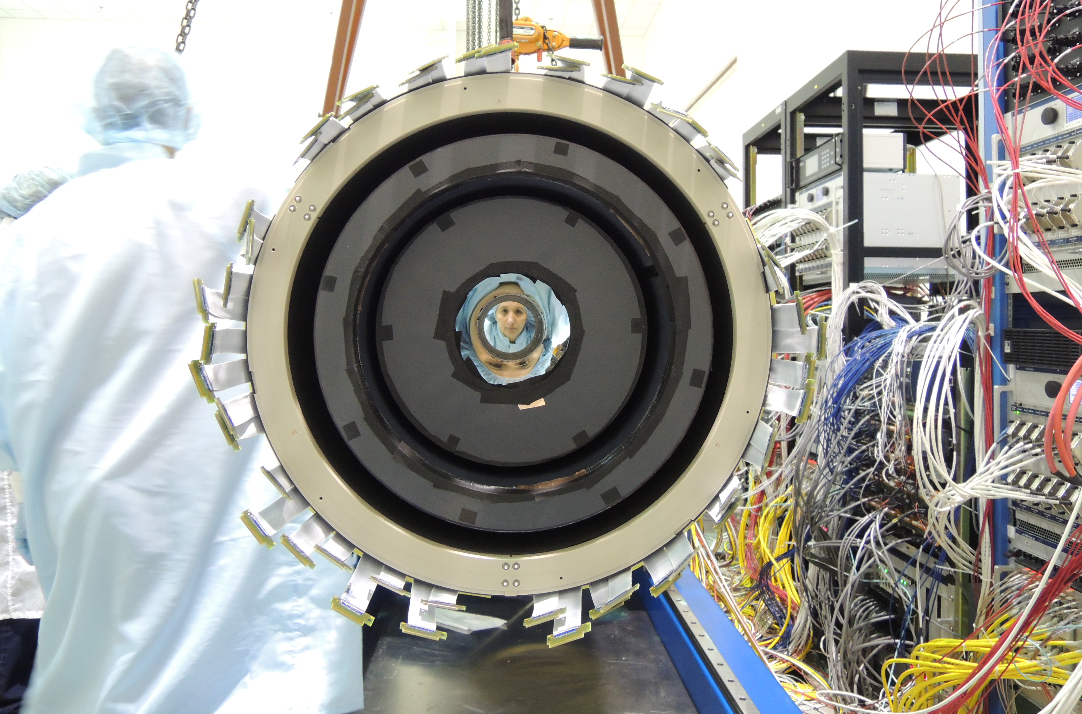
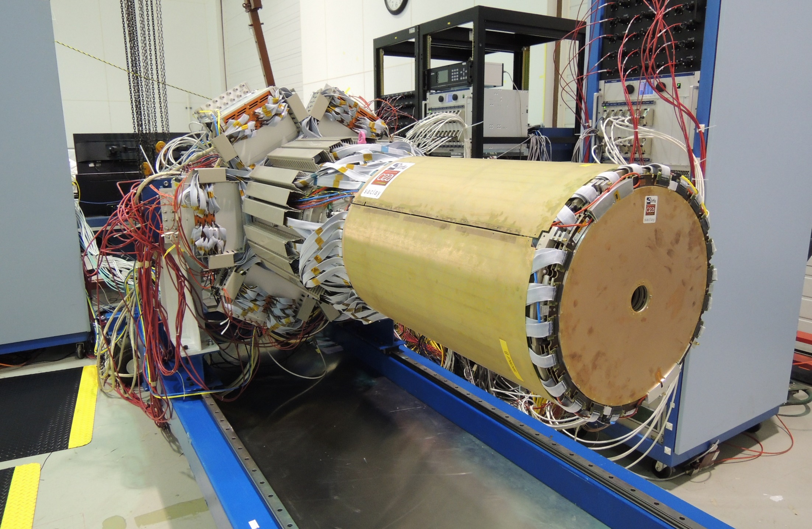
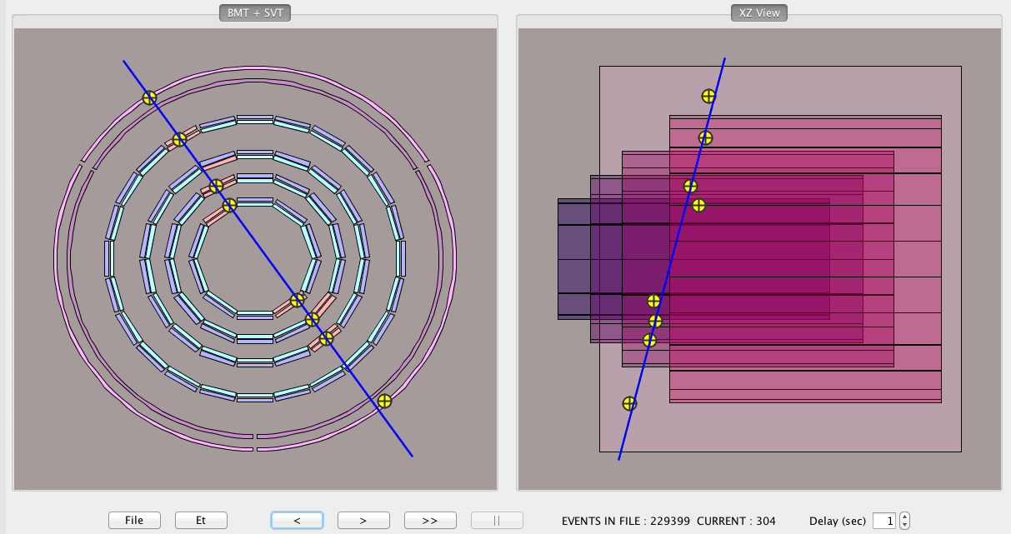
Vertex Tracker Configuration for KPP
4 Regions of SVT + 1 Region of MM
Plus FMM
Defines the focus of the reconstruction and simulation effort.
MVT+SVT integrated at JLab
Cosmic ray events in SVT+MVT

Slide 7
MM Project Schedule
So far
MVT-B2 (2-layer BMT and 3-layer FMT) tested since Dec. 2015 at Jefferson Lab
Key dates until completion of MVT project
June 2016: Send some detectors back to Saclay for drift cathode replacement
Fall 2016: Send full MVT-B2 (2-layer BMT+6-layer FMT) to Jefferson Lab
Late 2016+: Installation of MVT-B2 in Hall B
Feb. 2017+: Ready for KPP then CLAS12 engineering run
Spring 2017: Send remaining BMT detectors to Jefferson Lab
Summer 2017: Installation of MVT-B6
Fall 2017: Run Group A running time (start with commissioning)
Critical path was CERN delivery of raw detectors, but due to the late arrival of the solenoid and the full time presence of a Saclay technician at CERN, it is not an issue anymore.

Slide 8
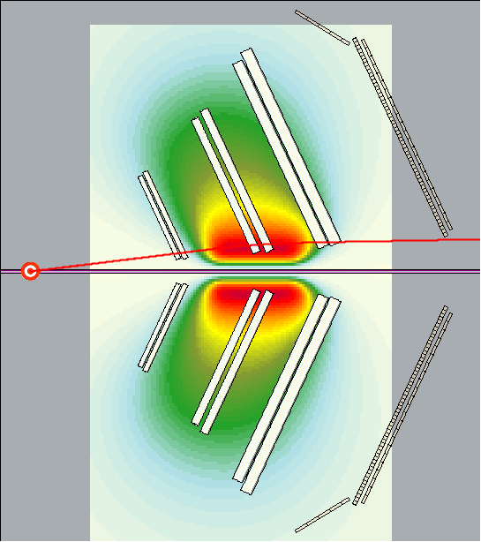
CLAS12 Torus Magnetic Field Mapping
Physics Requirement
Best dp/p resolution is from particle trajectories near the beam-line (highest B-field) → low-angle elastic scattering
Here is the trajectory of an elastically scattered electron from 11 GeV beam
(p = 10.1 GeV/c, θ = 7º)
For this track, dp/p ~ 0.3%
need to know $\int{B dl}$ to ~ 0.1%
position accuracy of ~ 0.1mm

Slide 9
Map Field Near Coils → sensitive to distortions
Need to know
radius to ~ 0.1mm

Slide 10
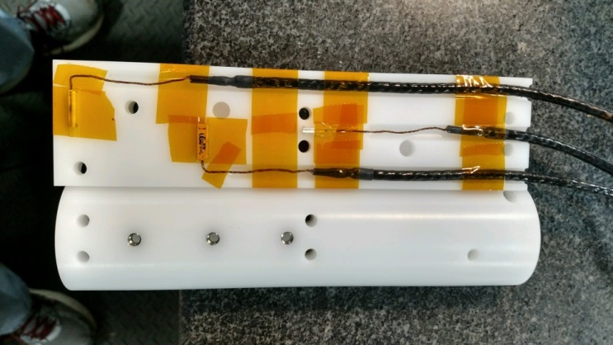
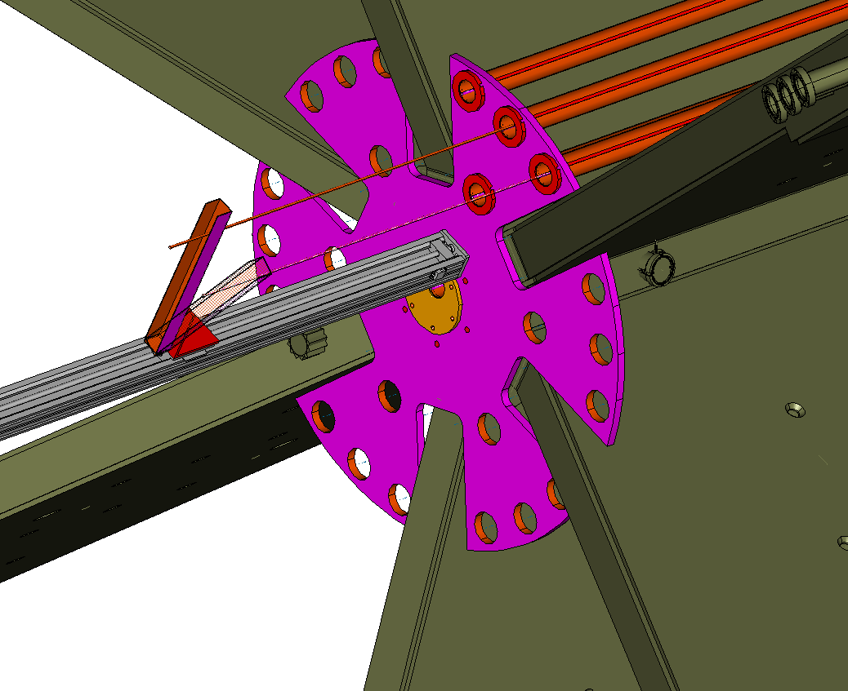
Three Hall Probes: Cylindrical Probe Holder in Precision Carbon Fiber Tubes
Tubes precision-located in ‘endplates’
Accurate z-motion stage
Tubes moved from sector to sector
Hall probe moved tube to tube
3 Hall Probes: X, Y, Z
- spaced 5cm apart
Assembled, calibrated, tested
Ready for measurement
One unit built, tested
Tubes, collars assembled
Endplate being machined

Slide 11
Fitting the Measurements: Results of a Toy Model Fit
2.0 mm
2.0242
Testing Fitting Method
moved each coil in radius
and azimuth (in red).
calculated (actual-ideal) fields
random smearing by 2 Gauss
fit to twelve adjustable
parameters (in black)
→Minuit determined coil positions
to better than 0.1 mm
4.0 mm
4.0054
0.2 deg
0.1967
0.7 deg
0.6989
3.0 mm
3.0102
0.15 deg
0.1545
1.0 deg
1.0006
1.5 mm
1.5327
0.1 deg
0.0984
0.3 deg
0.2997
1.0 mm
0.9987
2.0 mm
2.0288

Slide 12
Torus Mapping Status
Prototypes, methods tested
Labview control & DAQ software done
Endplate assemblies ready in mid-July
Installation and survey begins in mid-July
Map when torus operational→ mid-Aug?
Magnet group will provide technical support
we need collaboration help to take/analyse data

Slide 13
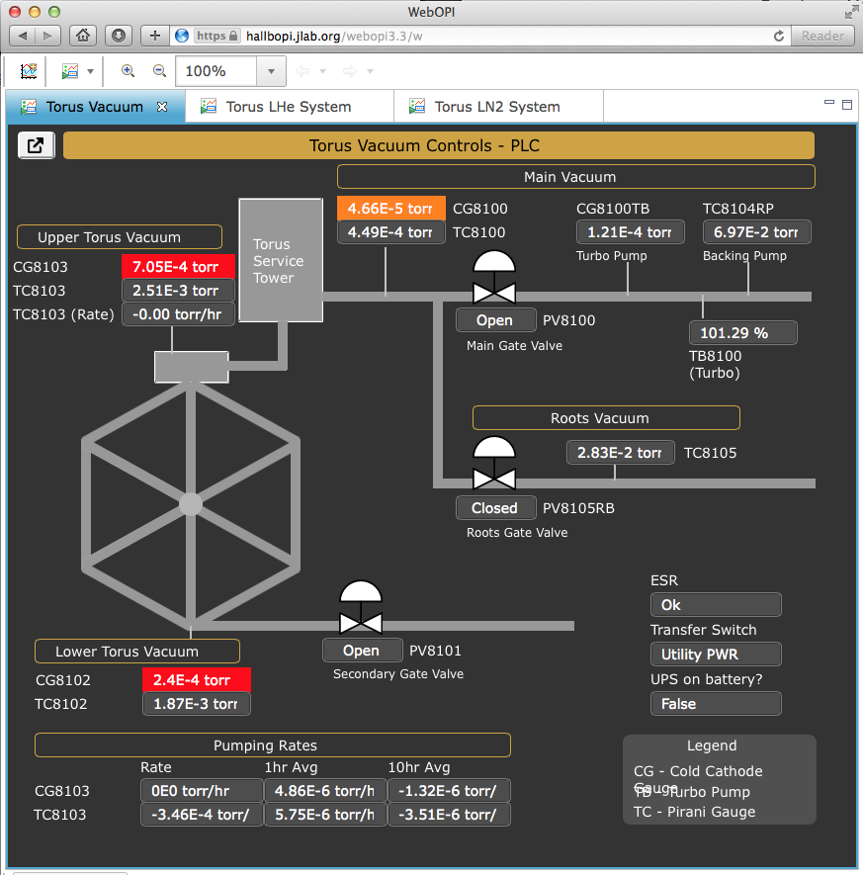
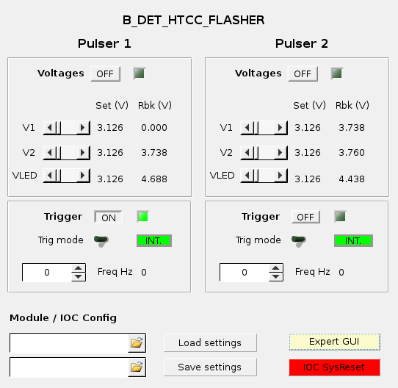
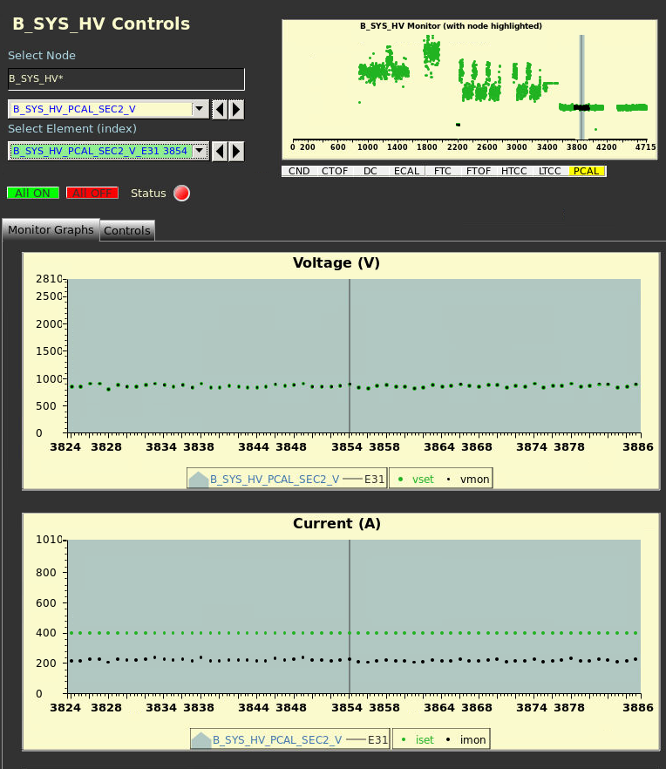
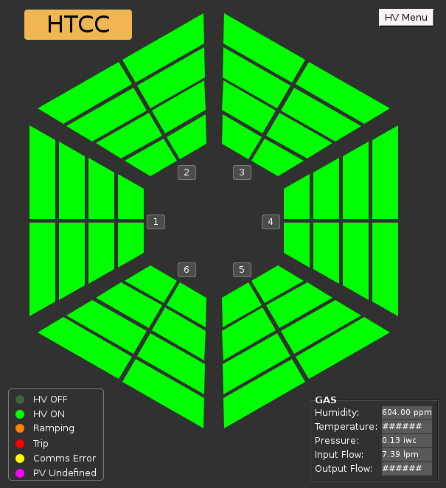
Slow Controls
CLAS12
Main Team (Glasgow & JLab): N. Baltzell, K. Livingston, B. McKinnon, W. Moore
Biweekly meetings (9:00 on Fridays in L210A)
Wiki: https://clasweb.jlab.org/wiki/index.php/CLAS12_Slow_Controls
with meeting agendas and minutes, planning docs, subsystem specs, improving documentation
First goal: KPP, Full baseline support by summer’s end
Working with DAQ & DSG groups for integration
Framework:
UI: java-based CS-Studio
OS: RHEL7
EPICS: R3.14.12.5
Lots of sharing with Hall-D
Recent Highlights:
Gas & Torus-Vacuum/Cryo/PS integration into EPICS and CS-Studio
Alarm system in use for Gas system and Torus
with automatic email notifications and alarm history archived
More detector specific GUIs developed (LTCC, HTCC, DC)
Hierarchical HV system now with voltage/current plotting
EPICS and CS-Studio support for JLab Flasher VME Board (HTCC, CND)
Off-site web browser access in testing (WebOPI, VDI)
JLab Scalers (DISC/FADC250) in EPICS
Coming Soon:
Møller Polarimeter: refurbish hardware/software
Saclay Cryotarget → EPICS+CS-Studio
HV/LV tolerance monitoring in EPICS
CND/MicroMegas/FTH → EPICS+CS-Studio
Install new cameras / weather sensors
…
JLab Mya EPICS archiver and viewer
BEAST alarm system inside CS-Studio
Porting/improving/replacing CLAS6 hardware/software
https://github.com/jeffersonlab/clas12-epics

Slide 14
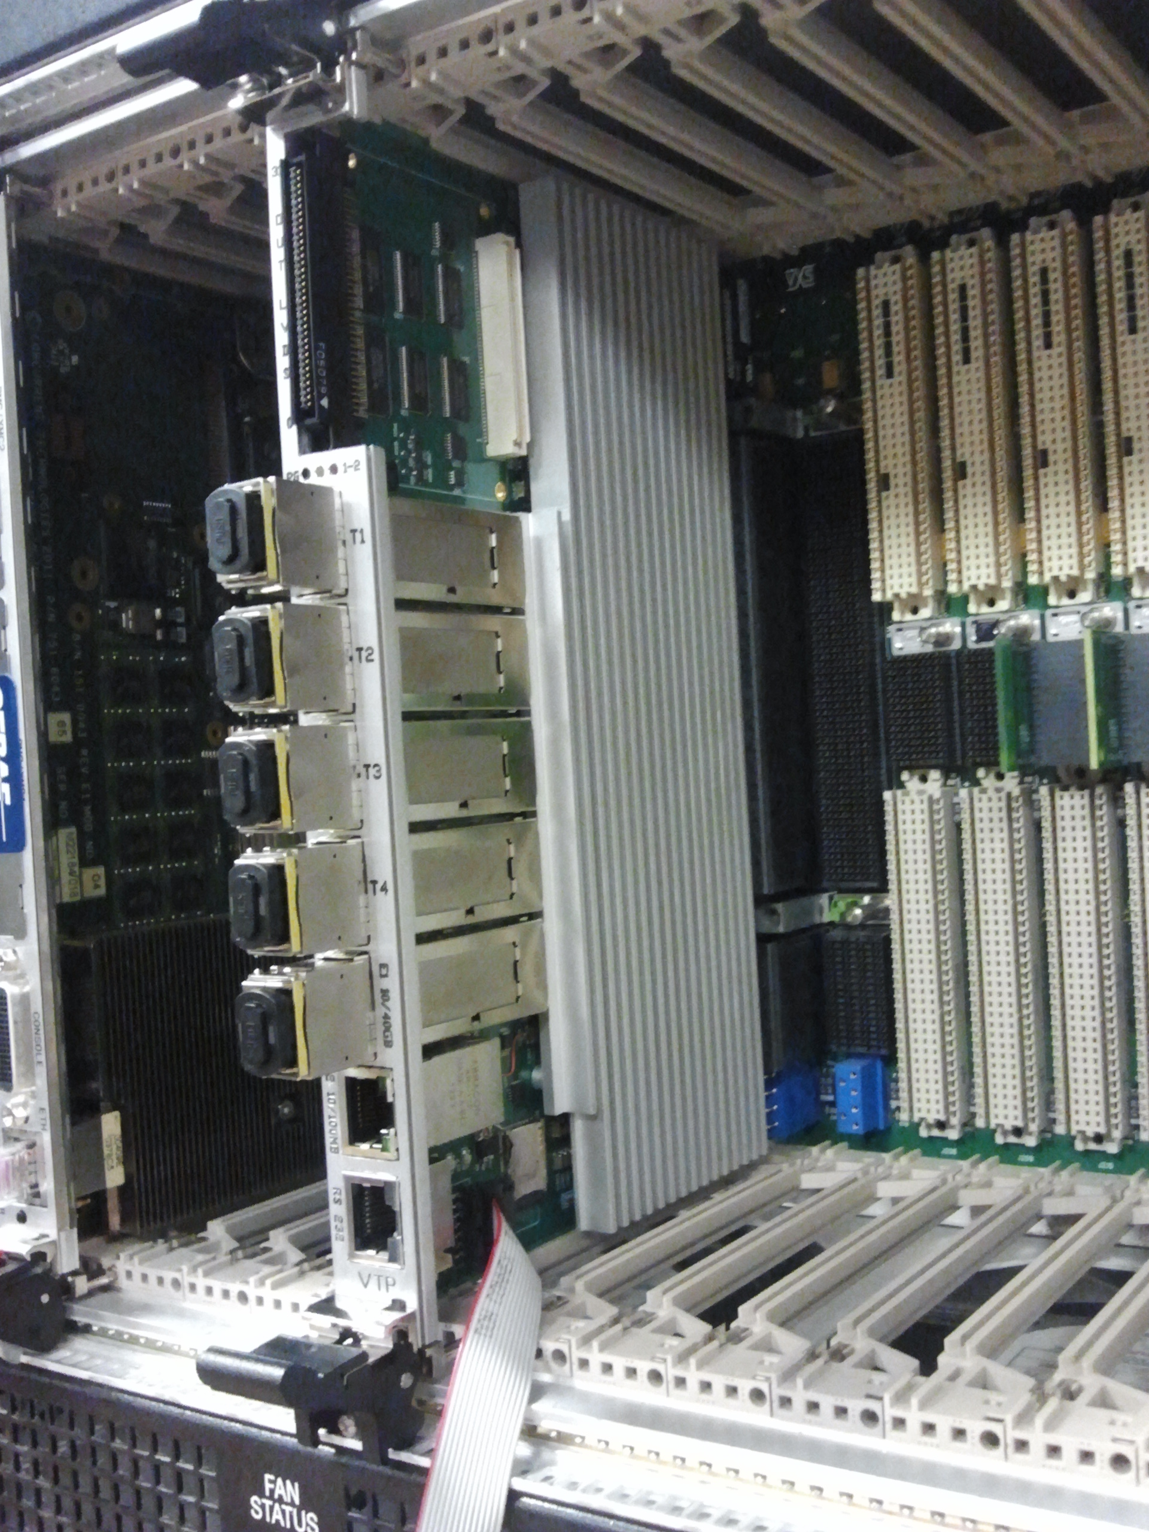
VTP (VXS Trigger Processor)
Four 5GBit links from each VXS slot (more bits for ADC integral, better timing resolution, possible use for readout)
40GBit fiber uplinks (faster data transfer, connect several crates in parallel to form the trigger)
Big FPGA and 4GB memory to accommodate ECAL/PCAL clustering and Drift Chamber road finding
LVDS output to Trigger Supervisor, and custom IO card
Status
First VPT board was received two month ago, evaluated by Ben Raydo everything works as expected. Remaining 24 VTP boards will arrive in few days
Trigger algorithms development is in progress, primary goal is to deliver electron trigger (ECAL+PCAL+HTCC) first with other detectors following

Slide 15
DAQ/Trigger Status
Main priority is trigger boards algorithms/programming: work in progress, finishing first model (ECAL) and starting testing in hardware, following by PCAL, Drift Chamber and ECAL+PCAL+HTCC decision
Significant part of hardware (DAQ on Subway and Space Frame) still in installation stage, depends on other activities in the Hall, completion time cannot be set as that moment; good news is the all electronics is running in test setups
Development of FT Trigger has started

Slide 16
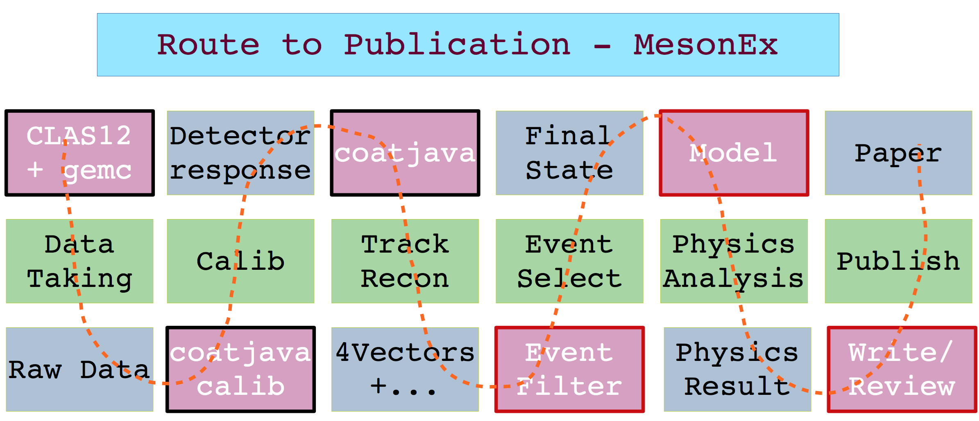
High Level Analysis Frame-work

Slide 17
Analysis Framework for 3D PDF Extraction
Data (contains N events with 4 vectors of reconstructed particles, N~1B)
MC (contains M events with 4 vectors of generated and reconstructed particles, M~10-100N)
acceptance
Define x-sections/normalized counts
Microscopic bins (counts in λ,Λ,x,y,[z,P_{T}][t], φ) defining detector acceptance, efficiency and material on path of leptons
Counts in microscopic bins in λ,Λ,x,y, [z,P_{T}][t],φ, corrected for detector acceptance and efficiency
GPD/TMD extraction framework
Fundamentals
SFs, evolution
Perform radiative corrections and fits
GPD/TMD extraction
Multiplicities and azimuthal moments in macroscopic bins in x,y, [z,P_{T}][t], corrected for Radiative Corrections
GPD/TMD library

Slide 18
Hall B Project Schedule
CLAS12
Hall B
2016 |  |  | 2017
J | J A S | O N D | J F M | A M J | J A S | O N D
Torus Leak Checking
Torus Pumpdown
Torus Cooldown
Torus Magnet Mapping
Install DC
Install FT
Solenoid Install & Test
Central Detector Install
Install HTCC
Cosmic Testing
Beamline Commissioning
KPP Commissioning
CVT Configure & Install
RICH Install
Engineering Run
Physics Run Group A
NP Div software review
ERR ancillary detectors
Hall B software
review
ERR CLAS12
Detector

Slide 19
Summary
All base detector construction completed, CTOF undergoing final commissioning, LTCC all six sectors installed , FTOF Panel 2 installed.
Beam line being finalized – shielding procurement ready
Torus assembly complete – pump down underway (slow), cool down expected in July, power-up and mapping planned for August.
Solenoid all 5 coils wound, potted, coil 1&2 and 3&4 shrink fitted; full assembly of all coils in progress.
CND to be tested, FT assembly and commissioning in EEL, MM - First barrel layers & FMT integrated with SVT, Final delivery of MM on track for delivery spring 2017. RICH detector on track for 2017 completion
VXS Trigger Processor (VTP) first article received and tested and the balance July, DCRBs (Drift Chambers new electronics) are ready for installation. Trigger firmware and simulation studies are in advance stage. Weekly online and trigger team meetings.
Slow Control on track for completion end of summer 2016
Offline software Release 6/15/16. Calibrations and commissioning & online monitoring for all the system in advanced stage
Work has started on procedures for high level analysis toward physics publication

