Slide 1
MEIC Cost Estimate Overview
JLEIC with 200q/A GeV Protons or HI’s
Leigh Harwood
Director’s Review of MEIC
Jefferson Lab
December 18, 2014
Leigh Harwood
JLEIC collaboration meeting
March 31 , 2016

Slide 2
Context
At the February meeting of the JLab Accelerator Advisory Committee (JLAAC) it was noted that the 100GeV x 10GeV design did not cover the full range of physics outlined in the EIC White Paper. The JLAAC recommended that we look at how much it would cost to cover the full range.
Note: This is not intended to become a new Baseline as it will cost more than the present version and we need to get the cost DOWN.

Slide 3
Task
Establish preliminary cost range for JLEIC alternate that has 200 GeV protons (or similar rigidity HI’s) in the collider ring.
Do estimates for 2 options
Option 1: Build it that way instead of present baseline (100 GeV)
Option 2: Do it as an upgrade from present baseline
Be ready to present to S&T in September, 2016.
Both options need a viable design for 200 GeV
200GeV 100GeV x 10GeV
100GeV x 10GeV ⇒ 200GeV x 10GeV

Slide 4
Cost Development
Will leverage information put together for NSAC review
Will need cost for “new” items
First look indicates arc ½ cells are a leading cost driver
New ½-cells need 48 T-m of BL (vs 24 T-m for 100 GeV)
Would like some external input on those costs
Will likely have a list of “TBD” items
Example: Potential tunnel length changes
Will proceed in phases with reliability of answer improving as we go along

Slide 5
Plan
Establish cost for 200 GeV version
Start with leveraged in formation
Improve with new detailed costs where available
Establish cost for evolutionary scenario
Cost for initial 100 GeV version
Likely some different from present baseline since it needs to accommodate later upgrade
Have to decide what gets thrown away in the upgrade
Optimize cost for initial 100 GeV version or total to get 200GeV?
Cost to remove items specific to 100 GeV
Cost to install items for 200 GeV
Go back and make changes where better knowledge has changed the technical answer and/or unit cost

Slide 6
Assumptions
200 GeV protons
10 GeV electrons
No major redesign/re-engineer initiative right now
No changes in
Electron chain (gun through storage ring)
Ion chain before collider ring (source, linac, booster)
Collider ring ramps 8⇒200 GeV
Duty-factor stays the same so retain luminosity
Magnets must ramp in same time ⇒ additional PS increase
Acceleration voltage has to be doubled
Tunnel length
Unchanged in initial estimate
May make mod in refined estimate

Slide 7
Changes in physical characteristics
Ion ring
Magnet fields: 2x
Magnets and power supplies
RF
Acceleration system for ion collider ring
Ion bunch-length control
Ion crabbing
2x voltage ⇒ 2x # of cryomodules (voltages are at their limit in baseline)
Abort system: Energy in circulating beam has doubled
Must handle 2x power
BBC: keep γ’s matched ⇒ 2x ERL energy
2x # of cryomodules (voltages are at their limit in baseline)
2x fields in transport system

Slide 8
Changes in physical characteristics (cont’d)
Ancillary changes
Cryo plant
Building sizes
Power and water
Open items:
Changes to BBC injector
IR layout and magnets

Slide 9
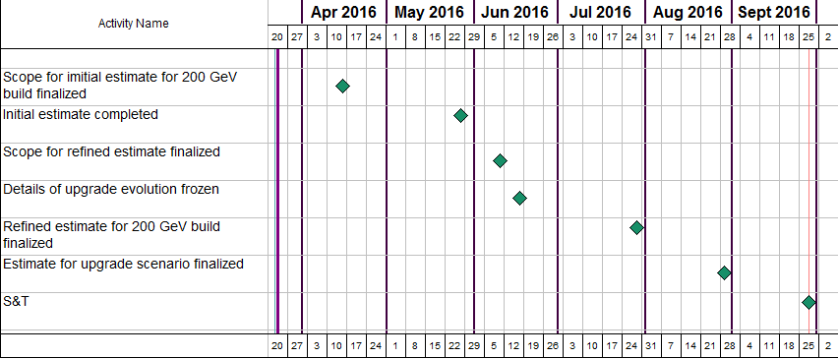
Timeline

Slide 10
Questions?

