Slide 1

Magnetized Beam Simulations (LDRD)
Fay Hannon
March 29, 2016
Notes:
Title Page

Slide 2
Overview

Slide 3
Goals
Produce a magnetized beam from a 350kV DC gun
Measure magnetization
Measure emittance
Demonstrate a round to flat transform

Slide 4
Beamline
‘Magnetizing’ Magnet
Solenoid 0.6m
Gun
Dump
H slit/ Viewer
1m
H slit/Viewer
1.38m
Fcup/viewer 1.6m

Slide 5
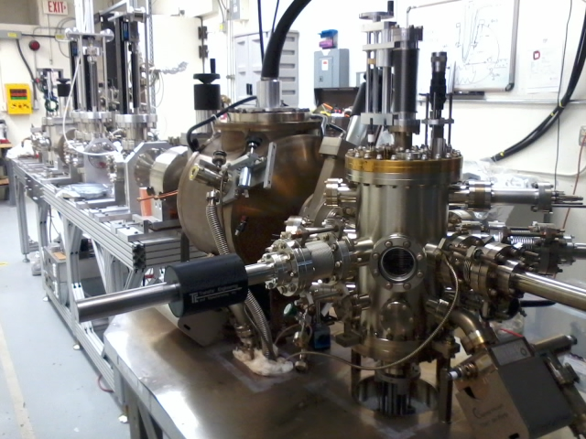
Beamline
diagnostics
Cathode prep chamber
solenoid
Gun

Slide 6
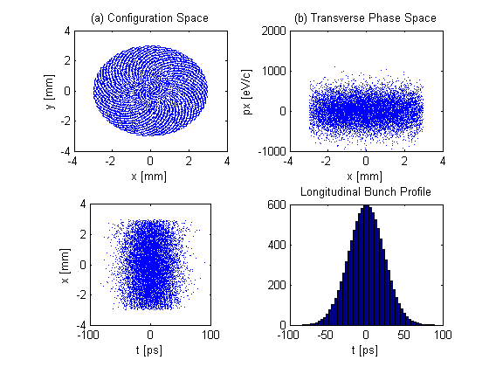
Beam Evolution
Parameter
Cathode Bz | 0.2T
XY_rms, top-hat | 1.5mm
t rms, Gaussian | 23ps
Charge | 0 – 420pC
Gun voltage | 350kV

Slide 7
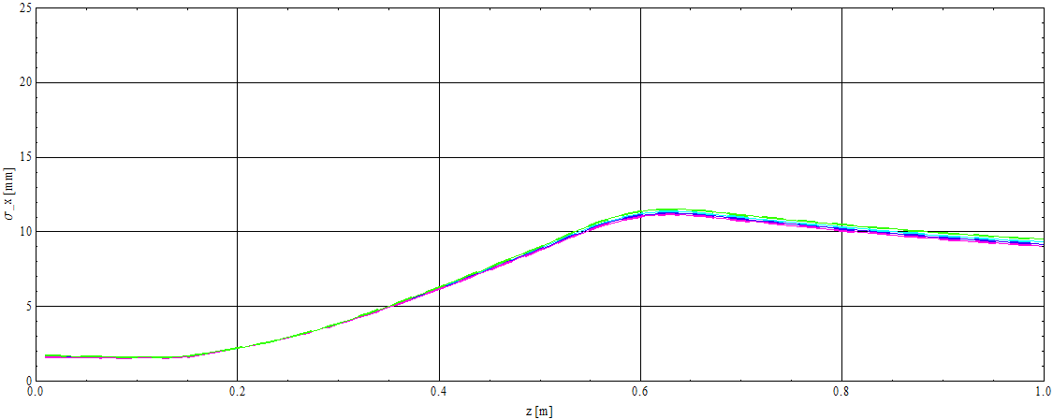
Transverse rms beam size
Location of solenoid
Big beam!
20pC, 100pC, 210pC, 420pC
TRANSPORT THE SAME: DOMINATED by canonical angular momentum!
Ldrd.010

Slide 8
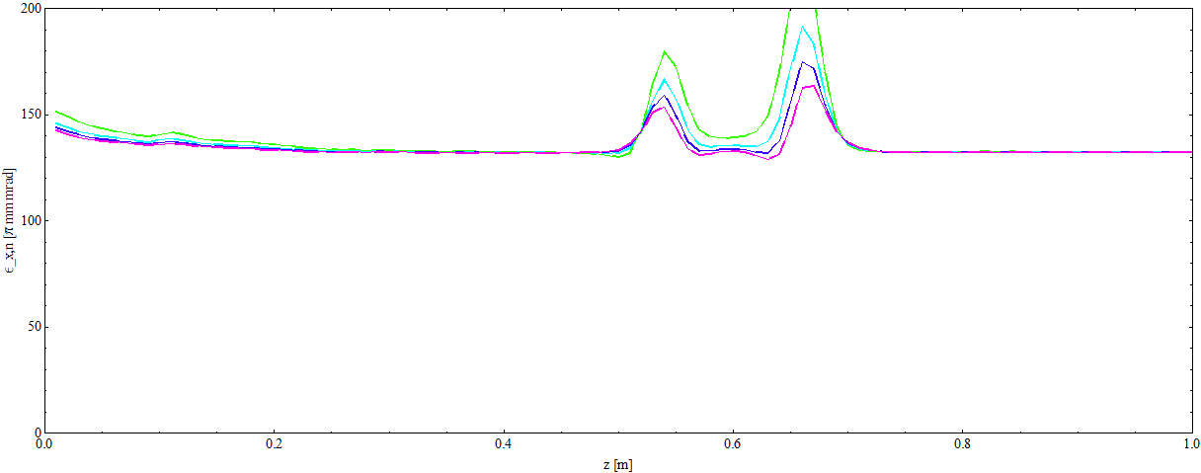
Transverse normalize trace-space emittance
Angular momentum included in calculation of emittance
Ldrd.010

Slide 9
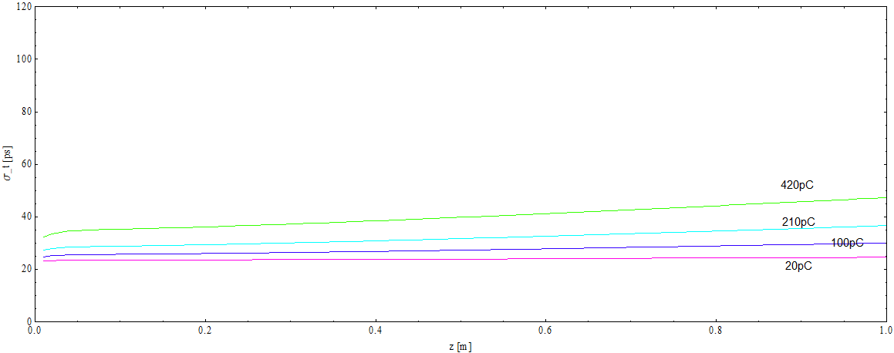
Bunch length rms
Longitudinally we see space charge as usual.
Ldrd.010

Slide 10
Measurements
- Emittance

Slide 11
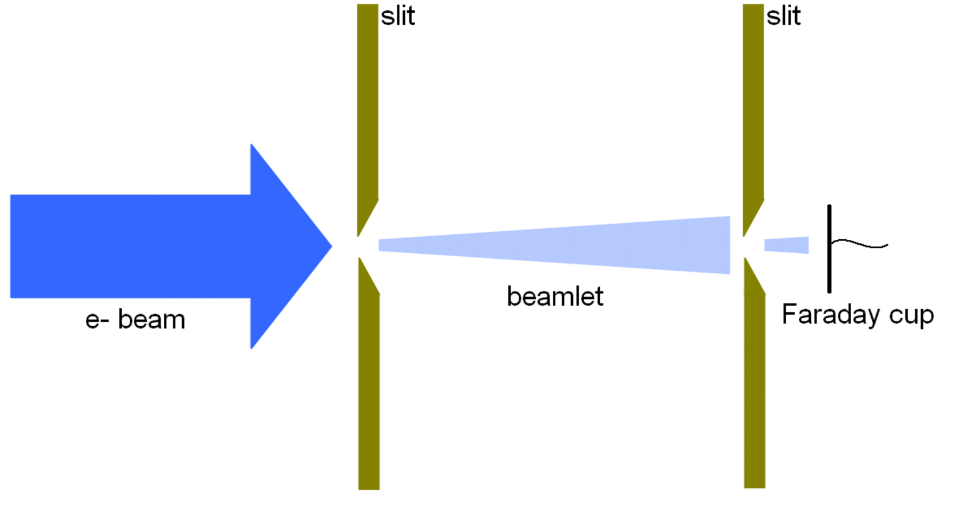
Double slit emittance measurement

Slide 12
Double slit virtual experiment
At the diagnostic, break the beam up into beamlets transversely to simulate the beam scanning over the slit
Let the beamlet particles drift to the second slit location (removing any that intercept the diagnostic)
Break the beamlet up into more beamlets
Count particles in each sub beamlet
Produce phase space

Slide 13
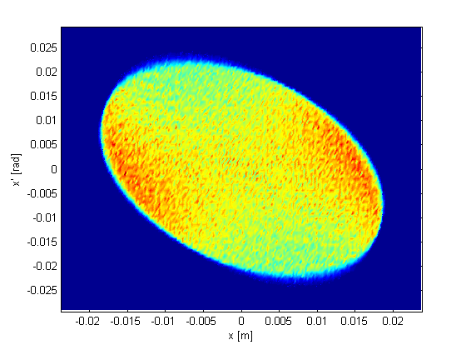
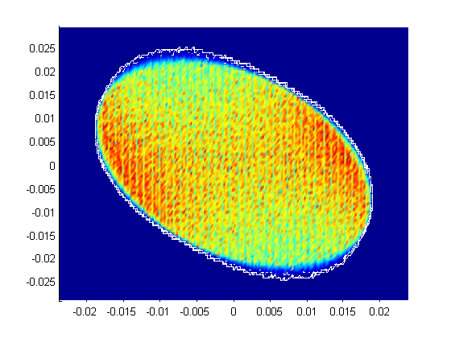
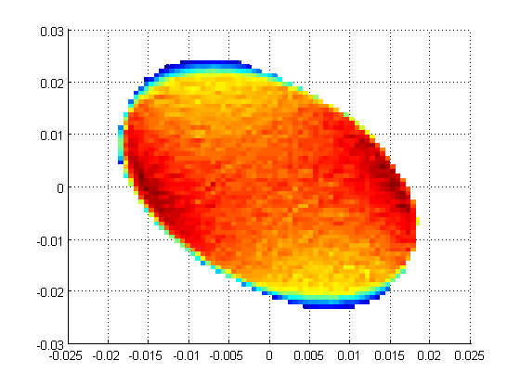
Virtual result
Directly from simulation
Reconstructed via 2 slit method
Can change slit size and spacing to get best design

Slide 14
Measurements
- Magnetization

Slide 15
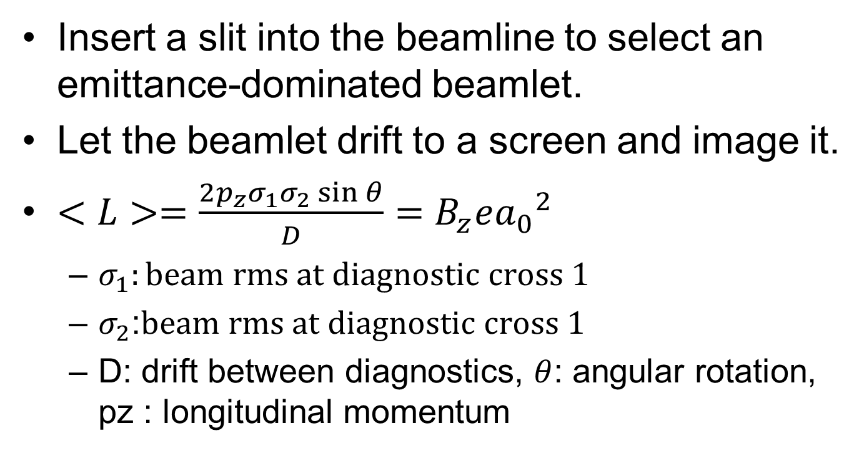
Magnetization/Angular momentum
Insert a slit into the beamline to select an emittance-dominated beamlet.
Let the beamlet drift to a screen and image it.
$<L>=\frac{2p_{z}σ_{1}σ_{2}\sin{θ}}{D}=B_{z}e{a_{0}}^{2}$
  $σ_{1}:beam rms at diagnostic cross 1$
  $σ_{2}$:$beam rms at diagnostic cross 1$
  D: drift between diagnostics, $θ$: angular rotation, pz : longitudinal momentum

Slide 16
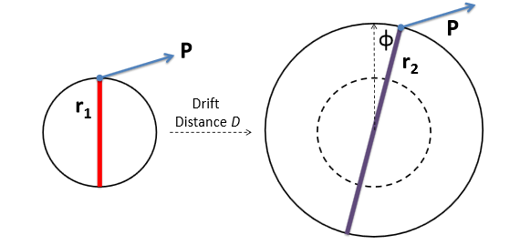
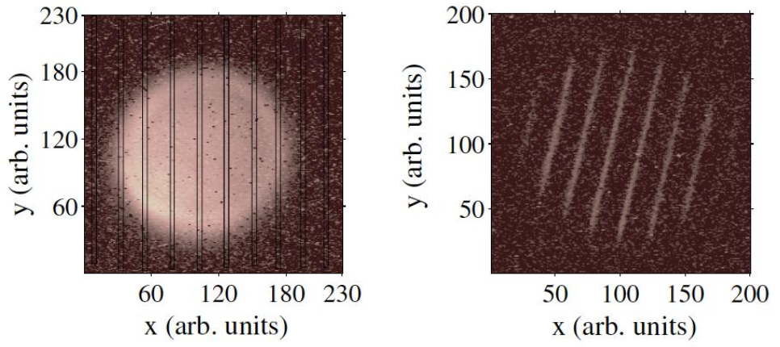
Fermilab experiment

Slide 17
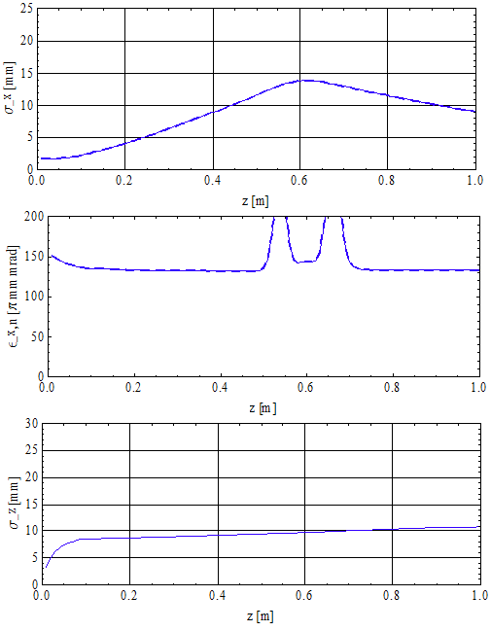
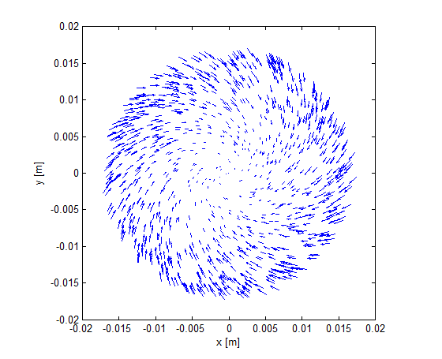
Example beam
Ldrd.014.001

Slide 18
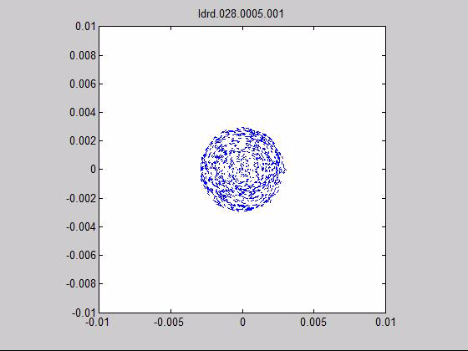
Movie

Slide 19
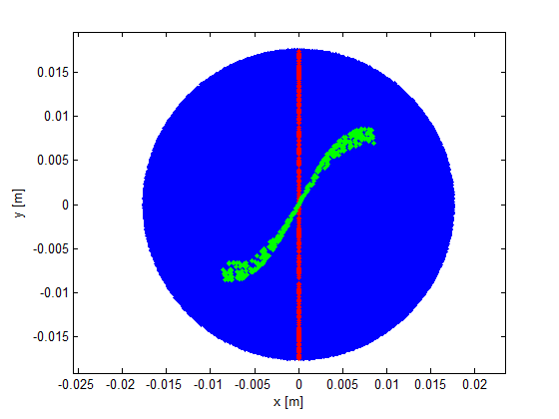
Magnetization virtual experiment
Blue – beam at the slit (500k, 20um slit)
Red – particles selected by slit
Green – particles tracked to screen 0.26m away
420pC
Not linear!
Assumes a solenoid at cathode with 0.2T peak
0.07% particles through slit
Ldrd.009.0100.001
Nrad=70, Nlong_in=100

Slide 20
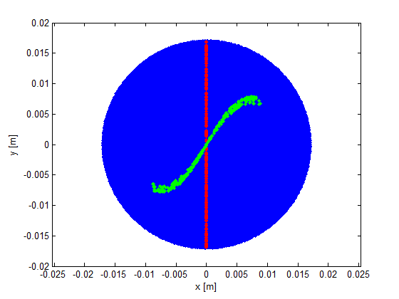
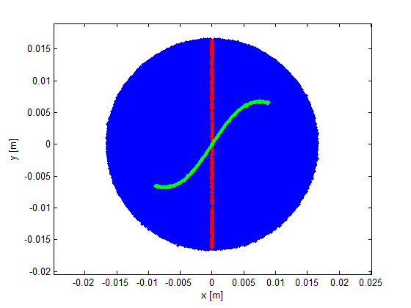
Magnetization virtual experiment
This isn’t charge related.
210pC
20pC
The curve is still evident at 20pC.
Ldrd.009.0100.002
Ldrd.009.0100.004
Nrad=70, Nlong_in=100

Slide 21
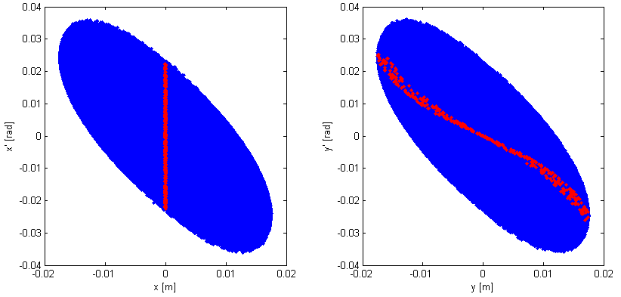
Phase space plots
This is what the slit cuts out in phase space
Ldrd.009.0100.001

Slide 22
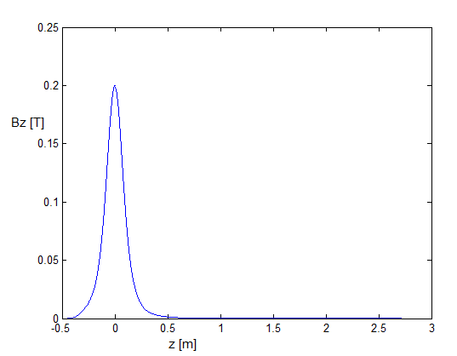
Why is there an ‘S’?
This is the solenoid field I used…
Could it be because the field isn’t uniform transversely over the emitting spot?

Slide 23
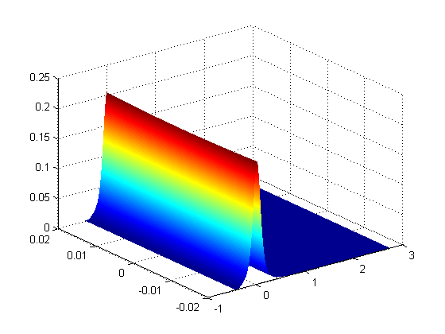
Why is there an ‘S’?
This is what simulation assumes off axis
Slight variation
Bz
x
z

Slide 24
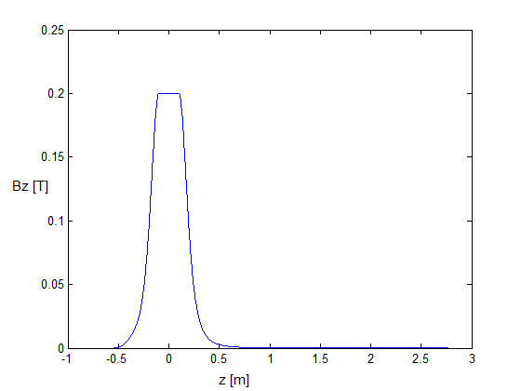
Why is there an ‘S’?
Make fake field map.
Cathode here!
Make fake Helmholz pair field

Slide 25
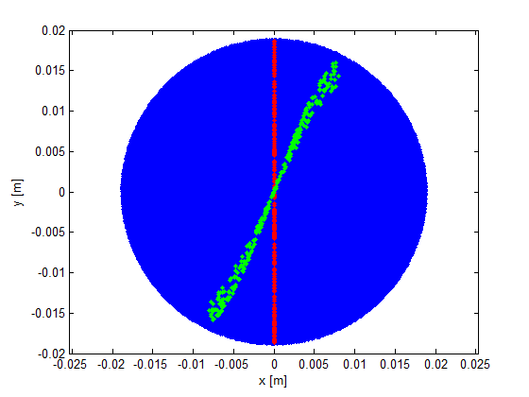
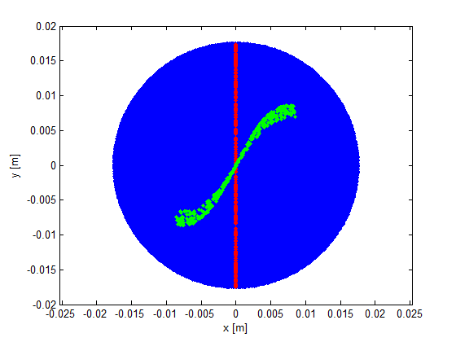
Compare
Both 420pC
Fake Helmholtz coil
Standard solenoid
Ldrd.010.001
Ldrd.009.001

Slide 26
4 real field maps, scaled to give ~0.2T

Slide 27
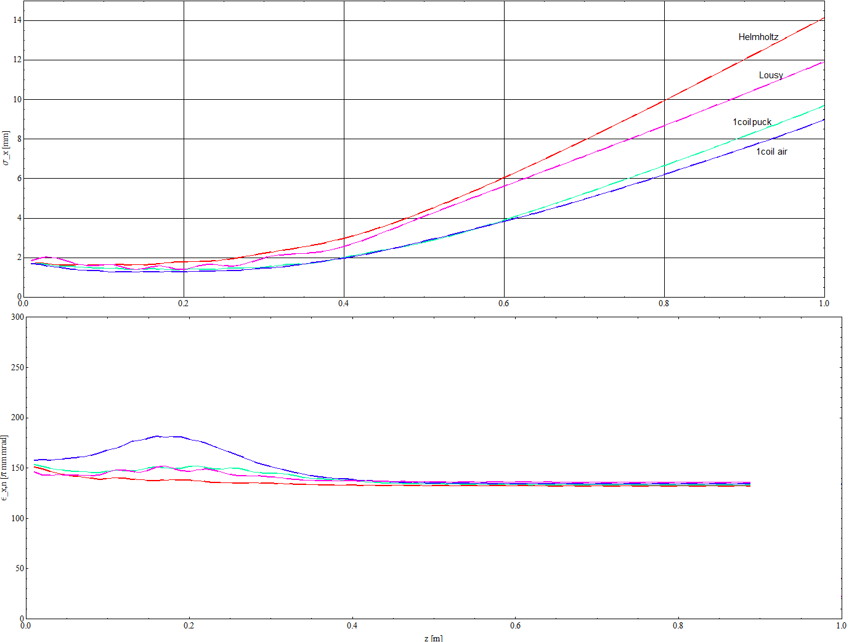
Transverse beam size, emittance

Slide 28
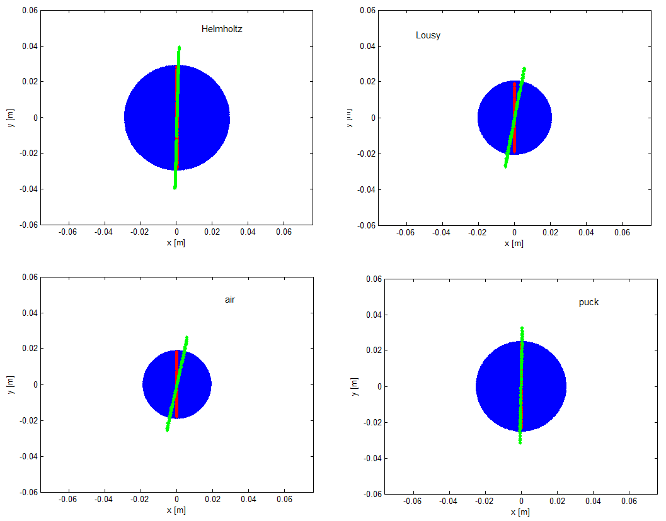
Magnetization virtual experiment
At 1m
Can’t see ‘S’
– all seem linear… why is this…
Ldrd.013.001-004

Slide 29
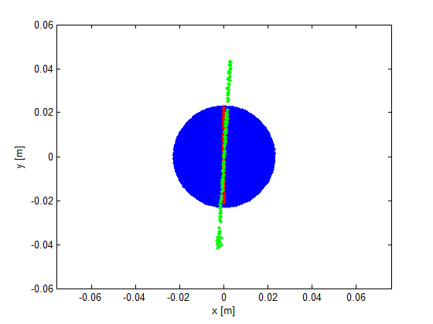
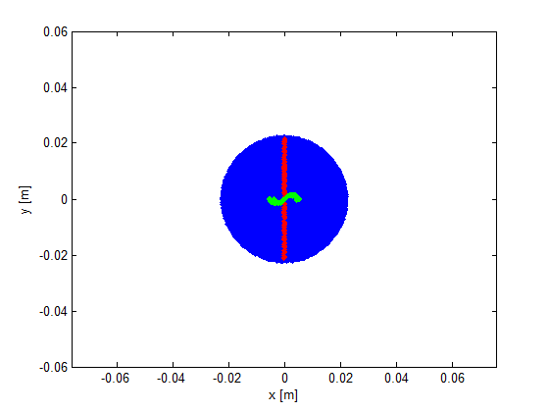
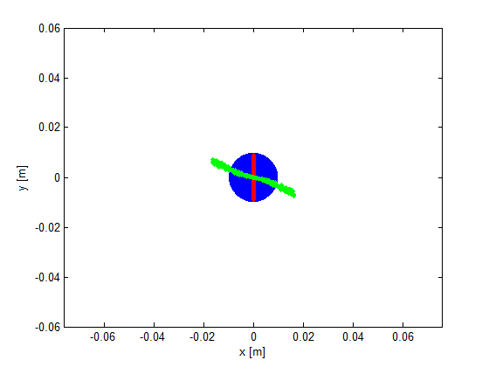
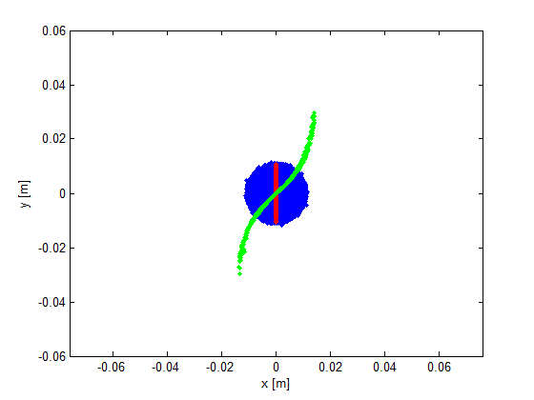
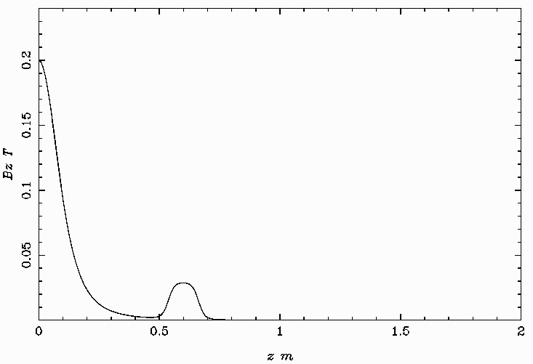
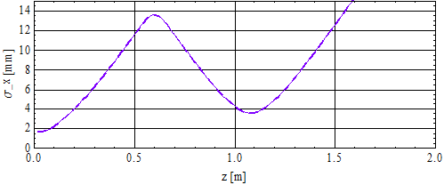
Normal solenoid
Ldrd.014

Slide 30
Normal solenoid
Ldrd.014

Slide 31
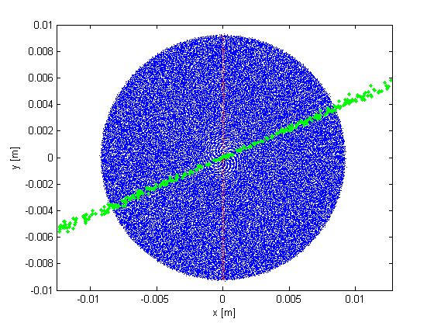
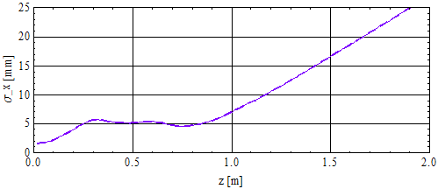
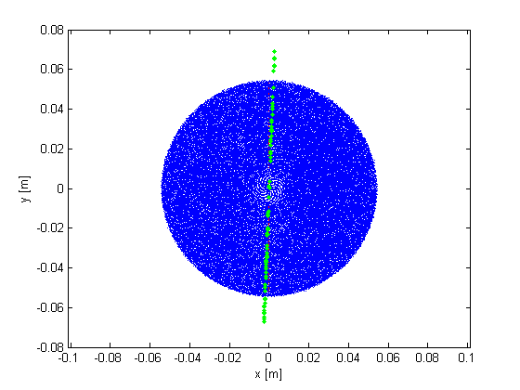
Is the trick to keep beam small in beamline solenoids?
Trying not to have different B.dl over transverse direction.
Ldrd.017.0072.004

Slide 32
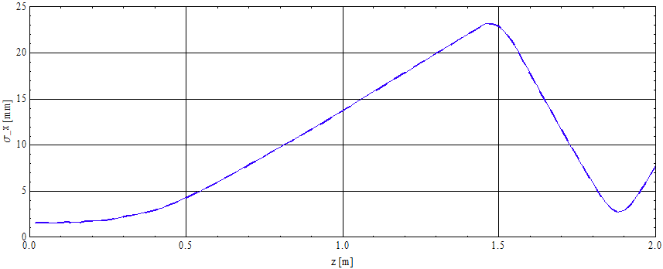
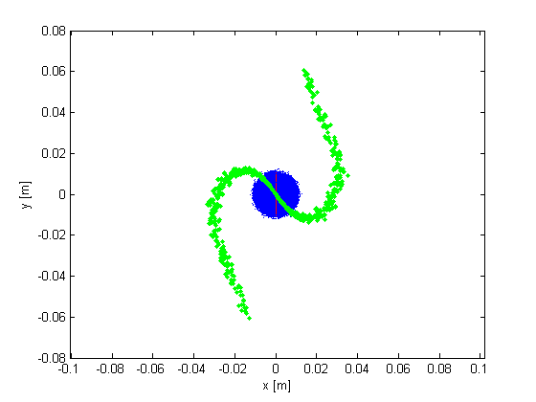
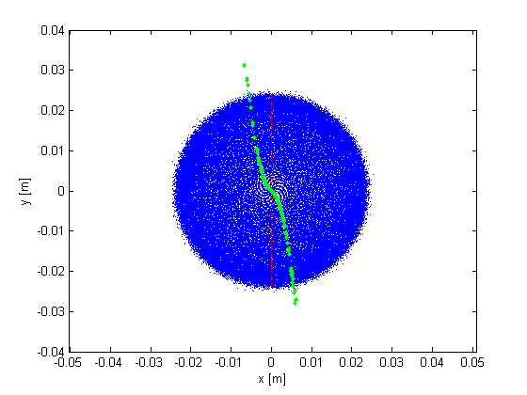
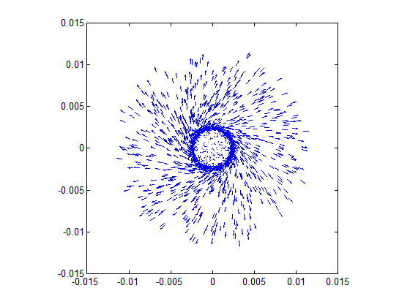
Let beam get big and then focus
So even with good Helmholtz field it can become distorted!
Ldrd.020

Slide 33
Measurements
- Round to Flat Transform

Slide 34
Modified beamline
‘Magnetizing’ Magnet
Solenoid 0.6m
3 skew quads
Gun
Dump
Diagnostics
x
x
y
y
Emittance splits into a large and small component

Slide 35
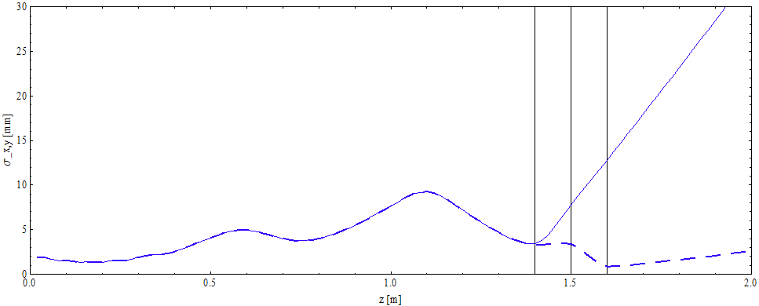
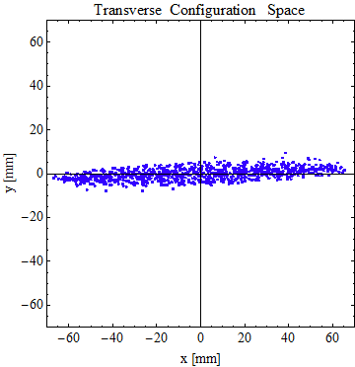
Beam evolution

Slide 36
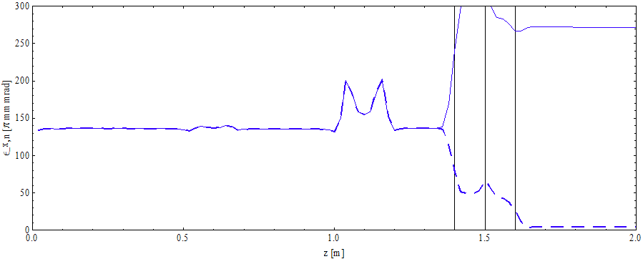
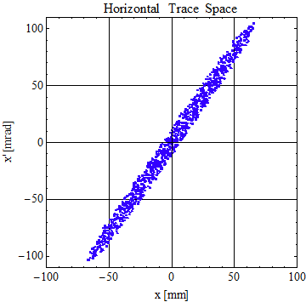
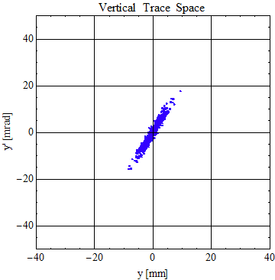
Beam evolution

Slide 37
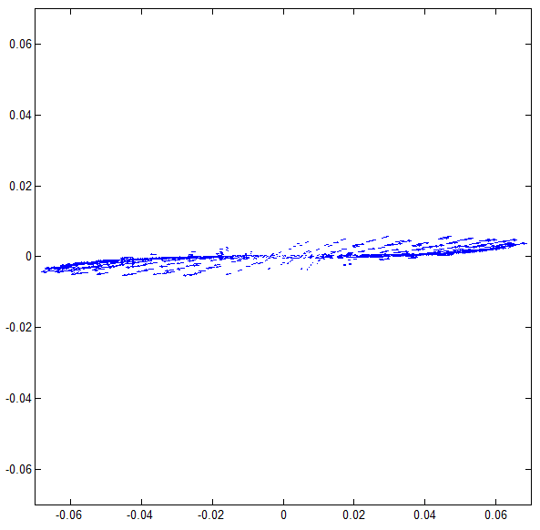
Beam evolution

Slide 38
Conclusions

Slide 39
Simulations show we should be able to demonstrate measurement of angular momentum dominate beams
Space charge does not effect transverse transport much
Should try to keep transverse size small
Round to flat possible with low energy beam

Slide 41
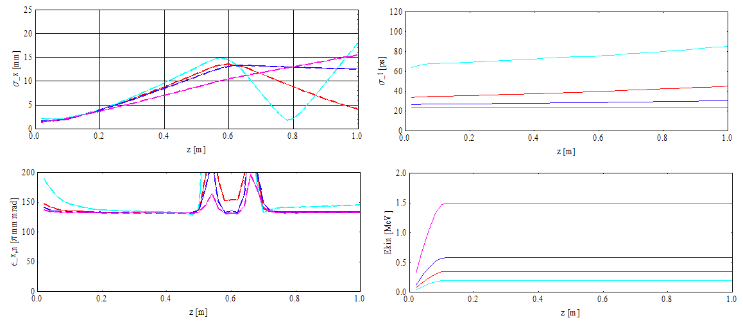
Increase gun voltage
CAM dominated
Ldrd.023

Slide 42
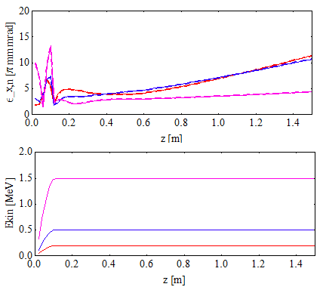
So what does the emittance look like
Remove the contribution from angular momentum. Calculate the angular momentum from a correlation in the x, px phase space and subtract prior to the emittance calculation.
Ldrd.024

Slide 43
Field calculation
In astra – off axis fields calculated from the on-axis field profile derivatives polynomial expansion
Bz(r)=Bz,0-(r^2/4*Bz’’)+(r^4/64*Bz’’’’)…etc
Br(r)=-r/2*Bz’+(r^3/16*Bz’’’)… etc
Flatter the profile, less variation in Bz off axis.

