Slide 1
Preparation of the Bunched Beam Cooling Experiment at IMP and JLab
Haipeng Wang (JLab)
Lijun Mao (Exp. Spokesperson) , Jie Li, Xiaoming Ma and Jianjun Su
Institute of Modern Physics, CAS, Lanzhou, Gansu, China
Yuhong Zhang, (LDRD 2014 PI) and He Zhang, Tom Powers, Kevin Jordan, Mike Spata and Andrew Hutton
Thomas Jefferson Lab, Newport News, VA USA

Slide 2
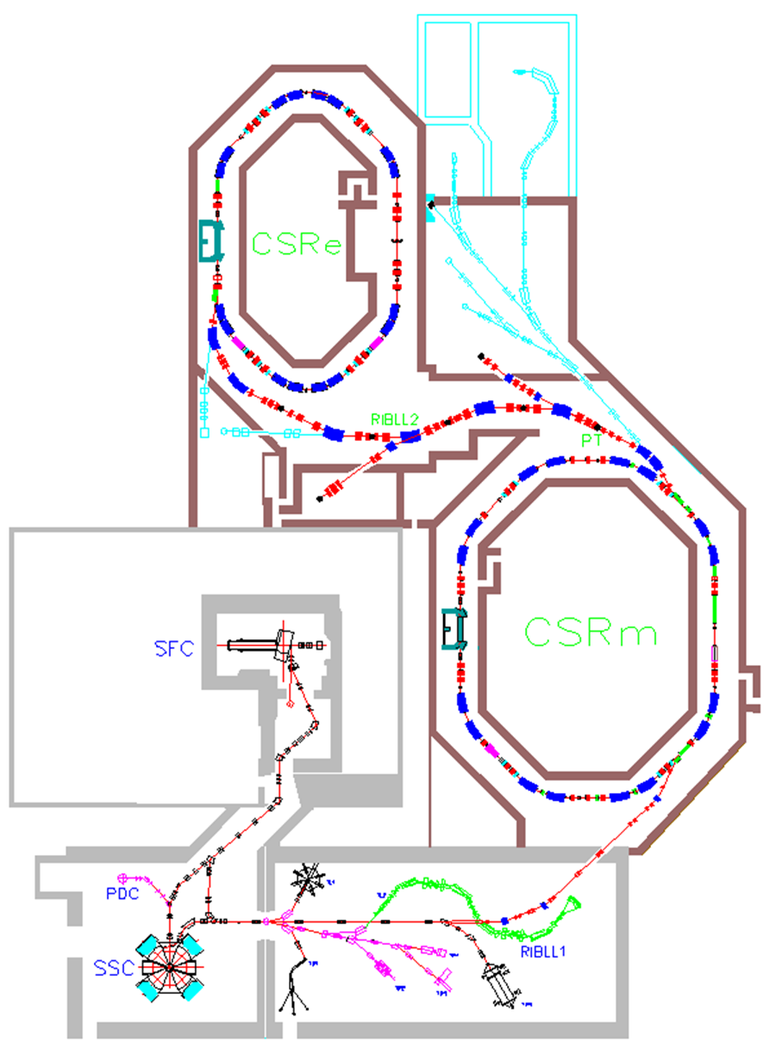
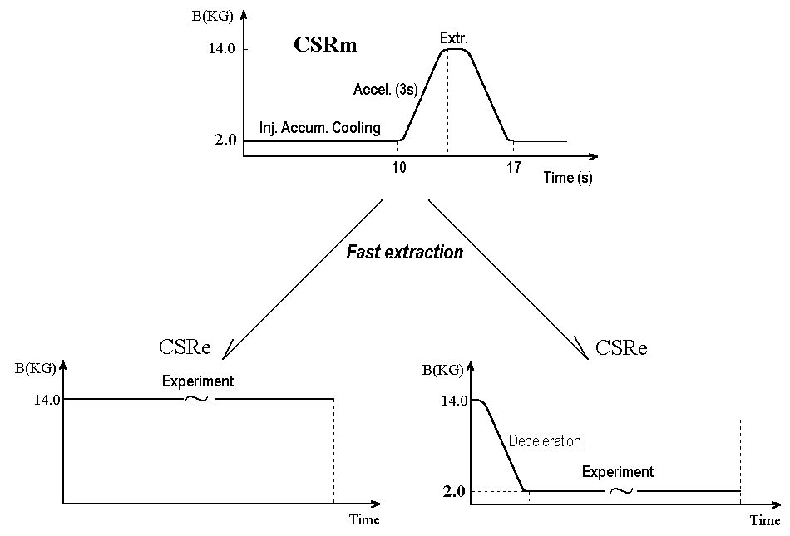
HIREL-CSR Layout and Performance Specification
EC-35 cooler
Sector Focusing Cyclotron
separated-sector cyclotron

Slide 3
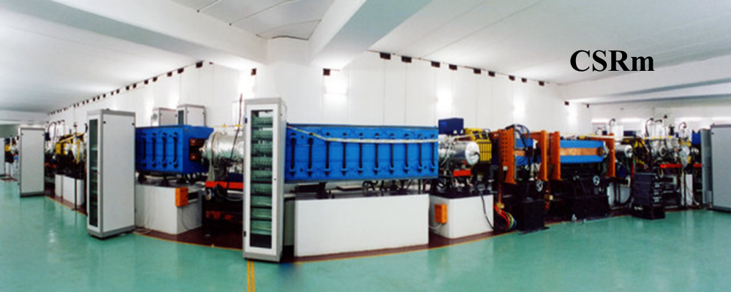
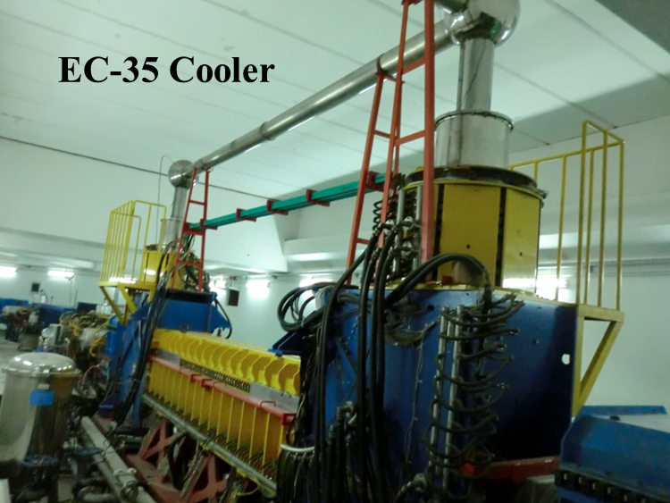
Proposed Bunched Electron Cooling Experiment and Top Parameters

Slide 4
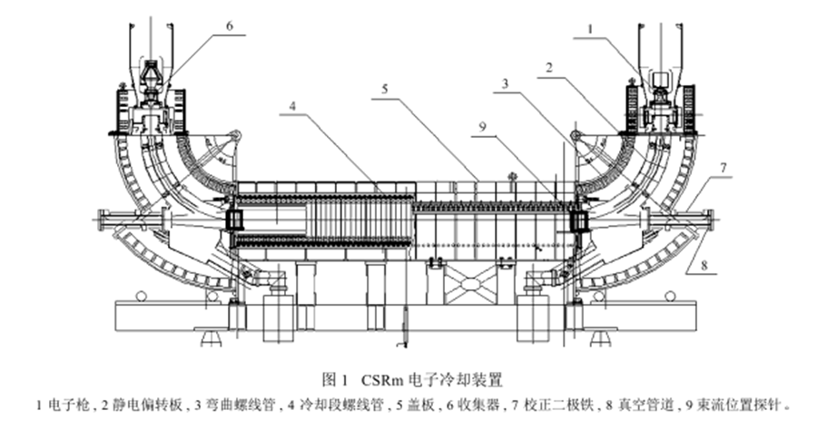
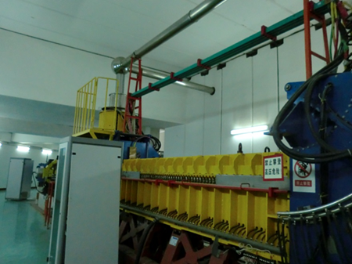
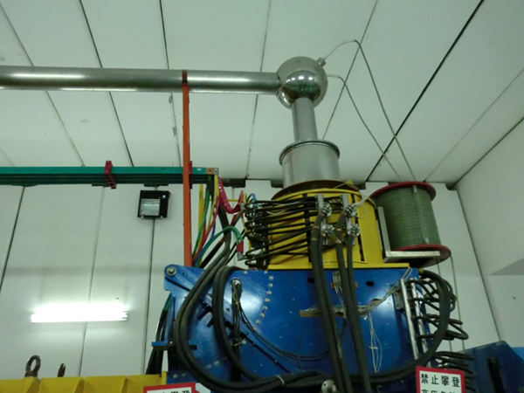
EC-35 DC Cooler and Commissioned Performance
1—electron gun, 2—electrostatic bending plates, 3—toroid, 4—solenoid of cooling section, 5—magnet platform, 6—collector for electron beam, 7—dipole corrector, 8—vacuum ﬂange for CSRm. Two BPMs placed in the cooling station, one is at upstream of electron beam at gun side in position 9, another one is at downstream collector side in the mirror symmetric position relative to 9.
Commissioned in March 2003
vacuum 2×10¹¹ mbar,
high voltage 20 kV,
electron beam current 1.6 A,
collector efﬁciency >99.99%,
angle of magnetic ﬁeld line in cooling section <2×10⁻⁵

Slide 5
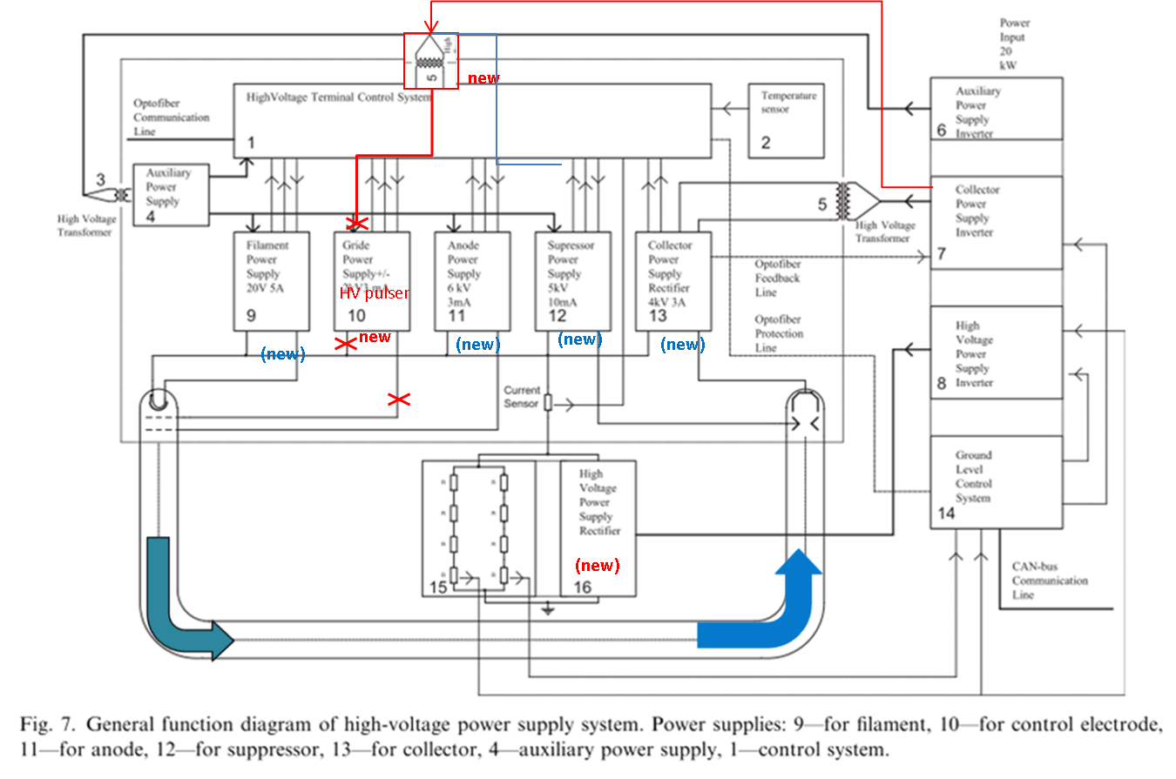
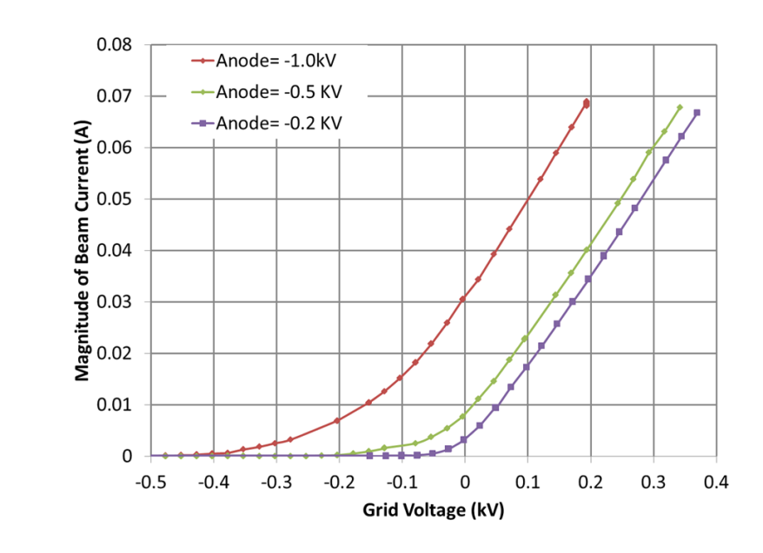
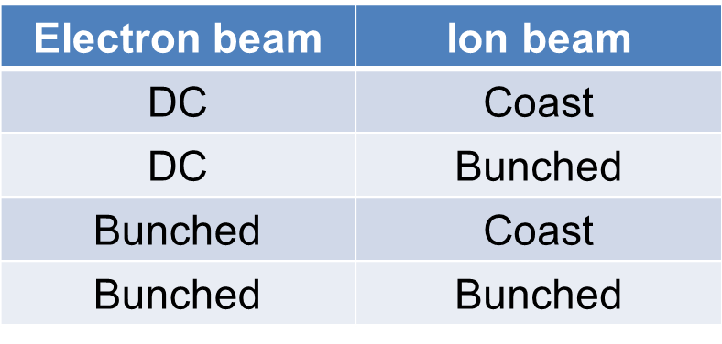
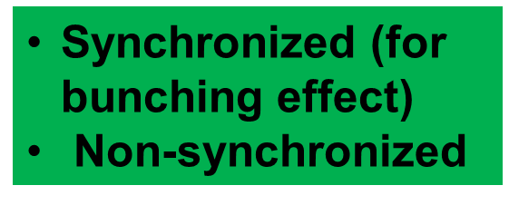



Terminal Circuit Diagram and Average Current Measurement
ions
electrons
Collector efficiency
$=\frac{I_{cathode}−I_{beam}}{I_{cathode}}$100%
$$I_{beam}=I_{collect}−I_{back}$$
$I_{charge}=I_{leak}+I_{cathode}−I_{beam}$

Slide 6
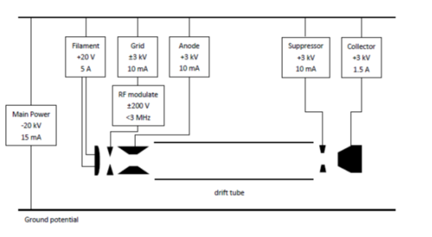
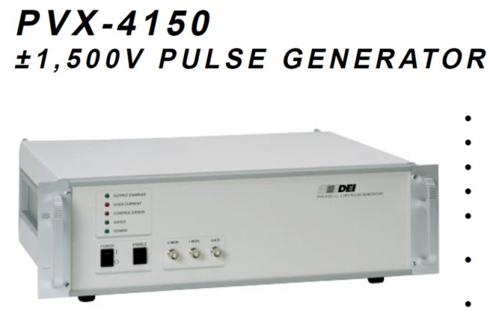
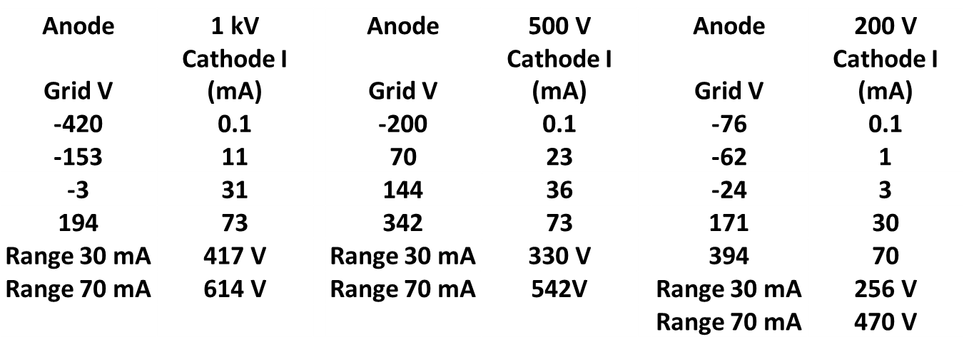
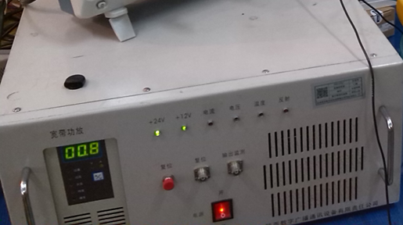
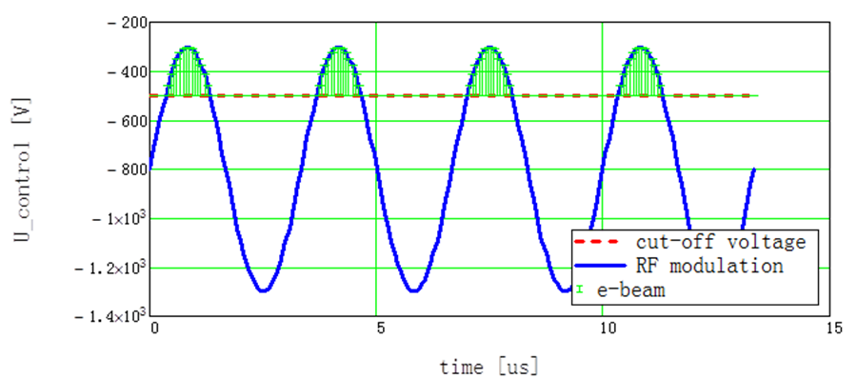
EC-35 Pulse Modulation + DC Bias Scheme for Bunched Electron Beam Formation
Option 1 (JLab, using HV pulser)
Option 2 (IMP, using RF amplifier)

Slide 7
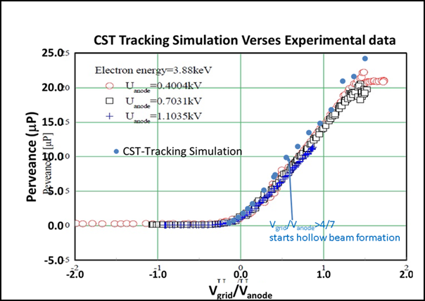
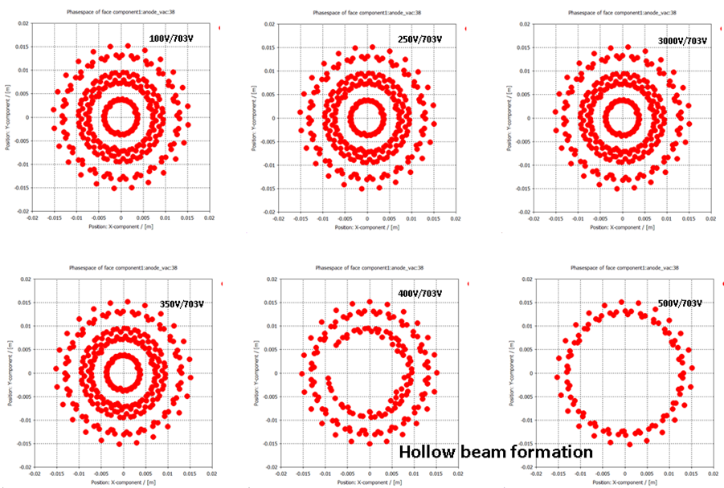
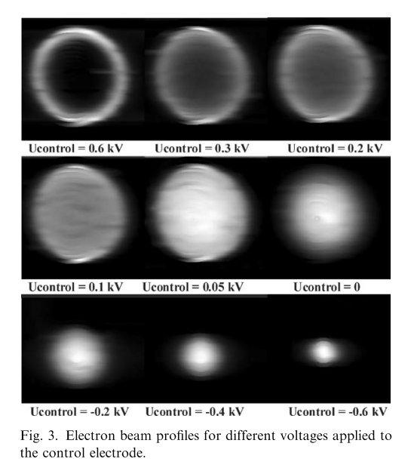
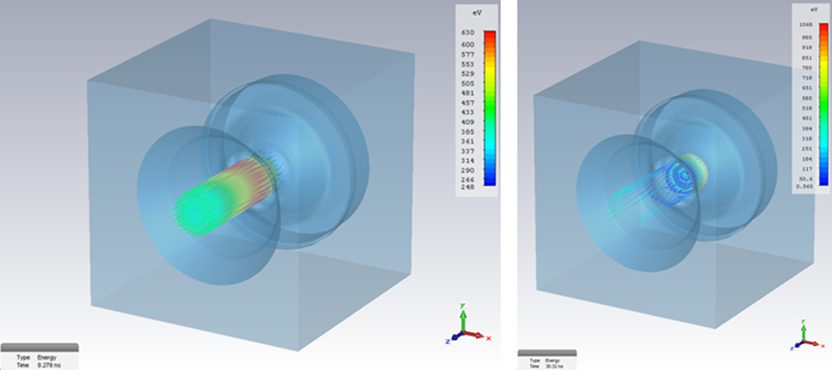
Hollow Beam Formation in CST-PS-Tracking Simulation and Experiments

Slide 8
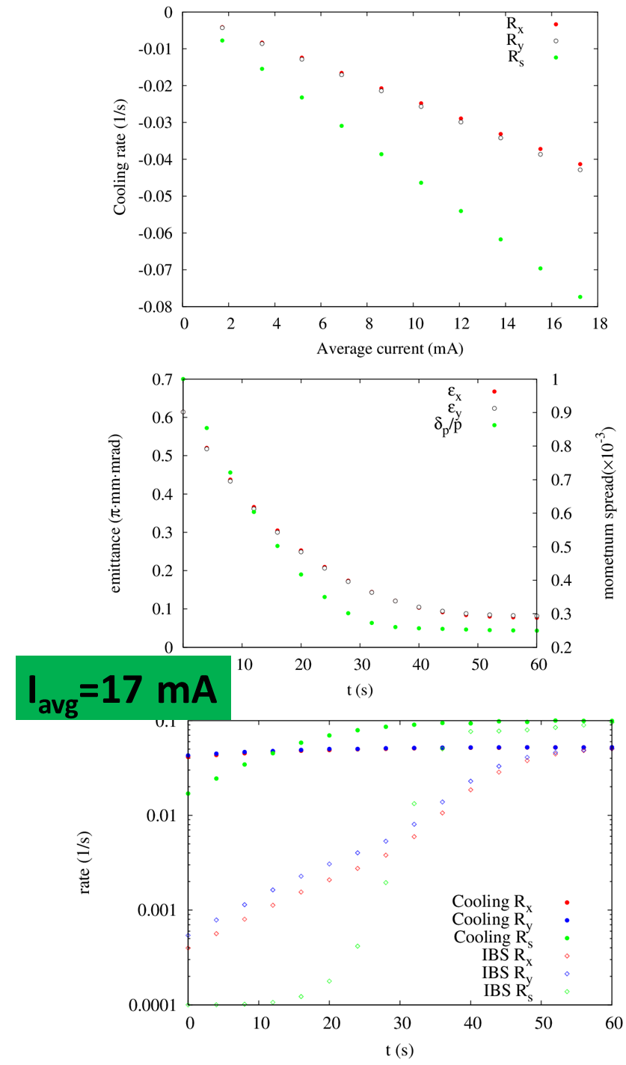
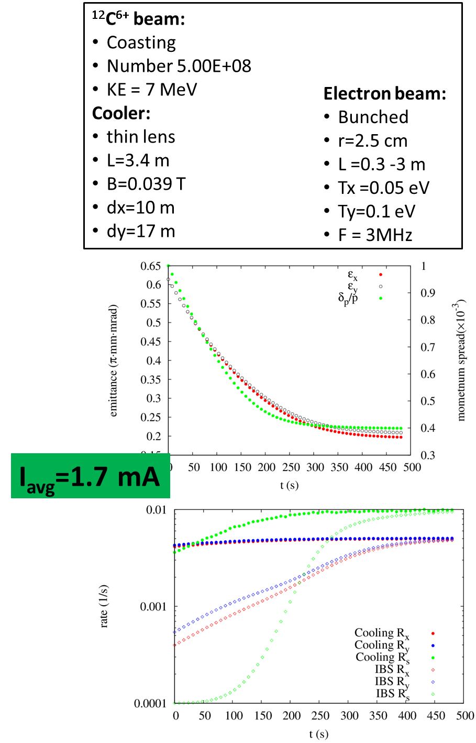
Cooling Rate Simulations Using Beta-Cool by He Zhang

Slide 9
Beam Diagnostic Devices for Bunched Electron Cooling Demo Experiment
existing
modification
new installation
Measurement | EC35-electron | CSRm-ions | Data-acquisition
average beam current | dc readings on PSs, sampling resistors | DCC(current)T(transformer)s | existing calibra. and DAS
peak beam current and pulse length | mod. freq. f_{m} Pearson coil on E-collector | rf or harmonic freqs n*f₀ | fiber optical link readout
Beam position | capacitive BPMs | capacitive BPMs | Re-calibra. and DAS put new attenuator
Beam trans.-profile | capacitive BPMs (off-line screen) | residual gas BPMs | DAS
Beam long.-profile | resonant BCMs on BPMs | resonant BCMs on BPMs or DCCTs Stochastic cooling pickup | fast scope and on-line DAS
Cooling rates | n.a. | Schorttky resonator and pickups | fast scope and on-line DAS Off-line side-band signal analysis

Slide 10
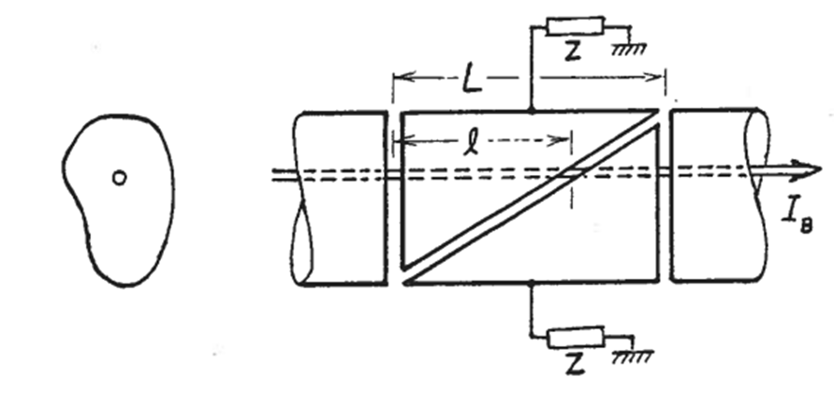
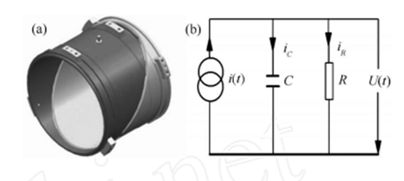
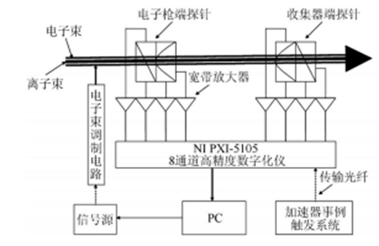



Existing BPM Devices at ECC-35 and CSRm for Electron/Ion BPMs
$$V\left(t\right)=\frac{R}{1+jωRC}I\left(t\right)=\frac{1}{βc}\frac{A}{πa}\frac{jωR_{eq}}{1+jωR_{eq}C}I_{b}\left(t\right)$$
$$x=2a\frac{V_{Δx}}{V_{Σ}}=2a\frac{V_{Right}−V_{Left}}{V_{Right}+V_{Left}+V_{Up}+V_{Down}}$$
$$y=2a\frac{V_{Δy}}{V_{Σ}}=2a\frac{V_{Up}−V_{Down}}{V_{Right}+V_{Left}+V_{Up}+V_{Down}}$$

Slide 11
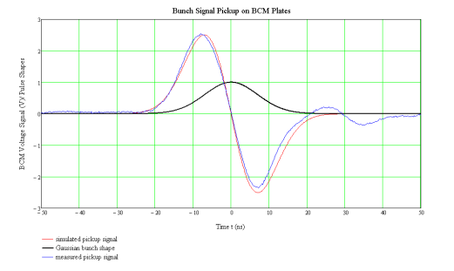
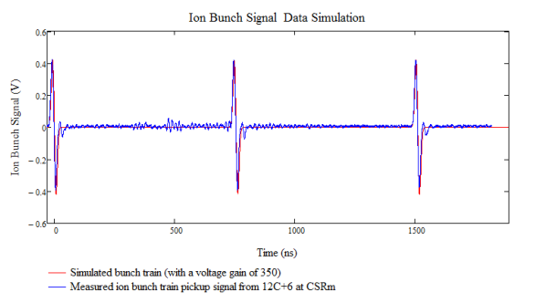
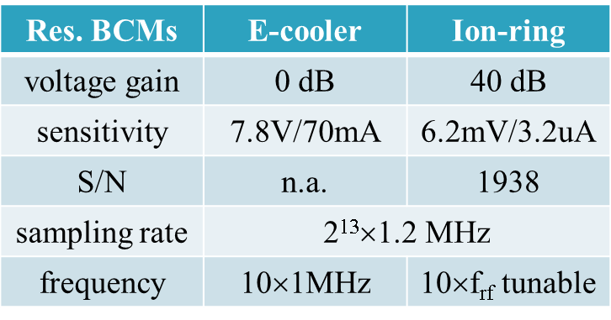
1D Signal Calculation for Gaussian Bunch and Ring-shape Pickup
Gaussian bunch shape distribution (black) in 7ns (rms) bunch length current picked up by 50 Ω shunt impedance’s voltage (red, calculation) and comparison to the experimental data (blue) for one of ¹²C⁺⁶ bunches accelerated in the CSRm ring at the β∼0.5 velocity. The blue data is measured by a fast oscilloscope on a L_{s}=15cm pickup cylinder. The voltage gain of such signal is ~350. The ion current is ~3μA. Signal ringing on the back is due to the pickup circuit.

Slide 12
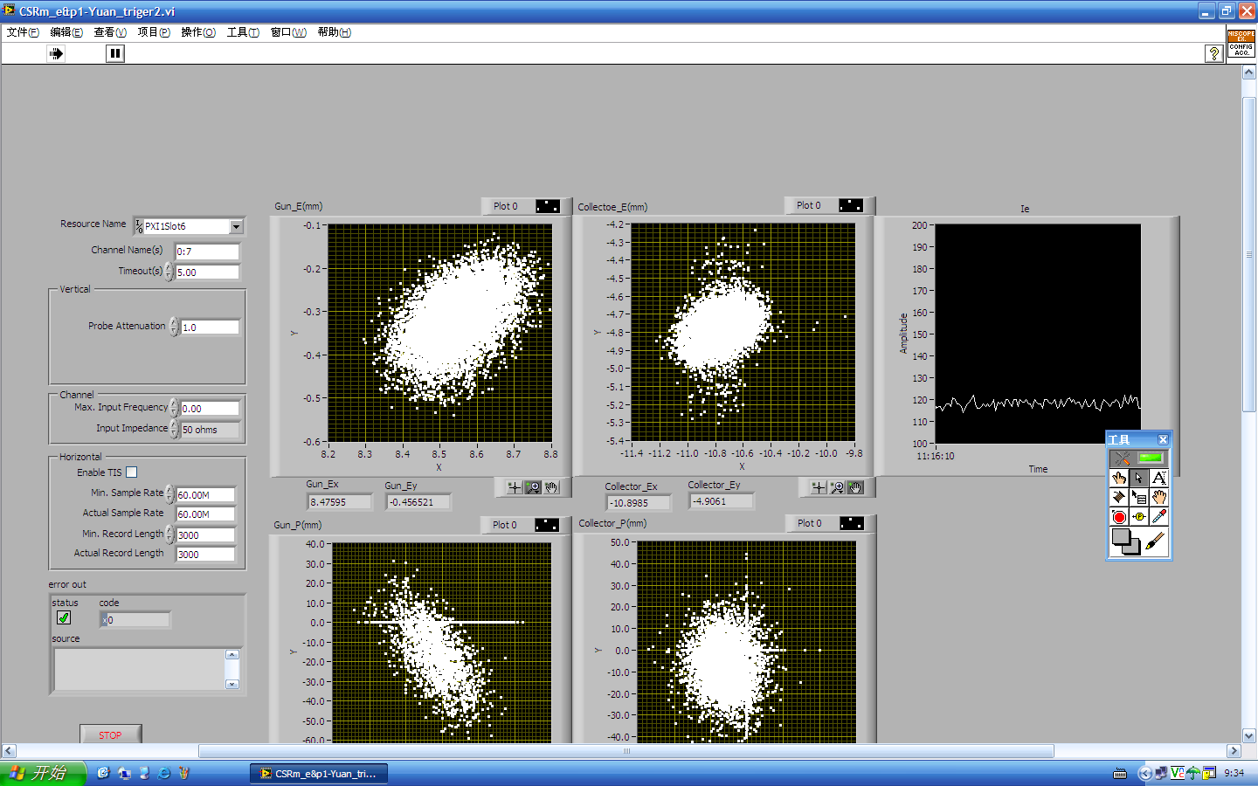
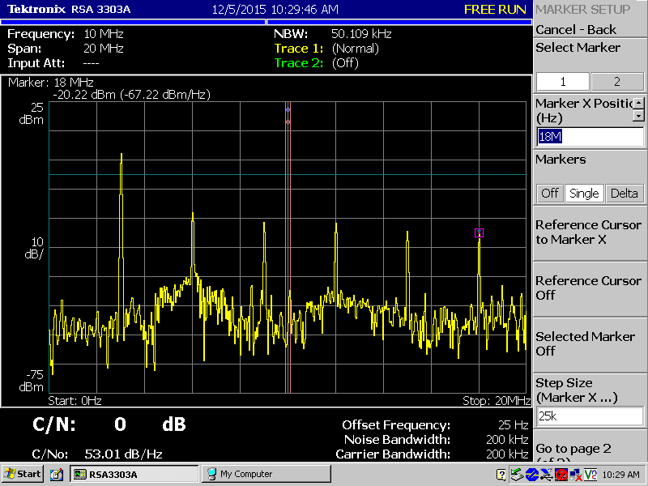
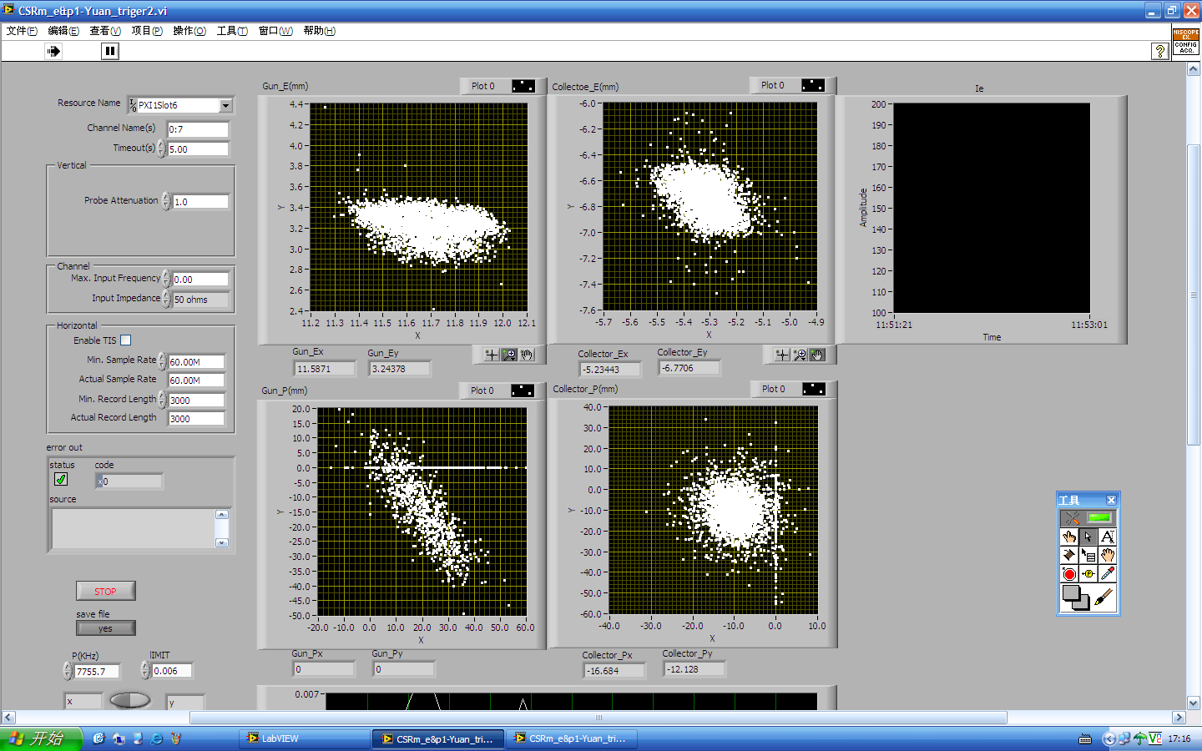
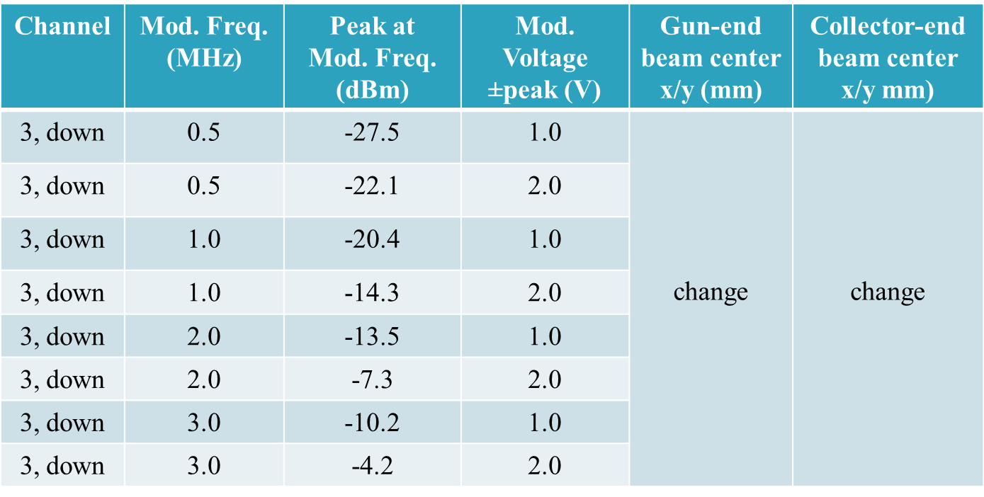
0.5-3MHz Gun Modulation Test, PoP Experiment for BPM
New HV pulser will overtake original BPM 3MHz modulation signal
Using gun grid modulation signal instead at ~1MHz
V_{bpm}∝f_{mod}×V_{grid}/V_{dc}
Electron BMP signal change is ~+60dB
Need to put a RF attenuator on each channel
Use original off-line BMP calibration
3MHz, +/-6.8V, 60Ms
Need recalibration of EC-35 BPMs
1MHz, +/-5.0V, 60Ms

Slide 13
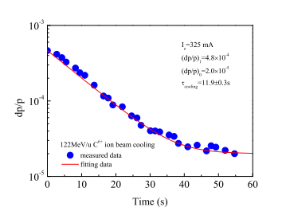
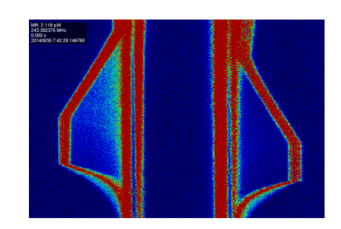
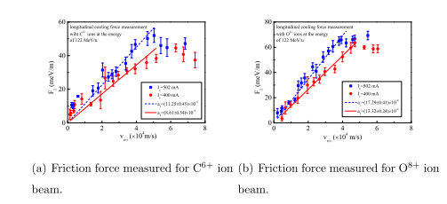
Using Longitudinal Schottky Diodes to Measure the Cooling Rates

Slide 14
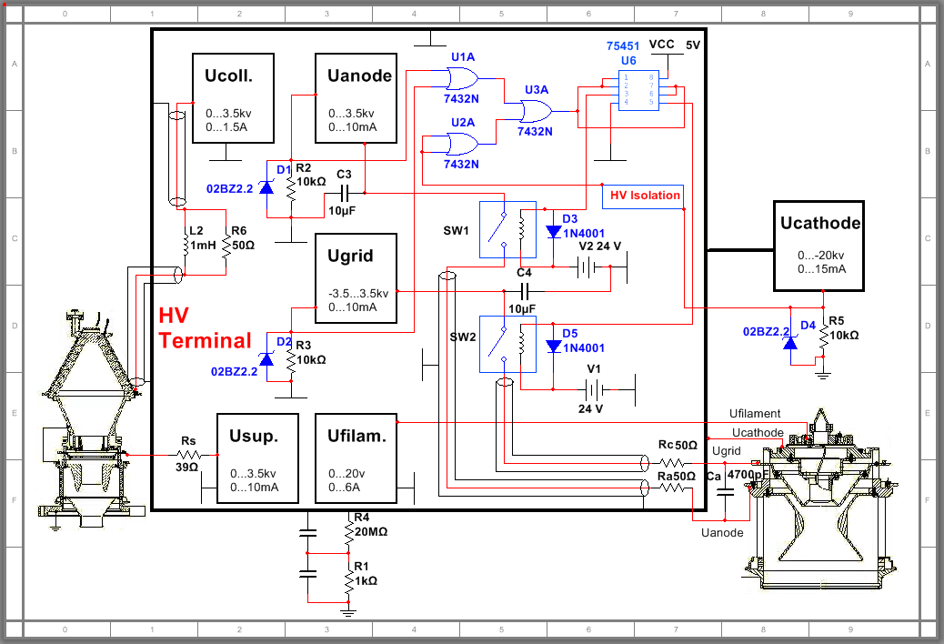
New DC Power Supply System Block Diagram From IMP

Slide 15
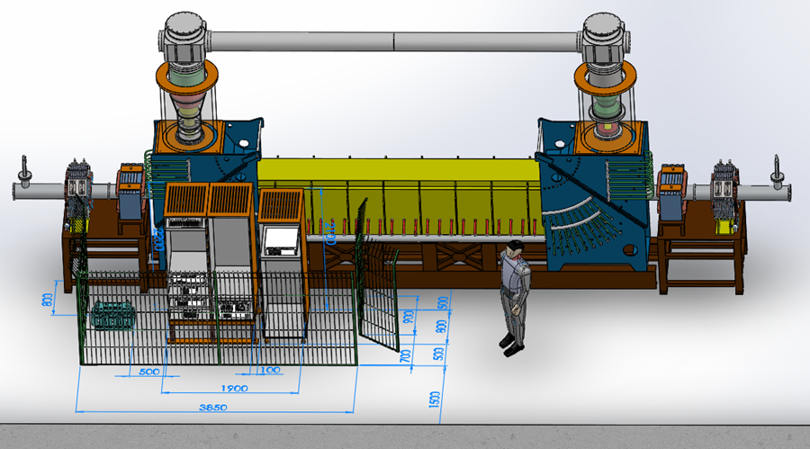
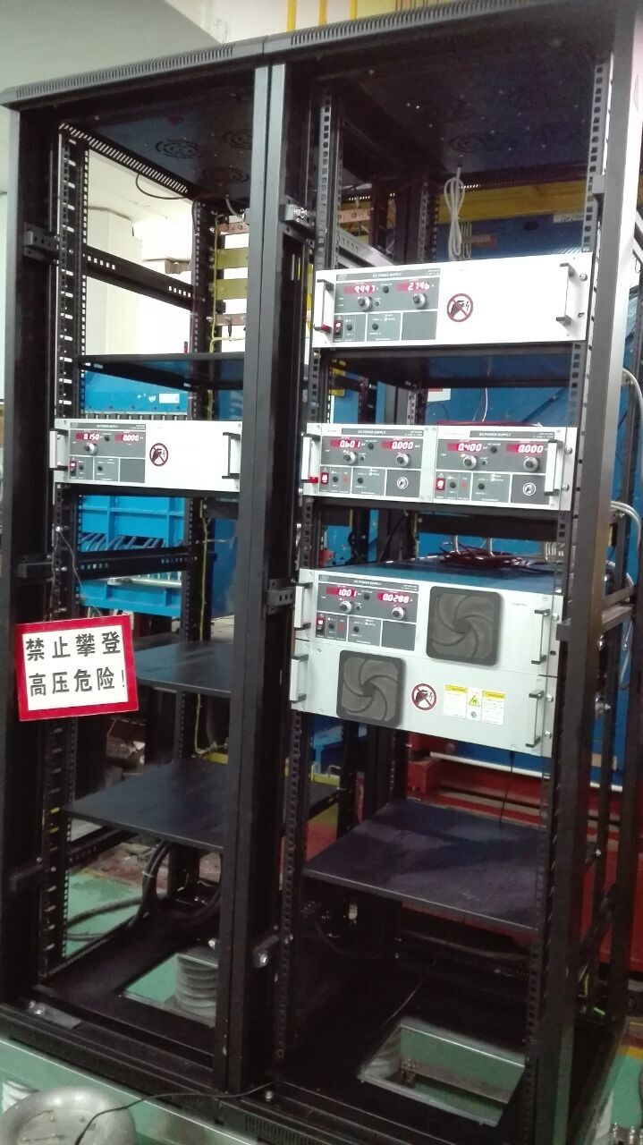
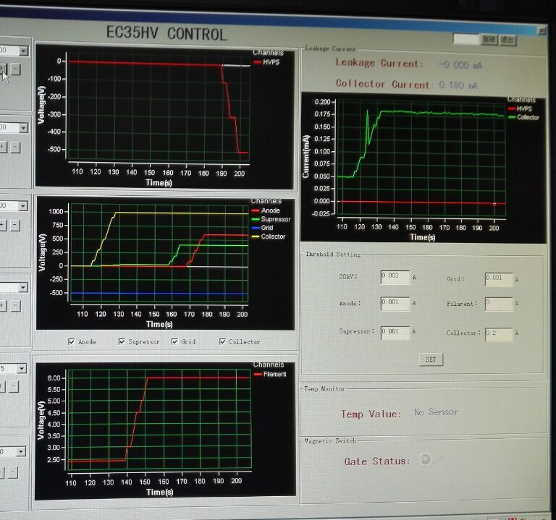
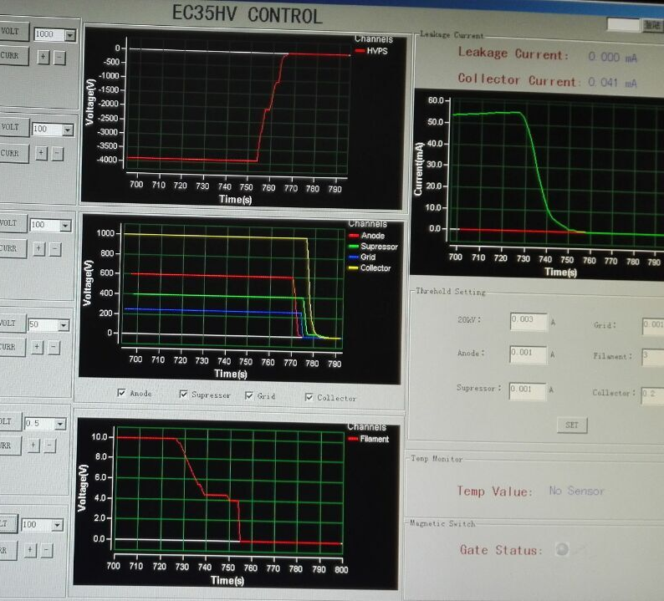
Upgrade All DC Power Supplies by IMP for the EC-35 Cooler System Improvement
Place for JLab pulser
Cathode filament
DC grid
anode and suppressor
collector
>95% beam transmission w/o BPM and max. DC beam current 55mA in last week’s result

Slide 16
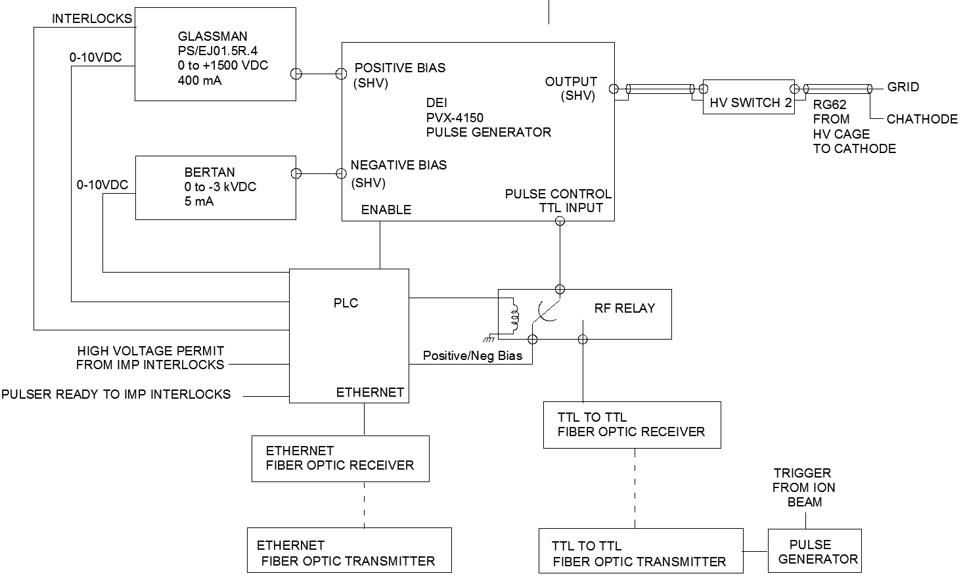
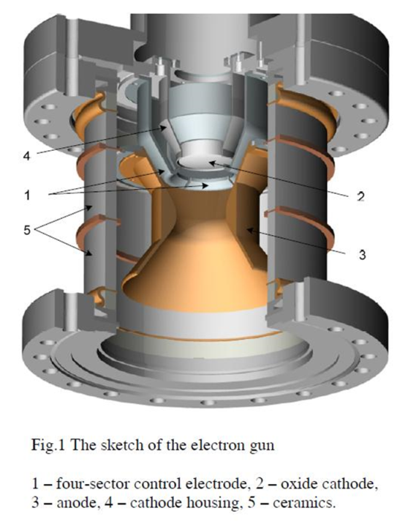
Block Diagram of JLAB Pulser Interface-Tom Powers
Anode power supply

Slide 17
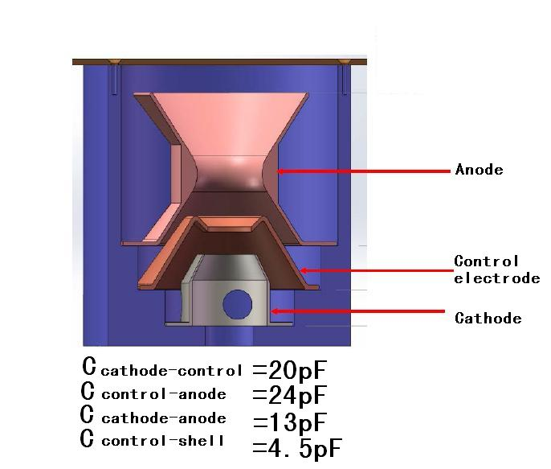
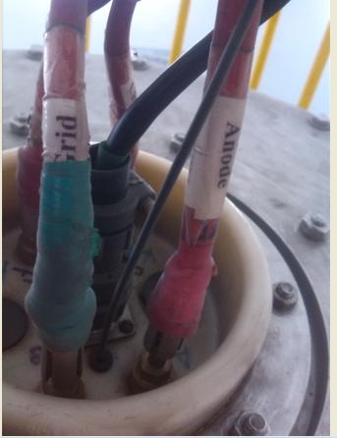


Capacitance Measurement on the Mockup E-gun
Values of capacitance measurement agrees with circuit series and parallel capacitances
(5pF)
$$\frac{1}{\frac{1}{\frac{1}{16}+\frac{1}{20}}+20}+\frac{1}{6}≈\frac{1}{5}$$
(5pF)
20pF
6pF
16pF
20pF
20pF
20pF
16pF
6pF
(6)pF
Bench measurement was done on the mockup gun with Mr. Xiaoming Ma on Dec. 16. and confirmed on Dec. 17.
To be updated very soon on the latest
gun connection
C_{cathode-shell} =

Slide 18
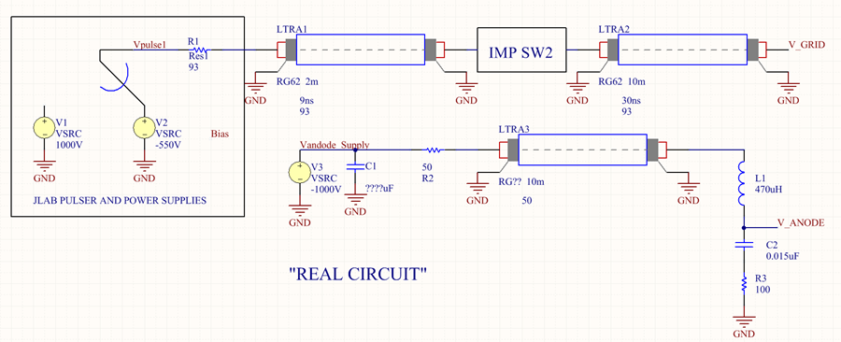
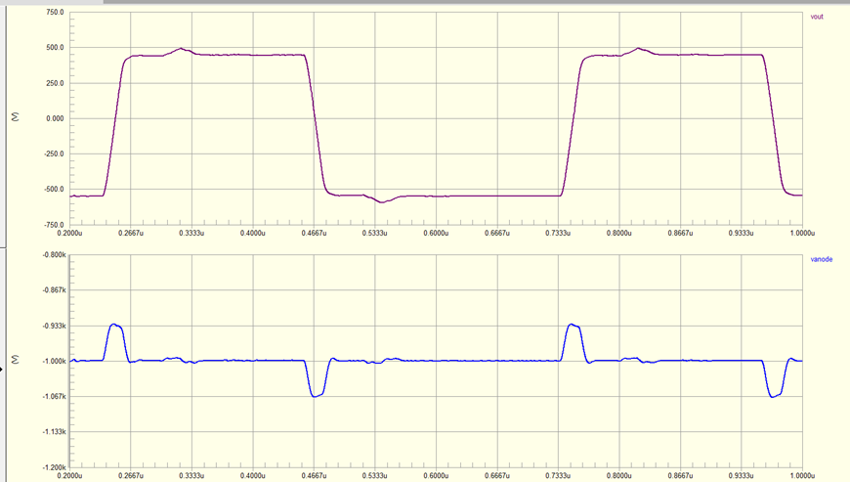
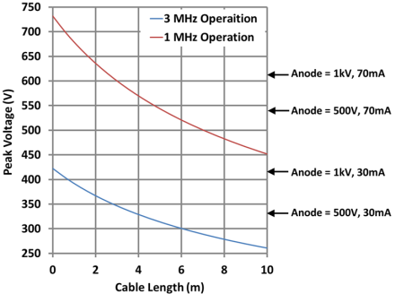
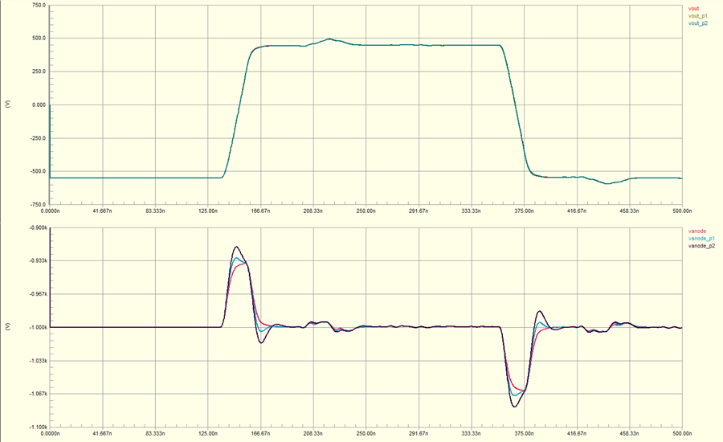
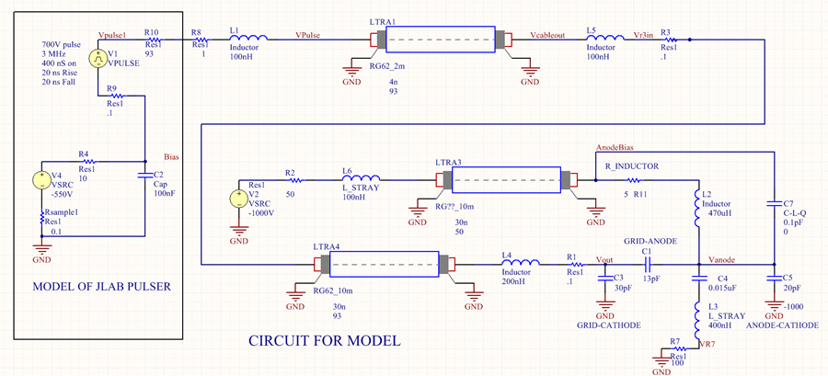

HV Modulation Pulser Circuit Simulation to Real Load-Tom Powers
V_{out}
V_{anode}
$$P_{Disp}=CV^{2}F<150 Watts$$
V_{out}
V_{anode}
Pulse waveform of 100 nH, 250 nH and 400 nH stray inductance and 100 Ohms in anode snubber circuit.

Slide 19





JLab High Voltage Pulser Bench Test Recent Result-Kevin Jordan
Load pickup signal
+1kV adj.
-0.8kV adj.
1us adj.
Neg. DC PS
DEI HV pulser
No snubber circuit yet
Pos. DC PS
PS pickup signal
matched load pickup signal
~20ns rise time
fiber optic trans/recv
ground controller

Slide 20
Summary
Bunched electron Beam Cooling Demo Experiment at IMP has been awarded in 2014 for LDRD at JLab and carried out by the collaboration team from 2015 up to now
HV power supplies and pulser hardware are under commissioning for the electron beam bunch modulation scheme
Little or no modification to IMP CSRm current BPM system to measure the beam bunch length and peak current is possible for our bunched electron cooling experiment
Engineering and commissioning efforts have been carried out at both IMP and JLab
Two exports from JLab will travel to IMP in April to help IMP team to install the HV Pulser and to commission the newly modified EC-35 Cooler system
This PoP experiment will do all of these schemes: DC to coasting, bunch to coasting and bunch to bunch, synchronization and non-sychronization demos.
IMP has put this experiment in the highest priority for the first half year’s beam schedule
Demo experiment is expected in May-June, 2016, after IPAC 2016

