Slide 1
Field Emission Onset for C50 Cryomodules in the CMTF
Michael Drury

Slide 2
Octirad vs. Decarad
Acceptance Testing Measurements available for 7 / 11 C50 cryomodules
Octirad used for Field Emission Measurements during Acceptance Testing for first ten C50 cryomodules
Decarad used for C50-12 measurements

Slide 3
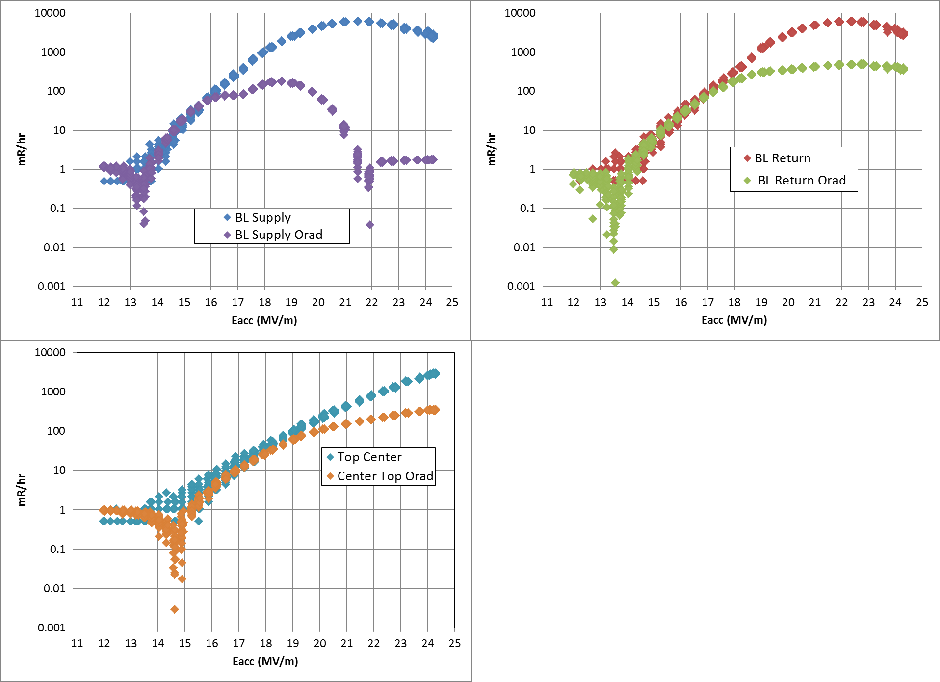
OctiRad / DecaRad Comparison
Cavity C100-7-2 on 06/01/12
Similar behavior for other cavities
Compared beamline tube positions and top center tube position
Relatively good agreement up to about 100 mR/hr
Octirad tubes saturate at much lower dose rates
Onset Gradients derived from octirad data tends to be higher by ~1 MV/m

Slide 4
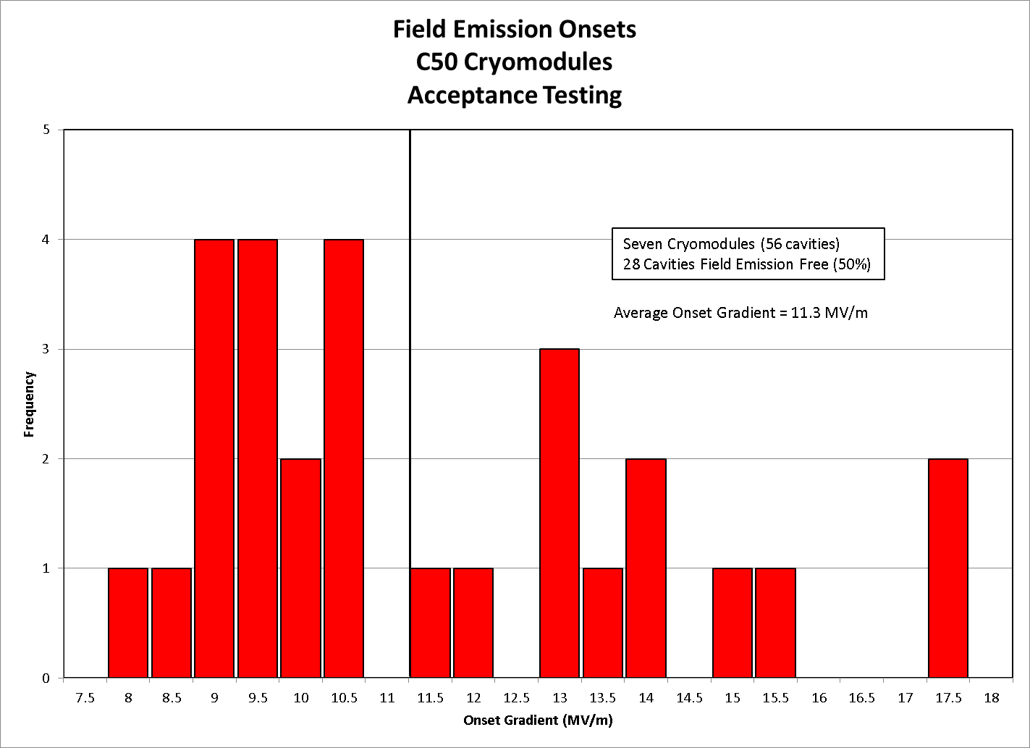
Distribution of C50 Onset Gradients

Slide 5
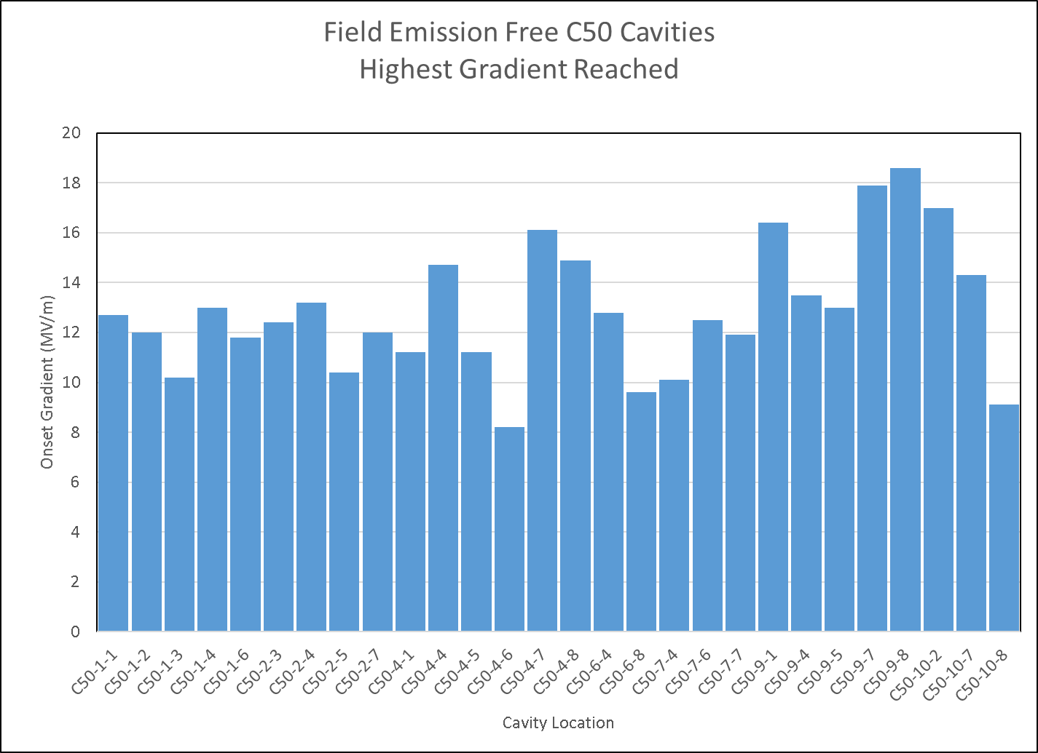
Field emission Free Cavities
C50-1 had 5 FE free Cavities
C50-4 had 6 FE free Cavities

Slide 6
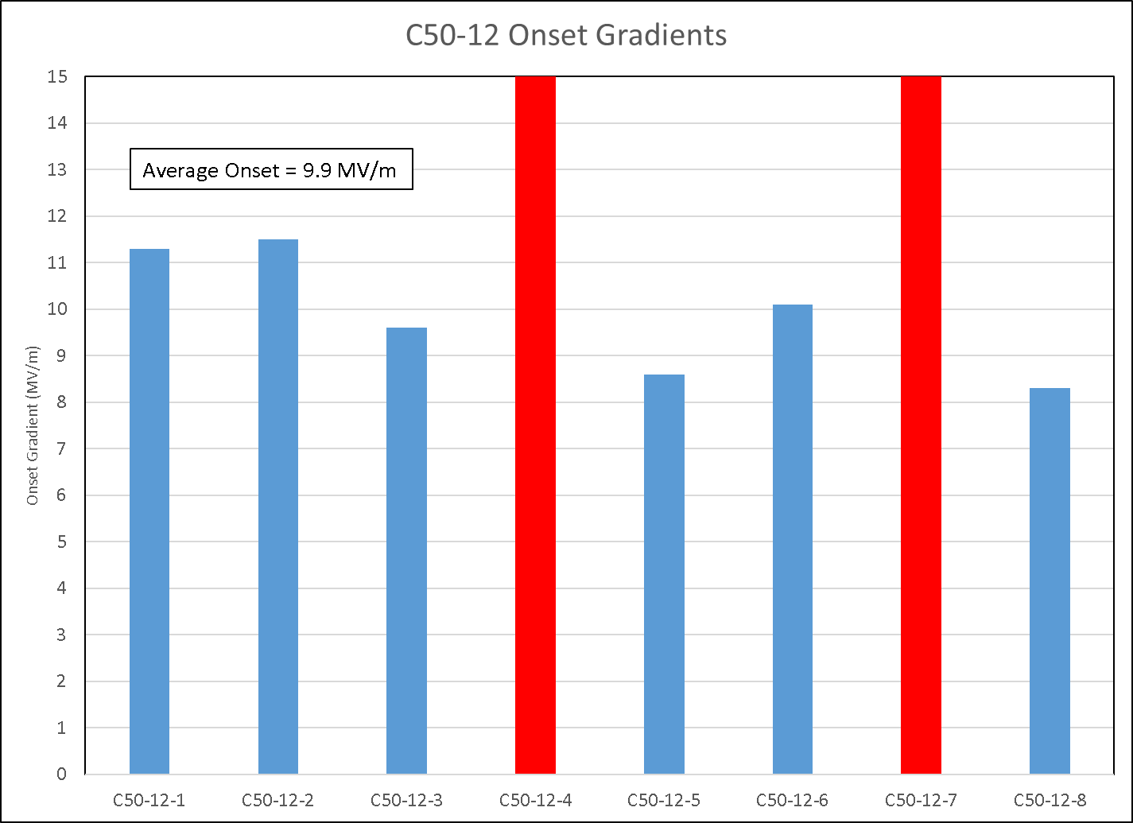
C50-12
Two field Emission Free Cavities
(up to 15 MV/m)

Slide 7
Conclusion
No significant change in Field emission behavior when compared to the earlier C50 Cryomodules

