Slide 1
Design and first use of the slow venting apparatus for NL12 warm girders and future improvements
Ari D. Palczewski, PhD
SRF Staff Scientist
09/12/16

Slide 2
Slow venting and slow pump down
Both designed to minimize particle migrations from “dirty” to “clean system” or within clean/dirty system.
Both designed to keep gas below laminar flow in clean environment.
Both ideally have a diffuse path for gas before reaching sensitive area.

Slide 3
Slow Venting used for Girder
Helium or Nitrogen inlet,
(hopefully pre-cleaned)
Vacuum 1 atm overpressure popoff
Connector to girder valve
MOTT 0.003μm ~ ultrapure gas filter
0.019C_{v} metering valve (swage BMG)
MOTT 0.003μm ~ ultrapure gas filter
Controlled by hand to vent rate of 7.6Torr/min ~ 10 turns on needle while looking at convector gauge – erring on the slow side (no diffuser)

Slide 4
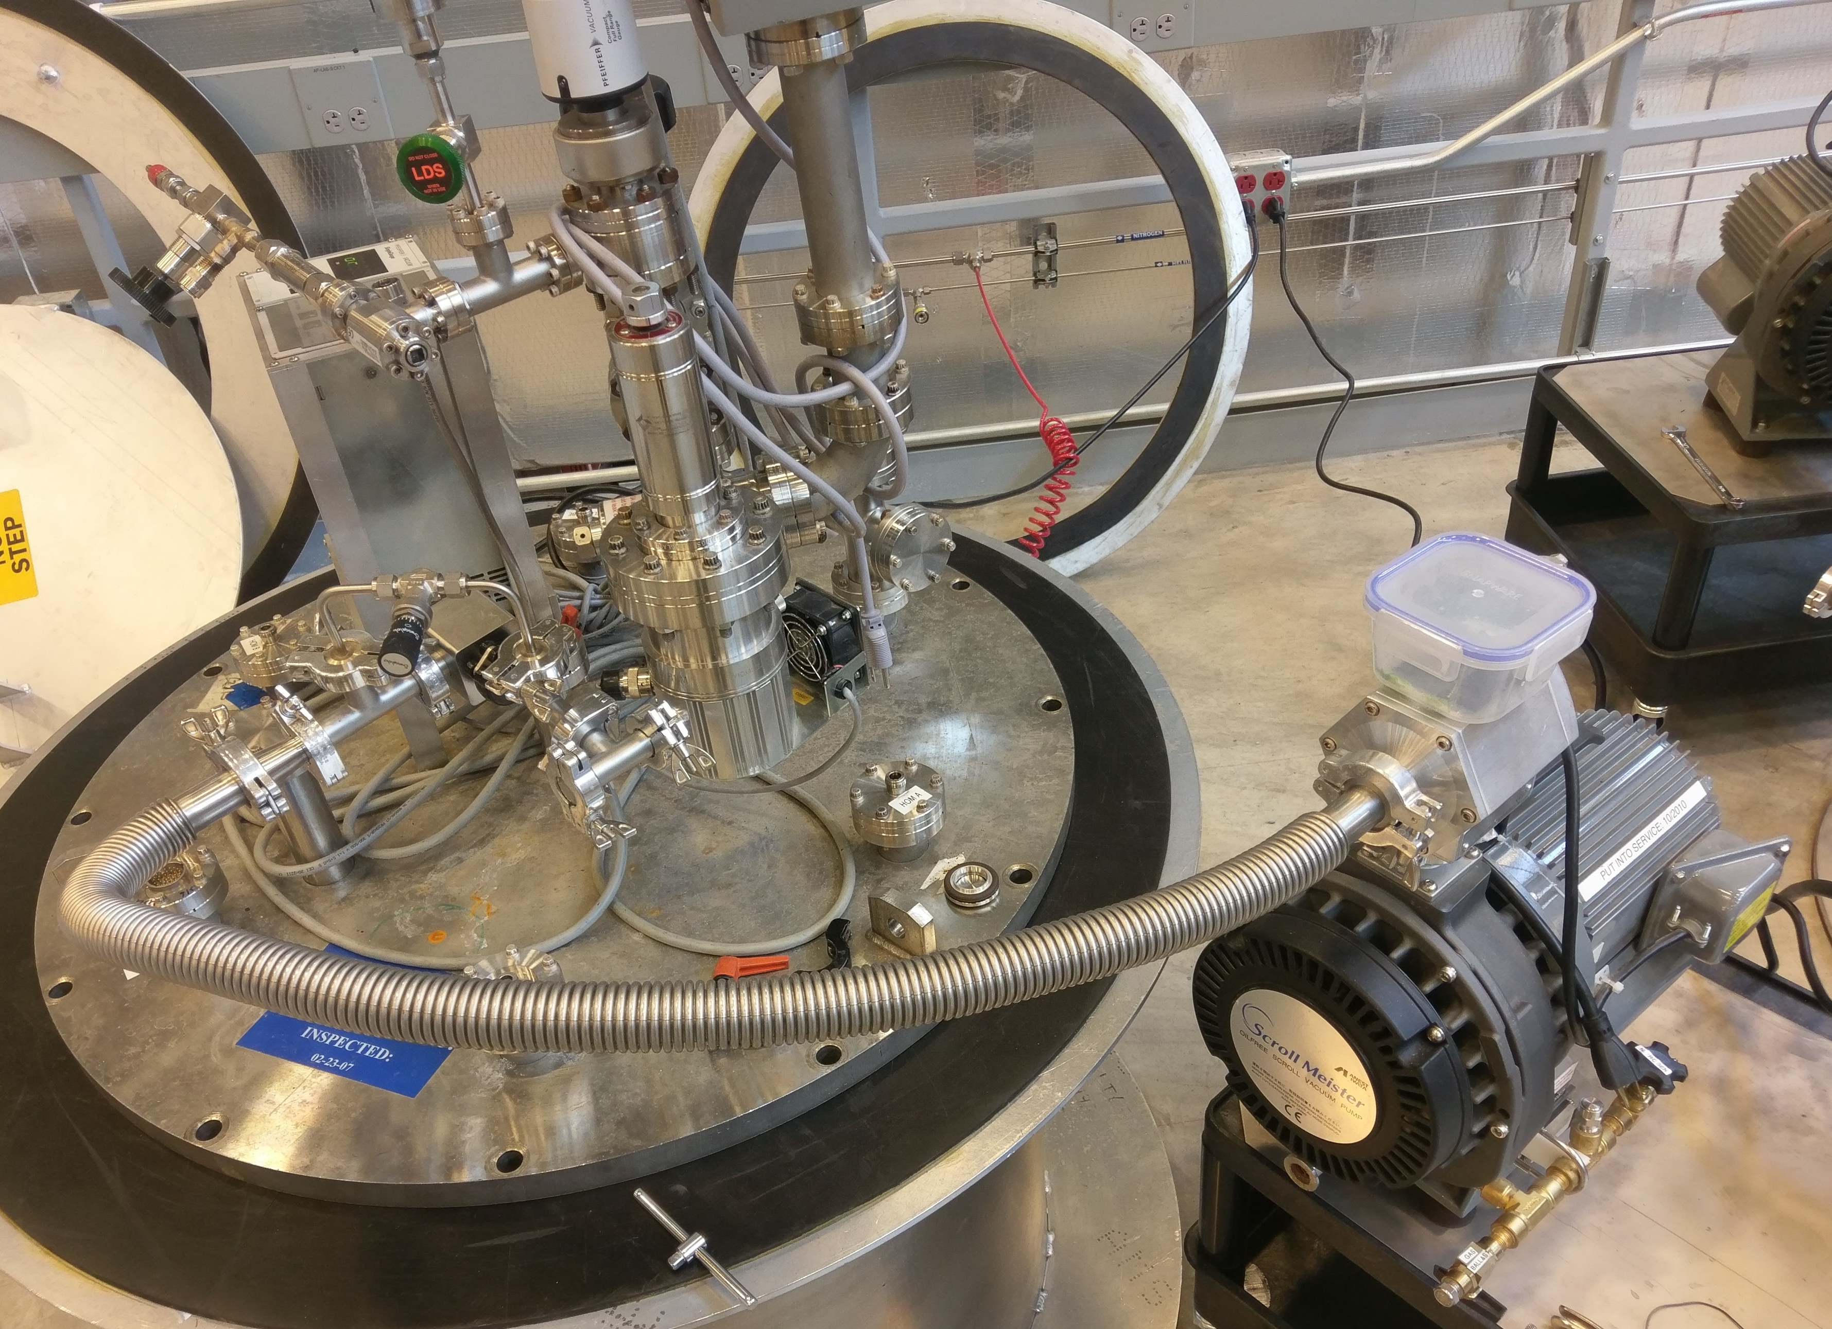
Slow pump-down system – standard system, same type of system used on girder
Max pump-down rate flow ~1L/min
Not controllable
Turbo on by hand below 10Torr pressure
To item being pumped
Metering valve 0.3C_{v}
Scroll pump for rough pumping

Slide 5
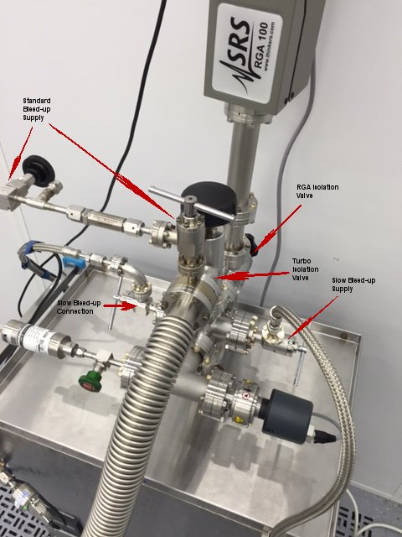
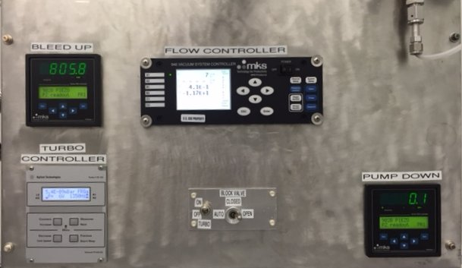
New cleanroom system
Stand alone PLC controller for pump down and venting with real-time feedback
Slow venting(not shown) has a diffuser at inlet to disperse gas.

