Slide 1


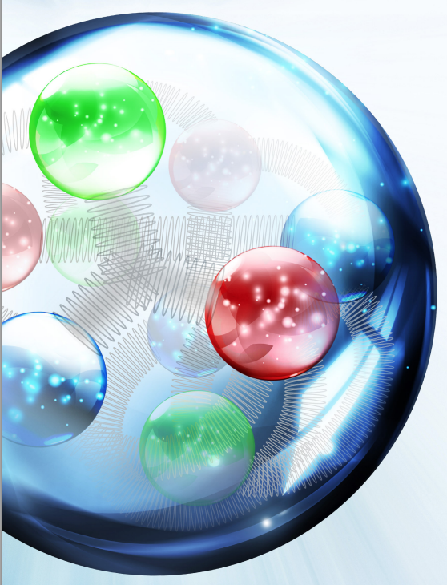
JLEIC Program Update
Fulvia Pilat
JLEIC 4th Collaboration Meeting
JLAB October 5-7 2016

Slide 2
JLEIC 4th Collaboration Meeting
Meeting goals:
Discuss technical issues and design improvement
Discuss and define roles, responsibilities, deliverables of collaborators for design, pre-project R&D, pre-CDR
Engage industrial partners and form basis for collaboration and potential SBIR’s
Plan future Collaboration Meetings
1st Collaboration Meeting March 2015
2nd Collaboration Meeting October 2015
3rd Collaboration Meeting: March 2016 topical
Bunched beam electron cooling and ERL cooler
Detector interface and interaction region
Update on R&D program
Plans for pre-CDR and project development
4th Collaboration Meeting October 2016 general

Slide 3
outline
JLEIC overview
Update and progress – last 6 months → Today
Baseline improvements
R&D goals and progress
Configuration management, simulations TF
EIC FOA and Collaborative proposal May 2016
Cost estimate for 200 GeV option June 2016
2nd EIC Users Group Meeting July 2016
JLAB LDRD September 2016
Plans and priorities for next 6 months → Friday
Advance design and R&D
Collaborations
EIC Prioritization Review Nov 29- Dec 2, Rockville MD
Preparation NP EIC R&D FOA, SBIR

Slide 4
Key Design Concepts
High luminosity: high collision rate of
short modest-charge low-emittance bunches
  Small beam size
    Small β* ⇒ Short bunch length ⇒
    Low bunch charge, high repetition rate
    Small emittance ⇒ Cooling
  Similar to lepton colliders such as
  KEK-B with L > 2×10³⁴ cm⁻²s⁻¹
High polarization: Figure-8 rings
  Net spin precession zero
  Spin easily controlled by small
  magnetic fields for any particle
  species
Full acceptance primary detector including far-forward acceptance
Beam Design
High repetition rate
Low bunch charge
Short bunch length
Small emittance
Damping
Synchrotron radiation
Electron cooling
IR Design
Small β*
Crab crossing

Slide 5

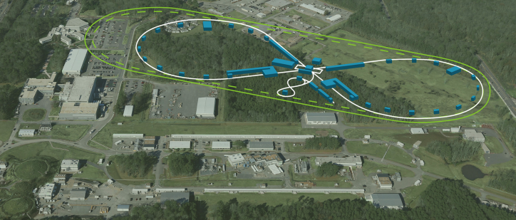
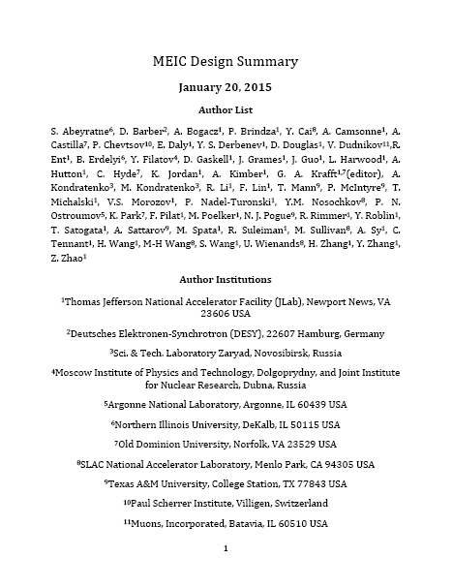
JLEIC baseline
Electron complex
  CEBAF
  Electron collider ring
Ion complex
  Ion source
  SRF linac (285 MeV/u for protons)
  Booster
  Ion collider ring
Optimal integration machine-experiment
8-100 GeV
3-10 GeV
8 GeV
energy range:
e-: 3-10 GeV
p : 20-100 GeV
2015
arXiv:1504.07961

Slide 6
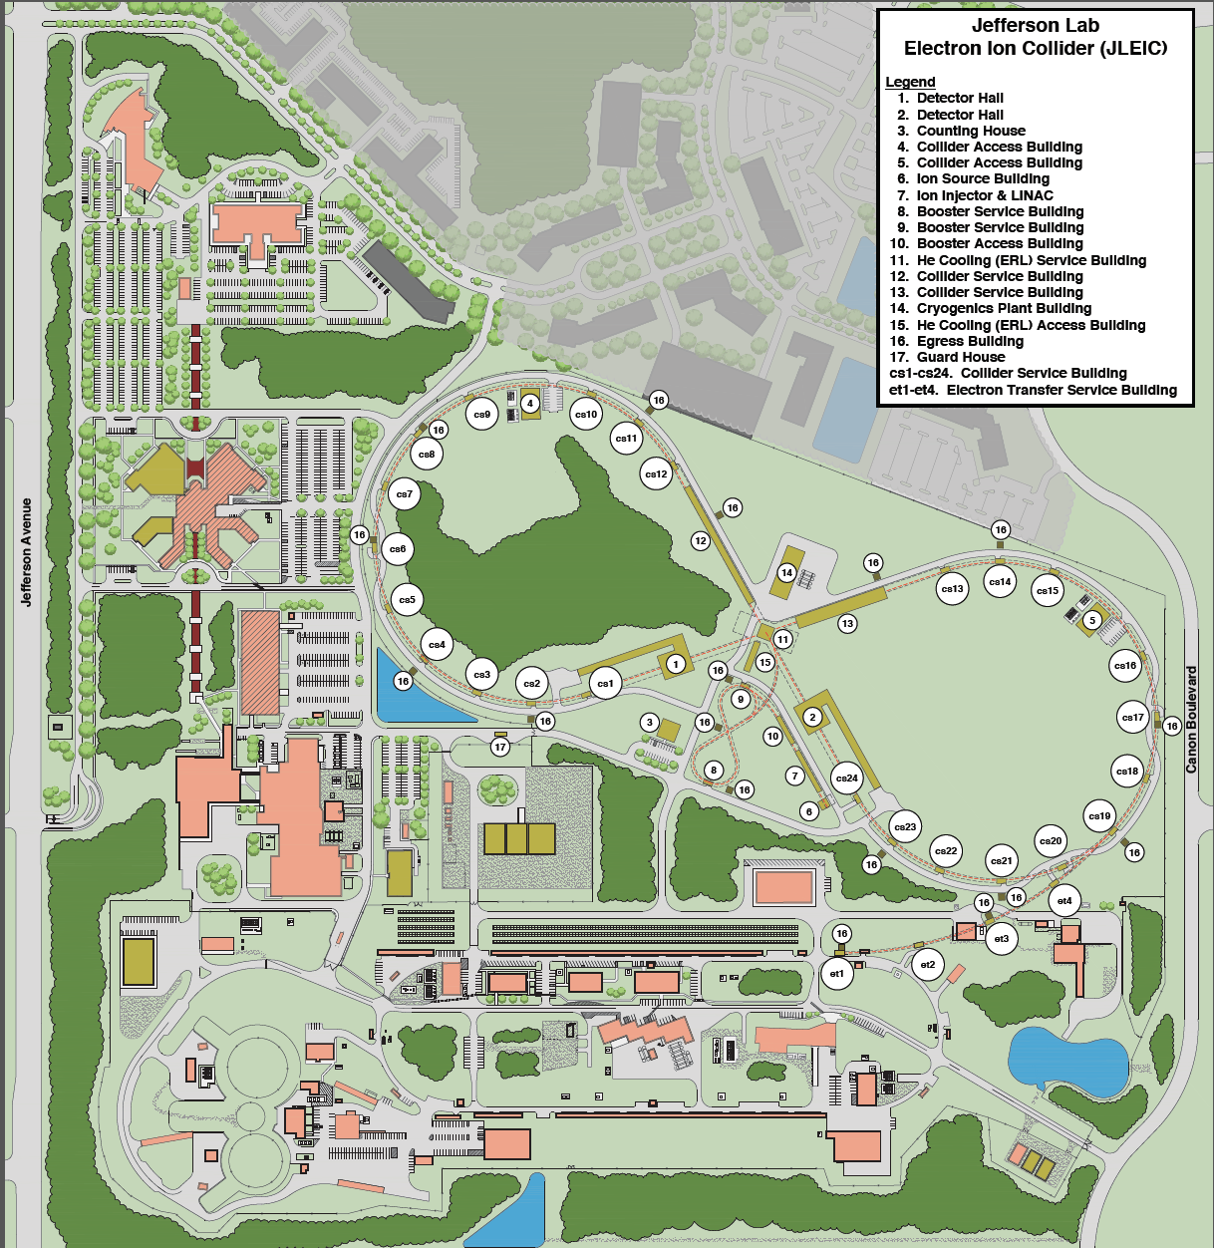
JLEIC Site Development
Cut-and cover and boring tunnel
options compared

Slide 7
JLEIC Planning Overview
Now to CD0 (est. end 2017 or 2018): Pre-project
Pre-project R&D: validation of basic design technology and further risk reduction (JLEIC baseline design minimizes project risk)
Pre-project activities (site evaluation and environmental impacts, configuration management)
Collaboration on EIC (National Labs: BNL, ANL, SLAC, LBL, Universities, International, EICUG)
Delivery of a pre-CDR, to prepare for full CDR
CD0 to CD1: On-project
On-project R&D (value engineering for performance optimization and cost reduction)
Delivery of full CDR

Slide 8
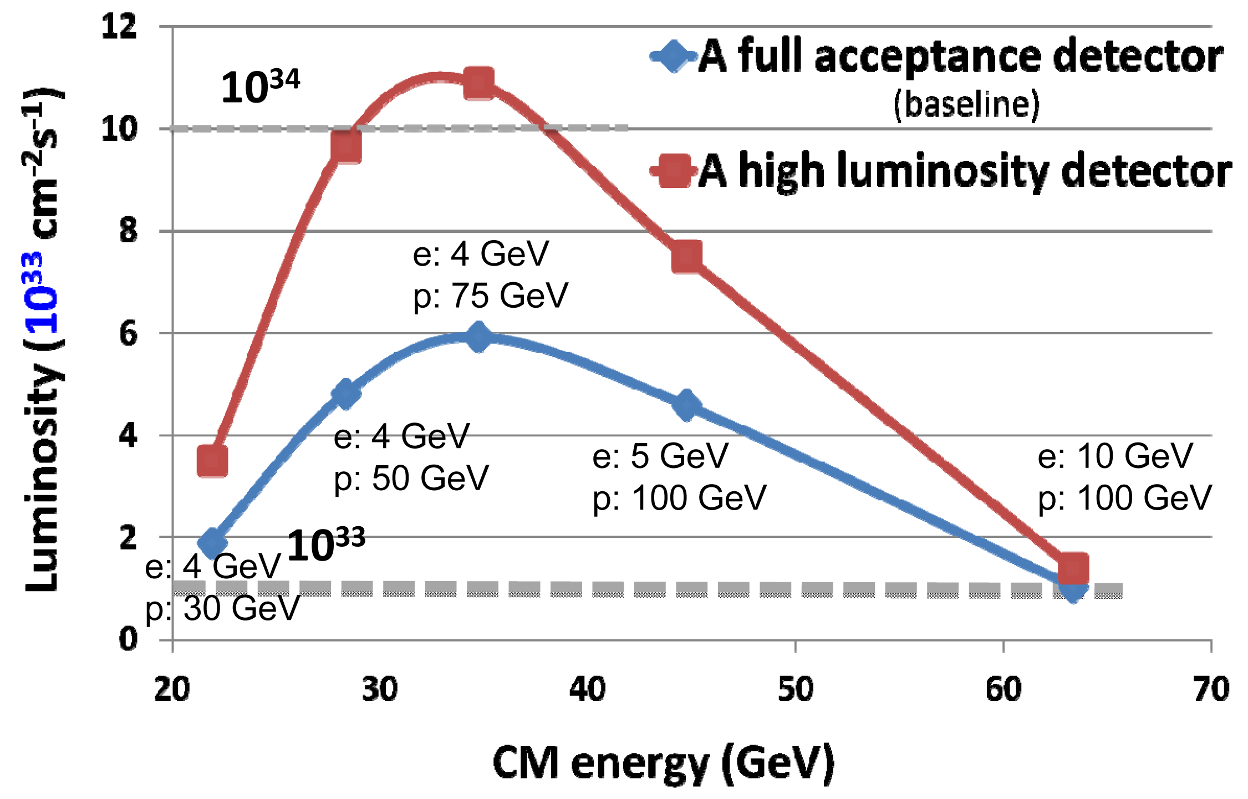
e-p Collision Luminosity
Design point (CM) | p energy (GeV) | e⁻ energy (GeV) | Main luminosity limitation
low | 30 | 4 | space charge
medium | 100 | 5 | equilibrium emittances
high | 100 | 10 | synchrotron radiation

Slide 9
Work in Progress
Study: without bunched beam e-cooling in the ion collider the luminosity is ~1-2 10³³ if we can re-inject every 2-3 hours
Performance optimization:
Multi-turn electron cooling:
re-circulate cooling beam a few times
  Advances in ERL cooler development
  Fast kicker development
Development of low emittance lattice of electron collider ring
Beam parameter optimization (beta*)
Cost optimization:
Reduction of SRF linac energy to 140 MeV

Slide 10
Lower-Energy Linac
Has been designed and optimized
End-to-end simulation completed
Low-energy Booster studies in progress

Slide 11
ERL Cooler
Ion Beam
1 Tesla Cooling Solenoid
De-chirper
Chirper
50 MeV Linac Cryomodule
Magnetized Gun
Booster
Beam dump
DESIGN of single pass ERL cooler → luminosity ~3x10³³
Design in progress
Space charge not a problem.
Good progress on magnetized gun
Initiated merger design
R&D to enable a re-circulator ERL cooler stronger electron cooling →luminosity >10³⁴
Fast kicker
Beam dynamics

Slide 12
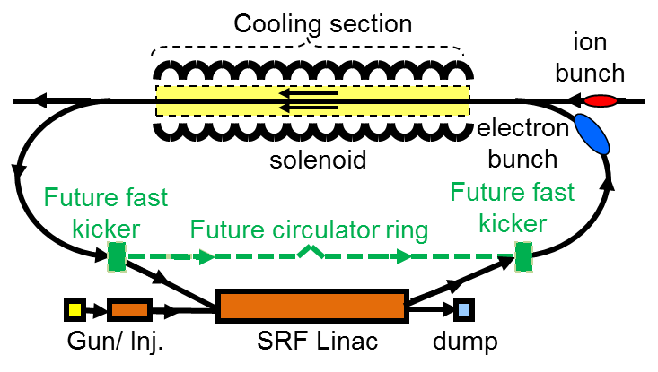
Multi-Turn Cooling
Electrons circulate 10 to 30 turns in circulator ring,
Beam current and bunch repetition frequency reduced by a factor of 10 to 30
Fast kickers needed
Fast
kicker
Fast
kicker
Circulator ring

Slide 13
Possible 4x Luminosity Increase
 |  | Present baseline |  | Improved baseline
 |  | p | e | p | e
Beam energy | GeV | 100 | 5 | 100 | 5
Collision frequency | MHz | 476 |  | 476
Particles per bunch | 10¹⁰ | 0.66 | 3.9 | 0.98 | 3.7
Beam current | A | 0.5 | 3 | 0.75 | 2.82
Polarization |  | >70% | >70% | >70% | >70%
Bunch length, rms | cm | 1 | 1.2 | 1.2 | 1.2
Norm. emittance, x/y | μm | 1/0.5 | 144/72 | 0.5/0.1 | 70/14
x/y β* | cm | 4/2 | 2.6/1.3 | 6/1.2 | 4/0.8
Vert. beam-beam param. |  | 0.006 | 0.014 | 0.015 | 0.053
Laslett tune shift |  | 0.01 | Small | 0.048 | Small
Detector space, up/down | m | 3.6/7 | 2.4/1.6 | 3.6/7 | 2.4/1.6
Hourglass (HG) reduction |  | 0.88 |  | 0.80
Lumi./IP, w/HG, 10³³ | cm⁻²s⁻¹ | 4.6 |  | 19.5

Slide 14
JLEIC Pre-Project R&D
Bunched beam electron cooling
ERL Cooler design (JLAB)
Magnetized source for e-cooler (JLAB LDRD, Cornell SBIR)
Bunched beam cooling experiment (JLAB, IMP)
Fast kicker for recirculator cooler (JLAB)
Magnets for the ion booster and collider
Super-ferric magnet R&D for 3T , prototype (Texas A&M, JLAB)
Super-conducting magnets design for 3T (LBL)
IR magnets design (Texas A&M, LBL)
SRF cavities and crab cavities
952 MHz crab cavity design, integration, prototype (ODU-JLAB)
952 MHz SRF cavities for cooler and ion collider: (JLAB)
Ion injector
SRF linac design, stripping, simulations (ANL, JLAB)
Evaluation warm vs. cold linac (MSU)
Interaction Regions and beam dynamics
IR design, detector interface, backgrounds, collimation (SLAC, JLAB)
Non-linear dynamics, corrections, DA (SLAC, JLAB)
Beam physics and modeling (JLAB, ODU, LBL, ANL, SLAC)

Slide 15
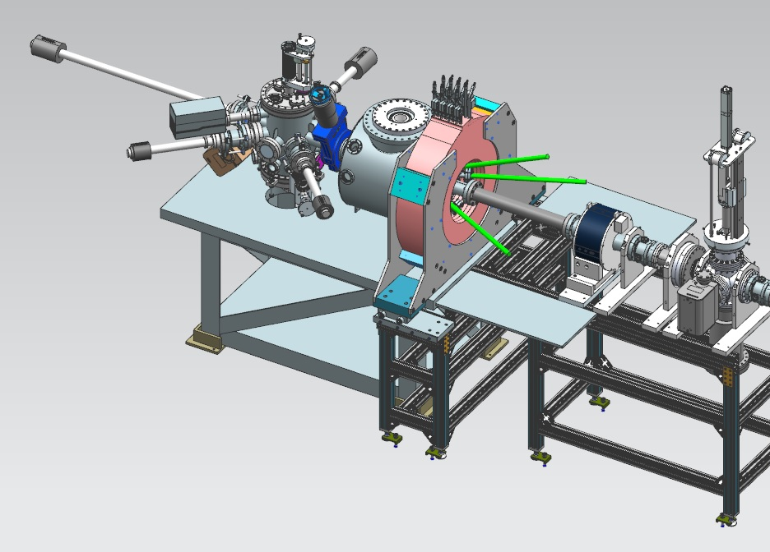
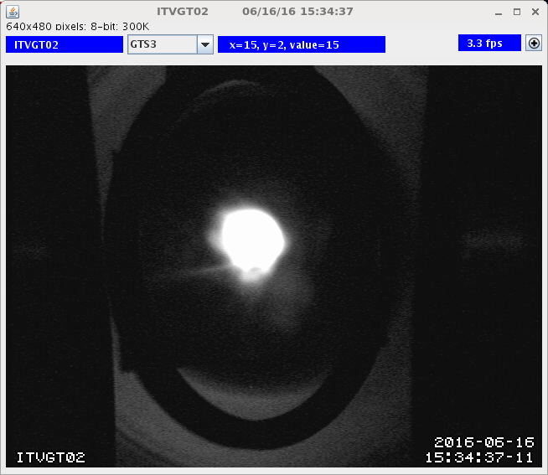
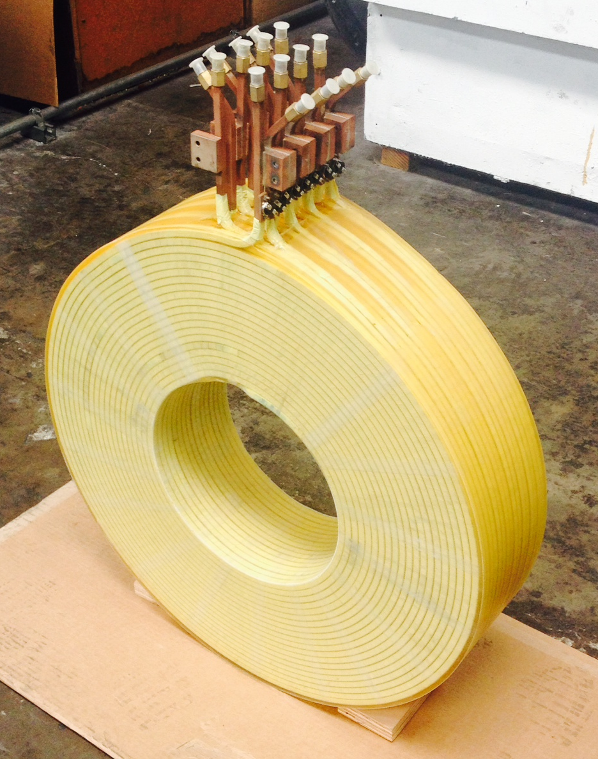
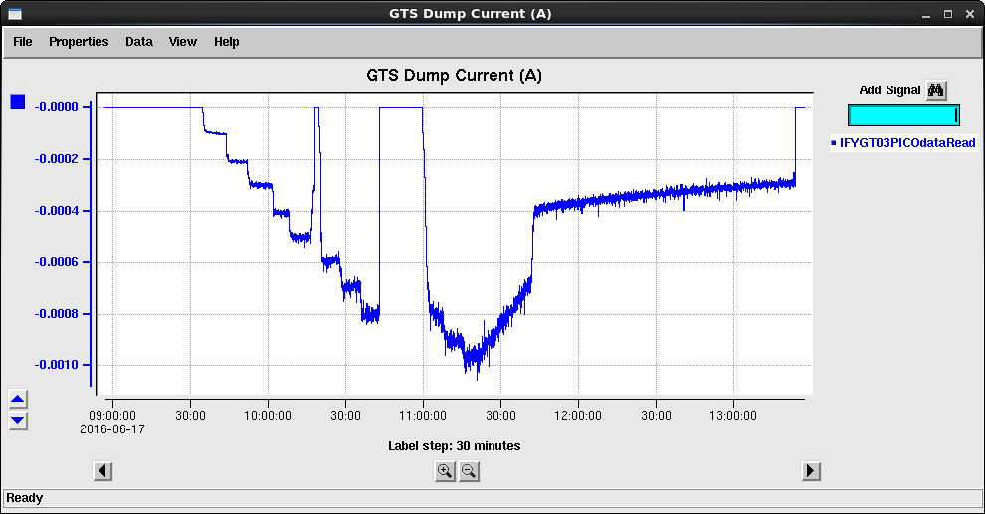
Source for Magnetized Cooling - Progress
1 mA beam (non magnetized)
First magnetized beam:
first quarter FY17

Slide 16
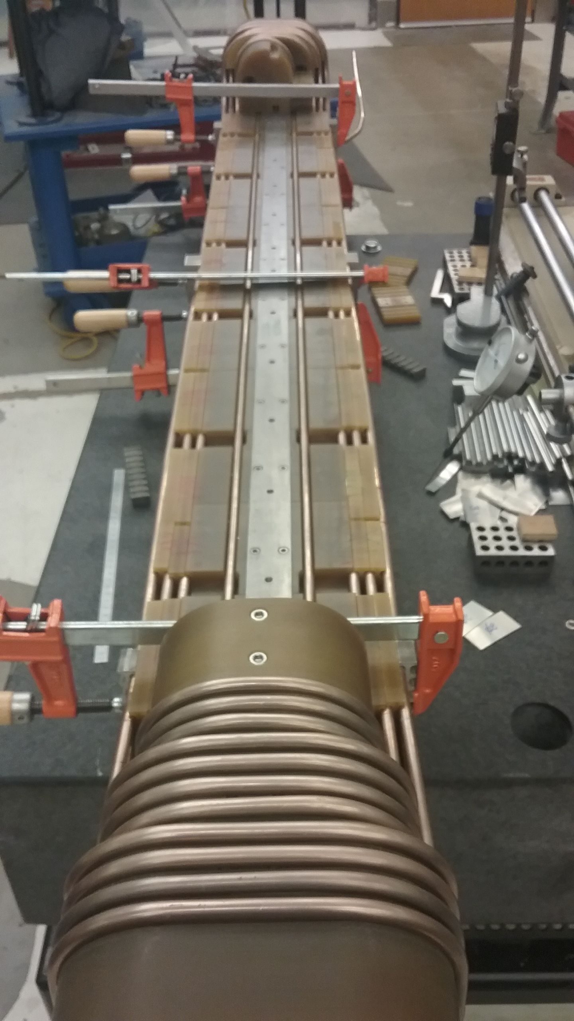
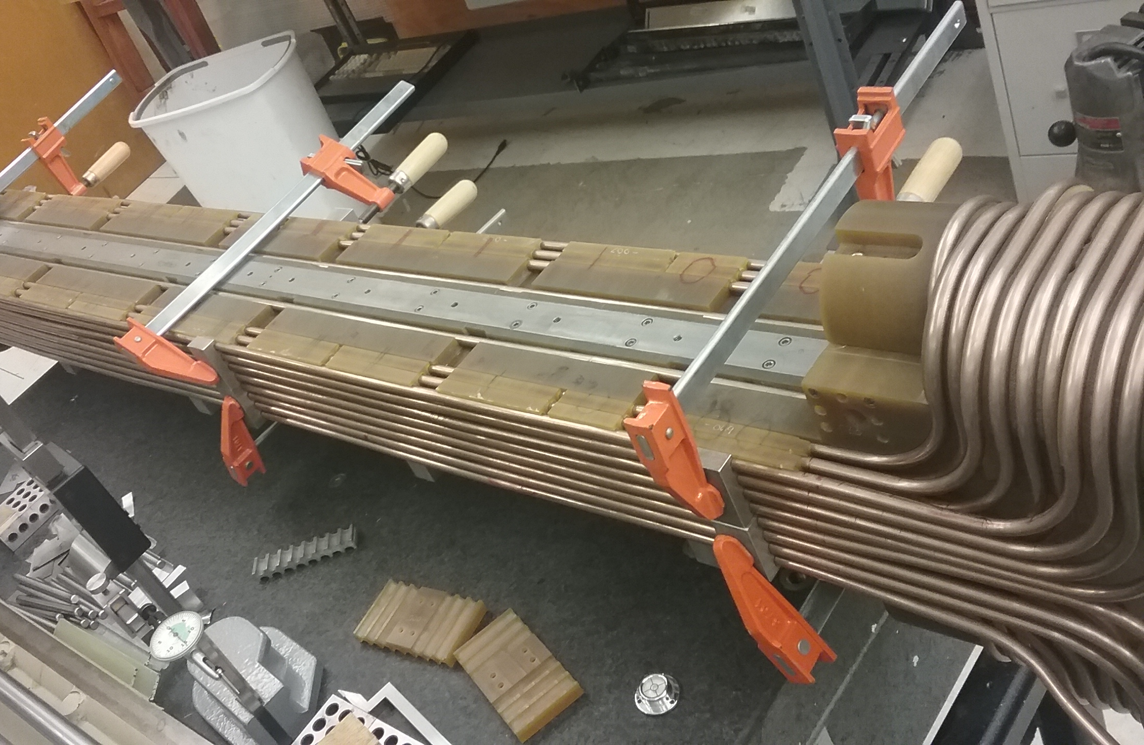
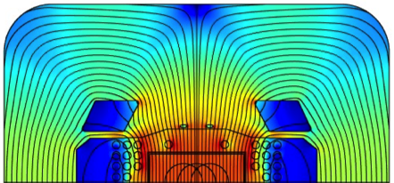
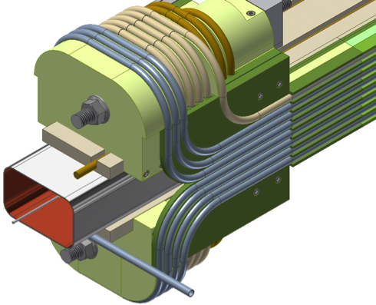
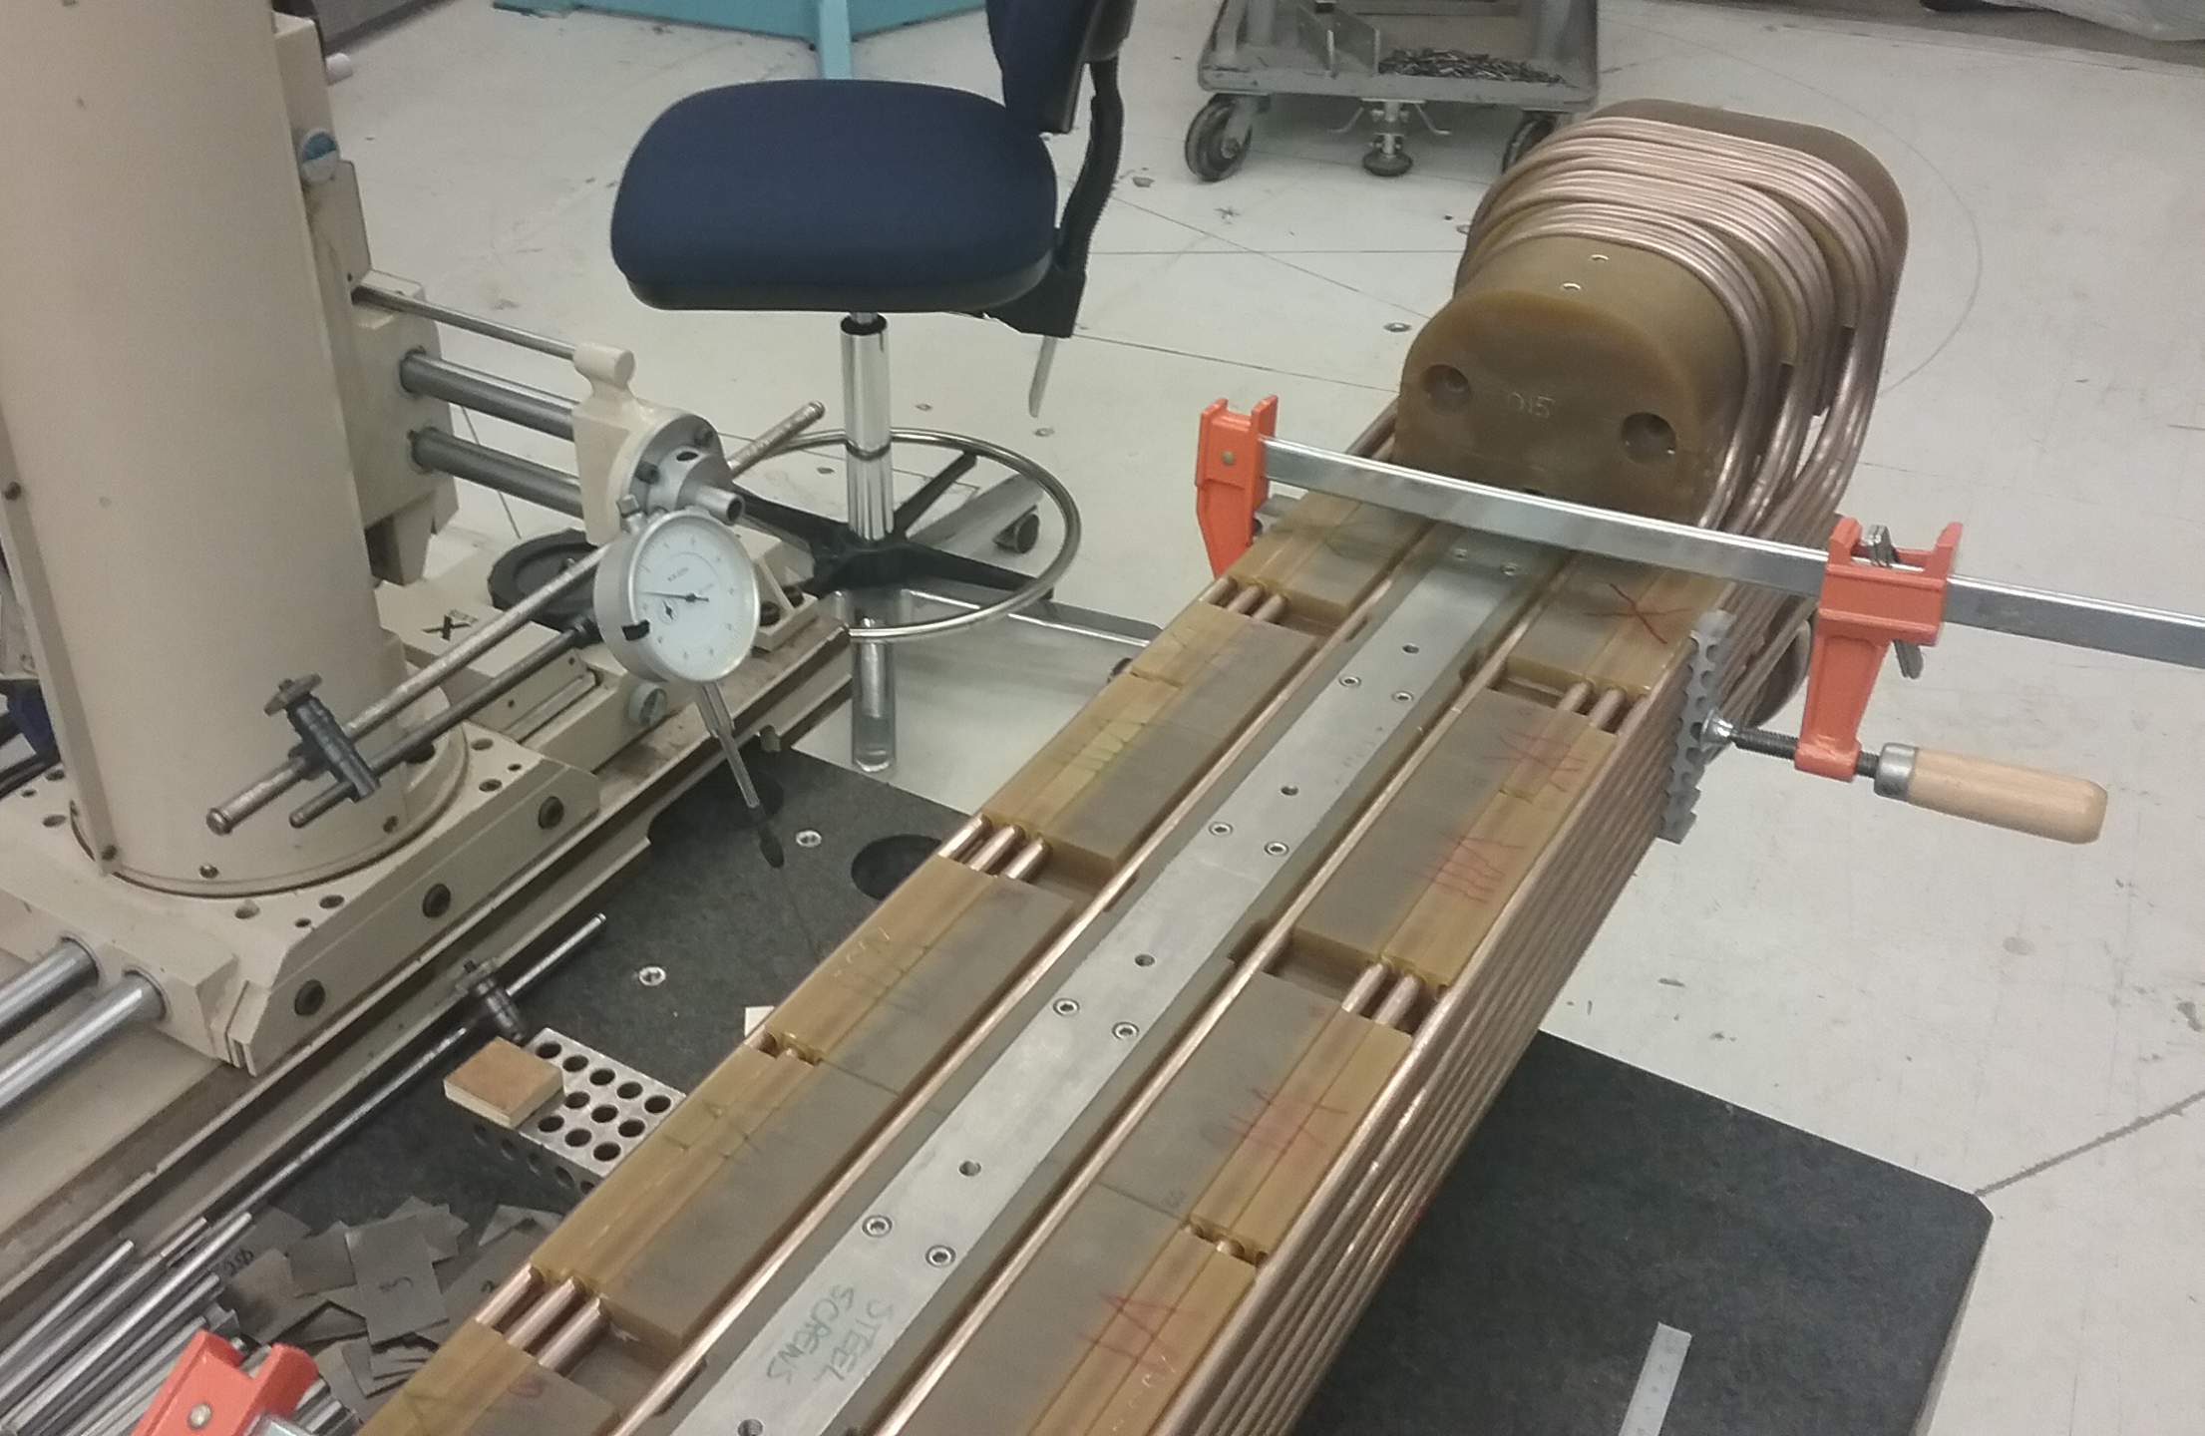
Super-Ferric Magnets
3 T
Potentially cost effective
Fast ramp rate [1 T/s]
Cable-in-conduit conductor
Prototype winding

Slide 17
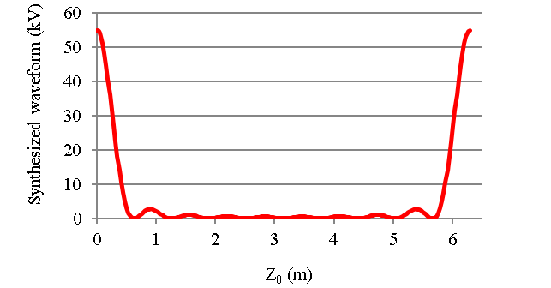
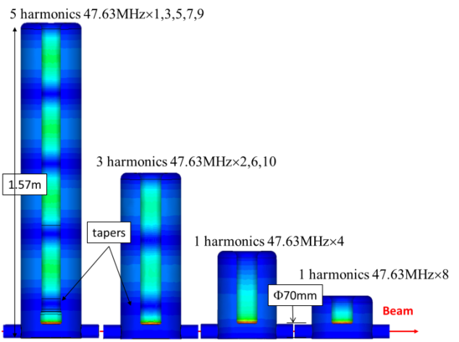
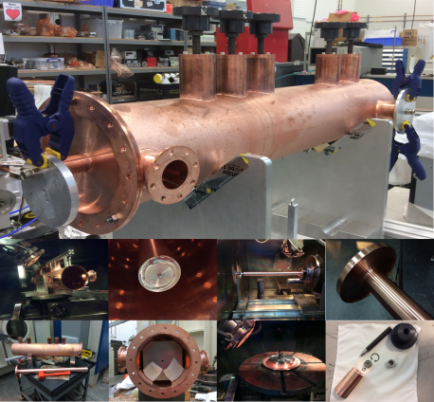
Fast Kicker
Enables cooling upgrade: performance improved / requirements relaxed by
circulating cooling beam a few times
Main challenge: kicking 952 MHz electron bunches in and out of circulator ring in <1 nsec
Harmonic kicker:
combination of N of RF harmonics
kicks every N’s bunch
Harmonic cavity kicker
  High power efficiency
  10 harmonics → 4 cavities
5 harmonic prototype built and being tested
10 harmonics

Slide 18
EIC R&D: NP FOA’ s
FY16
Research and Development for Next Generation Nuclear Physics Accelerator Facilities
Post date: March 4 2016
Close date: May 2 2016
To labs and university: 1.8 M$ including JLEIC, eRHIC and possibly other R&D
Collaborative agreement submitted: JLAB, SLAC, ANL, LBL, TAMU, ODU
JLAB, SLAC, ANL, TAMU funded July 2016; LBL, ODU deferred
FY17
In addition to the R&D FY17 funds NP will redirect and pool ~2.5% operations funds from JLAB and BNL to support EIC R&D
A Priority Review Committee will be convened on Nov 29- Dec 2 in Rockville to prioritize areas and topics, report in early January 2017
An FOA and call for proposal will follow at a later date in 2017
FY18 and beyond
Budget request for EIC are being formulated (with EIC recognized by LRP as the highest priority for new construction in NP)

Slide 19
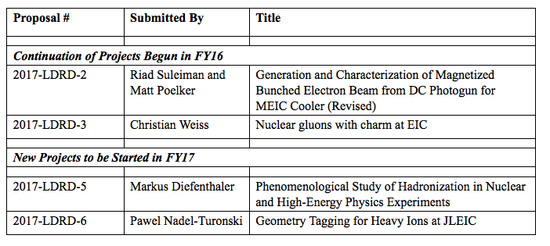
LDRD 2017

Slide 20
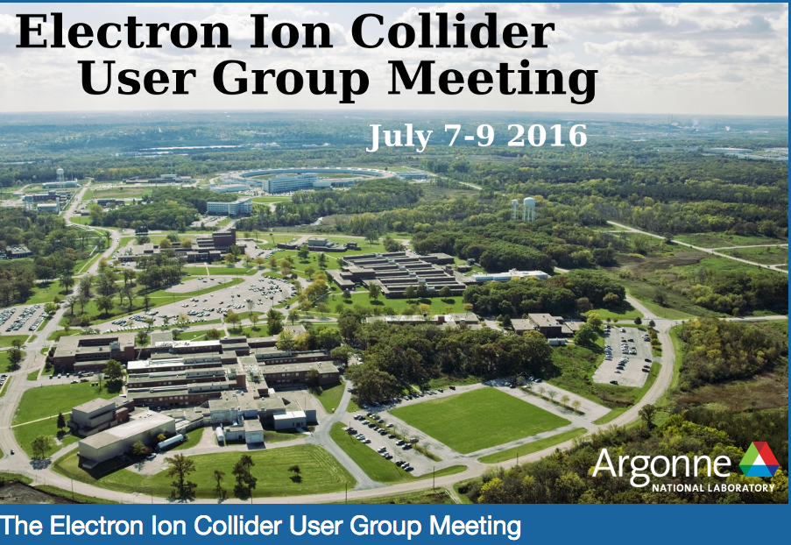
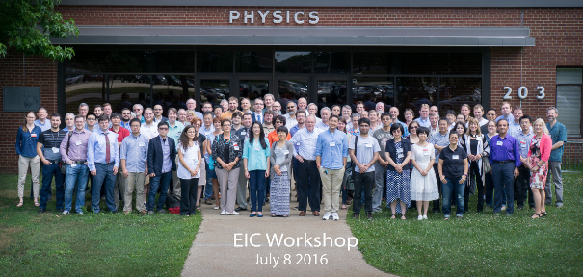
EICUG

Slide 21
Conclusions
Good progress on JLEIC in the past 6 months
Short term focus: EIC R&D Priorities Review end of November 2016
Longer term goals are to advance design and R&D and is deliver a pre-CDR by CD0
In my closing talk I will summarize relevant issues discussed at the collaboration meeting and outline a framework for collaborative efforts on design, R&D and pre-CDR

Slide 22
EIC Timeline
Activity Name | 2010 | 2011 | 2012 | 2013 | 2014 | 2015 | 2016 | 2017 | 2018 | 2019 | 2020 | 2021 | 2022 | 2023 | 2024 | 2025
12 GeV Operations
12 GeV Upgrade
FRIB
EIC Physics Case
NSAC LRP
NAS Study
CD0
EIC Design, R&D Pre-CDR, CDR
CD1(Down-select)
CD2/CD3
EIC Construction
pre-project
on-project
Pre-CDR
CDR
CD0 = DOE “Mission Need” statement; CD1 = design choice and site selection (VA/NY)
CD2/CD3 = establish project baseline cost and schedule

Slide 23
JLEIC lumi: Baseline and Upgrade

