Slide 1
JLEIC Beam Formation Scheme
Ion, Electron, and Positron
Jiquan Guo
for the JLEIC design study team
Oct 5, 2016

Slide 2
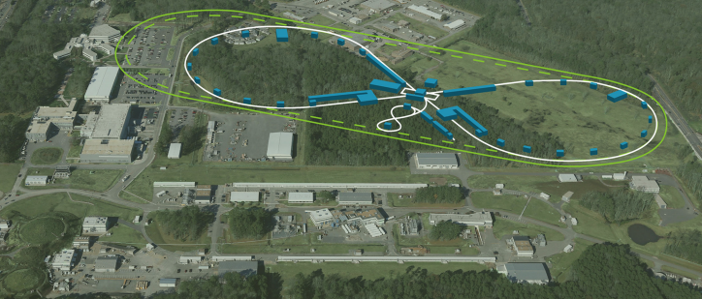

Overview of JLEIC
A high luminosity electron-ion collider
  High bunch reprate and high current
Electron complex
  CEBAF as injector
  Electron collider ring, 3-10GeV, up to 3A beam current, 476.3MHz RF system
  Possible e⁺ capability
Ion complex
  Ion source
  Booster
  Ion collider ring, 40-100GeV proton energy, 0.5A beam current with possibility to upgrade, 953MHz RF system

Slide 3
JLEIC Ion Complex
~8GeV H⁺
~2GeV Pb⁶⁷⁺
<=100GeV H⁺
<=40GeV Pb⁸²⁺
135MeV H⁻
40MeV Pb⁶⁷⁺
H⁻ Strip
Pb Strip
Multi-turn injection
Bucket-to-bucket transfer
collider ring with BB cooler
ion sources
SRF Linac
Booster with DC cooler
Major bottleneck and challenges for beam formation:
  Space charge tune shift, especially at the lowest energy of each ring (right after injection into the booster or collider)
  Splitting the bunches to 476.3MHz reprate, 952.6MHz in future upgrade
    RHIC bunch reprate is 9MHz w/o splitting
    LHC bunch is 40MHz, and each bunch train has only 72 bunches
  Kicker rise time
    RHIC ~100ns, LHC ~900ns
  Cost
Two options for linac energy: baseline 285MeV H⁻/100MeV Pb⁶⁷⁺, optional 135/40MeV for phase 1
Baseline booster energy (Ek) is 8.0GeV H⁻/2.0Gev Pb⁶⁷⁺
  2GeV might be slightly short for Pb due to high Laslett tuneshift after injecting into collider ring, considering raising to 2.4-2.8GeV (proton kinetic energy can increase to 9.2-10.4GeV with the same bending magnets)

Slide 4

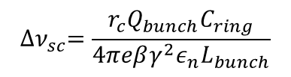
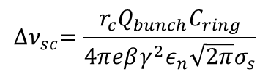
Laslett Tuneshift
Coasting beam
Gaussian beam
Rect bunched beam
$${∆ν}_{sc}=−\frac{r_{c}λ\left\langle R\right\rangle }{2βγ^{2}ε_{n}}=\frac{r_{c}Q_{ring}}{4πeβγ^{2}ε_{n}}$$
$${∆ν}_{sc}=\frac{r_{c}Q_{bunch}C_{ring}}{4πeβγ^{2}ε_{n}\sqrt{2π}σ_{s}}$$
$${∆ν}_{sc}=\frac{r_{c}Q_{bunch}C_{ring}}{4πeβγ^{2}ε_{n}L_{bunch}}$$
Current Laslett tuneshift calculation is based on coasting/rectangular beam. For Gaussian beam, if we use ±2σ (containing 95% of particles) as the equivalent rectangular bunch length, tuneshift will be ~1.6×.
The design limit for Laslett tuneshift is set at 0.15, although operating at 0.2-0.3 is possible
To keep space charge tuneshift within the limit, especially at the injection energy of each stage, we can choose
  High injection energy at each stage (associate with cost)
  Larger transverse beam size (limited by physical aperture and magnet cost)
    Cooling at the injection energy should be minimal or none
  Long bunch (as a ratio to the bucket size) at injection energy, a practical limit is ~0.7
  Limit the total charge in the rings
    For collider ring, it will put a cap on luminosity
    For booster ring, lower charge requires more injection cycles to the collider ring
  At the same energy, for given beam current, smaller ring can lower tuneshift; for given total charge, ring circumference won’t change tuneshift.
  Need to optimize among the above options and constraints

Slide 5
Ion Beam Formation Cycles
2. Accumulating coasting beam
4. Accelerate and cool
Step 6/7. Bucket-to-bucket transfer to the collider ring and BB cooling, repeat 26 times (Nh=28)
DC cooler
DC cooler
BB cooler
3. Capture to bucket
5. Bunch compression to ~56m, split into 2 bunches
2x80m gaps
Collider circumference 2252.8m, final harmonic # Nh=3584(7*2^9), booster circumference 281.6m
Eject the used beam from the collider ring, cycle the magnets
Multi-turn injection of polarized ion from linac to booster (non-polarized for heavy ions)
Capture beam into a bucket (~200m bunch length)
Ramp to an intermediate energy (~2.0GeV proton), perform DC cooling, ramp to ~8GeV (proton)
Compress the bunch length to 56m
Bucket-to-bucket transfer the long bunch into collider ring, each bucket 80m (gap between bunches ~24m, ~80ns)
Repeat step 2-6 for 26 times, each cycle ~1 min, total ~25 min
Ramp collider ring to collision energy
Perform binary bunch splitting up to 7 times to harmonic # Nh=3584 (when colliding high energy/low current electron beam, splitting can be reduced to 5 times to Nh=896), perform bunch length compression and BB cooling
Manipulate the beam to create/remove several extra empty buckets (476 MHz) in the gap (Nh=3580-3588 depending on ion energy, as required by beam synchronization).
Final bunch train structure in the collider ring
1664 bunches, ~1047m
Gap of 126-130 empty buckets
1664 occupied bunches, ~1047m
Gap of 126-130 empty buckets, ~80m

Slide 6
Alternative Ion Beam Formation Cycles (for 285/100MeV Linac at ~0.4A beam current)
2. Accumulating coasting beam
4. Accelerate to 7.9GeV and cool
Step 5/6. Bucket-to-bucket transfer to the collider ring and BB cooling, repeat 8 times (h=56, each dot refers to two bunches)
DC cooler
DC cooler
BB cooler
3. Capture into 7 buckets
2x40-80m gaps
Collider circumference 2252.8m, harmonic # Nh=3584(7*2^9), booster circumference 281.6m
we need to kick out 2-4 bunches to form the gaps
Eject the used beam from the collider ring, cycle the magnets
Multi-turn injection of polarized ion from linac to booster (non-polarized for heavy ions)
Capture beam into 7 buckets (~28m bunch length for quasi-rectangular beam)
Ramp to an intermediate energy (~2.0GeV proton), perform DC cooling, ramp to ~9GeV (proton)
Bucket-to-bucket transfer the long bunch into collider ring, each bucket 40m (gap between bunches ~12m, ~40ns)
Repeat step 2-6 for 8 times, each cycle ~1 min
Ramp collider ring to collision energy
Perform binary bunch splitting 6 times to harmonic # Nh=3584, perform bunch length compression and BB cooling
If needed, manipulate the beam to create/remove several extra empty buckets (476 MHz) in the gap (Nh=3580-3588 depending on ion energy).
Pros: Less booster cycles, faster injection time
Cons: Lower beam current in ion collider ring, or higher linac energy

Slide 7
SC Tune Shift in the Booster at Different Injection Energy
Particle | Proton |  |  | Pb⁶⁷⁺
Booster ring circumference (m) | 281.6 (1/8 of collider ring)
Collider ring circumference (m) | 2252.8 (Nh=3580@100GeV)
Collider ring beam current (A) | 0.5 | 0.39 | 1.38 | 0.5 | 0.41 | 1
Collider ring charge (µC) | 3.76 | 2.94 | 10.38 | 3.76 | 3.09 | 7.52
Linac extraction energy (MeV/u) | 135 | 285 | 285 | 40 | 100 | 100
Booster cycles | 26 | 8 | 26 | 26 | 8 | 26
Booster ring charge (µC) | 0.145 | 0.395 | 0.40 | 0.118 | 0.339 | 0.236
Normalized emittance, step 3 (µm) | 1.65 | 2.63 | 2.66 | 0.93 | 1.51 | 1.5
Booster SC tune shift, step 3 | 0.15 | 0.15 | 0.15 | 0.144 | 0.15 | 0.11
6σ aperture, step 3 (mm, β_{x,y}=14m) | 38.7 | 39.8 | 40.0 | 39.9 | 40.1 | 39.9
Step 3 Δν_{SC} limited at 0.15, beam stay-clear (6σ aperture) limited at 40mm.
Assuming we can get the desired emittance by controlling the phase painting, DC cooling rate, and maybe scraping

Slide 8
Ion Collider Ring SC Tune Shift
Particle from the booster | H⁺ |  | Pb⁶⁷⁺
Collider ring circumference (m) | 2252.8 (Nh=3580@100GeV)
Collider ring beam current (A) | 0.5 | 1.38 | 0.5 | 0.5 | 1.0 | 1.0
Collider ring charge (µC) | 3.76 | 10.4 | 3.76 | 3.76 | 7.52 | 7.52
Booster extraction energy (GeV/u) | 7.9 | 7.9 | 2.43 | 2.04 | 2.82 | 2.04
Equiv H extraction energy (GeV) | 7.9 | 7.9 | 9.15 | 7.9 | 10.4 | 7.9
Booster ring charge (µC) | 0.145 | 0.40 | 0.118 | 0.118 | 0.236 | 0.236
Normalized emittance, end of step 5/6 (µm) | 0.5 | 1 | 0.93 | 1.21 | 1.50 | 2.41
Collider ring SC tune shift, end of step 5/6 | 0.10 | 0.14 | 0.15 | 0.15 | 0.15 | 0.15
6σ aperture, step 5/6 (mm, β_{x,y}=14m) | 5.2 | 7.3 | 11.7 | 14.2 | 13.9 | 20.0
If emittance at step 5/6 (after the collider ring is filled) can be blown up from step 3 (after the booster ring bunch captured in one RF bucket), 7.9GeV booster should be enough for all particles up to 1A. Otherwise Pb energy needs to be raised to 2.4-2.8GeV (equivalent to 9.2-10.4GeV proton).

Slide 9
Alternative Ion Beam Formation Cycles
(binary bunch split in the booster ring)
2. Accumulating coasting beam
4. Accelerate and cool
Step 6/7. Transfer the bunch train bucket-to-bucket into the collider ring, repeat 24 times, then ramp energy and perform BB cooling
DC cooler
BB cooler
DC cooler
3. Capture to bucket
5. compress bunch to ~56m, split into 32 bunches (~80m train) with 5 stages splitting
Collider circumference 2252.8m, harmonic # Nh=3580-3588 (for different collision energy), booster circumference 281.6m
Eject the used beam from the collider ring, cycle the magnets
Multi-turn injection of polarized ion from linac to booster (non-polarized for heavy ions)
Capture beam into a bucket (~200m bunch length)
Ramp to an intermediate energy (~2.0GeV proton), perform DC cooling, ramp to ~8GeV (proton)
Compress the bunch length to 56m, perform 5 stages binary split and form a 80m train with 32 bunches (bunch reprate 119MHz)
Bucket-to-bucket transfer the 80m bunch train into the collider ring
Repeat step 2-6 cycle for 24 times, leaving a gap of ~14m (5-6 119MHz buckets, ~45ns for kicker rise time) between the 80m trains
Ramp collider ring to collision energy
Perform up to 2 stages binary splitting (no splitting needed for low reptate option with high energy/low current electron beam), perform bunch length compression and BB cooling
Manipulate the beam to create/remove several extra empty buckets (476 MHz) in the gap (Nh=3580-3588 depending on ion energy, as required by beam synchronization).
Pros: Less splitting cavities in the collider ring
Potential problems:
Need to split beam 5 times in each of the 24 cycles
Total gap length is larger, especially if inject kicker rise time is longer than 45ns; may still need longer gap for abort kicker

Slide 10
Alternative Ion Beam Formation Cycles
(less bunch splitting stages)
2. Accumulating coasting beam
Step 6. Transfer the bunch train bucket-to-bucket into the collider ring, repeat 8 times, then ramp energy and perform BB cooling
4. Accelerate and cool
DC cooler
BB cooler
3. Capture to 119MHz bucket
Collider circumference 2252.8m, harmonic # Nh=3580-3588 (for different collision energy), booster circumference 281.6m
Eject the used beam from the collider ring, cycle the magnets
Multi-turn injection of polarized ion from linac to booster (non-polarized for heavy ions)
Capture beam into 112 buckets (119MHz bucket, ~1.8m bunch length), kick out 5-6 bunches to form a gap for extraction kicker rise time
Ramp to an intermediate energy (~2.0GeV proton), perform DC cooling, ramp to ~8GeV (proton)
Bucket-to-bucket transfer the ~270m bunch train into the collider ring
Repeat step 2-6 cycle for 8 times
Ramp collider ring to collision energy
Perform up to 2 stages binary splitting (no splitting needed for low reptate option with high energy/low current electron beam), perform bunch length compression and BB cooling
Manipulate the beam to create/remove several extra empty buckets (476 MHz) in the gap (Nh=3580-3588 depending on ion energy, as required by beam synchronization).
Pros: Much less splitting stages.
Potential problems:
Lower ion collider ring beam current or higher ion linac energy.

Slide 11
Summary for Ion beam formation scheme
The current preferred scheme is to inject compressed long bunches from the booster into the collider ring, and perform multiple (up to 7) binary splits in the collider ring.
Compress the bunch length in the booster (at the booster’s top energy) allows more booster cycles, resulting higher ion collider ring beam current and/or lower linac energy, with a safe space charge tuneshift. The total injection time is longer, but still in ~0.5hr range
The gap between long bunches is preferred to be ~80ns for a conservative injection kicker rise time, but 40ns or shorter is possible to achieve.
To split bunched beam, binary splitting needs the most number of stages, but is easier to get even splitting with low beam loss. It also requires the least number of RF frequencies.
Moving (most of) the bunch splitting to the booster ring is possible, but results in extra gaps in the collider ring. The splitting needs to be repeated for each booster cycle, which may result in a longer beam formation time.
An alternative to binary splitting bunched beam is to form a rectangular beam with barrier bucket, and split to 119MHz or 476MHz with single frequency.

Slide 12
Electron Ring Injection (electron and positron)
Electron: no much change since last year
  Using CEBAF to accelerate electron pulses of ~1050m bunch trains, yielding ~5.5MW pulsed extracted beam power.
  Bunch reprate 68MHz in CEBAF to match the electron ring/PEP-II RF frequency, up to 35pC per bunch
  Each bunch train fills 1/7 of the buckets in half of the electron ring alternately with alternating polarization; ~1× electron ring damping time between two injecting bunch trains
  Injection time range from a few minutes to 20 minutes, depending on energy and beam current in the collider ring.
  Using feedforward to match CEBAF klystron power with beam pattern and minimize linac gradient drooping
Positron:
  Polarized positron source using ~10MeV electron beam shower
    ~10⁻⁴ yield including collecting efficiency
    Simply increasing charge per bunch in the electron gun can not produce positron at anything close to 35pC/bunch, but average positron beam current is sufficient for JLEIC injection with current electron gun capability
  Need to adapt the source’s low peak current/high duty factor characteristics for JLEIC injection
    Multi-turn injection into an accumulator ring from electron gun with phase painting
    Multi-turn injection into JLEIC within one damping cycle using phase painting (may also apply to electron injection)

Slide 13
CEBAF as JLEIC Positron Injector
500-Turn
Accumulator Ring
(23.8m)
Positron Conversion/Collection Efficiency ~ 10⁻⁴
Polarized
Electron
10 MeV Injector
Bunch
Management
Harmonic kicker
Extraction
to CEBAF/JLEIC
10 MeV pol e⁻
0.67 nC bunches
@ 1500 MHz
10 MeV polarized e⁻
0.67 nC @ 68.1 MHz
(22× stretching)
10 MeV polarized e⁻
1.33 pC @ 1500 MHz
5-7 MeV Polarized e⁺
67 fC @ 68.1 MHz
Polarized Electron Source | Accumulator Ring | Electrons at Converter | Polarized Positron Source | R&D Challenge
1.33 pC @ 1497 MHz 2 mA peak Up to 0.12mA avg ~40μs mini train | 1497 MHz 1 A peak 119 bunches | 68.1 MHz 45mA peak up to 0.12mA avg 1.75μs, 525m train | 68.1 MHz 4.5μA peak up to 12nA avg 1.75μs, 525m train | Electron accumulator Harmonic extraction Target: 450 kW peak
One macro bunch train contains about 30 mini trains; Mini train is 40μs from the source, ~80ns in the accumulator, and stretched to 1.75μs in CEBAF. Each of the 30 mini trains will be injected into the same 119 buckets in a quarter of the JLEIC collider ring at the interval of ~6 collider ring revs (~45μs) with phase painting. Interval between macro bunch trains will be around 2x transverse damping time, ranging from 20-700ms depending on energy and use of damping wigglers.
Using 20ms interval and 10GeV 0.71A colliding beam, the injection time can be <10 min.
For lower collision beam energy, it may take longer due to damping time, but we may have options to increase injection rate, like increasing the painting cycles in one damping cycle, and using damping wigglers
13

Slide 14
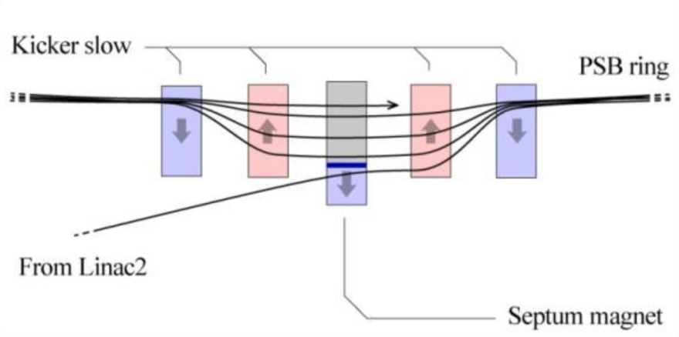
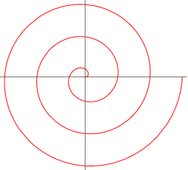
Multi-turn Injection: Phase Painting
Concept: an orbit bump created near a septum and then slowly reduced as beam being injected (phase-space painting)
A number of painting schemes have been developed
Process can also be simultaneously occurring in vertical and
longitudinal dimensions
CERN’s LEIR has a design for 75-turn injection of Pb⁵⁴⁺,
We plan to push this number to a few hundred to ~1000 in the
accumulator using low electron emittance, and ~30 in collider ring
Main injection system components
  Magnetic or electrostatic septum
  Four bumper magnets with ~1 μs rise time for 10MeV, reasonably
  fast fall-off time and ~10 mrad maximum deflection
  For 3-10GeV electron beam, rise time ~1.4ms (180 turns), ~1mrad
x′
> Septum thickness +
bunch width
Accumulator ring
x
Injected beam
14

Slide 15
Harmonic Kicker Extraction
Example: A ring using a harmonic kicker to extract bunch train 3× longer
Empty ring buckets already kicked out to linac
Ring buckets still occupied by bunches
Empty linac buckets
Linac buckets occupied by extracted bunches
Harmonic kicker that kicks every 3rd bunch
Ideal kicker pulse
Generate 68MHz (or 34/17MHz) bunch train for JLEIC injection from a compact 1497MHz accumulator (i.e., 24m circumference).
The extracted bunch train will be stretched, and it will be ideal if it matches the bunch train length in the collider ring or its fraction (1050m or 525/350m)
Harmonic kicker kicks out 1 in every 22 bunches to generate 68MHz beam from 1497MHz beam. In synergy with the harmonic kicker R&D for the circulating e-cooler ring, which kicks 1 in every 10 or 25 bunches (Y. Huang’s talk in this meeting).
Accumulator ring harmonic number needs to be reciprocal with 22 (or other bunch stretching ratio to be used).
Kicker rise time should be few ns (unless Nh=stretching ratio±1, where a gap in the ring won’t break the continuity of the stretched bunch train), possible with stripline kicker (and the stripline’s power requirement for 10MeV beam is not bad).
If the harmonic kicker rise time is a problem (comparable to the accumulator ring revolution time), we need a second ring, in which a harmonic extraction kicker keeps firing all the time.

Slide 16
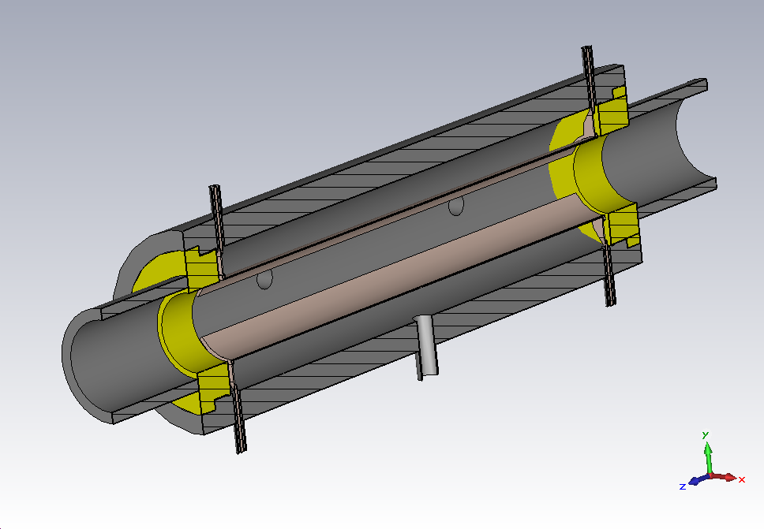

Harmonic Stripline Kicker
Port4, to matched load
Z₀, 50-100Ω
Port2
+V
d
-V
Port3, to matched load
Port1
PEP-II feedback kicker design as an example
  Travelling wave TEM mode RF kicker
  Need to adjust the length of the kicker to optimize the efficiency for desired waveform, ~0.7 wavelength of the highest mode
  Kicker rise time should be twice the electrical length of the kicker (~1ns in our case) plus the rise time of the RF sources (including sync error of different modes).
  Less than 1kW needed to get ~1mrad for 10MeV beam and kicking ratio of 22

Slide 17
Alternative Parameters for Positron Formation
Stretching bunch train with gap in the accumulator ring
500-Turn
Accumulator Ring
(18m)
Positron Conversion/Collection Efficiency ~ 10⁻⁴
Polarized
Electron
10 MeV Injector
Bunch
Management
Harmonic kicker
Extraction
to CEBAF/JLEIC
10 MeV pol e⁻
2 nC bunches
@ 748.5 MHz
10 MeV polarized e⁻
2 nC @ 17 MHz
(44× stretching)
10 MeV polarized e⁻
4 pC @ 748.5 MHz
5-7 MeV Polarized e⁺
0.2 pC @ 17 MHz
Polarized Electron Source | Accumulator Ring | Electrons at Converter | Polarized Positron Source | R&D Challenge
4 pC @ 748.5MHz 3 mA peak Up to 0.09mA avg ~40ns×500×30 train | 748.5 MHz 1.5 A peak 30/45 bunches 20ns gap | 17MHz 34mA peak up to 0.09mA avg 1.75μs, 525m train | 17 MHz 3.4μA peak up to 9nA avg 1.75μs, 525m train | Electron accumulator Harmonic extraction Target: 340 kW peak
20ns gap allows more reasonable kicker rise time
17MHz allows reducing collider ring bunch reprate by factor of 4, may help increase luminosity for low beam current/high energy collision cases, when beam-beam is not a bottleneck.
Factor of 44 stretching might be more challenging for harmonic kicker design
17

Slide 18
Summary for Electron and Positron Injection
Positron:
  A small accumulator ring can increase the charge per bunch from the source, multi-turn phase painting is the key
  Need multi-turn injection into the collider ring within a damping cycle, Also needs phase painting.
  Need a harmonic kicker to convert 1497MHz beam into 68MHz (or 34/17MHz) beam
Electron injection scheme has not changed much since last year, but we might adapt the phase painting technic, if further study shows that it’s feasible. It could either provide faster injection rate when damping time is really long, or help alleviating the charge per bunch requirement for the gun and the gradient droop in CEBAF.

Slide 19
Acknowledgements
This work is done by the whole MEIC accelerator design study team, particularly
Alex Bogacz, Joe Grames, Fanglei Lin, Vasiliy Morozov, Robert Rimmer, Todd Satogata, Haipeng Wang, Shaoheng Wang, Yuhong Zhang

Slide 20
Backup Slides

Slide 21








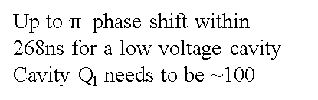
Adding Extra Bucket to Change Nh
Synchronizing low β ion beam with electron beam may need to change harmonic number in the collider ring by increment of 1, by a total of up to 10. Binary bunch splitting scheme for certain Nh will not work for Nh+1
We may split the bunch to Nh, and add extra buckets in the gap by ramping the RF frequency and jump phase in the gap.
two bunch trains plus Gap1
Total 27/28 circumference
Gap2, 1/28 circumference, 268ns
Cav freq (on resonance)
RF phase shift in gap2
After splitting to Nh
f₀
0
Harmonic number kept at Nh during ramp
Ramping frequency
$$f_{0}+∆f$$
$$2π\frac{27∆f}{f_{0}}$$
Up to $π$ phase shift within
268ns for a low voltage cavity
Cavity Q_{l} needs to be ~100
$f_{0}+f_{0}$/(2Nh)
$$−π$$
Ramping frequency
$$f_{0}+f_{0}\text{/}\text{Nh}−∆f$$
$$−2π\frac{27∆f}{f_{0}}$$
Ramping complete
$f_{0}+f_{0}$/Nh
$$0$$
Harmonic number change to Nh+1

