Slide 1
JLEIC Hadron Bunch Splitting Simulations
Todd Satogata and Randika Gamage
IPAC’16 Paper
http://accelconf.web.cern.ch/AccelConf/ipac2016/papers/wepmw013.pdf

Slide 2
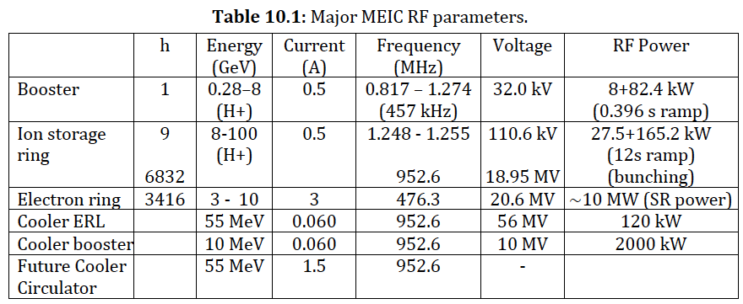
The Earlier Problem
JLEIC (MEIC) Arxiv paper: 1504.07961v1.pdf
Specified hadron bunch splitting from h=9 (injection and acceleration RF) to h=6832 (storage and collision RF)
Unprecedented splitting, hadron bunch length/RF freq
State of the art: 1->12 (CERN PS for LHC)

Slide 3
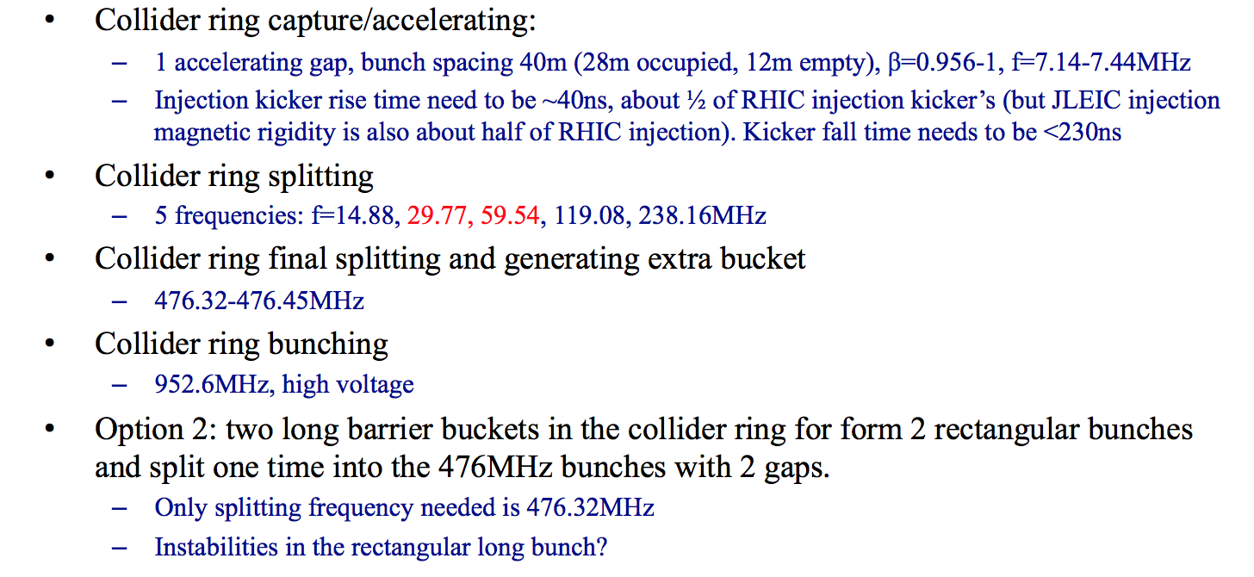
The Updated Problem
Jiquan provided an update to a bunch formation scheme in slides on Jun 24 2016 (with an update at this meeting)
h=56, Circumference=40.28m*56=2255.75m
h=56, 112, 224, 448, 896
h=1792
h=3584
Quasi-coasting beam instabilities?

Slide 4
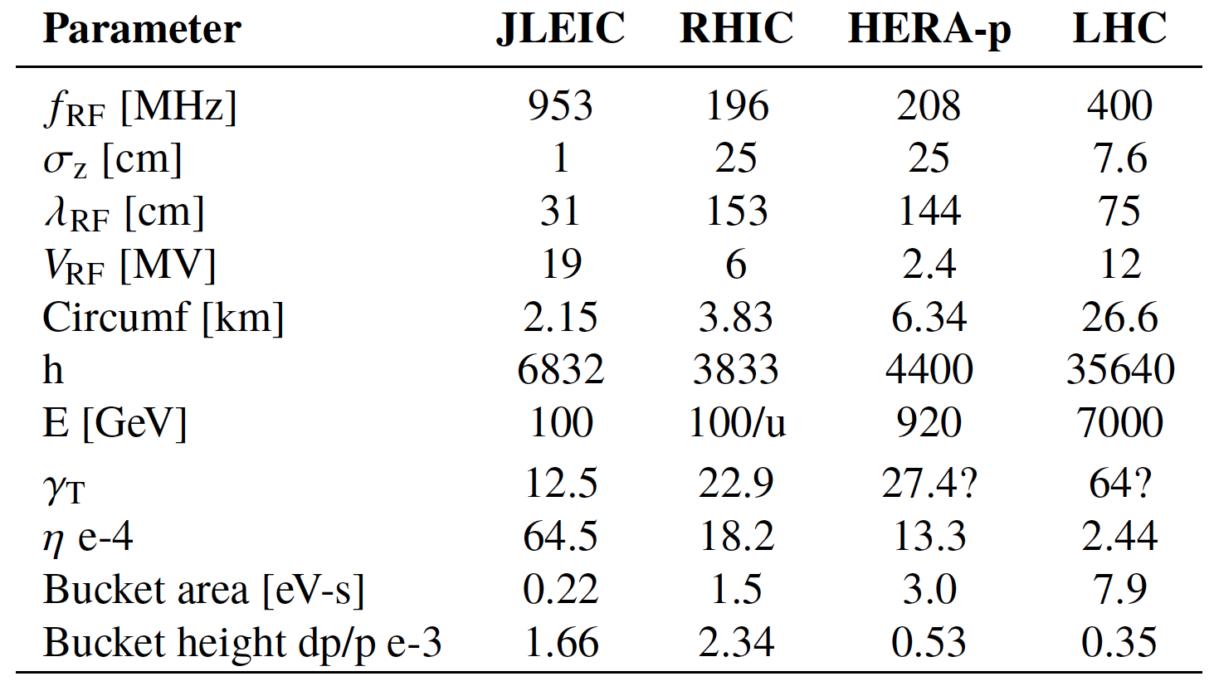
Hadron Collider Comparison

Slide 5
Debunch/Rebunch
The old conventional method for changing the longitudinal structure of the beam is to debunch by cancelling the voltage at the initial frequency, to drift without longitudinal focusing, and to rebunch withanother RF frequency. To minimize emittance blow-up, voltage variations have to be iso-adiabatic over a large dynamic range. Although widely used, this technique presents a number of drawbacks:
RF voltages must be controlled down to small amplitudes in the presence of beam loading,
While drifting, the beam is left uncontrolled,
The full circumference is filled with particles,
The continuous beam has a very small Δp/p which makes it prone to microwave instability.
Randy is simulating debunch/rebunch at present, including realistic impedances as measured at RHIC
Can be applied to barrier bucket scheme as well: small Δp/p?
(R. Garoby)

Slide 6
9:18 Debunch/Rebunch (no impedance)

Slide 7
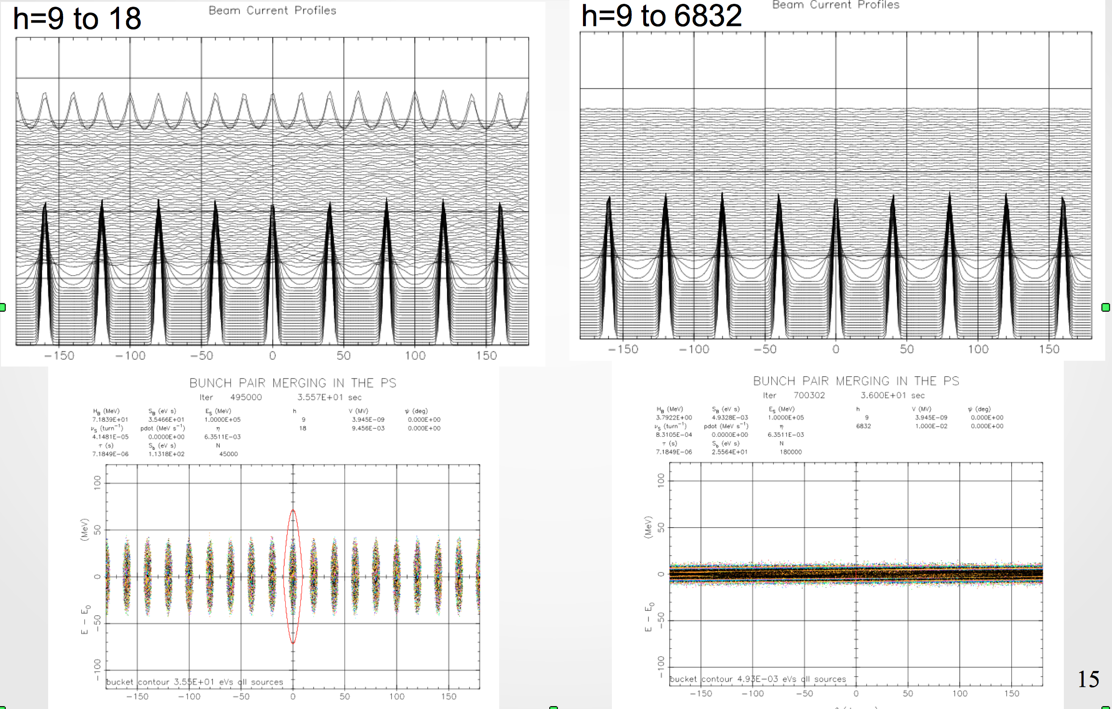
Debunch/Rebunch (no impedance)

Slide 8
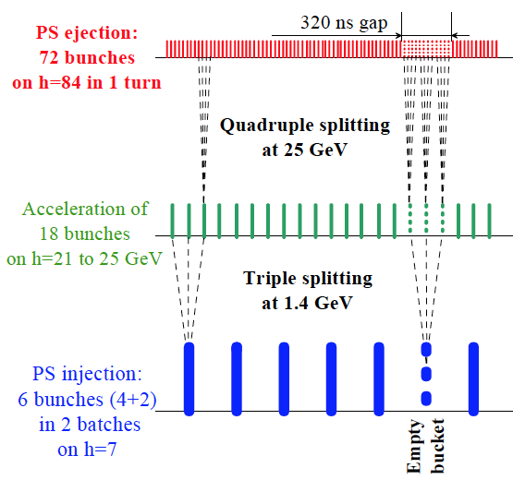
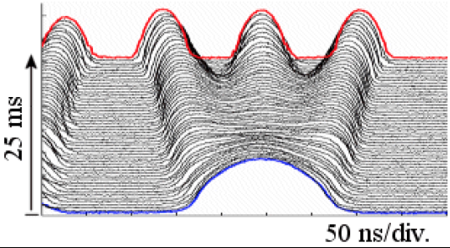
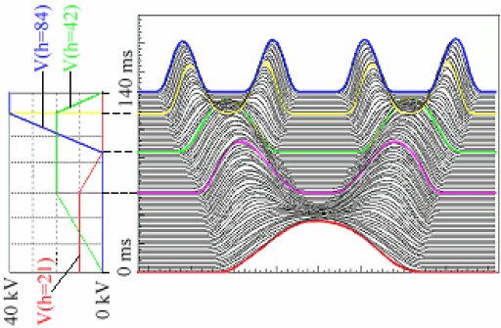
Bunch Splitting
CERN PS splits 6:18 (3x) then 18:36 (2x) then 36:72 (2x)
20 ns/div.
Fig 7.1, LHC design report
Figs 7.3-4, LHC design report

Slide 9
Adiabatic Bunch Splitting
Good 1:2 split
Bad 1:2 split
Have put parameter set into ESME
Fermilab longitudinal dynamics (only) code
faster, longitudinally oriented compared to many other codes
Have running on cluster (e.g. jlabl4) for GA optimizations
Optimize split times, voltages vs longitudinal emittance growth
Have source code, support from Francois Ostiguy at Fermilab

Slide 10
Single Split Optimization
Bunch splitting for JLEIC requires several splits
Each splitting must be reasonably well-optimized
Even small (few percent) longitudinal emittance growth per split becomes intolerable
Conditions for emittance growth
Initial longitudinal emittance very small
Bunch splitting too fast (non-adiabatic)
Parameterize transverse emittance growth in 2:1 split
Use scaled parameters for universality
vs initial emittance/bucket size
vs splitting time/initial synchrotron period
Used JLEIC first split (h=9 to h=18) parameters
Plot relative emittance growth vs two “vs” parameters

Slide 11
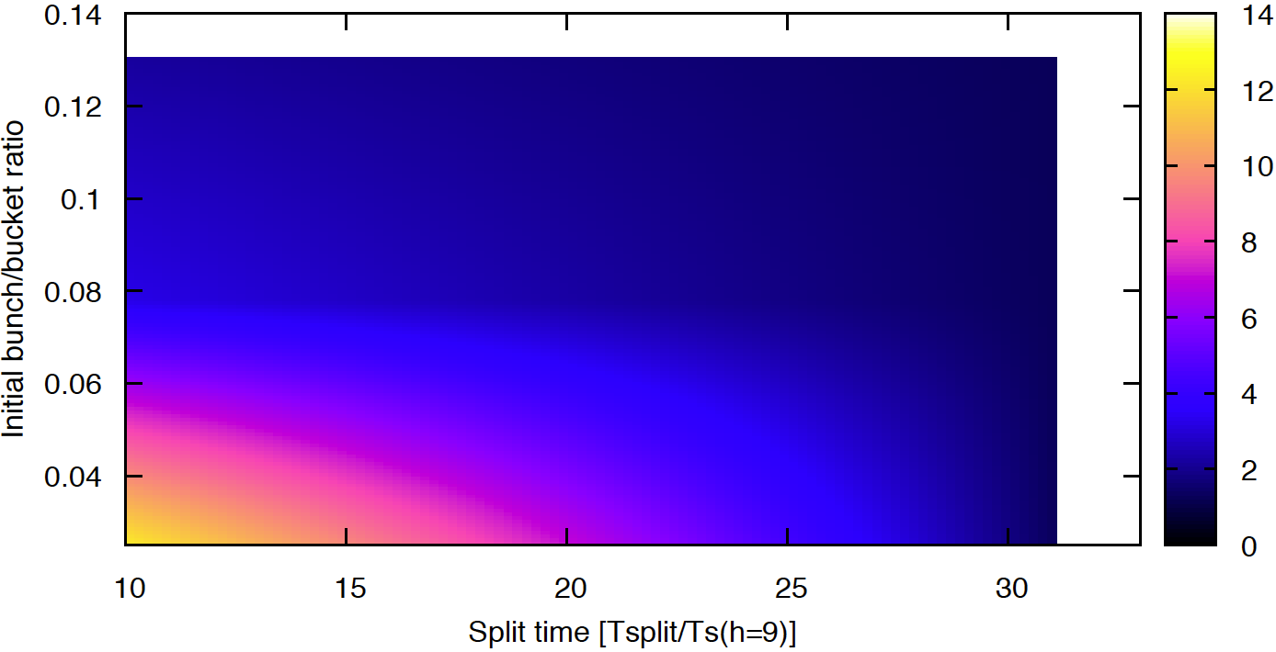
Parameter Scan Results (1)
Region of large emittance growth
Small split time and/or small initial emittance
Relative emittance growth: well over 100%

Slide 12
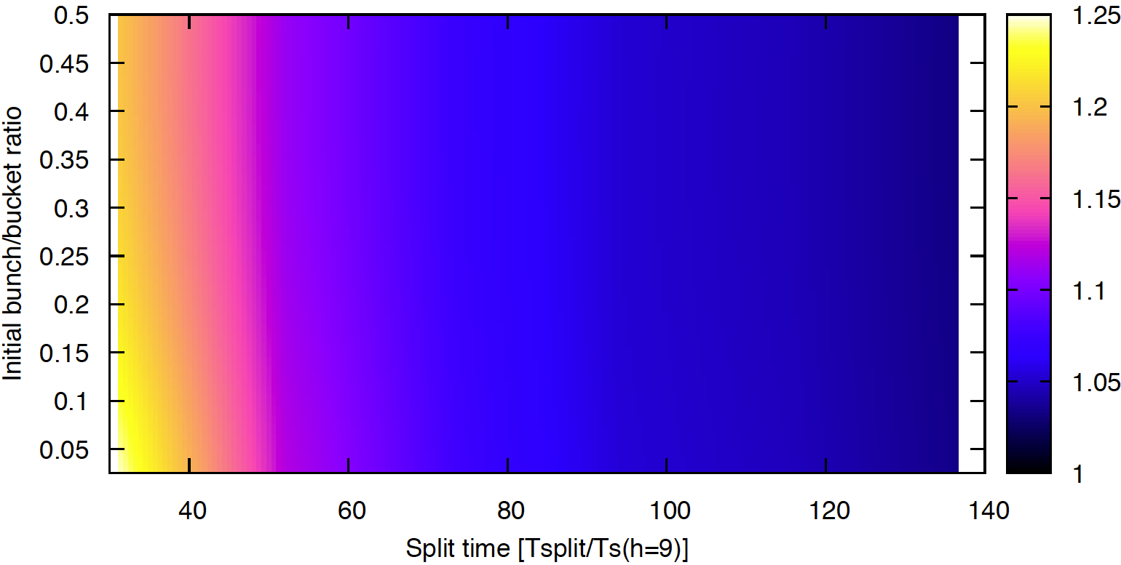
Parameter Scan Results (2)
Region of modest emittance growth
Requires split time to be 100+ synchrotron periods
But given that, almost immune to initial bunch size

Slide 13
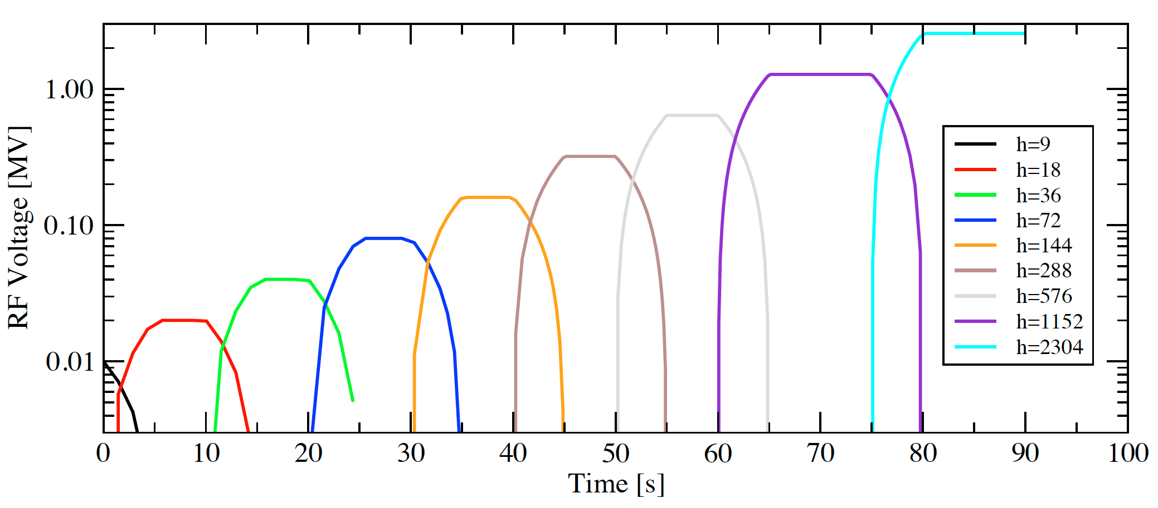
Bunch Split Scaling
Assume bucket area scales as the split
Initial area is evenly divided into split buckets
Implies that RF voltage doubles with every split
E.g. V_{RF,h=18} = 2V_{RF,h=9} for first split
Synchrotron period scaling is then that synchrotron period halves with every successive split
T_{s,h=9} = 2 T_{s,h=18}
Can make splits faster at higher harmonics

Slide 14
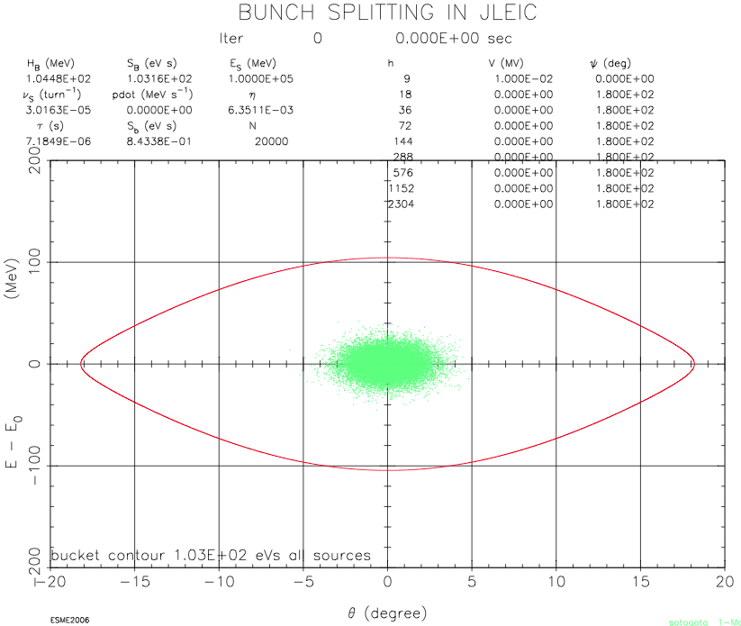
2⁹ Split Simulation: Initial Conditions

Slide 15
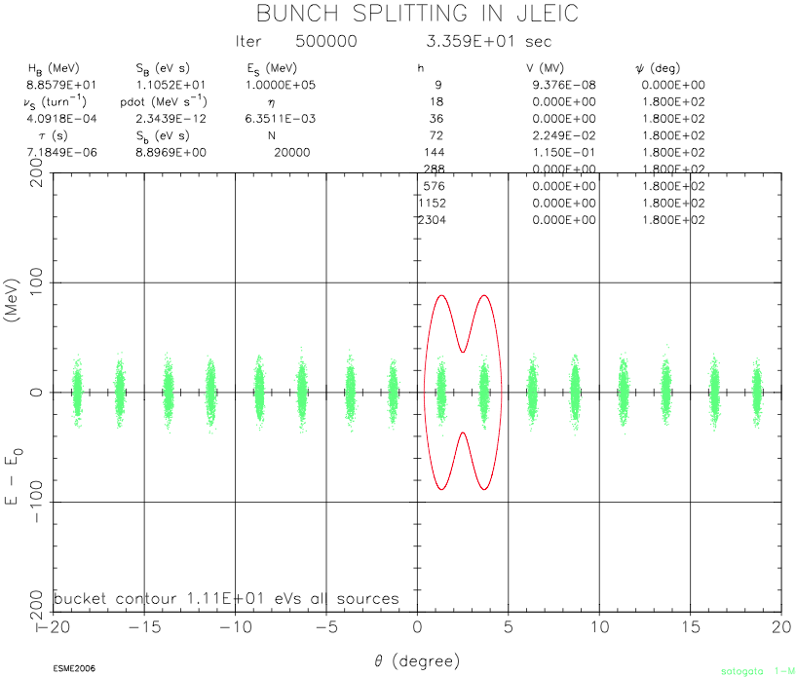
2⁹ Split Simulation: Halfway Through

Slide 16
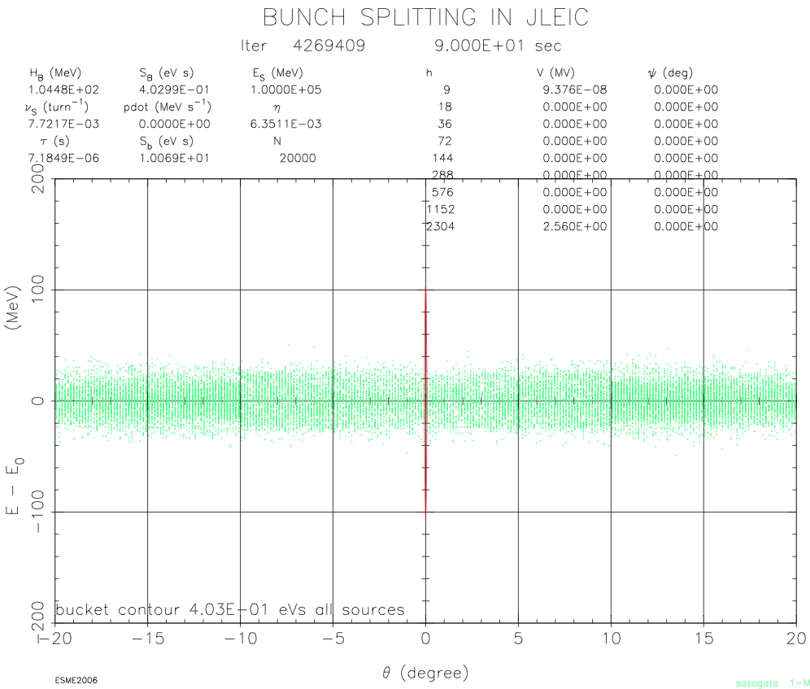
2⁹ Split Simulation: After All Splits

Slide 17
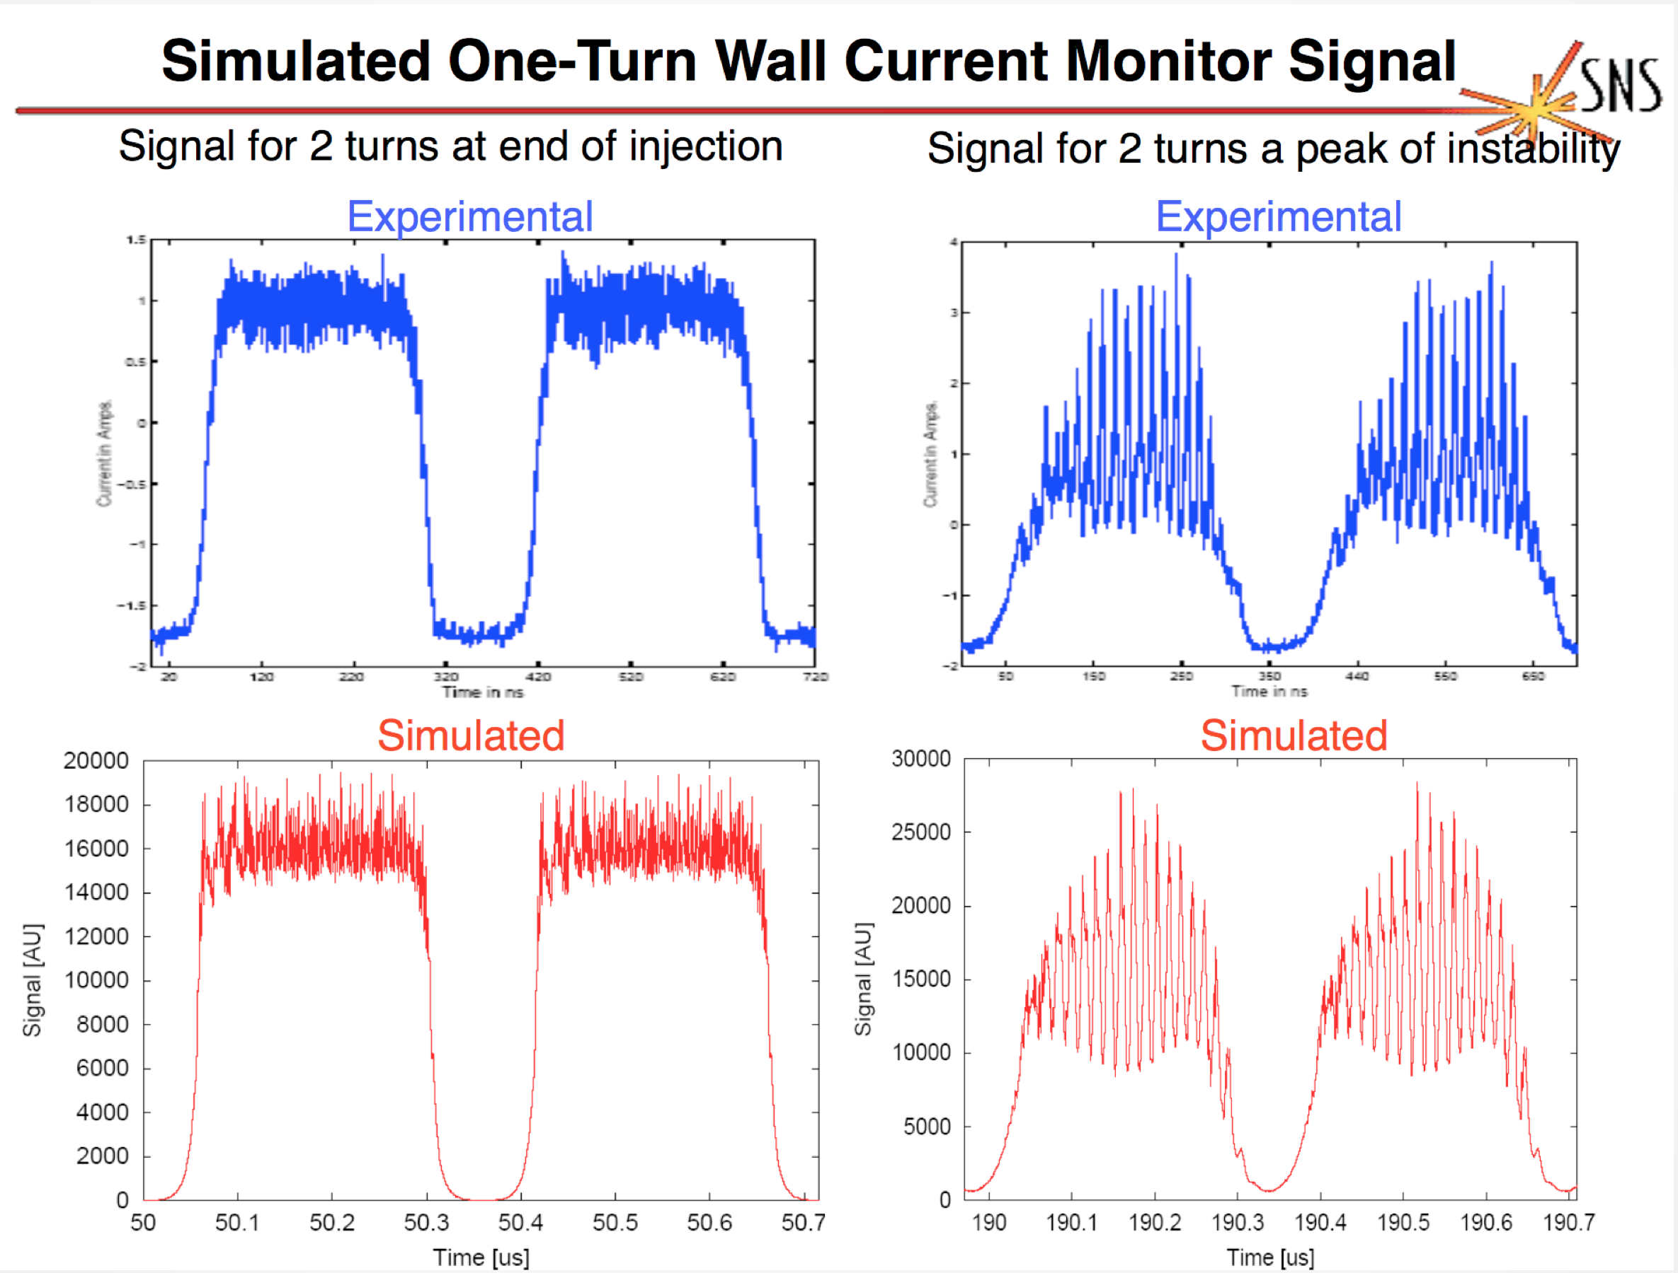
Esme Microwave Instability Simulation
From Chris Beltran’s PhD Thesis, 2004
Impedance-driven longitudinal instability in Los Alamos PSR

