Slide 1

Update on GHOST Code Development
Balša Terzić
Department of Physics, Old Dominion University
Center for Accelerator Studies (CAS), Old Dominion University
JLEIC Collaboration Meeting, Jefferson Lab, October 5, 2016

Slide 2
Interdisciplinary Collaboration
Jefferson Lab (CASA) Collaborators:
Vasiliy Morozov, He Zhang, Fanglei Lin, Yves Roblin, Todd Satogata
Old Dominion University (Center for Accelerator Science):
  Professors:
  Physics: Balša Terzić, Alexander Godunov
  Computer Science: Mohammad Zubair, Desh Ranjan
  Students:
  Computer Science: Kamesh Arumugam, Ravi Majeti
  Physics: Chris Cotnoir, Mark Stefani

Slide 3
Outline
Motivation and Challenges
    Importance of beam synchronization
    Computational requirements and challenges
  GHOST Code Development: Status Update
    Review what we reported last time
    Toward new results
      Implementation of beam collisions on GPUs
      “Gear change” on the horizon
Checklist and Timetable

Slide 4
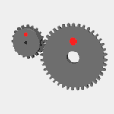
Motivation: Implication of “Gear Change”
Fast beam
Synchronization – highly desirable
  Smaller magnet movement
  Smaller RF adjustment
Detection and polarimetry – highly desirable
  Cancellation of systematic effects associated with bunch charge and polarization variation – great reduction of systematic errors, sometimes more important than statistics
  Simplified electron polarimetry – only need average polarization, much easier than bunch-by-bunch measurement
Dynamics – question
  Possibility of an instability – needs to be studied
  (Hirata & Keil 1990; Hao et al. 2014)
Slow beam

Slide 5
Computational Requirements
Perspective: At the current layout of the JLEIC
1 hour of machine operation time ≈ 400 million turns
Requirements for long-term beam-beam simulations of JLEIC
    High-order symplectic particle tracking
    Speed
    Beam-beam collision
    “Gear change”
We employ approximations which speed computations up:
  One-turn maps
  Approximate beam-beam collision (Bassetti-Erskine)

Slide 6
GHOST: Outline
GHOST: Gpu-accelerated High-Order Symplectic Tracking
GHOST resolves computational bottlenecks by
  Uses one-turn maps for particle tracking
  Employing Bassetti-Erskine approximation for collisions
  Implementing the code on a massively-parallel GPU platform
GPU implementation yields best returns when:
  The same instruction for multiple data (particle tracking)
  No communication (particle tracking; parallel collision)
Two main parts:
    Particle tracking
    Beam collisions

Slide 7
Reported at the Last Meeting
Long-term simulation require symplectic tracking
GHOST implements symplectic tracking just like COSY
  Demonstrated equivalency of results
GHOST tracking results match those with elegant
  Elegant is element-by-element, GHOST one-turn map
GPU implementation of GHOST tracking speeds execution up
  Execution on 1 GPU over 1 CPU is over 280 times faster
Collisions in GHOST done on a CPU only
  Hourglass effect reproduced
  Benchmarked with BeamBeam3D – excellent agreement
Tracking: Finished
Collisions: Started

Slide 8
GHOST: Beam Collisions
Bassetti-Erskine Approximation
  Beams treated as 2D transverse Gaussian slices
  (Good approximation for the JLEIC)
  Poisson equation reduces to a complex error function
  Finite length of beams simulated by using multiple slices
We generalized a “weak-strong” formalism of Bassetti-Erskine
  Include “strong-strong” collisions (each beam evolves)
  Include various beam shapes (original only flat beams)

Slide 9
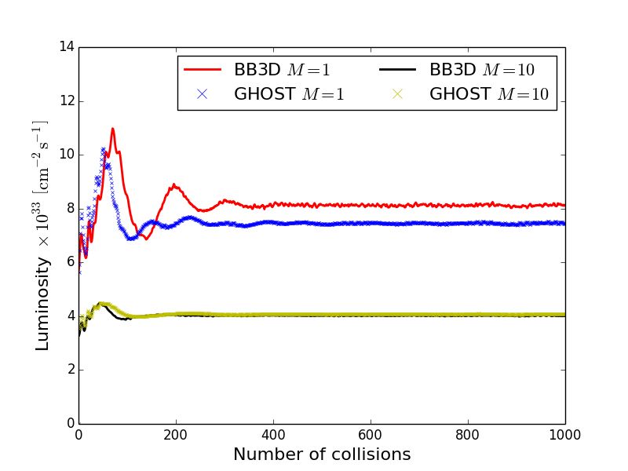
GHOST Benchmarking: Collisions
Code calibration and benchmarking
  Convergence with increasing number of slices M
  Comparison to BeamBeam3D (Qiang, Ryne & Furman 2002)
GHOST, 1 cm bunch
40k particles
BeamBeam3D & GHOST, 10 cm bunch
40k particles
Finite bunch length
accurately represented
Excellent agreement
with BeamBeam3D

Slide 10
GHOST Benchmarking: Hourglass Effect
When the bunch length σ_{z} ≈ β*at the IP, it experiences a
geometric reduction in luminosity – the hourglass effect
(Furman 1991)
GHOST, 128k particles, 10 slices
Good agreement with theory

Slide 11
“Gear Change” with GHOST: Approach
“Gear change” provides beam synchronization for JLEIC
  Non-pair-wise collisions of beams with
  different number of bunches (N₁, N₂) in each
  collider ring (for JLEIC N₁ = N₂+1 ≈ 3420)
  If N₁ and N₂ are mutually prime,
  all combinations of bunches collide
The load can be alleviated by implementation on GPUs
  The information for all bunches is stored: large memory load!
Approach
  Implement single-bunch collision right and fast
  Collide multiple bunches on a predetermined schedule
    N_{bunch} different pairs of collisions on each turn
Fast beam
Slow beam

Slide 12
“Gear Change” with GHOST: Toward Results
Technical implementation
FINISHED
Gaining confidence in the results:
  Do the single collision right. Compare to BeamBeam3D.
  Reproduce the hourglass effect.
  Collide multiple pairs of bunches at different turns.
  Reasonableness check: 1-1 the same as 10-10?
  Conduct convergence studies.
We will share first results only upon completing all five steps
Validation and benchmarking
UNDERWAY

Slide 13
“Gear Change” with GHOST: Preliminaries
How GHOST Scales with Bunches and Particles on 1 GPU
Linear with the
number of bunches
Linear with the
number of particles
per bunch

Slide 14
GHOST: Checklist and Timetable
Stage 1: Particle tracking (Year 1: COMPLETED)
  High-order, symplectic tracking optimized on GPUs
  Benchmarked against COSY: Exact match
  400 million turn tracking-only simulation completed
  Submitted for publication (NIM A: waiting since June!)
Stage 2: Beam collisions (Year 1: COMPLETED or UNDERWAY)
  Single-bunch collision implemented on GPUs
  Multiple-bunch collision implemented on a single GPU (arbitrary N_{bunch})
  Multiple-bunch validation, checking, benchmarking and optimization
  Multiple-bunch collision implemented on a multiple GPUs
Stage 3: Other effects to be implemented (Year 2 & Beyond)
  Systematic simulations of JLEIC
  Other collision methods: fast multipole
  Space charge, synchrotron radiation, IBS
☑
☑
☑
☑
☑
☑
☐
☐

Slide 15
Backup Slides

Slide 16
Last Time: Symplectic Tracking Needed
Symplectic tracking is essential for long-term simulations
Non-Sympletic Tracking
500 000 iterations, 3rd order map
Sympletic Tracking
500 000 iterations, 3rd order map
p_{x}
p_{x}
x
x
Energy not conserved
Particle will soon be lost
Energy conserved

Slide 17
Speedup
 |  |  |  | 6Slices | 1Turn
Npart | CPU |  |  | GPU |  |  | Speedup CPU
 | Tracking | Collision |  | Tracking | Collision
1000 | 0.644896 | 13.2116 |  | 0.644768 | 15.4794 |  | 0.85
10000 | 1.02157 | 129.49 |  | 1.04451 | 17.9388 |  | 7.22
100000 | 5.86016 | 1287.17 |  | 5.91194 | 29.8827 |  | 43
1000000 | 54.5349 | 12851 |  | 54.8268 | 147.746 |  | 86
 |  |  |  | 10k Particles |  | 6Slices
Nturn | CPU |  |  | GPU |  |  | Speedup CPU
 | Tracking | Collision |  | Tracking | Collision
1 | 1.04202 | 129.479 |  | 1.03523 | 17.823 |  | 7.26
10 | 0.953088 | 131.204 |  | 0.96128 | 17.7718 |  | 7.38
100 | 0.965376 | 143.975 |  | 0.961472 | 17.4446 |  | 8.25
1000 | 0.951872 | 119.376 |  | 0.989312 | 12.4215 |  | 9.61
 |  |  |  | 1Million Patricles |  | 1Turn
Nslices | CPU |  |  | GPU |  |  | Speedup CPU
 | Tracking | Collision |  | Tracking | Collision
1 | 54.473 | 2235.67 |  | 54.8347 | 30.738 |  | 72
2 | 54.4848 | 4396.9 |  | 54.7464 | 54.4933 |  | 81
3 | 54.4546 | 6480.04 |  | 54.7209 | 75.2644 |  | 86
4 | 54.4835 | 8612.99 |  | 54.8068 | 99.6275 |  | 86
5 | 54.5129 | 10708.2 |  | 54.7883 | 125.001 |  | 86
6 | 54.4469 | 12843.6 |  | 54.7732 | 147.913 |  | 87

Slide 18
Last Time: High-Order Symplectic Maps
Higher-order symplecticity reveals more about dynamics
2nd order symplectic
3rd order symplectic
5000 turns
4th order symplectic
5th order symplectic

Slide 19
Last Time: Symplectic Tracking With GHOST
Symplectic tracking in GHOST is the same as in COSY Infinity
(Makino & Berz 1999)
Start with a one-turn map
Symplecticity criterion enforced at each turn
Involves solving an implicit set of non-linear equations
  Introduces a significant computational overhead
Initial coordinates
Final coordinates

Slide 20
Last Time: Symplectic Tracking With GHOST
Symplectic tracking in GHOST is the same as in COSY Infinity
(Makino & Berz 1999)
Non-Sympletic Tracking 3rd order map
COSY GHOST 100,000 turns
Sympletic Tracking 3rd order map
COSY GHOST 100,000 turns
Perfect agreement!

Slide 21
Last Time: GHOST Symplectic Tracking Validation
Dynamic aperture comparison to Elegant (Borland 2000)
400 million turn simulation (truly long-term)
GHOST Elegant 1,000 turns
Sympletic Tracking 4th order map
Excellent agreement!

Slide 22
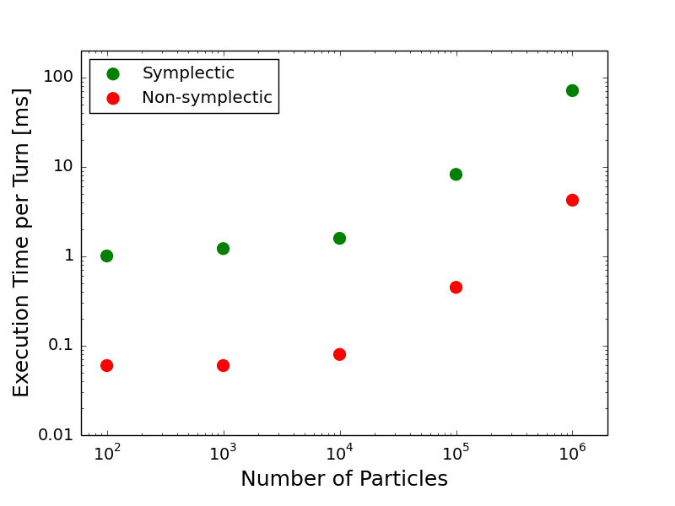
GHOST: GPU Implementation
GHOST: 3rd order tracking
1 GPU, varying # of particles
100k particles, varying # of GPUs
Speedup on 1 GPU over 1 CPU over 280 times
400 million turns in an JLEIC ring for a bunch with 100k particles:
< 7 hr non-symplectic, ~ 4.5 days for symplectic tracking
With each new GPU architecture, performance improves

Slide 23
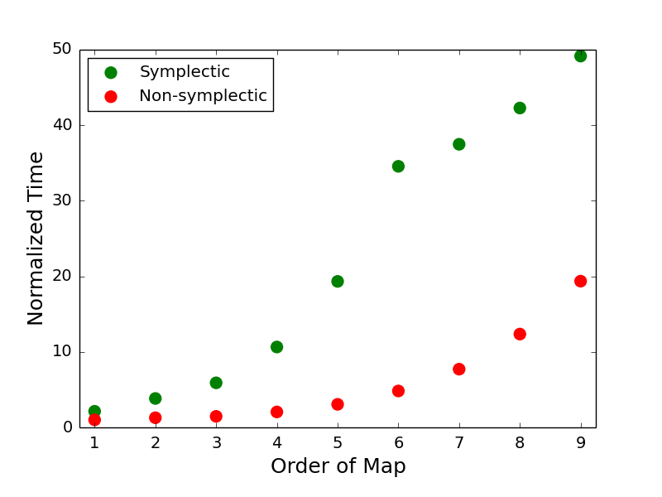
GHOST GPU Implementation
GHOST Tracking on 1 GPU

Slide 24
JLEIC Design Parameters Used

Slide 25
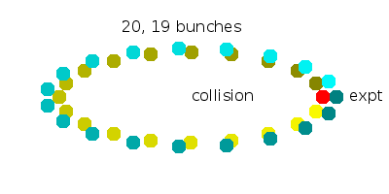
“Gear Change” with GHOST
“Gear change” provides beam synchronization for JLEIC
  Non-pair-wise collisions of beams with different number of
  bunches (N₁, N₂) in each collider ring (for JLEIC N₂ = N₁-1 ~ 3420)
    Simplifies detection and polarimetry
    Beam-beam collisions precess
    If N₁ and N₂ are incommensurate,
    all combinations of bunches collide
    Can create linear and non-linear
    instabilities?
    (Hirata & Keil 1990; Hao et al. 2014)
The load can be alleviated by implementation on GPUs
  The information for all bunches is stored: huge memory load!
Approach
  Implement single-bunch collision right and fast
  Collide multiple bunches on a predetermined schedule
    N_{bunch} different pairs of collisions on each turn

