Slide 1

Beam-Beam Effects
Edward Nissen
JLEIC Fall Collaboration Meeting
6 October 2016

Slide 2

Outline
Background on the Beam-Beam effect
System under consideration, and software used
Initial analysis of the system in question
Different methods of measuring growth rates
Which model to use

Slide 3
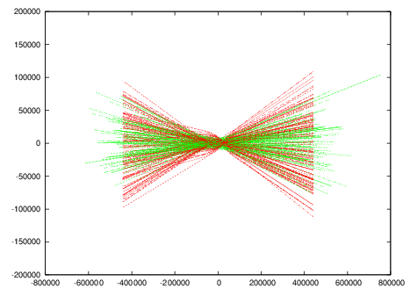
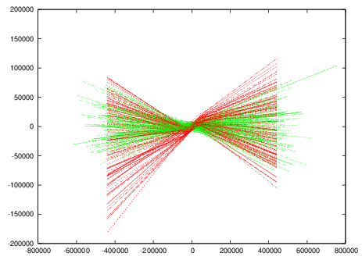
Background on Beam-Beam effect
Horizontal Position
Horizontal Position
Longitudinal Position
Longitudinal Position
Tune Shifts
Offsets

Slide 4
Background on Beam-Beam effect (cont’d)
Path of electron beam through ion beam
Angular offset along length of proton beam

Slide 5
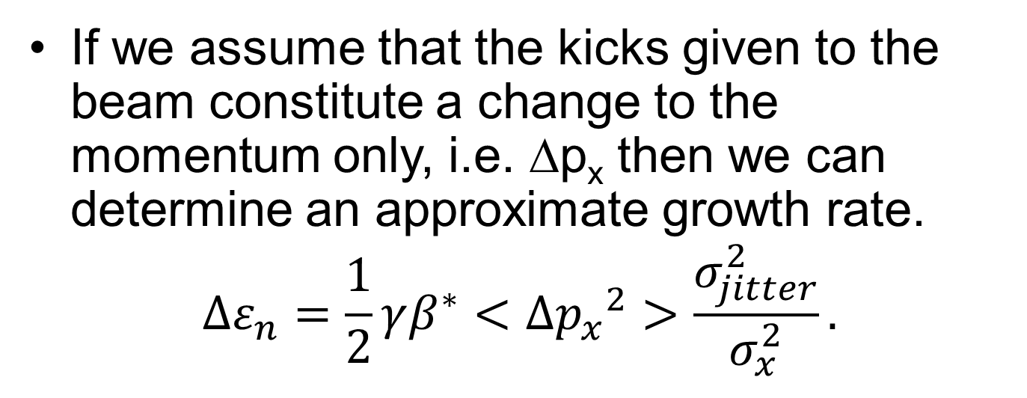
Predicting the emittance growth rate
If we assume that the kicks given to the beam constitute a change to the momentum only, i.e. ∆p_{x} then we can determine an approximate growth rate.
$$∆ε_{n}=\frac{1}{2}γβ^{∗}<∆{p_{x}}^{2}>\frac{σ_{jitter}^{2}}{σ_{x}^{2}}.$$
<∆p_{x}²> can be found numerically, and under some circumstances analytically.

Slide 6
Beams Under Study
 | Protons | Electrons
Energy (GeV) | 100 | 10
β*_{x} (m) | 0.10 | 0.10
β*_{y} (m) | 0.02 | 0.02
ε_{xn} (μm) | 1.0 | 182
ε_{yn} (μm) | 0.5 | 91
ν_{x/}ν_{y} | 0.22/0.16 | 0.89/0.61
Dx/ Dy | .016/.051 | .056/.17
ξ_{x}/ξ_{y} | .00517/.00327 | .0375/.0237
Based on design for collider ring.
Electron parameters scaled to fit proton spot size
Electron tunes come from 2015 MEIC design update.
No RF or longitudinal motion has been included.

Slide 7
Software Used
For single particle beam-beam studies, added a Basetti-Erskine kick to the map in COSY Infinity.
For Multi-particle studies, used Guinea-Pig
  Self consistent PIC solver to study beam-beam interactions
  Paired with single turn map to propagate ion beam through collider ring

Slide 8
Tune Footprints
Amplitude dependent tune shifts can push parts of the beams onto resonances.
4σ tune footprint shown. (Orange without beam-beam, green with beam-beam)

Slide 9
Poincare Sections
4th Order Tracking
5th Order Tracking
The 5th order resonance shown earlier significantly reduces the dynamic aperture.
A retune is necessary.

Slide 10
Working Point Optimization

Slide 11
Working Point Optimization (cont’d)
This is an involved process and should be included with general dynamic aperture studies.

Slide 12
Gear Changing
In the energy ranges envisioned for JLEIC the ions and electrons do not move at the same speed.
A method of maintaining synchronization without moving any hardware involves using different numbers of electron and ion bunches spaced such that they collide.
This means that each ion bunch collides with each electron bunch.
Has positive aspects for nuclear physics.
Has positive/negative aspects for beam physics.

Slide 13
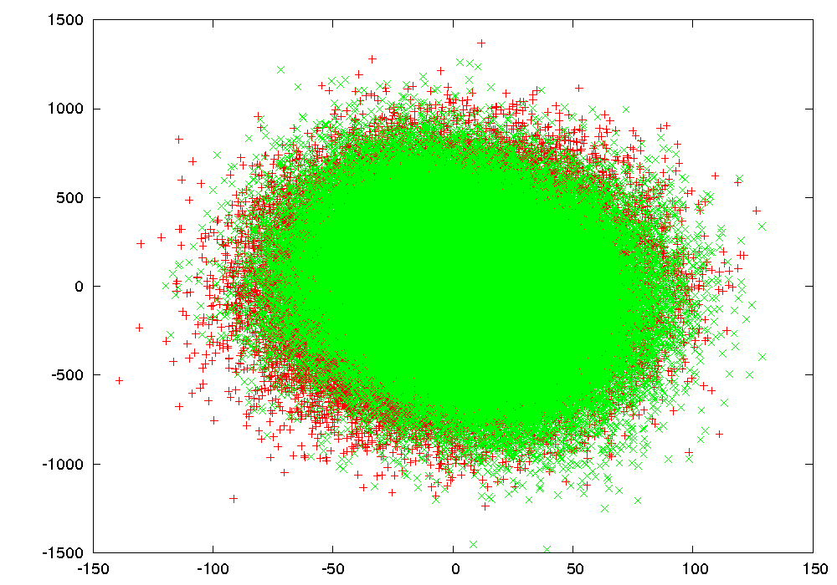
Synchrotron Tracking
Each bunch sees the same bunch repeatedly.
Due to nonlinearities in the accelerator, and due to the beam-beam effect, an offset will be spread out over a larger phase space leading to an increased emittance, and an eventual equilibrium.

Slide 14
Synchrotron Tracking (cont’d)
Normalized Emittance (m)
Turns

Slide 15
Synchrotron Tracking (cont’d)
Normalized Emittance (m)
Turns

Slide 16
Synchrotron Tracking (cont’d)
Normalized Emittance (m)
Turns
Different electron beam tunes can drastically change the output.

Slide 17
Linac Type Modeling
With a Linac-ring system, the electron beam is replaced after each interaction.
The offsets can be modeled as random, and unconnected to each other.

Slide 18
Linac Type modeling (cont’d)
Emittance (m)
Turns
With 5% σx jitter we get a growth rate of 6x10⁻¹³ m/turn (way too high)

Slide 19
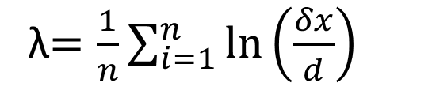
Lyapunov Exponents (Which Model)
λ$=\frac{1}{n}\sum_{i=1}^{n}{ln⁡\left(\frac{δx}{d}\right)}$
Where d is a small initial offset
Lyapunov time = 1/λ also known as the e-folding time.
A stable system gives λ<=0, λ>0 is chaotic with a diverging distance.

Slide 20
Lyapunov Results
Different parts of the beam have different “memories” of their past.
Gear changing will require more than 3400 interactions before returning to the original colliding bunches.
Both the core and outer portions of the beam will need to be simulated with gear changing in a self consistent manner.
Lyapunov Time (turns)
Radius (σ_{x})

Slide 21
Conclusions
The beam-beam effect can limit beam lifetime in JLEIC
A retune will be necessary to get the system off of the 5th order resonance, which should be added to the Dynamic aperture study.
The Lyapunov exponents show that a full simulation of the system is necessary to properly understand the effects of gear changing on the emittance of the system.

