Slide 1
Teach the Teachers
John Roberts
School of Physics and Astronomy
The University of Manchester
Nuclear Physics Community Meeting
University of Warwick
6th January 2017

Slide 2
How It Started
STFC Grant for David Jenkins
2010 - Workington – 12 teachers
David Jenkins - Nuclear Physics
John Roberts – Nuclear Energy
Andy Boston – Nuclear Medicine
Rodi Herzberg – Superheavy Elements
Funding since 2011 from the Nuclear Institute

Slide 3
Subsequent Events
2011 – Manchester 25 teachers
2013 – Manchester 30 teachers
2014 – Manchester 35 teachers
2014 – RAL 40 teachers
2014 – Liverpool 9 teachers
2015 – Manchester 24 teachers
2016 – Bangor 20 teachers
2016 – RAL 5 teachers

Slide 4
Typical Schedule
Time | Presentation | Speaker
10:00 – 10:10 | Welcome and Introduction to the Programme | John Roberts – The University of Manchester
10:10 – 10:55 | Alchemy in the 21st Century: the Quest for Super Heavy Elements. | Rodi Herzberg – The University of Liverpool
10:55 – 11:15 | Coffee Break
11:15 – 12:00 | Nuclear Physics at CERN | David Jenkins – University of York
12:00 – 1:30 | Lunch (Practical Demonstrations)
1:30 – 2:15 | The Evolution of a Star | Elizabeth Cunningham – STFC and University of Surrey
2:15 – 2:30 | Coffee
2:30 – 3:15 | Nuclear Energy – The Facts Behind the Fuss | John Roberts – The University of Manchester
3:15 – 3:30 | Feedback and Evaluation
3:30 | Close
Notes:
Samantha Colosimo, Stephen Moon, Laura Harkness-Brennan

Slide 5
Ingredients For Success
Need a local organiser
Advertise the event through their teacher networks
Book the venue and catering
Arrange the feedback forms
Speakers then arrive, (engage with the teachers) deliver their presentation
NI provide funding to cover the travel of the speakers – not the teachers
For the Bangor Event, partnering with Horizon Nuclear Power, enabled the travel costs of the teachers to be covered as well as the cost of a supply teacher BUT……

Slide 6
Teachers Like To Take Something Back To Their School

Slide 7
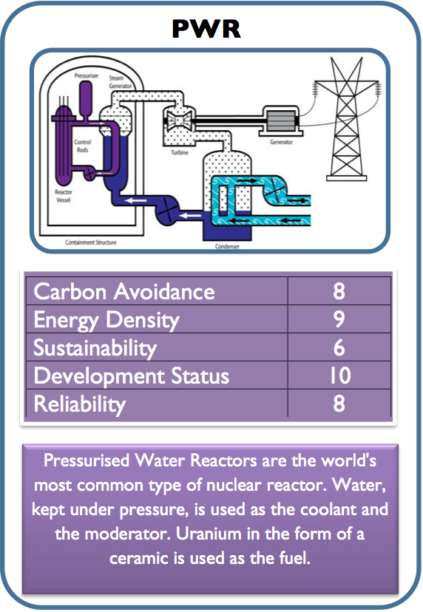
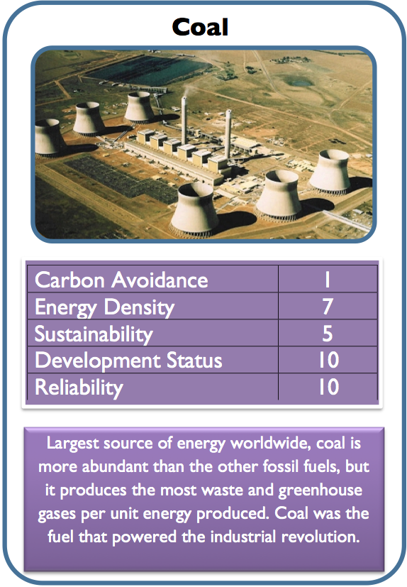
Teachers Like To Take Something Back To Their School

Slide 8
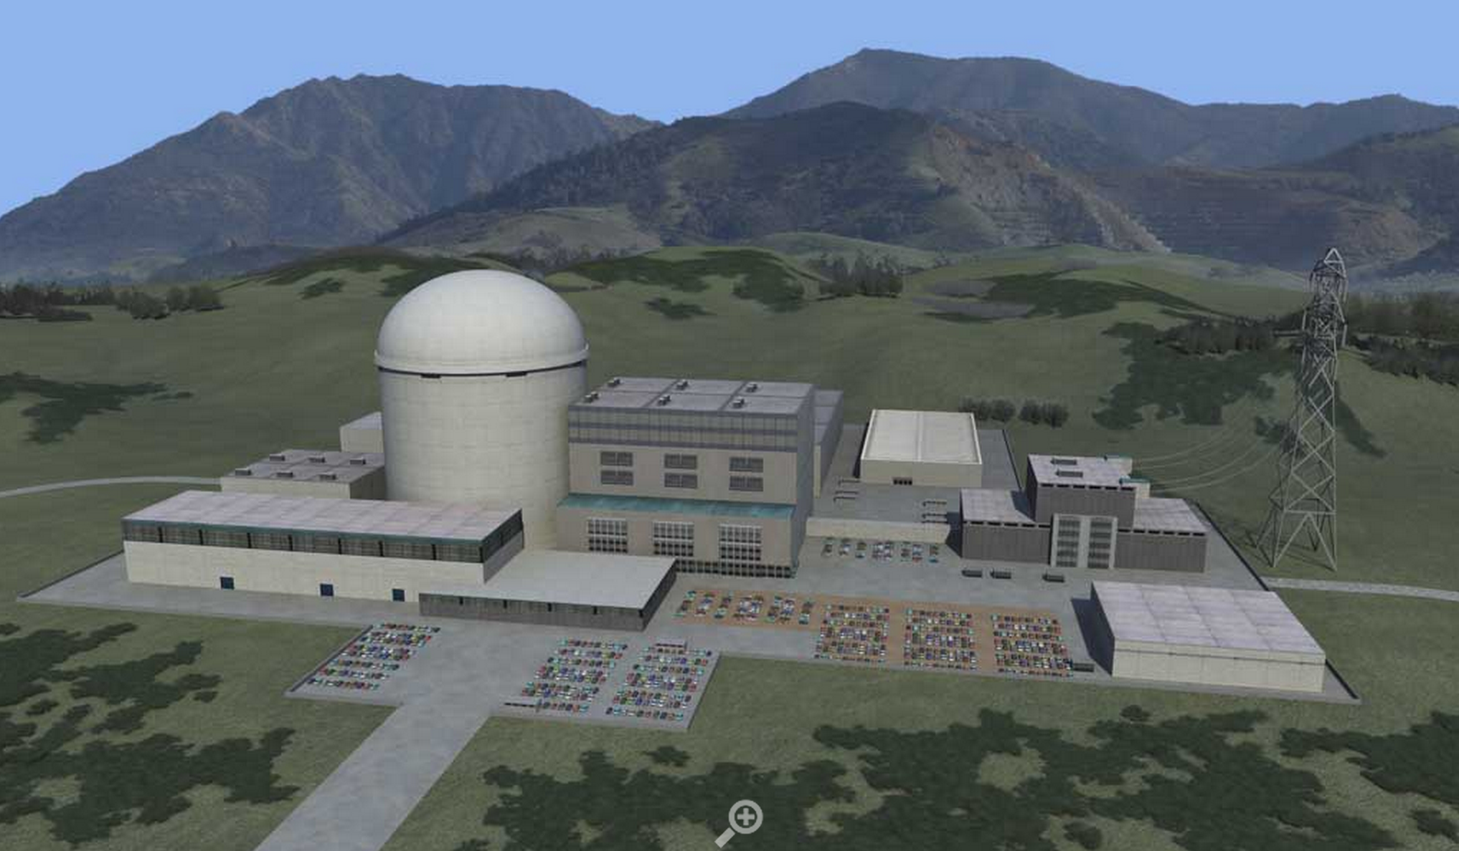

Slide 9
