Slide 1


EicRoot: a brief overview
of geometry & tracking
implementation
Alexander Kiselev
EIC R&D Software Consortium Meeting
BNL October,17 2016

Slide 2
FairRoot overview
Active project, officially supported by GSI
Large experiment and user base
Regular releases, active forums, long-term developer support
Several software building blocks readily available
Designed with flexibility in mind
Simulation and reconstruction in the same environment
ROOT-based I/O
Virtual geometry concept (several formats supported)
Virtual Monte-Carlo concept (easy switching between GEANT 3 & 4 transport engines in particular)

Slide 3
FairRoot experiments
Slide from Florian Uhlig (ROOT 2015 Workshop)
#1: user base

Slide 4
EicRoot framework building blocks
Interface to GEANT, ROOT, …
FairBase
PandaRoot
FopiRoot
“Ideal” track finder,
Interface to GenFit
…
TPC R&D stuff, …
EicRoot
CbmRoot
eic-smear
MC generated evts import
Fast smearing codes
RICH stuff
solenoid
modeling
IR design
configuration
#2: modularity

Slide 5
End user view
No executable (steering through ROOT macro scripts)
simulation
digitization
reconstruction
PID; assembly
-> MC points
-> Hits
-> Tracks, clusters
-> Events
ROOT files for analysis available after each step
C++ class structure is well defined at each I/O stage
#3: objects

Slide 6
Geometry description
Input formats:
ROOT TGeo (required for tracking detectors)
GEANT GDML
Old HADES .geo files
CAD design drawings (.stp, .stl, .slp)
Output format:
ROOT TGeo

Slide 7
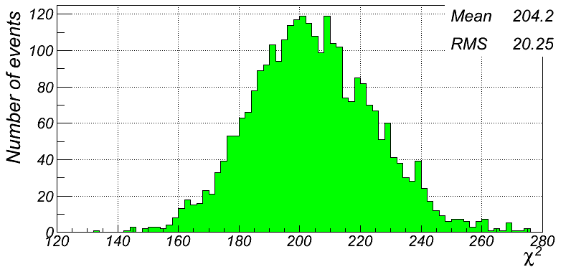
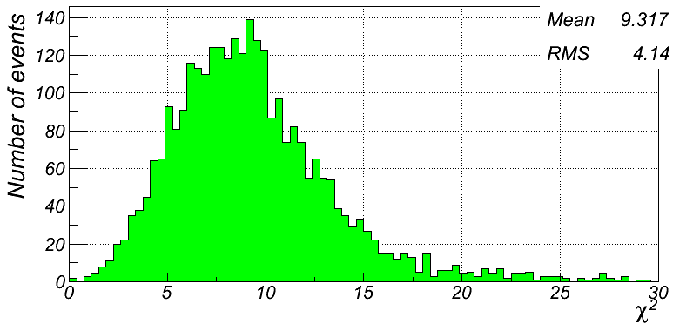
Tracking code implementation
Large parts of other experiment’s codes adapted:
PandaRoot: “ideal” track finder, GenFit fitter, etc
FopiRoot: TPC digitization, realistic track finders (Hough transform; Riemann sphere fit), GenFit fitter, RAVE vertex builder, etc
HERMES: linearized Kalman filter for forward spectrometers
OLYMPUS: forward track finder
Kalman filter fit quality for two “extreme” track configurations
<ndf> = 206
<ndf> = 9
1 GeV/c π⁺ tracks at η=0.5:
32 GeV/c π⁺ tracks at η=3.0:

Slide 8
Tracking: feature list & restrictions
Modularity and flexibility in geometry description
Several detector templates available in digitization:
Flat 1D (strip) and 2D (pixel) sensors; gaussian and sqrt(12) smearing
Flat 2D {r,φ} sensors (endcap-like)
Volume 3D (TPC-like)
Volume 1+2D (axial symmetric along the track)
Kalman filter fitting through all hits at once (via GenFit)
No coding required rather than detector geometry description and steering macros (all in ROOT C++)

Slide 9
Tracking: feature list & restrictions
Only ROOT TGeo “constructive” geometry is supported
Mapping information should be bundled in the same ROOT files with TGeo geometry description and it is directly available for digitization and reconstruction codes (so for each MC hit the information about physical volume it belongs to - shape, 3D transformation, etc - can be polled on-the-fly at any time)
“Ideal” (known a-priori) hit-to-track association is typically assumed (suffices for resolution studies)

Slide 10
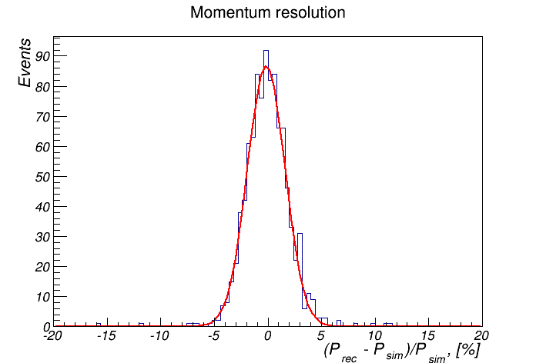
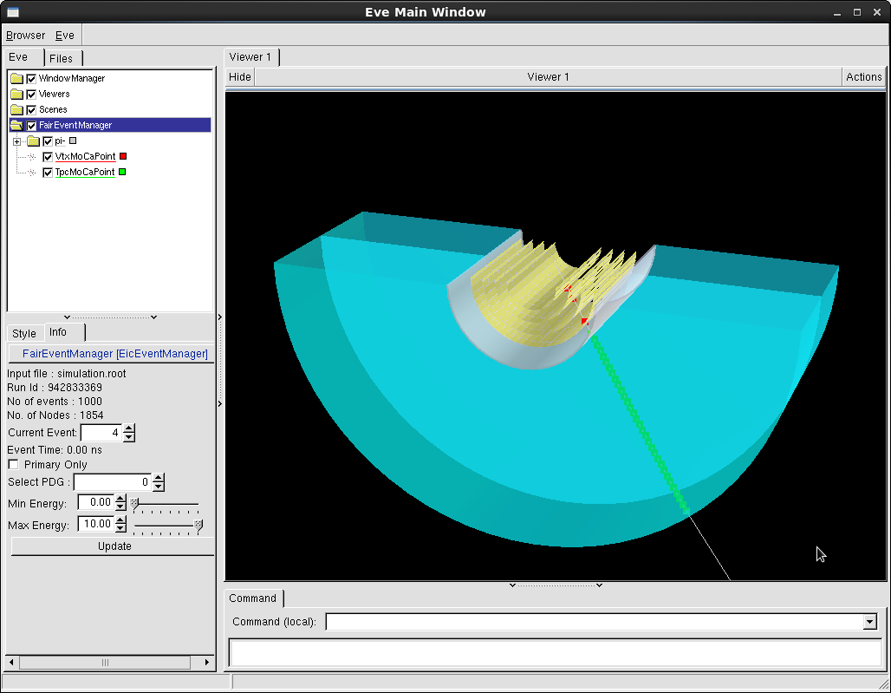
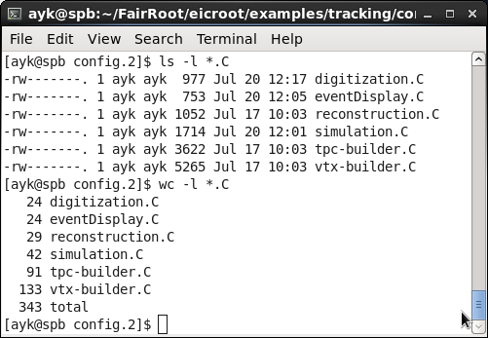
Example: basic vertex+barrel tracker
Vertex tracker + TPC in 3T field; 10 GeV/c pions at θ=75º; momentum resolution?
-> see examples/tracking/config.2 directory for details

Slide 11
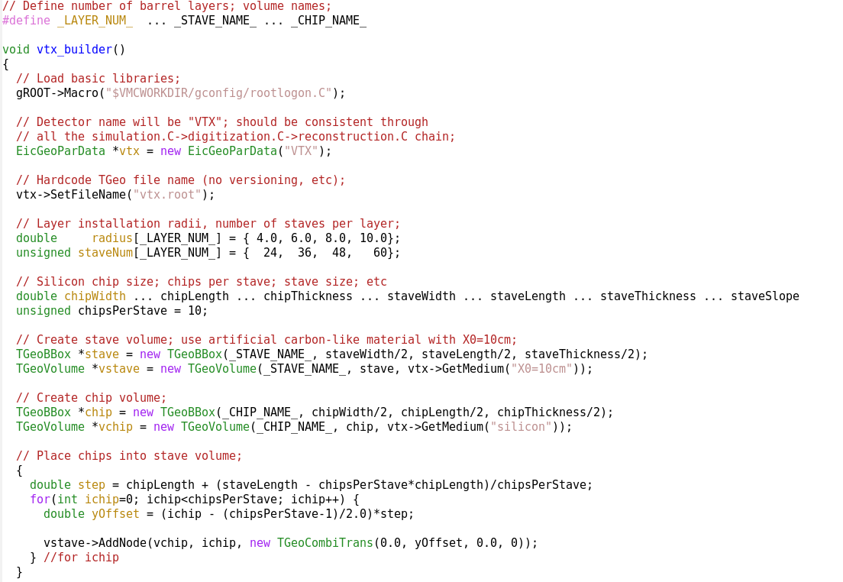
vtx-builder.C: objects (chips, staves)
(Unavoidable) geometry description overhead: fairly trivial C++ coding
The only two “sparsified” places
← this mapping structure will be appended to TGeo file
← 4 barrels at fixed radii; hardcoded number of staves
← TGeo stave volume
← TGeo chip volume
← stave assembly

Slide 12
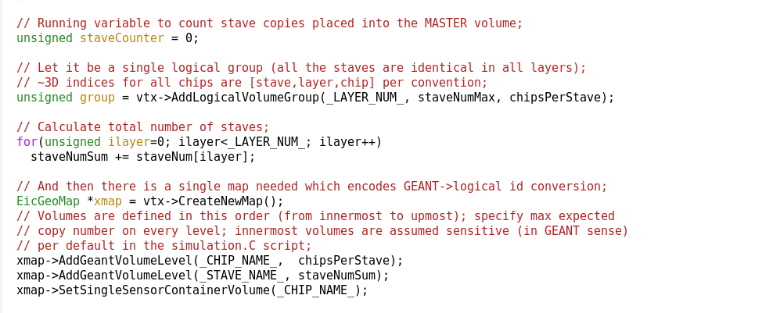
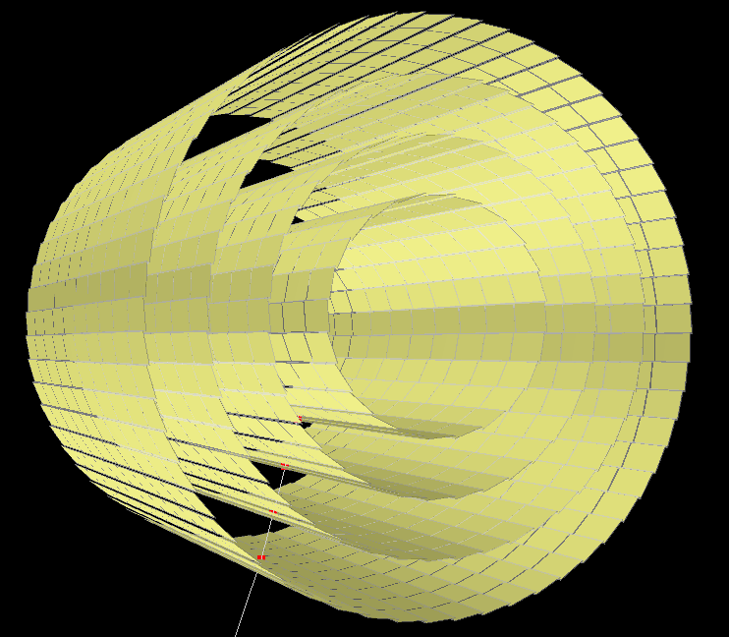
vtx-builder.C: logical map initialization
Create a unique entry for every elementary sensitive volume (silicon chips in this case)
Keep this information as a single record in the same ROOT TGeo file
Copy this record over as a whole into the file with simulated events (and thus make readily available for digitization and reconstruction)
Couple all hits to their respective sensitive volume IDs (and all parent IDs) in the simulation

Slide 13
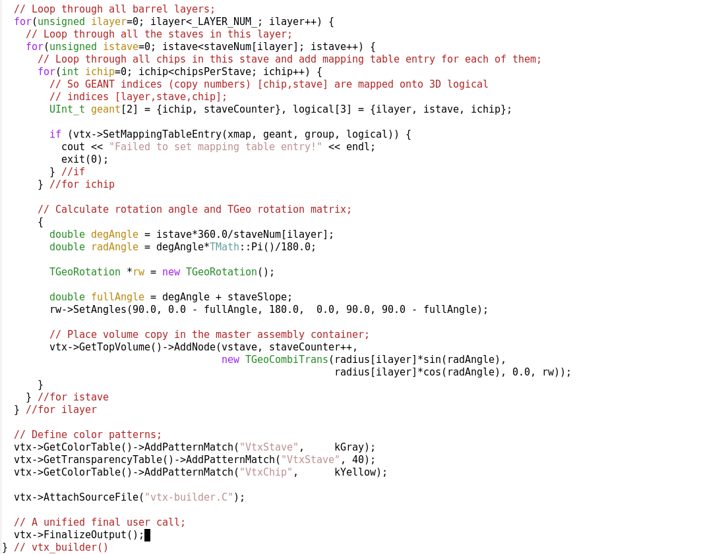
vtx-builder.C: composition, mapping, …
← essential mapping entry creation call
← arrange 10-chip staves in 4 barrels
← assign color attributes using name patterns
← be paranoid if needed

Slide 14
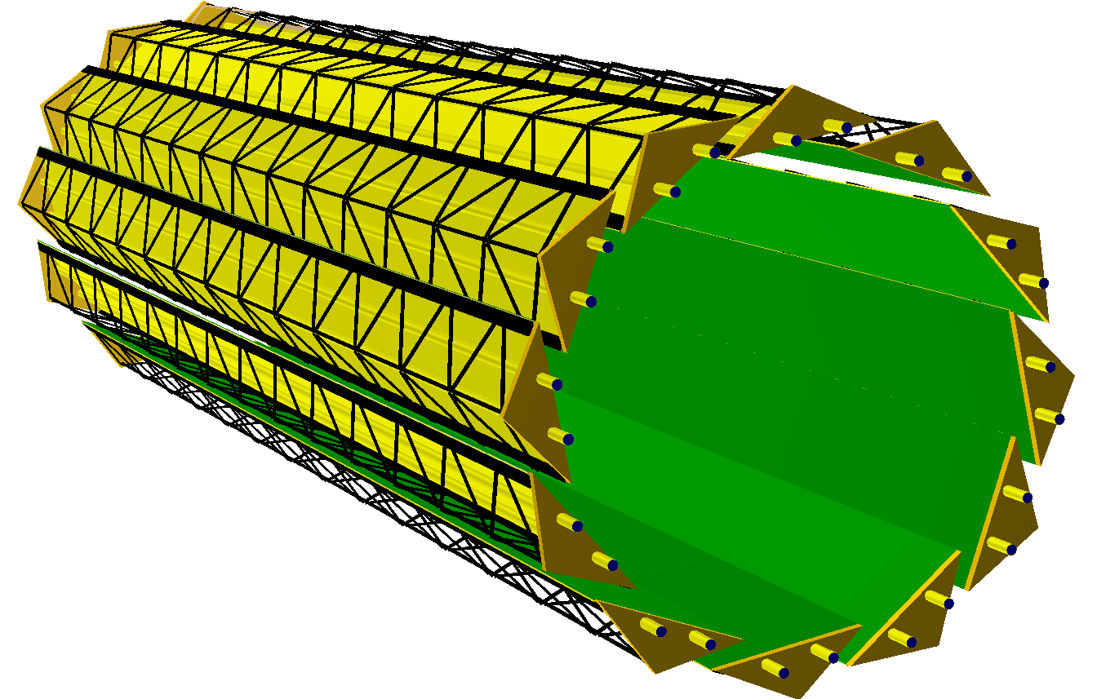
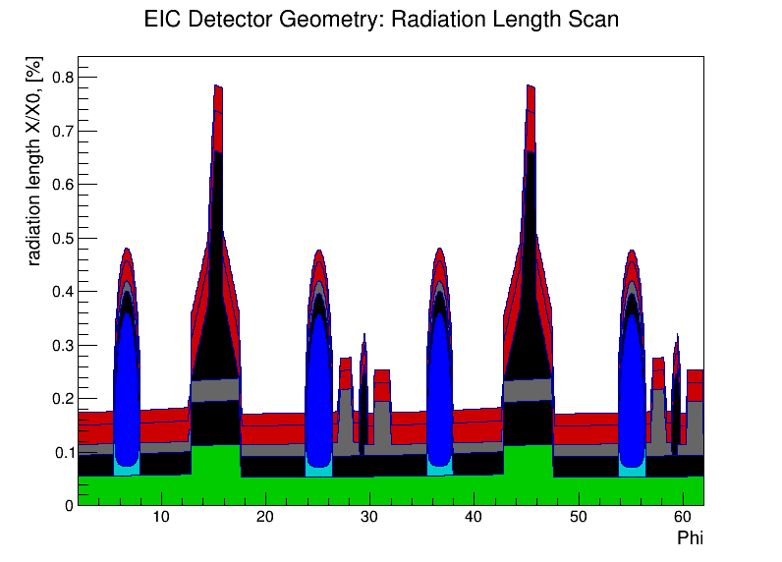
Geometry description: a side remark
Respective radiation length scan
eRHIC model detector vertex tracker element (TGeo geometry coded in C++)
How can one code such a thing in ASCII file by hand?!
Otherwise: what sense does it make to have some custom intermediate format instead of coding in TGeo directly?
The prototype: ALICE ITS upgrade configuration

Slide 15
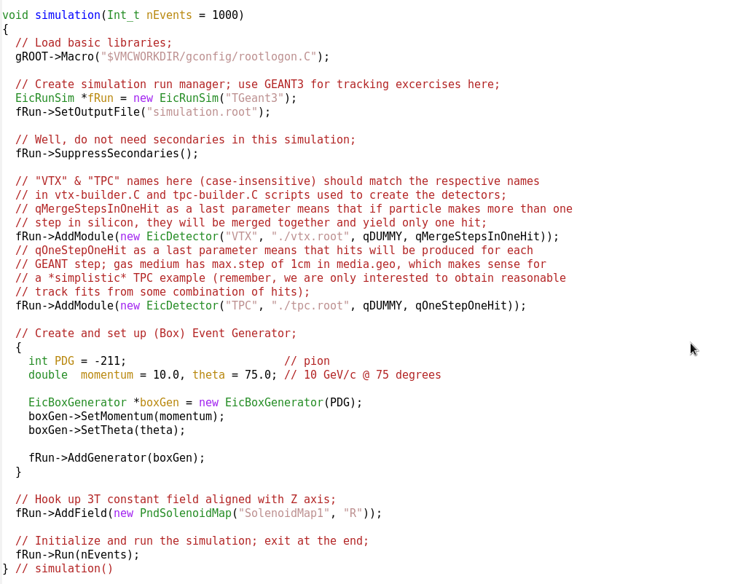
simulation.C
← use GEANT3 transport engine
← add vertex detector
← add the TPC
← define particle kinematics
← define magnetic field

Slide 16
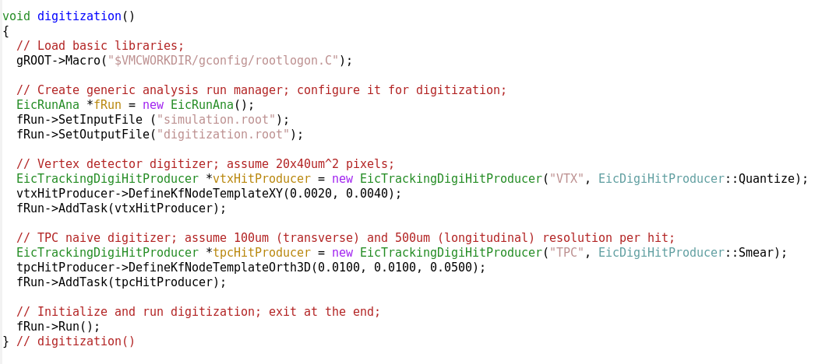
digitization.C
← digitize silicon as 20x40um pixels
← digitize TPC assuming 100um gaussian single point resolution in XY

Slide 17
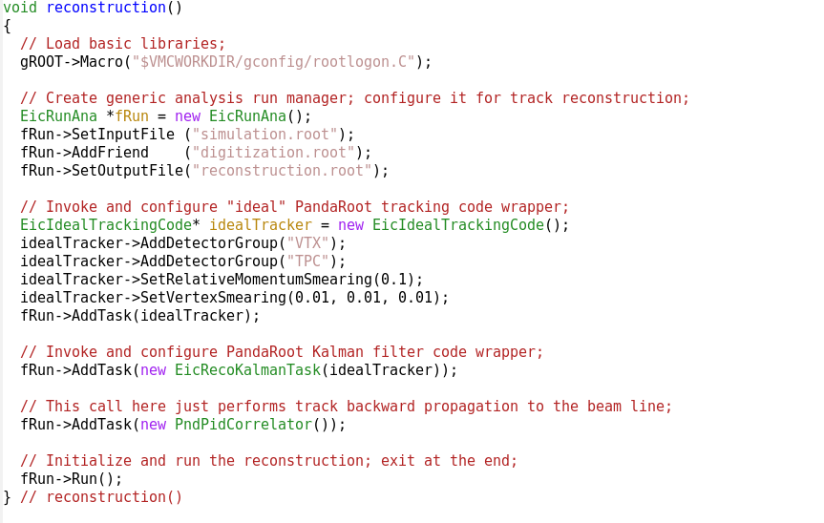
reconstruction.C
← use silicon vertex detector hits
← use TPC hits
← perform Kalman filter track fitting
← perform back propagation to beam axis, etc

Slide 18
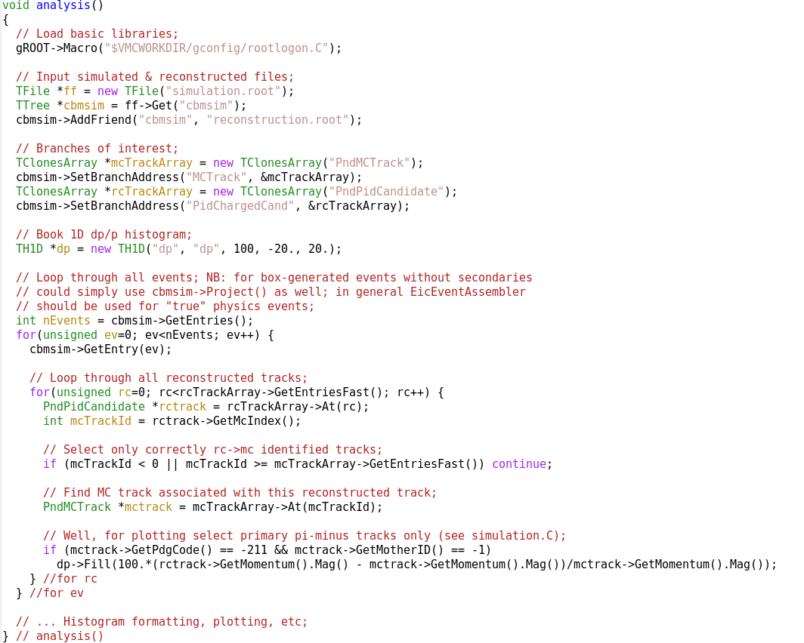
analysis.C
← open ROOT files; get TTree object
← define branches of interest
← loop through events and build plots

Slide 19
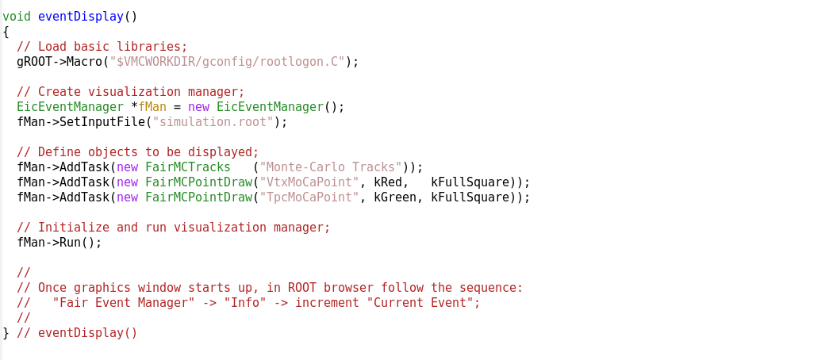
eventDisplay.C
← want to see tracks and hits

Slide 20
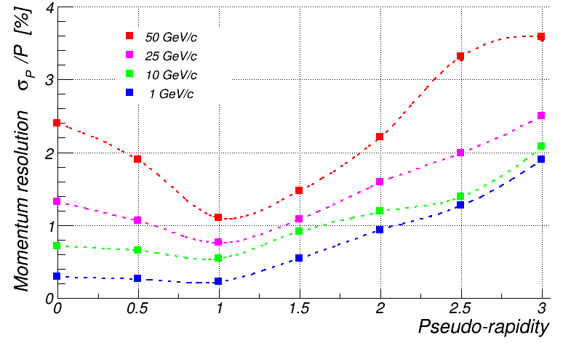
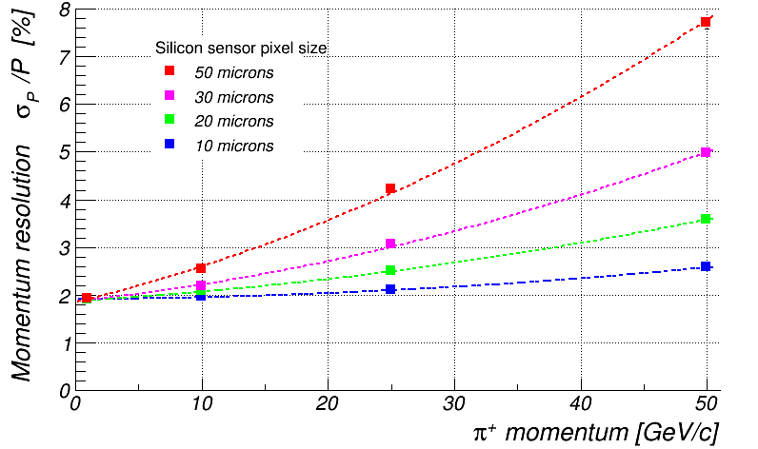
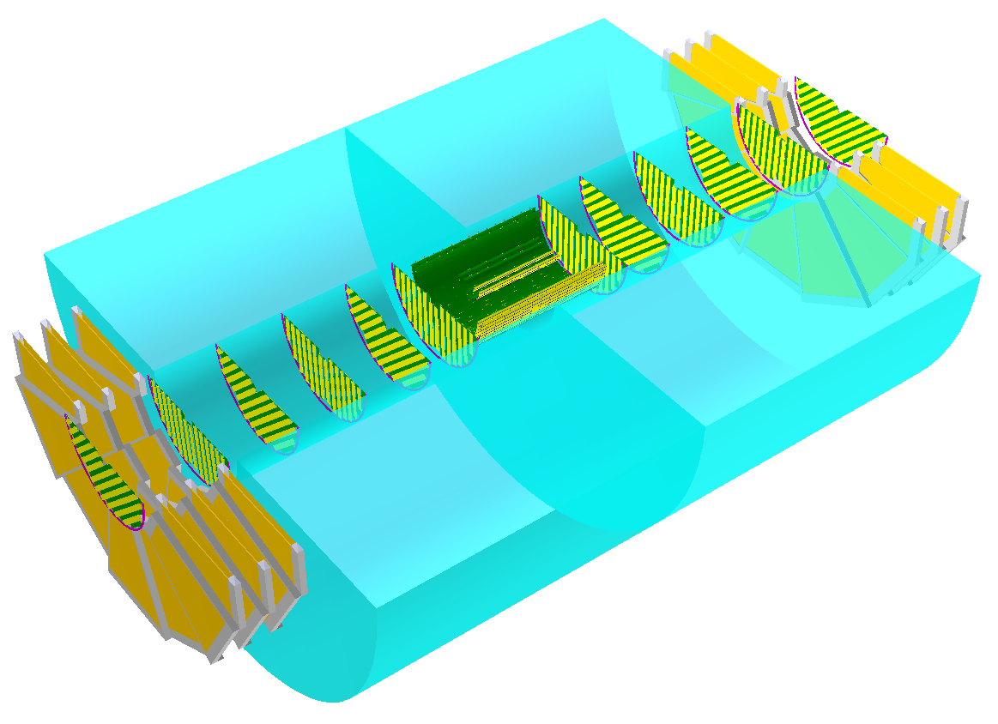
Example: EIC model detector tracker
π⁺
π⁺; η=3
Same codes as for “simple configuration”
Any sub-detector can be easily swapped in/out or replaced by the other (assuming properly cooked TGeo file exists and some known digitization template selected)

Slide 21
Take away message
A relatively complete implementation exists already …
… and can be used to start doing something
Codes available for download from BNL SVN server
-> the slides and status are from Sep’2015;
are we now going to debate for another year?

