Slide 1
Deep learning
modern tools, and particle physics

Slide 2
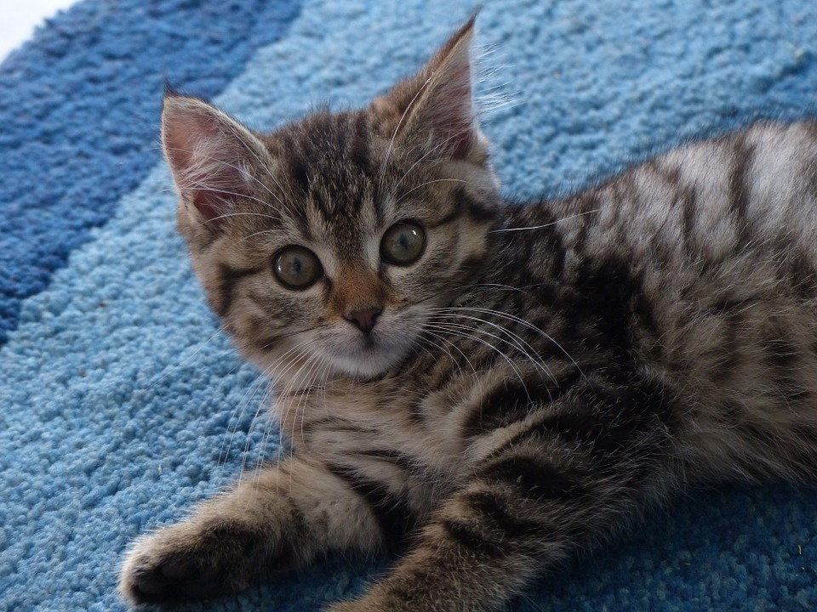
In the last decade humanity made a tremendous progress in ability to say that Kitten is a kitten

Slide 3
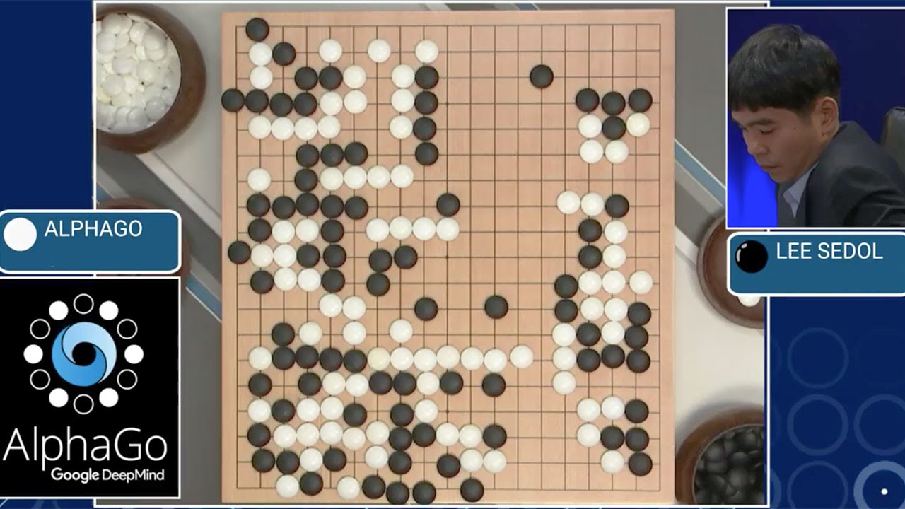
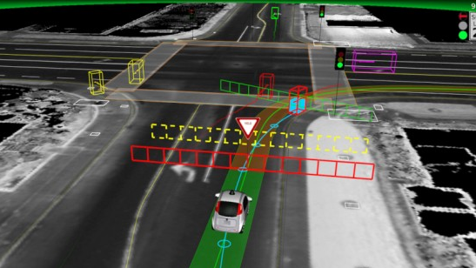
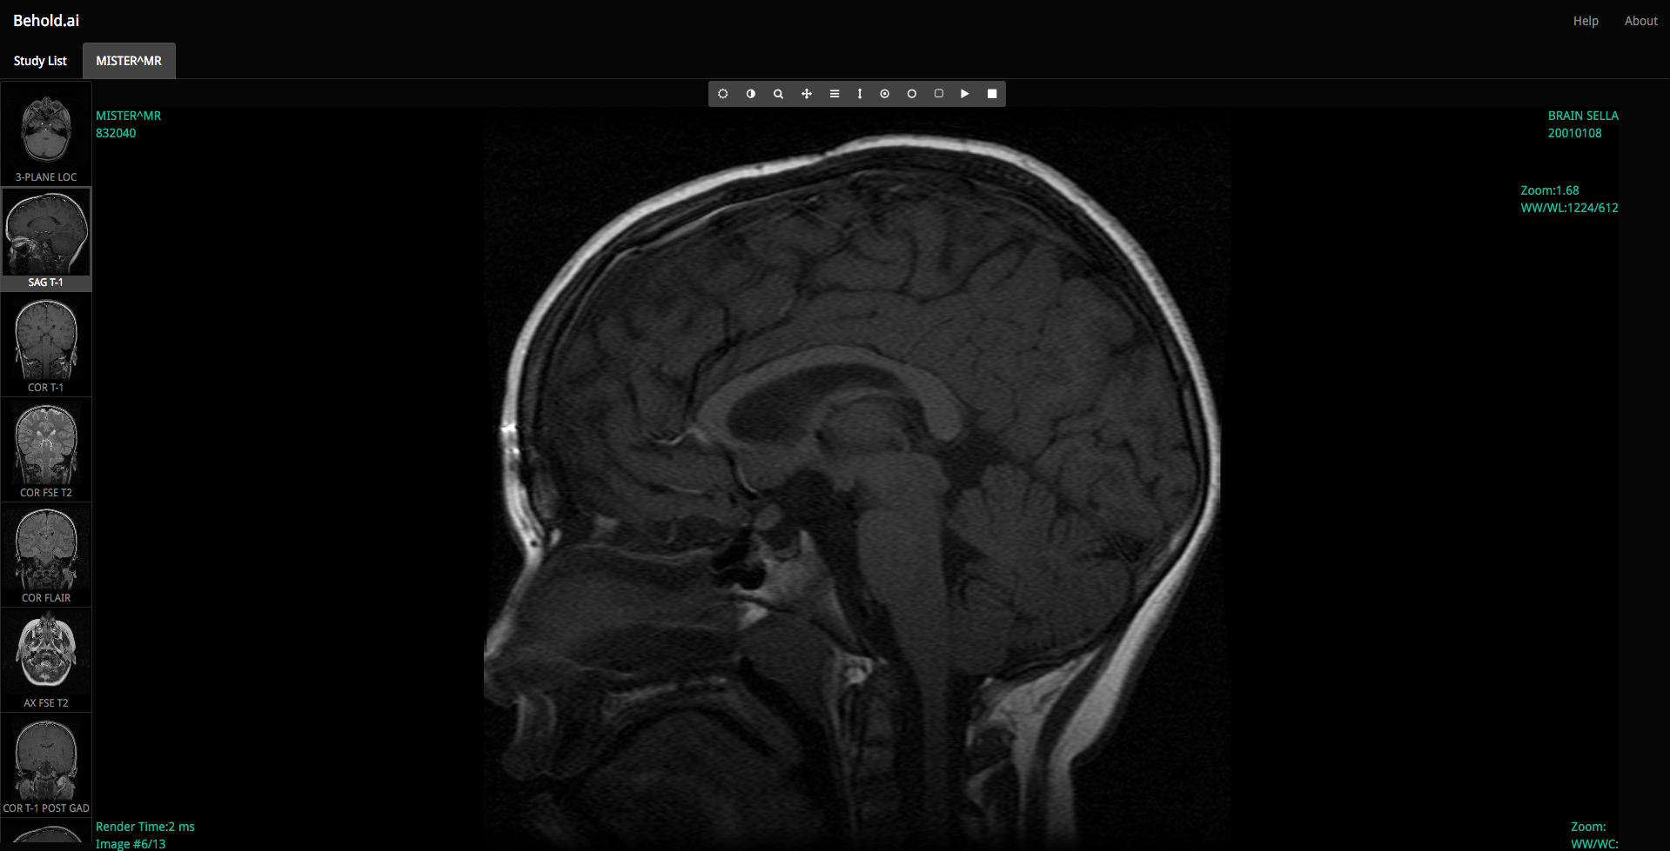
Neural network winning “intuition” games
Self driving cars
At some tasks NN outperforms humans
A lot of applications on your phone already have them

Slide 4
This talk
Give the quick and general idea how neural networks work
Go through examples of how to construct and use neural networks
Give modern techniques which you can use
Review some approaches to our common problems (PID., pattern matching., etc.)
This talk is about neural networks only

Slide 5
Skepticism and Concerns

Slide 6
Skepticism 1
Neural networks are known for decades, but where are the results?

Slide 7
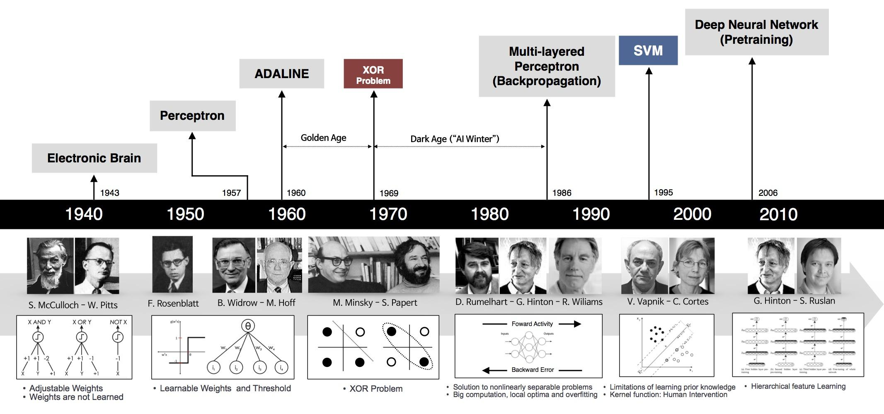
History and background
1940
1950
1960
1970
1980
1990
2000
2010
cybernetics
connectionism + neural networks
deep learning
Citations count
Year
Andrew L. Beam Deep Learning 101 - Part 1: History and Background

Slide 8
Deep neural networks vs machine learning
Large NN
In our field of physics
We have large ammounts of data
So we should use Large NN
To get the best performance
WE SHOULD USE
Medium size NN
performance
Small size NN
Machine learning
WE ARE HERE
training data size
Why does deep and cheap learning work so well?

Slide 9
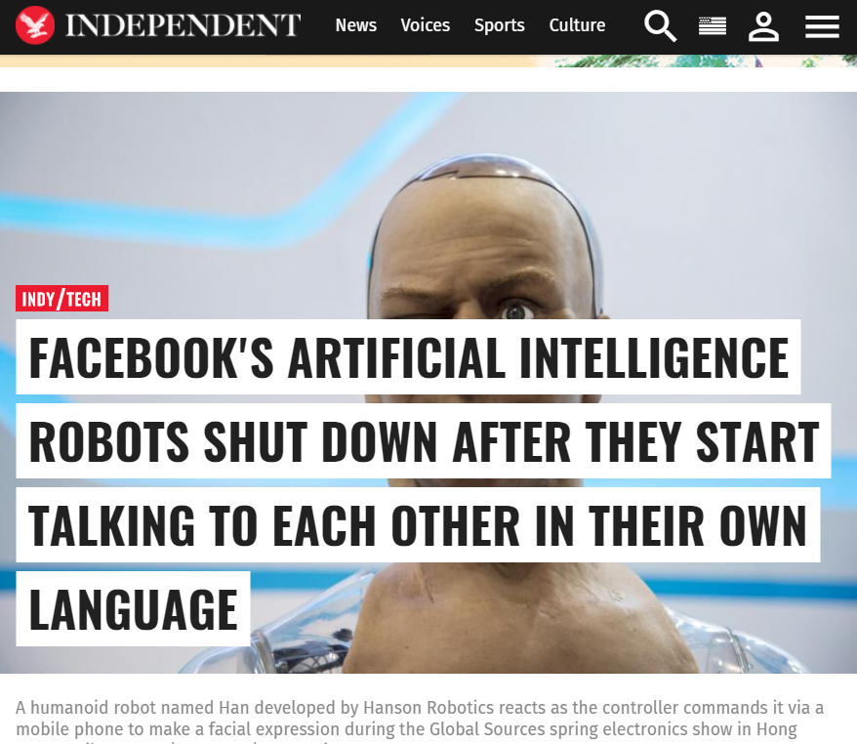
Deep learning can solve any problem! How is that possible?!! You have a problem, deep learning solves it!

Slide 10
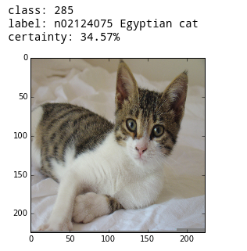
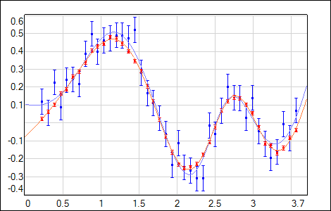
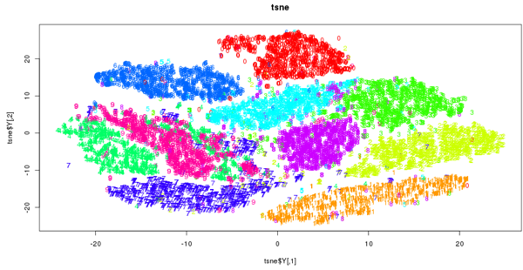
DNN are good at
Regression
Classification
Clustering

Slide 11
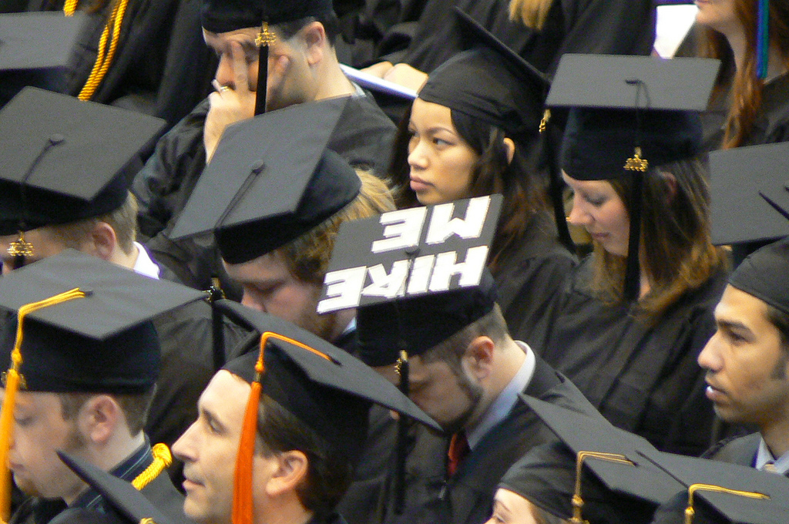
Skepticism 2
Neural networks are black boxes
…and nobody knows that they really think about us…

Slide 12
Demystihying
There are techniques to evaluate NN performance
Application of neural networks are much better understood now
It worth a separate talk!
Results require thorough check with or without NN
Most of the validation methods work on neural network too
Results reproducibility is a problem in modern science (There are academic courses., projects or just wiki articles about it)

Slide 13
Tensorflow and other frameworks
Tensorflow (Google)
Python, C++, C
MS Cognitive framework
mxnet
Comparison of deep learning software (Wikipedia)
Tensoflow vs mxnet vs others (presentation)

Slide 14
Higher level frameworks
tflearn, TensorFlow-Slim, tf.contrib.learn
eras
MXNet, Deeplearning4j, Tensorflow, CNTK or Theano

Slide 15
Sample problem. Setup
Drift chambers with 8 layers
Separate pairs of π⁺π⁻ from μ⁻μ⁺
μ⁻
μ⁺
Event data
4 2 2 2 3 2 1 0

Slide 16
Sample events
pi
mu
1
2
3
4
5
6
7
8
9
0
11
12
1 1 0 1 0 0 0 0 1 1 0 0 0 0 0 0 0 0 0 0 0 0 0 0 2 0 0 0 0 0 0 0 0 2 0 0 0 0 0 0 1 0 0 0 0 0 0 0 5 3 1 0 0 0 0 0 1 0 0 0 0 0 0 0 0 2 0 0 0 0 0 0 4 2 1 1 1 1 0 0 1 5 0 3 0 0 0 0 2 0 0 4 0 1 0 0
2 2 3 2 2 2 2 2 1 1 1 1 1 1 1 1 4 2 2 2 3 3 1 1 2 2 2 2 2 2 2 2 2 1 1 1 1 5 1 1 2 1 1 1 1 1 1 2 2 6 2 1 1 1 1 1 2 2 2 2 2 2 3 2 2 2 2 2 2 2 2 2 1 1 1 1 1 1 1 2 2 2 2 2 3 2 2 2 2 2 2 2 2 3 3 3

Slide 17
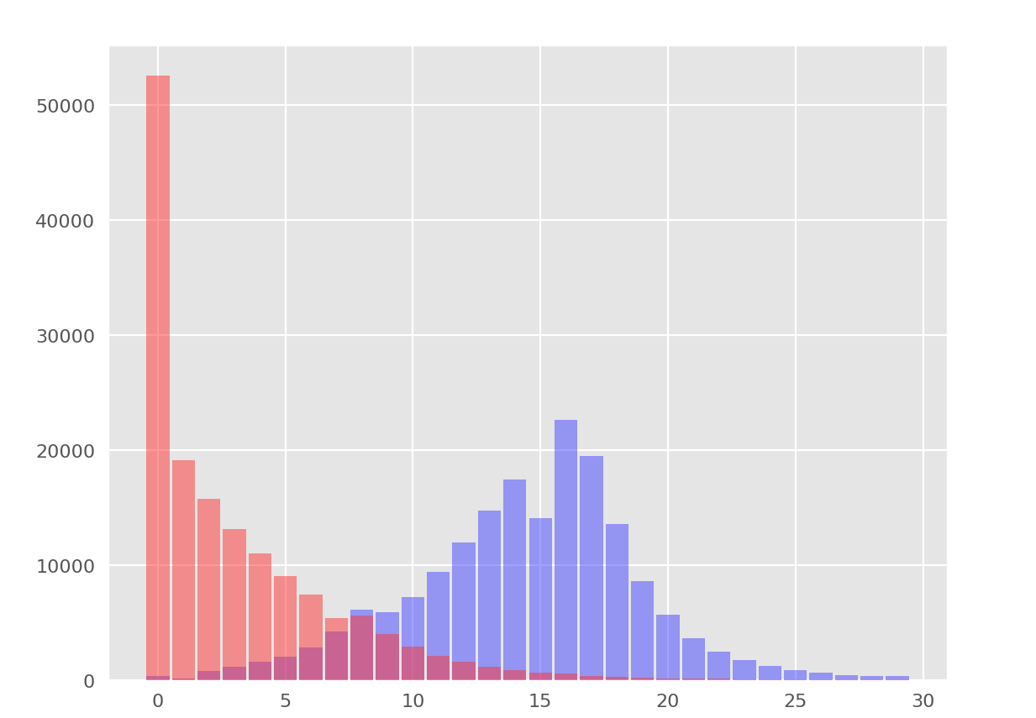
Cut separation
pi
mu

Slide 18
To solve this problem we will use…
Supervised learning
Small Feed forward neural network
Tensorflow

Slide 19
Supervised learning
Put sample data & evaluate the result
Calculate distance (error) of calculated and the real answer
Adjust network to minimize the error
Repeat

Slide 20
Feed forward neural networks
Hidden layer/s
Input layer
Output layer

Slide 21
Feed forward neural networks

Slide 22
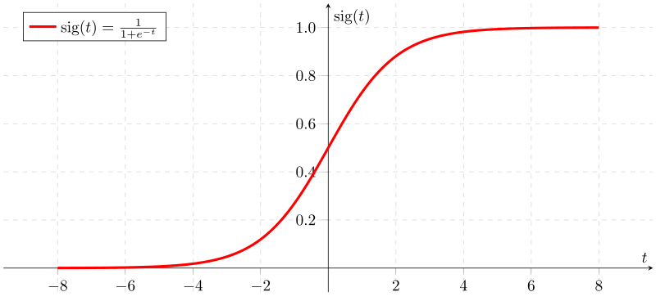
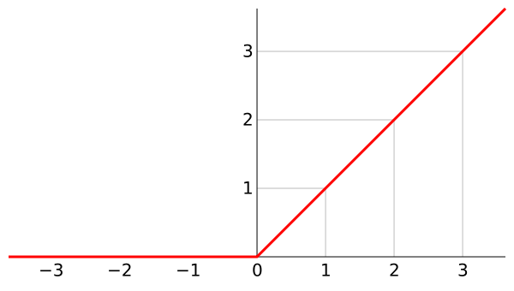
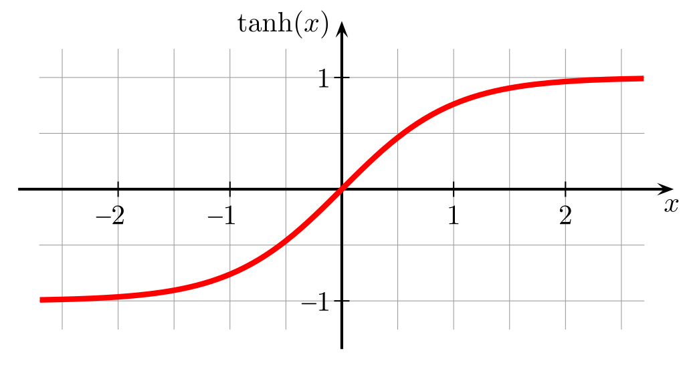
Feed forward neural networks
$$L=\sum_{i=0}^{n}{x_{i}∙{\text{ω}}_{i}+b}$$
$$L=\sum_{i=0}^{n}{x_{i}∙{\text{ω}}_{i}}$$
x₁
$$f(L)$$
Neuron:
Sums inputs multiplied by weights
Adds bias Put it through some
function
ω₁
x₁ ω₁
$$f(L)$$
$$L$$
x₂
$$f(L)$$
x₂ ω₂
ω₂
ω₃
x₃ω₃
x₃
x₄ ω₄
$$L$$
ω₁
$$f(L)$$
b
$$L$$
x₄
This Photo by Unknown Author is licensed under CC BY-SA

Slide 23
Feed forward neural networks
Input layer
Output layer

Slide 24
Feed forward neural networks
Input layer
Output layer

Slide 25
Feed forward neural networks

Slide 26
Feed forward neural networks

Slide 27
Supervised learning
Put sample data & evaluate the result
Calculate distance (error) of calculated and the real answer
Adjust network to minimize the error
Repeat

Slide 28
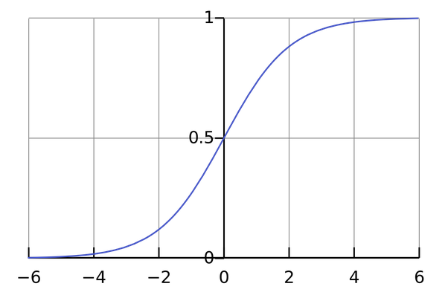
0 1 1 0 1 0 0 0 0 pi
1 1 1 1 1 1 1 1 1 mu
2 2 2 2 2 2 2 2 2 mu 3 0 0 0 0 0 0 0 0 pi
4 4 2 2 2 3 3 1 1 mu 5 5 3 1 0 0 0 0 0 pi …
1
1
0
1
0
0
0
0
0.99
0.03
softmax(L) = $\frac{e^{L}}{\left\|e^{L}\right\|}$
W_{0,0} W_{0,1}
W_{1,0} W_{1,1}
W_{2,0} W_{2,1}
W_{3,0} W_{3,1}
W_{4,0} W_{4,1}
W_{5,0} W_{5,1}
W_{6,0} W_{6,1}
W_{7,0} W_{7,1}
$$f(L)$$
pi
mu
b₀ b₁
$$L$$

Slide 29
Forward propagation
X
W
0 1 1 0 1 0 0 0 0 pi
1 1 1 1 1 1 1 1 1 mu
2 2 2 2 2 2 2 2 2 mu 3 0 0 0 0 0 0 0 0 pi
4 4 2 2 2 3 3 1 1 mu 5 5 3 1 0 0 0 0 0 pi … 99 1 1 0 0 0 0 0 0 pi
W_{0,0} W_{0,1}
W_{1,0} W_{1,1}
W_{2,0} W_{2,1}
W_{3,0} W_{3,1}
W_{4,0} W_{4,1}
W_{5,0} W_{5,1}
W_{6,0} W_{6,1}
W_{7,0} W_{7,1}
L_{0,0} L_{0,1}
L_{1,0} L_{1,1}
L_{2,0} L_{2,1}
L_{3,0} L_{3,1}
L_{4,0} L_{4,1}
L_{5,0} L_{5,1}
. . .
L_{99,0} L_{99,1}
1 1 0 1 0 0 0 0
1 1 1 1 1 1 1 1
2 2 2 2 2 2 2 2 0 0 0 0 0 0 0 0
4 2 2 2 3 3 1 1 5 3 1 0 0 0 0 0 . . . 1 1 0 0 0 0 0 0
b₀ b₁
.
=
= XW
+ b = L
Y = tf.softmax(tf.matmul(X, W) + b)
the output of the network

Slide 30
Supervised learning
Put sample data & evaluate the result
Calculate distance (error) of calculated and the real answer
Adjust network to minimize the error
Repeat

Slide 31
Error estimation
pi
mu
0
1
Real answer
$$−\sum{Y_{i}^{′}log({Y_{i})} }$$
Cross entropy
pi
mu
0.03
0.99
Computed score
cross_entropy = -tf.reduce_mean(Y_ * tf.log(Y))

Slide 32
Supervised learning
Put sample data & evaluate the result
Calculate distance (error) of calculated and the real answer
Adjust network to minimize the error
Repeat

Slide 33
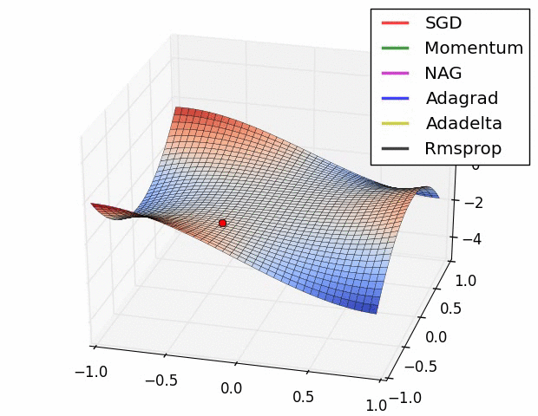
Back propagation and gradient descent
Backpropagation is a method used in artificial neural networks to calculate the error contribution of each neuron after a batch of data is processed
train_step = tf.train.GradientDescentOptimizer(0.001).minimize(cross_entropy)

Slide 34
Tensorflow lines of code
X = tf.placeholder(tf.float32, [None, 8]) Y_ = tf.placeholder(tf.float32, [None, 2]) W = tf.Variable(tf.zeros([8, 2])) # weights W[8, 2] b = tf.Variable(tf.zeros([2])) # biases b[2] Y = tf.nn.softmax(tf.matmul(X, W) + b) cross_entropy = -tf.reduce_mean(Y_ * tf.log(Y)) * 200.0 # normalized for batches of 100 images, # *2 because "mean" included an unwanted
# division by 2 train_step = tf.train.GradientDescentOptimizer(0.001).minimize(cross_entropy)

Slide 35
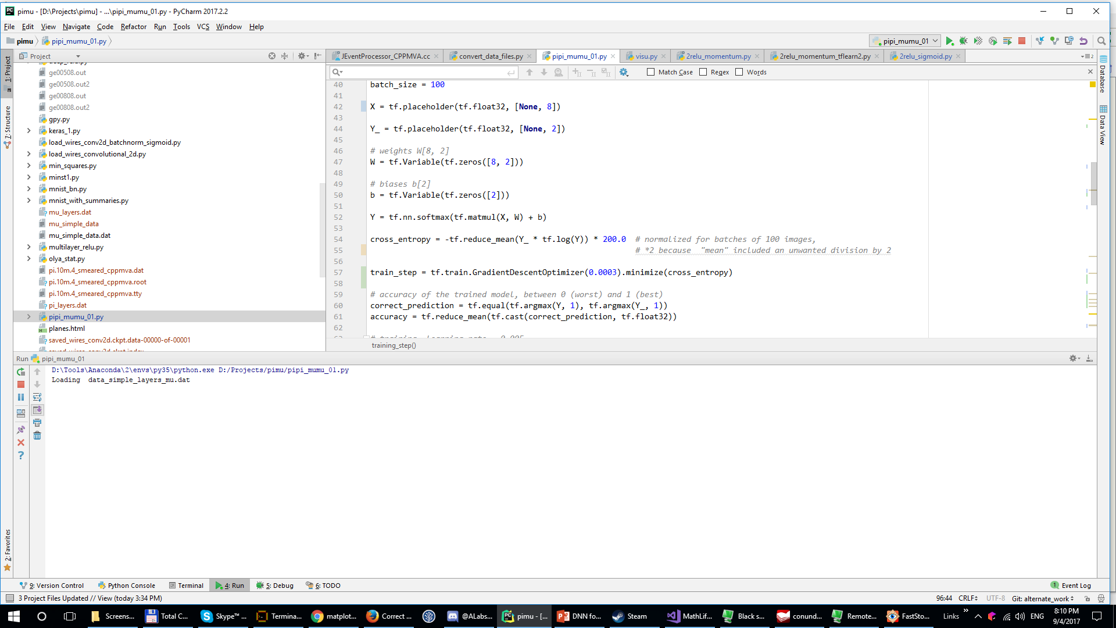
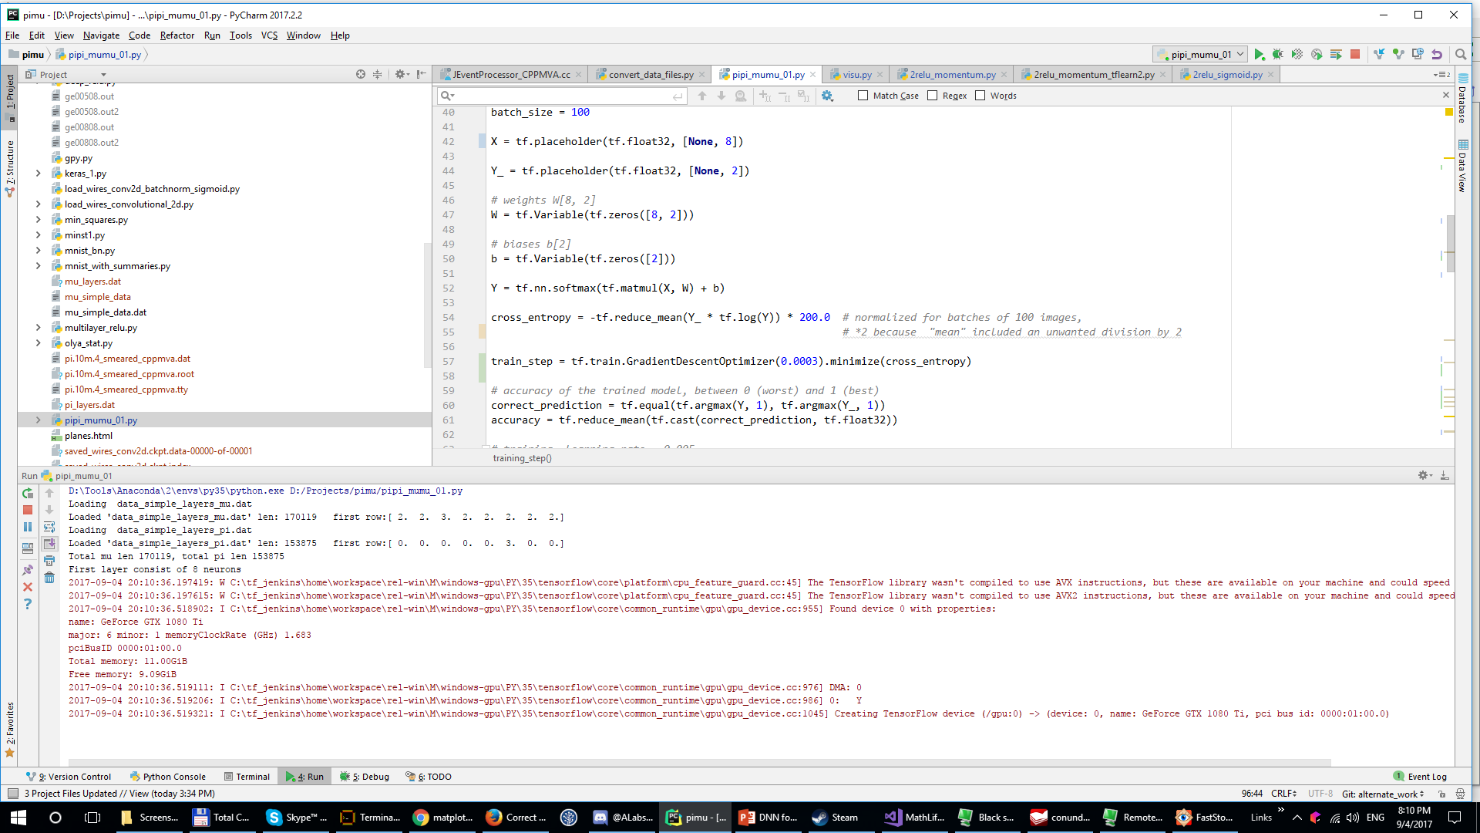
Start training

Slide 36
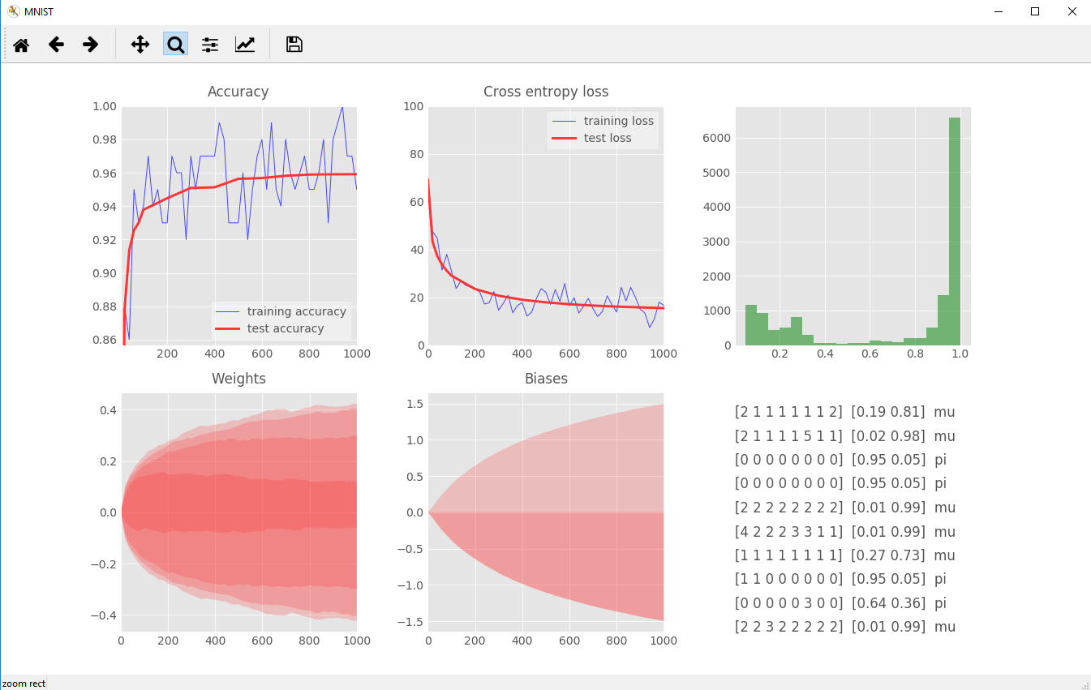
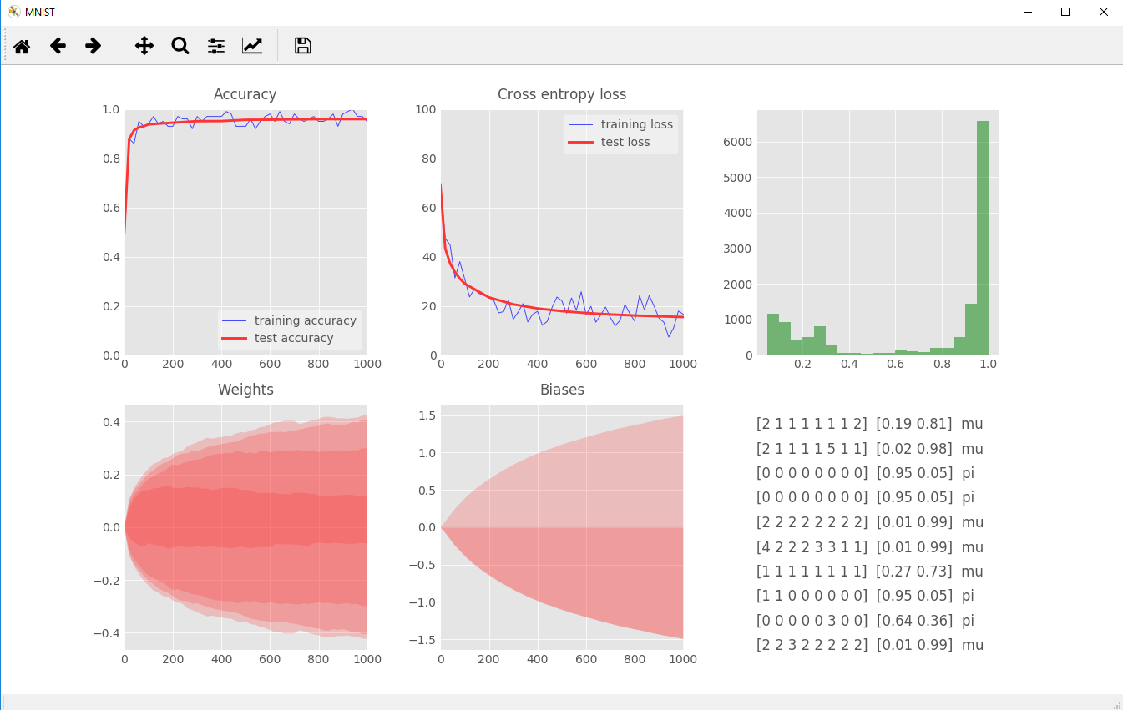
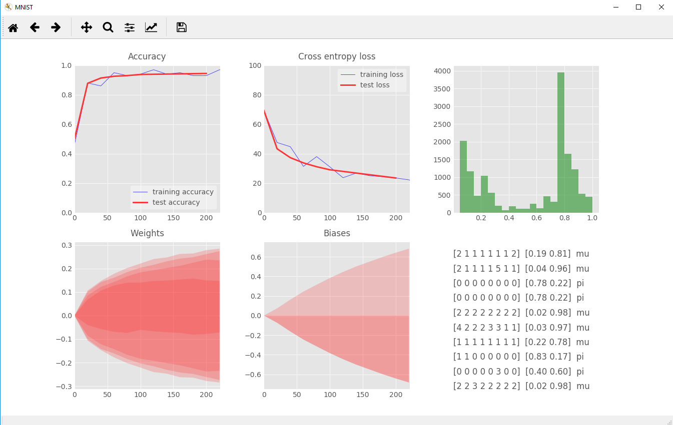
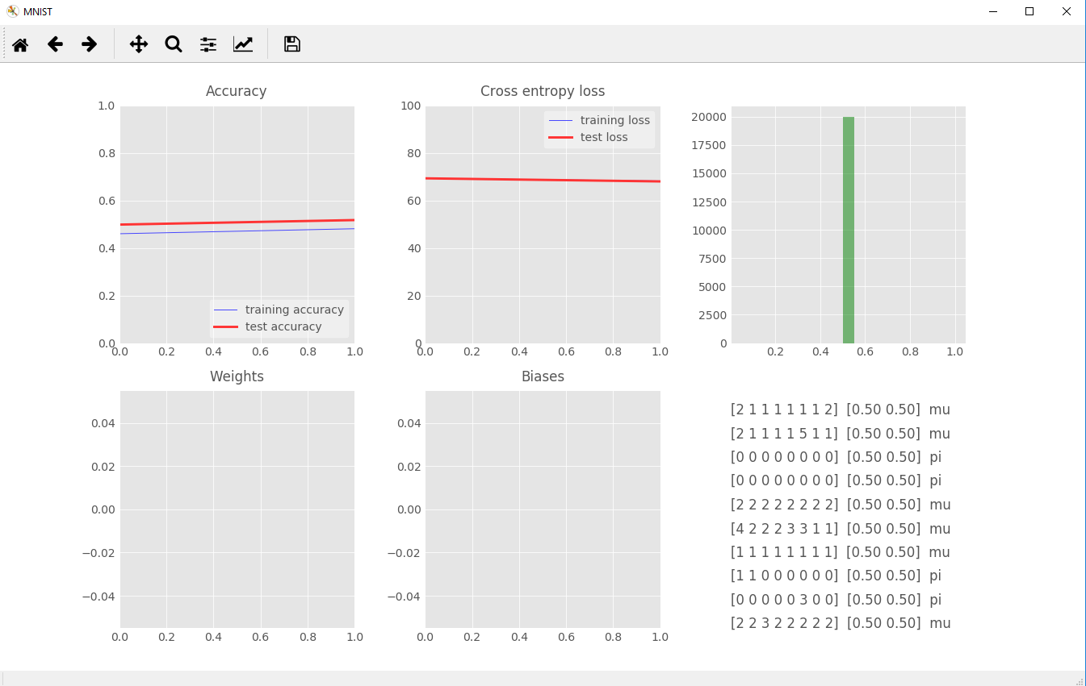
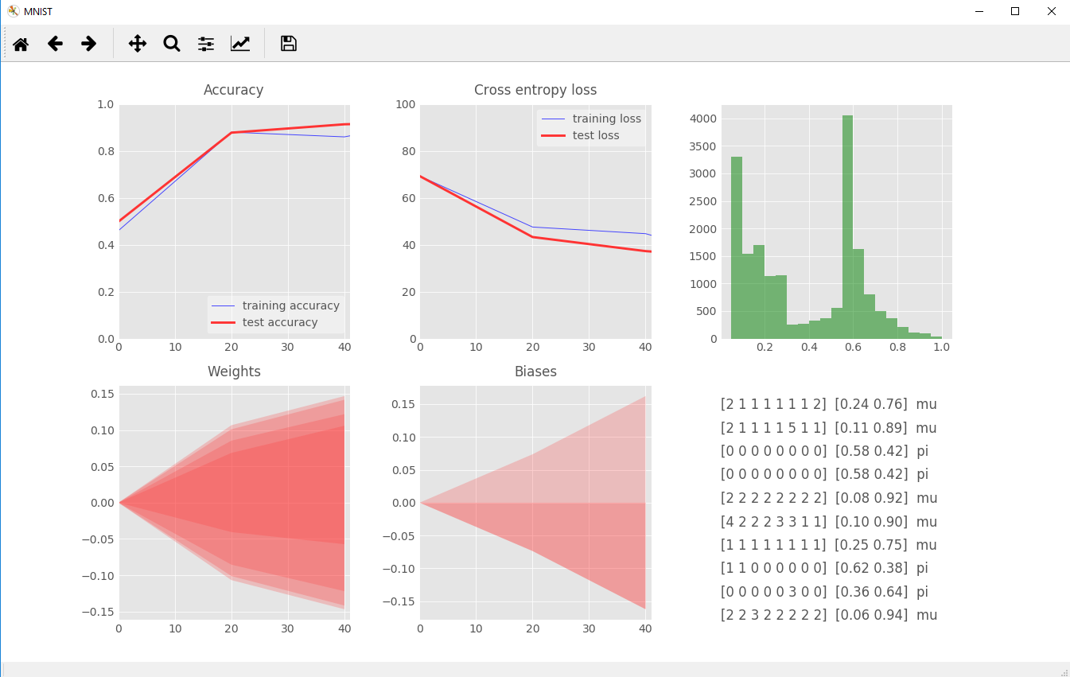
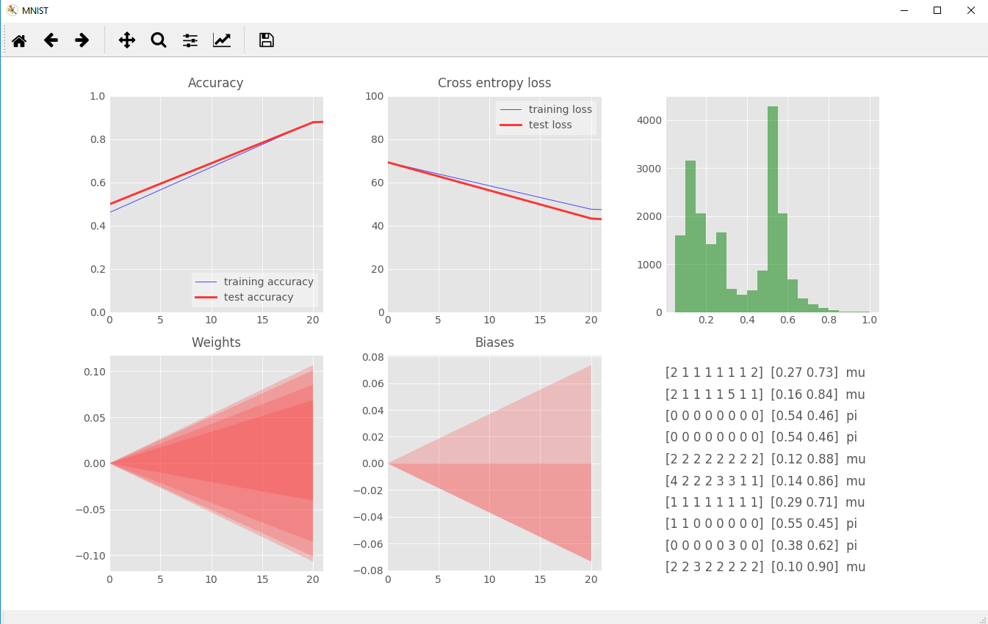
Training

Slide 37
How to improve the results?
Add more layers

Slide 38
Feed forward neural networks

Slide 39
Or even more layers

Slide 40
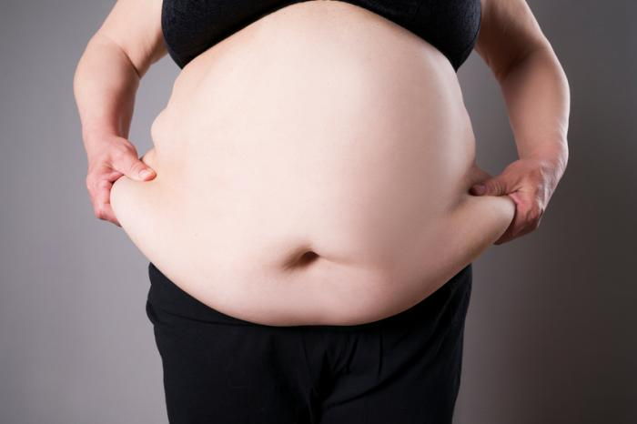
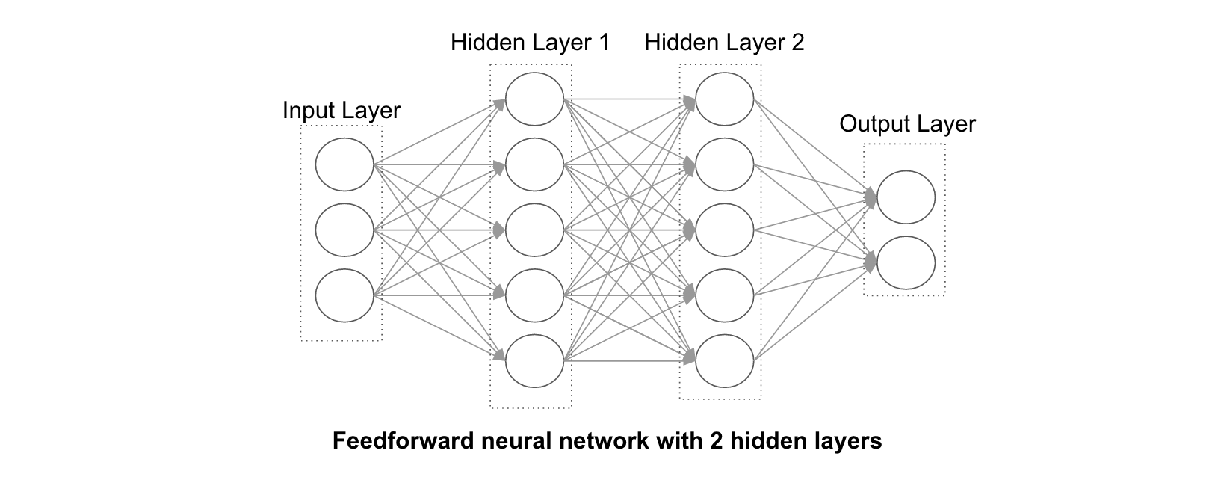
Why “deep”?
NO NEED TO GO WIDER

Slide 41
Adding inner layers
$$f(L)$$
Rectified linear unit (ReLU)
$$L$$
$$f\left(L\right)=\left\{\begin{aligned} 0, L<0 \\ & L, L≥0\end{aligned}\right.$$
Y1 = tf.nn.relu(tf.matmul(X, W1) + B1)

Slide 42
Tensorflow code for more neurons

Slide 43
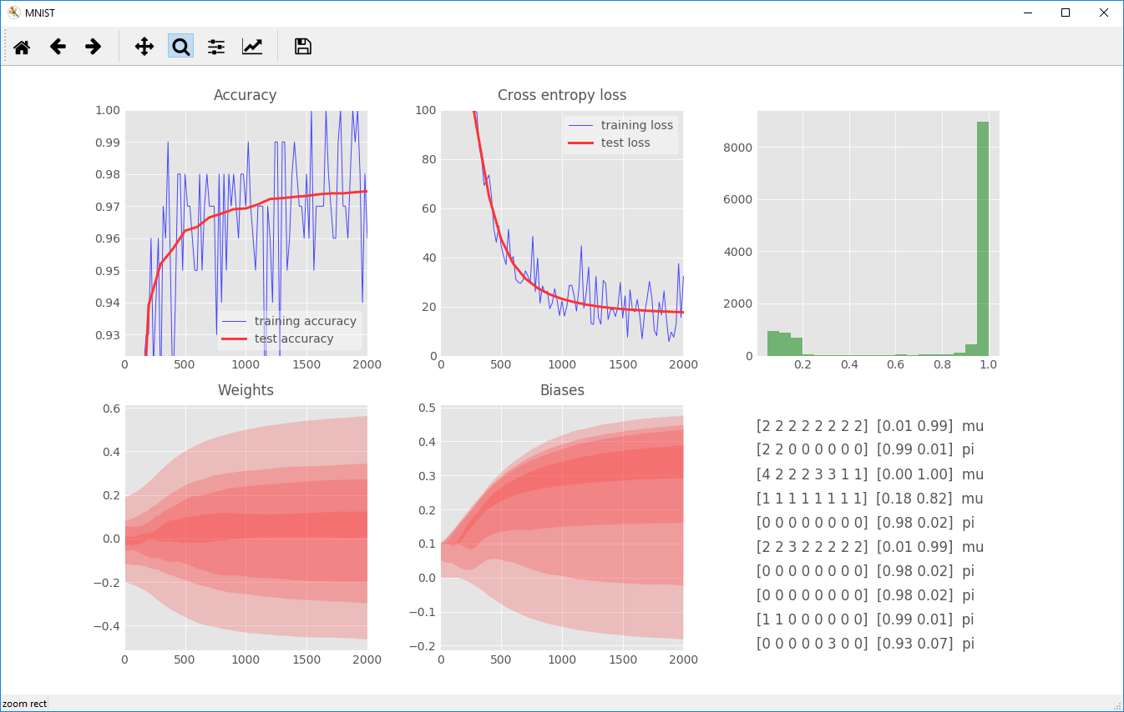
Running the new network
Accuracy converge to 97.5% (+1.5%)

Slide 44
How to improve the results more?
Instead of hits per layer, directly use deposits in wires of the dirft chamber
The DC has ~1120 wires
Build a bigger neural network

Slide 45
Larger and deeper neural network
1120 inputs
800 neurons
200 neurons
50 neurons
pi
mu
Will not bring much better results
because doesn’t hold geometric relations between the wires

Slide 46
Sample task conclusion
Even simplest neural network may separate π⁺π⁻ from μ⁻μ⁺ with 96% accuracy
Larger networks can do it with about 98% efficiency
The best result could be achieved with convolutional neural networks

Slide 47
Feed forward network results
Performance of the CDF neural network electron isolation trigger Nucl.Instrum.Meth. A356 (1995) 485-492 The neural network chip used to perform the isolation calculation exhibited no problems with reliability or stability during 8 months of running.
Neural networks technique based signal-from-background separation and design optimization for a W/quartz fiber calorimeter (2003) Neural network methods performs better
C. Adler, et al., ALICE Collaboration, Electyron/pion identification with ALICE TRD prototypes using a neural network algotithm Nuclear Instruments and Methods in Physics Research Section A 552 (2005) 364

Slide 48
ALICE TRD. NN compared to LQX

Slide 49
Resources and links
Tensorflow and deep learning - without a PhD by Martin Görner
Hvass-Labs in Jupiter notebook
http://www.deeplearningbook.org/

Slide 50
Brief review of other network types Their application in nuclear and HEP physics

Slide 51
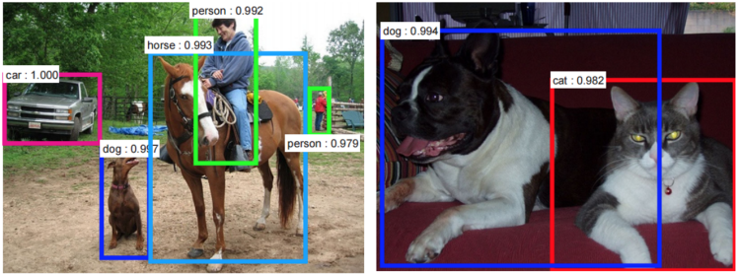
Convolutional neural networks
Use CNN if geometrical relationships matter

Slide 52
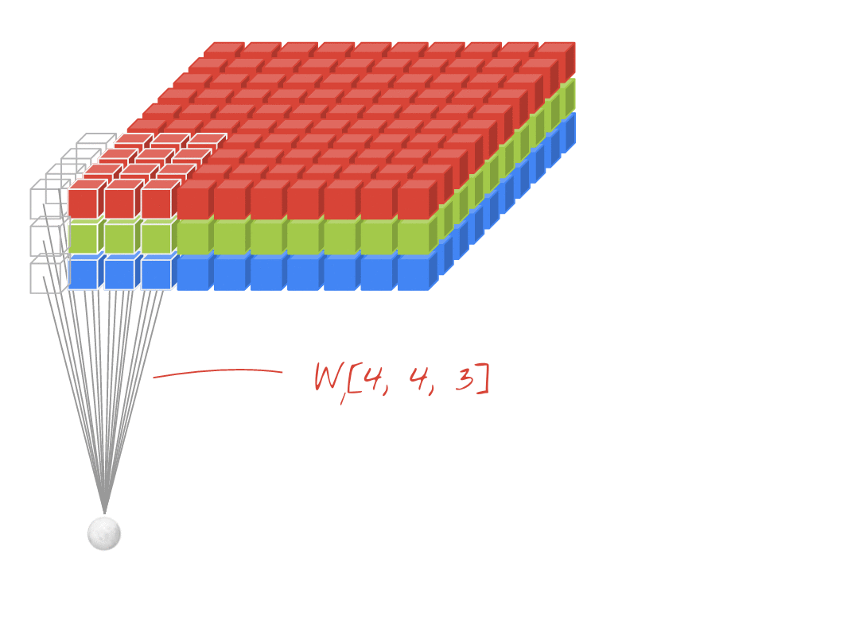
Convolutional neural networks (CNN)

Slide 53
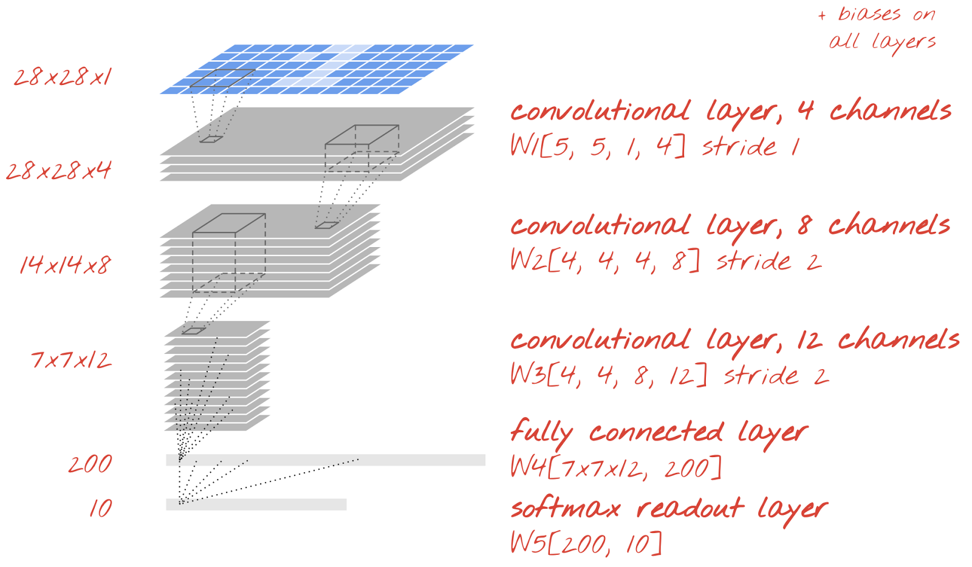
Example of convolutional architecture

Slide 54
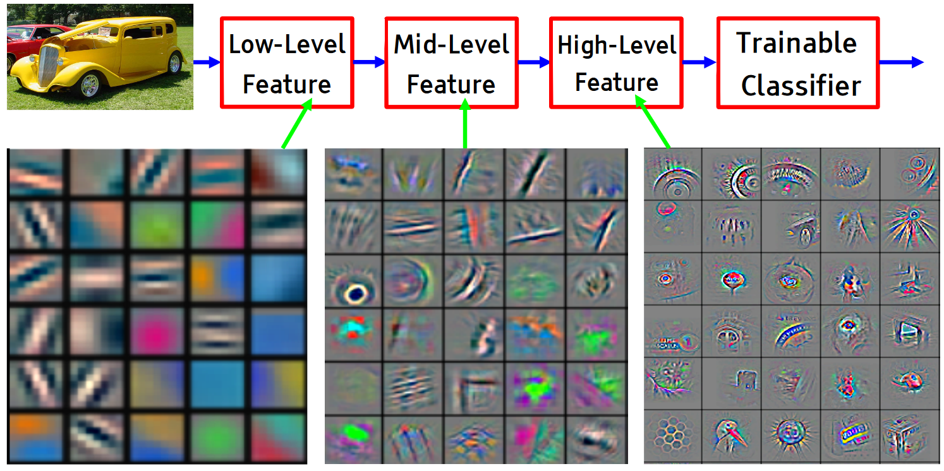
Intuition behind CNN
Nips 2015 tutorial

Slide 55
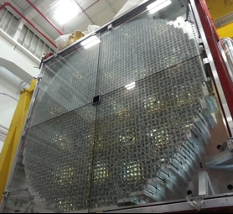
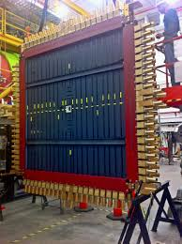
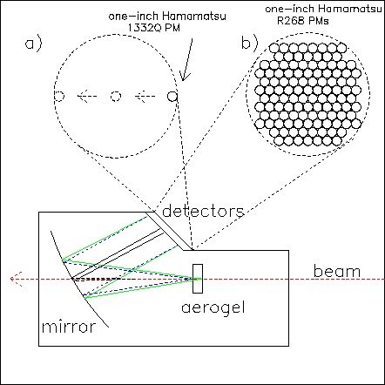
Applications

Slide 56
CNN for calorimetry
Deep learning in color: towards automated quark/gluon jet discrimination (Feb 2017)
- Center for Theoretical Physics, Massachusetts Institute of Technology, Cambridge, MA 02139, USA
- Department of Physics, Harvard University, Cambridge, MA 02138, USA
Our approach builds upon the paradigm that a jet can be treated as an image, with intensity given by the local calorimeter deposits. We supplement this construction by adding color to the images, with red, green and blue intensities given by the transverse momentum in charged particles, transverse momentum in neutral particles, and pixel-level charged particle counts.

Slide 57
Jet discrimination

Slide 58
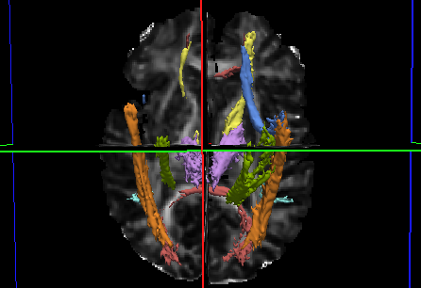
CNN for time-spatial recognition
3D and even 4D convolutional neural networks allow one
to get the best performance on volumetric (or even space-time) data.

Slide 59
Neutrino Event Classifier
A Convolutional Neural Network Neutrino Event Classifier (Aug 2016) Fermilab
This algorithm, CVN (Convolutional Visual Network) identifies neutrino interactions based on
their topology without the need for detailed reconstruction and outperforms
algorithms currently in use by the NOvA collaboration.

Slide 60
CNN neutrino event recognition

Slide 61
How hard is to try to use them?
Using higher level libraries like Keras or Tflearn makes creating neural networks is easy

Slide 62
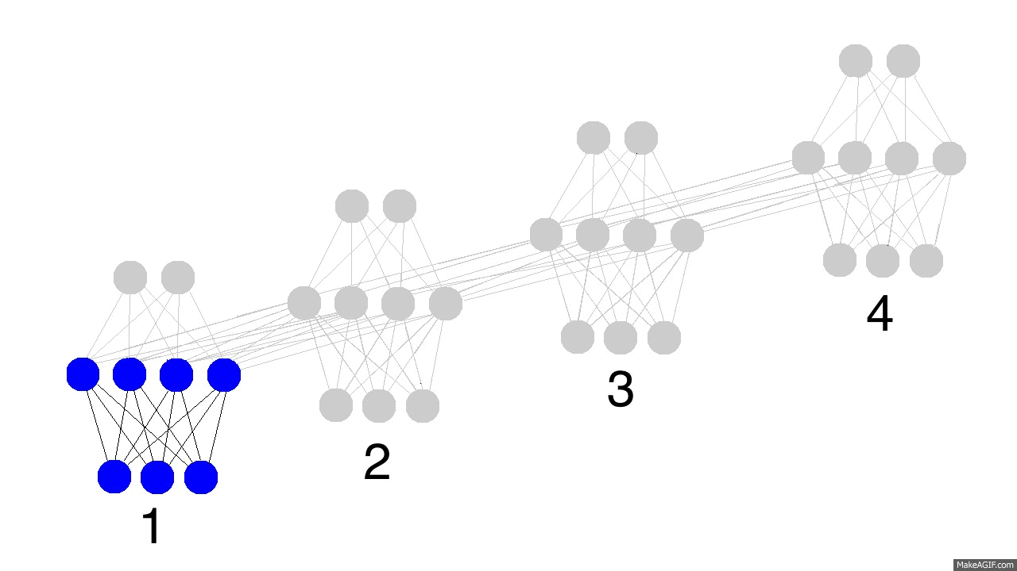
Recurrent Neural Networks (RNN) and Long Short-Term Memory (LSTM)
Inputs
Recurrent part
Use RNN if context matters

Slide 63
RNN use cases
Language modeling (The tensorflow tutorial on PTB is a good place to start Recurrent Neural Networks) character and word level LSTM’s are used
Machine Translation also known as sequence to sequence learning (https://arxiv.org/pdf/1409.3215.pdf)
Image captioning (with and without attention, https://arxiv.org/pdf/1411.4555v...)
Hand writing generation (http://arxiv.org/pdf/1308.0850v5...)
Image generation using attention models (https://arxiv.org/pdf/1502.04623...)
Question answering (http://www.aclweb.org/anthology/...)
Video to text (https://arxiv.org/pdf/1505.00487...)

Slide 64
Example of RNN usage
QCD-Aware Recursive Neural Networks for Jet Physics (2 Feb 2017)
Comparison between Jet finding and natural language processing
Proof of concept
…like a sentence is composed of words following a syntactic structure organized as a parse tree, a jet is also composed of 4-momenta following a structure dictated by QCD and organized via the clustering history of a sequential recombination jet algorithm.
In conclusion, we feel confident that there is great potential in hybrid techniques like this that incorporate physics knowledge and leverage the power of machine learning

Slide 65
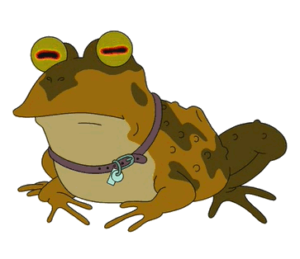
Conclusions
We now at the 3d wave of AI enthusiasm. Deep learning is booming!
Excellent new tools available
No deep knowledge of machine learning is needed to start
So… everyone should love hypnotoad it is a good time to start with neural networks

Slide 66
Thank you!
Feedback and future talks? romanov@jlab.org

Slide 67
Backup slides

Slide 68
Training data in batches
Training sample by sample – online training
Training N samples at a time – batch training
Test set
15%
15%
70%
Best error 1% (human error)
Training error 5%
Validation error 6%
Dev set
Training set

Slide 69
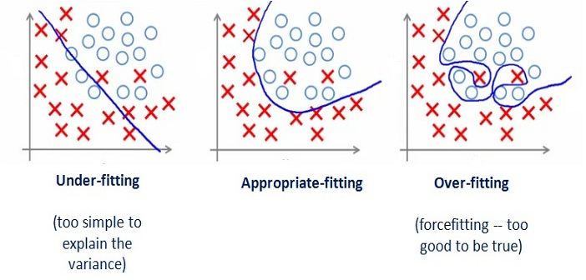
Overfitting

Slide 70
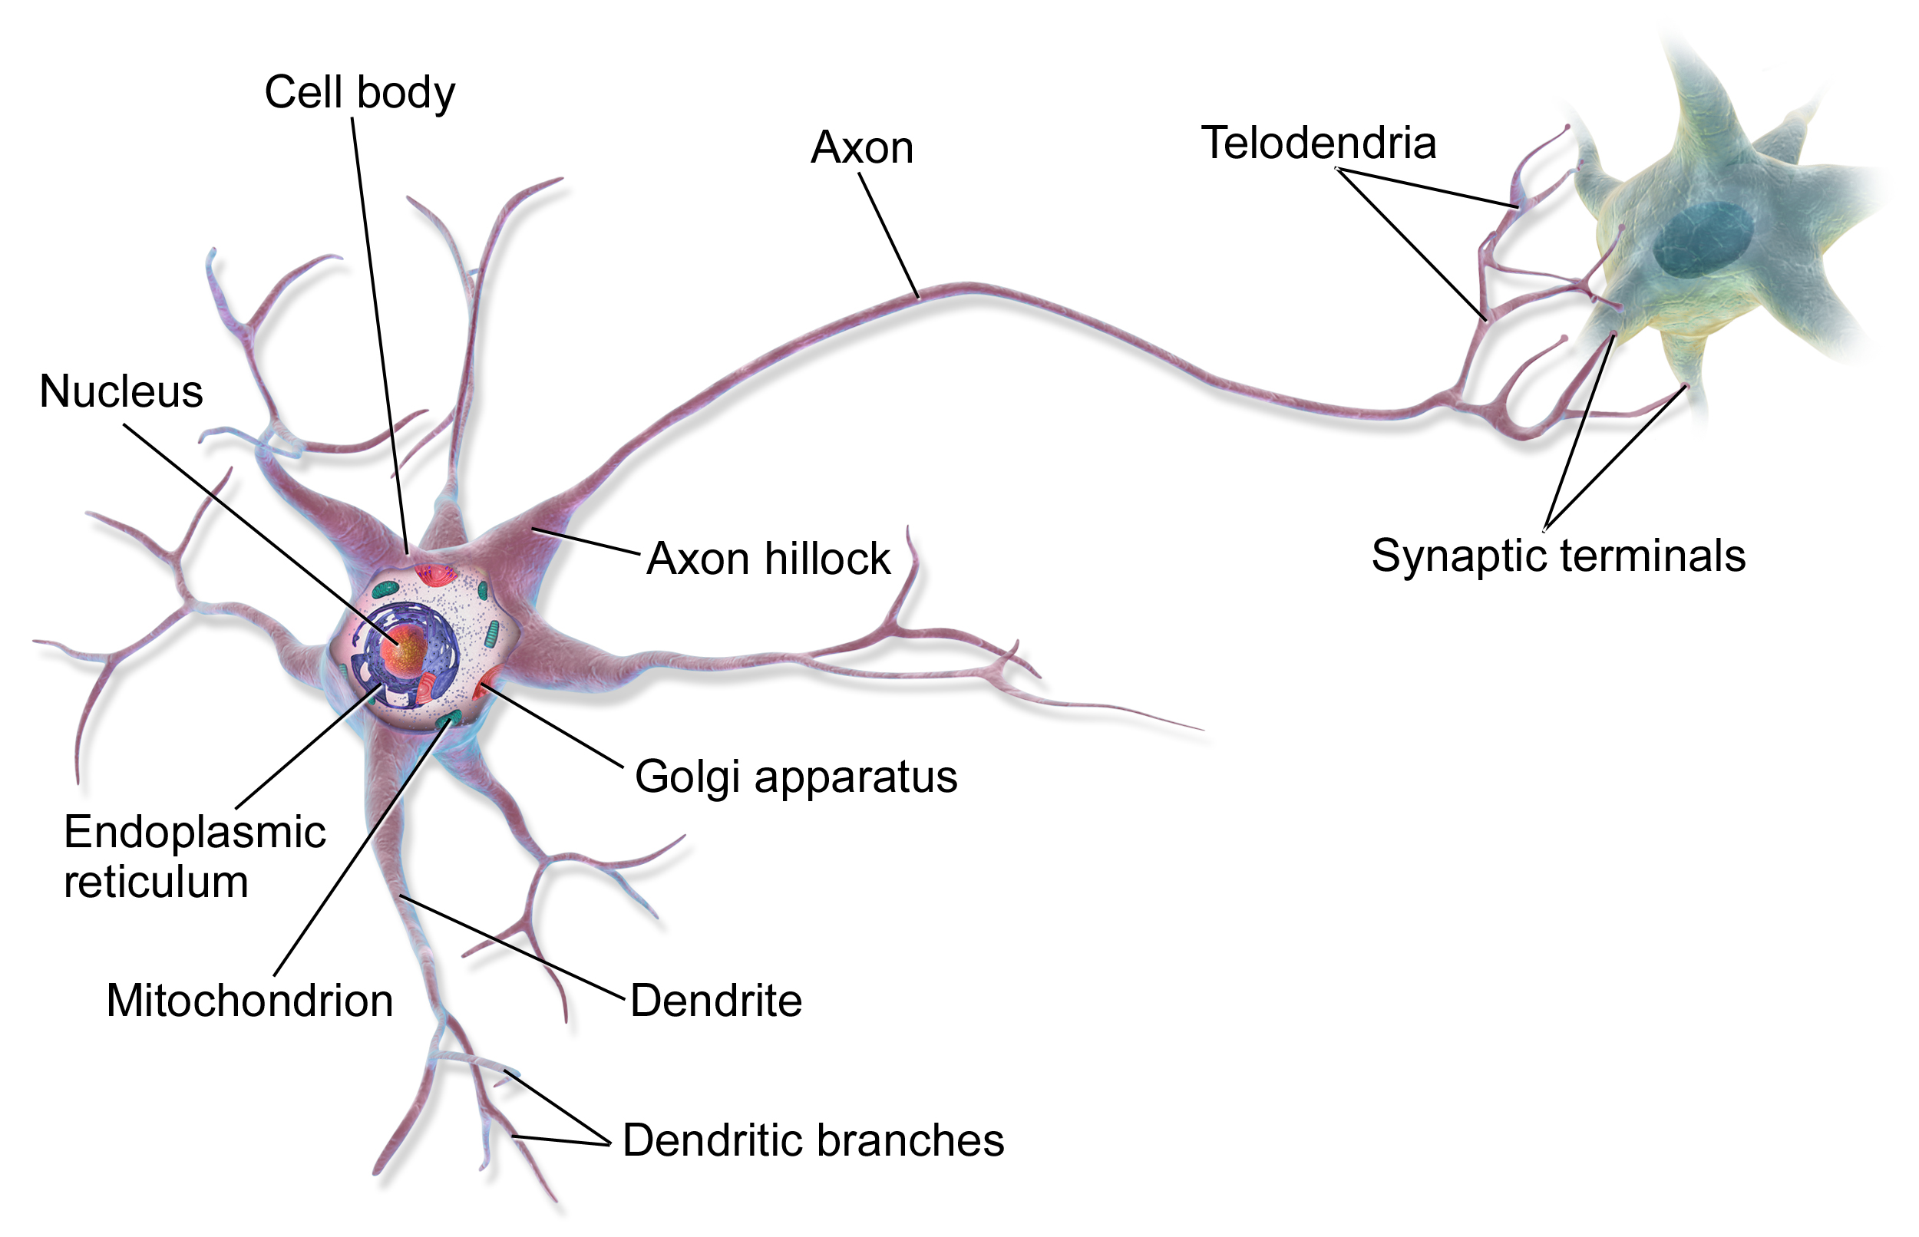
A neuron
J Neuroendocrinol. 2017 Jun;29(6). doi: 10.1111/jne.12480.
Evidence of involvement of neurone-glia/neurone-neurone communications
via gap junctions in synchronised activity of KNDy neurones.
computational neuroscience

Slide 71
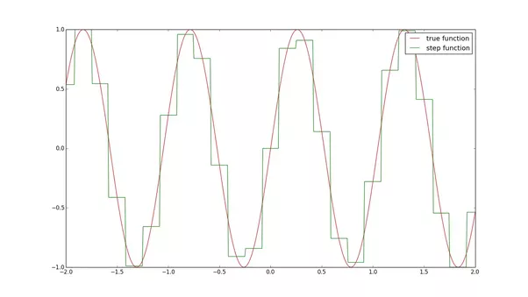
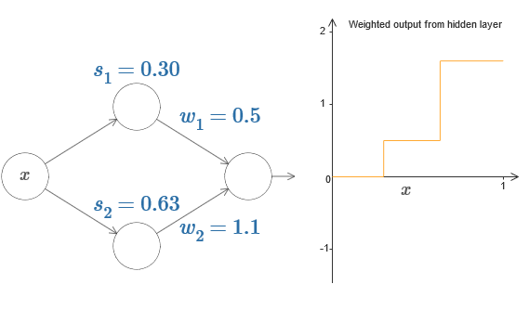
Universal approximation theorem
A feed-forward network with a single hidden layer containing a finite number of neurons can approximate continuous functions on compact subsets of Rn
Theorem says that any measurable function f on Rd can be approximated by step functions
http://neuralnetworksanddeeplearning.com/chap4.html

Slide 72
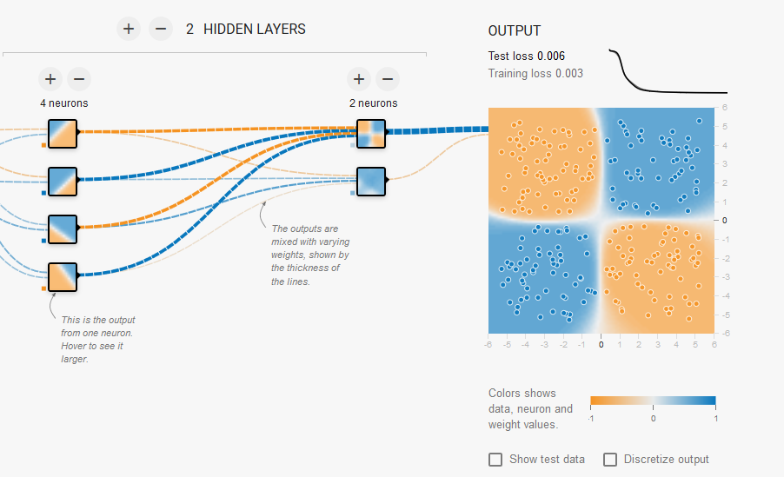
Google tensorflow playground

Slide 73
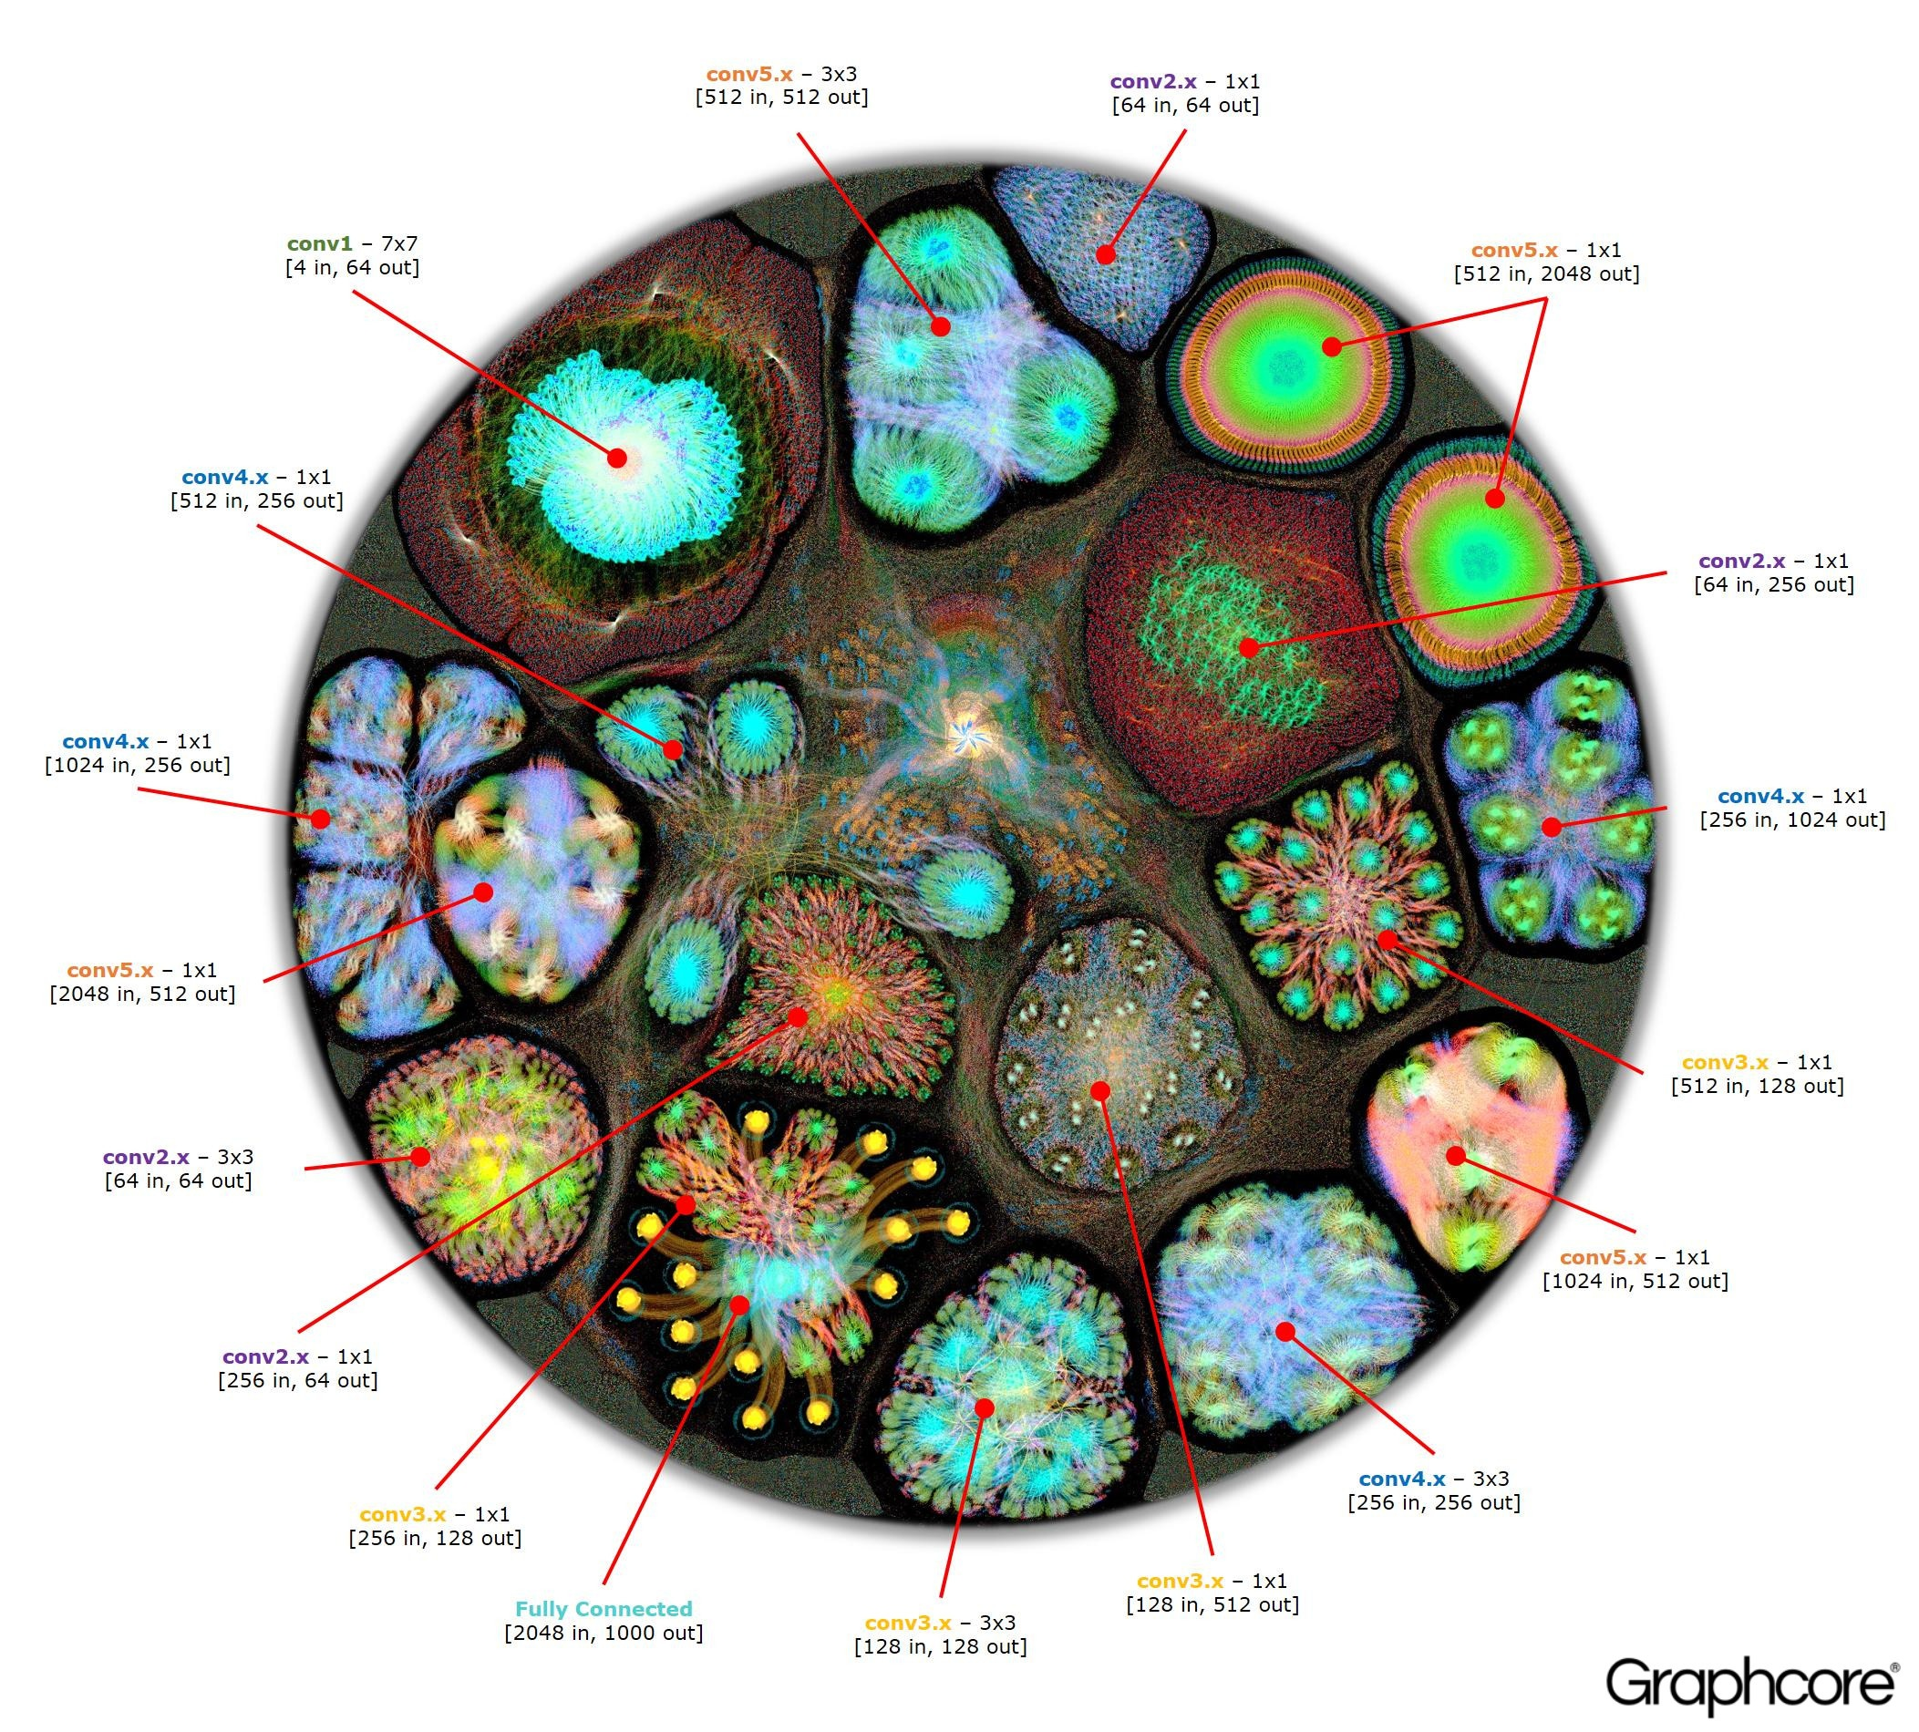
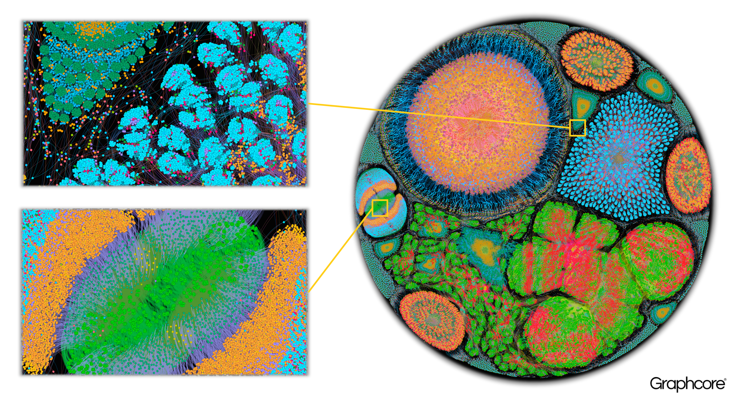
What does deep neural network look like?
what-does-machine-learning-look-like

Slide 74
Reproducible research problem
In 2016., Nature conducted a survey of 1.,576 researchers who took a brief online questionnaire on reproducibility in research. According to the survey., more than 70% of researchers have tried and failed to reproduce another scientist's experiments., and more than half have failed to reproduce their own experiments. "Although 52% of those surveyed agree there is a significant 'crisis' of reproducibility., less than 31% think failure to reproduce published results means the result is probably wrong., and most say they still trust the published literature."^{[24]}

Slide 75
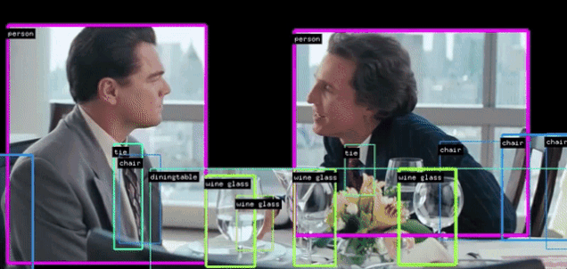
Real time DNN
YOLO:

