Slide 1
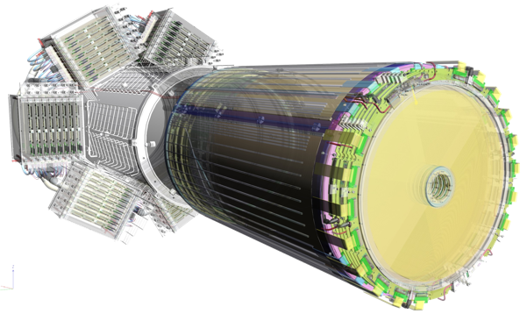
Micromegas Vertex Tracker Status Report
Latest news about the MVT, FMT and the associated electronics

Slide 2
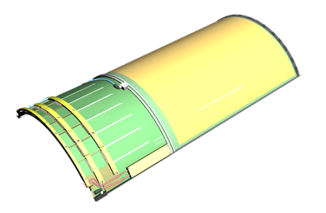
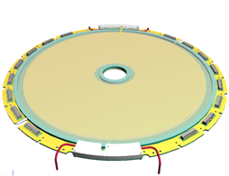
The CLAS12 MVT Project : Barrel and Forward
The CLAS12 MVT Project
Setup
18 Barrel Tiles
Total of 6 layers segmented in φ (3 x 120° sectors)
Total of 18000 channels
Resistive strips
Two phases: 2 Layers (6 det.) then 6 Layers (18 det.)
6 Forward Disks
Resistive strips divided in 2 zones: inner/outer
1024 strips, pitch 525 µm
Dimensions: 430 mm diam. disk with a 50 mm diam. hole

Slide 3
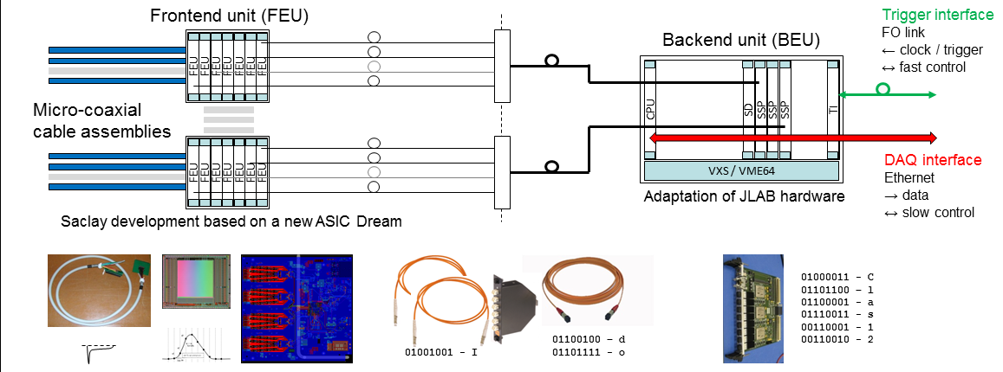
Electronics: MVT readout system
Detector links
Off-detector frontend electronics 1.5-2 m
Data concentration backend electronics 10-15 m
Optical links
26k channels
~400 cable assemblies
54 512-channel FEUs
~500 Dream ASICs
54 optical links @ 2.5Gbit/s
1 BEU (may be 2) with 3-4 SSPs
20 kHz trigger rate
16 µs trigger latency

Slide 4
Electronics Status
All the needed Electronics components have been produced.
MVT / FTT DAQ enriched with self-trigger readout mode -> Handy for tests with cosmics -> Possibility to select multiplicity on frontend and backend levels
Interface between the MVT / FTT slow control and the Clas12 EPICS framework validated -> Major part of the remaining work will be accomplished during the June 2017 integration period
On-going work to secure MVT / FTT Low Voltage distribution -> Choice to use more robust Harting connectors

Slide 5
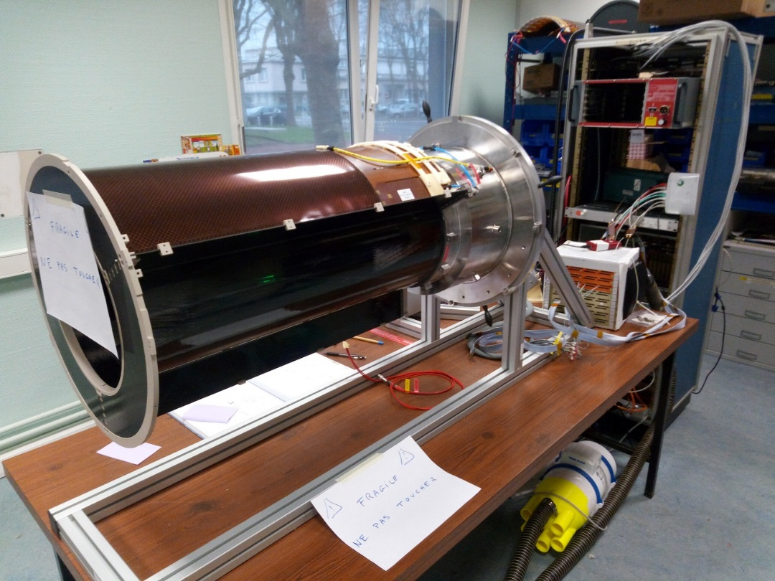
MVT barrel B6 filling with detectors
MVT – 6-layer mechanical structure
Barrel carbon mechanics ready
Interface B6 (3 double layers) with MVT tube ready
Integration of 6 curved micromegas for sector 1 under progress for autotrig cosmic run week 13 (March 27 to 31)
Integration of micromegas in sector 2 and 3 weeks 14-16
Full B6 cosmic run week 16 (April 18 to 21)
MVT and FTT electronics air cooling with remote fan validated
3D printing of final component under progress
MVT B6 with CR6C in sector 1
Remote fan

Slide 6
Forward vertex tracker
The 6 detectors have been delivered to Jlab
2 spare detectors are still under construction and are foreseen to be ready during Fall 2017

Slide 7
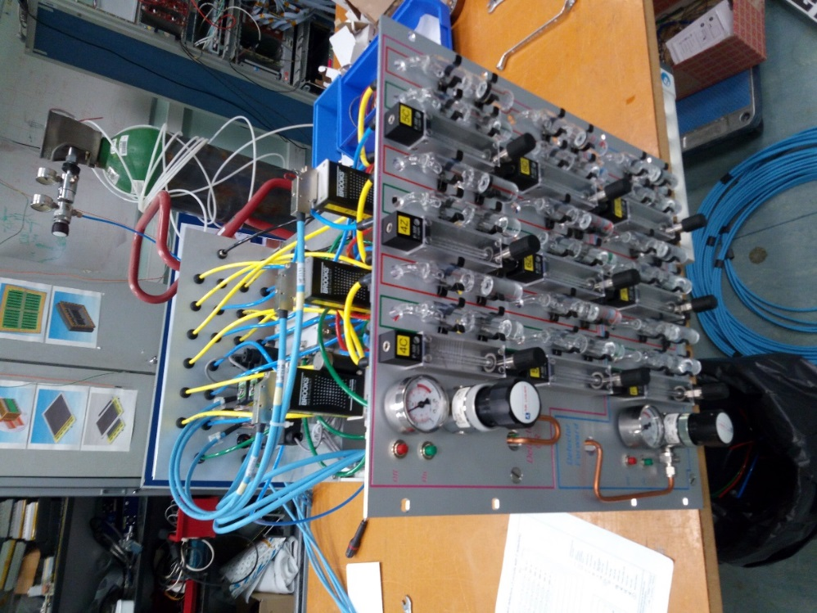
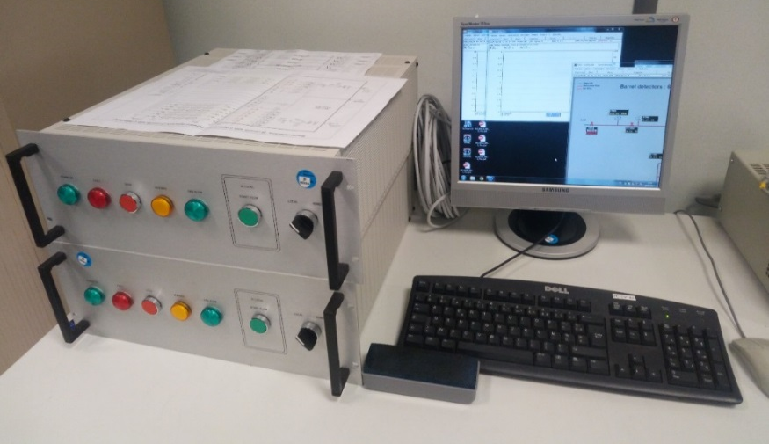
MVT gas distribution rack and control rack
MVT distribution rack (DR) done and tested
MVT control rack with (CR) PLC done and under test with DR
PDF documentation in progress ☺
Ready for MVT cosmic run at Saclay for week 13
MVT barrel and forward gas control rack
MVT distribution gas rack under test

Slide 8
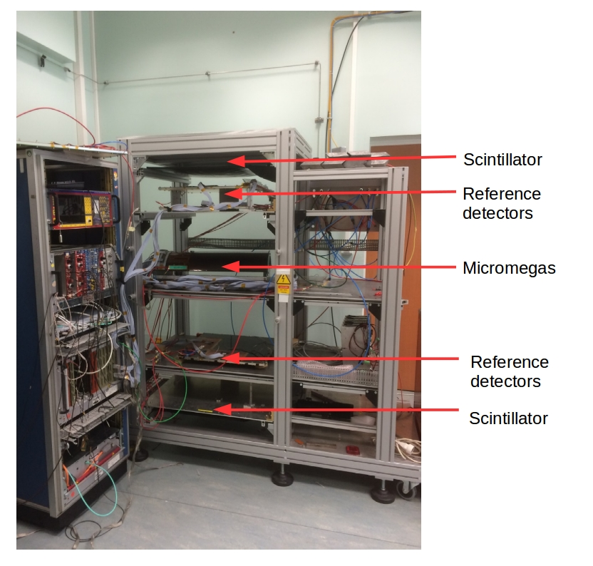
Barrel tests – Cosmic bench
Trigger
- 2 Scintillators in coincidence
Efficiency calculation
- Compute track of particles using reference detectors.
- Check if the Micromegas has signal at the expected position.
- Efficiency is the ratio :

Slide 9
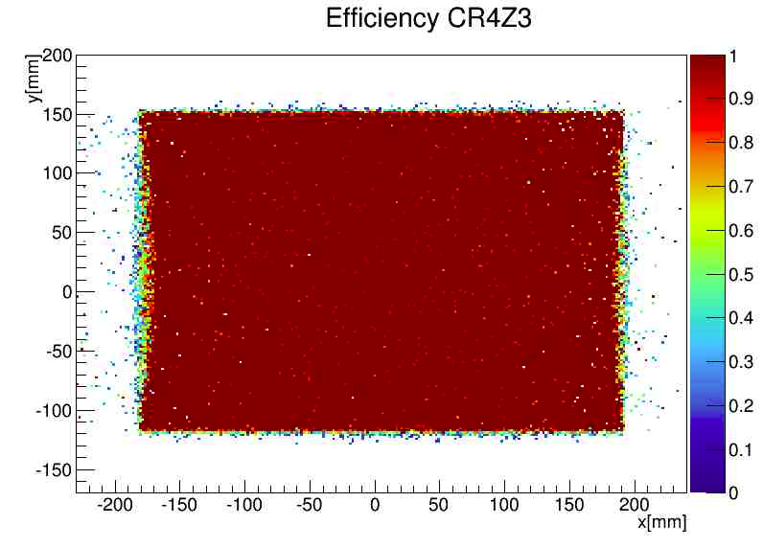
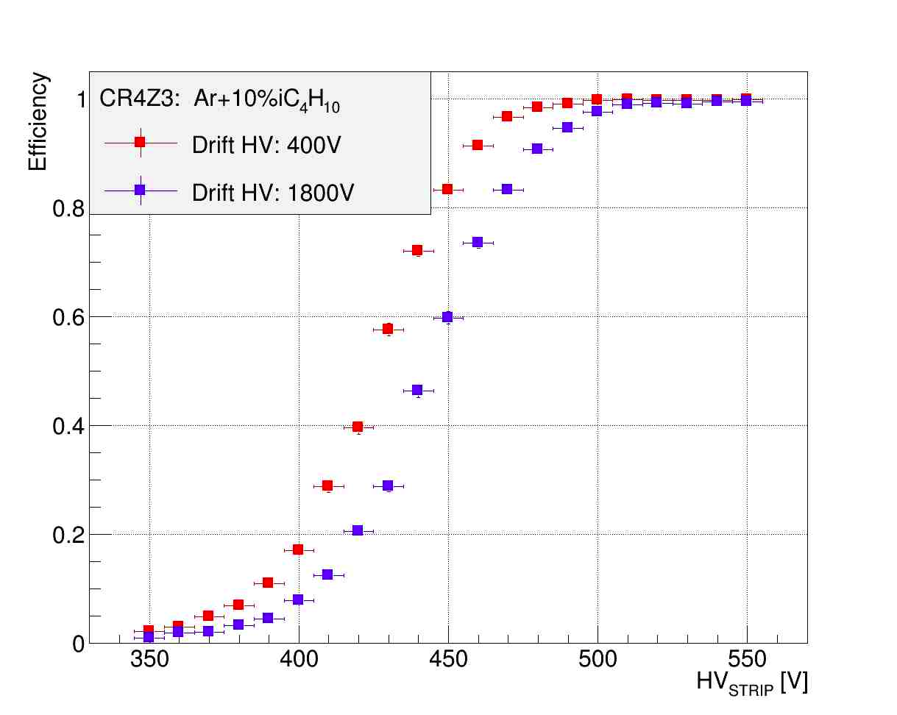
Detector tests – Cosmic bench
Barrel detectors Tests (layer by layer) :
- CR4Z : 4 detectors : tests OK, in boxes
- CR4C : #1 and #2 detectors tests OK, #3 in test, #4 ready for test
- CR5Z : #1 to be redone, #2 in test, #3 and #4 ready for test
- CR5C : #1 under integration at Saclay #2 test flat OK, #3 under bulk at CERN => Saclay week 13, #4 under bulk at CERN
=> Saclay week 18
- CR6Z : 4 detectors : tests OK, in boxes
- CR6C : 3 detectors : tests OK, in boxes CR6C v2 : 4 spares to be made for June

Slide 10
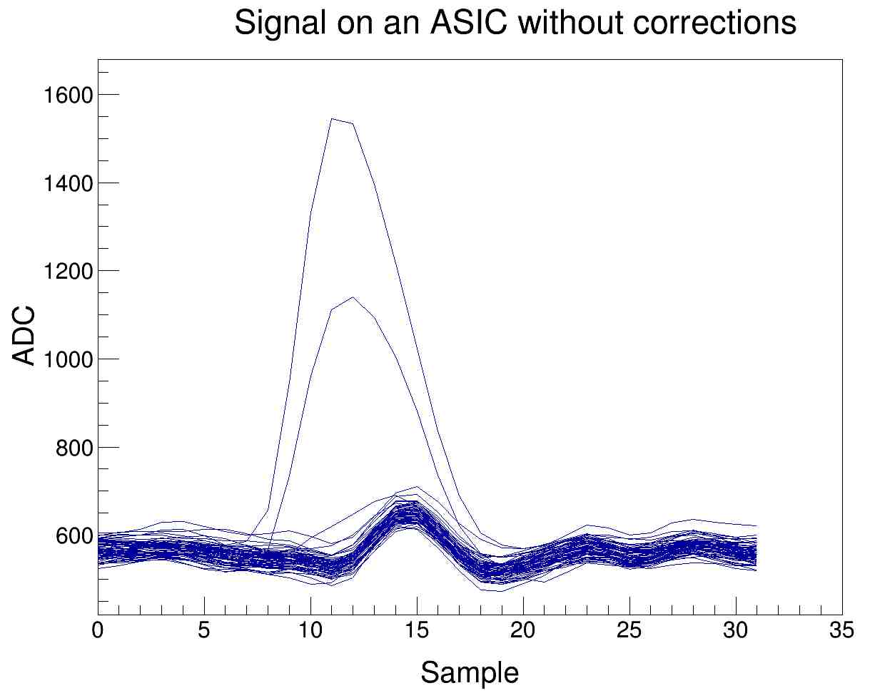
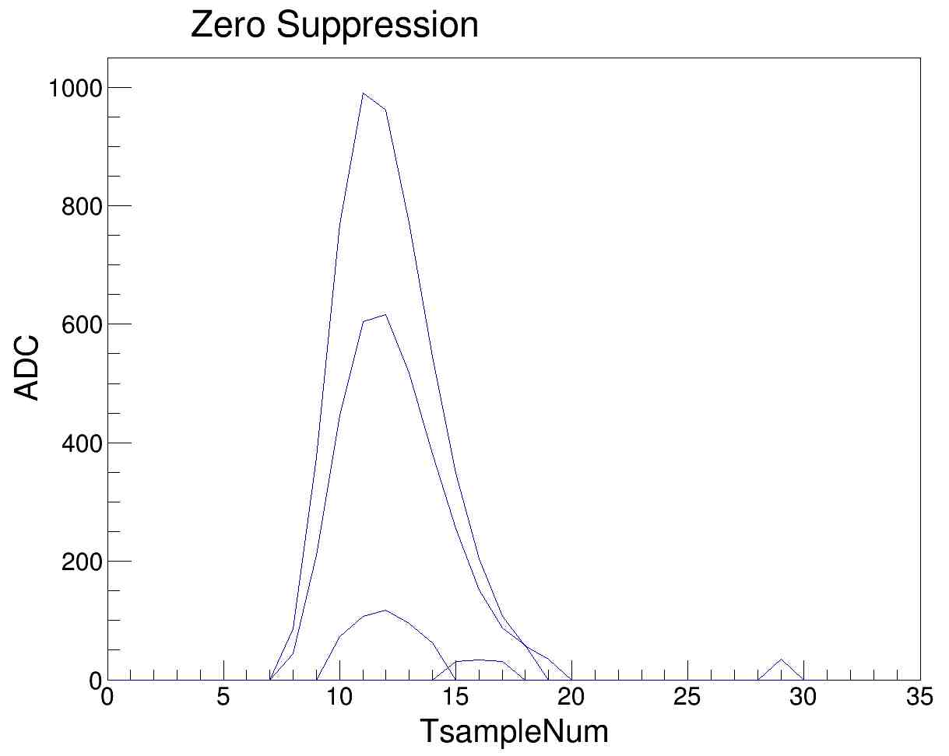
Software
1 - Files are decoded 2 - Pedestals substraction (average of the ADC without signal)
3 - Common noise suppression (noise common to all the strips of an ASIC)
4 – Zero suppression (root mean square (RMS) calculation and suppression of signals below a threshold (5 times RMS for example))
Geometry of the detectors has been implemented in Gemc (M. Garçon)
Hitprocess nearly ready and calibration software as well
Next important step will be merging with COATJAVA
Maxime Defurne will be at Jlab in a fortnight to stay for one year and will be on site to complete the work. He will be joined in June by Guillaume Christiaens, PhD Student

Slide 11
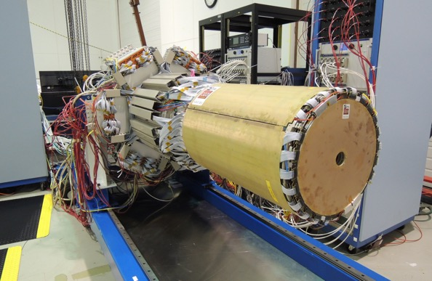
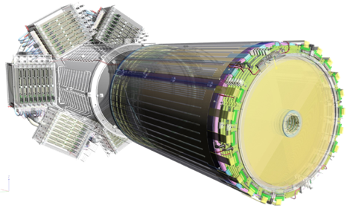
CONCLUSION
Project started with R&D at the end of 2005.
Design
Tracker
Three Scientific Supervisors were involved throught the years on the Project but there is still one and only unalterable S. Aune as Project Leader.
The team is looking forward to start the final installation at Jlab which will be initiated in June 2017.

