Slide 1
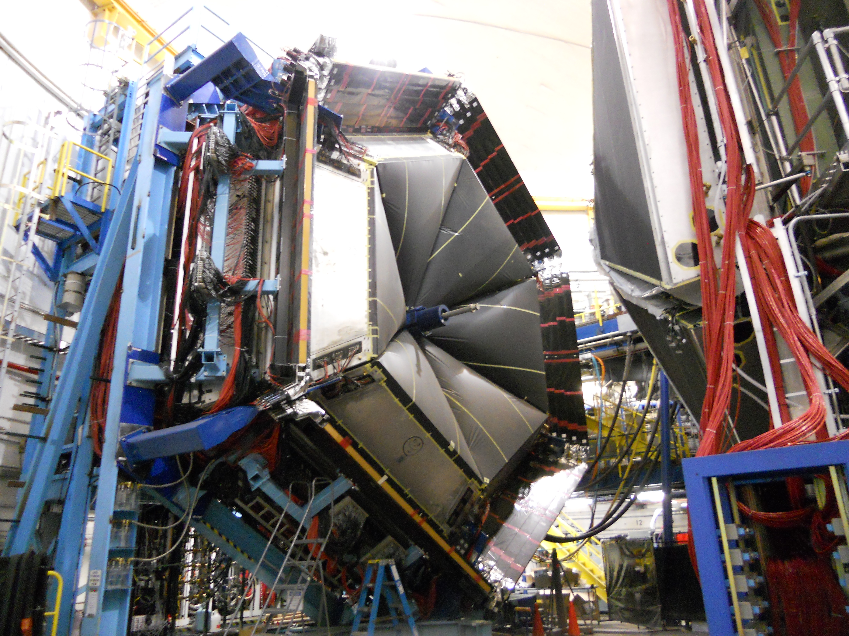
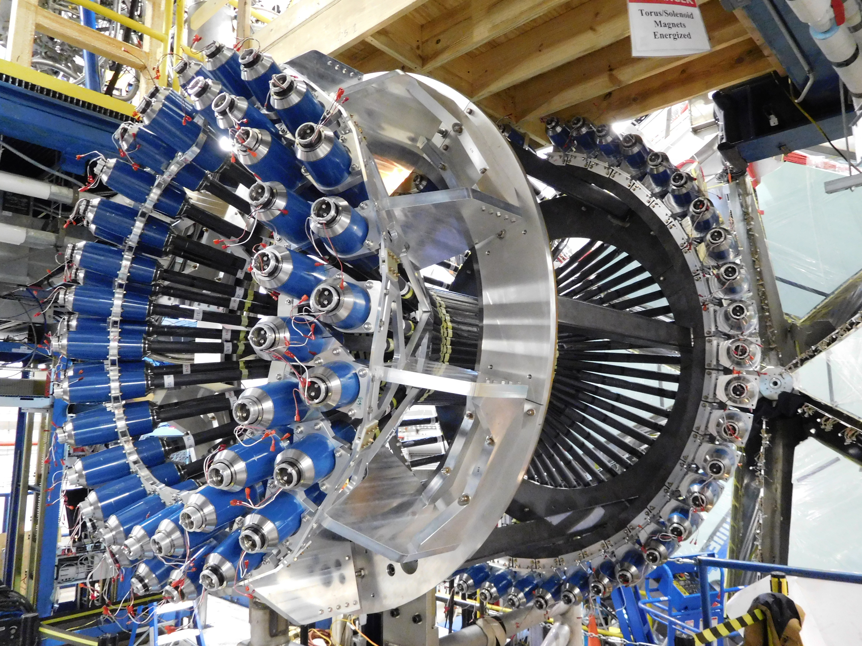
FTOF and CTOF Hardware, Calibration, Reconstruction, Simulation Software Status
Daniel S. Carman
Jefferson Laboratory

Slide 2
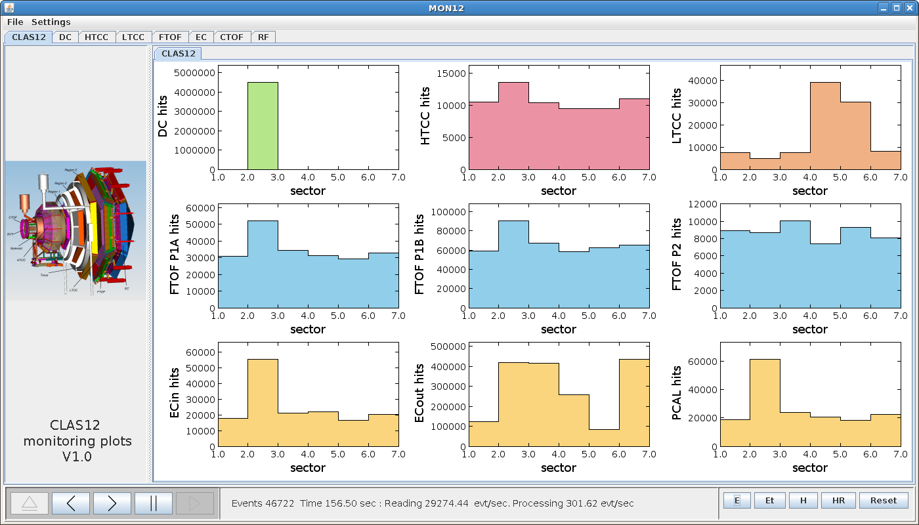
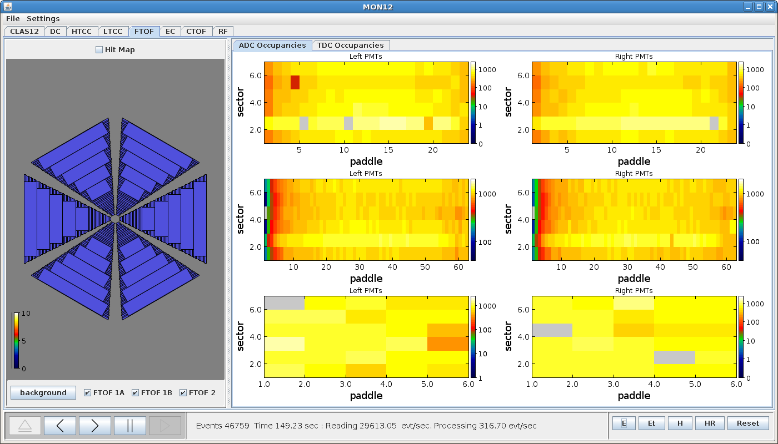
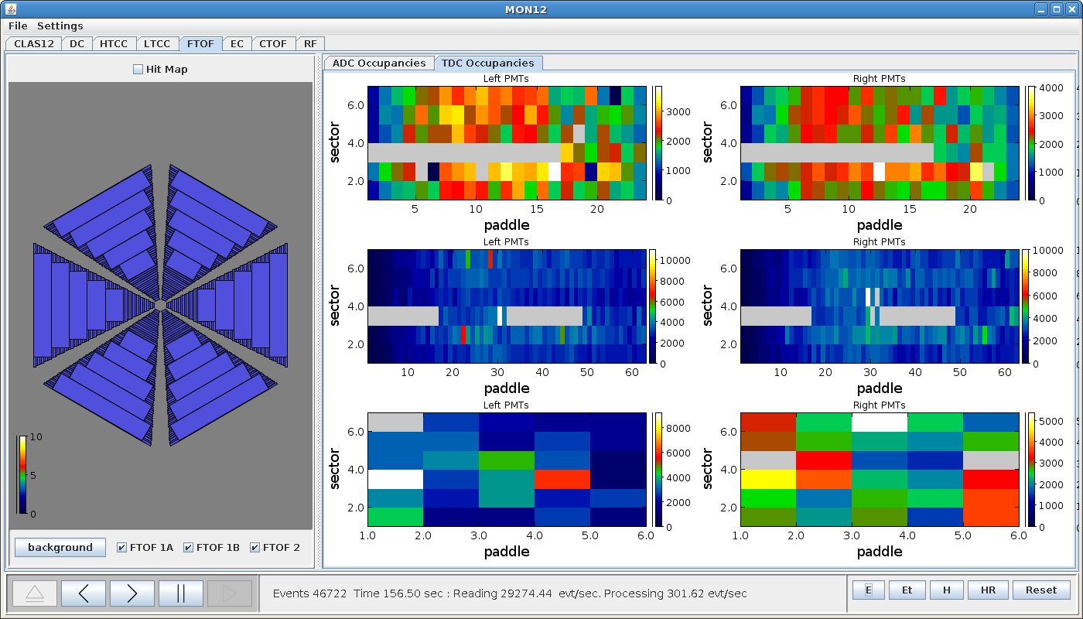
FTOF KPP Hardware Status
MON12 System Monitor
Issue with missing TDCs in S3 for KPP run due to missing clock signal
Raffaella De Vita

Slide 3
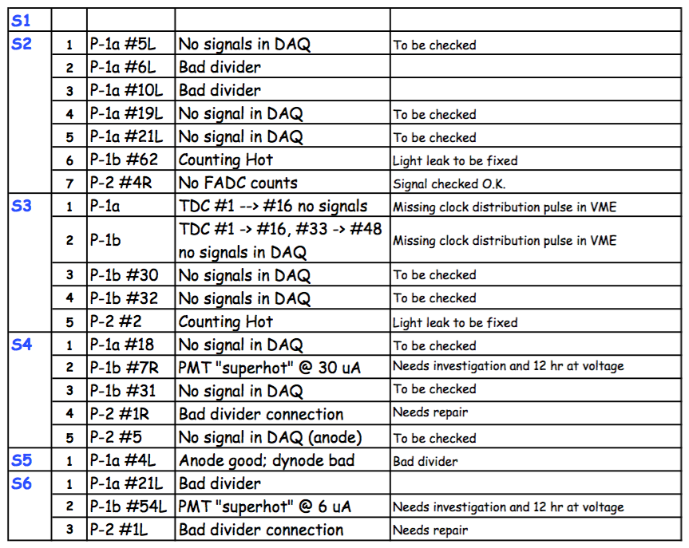
FTOF KPP Hardware Status

Slide 4
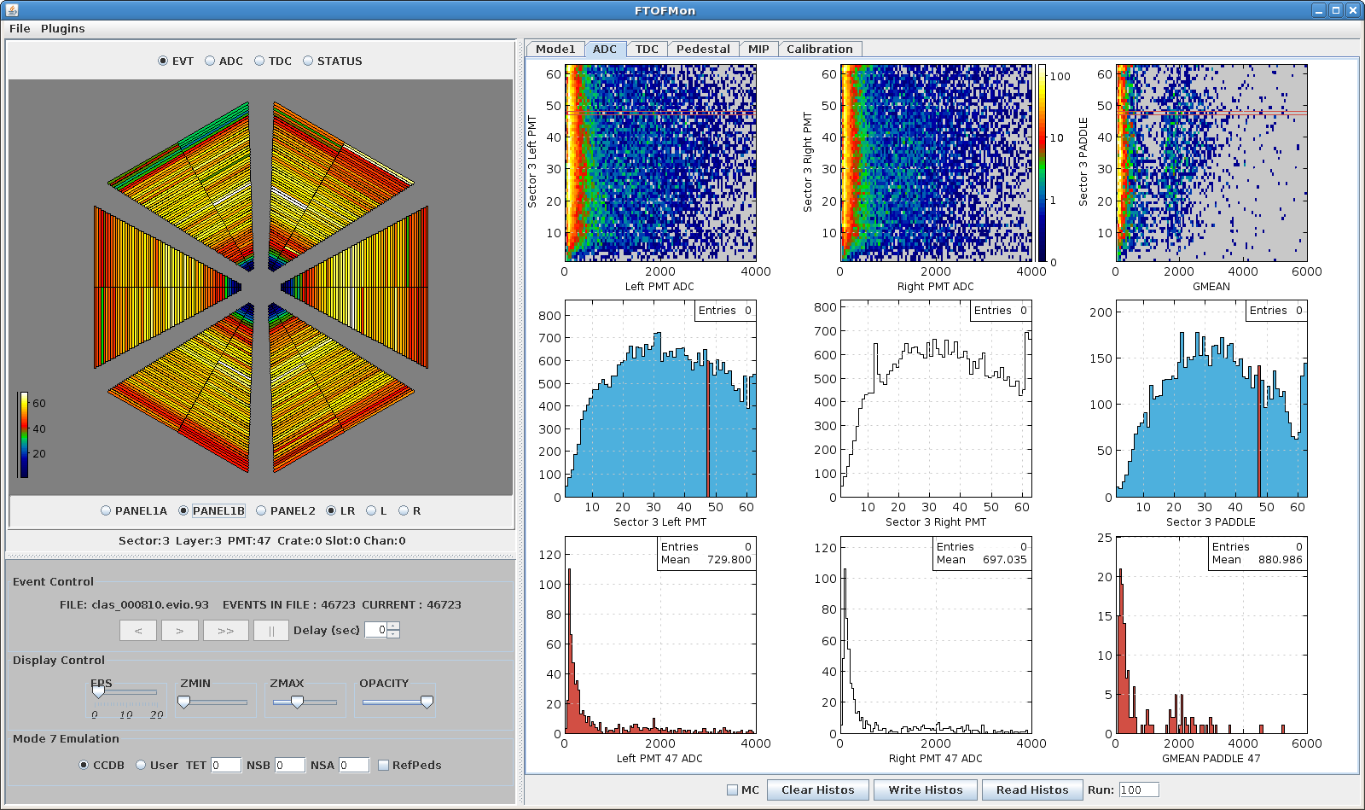
Hardware Monitoring Tool
Mode1 pulse display
ADC / TDC display
FADC pedestals
FTOFMON
Cole Smith

Slide 5
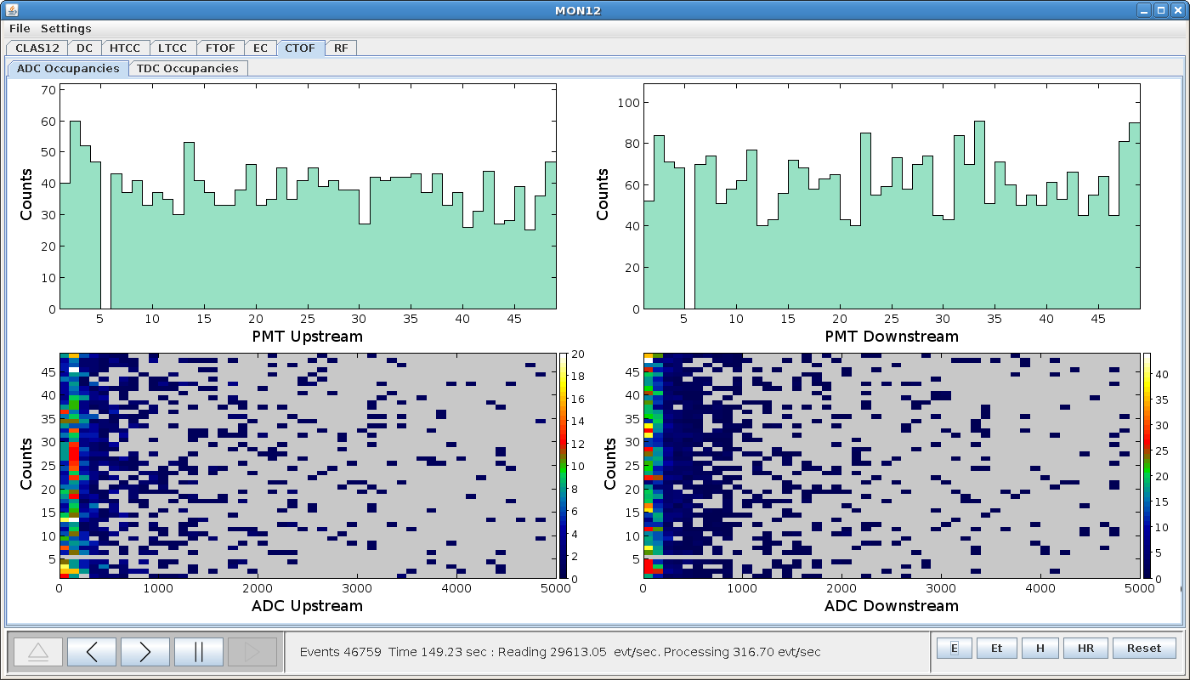
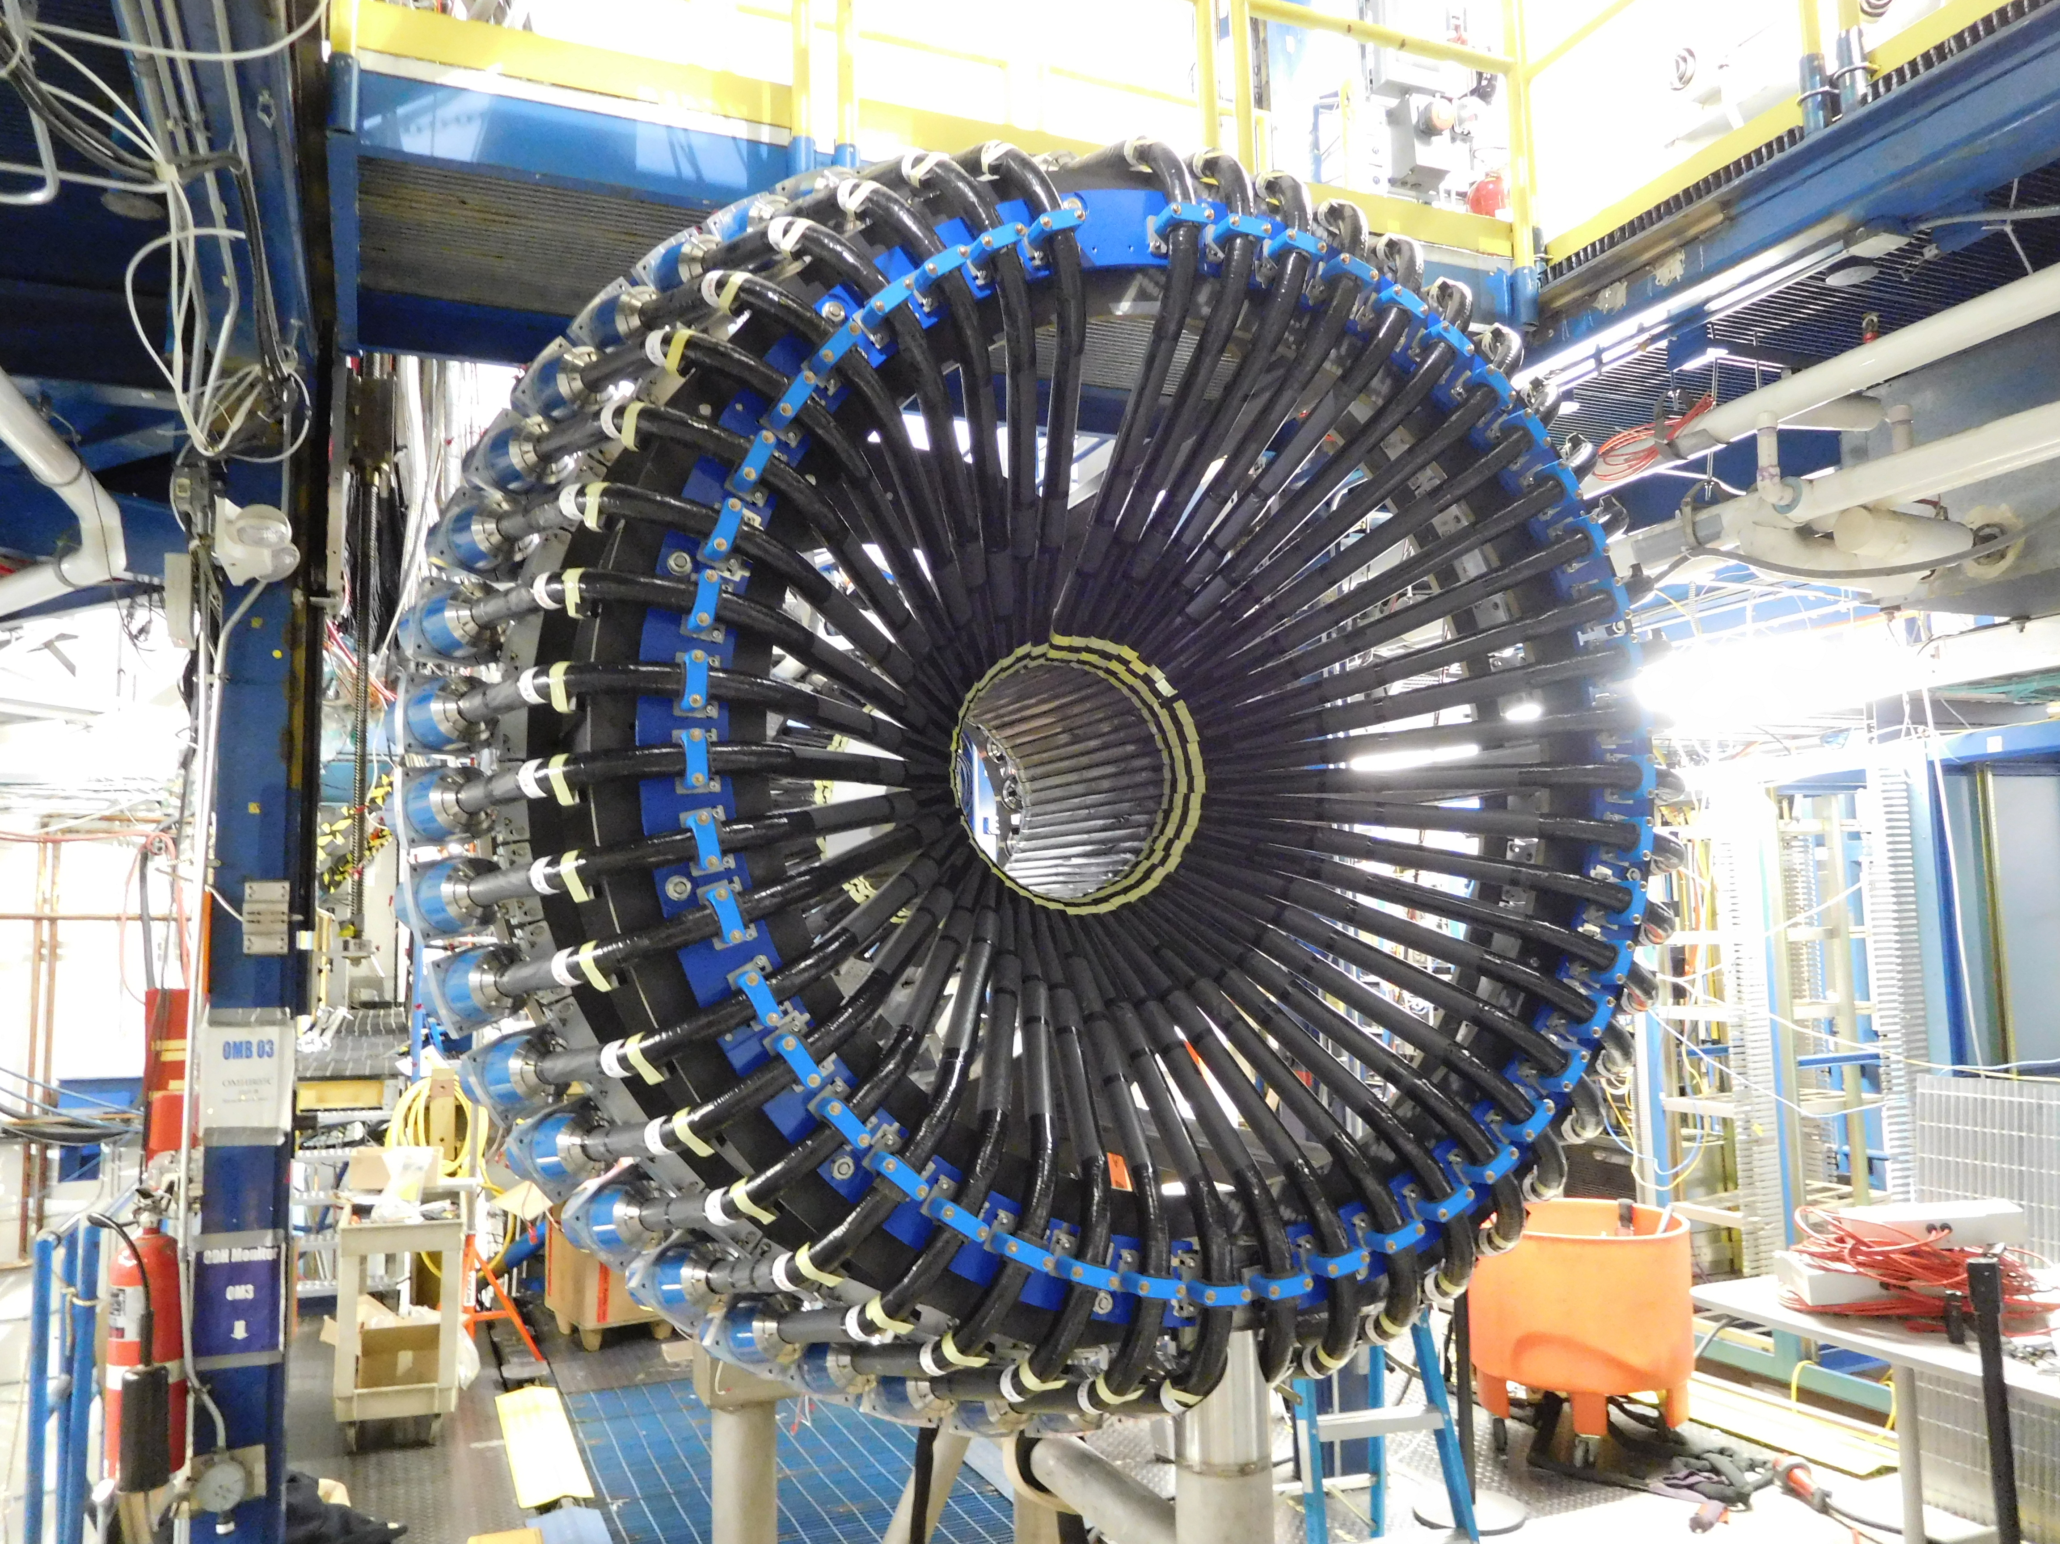
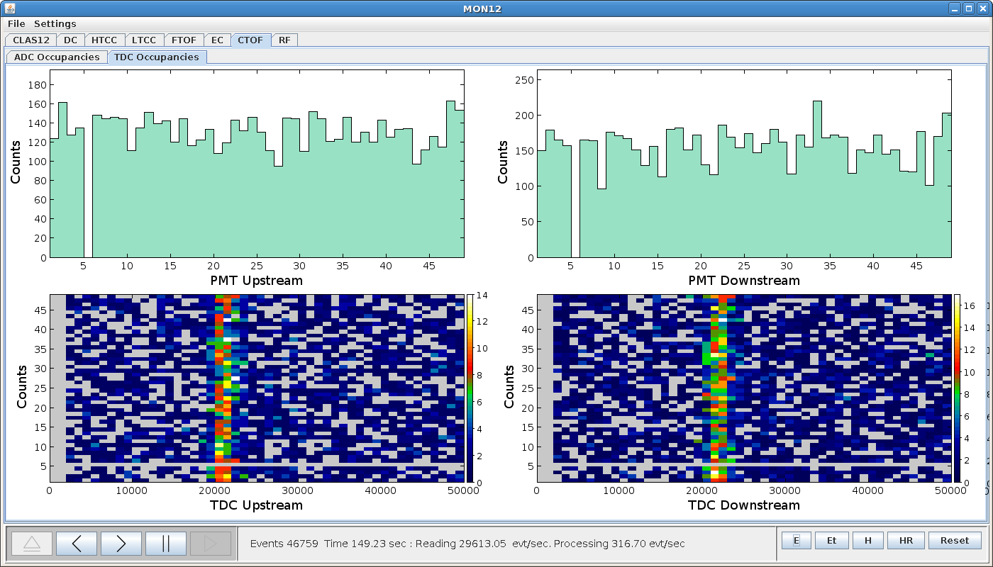
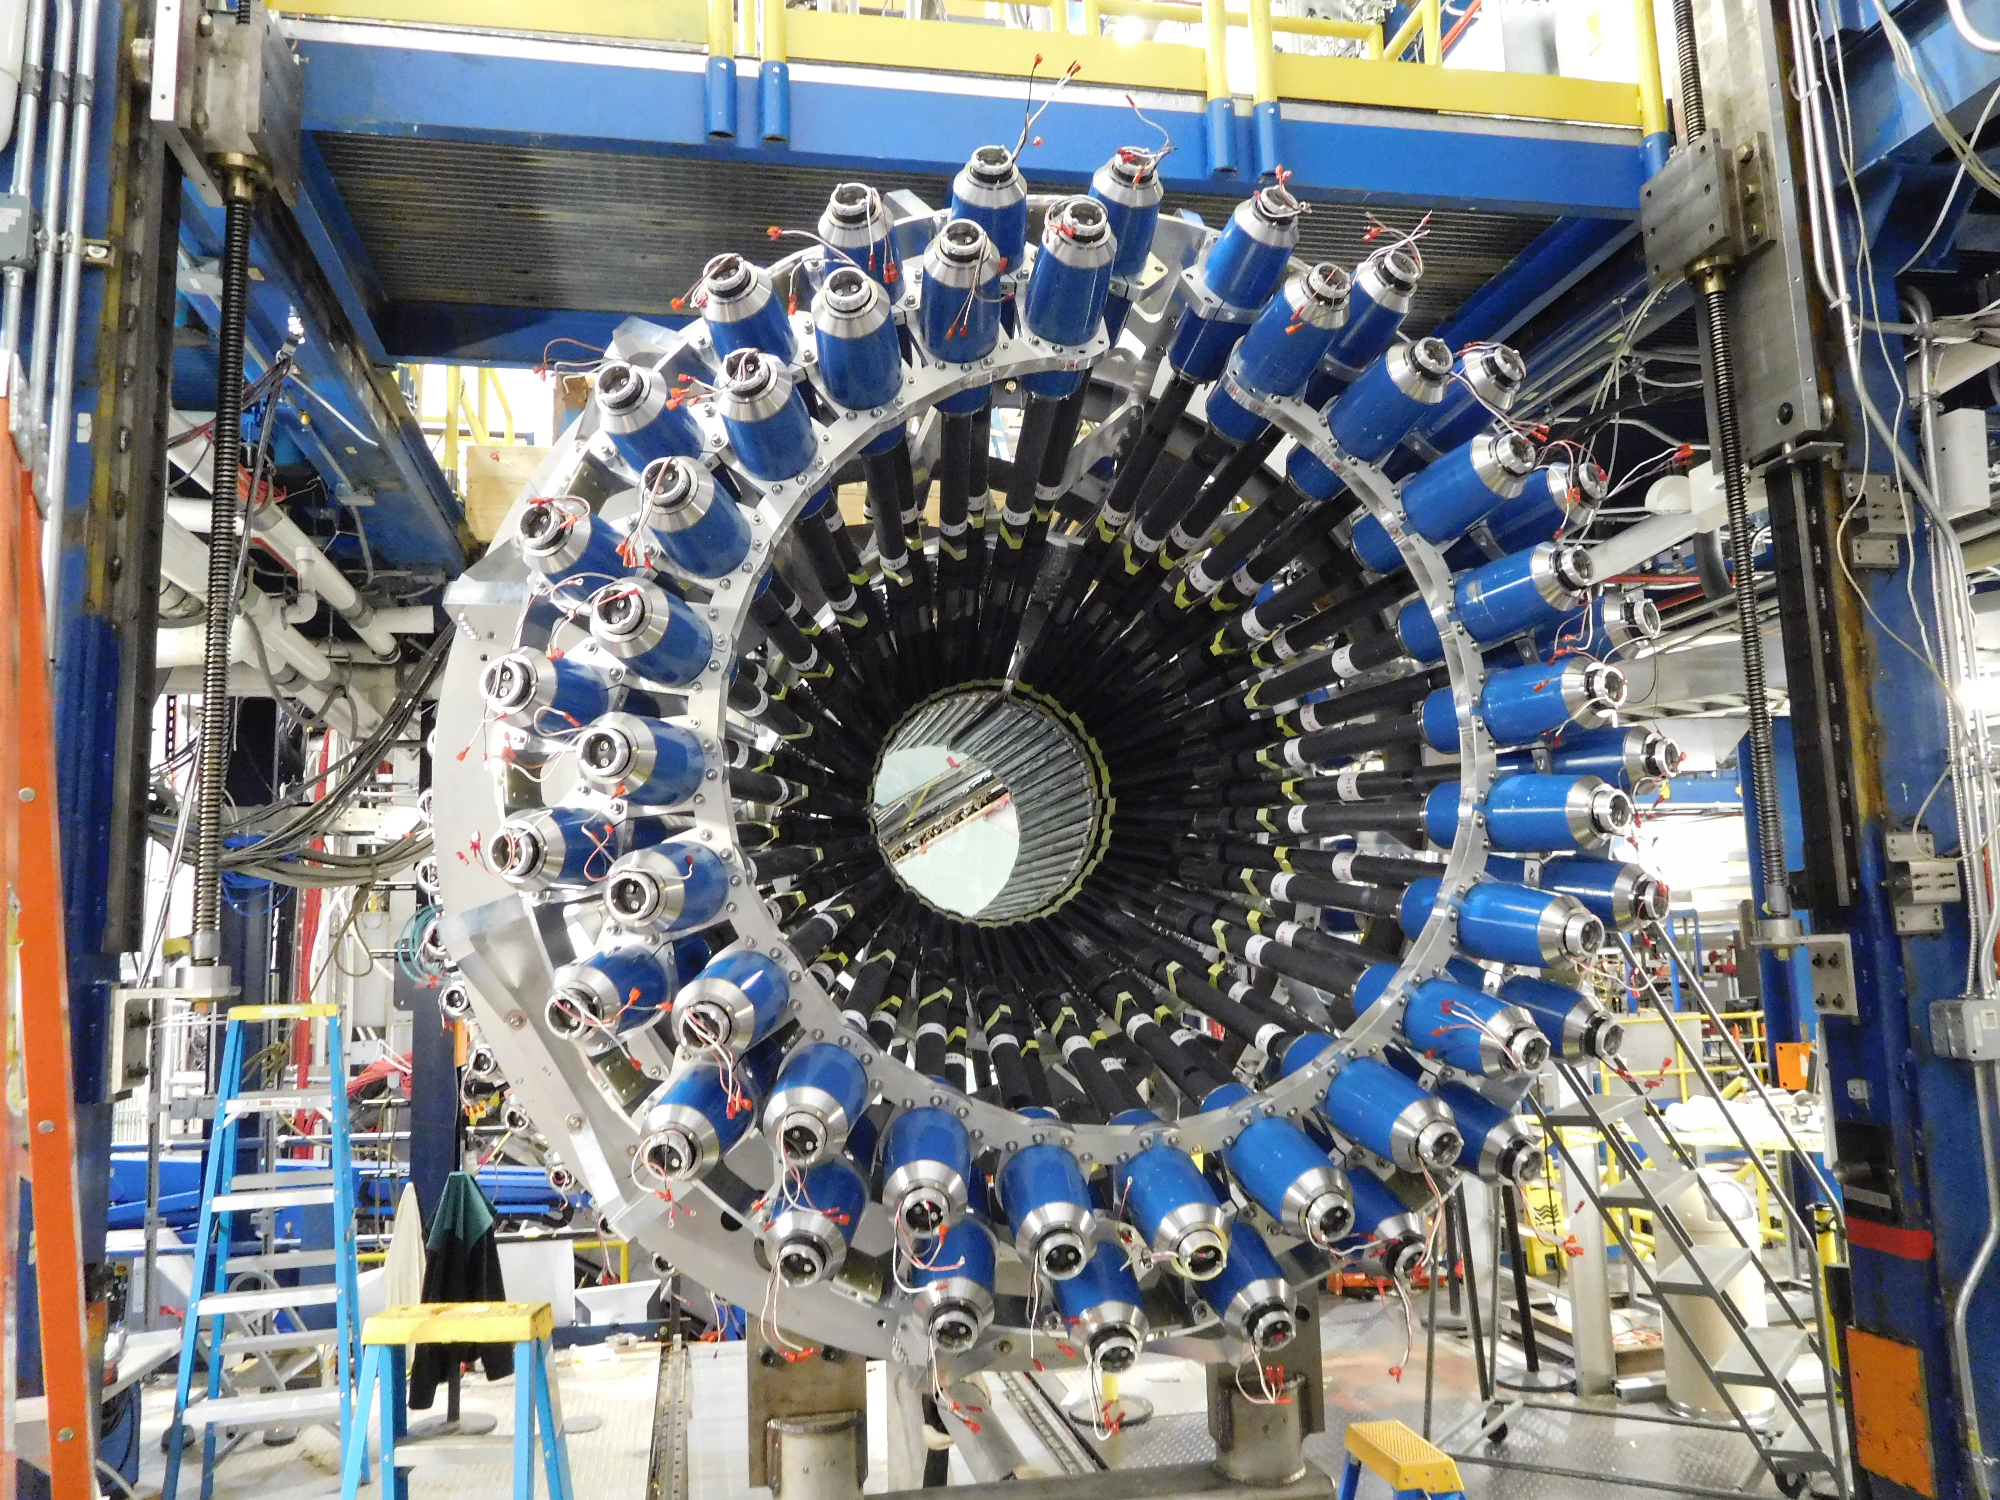
CTOF KPP Hardware Status
ADC
TDC

Slide 6
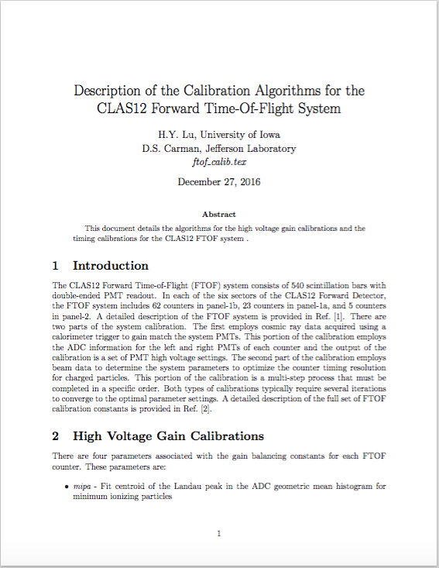
FTOF Calibration Sequence
HV/Gain Calibration
Step # | Action | Requirements
1 | Gain Calibration | EC Pixel Trigger
Timing Calibration
1 | PMT Timing Diff. | Raw TDC data
2 | Attenuation Length | Good Δt
3 | Effective Velocity | Good TBT + Δt
4 | Time-Walk | Good TBT + Δt
5 | P2P | Good TBT + Δt
6 | RF Offset | Good TBT + Δt
Nominal assumption is that for each counter both PMTs have good ADC and TDC values
– code will ultimately be able to complete calibrations for a subset of hardware failures

Slide 7
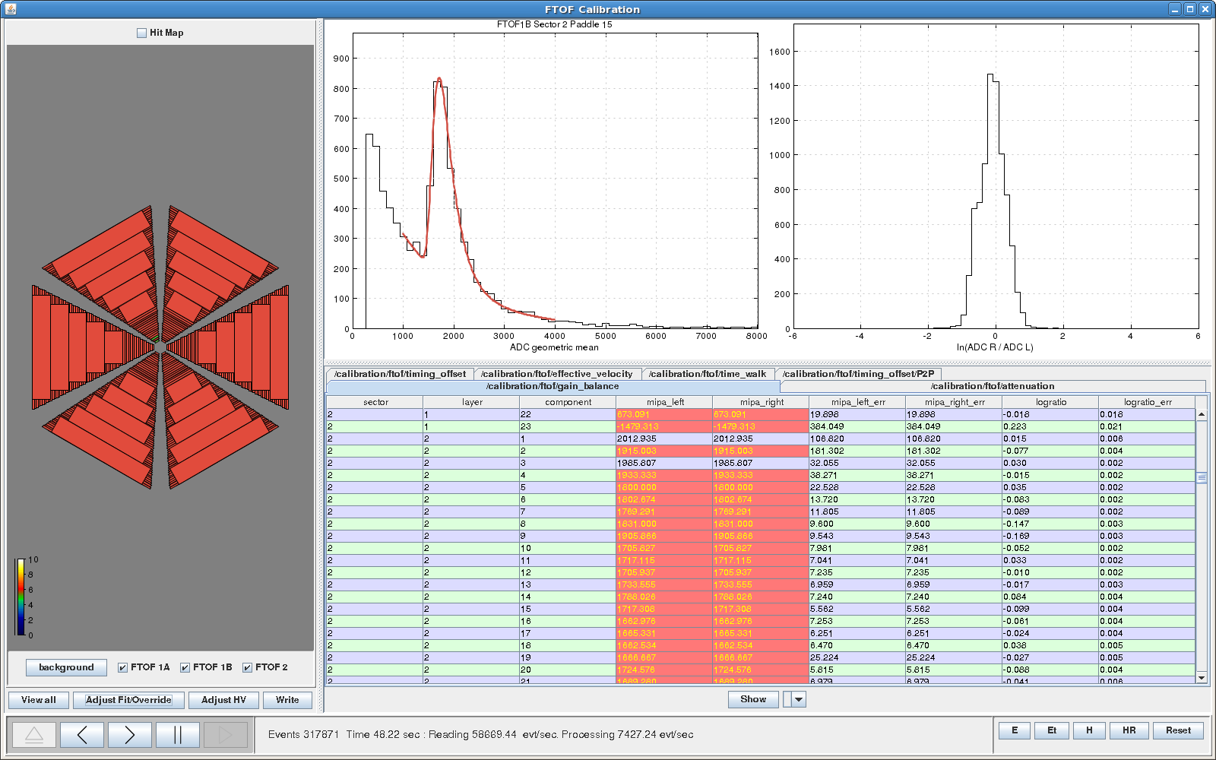
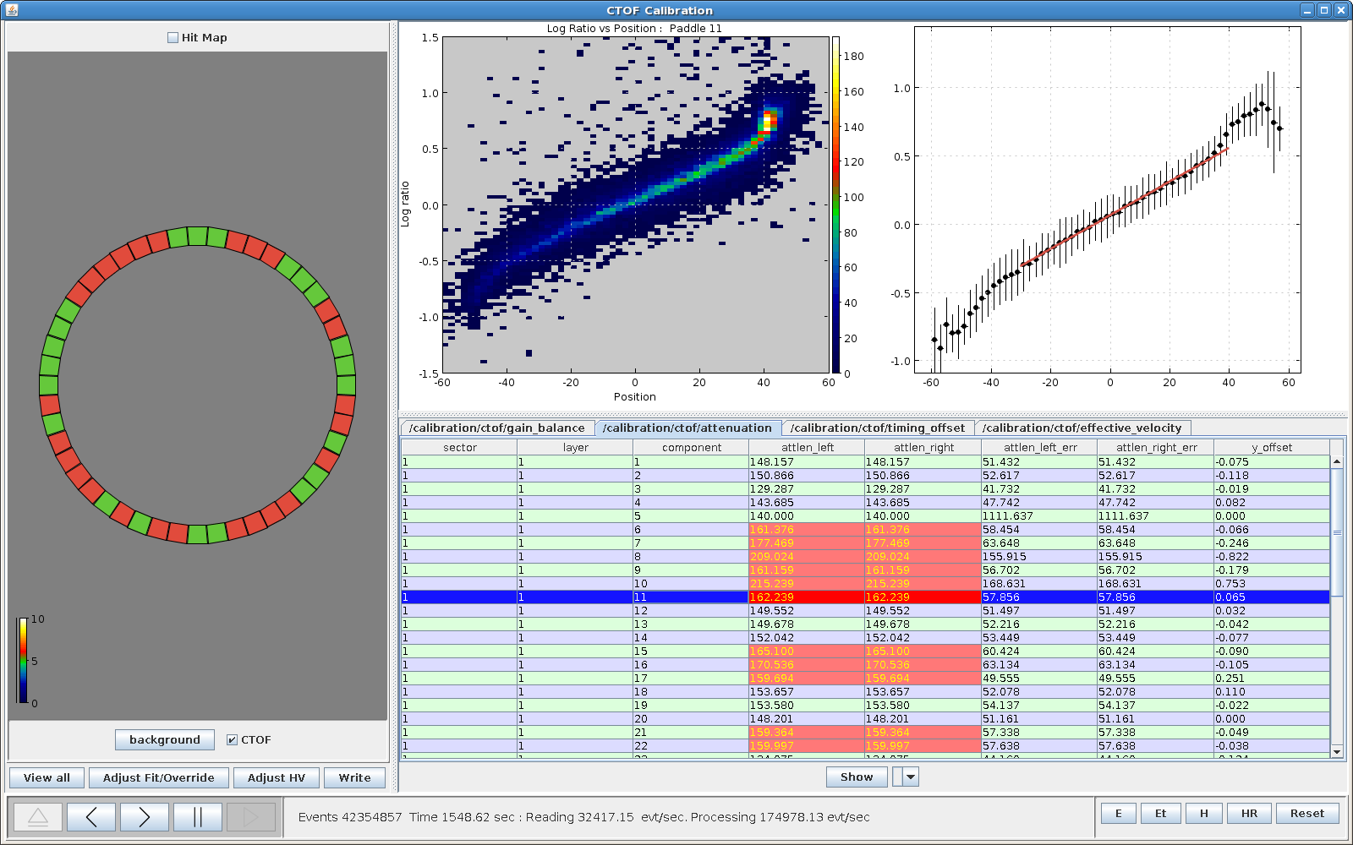
Calibration Suites
FTOF Calibration Suite
java-based, modular suites based on CLAS12 common tools APIs
CTOF Calibration Suite
Louise Clark, Haiyun Lu

Slide 8
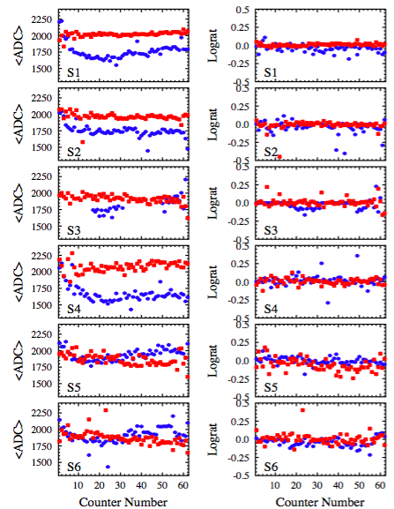
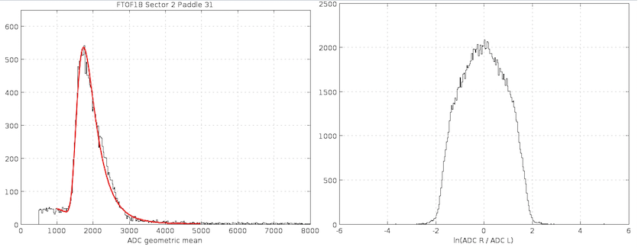
FTOF Gain Calibration
panel-1b
For each counter fit ADC geometric mean and ADC log ratio distributions
use to determine HV settings to gain balance the two PMTs and to position the minimum ionizing particle peak in a specific ADC channel
use for the energy loss calibration in the reconstruction code
cosmic data; KPP data

Slide 9
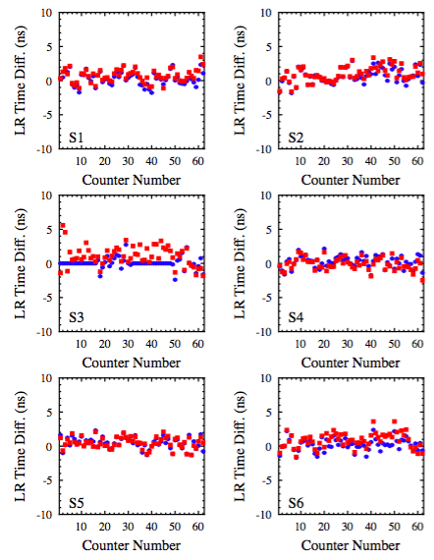
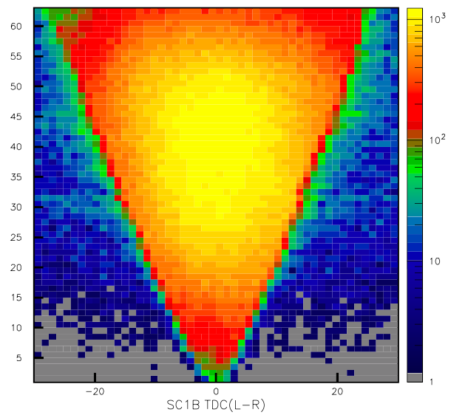
FTOF PMT Timing Difference
panel-1b
Center counter PMT time difference distributions about zero to account for differences in PMT transit times and signal propagation times
cosmic data; KPP data

Slide 10
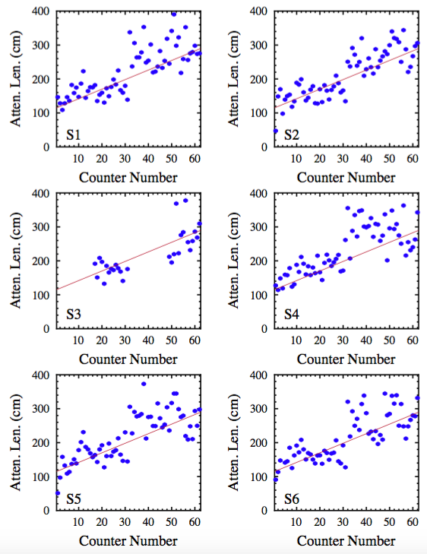
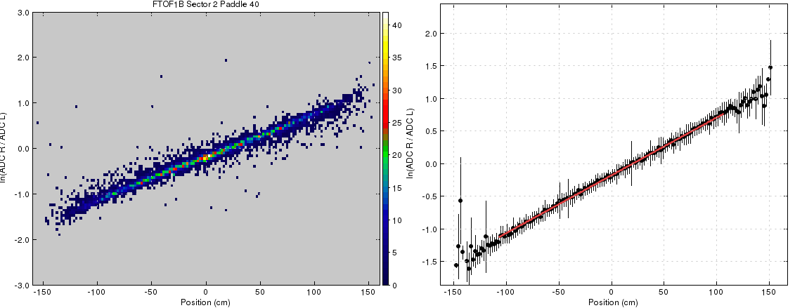
Attenuation Length
panel-1b
Use correlation of coordinate and ADC information to determine attenuation length of light for each counter
cosmic data; KPP data

Slide 11
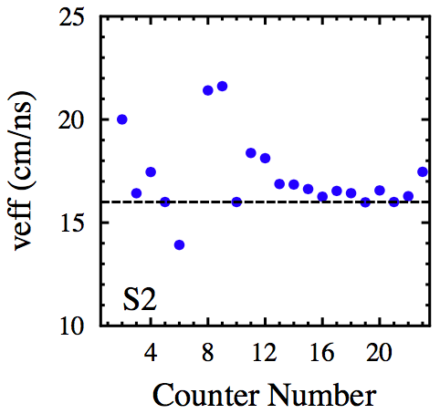
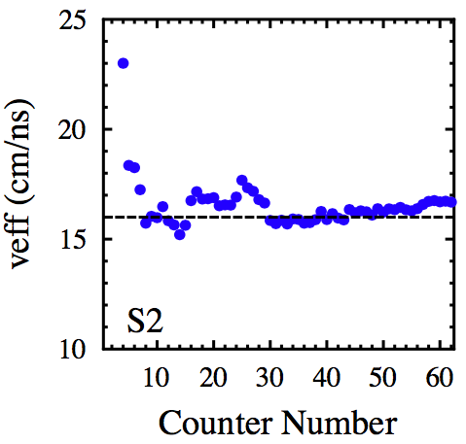
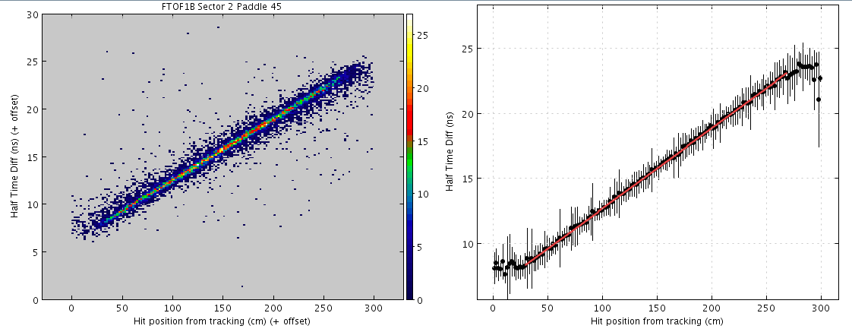
Effective Velocity
panel-1a
Match hit coordinate from FTOF to hit coordinate from DC tracking to find v_{eff}, the effective speed of light propagation in the scintillation bar
coor_{DC} = 0.5 (t_{L} – t_{R}) v_{eff}
panel-1b
KPP data

Slide 12
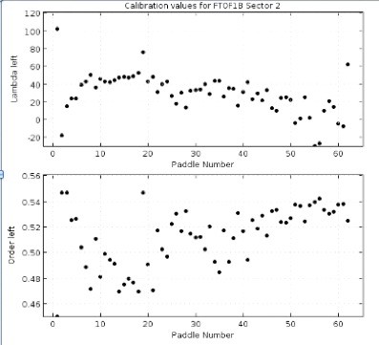
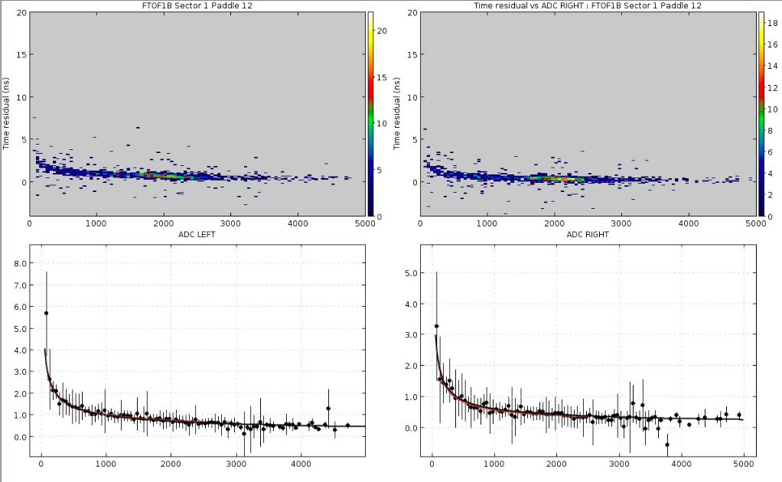
Time-Walk Correction
The FTOF system uses leading-edge discriminators for the readout
t=f(ADC) as pulses of different amplitude cross LED threshold at different times
(“time-walk”)
Time-walk functional uses RF time as the reference:
t_{res} = t_{FTOF} – L/β – t_{RF}
Fit t_{res} vs. ADC_{L,R} with function:
λ/ADC^{m}
λ
m
KPP data

Slide 13
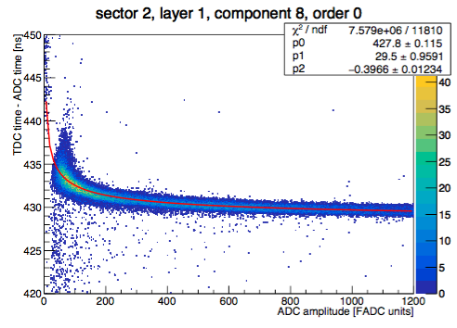
Time-Walk Correction
An alternative approach to time-walk corrections is to determine calibration parameters that do not depend on the RF or on DC tracking information
Compare the TDC time to the time derived from fitting the leading edge of the flash ADC pulse
Work is underway to compare the two time-walk algorithms and to better understand the systematics
The FADC timing resolution still needs to be improved to be able to employ this approach for corrections
KPP data
Determine time-walk parameters from the residual:
t_{res} = t_{TDC} – t_{FADC}
Fit t_{res} vs. ADC_{L,R} with function:
λ/ADC^{m}
Raffaella De Vita, Andrey Kim

Slide 14
Paddle-to-Paddle Correction
Determine initial RF offset for the FTOF system:
For each FTOF paddle compute:
Select electrons or pions with β~1
ΔRF = t_{RF} – (t^{e}_{FTOF} – L_{e}/β)
This leaves 2.004 ns ambiguity as beam bucket associated with the event is unknown
<ΔRF> = mod(ΔRF, 2.004 ns)
t¹_{FTOF} = t⁰_{FTOF} + <ΔRF>
Determine relative time offsets among paddles:
Use exclusive e-π^{+/-} concidences to link times of all counters across the system
Δt_{v} = t^{e}_{v} – t^{π}_{v}
P2P = max bin # Δt_{v} * 2.004 ns
t²_{FTOF} = t¹_{FTOF} - P2P
e
π
Algorithm now being developed/tested
Raffaella De Vita, Ralf Gothe

Slide 15
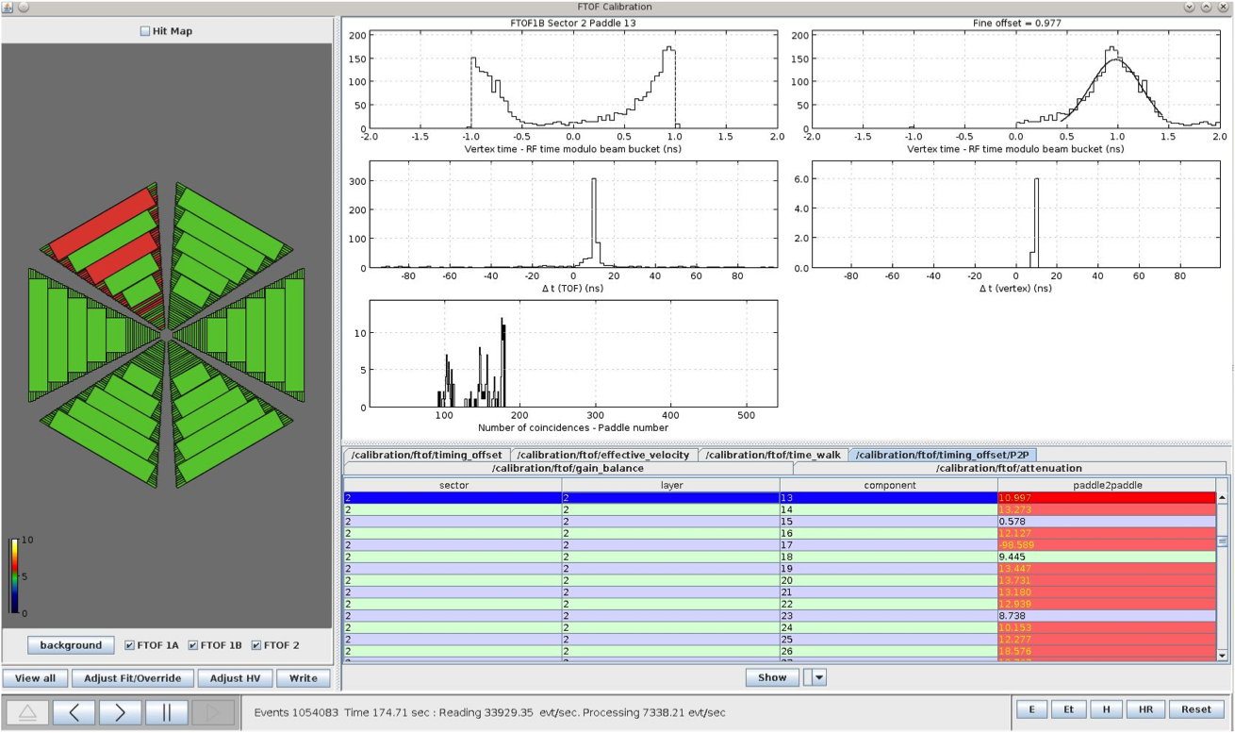
Paddle-to-Paddle Correction
RF Offset
P2P Offset
Coincidence statistics

Slide 16
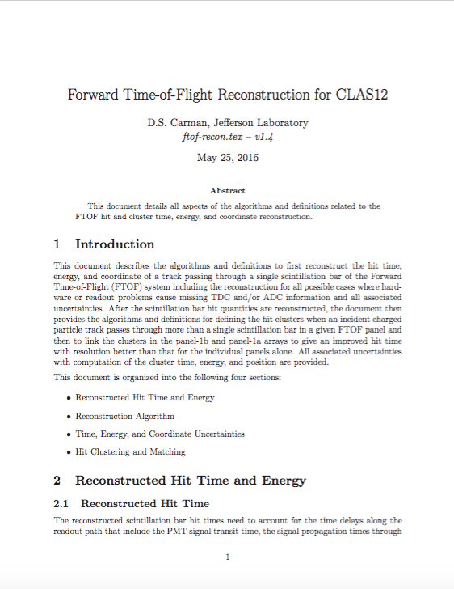
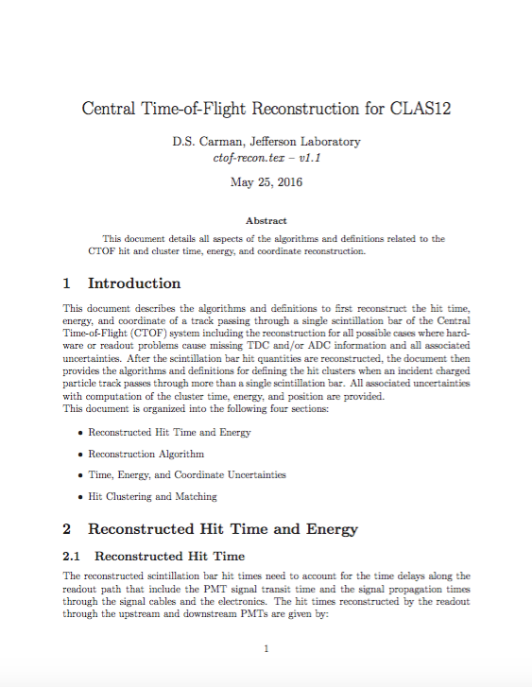
Reconstruction Software
TOF reconstruction code determines:
hit times (t_{L}, t_{R}, <t>)
hit coordinates (x)
deposited energies (E_{L}, E_{R}, <E_{dep}>)
associated time, coordinate, and energy uncertainties
performs hit clustering and matching
combines hit times from panel-1a and panel-1b
Veronique Ziegler
- Code designed to function for all “allowable” hardware conditions
- Most of the code validated in detail; work remains on combining hit times

Slide 17
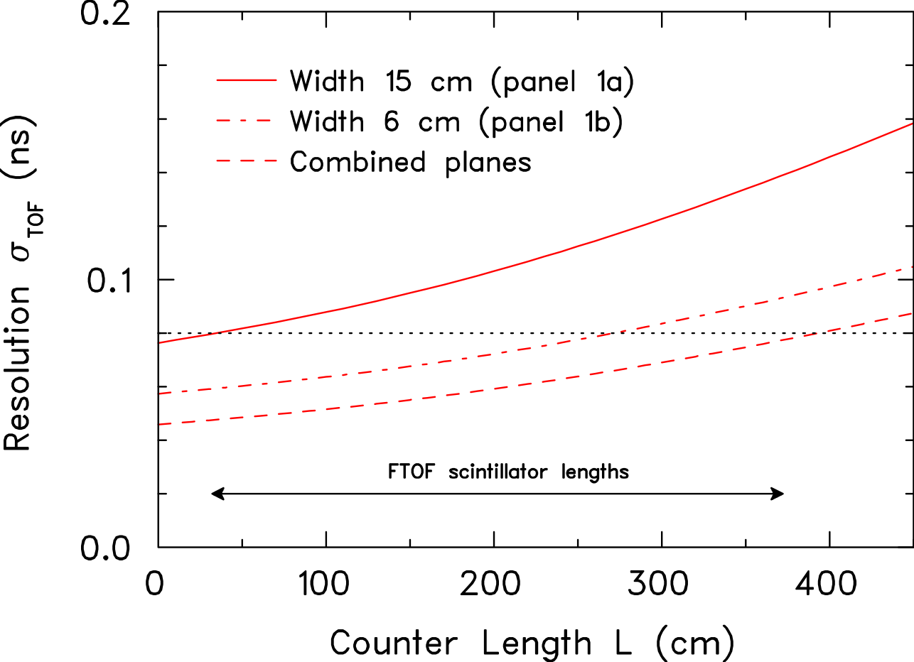
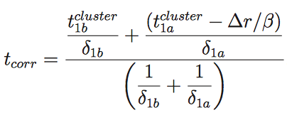
Optimizing System Time Resolution
TDR
Combine the measured times from the FTOF panel-1a and panel-1b to optimize the resolution
GEMC Studies with cluster=1
Algorithms for cluster > 1:
use hit with t_{min}
use hit with E_{max}
use weighted average
(20% gain) | e | p | π⁺ | π⁻
FTOF 1A | 152 ps | 164 ps | 160 ps | 151 ps
FTOF 1B | 62 ps | 67 ps | 65 ps | 61 ps
FTOF 1A+1B | 49 ps | 54 ps | 54 ps | 51 ps
Evgeny Golovach

Slide 18
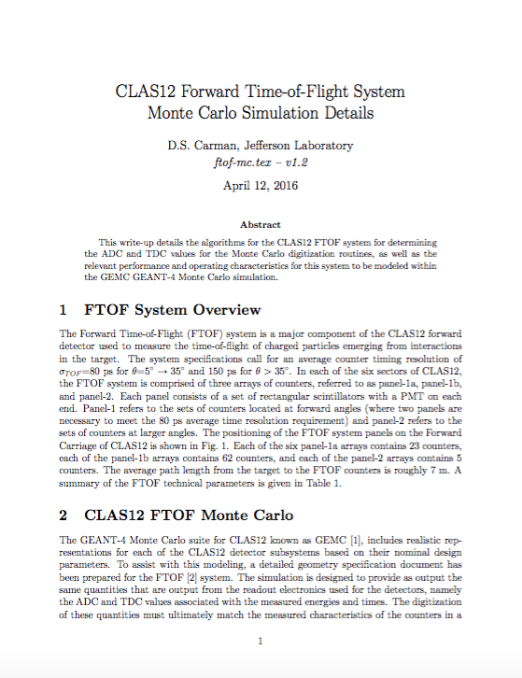
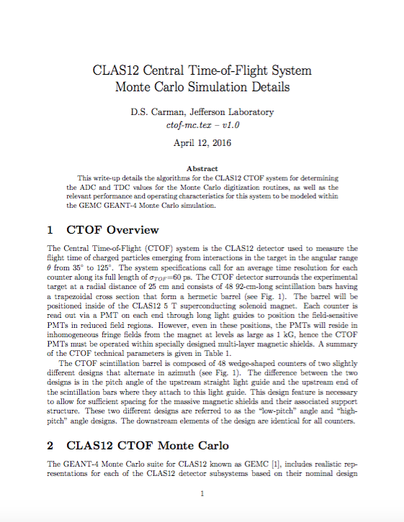
Simulation Code
The FTOF and CTOF system modeling in the CLAS12 GEMC simulation code is designed to match the actual hardware response:
ADC digitization:
Proper model for ADC pulse based on realistic modeling of photoelectron statistics
Includes attenuation length effects
Ultimately will use pulse shape to determine time from ADC data
TDC digitization:
Proper model for time-walk effects
Realistic PMT time resolutions
Realistic effective velocity
Include PMT time and P2P offsets
hit-process routines
FTOF & CTOF simulations studied in detail during December CALCOM Calibration Challenge

Slide 19
Remaining Work
Finish algorithm development for T-W, P2P, and RF offsets
Test algorithms on GEMC data and KPP beam data
Complete full calibrations of KPP data
Put constants in CCDB
Continue development of TOF calibration suites
Optimize calibration suites to improve user experience
Fitting of 2D histograms not done properly
Develop suite to calibrate around hardware failures
Explore alternative algorithms where improvements are promising
Update algorithm documents and prepare calibration tutorials
Add system survey offsets (Δx,Δy,Δz,θ_{x},θ_{y},θ_{z}) into geometry service
Hardware work:
CTOF detector installation, repairs, cabling, cosmic calibrations
FTOF detector repairs (where accessible)

Slide 20
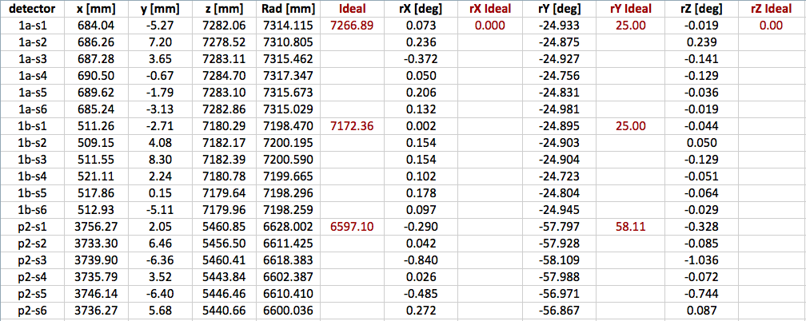
Preliminary FTOF Survey

Slide 21
Summary and Conclusions
The FTOF/CTOF calibration suites are becoming mature codes:
The calibration suites have been used to calibrate the KPP beam data (gain balance, PMT time diff., attenuation length, eff. vel., time walk)
Work ongoing to finish development of P2P and RF time offsets
The FTOF/CTOF reconstruction code has been validated through detailed systematic studies of Monte Carlo and KPP beam data:
All aspects of code functionality studied
Some minor work remains on combining hit times for FTOF
The FTOF/CTOF GEMC hit process digitization routines have been developed to match the actual hardware response:
Extensive testing during recent Calibration Challenge exercise
Work remains on using pulses for FADC modeling
FTOF hardware in good shape (<1% of channels have issues); Significant effort upcoming to install CTOF in solenoid and test. All installation procedures tested during KPP installation

