Slide 1




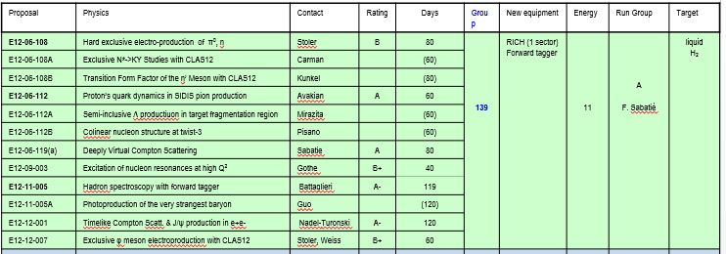
RUN GROUP A - Experiments
Duration: 139 days
20 days commissioning
60 days high luminosity
39 days low luminosity
20 days reversed torus polarity
Energy: 11 GeV
Target: LH2

Slide 2




Possible RG Schedule (straw man)
Run Group | Days | 2016 | 2017 | 2018 | 2019 | 2020 | 2021 | 2022 | Remain
All Run Groups | 1036^{#)} | 30 | 15 | 95 | 105 | 105 | 105 | 105 | 456
HPS | 180* | 15 |  | 35 | 10 | 10 | 10 | 10 | 90
PRad | 15* | 15 |  |  |  |  |  |  | 0
CLAS12 Comm |  |  | 3 15 |  |  |  |  |  | 0
RG-A + RG-K (proton) | 239* |  | 10 | 20/15 25 |  | 35 | 20 |  | 114*
RG-B (deuteron) | 90* |  |  |  | 40 |  |  |  | 50*
RG-F (BoNuS) | 42* |  |  |  | 21 |  |  |  | 21
RG-C (NH₃) | 120 |  |  |  | 35 | 25 |  |  | 60
RG-C-b (ND₃) | 65 |  |  |  |  | 35 |  |  | 30
RG-E (Hadr.) | 60 |  |  |  |  |  | 35 |  | 25
RG-H (Transv. Target) | 110* |  |  |  |  |  | 40 | 20 | 50
RG-D (CT) | 60 |  |  |  |  |  |  | 40 | 20
RG-G (LiD) | 55 |  |  |  |  |  |  | 35 | 20
^{#)} incl. RG-H

Slide 3
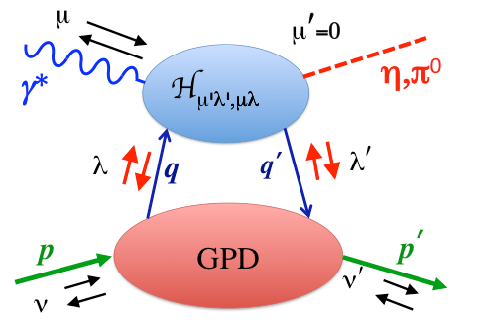
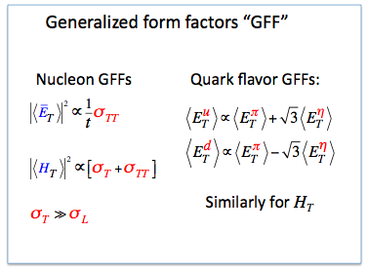
E12-06-108 Hard exclusive π0 and η electroproduction with CLAS12
Quark helicity flip
P. Stoler,
K. Joo,
V. Kubarovsky, M. Ungaro,
C. Weiss
Kroll, Goloskokov
Goldstein Liuti
Transversity GPDs
^{Physics objectives}
Quantify approach to small-size regime in exclusive π0, η production at Q² > 1 GeV²
Extract GFFs containing quark transversity GPDs and perform flavor separation
^{Observables and analysis}
Differential cross section dσ/dt: Q², W, t-dependence for reaction mechanism, size
L/T information from φ-dependent structure functions sufficient because σT >>σL, Rosenbluth separation not needed!
Method successfully demonstrated with 6 GeV data
^{Impact and significance}
Unique access to quark transversity: chiral symmetry breaking, lattice QCD

Slide 4

E12-06-108A Exclusive N* → KY Studies CLAS12
D.S. Carman,
R. Gothe,
V. Mokeev
Measure exclusive K⁺Λ and K⁺Σ⁰ electroproduction cross sections (and to extract the separated structure functions) from an unpolarized proton target with a longitudinally polarized electron beam using the CLAS12 spectrometer.
E_{b} = 11 GeV, Q² = 3 – 12 GeV², W = 1.6 – 3.0 GeV, cos θ_{K}* = [-1:1]
Key Motivations:
  Extract γ_{v}NN* electrocouplings for high-lying N* states that couple to KY vs. Q²
  - Important source of information on still poorly determined N*→ KY hadronic decays
  - Important independent check of electrocouplings derived from CLAS12 Nππ data
  Provide information on KY electroproduction amplitudes at distance scales that correspond to the transition from meson-baryon to quark-gluon degrees of freedom
  Enhance capabilities to search for new states of hadronic matter (“missing” N*’s, hybrid baryons)
A dedicated experiment to study N* structure in the electroproduction of exclusive non-strange (Nπ, Nππ) final states with CLAS12 has already been approved (E12-09-003).
The KY experiment results in a more complete N* program with CLAS12

Slide 5
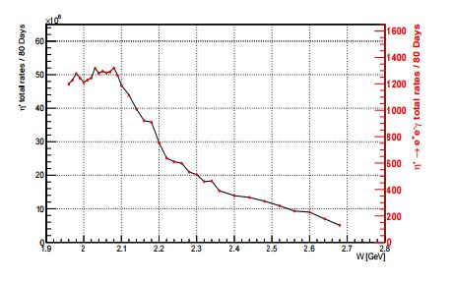
E12-06-108B Transition Form Factor of the η’ Meson with CLAS12
M. C. Kunkel
D. Lersch
From previous CLAS analyses using the g12 data set, it was shown that measurements of the time-like transition form factor were achievable, but without the statistical precision needed to be competitive.
Therefore, we propose to use CLAS12 to measure the Dalitz decay channel of the reactions
ep → e’p η’ , where η’ → e +e −γ, through detection of the final state proton and η’ decay products. Preliminary studies using the CLAS12 simulation suite have shown that a beam time of 80 days, at full luminosity, will accumulate a data sample at least one order of magnitude larger in statistics than the most current η’ → e +e −γ measurement and would yield a statistical uncertainty . 0.5%
Total η’ production rate per 80 days (left y-axis) and
total η’ → e +e −γ rates per 80 days (right y-axis) as
a function of W

Slide 6
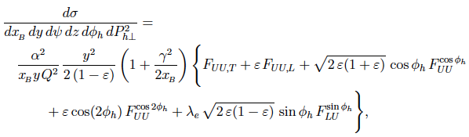
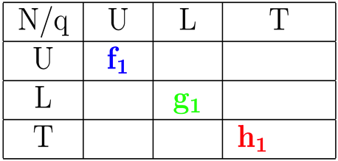
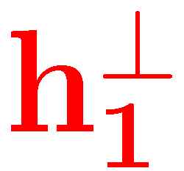





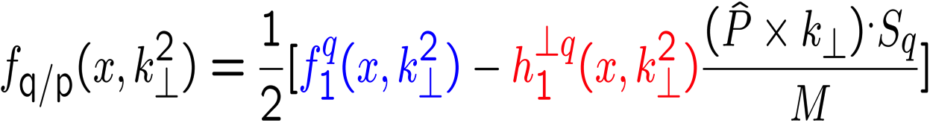
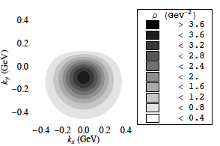
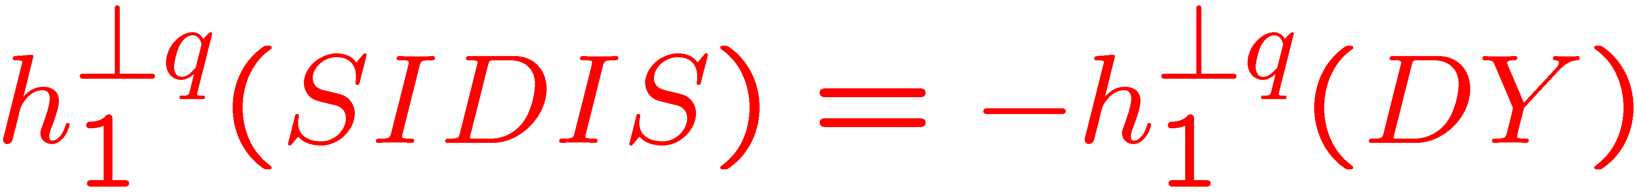
E12-06-112 Proton’s quark dynamics in semi-inclusive pion production at 11 GeV
H.Avakian, M.Contalbrigo, Z.Meziani,
B. Seitz, K.Joo
T
HT
HT
u-quarks
HT
BM TMD (1998) describes correlation between the transverse momentum and transverse spin of quarks, requires FSI or ISI
d-quarks
BM TMD under intensive studies worldwide, including SIDIS and DY experiments, model calculations, lattice simulations.

Slide 7
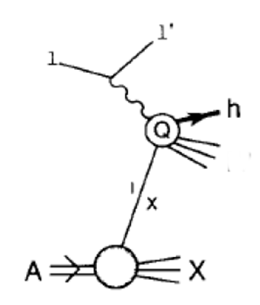
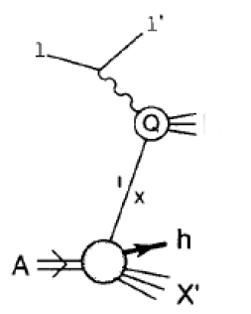
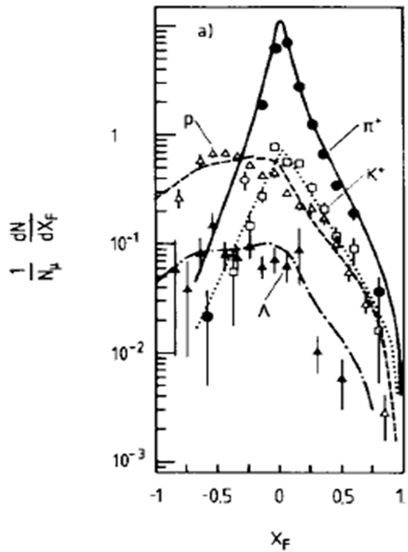
E12-06-112A Semi inclusive Λ production in target fragmentation region
Semi-Inclusive production of hadrons e p → e h X
M. Mirazita
Current Fragmentation Region, CFR
h is produced by the struck q
Target Fragmentation Region, TFR
h is produced by the nucleon remnants
Fracture Function
probability to produce a hadron h when the quark of type i is hit by the virtual photon
TFR is the dominant baryon production mechanism at backward angles
It may still contribute at forward angles
TFR/CFR separation needs to be understood

Slide 8
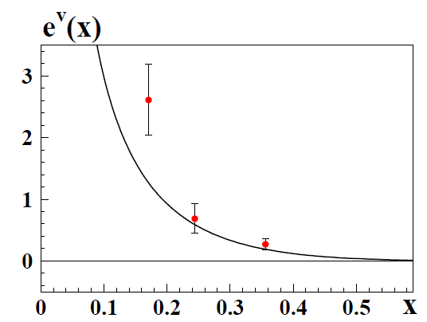
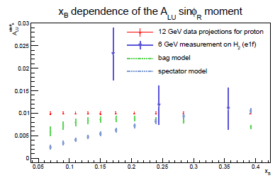
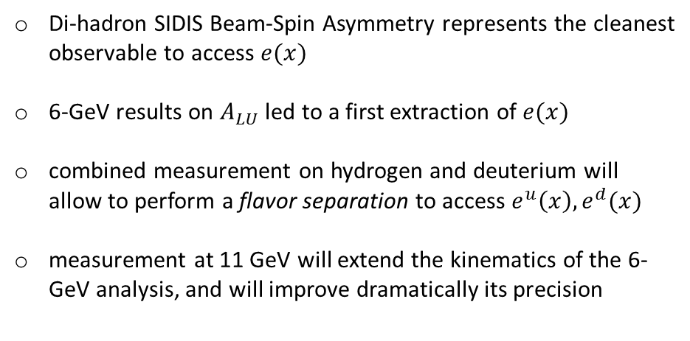
E12-06-112B/E12-09-00 Higher-twist collinear structure of the nucleon through di-hadron SIDIS on unpolarized hydrogen and deuterium.
S. Pisano
Higher-twist 1D Parton Distribution Function $e(x)$ offers important insight into the quark-gluon correlations, and its integral is related to the scalar charge of the nucleon and to the nucleon-pion sigma term
Di-hadron SIDIS Beam-Spin Asymmetry represents the cleanest observable to access $e(x)$
6-GeV results on $A_{LU}$ led to a first extraction of $e(x)$
combined measurement on hydrogen and deuterium will allow to perform a flavor separation to access $e^{u}\left(x\right),e^{d}(x)$
measurement at 11 GeV will extend the kinematics of the 6-GeV analysis, and will improve dramatically its precision
A. Courtoy, extraction on preliminary CLAS data - arXiv:1405.7659
LFCQM, Lorcé, Pasquini, Schweitzer, arXiv:1411.2550

Slide 9
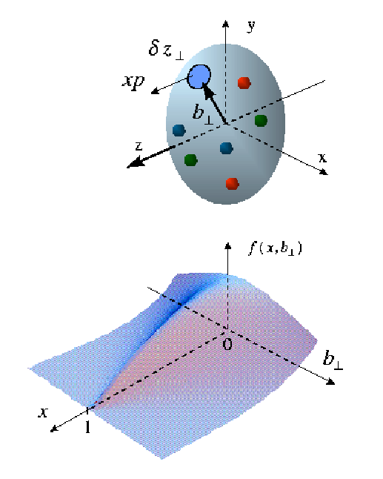


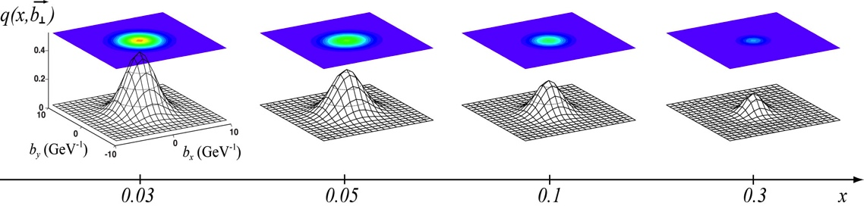
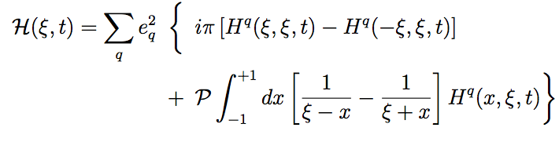

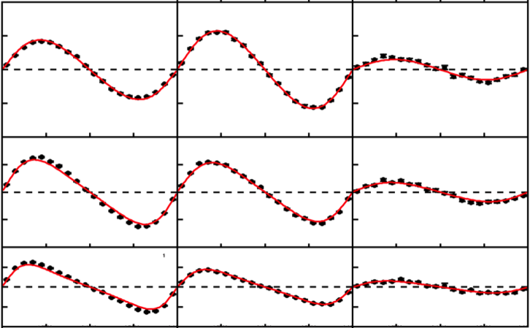
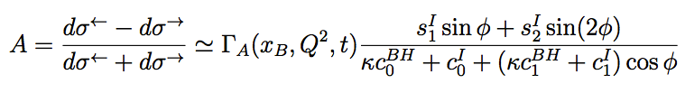


E12-06-119 Deeply Virtual Compton Scattering with CLAS12
F. Sabatie
A. Biselli
H. Egiyan
L. Elouadrhiri
M. Holtrop
D. Ireland
W. Kim
Q_{hard}² large
*
t = Δ²
Mueller, Ji, Radyushkin (94-96)
low -t process :
-t << Q_{hard}²
x + ξ
x - ξ
P - Δ/2
GPDs (x, ξ ,t)
P + Δ/2
Mostly H for unpolarized proton target
~
The DVCS amplitude is expressed in terms of Compton Form Factors (CFF) at LO:
(similarly for other GPDs)
GPD parametrization needed for ξ=0 or t=0 extrapolations
CLAS12 pseudo-data sample in :
0.2 < x_{B} < 0.5 , 2 < Q² < 5 GeV²
0.25 < -t < 0.35 GeV²
Q²
A_{LU}
0.5
Parametrized
GPDs
Lots of new
developments in
the next 5 years
By measuring Beam and Target Spin Asymmetries, and through an harmonic analysis,
one may extract Imaginary and Real parts of CFF :
0
-0.5
x_{B}
Fit to CLAS6 or CLAS12 A_{LU}

Slide 10
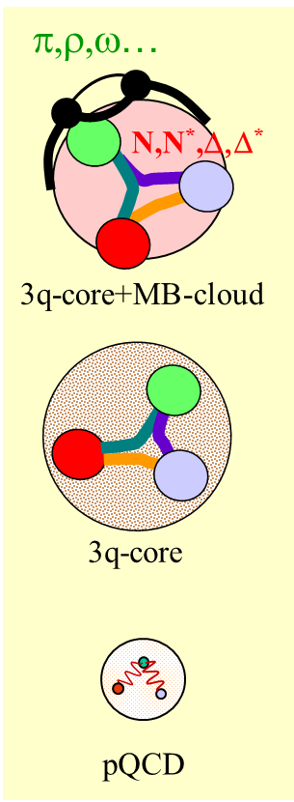
E12-09-003 Nucleon Resonance Studies with CLAS12
CLAS12 will be only available facility worldwide capable of obtaining electro-excitation amplitudes for all prominent N* states from exclusive measurements of single meson, double pion, and KY electroproduction at still unexplored ranges from low photon virtualities down to 0.05 GeV² up to the highest photon virtialities ever achieved for exclusive reactions (5.0 GeV² <Q²< 12 GeV²).
The expected results will allow at low Q² to
  search for new states of hadronic matter - hybrid baryon,
  extend the previous high-statitics analyses of exclusive meson photoproduction continuously to the new CLAS12 electroproduction data,
and at high Q² to
  probe quark distributions in excited baryons,
  explore the dressed quark mass evolution at the distances where the transition from quark-gluon confinement to pQCD regime is expected, and thus addressing the most challenging problems of quark-gluon confinement and on the nature of 98% of the hadronic mass in the universe.
R. Gothe
V. Burkert
P. Cole
K. Joo
V. Mokeev
P. Stoler
The “Studies of the Excited Baryon Structure with CLAS12” will continue a productive and synergetic collaboration between experiment, phenomenology, and theory. This program will be very beneficial for Jefferson Lab since it will substantially contribute to the broad international efforts on the exploration of the strong interaction in non-perturbative regime and thus solidifying the US leadership in this important area, Int. J. Mod. Phys. E, Vol. 22, 1330015 (2013) 1-99.
Notes:
10
3 channles times 4 structure functions (12) plus 9 single diff cross sec => 21 observables
60 days, lattice, GPDs, easier to study, different branching ratios, combined analysis, transition towards partonic degrees of freedom
November 14-18, 2016

Slide 11
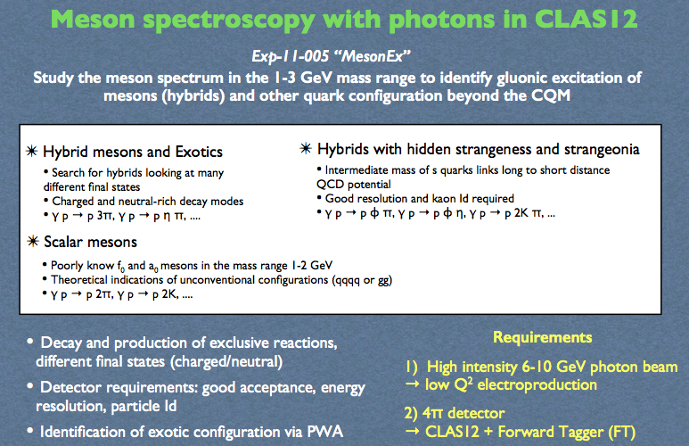
E12-11-005
M. Battaglieri
R. De Vita
C. Salgado
S. Stepanyan
D. Watts
D. Weygand

Slide 12
E12-11-005A Photoproduction of the very strangest baryons on a proton target in CLAS12
L. Guo
M. Dugger
J. Goetz
E. Pasyuk
I. Strakovski
D. Watts
N. Zachariou
V. Ziegler
 | Detected particles | Measured Decays | Overall Efficiency | Rate/hr | Total Detected
Ω⁻ | K⁺K⁺K⁰ |  | ~3.9% | ~3.6 | ~7k
Ω⁻ | K⁺K⁺K⁰K⁻ | Ω⁻ | ~0.5% | ~0.5 | ~1k
Ξ⁻ | K⁺K⁺π⁻ | Ξ⁻ | ~9.3% | ~440 | ~0.9M
Ξ⁻(1530) | K⁺K⁺π⁻ | Ξ⁻(1530) | ~7.4% | ~140 | ~270K
Ξ⁻(1820) | K⁺K⁺K⁻p | Ξ⁻(1820)Λ | ~0.63% | ~6 | ~12K
Ω⁻ photoproduction: Mass resolution
Expected Ω⁻ Cross section Measurements
Assuming half field and 80 beam days
Vertex Efficiency/Branching Ratio included

Slide 13
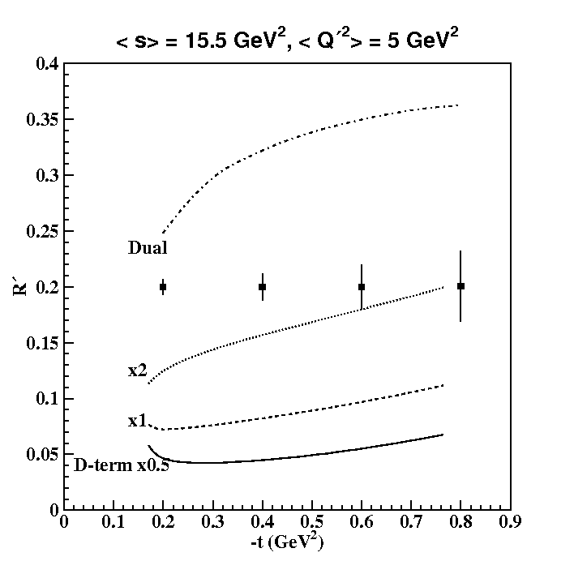
E12-12-001 Timelike Compton Scattering and J/psi photoproduction on the proton in e+e- pair production
P. Nadel-Turonski
M. Guidal
T. Horn
R. Paremuzyan
S. Stepanyan
Approved for 100 days with the run group and 20 additional days with reversed torus polarity
Timelike-spacelike correspondence and the universality of GPDs
Of fundamental importance for the GPD program
Analogous to universality of PDFs in DIS and Drell-Yan
Compton Form Factor fits
Combined fits of TCS and DVCS data significantly reduces uncertainty on CFFs compared with DVCS alone
TCS moments are sensitive to the D-term
  The figure shows statistical uncertainties in a rather wide bin of s and Q² for 100 days at a luminosity of 10³⁵. The lower curves show the double distribution with different values of the D-term (x1 is nominal).
First measurement of J/ψ production near threshold
Establish reaction mechanism
Access to gluonic structure of the nucleon

Slide 14
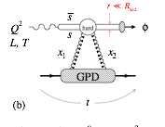
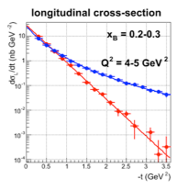
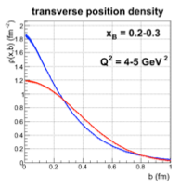
E12-12-007 Exclusive Phi Meson Electroproduction with CLAS12
P. Stoler
C. Weiss
F. X. Girod
M. Guidal
V. Kubarovsky
^{Physics objectives}
Quantify approach to small-size regime in exclusive phi production at Q² > 1 GeV²
Extract nucleon’s gluonic transverse size in valence region
Explore signatures of possible intrinsic s-sbar near threshold
Simple final state, analysis well understood, multiple cross-checks
Immediate physics impact, no global analysis required
^{Impact and significance}
Unique access to gluons in JLab12 kinematics
Complements studies of quark transverse distributions with elastic FFs & GPDs
Results can be directly interpreted & connected with high-energy data
Growing interest in gluonic structure & imaging with future EIC
^{Observables and analysis}
Differential cross section dσ/dt: Q² and W dependence for reaction mechanism, t-dependence for gluonic size — insensitive to absolute normalization
L/T ratio from φ -> KK decay — simple, well established technique
Possible to check φ reconstruction using KL KS mode

Slide 15
Possible RG Schedule (straw man)
Run Group | Days | 2016 | 2017 | 2018 | 2019 | 2020 | 2021 | 2022 | Remain
All Run Groups | 1036^{#)} | 30 | 15 | 95 | 105 | 105 | 105 | 105 | 456
HPS | 180* | 15 |  | 35 | 10 | 10 | 10 | 10 | 90
PRad | 15* | 15 |  |  |  |  |  |  | 0
CLAS12 Comm |  |  | 3 15 |  |  |  |  |  | 0
RG-A + RG-K (proton) | 239* |  | 10 | 20/15 25 |  | 35 | 20 |  | 114*
RG-B (deuteron) | 90* |  |  |  | 40 |  |  |  | 50*
RG-F (BoNuS) | 42* |  |  |  | 21 |  |  |  | 21
RG-C (NH₃) | 120 |  |  |  | 35 | 25 |  |  | 60
RG-C-b (ND₃) | 65 |  |  |  |  | 35 |  |  | 30
RG-E (Hadr.) | 60 |  |  |  |  |  | 35 |  | 25
RG-H (Transv. Target) | 110* |  |  |  |  |  | 40 | 20 | 50
RG-D (CT) | 60 |  |  |  |  |  |  | 40 | 20
RG-G (LiD) | 55 |  |  |  |  |  |  | 35 | 20
^{#)} incl. RG-H

Slide 16
RUN Group A Beam Time Request
In addition to the 20 days for the commissioning experiment, high luminosity running of 60 days is needed for 4 experiments (E12-06-108, E12-06-119, E12-11-005, E12-12-001). Experiment E12-11-005 requires lower luminosity operation for 39 days. Experiment E12-12-001 declared that the 80 days plus the 39 days addition low luminosity days are equivalent to the total of 100 days they had requested.
2) E12-12-001 received approval for additional 20 days of running at reversed Torus polarity.
The listed RG-A time of 139 days will thus serve all PAC-approved experiments with a total of 559 days of individually approved beam times. (This number does not include the run group experiments, which account for an additional 300 days if run independently.)
3) Experiment E12-11-005 part of RG-A requires the Forwards Tagger (FT) that allows for electron scattering at very low Q² (10⁻² −10⁻¹ GeV²), which provides a high photon flux and a high degree of linear polarization, complementary to the capabilities of Hall D. The FT detector systems will require an independent Experimental Readiness Review (ERR) prior to installation and operation as part of CLAS12.

Slide 17
RUN Group A 2017
- KPP run has been a success indeed because it gathered people to focus on this briliant achievement.
- The same effort has to be repeated now and RGA is on the first line, starting with the engineering run.
- With the hopeful delivery of the Solenoid and the full Central Detector, there will be some added difficulties but we will have better tracking..
- C4F10 issue …
The obvious main steps being :
Alignment : how do we go from perfect geometry to reality. Need persons in charge (probably for each detector) and procedures and documentation.
Cosmic runs during October will be a good opportunity to debug the systems.
Calibration: define calibration persons in charge for each detector subsystem.
Reconstruction: Proof of principle with simulated data. Seems in good shape
Analysis: from reconstructed data to the physics results. Proof of principle with simulated data. Again, need one (or more) person in charge. Is the software ready and available?
Etc…
- Use the ACE Committee to transmit our recommendations.

