Slide 1
Data Management with HDF5
Quincey Koziol
Principal Data Architect
NERSC – LBNL
koziol@lbl.gov

Slide 2
Why HDF5?
Have you ever asked yourself:
  How will I deal with one-file-per-processor in the petascale era?
  Do I need to be an “MPI and Lustre pro” to do my research?
  Where is my checkpoint file?
HDF5 hides all complexity so you can concentrate on Science
  Optimized I/O to single shared file

Slide 3
Goal
Introduce you to HDF5
  HDF5 Overview
  Data Management Overview
  Managing HDF5 Data
Notes:
300+ API
High points, little programing,

Slide 4
What is HDF5?

Slide 5
What is HDF5?
HDF5 == Hierarchical Data Format, v5
Open file format
  Designed for high volume or complex data
Open source software
  Works with data in the format
An extensible data model
  Structures for data organization and specification
Notes:
HDF5 no relationship to HDF4, not back ward compatable, translater.
Open source, downloat, patches, like to hear
Analogous to…..

Slide 6
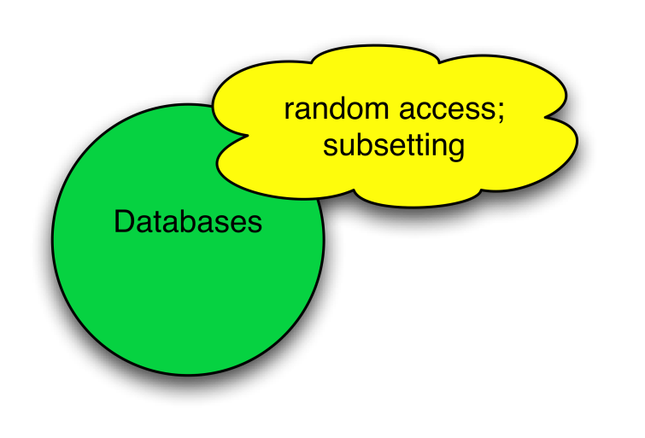
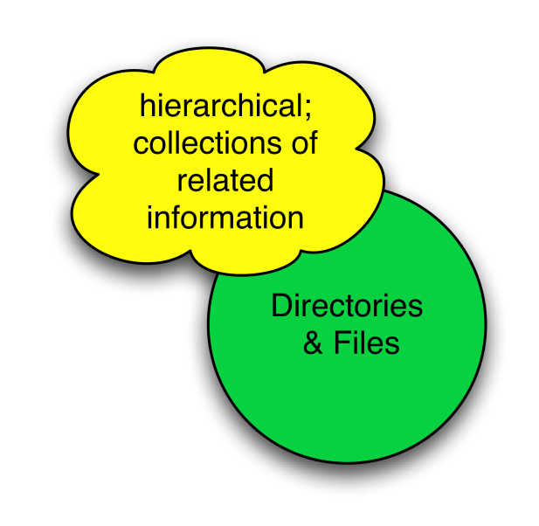
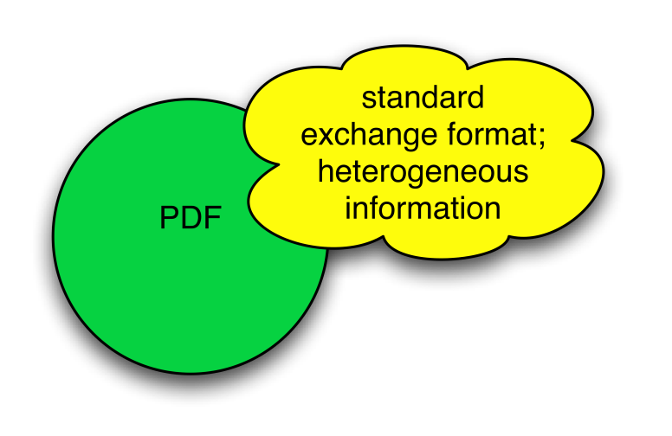
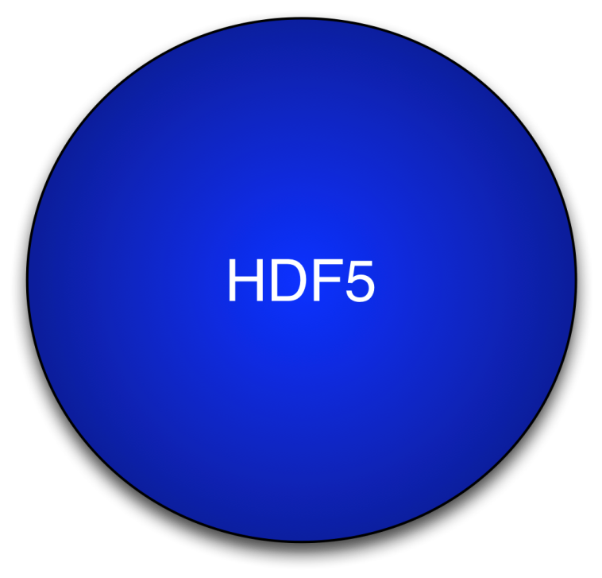
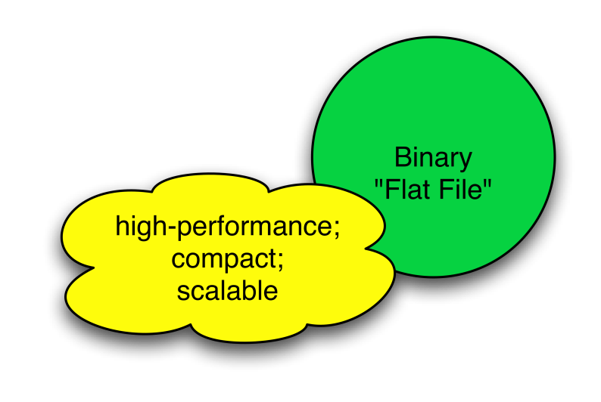
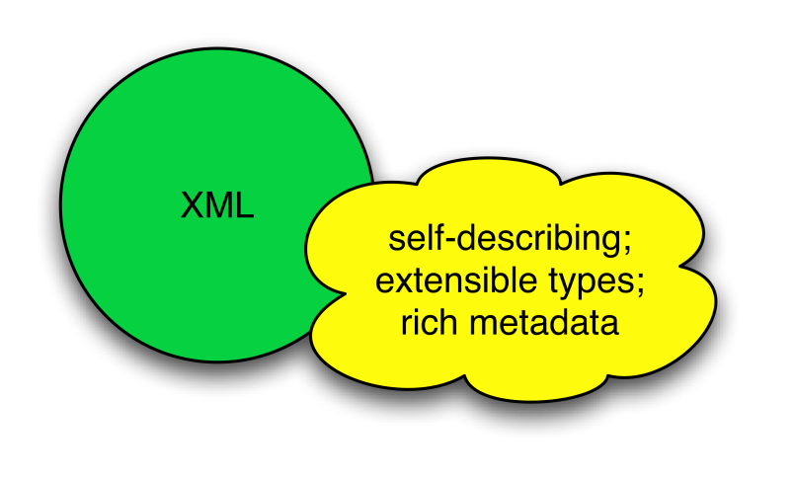
HDF5 is like …
Notes:
Xml –
Binary component
Pdf of science data, portable
Like a grouping, links between object,
Not exactly like any of these things, fast, runs everywhere,

Slide 7
HDF5 is designed …
for high volume and/or complex data
for every size and type of system (portable)
for flexible, efficient storage and I/O
to enable applications to evolve in their use of HDF5 and to accommodate new models
to support long-term data preservation
Notes:
Get data back in 50 years, simulation data available for future comparison, NASA satellite data available for 50 plus years, archive the data.

Slide 8
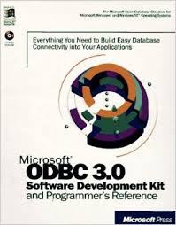
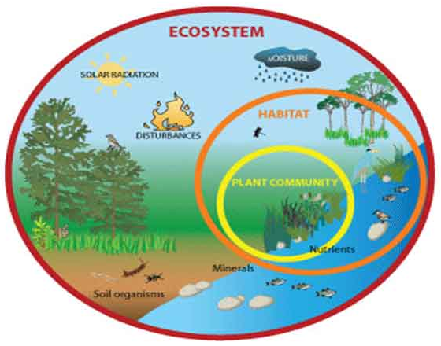




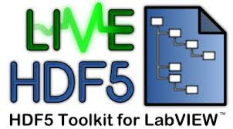
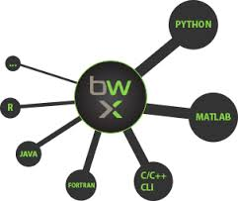




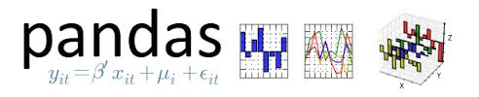

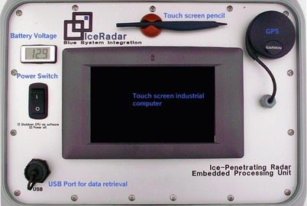













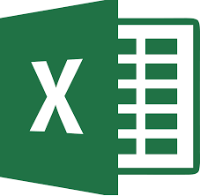




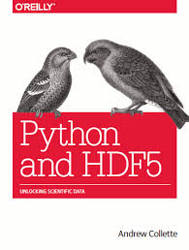





HDF5 Ecosystem
Supporters
Data Model
…
Library
File Format
…
Tools
Documentation

Slide 9
HDF5 Data model
Notes:
Ab

Slide 10
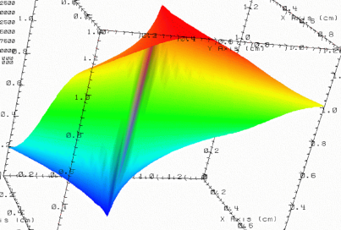


HDF5 File
lat | lon | temp
----|-----|-----
12 | 23 | 3.1
15 | 24 | 4.2
17 | 21 | 3.6
An HDF5 file is a container that holds data objects.
Experiment Notes:
Serial Number: 99378920
Date: 3/13/09
Configuration: Standard 3
Notes:
Container to hold objects

Slide 11
HDF5 Data Model
Dataset
Link
Group
HDF5
Objects
Datatype
Attribute
Dataspace
File
Notes:
Componets and building blocks. On the left are the fundemental components and on the right are the supporting componets , these are the compontes when you work with HDF5.

Slide 12
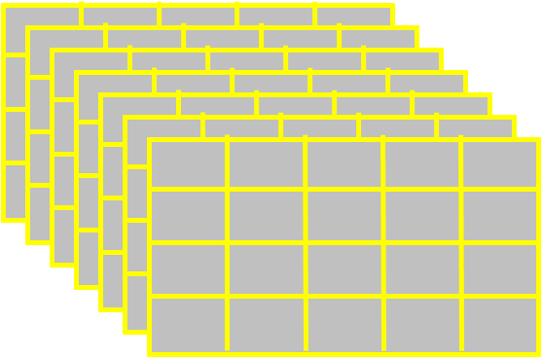
HDF5 Dataset
HDF5 Datatype
Integer: 32-bit, LE
HDF5 Dataspace
Rank
Dimensions
3
Dim[0] = 4
Dim[1] = 5
Dim[2] = 7
Specifications for single data
element and array dimensions
Multi-dimensional array of
identically typed data elements
HDF5 datasets organize and contain data elements.
  HDF5 datatype describes individual data elements.
  HDF5 dataspace describes the logical layout of the data elements.
Notes:
Beginning with HDF, multi dimensional, they are extensiable.
½ of dataset, the other ½ in the metadata, the data is self describing so you have to tell what type of data it is, the rank of the data and the dimension in each direction.

Slide 13
HDF5 Dataspace
Describes the logical layout of the elements in an HDF5 dataset
  NULL
    no elements
  Scalar
    single element
  Simple array (most common)
    multiple elements organized in a
    rectangular array
      rank = number of dimensions
      dimension sizes = number of elements in each dimension
      maximum number of elements in each dimension
        may be fixed or unlimited
Extreme Scale Computing Argonne
Notes:
Scalar (attributes), maxium so that can extent.

Slide 14
HDF5 Dataspace
Two roles:
  Dataspace contains spatial information
  Rank and dimensions
  Permanent part of dataset
  definition
  Partial I/0: Dataspace describes application’s data buffer and data elements participating in I/O
Rank = 2
Dimensions = 4x6
Rank = 1
Dimension = 10
Notes:
To roles: the i
Talk more about selection later

Slide 15
HDF5 Datatypes
Describe individual data elements in an HDF5 dataset
Wide range of datatypes supported
  Integer
  Float
  Enum
  Array
  User-defined (e.g., 13-bit integer)
  Variable-length types (e.g., strings, vectors)
  Compound (similar to C structs)
  More …
Extreme Scale Computing HDF5
Notes:
The other ½ of a dataset it datatypes, 13 bit (satalite sensors etc). Can be as

Slide 16
HDF5 Dataset
3
5
12
Datatype: 32-bit Integer
Dataspace: Rank = 2
Dimensions = 5 x 3
Notes:
And the value is 12.

Slide 17
HDF5 Dataset with Compound Datatype
3
5
V
V
V
V V V
V V V
uint16
char
int32
2x3x2 array of float32
Compound
Datatype:
Dataspace: Rank = 2
Dimensions = 5 x 3
Notes:
Similarly, compound data type. 32 bit int, whole array is templated out with these compound data types.

Slide 18
How are data elements stored?
Buffer in memory
Data in the file
Data elements stored physically adjacent to each other
Contiguous
(default)
Better access time for subsets; extendible
Chunked
Chunked & Compressed
Improves storage efficiency, transmission speed
Notes:
3 most popular one
Very fast, simple, underlinig IO find it.
Break up dataset into chunks, to IO then you can read in just that simple part, otherwise you have to read and seek. So if you have a IO pattern that allows for chunking then you should do it, it also allows the data set to extendable. Sub set, with contiguous the extension is eventually going to bump into something else piece of it are stored around and they are indexed to find them.

Slide 19
HDF5 Attributes
Typically contain user metadata
Have a name and a value
Attributes “decorate” HDF5 objects
Value is described by a datatype and a dataspace
Analogous to a dataset, but do not support partial I/O operations; nor can they be compressed or extended
Notes:
Can to groups or datasets,
Designed to be small, metadata that you add to things.

Slide 20
HDF5 File
lat | lon | temp
----|-----|-----
12 | 23 | 3.1
15 | 24 | 4.2
17 | 21 | 3.6
An HDF5 file is a smart container that holds data objects.
Experiment Notes:
Serial Number: 99378920
Date: 3/13/09
Configuration: Standard 3

Slide 21



HDF5 Groups and Links
HDF5 groups
and links
organize
data objects.
Every HDF5 file
has a root group
/
Experiment Notes:
Serial Number: 99378920
Date: 3/13/09
Configuration: Standard 3
Parameters
10;100;1000
Viz
SimOut
lat | lon | temp
----|-----|-----
12 | 23 | 3.1
15 | 24 | 4.2
17 | 21 | 3.6
Timestep
36,000
Notes:
Want to have structure,
Can create grouping structures, links, refer to objects in other containers.
A lot like a file system, all has a root group.

Slide 22
HDF5 software

Slide 23
HDF5 Home Page
HDF5 home page: http://hdfgroup.org/HDF5/
  Latest release: HDF5 1.10.0 (1.10.1 coming May 2017)
HDF5 source code:
  Written in C, and includes optional C++, Fortran APIs, and High Level APIs
  Contains command-line utilities (h5dump, h5repack, h5diff, ..) and compile scripts
HDF5 pre-built binaries:
  When possible, include C, C++, Fortran, and High Level libraries. Check ./lib/libhdf5.settings file.
  Built with and require the SZIP and ZLIB external libraries

Slide 24
Useful Tools For New Users
h5dump:
Tool to “dump” or display contents of HDF5 files
h5cc, h5c++, h5fc:
Scripts to compile applications
HDFView:
Java browser to view HDF5 files
http://www.hdfgroup.org/hdf-java-html/hdfview/
HDF5 Examples (C, Fortran, Java, Python, Matlab, …)
https://www.hdfgroup.org/HDF5/examples/
Notes:
Groups, datasets,
Building complicated, not expected to use these wrappers., java browers,

Slide 25
Data Management Overview

Slide 26
Data Centric Computing
A variety of services to support data-centric workloads. Encompasses tools in the areas of:
Data Analytics (statistics, machine learning, imaging)
Data Management (storage, representation)
Data Transfer
Workflows
Science Gateways
Visualization

Slide 27
Data Centric Computing
A variety of services to support data-centric workloads. We provide tools in the areas of:
Data Analytics (statistics, machine learning, imaging)
Data Management (storage, representation)
Data Transfer
Workflows
Science Gateways
Visualization

Slide 28
Why Manage Your Data?
“Data management is the development, execution and supervision of plans, policies, programs and practices that control, protect, deliver and enhance the value of data and information assets.”*
*DAMA-DMBOK Guide (Data Management Body of Knowledge) Introduction & Project Status
Notes:
Story about NASA’s tape baking machine

Slide 29
General Recommendations
Use modern, scientific I/O libraries (HDF5, NetCDF, ROOT) to represent and store scientific data.
Use database technologies (MongoDB, SciDB, MySQL, PostGreSQL) as a complementary mechanism for storing and accessing data when appropriate.
Restrict use of low-level, POSIX I/O from applications to NERSC file systems, if possible.

Slide 30
Scientific I/O Goals
I/O is commonly used by scientific applications to achieve goals like:
Storing numerical output from simulations for later analysis
Implementing 'out-of-core' techniques for algorithms that process more data than can fit in system memory and must page data in from disk
Checkpointing to files, to save the state of an application in case of system failure.
Notes:
In most cases, scientific applications write large amounts of data in a structured or sequential 'append-only' way that does not overwrite previously written data or require random seeks throughout the file.

Slide 31
Why I/O Middleware?
The complexity of I/O systems poses significant challenges in investigating the root cause of performance loss.
Use of I/O middleware for writing parallel applications has been shown to greatly enhance developer’s productivity.
  I/O middleware hides many of the complexities associated with performing parallel I/O, rather than relying purely on programming language aids and parallel library support, such as MPI.
Notes:
Potential factors that may prevent the I/O systems from achieving the peak bandwidth include poor I/O access patterns, load imbalance either among the MPI processes or in the underlying file system or both, lock contention, etc.

Slide 32
I/O Middleware
HDF5
  A data model and set of libraries & tools for storing and managing large scientific datasets.
netCDF
  A set of libraries and machine-independent data formats for creation, access, and sharing of array-oriented scientific data.
ROOT
  A self-describing, column-based binary file format that allows serialization of a large collection of C++ objects and efficient subsequent analysis.
FITS, CGNS, …

Slide 33
Science Data Management Problems

Slide 34
Problems
“A supercomputer is a device for turning compute-bound problems into I/O-bound problems.” (Ken Batcher)
My application spends too much time in I/O.
It doesn’t scale because of I/O.
I’m told my system is capable of X, but I’m getting less than 1% of X.
…

Slide 35
Common Causes of I/O Problems
Undersized I/O system for the compute partition
Misconfigured system (for the application)
Interference with other running applications
The way your application reads and writes data leads to poor I/O performance
While 1 - 3 are possibilities, 4 is the most likely scenario. (… and it’s not always your fault!)

Slide 36
Towards Achievable Goals
Rule out / quantify 1 - 3 through benchmarking and repeated application runs
Characterize application I/O through profiling
Create a performance improvement plan
  “Spectrum of control”
    My I/O layer] ← … → [Closed-source 3rd-party lib.
  Know your system’s capabilities and your resources (budget, skills, …)
  Be prepared to settle for a lot less (sometimes).

Slide 37
Methodology
Most of this is common sense, but deserves to be repeated.

Slide 38
Prepare a Baseline
Full application vs. I/O kernel
Performance model
  Back-of-the-envelope calculations
Benchmarks
Application runs with representative workloads
Metrics (examples)
  I/O size in megabytes read and written
  I/O rate in MB/s
  Percentage of application time spent in I/O
  Distribution of write and read sizes

Slide 39
Define the Search Space
Goal is to establish the “fundamentals” (or rule out certain causes)
Define lines (loops!) of investigation
Walk the loop(s) and document setup and results
  Low hanging fruit first (if there are any)
Fewer variables are better than too many
  NEVER change more than one variable at a time
Depends on level of control and budget

Slide 40
Know When to Stop
You might have:
Reached your goal (unlikely)
Exhausted your budget (frequently)
Gotten on a path of diminishing returns (most likely)
New problem in a different part of the application (always)

Slide 41
Managing HDF5 Data

Slide 42
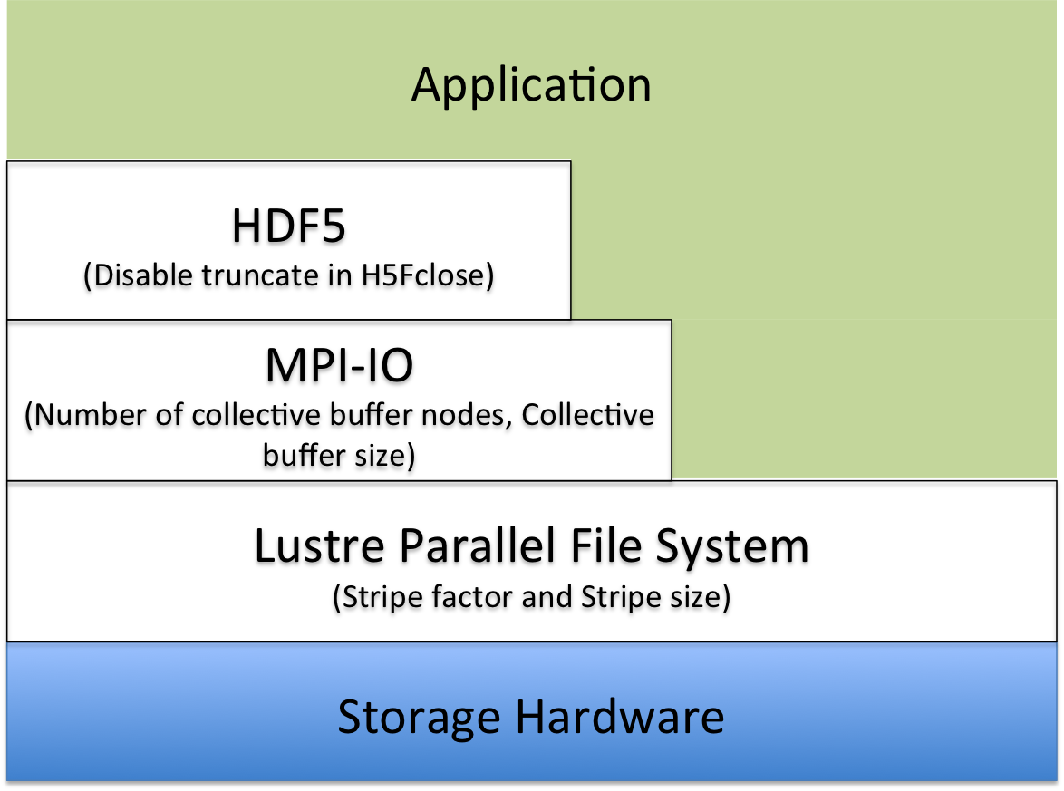
Don’t Forget: It’s a Multi-layer Problem

Slide 43
Data and Metadata I/O in HDF5
Data
Metadata
Problem-sized
I/O can be independent or collective
Improvement targets:
  Avoid unnecessary I/O
  I/O frequency
  Layout on disk
    Different I/O strategies for chunked layout
  Aggregation and balancing
  Alignment
Small
Reads can be independent or collective
All modifying I/O must be collective
Improvement targets:
  Metadata design
  Use the latest library version, if possible
  Metadata cache
    In desperate cases, take control of evictions

Slide 44
HDF5 Inside…

Slide 45


Slide 46
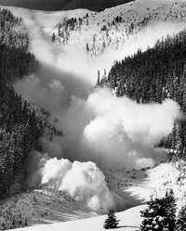
The National Snow and Ice Data Center
NSIDC at the University of Colorado at Boulder supports research into our world's frozen realms: the snow, ice, glaciers, frozen ground, and climate interactions that make up Earth's cryosphere.

Slide 47
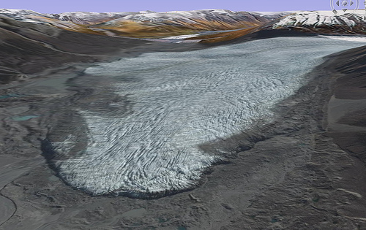
NSIDC
NSIDC manages and distributes scientific data, creates tools for data access, supports data users, performs scientific research, and educates the public about the cryosphere.
NSIDC manages cryosphere-related data ranging from the smallest text file to terabytes of remote sensing data from NASA’s Earth Observing System satellite program.

Slide 48
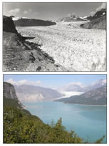
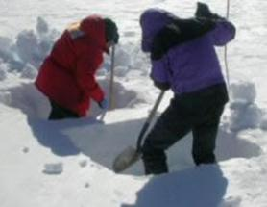
Here, scientists dig snow pits as part of the Megadunes expedition in Antarctica.
Muir Glacier in Alaska, like many glaciers around the world, has changed through time. At top, the glacier in 1941; at bottom, the glacier in 2004.

Slide 49
Data management at NSIDC
NSIDC archives data and makes hundreds of scientific data sets accessible to researchers around the world.
We work with data providers and users to understand their needs and offer documentation, tools, and formats that support scientific research.
NSIDC also works to ensure that data and related information are continually preserved and will be accessible for the longer term, so that researchers can study climate change over long periods.
Together, these practices ensure the physical and scientific integrity of the data we manage and disseminate.

Slide 50
HDF5 Inside…

Slide 51

NPOESS
The National Polar-orbiting Operational Environmental Satellite System

Slide 52
What is NPOESS?
NPOESS is the next generation of low earth orbiting environmental satellites.
The NPOESS will circle the Earth approximately once every 100 minutes.
The NPOESS will provide global coverage, monitoring environmental conditions, collecting, disseminating and processing data about the Earth's weather, atmosphere, oceans, land, and near-space environment.
The NPOESS will collect a massive amount of earth surface, atmospheric and space environmental measurements from a variety of on-board sensors.

Slide 53
Benefits of NPOESS
Will aid in reducing the potential loss of human life and property by allowing more efficient disaster planning and response to severe weather conditions such as tornadoes and floods.
Citizens will benefit in the areas of general aviation, agriculture, and maritime activities.
Will permit the military to capitalize on favorable weather conditions or avoid harsh weather conditions that could hinder maneuverability.

Slide 54
HDF5 Inside…

Slide 55


VISION
“Proud of our past, with a Vision for Tomorrow”
Aberdeen Test Center

Slide 56
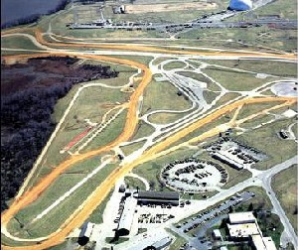
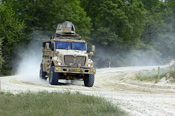

Slide 57
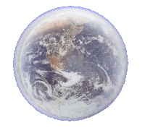
VISION
Knowledge Management Systems
Scripted Scenarios
Test Environment
High Speed Network
Internet
Analyst’s
Workstation
Integrated
Information Systems

Slide 58
Database Methods Considered
Relational database with engineering unit data in tables
Relational database using BLObs and employing Just In Time (JIT) deblobing
Commercial Object-Relational Database
Relational database with engineering unit data in HDF-5 file system

Slide 59


Typical VISION Enterprise HDF5 File Layout
/ (root)
Versions
ChannelDataLabeled
EMETA
Modifications
Purged Channels
Verifications
ChannelData
RMETA
Res_Obj
Misc_Images
Configuration
Validation_Messages
Instrumentation Specific
.
.
.
Date/What
Changed
.
.
Same As ChannelData
Date/What
Changed
.
.
ORIGINAL_FILE_NAME
Instrumentation Specific
.
.
.
RES_UUID
CONFIG_UUID
INV_ID
AST_ID
CTR_ID
PRJ_ID
RES_TYPE
Res_Start_Time
Res_Stop_Time
BlobfileBytes
.
.
.
THUMBNAIL GPS MAP IMAGE (bytes)
ConfigFileUsed (string)
Hardlink
WIDE GPS MAP IMAGE (bytes)
Inventory_Item
Steer Angle (e.g. – Alias from config file)
13 (ID from EUDB)
Tax. params
.
.
.
Thumbnail_GIF (bytes)
ZOOMED GPS MAP IMAGE (bytes)
INV_NOTES
OFFSET_SEC
OFFSET_SEC Removed Data
PASSED VALIDATION CHECKS
Name/Reason
Project
FAILED VALIDATION CHECKS
Name/Reason
.
.
.
VALUE
VALUE Removed Data
Thumbnail_GIF All Data (bytes)
PRJ_NOTES
PRJ_NAME
PRJ_TC_NUMBER
MIN
AVG
MAX
NUMPTS
Extracted Features
Name/ Value
Legend
MIN
AVG
MAX
NUMPTS
TestCenter
.
.
.
.
.
.
Groups
CTR_Abbreviation
CTR_FullName
CTR_HomePage
Histogram
Attributes
Wed Oct 27 12:30:02 EDT 2004
.
.
.
Min,Max,NumBins,Mean,10%,90%,StdDev
BinDataArray
Data Sets
Thumbnail_GIF
Mime
BinDataArray Removed Data
.
.
.
Wed Oct 28 15:45:00 EDT 2004
MimeType
Extension
OriginalFileName
Data (bytes)
Thumbnail_GIF Removed Data

Slide 60
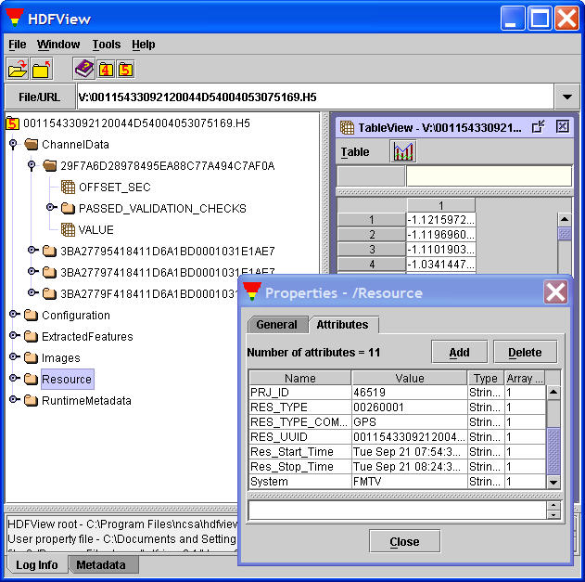
HDF-5 File System

Slide 61
The VISION Engineering Units Database
–
Simplified Diagram

Slide 62
Engineering Units Database
And
HDF-5 File System

Slide 63
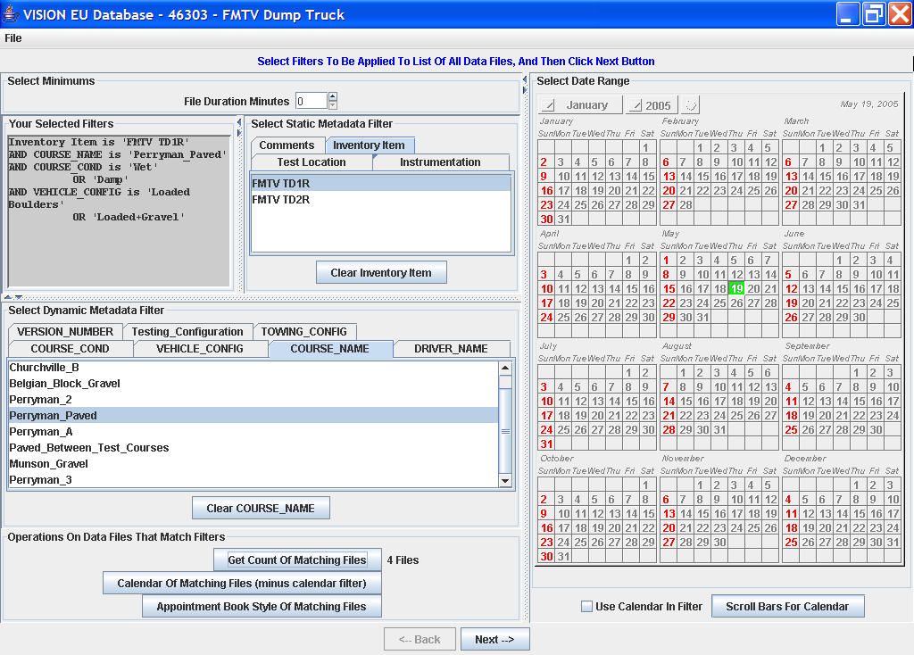
Test Item 1
Test Item 1
Test Item 1
Test Item 2

Slide 64
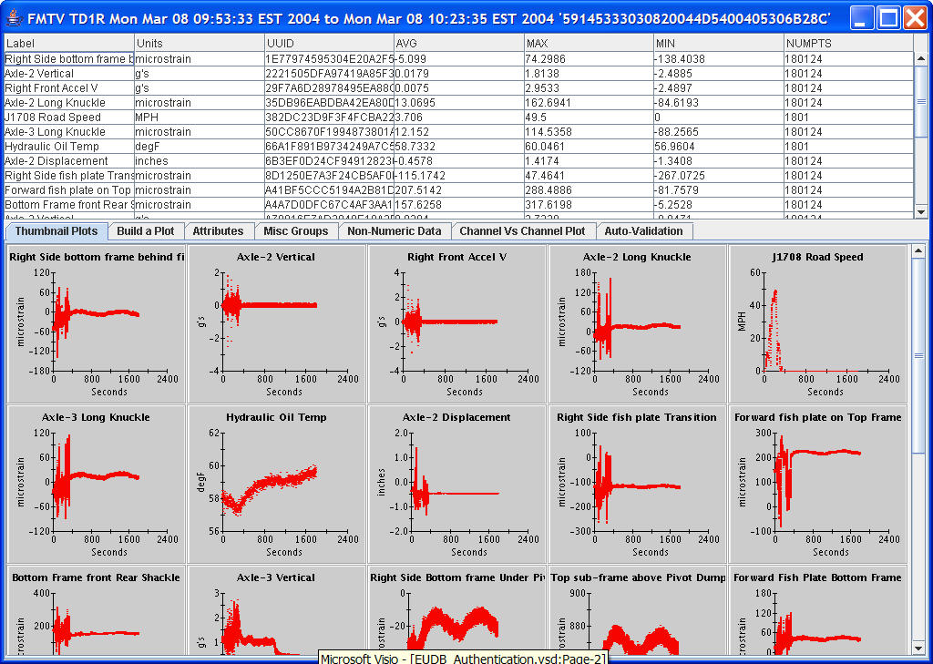
Test Item 1

Slide 65
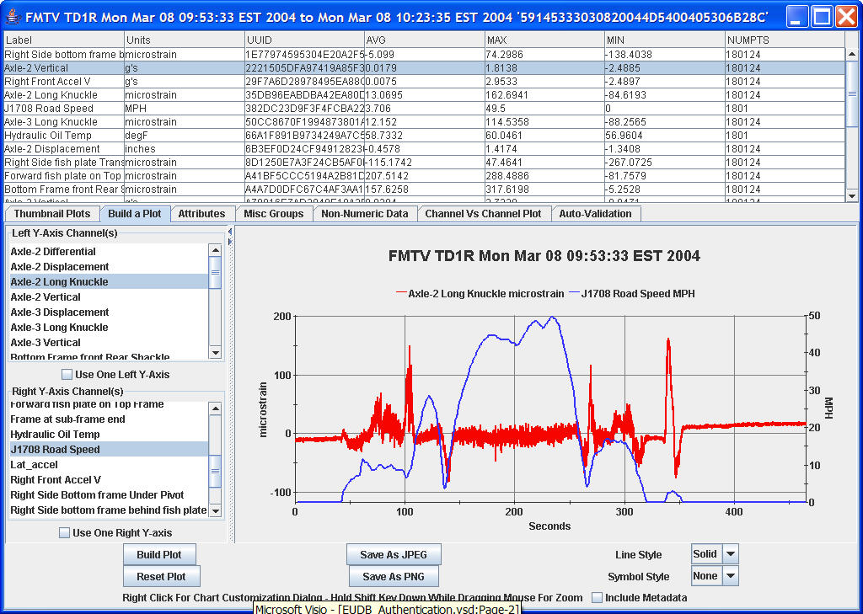
Test Item 1
Test Item 1

Slide 66
HDF5 Inside…

Slide 67
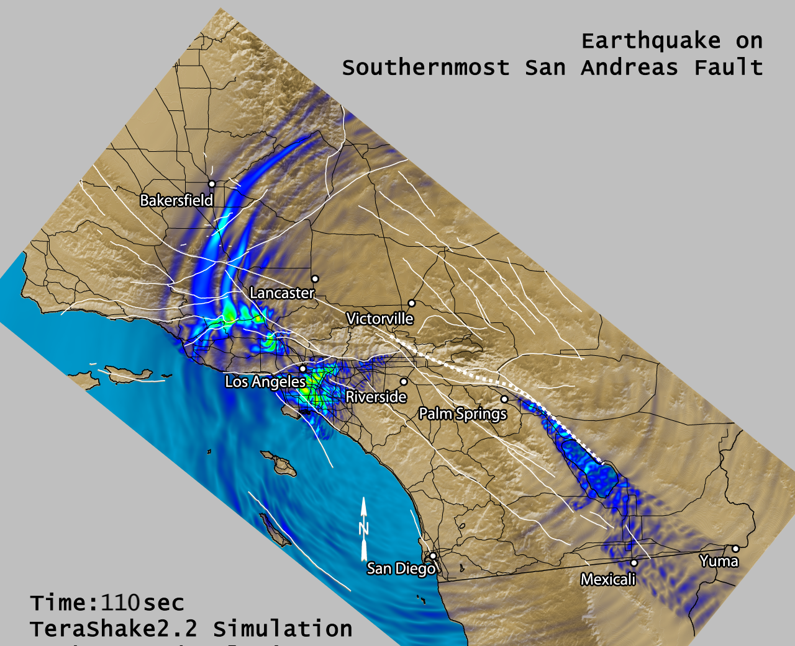
SCEC TeraShake

Slide 68
SCEC TeraShake
The Southern California Earthquake Center digital library publishes scientific data generated by seismic wave propagation simulations.
The output from a single simulation may be as large as 50 Terabytes of data and 400,000 files. The total size of the digital library is over 130 Terabytes with nearly three million files.

Slide 69
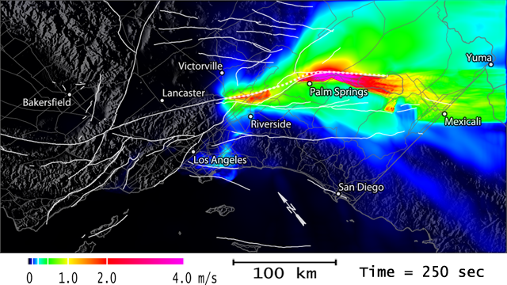
TeraShake Surface Seismograms
4D Array (1.2 TB)
  Time (22,728)
  Horizontal (3,000)
  Vertical (1,500)
  Vector Component (3)
Each file:
  22,728 x 3,000 x 5 x 1
  1,363,680,000 Bytes
TeraShake scenario
  900 files

Slide 70
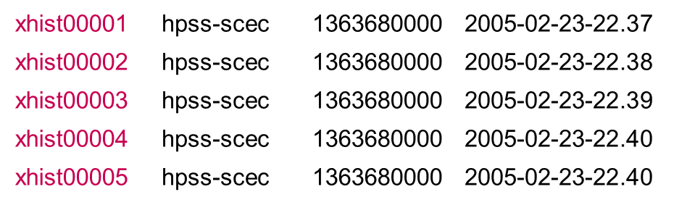
Example HDF5 File
HDF5
File
32-bit
float
22,728
3,000
25

Slide 71
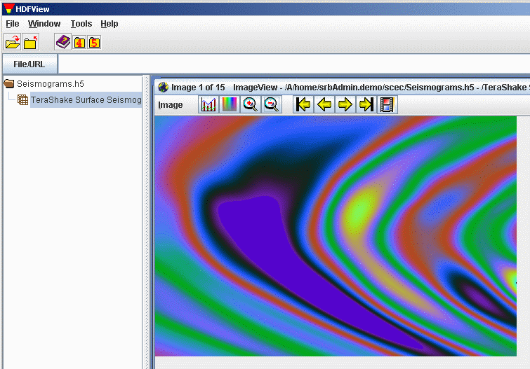
HDFView

Slide 72


Slide 73
HDF5 Inside…

Slide 74
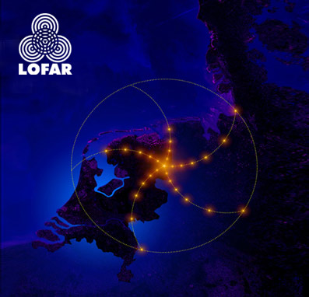

Slide 75
LOFAR Radiotelescope
LOFAR (LOw Frequency ARray) will be the largest radio telescope in the world.
LOFAR is a 'software' radiotelescope.
It is formed by a network of over 25000 small and simple antennas, which are distributed over several Dutch provinces as well as a part of Germany.
These antennas are connected to a supercomputer through an extensive glassfiber network.

Slide 76
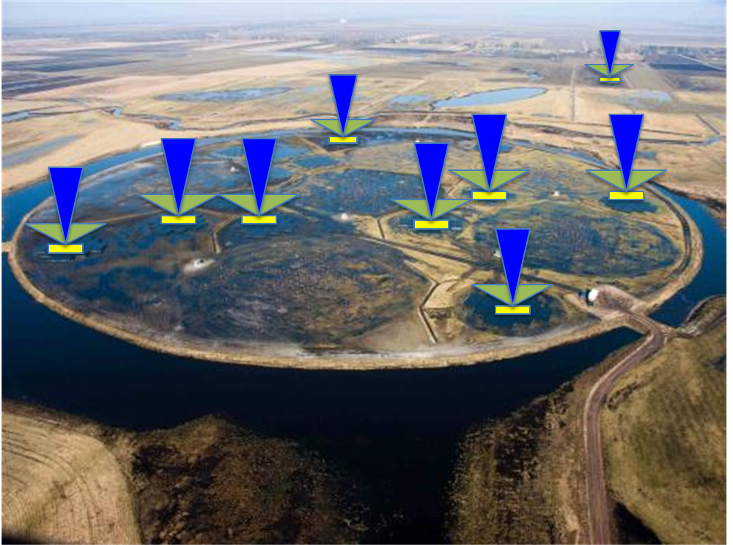
LOFAR “beams”

Slide 77
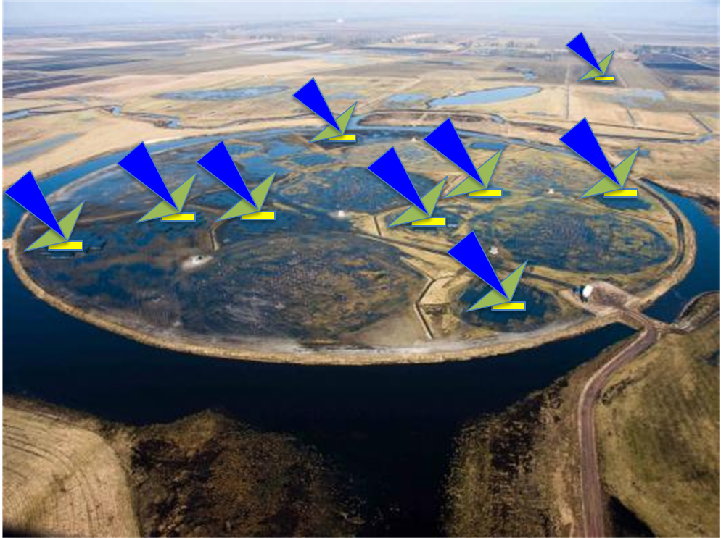
LOFAR “beams”

Slide 78
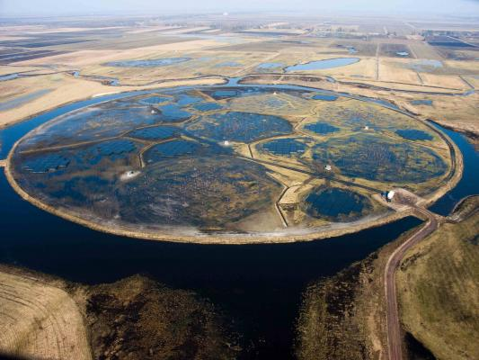
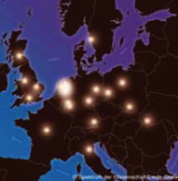
LOFAR “beams”
Multiple
Stations
Future:
40 stations (NL)
8+ stations (EUR)
Currently Operational:
30 stations (NL)
5 stations (EUR)
5.1 nano-second time resolution

Slide 79
LOFAR: Data Challenges and HDF5
Anastasia Alexov
On behalf of the LOFAR Project
ADASS XX, “Towards HDF5…” BoF
November 10, 2010 (Boston)

Slide 80
Data Variety, Complexity and Size!
LOFAR has many observing modes [Imaging/Visibility Data, Beam-Forming (BF)/Time-Series, Transient Buffer Board (TBB) dumps, Rotation Measure Synthesis, etc]
Many different observing modes create data diversity/variety [6 basic LOFAR data types]
Using 30+ LOFAR stations creates enormous data rates and sizes [max ~23TB/hour = ~6GB/s]

Slide 81
LOFAR Sample Dataset Sizes
Exposure Time | Number of Subbands | Number of Stations | File Size Known Mode | File Size Search Mode
1 min | 248 | 5 | 11.2 GB | 56 GB
1 min | 248 | 20 | 11.2 GB | 244 GB
10 min | 248 | 5 | 112 GB | 560 GB
10 min | 248 | 10 | 112 GB | 1.1 TB
10 min | 248 | 20 | 112 GB | 2.2 TB
10 min | 248 | 30 | 112 GB | 3.3 TB
20 min | 248 | 5 | 224 GB | 1.1 TB
30 min | 248 | 5 | 336 GB | 1.7 TB
1 hr | 248 | 5 | 672 GB | 3.4 TB
1 hr | 248 | 10 | 672 GB | 6.7 TB
1 hr | 248 | 20 | 672 GB | 13.4 TB
1 hr | 248 | 30 | 672 GB | 26.8 TB
2 hr | 248 | 5 | 1.3 TB | 6.7 TB
12 hr | 248 | 5 | 8.0 TB | 40.3 TB
12 hr | 248 | 15 | 24.0 TB | 120.1 TB

Slide 82
Astronomical Data “Containers”
(non-comprehensive list)
Binary
FITS (all wavelengths)
CASA [casacore] (Radio)
MBFITS
And many OTHERS (usually for ONE type of data)
Presto
apsr
asp
bcpm
bpsr
caspsr
cpsr
cpsr2
dada
dummy
fadc
fits
gmrt
lbadr
lbadr64
spda1k
mark4
mark5
maxim
mwa
pmdaq
puma
puma2
s2
sigproc
spigot
wapp
  …As a result:
    Software data I/O becomes a mess!
    Tools have to be adapted per data container

Slide 83
Why LOFAR chose (yet) another data format:
Hierarchical Data Format, version 5 (HDF5)
Question: Can only ONE of the astronomical formats (like FITS or CASA) do ALL these things?
HDF5 is a data model, library, and file format for storing and managing large and complex scientific data (images, N-D arrays, tables, metadata).
It supports an unlimited variety of datatypes, and is designed for flexible and efficient I/O and for high volume and complex data.
Self-describing and portable to a diversity of computational environments
No inherent file size limitations; no header Attributes/keys character length limits
C, C++, Java, Fortran 90 interfaces
Can be run on single node or massively parallel/distributed systems (~600 cores)
Built-in compression (GNU zlib, but can be replaced with others)
Parallel reading and writing (via MPI-I/O)
Partial I/O: “Chunked” (tiled) data for faster access
Free and in use for 20+ years by NASA and other projects
Inspection and visualization tools exist (HDFView + command line tools, Visit + pluggin, PyTables, h5py, MATLAB)

Slide 84
Datasets of the Future…
(in HDF5)
Future telescopes have similar challenges:
  Radio: EVLA, ALMA, ASKAP, MeerKAT, MWA, LWA, eMERLIN and SKA!
  Non-Radio: Pan-Starrs, LSST, TMT, GMT, ELT
Collaborations needed to expand HDF5-usage and tool-set in astronomy
Time is ripe to solve this issue across wavelengths and projects; HDF5 is mature and used extensively in science
This is NOT just a “Radio-problem”, it’s an astronomical problem!
Thank You

Slide 85
http://www.youtube.com/watch?v=gHexvdaGygk

Slide 86
HDF5 Inside…

Slide 87


Field3d

Slide 88
Field3d
An open source library for storing voxel data.
Provides C++ classes that handle storage in memory, as well as a file format based on HDF5 that allows the C++ objects to easily be written to and read from disk.
Developed at Sony Pictures Imageworks as a replacement for the three different in-house file formats already used to store voxel data.
The foundation for Imageworks’ in-house simulation framework and volume rendering software.
It is actively used in production.

Slide 89
http://www.strongmocha.com/2009/08/03/imageworks-sony-pictures-release-open-source-program/

Slide 90
HDF5 Inside…

Slide 91

An adaptive mesh refinement (AMR), grid-based hybrid code which is designed to do simulations of cosmological structure formation.

Slide 92
What is ENZO for?
At UC San Diego ENZO cosmology is used to simulate the universe from first principles, starting near the Big Bang.
Researchers using ENZO have conducted the most detailed simulations ever of a region of the universe more than 1.5 billion light years across.
“We need to zoom in on these dense regions to capture the key physical processes -- including gravitation, flows of normal and ‘dark’ matter, and shock heating and radiative cooling of the gas,” said Mike Norman. “This requires ENZO’s ‘adaptive mesh refinement’ capability.”

Slide 93
“AMR codes begin with a coarse grid spacing, and then spawn more detailed subgrids as needed to track key processes in higher density regions.
“We achieved unprecedented detail by reaching seven levels of subgrids throughout the survey volume -- something never done before -- producing more than 400,000 subgrids,” said SDSC computational scientist Robert Harkness.
“Norman is one of the largest users of supercomputing time in the world, with 16 million computing hours at the TACC, and millions more on TeraGrid systems at SDSC, PSC, and NCSA.”
“The HDF Group provided important support for handling the output, and SDSC’s data storage environment allowed the researchers to efficiently store and manage the massive data.”

Slide 94
http://www.sdsc.edu/us/visservices/projects/enzo/

Slide 95
HDF5 Inside…

Slide 96

CFD General Notation System
CFD: Computational fluid dynamics

Slide 97
What is CFD?
Computational fluid dynamics (CFD) is a branch of fluid mechanics that uses numerical methods and algorithms to solve and analyze problems that involve fluid flows.

Slide 98
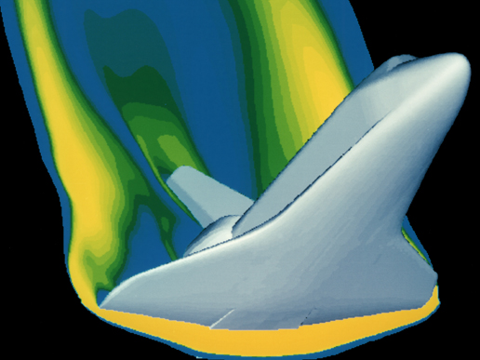
This CFD computer generated image shows a model of the space shuttle. CFD has taken the place of wind tunnels for many evaluations of aircraft and, as computing power increases and computer models become more sophisticated, CFD will largely replace wind tunnels.

Slide 99
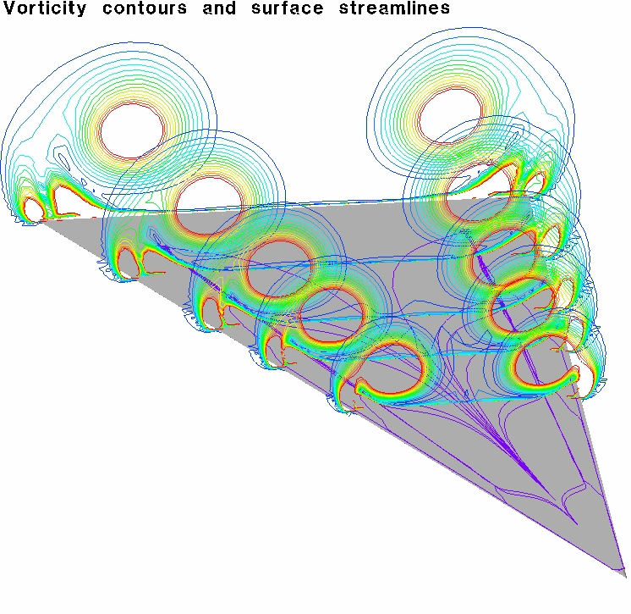

Slide 100
Animations
Pyramid: http://tinyurl.com/3cx6h8b
Boat: http://tinyurl.com/3dhnybl
Surface tension: http://tinyurl.com/3kx7qan

Slide 101
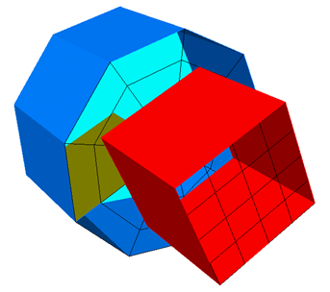
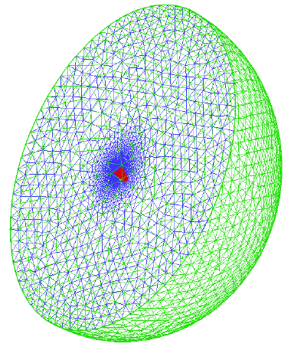
Data structures

Slide 102
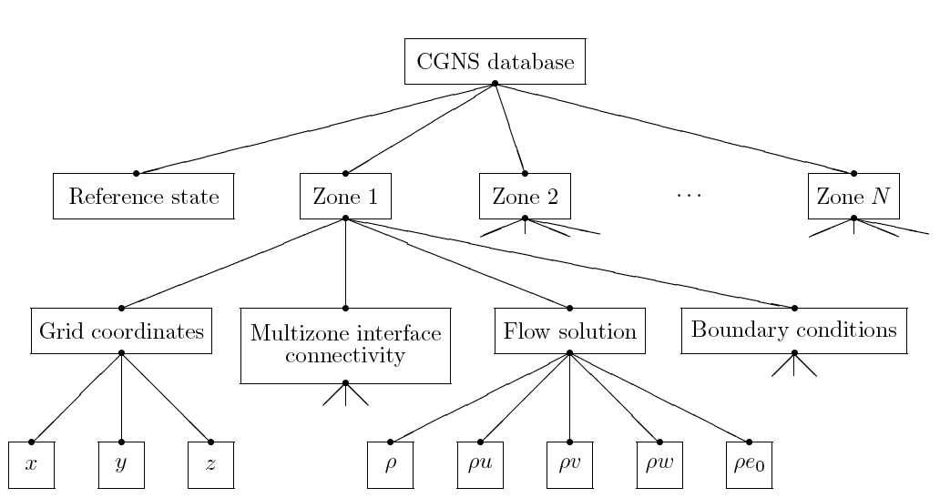
CGNS

Slide 103
What is CGNS ?
Standard Interface Data Structures (SIDS)
  Collection of conventions and definitions that defines the intellectual content of CFD-related data.
SIDS to ADF Mapping
  Advanced Data Format
SIDS to HDF5 Mapping
  Defines how the SIDS is represented in HDF5
CGNS Mid-Level Library (MLL)
  Application Programming Interface (API) which conforms to the SIDS
  Built on top of ADF/HDF5, which do I/O operations

Slide 104
CGNS and HDF5*
CGNS was originally built using the ADF format.
However, ADF does not have parallel I/O or data compression capabilities, and does not have the support and tools that HDF5 offers.
HDF5 has rapidly grown to become a world-wide format standard for scientific data.
HDF5 has parallel capability as well as a broader support base than ADF.
Therefore, CGNS has adopted HDF5 as the default (official) data storage mechanism.
* Paraphrased from http://cgns.sourceforge.net/hdf5.html.

Slide 105
CGNS Steering Committee
Membership – 20 organizations
NASA Ames | US Air Force / AEDC
NASA Langley | CD ADAPCO
NASA Glenn | Intelligent Light
Boeing Commercial | Pointwise
Boeing – Rocketdyne | Aerospatiale Matra Airbus
Boeing Integrated Defense Systems | NUMECA
Pratt & Whitney | ONERA
ICEM CFD Engineering | Stanford University
Fluent, Inc. | Utah State University
Rolls-Royce Allison | ANSYS CFX

Slide 106
User Base
Registered Users
  591 users from more than 25 countries
SourceForge (last 2 years)
  Average of 20 page views and 7.5 downloads per day
Known implementations
  13 commercial, 9 government, 5 industry, 3 academia

Slide 107
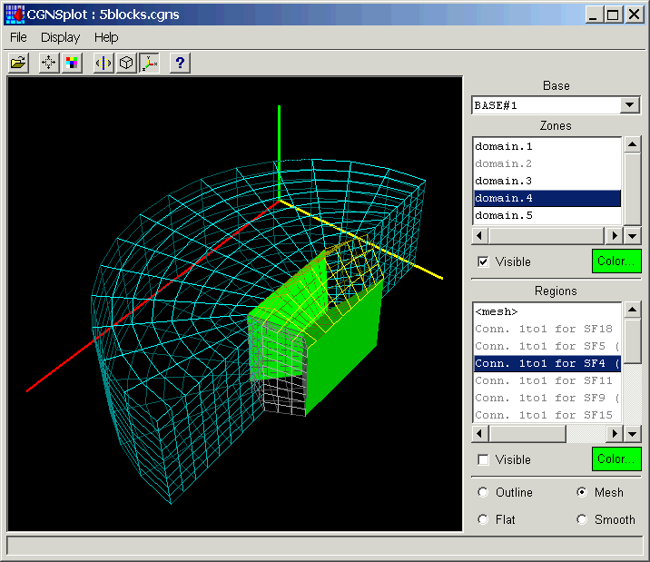
CGNS Tools
CGNSplot
File conversion
  Patran, PLOT3D, Tecplot files to CGNS
  CGNS to PLOT3D and Tecplot
CGNS file manipulation
  Utilities for modifying the solution location, solution variables, and data class
  Subset extraction and interpolation

Slide 108
Lighthouse: http://tinyurl.com/3k76bfr

Slide 109
HDF5 Inside…

Slide 110
HDF5 for financial data
Notes:
It turns out that financial data challenges are often very similar to data challenges that many other organizations have to deal with.
E.g. Flight testing, synchrotrons, and satellites all involve ingestion of streams of time-sequenced data at high speed.
Uses of HPC in finance require many of the same capabilities that defense, weather, and other applications require.
Whenever data is big, structured, and possibly complex, HDF5 has a potential role. That includes finance in many instances.
The HDF Group has some experience
8 years experience with Chicago-based hedge fund
Tickdata gathering, processing, mining
Storage system architecture advice
HDF5 features and tuning
Nanex, PDT, and others

Slide 111



HDF5 Third-party Software
  MATLAB
  IDL
  Mathematica
  Python, H5py, Pandas, Pytables

Slide 112
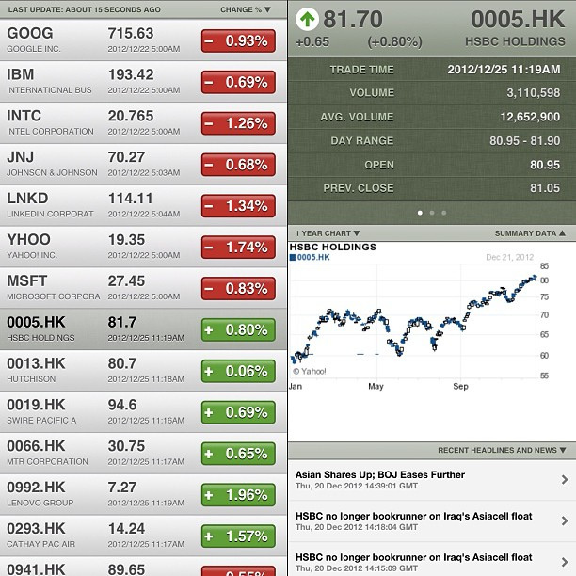
Types of financial data found in HDF5

Slide 113
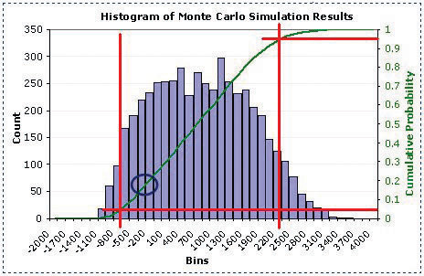

Slide 114
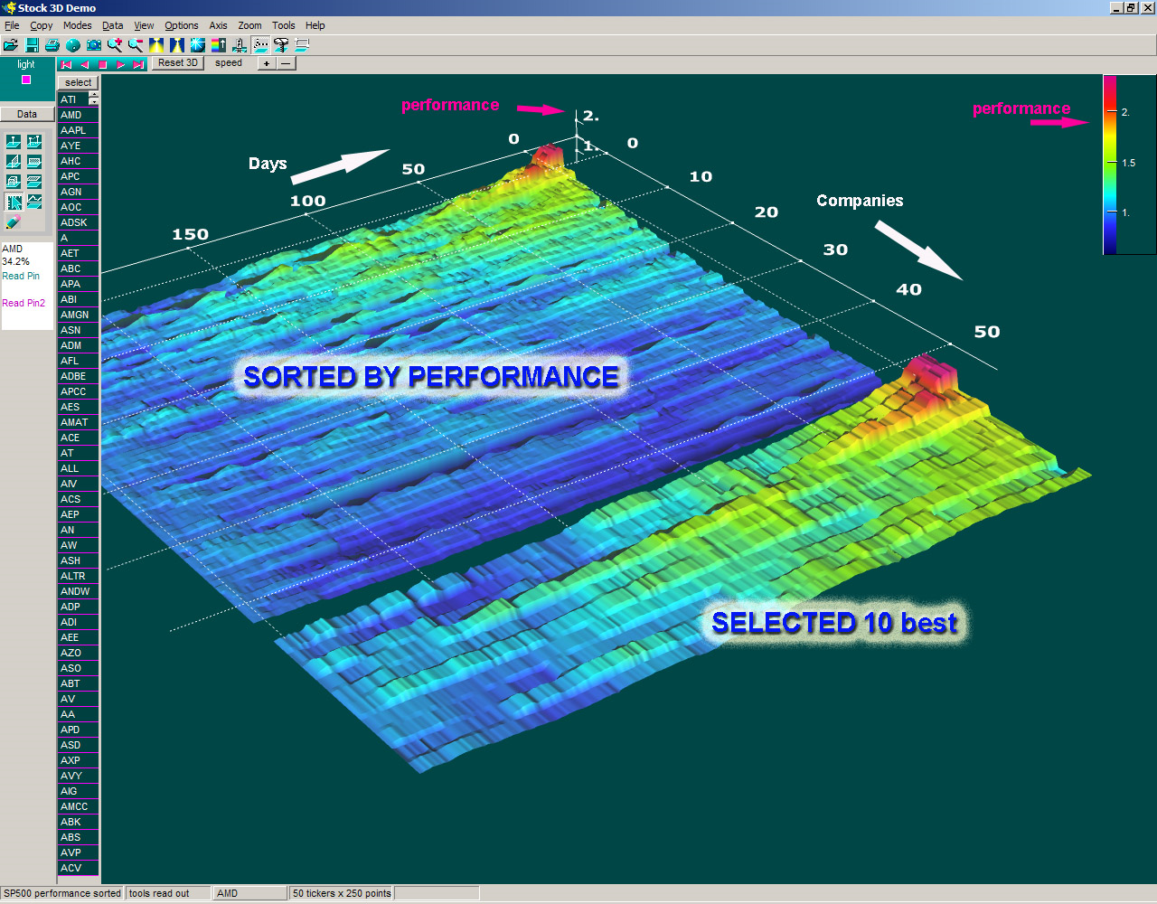

Slide 115
Tickdata archive

Slide 116
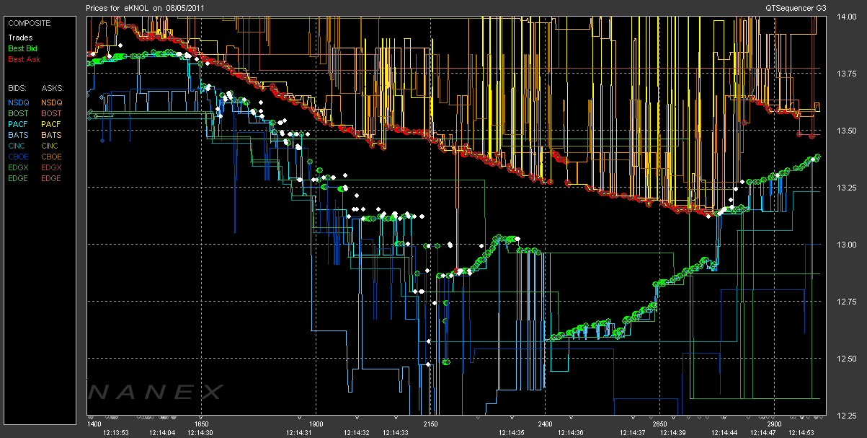
Distribution of archive data
Notes:
The U.S. Option market (OPRA) transmits over 1,400,000 quotes per second, and 6 billion quotes per trading day.

Slide 117
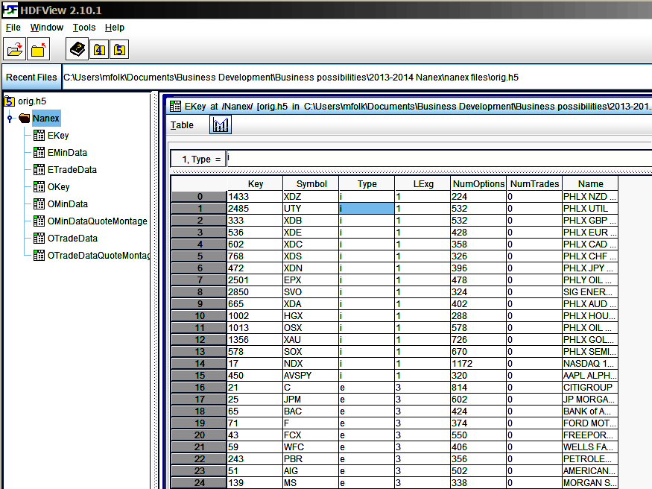

Slide 118
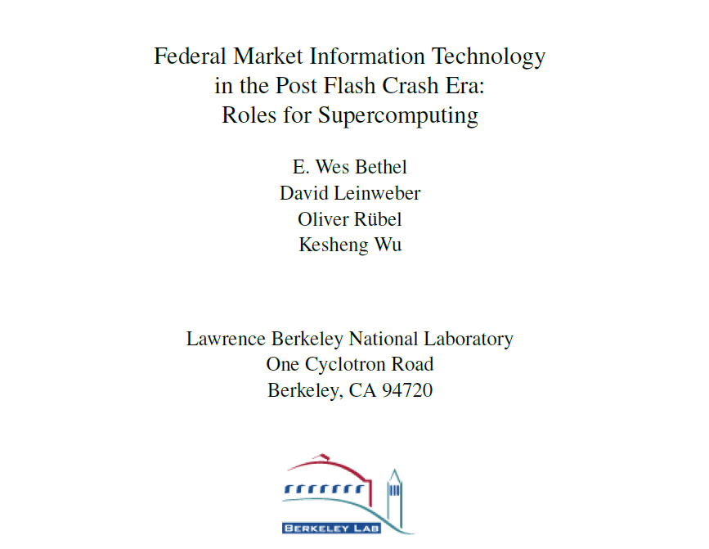
Post flash crash simulation

Slide 119
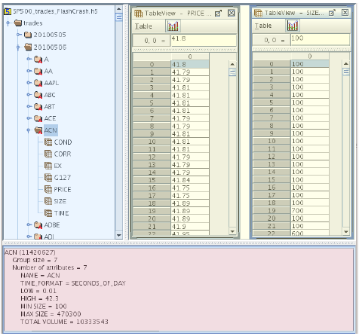
Figure 5: HDF5 data-layout used for storing trades data showing:
the organization of the data via HDF5 groups and datasets (blue),
example meta-data for ACN, 05/06/2010 (red), and
spreadsheet-view of PRICE and SIZE data array for ACN, 5/06/2010 (yellow).

Slide 120
HDF5 Inside…

Slide 121


BioHDF : Toward Scalable Bioinformatics Infrastructures
NIH STTR with Geospiza, Seattle WA
TM

Slide 122




Next Generation DNA Sequencing
“Transforms today’s biology”
NGS is Powerful
“Democratizing genomics”
“Changing the landscape”
“Genome center in a mail room”
“The beginning of the end for microarrays”

Slide 123
BioHDF Project
Goal: Move bioinformatics problems from organizing and structuring data to asking questions and visualizing data
  Develop data models and tools to work with NGS data in HDF5
  Create HDF5 domain-specific extensions and library modules to support the unique aspects of NGS data → BioHDF
  Integrate BioHDF technologies into Geospiza products
Deliver core BioHDF technologies to the community as open-source software

Slide 124
Thank You!
Questions?

