Slide 1

UNIVERSITY OF
CALIFORNIA

Slide 2
Overcoming I/O Limitations on HPC Platforms with In Situ Methods and Infrastructure for Analysis and Visualization
E. Wes Bethel
Lawrence Berkeley National Laboratory
05 May 2017
Trends 2017 - Jefferson Lab
Newport News, VA, USA

Slide 3
What are the Problems?
Not enough I/O capacity on current HPC systems, and the trend is getting worse.
If there’s not enough I/O, you can’t write data to storage, so you can’t analyze it: lost science.
Energy consumption: it costs a lot of power to write data to disk.
Opportunity for doing better science (analysis) when have access to full spatiotemporal resolution data.

Slide 4
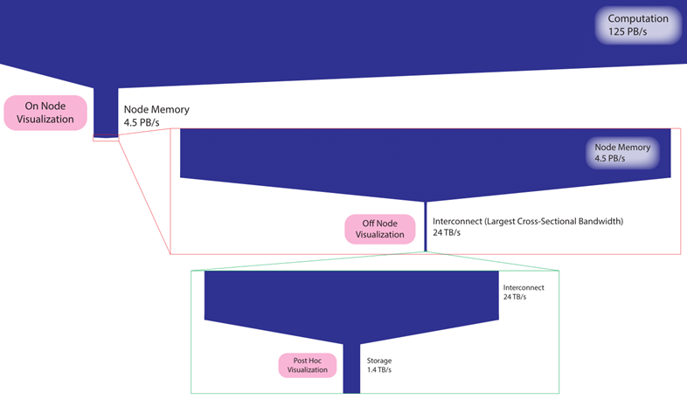
Five Orders of Magnitude Between Compute and I/O Capacity on Titan Cray System at ORNL
Computation
125 PB/s
O(2)
Node memory
4.5 PB/s
Node memory
4.5 PB/s
O(2)
Interconnect
24 TB/s
Interconnect
24 TB/s
O(1)
Storage
1.4 TB/s
Image courtesy Ken Moreland

Slide 5
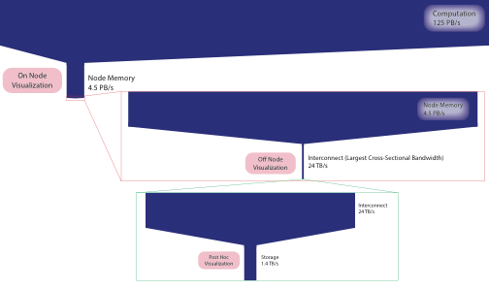
Five Orders of Magnitude Between Compute and I/O Capacity on Titan Cray System at ORNL
O(5) difference has devastating impact:
Can write out 1 of every 100,000 timesteps
Can write out 1 of every 100,000 data values
Computation
125 PB/s
O(2)
Node memory
4.5 PB/s
Node memory
4.5 PB/s
O(2)
Interconnect
24 TB/s
Interconnect
24 TB/s
O(1)
Storage
1.4 TB/s

Slide 6
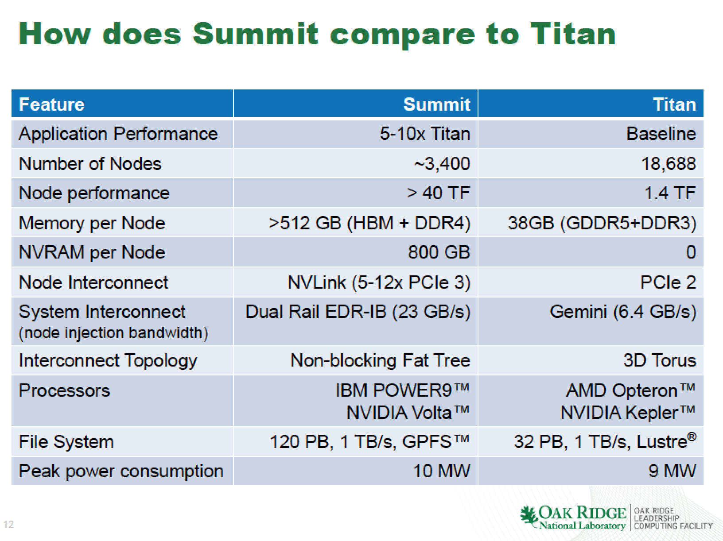
The Problem is Not Going Away
Data courtesy A. Geist (ORNL)

Slide 7
What is In Situ Data Analysis and Visualization?
Two use models:
  Post processing (post hoc): save to disk, then later, a separate analysis/vis program reads that data and operates on it.
  In situ processing: process data as it produced without writing to and reading from storage. Processed “in place”.
    Many flavors/terms: tightly coupled, loosely coupled, in transit, co-processing, etc.
    Practical view: anything processed but not written to persistent storage is in situ
In situ – no data movement:
Simulation and in situ methods share memory
In transit – data is moved: Simulation and in situ methods do not share memory
Simulation Cores
In Situ/In-transit Cores

Slide 8
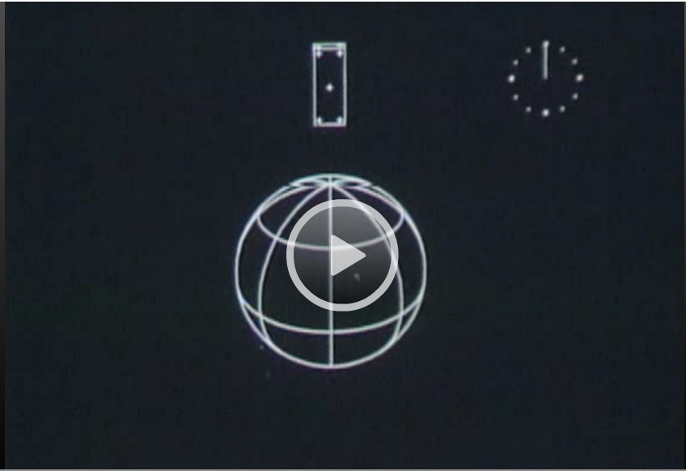
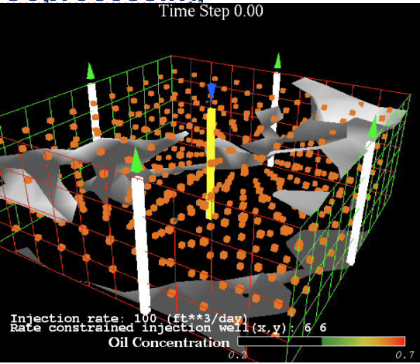
Whirlwind Survey of Previous Work
1961: Direct-to-film process, first computer generated movie. E. Zajac, CACM 7(3), Mar 1964.
1990s: golden era of co-processing: AVS, pVS, CUMULVS
1999s-2000s: “Problem solving environments”: Cactus, SCIrun, etc.
1990s-2000s: HPC in situ computation of visualization
1990s-2010s: in situ computation of “extracts” for post hoc analysis: isosurfaces, flow lines, other types of “features”

Slide 9
Contemporary In Situ Infrastructures
Package | Description | Comments
ParaView/Catalyst | “Bespoke” in situ API, access to significant parallel visual data exploration and analysis capability | Open source www.paraview.org/in-situ Size of executables, shared libs
VisIt/Libsim | “Bespoke” in situ API, access to significant parallel visual data exploration and analysis capability | Open source https://www.visitusers.org/index.php?title=VisIt-tutorial-in-situ Size of executables, shared libs
ADIOS | An I/O library that allows the assembly of arbitrary processing, including with user-written components, coupling to VisIt or ParaView. | Open source https://www.olcf.ornl.gov/center-projects/adios/ 3rd party libs for marshaling data, resources
GLEAN | Introspects I/O stream and invokes user-specified processing. Alternately, a bespoke in situ API | Not open source, at ANL https://www.alcf.anl.gov/glean
Henson | Cooperative multi-processing, code coupling | Open source https://github.com/mrzv/henson

Slide 10
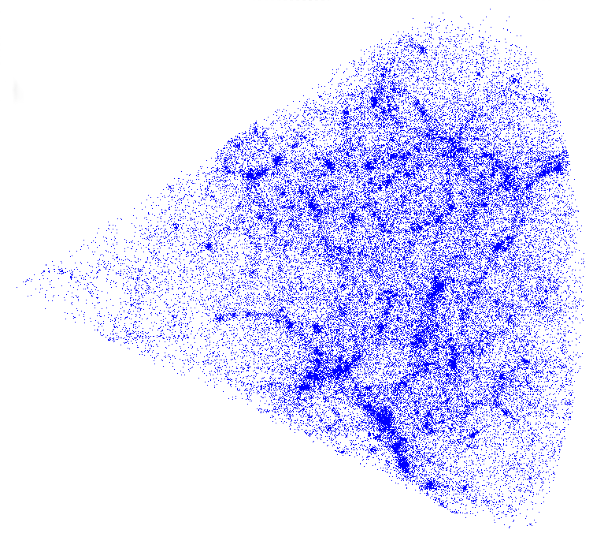
Henson: Cooperative Computing for In Situ
Problems/Questions
Dynamic code coupling is difficult, but needed for some science use cases
Science users want simple, easy-to-use mechanisms for specifying in situ/in-transit code execution patterns
A lightcone calculation, computed in situ, helps computational cosmologists to construct mock sky catalogs, essential to prepare for the next generation sky surveys
Results
Flexibility: supports broader set of use cases, e.g., surrogate models, computational steering, two-way data movement
Performance: Zero-copy data sharing with separate executables
Study at scale using analysis with a cosmology code published at HPDC 2016
Open source code release: vis.lbl.gov/Software
Approach
View in situ as a dynamic coupling of code
Externalize control, simple but powerful scripting language (loops, conditionals)
Puppet model – modular, easily extensible
Codes are executables and DLLs, can share memory without any changes
Minimal impact of instrumentation on code
Morozov and Lukic. Master of Puppets: Cooperative Multitasking for In Situ Processing. Proceedings of the Symposium on High-Performance Parallel and Distributed Computing (HPDC), 2016.
Notes:
Science use cases that can benefit from dynamic code coupling
Co-processing, computational steering: e.g., surrogate models
In those cases, want the flexibility to do zero-copy AND multiple independent executables

Slide 11
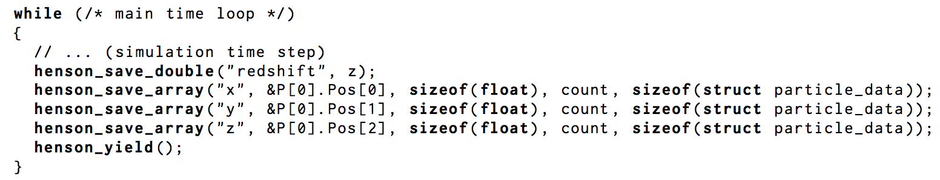
Henson Code Example – Data Producer (Simulation)

Slide 12
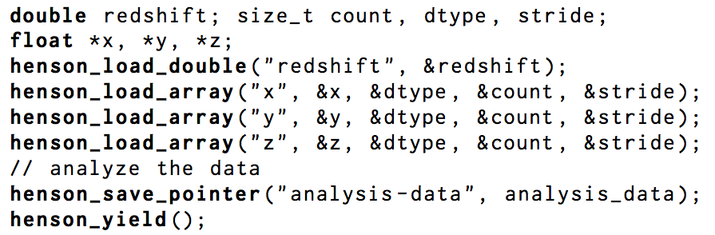
Henson Code Example – Data Consumer (Analysis)
Ingest data
Output data

Slide 13
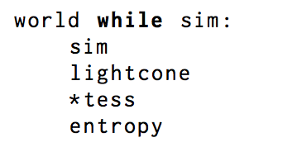
Henson Code Example – In Situ Script
4 puppets
One producer
Three analysis steps
Zero-copy data sharing

Slide 14
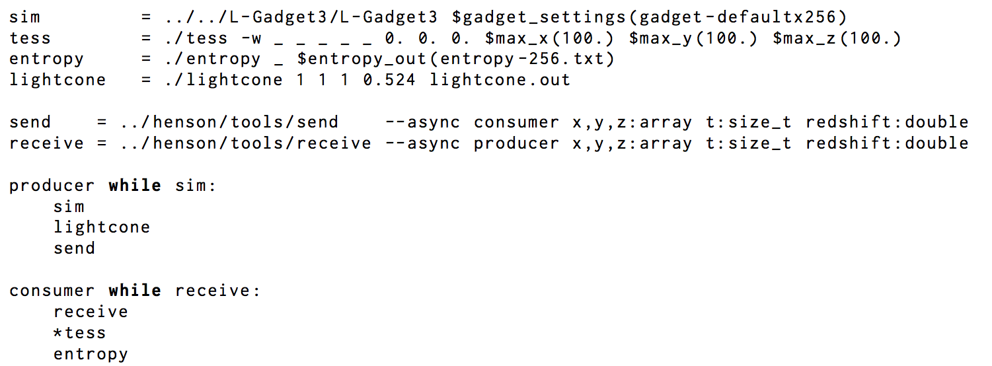
Henson Code Example – In Transit Script
Puppets
Henson Script

Slide 15
Henson Comments
Flexible, modular design
Puppets are the modular, combinable components
A simple scripting language for composing in situ and in transit configurations
Code coupling, including advanced methods: e.g., surrogate models
Runs at scale, negligible overhead
See the 2016 HPDC paper for more information.
Morozov and Lukic. Master of Puppets: Cooperative Multitasking for In Situ Processing. Proceedings of the Symposium on High-Performance Parallel and Distributed Computing (HPDC), 2016.

Slide 16
Challenges to Portability of Methods, Across Infrastructures
The Data Model
The API

Slide 17
Portability and the In Situ Interface
Let’s say that:
You are a sim code developer and want to instrument your code to use in situ methods and infrastructure.
You are a developer of methods to be run in situ.
Each of those 4-5 in situ infrastructures has a different API. ☺
An “generic” interface would be highly beneficial:
Code portability, reusability
Reduced costs of code dev, maintenance

Slide 18
What is the SENSEI Generic In Situ Interface?
Problem statement
  Multiple in situ infrastructures, multiple instrumentation APIs
  Little opportunity for code/method reusability
Approach – an API that:
  Enables a simulation code to use “any” in situ infrastructure through a single API
  Enables a new in situ method to be used/invoked from “anywhere” w/o modification
U. Ayachit, et al., The SENSEI Generic In Situ Interface, ISAV 2016 (SC16 workshop), Nov 2016.

Slide 19
SENSEI In Situ Interface, ctd.
Data model strategy: developer provides a mapping from sim-side to vtkGenericDataArray, and from vtkGenericDataArray to consumer-side data structures.
Notes: array of structures, structure of arrays, zero-copy (where possible), shallow or deep copies if needed.
Adaptors for VisIt/Libsim, Paraview/Catalyst, ADIOS.
U. Ayachit, et al., The SENSEI Generic In Situ Interface, ISAV 2016 (SC16 workshop), Nov 2016.

Slide 20
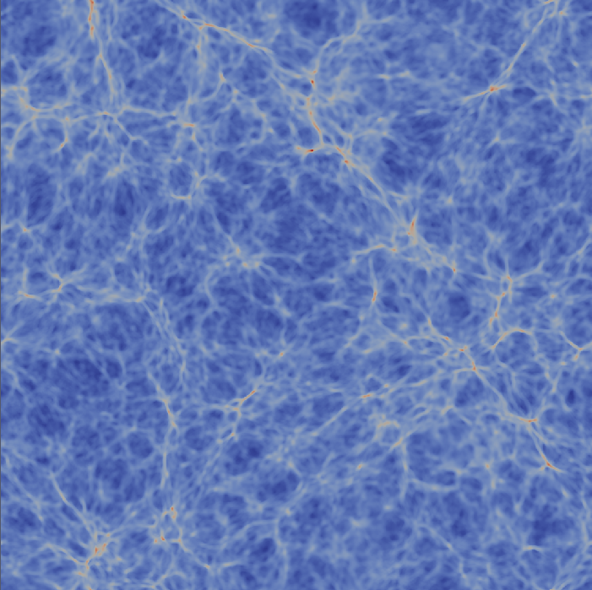
Low-overhead, Scalable In Situ Infrastructure Accelerates Scientific Knowledge Discovery
Key questions:
How much overhead does an in situ infrastructure incur?
How well does it scale?
How much faster is in situ than post hoc?
What about portability of methods?
Applicability to time-varying problems?
Approach:
Use Miniapps that follow key design and execution patterns.
Scalability studies, and studies that compare in situ and post hoc time-to-solution.
Generic data interface for portability across methods, infrastructures.
Novel in situ method based on autocorrelation for time-varying analysis.
Results:
Miniapp that does BSP time-varying computations at each core.
Interface memory footprint cost: negligible impact in weak scaling configuration (1K, 6K, 45K cores on Cori/NERSC).
Compared to post hoc, at 45K cores, in situ is >20x faster by avoiding I/O.
Demonstrated scaling to over 1M cores on Mira with the Phasta code.
U. Ayachit, A. Bauer, E. P. N. Duque, G. Eisenhauer, N. Ferrier, J. Gu, K. E. Jansen, B. Loring, Z. Lukic, S. Menon, D. Morozov, P. O’Leary, R. Ranjan, M. Rasquin, C. P. Stone, V. Vishwanath, G. H. Weber, B. Whitlock, M. Wolf, K. J. Wu, and E. W. Bethel. Performance Analysis, Design Considerations, and Applications of Extreme-scale In Situ Infrastructures. In Proceedings of SC16, November 2016. In press.

Slide 21

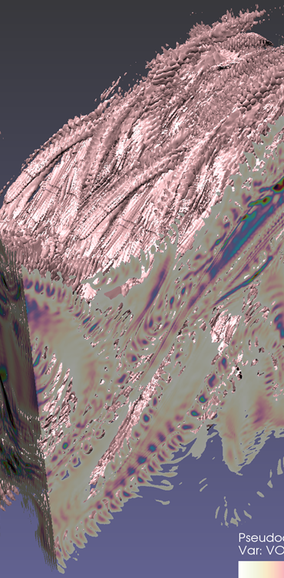
Science Application Examples
Three examples: CFD, Combustion modeling, Comsology
Each of these case studies could be a standalone talk
CFD
PHASTA, used for airfoil optimization, employs the new SENSEI interface to achieve >1M-way in situ runs on Mira.
Combustion
Coupled AVF-Leslie with Libsim to enable high temporal resolution analysis on DOE HPC platforms.
Cosmology
Developed new in situ methods for computing features (halos) in the Nyx cosmological simulation code accelerates time to solution by avoiding I/O.

Slide 22
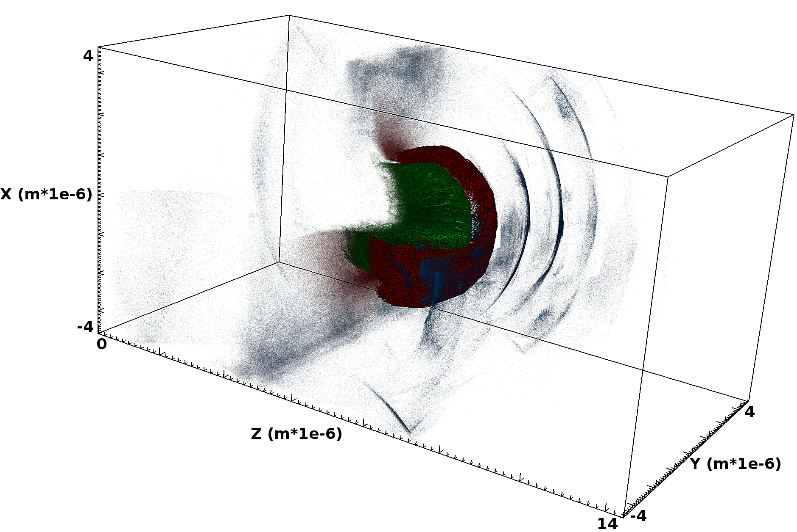
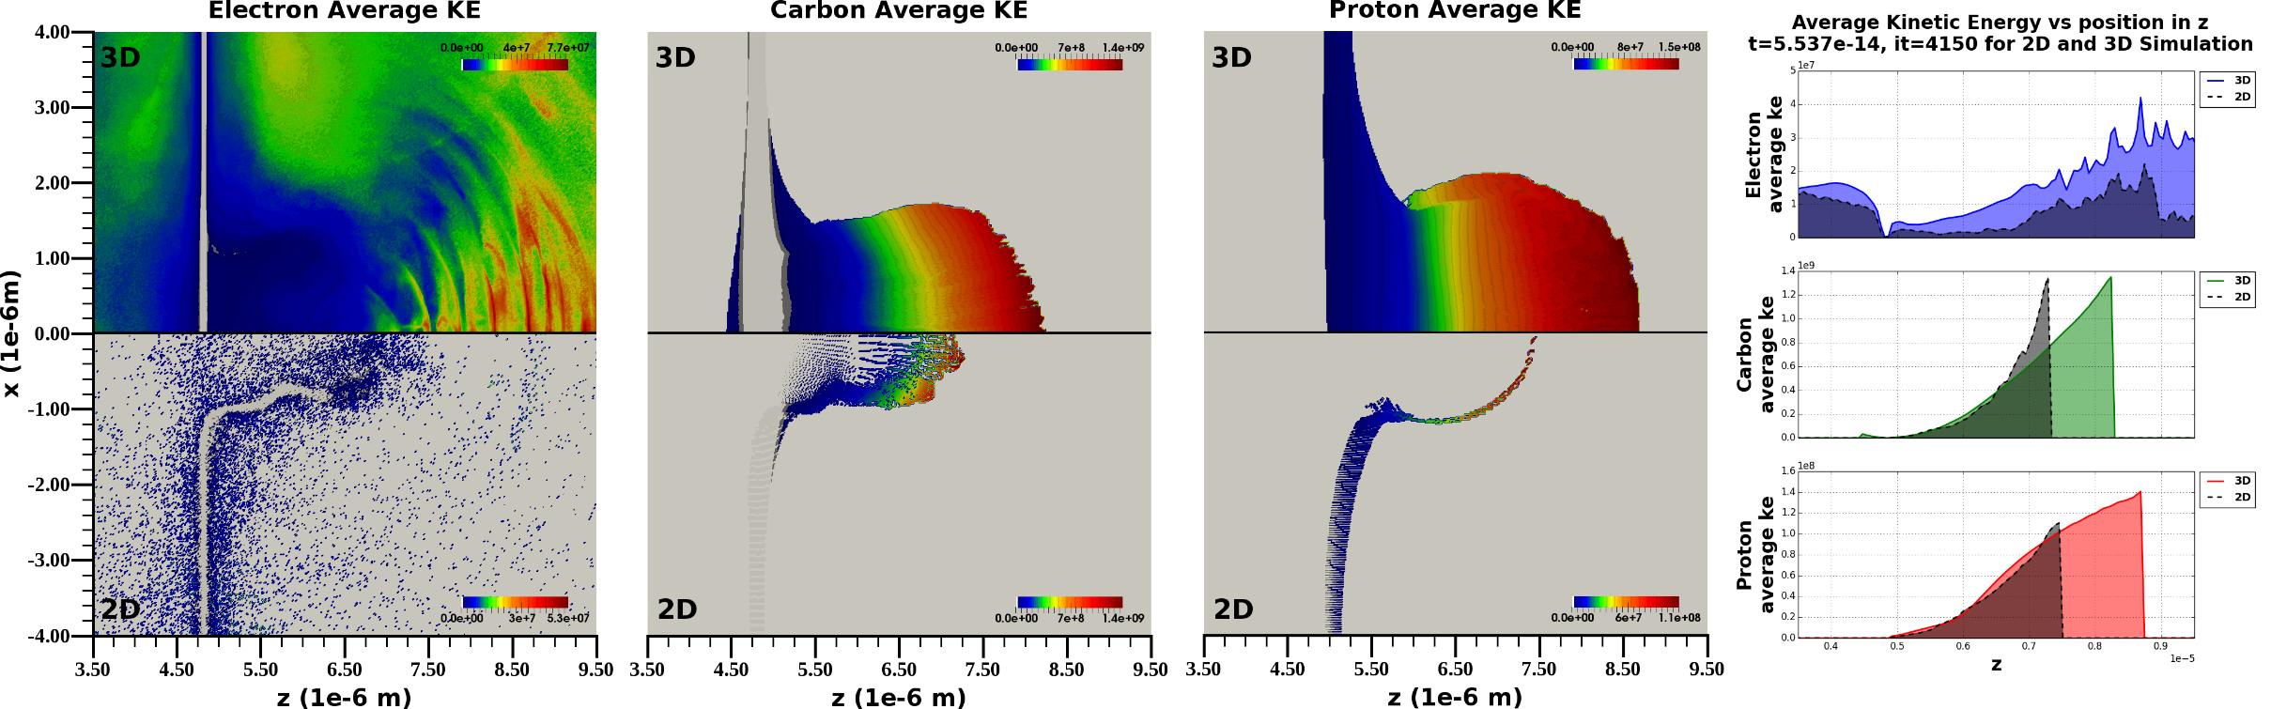
In situ Visualization and Analysis of Ion Accelerator Simulations
Problem
In the post hoc use case, simulation resolution is constrained to the limits of I/O, which limits scientific understanding
Approach
Transition to in situ methods for analysis and rendering to overcome I/O limits, and facilitate running the simulation at much higher spatiotemporal resolution.
Impact
Using in situ, new studies made it possible to compare differences between 2D and 3D models at unprecedented resolutions. We found that 3D models are necessary to capture beam shape and dynamics.
O. Rubel et al., “In situ Visualization and Analysis of Ion Accelerator Simulations using Warp and VisIt”, IEEE CG&A 36(3), May 2016,
22

Slide 23
2D vs. 3D:
Are 2D ion accelerator simulations good enough?
~1.24μm
2D is qualitatively similar to 3D
In 3D the proton bubble propagates faster and further over the same time period
In 3D higher energies are reached

Slide 24
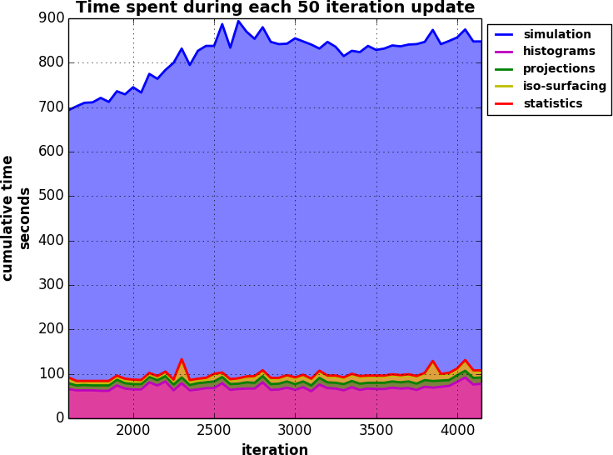
Performance
Compute time
I/O
Category | Actually written to disk
histograms | 4.48984 MB
projections | 795.969 MB
iso-surfaces | 40.7662 MB
statistics | 3484 b
total | 841.228 MB
>85% of the compute time consumed by the simulation
11 – 15% of the compute time consumed by the vis at each update
3.2 TB required to capture the minimum amount of data to perform the same analysis post hoc
4033 times reduction in I/O using in situ analysis
Notes:
“simulation”, for the Warp solver computations;
“histograms”, for the computation and I/O of 12 histograms (e.g. Fig 3, 7);
“projections”, for the computation and I/O of 18 2D projections
“iso-surfaces”, for the 3D iso-surface computation, translucent rendering, and image I/O of the Ke and density
“statistics”, for a number of simple descriptive statistics computations and I/O

Slide 25
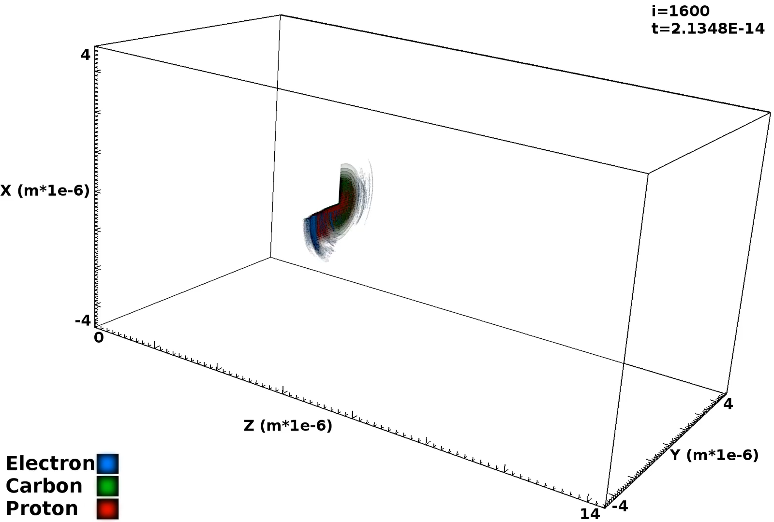
WarpIV
WarpIV: https://bitbucket.org/berkeleylab/warpiv
WARP: http://warp.lbl.gov/
VisIt: https://visit.llnl.gov/
CG&A Session Papers: https://www.computer.org/web/computingnow/cga-papers-at-ieee-vis-2016
Movie courtesy: Burlen Loring, Oliver Ruebel, Jean-Luc Vay, David P. Grote,
Remi Lehe, Stepan Bulanov, Henri Vincenti (LBNL)

Slide 26
What’s in the future?
Code coupling, and more code coupling
Usability issues: encapsulating complexity, the tradeoff between exploratory analysis and “know before you go”
Code repositories and interchangeable components, “cookbook” of examples
More commonplace, routine use of in situ methods (akin to I/O libraries). A necessity for exascale computing
I/O libraries evolve to do more ”in situ” computations
I/O and post hoc use cases not going away

Slide 27
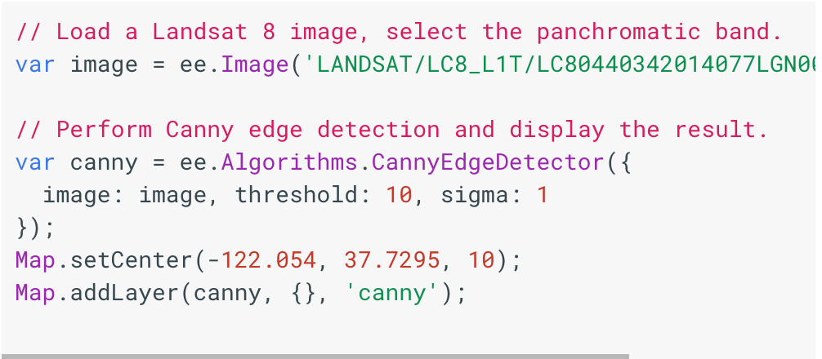
Google Earth Engine: An Integrated Data+Compute Platform
Access to multi-PB collections of satellite imagery and geospatial datasets
  LANDSAT, Sentinel, Modis, high-res imagery (1m) since 2003,
Code development environment: you write analysis code and access geospatial data w/o moving it
  JS and Python APIs
  Tutorials, tons of examples, lots of operators/libraries: image analysis, classifiers,
Free access for scientific community
Layered atop Google’s cloud infrastructure
See: earthengine.google.com

Slide 28
Further Reading
SENSEI Interface and SENSEI In Situ Project | www.sensei-insitu.org U. Ayachit, B. Whitlock, M. Wolf, B. Loring, B. Geveci, D. Lonie, and E. W. Bethel. The SENSEI Generic In Situ Interface. ISAV 2016, Salt Lake City, UT, USA, November 2016
SC16 in situ performance study | U. Ayachit, A. Bauer, E. P. N. Duque, G. Eisenhauer, N. Ferrier, J. Gu, K. E. Jansen, B. Loring, Z. Lukic, S. Menon, D. Morozov, P. O’Leary, R. Ranjan, M. Rasquin, C. P. Stone, V. Vishwanath, G. H. Weber, B. Whitlock, M. Wolf, K. Wu, and E. W. Bethel. Performance Analysis, Design Considerations, and Applications of Extreme-scale In Situ Infrastructures. In Proceedings of SC16, November 2016.
EuroVis 2016 State of the Art Report | A. C. Bauer, H. Abbasi, J. Ahrens, H. Childs, B. Geveci, S. Klasky, K.Moreland, P. O’Leary, V. Vishwanath, E. W. Bethel. In Situ Methods, Infrastructures, and Applications on High Performance Computing Platforms. Computer Graphics Forum 35(3), 2016. EuroVis 2016 State-of-the-Art Report. June, 2016. Groningen, Netherlands.
Henson | https://github.com/mrzv/henson D. Morozov and Z. Lucik. HPDC 2016.
ParaView/Catalyst | www.paraview.org/in-situ
VisIt/Libsim | https://www.visitusers.org/index.php?title=VisIt-tutorial-in-situ
ADIOS | https://www.olcf.ornl.gov/center-projects/adios/

Slide 29


