Slide 1
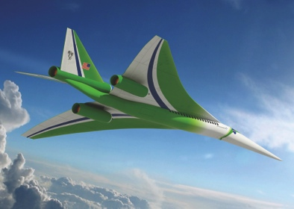
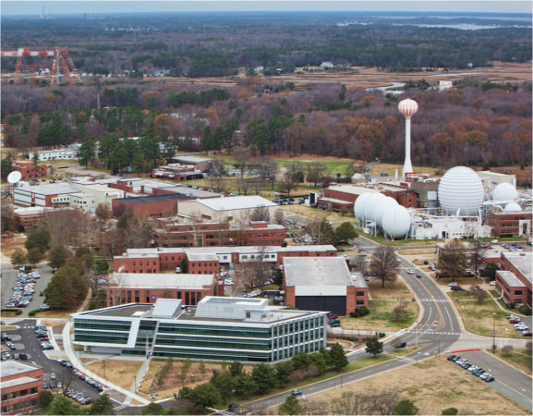
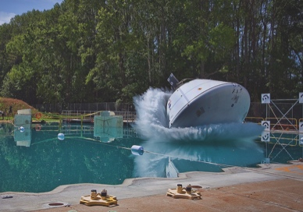
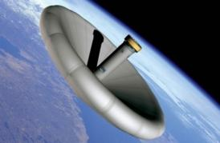
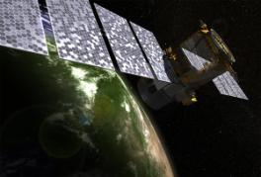
L A N G L E Y R E S E A R C H C E N T E R
Data Analytics and Machine Intelligence Capability Team
Comprehensive Digital Transformation
Aerospace Data Analysis and Machine Learning
at NASA Langley
Jeremy Yagle
NASA Langley Research Center
Technical Lead, Data Analytics and Machine Intelligence Capability Team
Notes:
Welcome.
Introductions.
Review Agenda

Slide 2
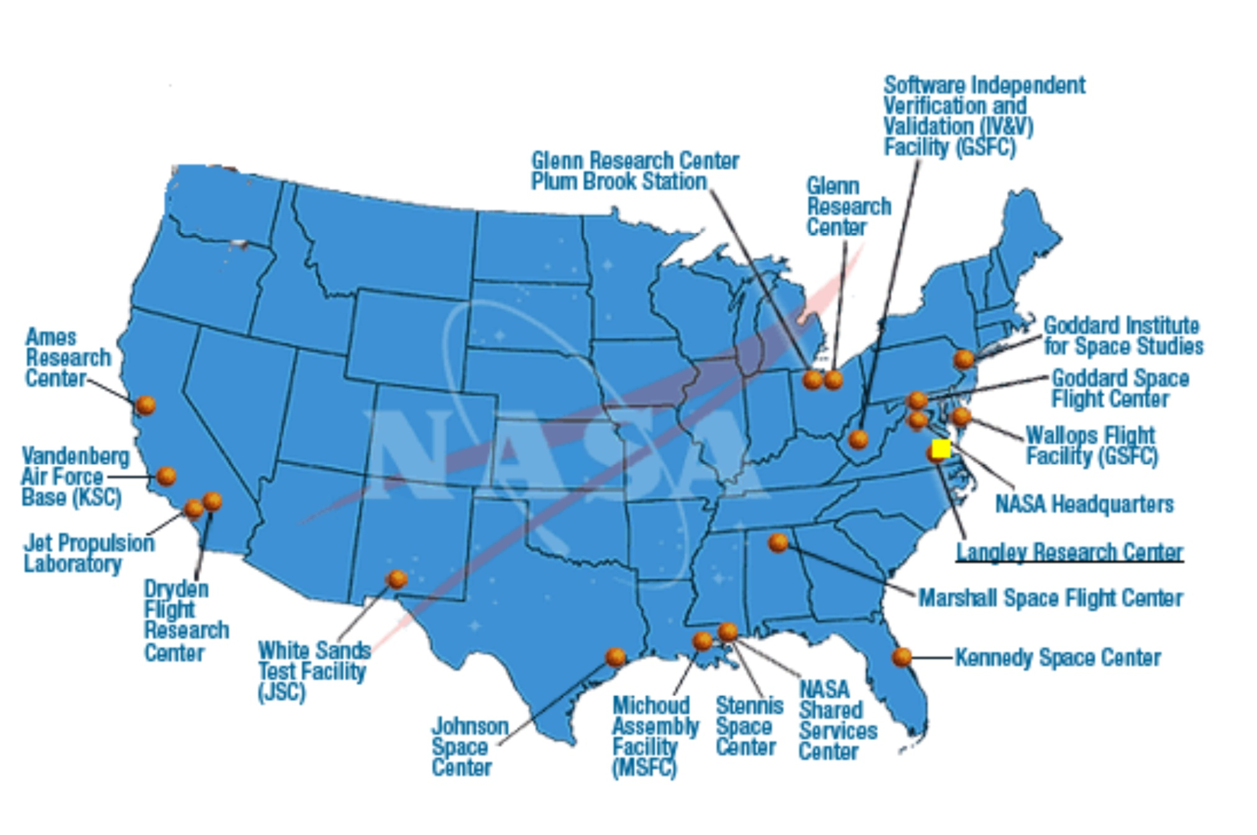
NASA Vision and Centers
Comprehensive Digital Transformation
NASA Vision: “To reach for new heights and reveal the unknown so that what we do and learn will benefit all humankind”

Slide 3
NASA Langley Technical Areas
Comprehensive Digital Transformation
Mission: NASA Langley is a research, science, technology and development center that provides game-changing innovations to enable NASA to make significant contributions to the nation
Aerosciences
Systems Analysis & Concepts
Measurement Systems
Intelligent Flight Systems
Entry, Descent & Landing
Atmospheric Characterization
Advanced Materials & Structural Systems

Slide 4
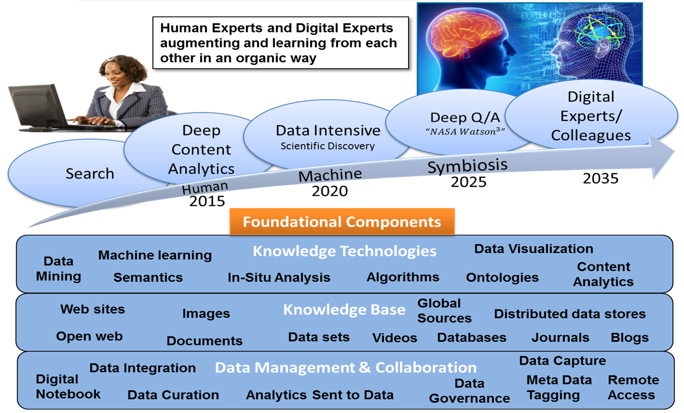
Data Analytics and Machine Intelligence Capability Vision
Comprehensive Digital Transformation
Long-term Goal:
Virtual Research & Design Partner that will enable greater scientific discovery and system design optimization

Slide 5
Focus Areas
Comprehensive Digital Transformation
Science and Engineering
Case Studies
Text Analytics for
NASA Domains
Expert
Systems
Develop machine learning and data mining capabilities that will help NASA experts save time, derive new insights, and make new discoveries from complex experimental and computational data
Using open-source platforms and tools
Provide the technical community with content analysis technologies to quickly make sense of internal and external knowledge
Proof of Concepts to assess the application of cognitive systems in NASA domains, and to help us better understand how we should prepare to take advantage of these technologies
Using IBM Watson Content Analytics with open-source tools
Using IBM Watson Discovery Advisor

Slide 6
Team Composition
Comprehensive Digital Transformation
Domain Expertise
Subject Matter Experts drive the process
Computer Science
Mathematics & Statistics
Ensures that data science methods are appropriate for the problem, and that results can be verified and validated
Development and application of methods for data processing, machine learning, data visualization, and user interfaces

Slide 7
Data Science in NASA Domains
Comprehensive Digital Transformation
Current State
Methodology
SME-defined subset of data
Develop tools that mimic human expertise and human approach to analysis
Saves SME time
Data
experimental, computational, or text
Data
Team and SMEs working together
SME relies on traditional methods to pre-select data; time-consuming and prone to bias
Apply tools to experimental data, computational data, and text
Yields New Insights
New Approach
Techniques to detect relationships in the data…validated by SMEs
Future State
Virtual Expert
Autonomous Assistant that analyzes all possible data and augments decision making

Slide 8
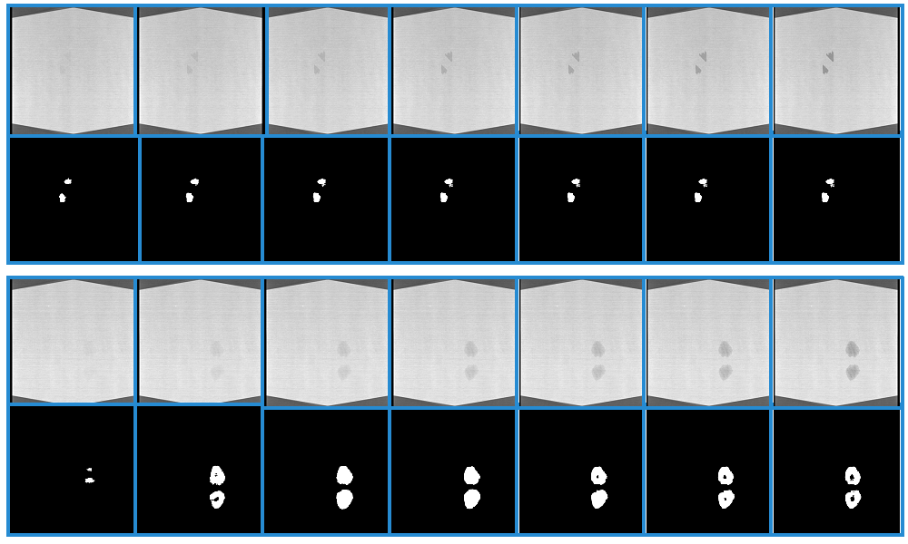
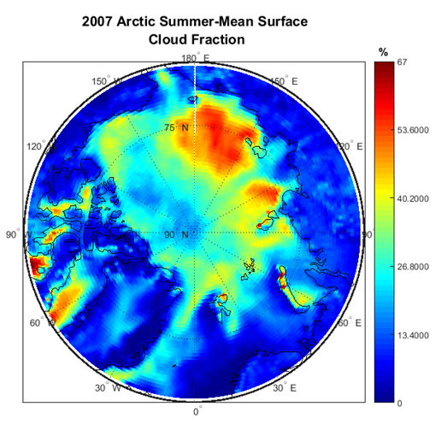
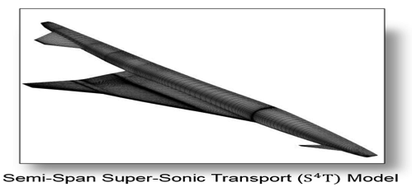
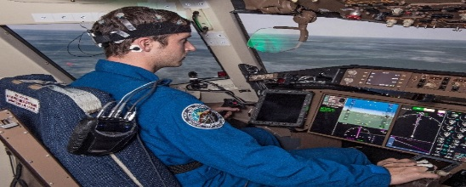
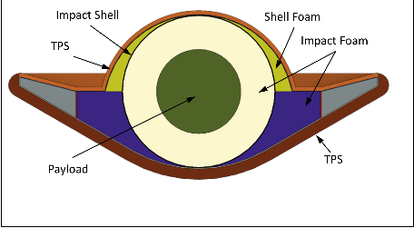
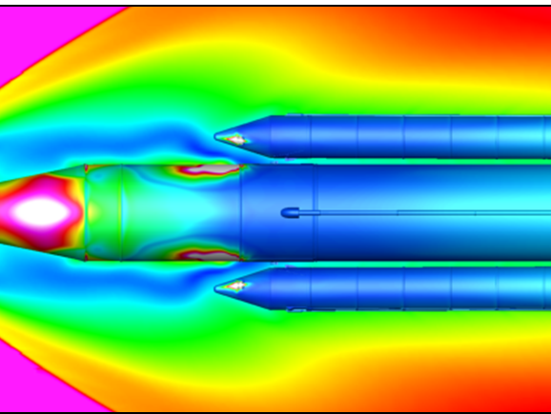
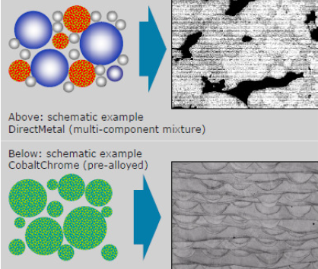
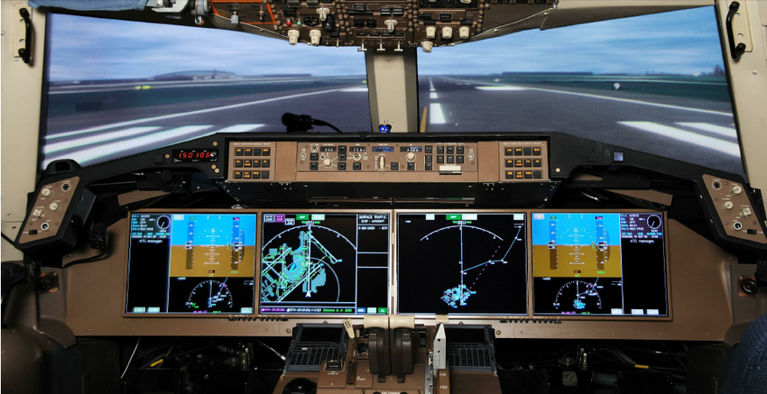
Science and Engineering Case Studies
Comprehensive Digital Transformation
Anomaly Detection in Non-Destructive Evaluation Images
Automated algorithms for detecting delaminations in carbon fiber
Predicting Flutter from Aeroelasticity Data
Detecting patterns in the data to help SMEs better understand the precursors to flutter
Crew State Monitoring
Predict a pilot’s cognitive state using physiological data during flight simulations
Rapid Exploration of Aerospace Design
Provide a machine learning platform to more efficiently analyze modeling and simulation data
Hypersonic Inlet Unstart
Effectively define the areas of operability of a scramjet vehicle for design optimization
Cloud Fraction Model Parameterization
Using neural networks to improve climate science reanalysis models
Space Launch System (SLS) Booster Separation
Multi-fidelity models driven by machine learning techniques to use resources more intelligently
Additive Manufacturing Certification
Understanding the origin, manifestation, and effects of defects in additively manufactured components
Trajectory-Based Optimization
Optimizing simulations with data analytics and developing new scenarios to explore gaps
SansEC Sensor Technology
Classification of sensor output to characterize dynamics in the system
Machine learning and statistical techniques using MATLAB, R, Python, C++, TensorFlow, Caffe…

Slide 9
Methods for Science and Engineering Case Studies
Materials
Testing
Ensemble Learning
Statistical Algorithms
Literature Analysis
Clustering
Methods
Convolutional Neural Network
Facial Recognition
Crew Cognitive State
Logistic Regression for Small Datasets
Aeroelastic Flutter
SansEC Sensors
SLS Booster Database
Feedforward Neural Network
Random Forests
Sequential Pattern Mining
Active Learning
Inlet Unstart
Cloud Fraction Models

Slide 10
Methods for Science and Engineering Case Studies
Materials
Testing
Ensemble Learning
Statistical Algorithms
Literature Analysis
Clustering
Methods
Convolutional Neural Network
Facial Recognition
MATLAB, Python
MATLAB, R, Python, C++
MATLAB, R, Python, WCA
Crew Cognitive State
Logistic Regression for Small Datasets
Caffe, TensorFlow
Aeroelastic Flutter
SansEC Sensors
SLS Booster Database
Feedforward Neural Network
Random Forests
R
Sequential Pattern Mining
Active Learning
MATLAB, Python
Inlet Unstart
Cloud Fraction Models
MATLAB, Python
Caffe, TensorFlow
MATLAB, R, Python

Slide 11
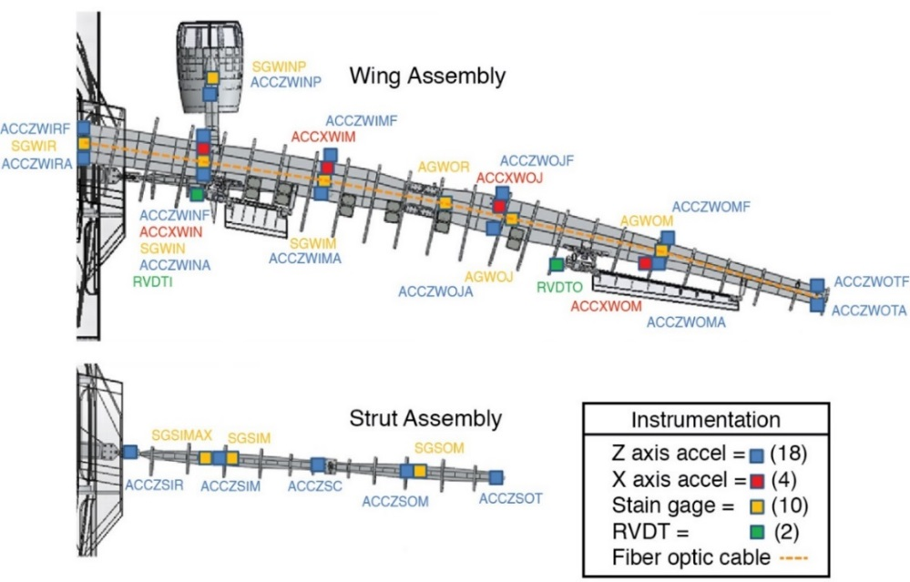
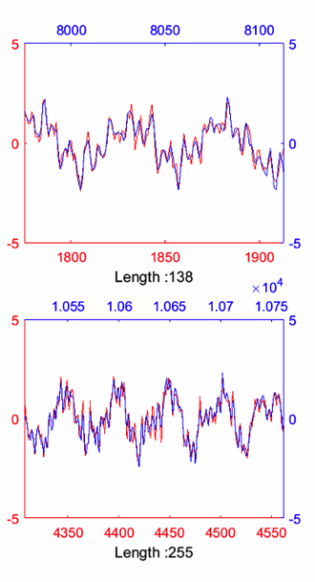
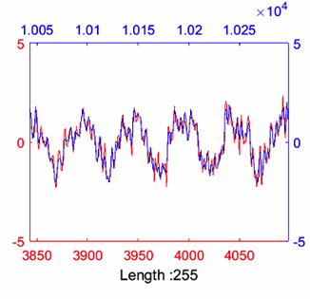
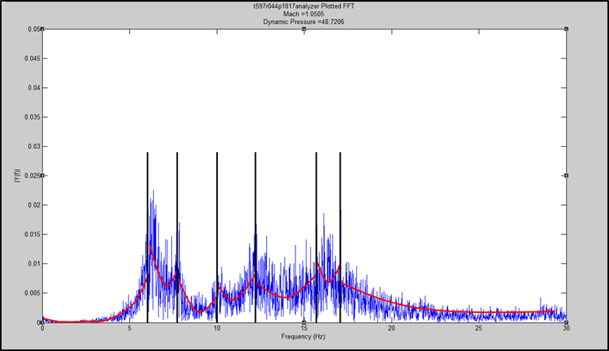
Predicting Aeroelastic Flutter
Comprehensive Digital Transformation
Goals
Identify flutter precursors to:
Create a dictionary of motifs for a given configuration
Classify data for use with machine learning algorithms that will support real-time monitoring
Methods
Application of the Motif Enumeration (MOEN) algorithm created by Dr. Abdullah Mueen (UNM)
Piecewise Regression for Peak Detection
Scott, Robert C., et al. "Aeroservoelastic Wind-Tunnel Test of the SUGAR Truss Braced Wing Wind-Tunnel Model." 56th AIAA/ASCE/AHS/ASC Structures, Structural Dynamics, and Materials Conference. 2015.
Peak Detection: Piecewise Regression attempts to fit n + 1 quadratics to an FFT, where n is the total number of modes to be found. Quadratics fill the spaces bordering and between each mode.
In order to detect motifs, a given sensor’s output (Signal A) is compared to another sensor (Signal B) by creating a composite signal (Signal A/B). The algorithm is then applied to the composite signal to detect the motifs (above right) common to both sensors.

Slide 12
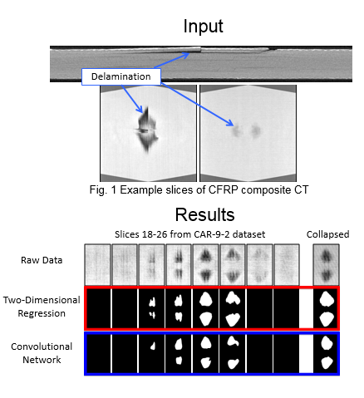
Identifying Delaminations in Carbon Fiber
Comprehensive Digital Transformation
Goals
Significantly reduce SME analysis time and assist experts in accurately detecting and characterizing the damage
Help to design better material compositions and structures
Methods
Two-Dimensional Regression
Machine learning classifiers first identify which images have delaminations, a statistical algorithm then removes the image background and thresholds the image to find anomalous pixels, and image processing algorithms are used to remove noise.
Deep Learning
Utilizing convolutional networks, a model is trained to directly perform segmentation from the raw data using an encoder-decoder architecture. The trained model is then used to perform segmentation on novel images.

Slide 13
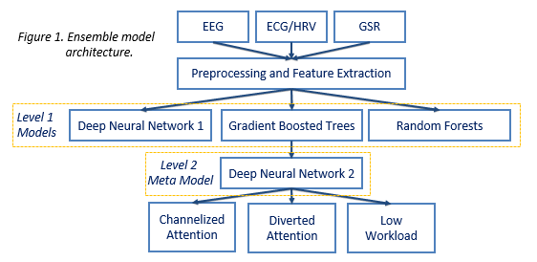
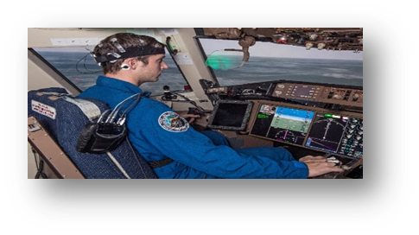
Crew State Monitoring
Comprehensive Digital Transformation
Goals
Develop machine learning classifiers that can accurately predict pilot cognitive states across temporal shifts.
Classification models will be developed for pilot simulation training, providing real-time cognitive state feedback to instructors evaluating pilot performance.
Methods
Pilots are classified into one of three cognitive states using data from electroencephalogram (EEG), electrocardiogram (ECG), and galvanic skin response (GSR) sensors; inputs consist of power spectral density features from each sensor stream
A 5-fold cross-validation procedure is used, with cross-validation where the time-series data was partitioned into sequential segments to evaluate the model’s classification accuracy.

Slide 14
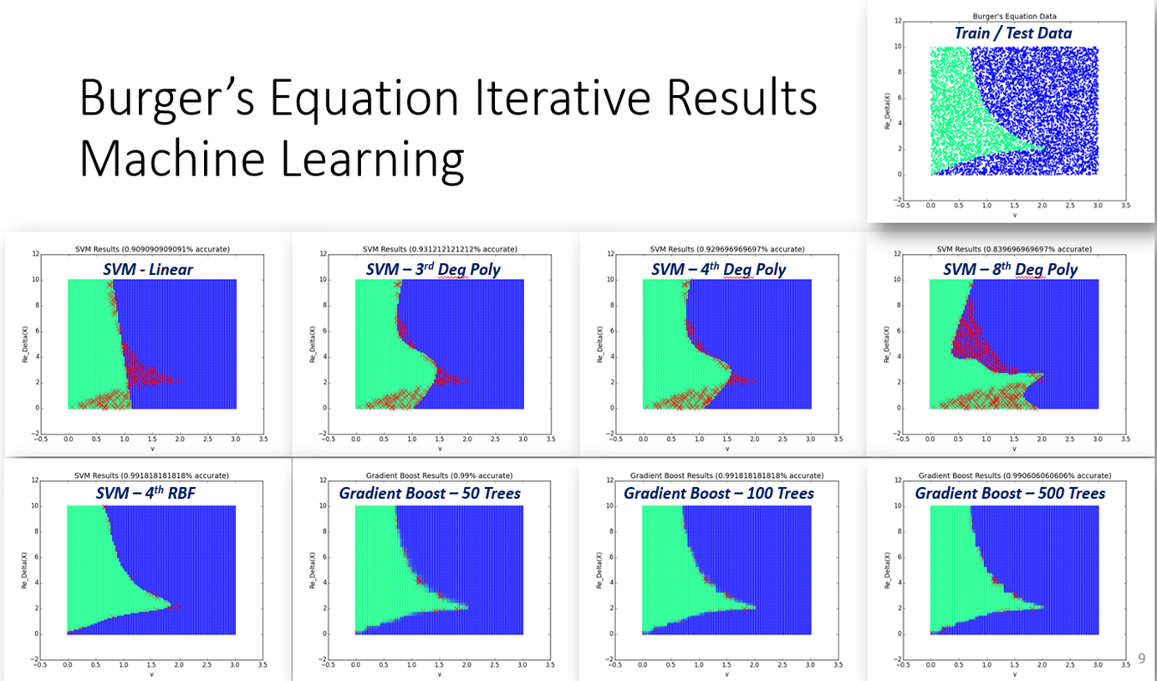
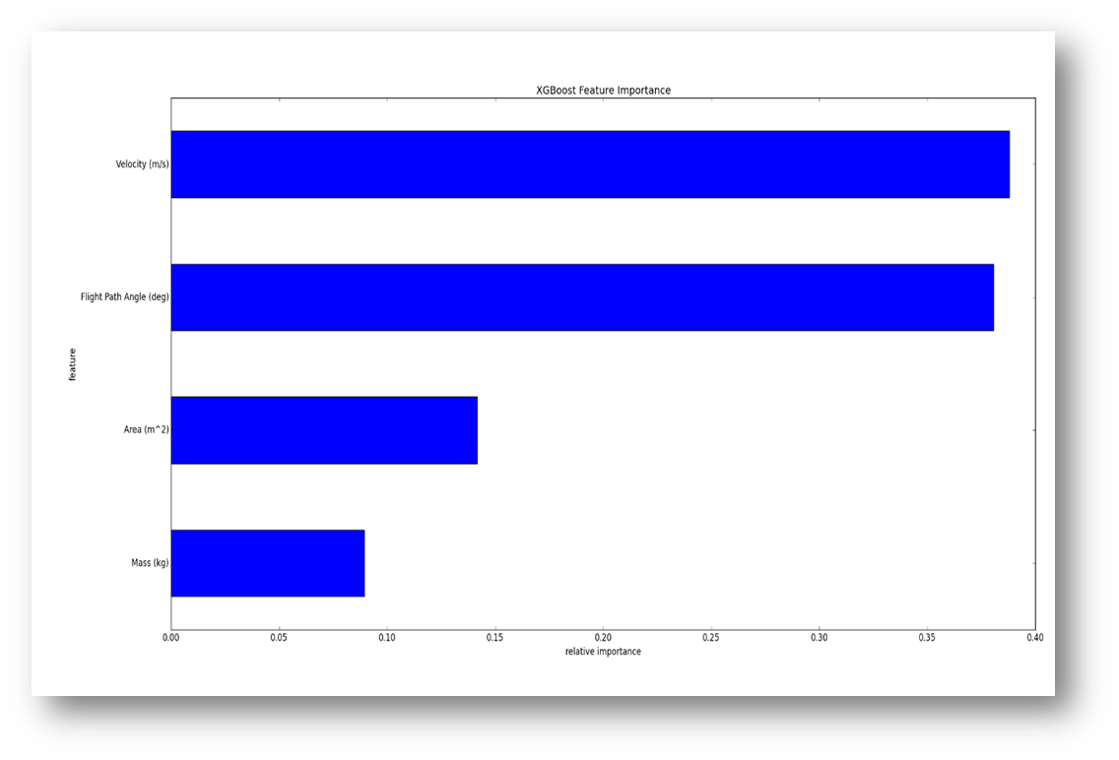
Rapid Exploration of Aerospace Design
Comprehensive Digital Transformation
Goals
Provide a machine learning-based platform for exploration of a design space with a large number of attributes – surrogate modeling
Develop a web-enabled interface that will help SMEs to use machine learning techniques during early design of aerospace vehicles
Methods
Support Vector Machines
Fit hyperplanes on the boundaries between discrete classes, employing a radial basis function to more accurately separate dimensions
Gradient Boosting
Ensemble model combining multiple decision trees; trained iteratively, greedily adding trees as performance is increased
Burger’s Equation (Gas Dynamics): The data presented a binary classification problem with only two inputs. Results for multiple SVM and Gradient Boost models are shown above.
POST: This dataset was generated from mod-sim code used to simulate a Venus entry, descent and landing (EDL). The plot on the left shows feature importance created during model training.

Slide 15
Tools to Support NASA Researchers
Comprehensive Digital Transformation
NDE Delamination Detector
READ (surrogate modeling)
Wind Tunnel Sensor Motifs
Watson Content Analytics

Slide 16
Process Workflow
Validate Approach and Methods with Subject Domain Experts
Comprehensive Digital Transformation
Collaborate with SMEs to Understand Data
Ongoing Validation with SMEs
Feature Engineering
Train/Validate/Test
Collaboration with Algorithm Designers
Iterative Evaluation with SMEs
Surrogate Modeling
Monitoring
Deployment
Prediction
Uncertainty Quantification
Interpretation

Slide 17
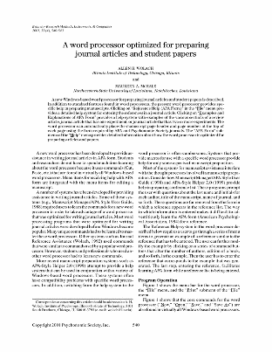
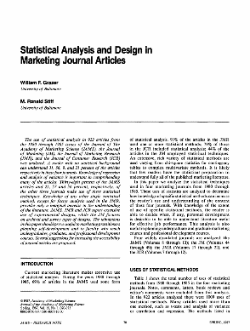
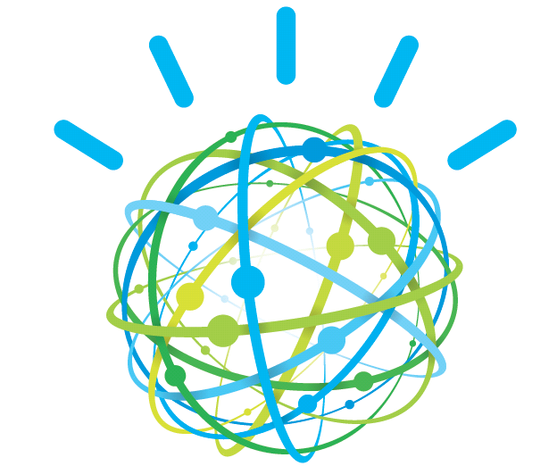
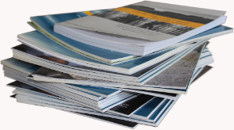
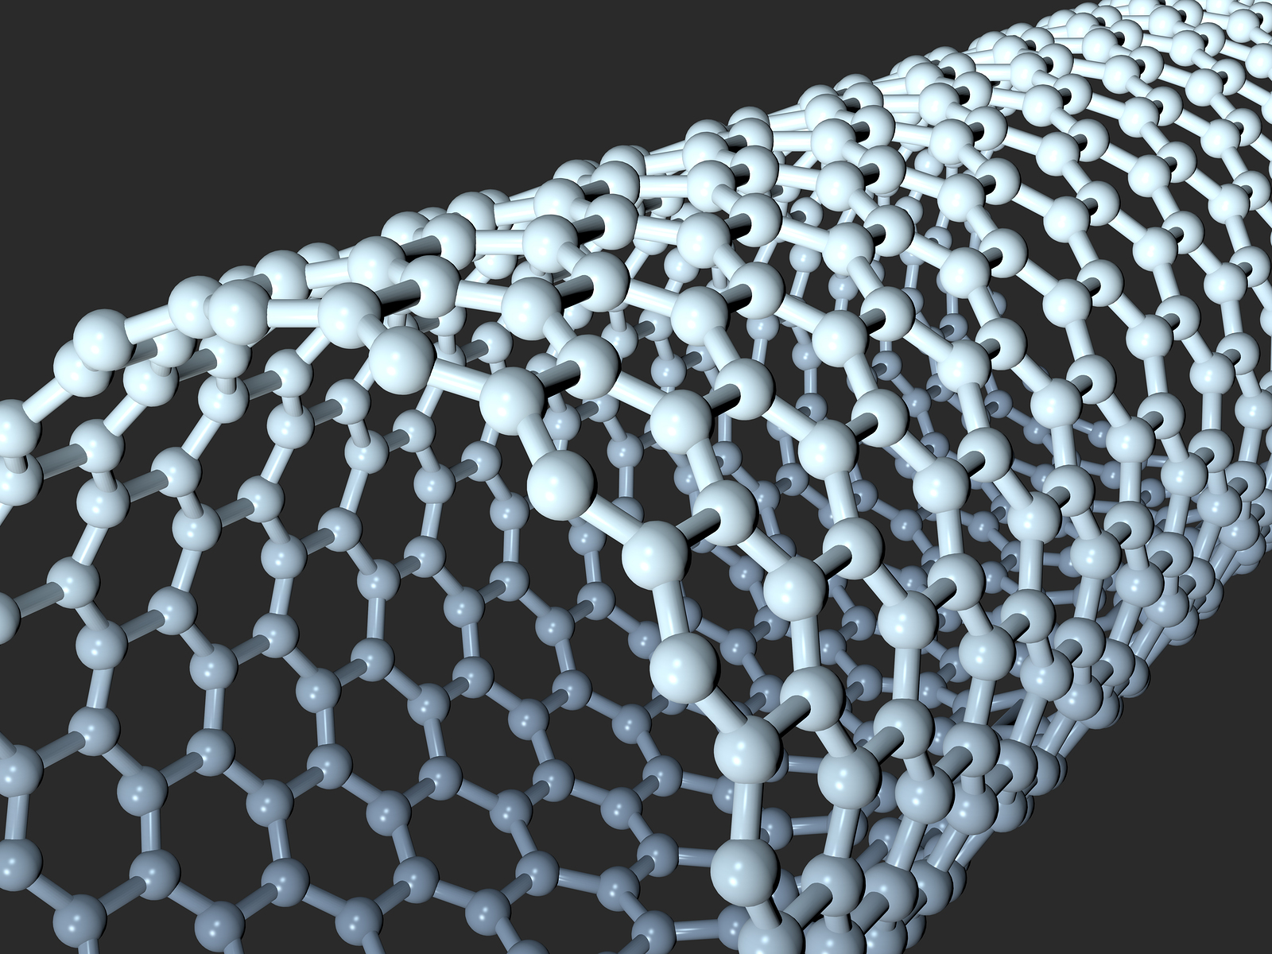
Text Analytics for NASA Domains
Comprehensive Digital Transformation
Analyzing and digesting all available information is an impossible task for scientists and engineers
Content Analytics
Watson Content Analytics
Key Collections
Key Capabilities
Digest and analyze thousands of articles without reading
Rapidly identify trends
Identify expert connections
Technology gap exploration
Identify cross-domain research
Knowledge Engineering
Saving SME time
Space Radiation
Aerospace Vehicle Design
Carbon Nanotubes
Autonomous Flight
NASA Lessons Learned
Uncertainty Quantification
Engineering Design Reviews
Human-Machine Teaming

Slide 18
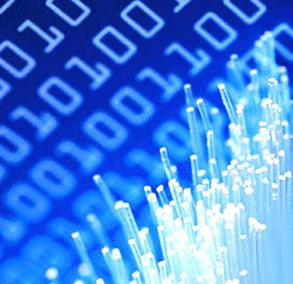
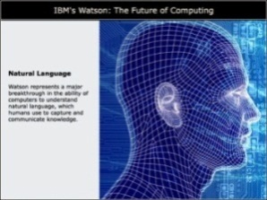
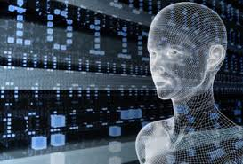
IBM Methodology
Comprehensive Digital Transformation
Cognitive Computing (IBM Watson)
4
Compose and visualize discoveries and answers
1
Understand scientific and domain language using NLP
3
2
Generate new hypothesis and discoveries
Adapt and learn quickly from inquires, results, selections and iteration
Domain content
Extraction at scale
Visualize at scale
Discover at scale
Learn with speed
Notes:
Main point: At the core of what makes Watson different are three powerful technologies - natural language, hypothesis generation, and evidence based learning. But Watson is more than the sum of its individual parts. Watson is about bringing these capabilities together in a way that’s never been done before resulting in a fundamental change in the way businesses look at quickly solving problems
Further speaking points:. Looking at these one by one, understanding natural language and the way we speak breaks down the communication barrier that has stood in the way between people and their machines for so long. Hypothesis generation bypasses the historic deterministic way that computers function and recognizes that there are various probabilities of various outcomes rather than a single definitive ‘right’ response. And adaptation and learning helps Watson continuously improve in the same way that humans learn….it keeps track of which of its selections were selected by users and which responses got positive feedback thus improving future response generation
Additional information: The result is a machine that functions along side of us as an assistant rather than something we wrestle with to get an adequate outcome
18

Slide 19
Watson Discovery Advisory
Comprehensive Digital Transformation
Watson Aerospace Innovation Advisor
Watson Pilot Advisor
Explore how – during an emergency event – a member of a commercial flight crew could be assisted in bringing the aircraft under control by accessing information from:
operation manuals
similar prior events
general aviation information
weather conditions
Proof of Concept completed in December 2016
Explore documents to assess existing regulatory environment for autonomous vehicles
Gain new insights to guide On Demand Mobility (ODM) technology and policy development
Proof of Concept underway

Slide 20
Strategy
Comprehensive Digital Transformation
Area | Past | Present & Near Term | Future Possibilities
Machine Learning | Aeroelastic Flutter Non Destructive Evaluation | Crew State Monitoring Additive Manufacturing Hypersonics Flight Deck Analytics SansEC | Autonomy Trajectory-Based Operations Cybersecurity Mission Support Organizations
Automated Literature Analysis | Watson Pilot Advisor Watson Content Analytics | Watson Aero Advisor Watson Explorer | Open Source Platforms Supporting Architectures
Training & Education | Seminar Series | Tutorials and Workshops | Online Resources
Philosophy | Core team “do” for customers | Continue doing; more teaming and consulting | Balance do, team, consult Grow embedded workforce

Slide 21
L A N G L E Y R E S E A R C H C E N T E R
Data Analytics and Machine Intelligence Capability Team
Comprehensive Digital Transformation
Questions?
Jeremy Yagle
Technical Lead, Data Analytics and Machine Intelligence Capability Team
Comprehensive Digital Transformation (CDT)
NASA Langley Research Center
jeremy.j.yagle@nasa.gov

