Slide 1
PURIFICATION OF 6 GHZ RESONATORS AT EXTREMELY HIGH TEMPERATURES AT ATMOSPHERIC PRESSURE
5th Workshop on Thin films and New Ideas for pushing the limit of SRF,
July 18--20, 2012, Jlab, Newport News VA
A.A. Rossi, S. Stark, R. K. Thakur, N. Visonà and V. Palmieri
ISTITUTO NAZIONALE DI FISICA NUCLEARE
Legnaro National Laboratories
and University of Padua

Slide 2
There is a plenty of incredible games to play just close to the melting point of Niobium ….

Slide 3
BCS_{NB}
Bulk Nb
6 Ghz @4,2K

Slide 4

Nb₅N₆; Nb₄N₃
δ−NbN _{1-x}; η-NbN (hexagonal);
δ’−NbN (hexagonal);
β-Nb₂N (hexagonal); γ-Nb₄N_{3-x}
α-Nb (N) (bcc solid solution)
Niobium

Slide 5
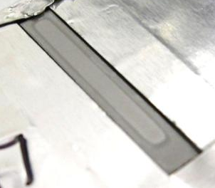
1 – 3 mm of nitridation in a couple of minutes

Slide 6
SC 2
SC 1
Vacuum
λ₁
H_{z}
a
λ₂
Niobium
Overlayer

Slide 7
SC 2
SC 1
Vacuum
For a “2 Superconductor system”
λ₁
H_{z}
a
Q₂
λ₂
ΔQ
Q₁
λ₁/a

Slide 8
SC 2
SC 1
Vacuum
λ₁
H_{z}
Q₂
a
λ₂
Q₁
λ₁/a
An hypotesis:
Gap and Penetration depth depends on magnetic field

Slide 9
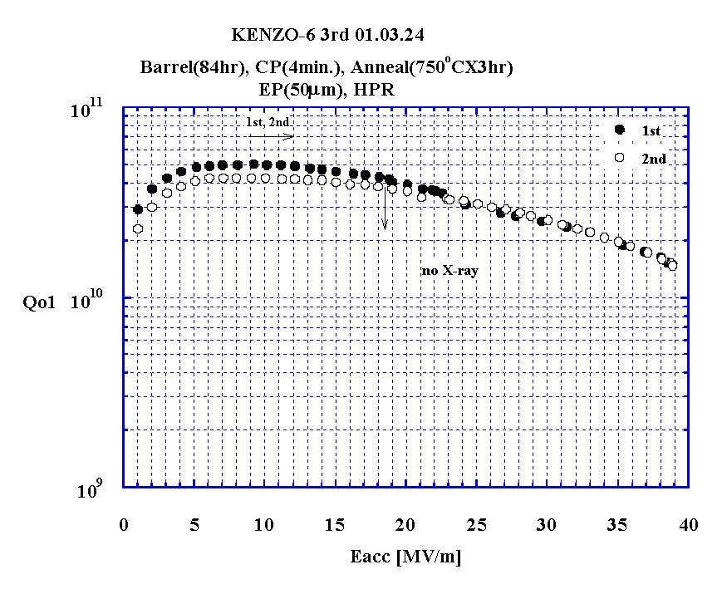

Slide 10
Q2
Q_{Tot}
Q1
5
10
15
20
25
30
35
40
45
b
50

Slide 11
=
+
Why Q increases with field?
Q2
Q₂e^{-k2b}
The more λ1 increases vs field
Q1
The more SC2 ( low losses) is involved
b

Slide 12
=
+
The ticker is SC 1, the smoother is the Q-rise
a/λ₀
Q2
O
0.1
1
10
Q1
b

Slide 13
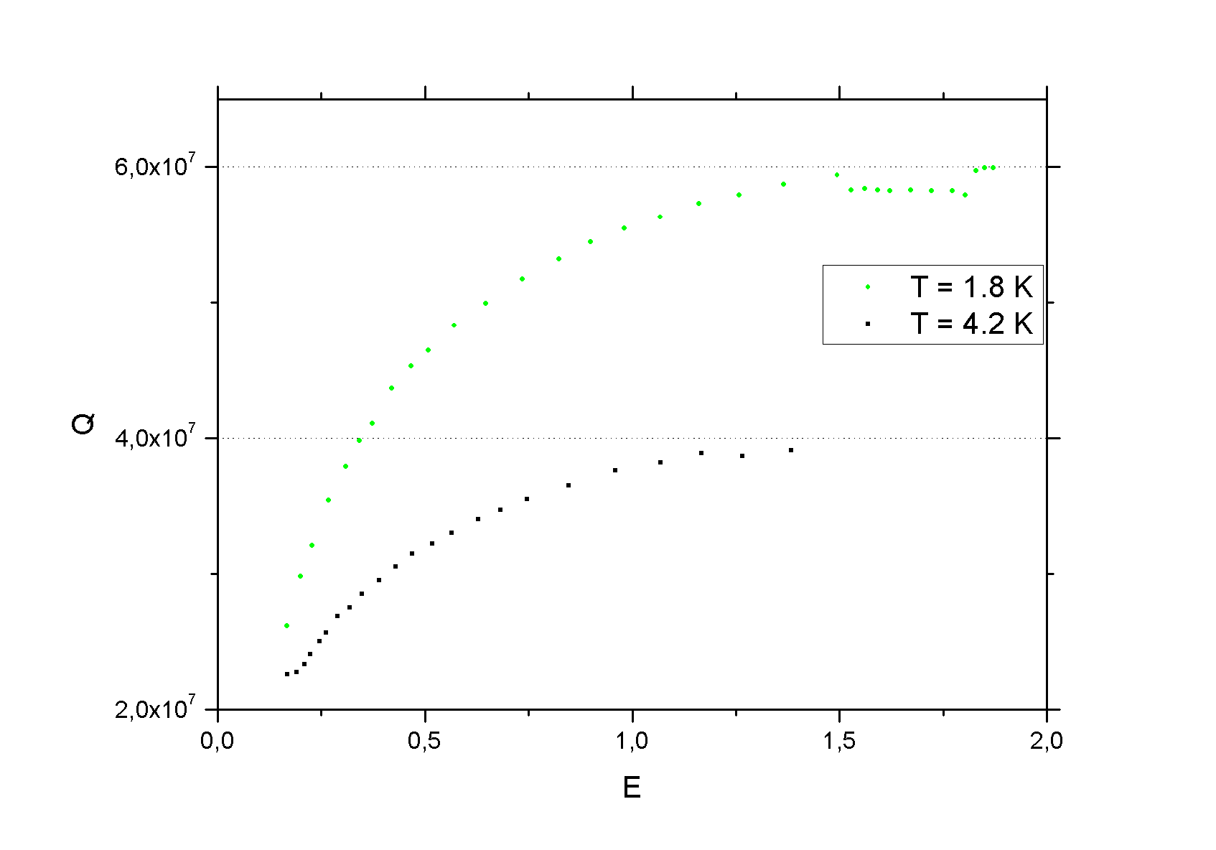
One of our thermal diffused NbN

Slide 14
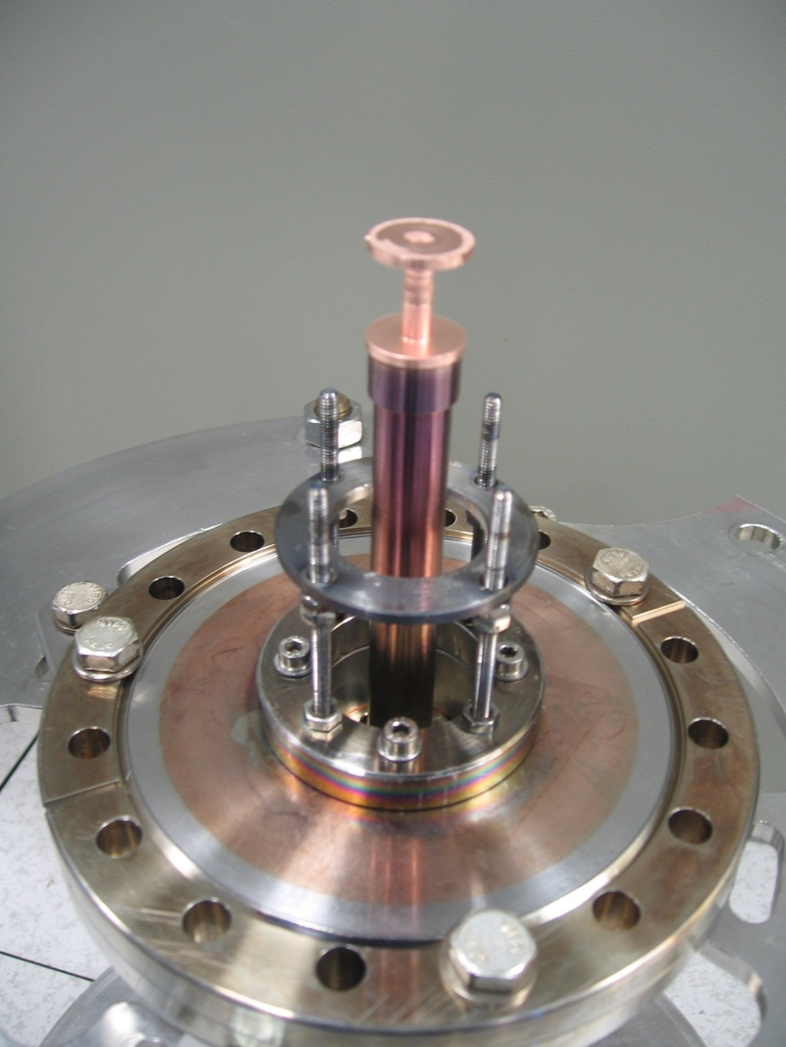
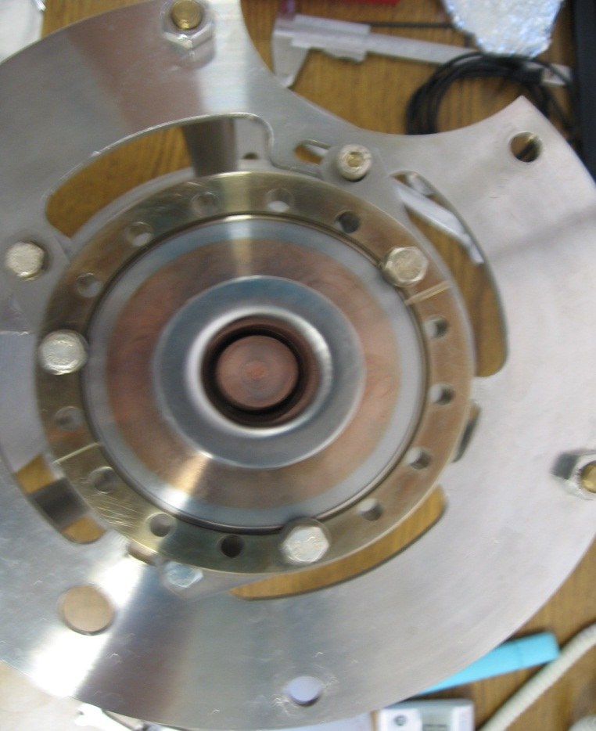
Cu sputtering into Nb 6GHz cavity
Cavity
Cathode

Slide 15
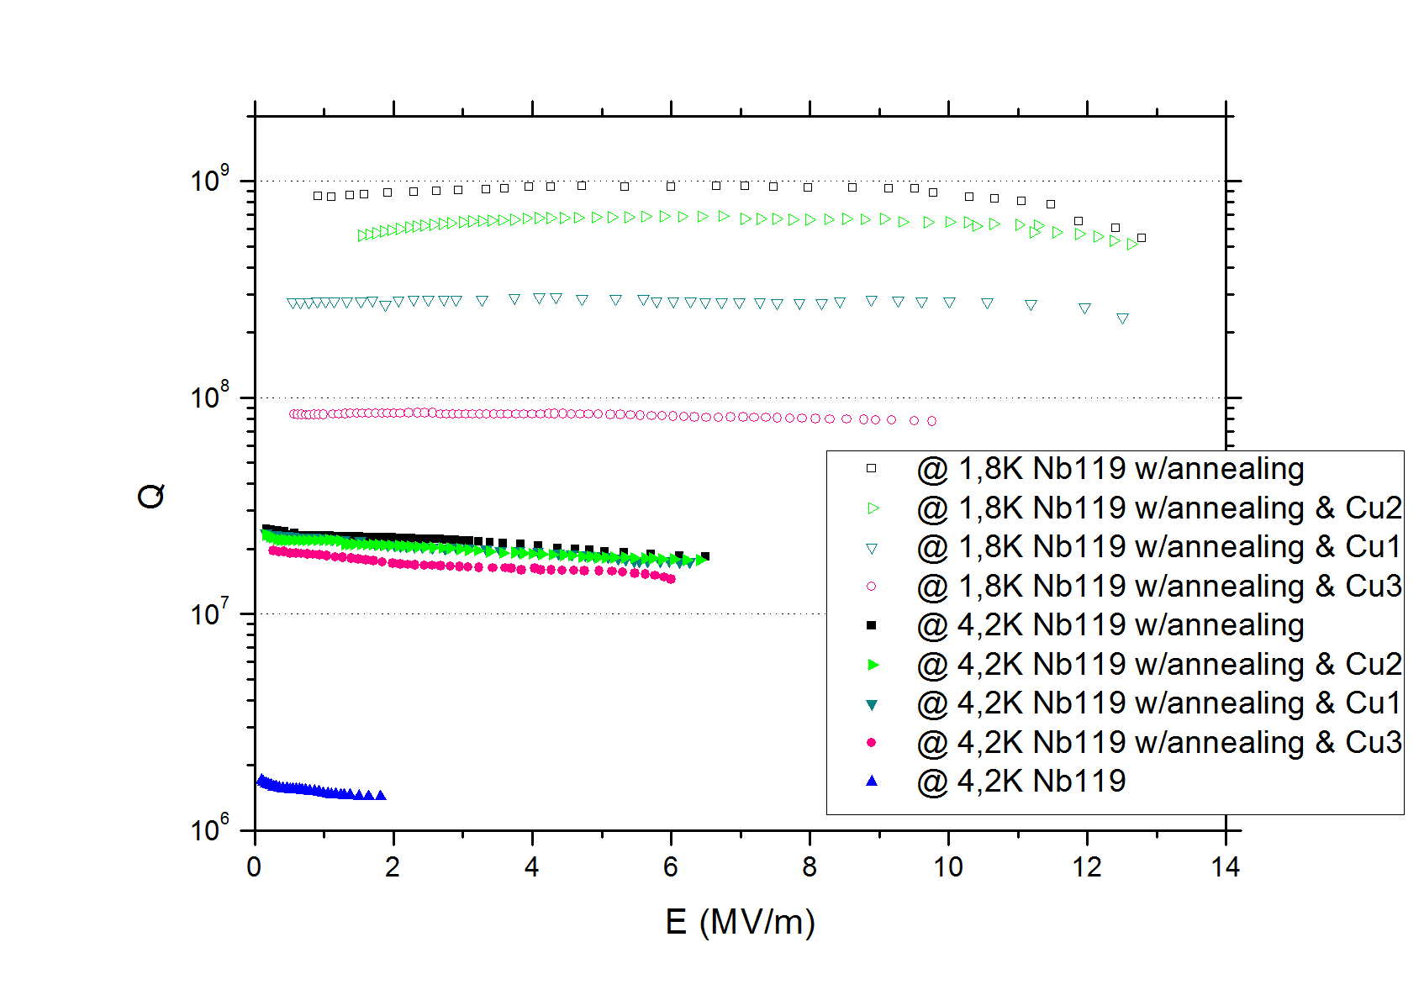
Sputtering of a Cu overlayer onto a Nb 6GHz cavity

Slide 16
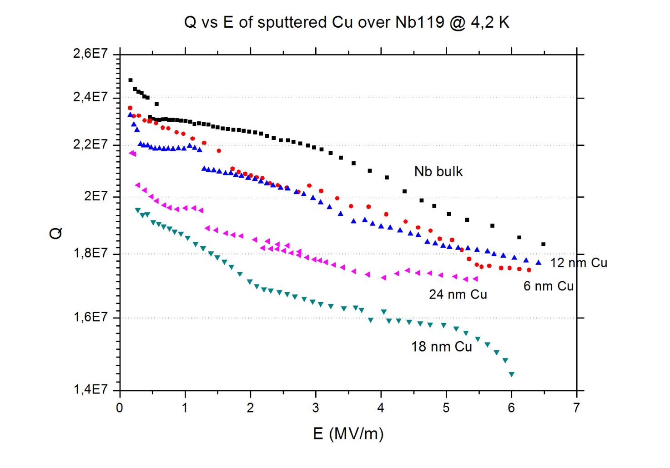

Slide 17
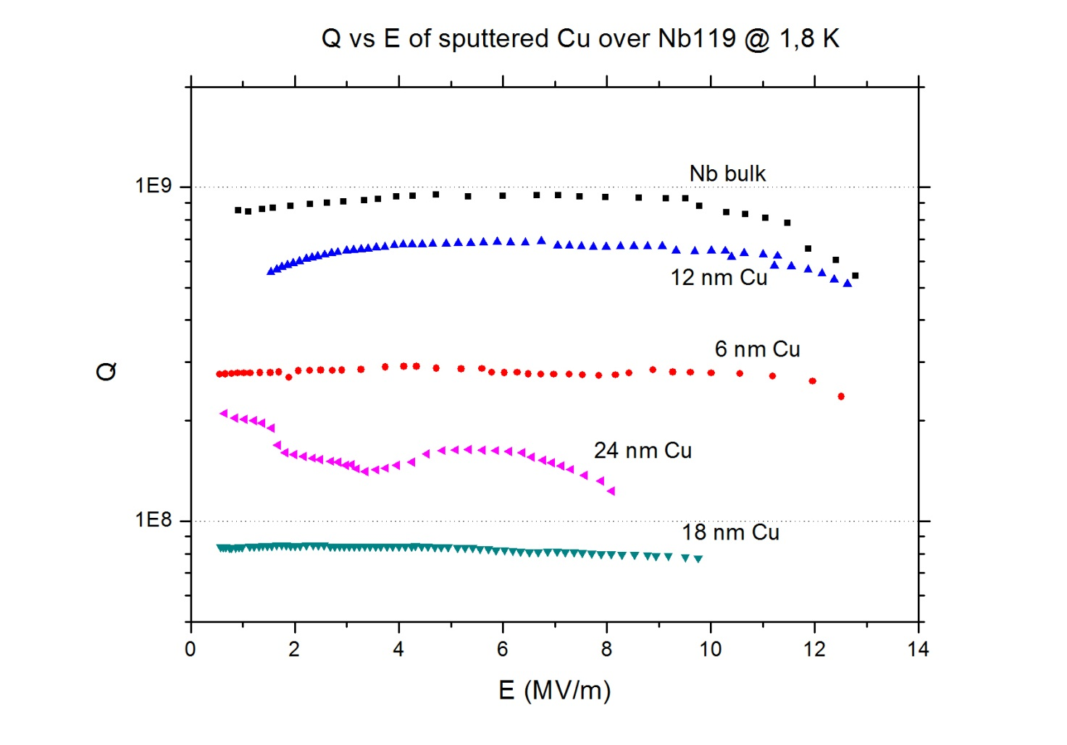

Slide 18
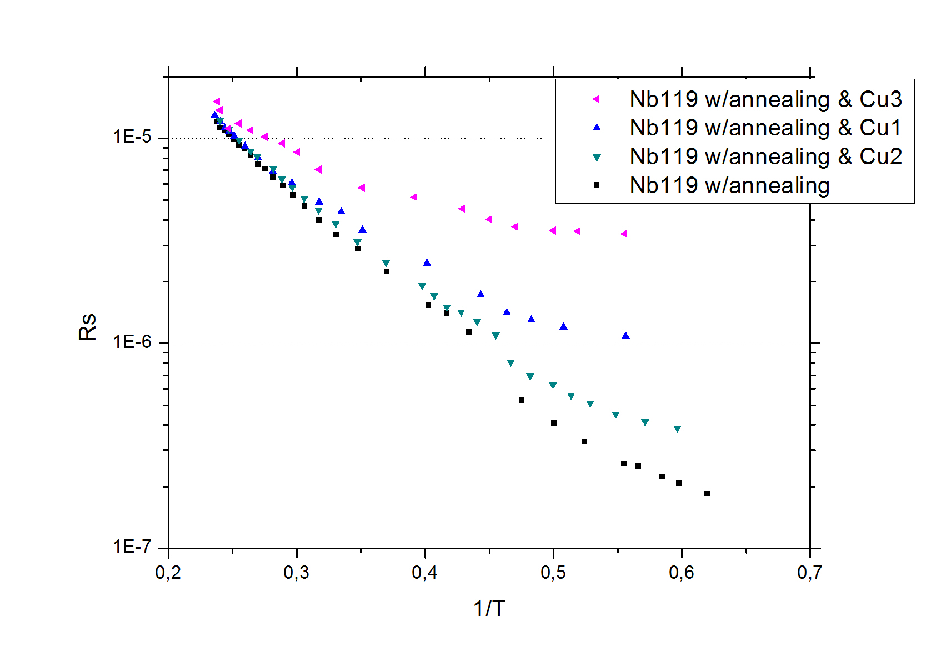

Slide 19
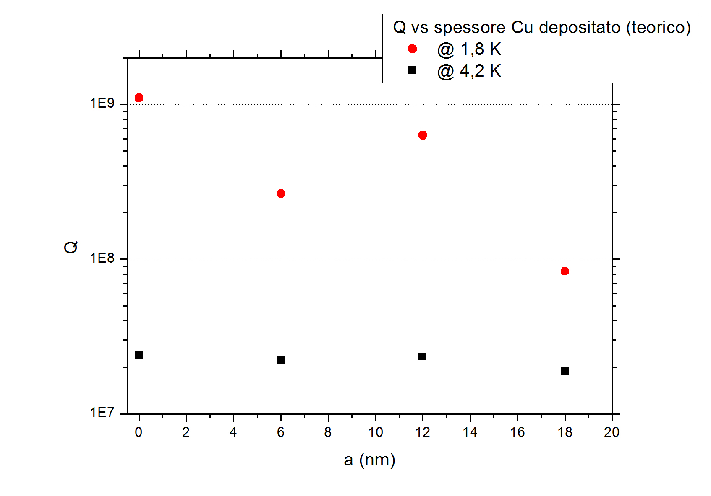

Slide 20
Didn’t you notice anything strange?

Slide 21
Sputtering of a Cu overlayer onto a Nb 6GHz cavity

Slide 22
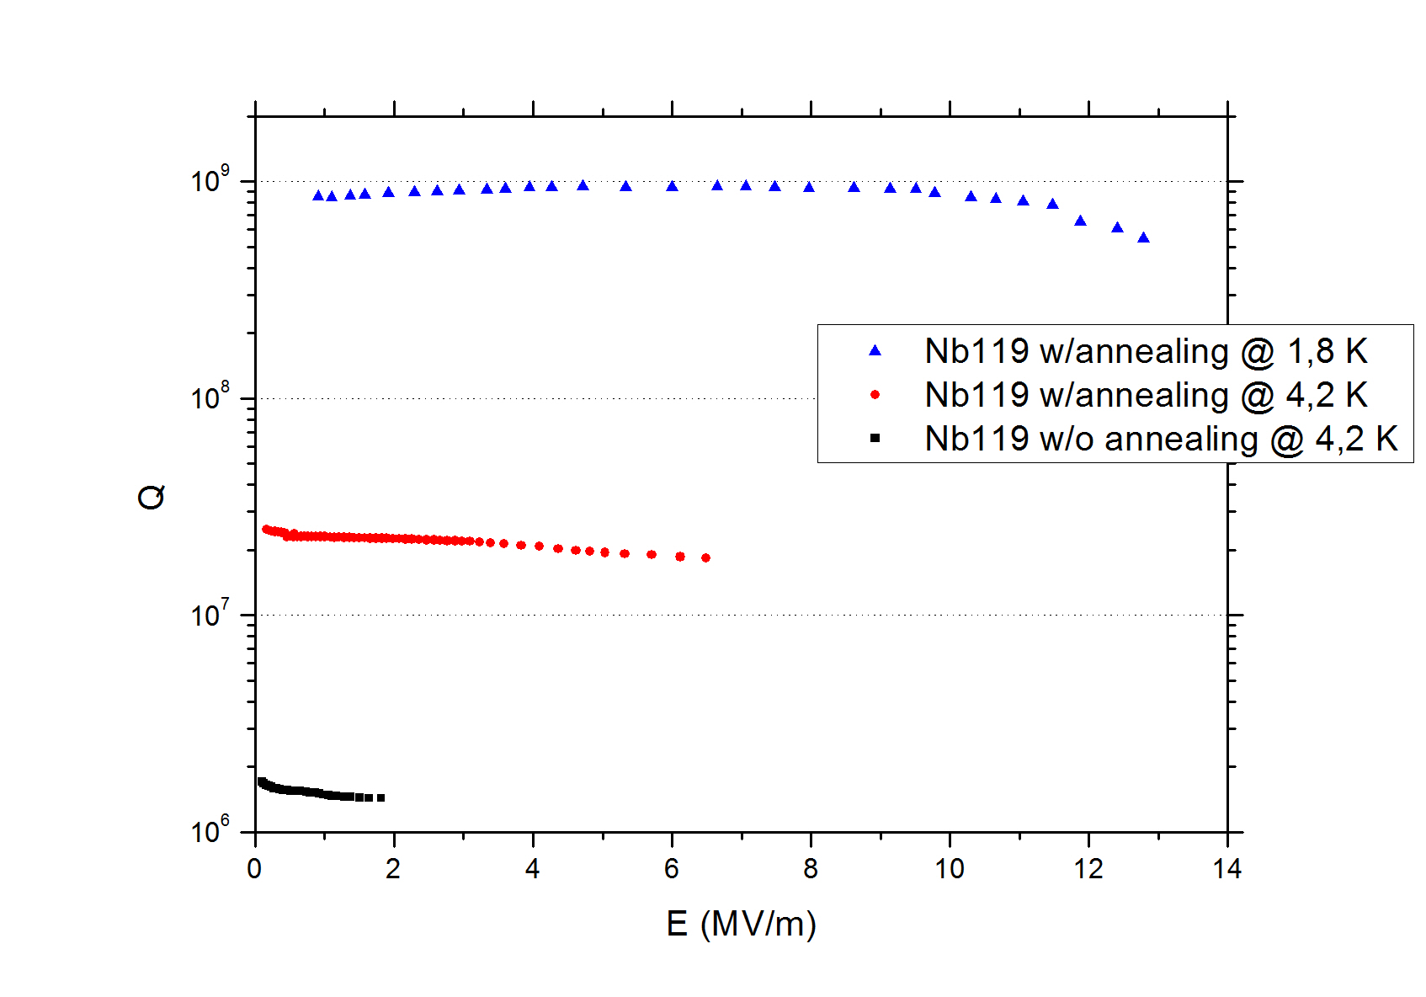

Slide 23
Sketch of the furnace
Exhaust gases
Cavity or Sample
Coil
(250-3000)ºC
Gas
bottle
Pyrometer
Work head
15 KW
Input gas
Power
supply
Low overpressure

Slide 24
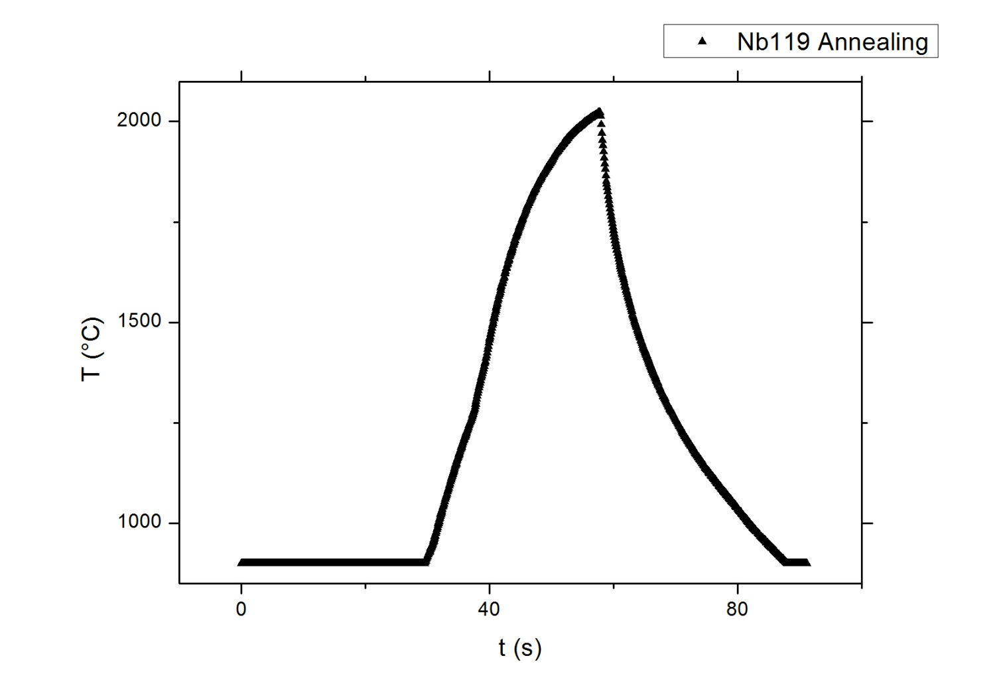

Slide 25
We took a contaminated cavity, exposed to air for years and with a Q around 1e+6
We treated at 2000°C for only a few tenths of seconds at atmospheric pressure without using vacuum
The Q at 1,8 K jumped up for 3 orders of magnitede

Slide 27
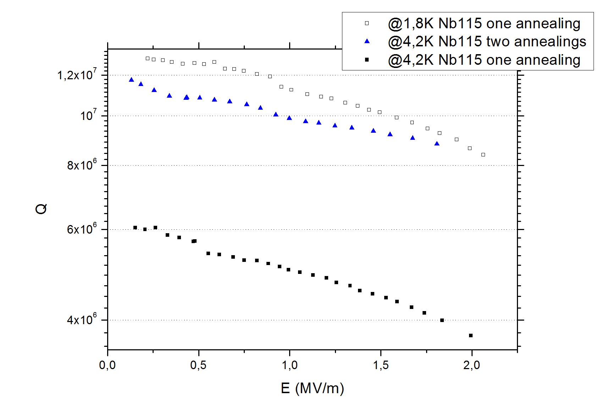

Slide 28
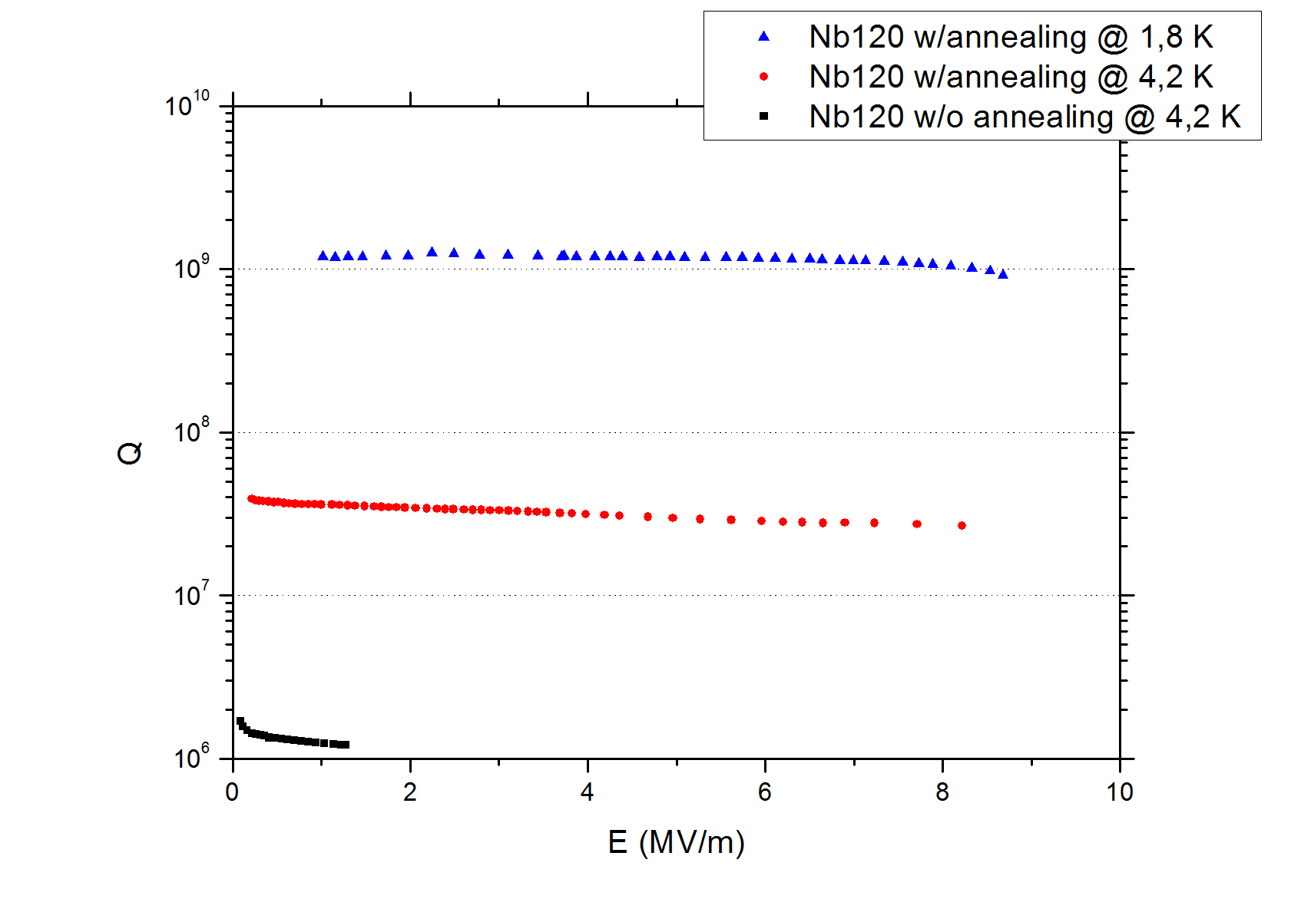

Slide 29
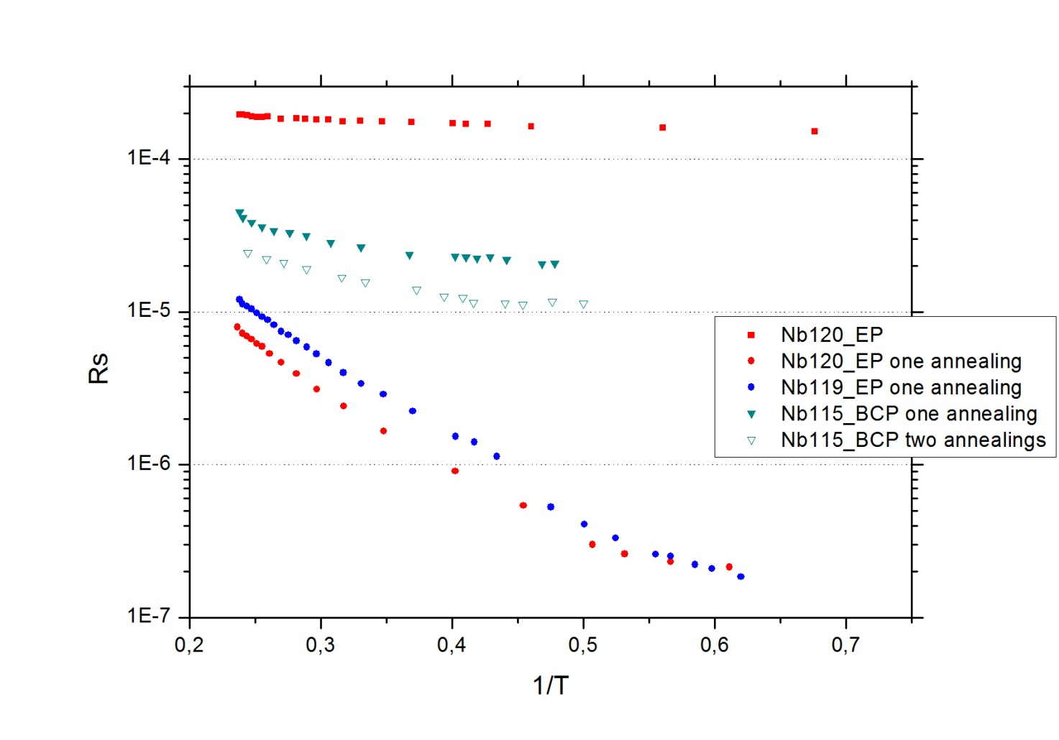
We did not act onto R_{Res}.
We acted onto R_{BCS}!!!

Slide 30
CONCLUSIONS
A new treatment of the of time of the minute, at temperatures over 2000°C, without using vacuum, allows the recovery of performances of 6 GHz cavities

Slide 31
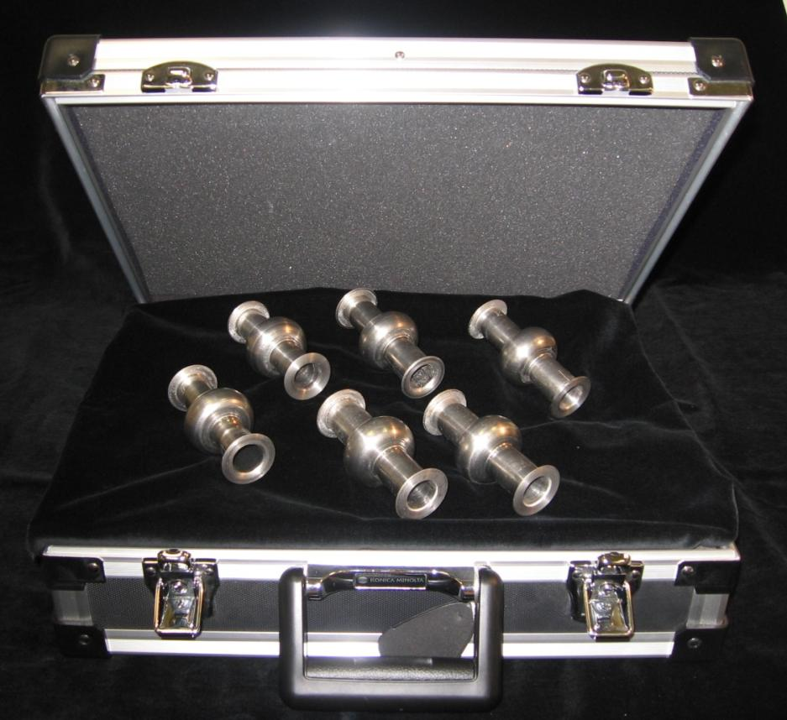
THANK YOU

