Slide 1




Nb films produced by Energetic Condensation via ECR
A-M Valente-Feliciano, J. Spradlin, L. Phillips, C. Reece, G. Eremeev, B. Xiao, X. Zhao, O. Trofimova (Jlab)
F. Stevie, D. Batchelor
(NCSU)
,

Slide 2
OUTLINE
Motivation/Approach for SRF thin films development
Nb Films on Insulators
Nb Films on Copper
Concluding Remarks

Slide 3
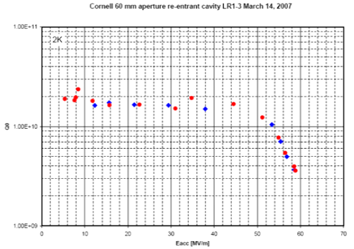
Superconducting RF Cavities
Nb has the highest T_{c} among all pure metals and the highest lower critical field H_{c1}≈170 mT (2K) among all superconductors . Meissner state can exist up to H = H_{c}.
Breakdown fields close to the de-pairing limit of 50 MV/m for Nb. Best Nb cavities approaching their intrinsic limit at H_{max} = H_{C}

Slide 4
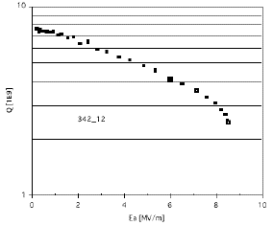
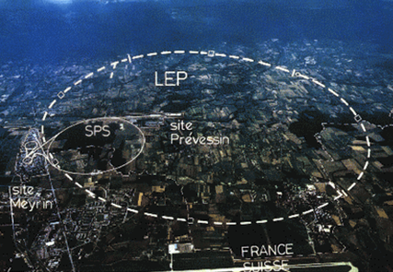
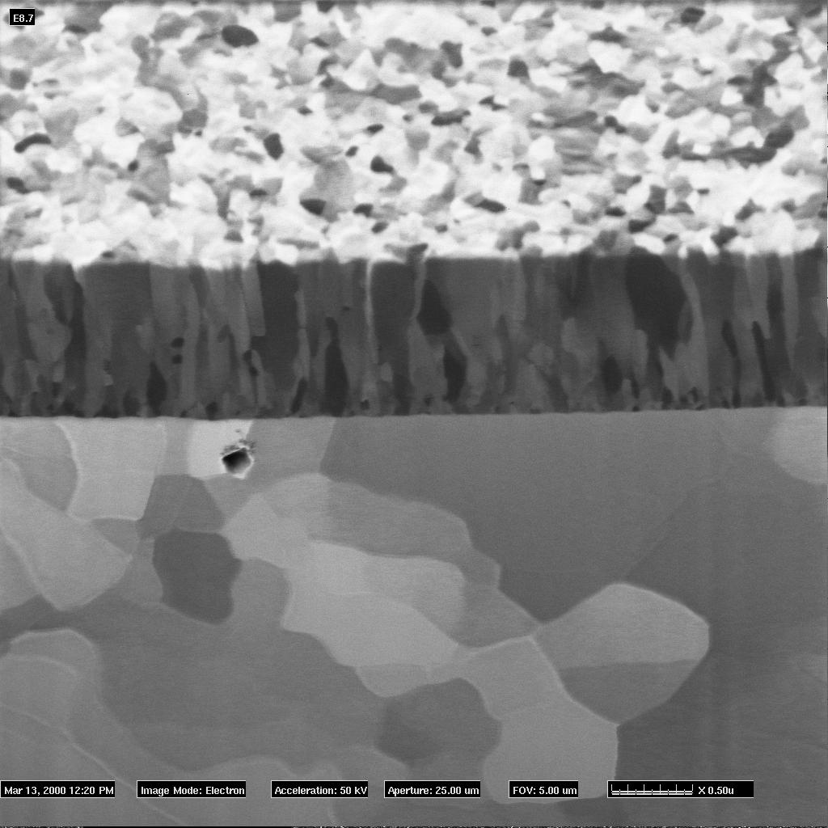
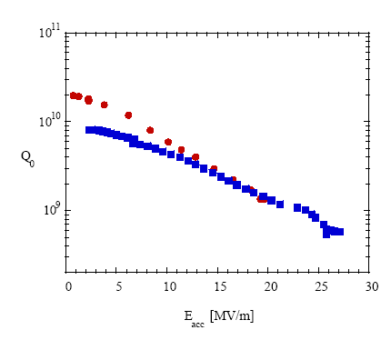
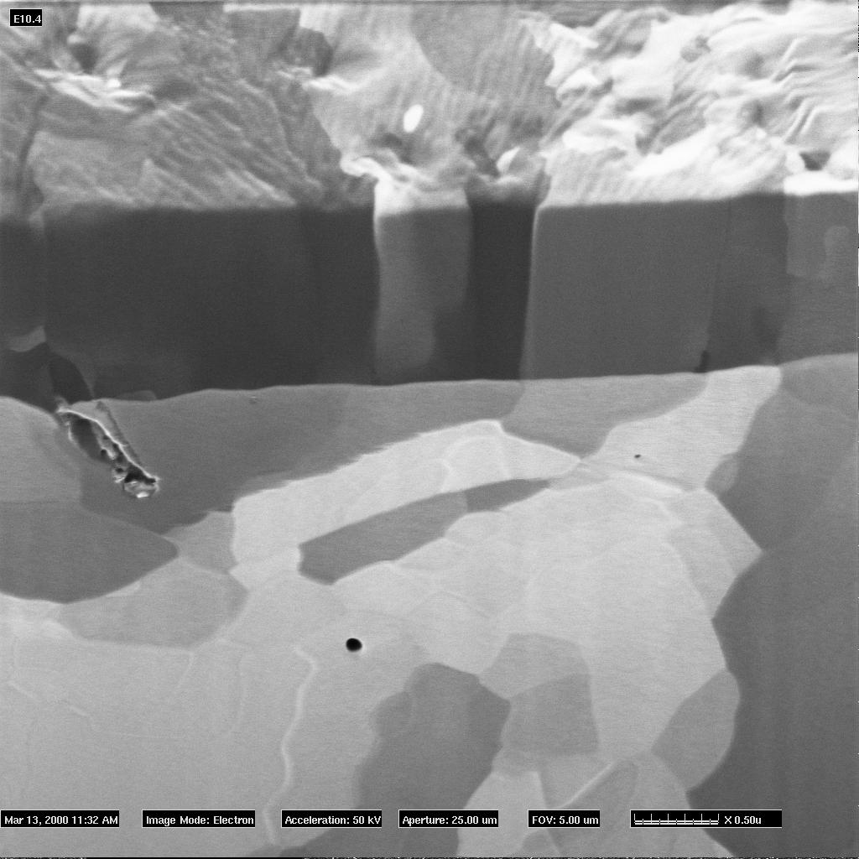
Thin Films: niobium –state of the art
CERN LEP 2 272 x 353MHz Nb/Cu 4-cell cavities
INFN Legnaro 52 x 160 MHZ Nb/Cu QWR
Standard films
1.5 GHz Nb/Cu cavities, sputtered w/ Kr @ 1.7 K (Q₀=295/R_{s})
1.5 GHz Nb/Cu cavities, sputtered w/ Kr @ 1.7 K (Q₀=295/R_{s})
Columnar grains, size ~ 100 nm
In plane diffraction pattern: powder diagram
(110) fiber texture ⊥ substrate plane
Bulk Nb
RRR_{max} =28
1.5 GHz Nb/Cu
LEP II
350MHz Nb/Cu (4.2K)
Courtesy: P. Jacob - EMPA
Oxide-free films
Equi-axed grains, size ~ 1-5μm
In plane diffraction pattern: zone axis [110]
Heteroepitaxy
Nb (110) //Cu(010) , Nb (110) //Cu(111),Nb (100) //Cu(110)
CERN 2000
RRR_{max}= 40
RRR_{Nb}= R_{300K}/R_{10K}
Gauge for mean free path & material quality, affected by scattering centers such as structural defects, impurities …

Slide 5
1.5 GHz Nb/Cu cavities, sputtered w/ Kr @ 1.7 K (Q₀=295/R_{s})
Bulk Nb
1.5 GHz Nb/Cu
LEP II
350MHz Nb/Cu (4.2K)
CERN 2000
major system simplifications.
highest level of quality assurance and reliable performance.
Use of substrates with higher thermal conductivity
Bulk-like performance Nb film

Slide 6
Tailoring for optimum RF performance
3 sequential phases for film growth
  Film nucleation on the substrate (Nb, Al₂O₃, Cu; single crystal & polycrystalline)
  Growth of an appropriate template for subsequent deposition of the final RF surface
  Deposition of the final surface optimized for minimum defect density.
Careful characterization of the attained composition and microstructure
Close association with resulting rf surface impedance and superconducting properties

Slide 7
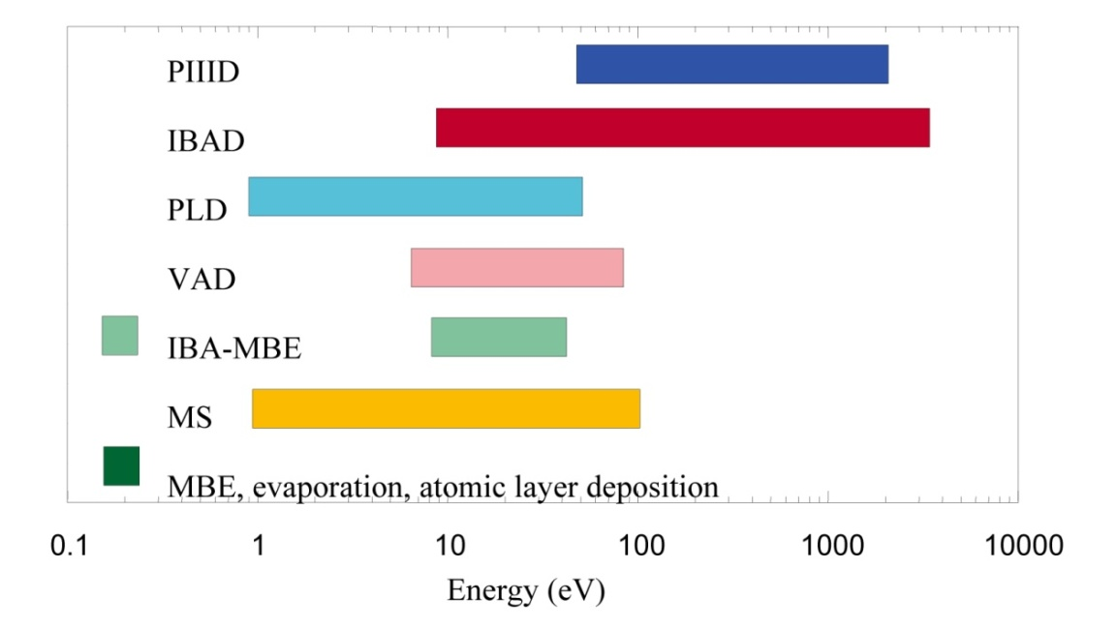
Deposition Techniques
Control over the deposition process is exercised by only
3 first-order vapor parameters & 1 first-order substrate parameter.
Vapor parameters Absolute arrival rates of film atoms
Partial pressures of background gases in the chamber Energies of the deposition fluxes.
Substrate parameter Substrate temperature T.
Without energetic atoms, only the substrate temperature influences the processes of physi- and chemisorption, thermal desorption, nucleation, nuclei dissociation, surface diffusion, and formation of specific nucleation sites.
Typical energy ranges for different PVD processes.
PIIID = plasma immersion ion implantation and deposition
IBAD = ion beam assisted deposition
PLD = pulsed laser deposition
VAD = vacuum arc deposition
IBA-MBE = ion beam assisted molecular beam epitaxy
MS = magnetron sputtering
MBE = molecular beam epitaxy.
However practical substrates for SRF cavities (Al, Cu) may not allow heating to high temperature!

Slide 8
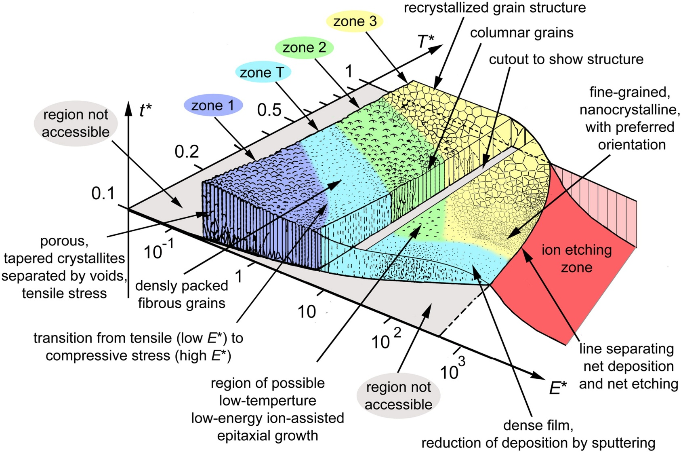
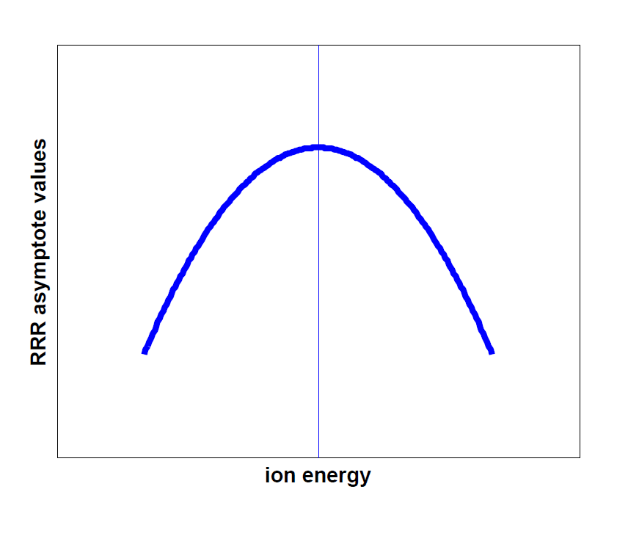
Energetic Condensation
Generalized Structure Zone Diagram
The additional energy provided by fast particles arriving at a surface can induce the following changes to the film growth process:
A. Anders, Thin Solid Films 518(2010) 4087
residual gases are desorbed from the substrate surface
chemical bonds may be broken and defects created thus affecting nucleation processes and film adhesion
film morphology changes
microstructure is altered
stress in the film alters
As a result of these fundamental changes, energetic condensation allows the possibility of controlling the following film properties:
  the density of the film may be modified to produce improved optical and corrosion-resistant coatings
  the film composition can be changed to produce a range of hard coatings and low friction surfaces
  crystal orientation may be controlled to give the possibility of low-temperature epitaxy

Slide 9
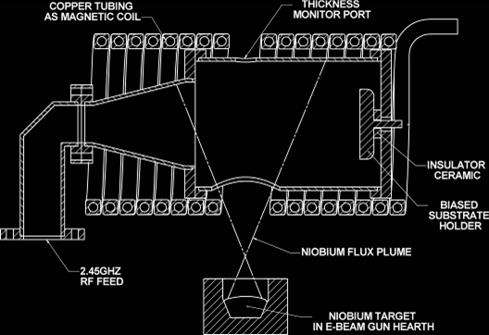
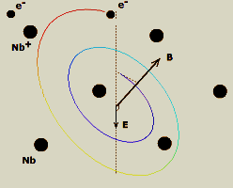
Energetic Condensation via ECR
Niobium vapour produced by an e-beam gun is ionized by an ECR process. The Nb ions can be accelerated to the substrate by an appropriate bias. Energies in excess of 100 eV can be obtained.
Generation of plasma
3 essential components:
Neutral Nb vapor
RF power (@ 2.45GHz)
Static B ⊥ ERF with ECR condition
Why ECR?
No working gas
High vacuum ie. reduced impurities
Singly or “quasi-singly charged” ions
Controllable deposition energy
90° deposition flux
(Possible to help control the crystal structure)
Excellent bonding
No macro particles
Wu, G., et al.
J. Vac. Sci. Technol. A Vol. 21, No. 4, (2003)

Slide 10
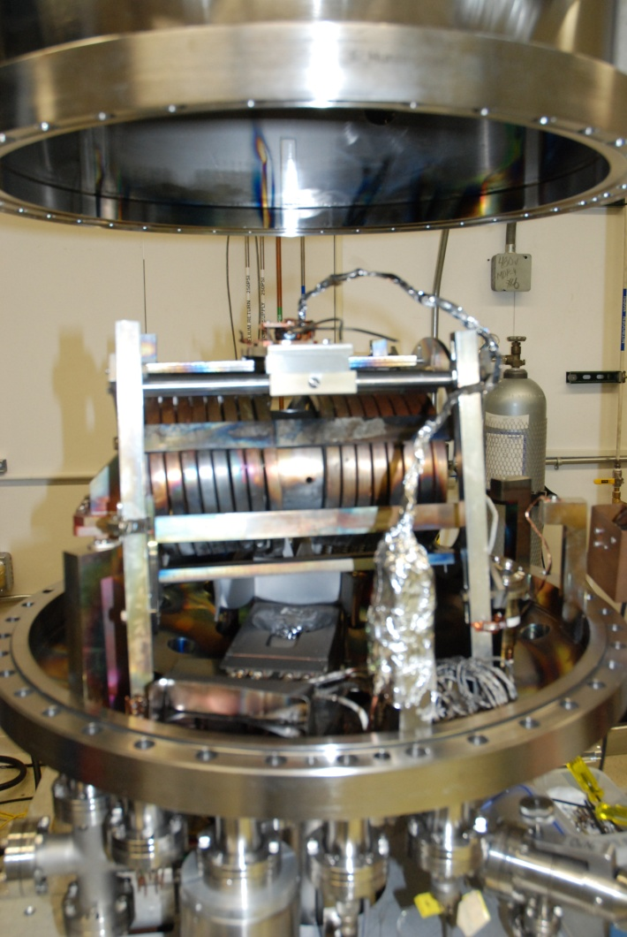
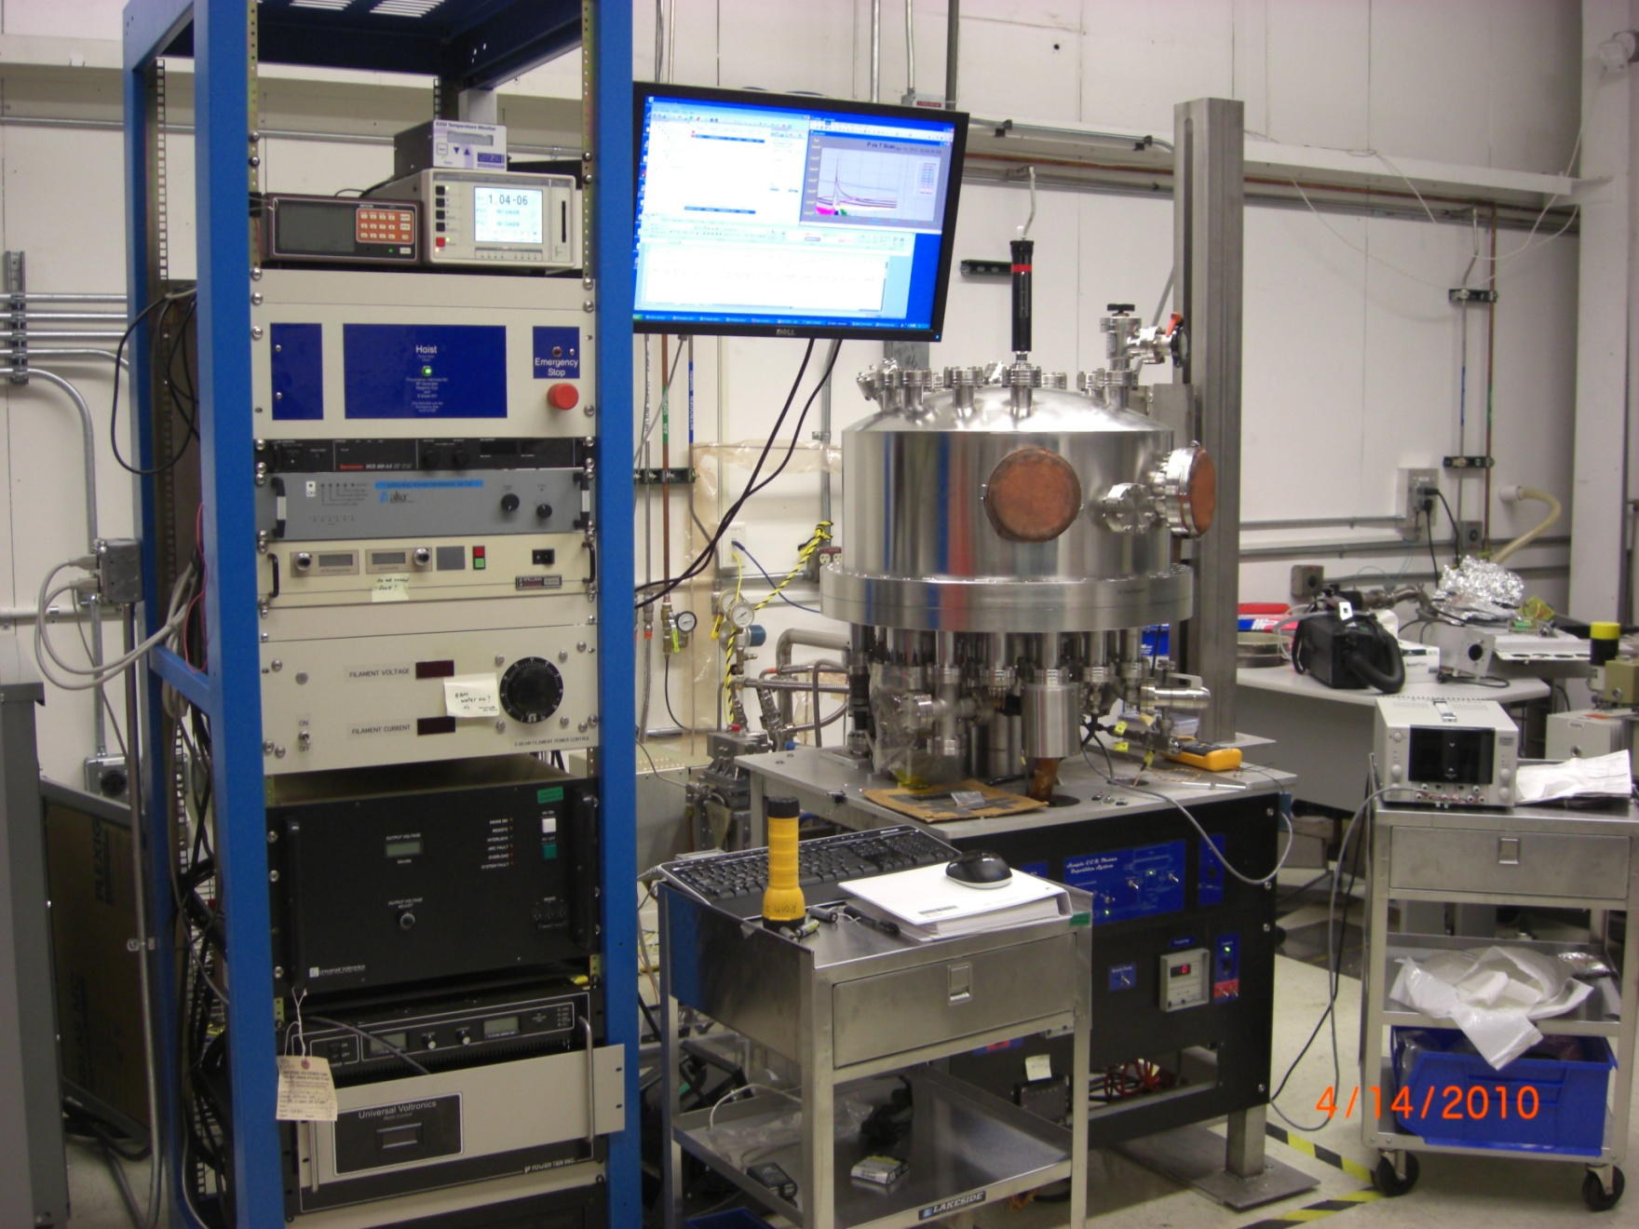
Energetic vacuum deposition by ECR plasma

Slide 11
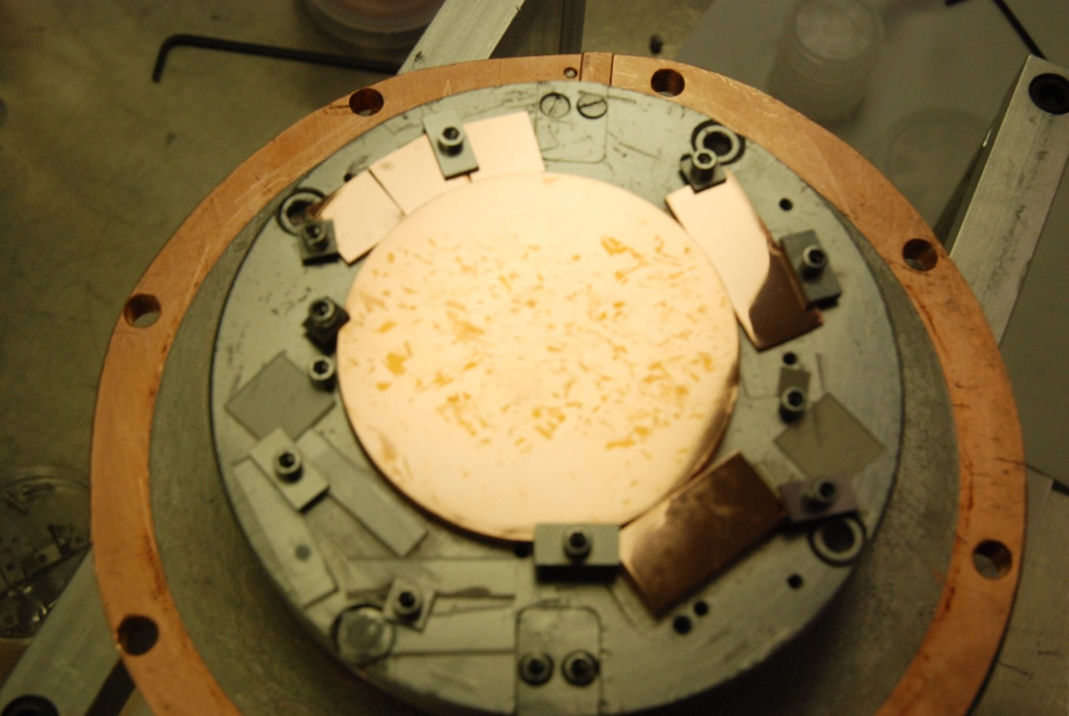
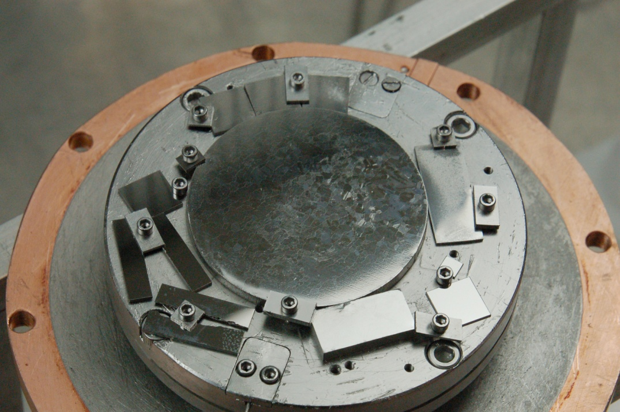
Samples produced on different substrates
Metallic:
  Cu (100)
  Cu (110)
  Cu (111)
  Fine grain Cu
  Large grain Cu
Insulating:
    Al2O3 (11-20)
    Al2O3 (11-20)
    MgO(100)
    SrTiO₃
Amorphous (Al2O3 , AlN), fused silica
  Effect of interface quality :
  Substrate pre-treatment ex-situ & in-situ
Cu grain size and presence/absence of Cu oxide at interface
  Influence of energy of incoming ions : Bias voltage (0V, -150V)
  Influence of adatom mobility : Coating temperature
Typical vacuum during plasma in ECR system:<5x10⁻⁸ Torr

Slide 12
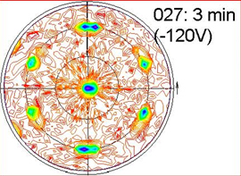
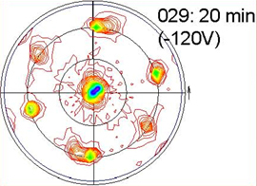
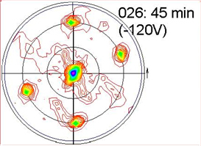
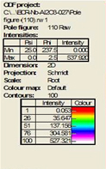
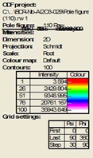
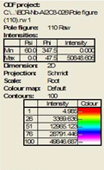
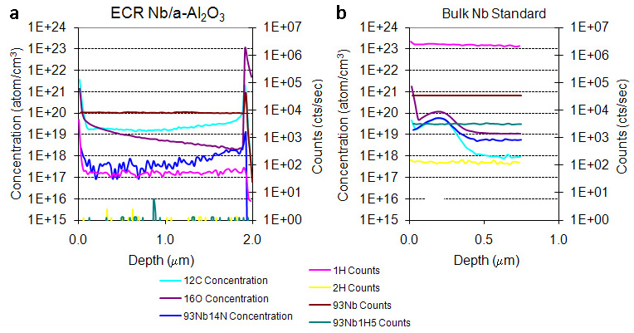
Nb films grown on insulators
Evolution of crystal structure with thickness
XRD pole figures show the presence of growth domains (rotation the poles of 70°)
As the film grows one growth variant prevails.
Less impurities than bulk Nb – SIMS data
The hydrogen content of ECR Nb films is found to be much lower than for the standard bulk Nb material as shown by the SIMS data.

Slide 13
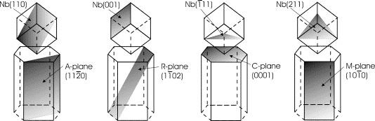

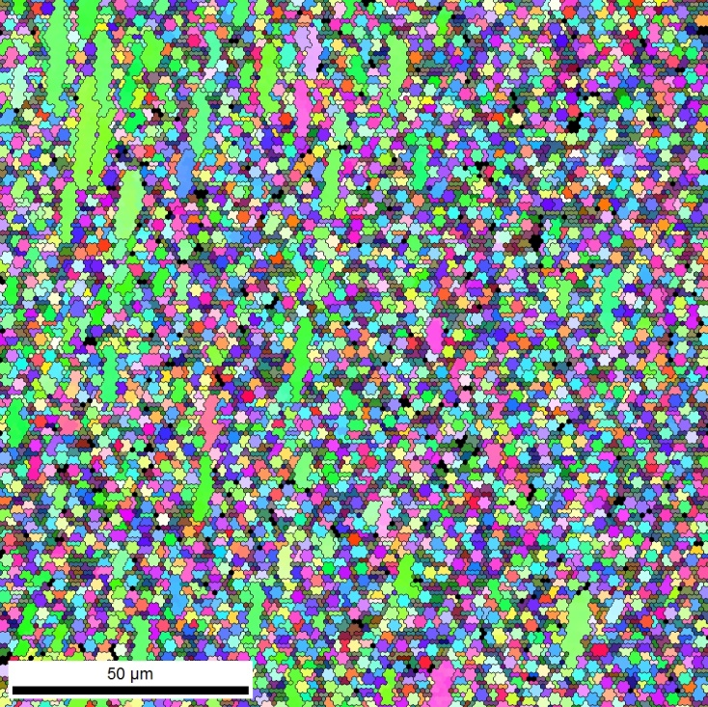
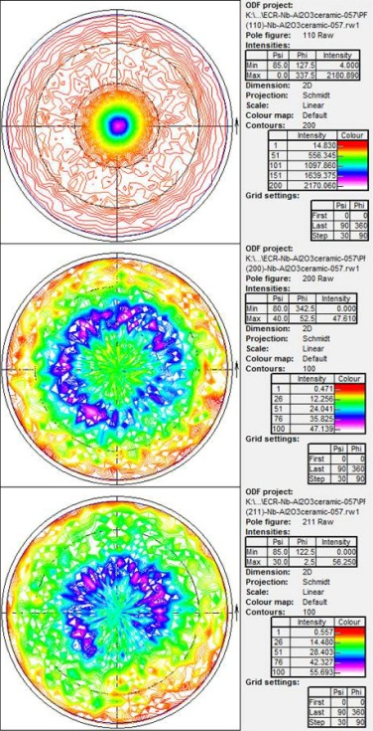

Nb films grown on insulators
A. R. Wildes et al., Thin Solid Films, 401 7 (2001)
Crystalline Al₂O₃ (11-20)
“Amorphous” Al₂O₃ ceramic
RRR= 247
RRR=89
ECR Nb films
Coated simultaneously
Epitaxy of Nb on Al₂O₃ (11-20) , Al₂O₃ (0001), MgO (100), (110), (111)
Polycrystalline films with micron size grains grown on nano-crystalline/amorphous materials such Al₂O₃ and AlN ceramics and fused silica.

Slide 14
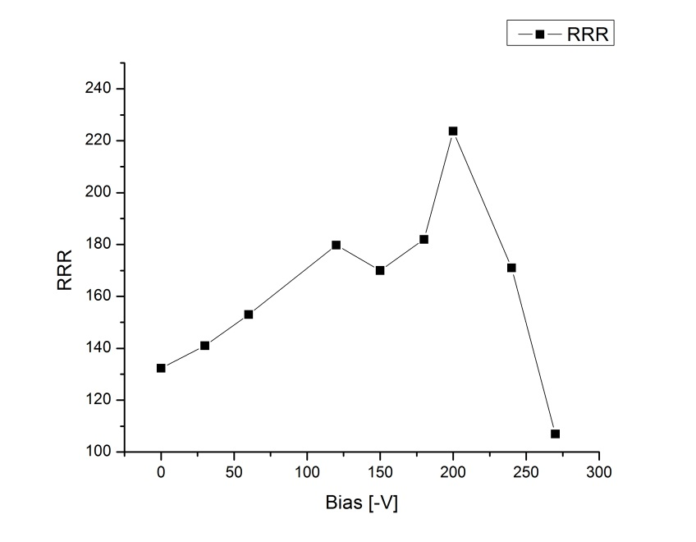
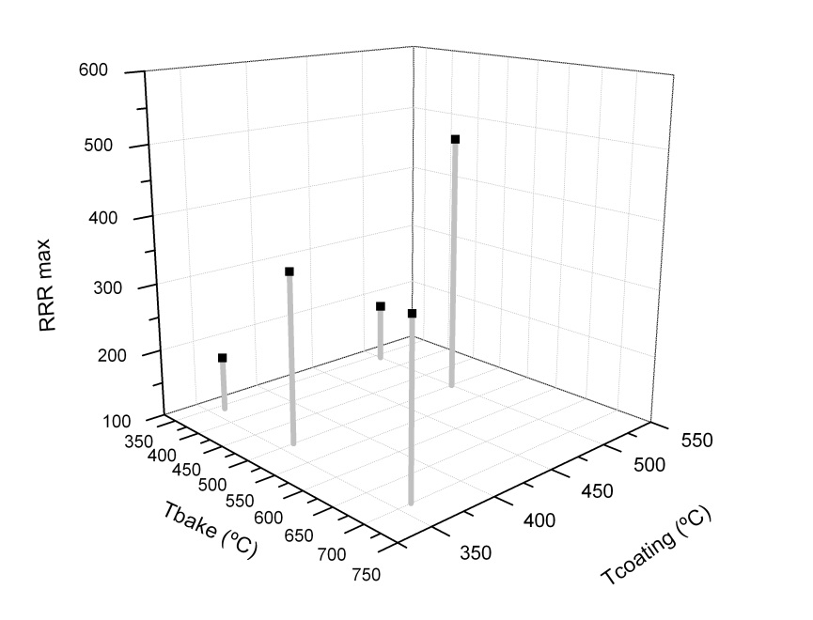
Nb films grown on insulators
Effect of Ion energy, baking & coating temperatures
on RRR
Nb grown on (11-20) sapphire
RRR vs. Bias
Nb grown on (11-20) sapphire (Bias -120V)
RRR vs. .Bake & Coating Temp.
30’ coating, pressure during coating ~2.5e-8Torr, 360°C

Slide 15
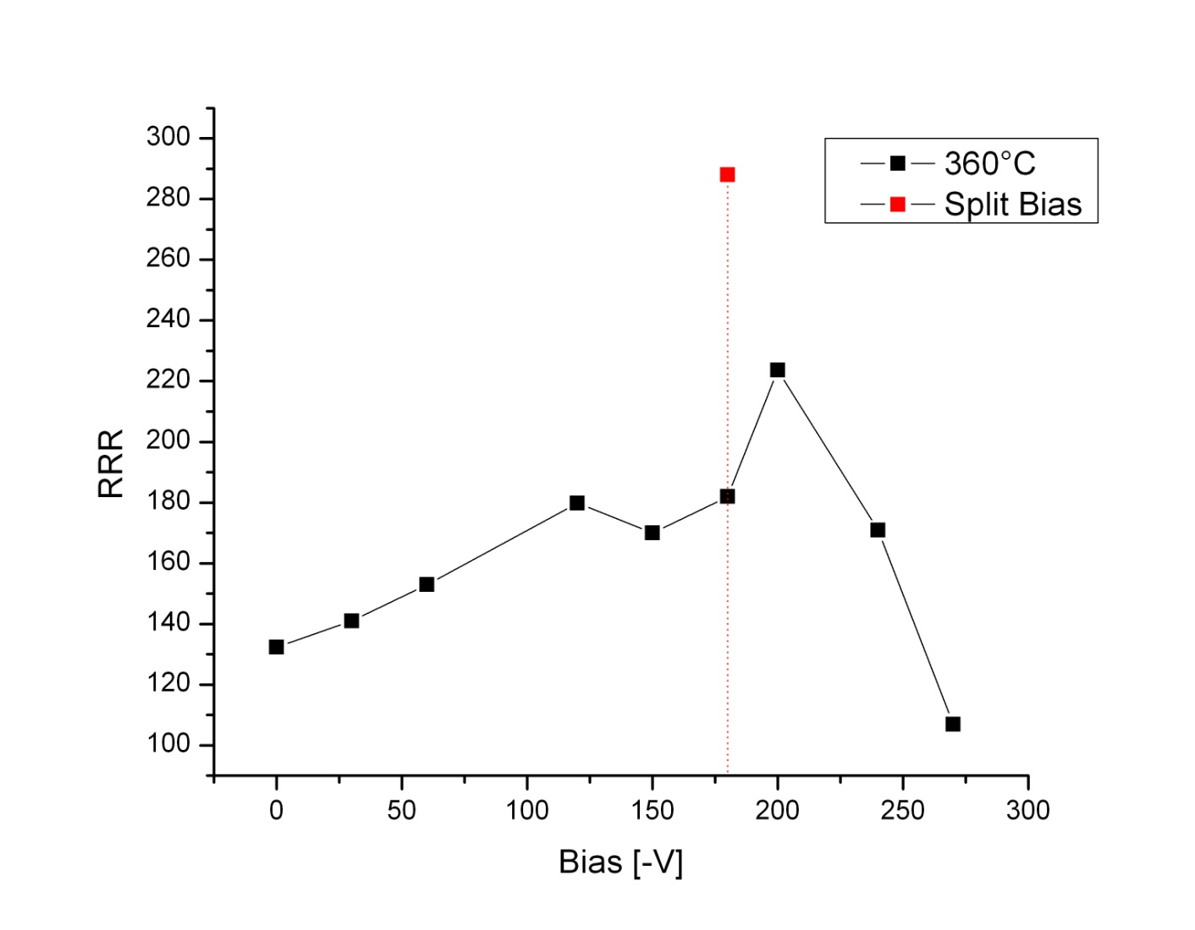
Nb films grown on insulators
Effect of Ion energy: Template creation/subsequent growth
-180V+0V
Indication that once adequate template created, higher film quality can be achieved with subsequent growth at energies that promote epitaxy and less defects

Slide 16
Highest RRR measured for Nb/insulators
Substrate | RRR
Single crystal insulator
MgO (100) | 176
MgO (110) | 424
MgO (111) | 197
a-Al₂O₃ | 488
c-Al₂O₃ | 247
Amorphous
Al₂O₃ ceramic | 89
AlN ceramic | 72
Fused Silica | 34

Slide 17
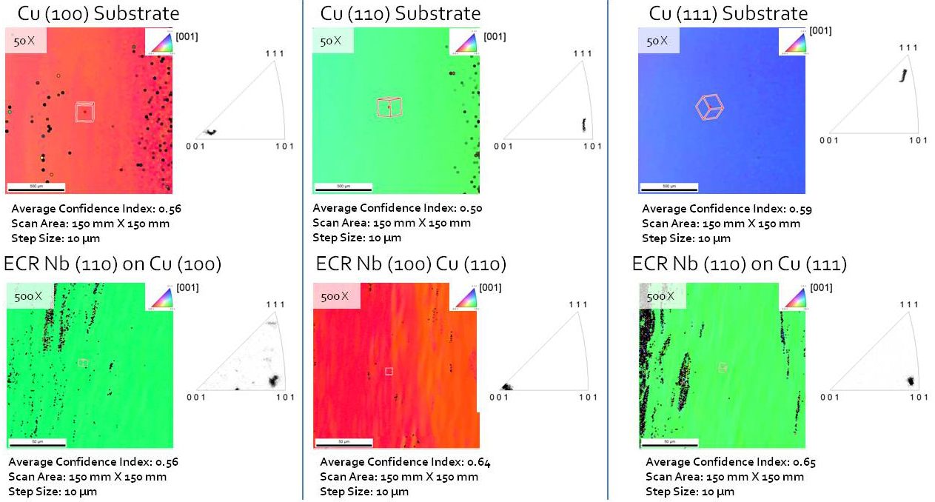
Nb on Cu single crystals
RRR=88
RRR=76
RRR=242
In the same run, Nb/fine grain Cu RRR=82
Nb/large grain Cu RRR=169

Slide 18
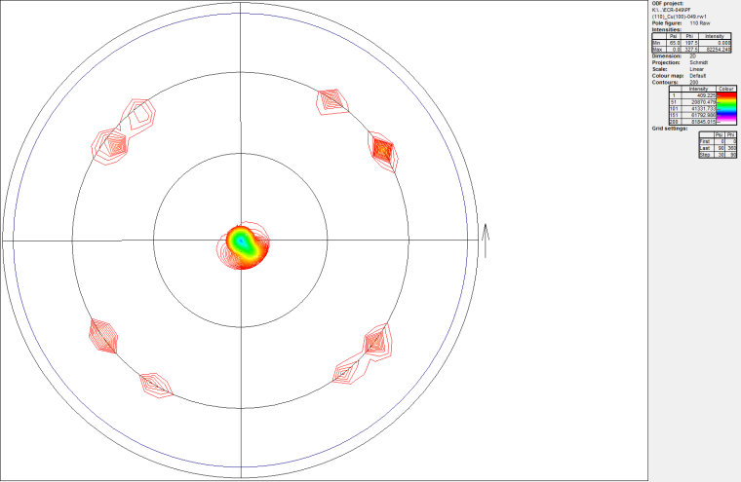
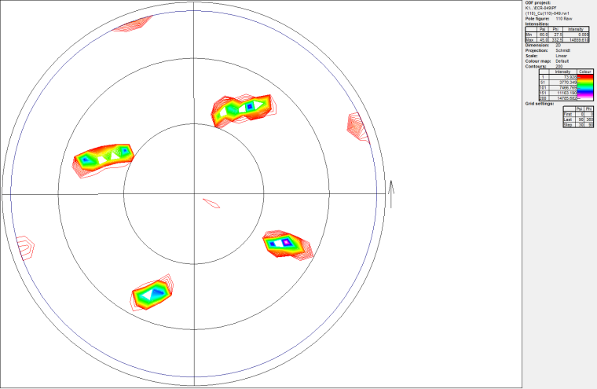
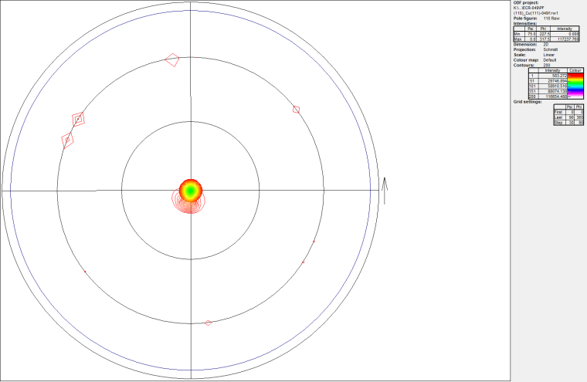
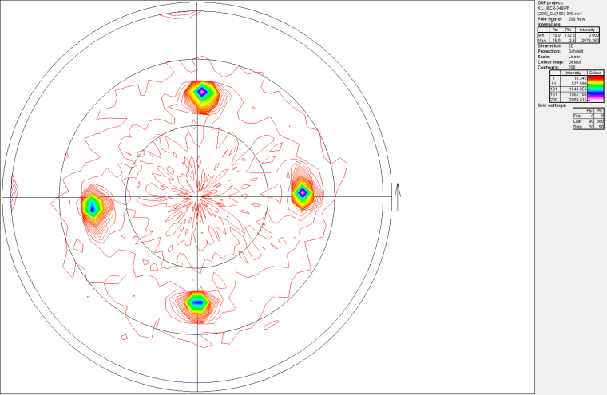
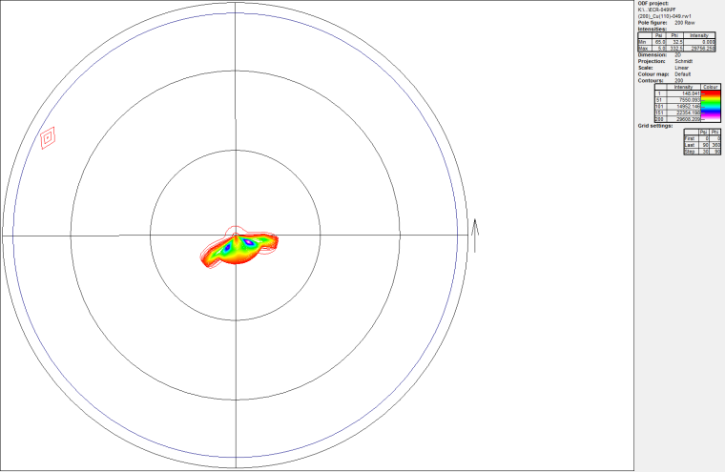
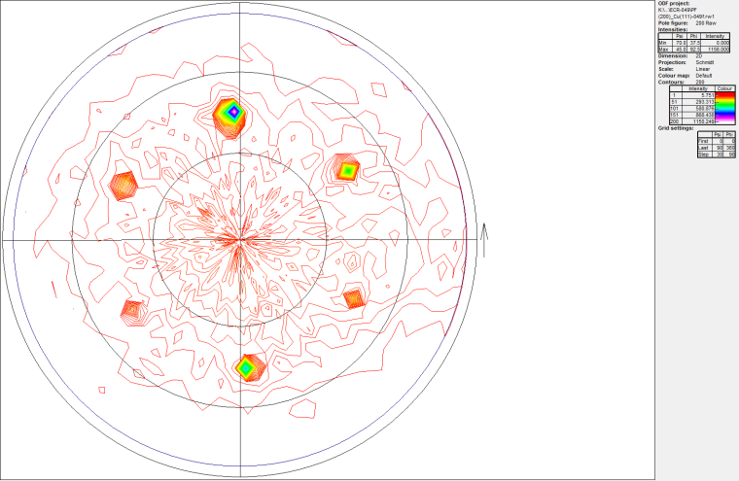
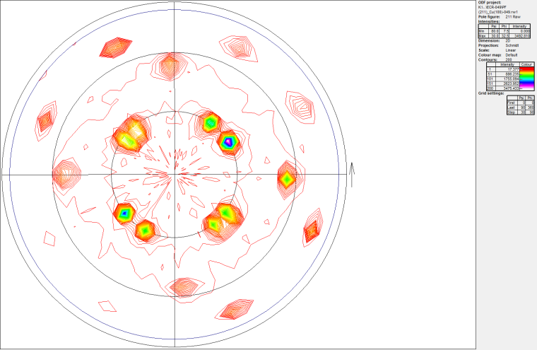
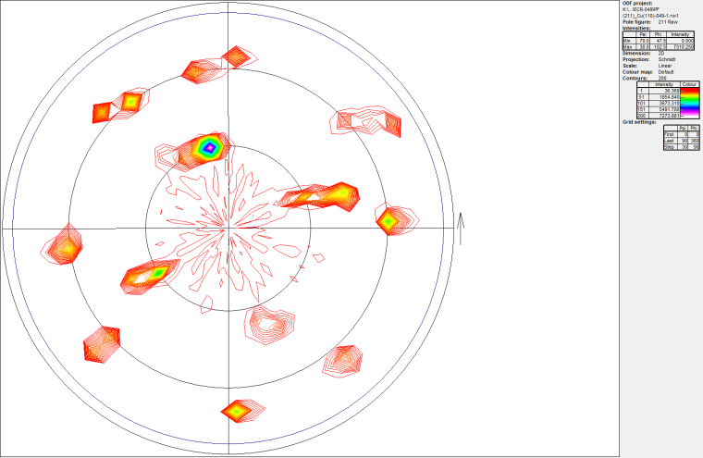
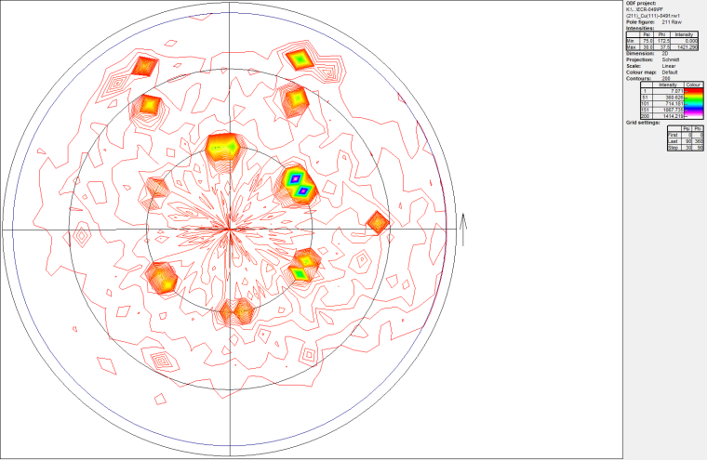
Nb on Cu single crystals
ECR Nb (110) on Cu(100)
ECR Nb (100) on Cu(110)
ECR Nb (110) on Cu(111)
{110} Nb
{110} Nb
{110} Nb
{200} Nb
{200} Nb
{200} Nb
{211} Nb
{211} Nb
{211} Nb

Slide 19
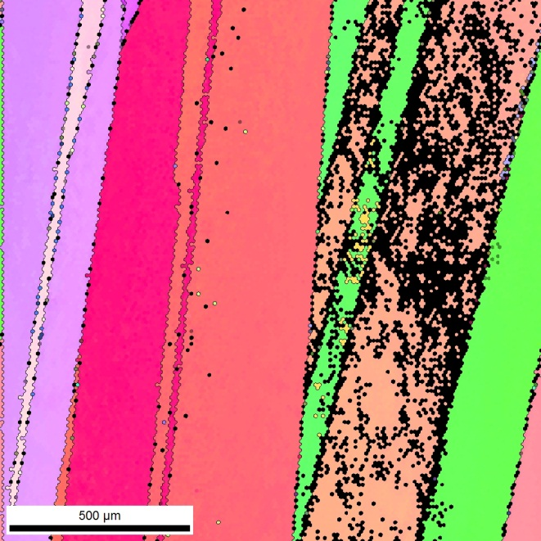
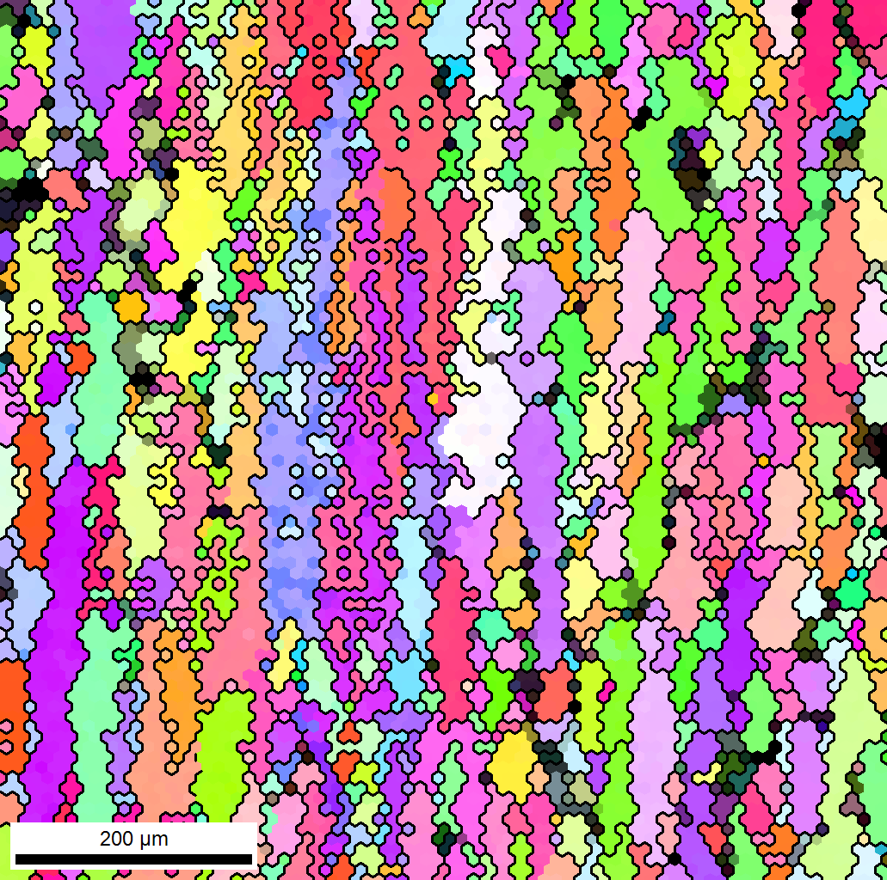
Nb films on polycrystalline Cu substrates
Nb/large grain Cu
(substrate heat treated ex-situ @ 1000°C, 12h)
Nb/fine grain Cu
RRR=169
RRR=82

Slide 20
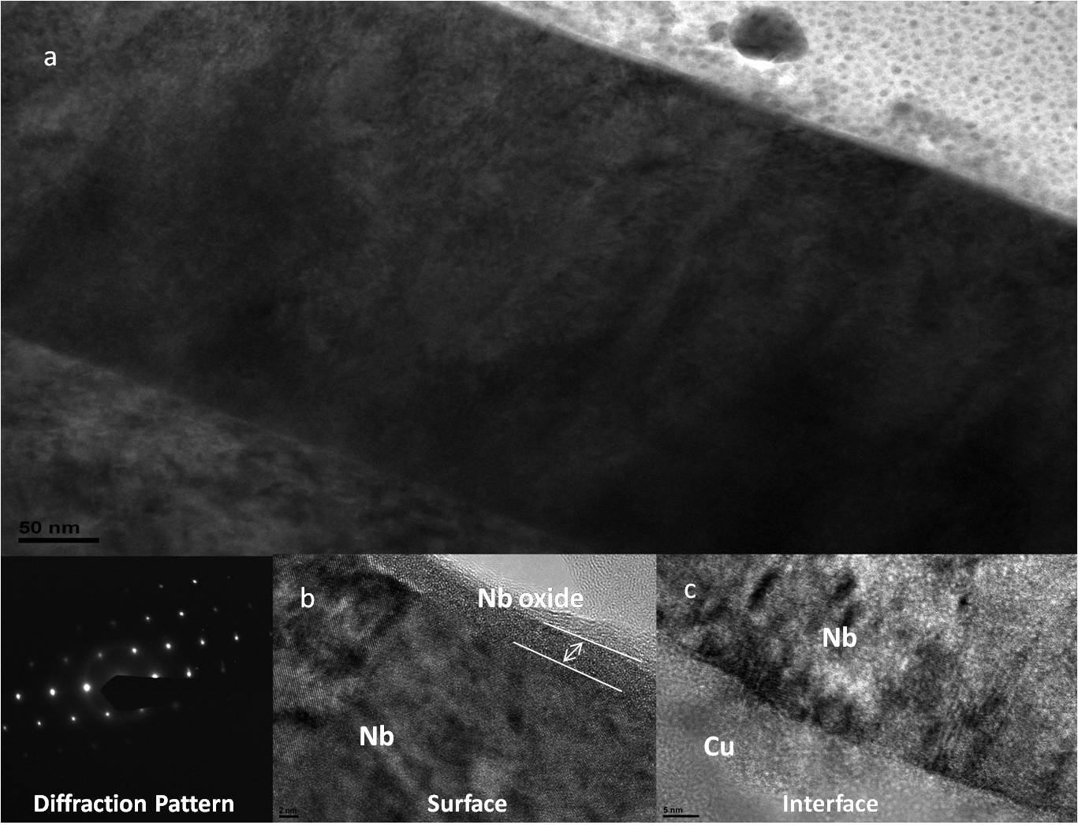
Nb/Cu – High Resolution TEM

Slide 21
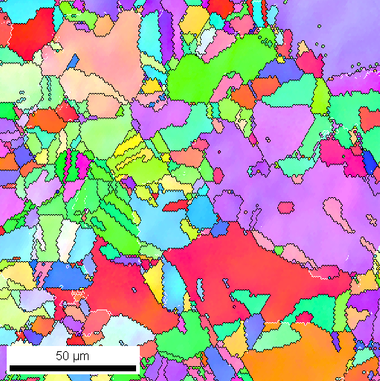
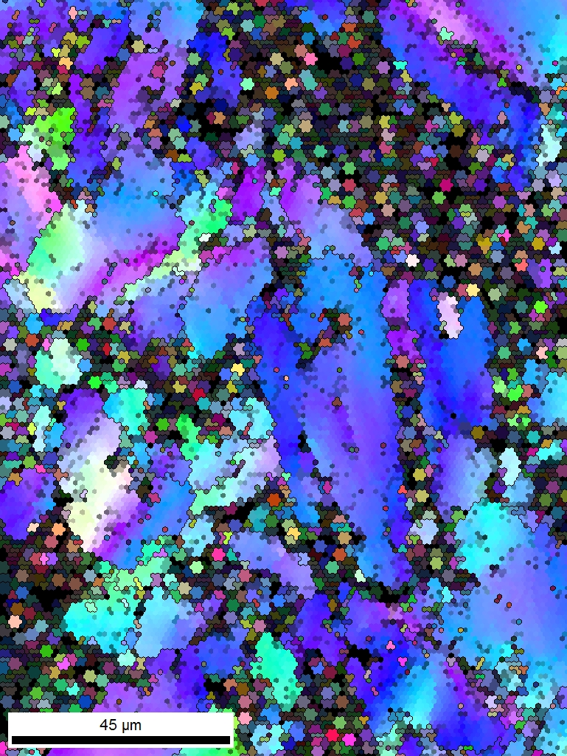
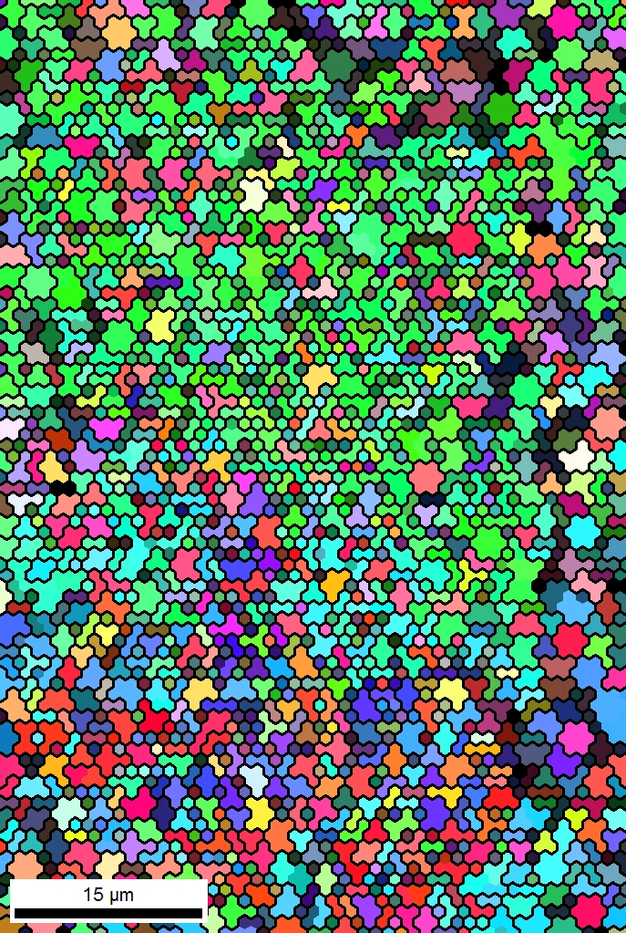
Nb films on polycrystalline Cu substrates
Effect of Bias Voltage
150 x 150 μm, 1 μm resolution, CI Avg. 0.71
Typical Cu substrate
Bias 0V , 4μm
Bias -120V, 2μm
Ab-normal growth
vith bias
vs.
columnar growth
without bias
120 x 150 μm, 1 μm resolution,
CI Avg. 0.23
50 x 75 μm, 1 μm resolution,
CI Avg. 0.16

Slide 22
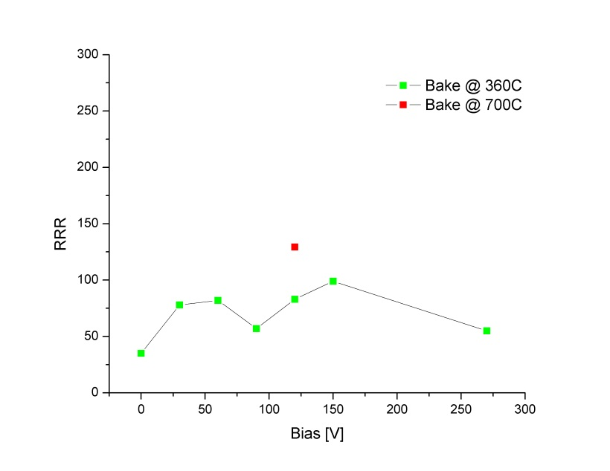
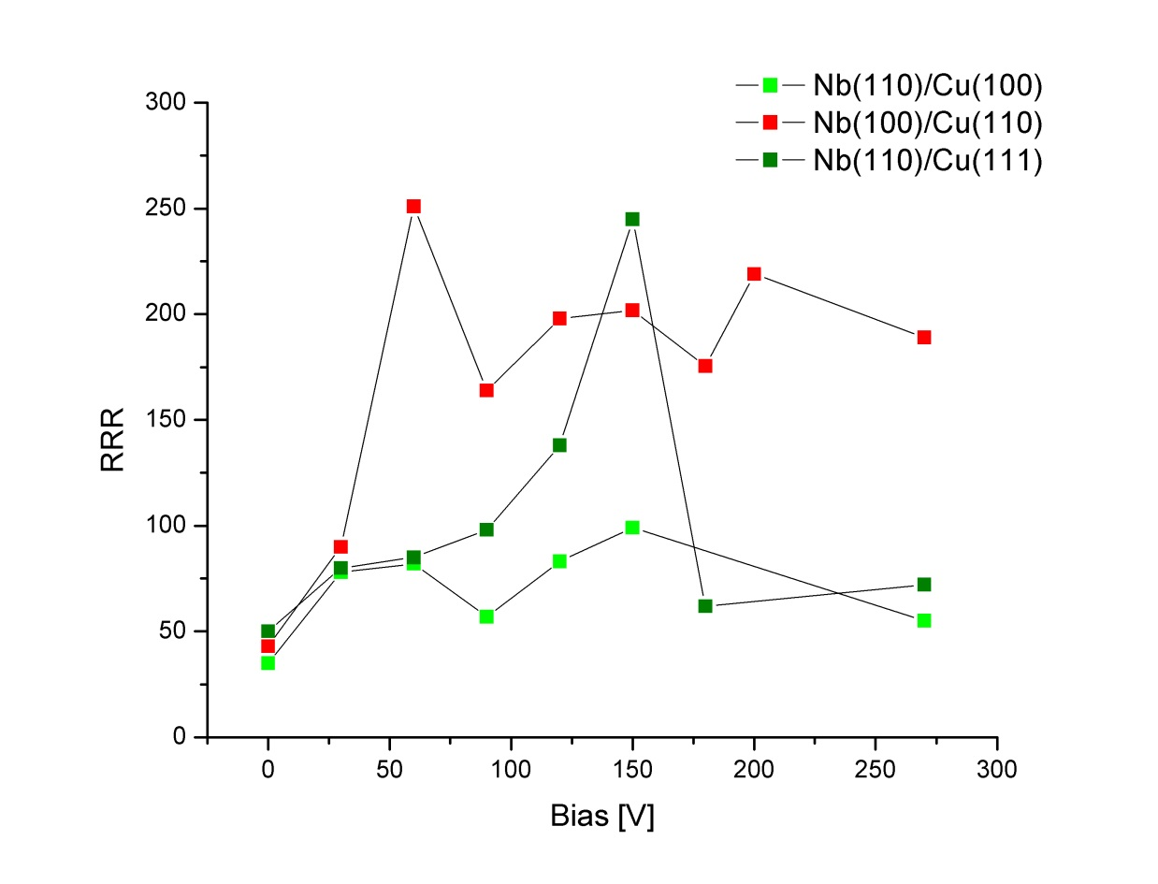
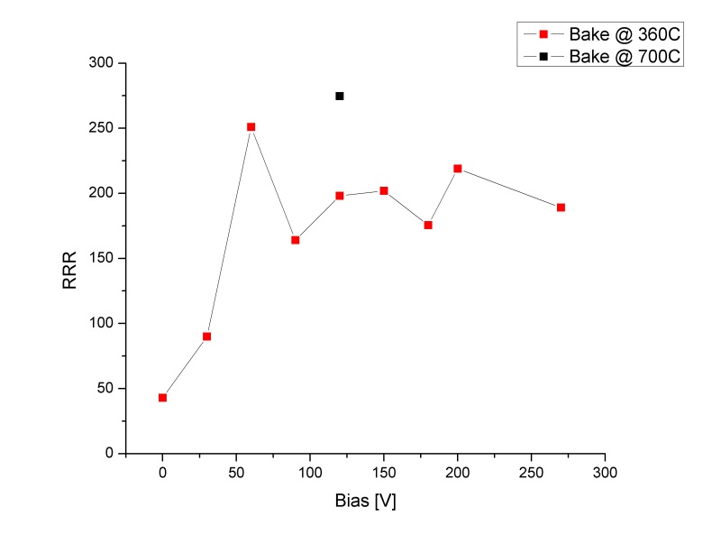
Nb films on Cu substrates - RRR
Cu (100)
Single crystal Cu substrates
Cu (110)

Slide 23
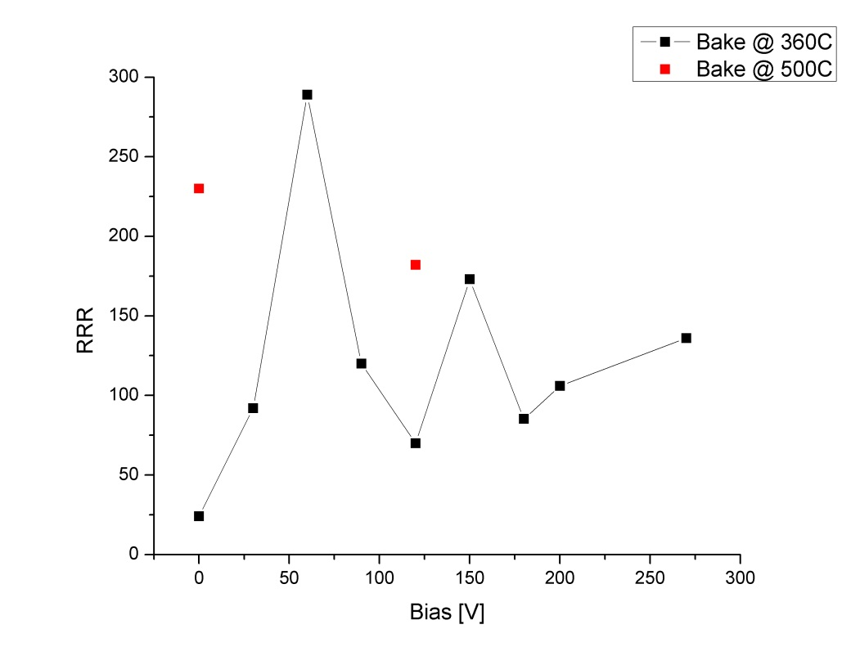
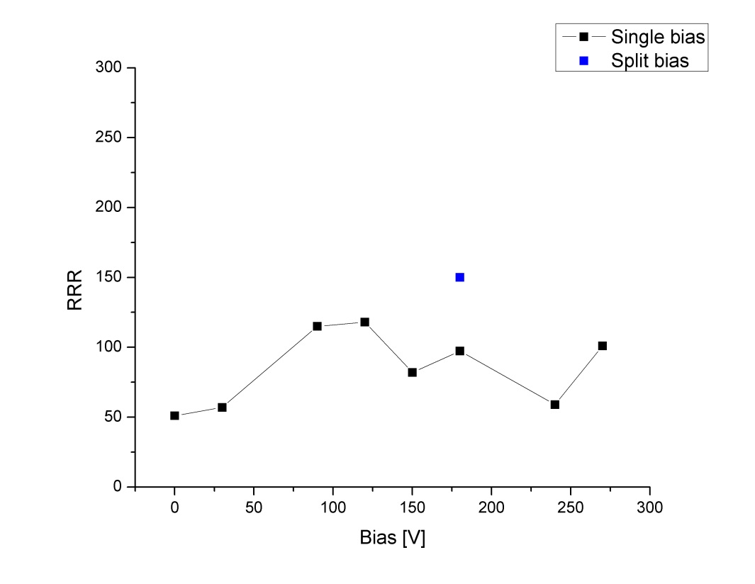
Nb films on Cu substrates - RRR
Large grain Cu substrates
(Heat Treated @ 1000°c ex-situ)
Fine grain Cu substrates

Slide 24
Nb films on Cu substrates
Substrate | RRR
Single crystal
Cu (100) | 129
Cu (110) | 275
Cu (111) | 242
Polycrystalline
Cu fine grains | 150
Cu large grains | 289
High RRR are also achieved on Cu substrates both mono-crystalline and polycrystalline.
Some dependence of RRR on the incident ion energy is observed. However, additional studies are necessary due to the strong influence of substrate crystalline quality on the resulting film structure. Similar high RRR values are achieved for both single crystal and polycrystalline substrates, suggesting that the presence of grain boundaries is not necessarily detrimental.

Slide 25
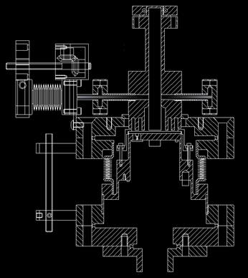
RF Performance of ECR Nb films
One of the parameters of choice for evaluating SRF surfaces is the surface resistance below T_{c}.
A series of surface resistance measurements in a 7.5 GHz sapphire-loaded TE011 cavity [10] is under way for films coated simultaneously with those for which the RRR values are presented, both on polycrystalline Cu and single crystal sapphire substrates

Slide 26




Niobium Films – towards cavity coating
Cut for thickness measurement
A 2.8Gz half-cell was coated in the ECR chamber: The film thickness along the cell profile varies from 4μm (equator) to 6μm (iris) →conformality of the ECR process
Note: the substrate is very rough, was only grossly mechanically polished
Location | Thickness [μm]
L1 | 3.804
L2 | 4.275
L3 | 4.200
L4 | 4.714
L5 | 5.136
L6 | 4.288
Location | Thickness [μm]
L1 | 6.189
L2 | 5.675
L3 | 6.081
L4 | 5.986
L5 | 6.015
L6 | 6.893

Slide 27
Niobium Films – towards cavity coating
Concept for a cavity coating system based on energetic condensation (HiPIMS or ECR enhanced sputtering)
                Easily scalable for different cavity frequencies.
                A must for 200MHz muon cavities!
Cavity
Gate valves
Kr injection
port
Advantages
Energetic condensation
Normal angle of incidence
→ better film structure
Source of ions in vacuum
Low gas pressure and use of Krypton
→ no gas inclusion →high RRR
No thermalization of the ions in transit
Cavity
Bias Grid
Bellow
Nb cathode
Nb cathode

Slide 28
SUMMARY
Nb films deposited by energetic condensation via ECR exhibit high crystalline quality:
  Film quality highly dependent on interface ( crystalline, amorphous…), substrate cleanliness
  Improved quality by in-situ pre-heating of substrates. Some substrate heating during coating seems necessary to improve RRR and reduce surface resistance around 2K.
  Unprecedented film quality due to energetic ions across all substrates.
  Exploration of zones in Structure Zone model never achieved before
  Some dependence observed as a function of ion arrival energy for sapphire, magnesium oxide and copper substrates.
  Indication that good quality substrate can be created for subsequent growth at energies that promote epitaxy and generate less defects.
Nb films with unprecedented RRR values (equivalent to bulk niobium) have been produced.
The investigation of the surface impedance as a function of the coating parameters and superconducting characteristics of the films is under way.
Preparation for cavity coating in 2013

Slide 29
SRF Thin Films Collaboration
Jlab: C.Reece, A-M Valente-Feliciano, J. Spradlin, L. Phillips, X. Zhao, B. Xiao, A. Wu
W&M: A. Lukaszew, D. Beringer, W. Roach, C. Clavero , R. Outlaw, O. Trofimova
NSU: Q. Yang
ODU: H. Baumgart, D. Gu
Black Labs LLC: R. Crooks
NCSU: F. Stevie, D. Batchelor
Under DOE HEP Grant ARRA & U.S. DOE Contract No. DE-AC05-06OR23177

