Slide 1
MgB₂ Thin Films for SRF Cavities
Xiaoxing Xi
Department of Physics
Temple University, Philadelphia, PA
Contributors
Teng Tan, Alex Krick, Narendra Acharya, Evan Johnson, Chenggang Zhuang, Ke Chen
Collaborators
Enzo Palmieri Group (INFN), Tsuyoshi Tajima and Leonardo Civale Groups (LANL), Charlie Reese Group (JLab), Michael Kelley Group (WM)
July 18, 2012
5th Workshop on Thin Film SRF
JLab, Newport News, VA
Supported by DOE/HEP

Slide 2
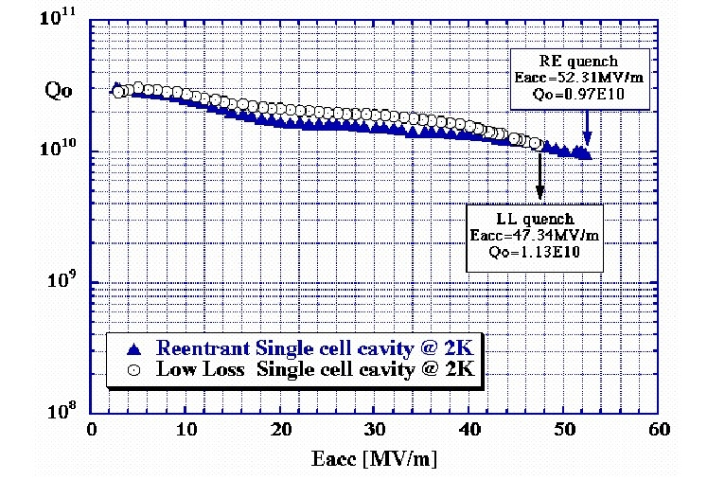
Looking Beyond Nb
Nb has the highest T_{c} for a pure metal and the highest lower magnetic field H_{c1}
Nb cavities performance have reached close to its theoretical limit (H_{c} = 200 mT, H_{c1} = 170 mT)
For further improved cavity RF performance, new superconductor needed
KEK&Cornell

Slide 3
MgB₂: Potential Low RF loss and High Gradient
 | Niobium | MgB₂
T_{c}/K | 9 | 40
ρ₀ /(μΩ cm) | 5 | 0.1
Energy gap/meV | 1.5 | 7 (σ), 2(π)
B_{c}(0)/T | 0.20 | possibly 0.80
B_{c1}(0)/T | 0.17 | <0.1
RF surface resistance depends on energy gap and residual resistivity. Larger gap and lower resistivity indicate potential low RF loss than in Nb.
Field gradient is ultimately limited by thermodynamic critical field. For MgB₂, B_{c}(0) could be as high as 800 mT, vs. 200 mT for Nb.
Lower critical field B_{c1}(0) may be important.

Slide 4
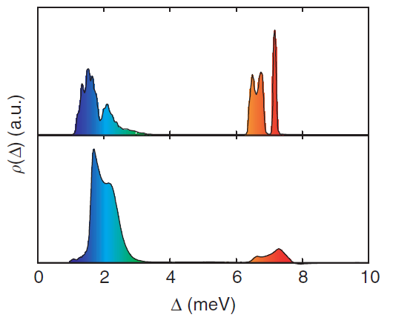
Epitaxial MgB₂ Films by HPCVD
Lower Residual Resistivity
Larger Energy Gap
Theory (Choi et al.)
Tunneling spectroscopy
Xi et al, Physica C 456, 22 (2007)
Chen et al, Nature Commun. 3:619 | DOI: 10.1038/ncomms1626

Slide 5
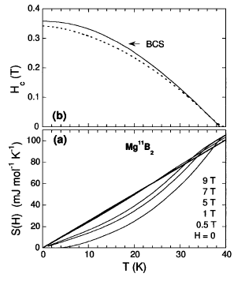
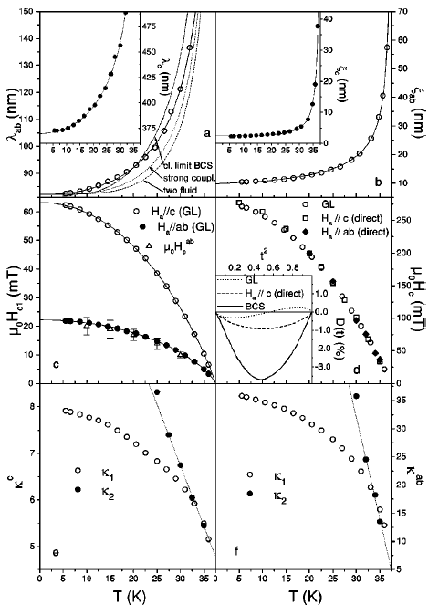
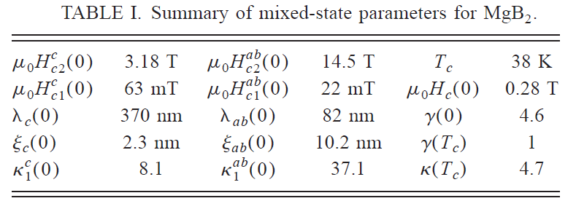
Experimental Measurement of H_{c} of MgB₂
Powder, Specific Heat
Single Crystal, Magnetization
Bouquet et al, PRL 87, 047001 (2001)
Zehetmayer et al, PRB 66, 052505 (2002)

Slide 6
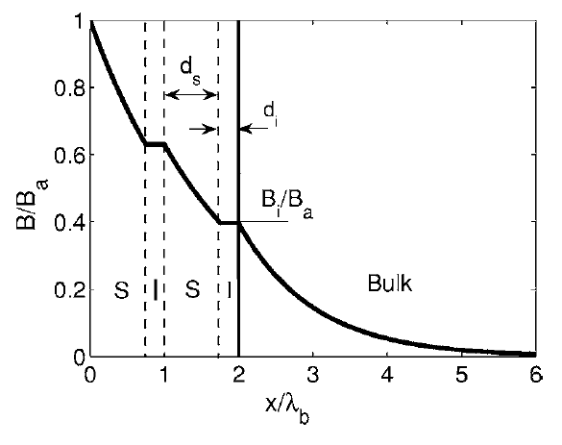
Enhancing B_{c1} by Multilayering
When vortices enter the superconductor, their motion driven by the RF field can contribution to RF loss.
When film thickness d < λ, B_{c1} is larger than the bulk B_{c1}
B_{c1} = (2φ₀/πd²)[ln(d/ξ)]
Vortex entrance field an be enhanced by coating a superconducting cavity with several thin film superconductors with d < λ.
Gurevich, APL 88, 012511 (2006)
Notes:
6

Slide 7
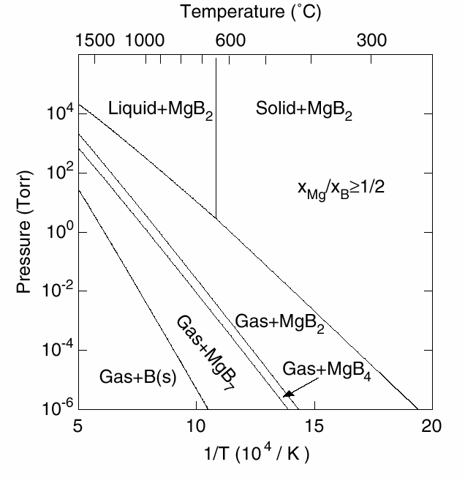
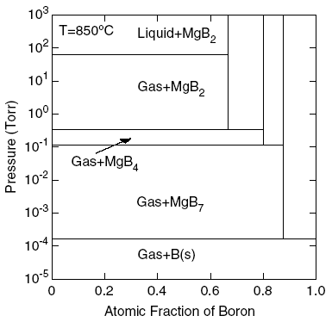
Keys to Growth of MgB₂ Films
Keep a high Mg pressure for phase stability
For example, at 600°C Mg vapor pressure of 0.9 mTorr or Mg flux of 500 Å/s is needed
No need for composition control，as long as the Mg:B ratio is above 1:2.
Keep oxygen away: Mg reacts strongly with oxygen - forms MgO, reduces Mg vapor pressure.
Avoid carbon: Carbon doping reduces T_{c} and increases resistivity
Liu et al., APL 78, 3678 (2001)

Slide 8
Hybrid Physical-Chemical Vapor Deposition
Schematic View
get rid of oxygen
prevent oxidation
make high Mg
pressure possible
H₂ (~100 Torr)
B₂H₆ (~ 5 - 250 sccm)
pure source of B
B supply (B₂H₆ flow rate) controls growth rate
generate high
Mg pressure: required by thermodynamics
Mg
Substrate
550–760 °C
Pure source of Mg
high enough T
for epitaxy
Susceptor
Notes:
8

Slide 9
“Magnesium Diboride Thin Films for Superconducting RF Cavities”
Supported by DOE HEP, “Fundamental Research in Superconducting RF Cavity Design” Program
Project period: 6-15-10 to 6-14-13
Project objective: Develop HPCVD technology for MgB₂ SRF cavities
Research activities:
Study of MgB₂ film properties related to the RF cavity application
Coating single-cell RF cavities with MgB₂ film
Film research:
Deposit large-area (2" - 4" diameter) films using both in situ HPCVD and two-step annealing process
Deposit on sapphire and metal substrates, such as Nb, Mo, and Cu
Effects of smoothness, thermal expansion mismatch, hydrogen, film stability, two-gap nature of MgB₂, and multilayer structure on RF properties
Coating cavity:
Both in situ HPCVD and two-step annealing process
First step: 6 GHz cavity from INFN
Next step: larger cavities

Slide 10
Scaling up HPCVD for Large Area Films
Penn State
Temple University
B₂H₆
B₂H₆
Mg
Mg
550–760°C
Resistive
Heater
Susceptor
Inductive heater
Successful
5mm x 5mm
Resistive heater
Designed for 2" dia.
Notes:
10

Slide 11
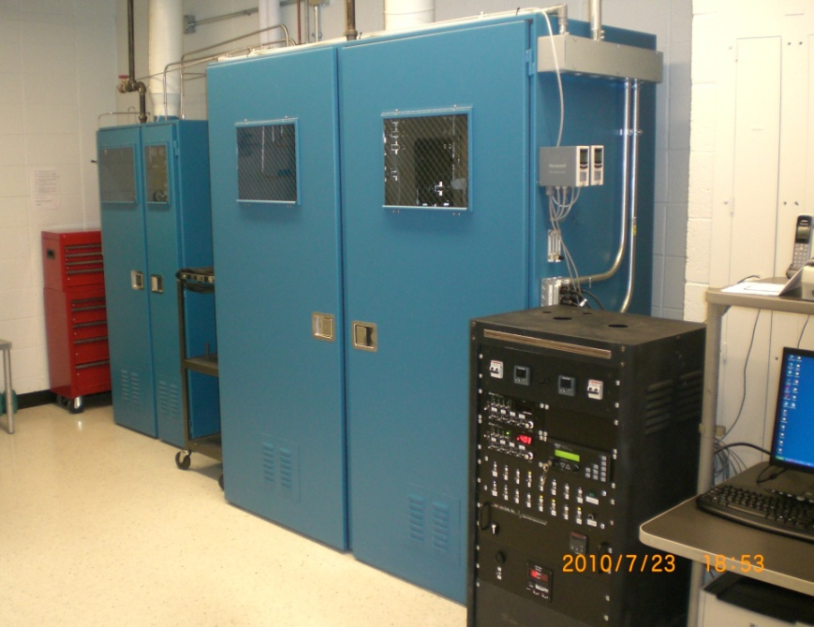
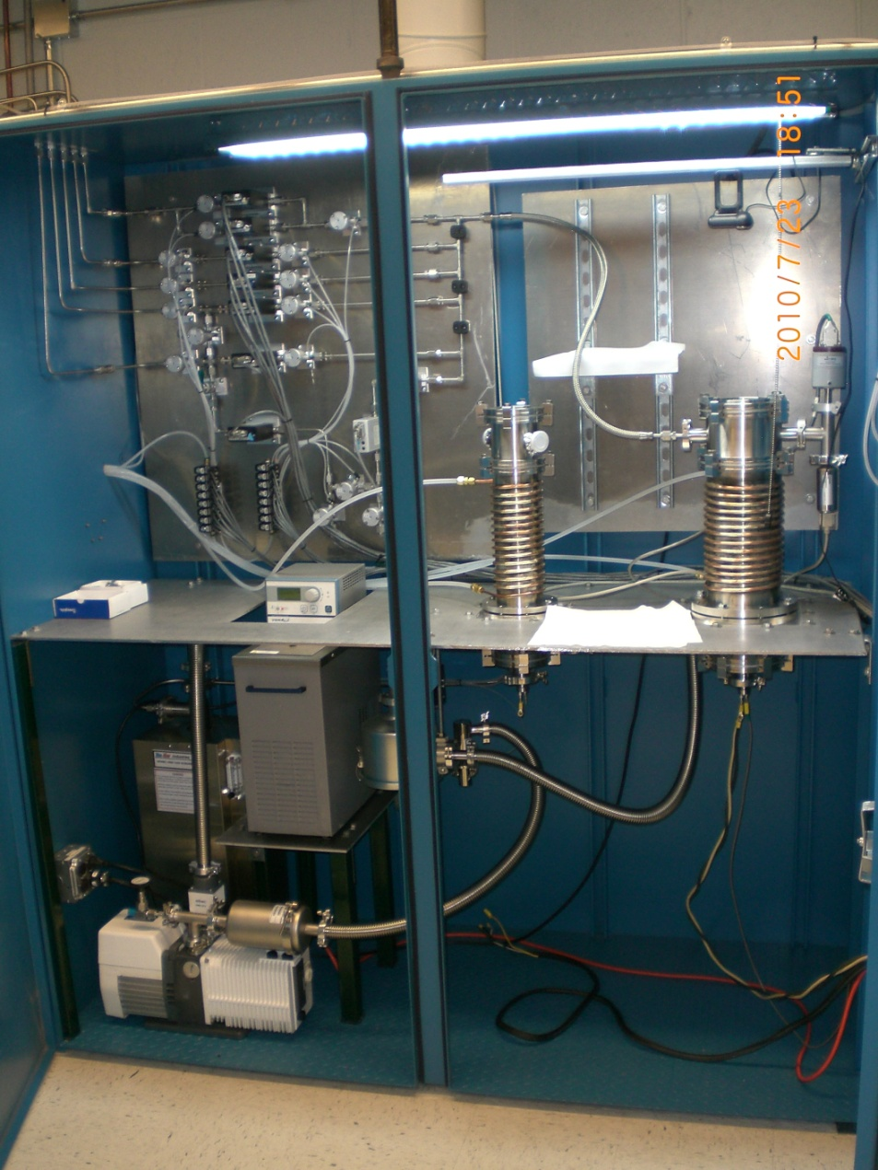
HPCVD Reactors at Temple University
Two HPCVD reactors with resistive heaters
Smaller reactor for 15mm x 15mm films
Larger reactor for 2” diameter films

Slide 12
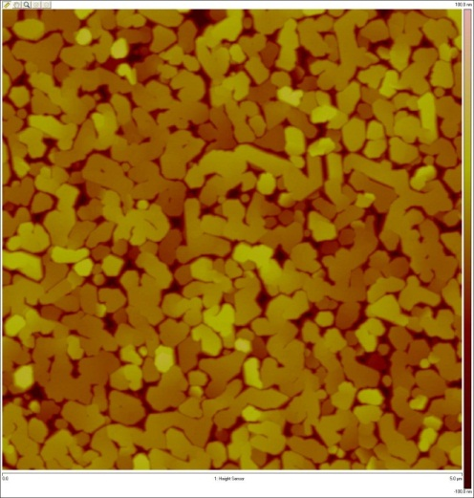
2” MgB₂ Films Grown by HPCVD
200 nm 2’’ MgB₂ film on sapphire
AFM image of film surface

Slide 13
2” MgB₂ Films: Uniformity of T_{c} and RRR

Slide 14
Clean 2” MgB₂ Films: Low H_{c2}

Slide 15
Clean 2” MgB₂ Films: High J_{c}, Low Pinning

Slide 16
Surface Impedance Compared to Nb
7.4 GHz, measured at JLab
Xiao et al., Supercond. Sci. Technol. 25, 095006 (2012)
◆0926A ●0926D Surface resistance vs temperature of MgB₂ on sapphire substrate.
▇ Surface resistance vs temperature of BCPed large grain Nb sample.
--- Theoretical value with 1.54 μΩ residual resistance.
— BCS resistance with Δ/kT_{c} = 1.842±0.002, London penetration depth = 36.1±0.1 nm, coherence length = 51.3±0.5 nm, mean free path = 256±5 nm.

Slide 17
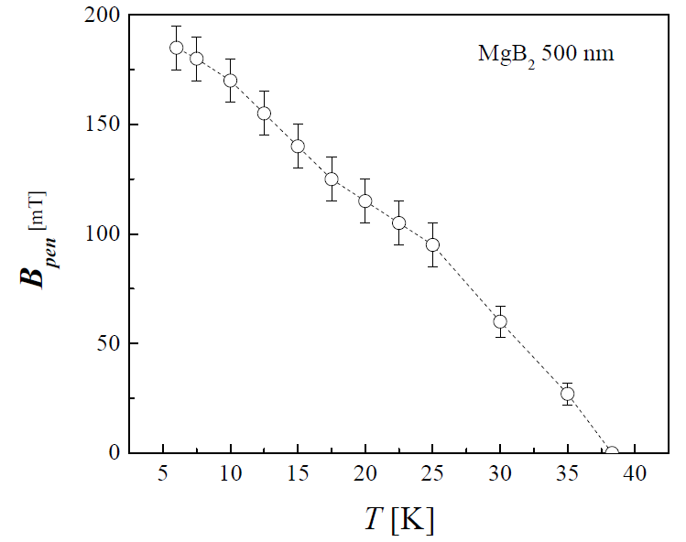
Vortex Penetration Field Measurement at LANL
Departure of magnetization from the Meissner slope indicates vortex entry.
Higher than Nb. Much higher than reported value of 23 mT.
Surface barrier may be responsible.

Slide 18
MgB₂-MgO Multilayer Films
MgB₂
MgO
MgB₂
MgO
MgB₂
Sapphire
Alternating MgB₂-insulator structures have been fabricated on sapphire substrate:
40 nm MgO as insulating layer, sputtered.
MgB₂ deposited by HPCVD ex situ. 150, 100, and 75 nm in thickness.
T_{c} near 40 K for 100 and 150 nm films. Lower for 75 nm film.
Notes:
In fabricating multilayer films. We use sputtered MgO as our insulator material. The MgO insulating layer is deposited using an MgO target and sputtered with 200W RF power for 30min. Then the film will be transferred back to the HPCVD chamber to deposit a layer of MgB2 on top of it. Comparing with bottom film, the film grown on top of the MgO showed decreased Tc and RRR. The Tc 38.4 K is close to the film on single crystal MgO substrate. 3 layers of mgb2 have been successfully fabricated with MgO between each 2 films.

Slide 19
Properties of MgB₂-MgO Multilayer Films
Top film has higher resistivity and lower T_{c} compared to bottom film.
The MgB₂-MgO multilayer films are c-axis oriented.

Slide 20
Determining Vortex Entrance Field: M vs H
∆
Vortex entry indicated by the deviation of M from linear M-H dependence.
Results from measurement of trapped vortices via residual M consistent with the ∆M method.
Notes:
In fabricating multilayer films. We use sputtered MgO as our insulator material. The MgO insulating layer is deposited using an MgO target and sputtered with 200W RF power for 30min. Then the film will be transferred back to the HPCVD chamber to deposit a layer of MgB2 on top of it. Comparing with bottom film, the film grown on top of the MgO showed decreased Tc and RRR. The Tc 38.4 K is close to the film on single crystal MgO substrate. 3 layers of mgb2 have been successfully fabricated with MgO between each 2 films.

Slide 21
Enhancement of Vortex Entrance Field
Multilayer films with thin MgB₂ layers show higher H_{c1} than the 300 nm film even though the total thickness are the same.
Multilayer films show the same H_{c1} as single-layer thin films of the same layer thickness.
Top and bottom layers show the same H_{c1}.
Lower H_{c1} in the 70 nm-thick thin film and multilayer is due to lower T_{c}.
Notes:
In fabricating multilayer films. We use sputtered MgO as our insulator material. The MgO insulating layer is deposited using an MgO target and sputtered with 200W RF power for 30min. Then the film will be transferred back to the HPCVD chamber to deposit a layer of MgB2 on top of it. Comparing with bottom film, the film grown on top of the MgO showed decreased Tc and RRR. The Tc 38.4 K is close to the film on single crystal MgO substrate. 3 layers of mgb2 have been successfully fabricated with MgO between each 2 films.

Slide 22
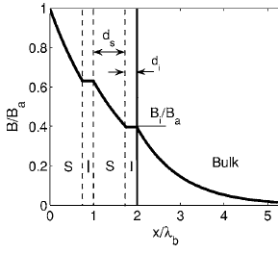
Multilayer-Coated MgB₂ SRF Configuration
Multilayer coated SRF cavity:
Field inside of the cavity, thus only one side of the coating.
Thick MgB₂ layer to shield field from the metal substrate. Higher H_{c} can lead to ultimate higher breakdown field.
Multilayer with thin MgB₂ layers to enhance H_{c1}.
MgB₂
metal substrate
Testing structure:
Field on both sides of the multilayer structure.
Multilayers need to be at both top and bottom of the structure to demonstrate their benefits.
MgB₂

Slide 23
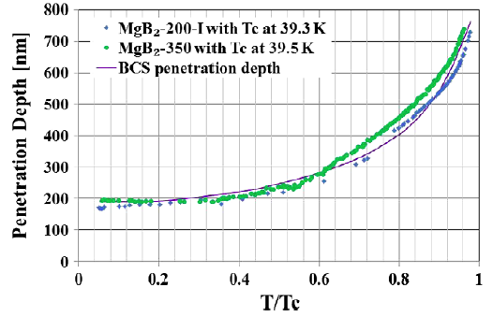
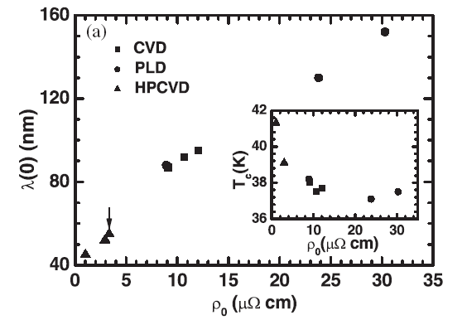
What is the Penetration Depth of MgB₂ Films?
The enhancement of H_{c1} by multilayer films indicates that the penetration depth of MgB₂ films is longer than the film thickness.
The H_{c1} values from 40 nm to 180 nm have been reported for our MgB₂ films.
Estimate from theory: λ_{π}(0) = 33.6 nm, λ_{σ}(0) ~ 47.8 nm [Moshchalkov et al. PRL 102, 117001 (2009), based on Mazin et al., PRL 89, 107002 (2002)]
What is the H_{c1} value for our MgB₂ films?
Xiao et al., Supercond. Sci. Technol. 25, 095006 (2012)
Jin et al, SC Sci. Tech. 18, L1 (2005)
Notes:
In fabricating multilayer films. We use sputtered MgO as our insulator material. The MgO insulating layer is deposited using an MgO target and sputtered with 200W RF power for 30min. Then the film will be transferred back to the HPCVD chamber to deposit a layer of MgB2 on top of it. Comparing with bottom film, the film grown on top of the MgO showed decreased Tc and RRR. The Tc 38.4 K is close to the film on single crystal MgO substrate. 3 layers of mgb2 have been successfully fabricated with MgO between each 2 films.

Slide 24
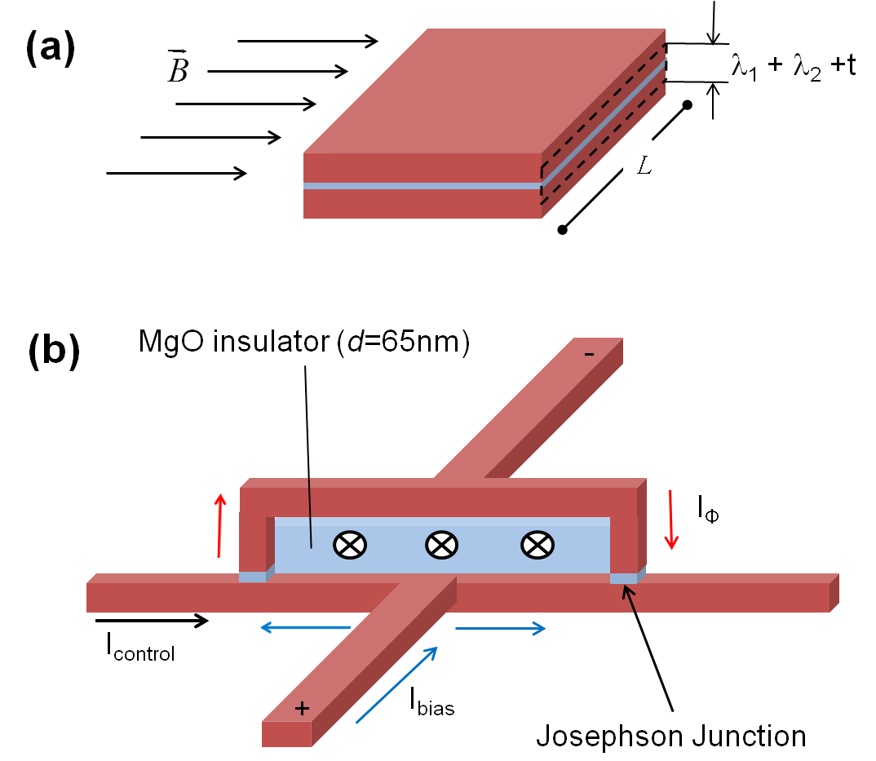
Measuring λ Using Josephson Junctions
Magnetic field modulation of junction critical current. The period of the Fraunhofer patter depends on the penetration depth:
(b) Inductance of the microstrip in the SQUID loop. The period of control current modulation of the SQUID voltage is one fluxon through the SQUID loop, related to the Inductance of the microstrip:

Slide 25
Measurement of λ Using Josephson Junctions
Magnetic field modulation of junction critical current.
Range: λ = 37-58 nm
Most results: λ = 40-45 nm
(b) Inductance of the microstrip in the SQUID loop.
λ = 40 nm

Slide 26
Choice of Cavity Materials
Materials | Reaction with Mg vapor | Melting Point ºC | Electrical Resistivity μΩcm | Thermal Conductivity W/mK (20º) | Thermal Expansion x 10⁻⁶ / K (20~100ºC)
MgB₂ |  |  |  |  | 5.5
Niobium | stable | 2477 | 12.5 | 53.7 | 7.02
Copper | alloyed at 500ºC | 1084 | 1.67 | 401 | 17.6
Molybdenum | stable | 2623 | 5.34 | 138 | 5.43
Tantalum | stable | 3017 | 13.15 | 57.5 | 7.02
Iron | stable | 1538 | 9.71 | 80.2 | 12.2
Molybdenum has relatively high thermal conductivity, similar thermal expansion coefficient to MgB₂, and does not react with MgB₂.

Slide 27
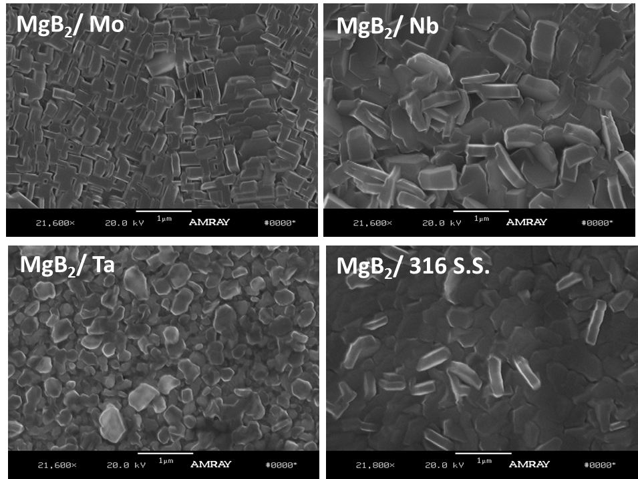
Polycrystalline MgB₂ Films on Metal Substrates

Slide 28
MgB₂ on Metal: T_{c} Measured by Mutual Inductance

Slide 29
Clean MgB₂ on Metal: Low H_{c2}

Slide 30
Clean MgB₂ on Metal: High J_{c}, Low Pinning

Slide 31
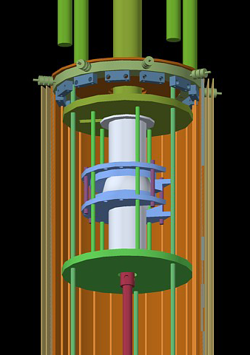
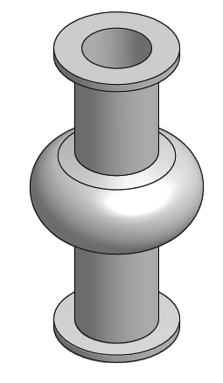
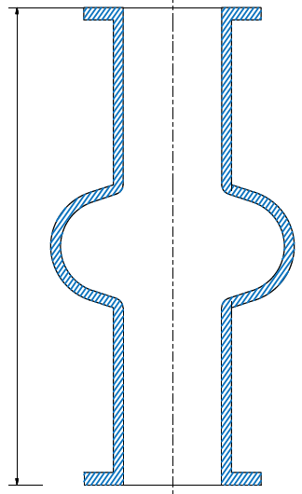
In Situ Coating of 6 GHz Nb Cavity
6 GHz Nb cavity provided by Enzo Palmieri, INFN. Characterization capability exists at INFN.
Small size: Can be coated using existing equipment in the lab; Low cost for optimization; First step towards coating of larger cavities.
Setup design near finish
B₂H₆
4"
Mg

Slide 32
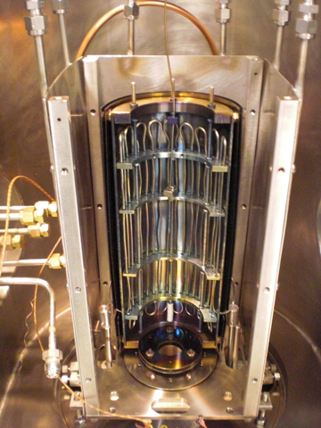
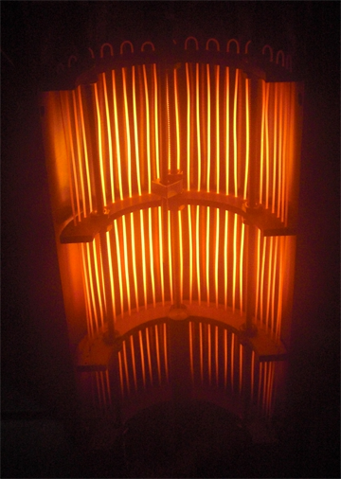
Cavity Coating System Under Testing
Back half of the cavity heater

Slide 33
Test Film on Sapphire Substrate
Sample mounted on a SS tube with small opening.
Deposition temperature: Clamshell heater 800C; Mg heater 650C
50 sccm diborane for 5min.

Slide 34
Summary
Clean MgB₂ thin films have promising properties for SRF application:
low resistivity (<0.1 μΩcm) and high T_{c} promise low BCS surface resistance
High H_{c}: possibly as high as ~ 820 mT
Low H_{c1}: multilayer necessary
Two gap effects need to be investigated.
MgB₂ thin film research for SRF application:
Clean 2" MgB₂ films with good properties successfully deposited
RF measurements show promising results
Films on metal show good properties
Multilayer enhances H_{c1}
The value of the penetration depth of MgB₂ remains unresolved: 40 nm or 180 nm?
MgB₂ coating of SRF cavity:
Coating of 6 GHz cavity by in situ processes investigated
After many modifications, MgB₂ test films with good properties have been produced.

