Slide 1
Magnetic Flux Structure at Different Fields in Cavity Niobium by Bitter Decoration
F. Barkov, A. Romanenko

Slide 2
Motivation
Magnetic flux penetration is a possible candidate for losses in SRF cavities
No high resolution studies of magnetic flux entry into cut-out samples were produced before
Bitter decoration technique allows to investigate magnetic field distribution with a “single-vortex” spatial resolution
The main idea was to directly observe spatial variations of surface superconducting properties

Slide 3
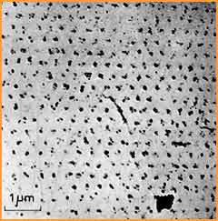
Experimental technique
1. Superparamagnetic nanoparticles are deposited to mark regions with magnetic field
1 – Helium cryostat; 2 – Insert with decoration chamber (A); 3 – Plug/socket combination; 4 – Evaporator; 5 - Sample; 6 – Protective screen; 7 – Thermometer; 8 – Mechanical valve; 9 -Solenoid
This is how the first direct observation of the vortex lattice was obtained!
2. Scanning electron microscope is used to examine particles distribution
U. Essman and H. Trauble,
Physics Letters 24A, 526 (1967)

Slide 4
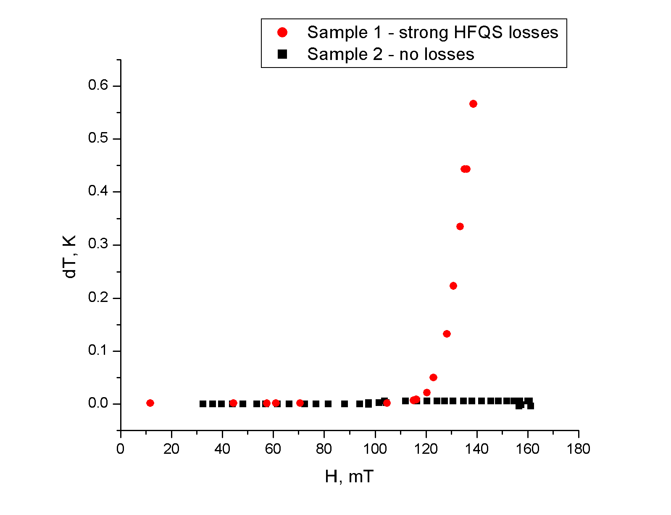
Experimental parameters
Samples
Cut-outs from cavities:
-hot spots
-120C baked spots
Mechanically polished + 800C baked
Mechanically polished + 800C baked+ 20 microns EP
Mechanically polished + 800C baked + 20 microns BCP
T=1.7->5..6 K
H=0..120 mT

Slide 5
Field Cooling Results
Hot Spot
H=10 mT. Hot spot. Flux bundles are observed instead of individual Abrikosov vortices.

Slide 6
flux bundles
Meissner regions
Hot Spot
H=10 mT. Hot spot. Zoom-in from previous picture. Average number of magnetic flux quanta per bundle is ~80

Slide 7
Hot Spot
H=10 mT. Hot spot. No single vortices are resolved even at highest magnification

Slide 8
flux bundles
Meissner regions
Baked Spot
H=10 mT. Baked spot. No vortices, just flux bundles.

Slide 9
Hot Spot
H=32 mT. Hot spot. Flux regions now form a “connected” structure

Slide 10
Hot Spot
H=32mT. Hot spot. Zoom-in from previous picture

Slide 11
Hot Spot
H=32 mT. Hot spot. High-magnification image. No single vortices are resolved

Slide 12
Hot Spot
H=60 mT. Hot spot.

Slide 13
Hot Spot
B=76±5 mT
H=60 mT. Hot spot. Zoom-in from white spot from previous picture. Individual vortices are observed. Inset: Fast Fourier Transform pattern with 6 maxima corresponding to a long range ordered hexagonal lattice

Slide 14
Hot Spot
H=80 mT. Hot spot. Vortex lattice is everywhere, there are no Meissner regions.

Slide 15
Baked Spot
H=60 mT. Baked spot. The topology of Meissner regions is different.

Slide 16
Baked spot
B=74±5 mT
H=60 mT. Baked spot. Zoom-in from previous picture.

Slide 17
Results for flat samples
Abrikosov vortices
flux bundles
Flat sample
H=8 mT. BCP sample

Slide 18
flux bundles
region with Abrikosov vortices
Flat sample
H =8 mT. BCP sample. Coexistence of Abrikosov vortices and Shubnikov domains.

Slide 19
Flat sample
H=8 mT. BCP sample. Vortices do not form ordered lattice. FFT pattern is a circle.

Slide 20
Zero Field Cooling Results
We did not observe penetration of magnetic field into samples up to:
60 mT for baked spot
120 mT for hot spot

Slide 21
Summary
We have investigated how magnetic field penetrates into cavity cutouts and flat niobium samples
Cavity grade niobium is “type 1.5” superconductor
Coexistence of regions with Abrikosov vortices and flux bundles is observed for flat samples
Field driven transition from type-I to type-II superconductivity is observed for cavity cutouts
Hot and baked spots behave similarly
Pinning plays a significant role and prevents vortices penetration from the sample edges in ZFC regime

Slide 22
Acknowledgments
Marianne Bossert, Rob Schuessler, Donna Hicks, FNAL – samples preparation
Prof. L.Ya.Vinnikov and Prof. V.V. Ryazanov, ISSP RAS – help with the experiments, useful discussions

