Slide 1
CLAS12 DAQ/Trigger/Online Status
Sergey Boyarinov
June 13, 2017
In particular:
Drift chamber noise
Trigger progress
Real time database
Messaging system

Slide 2
DAQ/Trigger Hardware
19
1
1
3
1
19
18
3
NOW: 61 crates,
81 readout controllers

Slide 3
CLAS12 DAQ Status
Electronics installed (and was used for KPP): ECAL, PCAL, FTOF, LTCC, DC, HTCC, CTOF, SVT
Online computer cluster is 100% complete and operational
Networking is 100% complete and operational
DAQ software is operational, reliability is acceptable
Performance observed: 5kHz, 200MByte/sec, 93% livetime (defined by hold-off timer = 15microsec)
DC noise problem resolving is in progress
SVT/MM test setup is running, to be installed (3 crates)
FT/forwardMM test setup is running, to be installed (4 crates)
Need to add scalers for Faraday Cup, helicity etc
CAEN v1290/v1190 boards (re)calibration
DAQ performance test

Slide 4
(from B.Raydo)
DC Noise Sources (main)
DCRB (Drift Chamber Readout Board) were found to emit common mode noise on preamp cables that couple to R2 chamber through air. Creates very high noise rates making unusable.
Torus turbo pump uses noisy power supply – creates very high noise rates making R2 chambers unusable.

Slide 5
DC Noise Work
(from B.Raydo)
Turbo pump was moved (was already planned work luckily)
  Dramatic improvement on noise
  see next slide for noise rates before & after
R2 DCRB modules were modified to improve power supply noise return path
  Dramatic improvement on noise
  see next slides for noise rates before & after
  Currently can run at -45mV thresholds for R2 (lower for R1 & R3)
R1 & R3 DCRB modules are planned for modified week of June 12th
  Since R1 & R3 DCRB contribute noise to R2 we expect a noticeable noise improvement on R2 after all DCRB modification complete
  See final slides which shows expected R2 noise when all DCRB modification complete (R1 and R3 crates were off for this measurement

Slide 6
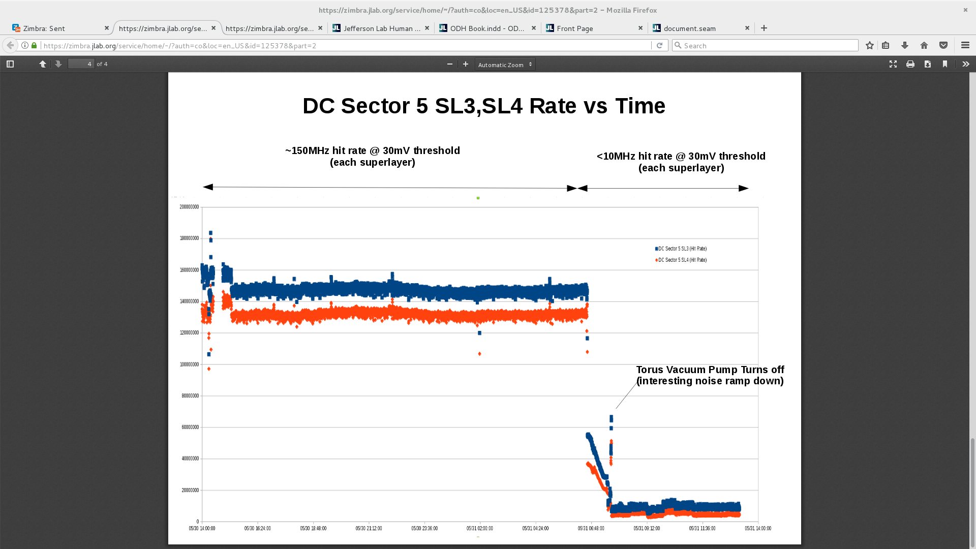
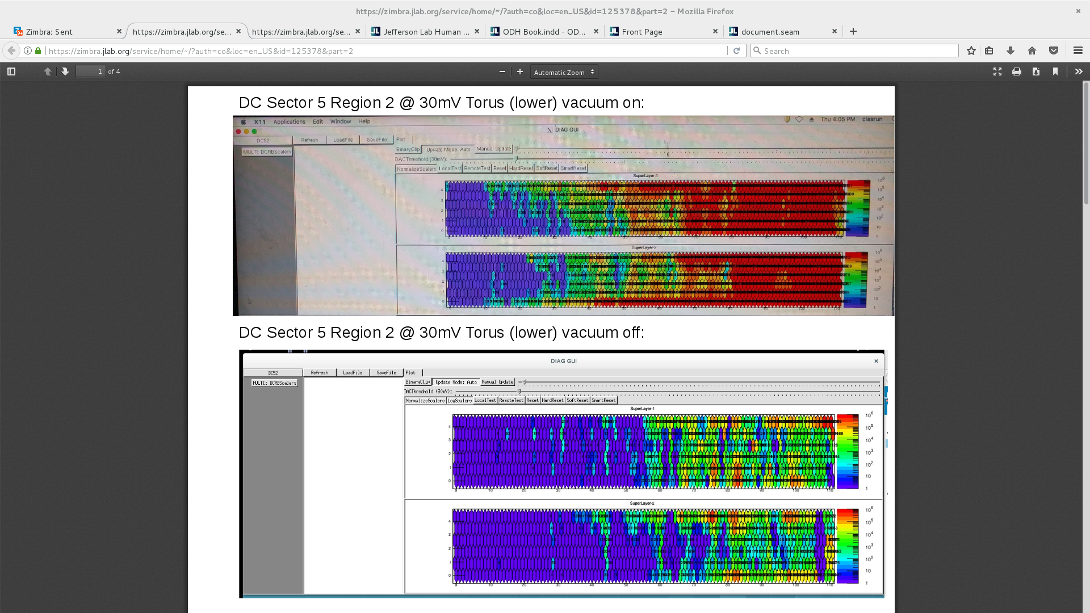
DC Noise (S5R2) @ 30mV
Before & after Torus turbo pump Moved
(from B.Raydo)
Before:
(~300MHz hit rate noise)
After:
(<2MHz hit rate noise)
Before:
(~300MHz hit rate noise)

Slide 7
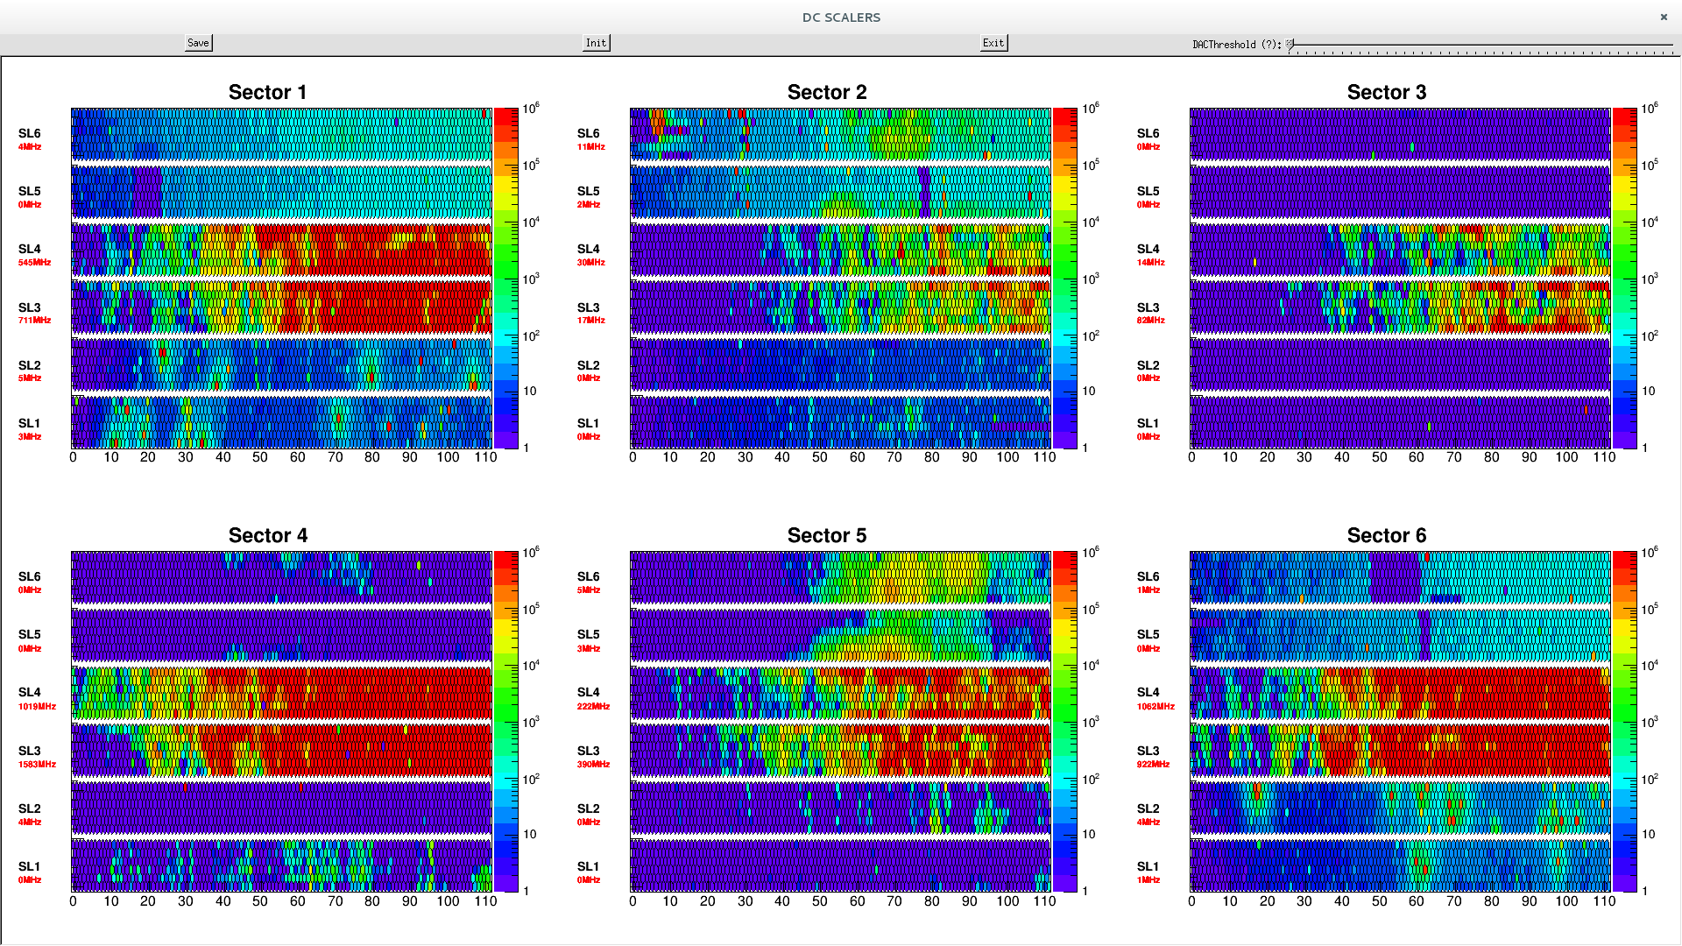
DC Noise @ 30mV only S5R2 DCRB modified for noise improvement
(from B.Raydo)

Slide 8
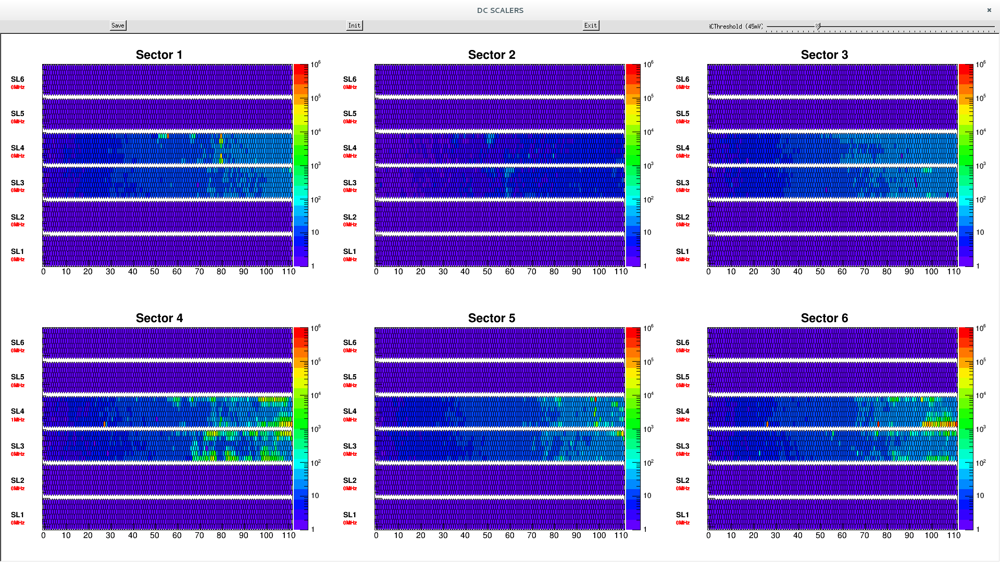
DC Noise @ 45mV expected R2 noise when all DCRB are modified
(from B.Raydo)

Slide 9
CLAS12 Trigger System Logic
VTP for FT (3)
Notes:
HTCC – not “central” detector

Slide 10
DC Trigger: Segment Finder, 4 hits minimum
ORIGINAL DATA:
5> -|-------------- ---------------- ---------------| ---------------- ---|---------||- ---------------- ---------------|
4> -|-------------- ---------------- ---------------| ---------------- --------------|- ---------------- ---------------|
3> ---------------- ---------------- ---------------| ---------------- ---|------------ ---------------- --------------|-
2> ---------------- ---------------- ---------------| ---------------- ---------------- ---------------- --------------|-
1> |--------------- ---------------- ---------------- |--------------- -------|-----|-- ---------------- ----------------
0> |--------------- ---------------- ---------------- |--------------- ------------||-- ---------------- --------------|-
INPUT DATA:
5> ---------|------ ---------------- ---------------- -------|-------- -----------|---- -----||--------- ---------------- -------|--------
4> ---------|------ ---------------- ---------------- -------|-------- ---------------- ------|--------- ---------------- -------|--------
3> ---------------- ---------------- ---------------- -------|-------- -----------|---- ---------------- ---------------- ------|---------
2> ---------------- ---------------- ---------------- -------|-------- ---------------- ---------------- ---------------- ------|---------
1> --------|------- ---------------- ---------------- --------|------- ---------------| -----|---------- ---------------- ----------------
0> --------|------- ---------------- ---------------- --------|------- ---------------- ----||---------- ---------------- ------|---------
OUTPUT ARRAY:
8> ---------------- ---------------- ---------------- ---------------- ---------------- ---------------- ----------------
7> ---------------- ---------------- ---------------- ---------------- ---------------- ---------------- ----------------
6> ---------------- ---------------- ---------------- ---------------- ---------------- ---------------- ----------------
5> ---------------- ---------------- ---------------- ---------------- ---------------- ---------------- ----------------
4> ---------------- ---------------- ---------------- --|------------- ---------------- ---------------- ----------------
3> ---------------- ---------------- ---------------- -|||------------ ---------------- ---------------- ----------------
2> ---------------- ---------------- ---------------- -||------------- ---------------- ---------------- ----------------
1> ---------------- ---------------- ---------------- -|-------------- ---------------- ---------------- ----------------
0> ---------------- ---------------- ---------------- |--------------- --------------|- ---------------- ---------------|
-1> -|-------------- ---------------- ---------------| ---------------- --------------|- ---------------- ---------------|
-2> ---------------- ---------------- --------------|- ---------------- -------------|-- ---------------- --------------||
-3> ---------------- ---------------- ---------------- ---------------- ---------------- ---------------- -------------|--
-4> ---------------- ---------------- ---------------- ---------------- ---------------- ---------------- ------------|---
-5> ---------------- ---------------- ---------------- ---------------- ---------------- ---------------- ----------------
-6> ---------------- ---------------- ---------------- ---------------- ---------------- ---------------- ----------------
-7> ---------------- ---------------- ---------------- ---------------- ---------------- ---------------- ----------------
-8> ---------------- ---------------- ---------------- ---------------- ---------------- ---------------- ----------------
try all possible segments for layer 0 wire 0,
repeat 112 times moving along layer 0,
fill 2-dim array below
W5-w0 (-8..+8)
performance: 32ns per event
(defined by backplane bandwidth)
wire number (111-0)

Slide 11
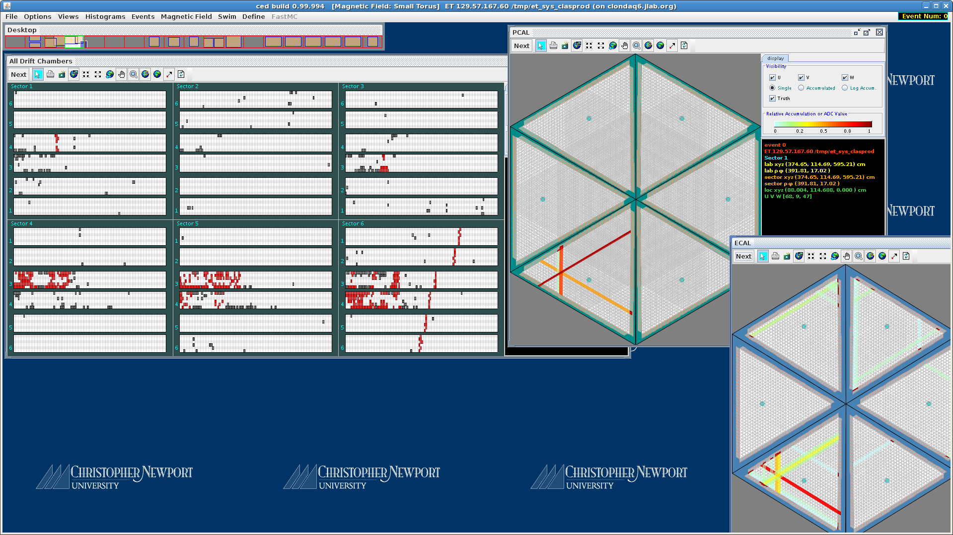

Slide 12


Slide 13
CLAS12 Trigger Status
All available trigger electronics installed. It includes 22 VTP boards (stage 1 and 3 of trigger system) in ECAL, PCAL, HTCC, R3 for all sectors and R1/R2 for sector 5 in Drift Chamber and main trigger crates, and 9 SSP boards in stage 2.
All trigger algorithms modeling completed including ECAL, PCAL, DC and HTCC
‘pixel’ trigger is implemented in ECAL and PCAL for cosmic calibration purposes
DC trigger is implemented: segment finder with real segment dictionary, road finder is based on superlayer multiplicity
20 additional VTP boards are ordered to be used in DC, FT and FTOF trigger subsystems
Work in progress to implement following into hardware: cluster finding for PCAL, improved energy correction for both ECAL and PCAL – more time requires
Notes:
Experienced delays in trigger development, now back on track

Slide 14
Online Status
Computing hardware is available for most online tasks (runtime databases, messaging system, communication with EPICS etc)
There is no designated ‘online farm’ for data processing in real time, two hot-swap DAQ servers can be used as temporary solution
Available software (some work still needed): process monitoring and control, CLAS event display, data collection from different sources (DAQ, EPICS, scalers etc) and data recording into data stream
Work needed: runtime database (transformation to RCDB), data monitoring (some components available): RCDB and new messaging – work in progress

Slide 15
RCDB (Run Conditions Data Base)
CPP library installed, examples tested – from Dima Romanov (Hall D)
There are no fixed tables, items can be added or deleted using commands:
rcnd --create run_start_time --type time --description "Run start time"
rcnd --create json_cnd --type json --description "Basic run info”
rcnd –remove json_cnd
Database server: clondb1, database: “rcdb”
Web interface (clasweb.jlab.org/rcdb/) contains search facility
Implementation is in progress

Slide 16
RCDB – cpp example
Goal 1: fill database with runtime information
Goal 2: provide information in the form suitable for web presentation and search
// Create DB connection
rcdb::WritingConnection connection(connection_str);
connection.AddRun(999);
connection.AddRunStartTime(999, start_time);
connection.AddRunEndTime(999, end_time);
connection.AddCondition(999, ”event_count", 123456);
………………………………………………………….
using json = nlohmann::json;
// You can create json a way, which looks very similar to the JSON itself)
json j = {
{"event_count", event_count},
{"events_rate", events_rate},
{"temperature", temperature},
{"beam_energy", beam_energy},
{"daq_trigger", daq_trigger},
{"test", test},
{"list", {1, 0, true}},
{"object", {{"currency", "USD"}, {"value", 42.99}}},
{"c_vector", c_vector},
{"start_time", StringUtils::GetFormattedTime(start_time)}
};
// or act as a dictionary
// add a number that is stored as double (note the implicit conversion of j to an object)
j["pi"] = 3.14;
connection.AddCondition(999, "json_cnd", j.dump());

Slide 17
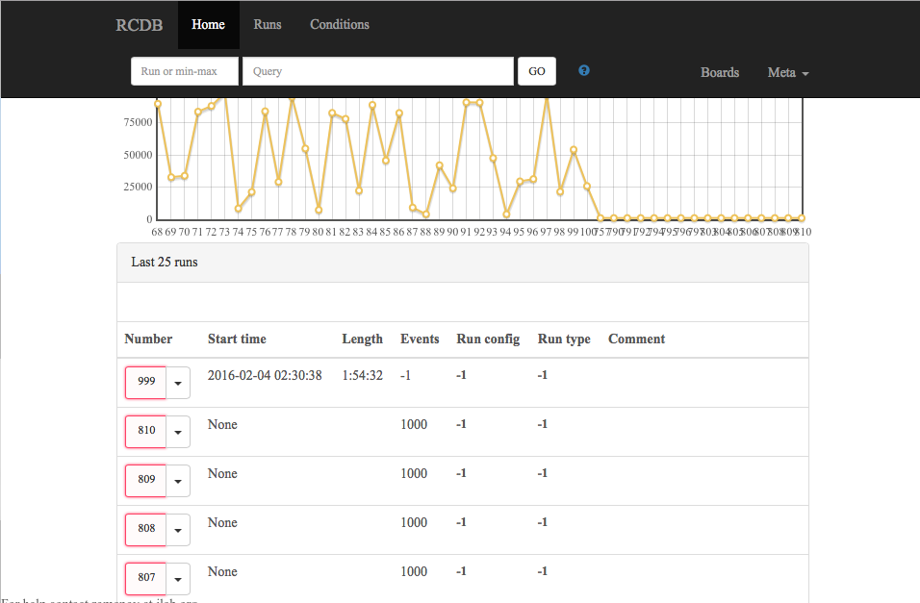

Slide 18
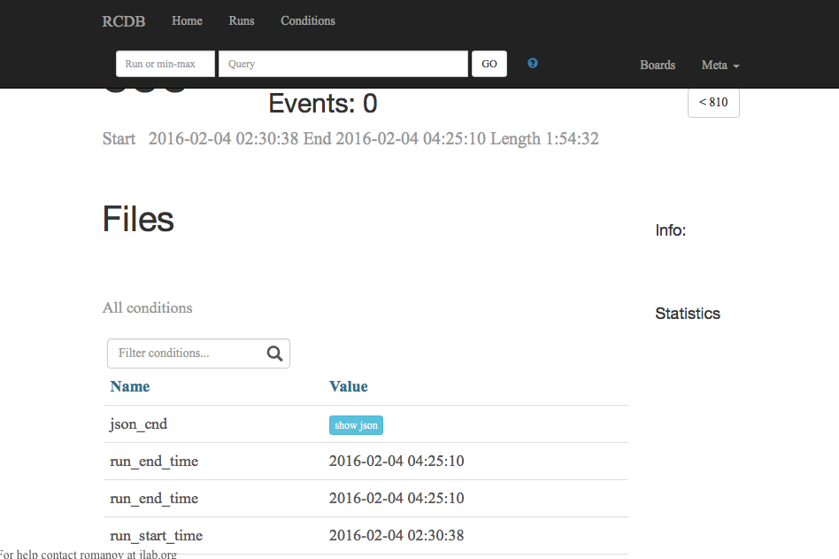

Slide 19
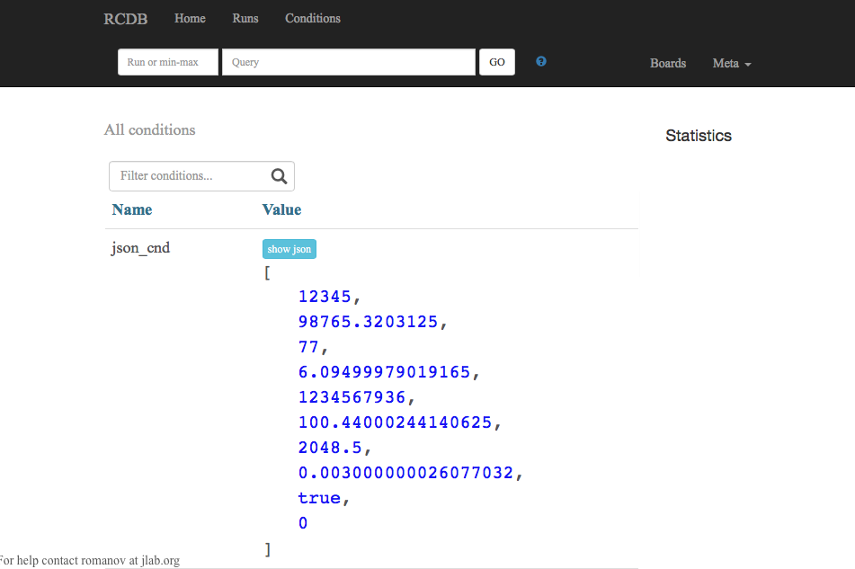

Slide 20
Messaging (ActiveMQ)
Old Smartsockets to be replaced with ActiveMQ
ActiveMQ is installed on clon machines and tested on all platforms where it suppose to be used (including DAQ and trigger boards)
Dave Heddle and two students are working on both cpp and java implementation

Slide 21
Conclusion
CLAS12 DAQ, computing and network was tested during KPP run and worked as expected, reliability meets CLAS12 requirements, performance looks good but final tests have to be done with full CLAS12 configuration (waiting for solenoid, remaining detectors and complete trigger)
Trigger system worked as expected during KPP; some parts of stage 1 were not ready, but all completed components performed well; DC trigger was added after KPP and tested with cosmic; modeling for all algorithms completed; firmware development is in progress; remaining hardware has been ordered
Online software development in progress, available tools allows to run but more work needed to complete the system (RCDB, messaging)
Everything have to be ready for final testing by September 1

