Slide 1
DC monitoring - calibration - simulation - corrections
Monitoring (Olga Cortes, Michael Kunkel, Latiful Kabir)
Standard plots, exploratory package (ntuple)
Calibration (Krishna Adhikari, MK, LK)
Fit time as function of (doca, beta, B, local angle)
Write calibration constants to CCDB
Same function used for reconstruction and simulation
Simulation
Distance to time (KA, Daniel Lersch)
non-linear function, time walk correction, random walk smearing
Efficiency (DL, Michael Kunkel)
intrinsic inefficiency, background inefficiency, malfunction-related inefficiency
Corrections (No one yet! )
Time-of-flight, signal propagation, alignment, wire sag, endplate bowing
Torus Mapping (Joseph Newton)
Compare sector to sector, measurement to model
Fit to individual misplacement, distortion

Slide 2
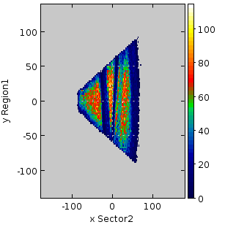
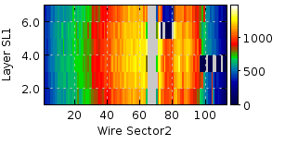
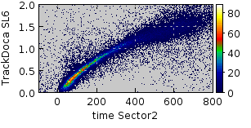
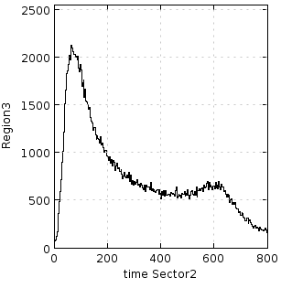
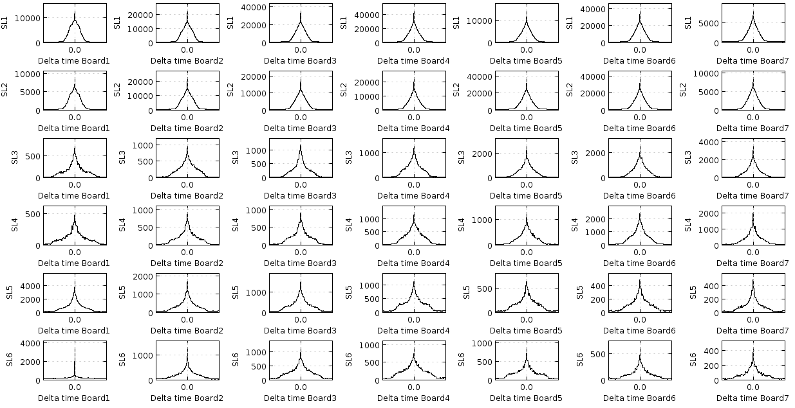
DC monitoring: ‘standard plots’ done
Occupancy
: dead areas
DOCA vs. time
Time Differences
- spike at zero
→ coherent noise

Slide 3
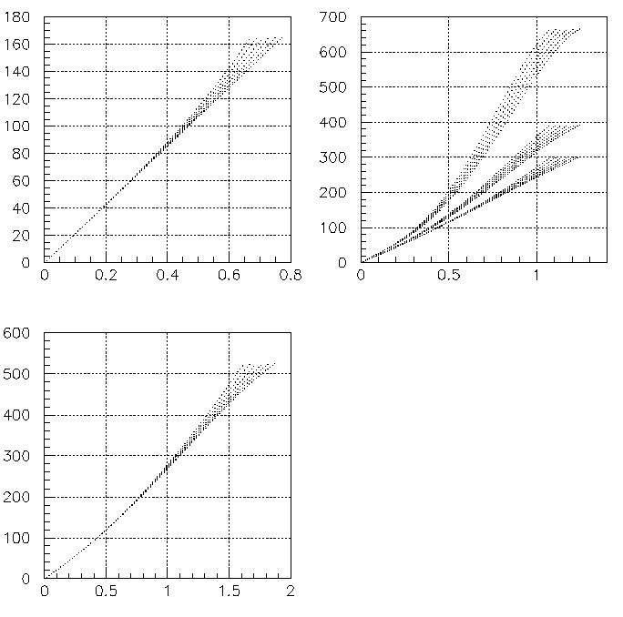
DC distance → time calibration
Distance → time
non-linear fit of time as function of doca, local angle, B-field
numerically inverted to obtain time → distance tables for 2 angular bins; 5 bins of B-field strength
Reconstruct
write out track banks
cut on beta, angle, B-field
fit time, DOCA histogram
write constants to CCDB
Iterate
B=2T
B=1T
Region 1
Time (ns)
Region 2
B=0T
Distance (cm)
Distance (cm)
local angle = 0⁰
Region 3
local angle = 30⁰
Time (ns)
inflection point
Distance → Time
-local-angle and B-field dependence
“Factory setting”
Distance (cm)

Slide 4
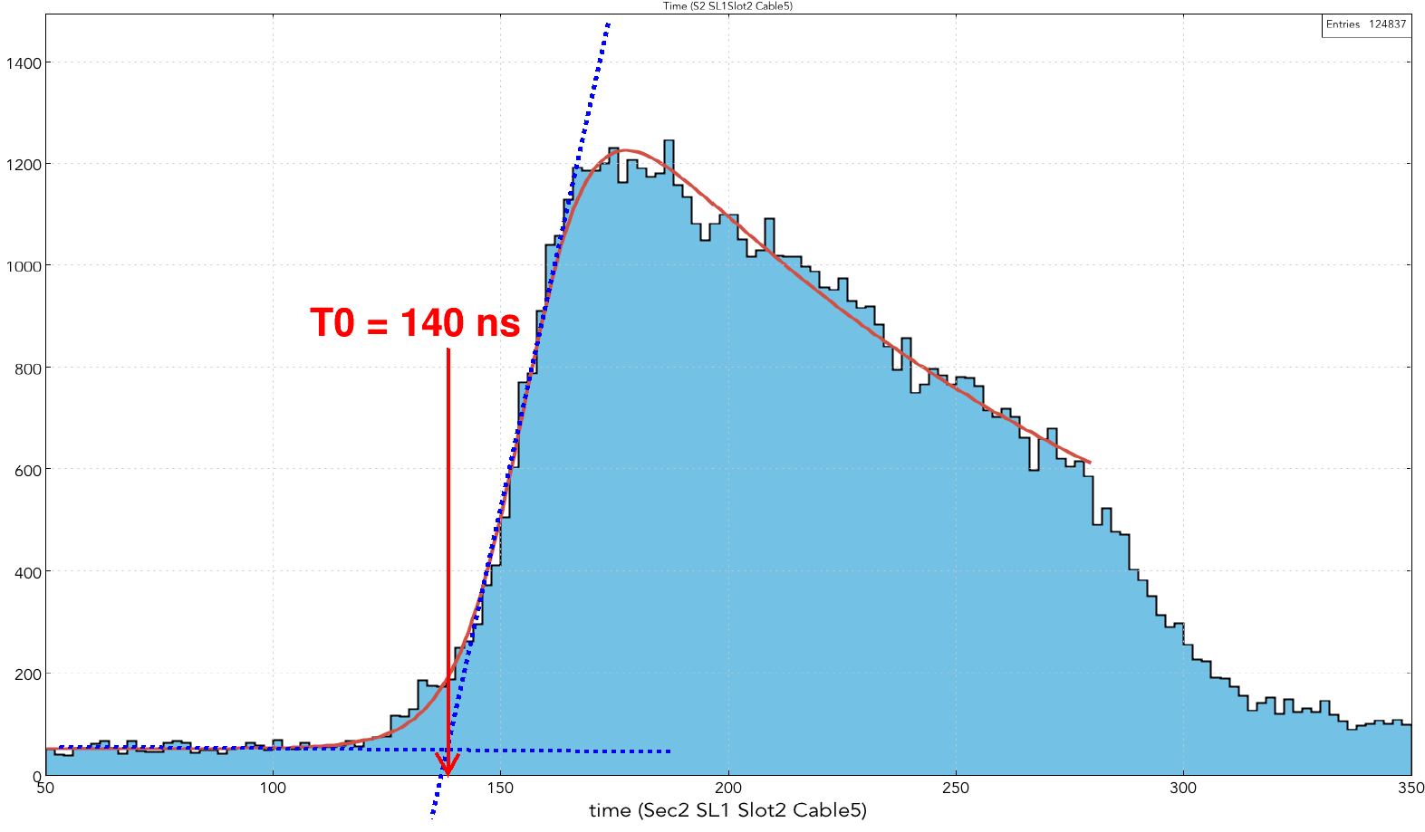
DC distance → time calibration
First find “t0”
Find t0 for each of 1512 signal cables (252 from sector 2)

Slide 5
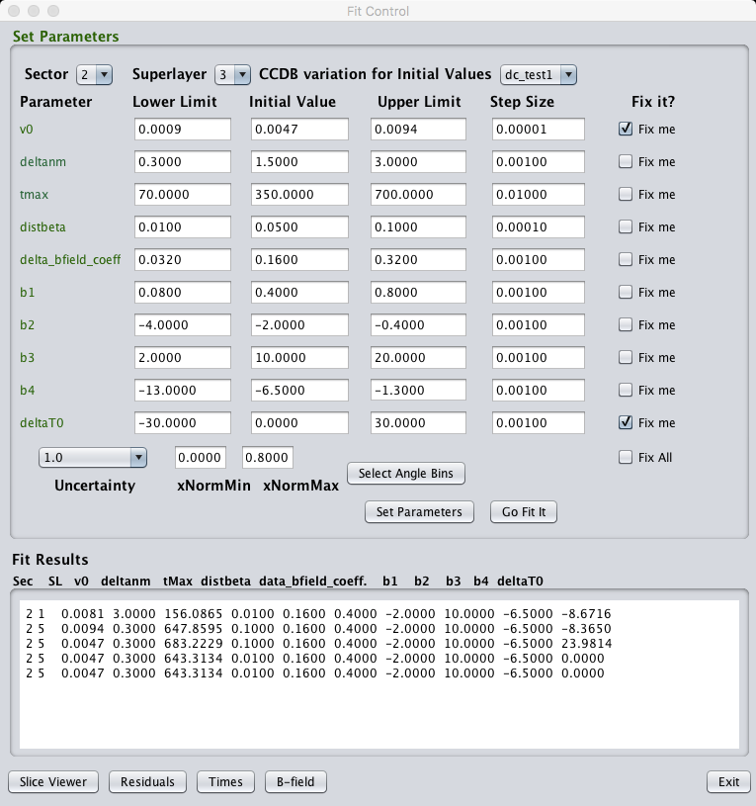
DC distance → time calibration
Calibration GUI in operation
select events
select local angle
select range of fit
fix or free paramers
script to write to CCDB
Tune parameters
Different D→T functions
polynomial ? exponential?
Which parameters to fix?
Iteration not improving resolution

Slide 6
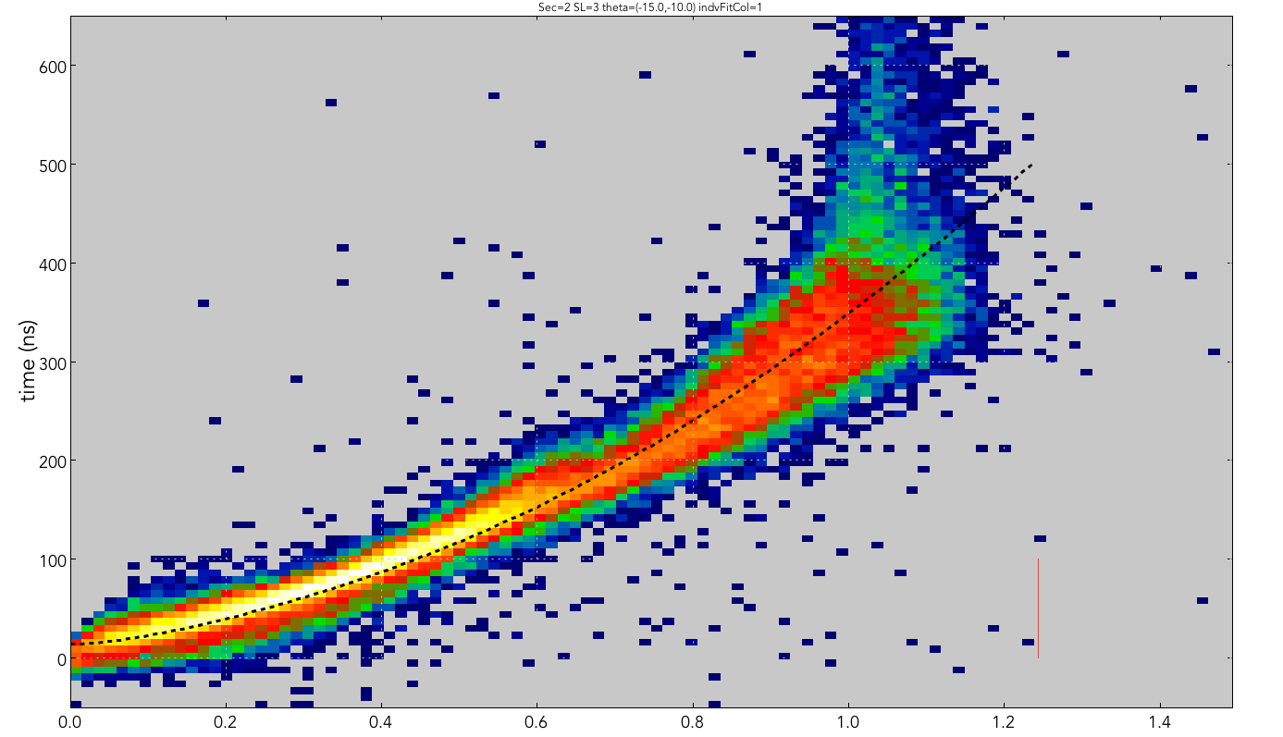
DC distance → time calibration
Fits work pretty well

Slide 7
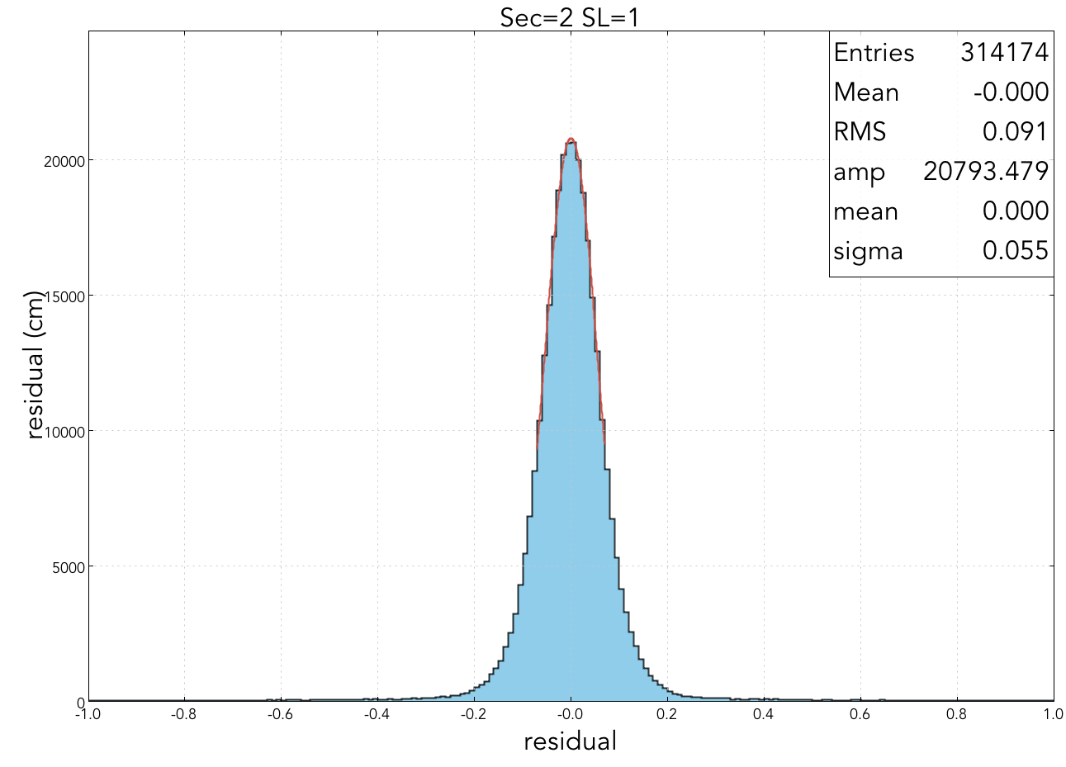
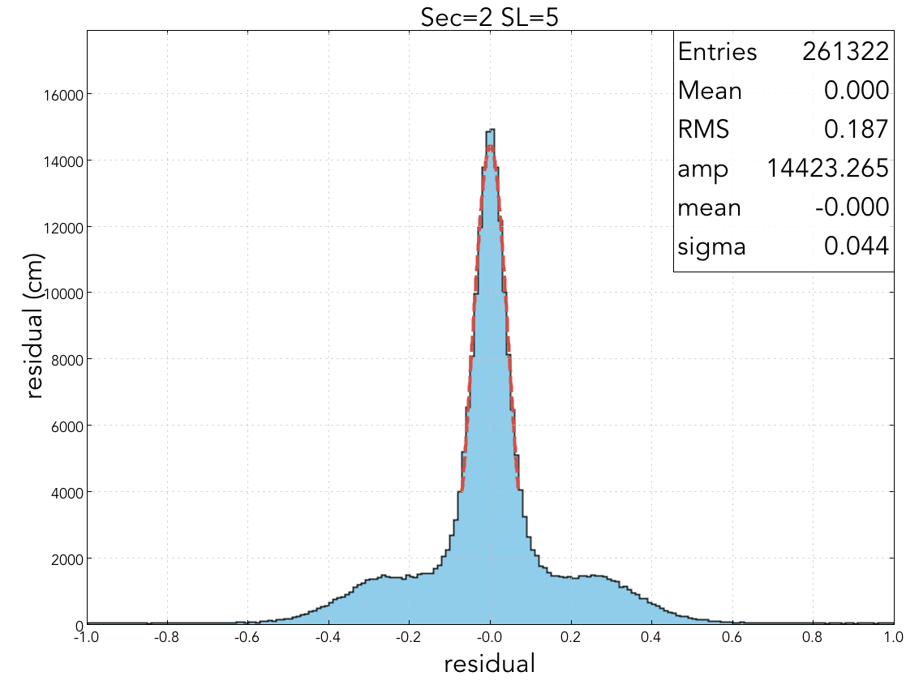
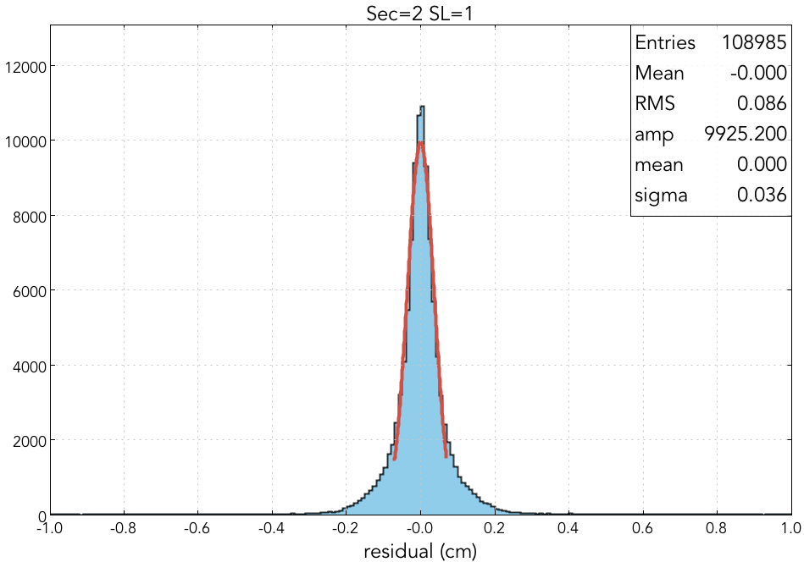
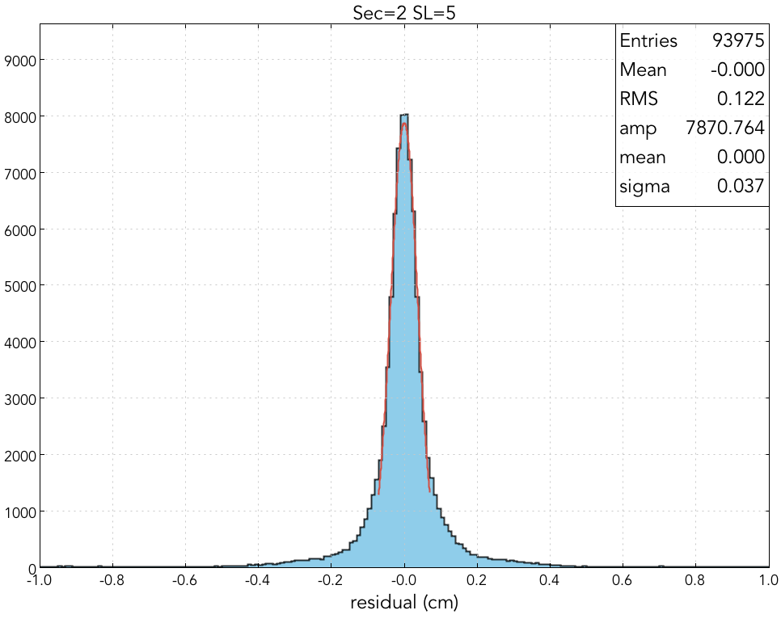
DC Calibration - Residuals Comparison
Superlayer = 1
σ = 0.055 cm
Superlayer = 5
σ = 0.044 cm
Before Calibration
cm
Superlayer = 1
σ = 0.036 cm
Superlayer = 5
σ = 0.037 cm
After Calibration

Slide 8
DC simulation: distance → time; time smearing; efficiency
Simulate distance → time (including smearing)
non-linear distance to time function (SAME as for calibration)
time-walk (beta-dependent) time smearing
random walk smearing
Simulate wire-hit efficiency
intrinsic efficiency (distance dependent)
malfunction related (run dependent)
malfunction table in MySQL (date, wire-list, statchange)
translation table (equipment → wire)
→ run-dependent wire status table in CCDB
background related
on-track (handled by GEMC)
out of time (need to merge events)

Slide 9
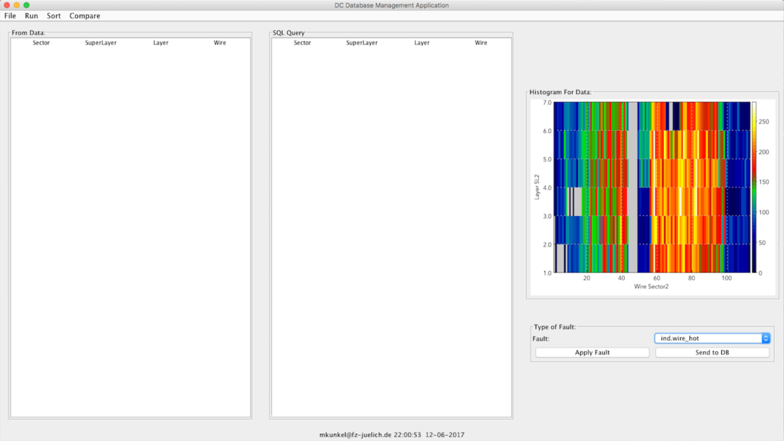
DC simulation: efficiency
Simulate malfunction-related inefficiencies

Slide 10
DC Corrections
Time corrections
time of flight (with and without particle id.)
signal propagation time along wire
Alignment
‘straight-track’ runs
Distortions
endplate bowing
wire sagging
Parameterizations known
→ implementation & testing

Slide 11
Torus Field Mapping
→ Midplane B-fields Vary by ~ 1/2% Sector to Sector

Slide 12
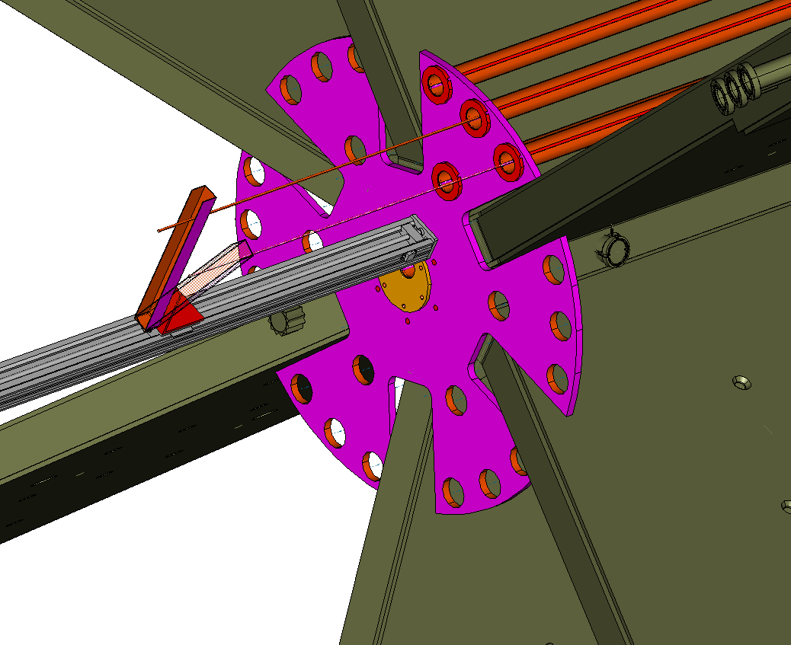
Torus Field Mapping
Torus field mapping
measure field at selected points
compare to calculation
calculation 2% low at 46.5 cm
calculation 5% low at 30 cm
→ Coil radius off by 1cm in calculation ??
2%
5%

Slide 13
DC monitoring - calibration - simulation - corrections
Monitoring
standard plots done, developing ntuple, summary strip charts
Calibration
code written, fine-tuning procedures
Simulation
t → d: code written, adjusting parameters to match data
malfunctions: GUI written, working on procedures
Corrections
time, geometry corrections to be done in summer
Torus Mapping
sector to sector variation ~ 0.5%; ready to fit
Credit to Idaho St., Mississippi St., Juelich Inst., ODU
Follow us at dc_team on Slack

