Slide 1

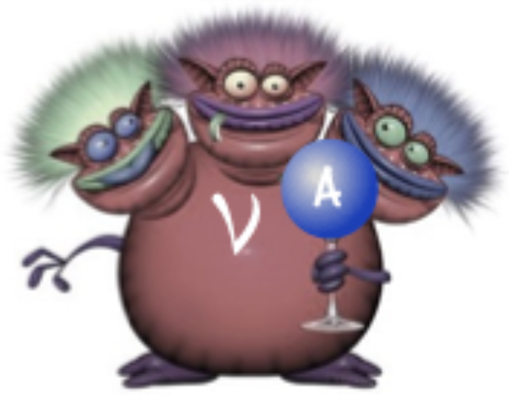
Electrons for Neutrinos: Addressing Critical Neutrino-Nucleus Issue
Proposal PR12-17-006
Spokespersons:
O. Hen (MIT), K. Mahn (MSU),
E. Piasetzky (TAU), S. Stepanyan (JLab)
and L.B. Weinstein (ODU).
CLAS Collaboration Meeting, 10/4/17

Slide 2
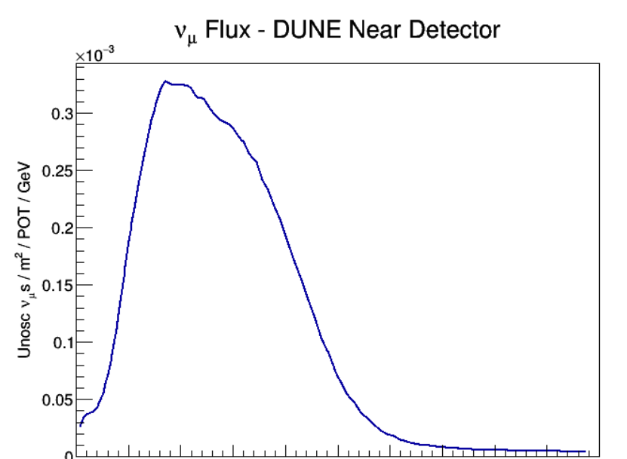
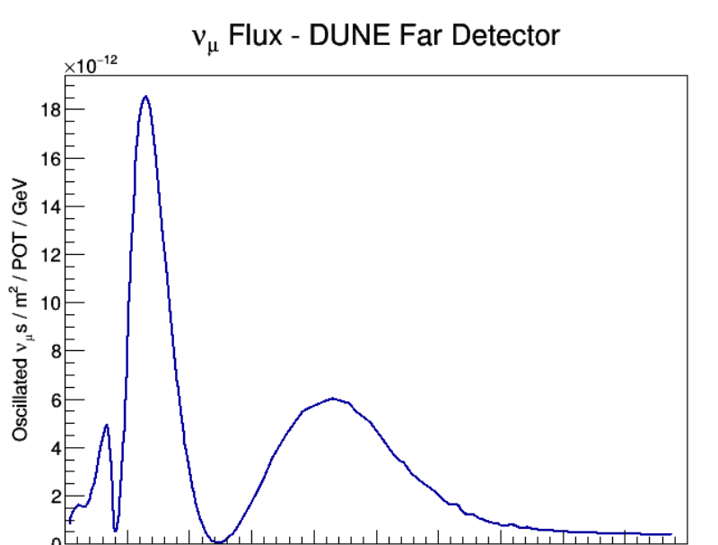
Long Baseline Oscillations
Near Det.
Far Det.
𝛎-Beam
0 2 4 6 8 10
E_{v} [GeV]
0 2 4 6 8 10
E_{v} [GeV]

Slide 3
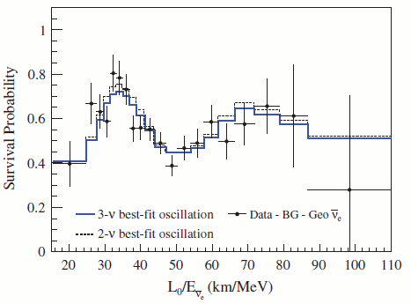
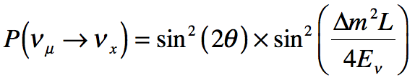
Neutrino Oscillations
Real E_{ν}
1
0.8
0.6
0.4
0.2
0
#Observed / #Expected
20 40 60 80 100
L/E_{ν} [km/MeV]
“Reconstructed” E_{ν}
KamLAND, PRL 100, 221803 (2008)

Slide 4
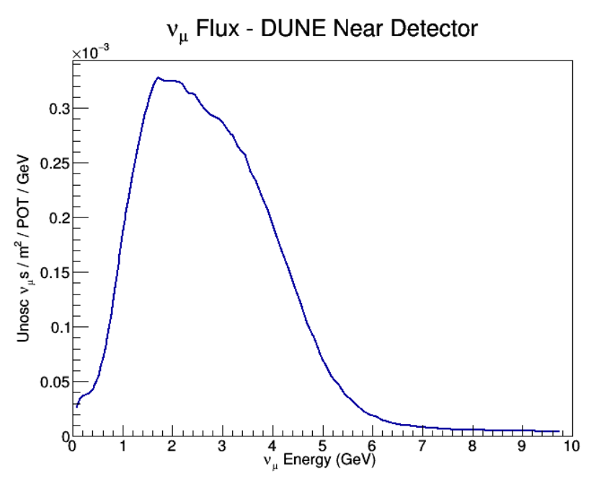
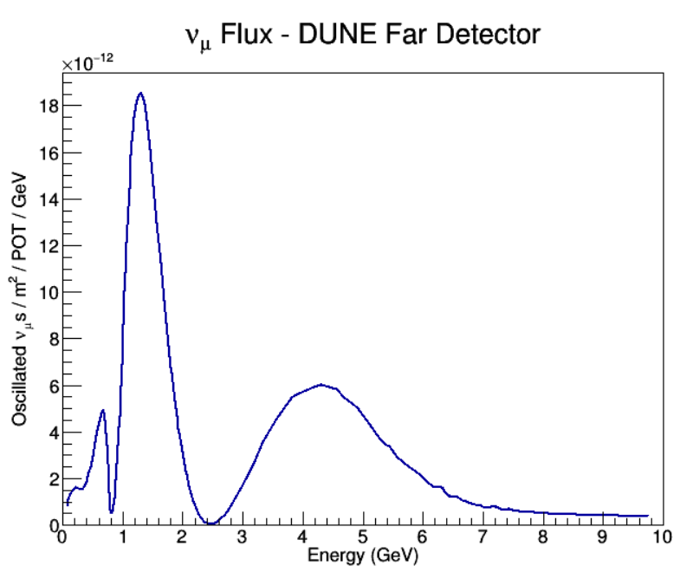
(Long Baseline) Oscillation Challenge
Oscillations are basically ratios of reconstructed 𝜈 energy spectra:
Energy (x-axis): Reconstructed from the measured final state.
Flux (y-axis): Reconstructed using reaction model (cross-section + FSI + …)
=> Incorrect neutrino-nucleus interaction modeling can bias the extracted oscillation parameters

Slide 5
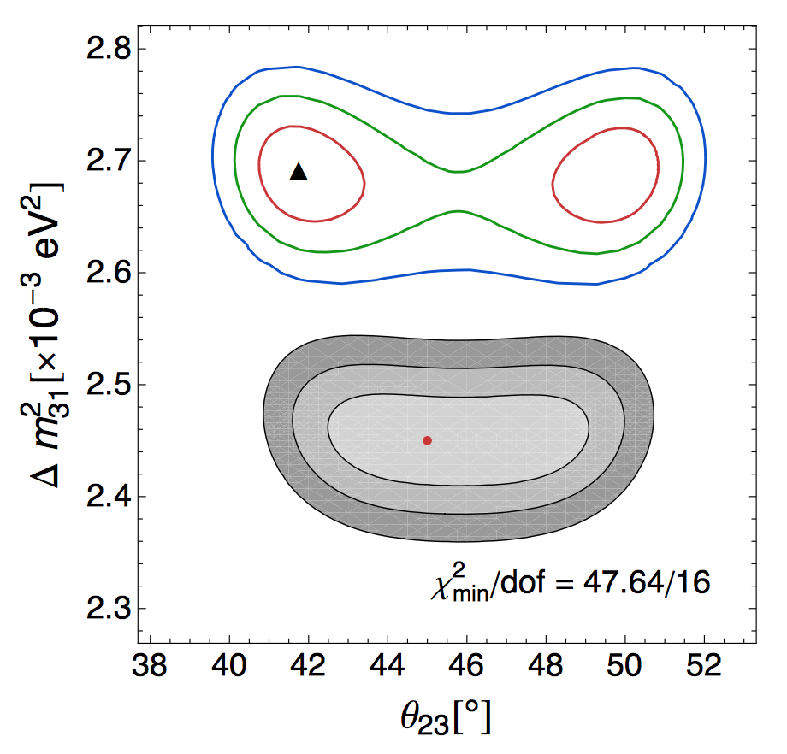
(Long Baseline) Oscillation Challenge
Oscillations are basically ratios of reconstructed 𝜈 energy spectra:
Energy (x-axis): Reconstructed from the measured final state.
Flux (y-axis): Reconstructed using reaction model (cross-section + FSI + …)
=> Incorrect neutrino-nucleus interaction modeling can bias the extracted oscillation parameters
Phys.Rev. D89 (2014), 073015
GENIE
GiBUU

Slide 6

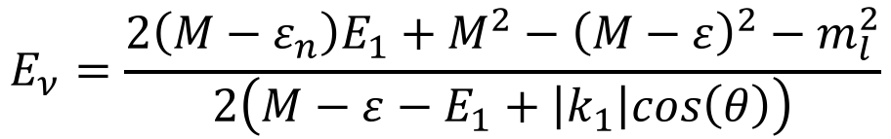
Neutrino detectors
Cherenkov detectors:
Electrons & Pions
No protons / neutrons
E_{𝜈} Reconstruction from lepton kinematics.
Tracking detectors:
Charged particles +π⁰
]Progress towards neutrons[
E_{𝜈} Reconstruction from
‘full’ final state.
$$E_{ν}=E_{l}+E_{p}^{kin}+E_{b}$$
$$E_{ν}=\frac{2\left(M−ε_{n}\right)E_{1}+M^{2}−{\left(M−ε\right)}^{2}−m_{l}^{2}}{2\left(M−ε−E_{1}+\left|k_{1}\right|cos\left(θ\right)\right)}$$

Slide 7




Attacking the Monster From All Sides
e-scattering
𝛎-scattering
(1) Monochromatic e-beam constraints:
Vector currents
Nuclear FSI
…
(2) 𝜈 ‘near-detector’ data constraints:
Axial / Vector-Axial currents
Ultra-low Q²
…
Event-Generators
(3) Must reproduce e-data and 𝜈 ‘near-detector’ data before reliably used to extract oscillation parameters.

Slide 8
Existing e-scattering data
“We’ve been throwing electrons at nuclei for over 40 years – why new data?”
Electron data is taken selectively to exclude ugly effects that make interpretation harder (pions, FSI, MEC, etc):
W-boson mass makes the neutrino ‘Mott’ cross-section flat. The electron cross section is very forward peaked.
A(e,e’): measured extensively; well described
A(e,e’p): measured primarily in selective kinematics (around the QE peak). Usually reported as ratio to theory.
A(e,e’n), A(e,e’NN): Sparse data, especially at GeV energies.
Resonance production: lacking systematic data on nuclei and at large particle multiplicities.

Slide 9
Mining For Neutrinos
Goal: Use CLAS data to study E_{beam} reconstruction and vector-current cross-sections for different energies / nuclei.
Means (for QE study):
  Select clean (e,e'p) events (no pions, 2nd protons, ...),
  Reweight by e-N / 𝝂-N cross-section ratio.
  Analyze as ‘neutrino data’ (assume unknown beam energy),
  Study beam energy reconstruction methods,
  Compare to GENIE predictions,
  Identify regions in phase-space where energy reconstruction and GENIE predictions agree well.

Slide 10
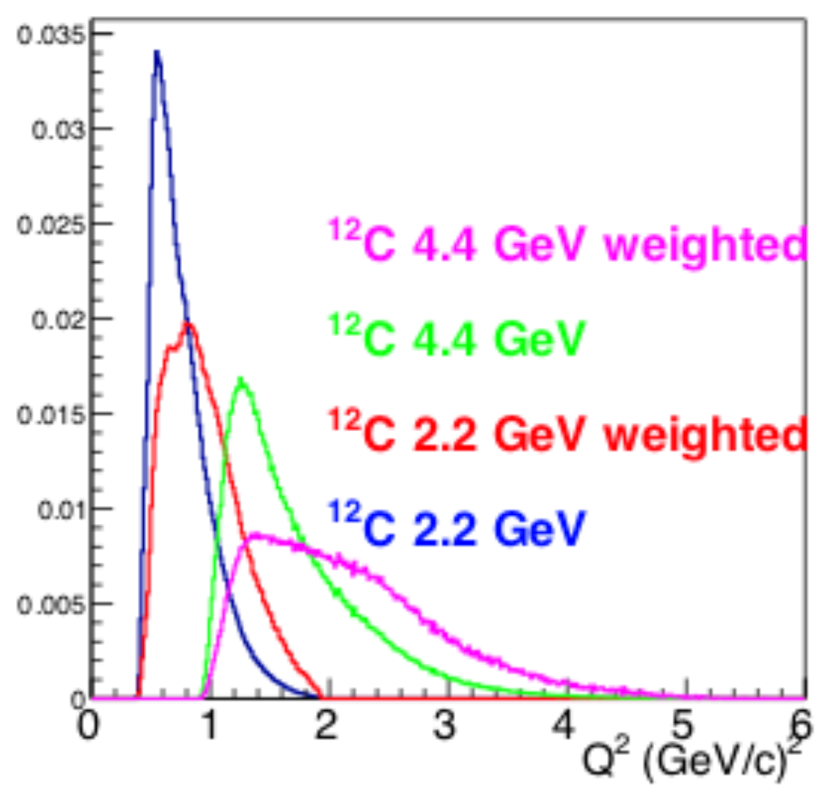
Existing CLAS6 Data
Target | 2.2 GeV |  | 4.4 GeV
 | (e,e’) | (e,e’p) | (e,e’) | (e,e’p)
³He | 24.5 | 9.3 | 4.1 | 1.5
⁴He | 46.3 | 17.3 | 8.0 | 2.8
¹²C | 30.0 | 11.0 | 4.8 | 1.5
⁵⁶Fe | 1.4 | 0.5 | 0.4 | 0.1
Millions of good events
Very limited medium / heavy nuclei data.
Limited low-Q² reach.
+ EG2 (~ x10 less stat): 5 GeV on d, ¹²C, ²⁷Al, ⁵⁶Fe, ²⁰⁸Pb (Q² > 1.5)

Slide 11
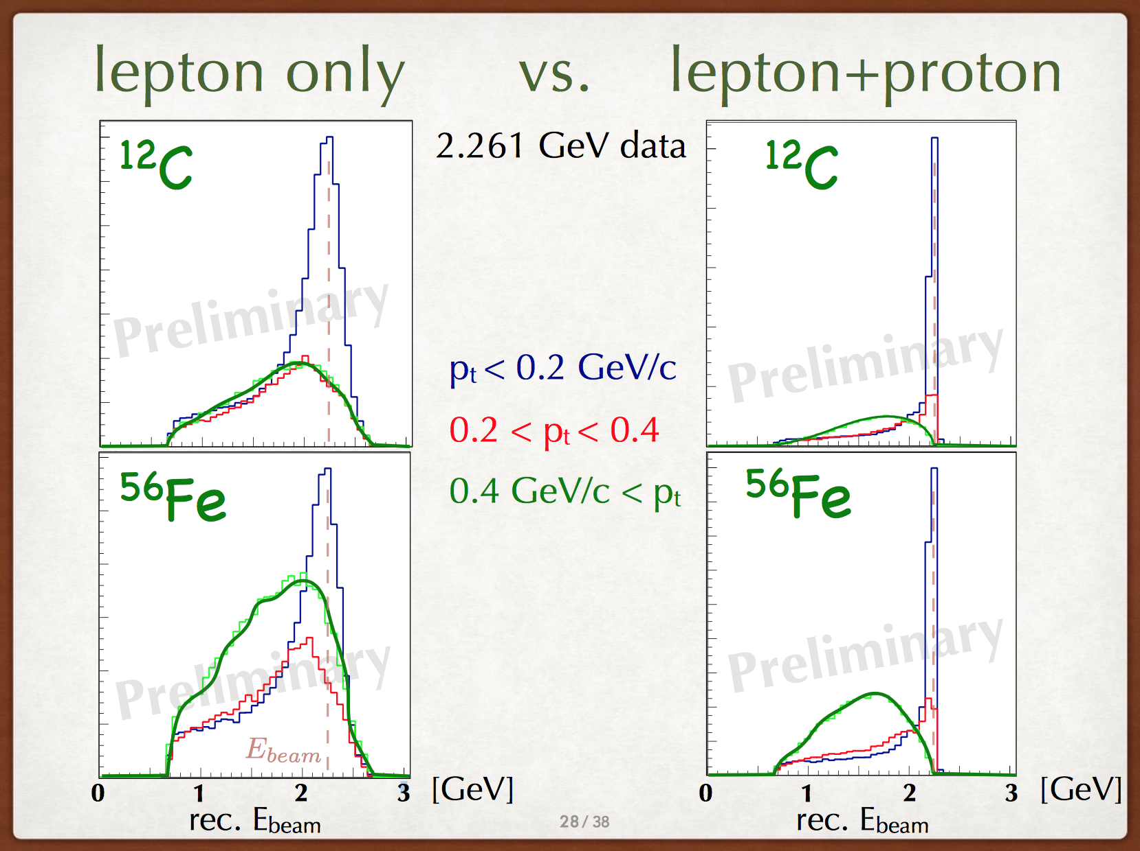

CLAS Energy Reconstruction Example
$P_{T}^{miss}=P_{T}^{lepton}$+$P_{T}^{Proton}$

Slide 12
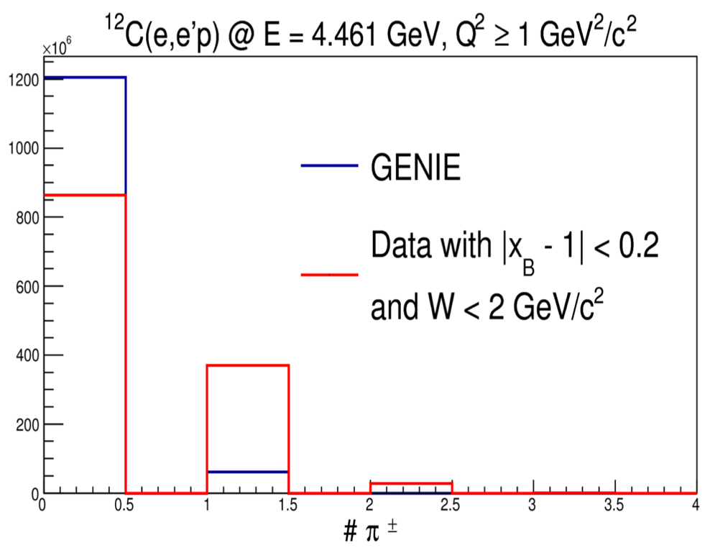
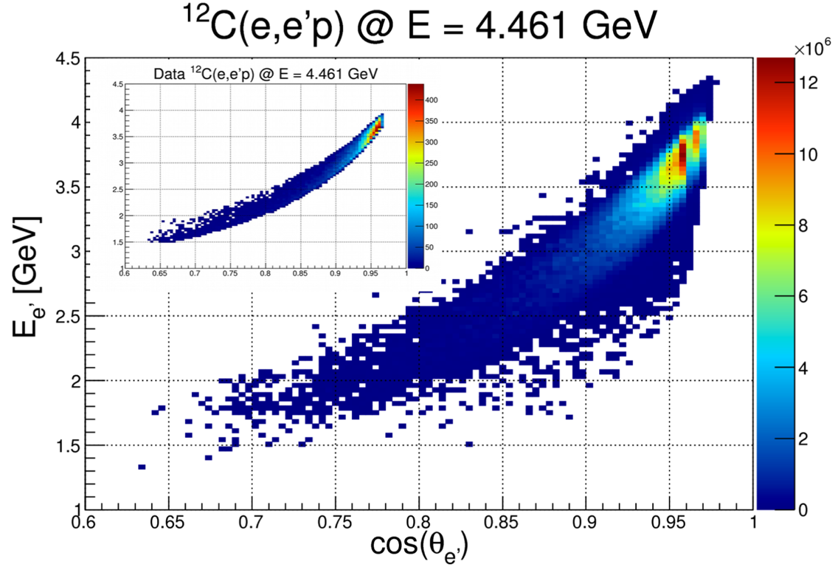
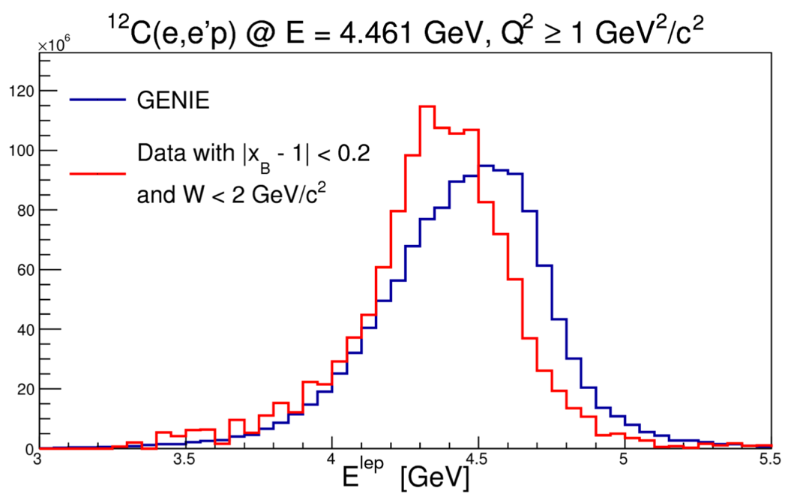
CLAS Data-Generator Comparisons
Pion Multiplicity
Lepton Energy
Kinematics
Preliminary

Slide 13
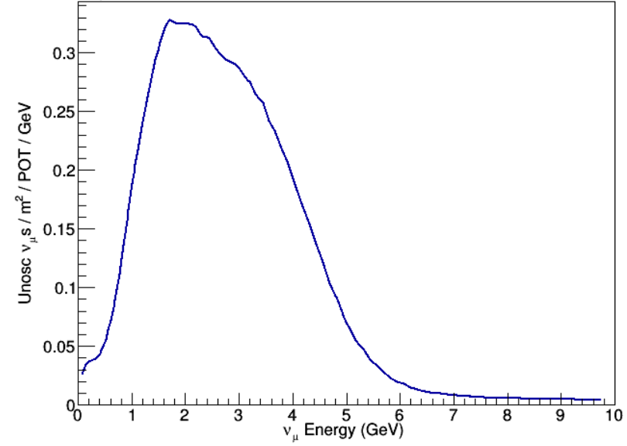
New Proposal: Systematic study!
Targets:
⁴He, ¹²C, ¹⁶O, ⁴⁰Ar, ¹²⁰Sn
Materials used in 𝜈 detectors
Beam Energies:
1.1, 2.2, 4.4, 6.6, 8.8 GeV
DUNE 𝜈 flux
CLAS12 Spectrometer:
Luminosity: x10 higher than CLAS6 !
Charged Particles: 5º – 120º
Neutrons: 5º – 120º + 160º – 170º
Threshold: ~300 MeV/c
=> High stat. semi-inclusive and exclusive data sets on multiple targets at multiple energies.

Slide 14
Electron data: E_{v} & Q² Reconstruction
High Q² events reconstructed as low Q²_{p} due to nuclear effects
Q² [GeV²]
2
1.5
1
0.5
0
2
1.5
1
0.5
0
Q² [GeV²]
P_{T} < 0.2 GeV/c
0 0.5 1 1.5 2
Q²_{p} [GeV²]
CLAS6 Data,
2.2 GeV Incoming beam.
¹²C(e,e’p) no pion events.
P_{T} > 0.4 GeV/c
0 0.5 1 1.5 2
Q²_{p} [GeV²]

Slide 15
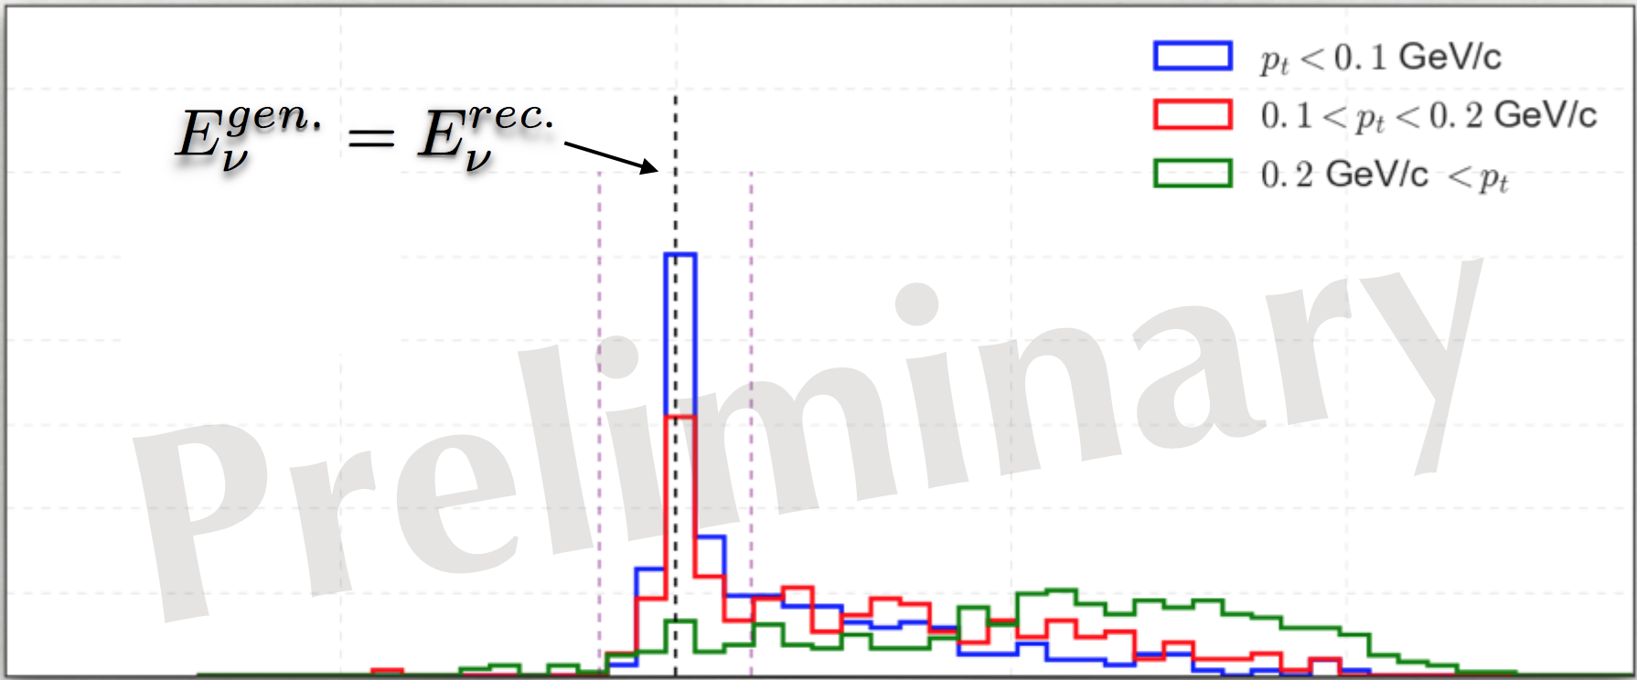
Neutrino MC: E_{v} & Q² Reconstruction
p_{t} < 0.1 GeV/c
p_{t} > 0.2 GeV/c
(E_{gen} – E_{rec}) / E_{gen}
MicroBooNE Preliminary (MIT-TAU Analysis)

Slide 16
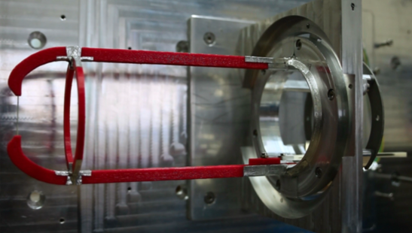
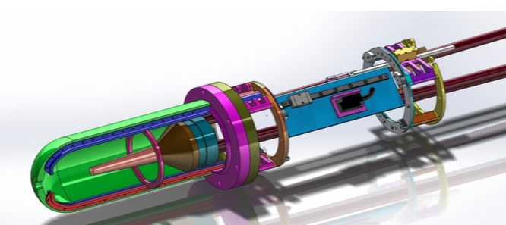
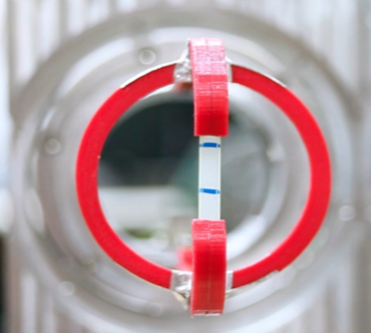
Electrons 4 Neutrinos
Energy [GeV] | H | ⁴He | ¹²C | ¹⁶O | ⁴⁰Ar | ¹²⁰Sn | Total
1 | 0.2 | 0.5 | 0.5 | 0.5 | 0.5 | 0.5 | 2.5
2.2 | 0.2 | 1 | 1 | 1 | 1 | 1 | 5
4.4 | 0.2 | 1 | 1 | 1 | 1 | 1 | 5
6.6 | 0.2 | 2 | 2 | X | 2 | 2 | 8
8.8 | 0.2 | 4 | 4 | X | 4 | 4 | 16
Total (days) | 1 | 8.5 | 8.5 | 2.5 | 8.5 | 8.5 | 37.5
4 days out-bending
[added low-Q² running @ 4.4,6.6 and 8.8 GeV]
1 day in-bending

Slide 17
Electrons 4 Neutrinos
C2 approved by PAC45
High impact study of bias in neutrino oscillation analyses:
  Incident energy reconstruction,
  Final State Interactions,
  Resonance production,
  Multinucleon effects.
The ‘Vector Currents’ partner of the short-baseline (near-detector) neutrino program.
Impact on high-luminosity accelerators R&D (RadCon interest to improve Geant4, Fluka etc.).
“benchmarking of the simulation packages such as Geant4 and FLUKA … is a long-standing important problem for the radiological evaluations at JLab and other high energy electron facilities” (RadCon)

Slide 18

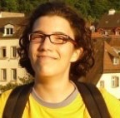

Electrons 4 Neutrinos Team
Mariana Khachatryan (ODU@JLab)
Afroditi Papadopoulou (MIT@FNAL)
Adi Ashkenazi (MIT@FNAL)
+
L.B. Weinstein (ODU),
O. Hen, A. Schmidt, A. Silva (MIT),
K. Mahn (MSU),
E. Piasetzky, E. Cohen (TAU)
S. Dytman (Pittsburgh),
M. Betancourt (FNAL)

Slide 19





Overwhelming Support
MINERvA

