Slide 1
CLAS12 DAQ & Trigger Status and Timeline
Sergey Boyarinov
Oct 3, 2017

Slide 2
Notation
ECAL – old EC (electromagnetic calorimeter)
PCAL – preshower calorimeter
DC – drift chamber
HTCC – high threshold cherenkov counter
FT – forward tagger
TOF – time-of-flight counters
MM – micromega tracker
SVT – silicon vertex tracker
VTP – VXS trigger processor (used on trigger stage 1 and stage 3)
SSP – subsystem processor (used on trigger stage 2)
FADC – flash analog-to-digital converter
FPGA – field-programmable gate array
VHDL – VHSIC Hardware Description Language (used to program FPGA)
Xilinx – FPGA manufacturer
Vivado_HLS – Xilinx High Level Synthesis (translates C++ to VHDL)
Vivado – Xilinx Design Suite (translates VHDL to binary image)
GEMC – CLAS12 GEANT4-based Simulation Package
CLARA – CLAS12 Reconstruction and Analysis Framework
DAQ – Data Acquisition System

Slide 3
CLAS12 DAQ Status
Online computer cluster is 100% complete and operational
Networking is 100% complete and operational
DAQ software is operational, reliability is acceptable
Performance observed (KPP): 5kHz, 200MByte/sec, 93% livetime (livetime is defined by hold-off timer = 15microsec)
Performance expected: 10kHz, 400MBytes/sec, >90% livetime
Performance limitation expected: 50kHz, 800MBytes/sec, >90% livetime (based on HallD DAQ performance)
Electronics installed (and was used for KPP): ECAL, PCAL, FTOF, LTCC, DC, HTCC, CTOF, SVT
TO DO: Electronics installed recently or will be installed soon: FT, FTMM, CND, MM, scalers, helicity
TO DO: CAEN v1290/v1190 boards (re)calibration
TO DO: Full DAQ performance test

Slide 4
DAQ/Trigger Hardware Layout
24
1
1
3
1
19
18
2
INSTALLED: 65 crates,
87 readout controllers

Slide 5
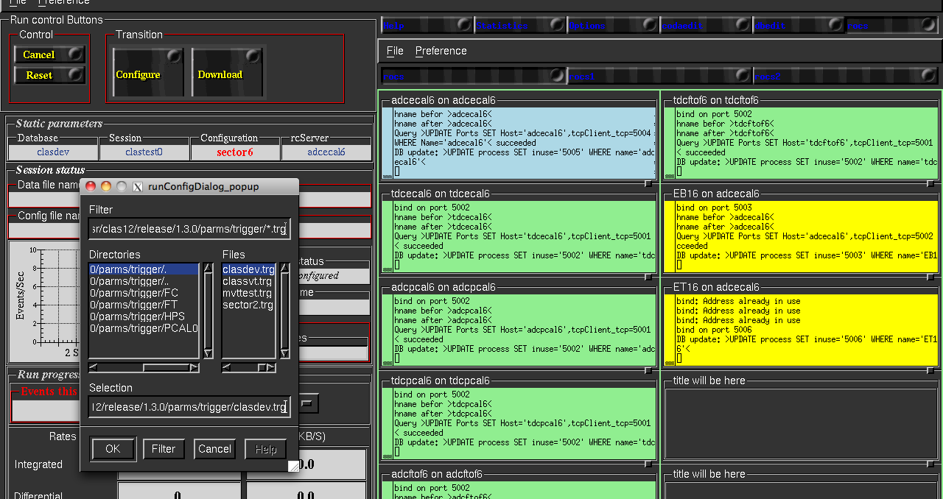
Runcontrol: setting DAQ/Trigger parameters

Slide 6
CLAS12 DAQ Commissioning
Cosmic test (no central detectors): set electron trigger without HTCC (ECAL+PCAL and ECAL+PCAL+DC), check data integrity, check noise for DC and other detectors, check monitoring tools
Cosmic test (central detectors only): set CTOF self-trigger and/or SVT self trigger, check data integrity and monitoring tools
Random pulser test: set low channel thresholds, measure event rate, data rate and livetime; check monitoring tools performance
Beam performance test: running from electron trigger – measure event rate, data rates and livetime with different beam conditions and DAQ/Trigger settings
Timeline: cosmic and pulser tests – one month (November); beam test - one shift; we assume that most of problems will be discovered and fixed during cosmic and pulser tests

Slide 7
CLAS12 Trigger Status
All available trigger electronics installed. It includes 25 VTP boards (stage 1 and 3 of trigger system) in ECAL, PCAL, HTCC, FT, R3 for all sectors and R1/R2 for sector 5 in Drift Chamber and main trigger crates, 9 SSP boards in stage 2
20 move VTP boards arrived and getting ready for installation in remaining DC crates and FTOF crates, should be ready soon
All C++ trigger implementation completed for ECAL, PCAL, DC and HTCC, TOF C++ implementation and FT C++ simulation to be done
Trigger hardware implementation completed for ECAL, PCAL and DC, HTCC and FT is in progress, TOF will follow
‘pixel’ trigger is implemented in ECAL and PCAL for cosmic calibration purposes
Validation procedures under development
Notes:
Experienced delays in trigger development, now back on track

Slide 8
CLAS12 Trigger System Layout
VTP for FT (3)
Notes:
HTCC – not “central” detector

Slide 9
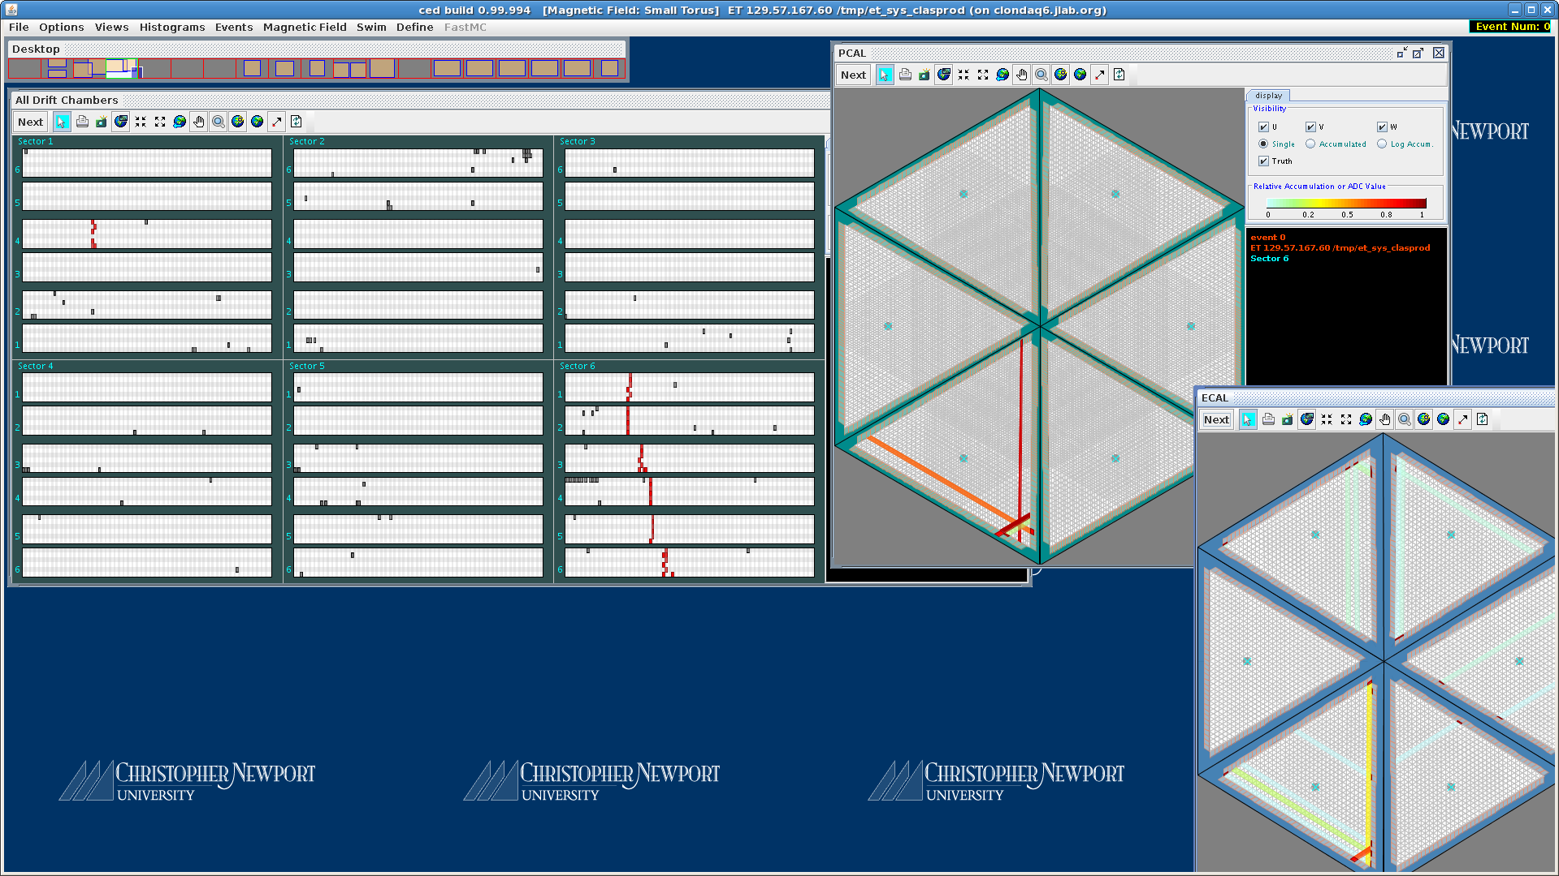
PCAL+DC trigger event example

Slide 10
CLAS12 Trigger Components Summary
stage | name | Clock (ns) | algorithm | input | Output to trigger | Output to datastream | Control registers
1 | ECAL | 32 | Cluster finding with energy correction | FADC | 4 clusters | List of clusters | Thresholds, windows
1 | PCAL | 32 | Cluster finding with energy correction | FADC | 4 clusters | List of clusters | Thresholds, windows
1 | DC | 32 | Segment finding | DCRB | Segment mask | Segment mask | Thresholds, windows
1 | HTCC | 4 | Cluster finding | FADC | Cluster mask | Cluster mask | Thresholds, windows
1 | FT | 4 | Cluster finding | FADC | Cluster mask | Cluster mask | Thresholds, windows
2 | sector | 4 | Stage1 components coincidence, DC road finding | stage1 | Component mask | Component mask | Coincidence logic, windows
3 | global | 4 | Stage2 components coincidence | stage2 | 16-bit trigger | Component mask | Coincidence logic, windows
NOTE: FTOF, CTOF and CND can be added to trigger stage 1

Slide 12
Trigger Configuration file
VTP_CRATE adcecal1vtp # trigger stage 1
VTP_ECINNER_HIT_EMIN 100 # strip energy threshold for 1-dim peak search
VTP_ECINNER_HIT_DT 8 # +-8clk = +-32ns: strip coincidence window to form 1-dim peaks,
# and peak-coincidence window to form 2-dim clusters
VTP_ECINNER_HIT_DALITZ 568 584 # x8: 71<dalitz<73
…………………………..
SSP_CRATE trig2 # trigger stage 2
SSP_SLOT all
SSP_GT_STRG_ECALIN_CLUSTER_EMIN_EN 0 1 # enable ECAL_INNER clusters in trigger
SSP_GT_STRG_ECALIN_CLUSTER_EMIN 0 2000 # ECAL_INNER cluster threshold
SSP_GT_STRG_ECALIN_CLUSTER_WIDTH 0 100 # coincidence window to coincide with PCAL etc
……………………………..
VTP_CRATE trig2vtp # trigger stage 3
# slot: 10 13 09 14 08 15 07 16 06 17 05 18 04 19 03 20
# payload: 01 02 03 04 05 06 07 08 09 10 11 12 13 14 15 16
VTP_PAYLOAD_EN 0 0 0 0 1 0 1 0 1 0 1 0 1 0 1 0
# 6780 corresponds to 7900 FADC latency
VTP_GT_LATENCY 6780
# sector bits: trig number, ssp trig mask, ssp sector mask, multiplicity,
# coincidence=number_of_extended_clock_cycles
VTP_GT_TRGBIT 8 1 1 1 1
………………………………
There is a plan to provide GUI to handle configuration files
Notes:
Experienced delays in trigger development, now back on track

Slide 13
CLAS12 Trigger Validation
All stage 1 trigger algorithms ether implemented in C++ (ECAL, PCAL, HTCC) or have C++ simulation of the hardware implementation (FT – to do)
Higher stages will be simulated – under discussion, likely the same way as stage 1
Validation process has 2 steps:
Comparison between C++ implementation and hardware response
Comparison between C++ implementation and GEANT and reconstruction results
Notes:
Experienced delays in trigger development, now back on track

Slide 14
FPGA Image Building Chain and Validation Step 1: Comparison between C++ implementation and hardware response
(cosmic and beam)
Trigger C++
.VHDL
.bin (FPGA image)
.evio
Xilinx
Vivado_hls
Xilinx
Vivado
Step 1
Validation
DAQ

Slide 15
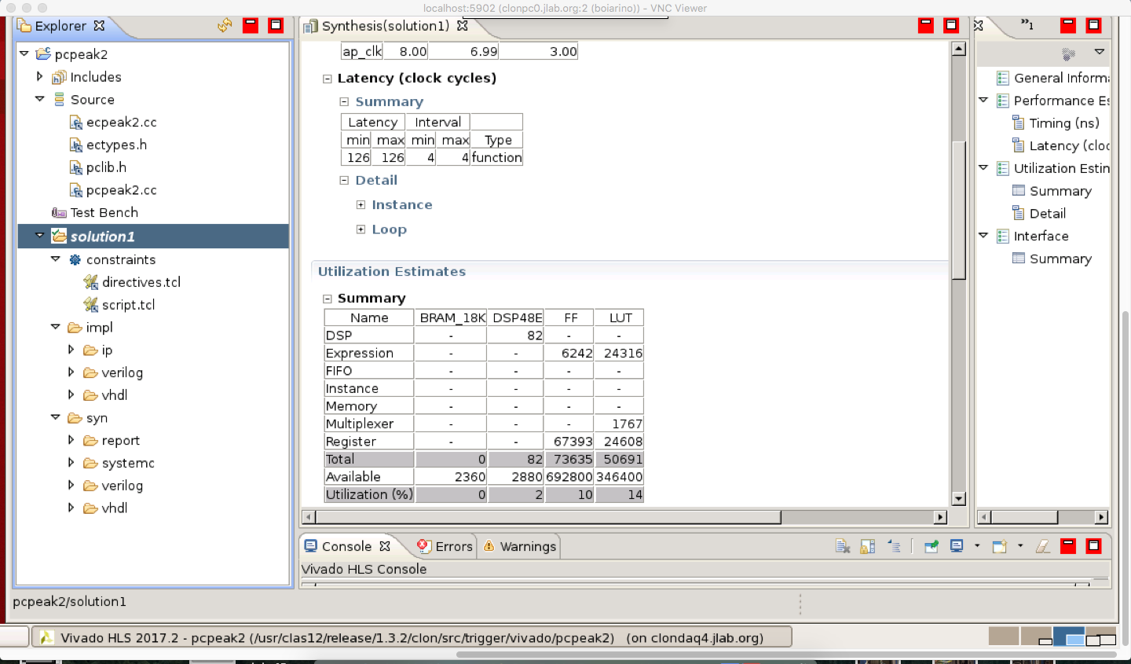
Xilinx Vivado_HLS (C++ to VHDL)

Slide 16
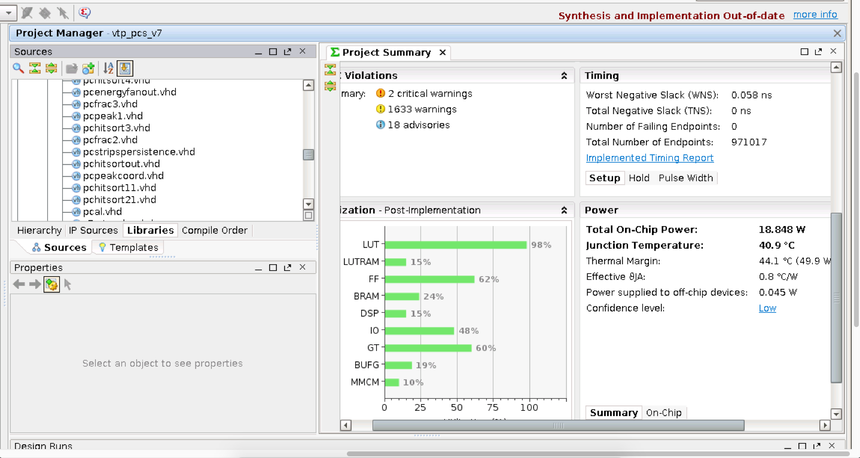
Xilinx Vivado (VHDL to FPGA image)

Slide 17
Validation Step 1: Comparison between C++ implementation and hardware response
/work/boiarino/data/vtp1_001212.evio.0 event 3:
FPGA implementation data bank ==========================
TRIG PEAK [0][0]: coord=298 energy=1610 time=7
TRIG PEAK [1][0]: coord=174 energy=1012 time=7
TRIG PEAK [1][1]: coord=174 energy=294 time=8
TRIG PEAK [2][0]: coord=447 energy=1226 time=7
TRIG HIT [0]: coord=298 174 447 energy=4936 time=7
C++ implementation using FADC data ======================
U: IT=7
peakU[0]: coord=298 energy=1610
V: IT=7
peakV[0]: coord=174 energy=1012
W: IT=7
peakW[0]: coord=447 energy=1226
SOFT HIT: coord=298 174 447 energy=4936

Slide 18
Validation Step 2: Comparison between C++ implementation and GEANT/CLARA
GEMC
Or
DAQ
(.evio)
Trigger C++
(.evio)
CLARA Offline Reconstruction
NOTE: that step allows Offline Reconstruction team to get ready for trigger results processing during beam time

Slide 19
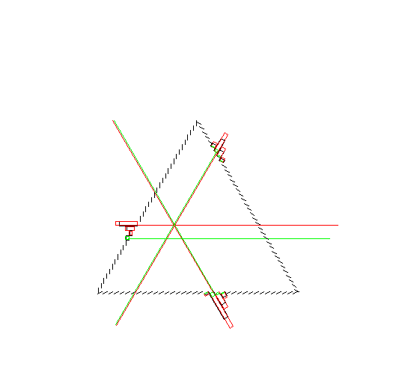
C++ trigger on GEANT data – ECAL event example

Slide 20
ECAL cluster finding: difference trigger-offline
Validation Step 2: Comparison between C++ implementation and GEANT/CLARA (cont.)

Slide 21
ECAL cluster finding: 5GeV electron, no PCAL, energy deposition, offline and C++ Trigger
Validation Step 2: Comparison between C++ implementation and GEANT/CLARA (cont.)
Sampling fraction 27%

Slide 22
CLAS12 Trigger Commissioning
Validation step 1 (cosmic): running from electron trigger (ECAL+PCAL and ECAL+PCAL+DC) and comparing hardware trigger implementation results with C++ trigger implementation results
Validation step 2 (GEANT with different event generators): processing GEANT evio file (currently contains ECAL and PCAL, will add HTCC, DC and FT) through C++ trigger implementation and producing evio file with trigger banks for following offline reconstruction analysis
Validation step 1(beam): running from electron trigger (ECAL+PCAL, ECAL+PCAL+DC, ECAL+PCAL+HTCC) and comparing hardware trigger banks with C++ trigger implementation banks
Beam data with random pulser – for trigger efficiency studies in offline reconstruction
Beam data with electron trigger (ECAL+PCAL [+HTCC] [+DC]) with different trigger settings – for trigger efficiency studies in offline reconstruction
Beam data with FT trigger - for trigger efficiency studies in offline reconstruction
Timeline: cosmic and GEANT tests – underway until beam time; beam validation – 1 shift, after that data taking for detector and physics groups

Slide 23
Future trigger development plans
Geometrical match between different detectors – stage 2
Drift Chamber road finding, probably using drift time information – stage 2
Trigger on tracks multiplicity – stage 3
Timeline: during following year, may require new hardware, requests from physics groups will help

Slide 24
Conclusion
CLAS12 DAQ, computing and network was tested during KPP run and worked as expected, reliability meets CLAS12 requirements, performance looks good but final tests have to be done with full CLAS12 configuration (waiting for remaining detectors electronics and complete trigger system)
Trigger system (included ECAL and PCAL) worked as expected during KPP. Other trigger components (DC, HTCC and FT) were added after KPP and being tested with cosmic; remaining hardware has been received and being installed
Timeline: few weeks before beam full system will be commissioned by taking cosmic data and running from random pulser; planning 2 shifts for beam commissioning

