Slide 1
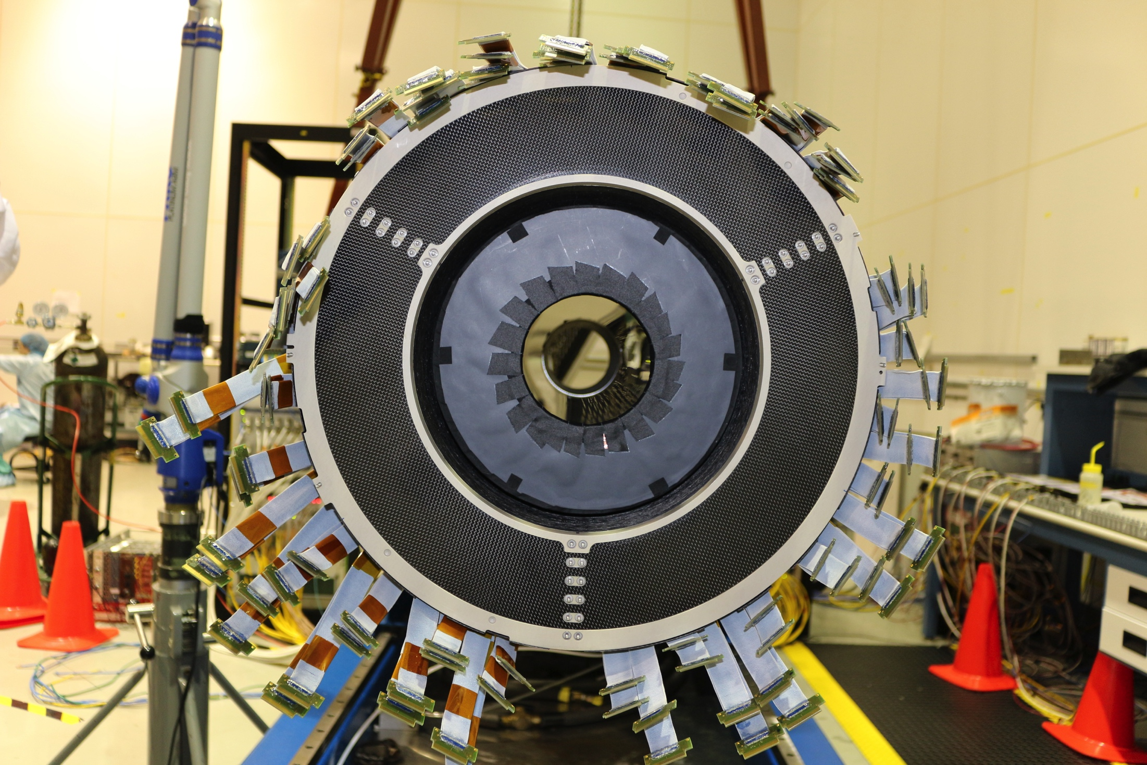
CLAS12 Combined Vertex Tracker
Online Monitoring
Yuri Gotra
Maxime Defurne
Guillaume Christiaens

Slide 2
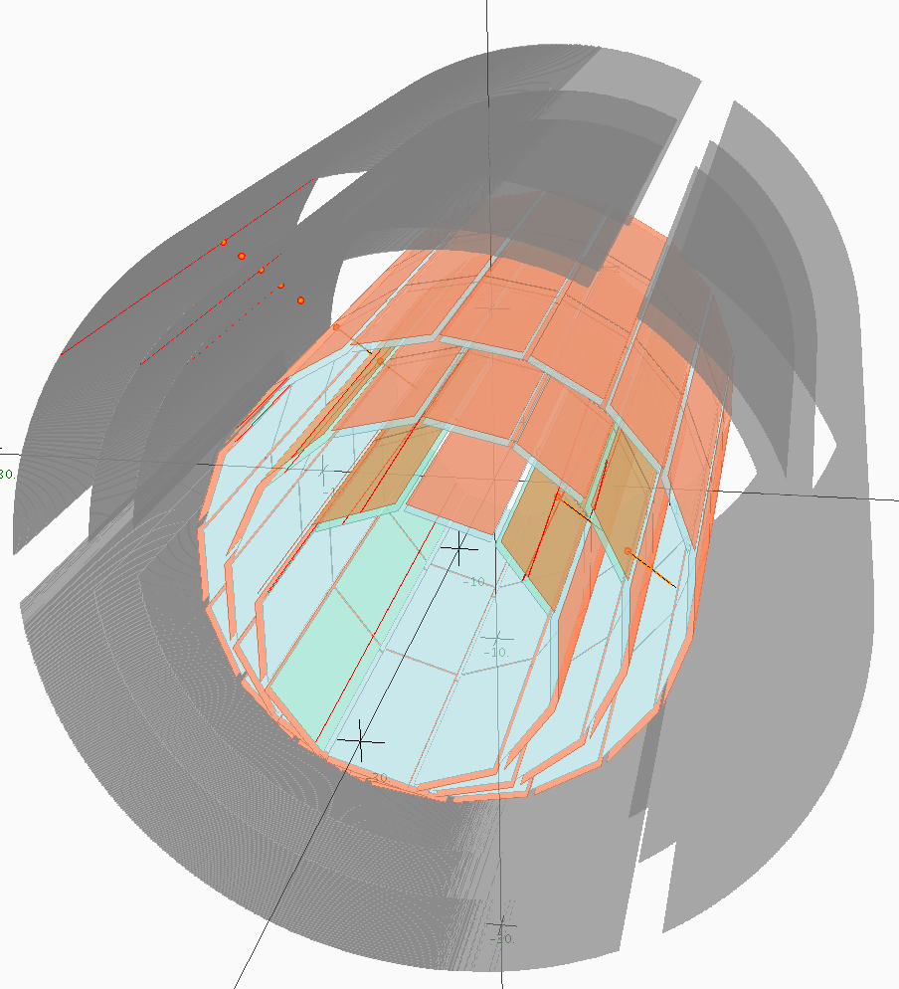
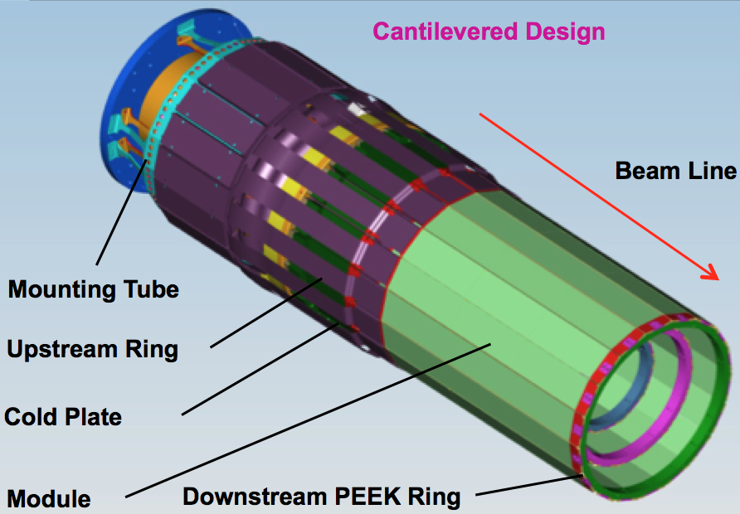
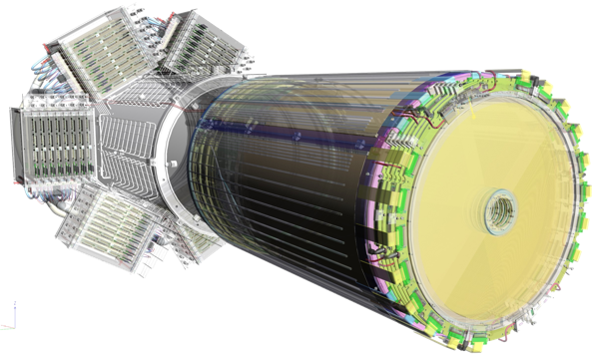
Tracker Design
PARAMETER | DESIGN VALUE
Angular coverage θ | 35°–125°
Angular coverage Φ | ~2π
Momentum resolution | ~6%
θ resolution | 1.5 mrad
φ resolution | ~5 mrad
Tracking efficiency | > 90%
Combined technology (solid state + gaseous)
3 Double silicon layers
6 micromegas layers
6 micromegas disks

Slide 3
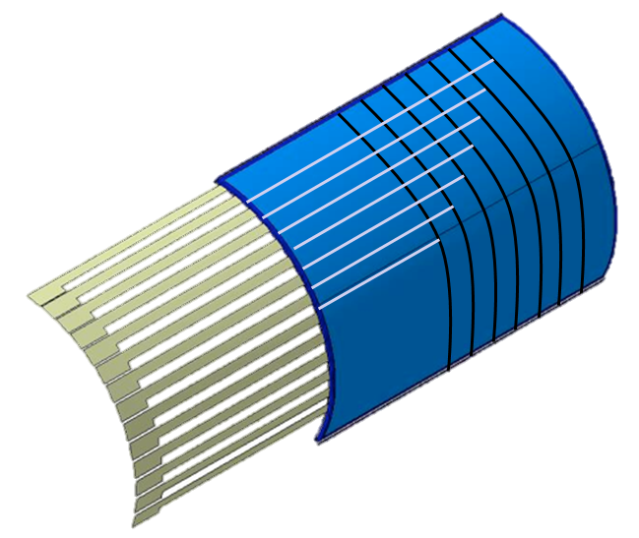
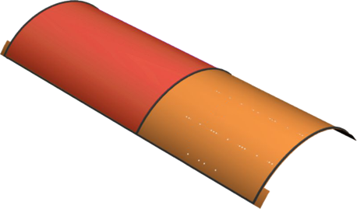
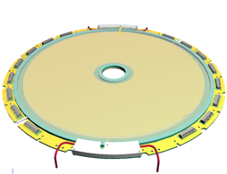
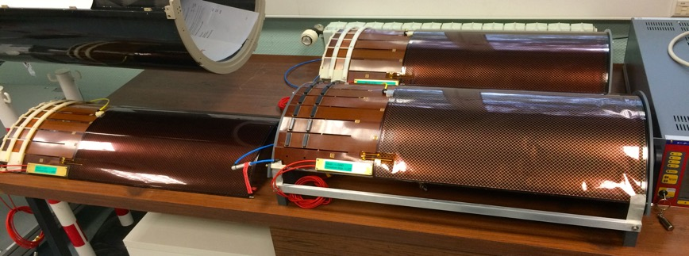
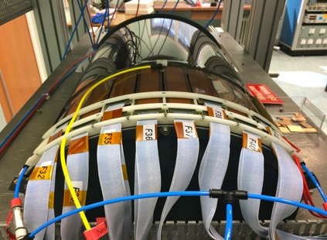
Micromegas Tracker
1152 “C” strips
221mm radius (C6)
Variable pitch from 330 to 670 µm
PCB thickness 100 µm
Drift thickness 250 µm
0.31% x/X₀
Drift Field 2.4 kV on 3 mm gap
Resistive strips technology
768 “Z” strips
225 mm radius (Z6)
528 µm pitch
PCB thickness 200 µm
Drift thickness 250 µm
0.35% x/X₀
Drift Field <2.4 kV on 3 mm gap
Resistive strips technology
1024 strips
215 (25) mm outer (inner) radius
525 µm pitch
Resistive strips technology
“C” Barrel
“Z” Barrel
Disk
18 Barrel Tiles, 18 k channels
6 Forward Disks
“Z” Barrel
“C” Barrel

Slide 4
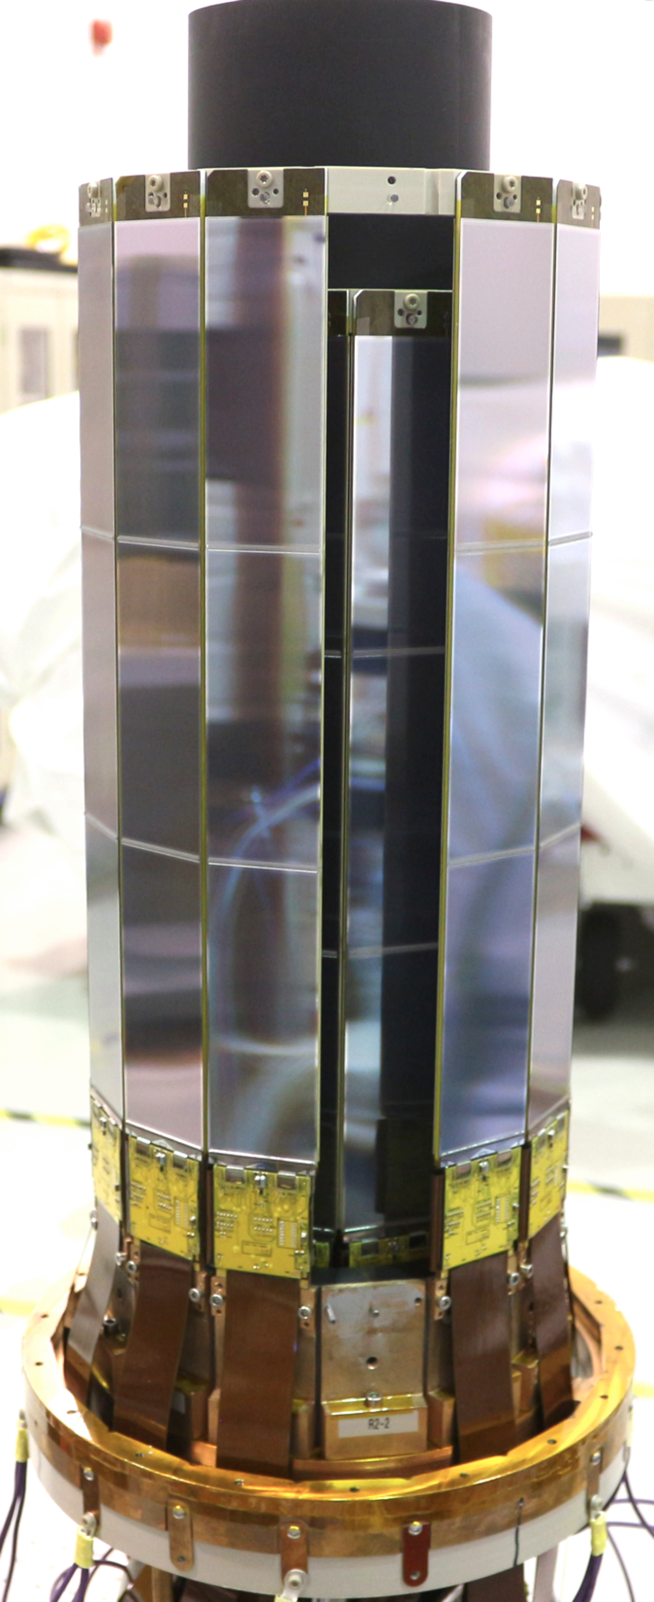
Silicon Vertex Tracker
Three regions (radii 65, 93, 120 mm)
1% of radiation length per region
42 sectors/modules (10, 14, 18)
21504 channels
168 front end chips
Cantilevered cylinders with support rings
Double sided modules with 3 daisy chained sensors
Single sided sensors with graded pitch
Rigi-flex hybrid with extended L1 disconnect
156 μm graded pitch 202 μm
3° stereo angle 2°
Barrel assembly
hybrid
sensor
SVT module close-up

Slide 5
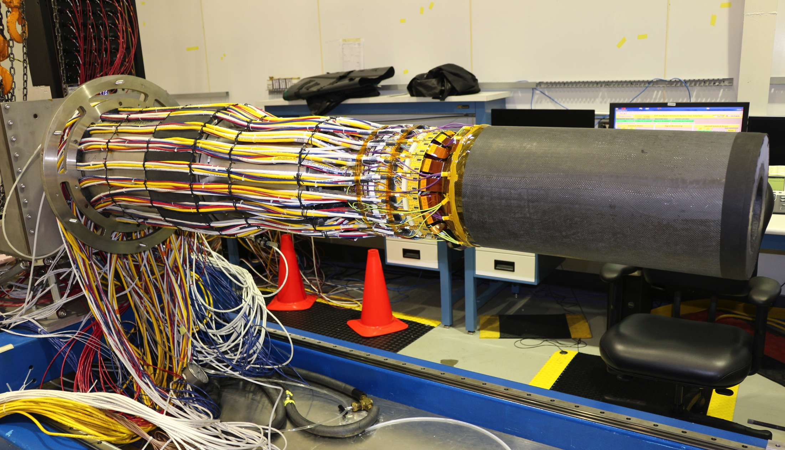
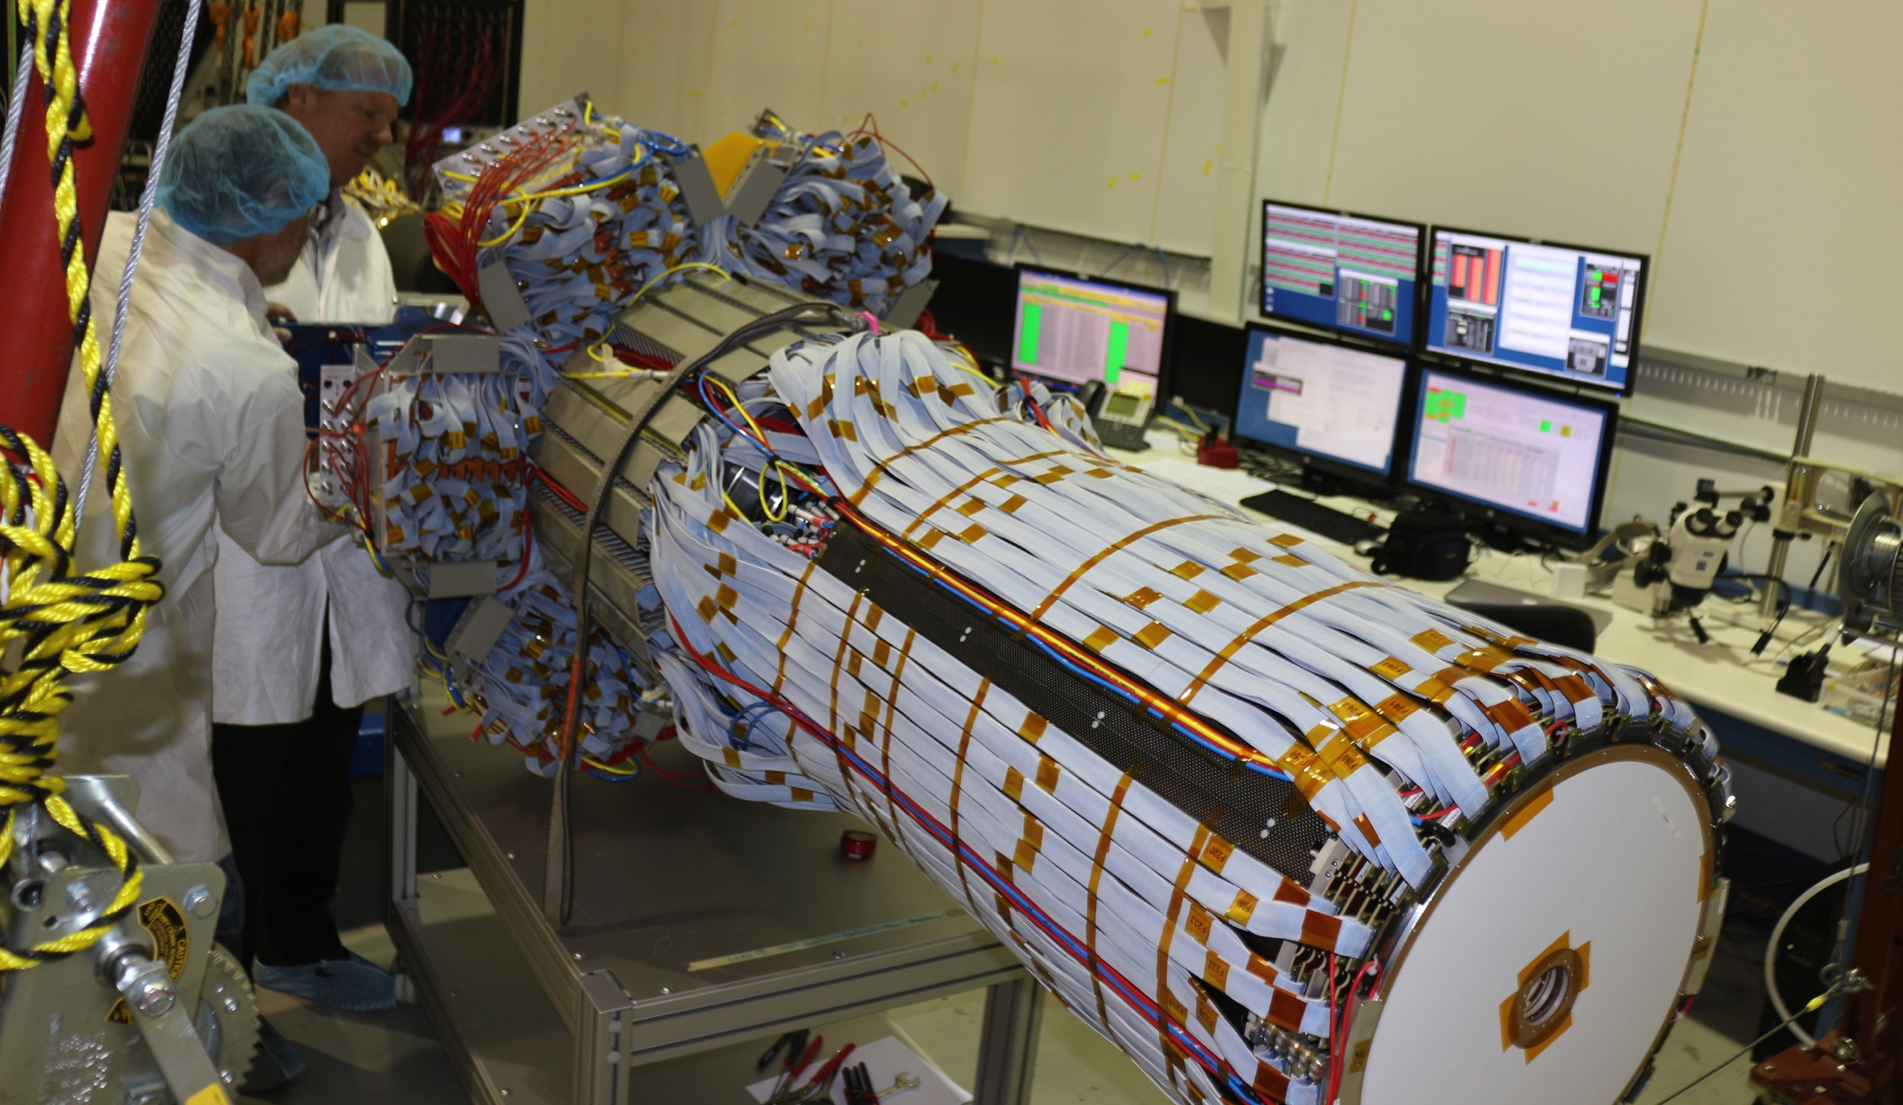
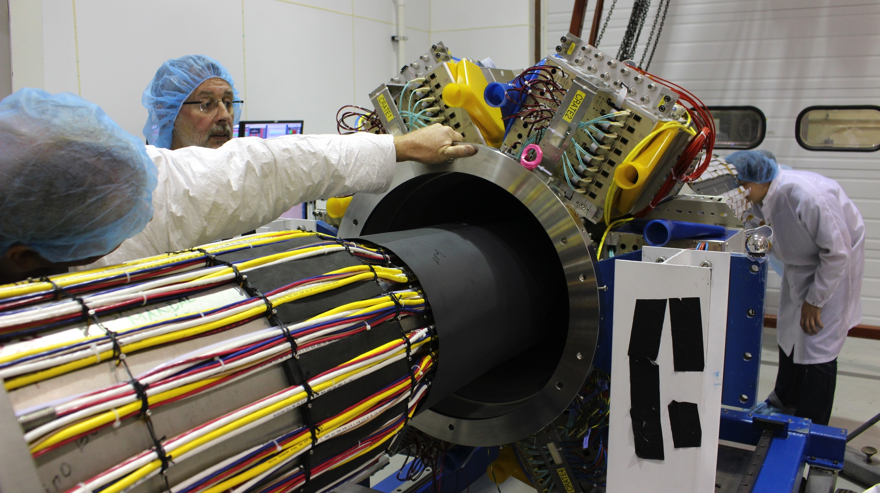
CVT Integration (May 2017)

Slide 6
SVT and MVT Online Monitoring Overview
Monitoring suites within MON12 framework (COATJava application)
Shifter Monitoring:
Top level summary plots to monitor system performance
Hit occupancy (raw data), FPGA scalers (from DiagGUIServer), MVT pulse timing
On-the-fly decoding and reconstruction of ET ring data, using CED monitoring
Local reconstruction and tracking summaries
Online track data visualization (XY, XZ, component views)
Expert Level Monitoring:
Hierarchical structuring of the event data (detector, region, layer, module, chip, channel) to check functionality of all system components
Detector view and selection of component to monitor
Color-coded plots (on/off track, hits, clusters, crosses)
Local reconstruction (hits, clusters, crosses, rates, multiplicities)
Track reconstruction (kinematic distributions, rates, multiplicities, trajectory, efficiencies, on-track vs. off-track distributions)
Component summaries (average values of monitoring variables)
Detector stability (time-line plots of occupancies and multiplicities)
Saving histograms as hipo file
Slow Controls Monitoring
System Overview, interlock status, shifter level control
Expert Level with authentication, multiple screens, hierarchical views
Single Event Effects (SEE) Monitoring
Monitor beam induced effects on tracker DAQ

Slide 7
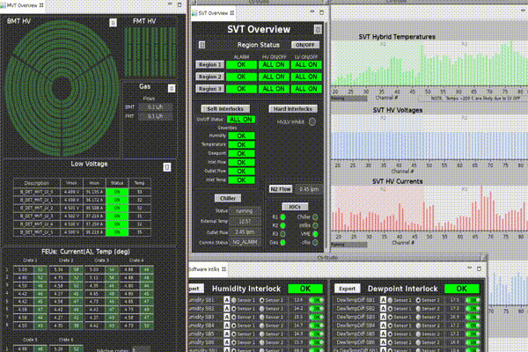
Slow Control Monitoring

Slide 8
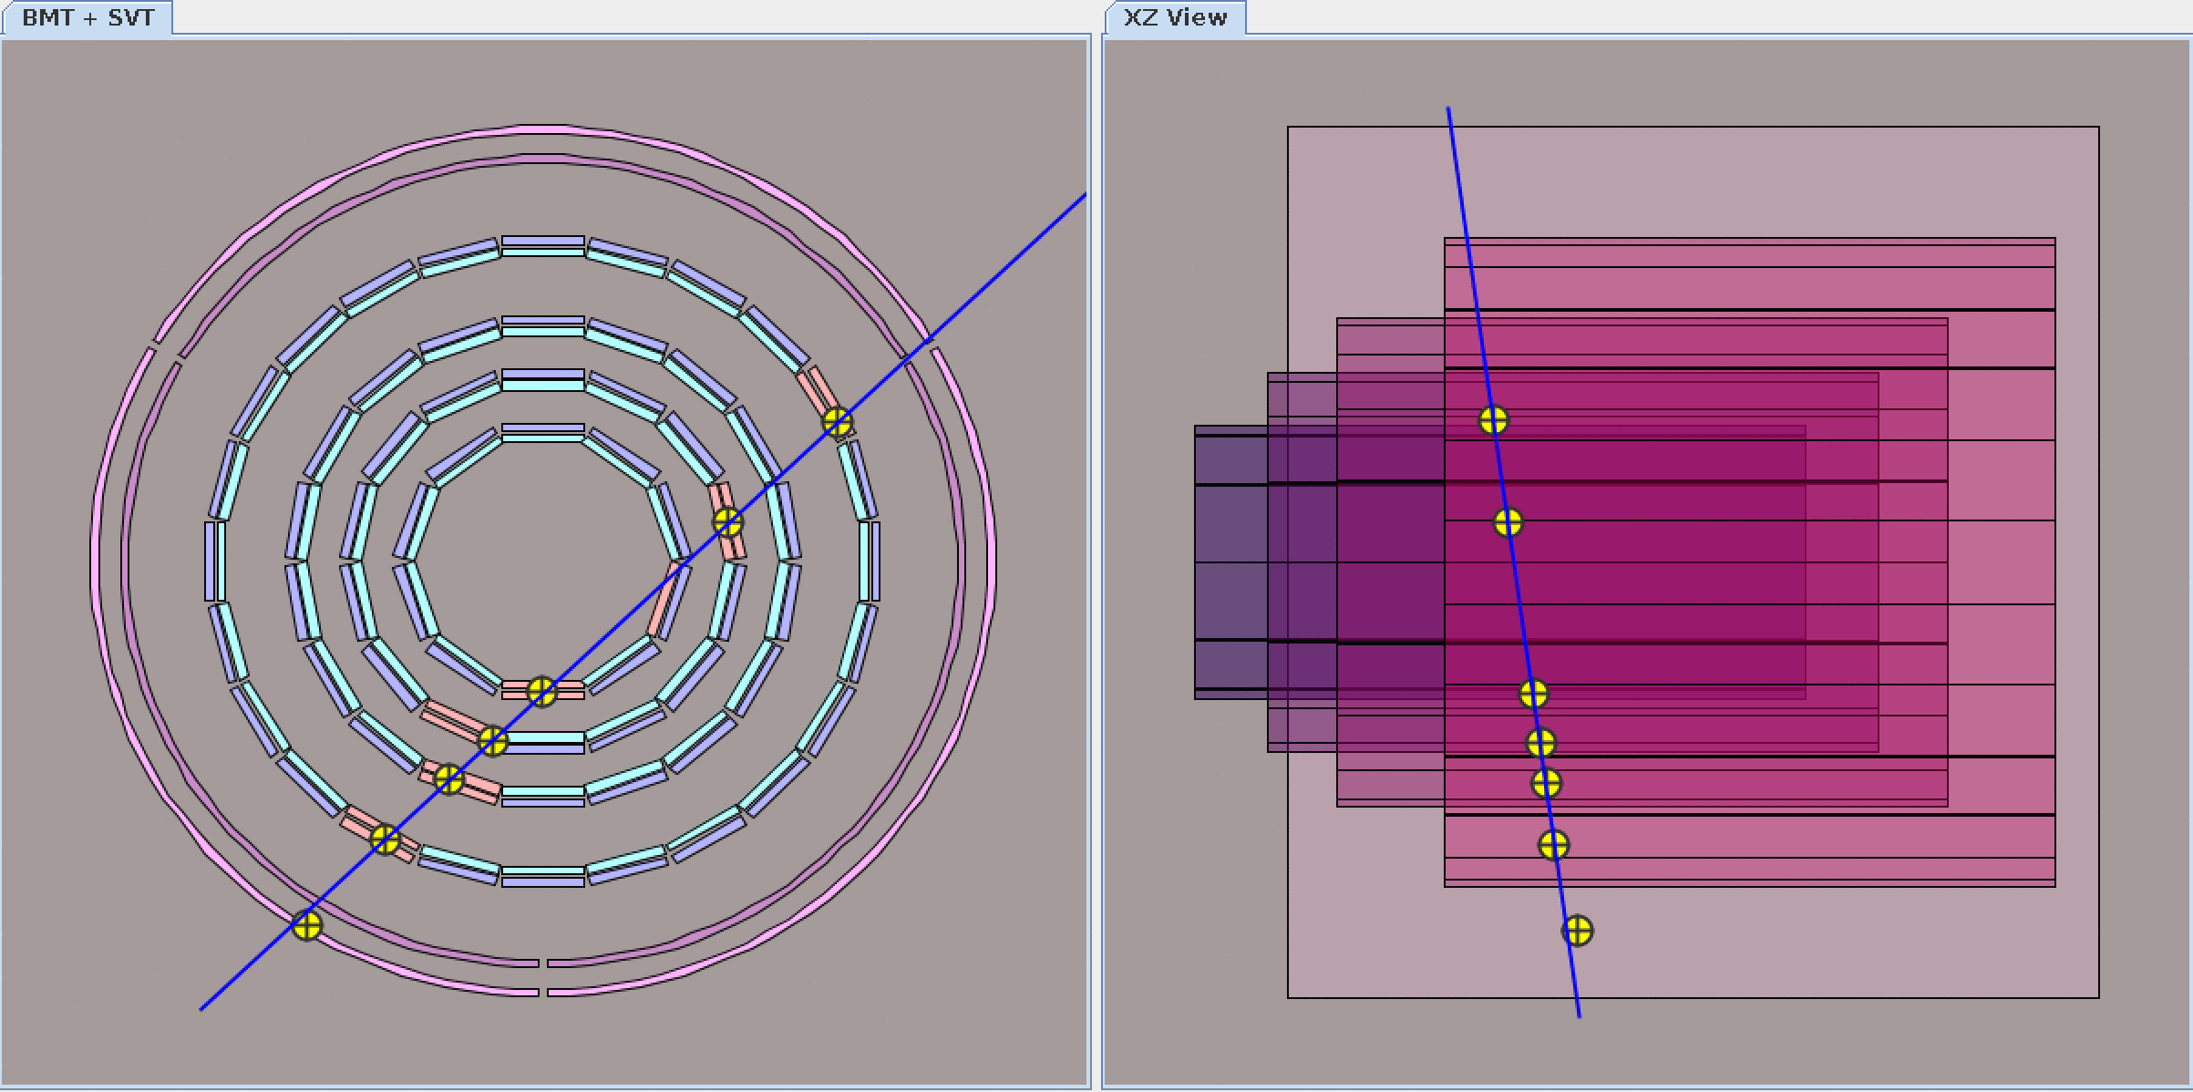
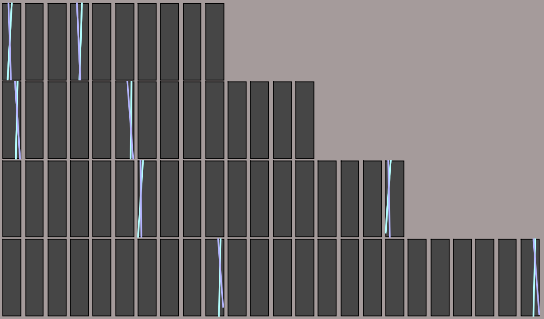
Online monitoring: track reconstruction
SVT
MVT

Slide 9
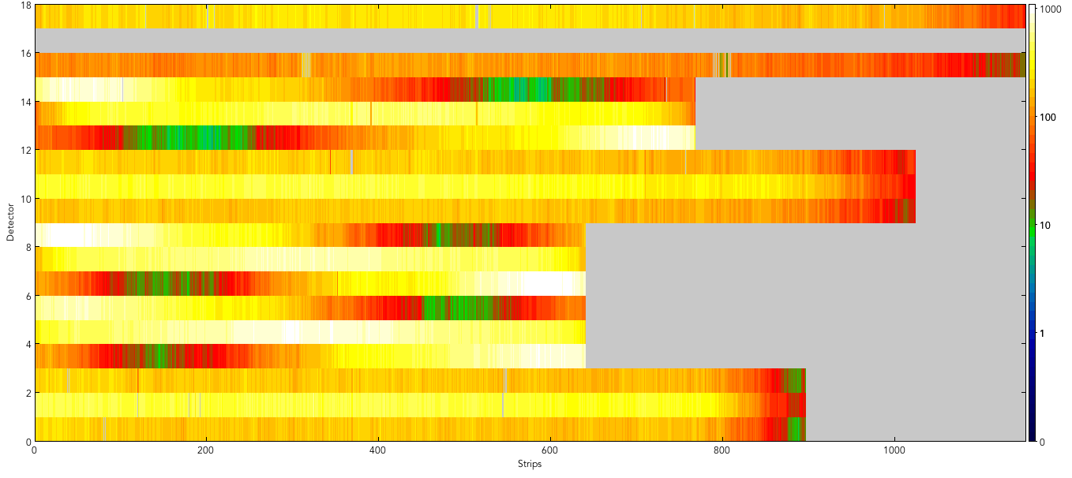
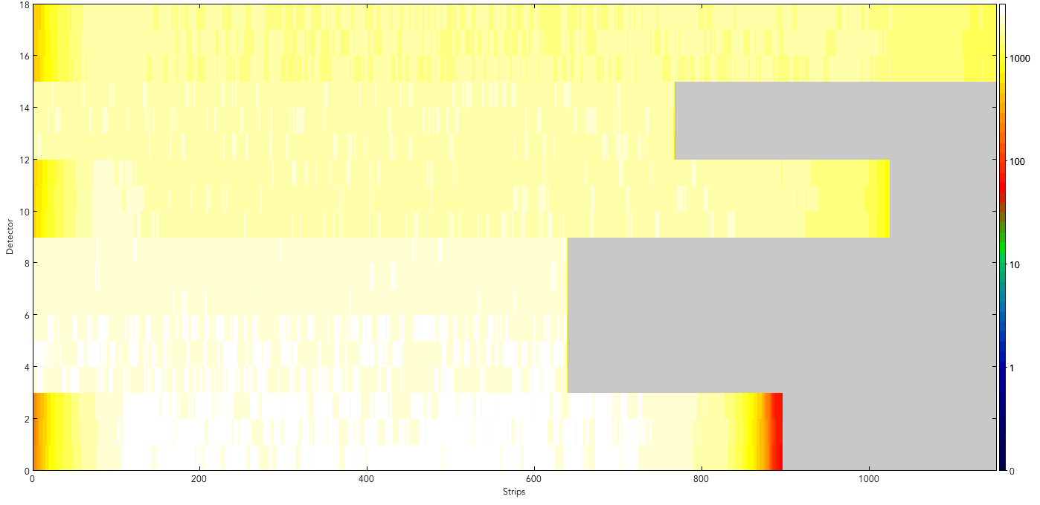
MVT Online Shifter Monitoring: Hit Occupancy
Cosmic Run
C
Z
Tiles ordered by layer and then by sector
Monte Carlo

Slide 10
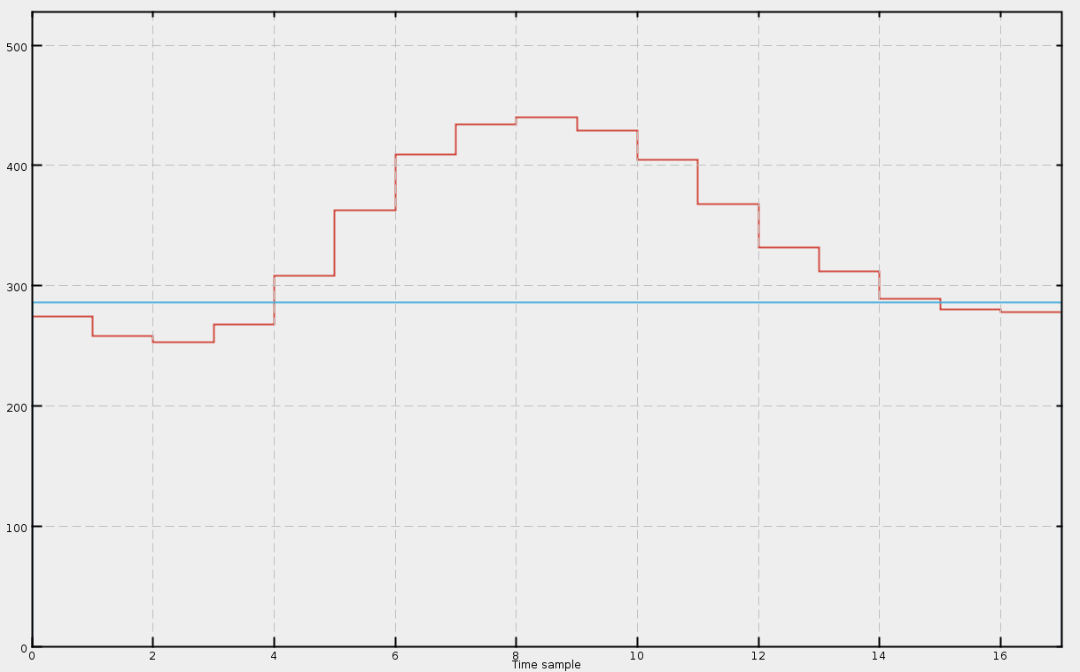
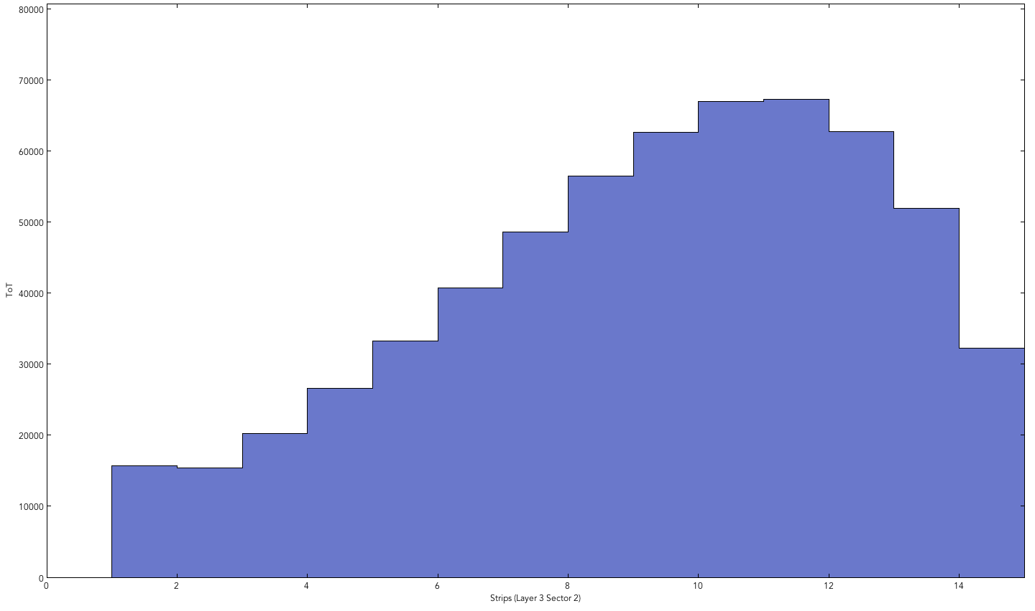
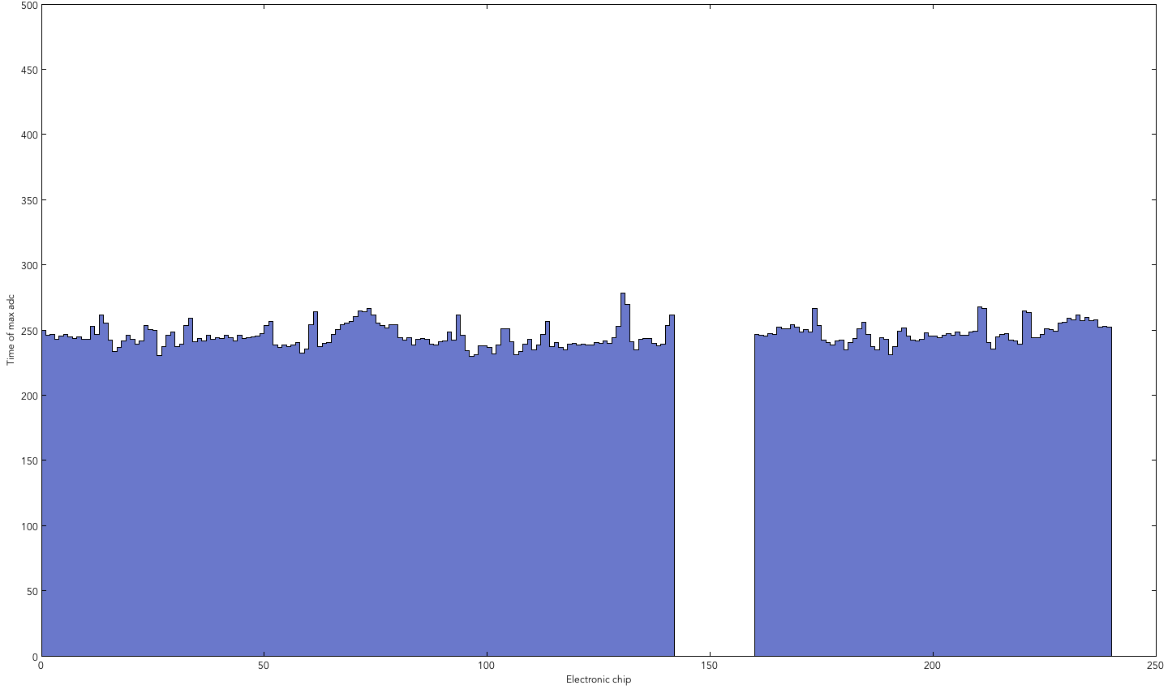
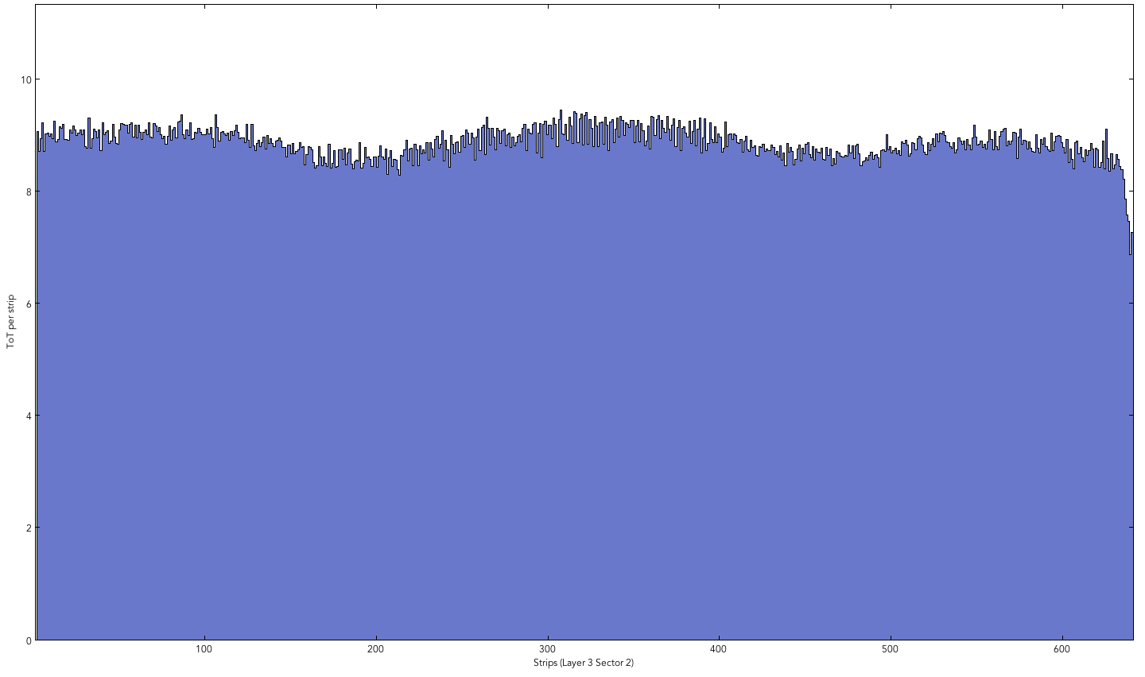
MVT Online Shifter Monitoring: Pulse Properties
Threshold
Entries
Number of samples over the threshold
Pulse : ADC vs. time samples
Time of max ADC
Entries
Chip
Strip
(test DAQ synchronization)
Number of samples over the threshold average

Slide 11
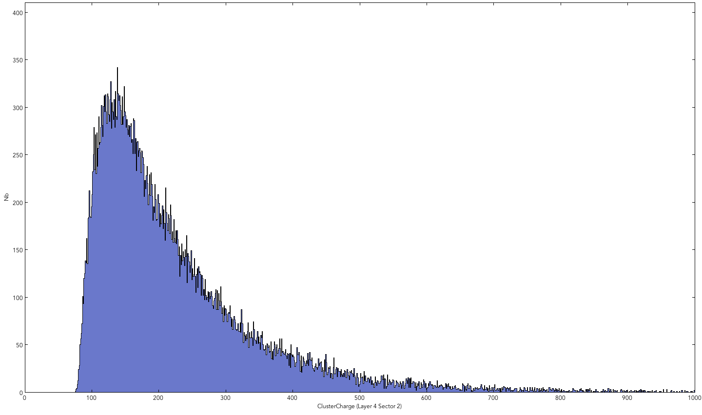
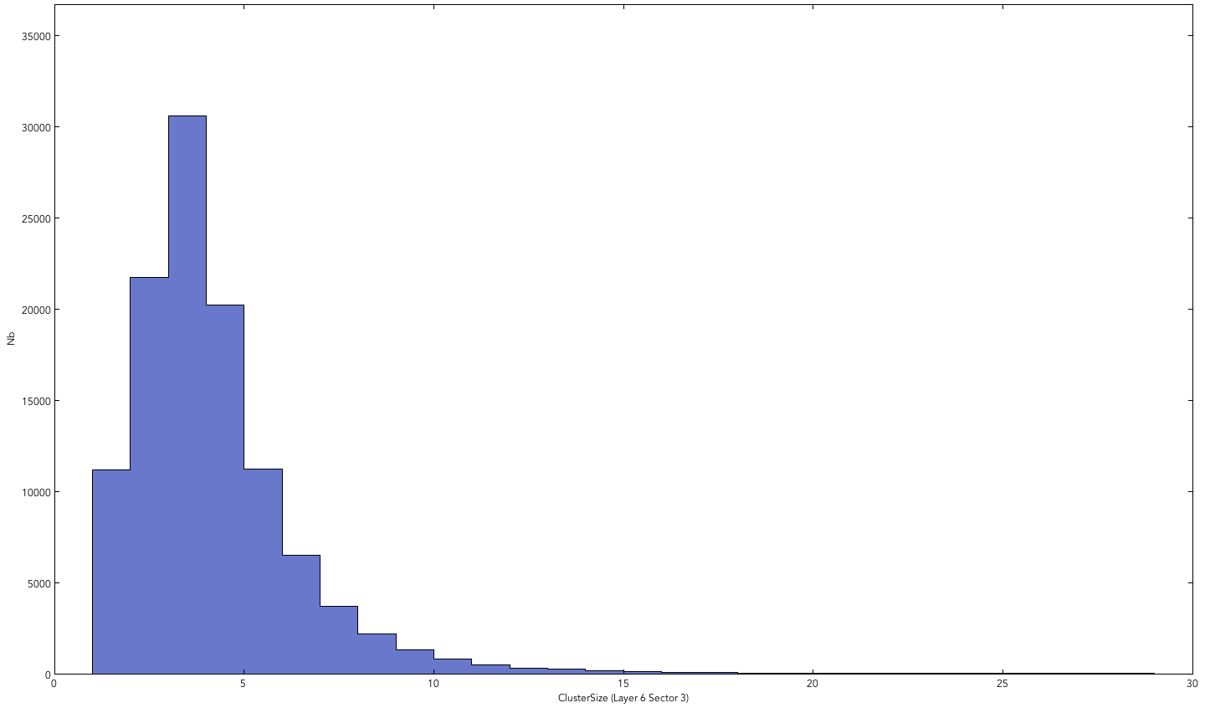
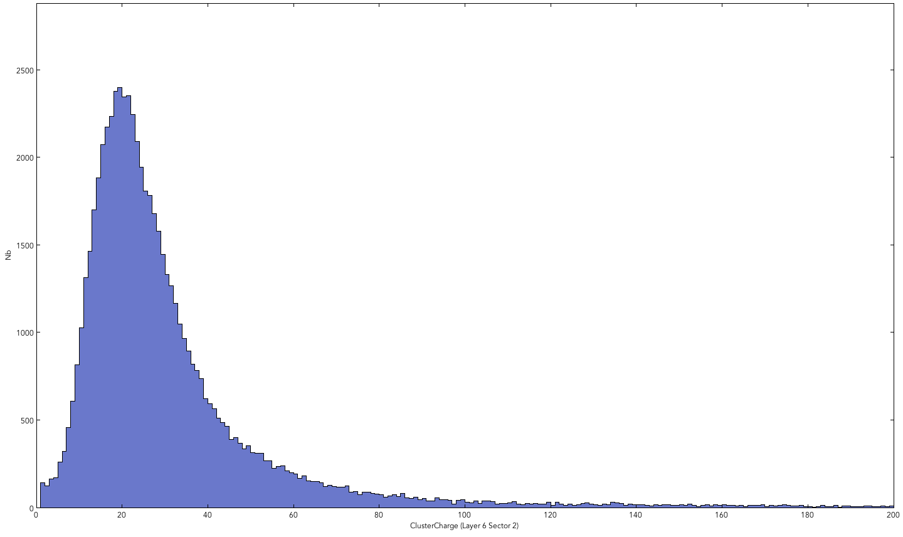
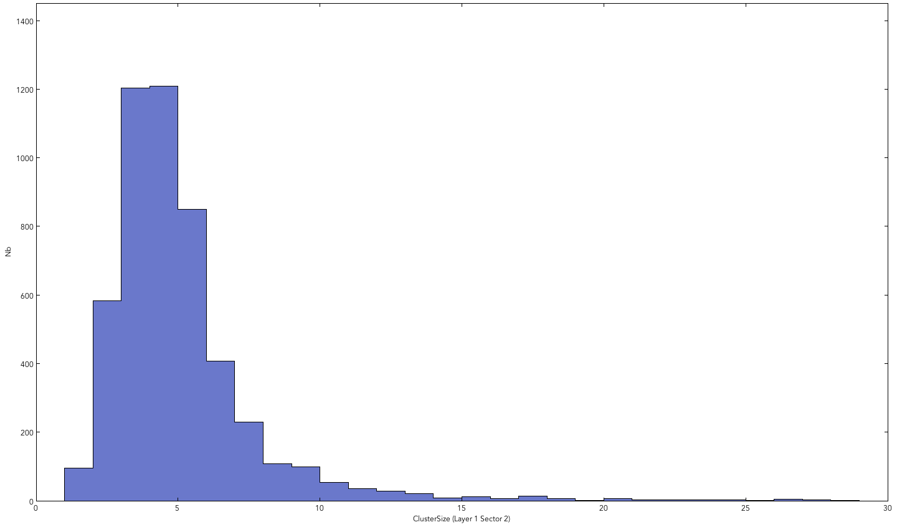
MVT Online Monitoring: Cluster Properties
Cosmic Run
Monte Carlo
Cluster Charge
Cluster Size

Slide 12
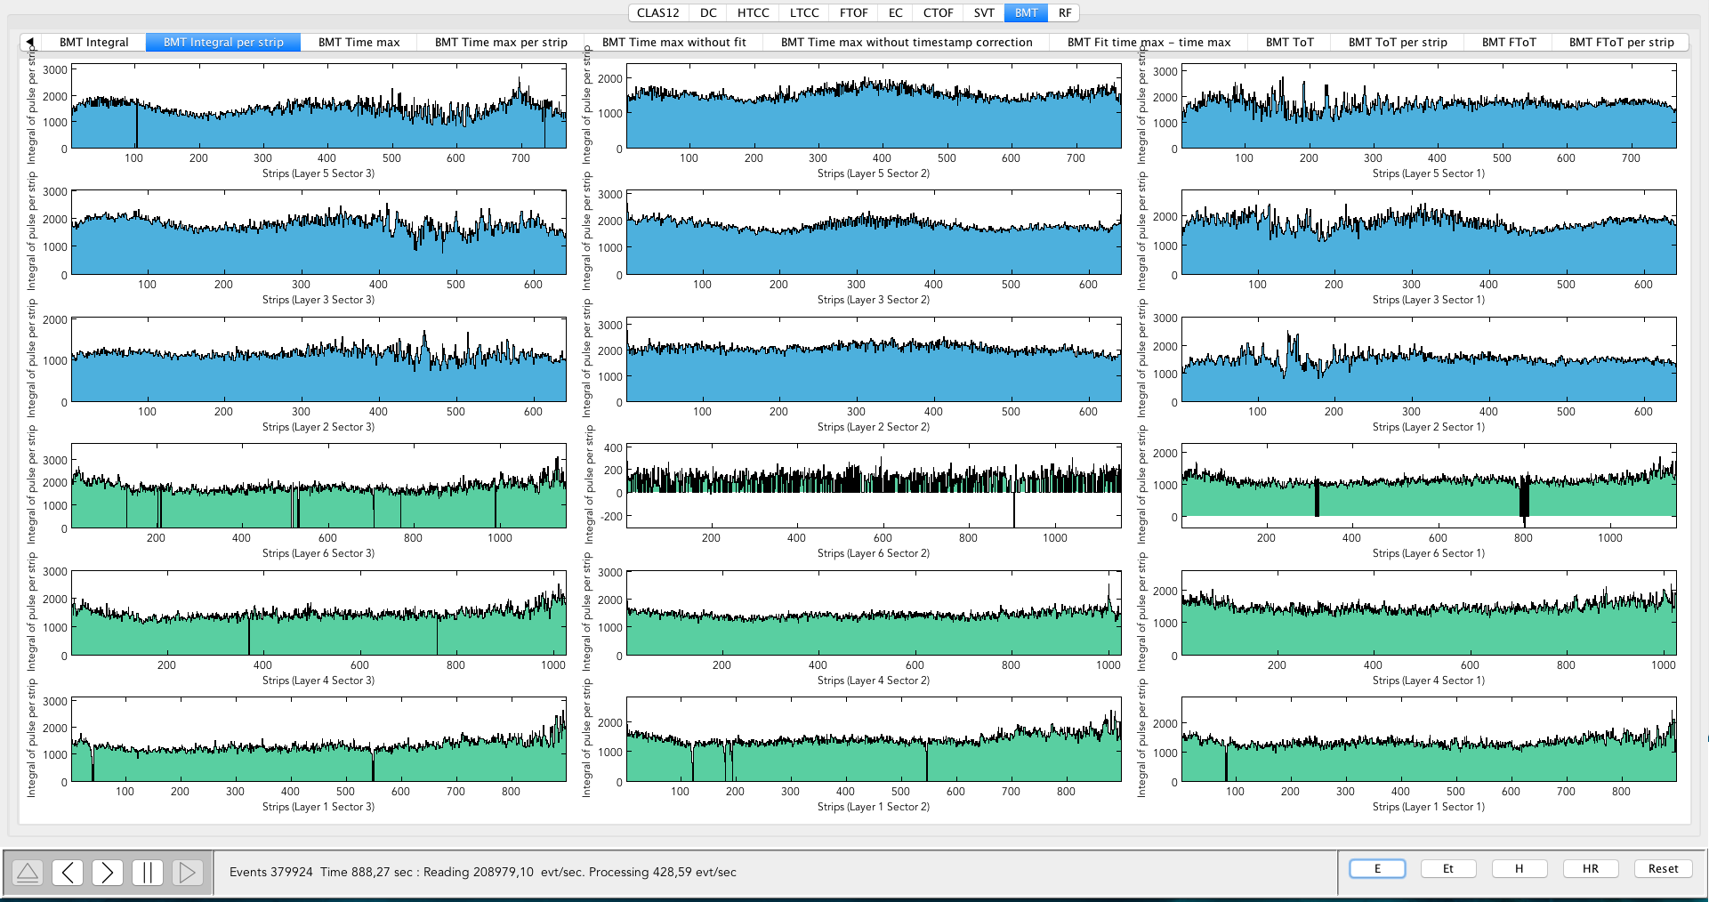
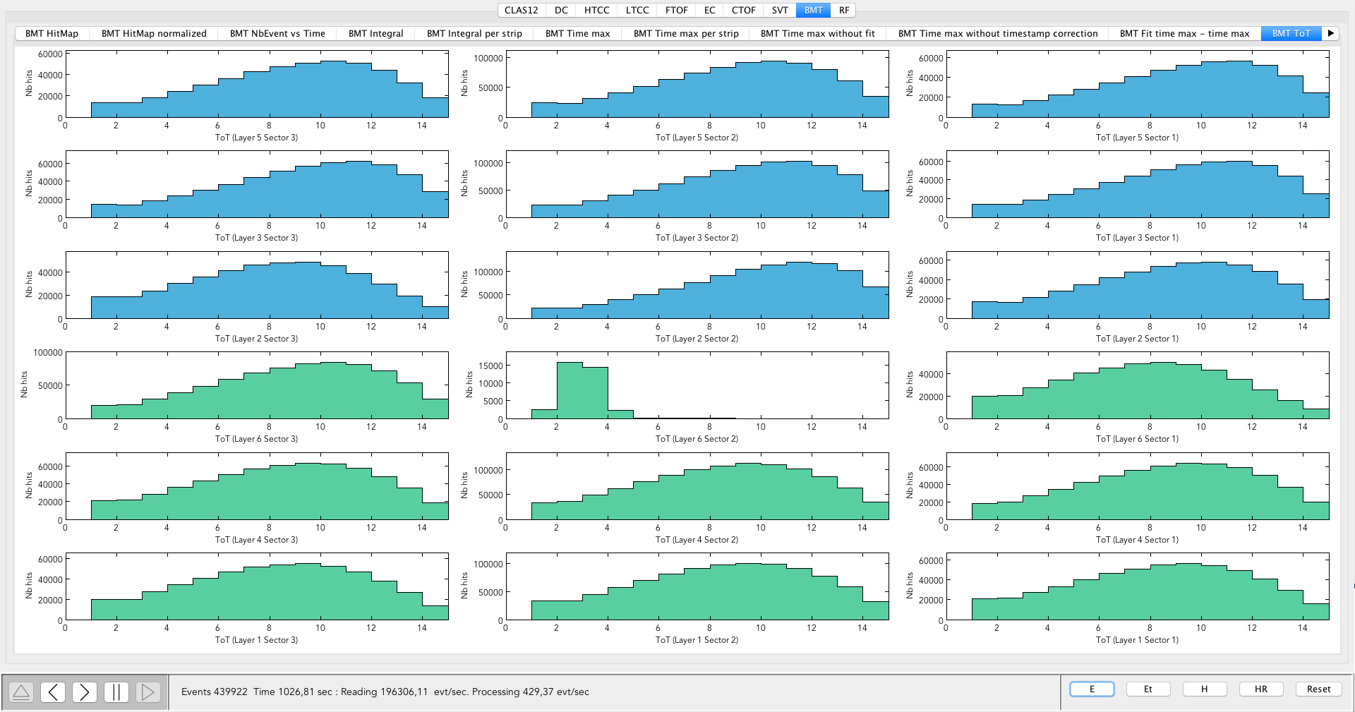
MVT: Expert Monitoring
Most plot have 2 versions:
Average per strip
Distribution for each tile
Occupancy plots
Rate plots
ADC plots
Integral over the pulse
Timing plots
Time of max
Number of samples over threshold
First sample over threshold
Integral of pulse ADCs vs. strip number
Number of samples over threshold

Slide 13
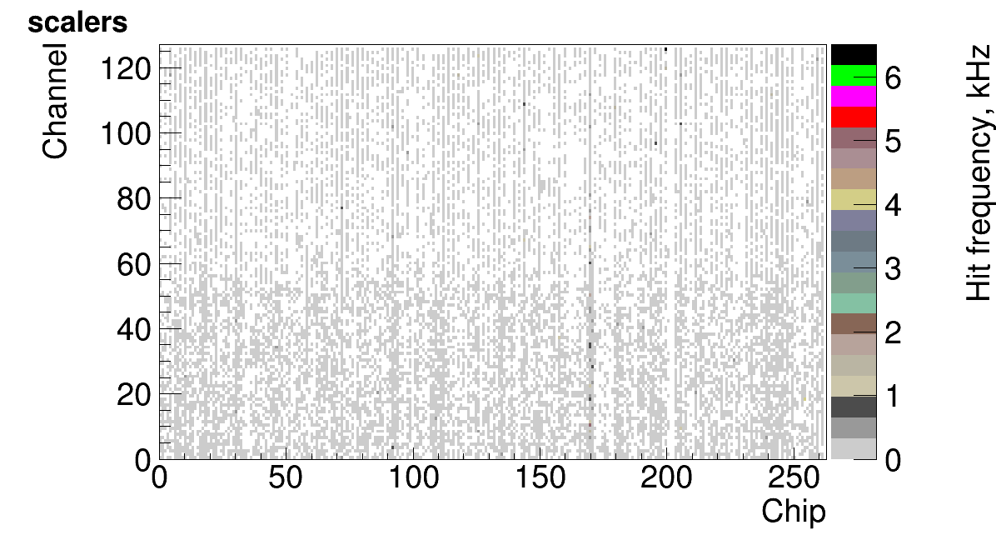
VSCM Scalers: noise hit occupancy map
DaqGuiServer running on svt1 and svt2

Slide 14
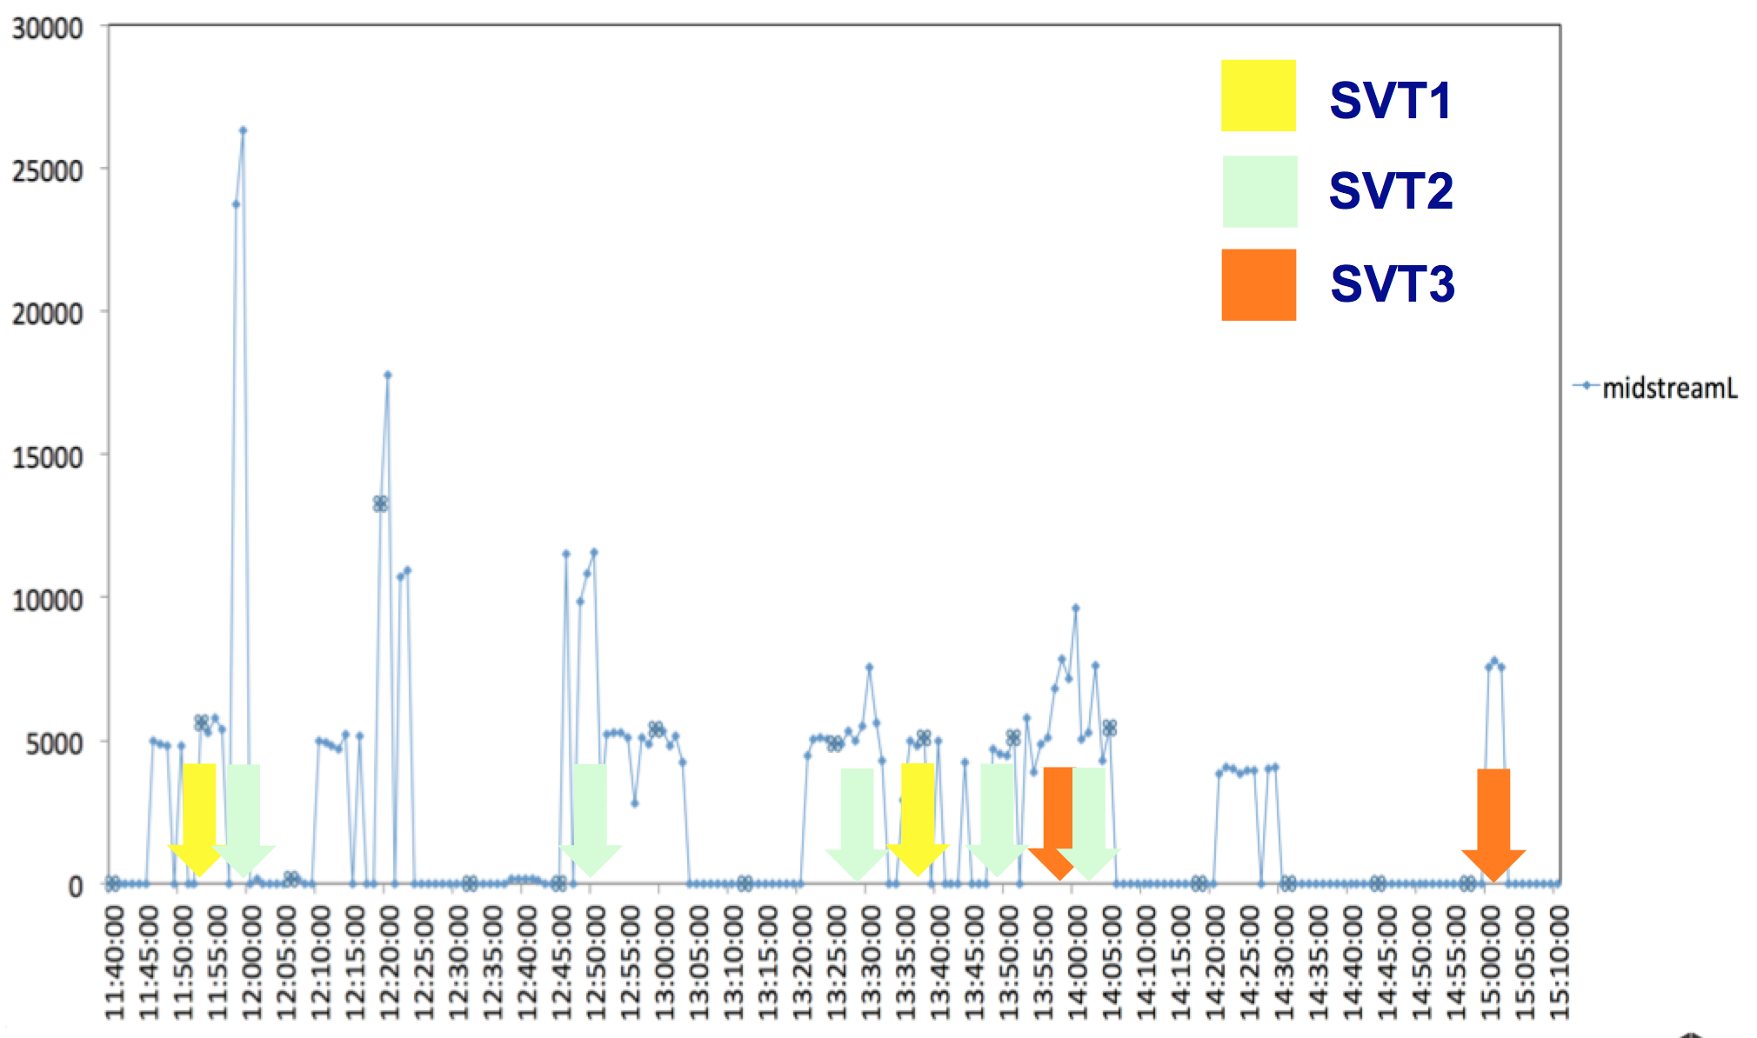
Singe Event Monitoring (SEM)

Slide 15
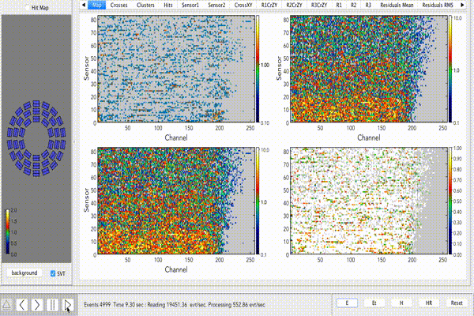
SVT Hit Occupancy Monitoring

Slide 16
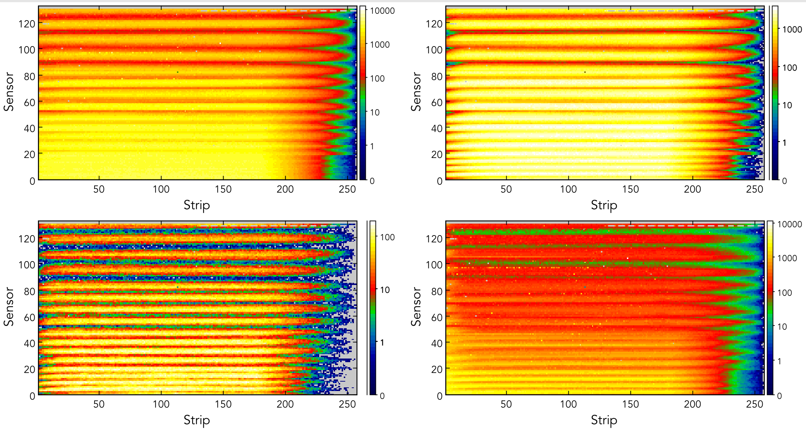
SVT Hit Occupancy Monitoring (Cosmic Run)
All hits
First track
Second track
Off track

Slide 17
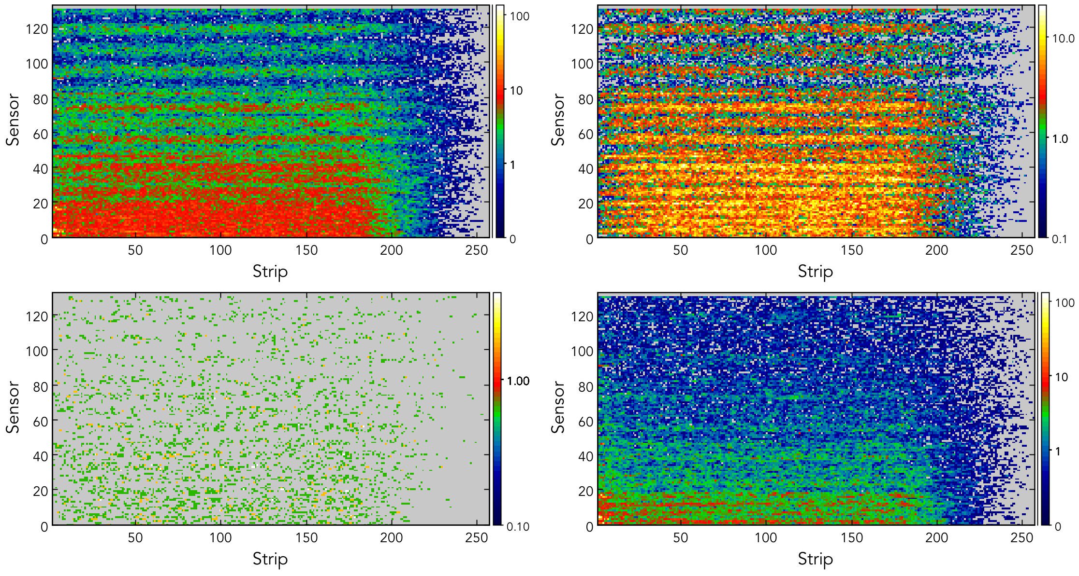
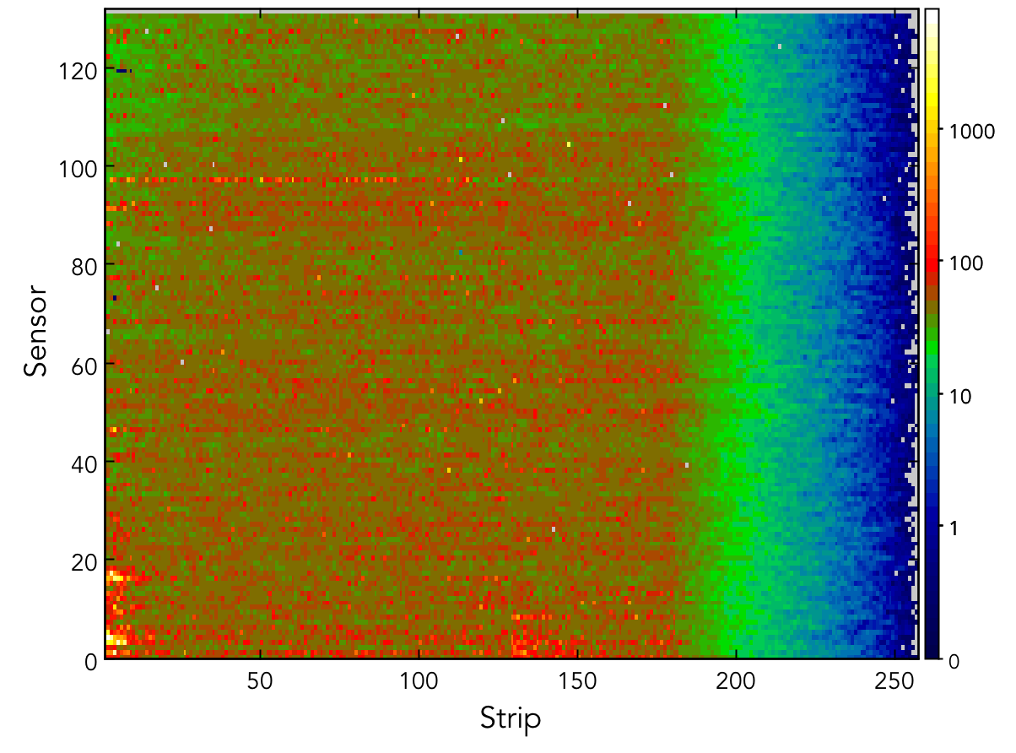
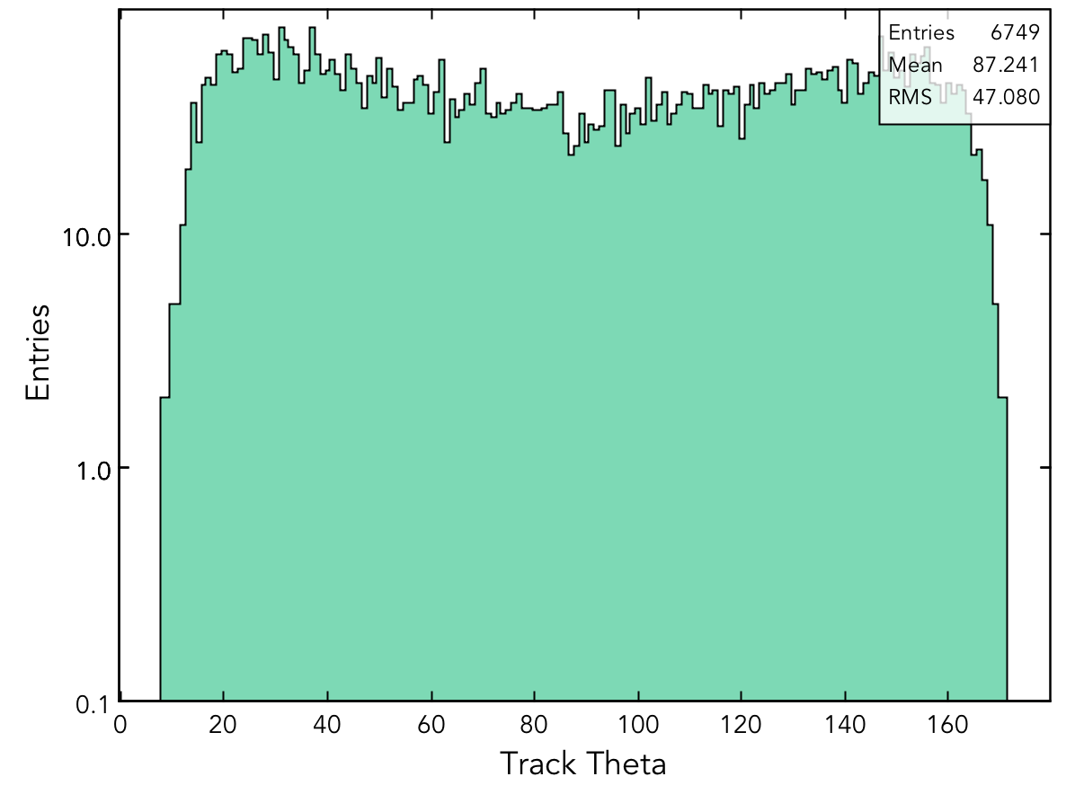
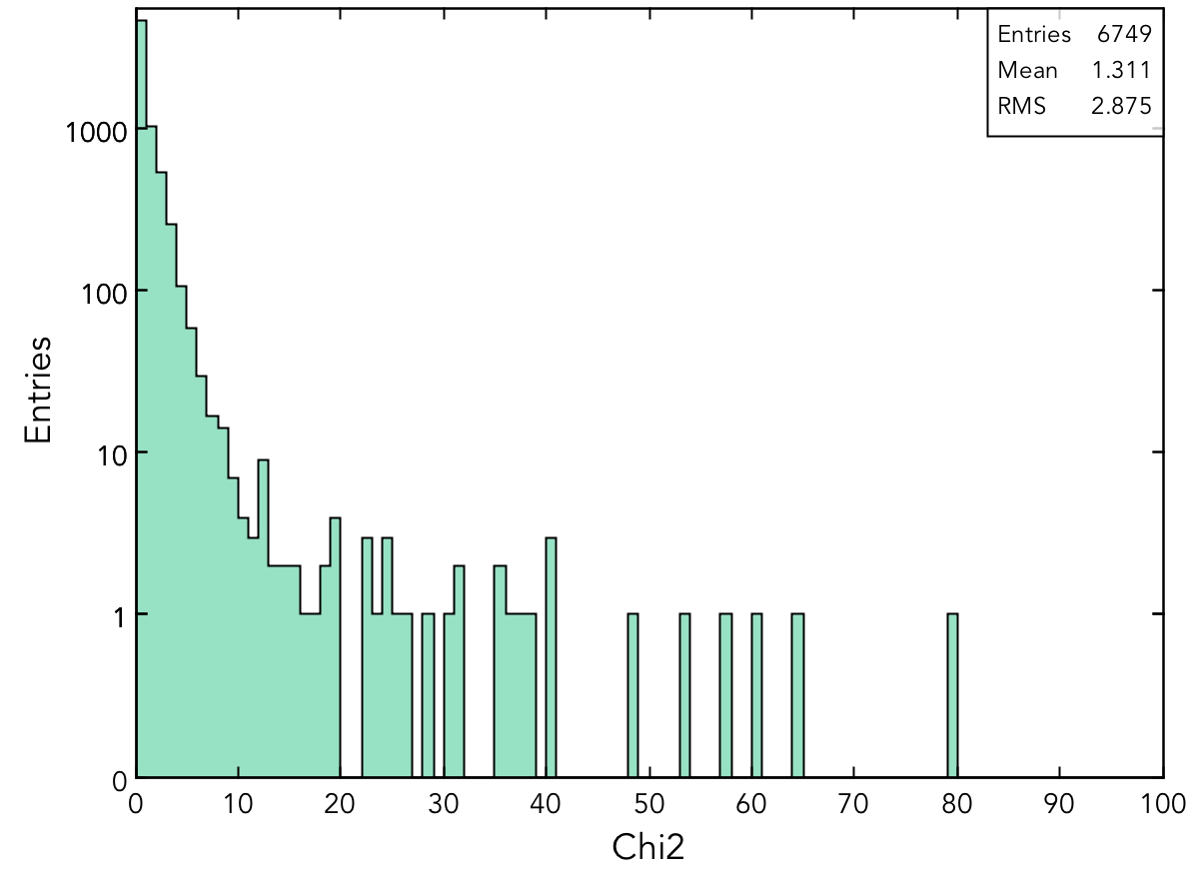
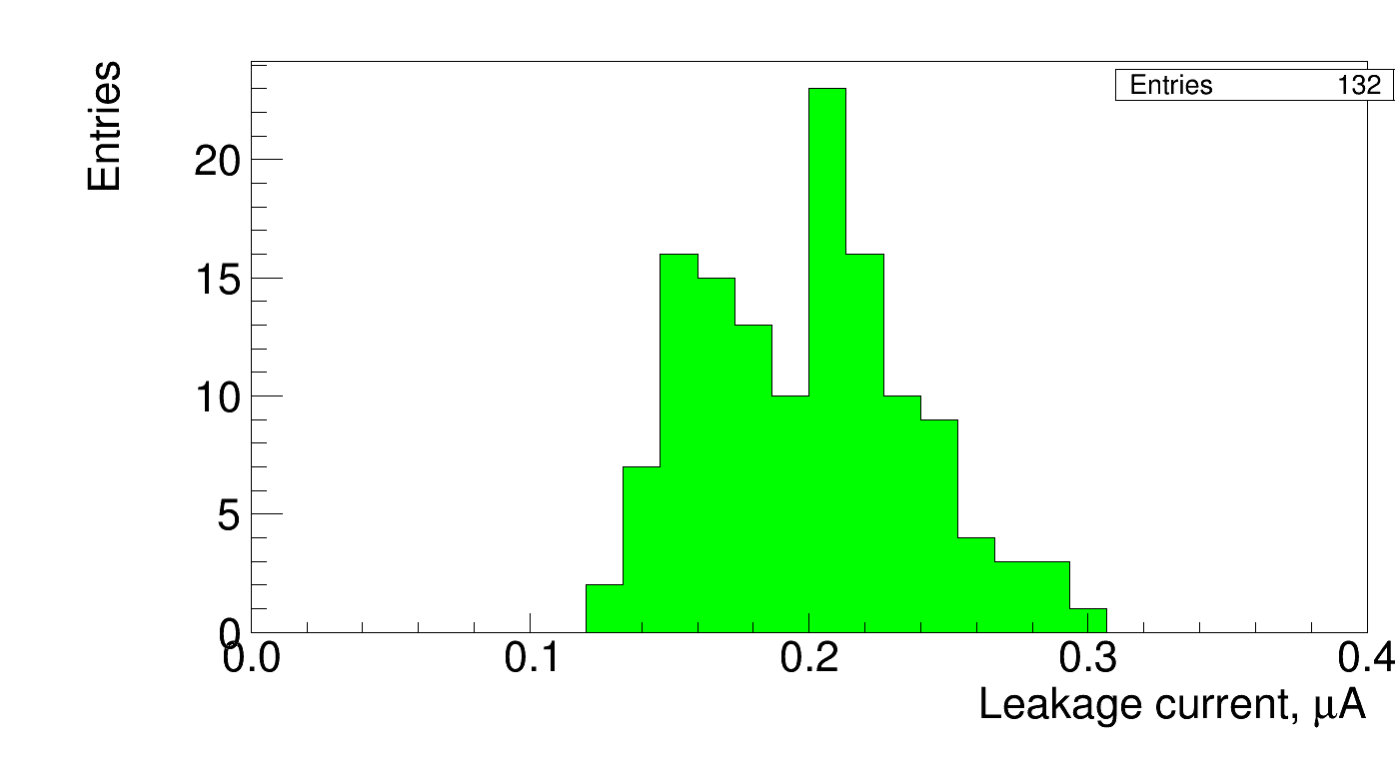
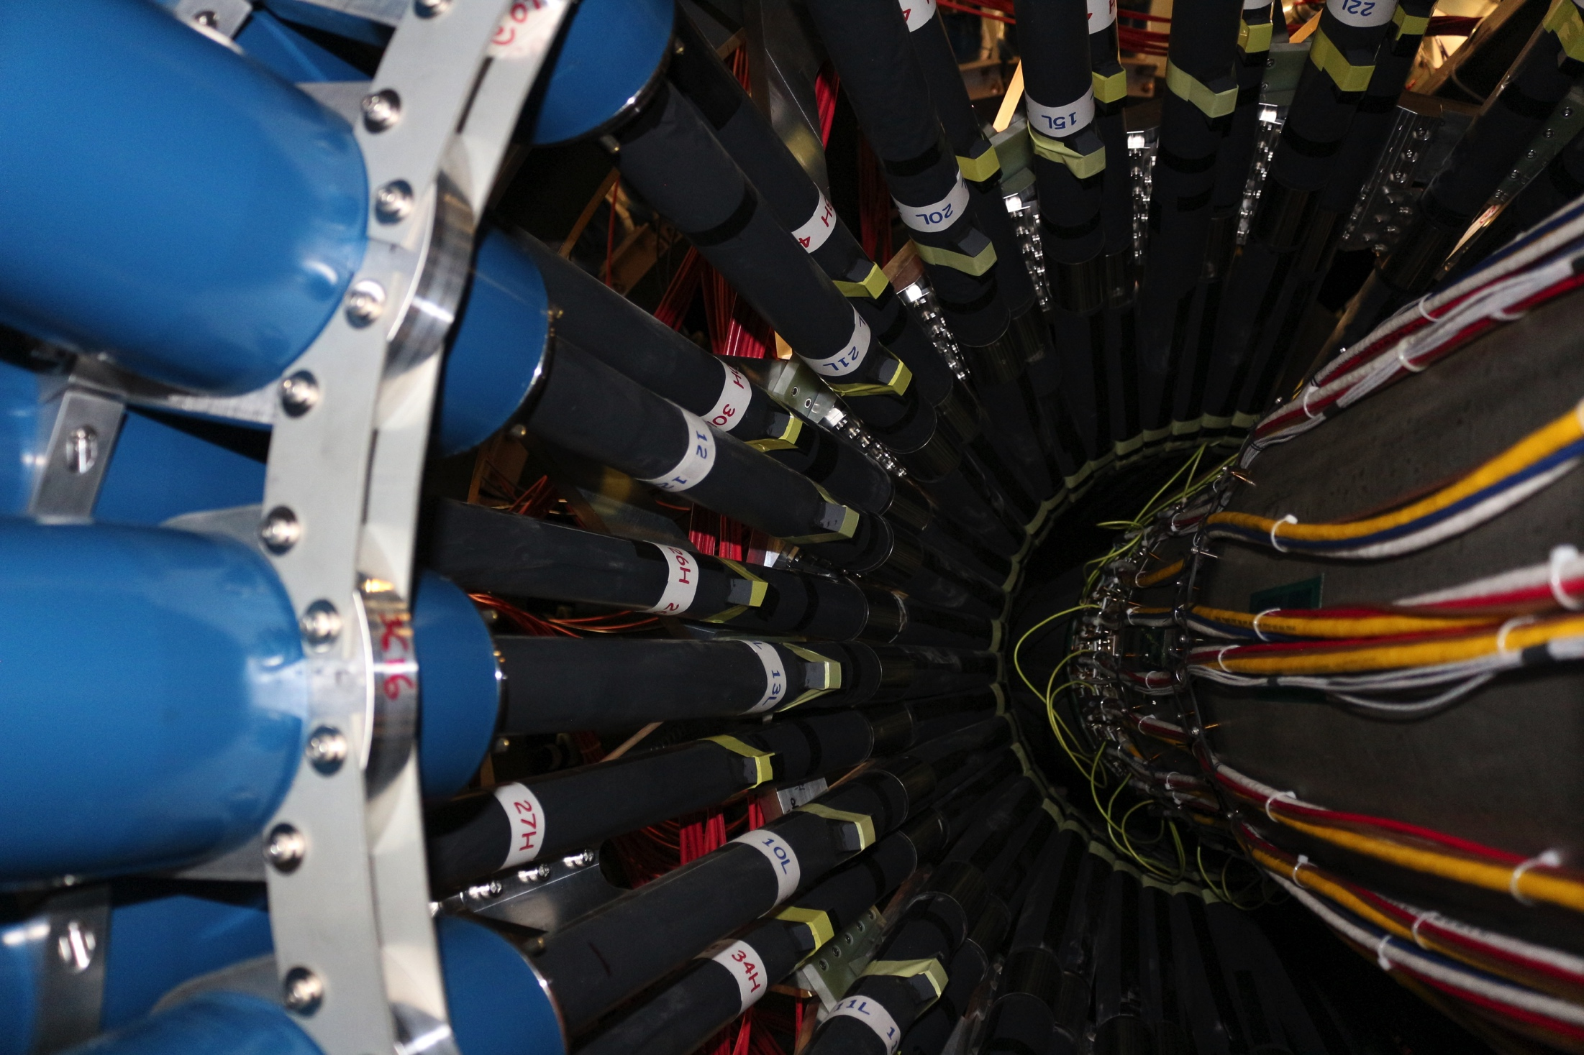
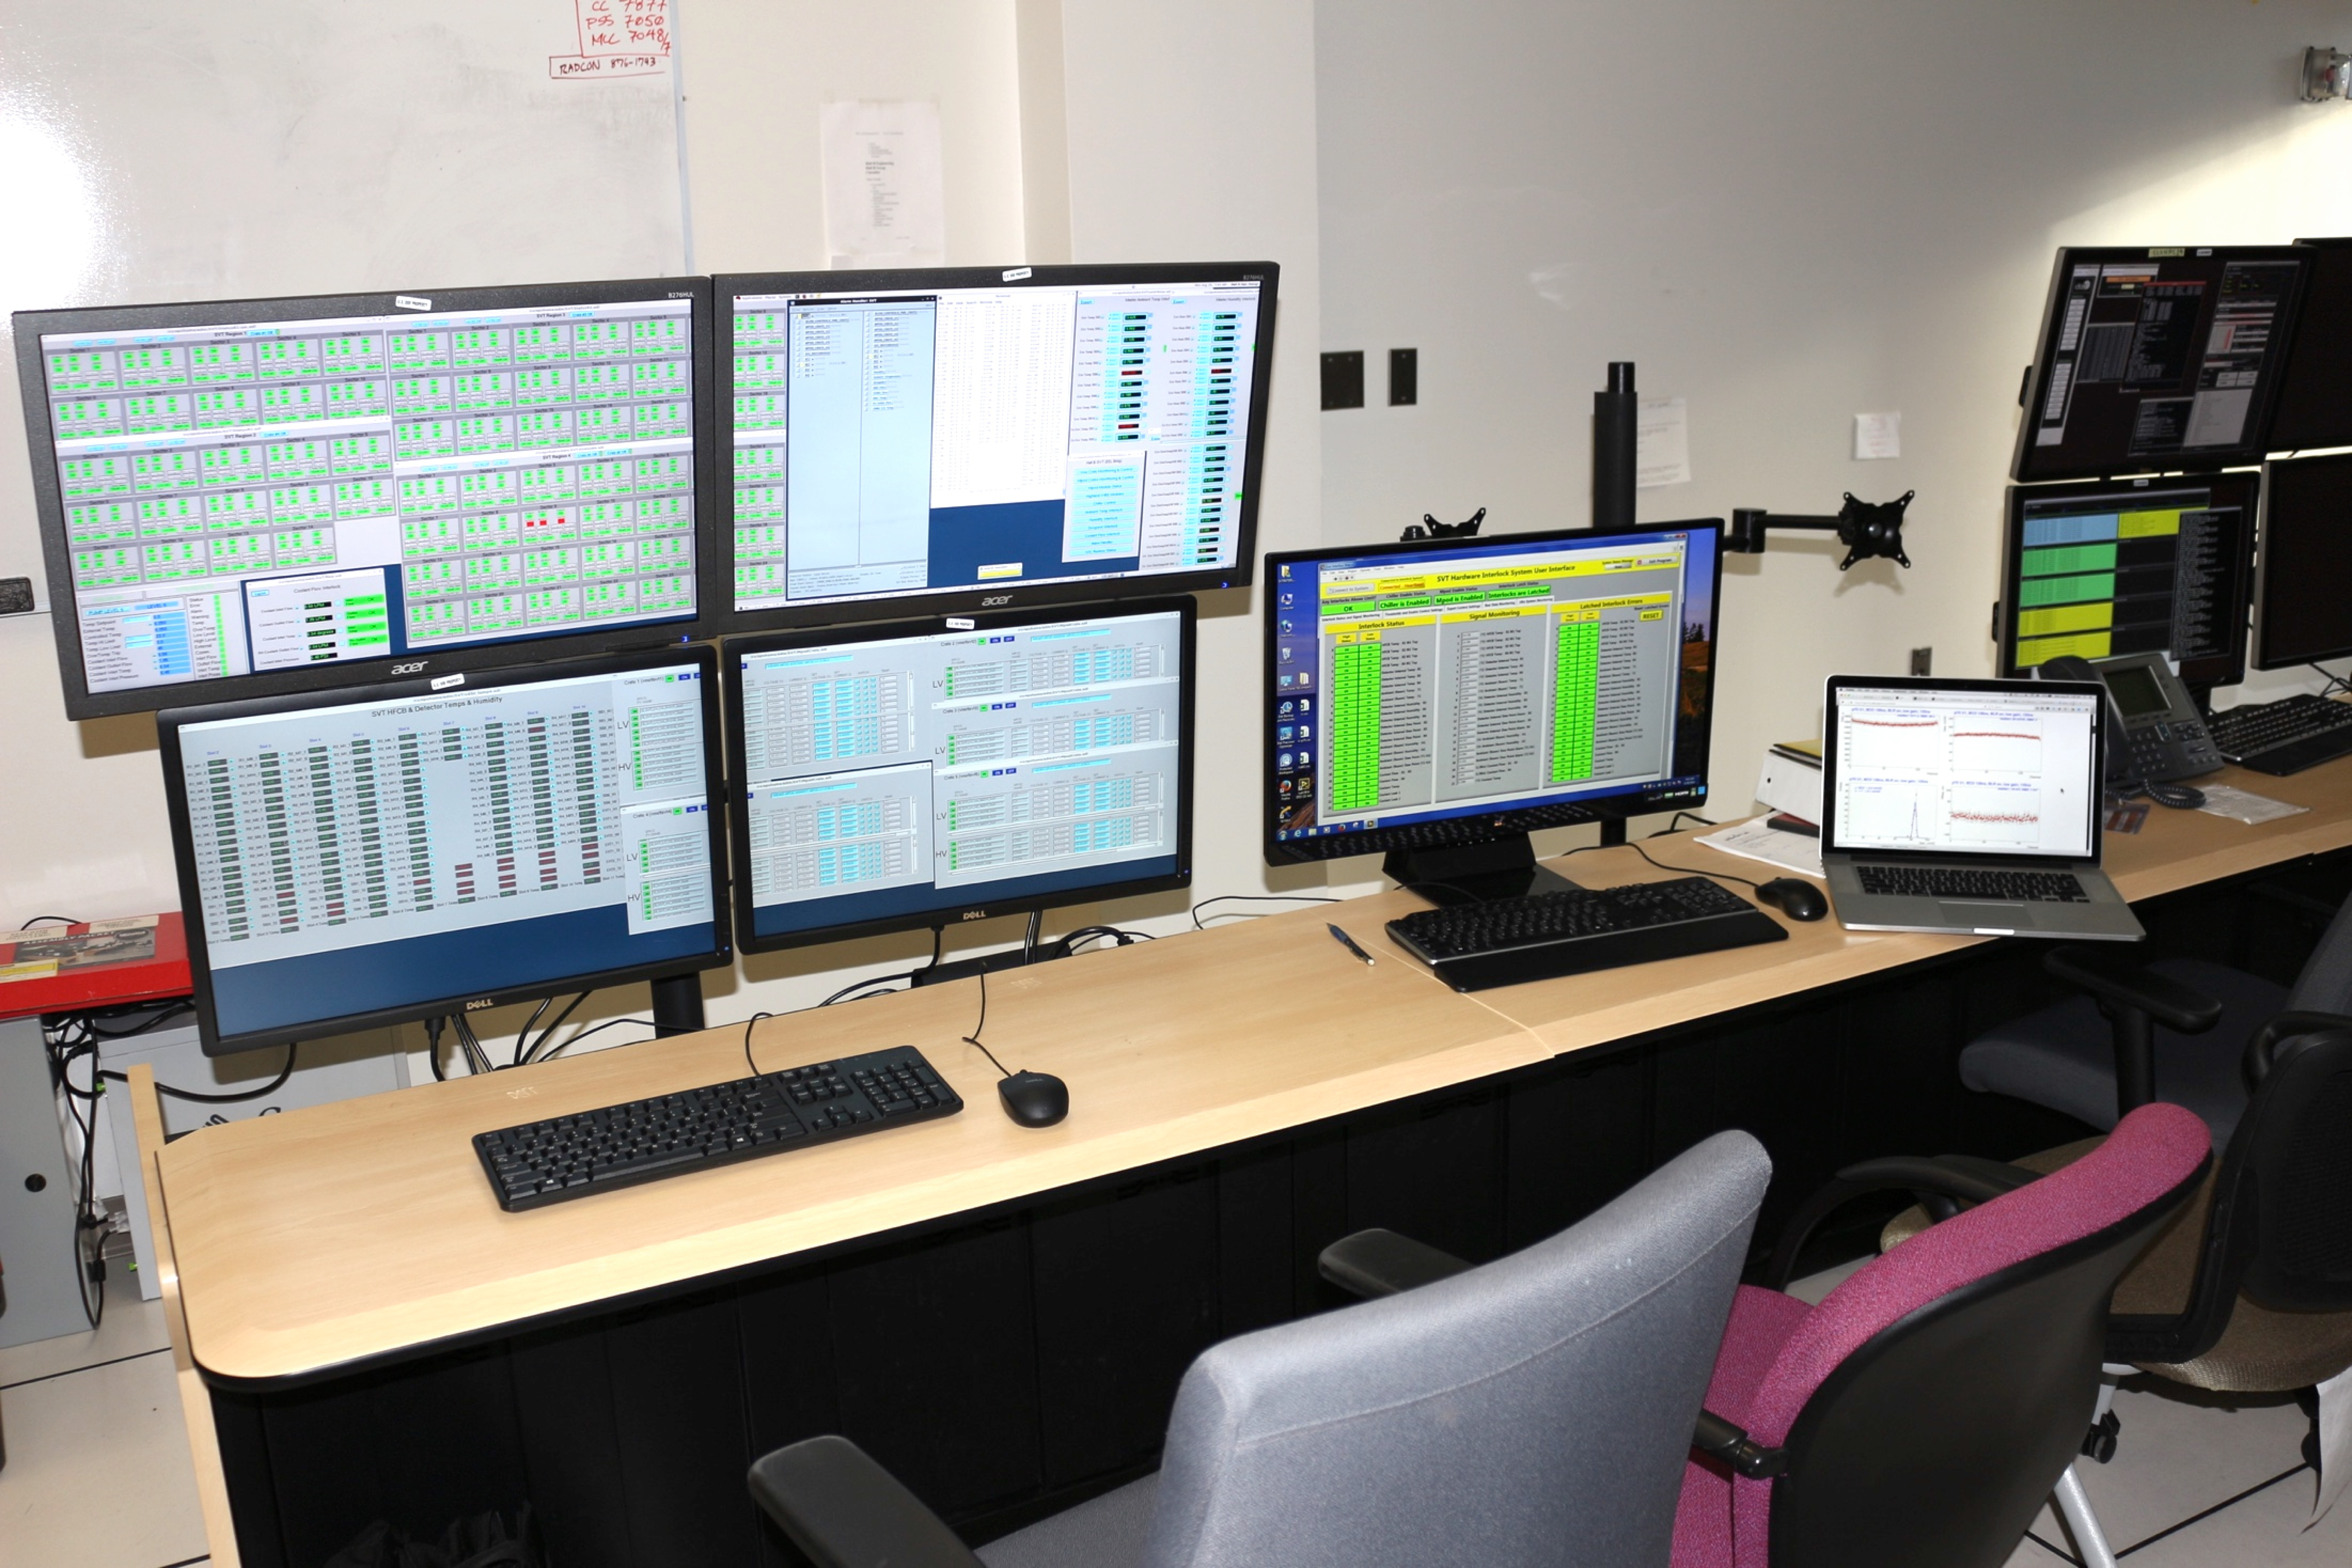
SVT Monitoring during KPP run
All hits
First track
Second track
Off track
Hall B counting room

Slide 18
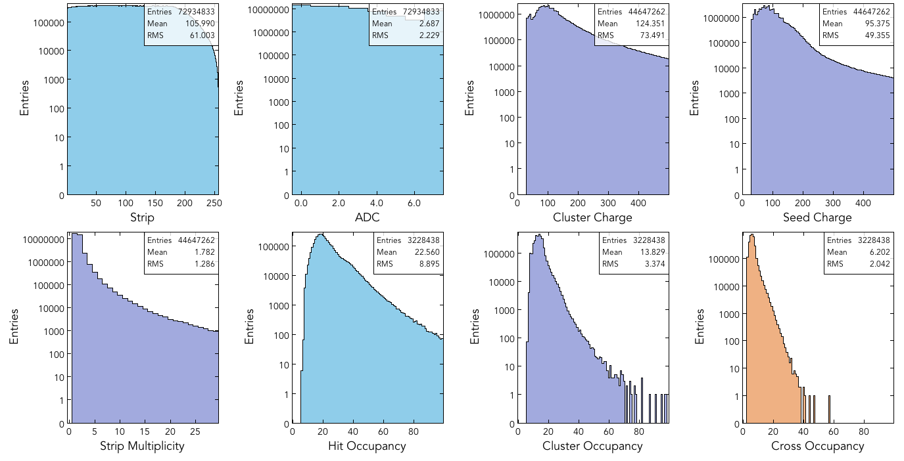
SVT Monitoring: Detector Level Histograms

Slide 19
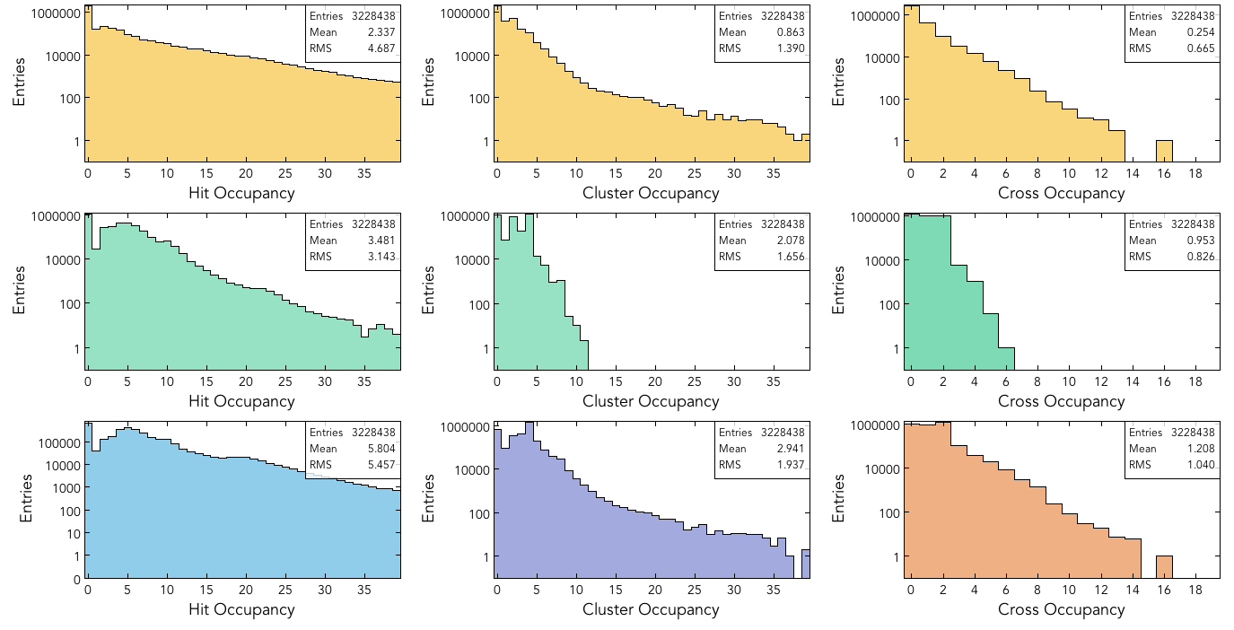
SVT Monitoring: Region Summaries

Slide 20
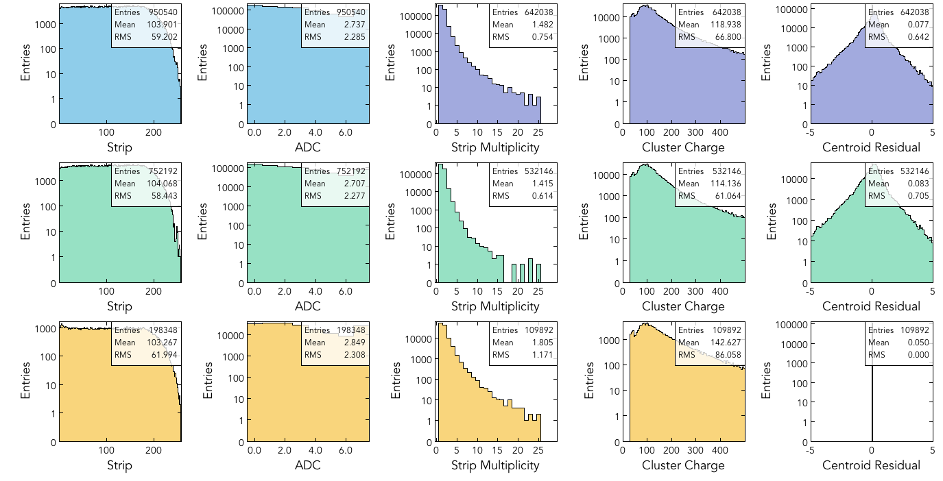
SVT Monitoring: Sensor Level Histograms

Slide 21
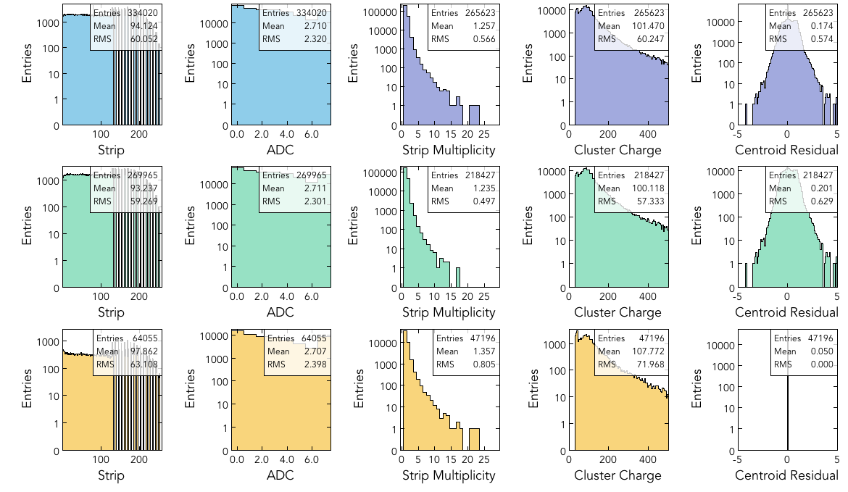
SVT Monitoring: Sensor Level Histograms
Bad VSCM connector (replaced)

Slide 22
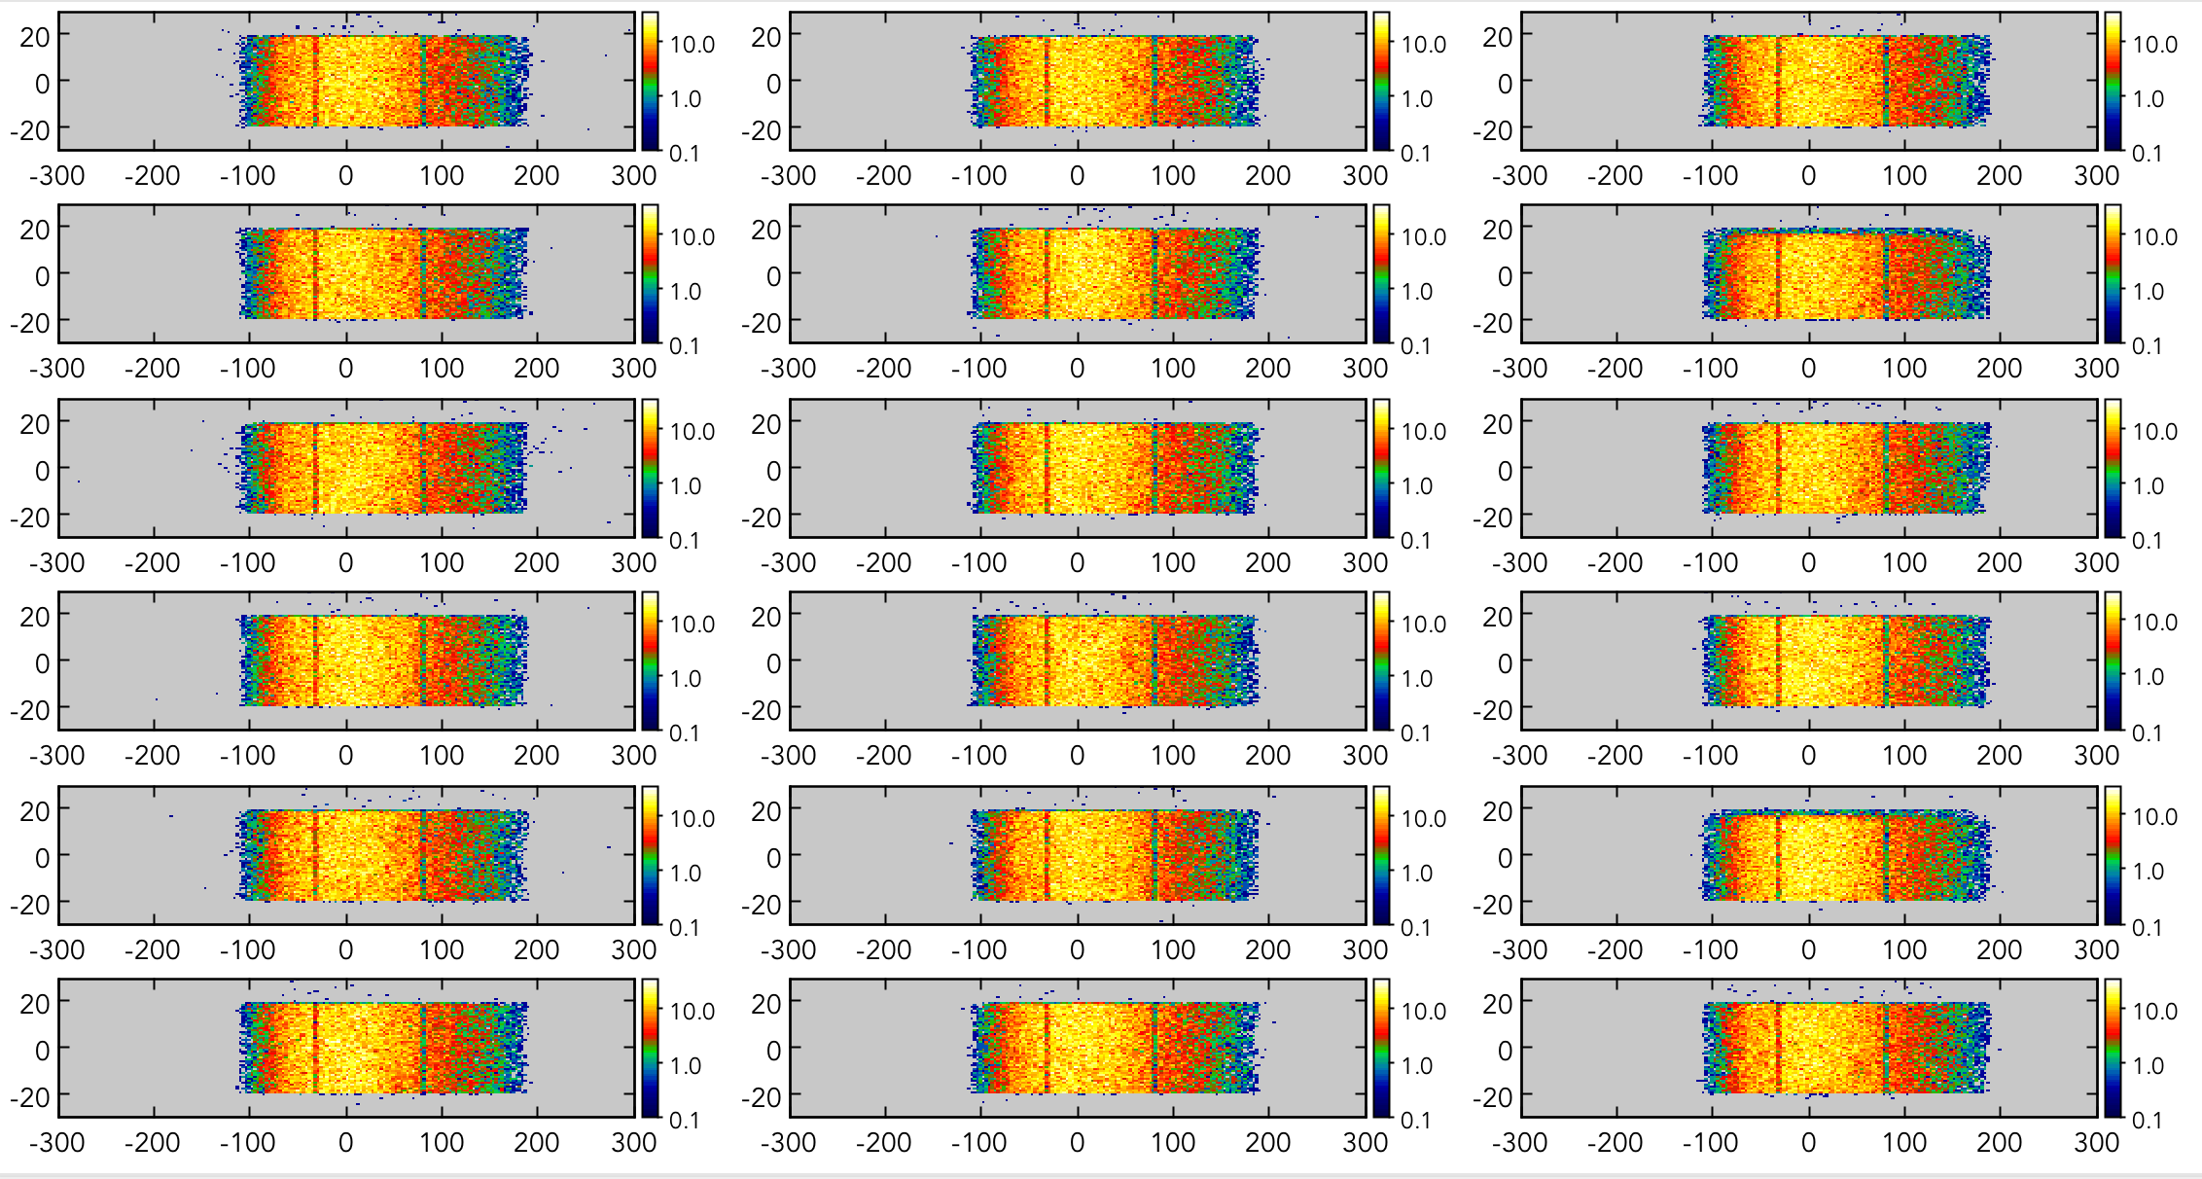
SVT Monitoring: Reconstructed On-Track Crosses

Slide 23
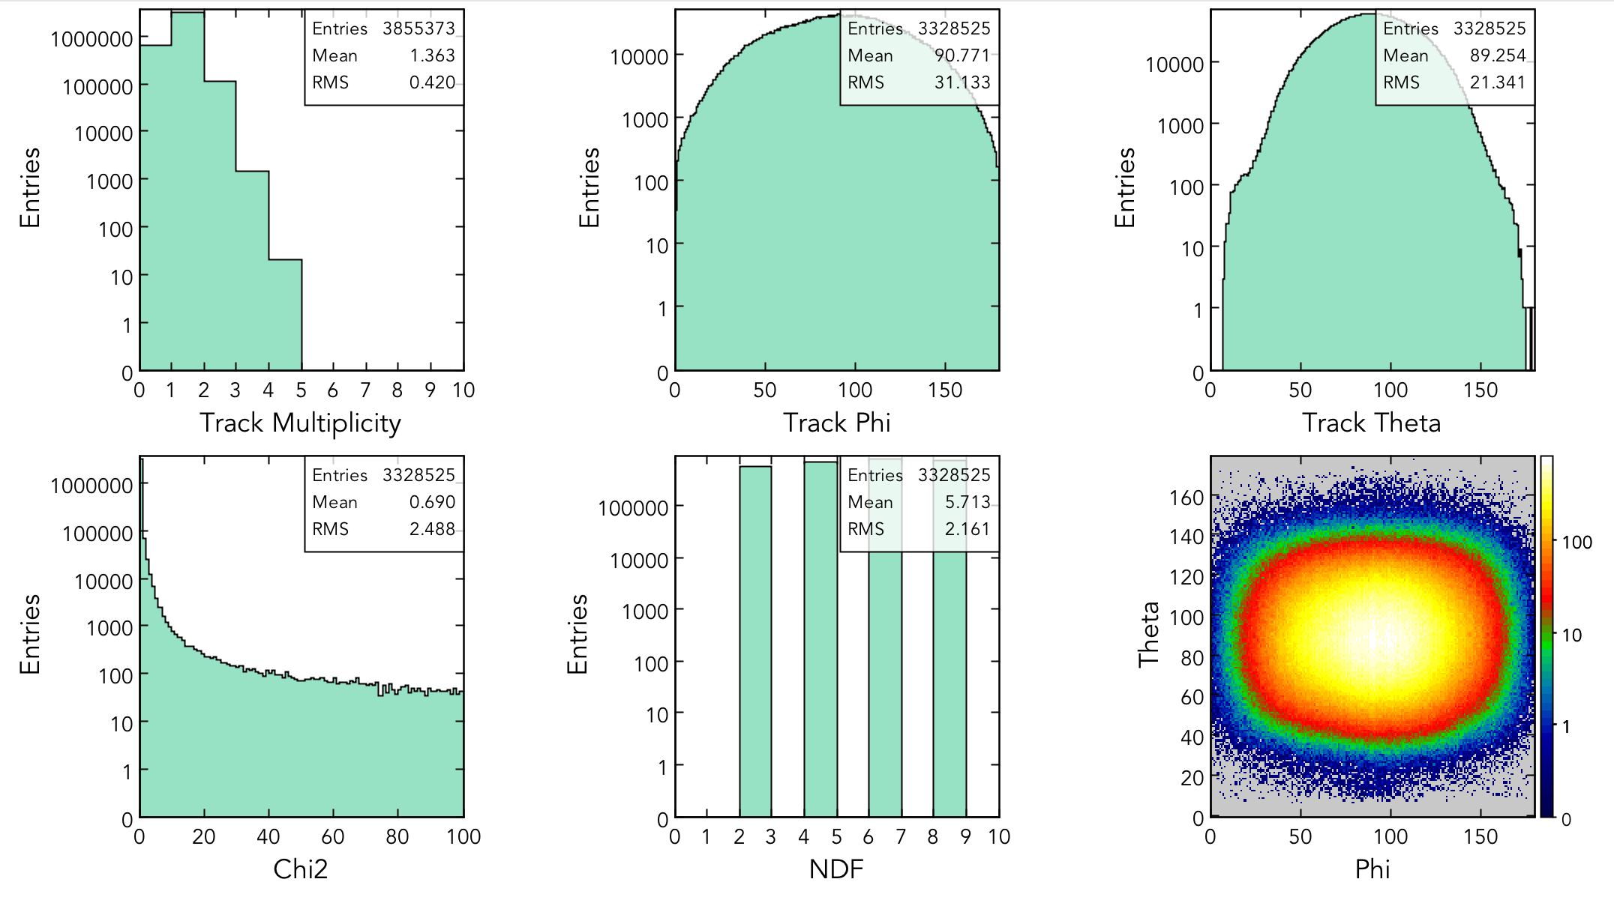
SVT Monitoring: Tracking (Cosmic Run)

Slide 24
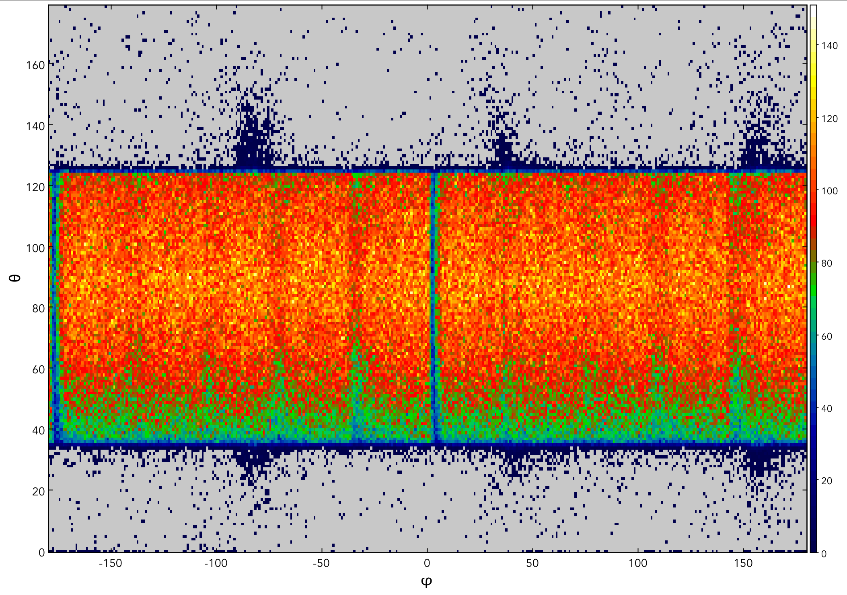
SVT Monitoring: Track kinematics (Simulated Data)

Slide 25
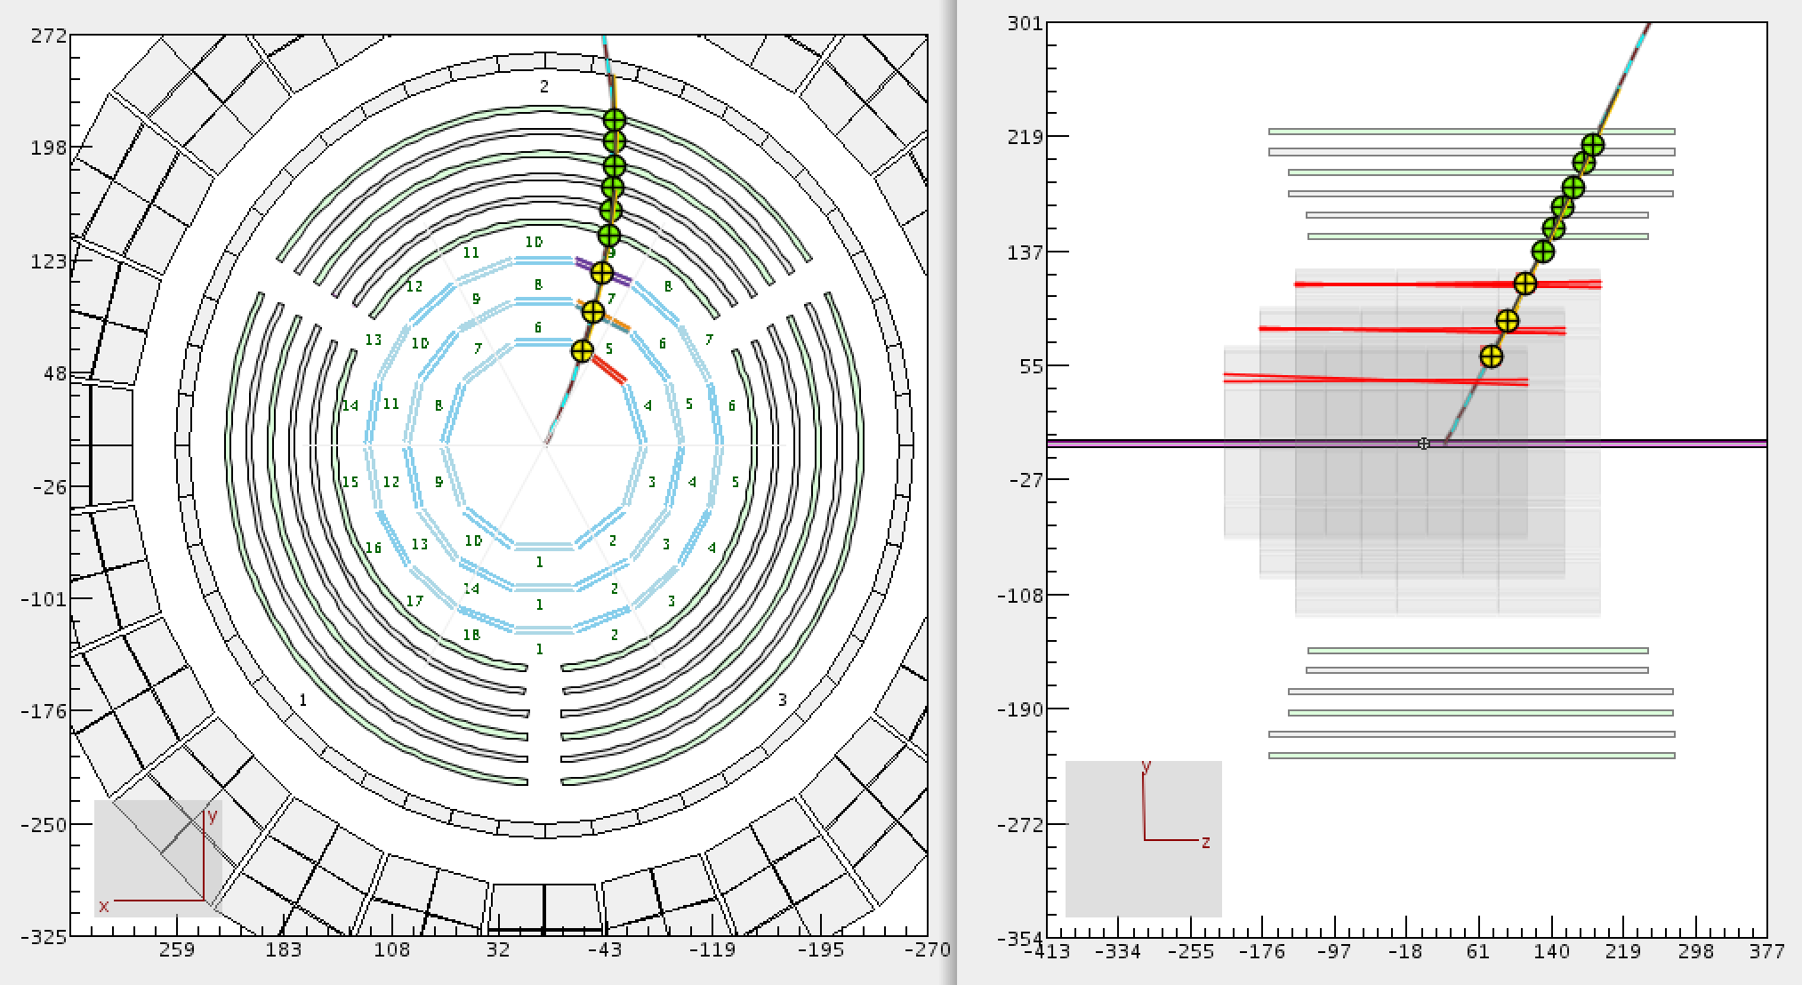
CLAS Online Display
Configurable monitoring histograms

Slide 26
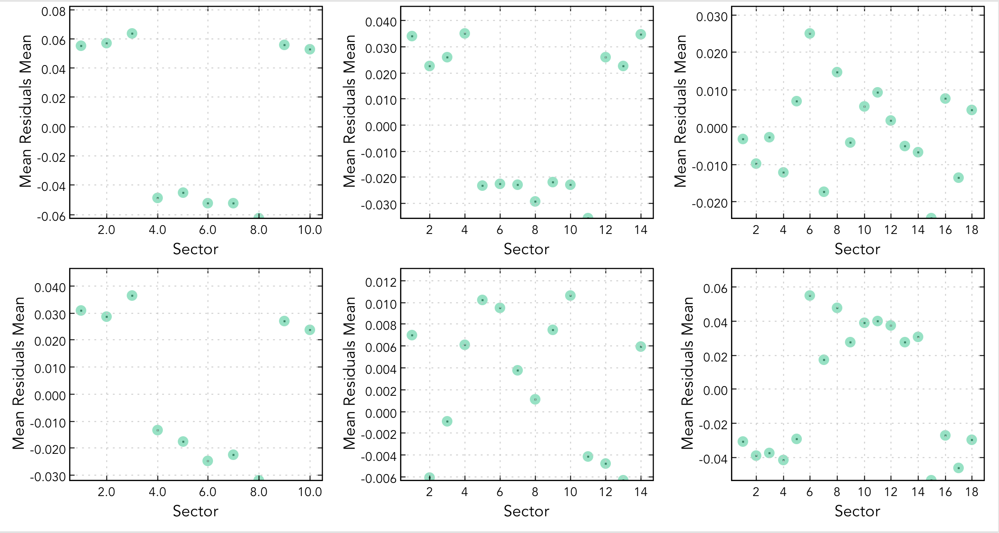
SVT Monitoring: Mean Residuals, mm
L1
L3
L5
L2
L4
L6

Slide 27
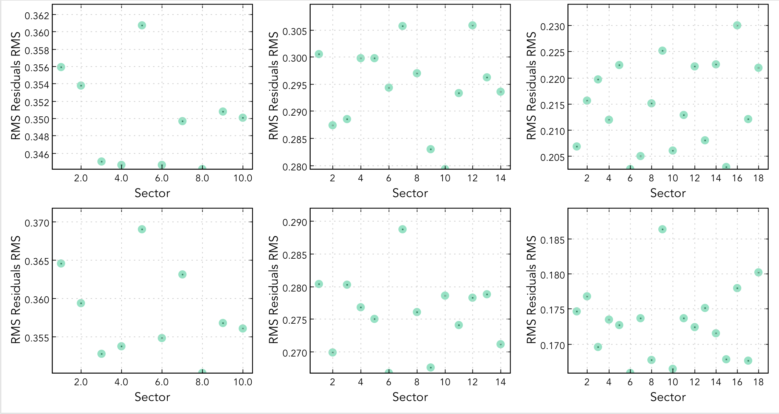
SVT Monitoring: RMS Residuals, mm
L1
L3
L5
L2
L4
L6

Slide 28
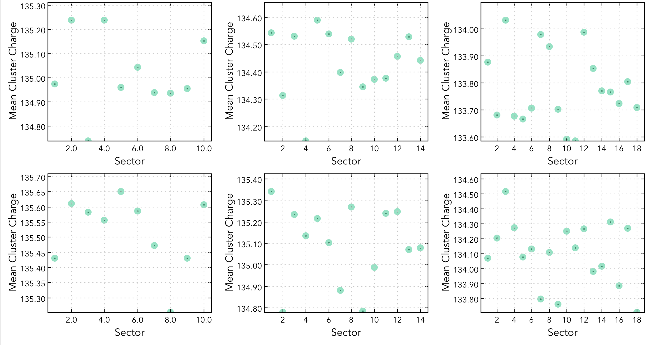
SVT Monitoring: Mean Cluster Charge
L1
L3
L5
L2
L4
L6

Slide 29
SVT Monitoring: Mean Cluster Size
L1
L3
L5
L2
L4
L6

Slide 30
SVT Monitoring: Mean Local Track Angle
L1
L3
L5
L2
L4
L6

Slide 31
SVT Monitoring: Mean Hit Occupancy (per event)
L1
L3
L5
L2
L4
L6

Slide 32
Summary
SVT and MVT online monitoring of detector performance developed as part of MON12 framework
Shifter and expert level monitoring defined
On-the-fly decoding and reconstruction validated on ET ring
Tracker monitoring has been tested on cosmic runs and in the KPP run
Slow Control Monitoring validated (system overview and expert level)
Path forward:
Time-line monitoring
Quality tests, automation, and logging
Integrate the suite with other MON12 subsystems and test performance
Establish EPICS monitoring of the scalers and SEE
Modify track visualization interface
Integration with CLAS Data Quality Monitoring Framework
Web Interface for shifter summary plots
Complete documentation on the monitoring suites

