Slide 1
Drift Chamber Monitoring
Are all systems functioning?
Do the time distributions look ok?
Is tracking functioning ok?
Do the tracks’ kinematic distributions look ok?
Are we in stable operation?

Slide 2
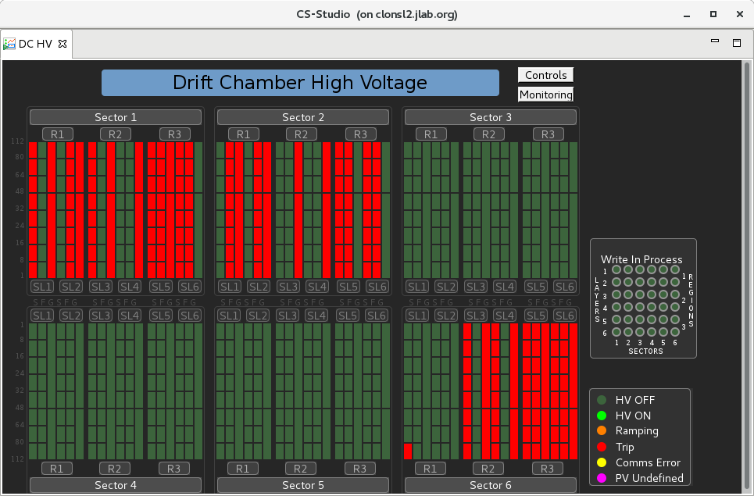
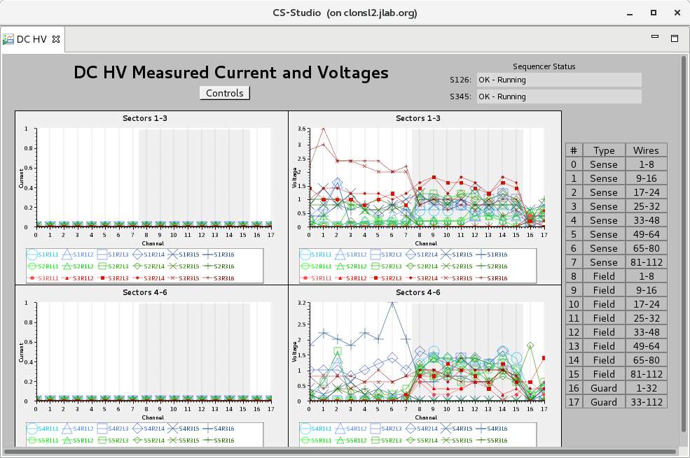
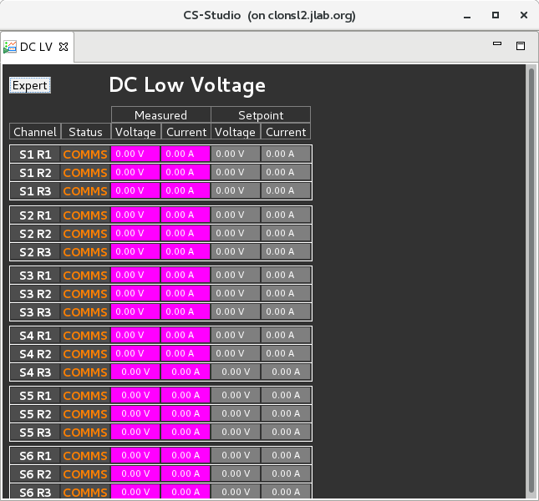
Drift Chamber Monitoring
Are all systems functioning?
EPICS

Slide 3
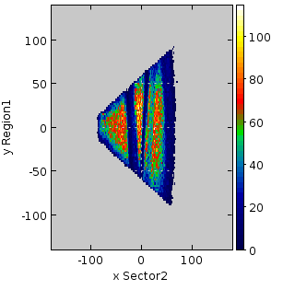
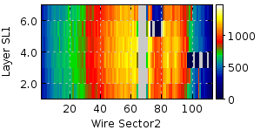
Drift Chamber Monitoring
Are all systems functioning?
any hot or dead areas?
for raw data and for hits on tracks
Coming soon! automatic procedure to indicate known problems
Occupancy plots
: dead areas

Slide 4
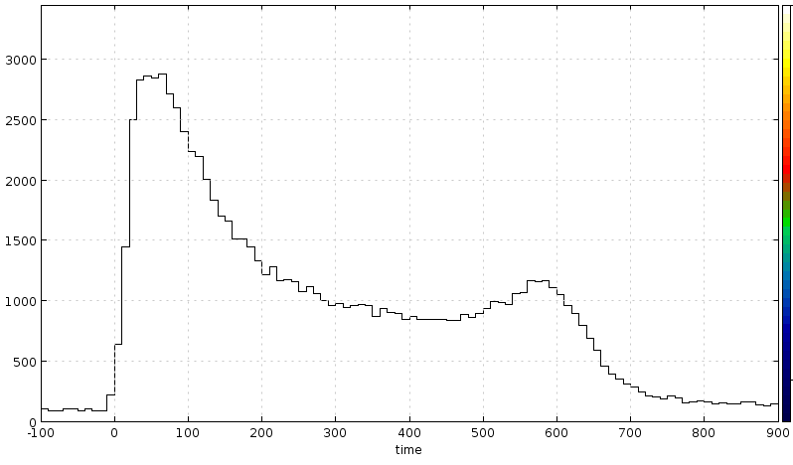
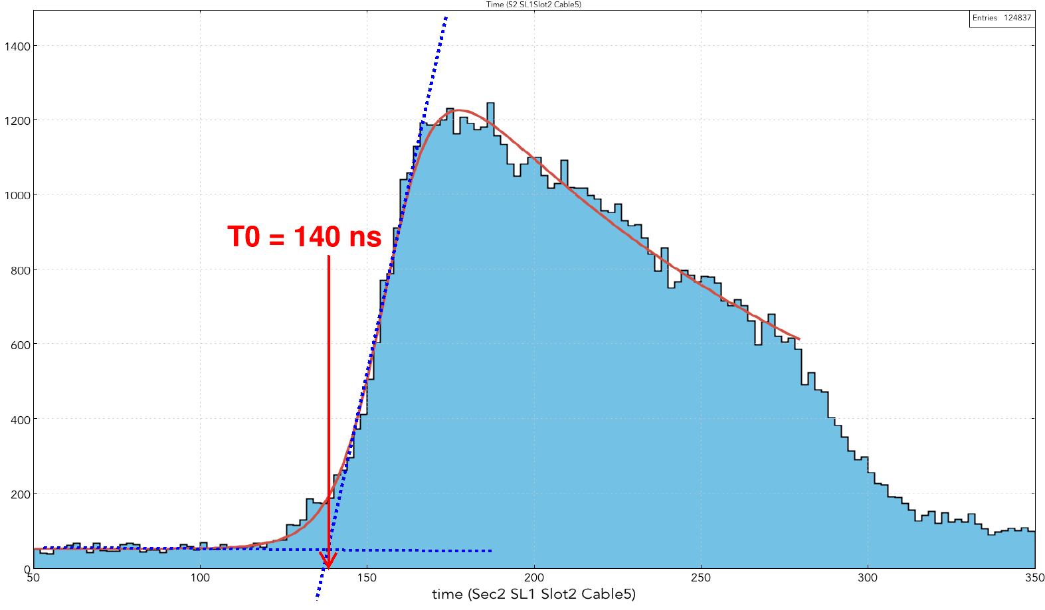
Drift Chamber Monitoring
Do the time distributions look ok?
Coming soon! Strip charts of t0 & tmax vs. run number
t0
tmax

Slide 5
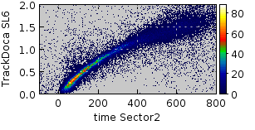
Drift Chamber Monitoring
Is tracking functioning ok?
Coming soon! average number of (tracks / event), (hits / track) and average residual vs. run number

Slide 6
Drift Chamber Monitoring
Do the tracks’ kinematic distributions look ok?
Coming soon! 1-D and 2-D histograms:
p vs. θ
θ vs. φ
x vs. y (crosses) for each region

Slide 7
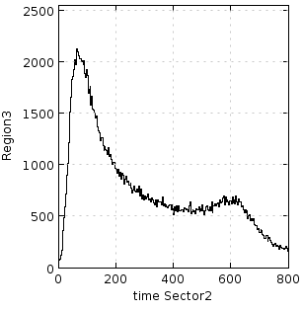
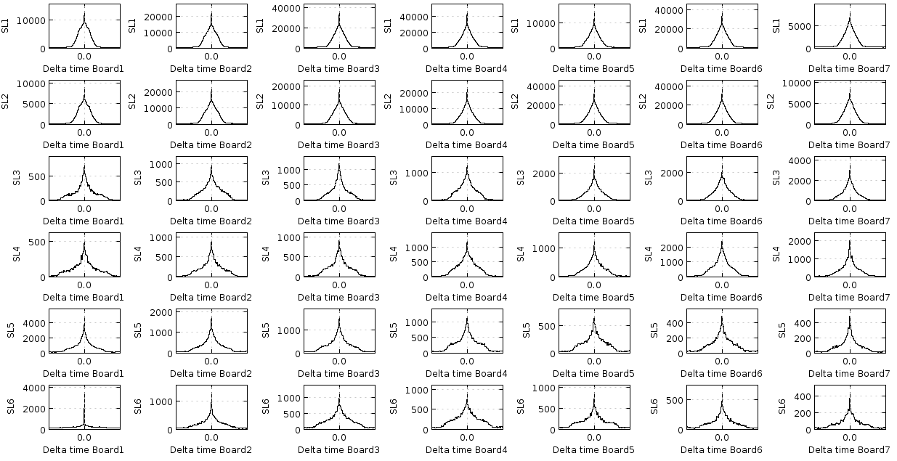
DC monitoring: ‘standard plots’ done
Occupancy
: dead areas
DOCA vs. time
Time Differences
- spike at zero
→ coherent noise

Slide 8
DC distance → time calibration
First find “t0”
Find t0 for each of 1512 signal cables (252 from sector 2)

Slide 9
Drift Chamber Monitoring
Are we in stable operation?
all standard plots have been done
next step is to analyse plots and extract essential information (e.g. “t0” from the time plot)
plot these extracted parameters vs. run number
Strip Charts for shift-takers
look for sudden jumps in parameters
Any questions?

