Slide 1
Status and Results From Recent
CLAS 6 DVCS Experiments
Carrying coals to Newcastle

Slide 2
1996 Introduction of GPD – handbag formalism for exclusive reactions
γ,π ,η,φ…
γ∗
Many experiments conducted
at Jlab for γ,π ,η,φ final states
GPD
Focus on DVCS.
Sensitive to GPD H – charge distribution.
But, very large Bethe-Heitler interference
γ∗
γ
GPD

Slide 3
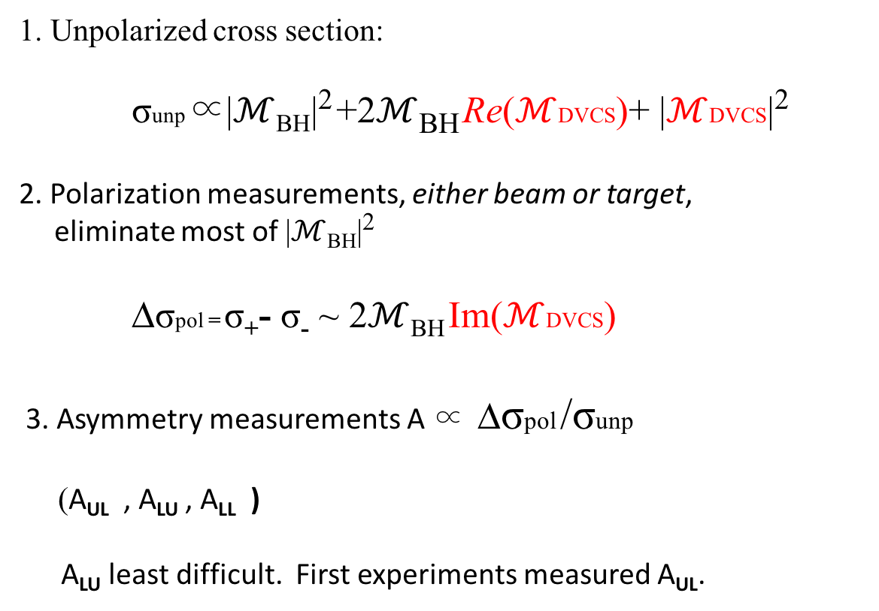
Experiments Performed at CLAS 6
1. Unpolarized cross section:
σunp ∝|$ℳ$_{BH}|² +2$ℳ$_{BH} Re($ℳ$DVCS)+ |$ℳ$DVCS|²
2. Polarization measurements, either beam or target,
eliminate most of |$ℳ$_{BH}|²
Dσpol = σ₊- σ₋ ~ 2$ℳ$_{BH} Im($ℳ$DVCS)
3. Asymmetry measurements A ∝ Dσpol /σunp
(A_{UL} , A_{LU} , A_{LL} )
A_{LU} least difficult. First experiments measured A_{UL}.

Slide 4
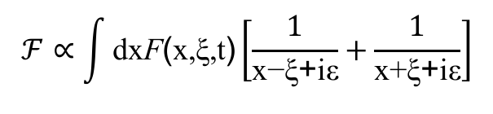
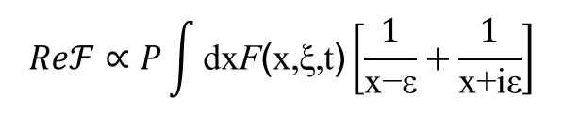


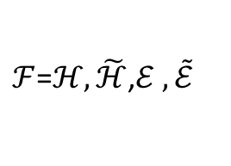


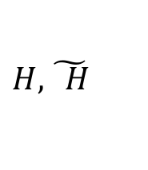
Experiments do not directly measure GPDs
but Compton Form Factors
DVCS
$$H,\tilde{ H}$$
Different observables sensitive
to different CFFs
GPDs:
$F=H,\tilde{H}$,E, $\tilde{E}$
$FT=HT,\tilde{HT}$,E$T$, $\tilde{ET}$
Form
Factors:
$ℱ$=$ℋ,\tilde{ℋ}$,$ℰ ,\tilde{ℰ}$
$ℱT$=$ℋT,\tilde{ℋT}$,$ℰT,\tilde{ℰT}$
DVCS
DVMP p, h
$$ℱ∝\int{\text{dx}\text{F}\text{(}\text{x}\text{,}\text{ξ}\text{,}\text{t}\text{)}\left[\frac{1}{\text{x}\text{−}\text{ξ}\text{+}\text{iε}}+\frac{1}{\text{x}\text{+}\text{ξ}\text{+}\text{iε}}\right]}$$
$$Reℱ∝P\int{\text{dx}\text{F}\text{(}\text{x}\text{,}\text{ξ}\text{,}\text{t}\text{)}\left[\frac{1}{\text{x}\text{−}\text{ε}}+\frac{1}{\text{x}\text{+}\text{i}\text{ε}}\right]}$$
Im$ℱ=−π\left[\text{F}\left(\text{ξ}\text{,}\text{ξ}\text{,}\text{t} \right)\text{∓}\text{F}\left(\text{−}\text{ξ}\text{,}\text{ξ}\text{,}\text{t} \right)\right]$

Slide 5
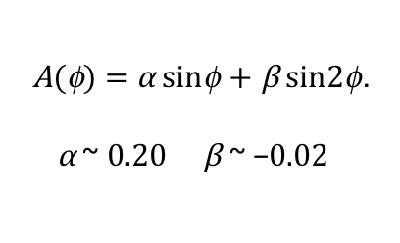
First CLAS DVCS experiments
Beam Spin Asymmetry
Target Spin Asymmetry
S. Stepanyan et al.,
Phys. Rev. Lett. 87, 182002 (2001)
S. Chen et al. ,
Phys. Rev. Lett. 97, 072002 (2006).
Q² ~ 1.82 GeV²/c²
t ~ 0.31 GeV²/c²
ξ ~ 0.16.
$$\text{A}\text{(}\text{f}\text{) = }\text{α} \text{sin}\text{f} \text{+} \text{β} \text{sin}\text{2}\text{f}\text{.}$$
$\text{α}$ ~ 0.20 $\text{β}$ ~ −0.02
Consistent with dominance of leading order (twist 2)
in expansion: A = S a_{n}sin(nf)

Slide 6
CLAS 6 GeV large kinematic acceptance experiments

Slide 7
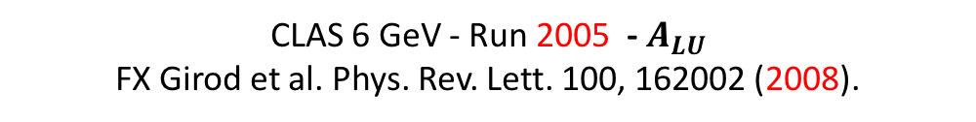
CLAS 6 GeV - Run 2005 - $A_{LU}$
FX Girod et al. Phys. Rev. Lett. 100, 162002 (2008).
Beam spin asymmetries. Integrated over all t
(Thesis FX Girod - 2006)
Expansion: A = S a_{n}sin(nf)
Leading order twist 2:
“Whether integrated in t or in each t -bin, the φ- distributions were always found to be compatible with leading-twist dominance”

Slide 8

First CLAS 6 GeV - Run 2005 A_{LU}
FX Girod et al. Phys. Rev. Lett. 100, 162002 (2008).
a(t)
$$A_{UL}=\frac{α(t)\sin{φ}}{1+β\cos{φ}}$$
Regge (Laget)
GPD Twist-3
GPD Twist-2
Good theory fits* show robust theory.
(but variations among models?)
*M. Guidal, M. V. Polyakov, A. V. Radyushkin, and
M. Vanderhaeghen, Phys. Rev. D 72, 054013 (2005).

Slide 9
Polarized beam and target - 2009
Beam, Target and Double beam/target asymmetry
Different geometry and beam conditions
A_{UL} - E. Seder et al. Phys. Rev. Lett. 114, 032001 (2015)
Full Article, A_{UL ,} A_{LU} A_{LL} – S. Pisano et al, Phys.Rev. D91 (2015)

Slide 10
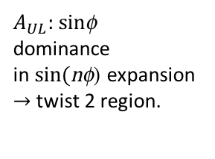


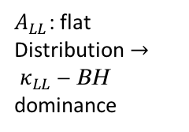
Target Spin Asymmetry
$$A_{UL}=\frac{α_{UL}\sin{φ}}{1+β\cos{φ}}$$
Double Spin Asymmetry
$$A_{LL}=\frac{κ_{LL}{+λ}_{LL}\cos{φ}}{1+β\cos{φ}}$$
$A_{UL}$: sinf dominance
in sin(nf) expansion $→$twist 2 region.
$A_{LL}$: flat
Distribution $→$
$κ_{LL}$ - BH dominance
Fit based on VGG with CFF allowed to vary

Slide 11
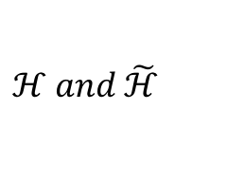

Compare target spin asymmetry with beam spin asymmetry
TSA Sensitive to
$$ℋ and \tilde{ℋ}$$
BSA Sensitive to
$$ℋ$$
a_{UL}
a_{LU}
Smaller t slope in a_{UL} than a_{LU}
Axial charge radius is smaller than charge radius.
Agrees with axial form factor measurements involving p⁰ and n.

Slide 12



Double Spin Asymmetry
$$A_{LL}=\frac{κ_{LL}{+λ}_{LL}\cos{φ}}{1+β\cos{φ}}$$
$𝒦$_{LL}
$λ$_{LL}
Agreement on BH dominance – but A_{LL} data cannot constrain DVCS

Slide 13
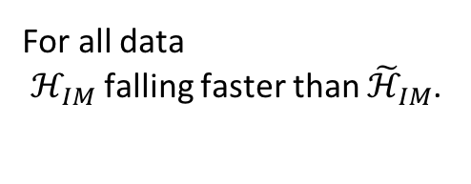
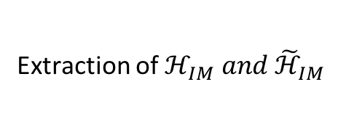
Pisano et al
Extraction of $ℋ_{IM} and{ \tilde{ℋ}}_{IM}$
For all data
$ℋ_{IM}$falling faster than ${\tilde{ℋ}}_{IM}$.
F.-X. Girod et al. (CLAS Collaboration),
Phys. Rev. Lett. 100, 162002 (2008)
S. Chen et al. (CLAS Collaboration),
Phys. Rev. Lett. 97, 072002 (2006).

Slide 14
DVCS1 Run: March to May 2005
J. S. Jo et al. Phys. Rev. Lett. 115, 212003 (2015). 21 bins in x_{B}, Q², t
Absolute Cross Section s and Ds measurements.
-VGG -BH, .. KM10 KMS

Slide 15


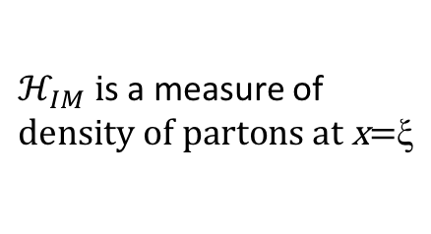
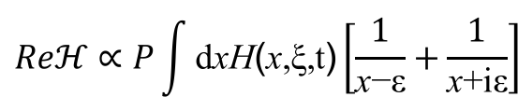



CFF extracted assuming only $ℋ$and $\tilde{ℋ}$.
$ℋ_{IM} i$s a measure of $density of partons at \text{x}\text{=}\text{ξ}$
$$ℋ_{IM}$$
VGG
Fit to data $ℋ_{IM}=ae^{bt}$
$$ℋ_{RE}$$
$ℋ_{RE}$ is more complicated
$$Reℋ∝P\int{\text{d}\text{x}\text{H}\text{(}\text{x}\text{,}\text{ξ}\text{,}\text{t}\text{)}\left[\frac{1}{\text{x}\text{−}\text{ε}}+\frac{1}{\text{x}\text{+}\text{i}\text{ε}}\right]}$$
a and b increase, in a systematic way, with decreasing x_{B}
⇒ The size of the nucleon increases as lower momentum fractions.
⇒ Increase of the partonic content of the nucleon as lower xB

Slide 16
Last result: DVCS2 run 2008-2009
Theses, B. Guegan and N. Saylor
Final edits of PR article in progress

Slide 17
Bin5
VGG
BH

Slide 18
Bin15
VGG
BH
BH+DVCS

Slide 19
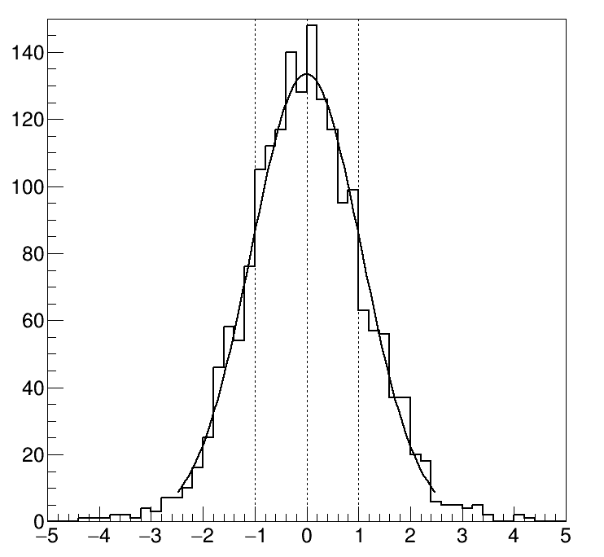
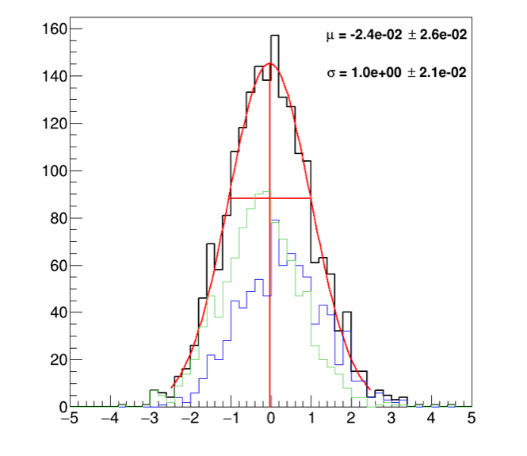
Comparison between DVCS2 and DVCS1
Different
beam energy: 5.88 vs 5.75
target length: 1.5 vs 4 cm
target position: 3 cm
solenoid/target offset
FX Girod: careful studies and extrapolate expected variations in σ
Ratio of cross section differences and errors added in quadrature
μ = 2x 10⁻²
Δδ = 1.0
Major issue for cross section measurements –elastic normalization

Slide 20
Example of analysis of Jlab DVCS data and Proton Tomography
R. Dupre, M. Guidal, S. Niccolai, M. Vanderhaeghen
Eur.Phys.J. A53 (2017) no.8, 171
arXiv: 1704.07330v1 [hep-ph]
Fitting procedures based on VGG and developed over the years in various publications.

Slide 21
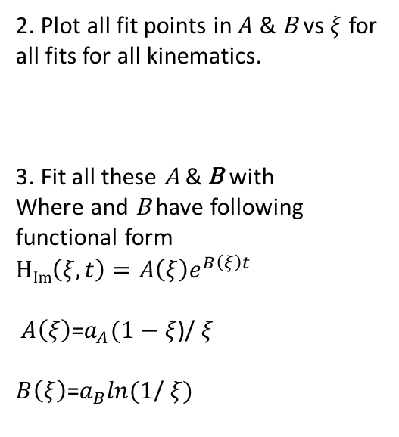
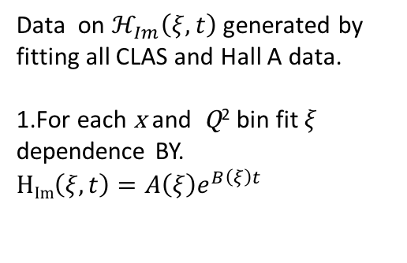
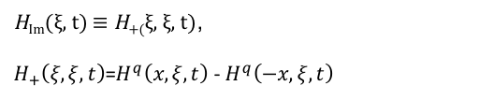
Data on $ℋ_{Im}\left(ξ,t\right)$ generated by fitting all CLAS and Hall A data.
1.For each x and Q² bin fit $ξ$ dependence BY.
H_{Im}$\left(ξ,t\right)=A\left(ξ\right)e^{B\left(ξ\right)t}$
2. Plot all fit points in $A$ & B vs $ξ$ for all fits for all kinematics.
3. Fit all these A & B with
Where and B have following functional form
H_{Im}$\left(ξ,t\right)=A\left(ξ\right)e^{B\left(ξ\right)t}$
$A\left(ξ\right)$=$a_{A}(1−ξ$)/ $ξ$
$B\left(ξ\right)$=$a_{B}ln(1$/ $ξ)$
H_{Im}(ξ, t) ≡ H₊₍ξ, ξ, t),
$H_{+}\left(ξ,ξ,t\right)$=$H^{q}\left(x,ξ,t\right)$ - $H^{q}\left(−x,ξ,t\right)$

Slide 22
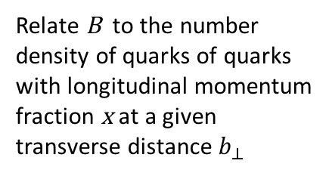
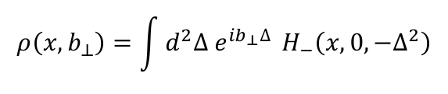
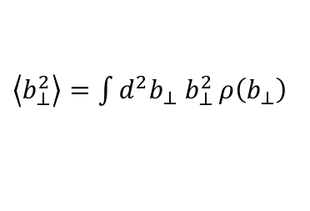
Relate B to the number
density of quarks of quarks
with longitudinal momentum
fraction x at a given
transverse distance $b_{⊥}$
$$ρ\left(x,b_{⊥}\right)=\int{d^{2}∆{ e}^{{ib}_{⊥}∆ } H_{−}\left(x,0,−∆^{2}\right)}$$
$\left\langle b_{⊥}^{2}\right\rangle =\int{{d^{2}b_{⊥} b}_{⊥}^{2}}ρ\left(b_{⊥}\right)$

Slide 23
Outlook for CLAS 12:
See F-X Girod talk in March 2017 Collaboration meeting

Slide 24
Next step – publish DVCS2 data
Run experiments at 12 GeV during first run period

