Slide 1


Status of Project X
Design plans, cavity and cryomodule development
Vyacheslav Yakovlev, Camille Ginsburg (FNAL)
TESLA Technology Collaboration (TTC) Meeting at JLab
November 5, 2012

Slide 2
Outline
Project X overview
Project X plan for implementation
Project X design status
Project X component status: focus on SRF cavities and cryomodules
Conclusions

Slide 3
Project X Overview

Slide 4
Project X
An opportunity to create the foremost Intensity Frontier facility in the world: multi-MW proton beams available at energies ranging from 1 – 120 GeV
Unique ability to provide high beam power, high duty factor, independent beam formats to multiple experiments simultaneously
Capitalizing on the rapid development of superconducting RF technology
Undertaken by an international collaboration

Slide 5
Project X Collaboration
Argonne National Laboratory
Brookhaven National Laboratory
Fermi National Accelerator Laboratory
Lawrence Berkeley National Laboratory
Pacific Northwest National Laboratory
Oak Ridge National Laboratory / SNS
SLAC National Accelerator Laboratory
Thomas Jefferson National Accelerator Facility
Cornell University
Michigan State University
ILC/Americas Regional Team
Bhabha Atomic Research Center
Raja Ramanna Center of Advanced Technology
Variable Energy Cyclotron Center
Inter University Accelerator Center

Slide 6
Project X Physics Mission
High-power proton beam with flexible beam formats delivered simultaneously to multiple users
  3 MW at 3 GeV
    rare process experiments
    CW at time scales >1 μsec, 20% DF at <1 μsec
    Extraction of up to 0.5 mA at 1 GeV is possible
  0.080-0.200 MW at 8 GeV
    Rare process experiments, neutrinos
  2 MW at 60-120 GeV
    Long-baseline neutrino experiments
Path toward neutrino factory or muon collider
  Would require ~4 MW at ~5-15 GeV
Possible missions beyond particle physics, e.g., energy applications
    Provision for 1 GeV extraction
Use of a CW linac creates a facility that is unique in the world, with performance that cannot be matched in a synchrotron-based facility

Slide 7
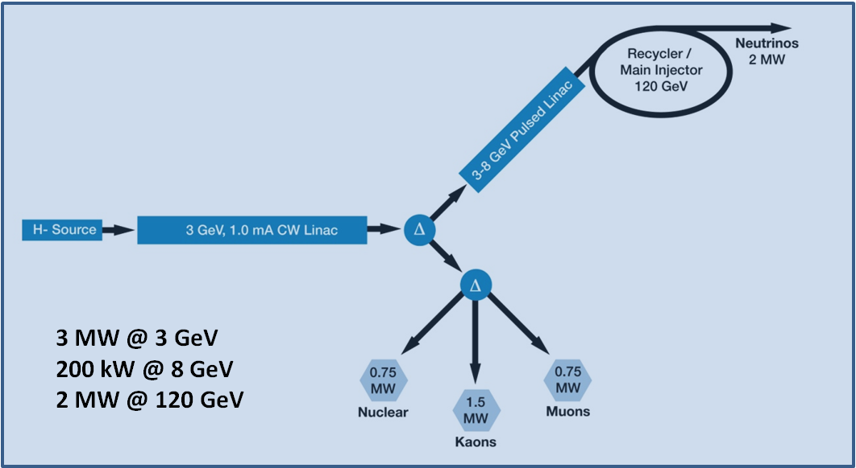
Project X Reference Design

Slide 8
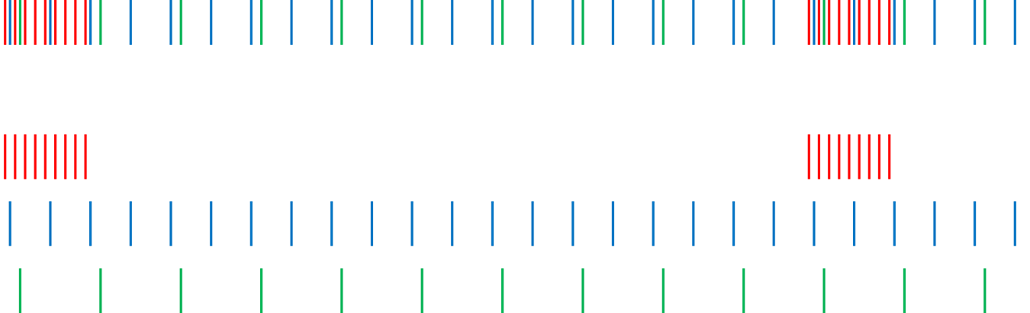
Project X CW Linac Operation
Different experiments require different time structures
Programmed chopping allows preparation of necessary structure for different experiments, to provide further separation by RF splitter
1 μsec period at 3 GeV
Muon pulses (17e7) 80 MHz, 100 nsec 700 kW
Kaon pulses (17e7) 20 MHz 1540 kW
Nuclear pulses (17e7) 10 MHz 770 kW
Separation scheme
1 μsec
Notes:
Ion source and RFQ operate at 4.4 mA
77% of bunches are chopped @ 2.1 MeV ⇒ maintain 1 mA over 1 μsec

Slide 9
Project X Plan for Implementation

Slide 10
Project X Staging Opportunities
Staging principles
  Significant physics opportunities at each stage
  Cost of each stage substantially <$1B
  Utilize existing infrastructure to the extent possible at each stage
  Achieve full Reference Design capabilities (including upgradability) at end of final stage
In January 2012 we described a four-stage plan, consistent with these principles, to DOE/OHEP
We subsequently provided DOE with cost profiles for the first three stages, including potential in-kind contributions from India.

Slide 11
Project X Staging Proposal
Stage 0 (ongoing): Proton Improvement Plan
Stage 1: 1 GeV CW linac
Stage 2: 3 GeV CW linac
Stage 3: Project X Reference Design
Stage 4: Beyond the Project X RDR
Project X Campaign
Notes:
Describe first line: what it is, and physics goals at each stage.

Slide 12
Project X Design Status

Slide 13
SRF Technology Map
β=0.11
β=0.22
β=0.47
β=0.61
β=0.90
β=1.0
CW
Pulsed
162.5 MHz
2.1-10 MeV
325 MHz
10-160 MeV
650 MHz
160-3000 MeV
1300 MHz
3000-8000 MeV
Section | Freq | Energy (MeV) | Cav/mag/CM | Type
HWR (β_{G}=0.1) | 162.5 | 2.1-10 | 8/8/1 | HWR, solenoid
SSR1 (β_{G}=0.22) | 325 | 10-42 | 16/8/2 | SSR, solenoid
SSR2 (β_{G}=0.47) | 325 | 42-160 | 36/20/4 | SSR, solenoid
LB 650 (β_{G}=0.61) | 650 | 160-460 | 42 /14/7 | 5-cell elliptical, doublet
HB 650 (β_{G}=0.9) | 650 | 460-3000 | 152/19/19 | 5-cell elliptical, doublet
ILC 1.3 (β_{G}=1.0) | 1300 | 3000-8000 | 224 /28 /28 | 9-cell elliptical, quad

Slide 14
Some Challenges for CW SRF
Microphonics
  Large loaded Q for small beam current <1 mA - Q_{load} = U/(R/Q)/I_{beam} ≈ 1-2e7
  Small cavity bandwidth - f / Q_{load} ~ tens of Hz
  Lorentz force detuning is important during turn on, compensated w/ piezos
  Microphonics needs continuous compensation
    Overcoupling too expensive for 3 MW machine
    Decrease of He pressure fluctuation may add expense to cryosystem
    Relying on long-term piezo operation may be risky (e.g., SNS, SARAF)
    df/dP minimization important in combination with all other means
Complex cavity shapes
  Avoid multipacting
Large dynamic heat loads
  ~200 W/cryo-module (100% duty cycle, E_{acc} = 17 MeV/m)
    Much different from ILC: <5 W/cryo-module (0.5 % duty cycle, E_{acc} = 35 MeV/m)
  Requirements for E_{peak} and B_{peak} are modest; high gradient is not needed
  Losses induced by HOM’s could be a concern
  High Q₀ is needed to minimize power dissipation, which drives cavity R&D
    see Anna Grassellino’s presentation

Slide 15
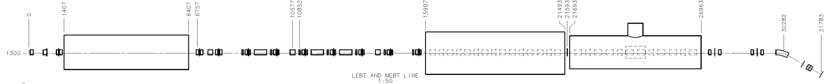
PXIE: Project X Injector Experiment
LEBT
RFQ
MEBT
HWR
SSR1
Dump
LBNL, FNAL FNAL, SLAC ANL FNAL
32 m, 30 MeV
PXIE will address some of the major technological challenges of Project X
Determine ion source lifetime
ValidateLEBT pre-chopping, chopper performance, kicker extinction, and MEBT beam absorber effectiveness
Validate vacuum management in the LEBT/RFQ region, and in the MEBT section
Confirm emittance preservation and beam halo formation through the front end
Operate a HWR in close proximity to 10 kW absorber
Operate a SSR with beam
Validate new spoke cavity cryomodule design concepts, including a room temperature strongback., and individual support posts to control axial motion
Estimate static and dynamic heat loads
Determine the practicality of tuner access ports.
Gain experience with conduction cooled magnet current leads
Validate single-window coaxial input coupler
Validate beam instrumentation
Gain experience with the required alignment tolerances, and alignment stability during cooldown.
Estimate static and dynamic heat loads.
Gain experience with strings of spoke cavities, solenoids, and beam instrumentation, e.g. cleanroom operations, shipping and handling, etc.
Gain experience with the overall assembly of individual components, cavity strings, cold mass assembly, and final assembly in the vacuum vessel.

Slide 16
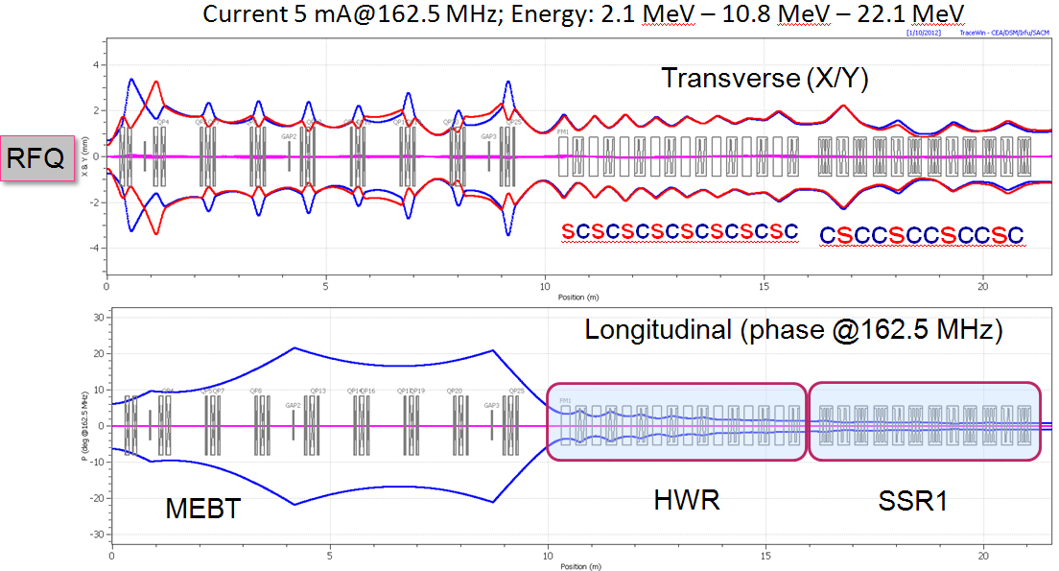
PXIE Beam Dynamics Overview
21.5 m
Optics optimized for operation of SRF CMs near the MEBT, where target may contaminate SRF CMs
  The first cavity is "protected" by the solenoid
Distance between HWR and SSR1 is minimized by "sacrificing" transverse optics in favor of longitudinal
  HWR has the cavity in the end and SSR1 has a cavity in the beginning.
Notes:
1mA is RDR, 2 mA after chopping is current plan

Slide 17
Project X Component Status:
Focus on SRF cavities and cryomodules

Slide 18
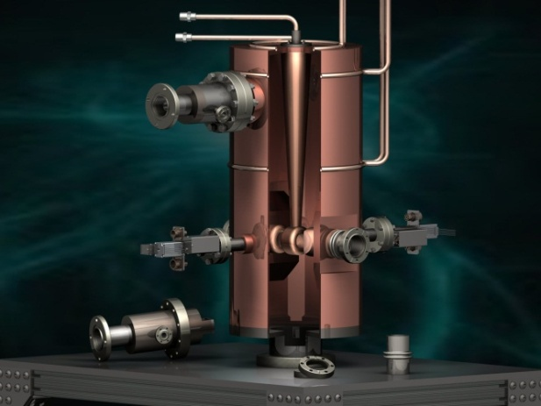
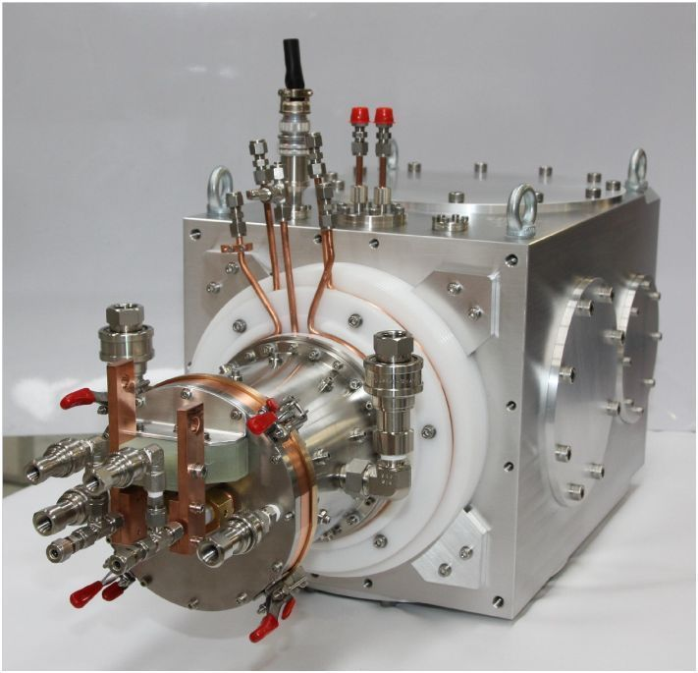
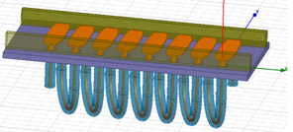
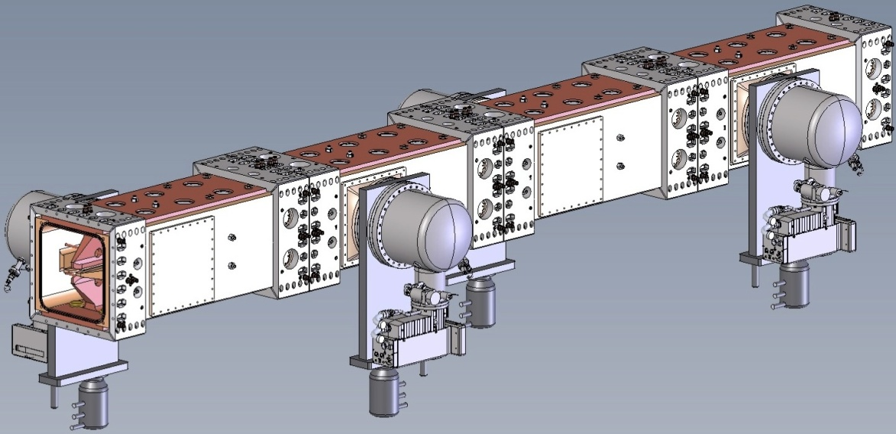
Front End Components
photo
50-Ohm dual-helix kicker
(one half)
162.5 MHz bunching
cavity
15 mA ion source (LBNL)
Emittance =0.25 mm-mrad
21 kW MEBT target
162.5 MHz, 2.1 MeV, 10 mA RFQ, 3D model (LBNL)
Major elements of the LEBT and MEBT are designed
Notes:
Ion source exists; bunching cavity is model

Slide 19
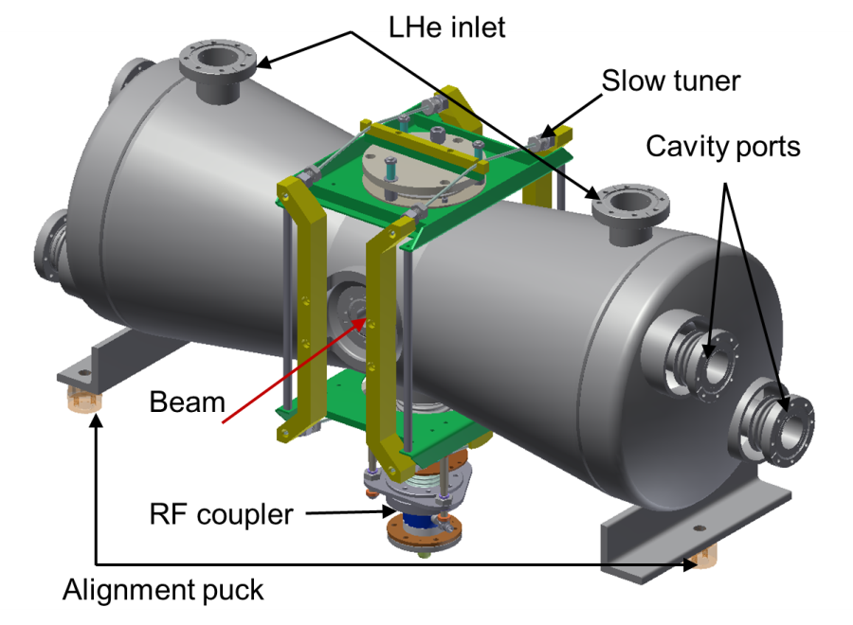
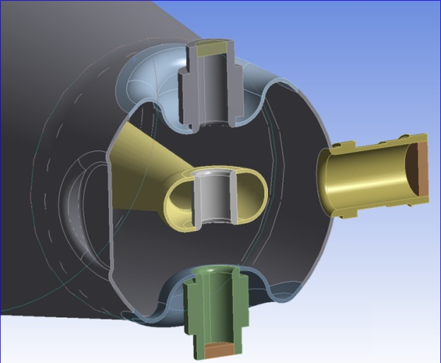
ANL 162.5 MHz HWR Cavity
pneumatic
Frequency, MHz | 162.5
Optimal beta, β_{OPT} | 0.112
L_{EEF}= β_{OPT}λ, cm | 20.7
Aperture, mm | 33
G = Q₀R_{S}, Ω | 48
R/Q₀, Ω | 272
E_{PEAK}/E_{ACC} | 4.67
B_{PEAK}/E_{ACC}, mT/(MV/m) | 5.0
E
H
df/dP control by disk depth
Cavity design is ready; df/dP control for passive microphonics damping is provided
See Zack Conway’s presentation
Notes:
Pneumatic tuner
Donut is used for compensation of the field quadrupole perturbation.

Slide 20
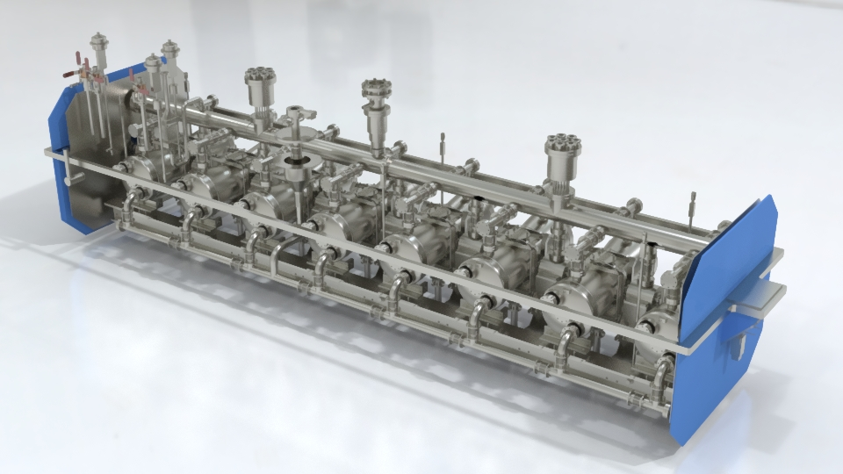
ANL HWR Cryomodule Design
HWR cryomodule design is well advanced
See Zack Conway’s presentation
Notes:
model

Slide 21
SSR1 Section Status
Dressed cavity
  Bare cavity design is complete
    Cavity was designed for pulsed operation
    Five have been tested (two prototypes, three production); some multipacting
    A production order for 10 cavities at Niowave-Roark is in progress
  Detailed design of the helium vessel and tuner in progress
  Input coupler reviewed, detailed design in progress; procurement of prototypes will follow; conditioning/test plans in progress
  Existing dressed cavity test facility being modified for testing at 2 K
Cryomodule
  Conceptual design of solenoid and current leads in progress
  Helium flow distribution within the cryomodule is well understood
  Alignment a known challenge, but a plan exists to address the requirements and to verify individual component positions after assembly and cooldown
  Modeling work on the overall cryomodule is well underway

Slide 22
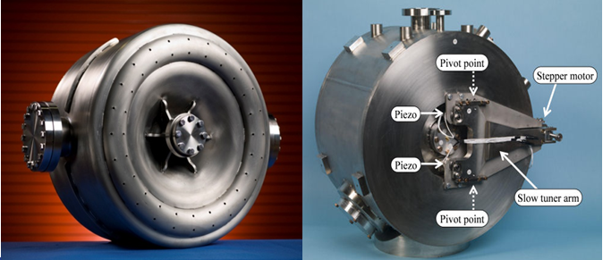
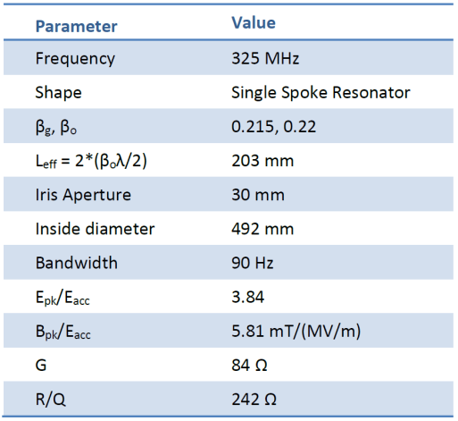
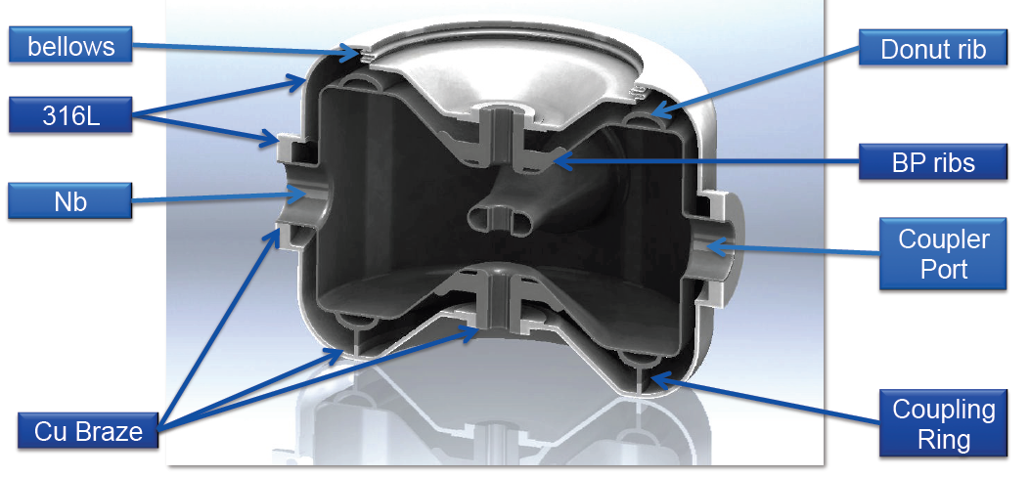
325 MHz SSR1 Cavity
Photos of prototypes
He vessel re-design for CW operation
Notes:
Add photo

Slide 23
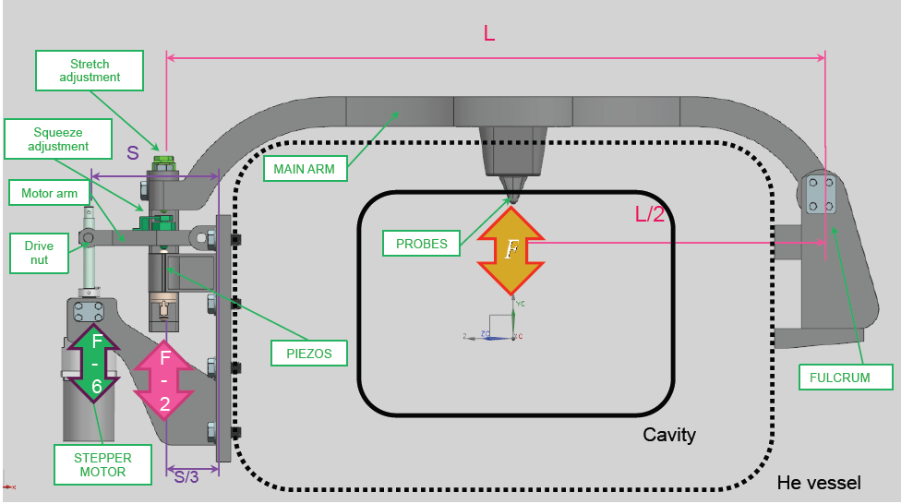
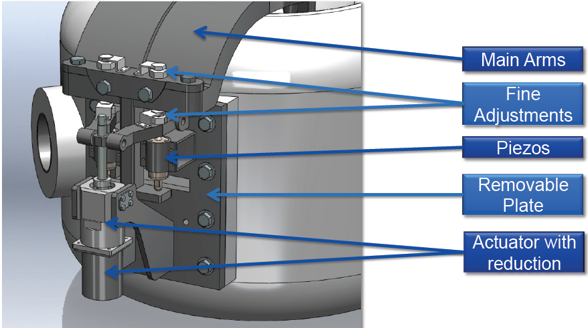
SSR1 Tuner Design
Tuner design is almost ready, technical review was made

Slide 24
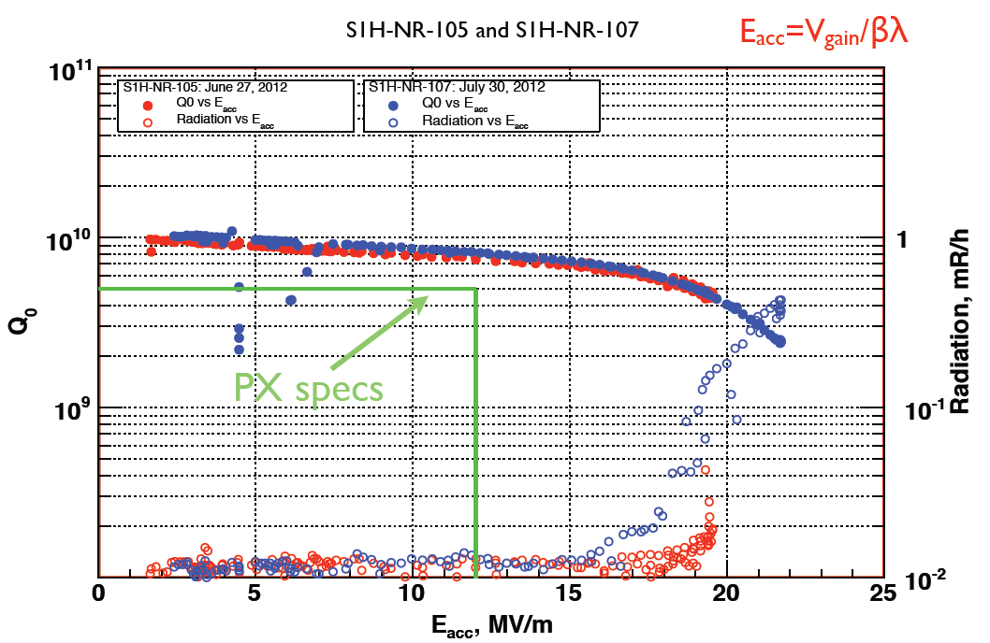
SSR1 Cavity Vertical Test Performance
Cavities processed with BCP
Performance of two production cavities exceeds PrX specs
Some multipacting was overcome

Slide 25
SSR1 Cryomodule Functional Reqs
Functional requirement for CM was developed, reviewed, and approved
Transverse and angular alignment tolerances for cavity and solenoid ok
Notes:
Transverse cavity alignment and angular alignment important – modest; also for solenoids

Slide 26
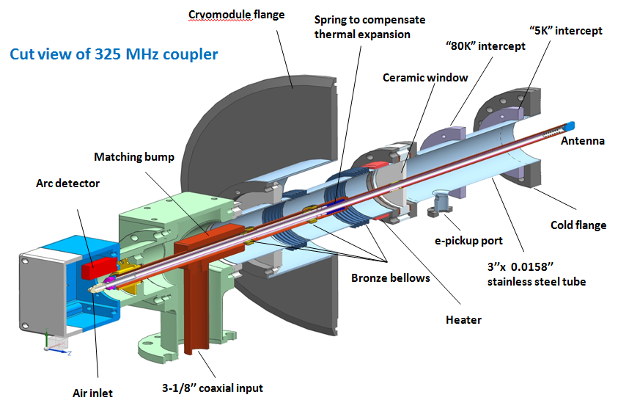
325 MHz SSR1 coupler
Single window, no copper plating, air-cooled, possibility to bias if necessary
Notes:
No copper plating, air cooling, single window. Possible to bias if necessary

Slide 27
SSR1 Cryomodule Heat Loads
SSR1 Cryomodule Heat Load Estimates
T. Nicol -February 9, 2012
SSR1 | Total
8 cavities, 4 solenoids | 70 K | 4.5 K | 2 K
Input coupler static | 42.88 | 22.56 | 4.00
Input coupler dynamic | 0.00 | 0.00 | 2.00
Cavity dynamic load | 0.00 | 0.00 | 14.24
Support post | 33.12 | 4.32 | 0.60
Conduction lead assembly | 147.20 | 52.80 | 4.96
MLI (total 70 K + 2 K) | 30.54 | 0.00 | 1.42
Cold to warm transition | 1.44 | 0.16 | 0.02
Total | 255.2 | 79.8 | 27.2
Detailed analysis of the static and dynamic heat loads for the SSR1 cryomodule has been performed
Total RF load at 2 K is <30 W

Slide 28
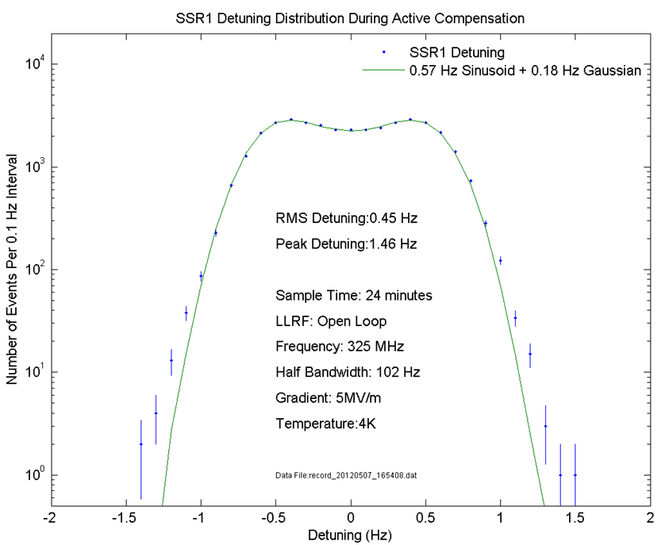
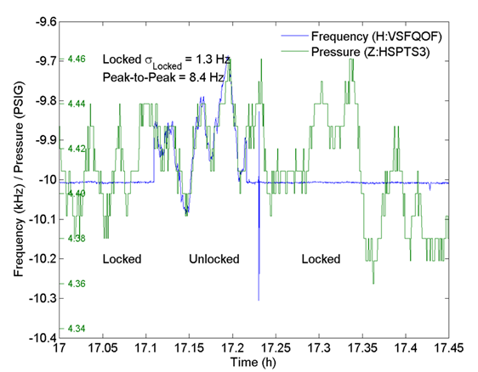
SSR1 Active Microphonics Control
W. Schappert and Yu. Pischalnikov
Microphonics control experiment using SSR1 cavity with prototype helium vessel/tuner design
With microphonics control on, cavity resonance frequency is constant (left)
Microphonics control ensures small frequency detuning: 0.45 Hz (rms), 1.46 Hz (peak) (right); also no long tails

Slide 29
SSR2 Cavity Status
The baseline version of SSR2 β=0.47 has been designed
  Magnetic asymmetric kick compensated by correctors
A preliminary solution for the mechanical design has been identified such that the bare cavity will survive the leak check and VTS tests.
  Typical circumferential ribs on the cavity cylinder have been omitted in favor of a thicker spoke collar. This will allow substantial savings and simplifications.
  The stiffness of the cavity end-wall has been evaluated and it appears ok from the tuning point of view.
  A helium vessel has been designed in order to achieve a df/dP as close as possible to zero. With an accurate selection of bellows diameter, the sensitivity can be set low and decoupled from tuner stiffness.
  Improved profiles of the end-wall are currently under study. It appears possible to reduce the number of end-wall rings to only one per side.

Slide 30
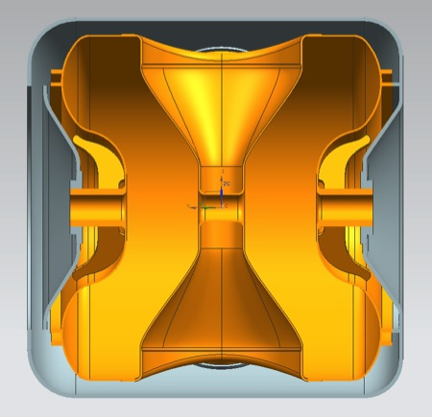
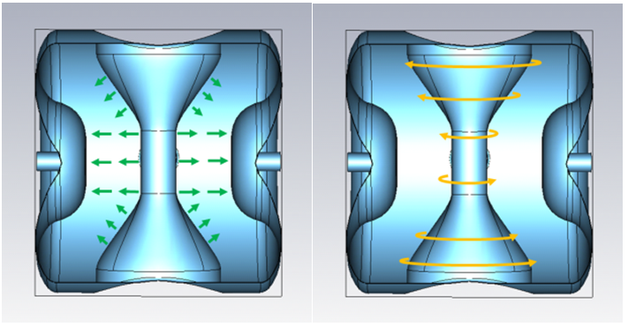
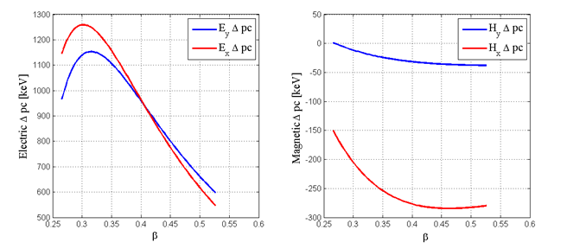
SSR2 Design Features
EM parameters SSR2 single spoke
Frequency [MHz] | 325
Optimal beta β_{opt} | 0.471
Effective length L_{eff}= β_{opt}/λ [m] | 0.4348
Beam pipe aperture [mm] | 40
Cavity radius [mm] | 270.7
E_{peak}/E_{acc} | 3.45
B_{peak}/E_{acc} [mT/(MV/m)] | 6.107
Max gain per cavity used in Project X[MeV] | 4.6
Max gain per cavity @ B_{peak}= 70 mT [MeV] | 4.98
G [Ω] | 112.98
R/Q [Ω] | 289.94
Particle energy range [MeV] | 35-165
    Magnetic asymmetric kick compensated with correctors
    Not possible to compensate kick by shaping the gap as in HWR
Baseline cavity design exists
Notes:
Beta is high and the gap is large
Large magnetic asymmetric kick has to be compensated by corrector elements; drawback is 10 leads instead of 6 leads. Two leads for horizontal, 2 for vertical, two for solenoid. For compensation, have to fit independently all four coils plus two for solenoid=10 leads.

Slide 31
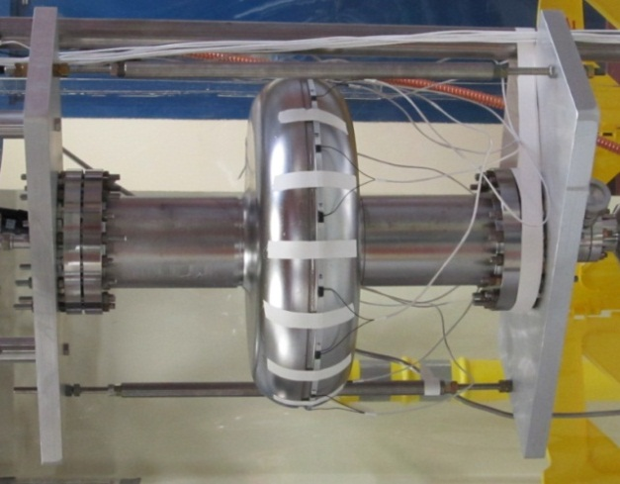
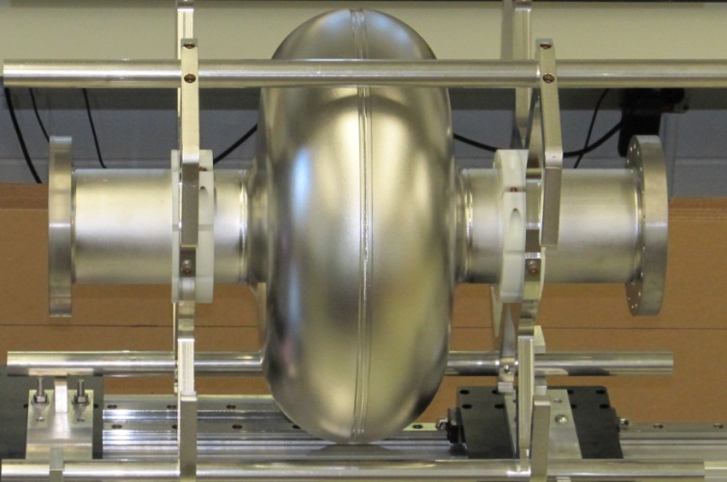
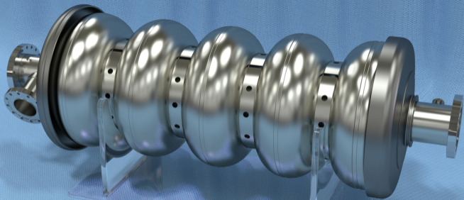
650 MHz Cavities
Single-cell prototypes (photos): 5-cell model, HE650 (FNAL)
LE 650 MHz (JLAB version) HE 650 MHz (FNAL)
Parameter |  | LE650 (JLAB) | LE650 (FNAL) | HE650(FNAL)
β_{geom} |  | 0.61 | 0.61 | 0.9
Cavity Length = n_{cell}∙β_{geom}λ/2 | mm | 694 | 703 | 1038
R/Q | Ohm | 297 | 378 | 638
G-factor | Ohm | 190 | 191 | 255
Acc. Gradient | MV/m | 17.3 | 16.6 | 17
Max surf. electric field | MV/m | 46.9 | 37.5 | 34
Max surf. magnetic field | mT | 83 | 70 | 61.5
Q₀ @ 2K | × 10¹⁰ | 1.7 | 1.5 | 2.0
P_{2K} max | [W] | 28 | 24 | 24

Slide 32
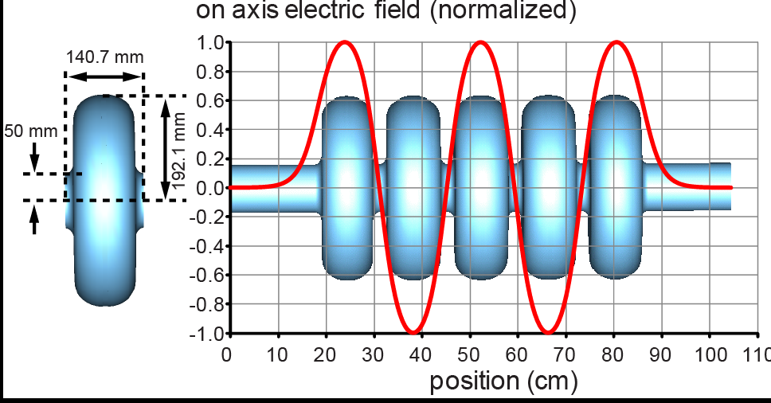
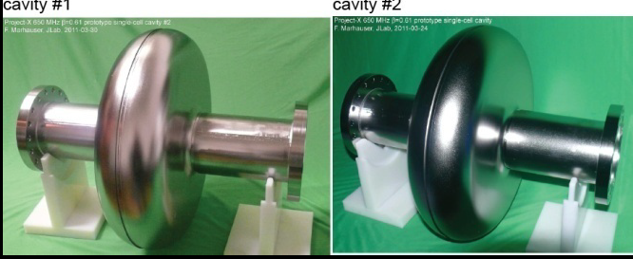
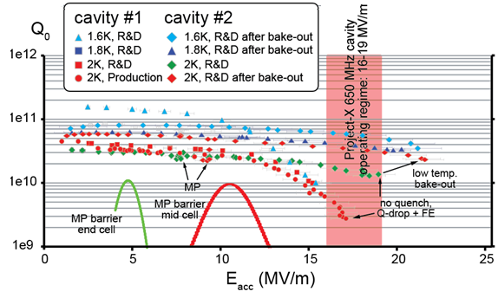
JLab 650 MHz beta=0.61 cavity
F. Marhauser et al., IPAC 2011
For cavity #2
Q₀ >2e10 @2K @17MeV/m
BCP processing
Proof of principle that 650 MHz design meets Project X requirements

Slide 33
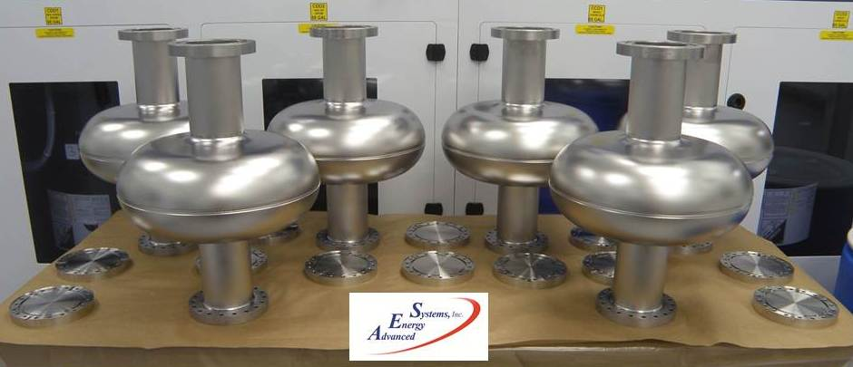
650 MHz cavity fabrication
Six single cell beta=0.9 received from AES in April (photo)
Six single cell beta=0.61 on order from RI
  3 each of JLab and FNAL designs
Four 5-cell beta=0.9 on order from AES
Additional cavities will be received from PAVAC

Slide 34
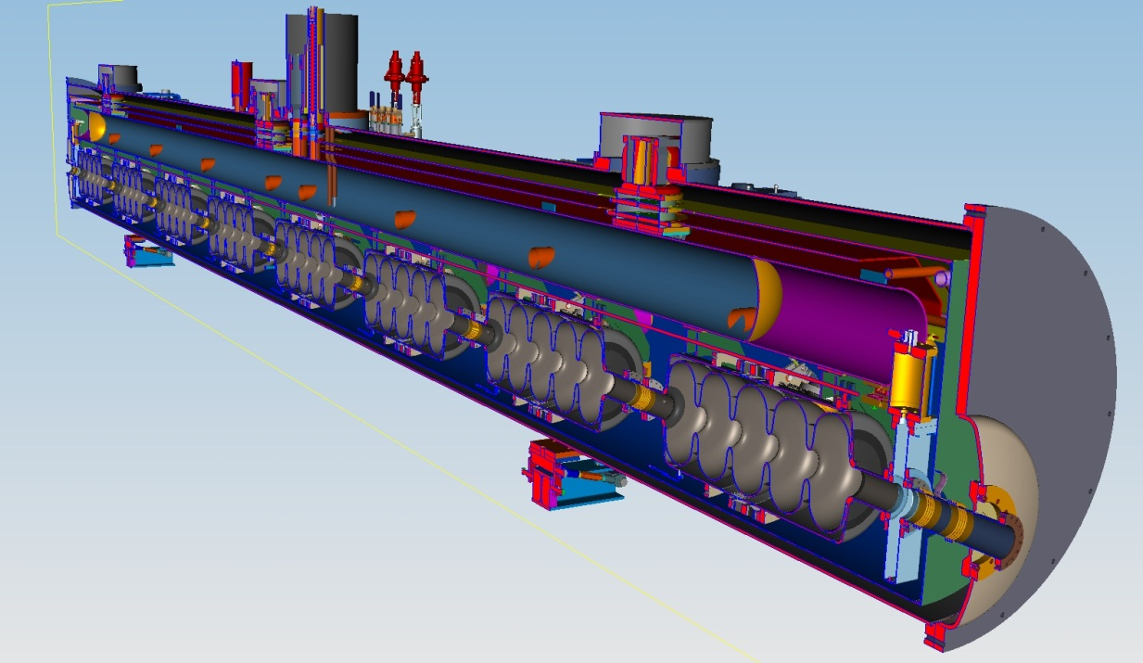
650 MHz beta=0.9 CM Concept
Conceptual design exists
8 cavities/CM
No focusing elements
Maximal RF load 250 W at 2 K
Standalone CM’s
  For CW operation, dynamic losses are much higher than static losses, and end effects do not increase the total losses
RT gaps contain RT focusing elements, diagnostics and collimation

Slide 35
Acknowledgements
Many thanks to colleagues, from whom we obtained information for this presentation
FNAL: P. Berrutti, S. Holmes, S. Kazakov, T. Khabiboulline, V. Lebedev, S. Nagaitsev, T. Nicol, Yu. Orlov, L. Ristori, A. Rowe, D. Passarelli, T. Peterson, Yu. Pischalnikov, W. Schappert, N.Solyak, A. Sukhanov, I. Terechkine
ANL: Z. Conway and P. Ostroumov
JLab: F. Marhauser

Slide 36
References
Project X Reference Design Report , http://projectx-docdb.fnal.gov/cgi-in/RetrieveFile?docid=776;filename =RDR-v0.9.pdf;version=1
S. Henderson, “Status of Fermilab Project X,” LINAC12, TU1A02.
V. Yakovlev and C.M. Ginsburg, “SRF Linac Technology Development, LINAC12, MO1A03.
Yu. Pischalnikov and W. Schappert, “SSR1 Active Microphonics Control,” Fermilab TD/T&I, June 04 2012.
T. Khabiboulline et al., “High Gradient Tests of the Fermilab SSR1 Cavity,” IPAC12, WEPPC052.
L. Ristori et al., “Design of SSR1 Spoke Resonators for PXIE,” IPAC12, WEPPC057.
P. Berrutti et al., “Optimization of the Geometric Beta for the SSR2 Cavities of the Project X,” IPAC12, WEPPC045.
F. Marhauser et al., “Design, Fabrication and Testing of Medium-Beta 650 MHz SRF Cavity Prototypes for Project X,” IPAC11, MOPC114.
Z. Conway, “Advanced Quarter- and Half-Wave Resonator Development at ANL ,” TTC 2012.
A. Grassellino, “Update on cavity processing R&D at FNAL: The hunt for higher Q0,” TTC 2012.

Slide 37
Conclusions
Project X will provide a high-power proton beam, with flexible beam formats, simultaneously to a wide range of physics experiments
A staged approach to construction is being considered, with physics impact at each stage
Most of the critical concepts and components have been designed, and many are at an advanced stage
PXIE will provide an experimental platform to test some of the most technically challenging aspects of Project X

Slide 38
Backup Slides

Slide 39
Staged Physics Program
Project X Campaign
Program: | NOνA + Proton Improvement Plan | Stage-1: 1 GeV CW Linac driving Booster & Muon, n/edm programs | Stage-2: Upgrade to 3 GeV CW Linac | Stage-3: Project X RDR | Stage-4: Beyond RDR: 8 GeV power upgrade to 4MW
MI neutrinos | 470-700 kW** | 515-1200 kW** | 1200 kW | 2450 kW | 2450-4000 kW
8 GeV Neutrinos | 15 kW + 0-50 kW** | 0-42 kW* + 0-90 kW** | 0-84 kW* | 0-172 kW* | 3000 kW
8 GeV Muon program e.g, (g-2), Mu2e-1 | 20 kW | 0-20 kW* | 0-20 kW* | 0-172 kW* | 1000 kW
1-3 GeV Muon program, e.g. Mu2e-2 | ----- | 80 kW | 1000 kW | 1000 kW | 1000 kW
Kaon Program | 0-30 kW** (<30% df from MI) | 0-75 kW** (<45% df from MI) | 1100 kW | 1870 kW | 1870 kW
Nuclear edm ISOL program | none | 0-900 kW | 0-900 kW | 0-1000 kW | 0-1000 kW
Ultra-cold neutron program | none | 0-900 kW | 0-900 kW | 0-1000 kW | 0-1000 kW
Nuclear technology applications | none | 0-900 kW | 0-900 kW | 0-1000 kW | 0-1000 kW
# Programs: | 4 | 8 | 8 | 8 | 8
Total max power: | 735 kW | 2222 kW | 4284 kW | 6492 kW | 11870kW
* Operating point in range depends on MI energy for neutrinos.
** Operating point in range is depends on MI injector slow-spill duty factor (df) for kaon program.

Slide 40
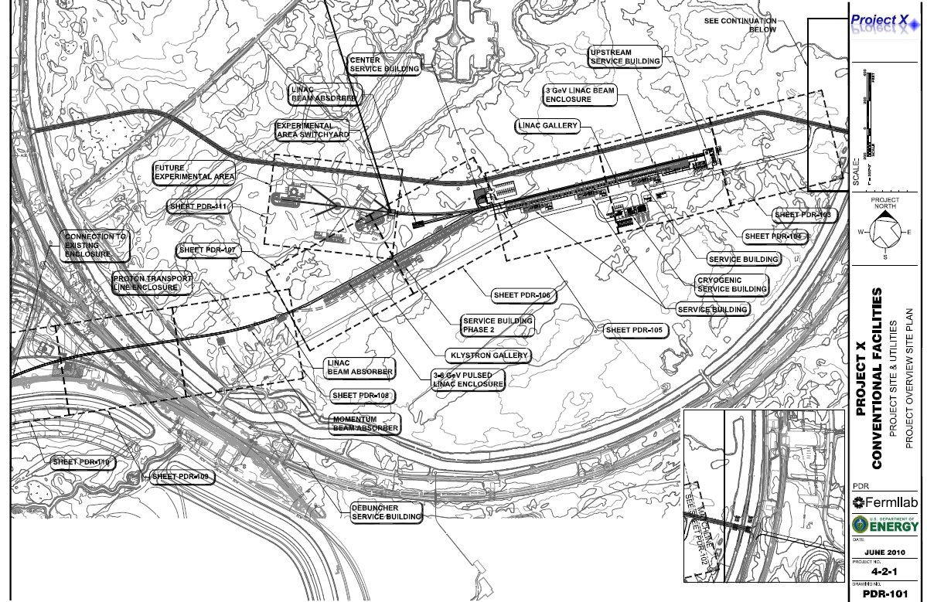
Reference Design Siting
3 GeV Experimental Area
CW Linac
8 GeV Linac
Beam Transfer

Slide 41
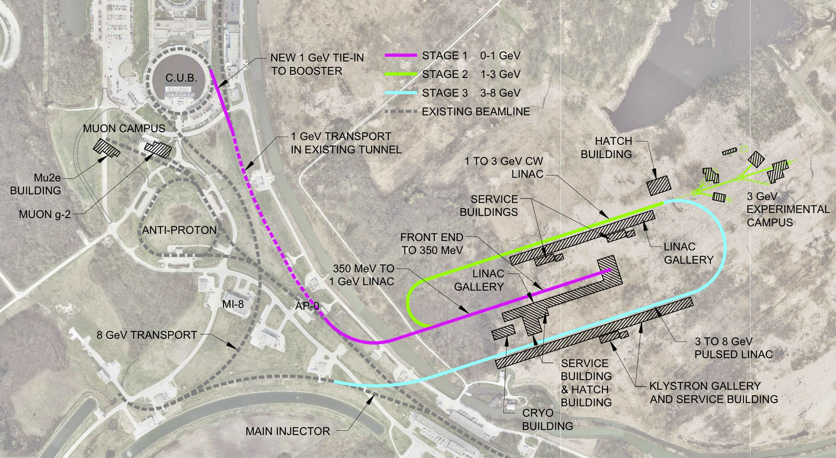
Siting option: “paper clip”
Notes:
Candidate for exclusion

Slide 42
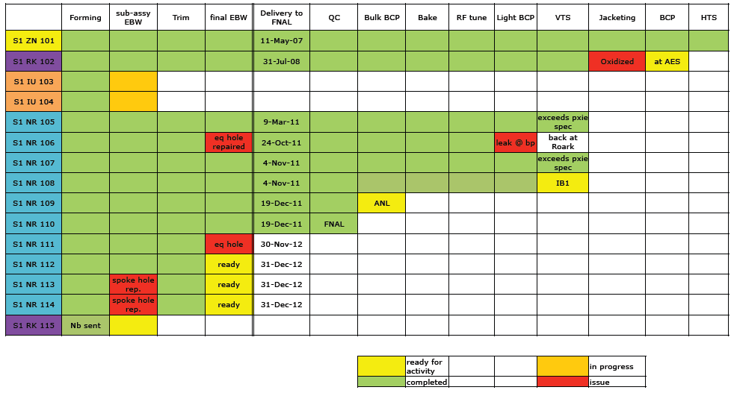
SSR1 Cavity Status

Slide 43
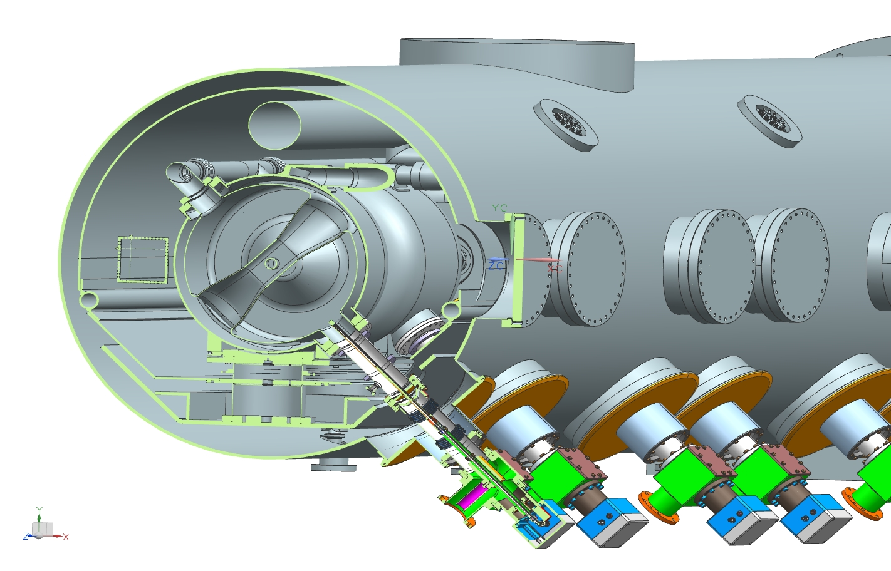
SSR1 Couplers in Cryomodule
Notes:
No room below the cryomodule and do not want to use horizontal coupler because of FE concerns
No coupler kick at all; very far from the beam

Slide 44
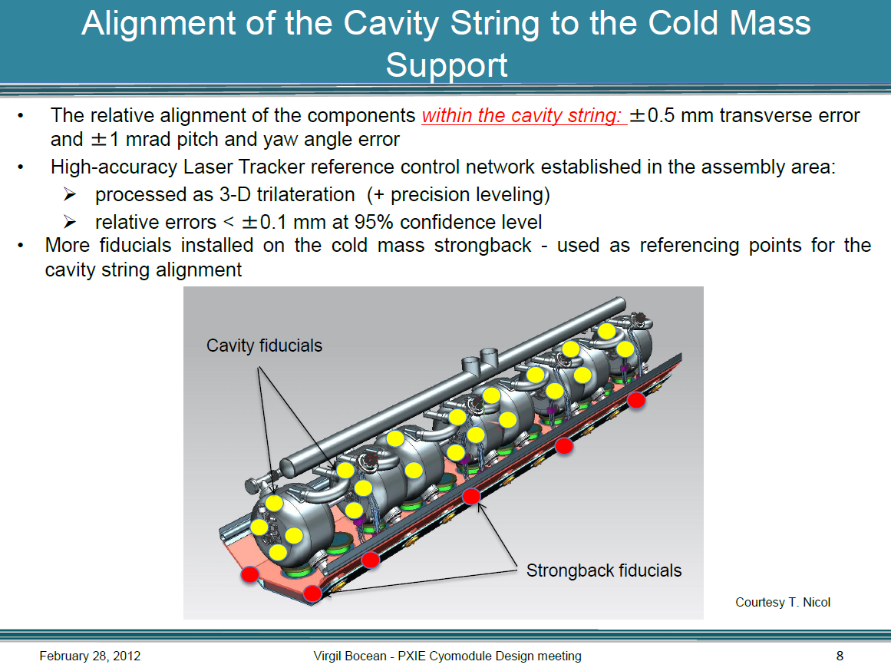
Cryomodule Alignment Strategy
Fiducials for the alignment at RT. After cooling we control the alignment using laser
beam and special targets, which will be accessible through windows in CM
Notes:
Alignment strategy: alignment made at RT, then install special targets on critical elements. Special windows in the CM to control alignment at cold temperature.
Very modest
Magnetic tablets with mirrors

Slide 45
SSR1 Cryomodule Heat Loads
SSR1 Cryomodule Heat Load Estimates
T. Nicol -February 9, 2012
SSR1 | Each unit |  |  | Mult | Total
8 cavities, 4 solenoids | 80 K | 4.5 K | 2 K |  | 70 K | 4.5 K | 2 K
Input coupler static | 5.36 | 2.82 | 0.50 | 8 | 42.88 | 22.56 | 4.00
Input coupler dynamic | 0.00 | 0.00 | 0.25 | 8 | 0.00 | 0.00 | 2.00
Cavity dynamic load | 0.00 | 0.00 | 1.78 | 8 | 0.00 | 0.00 | 14.24
Support post | 2.76 | 0.36 | 0.05 | 12 | 33.12 | 4.32 | 0.60
Conduction lead assembly | 36.80 | 13.20 | 1.24 | 4 | 147.20 | 52.80 | 4.96
MLI (total 70 K + 2 K) | 30.54 | 0.00 | 1.42 | 1 | 30.54 | 0.00 | 1.42
Cold to warm transition | 0.72 | 0.08 | 0.01 | 2 | 1.44 | 0.16 | 0.02
Total |  |  |  |  | 255.2 | 79.8 | 27.2
Notes:
1. Cavity dynamic loads from Nikolai Solyak, February 2012.
2. Input coupler static loads from S. Kazakov, February 2012, no copper plating on outer conductor,
intercepts at 15 K and 125 K.
3. Current lead heat loads assume 2 coils at 50 A, 1 coil at 200 A.
Detailed analysis of all the losses (static and dynamic) was made
Total RF load at 2 K does not exceed 30 W

