Slide 1
State of the Art and Future Potential of Nb/Cu Coatings
Sergio Calatroni, Giovanni Terenziani, and all CERN SRF community

Slide 2
Niobium Magnetron Sputtering
Sputtering parameters (1.5 GHz):
  Sputter gas pressure of 1.5x10⁻³ mbar (Ar or Kr)
  Plasma current stabilized at 3A - DC
  Sputter potential ~ -360 V
  Coating temperature is 150 °C.
  Thickness: 1.5 µm
“Standard films”:
  RRR: 11.5 ± 0.1
  Argon content: 435 ± 70 ppm
  Grain size: 110 ± 20 nm
  Tc: 9.51 ± 0.01 K
  Strain: Δa⊥/a ⊥ = 0.636 ± 0.096 %
-V

Slide 3
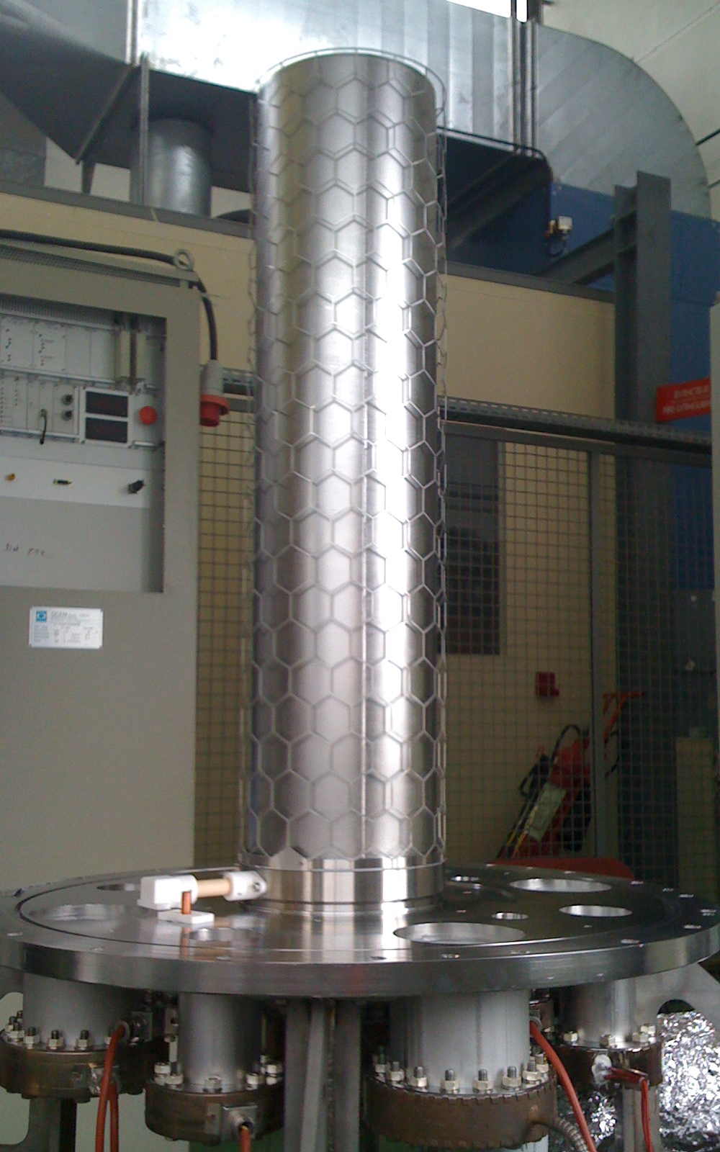
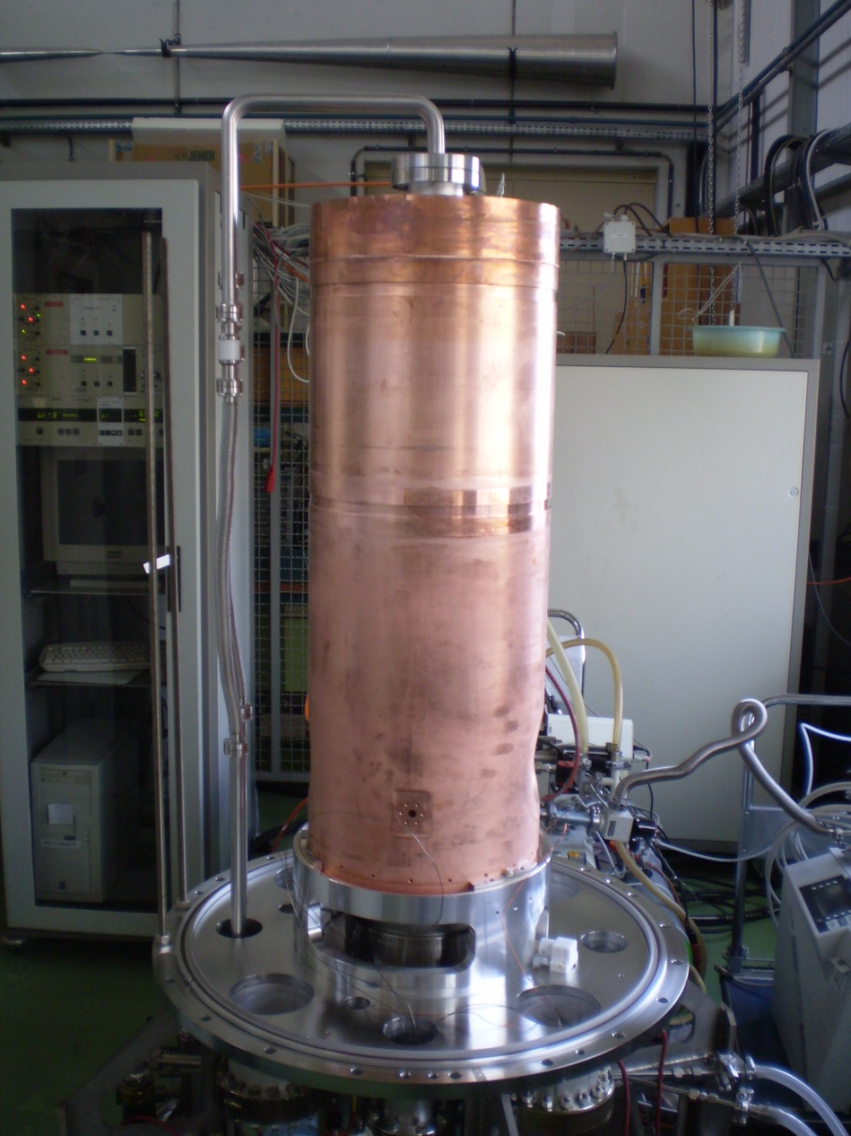
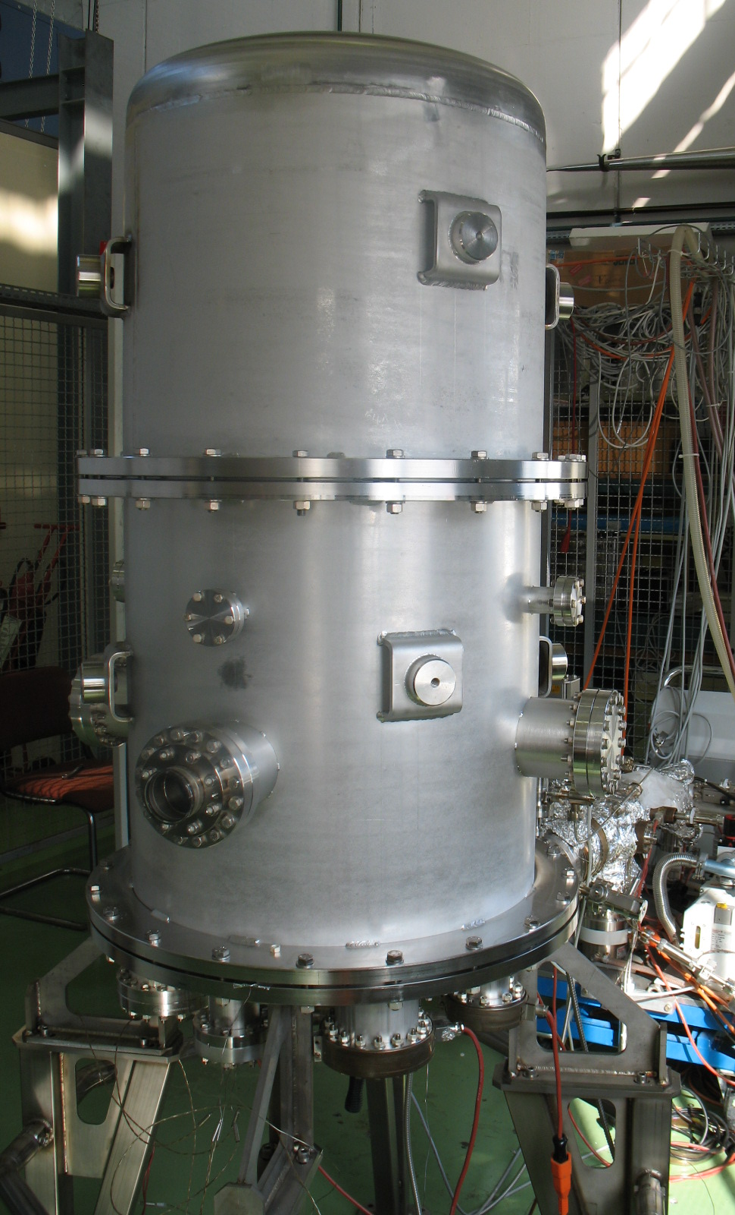
Diode sputtering

Slide 4
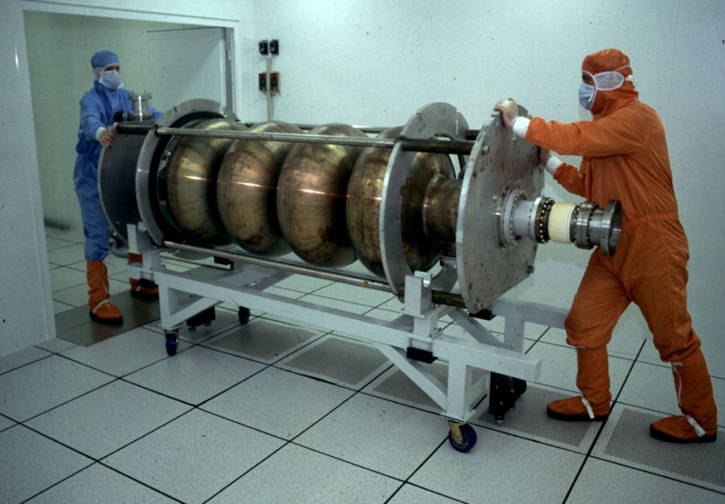
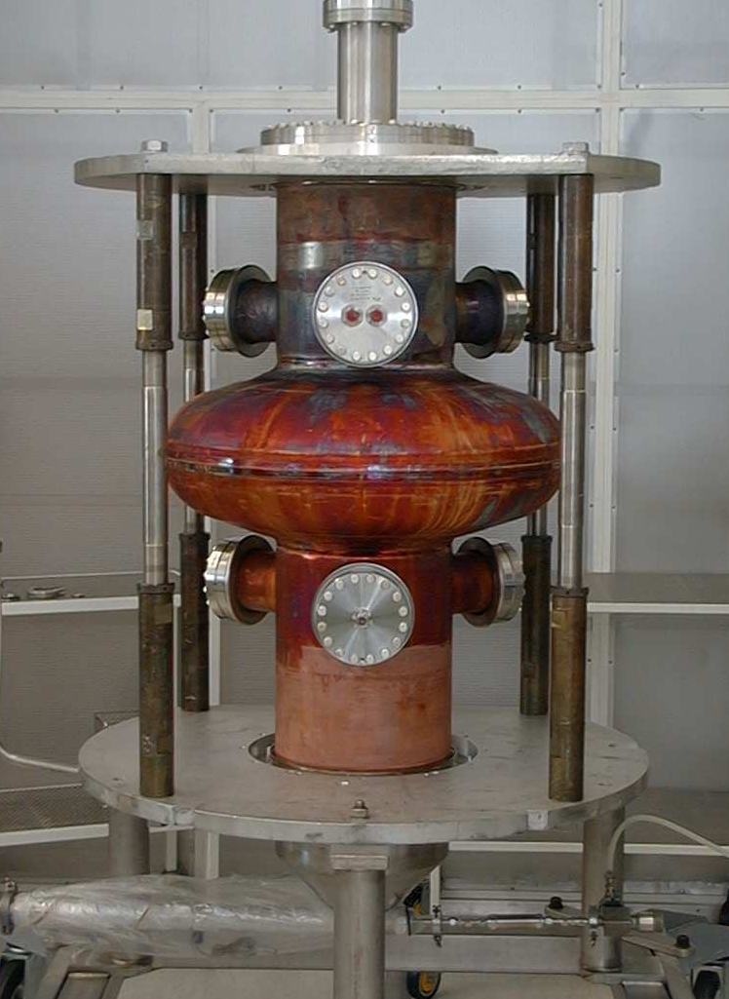
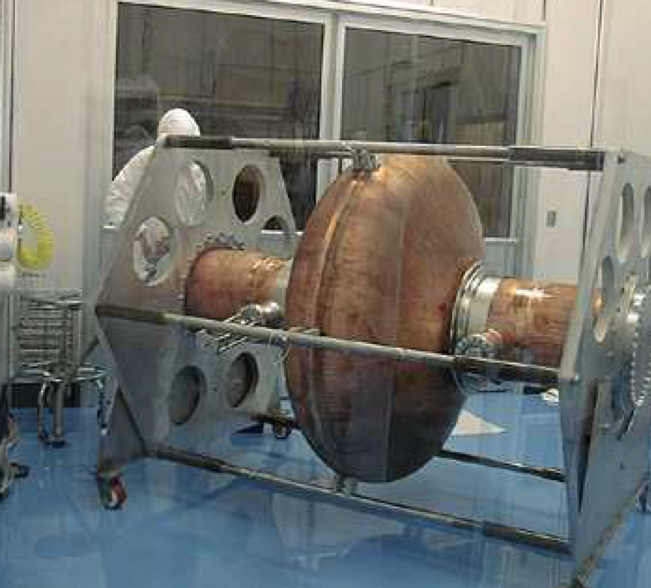
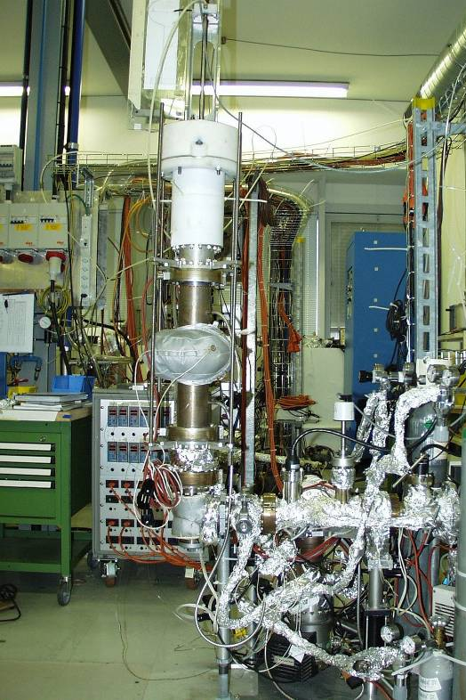
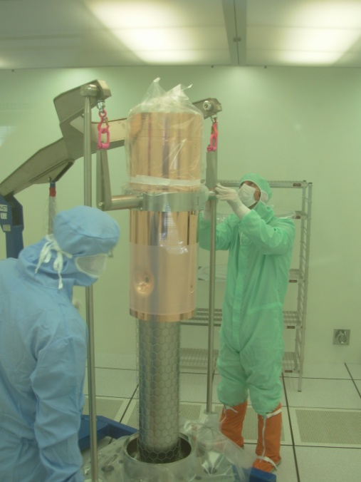
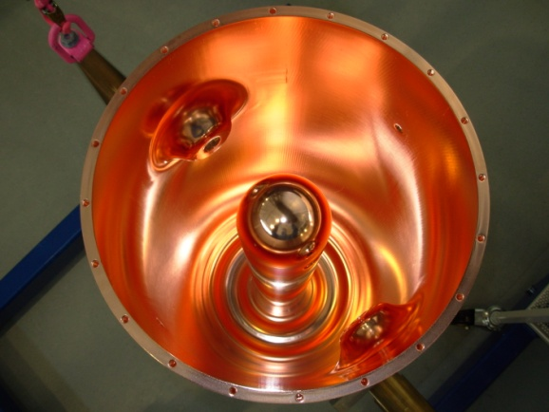
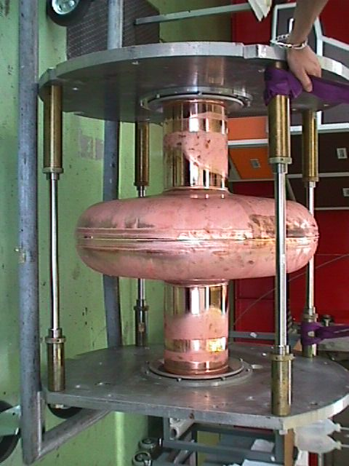
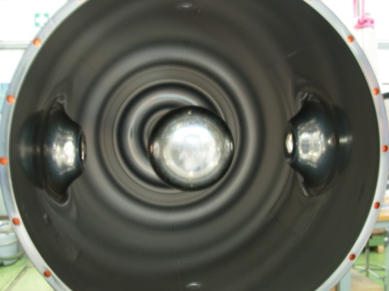
Coating of beta = 1 and lower beta cavities
288 Nb/Cu cavities installed in LEP
16 Nb/Cu cavities installed in LHC
About 300 coatings on 1.5 GHz for R&D
Low-beta studies, several 10’s of coatings
(+ Soleil prototypes, 3HC, 200 MHz Cornell...)
HIE-ISOLDE about 10 coatings

Slide 5
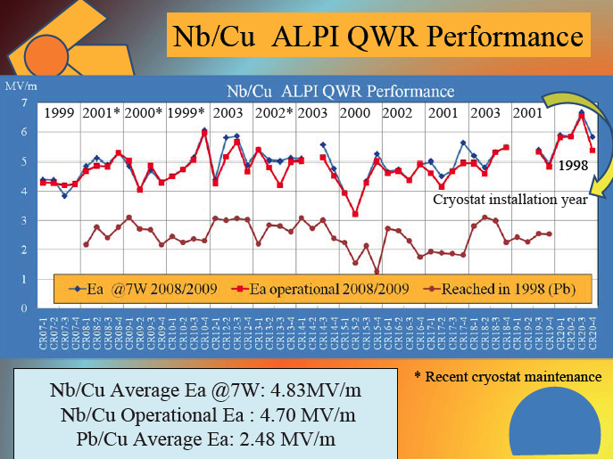
LNL
56 cavities total
A.M. Porcellato

Slide 6
Cost advantages
Cu OFE sheets: 10 EUR/kg
Nb RRR 300 sheets: 500 EUR/kg
Simpler cryostats (stainless steel), no magnetic shielding
Conduction cooling is possible
Cost of LEP200 RF cryomodules was about half of what it would have been if using cavities of bulk Nb (E. Chiaveri)

Slide 7
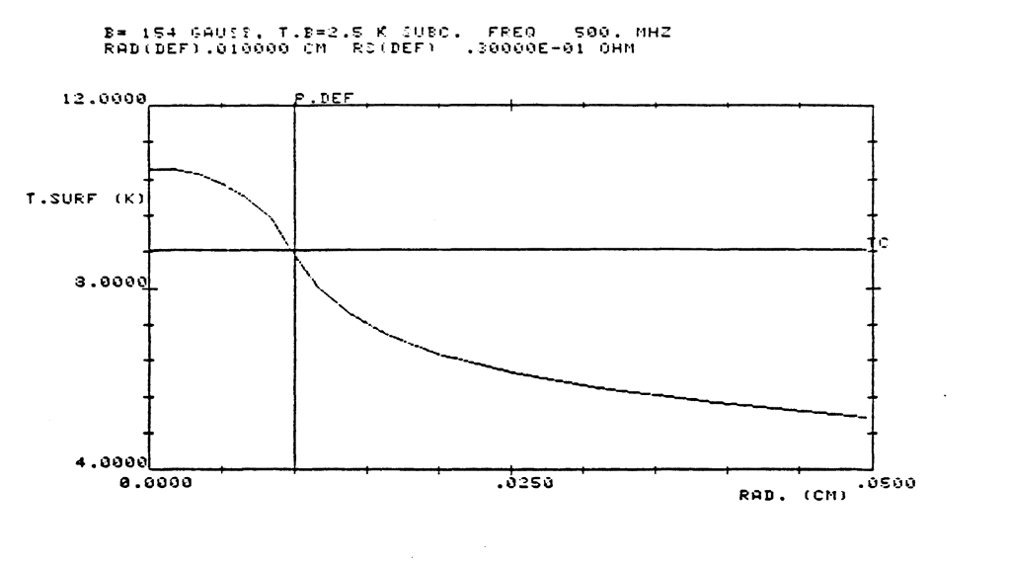
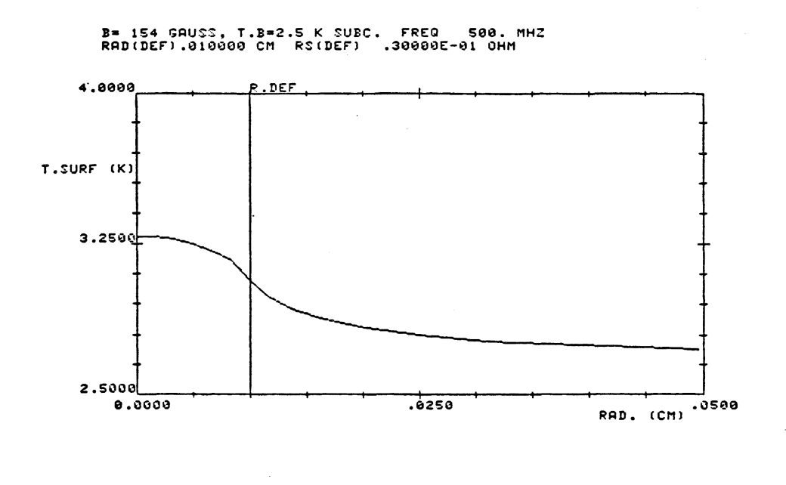
Quenches don’t happen
100 micron radius steel defect
Nb: 10.2 K
Nb/Cu: 3.3 K
Nb bulk
Nb / Cu
Joachim Tuckmantel - Thermal effects in superconducting RF cavities: some new results from an improved program
CERN-EF-RF-84-6. - 1984.

Slide 8
Effect of external magnetic field
Losses due to trapped external magnetic field at 1.7 K are characterized as
R_{fl} = (R_{fl}⁰ + R_{fl}¹ H_{RF}) H_{ext}
The minimum values are obtained using krypton as sputter gas:
R_{fl}⁰ = 3nΩ/G R_{fl}¹ = 0.4 nΩ/G/mT
Coatings on oxide-free copper
Coatings on oxidized copper
(a)
Coatings on oxide-free copper
Coatings on oxidized copper
(b)
bulk Nb
bulk Nb
100
10
R_{fl}⁰[nΩ/G]
R_{fl}¹[nΩ/G/mT]
10
1
1
1+πξ₀/2
10
1
10
1+πξ₀/2
R_{fl} (H_{RF}, H_{ext}, T) has a dependence on  similar to R_{BCS}(0,T), but the physical mechanism must be different

Slide 9
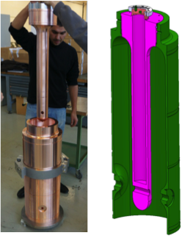
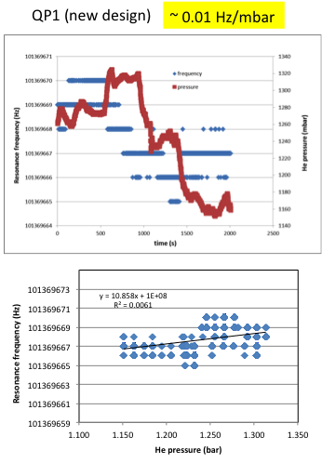
Mechanical stability
No dynamic tuning needed

Slide 10
BCS resistance at zero RF field
900
R_{BCS} at 4.2 K
(1.5 GHz)
Nb bulk: ~900 nΩ
Nb films: ~400 nΩ
R_{BCS} at 1.7 K
(1.5 GHz)
Nb bulk: ~2.5 nΩ
Nb films: ~1.5 nΩ
850
Nb bulk
800
750
700
Curve: theoretical
650
600
R_{BCS} (4.2K) [nΩ]
550
500
450
400
350
1
2
5
10
20
1+πξ₀/2
The dependence of R_{BCS} (0,T) on  was known theoretically and has been verified by changing the sputter gas

Slide 11
State-of-the-art at 1500 MHz – 1.7 K – single cell
H_{surf} [mT]
0 45 90
Q = 3x10⁹ @ 20 MV/m
Q = 1x10¹⁰ @ 15 MV/m
Q = 1x10¹⁰ @ 15 MV/m is a value that would make film cavities a competitive option for proton accelerators

Slide 12
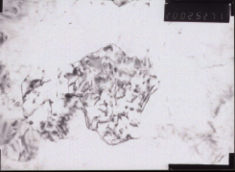
TEM view – film defects
~100 nm
RRR of films: 10 ÷ 30
⇒
mfp of films 30 ÷ 100 nm
Grain size of films > 100 nm
⇒
RRR limited by intragrain defects in most cases
Crystallographic defects can be at the origin of reduced H_{c1} compared to bulk Nb
A defect cluster has a different effect on resistivity and flux trapping

Slide 13
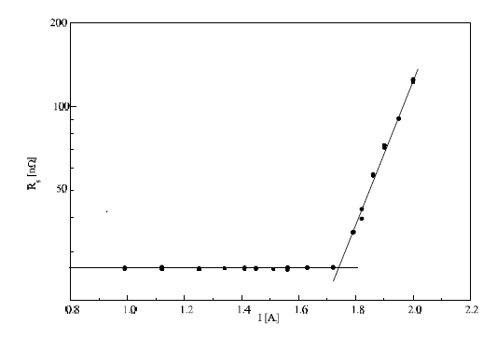
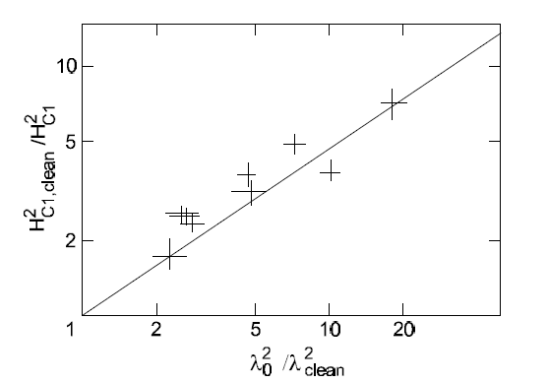
Measurement of H_{c1}
SC coil at the outer wall of the cavity at equator H_{ext} up to 2T over 3 cm²
H_{penetration} films ≤ 0.6 H_{penetration} bulk

Slide 14
Structure zone model from A. Anders
Based on “Structure Zone Model” - Thornton, J.Vac. Sci. Technol. 11 (1974) 666

Slide 16
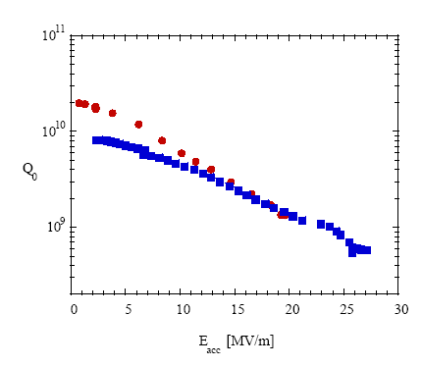
State of the art
1.5 GHz Nb/Cu cavities, sputtered w/ Kr @ 1.7 K (Q₀=295/R_{s})
Bulk Nb
1.5 GHz Nb/Cu
LEP II
350MHz Nb/Cu (4.2K)
CERN 2000

Slide 17
Angle of incidence of the coating
Average angle of incidence increases
There is a “threshold” effect

Slide 18
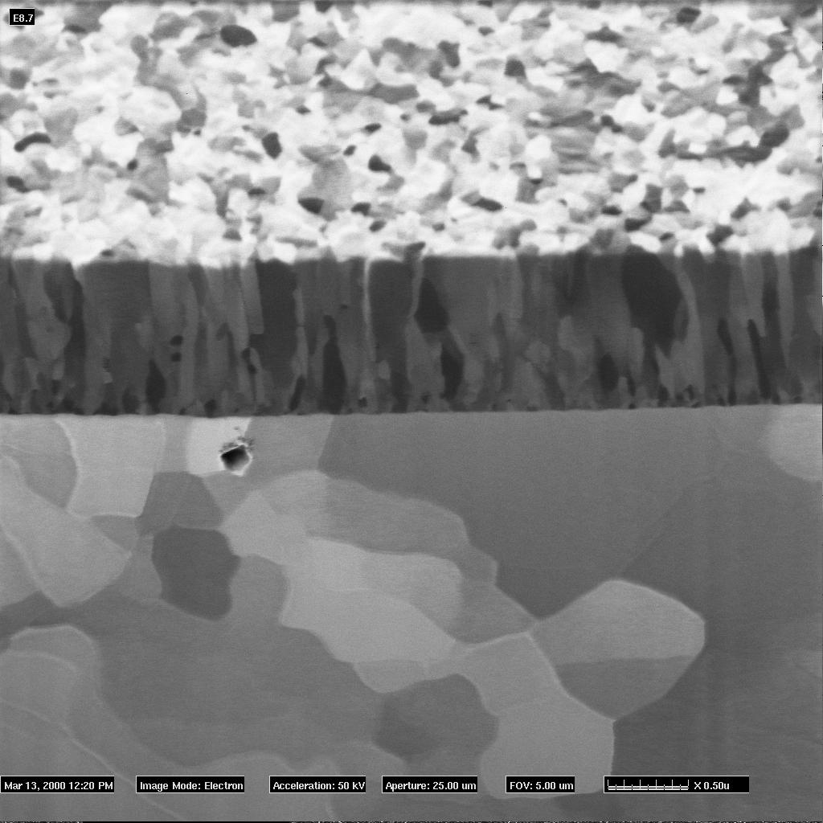
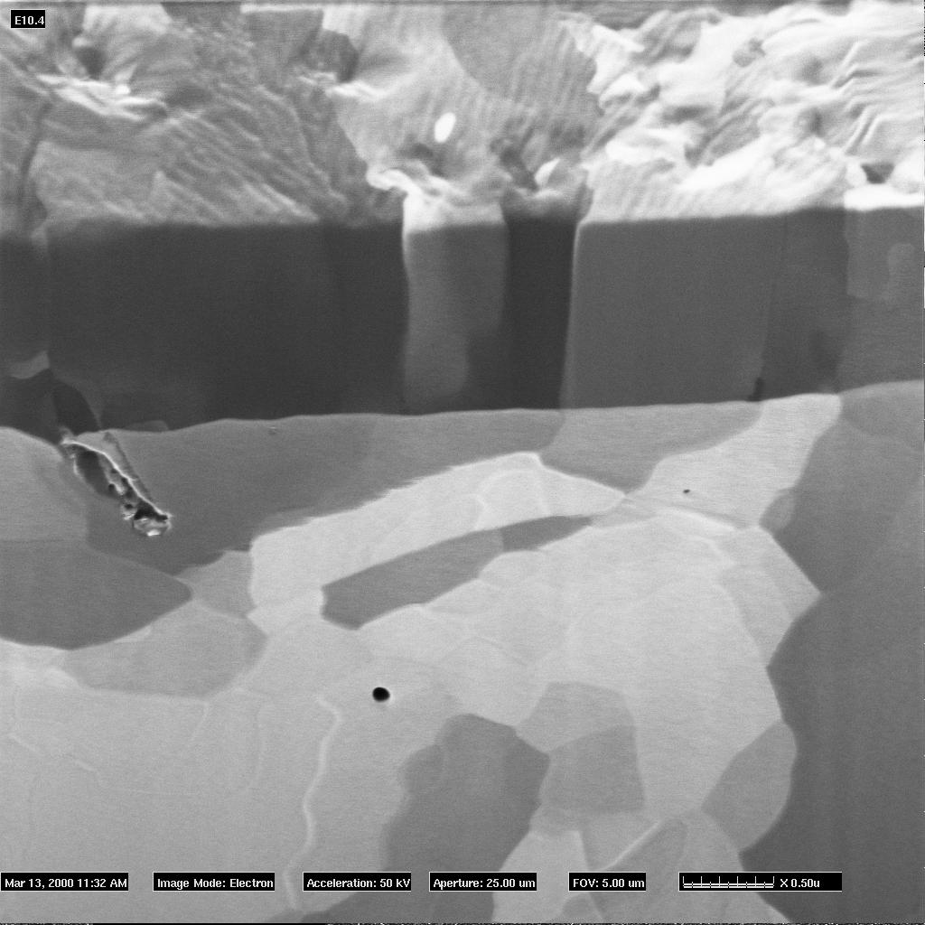
Film analyses
Standard films
Oxide-free films
 | Standard | Oxide-free
RRR | 11.5 ± 0.1 | 28.9 ± 0.9
T_{C} | 9.51 ± 0.01 K | 9.36 ± 0.04 K
Ar cont. | 435 ± 70 ppm | 286 ± 43 ppm
Texture | -110 | (110), (211), (200)
Hc₁ | 85 ± 3 mT | 31 ± 5 mT
Hc₂ | 1.150 ± 0.1 T | 0.73 ± 0.05 T
a₀ | 3.3240(10)Å | 3.3184(6) Å
Δa⊥/a⊥ | 0.636 ± 0.096 % | 0.466 ± 0.093 %
Stress | -706 ± 56 MPa | -565 ± 78 MPa
Grain size | 110 ± 20 nm | > 1 µm
0.5 µm
0.5 µm
FIB cross sections courtesy: P. Jacob - EMPA

Slide 19
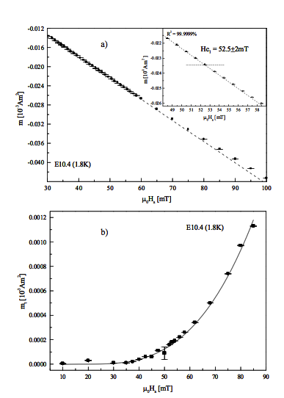
Measurements of H_{c1} on Nb films
Magnetic moment with squid magnetometer filed parallel to the sample
H_{C1} = 52.5 ± 2 mT
Same film, trapped magnetic moment with squid magnetometer
(fit with V.V. Moshchalkov et al., Physica C 175 (1991) 407)
H_{C1} = 31 ± 3 mT

Slide 20
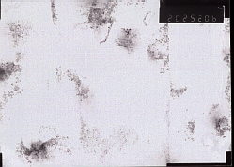
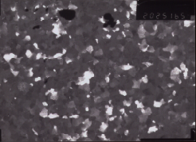
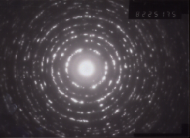
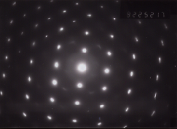
TEM micrographs in plan view
500nm
Grain size ~ 100 nm
Fibre texture
Diffraction pattern:
powder diagram
Standard
500nm
Grain size ~ 1-5μm
Heteroepitaxy
Diffraction pattern:
zone axis [110]
Oxide-free

Slide 21
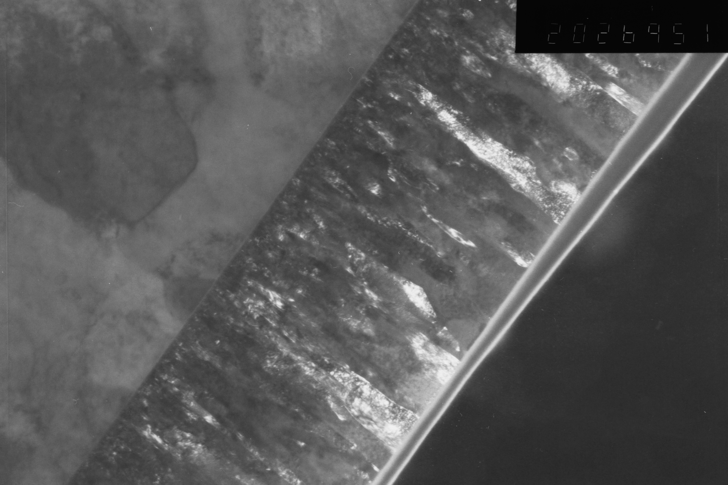
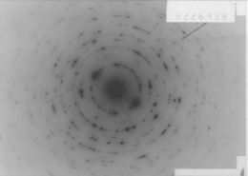
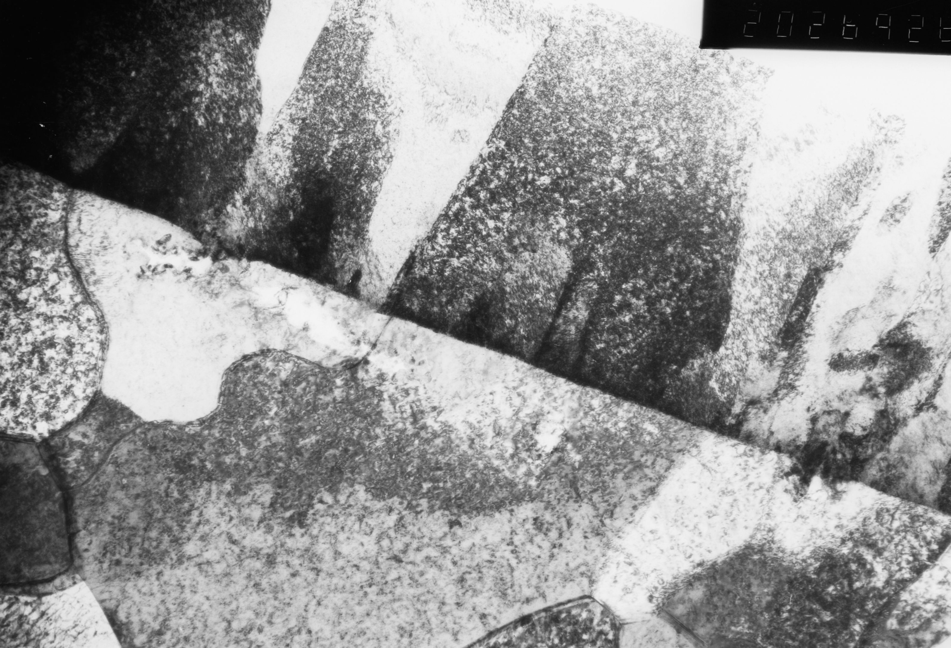
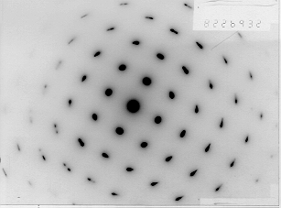
TEM micrographs in cross section
500nm
(110) fibre texture
⊥ substrate plane
Standard
500nm
Heteroepitaxy
Nb (110) // Cu(010)
Nb (110) // Cu(111)
Nb (100) // Cu(110)
Oxide-free

